Slide 1
  Change Request CR-0021
  New estimate of Z pole running power - Update
  Benno List, DESY
  TCMB Meeting
  15.9.2020

Slide 2
TDR Tables

Slide 3
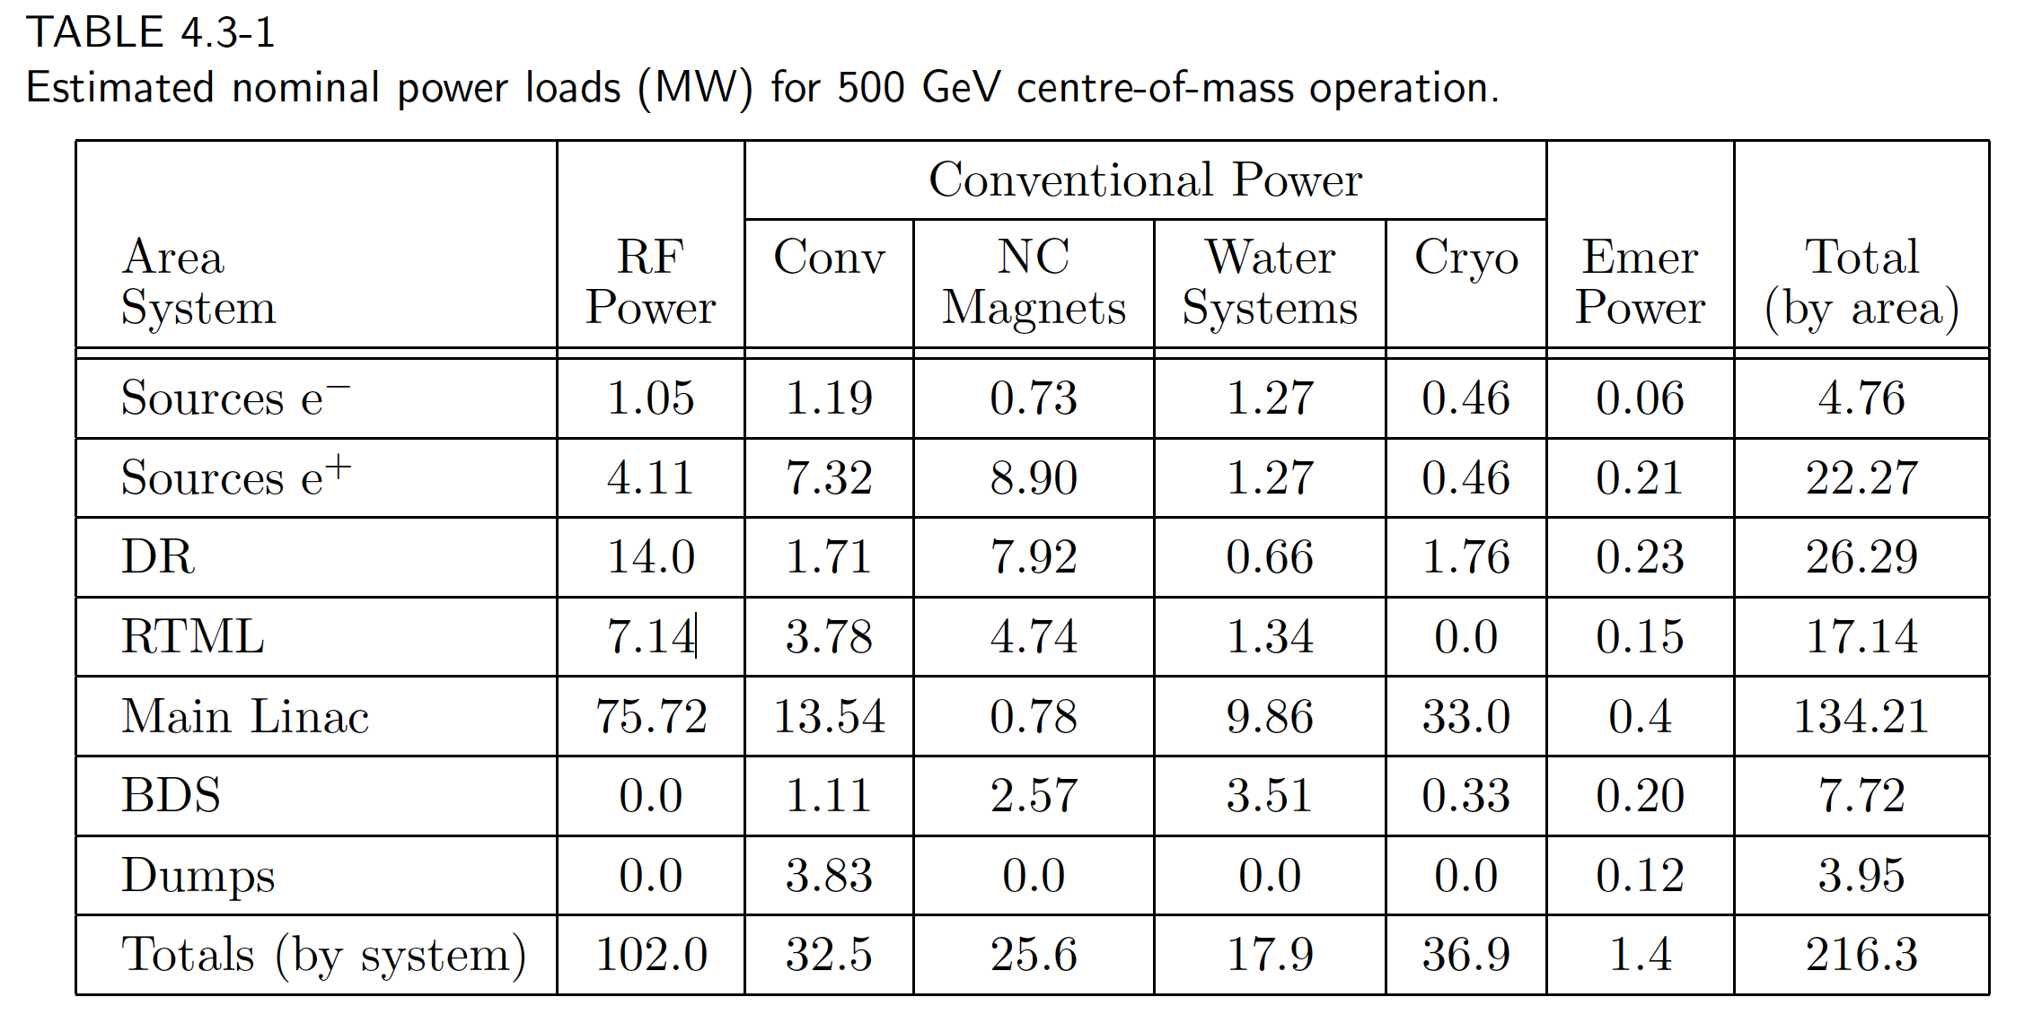
For Comparison: RDR Table
Note: This is for 2625 bunches!

Slide 4
Main Linac RF Power revisited
New issue considered since June:
In ”3.7+3.7Hz” operation, gradient in cavities alters between 31.5MV/m and 8.8MV/m from pulse to pulse
Gradient is changed only via klystron output. Coupler settings (Q_{ext}) are the same
  -> Q_{ext} is not matched to loaded Q_{L} for log gradient beam
  RF efficiency is further reduced
New calculation provided by Kaoru Yokoya:
  Fill times recalculated for electron beam at 46GeV and 125GeV, and positron beam at 46GeV, for 1312 and 2625 bunches
  RF power recalculated, considering effect of mis-match for 46GeV beam in electrion machine matched for 125GeV beam
New Klystron efficiencies estimated

Slide 5
Preliminary result
 | Electron ML |  | Pos ML | Electron ML |  | Pos ML
Scenario | Baseline |  |  | Lumi upgrade
Ebeam | 125 | 45.6 | 45.6 | 125 | 45.6 | 45.6
Bunches | 1312 |  |  | 2625
Gradient / MV/m | 31.5 | 8.8 | 8.8 | 31.5 | 8.8 | 8.8
Q_{ext} / 1E6 | 5.5 | 5.5 | 1.5 | 3.6 | 3.6 | 1.0
Tfill / us | 930 | 329 | 259 | 614 | 217 | 171
MBK eff | 67% | 53% | 48% | 67% | 53% | 48%
P_{AC} / MW | 9.0 | 3.1 | 2.1 | 12.9 | 5.1 | 3.6
Change to CR-0021 | - | +1.2 | +0.2 | -0.1 | +2.0 | +0.5
Note: Wall plug power PAC still under discussion,
need to understand treatment of efficiencies involved

Slide 6
Next steps
Finalize discussion of efficiencies
Apply new fill times etc to Nick Walker’s spread sheet to obtain effect on cryogenic power

