Slide 1
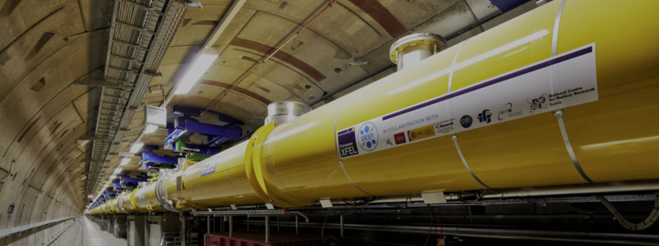
Recent developments in high-gradient SCRF
Marc Wenskat (UHH)
ILC@DESY – 23.11.2020

Slide 2
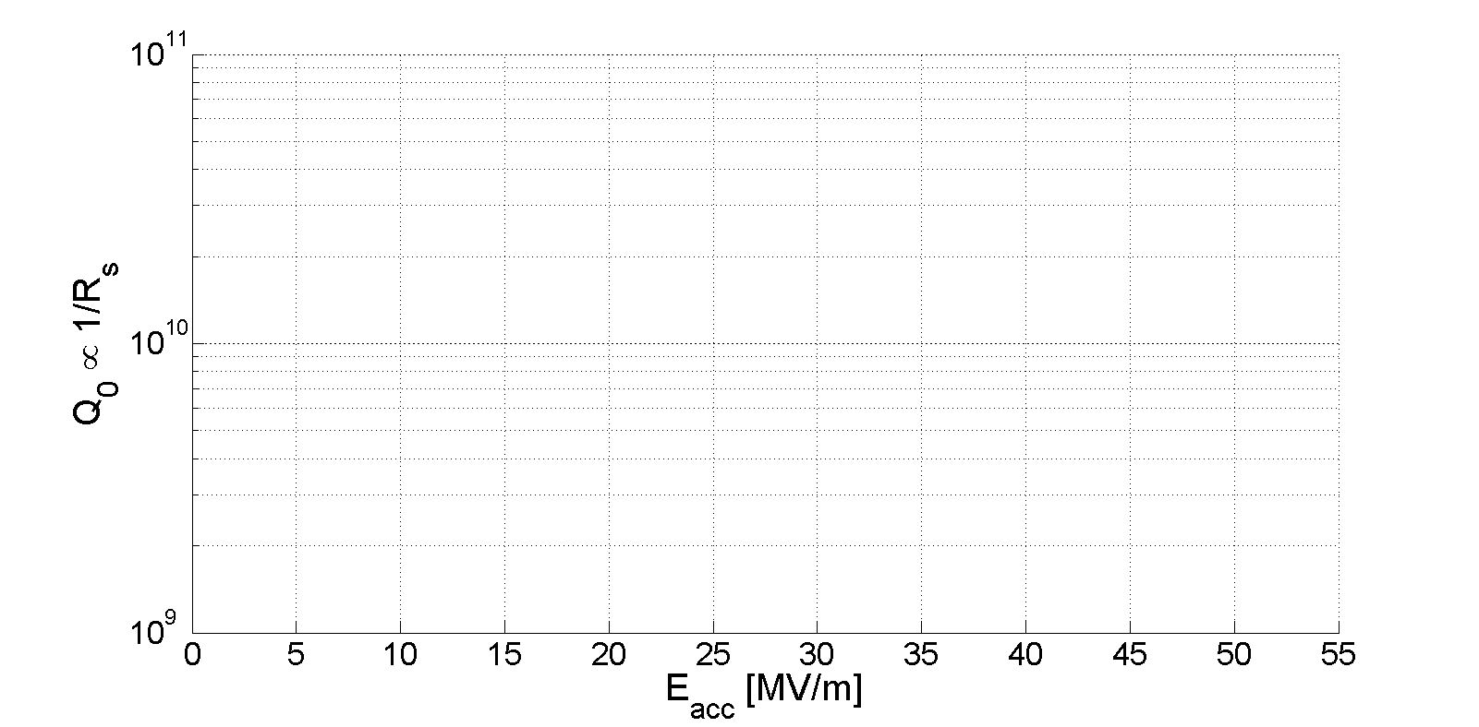
General R&D
See 168th ILC@DESY
Standard Cavity
Doped Cavity
Infused Cavity
Low-T Baked Cavity
Mid-T Bake
[Reschke et al., Phys. Rev. Accel. Beams, 20, 042004 (2017)]
[Grassellino et al., SUST, 26, 102001 (2013) ]
[Grassellino et al., SUST, 30, 094004 (2017) ]
[Grassellino et al., arxiv 1806.09824]
[Posen et al., Phys. Rev. Applied 13, 014024]
Cavities limited by quench

Slide 3
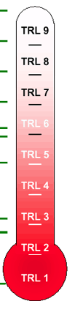
Technology Readiness Level
Developed by NASA in 1970
Actual system proven in operational environment
System complete and qualified
System prototype demonstration in operational environment
Standard Cavity
Doped Cavity
Infused Cavity
Low-T Baked Cavity
Mid-T Bake
Technology demonstrated in relevant environment
Technology validated in relevant environment
Technology validated in lab
Nb₃Sn
SIS
Experimental proof of concept
Technology concept formulated
Basic principles observed

Slide 4
Status of Infusion R&D
Enables pulsed @ high energy and cw @ medium energy operation
FNAL: No problems – focus on “Quantum Technology”
Cornell: Stopped R&D – want USP & process deemed to unstable
Jlab: Reduced R&D – focus on LCLS-II HE Upgrade and new Doping Recipe
KEK: Succeeded beginning of 2020 with first infusion after 3y and several fails
IJC: Started Infusion R&D and had same problem as DESY
DESY/UHH: 12 Infusion runs – only 3 with unchanged performance. Major invest in (i) upgrade of ZM furnace (ii) refurbishment of HIII furnace (iii) purchase of new UHV furnace for single cells
TRL 4: Technology validated in lab
TRL 5: Technology validated in relevant environment
TRL 6: Technology demonstrated in relevant environment
Not just technology development – but also science!

Slide 5
What if…
Infusion @ 160°C looks like a Doped Cavity (both introduce N into Nb)
Mid-T Bake has „anti-Q-Slope“ like Doped Cavity (UHV Bake @ 300°-400°C)
Infusion below 160°C (w./ N) looks like 120°C bake (w./o. N) but different Offset
What if all these annealing procedures do the same thing!
What is „the same thing“?
Why does “this thing” influence the rf properties?

Slide 6
„Impurity Tailoring“
Mixture of several models, measurements and ideas
Hydrogen is bad – tends to accumulate near the surface, form lossy hydrides
Native Nb-Oxides seem to have lossy TLS-Oscillations
→ Near-Surface Lattice is not in the perfect shape
Annealings do one thing: modify concentrations of H, N, O and vacancies
  Vacancies and interstitial N or O can trap hydrogen / prevent hydride formation
  Modify Nb-Oxides to form less defective phases
  Shift induced currents away from the lossy surface region by manipulating λ_{L}
  Spread currents over larger volume, effectively increase applicable gradient
  Change DOS, electron-phonon coupling and qp relaxation times
Fascinating new ideas – completely new approaches – fundamental new understanding
But: Where can we go with niobium? only so far…

Slide 7
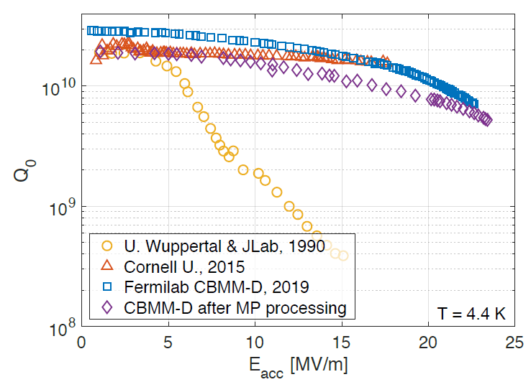
Beyond Niobium
Nb₃Sn
Nb₃Sn has higher T_{c} (18 K vs. 9.2 K) and higher H_{sh} (450 vs. 220 mT) than Niobium
Studied since 1990s (Wuppertal, Karlsruhe, Jlab) – Recent “breakthrough” at FNAL
In short: Impressive behavior in terms of Q – not so much in terms of E_{acc}
[Posen et al., https://doi.org/10.1088/1361-6668/abc7f7]
Simulations and Measurements exist – indicating a fundamental limit of 93 mT or 22 MV/m

Slide 8
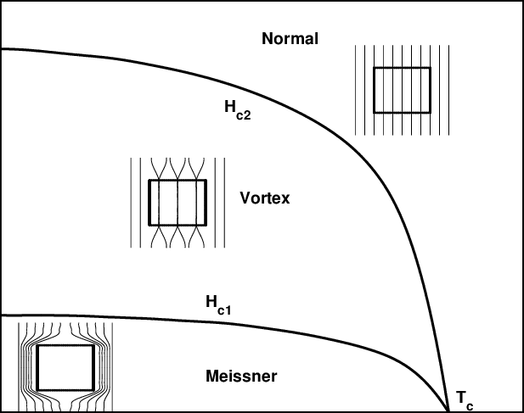
Beyond Niobium – Part II
Nb is Type II SC
  B_{c,1} is 170mT → 39MV/m
  B_{c,2} is 300mT
  B_{sh} is 230mT → 53MV/m

Slide 9
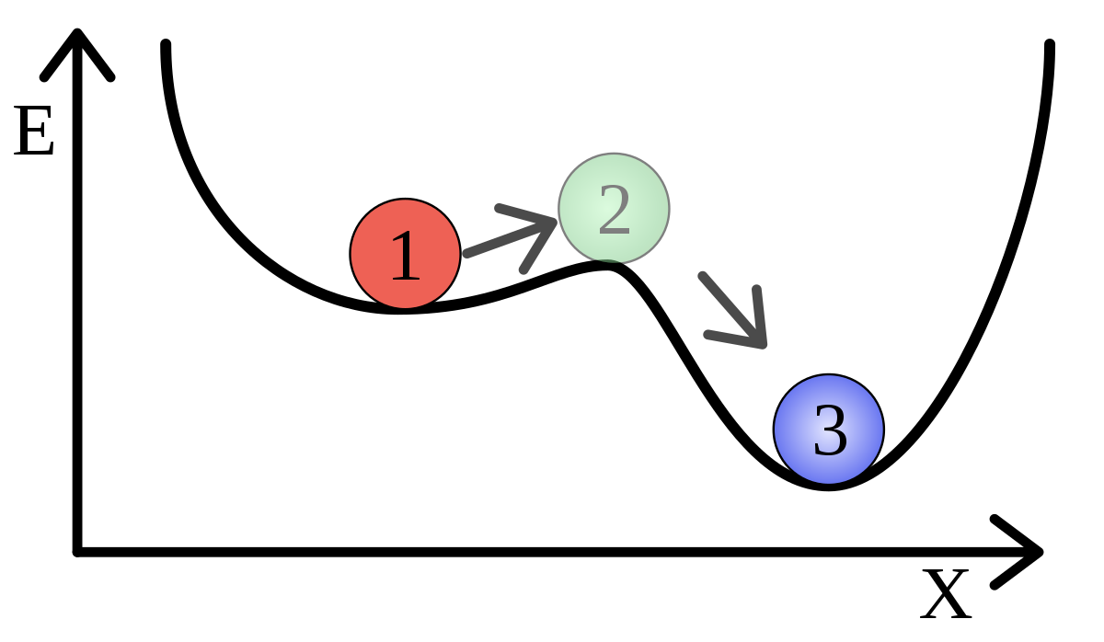
What is Superheating?
When does the flux enter?
  Meissner to Shubnikov phase are local minima w.r.t. magnetic field as parameter
Bean-Livingston studied intermediate state: Vortex near a surface
  Attractive mirror-vortex
  Repulsive surface current or “screening current”
H

Slide 10
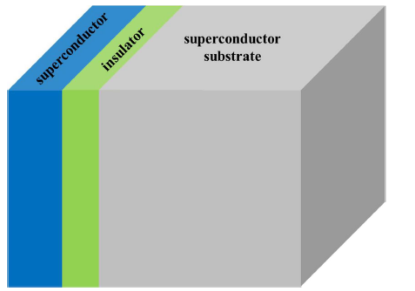
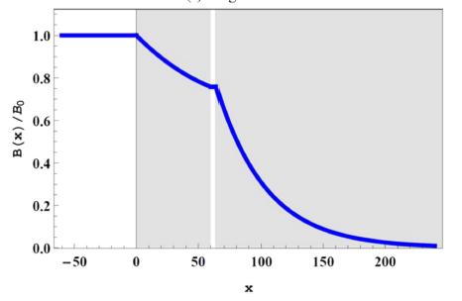
Welcome to „our mirror world“
Increase “mirror-surfaces”
Insulator is important!
  Add mirror-surfaces
  Prevent Josephson Junctions
  Trapp vortices in top-layers
Use higher T_{c} superconductors → less losses!
RF field on surface can be several times above B_{sh} of Nb → Higher Gradient
[Gurevich, Appl. Phys. Lett. 88, 012511 (2006)]

Slide 11
S-I-S R&D
4 Groups study these layered structures
  IJC – JLab – KEK/U Tokyo – U Hamburg/DESY
We use a coating technique easily applicable to cavity geometry (ALD) while Jlab and KEK uses Sputtering techniques
Started ~1y ago but have an excellent Network (CHyN, Nanolab, IExp, MSL) and collaborations (IJC, HZDR, RWTH, U Siegen) with promising results
NbTiN
Goal: 100 MV/m @ 10¹⁰ @ 2K (4K??)

Slide 12
Summary
SRF community shifts its focus a bit
  US: Goes Quantum or LCLS-II HE, Everyone else tries to find USP
Still no final picture – It’s a bit like the “Teilchenzoo” before Gell-Mann / Eightfold Way → Window of opportunity
Draw more and more material scientists and theorists into our field
Beyond Nb R&D picks up speed

Slide 13


Thanks for Listening!
Questions?

Slide 14
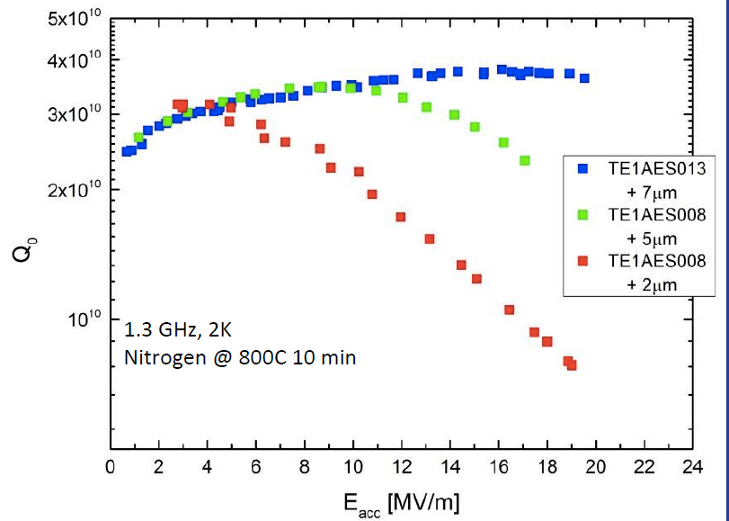
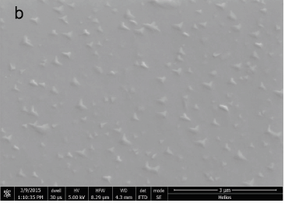
The Recipe
N-Doping: Change of baking procedure
N₂
800°C
Pressure [mbar]
Temperature [°C]
Time [h]
+ 5-10 μm removal of inner layer by chemical etching necessary

Slide 15
The Recipe
N-Infusion
N₂
800°C
Pressure [mbar]
Temperature [°C]
No chemistry needed
120°C
Time [h]
Problem: No one cooks like Grandma

Slide 16
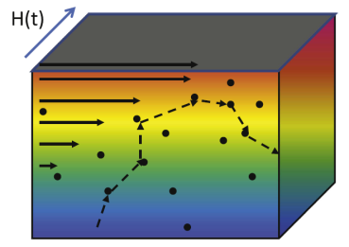
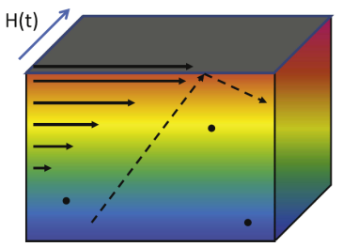
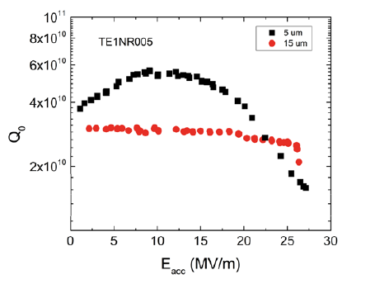
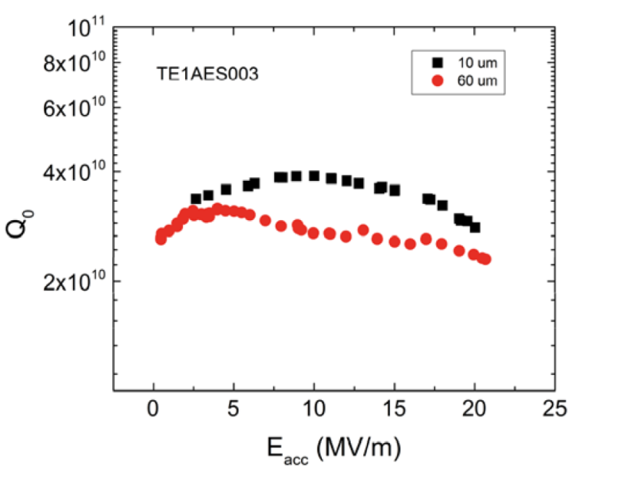

How is the performance affected?
Model can explain Q₀ increase but not difference between Doping & Infusion
Q₀(E) dependency change
Effect has not been seen in low mfp cavities
Difference in Quenchfield
Quench field does not increase/reset with more inner surface removal!
$R_{s}=R_{BCS}$+$R_{res}$

Slide 17
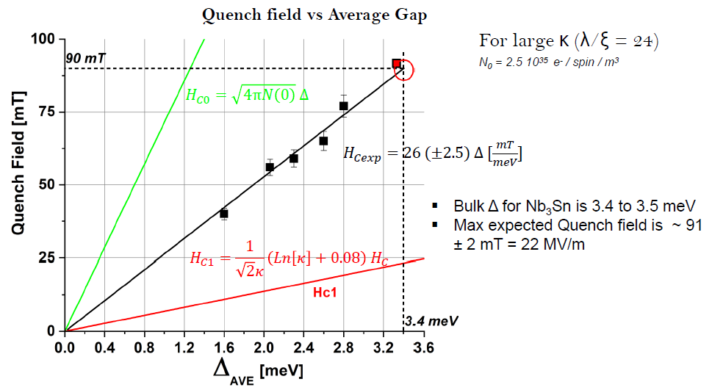

Slide 18
The whole is more than the sum of its parts
Putting a superconductor on top of Nb with a higher T_{c} and/or B_{sh} is not the point
The insulator plays a crucial role!

Slide 19
Here comes the insulator
Benefit is threefold!
Let some flux enter – but trap it
  No avalanche leading to a quench
  Majority of losses in the S layer
S layer thinner then its λ_{L} – otherwise its “bulk”
More “mirrors” create more screening currents means less flux!
Isolater thickness plays a role, too!

Slide 20
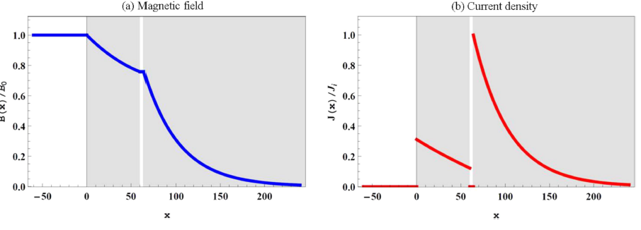
Why insulator is not irrelevant
Maxwell
λ_{L}=120nm
λ_{L}=40nm
Screening current J(x) ~ -B(x)‘/µ₀ ~ 1/λ_{L}
B is attenuated in finite I layer as well
Hence screening current at I-S interface decreases and mirror current S-I interface
Hence overall screening performance is attenuated and max. B_{c} reduced

Slide 21
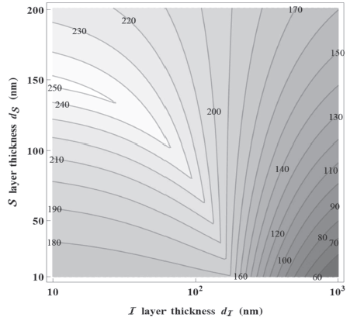
Optimal thickness?
If the thickness of the substrate and insulator is relevant – what is the optimal thickness for highest B_{applied}?
Depends on B_{c,1} and λ_{L} of both S
  Here NbN – I – Nb
This is B_{max}

Slide 22
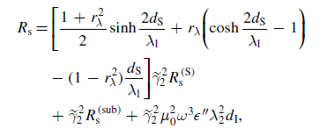
What about Q₀?
Have majority of losses in high T_{c} superconductor
R_{s} is reduced
Losses in I-layer is ~ d/nm x 10⁻⁷ nΩ
For NbN – I – Nb (150nm/20nm) only ~67% at 2K

Slide 23
What Materials?
Current candidates
  as insulator: Al₂O₃ and AlN
  as supercondutor: NbN, NbTiN, Nb₃Sn
  Other?
Questions to be addressed:
  Al₂O₃ and Nb-Oxides and then coating with elevated T – good idea?
  Thermal conductivity of insulator? (e.g. strange behavior|T-dependence for NbTiN-AlN-Nb sample from Jlab at HZB QPR)
  Mechanical stability of film(s) during HPR?

