Slide 1
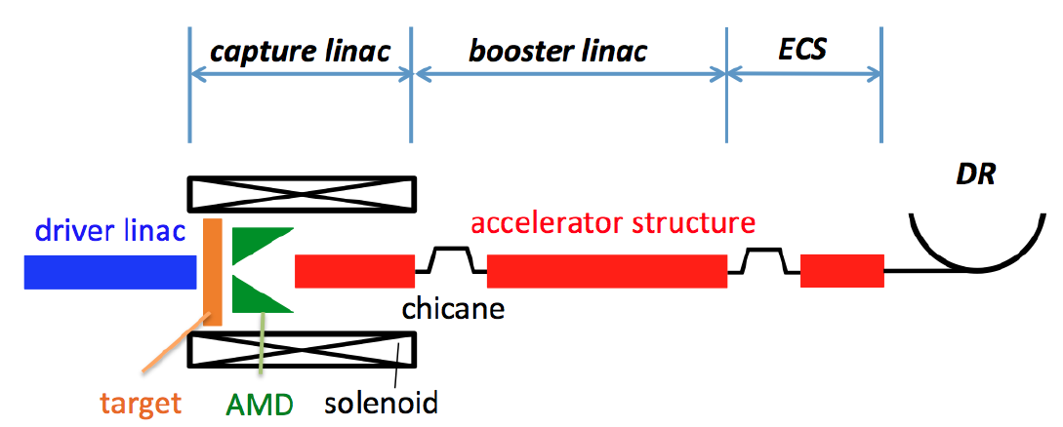
Sources Subgroup Summary, Oct.5.2020
K. Yokoya, IDT-WG2 Oct.6
Participants: M. Kuriki, H. Hayano, G. Moortgat-Pick, J. Grames, K. Yokoya, S. Michizono, A. Lankford
Timeline of IDT-WG2 : same as other three subgroups
Most discussion concentrated on the problem specific to our subgroup, i.e., technology selection between
  Undulator scheme (baseline) and
  Electron-driven scheme (backup)
125GeV electron
3GeV electron from a dedicated linac

Slide 2
Discussion on the “Selection”
The general timeline demands the budget request by Feb.2021.
“Selection” by this date seems impossible, but is the budget request possible without selection?
If we postpone the selection, we have to invest our limited budget and human resources to the two schemes.
It may be possible to start the Pre-Lab without the final selection.
100% feasibility must be guaranteed at the time of the selection. The technology for the e-Driven scheme is more mature now than the Undulator scheme, but not 100% now.
No conclusion at this moment on this issue.

Slide 3
Required Activities at ILC Pre-Lab
Three possible steps
Feasibility demonstration in the IDT period (might extend to the first part of the Pre-Lab period?)
4 years of Pre-Lab
For some items the development work might still be possible during the time of the tunnel construction
Start writing a table of the required activities.
Kaoru presented an example table
Improved table in the coming meetings
  Undulator scheme: Gudi
  e-Driven scheme: Masao
  Electron source: Joe
Eventually, we have to fill the columns of required cost and human resources and possible candidates of lab names
Next meeting on Oct.12 (Mon)
Then, switch to every other Monday pattern

