Slide 1
3rd meeting of SRF subgroup in IDT/WG2
New member of SRF subgroup
Brief report of KEK-DOE meeting
Brief report of SRF session in AWLC2020
Discussions on main items in technical preparation period
Others (if any)
Attendees: A. Yamamoto, A. Lankford, S. Michizono, H. Hayano, O. Napoly, D. Delikaris, N. C. Lasheras, S. Posen, R. Rimmer, R. Geng, M. Liepe, Kirk, S. Stapnes, P. McIntosh, R. Laxdal, P. Burrows
https://agenda.linearcollider.org/category/256/
Kirk

Slide 2
IDT-WG2 organization
IDT WG2
Shin Michizono (Chair)
Benno List (Deputy)
Charges of Sub-groups
Discuss and coordinate the topics for
- technical preparation (remaining topics) at Pre-lab
- preparation for mass production at Pre-lab
- possible schedule at Pre-lab
- international sharing candidates of these activities
Report to the IDT-WG2
SRF
DR/BDS/Dump
All members belong to some sub-group(s).
Yasuchika Yamamoto | KEK
Nuria Catalan | CERN
Dimitri Delikaris | CERN
Rongli Geng | JLAB
Hitoshi Hayano | KEK
Bob Laxdal | Triumf
Matthias Liepe | Cornell
Peter McIntosh | STFC
Olivier Napoly | CEA
Sam Posen | FNAL
Robert Rimmer | JLAB
Marc C. Ross | SLAC
Akira Yamamoto | KEK
Toshiyuki Okugi | KEK
Karsten Buesser | DESY
Philip Burrows | U. Oxford
Angeles Faus-Golfe | LAL
Jenny List | DESY
Thomas Markiewicz | SLAC
Brett Parker | BNL
David L. Rubin | Cornell
Nikolay Solyak | FANL
Luis Garcia Tabares | CIEMAT
Nobuhiro Terunuma | KEK
Glen White | SLAC
Kaoru Yokoya | KEK
Sources
Kaoru Yokoya | KEK
Joe Grames | JLAB
Hitoshi Hayano | KEK
Masao Kuriki | U. Hiroshima
Benno List | DESY
Gudrid Moortgat-Pick | U. Hamburg
Civil engineering
Nobuhiro Terunuma | KEK
John Andrew Osborne | CERN
Tomoyuki Sanuki | U. Tohoku

Slide 3
Brief report of KEK-DOE meeting
The meeting done at 7:00~8:22 on 27/Oct (JST)
Organized by A. Lankford
35 people attended
  Japan: S. Michizono, A. Yamamoto, K. Yokoya, N. Terunuma, Kirk
  Members of SRF subgroup in Americas: R. Rimmer, M. Liepe, R. Laxdal, R. Geng, S. Posen
Michizono-san presented ILC overview, IDT, technical preparation, budget request from KEK, Recommendations on ILC Project Implementation, SCRF, positron source, damping ring, final focus system, beam dump, potential US accelerator contribution, and so on.
A lot of discussions/questions/comments

Slide 4
Schedule of SRF subgroup meeting in IDT/WG2
Meeting # | Date | Contents
1 | 29/Sep/2020 | introduction, member list, schedule/work items in technical preparation, discussions
2 | 13/Oct/2020 | New member, discussions on how many cavities/CMs to be produced, AWLC2020
 | 19~22/Oct/2020 | AWLC2020 on virtual
3 | 27/Oct/2020 | Brief report of KEK-DOE mtg and AWLC, discussions on main items in technical preparation
4 | 10/Nov/2020
5 | 24/Nov/2020
6 | 8/Dec/2020
7 | 22/Dec/2020 | Draft of sharing work items in technical preparation period
? | 12/Jan/2021?
 | Feb/2021 | First draft of budget request in each region/lab., Submission to WG1/EB
 |  | Preparation for MOU between/among laboratories
 | Jun~Jul/2021 | Submission of budget request to MEXT, in case of Japan

Slide 5
Main discussion items based on
“Recommendations on ILC Project Implementation”
AWLC2020
Cavity and cryomodule production
  100 cavities produced in preparation for mass production
    ~1% of full production
    Japan: 50 cavities, other regions/countries: 50 cavities
  By new cost-effective production method
  Plug-compatibility re-confirmed/re-established
  To be checked RF performance/success yield
  High pressure gas regulation in Japan (cavity/cryomodule production)
  Coupler/tuner improved/produced/assembled/tested
  Cryomodule production/test
Cryomodule transport (“Global Cryomodule transfer”)
  Shipment/transport incl. inspection
  RF performance rechecked after transport

Slide 6
Pre-Lab schedule (translated into table)
 | Technical preparation period (Fiscal year)
Items | 1 |  | 2 |  | 3 |  | 4
Cost down R&D
Cost estimation based on TDR
Review |  |  |  | Internal | External
Engineering design report |  |  |  |  |  | Draft | Publish
Prototyping of critical items
Preparation for mass-production technology
Writing
We have to fit the SRF schedule to this overall schedule!

Slide 7
Brief view of cavity production by cost-effective method, and the best recipe
Step 1 (production)
  Cavity production by cost-effective method incl. selection of Nb material
  Reconfirmation of plug-compatibility (only flanges)
  Not necessary for satisfying high pressure gas regulation of Japan
  Not necessary for helium tank
Step 2 (decision of surface/heat treatment methods)
  Cold temp. EP or standard EP?
  N-dope, N-inf, Low temp. baking, Mid temp. baking, etc.?
Step 3 (RF performance check)
  VT1, but if not successful, VT2 done (after VT3, to be discussed)
Step 4 (success yield)
  Estimate success yield for 1st pass and 2nd pass (after 3rd pass, to be discussed)
Workshop is necessary to discuss those items

Slide 8
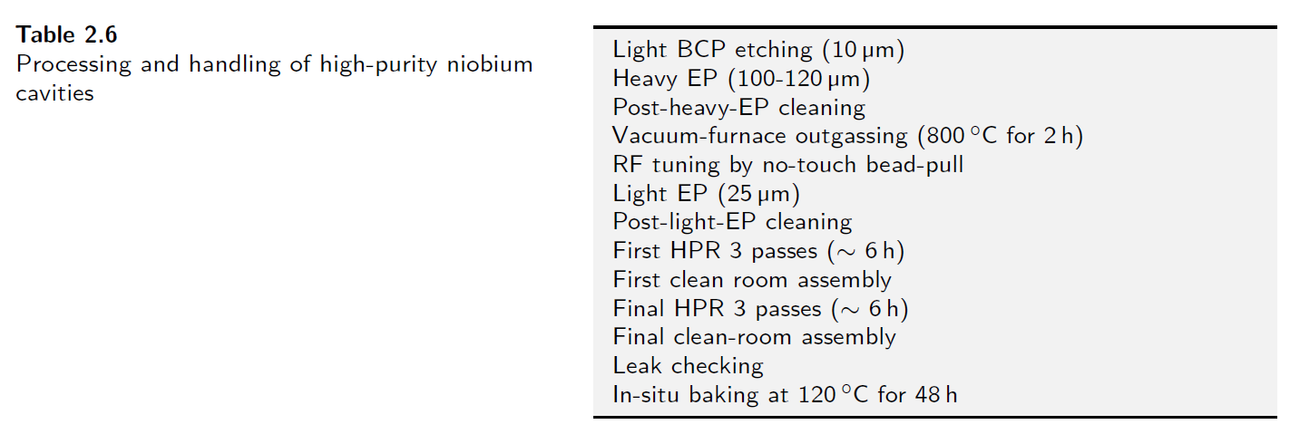
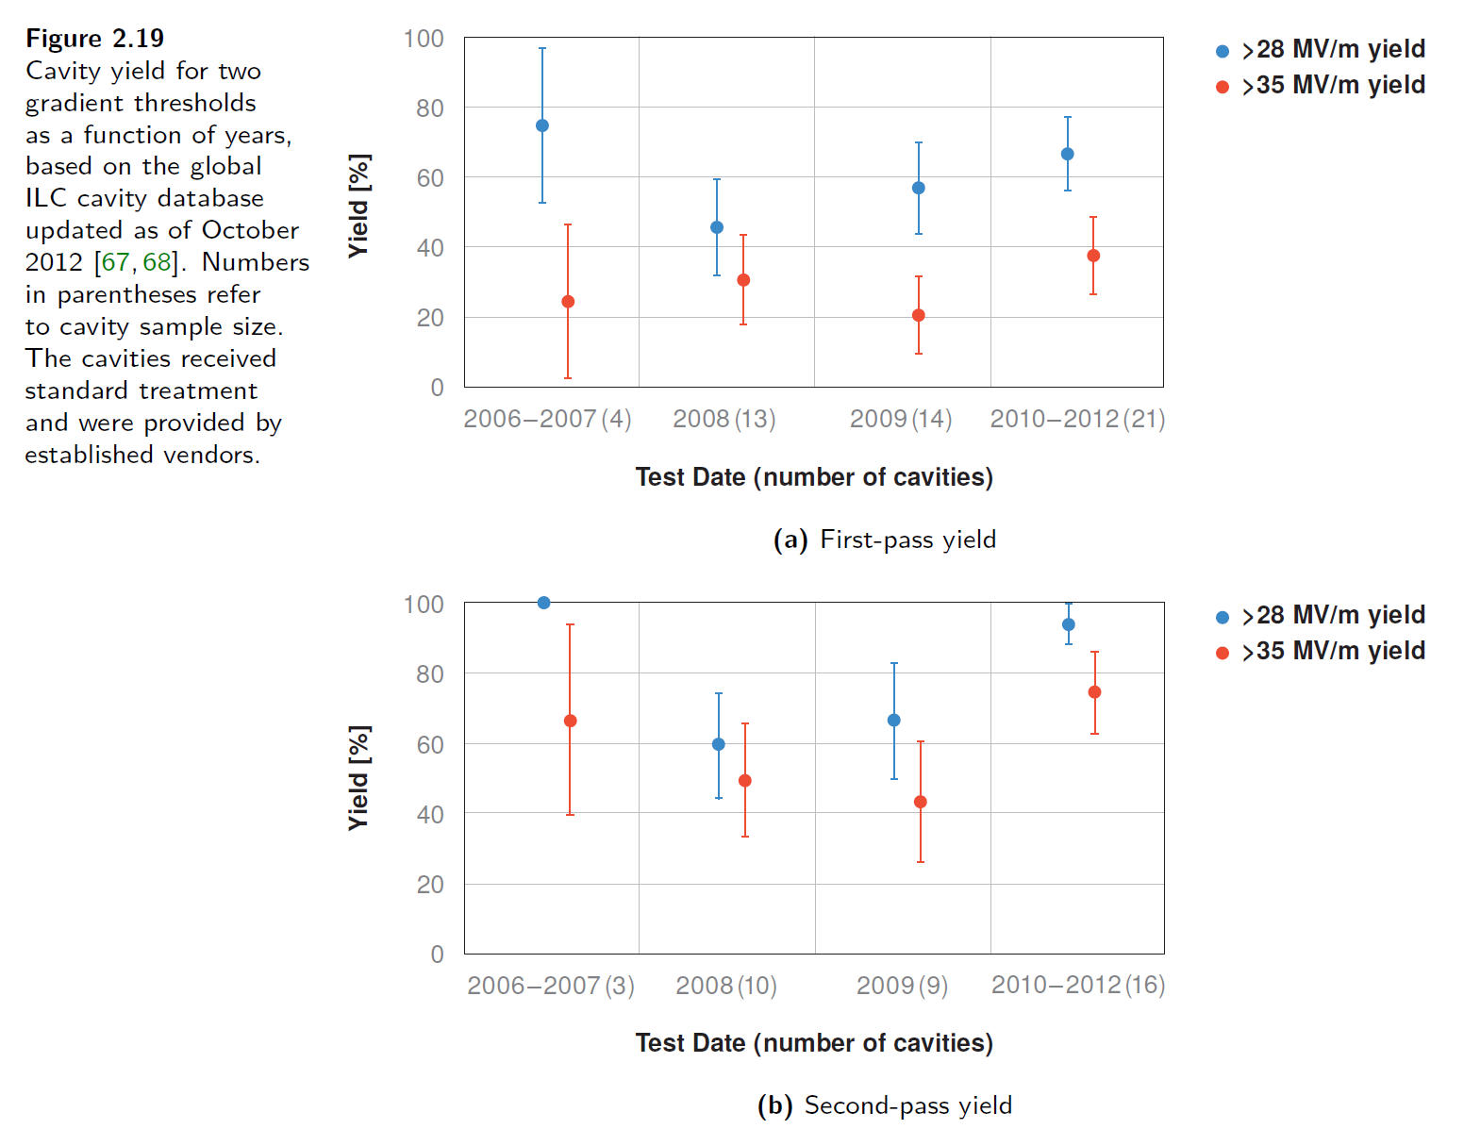
How many cavities are produced for mass production?
We can refer Volume 3 Part 1 in TDR.
At that time, 16 9-cell cavities (out of > 50 cavities, recognized as identical in fabrication and surface process) were used to evaluate cavity performance.
In the preparation phase, at least ~ 20 or much more cavities are necessary to evaluate recent surface treatment method including fabrication method much advanced since TDR.
Not only surface treatment method but also what type of Nb material/fabrication method is used has to be discussed.
Discussion item
Treatment method in TDR
History of cavity performance
When we evaluate success yield of cavity performance,
each region/lab. has to select one method of fabrication and surface process.
But, we don’t need world-unified method of fabrication and surface process.
Helium tank/tuner are not necessary for this evaluation
# of cavities | Japan (/Asia) | Americas | Europe
w/o helium tank/tuner | 20 | 20 | 20
w/ helium tank/tuner
At least 20 cavities are produced

Slide 9
Questions/Discussions/Comments (memorandum) @3rd meeting
Translation by Kirk
50 cavities satisfied with HPG? Or not? Cost should be effectively used. Cavities w/o helium tank is used for only estimation of success yield
  10 cavities w/o tank in 1st year, 10 cavities w/ tank satisfying with HPG in 2nd year…
Necessary for learning impact on high pressure gas regulation of Japan
How much is one cavity estimated?
Flexibility in surface treatment is necessary, to be discussed
  To be decided in technical workshop
International workshop is necessary to review material/fabrication/surface treatment methods
  plug-compatibility reconfirmed
  To be held after TTC meeting 2021 or next LCWS2021?
New vendors in US
  Important to find cavity fabrication vendor, in not only US but the other countries
  To be checked qualification, learning curve expected, capability of large number production, etc.
In GDE, cost estimation has been done by some vendors, but one vendor was dominant
Reexamine lesson/learned from what GDE have done
After E-XFEL construction, cavity fabrication cost is not changed, or a little changed
  Cost of power coupler increased
Laboratory-vendor collaboration in cavity fabrication is also necessary
  KEK has already done
Year and year plan is necessary in each region for technical preparation period
Americas laboratory proposals in next meeting
  Kirk requests responsible persons in each lab.

Slide 10
References
KEK homepage
  https://www2.kek.jp/ilc/en/
Technical Design Report
  https://ilchome.web.cern.ch/publications/ilc-technical-design-report
  https://www2.kek.jp/ilc/en/docs/
The International Linear Collider Progress Report 2015
  https://www2.kek.jp/ilc/en/docs/
The International Linear Collider – A Global Project
  Submitted to European Particle Physics Strategy Update, 2020.
  https://indico.cern.ch/event/765096/contributions/3295702/
ILC Action Plan
  https://www.kek.jp/ja/newsroom/2016/01/06/1400/
  https://www.kek.jp/ja/newsroom/2018/04/24/1200/
Recommendations on ILC Project Implementation
  https://www.kek.jp/ja/newsroom/attic/20191001_%20ILC%20Project.pdf

