Slide 1
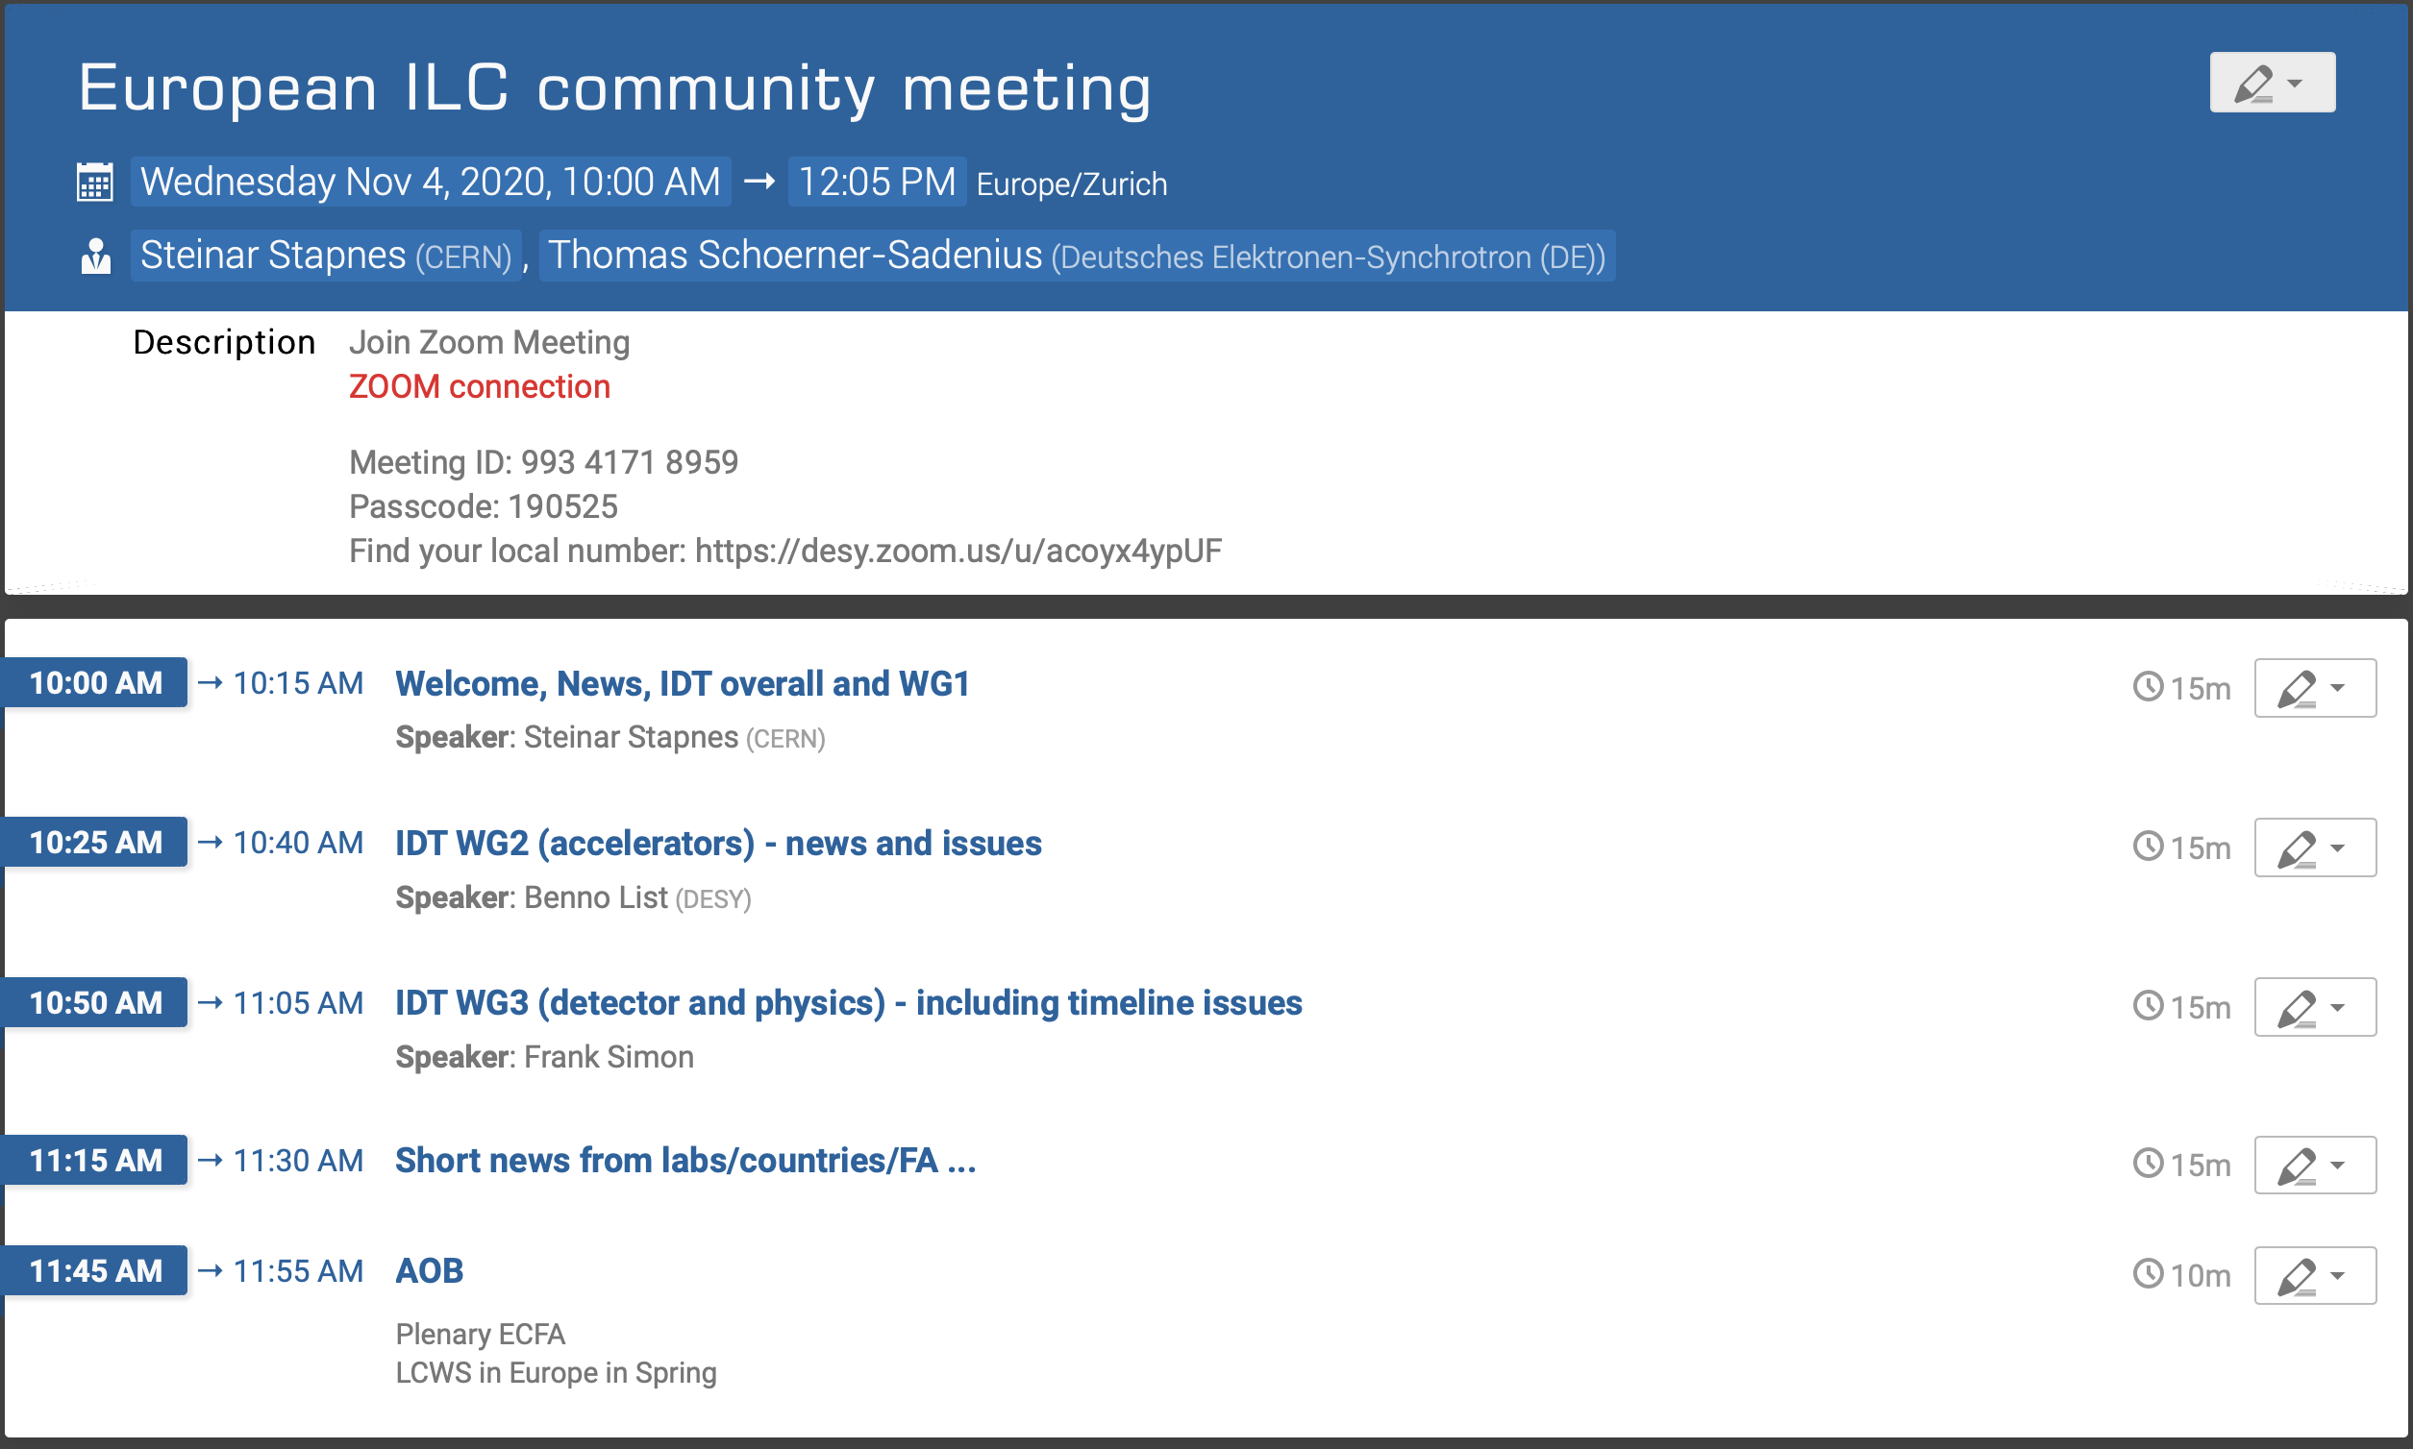
Welcome

Slide 2
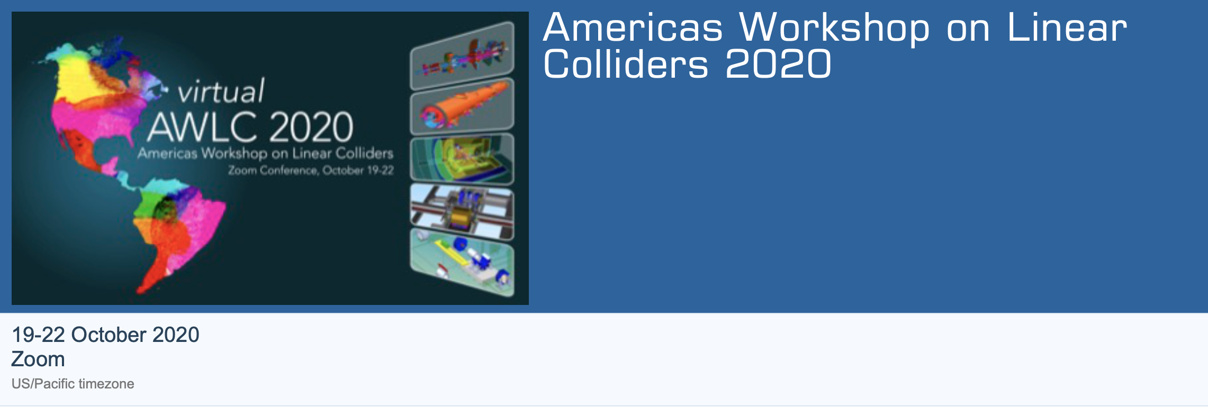
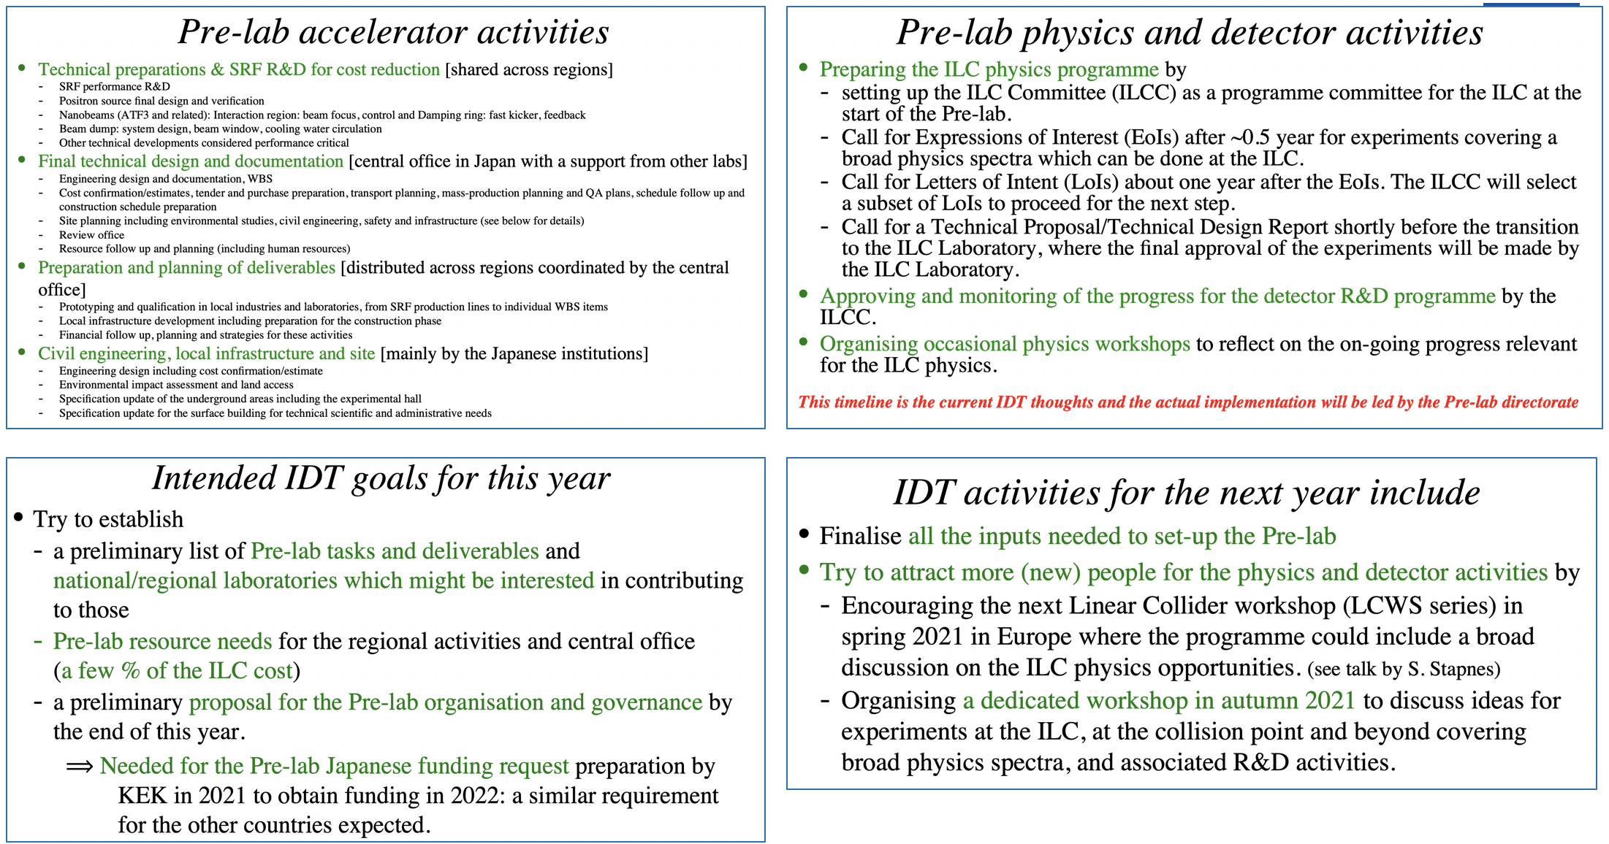
Americas WS on LCs
Americas LC workshop – IDT report:
See talks later of Benno and Frank

Slide 3
Following up
From the IDT report we can conclude:
Accelerator - next:
Urgent to build a table of European interests (R&D and possible deliverables)
Need a SCRF discussion meeting for a module prod. model for Europe
Detector and Physics – next:
ILC community build-up a priority, use workshops next year
LCWS in Europe in Spring - set up committee and determine date
  For ILC and CLIC, must include “EoI” physics session(s) for ILC (or maybe LCs generally)

Slide 4
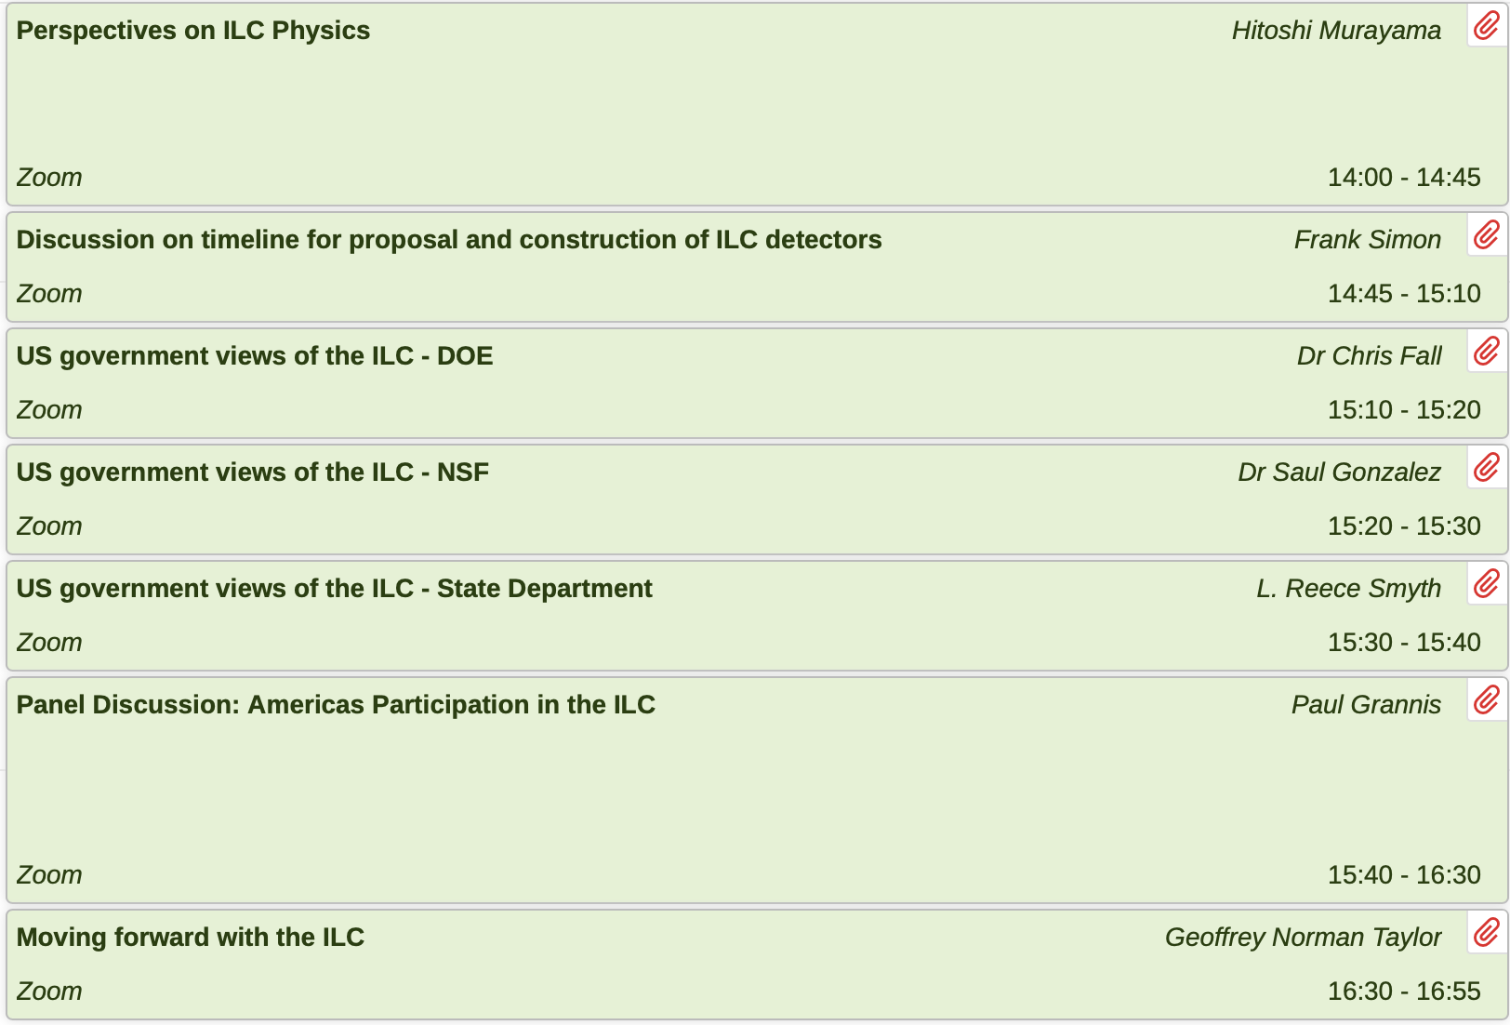
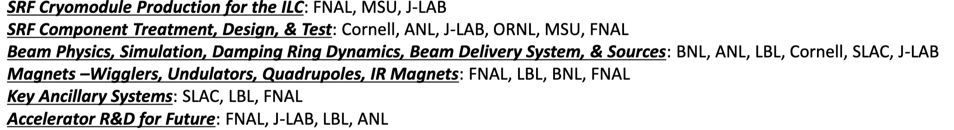
Americas WS on LCs
Americas LC workshop – US interest and capabilities clearly presented

Slide 5
Other updates
WG1 nominations for Europe ongoing
Increased participation in WG2 and 3 from Europe – but not completed
  And what do we do with the fact that we cannot have every country in WG3, but we do want every country and group to be informed and involved (WSs every 6 months not sufficient) ?
PECFA presentation 19.11: https://indico.cern.ch/event/966397/

Slide 6
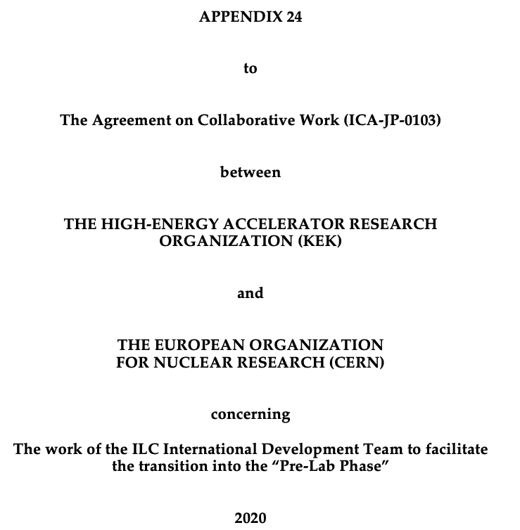
CERN – KEK agreement for the ILC IDT – being signed
CERN will facilitate the European participation in the work during the transition to the Pre-Lab Phase; including working groups on Pre-Lab preparation, accelerator and facility, and physics and detectors.
CERN will coordinate the European contributions to the Team's common fund, as well as the in-kind contributions to the tasks supported by the common fund during the preparation of the Pre-Lab Phase.
Collaborative work in studies related to:
  the accelerator’s beam-delivery system and the Accelerator Test Facility 2 (ATF2)
  high gradient acceleration for linear colliders;
  high efficiency klystrons
  detector, physics and software
  cryogenics systems, beam-dumps, superconducting radiofrequency (SC RF) module components and technologies, civil engineering (all areas where CERN has provided technical advice as part of the LCC collaboration); and
  other areas of common interest (e.g.: positron production and beam-dynamics) and/or information exchange related to common challenges (e.g.: costing methodology and power reduction studies).

Slide 7
Next
Next European meeting:
  Wednesday 9.12 10:00-12:00
  Wednesday 13.1 10:00-12:00.
Please forward emails to relevant colleagues and also ask them to sign up for the mailing list ilceurope-general@desy.de if they are interested to participate in future meetings.
This can be done with a simple email to sympa@desy.de from the mail address you want to register, with the subject line SUBSCRIBE ilceurope-general [firstname lastname]
If you want to un subscribe use subject line UNSUBSCRIBE ilceurope-general
Contact Thomas (thomas.schoerner@desy.de) or myself concerning WEB pages or email

