Slide 1
UK ILC Crab Thoughts
Graeme Burt

Slide 2
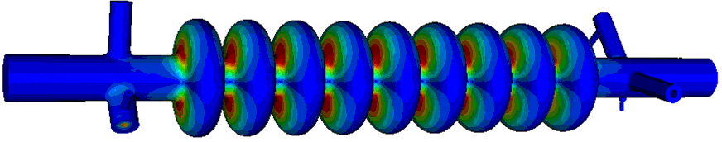
ILC-CC Design
Input Coupler
Based on the FNAL CKM Cavity
LOM Coupler
SOM Coupler
HOM Coupler
Beam-pipe radius = 18mm
Cavity iris radius = 15mm
Equator Radius = 47.37mm
Squashed to give >10 MHz dipole mode separation

Slide 3
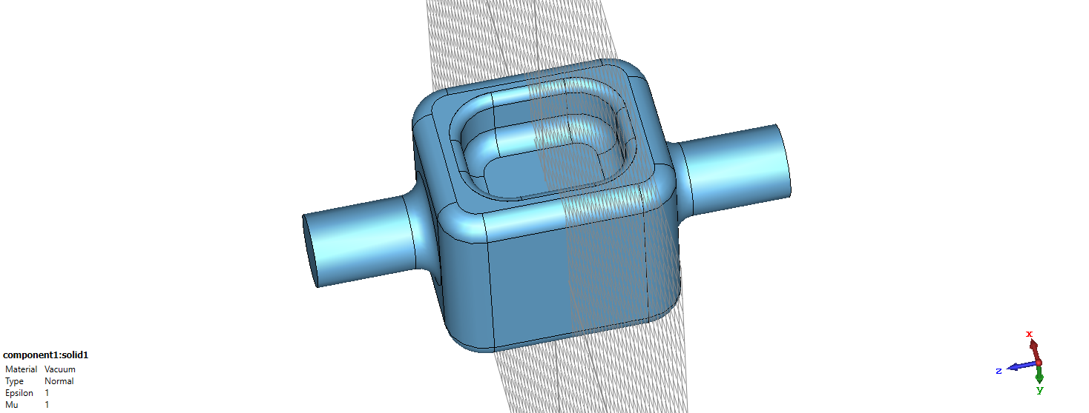
1.3 GHz RFD cavity for ILC
Same dimensions as the 3.9 GHz elliptical (100 mm height with 36 mm aperture)

Slide 4
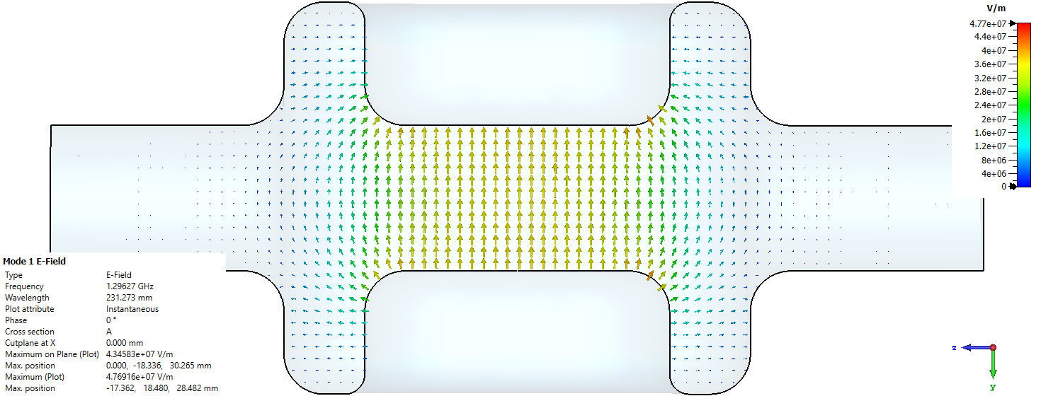
RF properties
Lower peak magnetic fields than the 3.9 GHz elliptical (10 MV/m may be possible a single 9 cell cavity would be sufficient)
Higher Epk but very low in both cases
R/Q significantly less, probably not a major issue

Slide 5
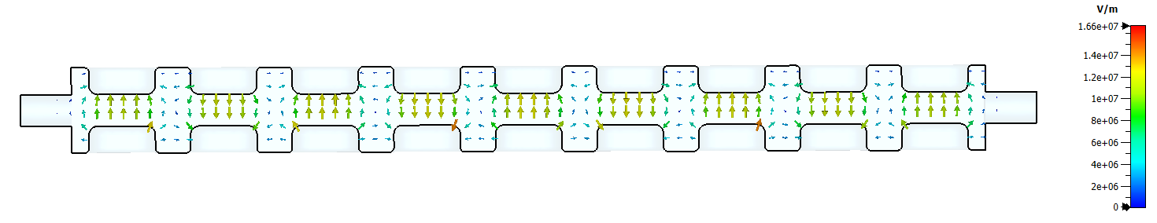
9 cell version
Strong cell to cell coupling may allow more cells if required
230 MHz frequency separation between pi and 0 mode
Cavity is long and thin (0.1m x 1m), may need stiffening. Two 5 cells may be better.

Slide 6
3.9 GHz elliptical: External Q factor s required for couplers
Beam-pipe cut-off
Same Order Mode, tough spec, requires active damping
Trapped modes might need attention
These specs are not tough but might need checking

Slide 7
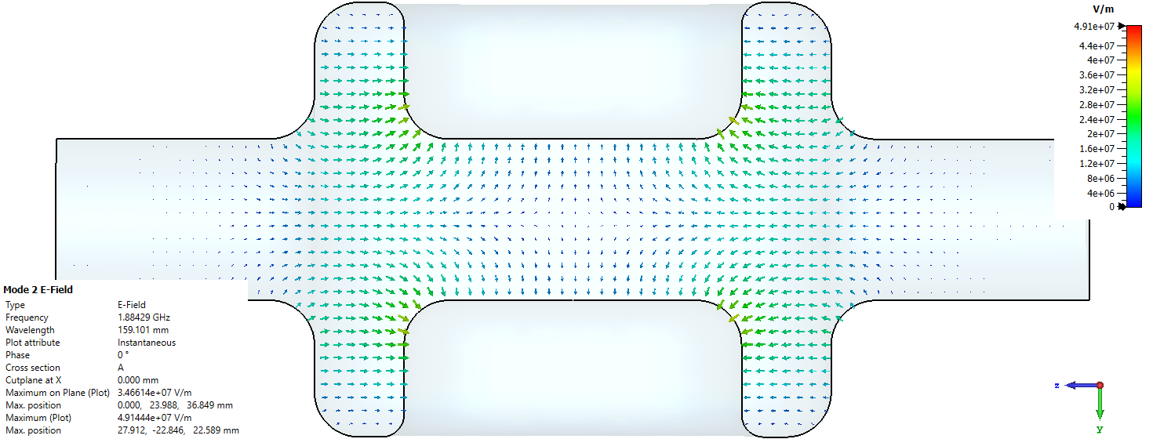
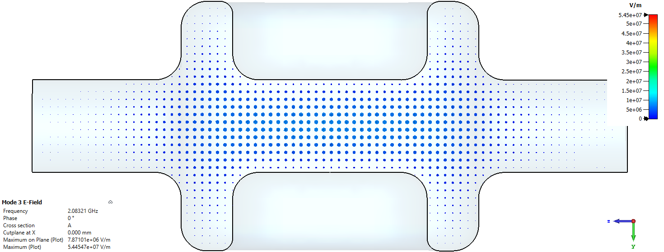
RFD resonances of note
1st monopole mode
No lower order mode, 1st monopole is at 1.88 GHz
Pretty fast attenuation in beamipe, will need on-cell coupling like LHC
Same order mode
Vertical dipole mode is at 2.08 GHz, well separated
No longer an issue

Slide 8
LLRF/Synchronisation Scheme (Final)
Crab to crab jitter is more important than crab to beam/clock so if using an external clock we need to half the jitter (or at least sqrt(2) for rms)
We proposed an RF interferometer to measure the phase at each cavity and synchronise
The longer the distance between cavities the harder that is, a longer distance would need optical links.
Over 50 m RF beats optical in 2008, not clear if that’s still true in 2020.
Hadn’t decided if we needed a single klystron and split the power or if the noise on each klystron would be small enough to have a klystron for each crab and still meet the phase spec.
e⁻
e⁺
synchronous
reference
phase
s
ignals
phase
detector
detector
divide
to
board
A
board
B
divide
to
1.3 GHz
Load
~ 50 metre
1.3 GHz
c
avity
c
ontrol
low loss
c
avity
c
ontrol
(high power)
A/D
coax link
A/D
phase shifter
FPGA
pin diode switch
FPGA
DSP
Load
1.3 GHz
1.299.8 GHz
Load
DSP
vector
oscillator
reference
vector
mod.
D/A
oscillator
D/A
mod.
A/D
A/D
FPGA
D/A
phase
3.9 GHz
FPGA
shifter
oscillator
vector
interferometer line
mod.
D/A
length adjustment
circuits
pin diode
precision
linac timing
switch
reflector
circuits

Slide 9
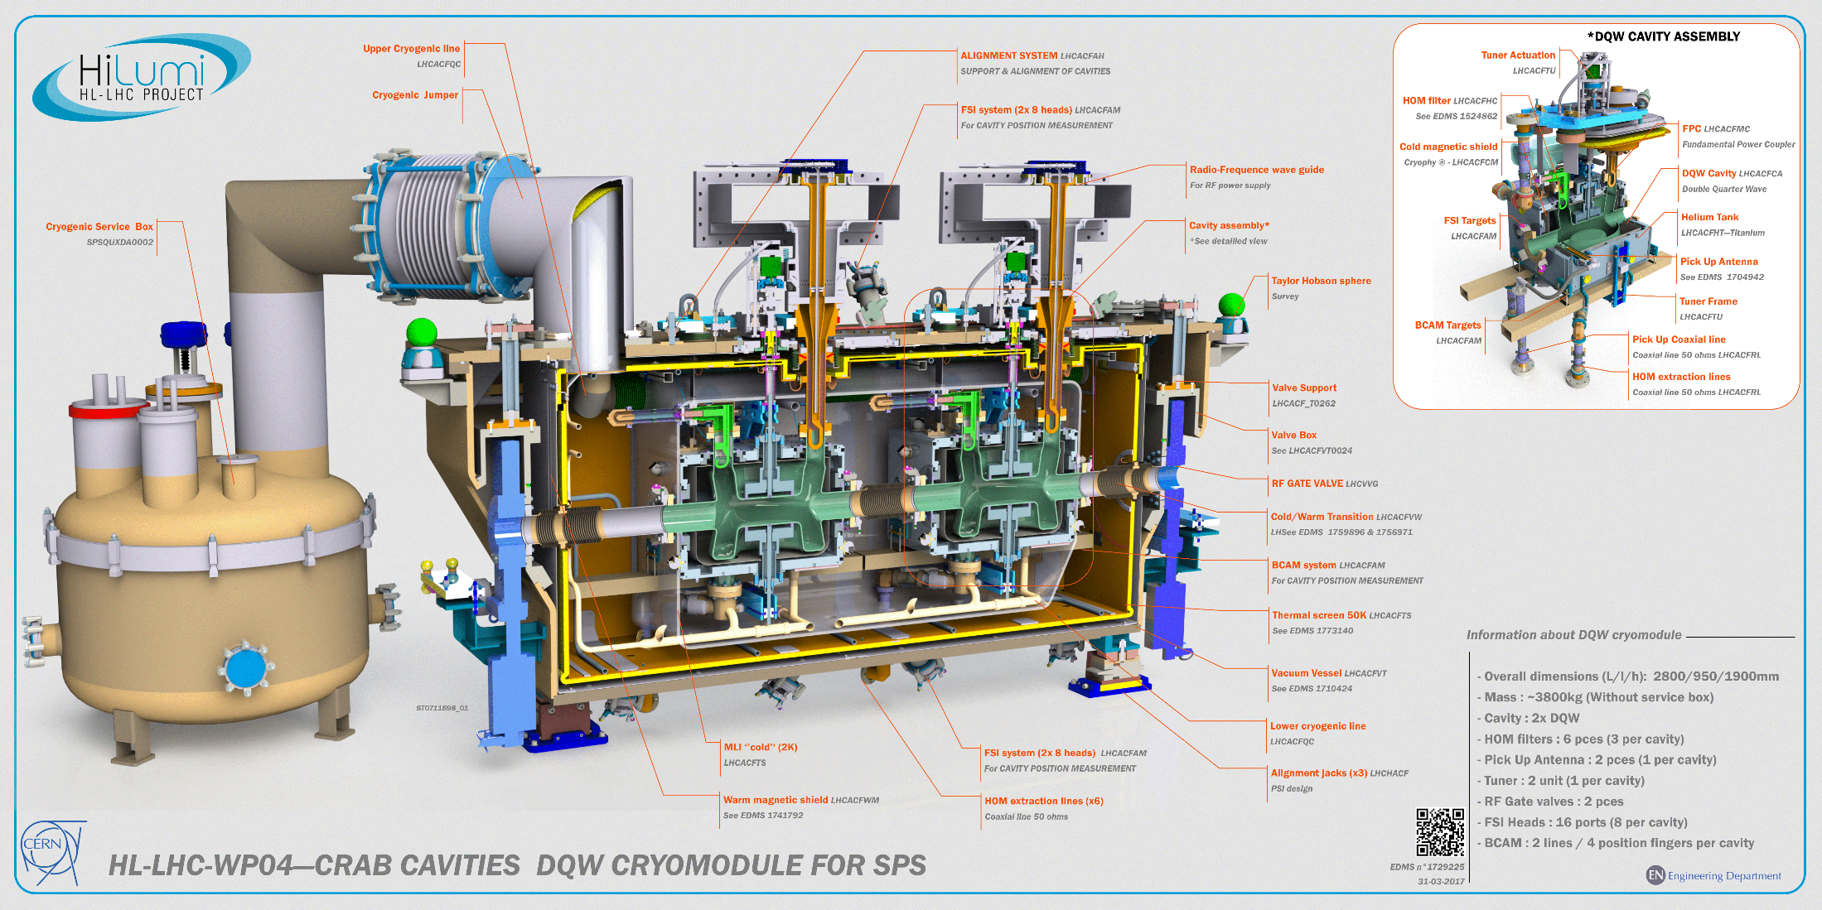

Slide 10
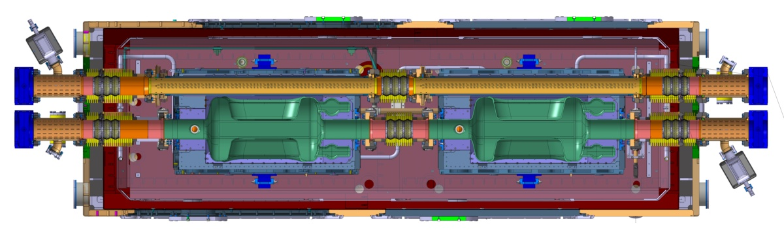
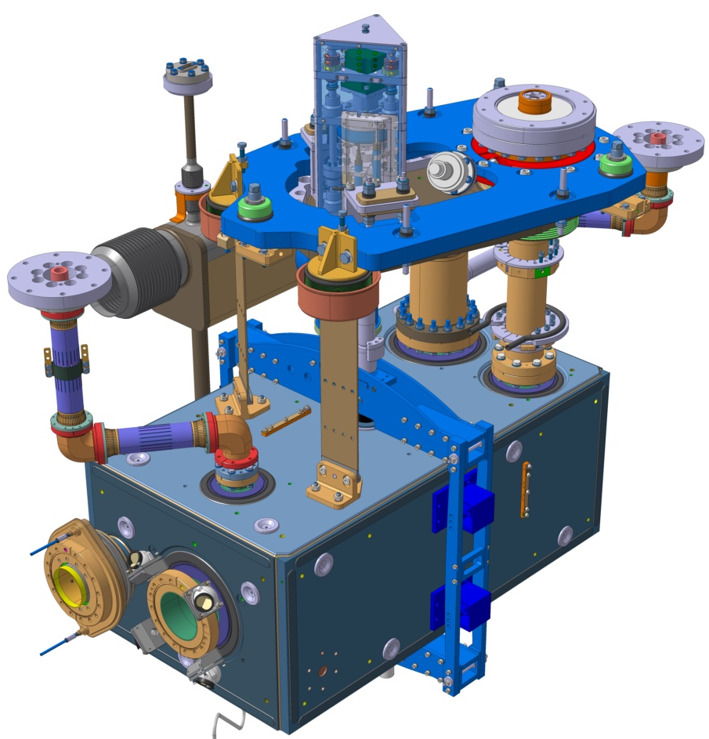
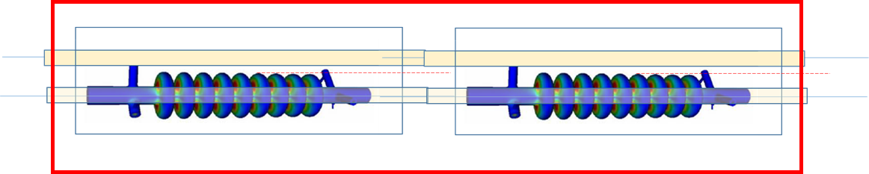
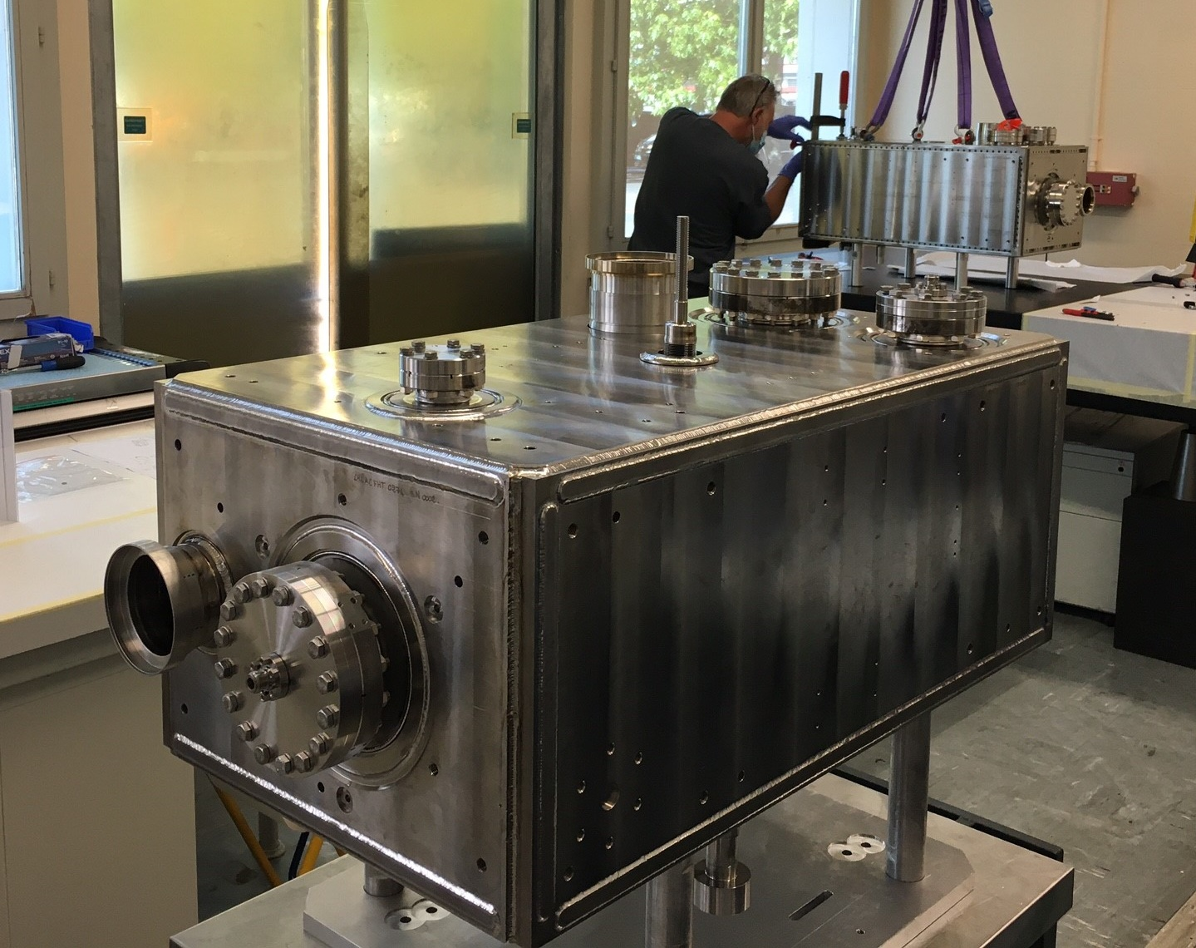
ILC Crab Cavity Cryomodule solutions
The solutions applied to HL-LHC may also suit the ILC-CC provided the dump beamline can be accommodated inside the Cryomodule.
LHC/SPS has proven solutions with beamlines going through the cryomodule either inside or outside the LHe vessel.
If this works for location at 14m then modifying it for the locations at 44m and 77m will not be too complicated.
197mm (Gap between the beam pipes)
Liquid Helium Reservoir
150 mm – max cavity radius

Slide 11
3.9 GHz LHe vessel
CKM LHe vessel is 160 mm diameter and housed a 13 cell version of the ILC crab cavity and has a tuner that fits in ILC.
Alignment tolerance on roll is 1 mrad, we proposed a 2nd single cell crab in the other plane to actively adjust crabbing plane (anti-crab)
80 mm
Dump line
LHe vessel
197 mm

Slide 12
Conclusions
Original location has no real issue, and the shorter distance may be better for synchronisation
The dump line can go through the cryomodule (demonstrated at LHC)
RFD @ 1.3 GHz has lower peak fields but will be twice as long. It also has no LOM and good separation to the SOM. Issues to be resolved are
  Is a 9 cell cavity stiff enough?
  Can we sufficiently damp the wakes with the small aperture?
  Timing stability has the same spec but the phase spec is hence three times tighter. Is this achievable?
The 3.9 GHz elliptical is fairly mature and meets requirements, is there a real need to have an RFD?

