Slide 1
Conventional Positron Target for the ILC, Cooled by Thermal Radiation. P.Sievers-CERN-Ret.
For the water cooled conventional target, a vacuum tight rotating ferro fluid seal is under study at KEK, T.Omori et al.
This seal is among the most crucial components of the positron target and long lifetime and robustness is necessary.
Therefore it may be prudent to also consider alternatives as backup solutions.
Here the possibility of cooling the target by thermal radiation is studied. Thus the use of a rotating seal can be avoided.

Slide 2
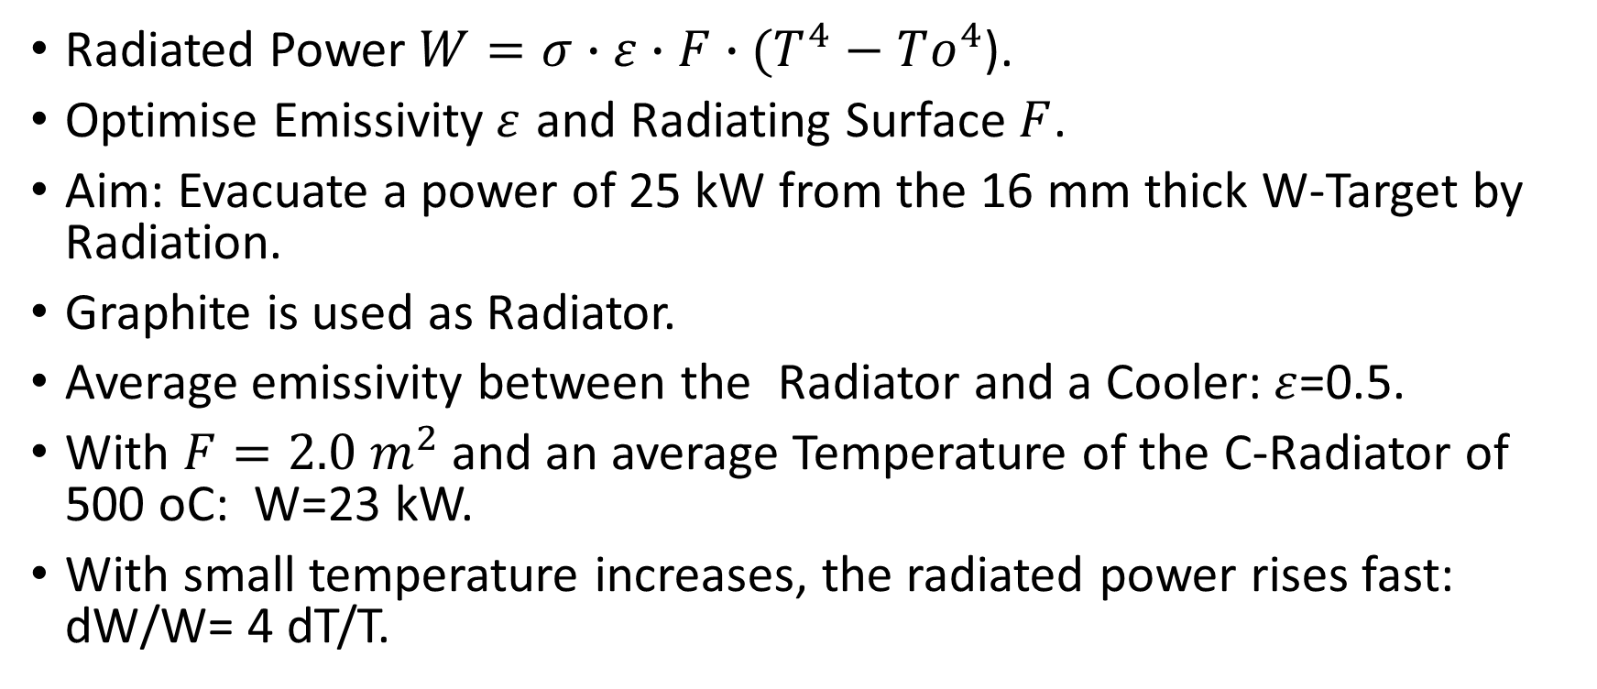
Cooling by Radiation through a Graphite Radiator:
Radiated Power $W=σ∙ε∙F∙(T^{4}−To^{4}$).
Optimise Emissivity$ε$ and Radiating Surface $F$.
Aim: Evacuate a power of 25 kW from the 16 mm thick W-Target by Radiation.
Graphite is used as Radiator.
Average emissivity between the Radiator and a Cooler: $ε$=0.5.
With $F=2.0 m^{2}$and an average Temperature of the C-Radiator of 500 oC: W=23 kW.
With small temperature increases, the radiated power rises fast: dW/W= 4 dT/T.

Slide 3





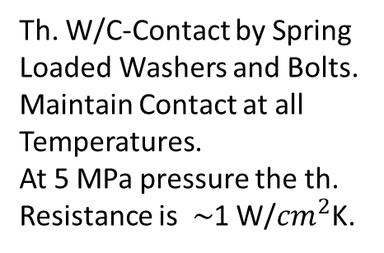








Conventional Target: Radiation Cooled Rotating Wheel.
W-Target 15 mm
Beam
W/Graphite Thermal Contact
Graphite Radiator
Radial Space for the Flux Concentrator
Tie Bolts
$$°$$
Th. W/C-Contact by Spring Loaded Washers and Bolts. Maintain Contact at all Temperatures.
At 5 MPa pressure the th. Resistance is$\sim$1 W/${cm}^{2}$K.
$$°$$
$$°$$
Local Spokes of the Carrier Wheel
$$°$$
$$°$$
15 cm
Stationary, water cooled Cooler
$$°$$
$$°$$
$$°$$
$$°$$
$$°$$
$$°$$
$$°$$
$$°$$
Rotating Axis

Slide 4











Conventional Wheel with Graphite Radiator: Downstream Side
Graphite Radiator
W-Target Sectors
$$°$$
$$°$$
$$°$$
$$°$$
$$°$$
$$°$$
$$°$$
$$°$$
$$°$$
Spoked Carrier Wheel
$$°$$
$$°$$

Slide 5
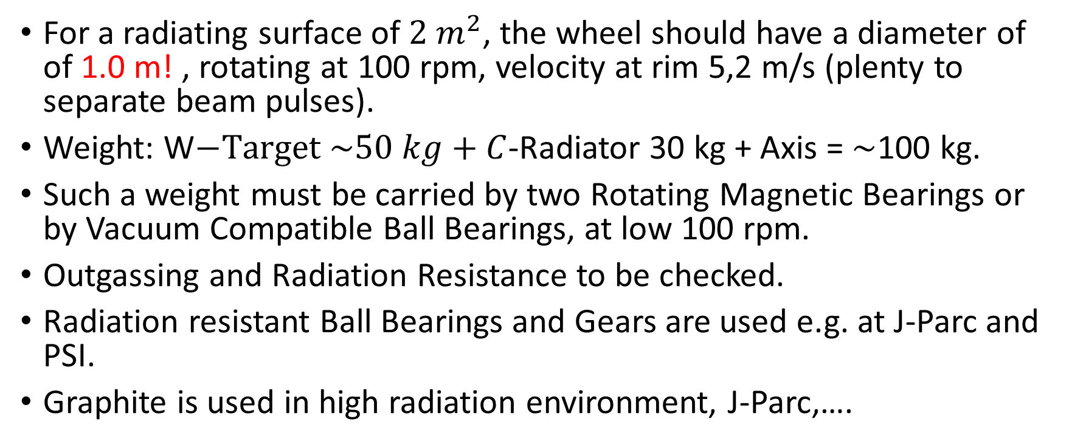
Design Parameters:
For a radiating surface of $2 m^{2}$, the wheel should have a diameter of of 1.0 m! , rotating at 100 rpm, velocity at rim 5,2 m/s (plenty to separate beam pulses).
Weight: W$−Target \sim 50 kg+C$-Radiator 30 kg + Axis = $\sim$100 kg.
Such a weight must be carried by two Rotating Magnetic Bearings or by Vacuum Compatible Ball Bearings, at low 100 rpm.
Outgassing and Radiation Resistance to be checked.
Radiation resistant Ball Bearings and Gears are used e.g. at J-Parc and PSI.
Graphite is used in high radiation environment, J-Parc,….

Slide 6
Options for Rotating Bearings.
Buffer to trap Outgassing from Ball Bearing
Vacuum Compatible Ball Bearing
Magnetic Bearing + Motor
Rotating Axis
Differential Pumping

Slide 7
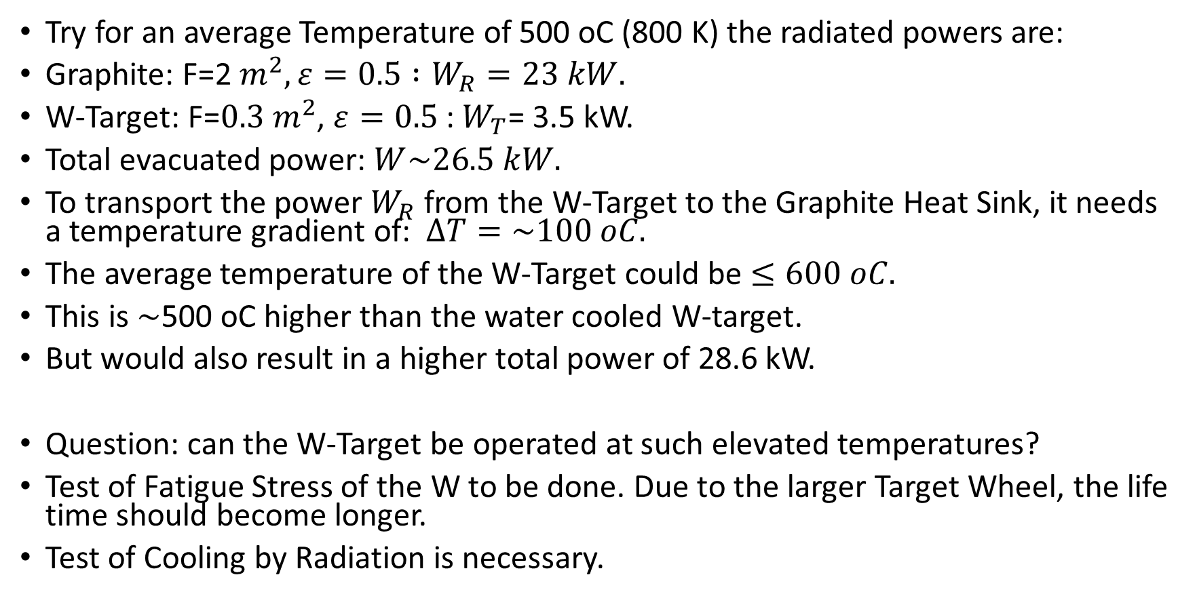
Temperatures and Evacuated Power.
Try for an average Temperature of 500 oC (800 K) the radiated powers are:
Graphite: F=2 $m^{2}, ε=0.5 :W_{R}=23 kW.$
W-Target: F=$0.3 m^{2}$, $ε=0.5$: $W_{T}$= 3.5 kW.
Total evacuated power: $W\sim 26.5 kW.$
To transport the power $W_{R}$ from the W-Target to the Graphite Heat Sink, it needs a temperature gradient of: $∆T=\sim 100 oC.$
The average temperature of the W-Target could be $≤600 oC.$
This is $\sim$500 oC higher than the water cooled W-target.
But would also result in a higher total power of 28.6 kW.
Question: can the W-Target be operated at such elevated temperatures?
Test of Fatigue Stress of the W to be done. Due to the larger Target Wheel, the life time should become longer.
Test of Cooling by Radiation is necessary.

Slide 8




Laboratory Set Up for Test of Radiation Cooling of a Target Sector.
Vacuum Tank
Side View
Multy Layer Super Insulation
W-Heat Conductor
$$°$$
1 kW Electrical Heater, simulating the average beam power.
$$°$$
«W-Target»
$$°$$
Th. W/C-Contact
Thermo-Couples
«Graphite-Radiator»
$$°$$
Water Cooled Cu-Cooler

Slide 9
Conclusion
Cooling of the rotating W-targe wheel by heat radiation avoids the use of a vacuum tight rotating seal.
Operating the W-target at temperatures of 500-600 oC with Graphite radiators, average powers of around 26-29 kW can be evacuated.
Such a wheel needs a diameter of about 1 m and a weight of 100 kg.
This enlarged wheel will have a longer lifetime.
Vacuum compatible Rotating Ball- or Magnetic Bearings must be validated.
The efficiency of the radiation cooling can readily be checked in simple laboratory tests.

Slide 10
Thank You for Your Attention.
Acknowledgement: Thanks are due to the members of the ILC-Positron Source Group, and in particular to T. Omori-san, for fruitful discussions and comments.

Slide 11
Water Cooled e-Driven Target Wheel
Beam Vacuum
Flux Concentrator
Rotating Target Wheel
Rotating Axis
Motor
Rotating Water Connection
Water Flow
Th. Water/Cu/W-Contact
Ball Bearings
Rotating Ferro-Fluid Seal
Vacuum Pump
Tungsten Target
Backup Labyrinth Vacuum Buffer
Critical Issue of Rotating Seal: Leak tightnes for UHV. Radiation resistance and radiochemistry of iron powder in oil, and permanent magnets (was tested Omori-san).

