Slide 1
Linear Collider Physics Analysis in Jupyter

Slide 2
Let's get started
Log on to your site
  For OSG: ssh -L 80xy:localhost:80xy login.snowmass21.io #replace the server name for your site
  x=0 y=9 is mine.
  Pick your own x and y.
Download julia
  wget https://julialang-s3.julialang.org/bin/linux/x64/1.5/julia-1.5.3-linux-x86_64.tar.gz
  tar xzf julia-1.5.3-linux-x86_64.tar.gz
  julia-1.5.3/bin/julia
Start julia – this is the REPL (read-eval-print loop)
  Powerful support for different modes: e.g., shell, package, julia, C++ modes
  ] add IJulia # ] starts the package mode
  build IJulia
  Backspace to get back to julia mode
Start the notebook
  On your laptop
    using IJulia
    notebook()
  On OSG/KEK/NAF
    source /cvmfs/belle.cern.ch/tools/b2setup release-04-02-08
    jupyter notebook --no-browser --port=80xy # use the same x and y from when you logged in.

Slide 3
Running the notebooks
Run the notebooks from here: https://github.com/jstrube/LC_with_Julia_examples/
You will see that it won't run!
Not all necessary packages have been installed. The error message will tell you what to do. Click on the + symbol to add a new cell and copy and paste the code that the error message suggests.
  This is how you add new packages.
Add all packages that you see in the notebook (using xxx)
  If you follow in the REPL instead of the notebook, replace "StatsPlots" with "UnicodePlots"
Run again
  You will see messages like "Precompiling...". This will take a while, but it's only necessary after installing or updating packages.
In the meantime, let's move on with the slides.

Slide 4
Program for today
https://github.com/jstrube/LC_with_Julia_examples/blob/main/FirstSteps.ipynb
  Introduction for how to open files and read a few collections
  If you have worked with LCIO before, the operations should be very familiar
https://github.com/jstrube/LC_with_Julia_examples/blob/main/NTupleExample.ipynb
  A simple example for how to read an LCIO file and write out a DataFrame for data analysis offline, including how to make cuts.
https://github.com/jstrube/LC_with_Julia_examples/blob/main/DL_Calo.ipynb
  An example for how to use the deep learning library Flux, using a simple calorimeter calibration
  A Gaussian distribution can be fit to the calibrated distribution.

Slide 5
Julia – the "ju" in Jupyter
Support for multithreaded, concurrent, and distributed processing
Unicode support for variables
Interactive programming
Multi-dimensional arrays (like numpy, but built-in)
Rich ecosystem for technical computing
  Statistics: Distributions.jl, Turing.jl (probabilistic programming), …
  Differential Equations: DifferentialEquations.jl, SciML.ai
  Deep Learning: Flux.jl, Knet.jl
  Plotting: Plots.jl (with different backends), PyPlot.jl (wrapper around matplotlib)
Salespoint for me: Allows me to explore the data, and when I need a fast function for serious work (e.g. a new calorimeter clustering), I can write it in the same language I use for interactive exploration.

Slide 6
First steps in Julia
Julia supports unicode: Enter \mu<TAB>
  UTF-8 is fully supported, but not everything has a \-shortcut
Full support for matrices
  X = randn((20, 10)) # makes a 20x10 matrix
  Y = X' # transposes the matrix
Iterations and printing similar to python
  for x in 0:10 println(x) end
  Note: no ":", but "end" to delimit blocks
Functions don't need type parameters (but you can use them)
  F(x) = sin(x) is a function
  function F(x::Int64) sin(1.5x) end is another function with the same name.
  Return is optional. The value of the last statement in the function is returned. function F(x::Float64) return sin(0.5x) end is also fine.

Slide 7
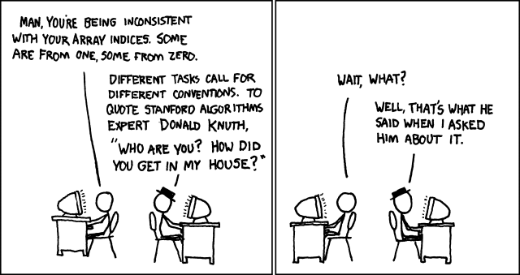
Some noteworthy differences to languages you may be familiar with
1-based indexing by default
  Or, random, if you want
Structs, yes, but no member functions
  Multiple dispatch instead
  Use the object as the first parameter of the function instead.
  Example: C++: vec.size() Julia: length(vec)
No semicolon required, no indentation or {} to delimit blocks
  if … end; for … end, function … end

Slide 8
Further information about Julia
Starting point: https://julialang.org
  Documentation: https://docs.julialang.org/en/v1/
    Note that things that run in v1.0 are guaranteed to run in any v1.x, but do choose the latest version to get more features.
  Other learning resources: https://julialang.org/learning/
The recent community conference online has a good mix of introductory and overview material https://www.youtube.com/playlist?list=PLP8iPy9hna6Tl2UHTrm4jnIYrLkIcAROR

Slide 9
LCIO
Common event data model for linear collider detector data
  SiD, ILD, CLICdp can freely share data and code and have done so extensively
Used by Whizard to implement features that aren't supported by stdhep (e.g. polarization)
Open source https://github.com/iLCSoft/LCIO
Implementations / bindings in C++, Python, go, Java, Fortran, Julia
API Documentation: https://ilcsoft.desy.de/LCIO/current/doc/doxygen_api/html/namespaceEVENT.html
  If LCIO uses obj.method(par1, par2), Julia uses method(obj, par1, par2)
  Not all methods are implemented or exported, yet. If you are missing anything, please file an issue: https://github.com/jstrube/LCIO.jl/issues

