Slide 1
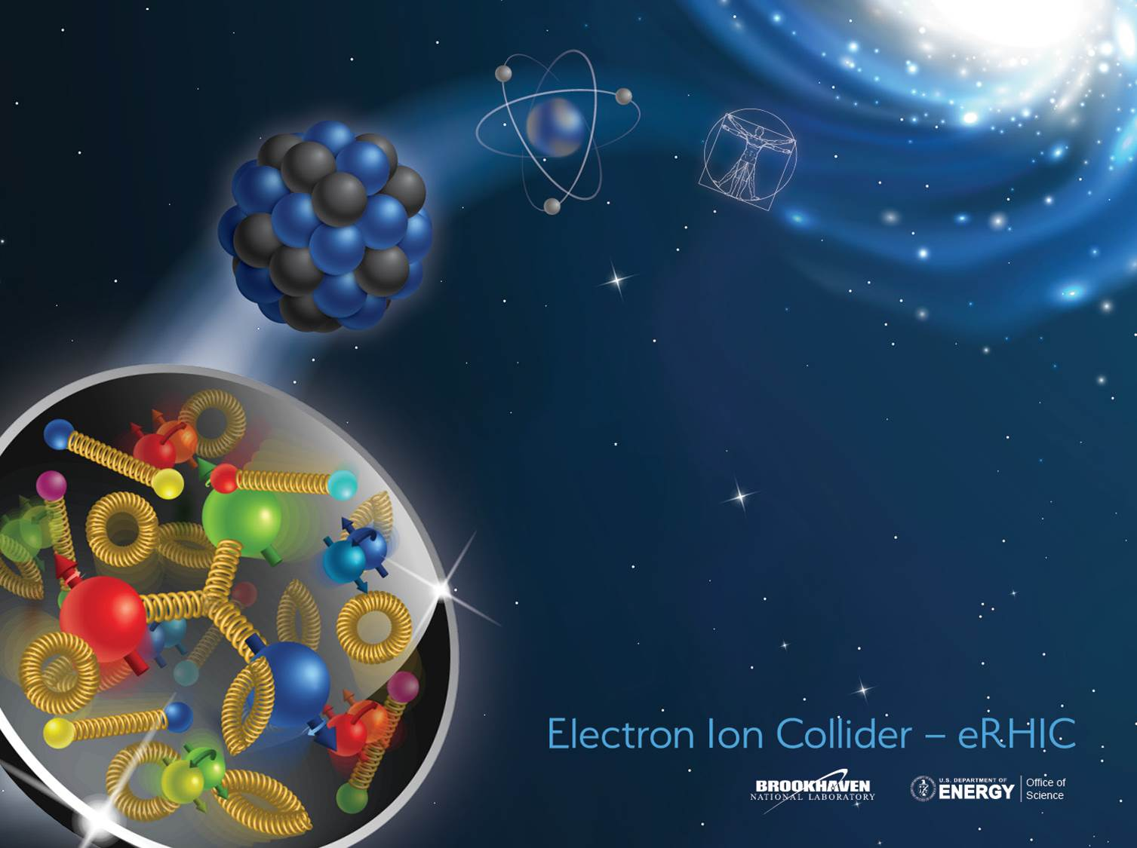
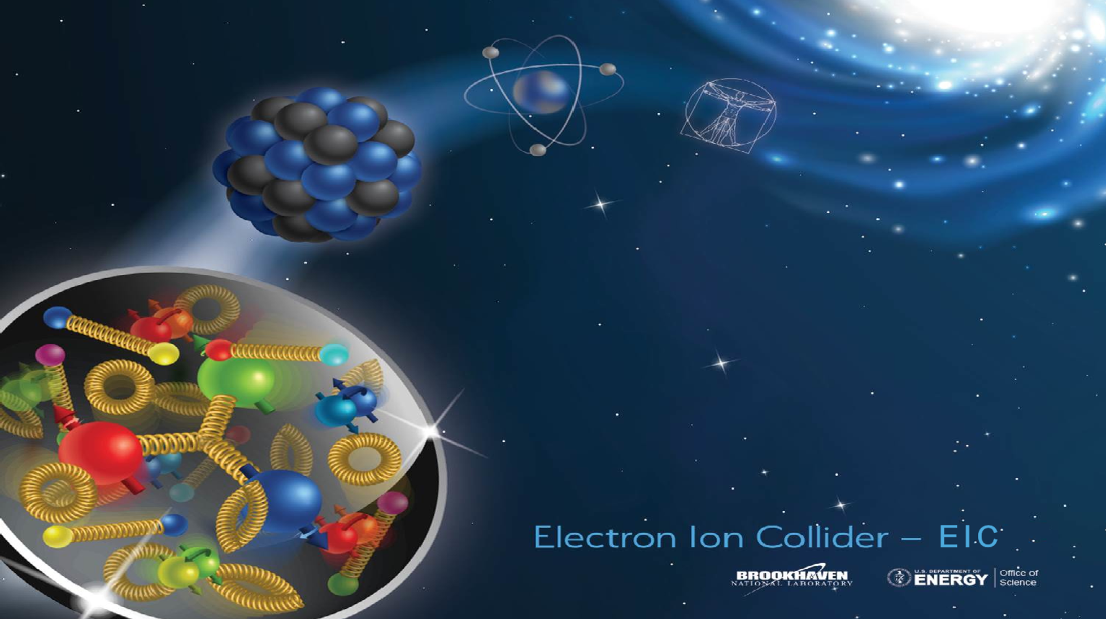
ILC Final Focus R&D for the EDR
Brett Parker / BNL, December 17, 2020

Slide 2
Outline: ILC Final Focus R&D for the EDR
ILC Final Focus Magnets TDR and R&D History
  QD0 Actively Shielded Coil design
  Force Neutral Anti-solenoid Concept
  QD0 Magnet and Service Cryostat Prototypes
New/Restarted Efforts for the ILC EDR
  QD0 R&D Prototype Vibration Stability Testing
  Update Coil Designs Using Sweet Spot and/or Dual Helical Coil Topology

Slide 3
ILC Final Focus (FF) R&D Magnet History (6 Slides)

Slide 4
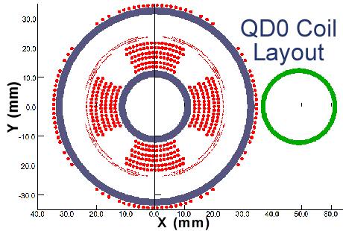
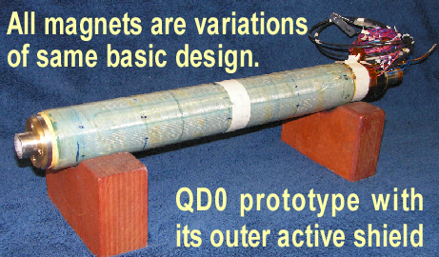
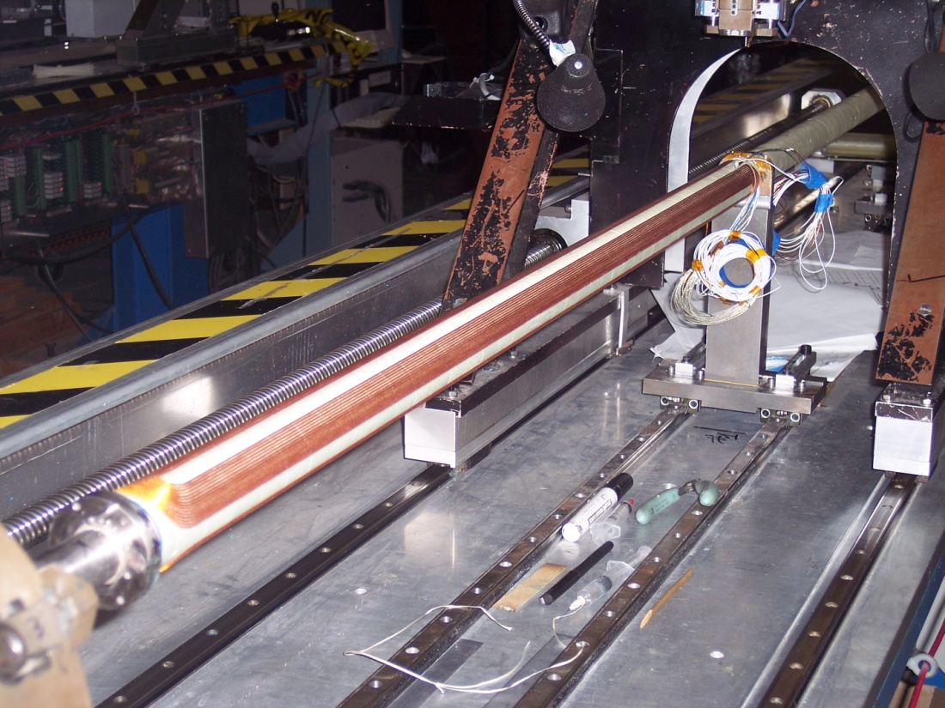
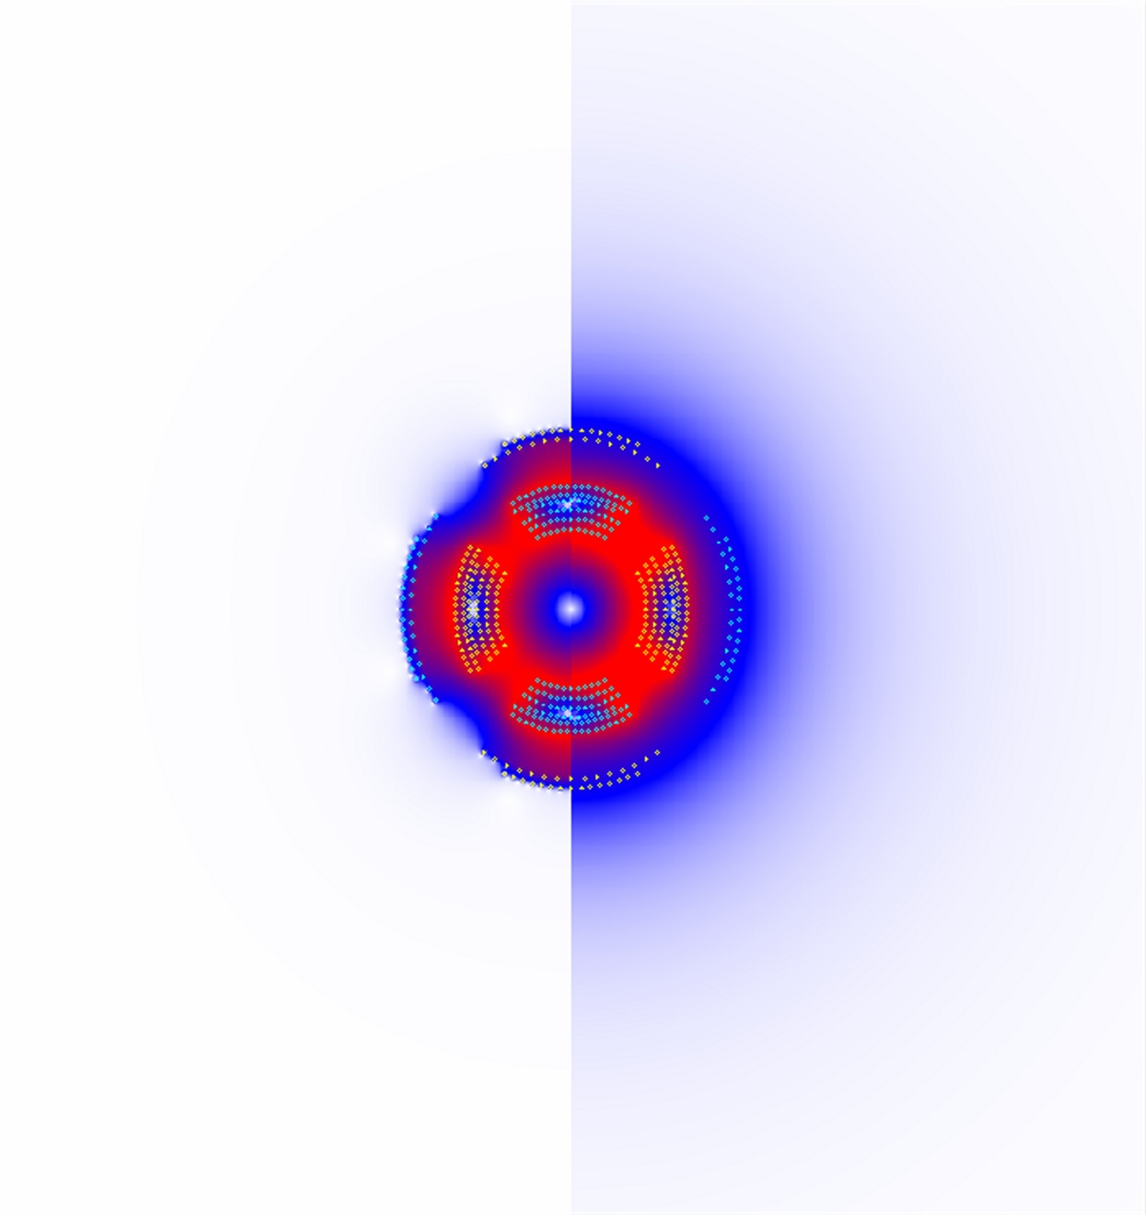
ILC Final Focus Magnets: TDR R&D History
QD0 Split Coil Winding
Main coils & correctors are wound on common support tube.
For the ILC IR we only need to pass the outgoing highly disrupted beams cleanly on to the beam absorbers.
Main requirement is to shield outgoing beam from any strong external fields… which is done with an active shielding coil.
Main 2.2 m QD0 coil is split in half for low energy optics flexibility and ease manufacturing challenges.
Note there is only a partial anti-solenoid overlapping QD0 (just enough to avoid luminosity loss due too overlapping fields†).
Off
On
QD0 Prototype Test Coil with Active Shielding
†Y. Nosochkov and A. Seryi, “Compensation of Detector Solenoid Effects on the Beam Size in a Linear
Collider,” Physical Review Special Topics - Accelerators and Beams, DOI: 8. 10.2172/829740.
QD0 with Active Shield Off/On

Slide 5
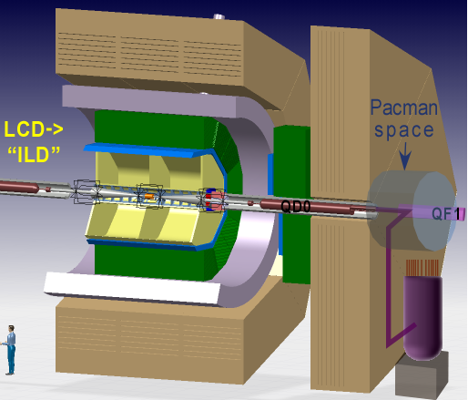
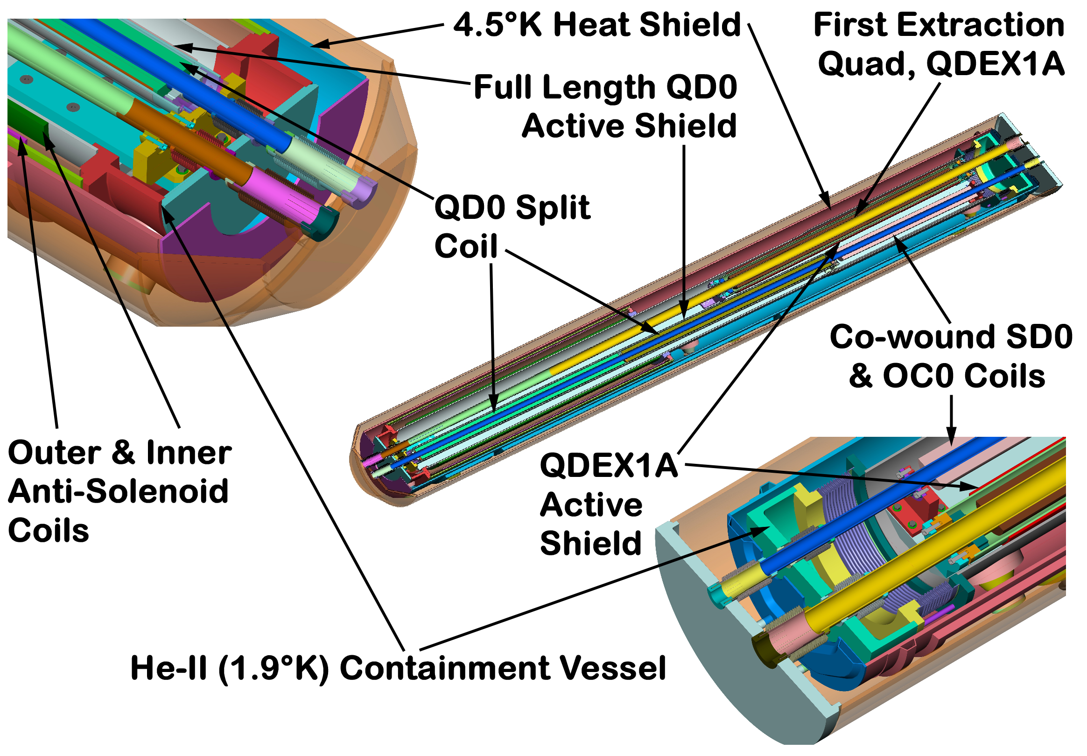
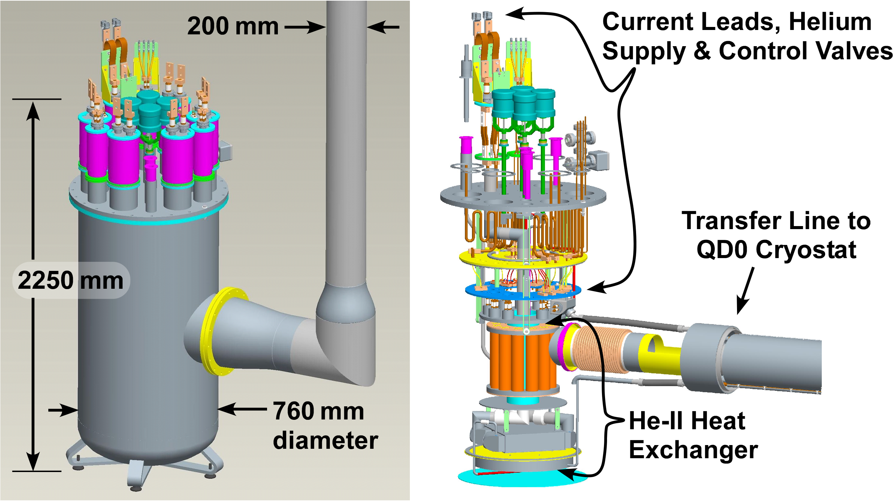
ILC Final Focus Magnets: TDR R&D History
We use 1.9 K pressurized superfluid helium cooling in order not to have “flowing cryogens” (avoid vibrations).

Slide 6
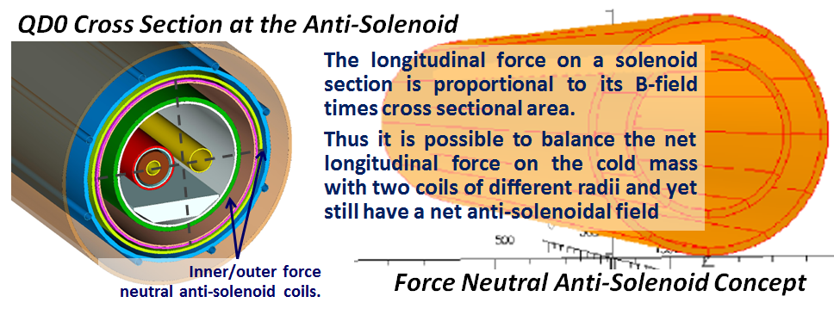
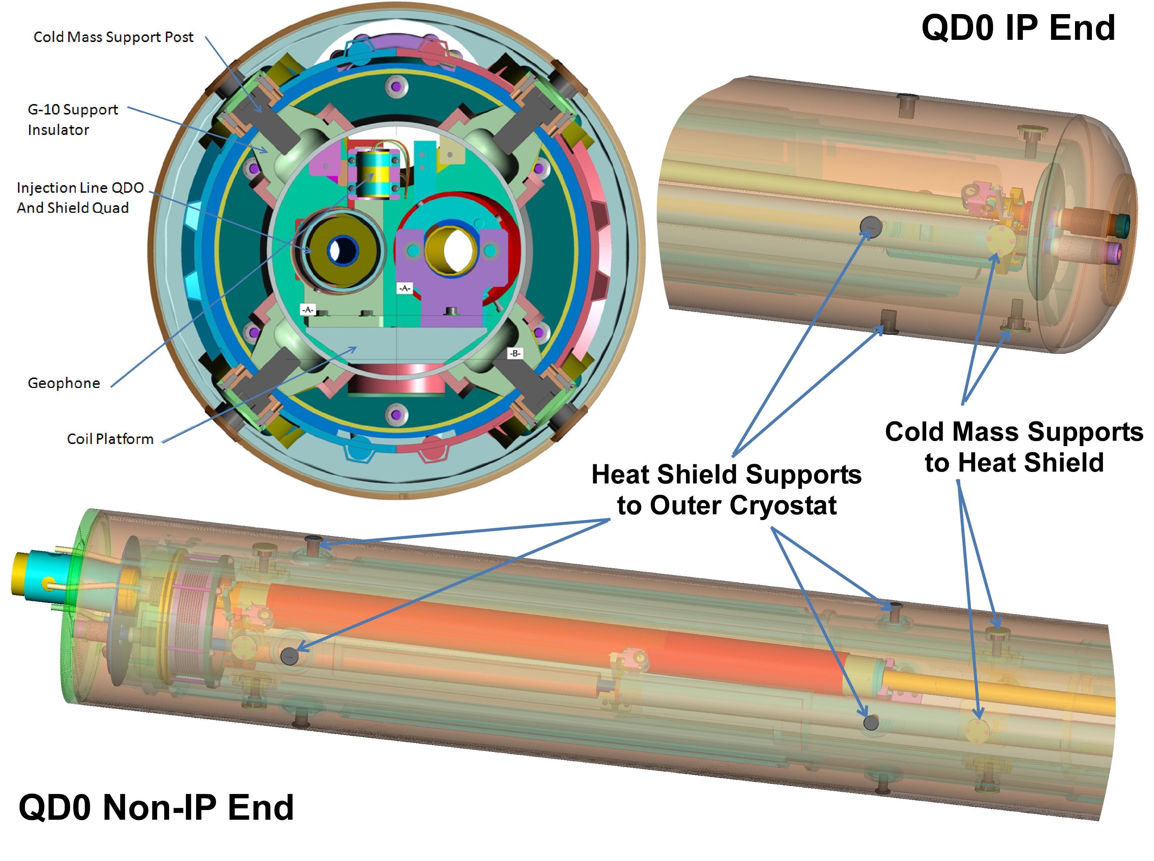
ILC Final Focus Magnets: TDR R&D History
In order not to have to deal with 40 tons of axial force in the warm-to-cold transition we use a “force neutral” anti-solenoid coil scheme so there is no net force on the cold mass (would take up extra space and add heat load).
Note in the QD0 R&D prototype shown here, even with thin walled shells, radial space is needed for thermal shield support structure.
Multiple IR magnets are mounted and kept in alignment on rigid sled structure (note geophones).
Use shielded bellows for the beam pipe warm-to-cold transitions (IR magnet beam pipes are cold).
In order to avoid having a large diameter “endcan region,” we need extra longitudinal space to interface with the cryogenic supply line, magnet leads, etc.

Slide 7
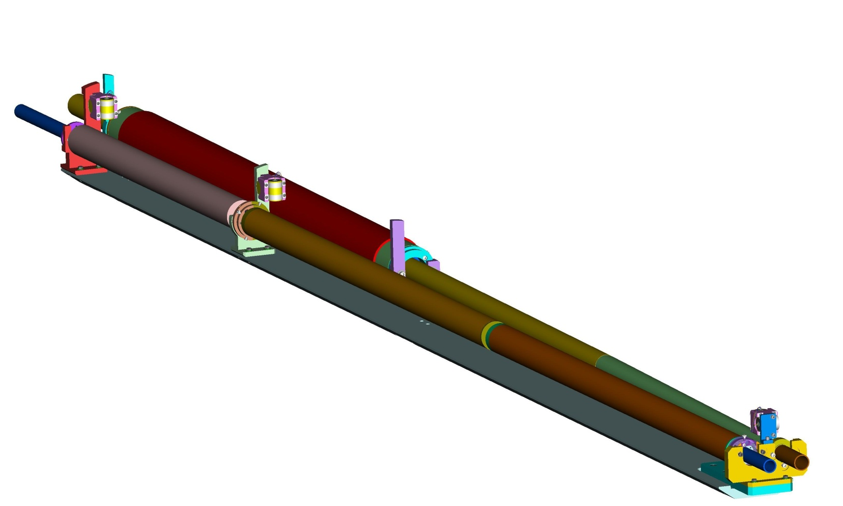
ILC QD0 Magnet Coil R&D History
Multiple main magnet and corrector coils were produced on common support tubes. These tubes are themselves supported from a rigid sled structure inside the cold mass.
QD0 Split Coil Winding
Lead End
Extraction Line
Quadrupole
Main coils & correctors are wound on common support tube.
Main
Sextupole, and Octupole Coil Package
View Inside QD0 Cryostat to Show Coil Positions and Support Infrastructure
R&D Geophone
Split QD0 Half Coils
(anti-solenoid is not shown)
IP End

Slide 8
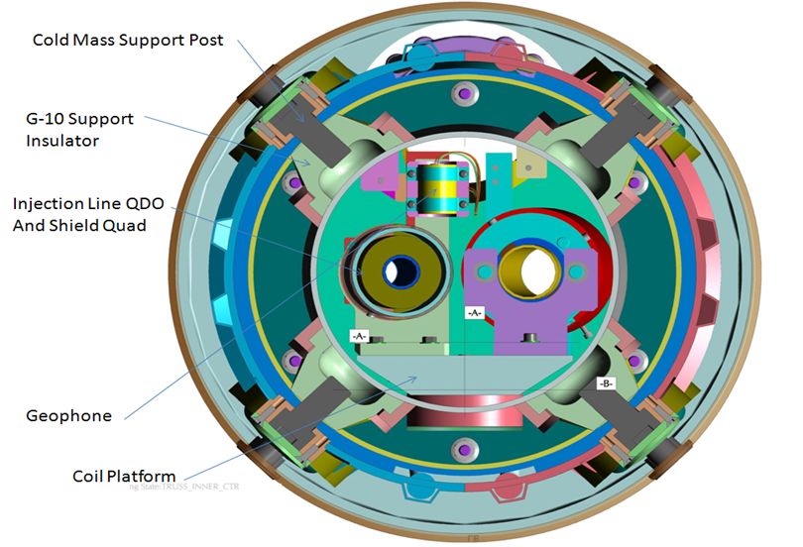
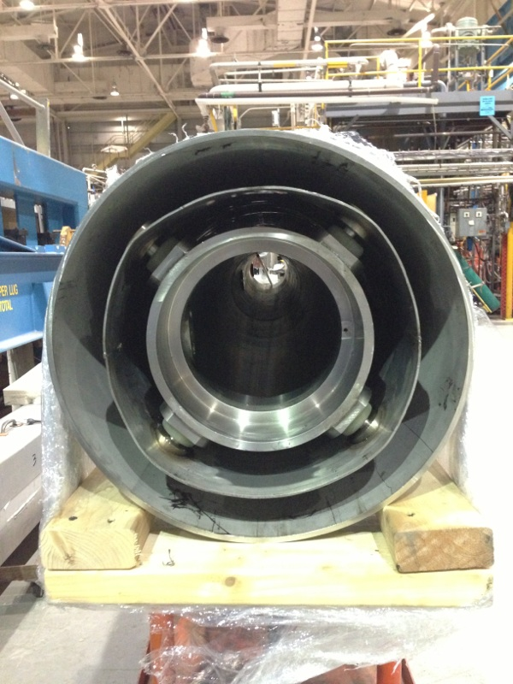
ILC QD0 R&D Magnet Cryostat History
ILC QD0
The ILC QD0 R&D magnet prototype cryostat is 90% complete and almost ready for insertion of the magnet coils on the “sled assembly.”
Finishing the Magnet Cryostat was given higher priority than making the transfer line parts.
ILC QD0 R&D Magnet Cryostat Assembly

Slide 9
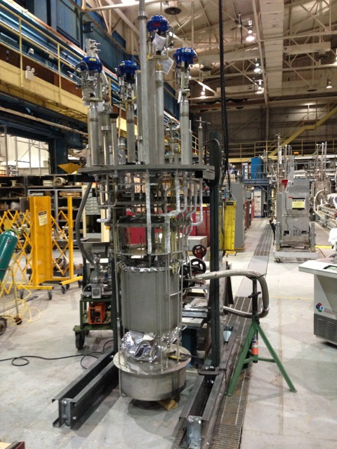
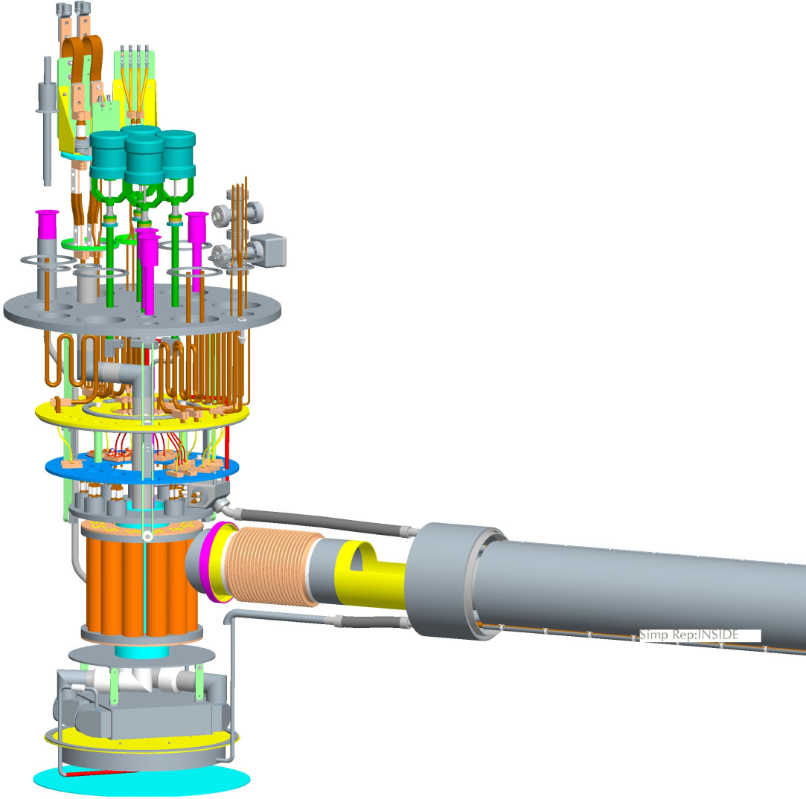
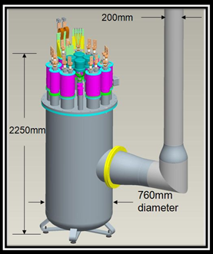
ILC QD0 R&D Service Cryostat History
Final assembly of the R&D Service Cryostat is
now proceeding.
Plan was to test it using a dummy heat load attached to where the transfer line exists.
We would like to mount
a geophone alongside
the dummy load to characterize
sources of vibration.
Transfer line parts drawings do
exist but all work has remained
stopped due lack of funds.
ILC Service Cryostat undergoing final leak testing before assembly with outer vessel.

Slide 10
Topic 1: Restart the ILC QD0 Vibration Stability R&D for EDR (2 Slides)

Slide 11
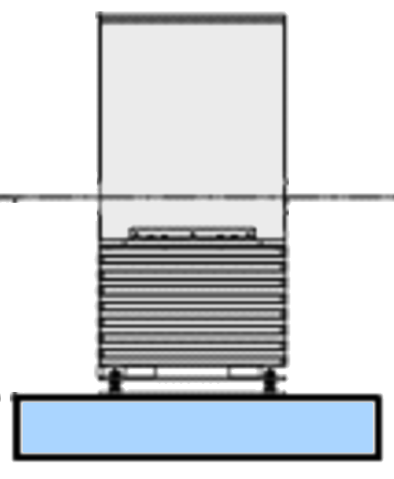
ILC QD0 Prototype R&D: Plans for IDT EDR
RHIC IR magnets have observable vibration when two-phase liquid helium flows (also observed on test stand via geophones and laser system). For the ILC QD0 we deliberately use 1.9 K superfluid He-II cooling to avoid having cryogens “flow” (cooling via long transfer line is effectively conduction cooling). For the ILC QD0 it is important to test this hypothesis as early as possible.
Laser ports with view to cold mass
BNL has already manufactured most of the parts needed for the QD0 R&D prototype vibration test (need transfer line & cryostat support).
Concept: Measure magnetic center movement via multiturn pickup coil and cross check against internal/external geophones and laser doppler vibrometer looking at cold mass inside the main cryostat.
We will take advantage of SuperKEKB developments (see next slide).
Previous work shows that it is much easier to stabilize a pickup coil with support from both ends (SuperKEKB uses single side support).
Cold and Warm Geophones
X/Y Pickup Coil
Double Sided Active / Passive Isolation Support
QD0 Cryostat
QD0 R&D Prototype Vibration Test Setup

Slide 12
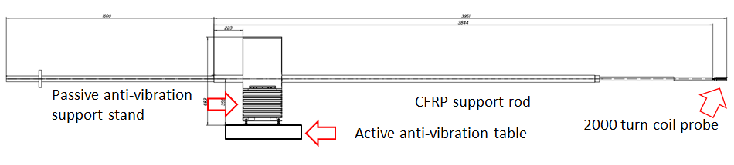
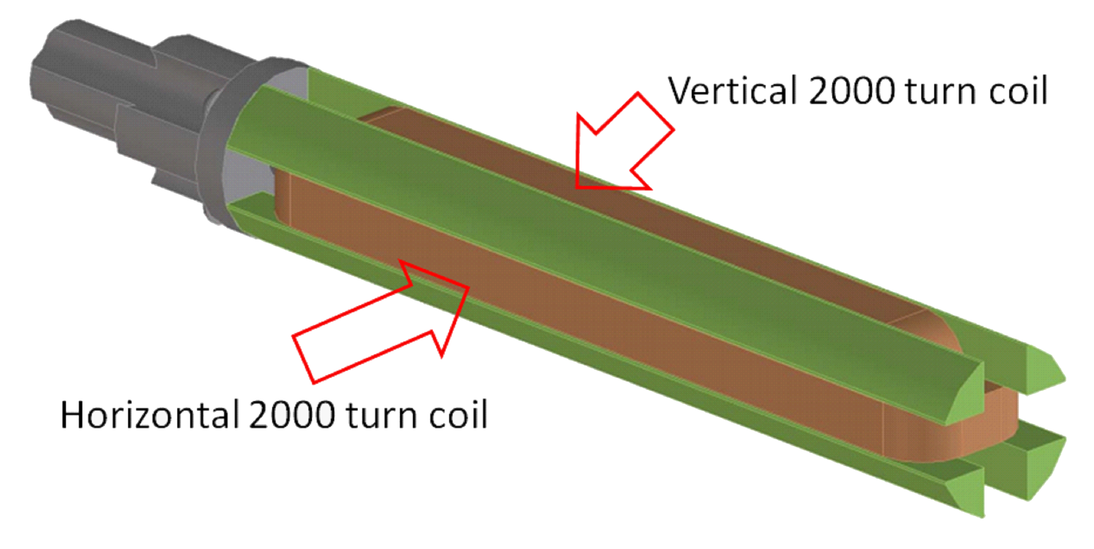
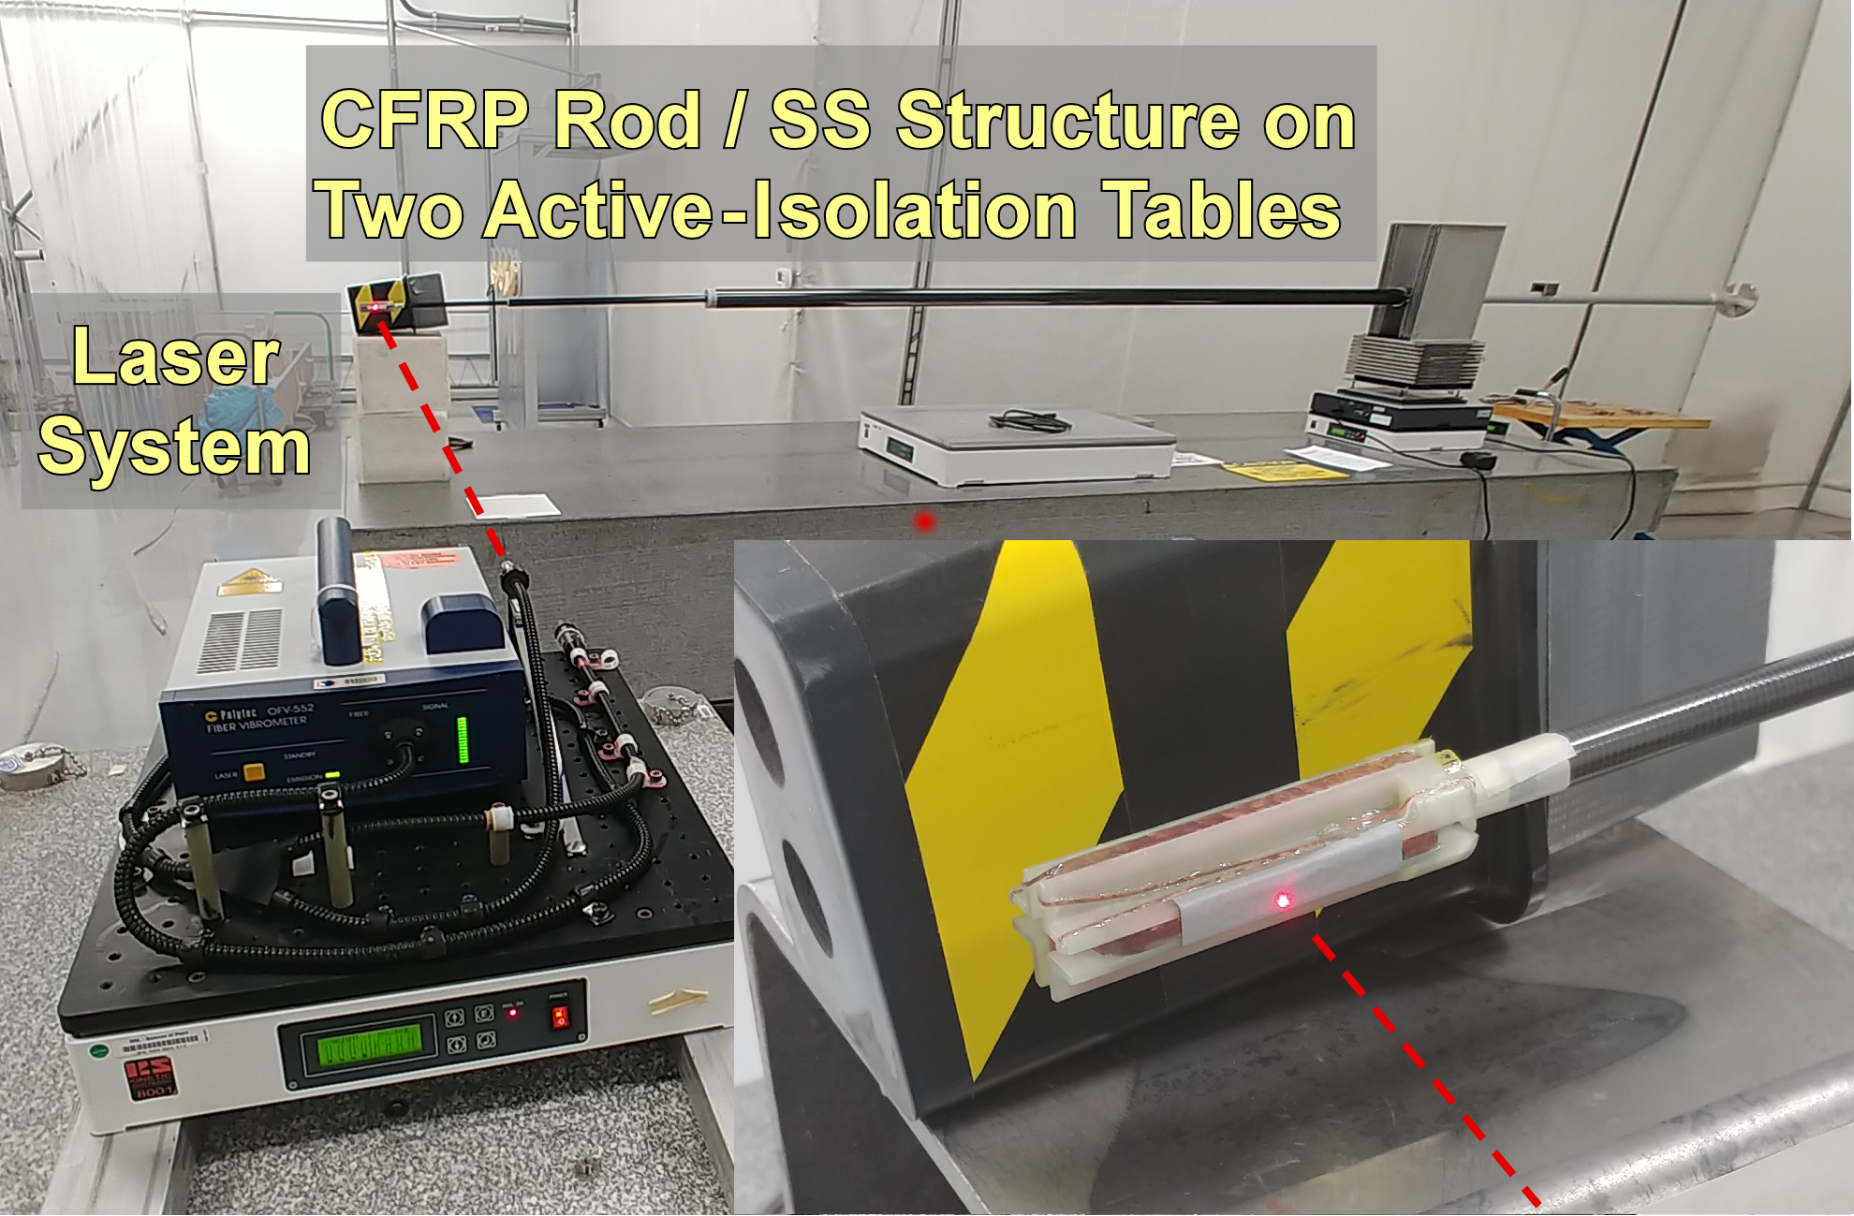
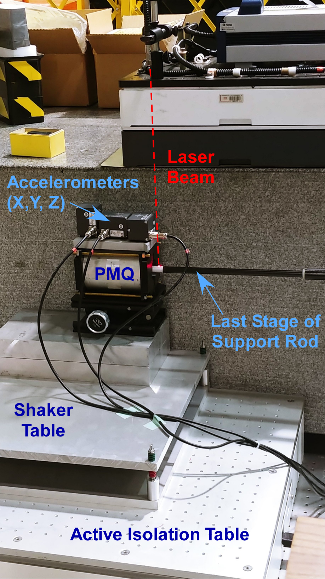
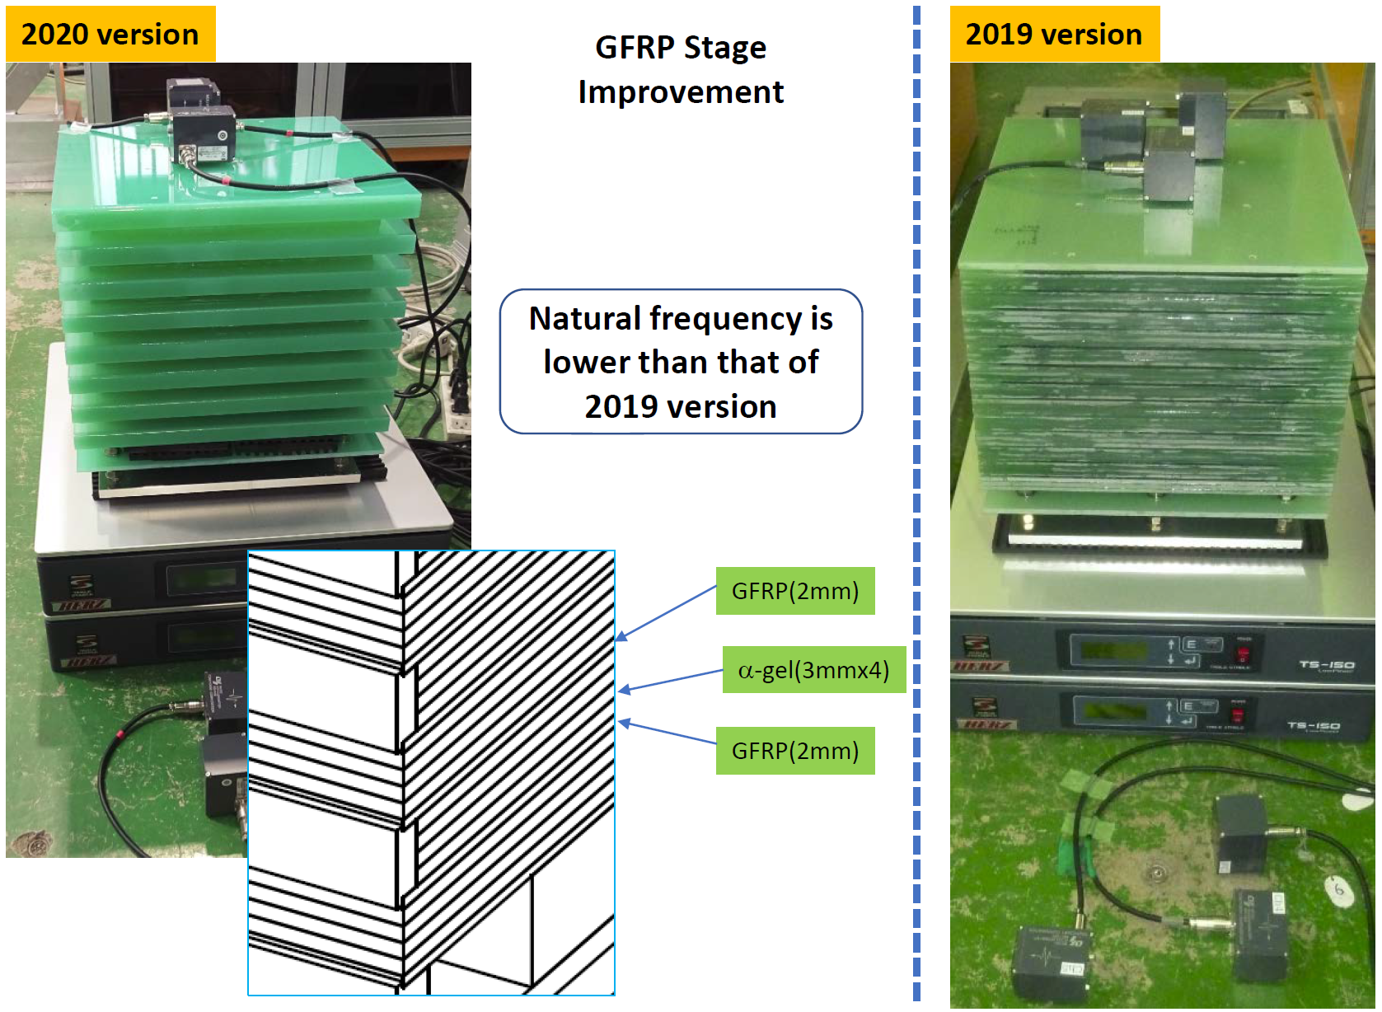
SuperKEKB IR Magnet Vibration Measurement R&D
SuperKEKB IR stability budget is 5 nm integrated motion @10 Hz (ILC QD0 is 50 nm to stay within bunch feedback capture range).
R&D is in progress to measure with 1 nm sensitivity (US/Japan).
Magnetic center change seen as voltage on multiturn probe coil.
But we must stabilize probe coil to measure the real motion.
Use laser for non-contact probe stability measurement and put the probe coil in a PMQ (IR quad stand in) to see voltage signal.
But for IR magnets in Belle-II we only have access from one side and single-sided support is more difficult than double sided support (multiple generations of support improvement).
We are close to few nm probe stability goal and look to measure SuperKEKB IR quads in situ during the summer 2022 shutdown.

Slide 13
Topic 2: Update ILC FF design taking into account technology progress since 2013 (5 Slides)

Slide 14
ILC FF Design Update: Topics for IDT EDR Work
BNL Direct Wind Production Coil Options
  Serpentine (used for BEPC-II & SuperKEKB; ILC & EIC baselines)
  Double Helical (now proposed for FCC-ee and EIC IR magnets)
Handling External Fields and Beamline Magnetic Crosstalk
  QD0 Active Shield Coil (present ILC 500 GeV TDR baseline)
  Side-by-side Self Consistent Coil Design (FCC-ee IR baseline)
  External Field Cancel Coils (implemented for SuperKEKB IR)
  Sweet Spot Coils (EIC B0 and in 2015 proposed for ILC 250 GeV)

Slide 15
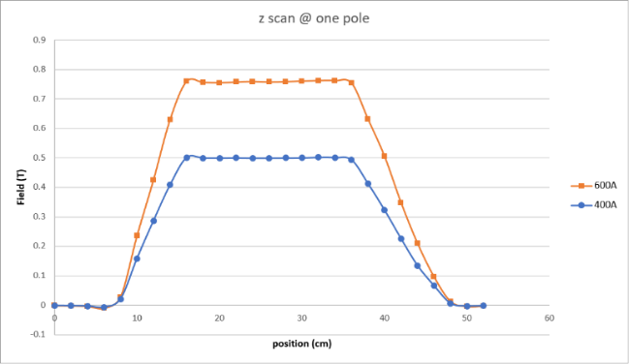
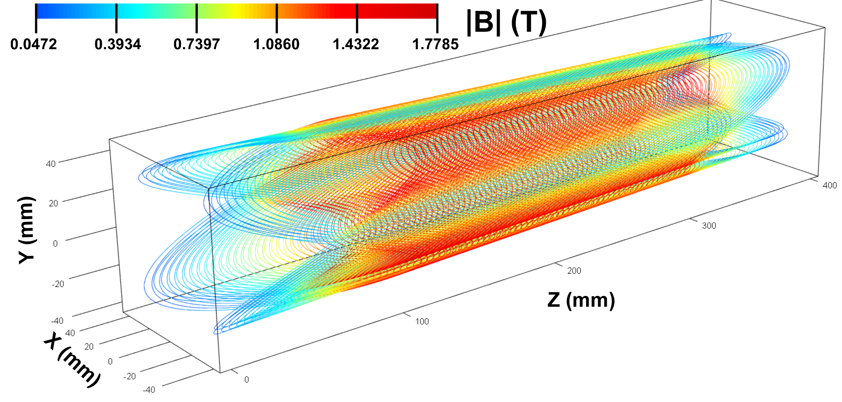
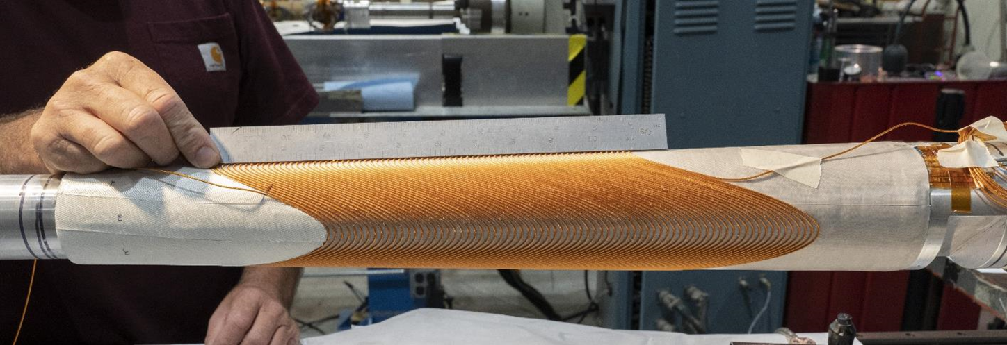
ILC FF Design Update: Topics for IDT EDR Work
Consider using Double Helical coils for ILC QD0!
Field Measurements
Tapered coils used for some EIC low-β quads that are closest to the IP (Q1APR/Q1ER).
To fit inside limited space use Double Helical coils produced via the BNL Direct Wind process (see below).
R&D Test Coil: 4 layers, aperture varies from 60 to 80 mm over 0.4 m length, gradient 43 T/m, 30-40 mm inner radius
Although aperture varies, the gradient is maintained constant.
Calculated Coil Field
Tapered Quadrupole – no training, reached 960 A short sample
H. Witte et.al. http://dx.doi.org/10.1109/TASC.2019.2902982.

Slide 16
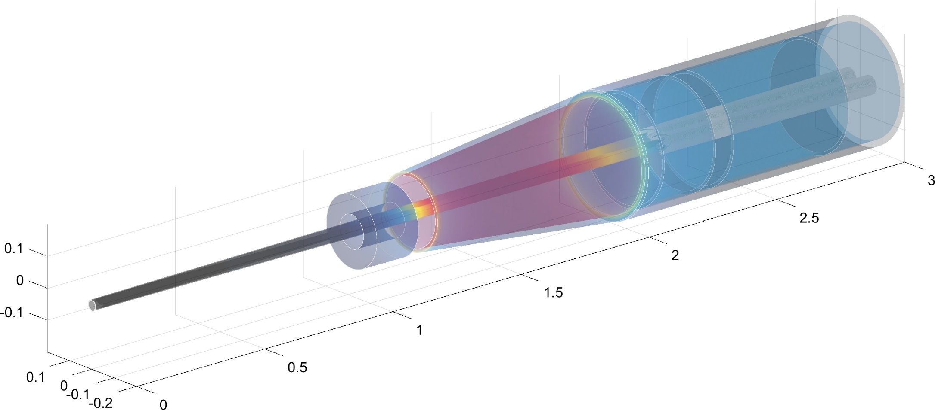
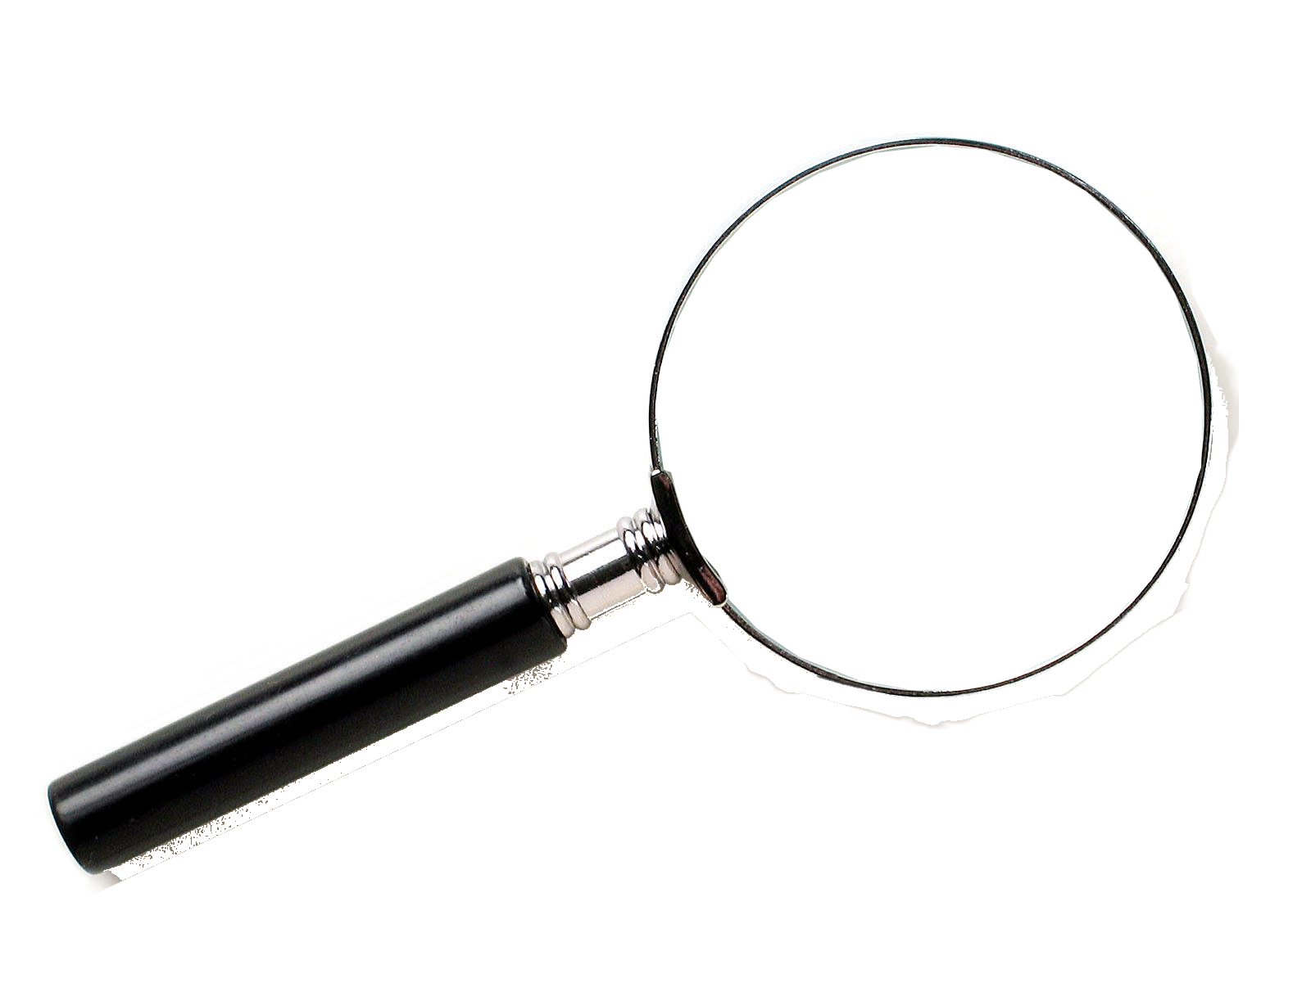
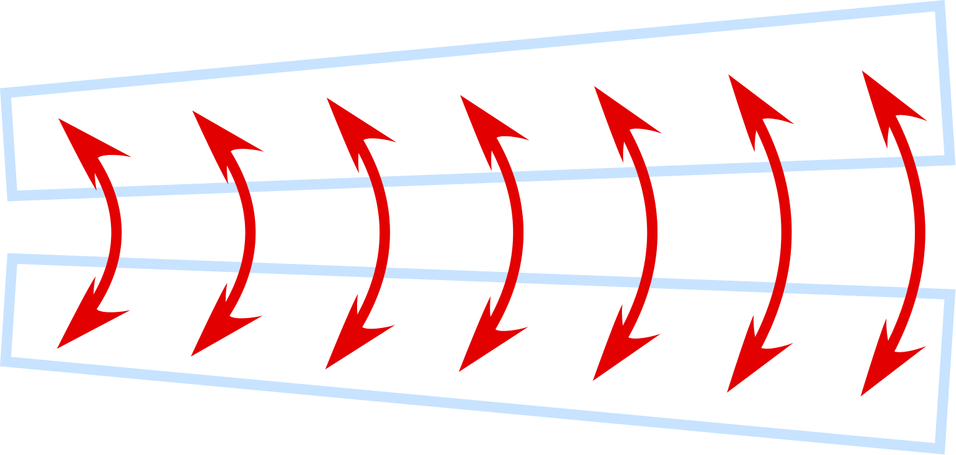
CERN FCC-ee IR Magnets: Double Helical Baseline
screening
solenoid
Challenge: Deal with magnetic crosstalk between the QC1 IR quadrupoles.
2D-top view with expanded x-coordinate
Compensating solenoid
QC1
QC1
100 mrad
QC1
Compensating solenoid
Lumical
IP
Be
shielding
Central detector
Lumical
Answer: Use flexible Double Helical coil design to locally adjust QC1 field much like we are doing for the BNL EIC IR.
HOM absorbers
L*=2.2m
L* = 2.2 m distance from IP to first quadrupole, 2 T detector
1.5 cm radius z ± 12.5 cm
Smaller central pipe: 1.0 cm for z ± 9 cm
(with taper starting at z ± 40 cm from IP)
We can use BNL Direct Wind technology to make double helical coils that by design eliminate magnetic cross talk.

Slide 17
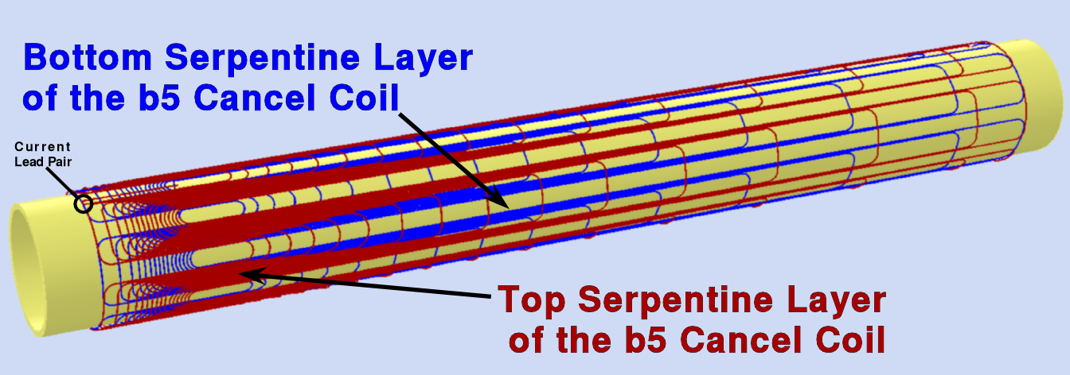
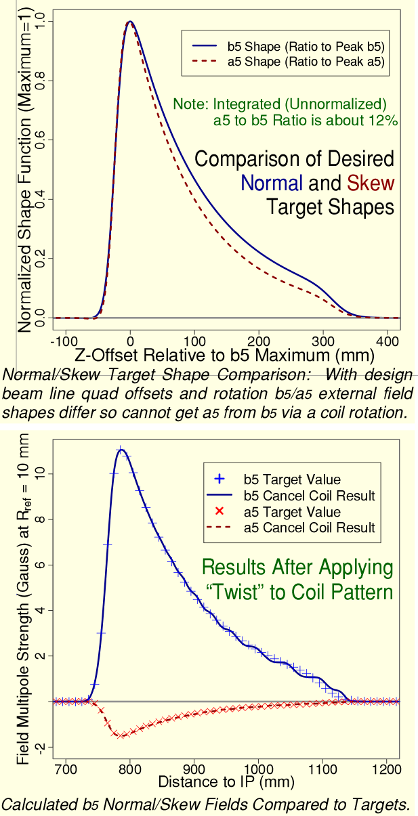
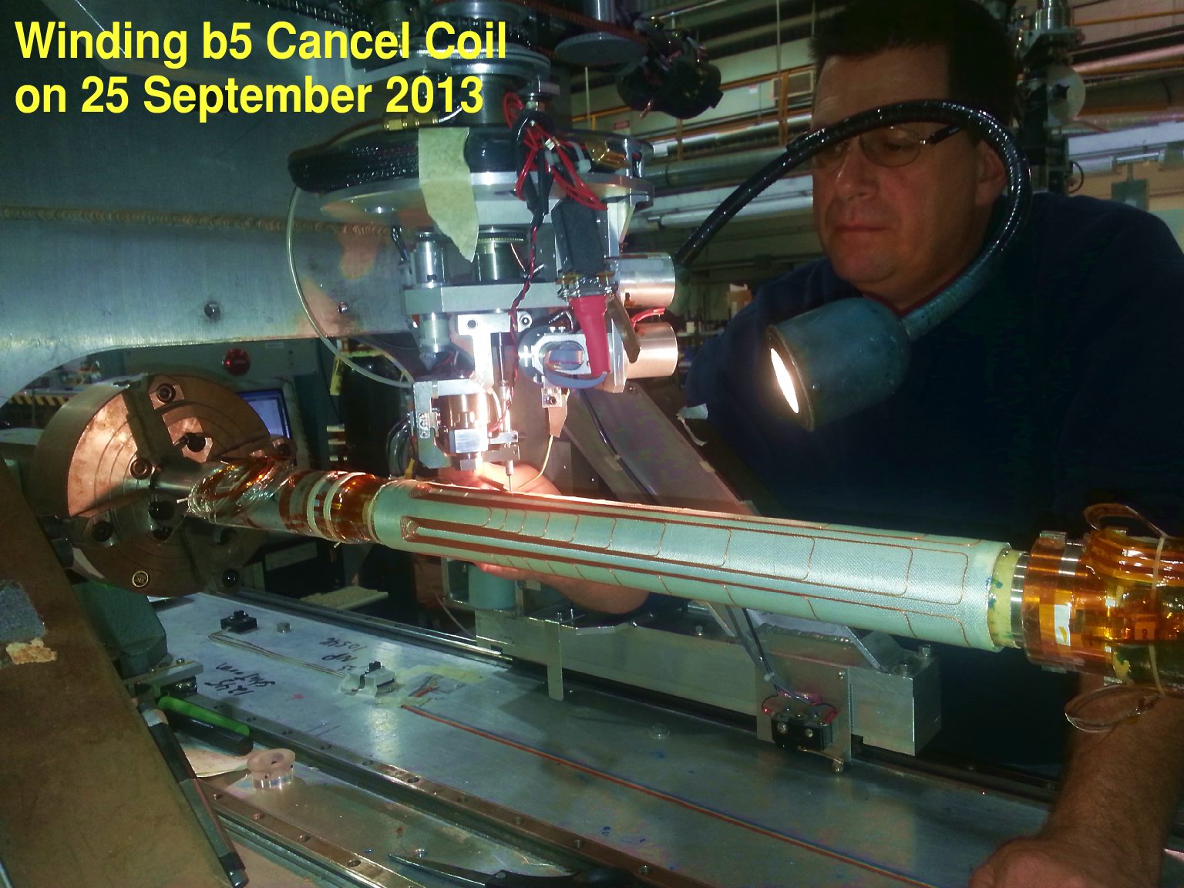
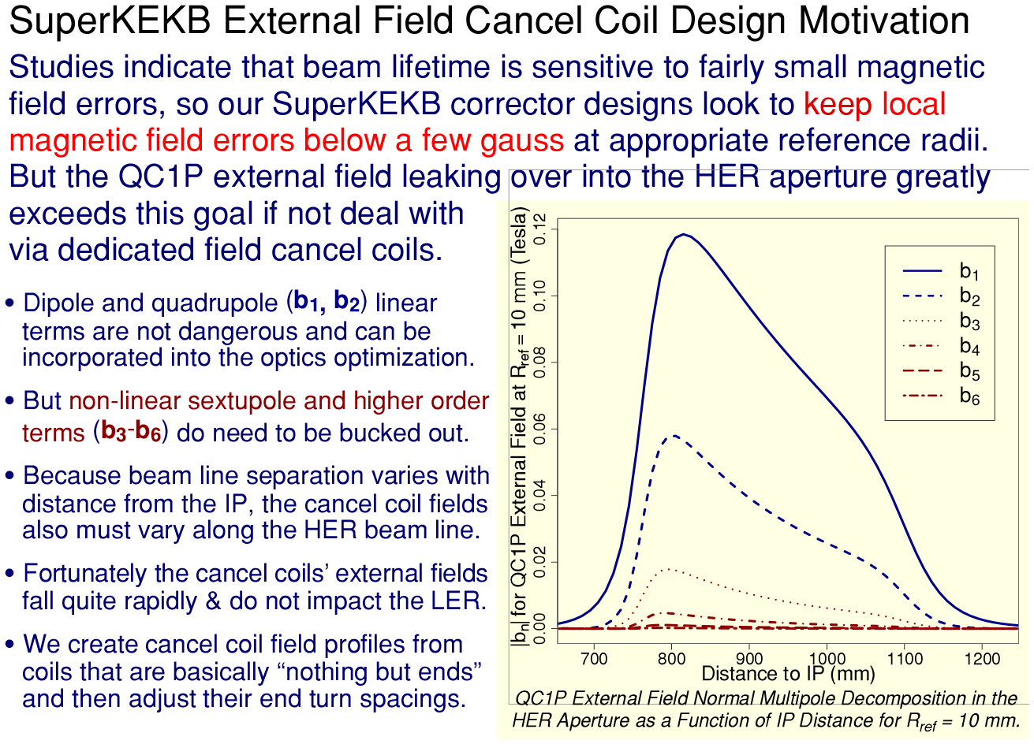
SuperKEKB IR Correctors and Cancel Coils: Designs
For external field compensation, the idea was not to cancel the linear (b₁, b₂) field components, but just include there influence during the optics optimization.
The desired non-linear field profiles were then created by “stretching one Serpentine coil’s end” (now can use dual helical).
Final results for the field profile were actually very good!

Slide 18
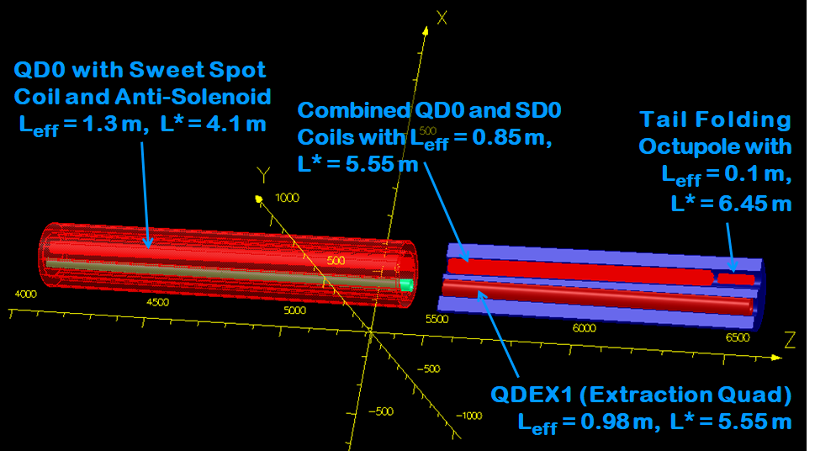
ILC FF Design Update: FF Option Design Study
ILC 250 GeV Option Using “Sweet Spot” Coils
In considering running for several years at 250 GeV CM, already in 2015 we suggested that it made sense to optimize the ILC FF for best possible luminosity performance (replacing a few FF magnets to go to 500 GeV is a small incremental addition compared to other major upgrade costs).
For EDR we should choose between Serpentine and Double Helical QD0.
And evaluate relative merits of keeping the TDR baseline actively shielded QD0 coil geometry or switch to one of the later alternate schemes for dealing with QD0 external field on the extraction beamline.
The force neutral anti-solenoid coil can more naturally be accommodated depending upon the QD0 coil topology ultimately chosen.
We also should reevaluate cryogenic heat loads, transfer line design, the Service Cryostat engineering details for the EDR.
Finally, based upon RHIC, SuperKEKB and QD0 R&D prototype vibration measurement experience, we should see if the QD0 design needs to be updated to ensure the required magnetic center position stability.
The above concept for a 250 GeV optimized final focus design was presented at an MDI workshop (just before ALCWS2015). In place of TDR active shielding baseline, we use Sweet Spot coils for a more compact QD0 and anti-solenoid structure with smaller affective L* (see 6-slide description in backup slides). More recently the B0 spectrometer for the BNL Electron Ion Collider (EIC) has adopted a variation on the Sweet spot theme (1 backup slide). In the 7 years since the TDR was written, new IR magnet options exist and we now have an opportunity to improve the 250 GeV IR FF performance for the EDR.

Slide 19
Backup Slides

Slide 20
Consider This Simple Coil Layout Thought Experiment
Quadrupole and Dipole Coils (powered in series)
Overlay a dipole coil with field, B_{o}, and a second quadrupole coil that has gradient , G_{o}.
Define the distance, X_{o} = B_{o}/G_{o}
Then B(-X_{o})= 0 and B(X_{o})= 2B_{o}
Thus if QD0 is centered at the B=0 field point of the combined dipole and quadrupole coils, we can create an arbitrary field at some point outside QD0 without shifting QD0’s field center.
QD0
-X_{o}
X_{o}
By=2B_{o}
By=0

Slide 21
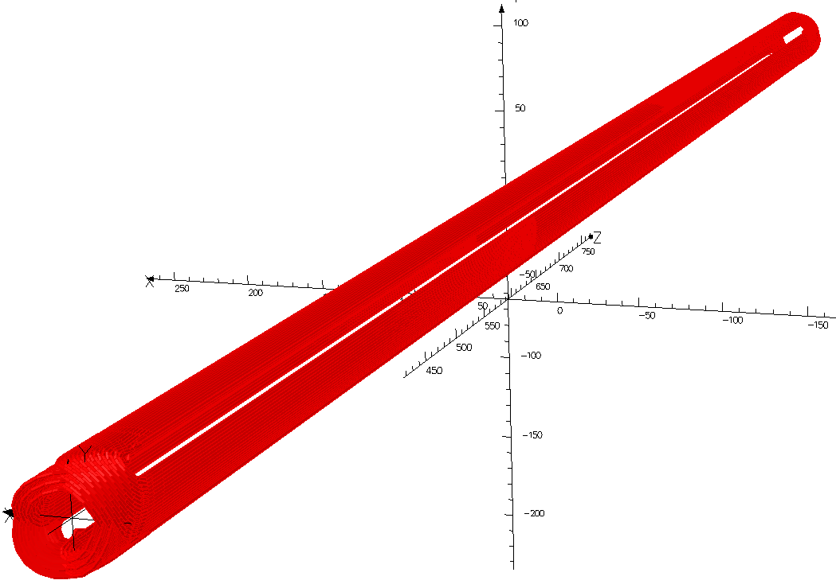
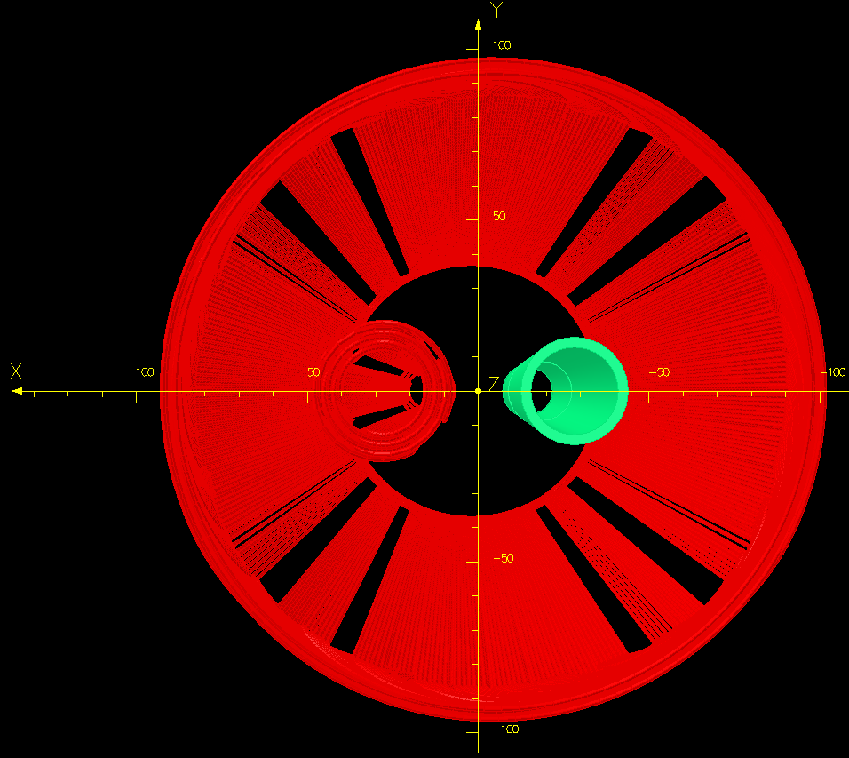
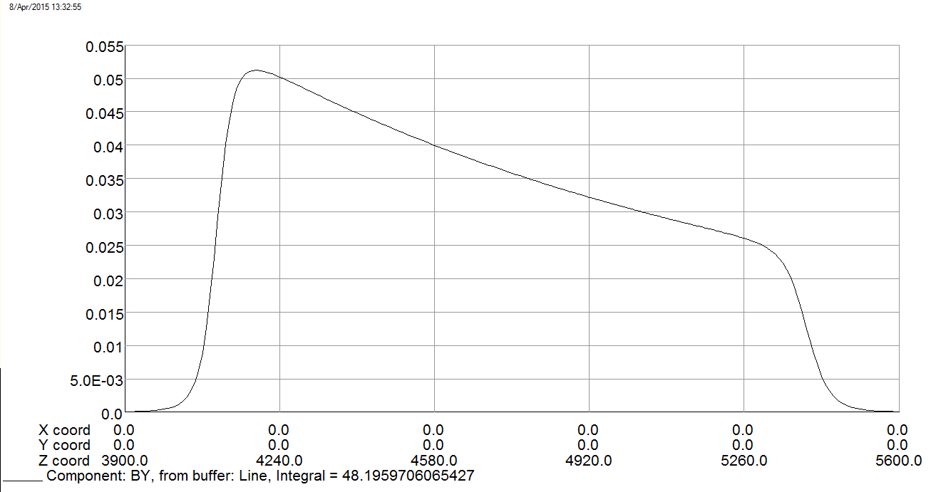
A Sweet Spot Coil Concept for QD0
Sweet Spot Coil
QD0
ILC Layout has 14 mrad Total Crossing Angle
By (T) at Extracted Beam Position
QD0 External Field
Extraction
Beam Line
L*=4.1 m
This sweet spot coil has dipole and quad windings, offset but parallel to QD0, that are powered in series such that their fields cancel at QD0 and add at the extraction beam line.
X, Y, Z (mm)

Slide 22
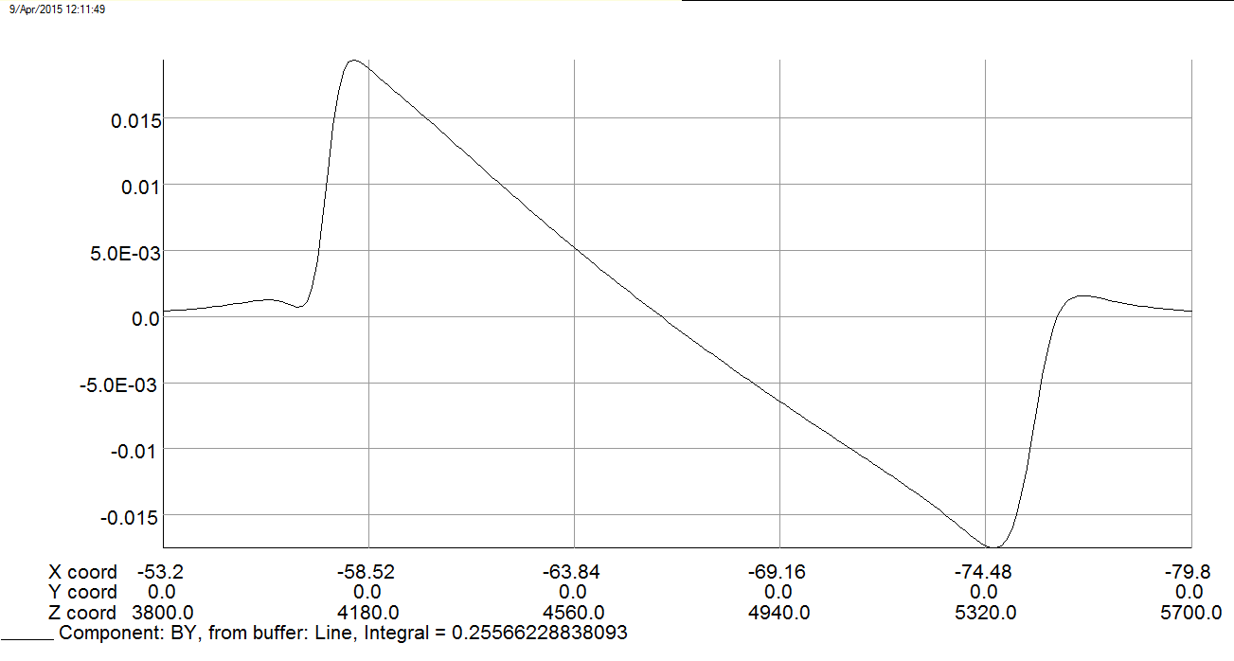
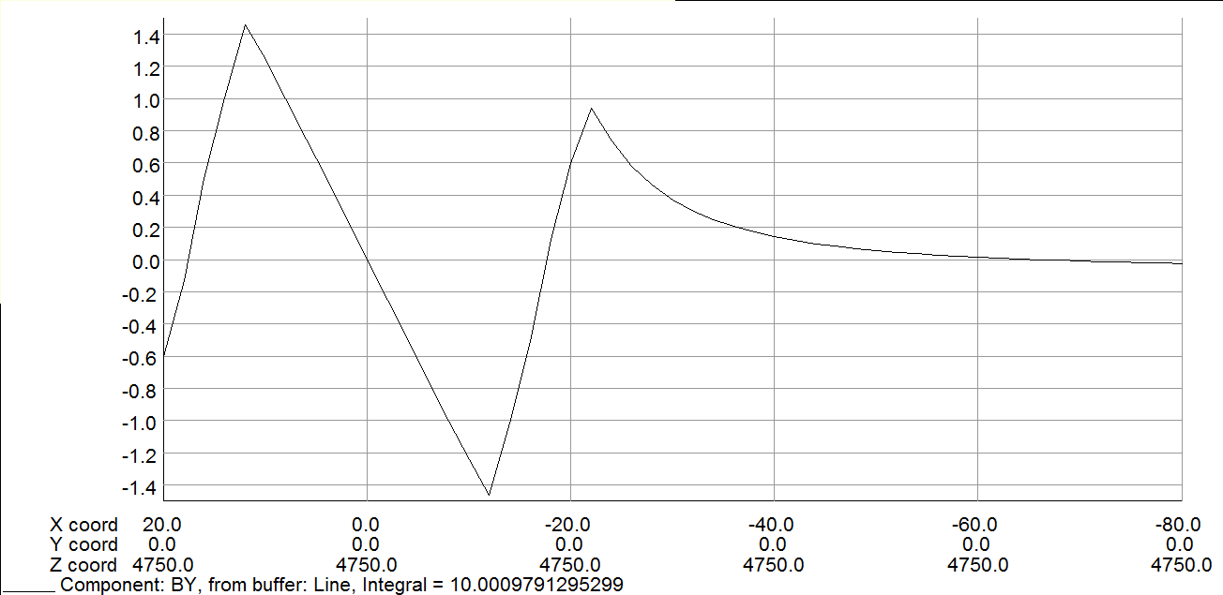

A Sweet Spot Coil Concept for QD0
Sweet spot coil is offset -33.05 mm with respect to QD0 which is the place where the dipole and quadrupole fields cancel.
So the sweet spot coil can be adjusted without changing the QD0 field center.
Original QD0 gradient is 124.66 T/m and with sweet spot coil energized, to buck QD0’s integrated external field, the gradient goes up 0.44% to 125.212 T/m
A simple sweet spot coil, with constant dipole and quad fields, under corrects at QD0’s front and over shoots at the end.
It should be possible to tailor the fields shapes, as was done for SuperKEKB, to improve the local field cancellation.
There is small residual weak focusing at the extraction beam line next to QD0 with this sweet spot magnet geometry.
By (T) at Extraction Line
QD0 Magnetic Length Covers 4100-5400 mm
QD0 Midpoint (Longitudinal)
QD0 Coil
QD0 Coil
Region for the Extracted Beam
QD0 Axis
(By = 0)

Slide 23
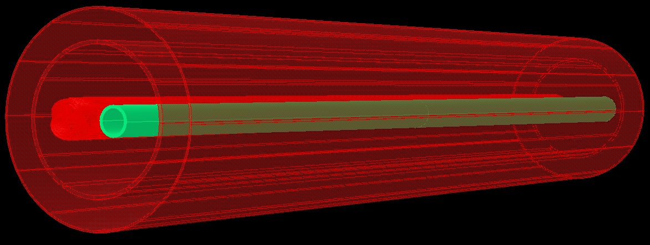
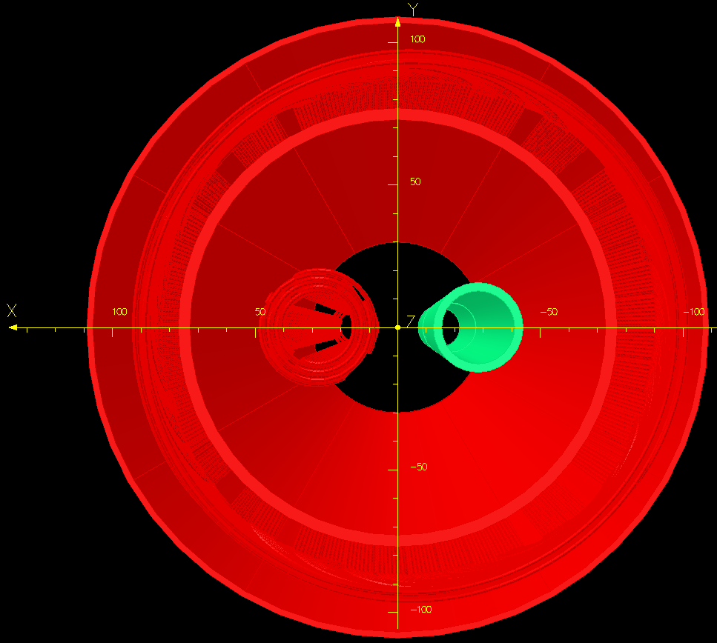
A Compact Anti-Solenoid Concept for QD0
QD0
Inner anti-solenoid coil for use in ILD
New anti-solenoid has little impact on detector field
quality.
QD0 Coil
Outer anti-solenoid coil for use in ILD
We look to reduce the anti-solenoid diameter via this new coil geometry (with the old QD0 layout the active shield coil was in the way).
We can roughly balance repulsion between the anti- and detector solenoids via a second opposite polarity coil powered in a 2:1 ratio.
Thus we can use the net anti-solenoidal field for optics compensation without then having to pass any large longitudinal force from the cold mass out to the warm support structure.
Sweet Spot Coil
Inner/outer anti-solenoid coils are nested with QD0 and the sweet spot coils.

Slide 24
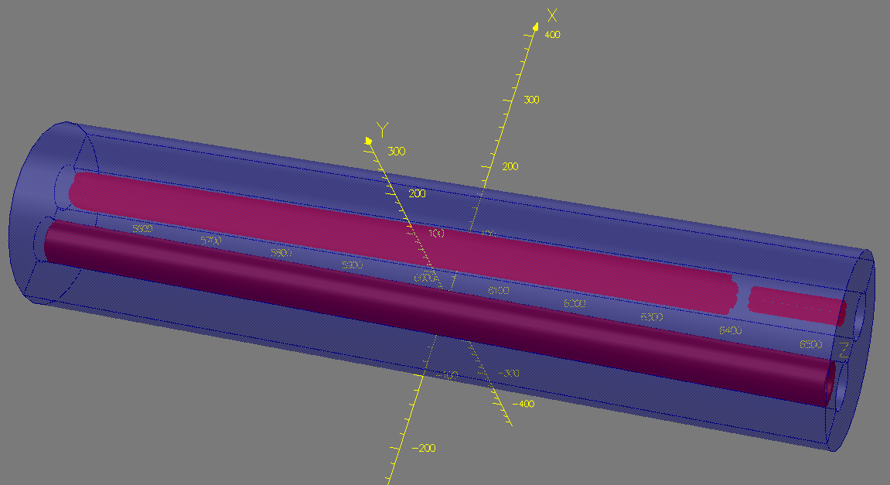
A Way to Reduce the QD0 Cryostat’s Length
For the new 4.1 m L*, both SiD and ILD detector fields may be low enough to have a magnetic yoke for the second part of QD0 (see SuperKEKB/Belle-II).
A not too saturated yoke automatically avoids the external field cross talk and lowers the coil operating currents.
We can then save space by nesting QD0 and SD0 coils (field calculations indicate operating margin is still fine).
But we should avoid overlaying the tail folding octupole coil with QD0 (avoid a semi-allowed quadrupole harmonic).
First extraction line quadrupole can take advantage of the full yoke length.
A Compact “Second Half QD0” Scenario
Overlay QD0 on top of SD0 Sextupole Coil
Tail Folding OD0 Octupole Coil
Extraction Line QDEX1 Coil
Coils share same magnetic yoke
Note: In all scenarios, I recommend against completely de-energizing the second half of QD0 in order to avoid persistent current effects.

Slide 25
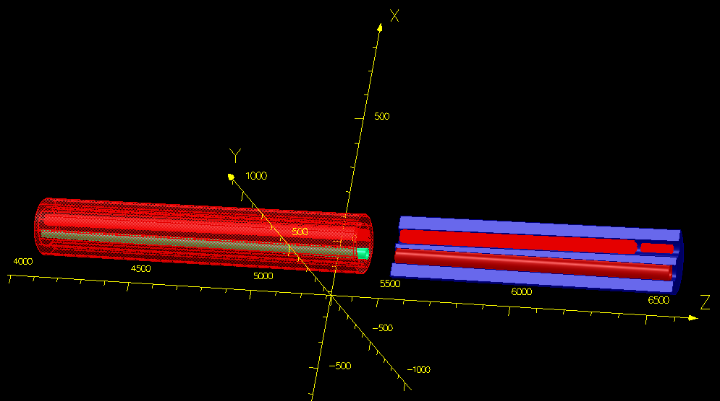
A Combined Compact QD0 Cryostat Coil Layout Example
QD0 with Sweet Spot
Coil and Anti-Solenoid
L_{eff} = 1.3 m, L* = 4.1 m
Combined QD0 and SD0 Coils with L_{eff} = 0.85 m,
L* = 5.55 m
Tail Folding
Octupole with
L_{eff} = 0.1 m,
L* = 6.45 m
QDEX1 (Extraction Quad)
L_{eff} = 0.98 m, L* = 5.55 m
Note: An early ILD anti-solenoid estimate had 1.3 m length. So, I lengthened the first part of QD0 in order not waste space and overly complicate the cryostat internal support structure; however, it may be that a shorter ILD anti-solenoid works fine and then we want to keep QD0 shorter for low CM energy (Z) running.

Slide 26
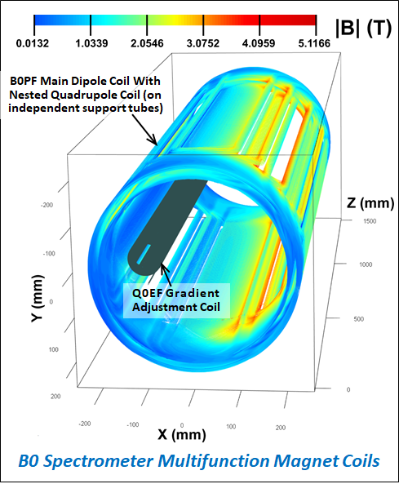
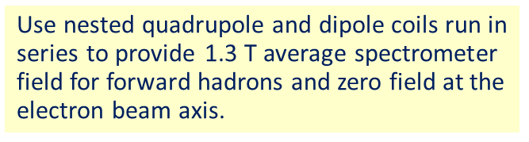
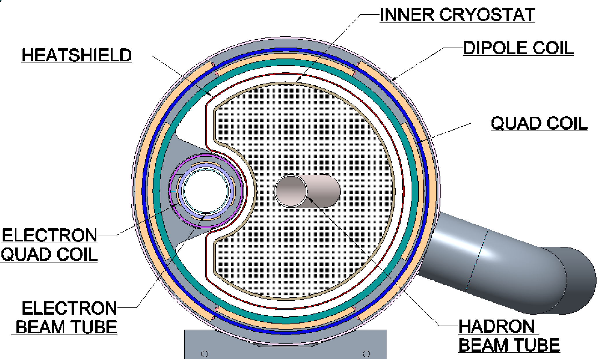
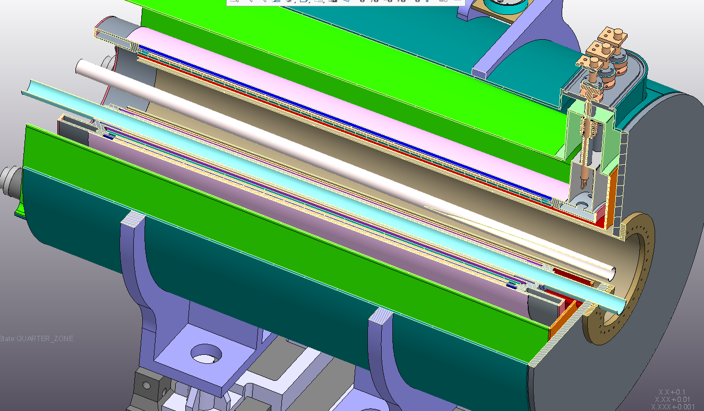
Sweet Spot Example: EIC B0 Spectrometer Magnet
Warm space available for physics detectors†
Challenge is to have warm space for physics detectors with magnetic field very close to the first electron IR quad.
Answer is to put the electron quad at a zero-field axis in the hadron combined function magnet.
Hadron Beam
Hadron coils give some focusing gradient but zero dipole field at the electron beam axis.
However, the hadron and electron beam energies must be separately adjustable to explore different kinematic regions…
Thus, we provide an electron quadrupole field adjustment coil.
Note: All coils are aligned parallel to the electron beam, so the hadron beam crosses B0 with the full 25 mrad crossing angle.
Electron Beam
†Q0EF physically covers some of the forward physics acceptance between the electron and hadron beams.

Slide 27
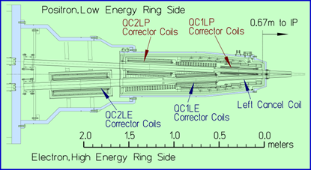
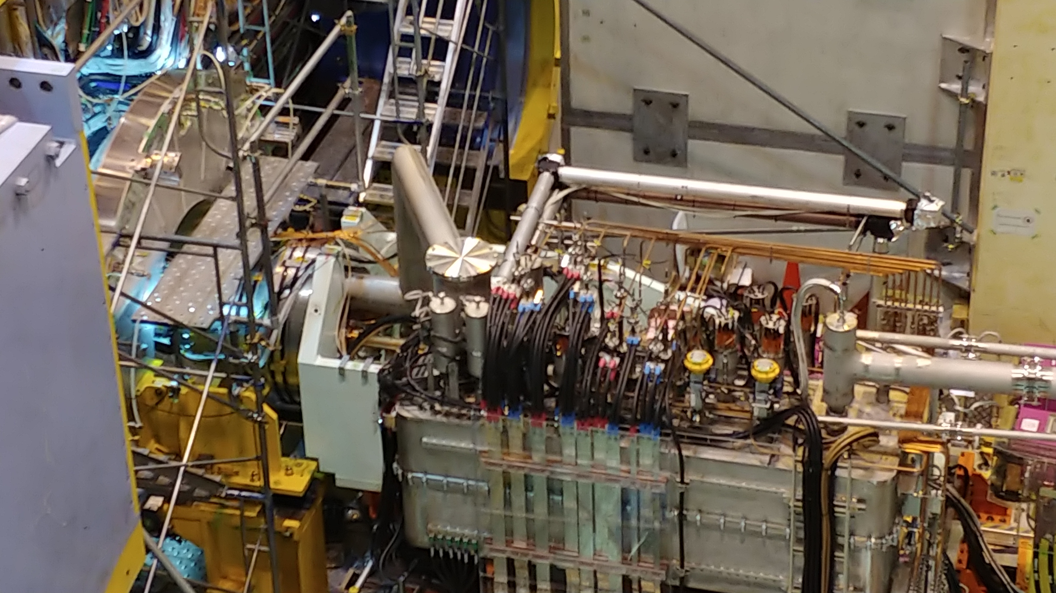
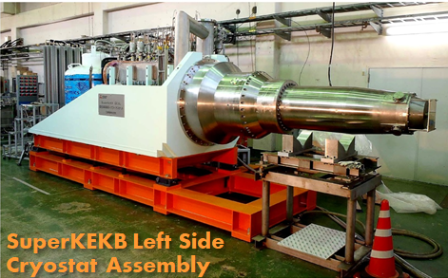


SuperKEKB IR Correctors and Cancel Coils: Designs
Cryogenics Connection
ILC Equivalent Service Cryostat
With 35 correction coils and 8 cancel coils we sometimes hear this referred to as a “complicated system” (criticism implied).
However, there are just enough knobs to allow the operator to adjust each quad’s hor/vert center position and roll angle.
In addition, the operator can make non-linear (normal and skew sextupole and octupole) local optics corrections.
We could have combined each of the 4 cancel coils on each side into a single multipole coil package, but dead reckoning what the optimum mix of fields would be, before everything was measured, would have been somewhat risky.

Slide 28




ILC QD0 R&D Service Cryostat History
Dummy Heat Load for Testing
Current Leads, Valves etc.
QD0 R&D Service Cryostat
Internal Plumbing
These pictures were taken in 2014; no additional work since then.

