Slide 1
Development of a TPC readout system
based on the SALTRO ASIC
A status report
12.1.2021
Leif Jönsson
Representing the Lund Group

Slide 2
The Lund group:
Björn Lundberg: previous electronics engineer at the division. He moved to a private company in 2010 but
has recently started his own private enterprise.
Ulf Mjörnmark: previous research engineer at the division. Since mid 2018 retired.
Anders Oskarsson: since the end of 2018 retired.
Lennart Österman: electronics engineer at the division. Is instructed to work mostly on the ATLAS experiment.
Leif Jönsson: since the end of 2010 retired.
We have financial support to finalize the present work but we have no chance to improve the manpower
situation. It means that all personal is working part time.
The work pace has also been slowed down by the COVID-19 disease.

Slide 3
Normal project layout:
Several groups and experts in each WP.
Each WP has user teams for evaluation
WP1: ASIC design, fabrication, packaging.
WP2: Front end boards
WP3: Data collection HW and FW
WP4: Data to computer, performance monitoring
WP5: Integration with detector, LV distribution, services, cooling, slow control
This project:
WP1: CERN design and fab: Lund die packaging
WP2: Lund. Packaging intergrated with the board design
WP3: HW, SRU from RD51. FW partly done by master
student in Lund.
WP4. Lund responsible for all evaluation
WP5: Cooling PISA. Slow control DESY? The rest is
Lund work in progress

Slide 4
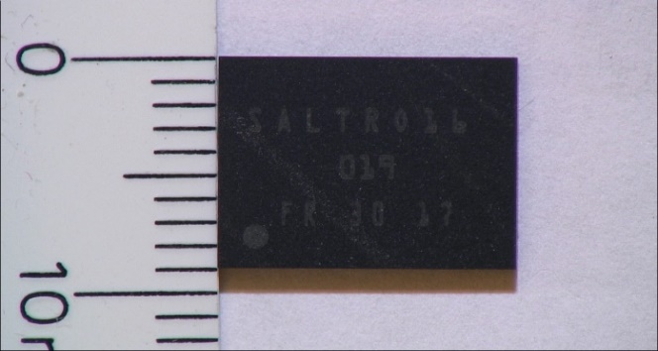
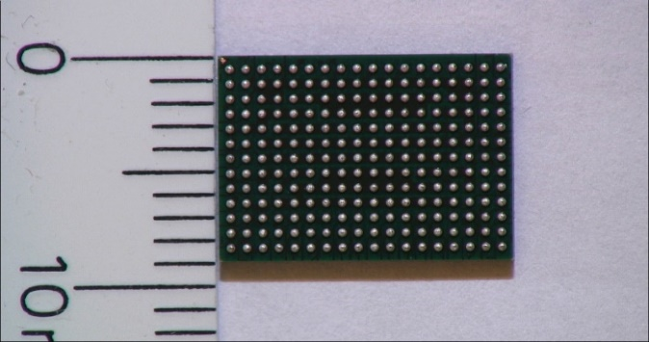
Retrospect:
The packaging of the SALTRO-dies was started at the end of 2017.
Top side 12 mm Bottom side with soldering balls in BGA pattern
9 mm
• Prior to the full production two pre-samples including in total 89 chips were packaged and tested.
• The packaging of the full number of dies was completed at the end of 2018 after careful tests of the pre-samples. Out of the initial number of 794 dies sent to the company, 748 were successfully packaged and delivered to Lund.

Slide 5
Test of the first MCM-version
• The first two boards were mounted at the end of 2019 by the DESY electronic workshop.
the first version was intended for testing the design and because of this only two chips were
mounted on one board and seven on the second.
• The test revealed the need for a few corrections to the circuit board design. These were
implemented and a new version was manufactured.
• The miniature MCM circuit board is very complicated to manufacture. Only a limited number
of companies are able to carry out the work. The cost is high (about 6000 Euro) per order and
the delivery time is about 2 months

Slide 6
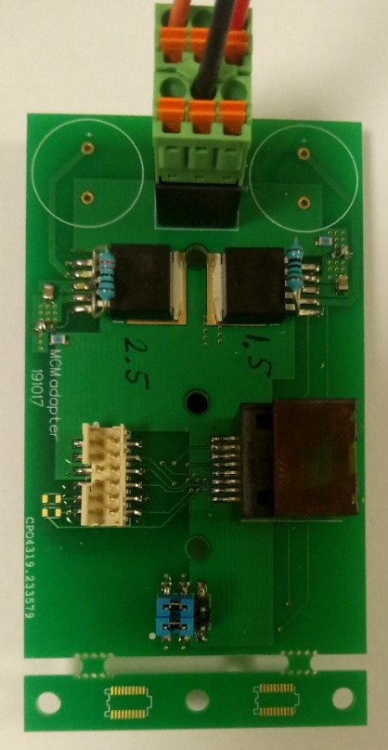
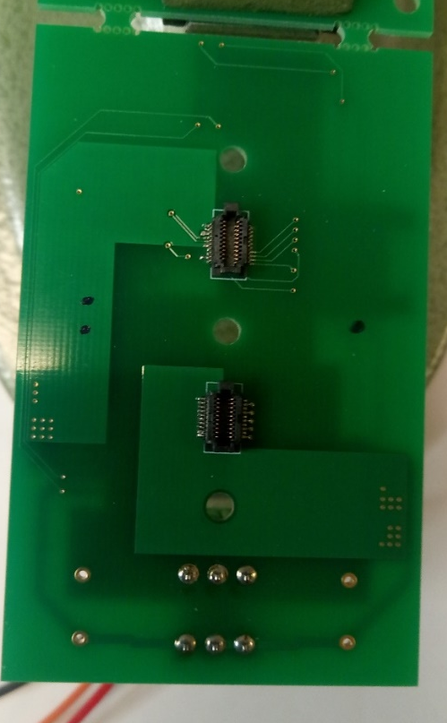
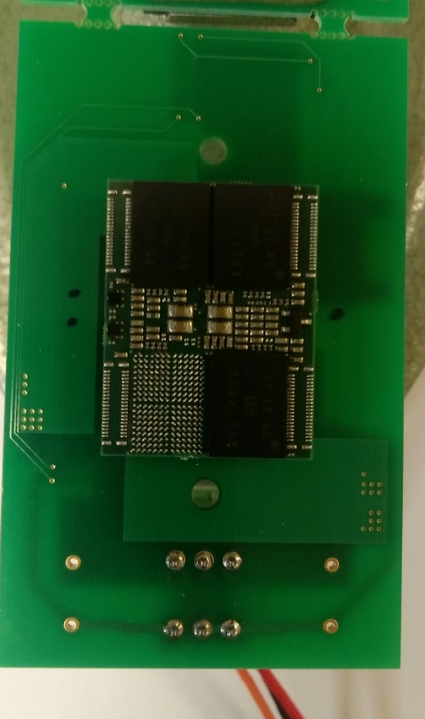
The LV prototype board
• For the tests of single MCM-boards a prototype LV-board was designed. The final LV-board will supply voltages for 5 MCM-boards.
• Due to the small size of the MCM-board the voltage regulators have to be placed on the LV-board.
• The MCM has seven different power domains. The R&D work has proven that these can be
reduced to two, requiring the power supplies 1.5 and 2.5 volts.

Slide 7
Readout problems known so far:
With the present DAQ-system we are limited to either perform a full readout of 2 channels out
of 16, or to read out all channels but limited to 135 samples per chip and per MCM.
• The SRU: A re-arrangement of the memory management is necessary for full readout of all 16 channels.
• A bug which occasionally causes the system to hang has to be solved.
• These problems have caused us months and months of delay
All this needs an FPGA programmer.
Until this has been solved no further chips will be tested.
• In order to perform the full chip tests in a reasable time we plan to use parts of the automatic system that was used in the tests of the SAMPA chip.

Slide 8
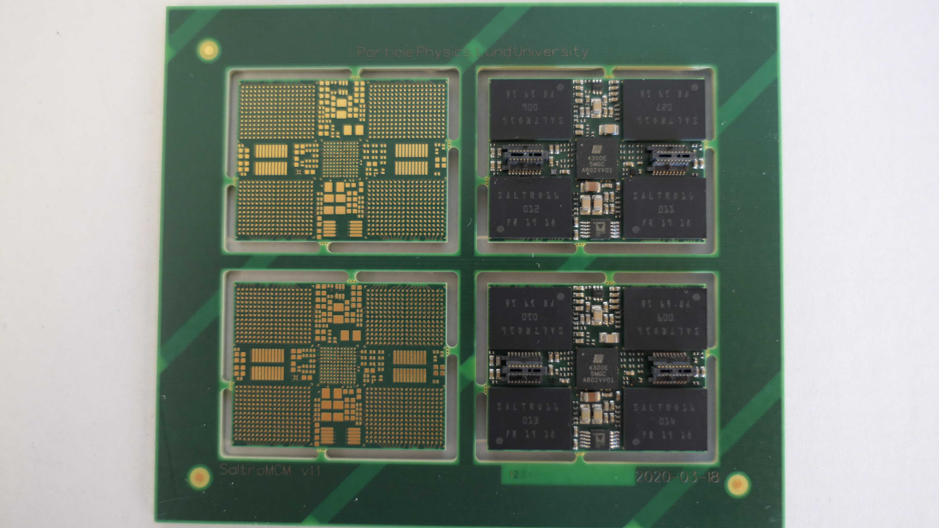
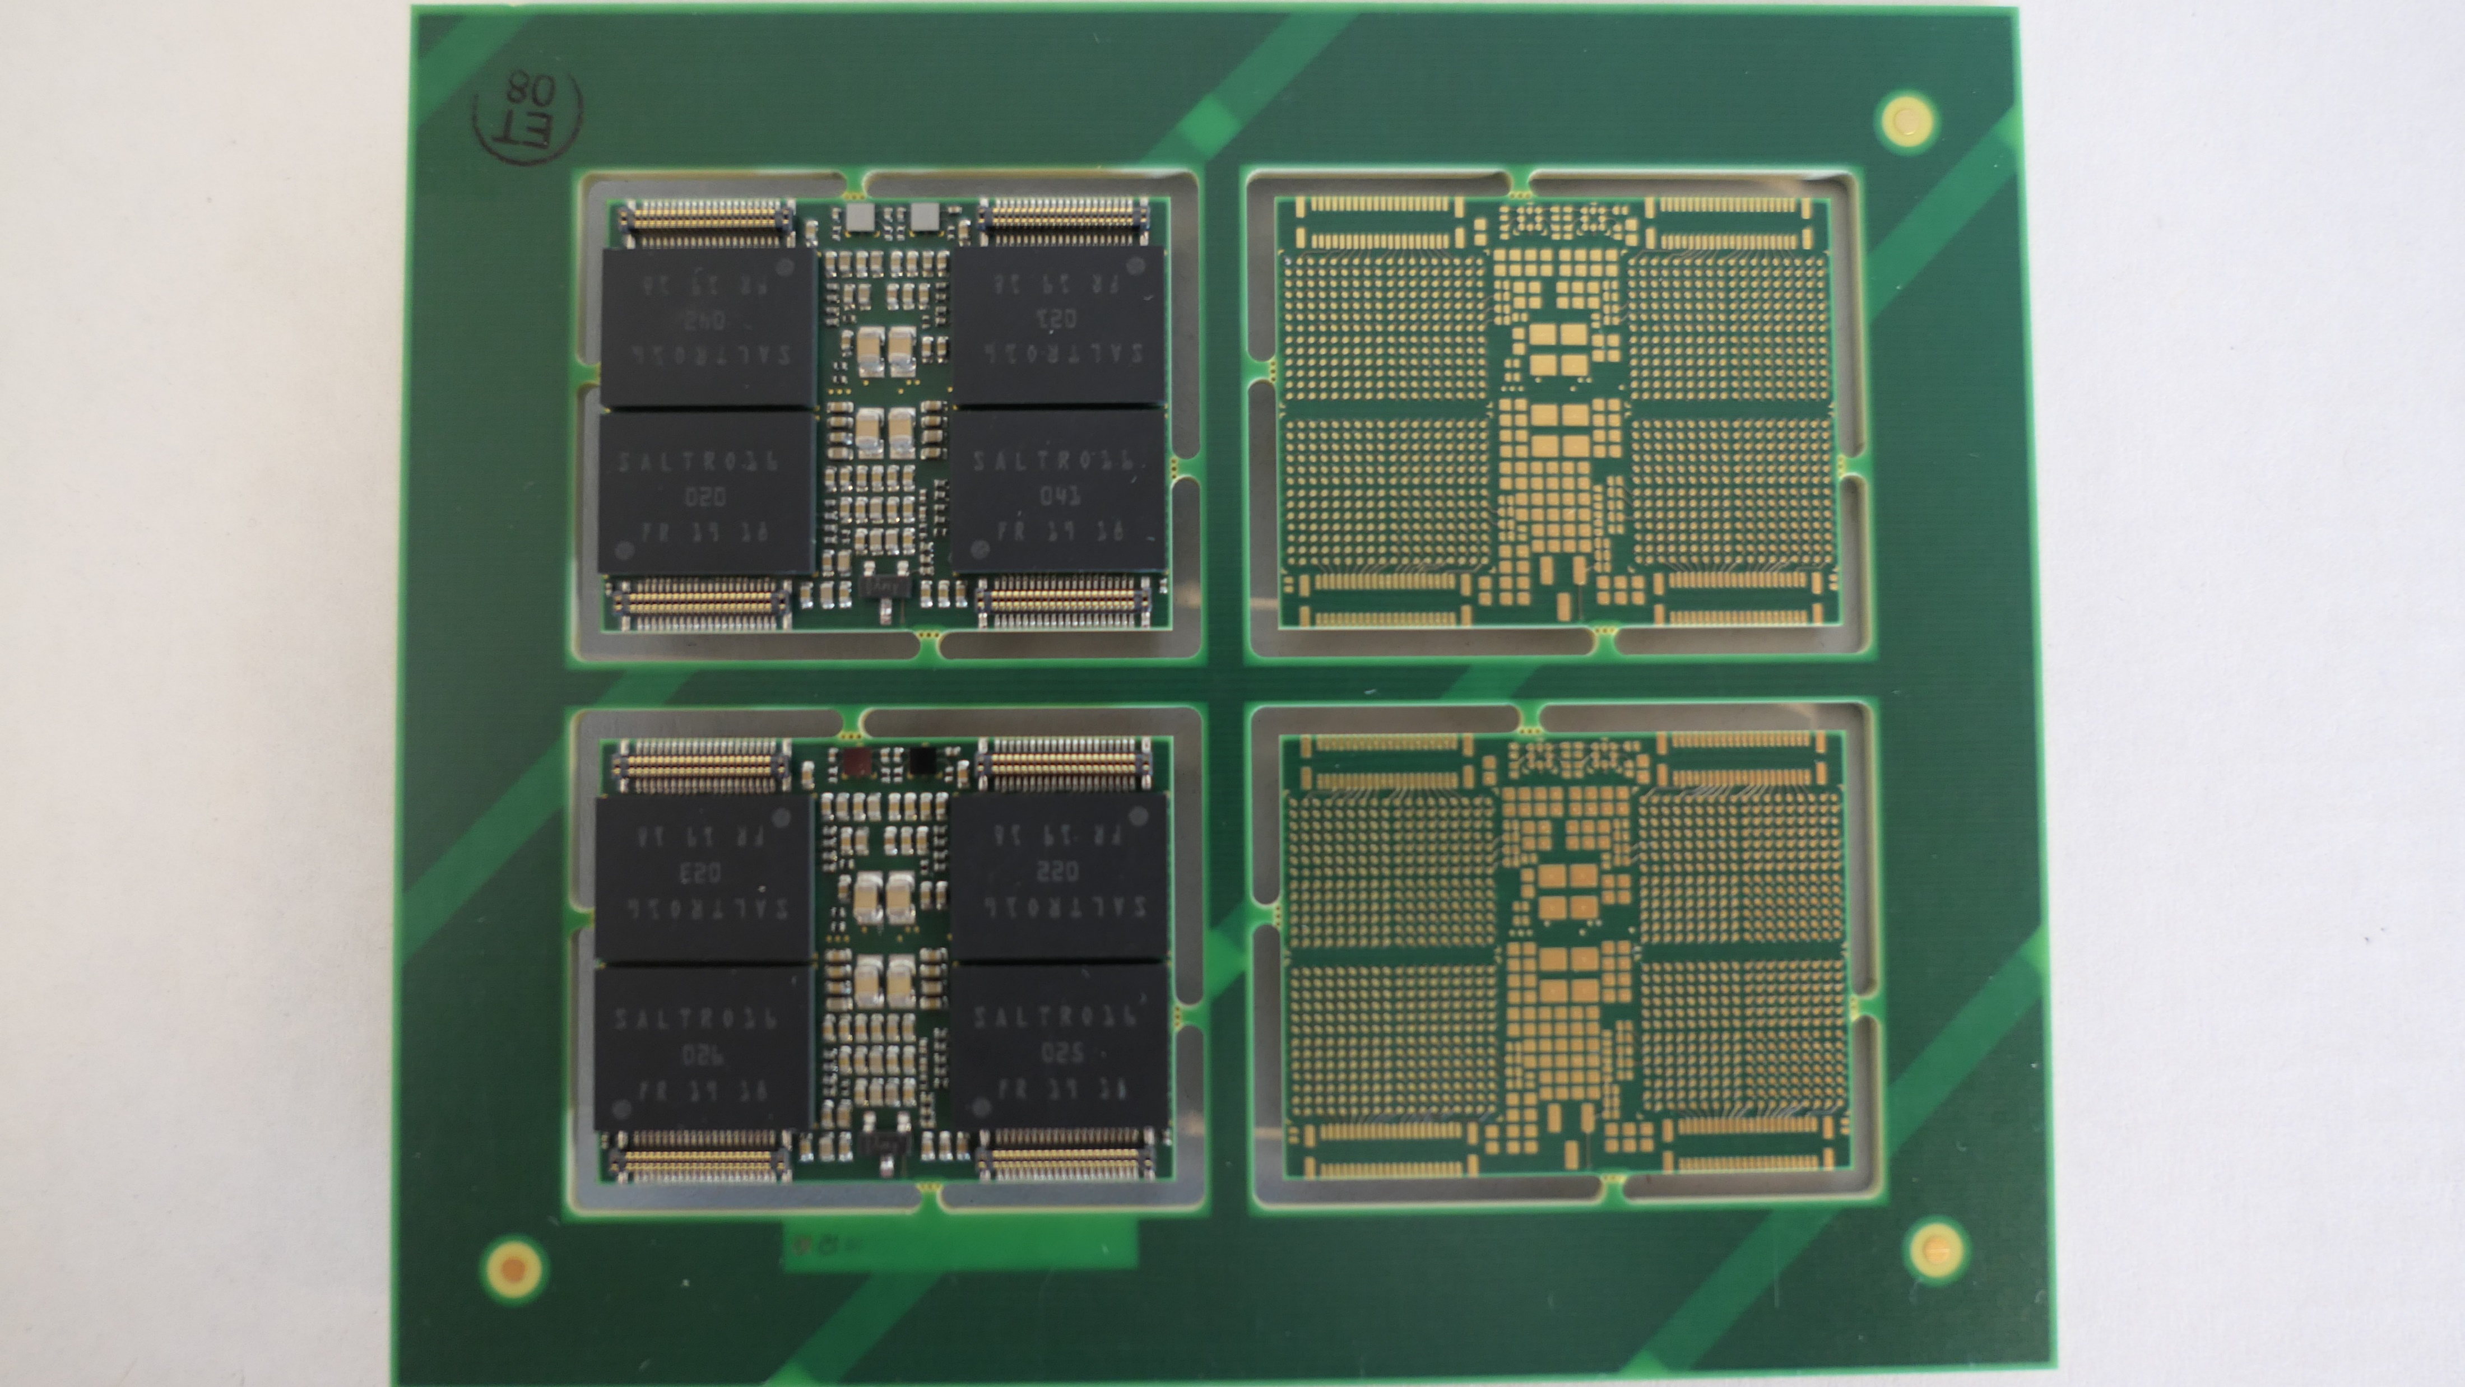
The present status
• The second version of the MCM-board was prepared and mounted in the middle of June 2020. Two
MCM-boards were mounted with eight SALTRO-chips each.
• One PCB panel contains 4 MCM-boards. Due to the small size of the soldering pads, the solder mask
has to be positioned very accurately.
• The soldering balls of the chips are 0.3 mm in diameter.
• In spite of the small and tight dimensions the challenging surface mounting of components by the
DESY electronics workshop was faultless for the two boards fully assembled.
Top side
32.5 mm
Bottom side
25 mm

Slide 9
Tests performed so far
Gain
(mV/fC)
Shaping
Time (ns)
12
15
19
27
P = pedestal runs
TS = time sweep
30
P, TS
60
P, TS
90
P, TS
120
P, TS
P, TS
P, TS
P, TS
Preamp decay time: 500 ns
Polarity: positive

Slide 10
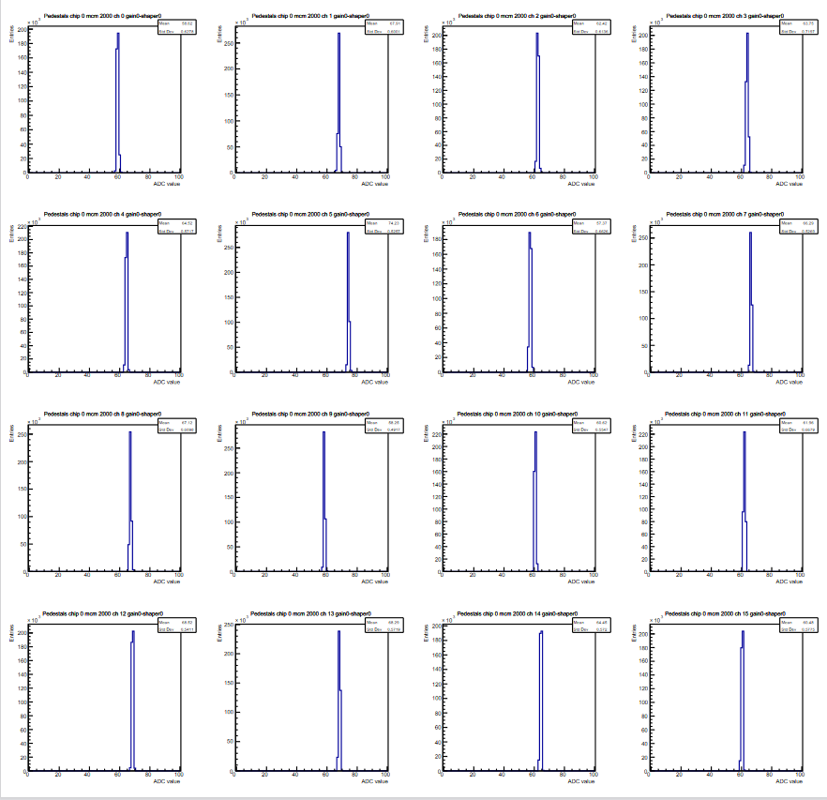
Pedestals
MCM 2
Chip 1
Channel 0 – 15
Gain 12 mV/fC
Shaper 120 ns

Slide 11
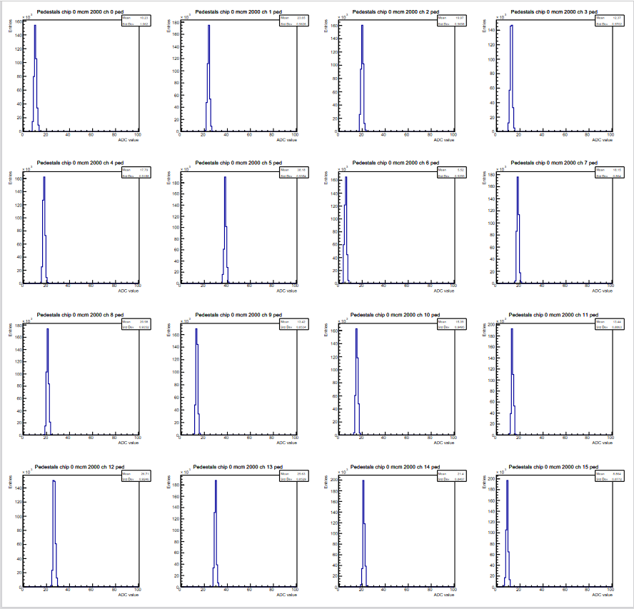
Pedestals
MCM 2
Chip 1
Channel 0 – 15
Gain 27 mV/fC
Shaper 120 ns

Slide 12
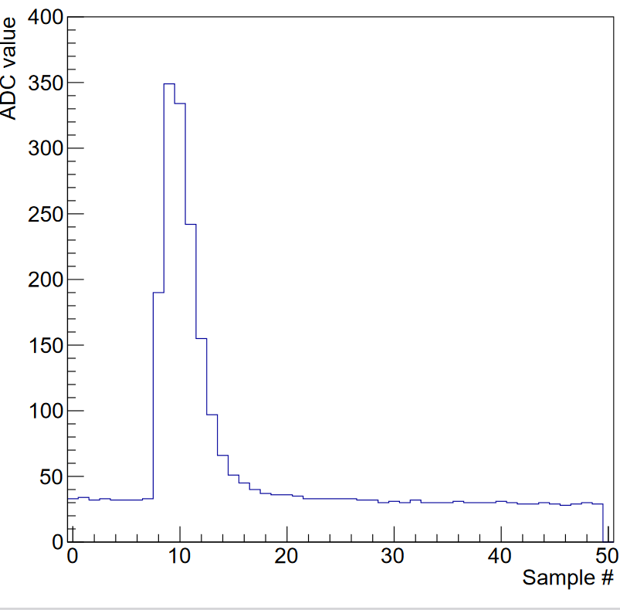
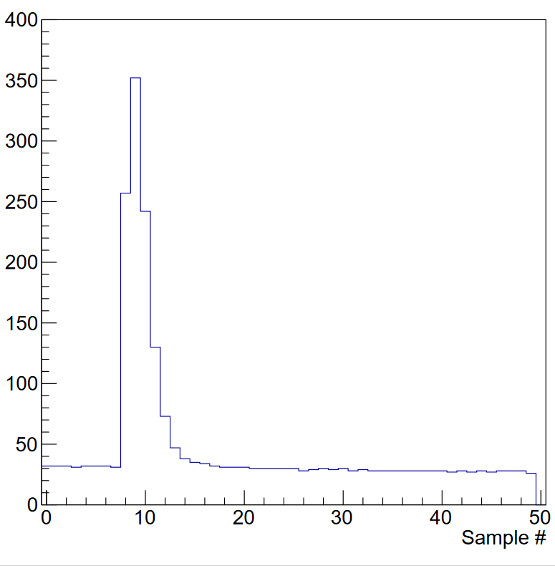
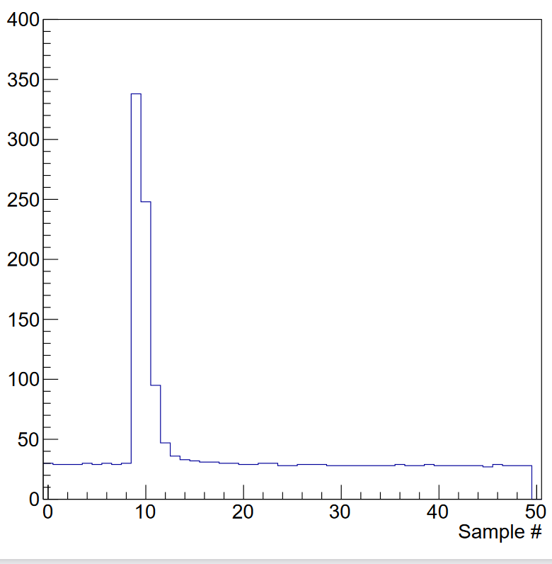
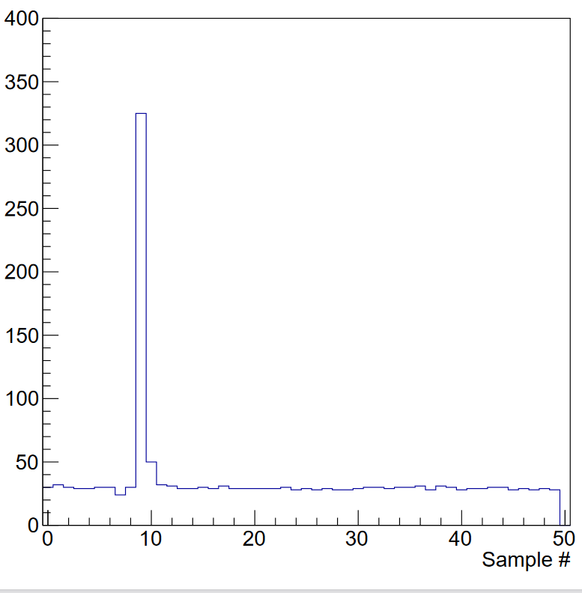
Pulse dependence on the shaping time
Gain 12 mV/fC
Shaper 120 ns
Shaper 90 ns
Shaper 60 ns
Shaper 30 ns

Slide 13
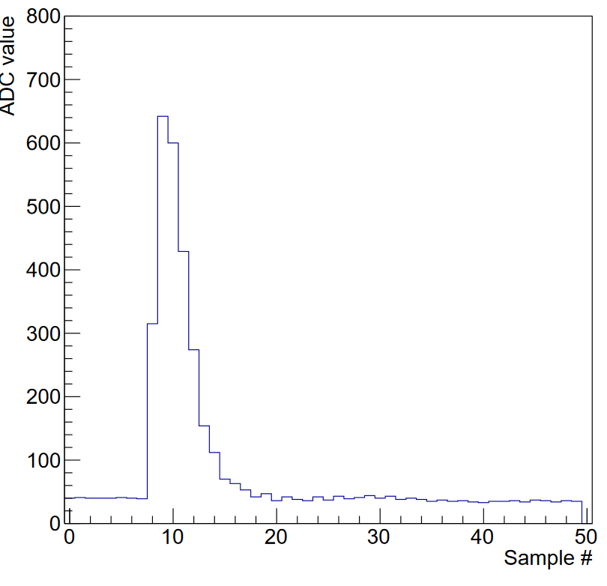
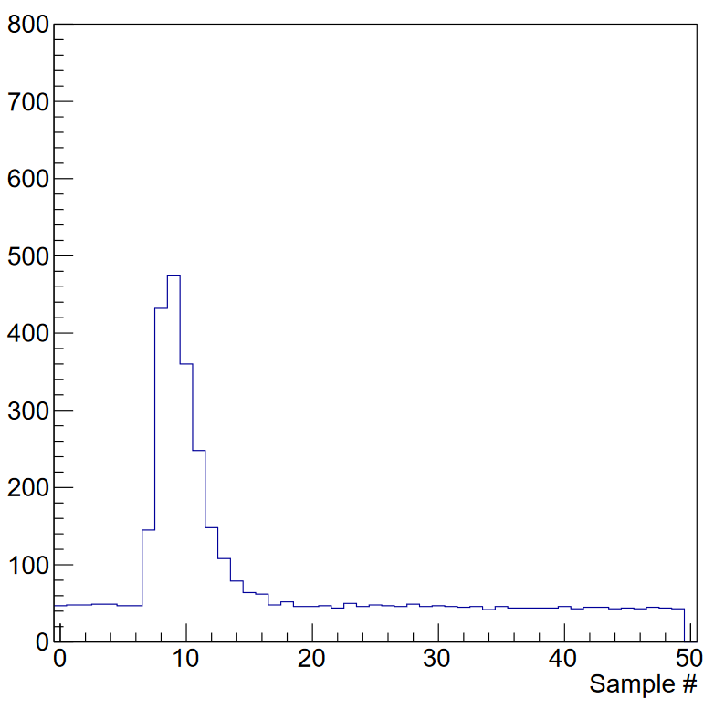
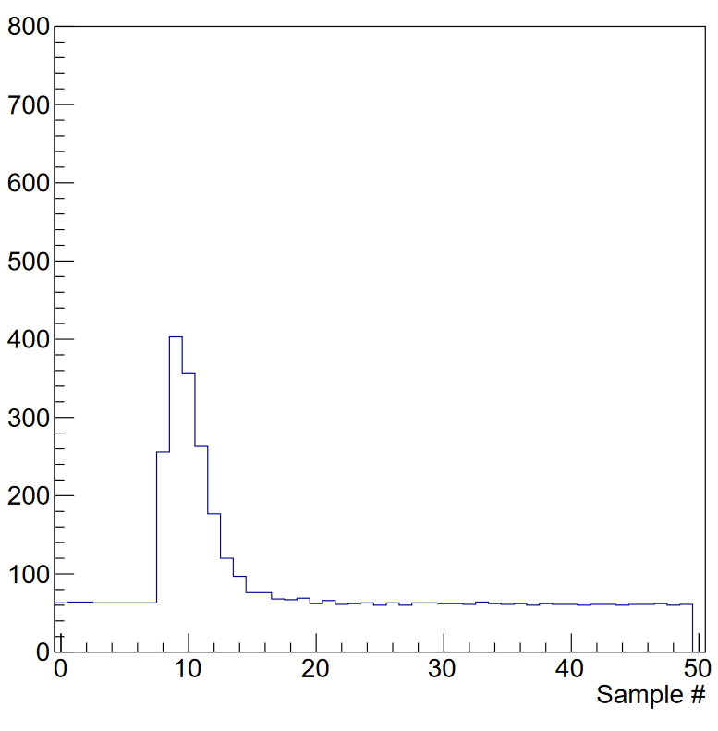
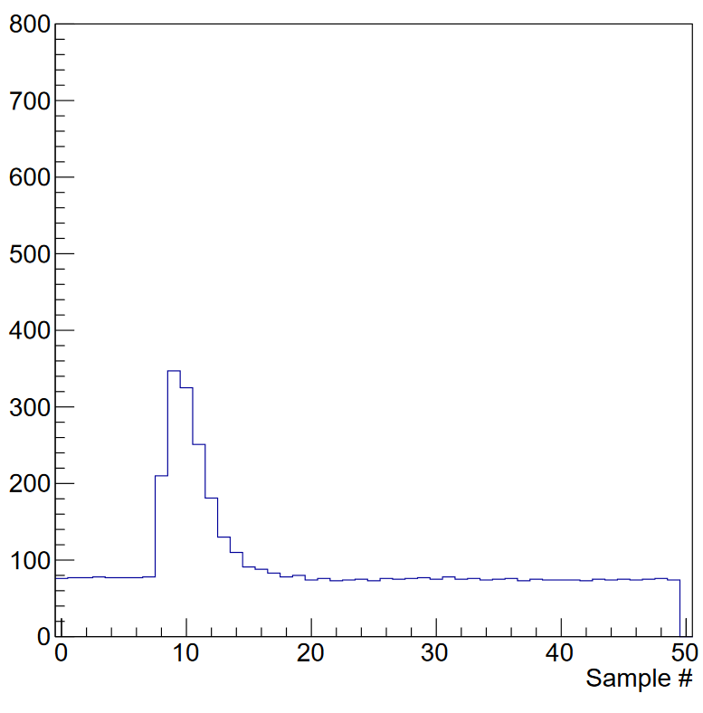
Pulse dependence on the gain
Shaping time 120 ns
Gain 27 mV/fC
Gain 19 mV/fC
Gain 15 mV/fC
Gain 12 mV/fC

Slide 14
Small dynamic effect
1-2 adc ticks when
digital activity starts.
If not solved- subtract
individual channel and
sample pedestals
Noise full MCM, 128 channels, gain 12mV/fC and shaping time 120ns
Time sweep 20MHz, one channel
1000 samples – 50 microsecs
Project on ADC axis
Calculate RMS
Mesured noise
Very low input capacitance
MPGD have very low input capacitance
(but a few pF higher than bare MCM)
Repeat for all 128
Channels on MCM
Measured noise includes:
Amplifier random noise
Noise due to digital activity
Discrete ADC scale
Baseline variations from nanosecs to seconds
Result
Noise average 0.6 ADC ticks
2mV/ADCtick and 12mV/fC gain -
625 electrons for full operation MCM of 128 channels.

Slide 15
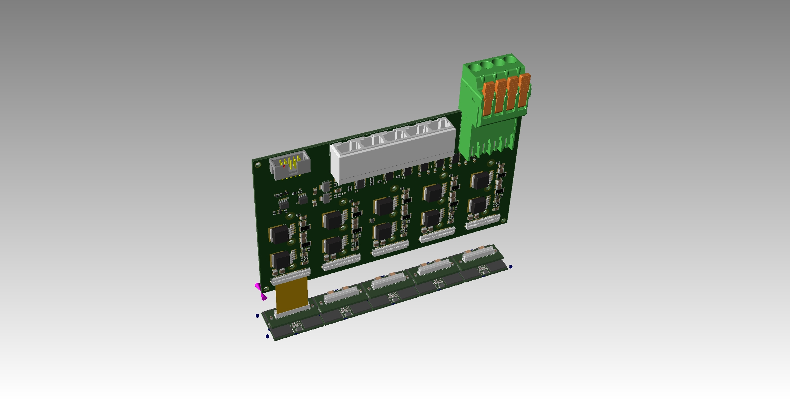
The LV-board
• The LV-board is connected via short flat cables to the MCM board. Since there was no contact for the flat cable to directly connect to the Samtec connectors on the MCM-board, it was necessary to introduce a small adaptor board in between. The use of a flat cable has the advantage that the precision of the connector positioning on the adaptor board is not critical. The other advantage is that the connectors on the pad plane must only be very accurately positioned to fit the connectors on individual MCM board and not for a complete ladder of 5 MCM boards
• The LV-board also contain an LVDS (Low Voltage Differential Signaling) repeater (tranciever) for the communication with the SRU.

Slide 16
Summary of the electronics development
• The MCM-board is working up to specifications
• We are struggling with getting rid of a small bump in the beginning of the sweep
• The design of the LV- board is ready
• The design of the adaptor board is ready
• Quotes for the LV-board and the adaptor board is in the pipe line
• The flat cables connecting the LV-board and the MCM-board are ordered with expected delivery
on the 18th of January
• Further chip testing is waiting for the FPGA-programming to be solved
• Before the final version of the MCM-board can be produced we need to test the chips

Slide 17
Cooling

Slide 18
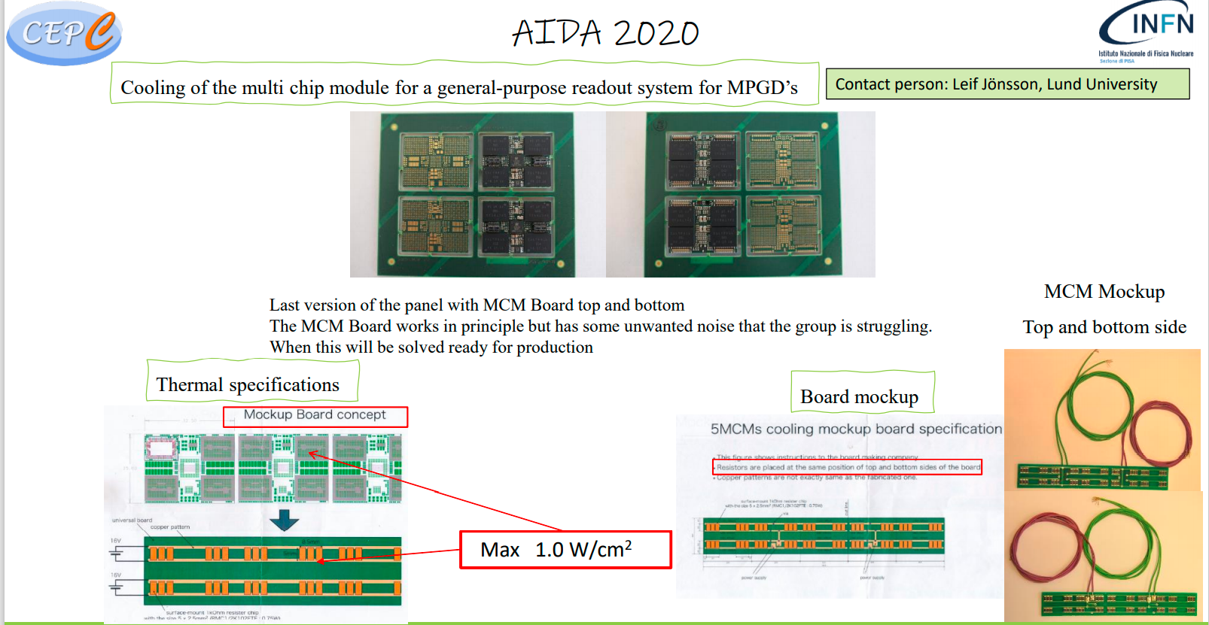

Slide 19
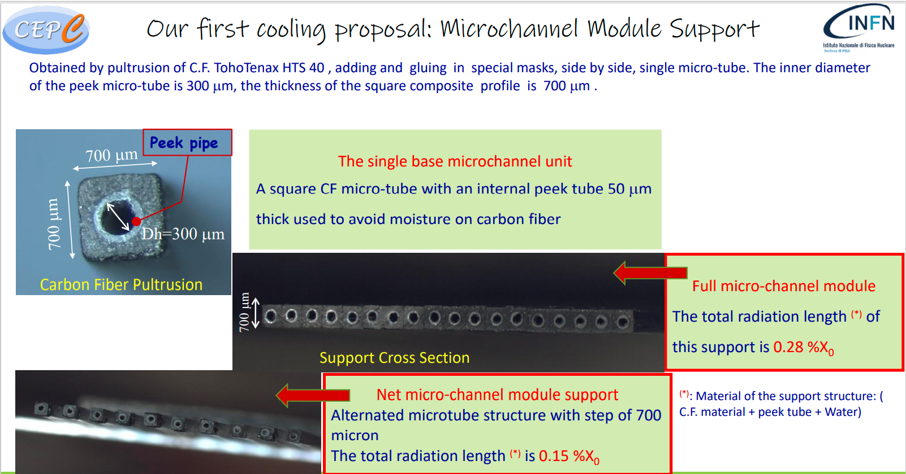

Slide 20
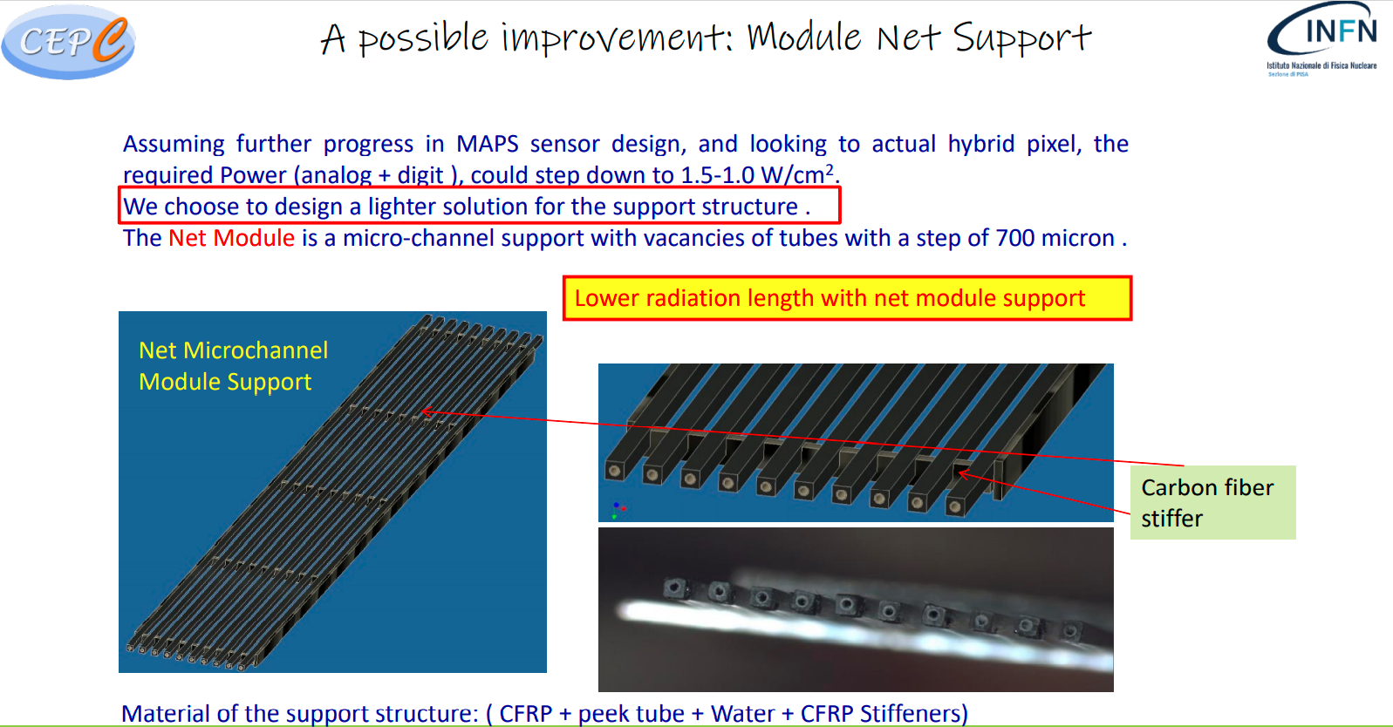

Slide 21
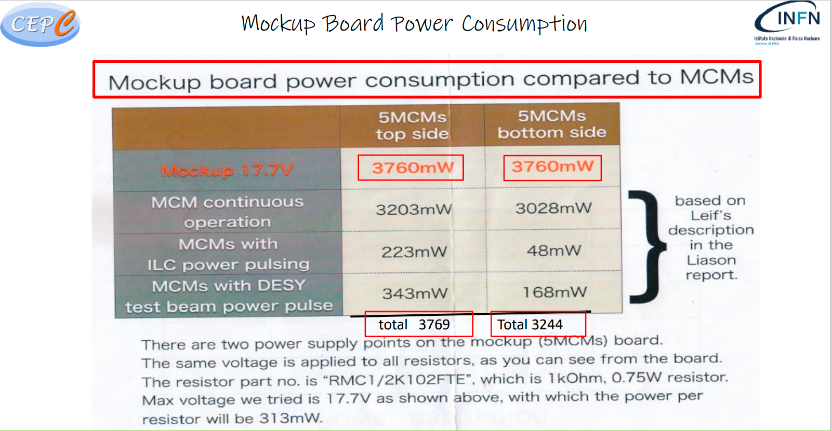

Slide 22
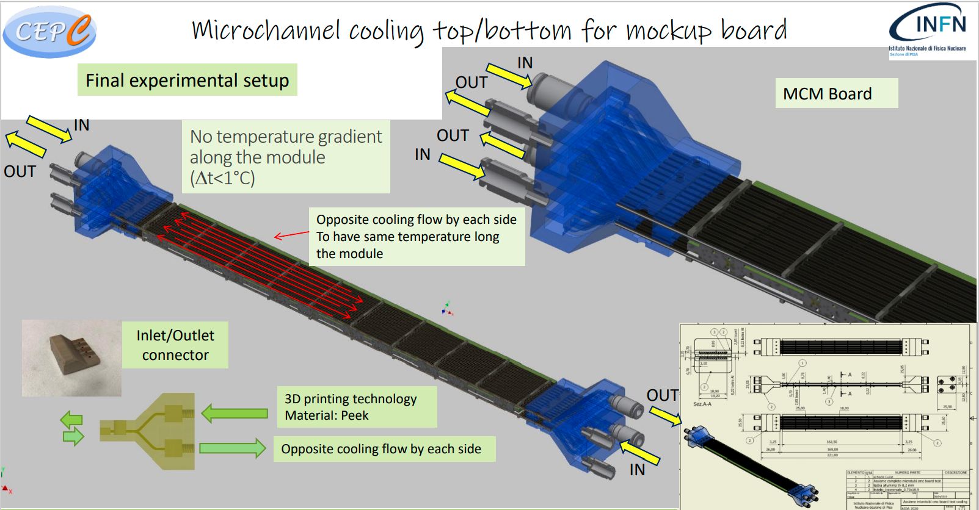

Slide 23
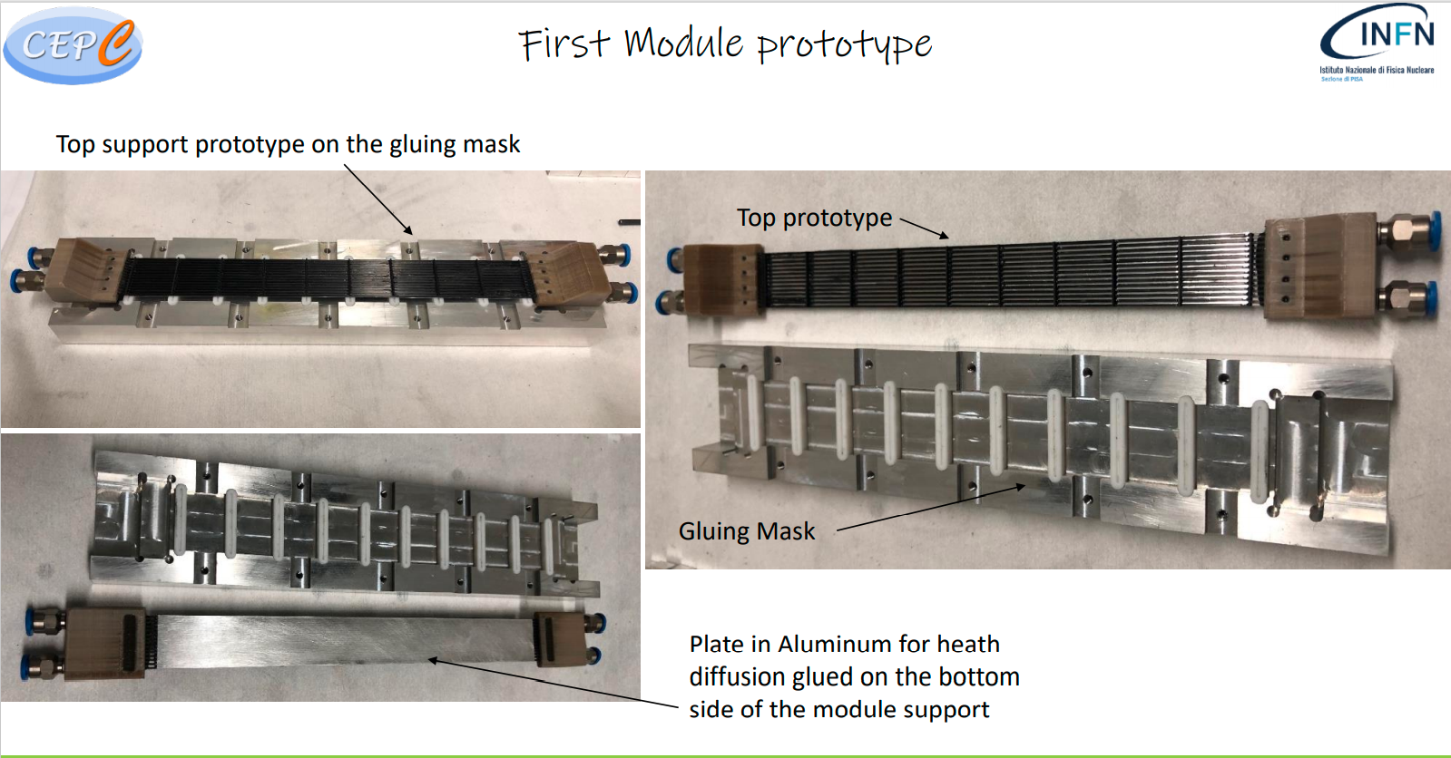

Slide 24
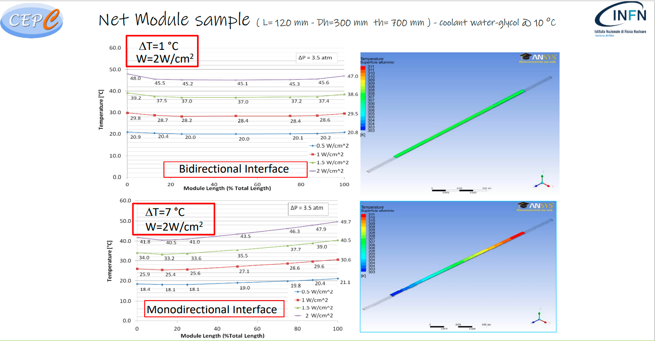

Slide 25
