Slide 1
News from Saclay
Paul Colas

Slide 2
Cooling plate (D. Attié, P.C., M. Riallot, O. Tellier, S. Ganjour,…)
Preparation of the pressure test with the module. Procurement of the gaskets in progress. Will be done with a gas bottle at 50, 100, and 120 bars.
Preparation of the test at DESY with TRACI. Planned for the week of May 17. Thanks Ralf! Hope Oliver can also participate, and maybe Japanese colleague(s).
Will re-consider the covid situation mid-March.
Will be done in connection with the T2K beam test planned for June 21-July 11

Slide 3
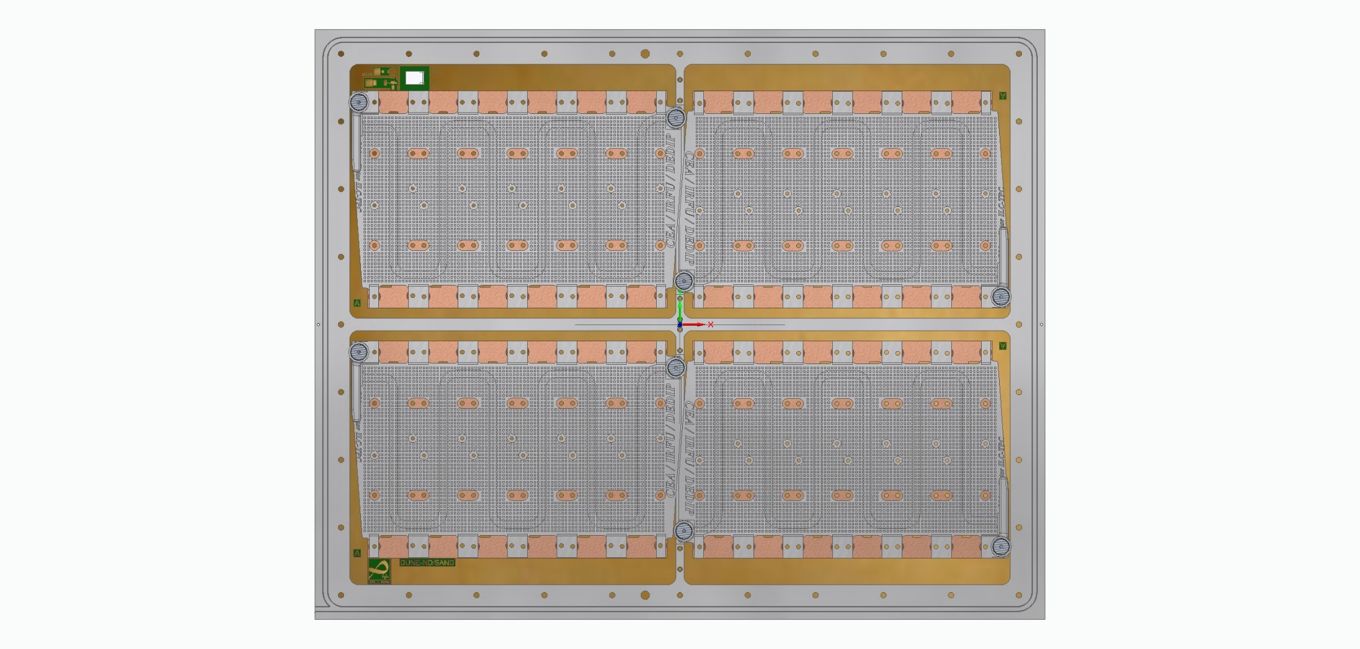
SAND prototype (6144 pads, 4.3mmx5mm)

