Slide 1
8th meeting of SRF subgroup in IDT/WG2
New member
International review
Detailed Explanation on cost estimation based on TDR
Discussions on crab cavity workshop
Others (if any)
Attendees: A. Yamamoto, S. Michizono, H. Hayano, K. Umemori, N.C. Lasheras, D. Delikaris, S. Posen, S. Belomestnykh, R. Rimmer, R.Geng, M. Liepe, E. Cenni,
L. Monaco, P. Burrows, P. McIntosh, L.G. Tabares, A. Faus-Golfe, B. List, A. Lankford, S. Stapnes, Kirk
https://agenda.linearcollider.org/category/256/
https://agenda.linearcollider.org/event/9047/
You can download 2nd version of the draft
Kirk

Slide 2
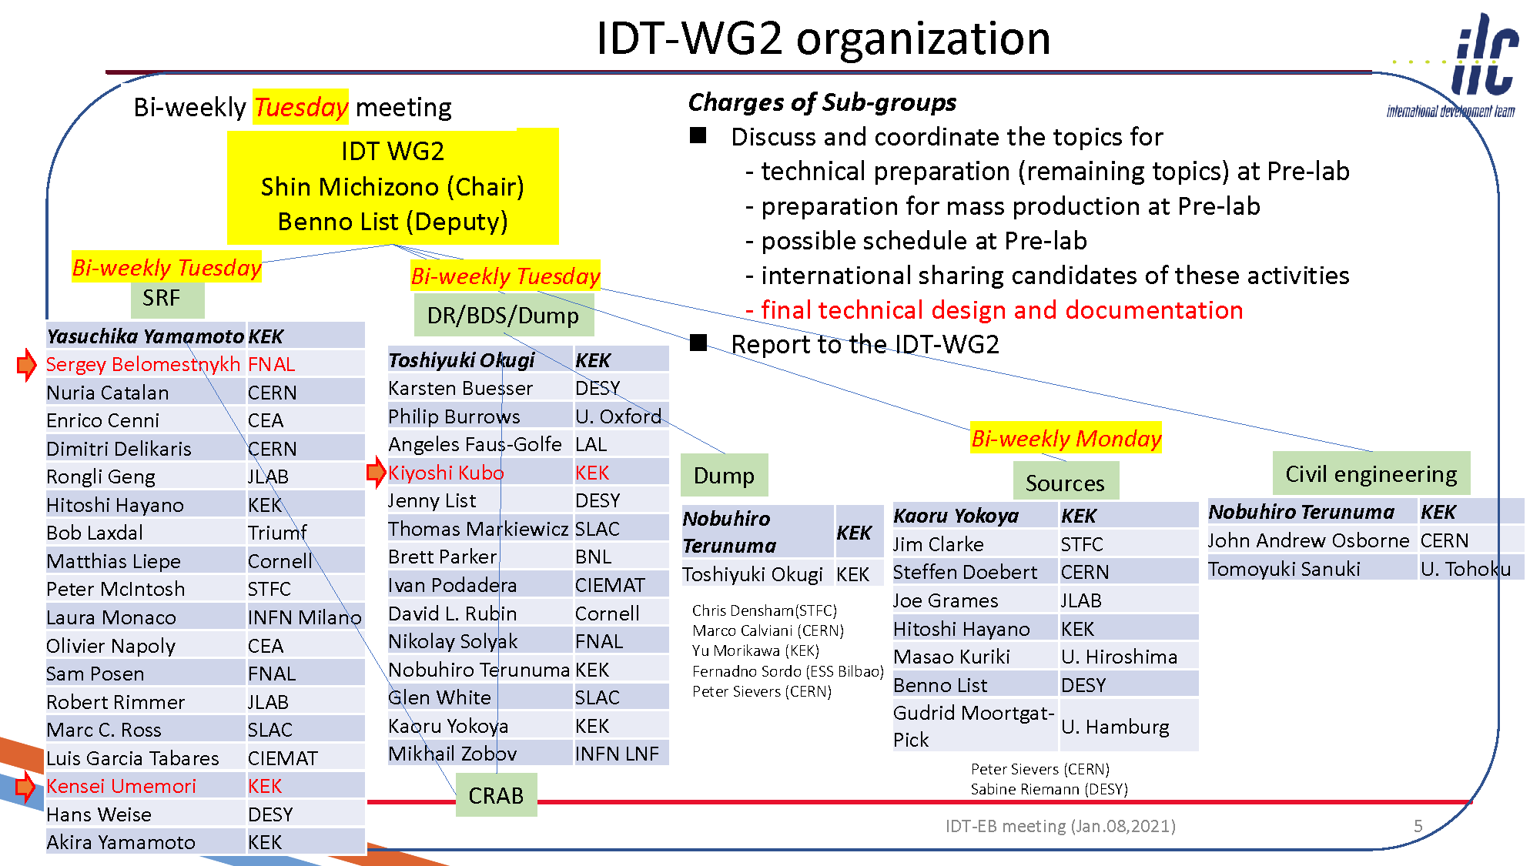

Slide 3
International (internal) review on SRF technology
Date/time: Feb. or Mar. (2~3 hours) after workshop of crab cavity
Organizer: IDT Executive Board
Reviewers: Three experts from three regions (Asia, Americas, Europe)
Contents: Overview (Kirk)
WP-1 (FNAL)
WP-2 (Kirk)
WP-3 (UK, or US? Presenter to be discussed in the crab workshop)
Each talk has 30 min incl. questions
Important points:
Are there any items missing from the table of budget request?
Contents of WP-1, -2, and -3 are valid?
Only proposal will be presented, not recent status of R&Ds
Material concerns (background for each item should be presented):
Recipe of surface treatment
Nb material
Design of Tuner/Coupler/SCQ-Magnet

Slide 4
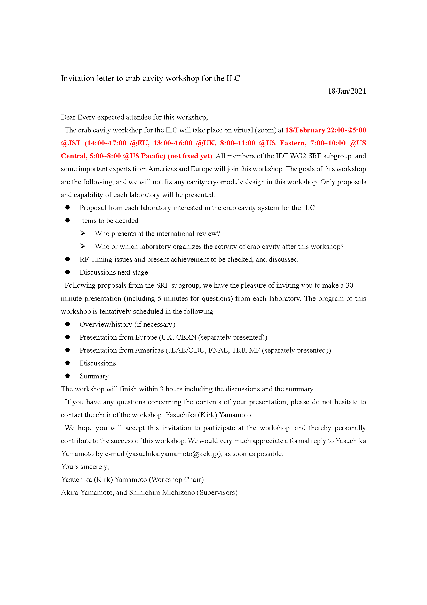
Workshop of crab cavity
Date/time: 18/Feb? (not fixed yet) before international review
Organizer: IDT WG2 SRF subgroup (chair person is Kirk)
Expected attendees: Members of SRF subgroup
G. Burt, A. Wheelhouse, S. Pattalwar from UK
R. Calaga from CERN
J. Delayen from ODU
S. Yakovlev from FNAL
Contents: Overview/history (if necessary)
Presentation from UK
Presentation from CERN
Presentation from JLAB/ODU
Presentation from FNAL
Each talk has 30 min incl. questions
Important points:
Who presents at the international review?
Who or which lab. organizes the activity of crab cavity after this workshop?
Each design is fitted to the installation area?
RF property is valid?
Timing issues and present achievement to be checked (everyone can gather these information)
18/Feb. is o.k.?

Slide 5
Schedule of SRF (incl. crab) subgroup meeting in IDT/WG2
Meeting # | Date | Contents
 | 8/Jan | Submission of budget request to EB
8 | 12/Jan | International review, Explanation on cost estimation, Discussions on crab cavity workshop plan
 | 19~21/Jan | TTC meeting 2021 on virtual
9 | 26/Jan
10 | 9/Feb
 | 18/Feb (?) | Crab cavity workshop
11 | 23/Feb
 | Feb or Mar | International review on SRF, BDS, Sources
12 | 9/Mar
 | 16~19/Mar | LCWS 2021 on virtual hosted by Europe
13 | 23/Mar
 |  | Preparation for MOU between/among laboratories
 | Jun~Jul | Submission of budget request to MEXT, in case of Japan
 | 28/Jun~2/Jul | SRF 2021 on virtual
 | 26~29/Oct | International conference related to ILC on virtual hosted by Japan (True name is not fixed yet!)

Slide 6
Questions/Discussions/Comments (memorandum) @8th meeting
International review
Global situation and proposal can be presented, not status of each region and R&D
Technology topics are included?
The background can be presented
Recipe for surface treatment, Nb material, design of tuner/coupler/SCQ-Mag
FNAL can present about WP-1
After the crab cavity workshop, this review will be held, and someone will present about WP-3 (to be discussed in the workshop)
Detailed explanation on cost estimation based on TDR
MILCU is used up to when?
Translation table should be added in the table
How much is MILCU expectedly increased in 2022-2025?
20-30%, or 10-15%?
Crab cavity workshop
Should be held before the international review
At 17/Feb, Snowmass will be held in US, 18/Feb is much better
Kirk is the chair person for this workshop, but after this, we have to discuss who leads the activity of crab cavity?
And, also who will present in the international review?
Other technical items should be discussed
LCWS2021
Not fixed yet, but there are four parallel sessions incl. CLIC
Until the end of Jan, it will be fixed
Translation by Kirk

Slide 7
Requests/Questions from SRF subgroup members
From Sam (FNAL)
In the cost estimation, how do we separate between the property cost and the labor cost?
Especially, CM assembly?
From Enrico (IRFU/CEA)
Nomura Research Institute report in English version
From Peter (STFC)
Add UK to WP-2
If you have any other requests or questions, please send us by e-mail!

