Slide 1
9th meeting of SRF subgroup in IDT/WG2
Preparation progress for crab cavity workshop
Progress of technical preparation document (incl. response from Americas/Europe)
International review
Progress report about high-pressure gas safety act in Japan
Others (if any)
Attendees: A. Yamamoto, S. Michizono, H. Hayano, K. Umemori, N.C. Lasheras, D. Delikaris, S. Posen, S. Belomestnykh, R. Rimmer, M. Liepe, E. Cenni, L. Monaco,
P. McIntosh, B. List, S. Stapnes, Kirk
https://agenda.linearcollider.org/category/256/
https://agenda.linearcollider.org/event/9047/
You can download 3rd version of the draft
Kirk

Slide 2
Preparation progress for crab cavity workshop
Date/time: 18/Feb 22:00~25:00 @JST (to be fixed in this meeting) before international review
Organizer: IDT WG2 SRF subgroup (chairperson is Kirk)
Expected attendees: Members of SRF subgroup
G. Burt, A. Wheelhouse, S. Pattalwar from UK
R. Calaga from CERN
J. Delayen/Subashini De Silva from ODU/JLAB
S. Yakovlev from FNAL
※the person with the underlined name is the candidate presenter
Contents: Overview/history (if necessary)
Presentation from UK
Presentation from CERN
Presentation from JLAB/ODU
Presentation from FNAL
Each talk has 30 min incl. questions
Important points:
Who presents at the international review?
Who or which lab. organizes the activity of crab cavity after this workshop?
Each design is fitted to the installation area?
RF property is valid?
Timing issues and present achievement to be checked (everyone can gather these information)

Slide 3
Progress of technical preparation document
This document will be public, but not opened for the document including cost/FTE-yr information in Appendix
Candidate labs. are also included in Appendix
The recent version (ver.3) was already updated
One note was added in “ML and SRF”
4-years profile of cost/FTE-yr incl. EDR preparation is under consideration in KEK
Possibly, each region/lab can also think about 4-years profile
Response from Americas/Europe
How about the recent progress?

Slide 4
International (internal) review on SRF technology
Date/time: Feb. or Mar. (2~3 hours) after workshop of crab cavity (not fixed yet)
Organizer: IDT Executive Board
Reviewers: Three experts from three regions (Asia, Americas, Europe)
Contents: Overview (Kirk)
WP-1 (FNAL)
WP-2 (Kirk)
WP-3 (UK, or US? Presenter to be discussed in the crab workshop)
Timeslot is not fixed yet
Each talk has 30 min incl. questions
Important points:
Are there any items missing from the table of budget request?
Contents of WP-1, -2, and -3 are valid?
Only proposal will be presented, not recent status of R&Ds
Material concerns (background for each item should be presented):
Recipe of surface treatment
Nb material
Design of Tuner/Coupler/SCQ-Magnet

Slide 5
Progress of High-Pressure Gas Safety Act in Japan
Two categories in Japan (see next slide by Nakai-san)
General High-Pressure Gas Safety (General HPGS) Ordinance (Regulations)
Refrigeration Safety (RS) Ordinance
Current status of KEK as follows (due to historical reason since 1970’s)
SC Magnet systems have (mostly) moved to the RS Ordinance
SC Cavity (SRF) systems have (mostly) stayed at the General HPGS Ordinance
Recent advances in new SRF cavity/CM projects in Japan, as follows
RILAC SRF cavities @RIKEN with the RS Ordinance → in operation since 2020
IFMIF SRF cavities @QST with RS Ordinance → under construction
We are considering “Refrigeration Safety Ordinance” is suitable for ILC, instead of “General High Pressure Gas Safety Ordinance”!
(See more explanation following)

Slide 6
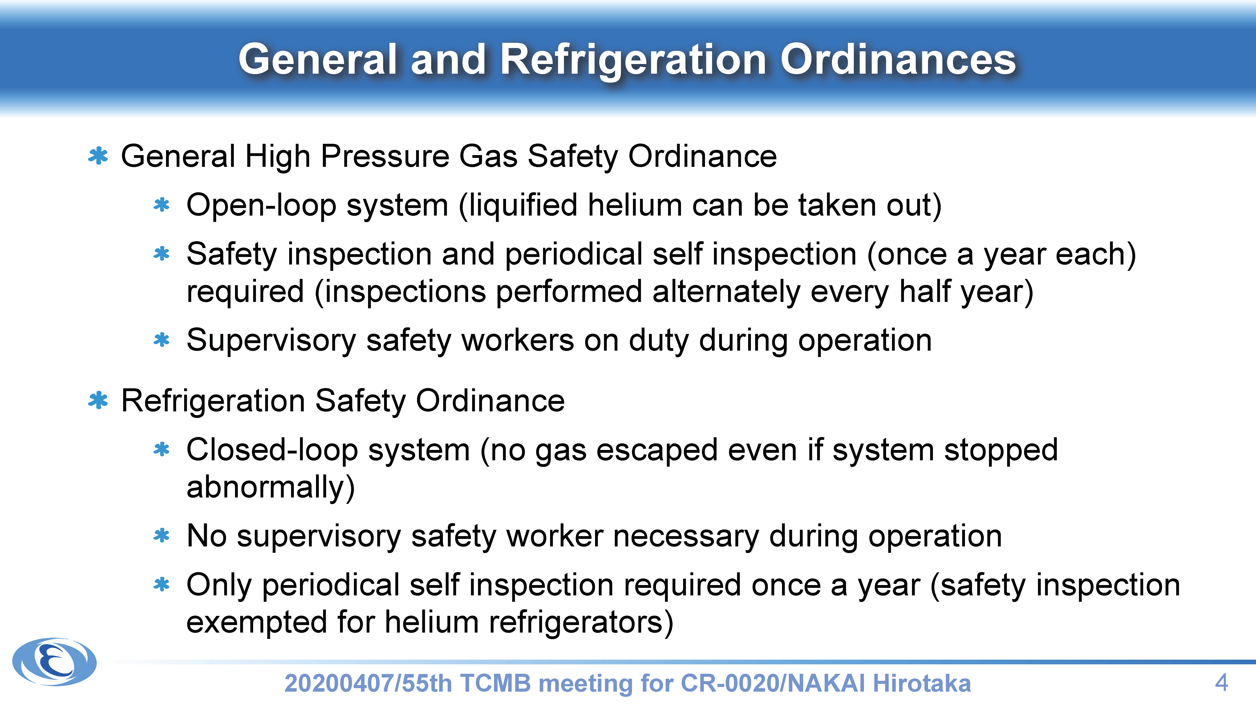

Slide 7
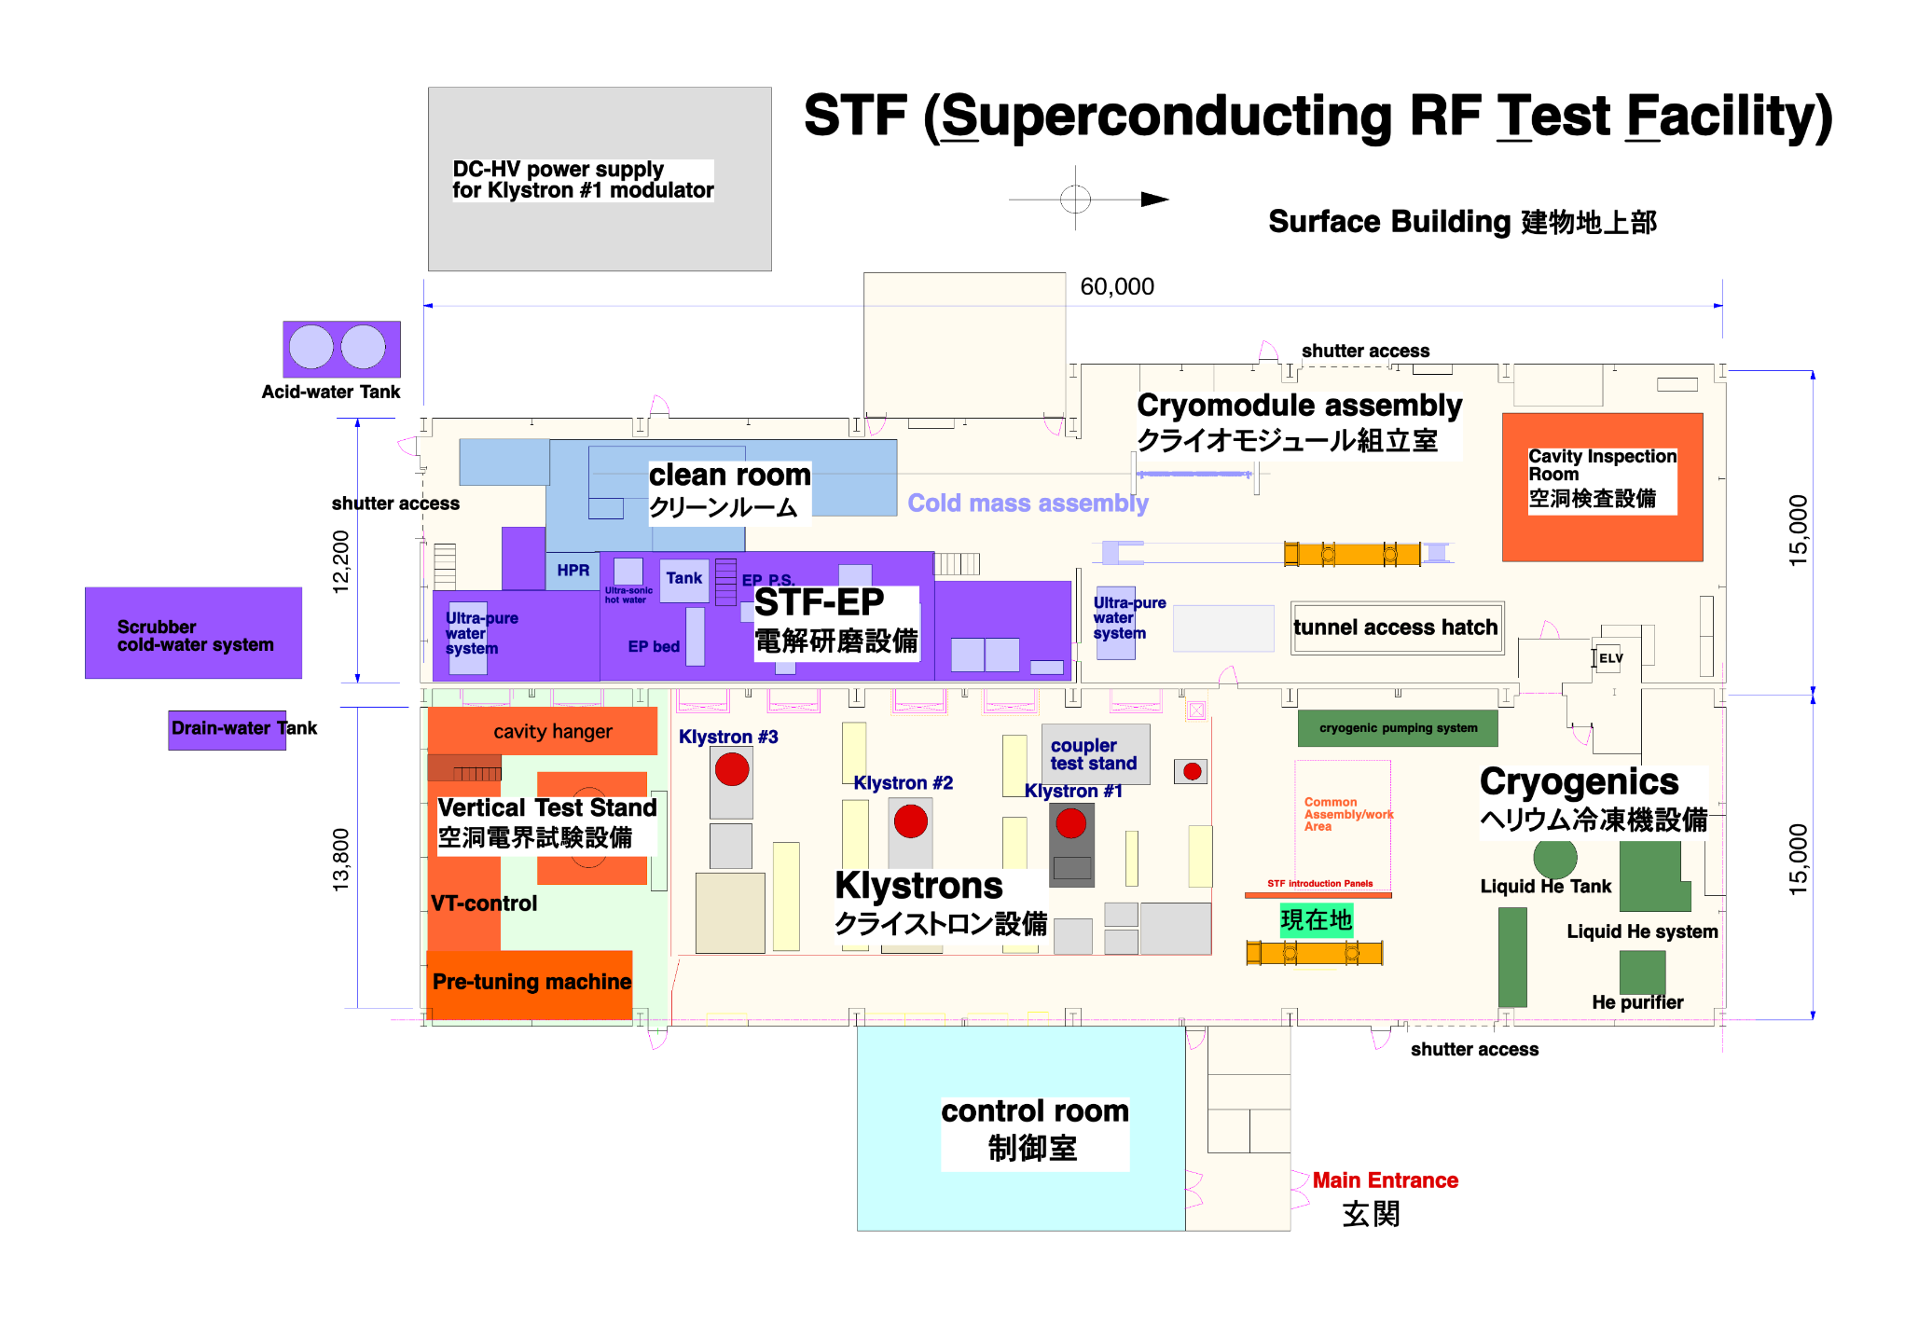
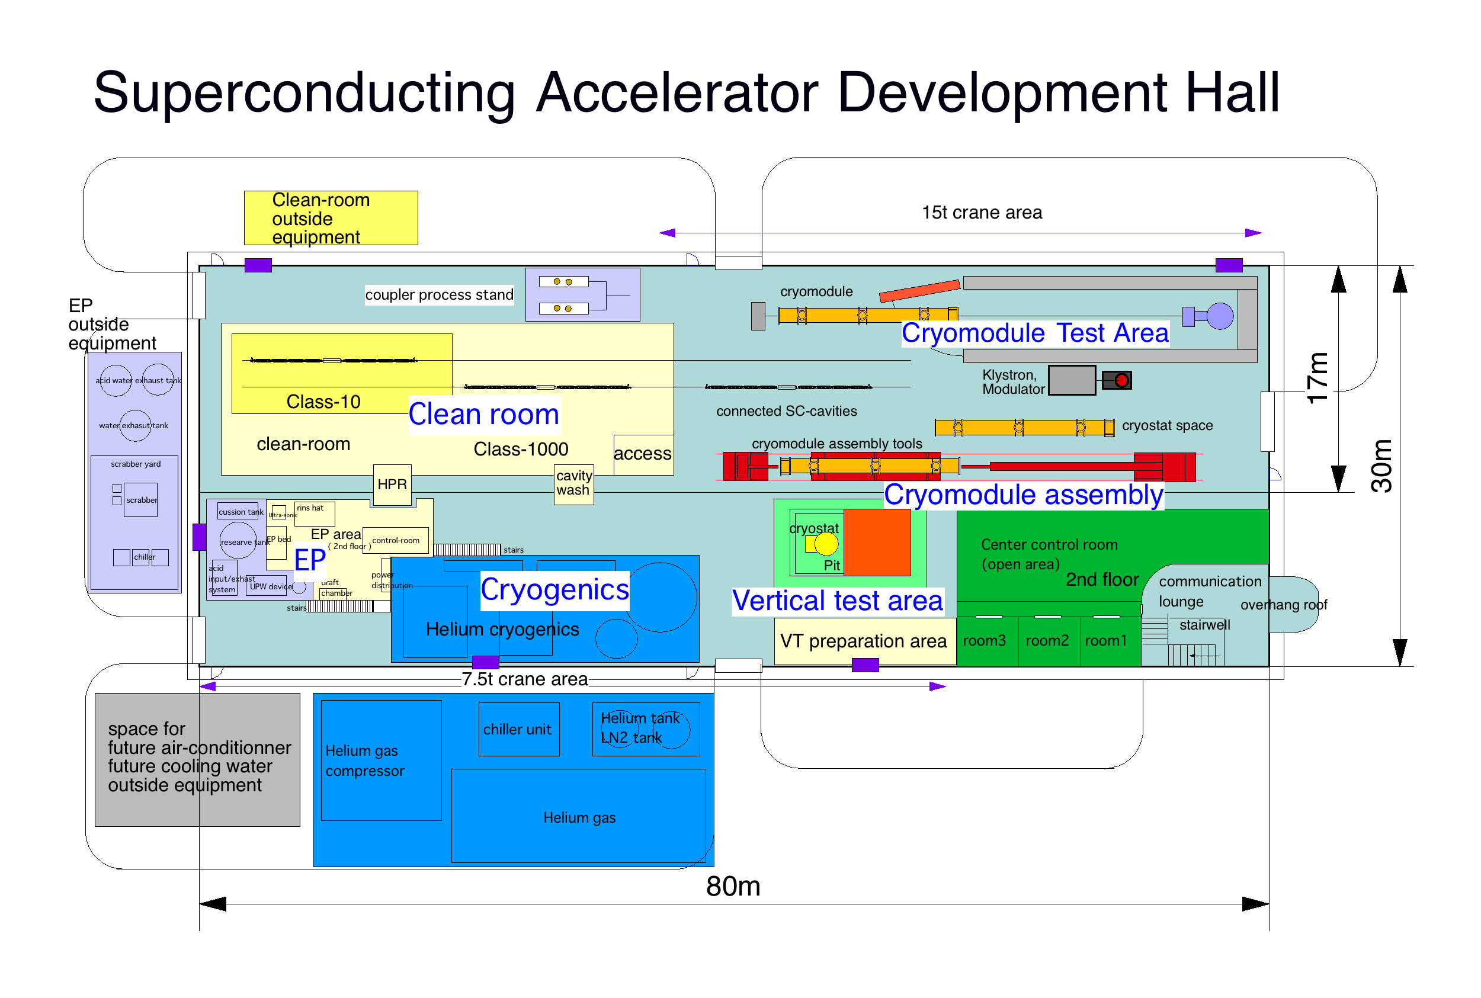
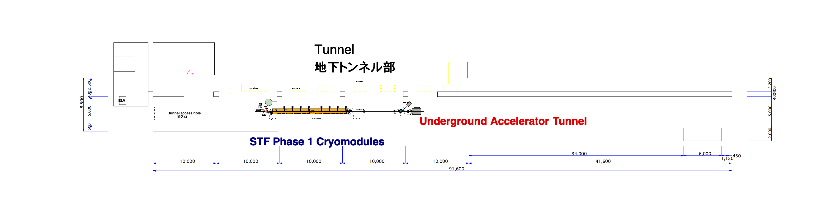
Schematic view of STF/COI in KEK (Current Status/Plan)
STF
(ground level)
COI
CM test cave
(for WP-2 “CM transport”)
General High Pressure Gas Safety Ordinance
General High Pressure Gas Safety Ordinance, currently, and a possibility to convert to Refrigeration Safety Ordinance to be investigated.
STF
(tunnel)

Slide 8
Schedule of SRF (incl. crab) subgroup meeting in IDT/WG2
Meeting # | Date | Contents
 | 8/Jan | Submission of budget request to EB
8 | 12/Jan | International review, Explanation on cost estimation, Discussions on crab cavity workshop plan
 | 19~21/Jan | TTC meeting 2021 on virtual
9 | 26/Jan | Discussions on crab cavity workshop plan, technical preparation document, international review, HPG safety act in Japan
10 | 9/Feb
 | 18/Feb | Crab cavity workshop
11 | 23/Feb
 | Feb or Mar | International review on SRF, BDS, Sources
12 | 9/Mar
 | 15~18/Mar | 9th International Workshop on "Thin films applied to Superconducting RF: Pushing the limits of RF Superconductivity"
 | 15~19/Mar | LCWS 2021 on virtual hosted by Europe
13 | 23/Mar
 |  | Preparation for MOU between/among laboratories
 | Jun~Jul | Submission of budget request to MEXT, in case of Japan
 | 28/Jun~2/Jul | SRF 2021 on virtual
 | 26~29/Oct | International conference related to ILC on virtual hosted by Japan (True name is not fixed yet!)

Slide 9
Questions/Discussions/Comments (memorandum) @9th meeting
Crab cavity workshop
The workshop date is fixed on 18/Feb
All speakers agreed to join and present their proposals
Technical preparation document
The document is separated into public part and confidential part
Cost/FTE-yr/Participating labs. are included in the confidential as appendix
Cost estimation is committed? Authorized by DG?
At international review, cost estimation will be reviewed. First of all, this has to be done by bottom-up scheme.
In Europe, the situation to get budget is too complicated. Negotiation should be done each by each country.
In this document, general cost/FTE-yr are shown regardless of individual circumstances, but local cost is different at each region.
International review
The date is not fixed
Presenter for WP-3 will be decided in the crab cavity workshop
High pressure gas safety act in Japan
Detailed presentation was given by Akira Yamamoto-san (Nakai-san’s slide is also useful to understand)
When cavity/CM to transport to Japan is manufactured abroad, we (KEK/Abroad Labs or Company) need to visit to KHK (High-pressure gas authority of Japan) and local government (Ibaraki-ken, Iwate-ken and etc.) to discuss something “before production”. After their agreement to produce cavity/CM or construct SRF accelerator, we can start the production. We have to submit a lot of documents, drawings, inspection sheets, and etc. We need to get High-pressure gas safety act diploma (KEK can support instead of abroad labs.).
Translation by Kirk

