Slide 1
The LUXE Experiment
Wolfgang Lohmann
(Brandenburg University of Technology Cottbus and RWTH Aachen University)

Slide 2
Physics
Explore Quantum Electrodynamics at high fields
Pertubative QED predicts electromagnetic phenomena with excellent
precision, e.g. Lamb shift, anomalous magnetic moment of the electron,
Bhabha scattering
At high fields, Heisenberg and Euler predicted in Z.Phys. 98 (1936) 714-732
Title:„Folgerungen aus der Dirac`schen Theorie des Positrons“
‘electromagnetic fields can create matter if they are strong enough’
Critical field strength: = 1.32 10¹⁸ Vm⁻¹
Denoted as ‚Schwinger limit‘!

Slide 3
Physics
For illustration: In a silicon sensor of 300 µm thickness and this field strength:
E_{e} = 400 TeV
t accelerates an electron over the distance of its Compton wavelength to E_{e} equal to its mass
New phenomenon: Field induced tunneling of e⁺e⁻ pairs off the vacuum,
Colloquial: ‚the vacuum starts boiling‘
Source of high electrical fields: chirped pulse amplification (CPA) laser, focal intensity 10²¹ Wcm⁻¹
_{L} = 10¹⁴ Vm⁻¹
Electron at high energy in a laser pulse: * = γ _{L} (1 + cos θ)
Example:
For E_{e} = 10 GeV, γ ≈ 10⁴ ➔ critical field strength will be reached !
γ = E_{e}/m_{e}

Slide 4
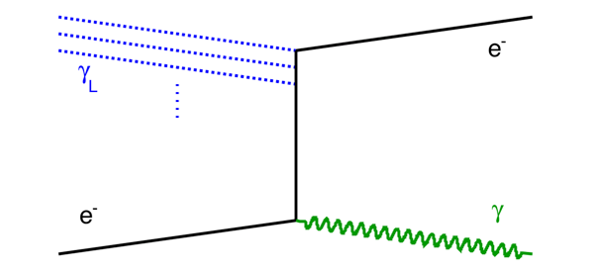
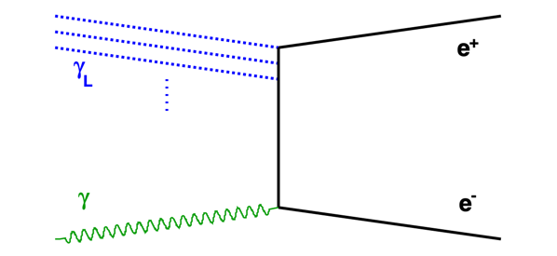
Processes
Non-linear Compton scattering
e⁻ + nγ_{L} e⁻ + γ_{C}
Breit-Wheeler process (BW)
γ + nγ_{L} e⁺ e⁻
The initial photon might be the γ_{C}
from non-linear Compton scattering (two step trident)
or a dedicated high-energy photon beam

Slide 5

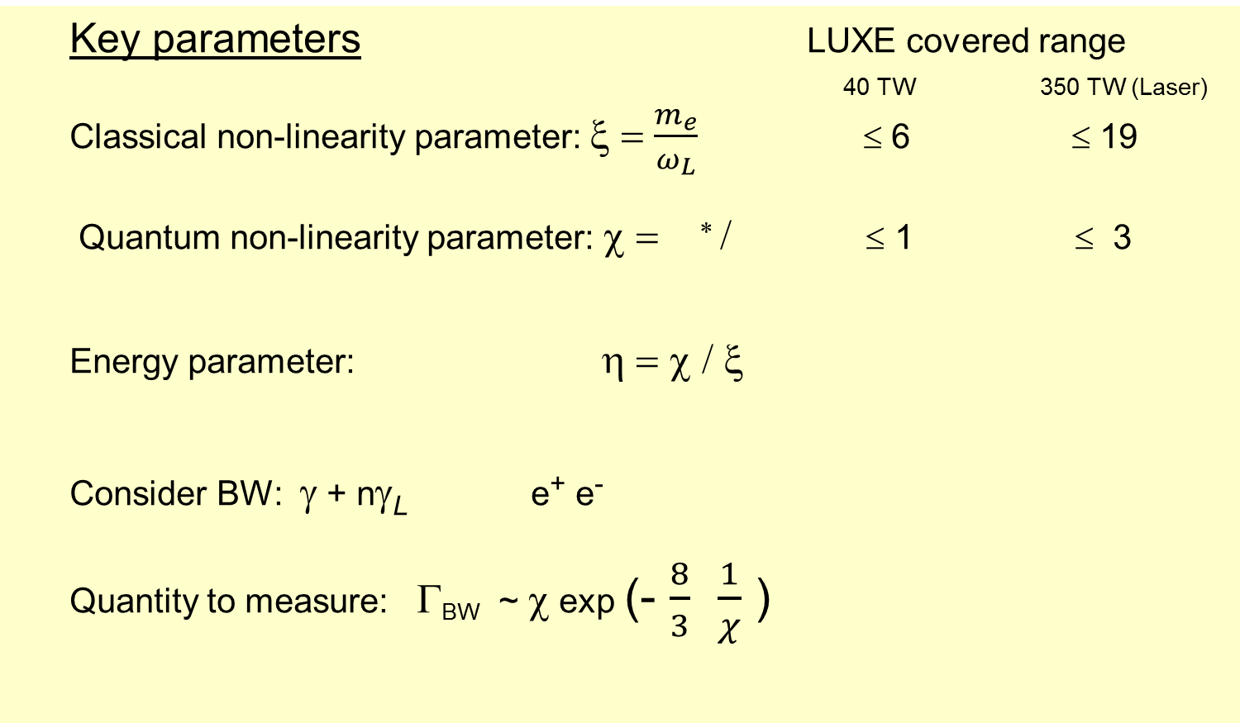
Physics
Key parameters LUXE covered range
40 TW 350 TW (Laser)
Classical non-linearity parameter: ξ = $\frac{m_{e}}{ω_{L}}$ ≤ 6 ≤ 19
Quantum non-linearity parameter: χ = ∗ / ≤ 1 ≤ 3
Energy parameter: η = χ / ξ
Consider BW: γ + nγ_{L} e⁺ e⁻
Quantity to measure: Γ_{BW} ~ χ exp (- $\frac{8}{3}$ $\frac{1}{χ}$ )
L

Slide 6
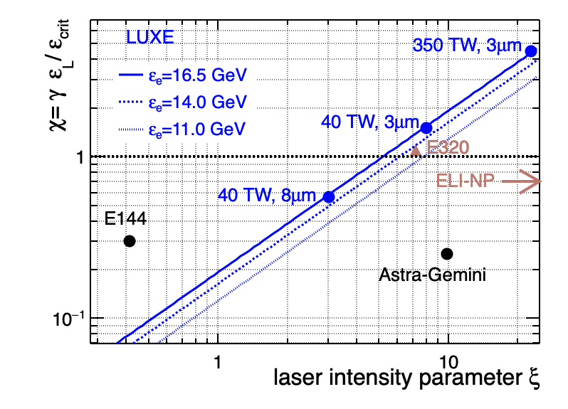
Physics
Comparison to similar experiments

Slide 7
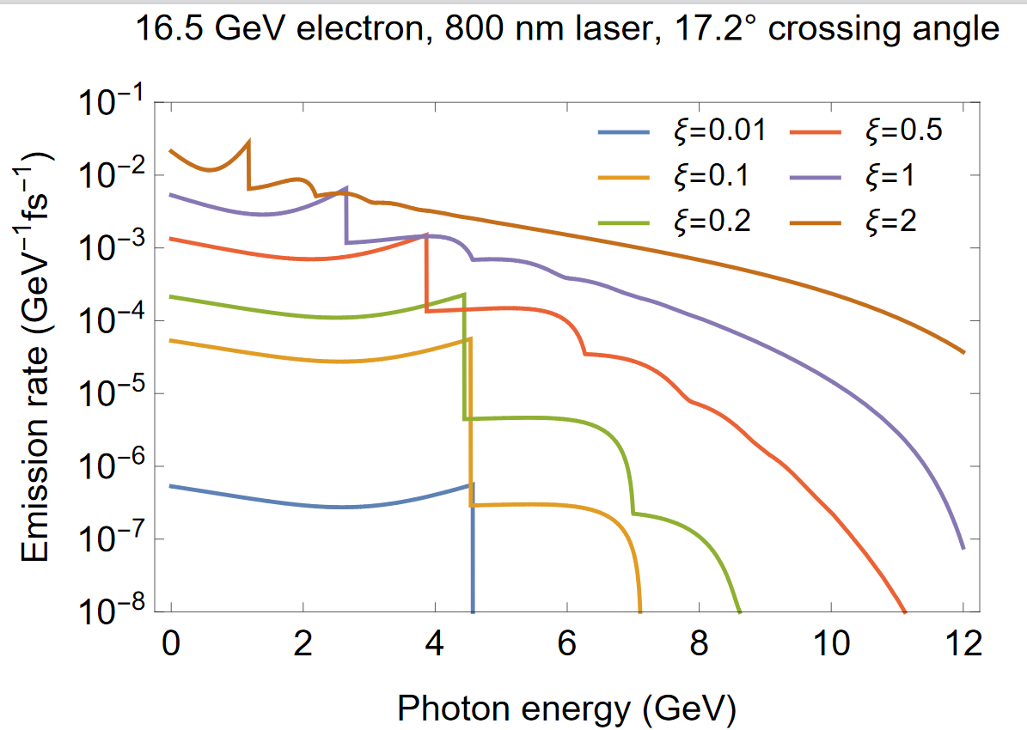
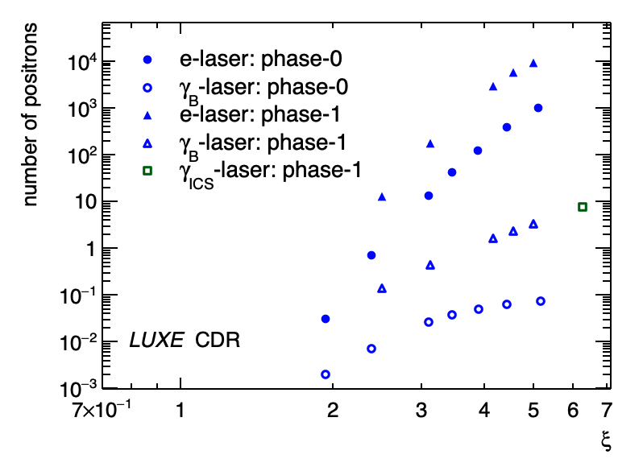
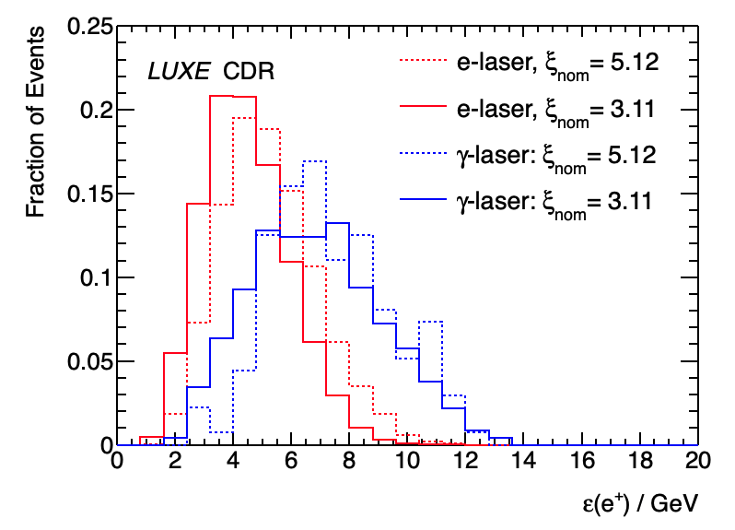
Physics
planned measurements
Compton spectra
(number and energy of the
scattered laser photons, or
the final state electrons)
Mass shift due to acceleration
Number of photons involved
Number and energy of positrons

Slide 8
Physics
Search for ALPS
Scalars or pseudoscalars with couplings to photons and electrons
Primary production,
ALPS in the range of a few MeV
Secondary production,
ALPS in the range of a few 100 MeV to GeV

Slide 9
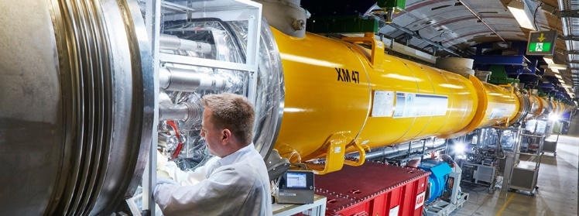
Technicalities
XFEL linear accelerator at DESY
Electron beam
  1.5 10⁹ e⁻ per bunch,
  E_{e} = 17.5 GeV,
  rate 10 Hz, one bunch per train for LUXE

Slide 10
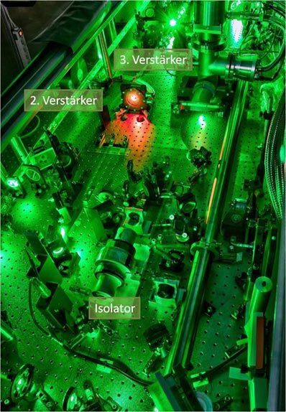
Technicalities
LASER
first run: 40 TW JETI, intensity 1.5 10²⁰ Wcm⁻² (focal width 3 µm)
second run: upgrade to 350 TW, intensity 1.1 10²¹ Wcm⁻²
Pulse length: 30 fs
Repetition rate: 1 Hz
Sychronised with the XFEL
Multiple diagnostics systems to monitor time and spacial pulse positions, pulse energy, and ξ.

Slide 11
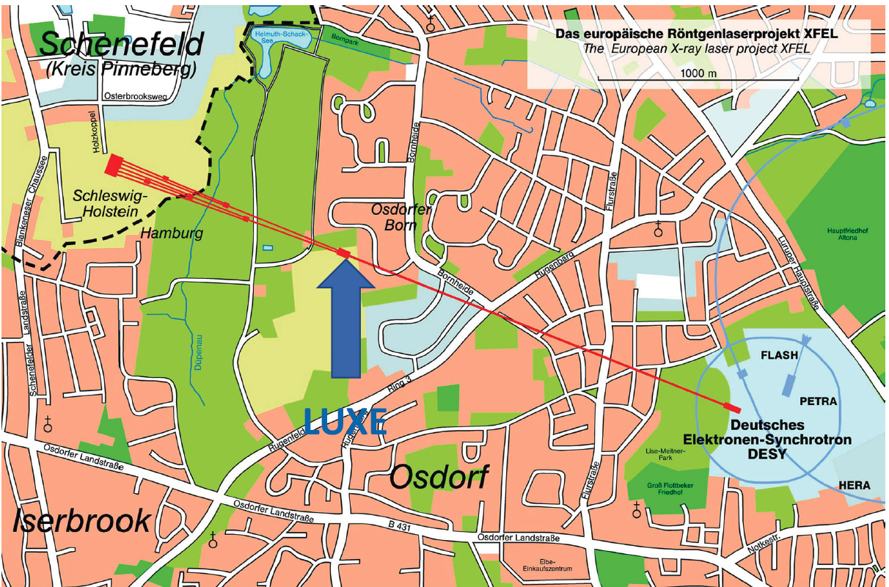
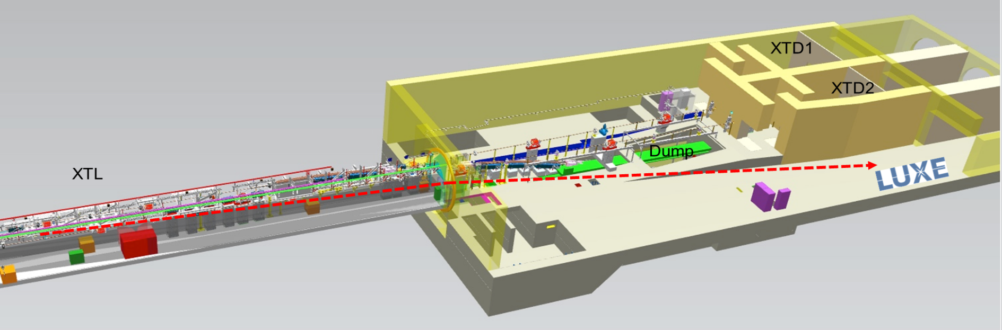
area

Slide 12
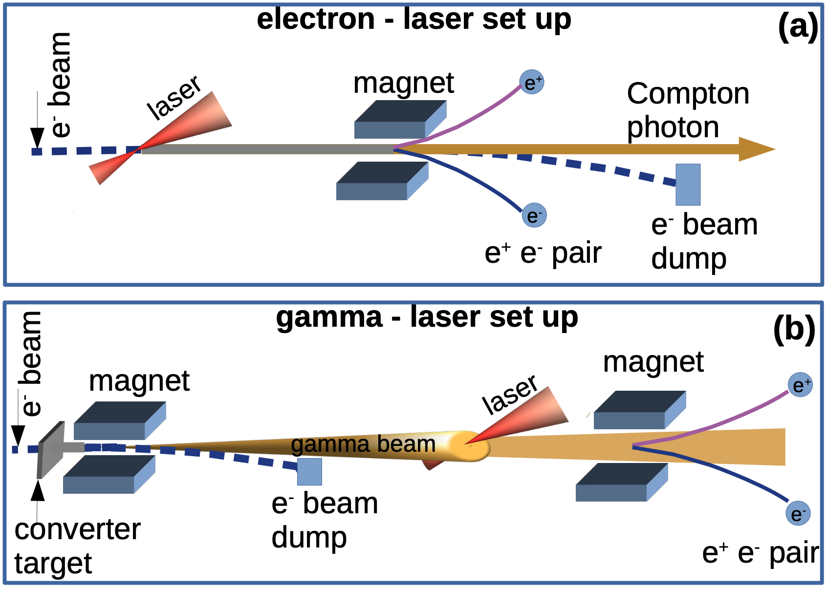
The experiment - schematic

Slide 13
The experiment - schematic

Slide 14
The experiment - schematic

Slide 15
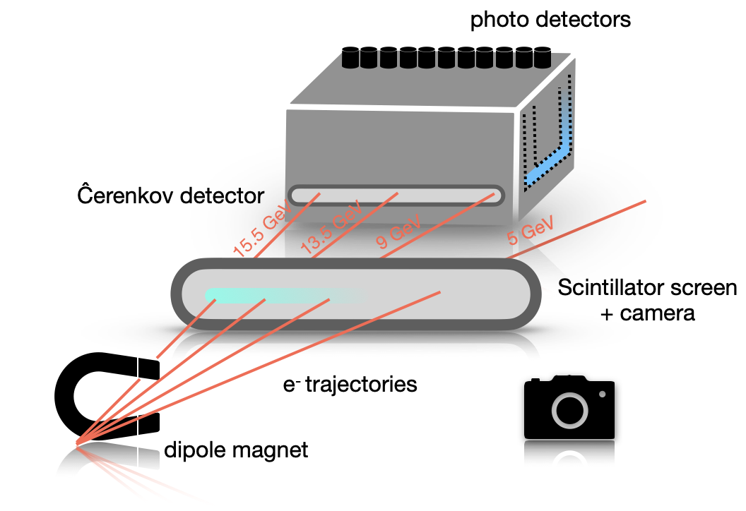
Electron detection system
Measurement range: 10⁴-10⁹ electrons per BX
Scintillation screen covers the full momentum range, the Cerenkov detector 5-8 GeV
Cerenkov detector developed for polarimetry the the ILC
Screen thicknes: 0.5 mm
Scintillator: Gandolinium Oxysulfide, Terbium doped
Position resolution:
500 μm
50 channels,
radiator: Ar, to match
the dynamic range
SiPMs

Slide 16
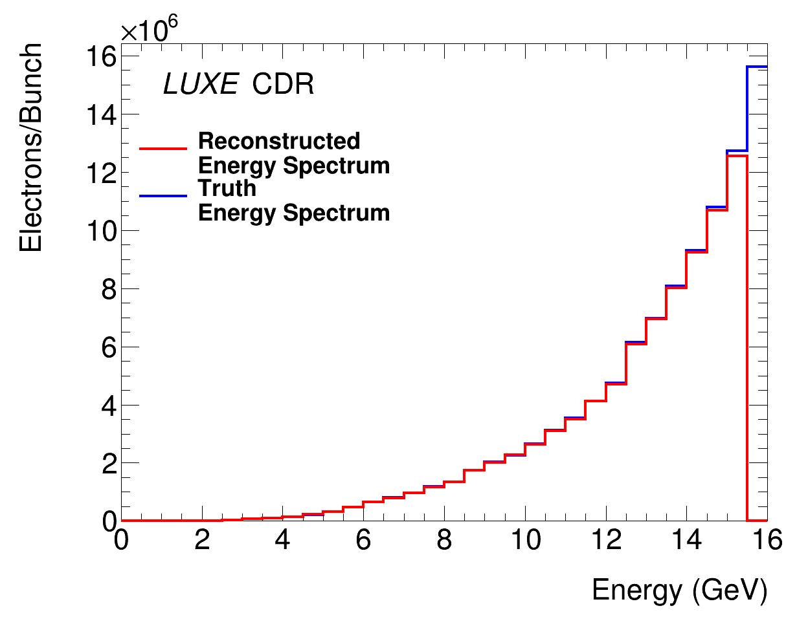
Electron detection system
Performance studies
Electron energy spectrum using the scintillator screen
ξ = 0.3
ξ = 1
Electron energy spectrum using the Cerenkov detector

Slide 17
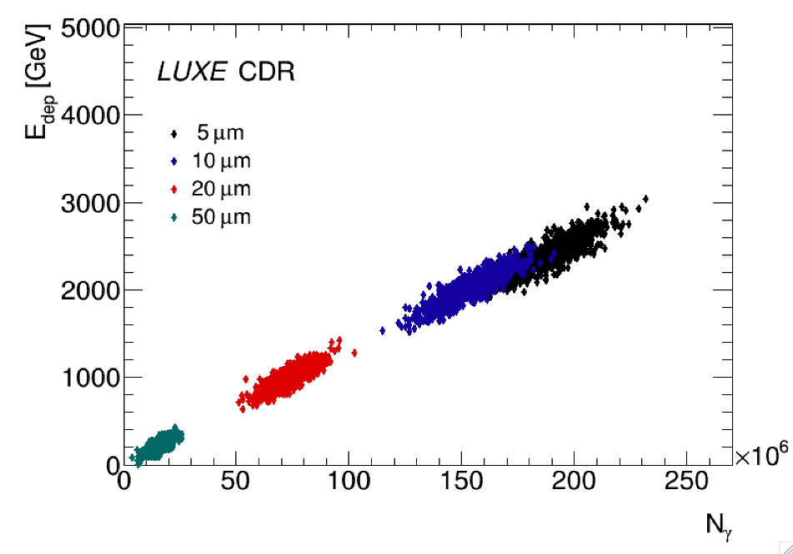
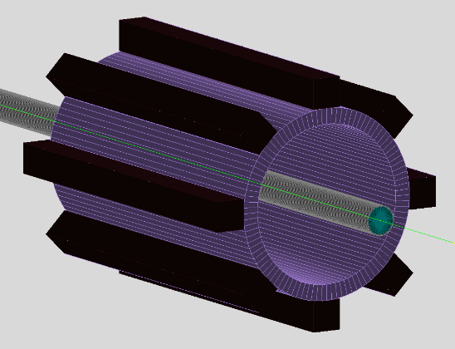
Photon detection systems
γ flux monitor
γ spectrometer
γ profiler
flux monitor
measures the particles backscattered from the photon dump
Lead-glass blocks

Slide 18
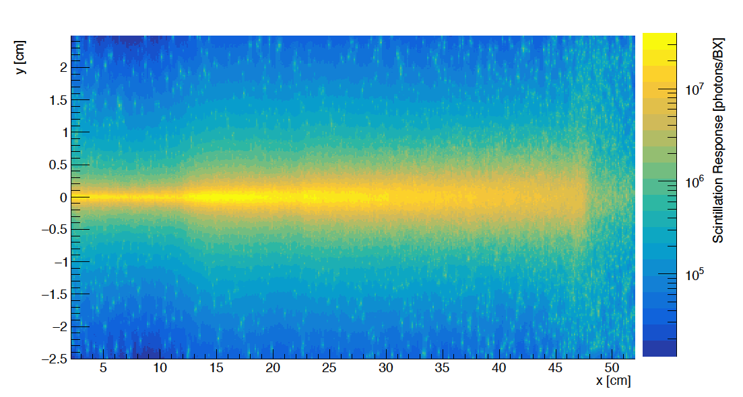
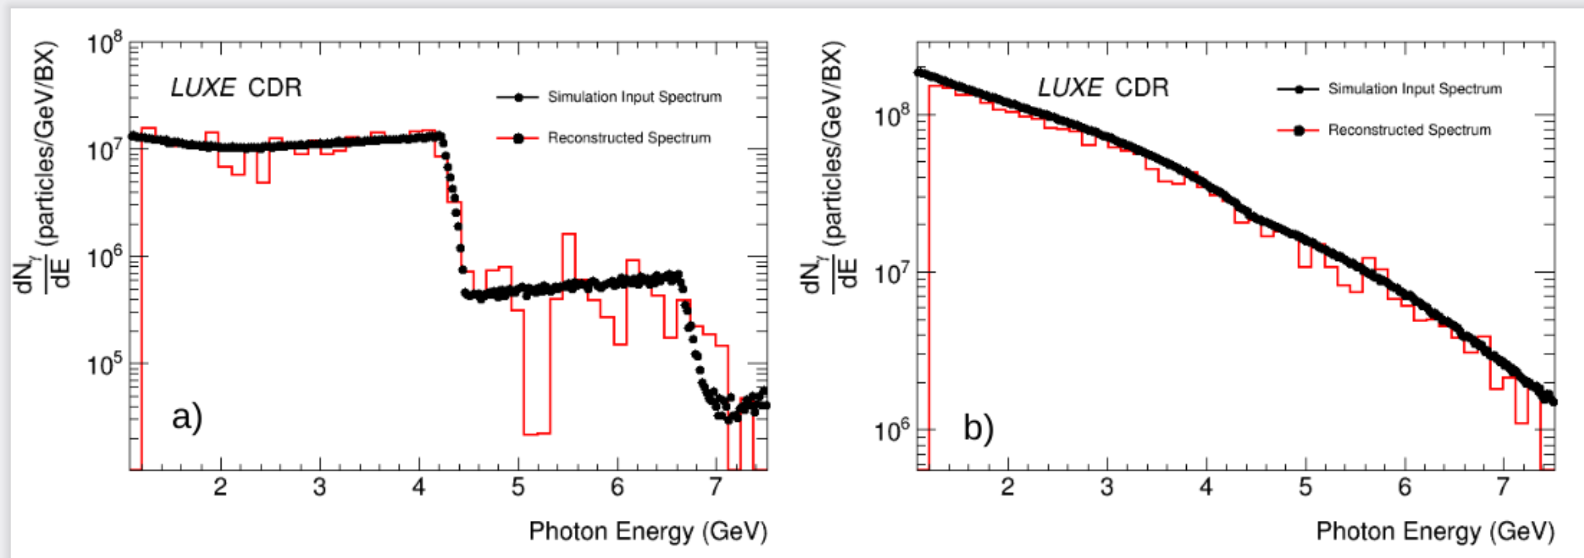
Photon detection systems
γ spectrometer
Expected scintillation output
Photon conversion in a 200 μm Kapton foil
Scintillator screen, Gd₂O₂S:TB, LYSO
Read out using an i-CCD camera
ξ = 0.31
ξ = 3.1

Slide 19

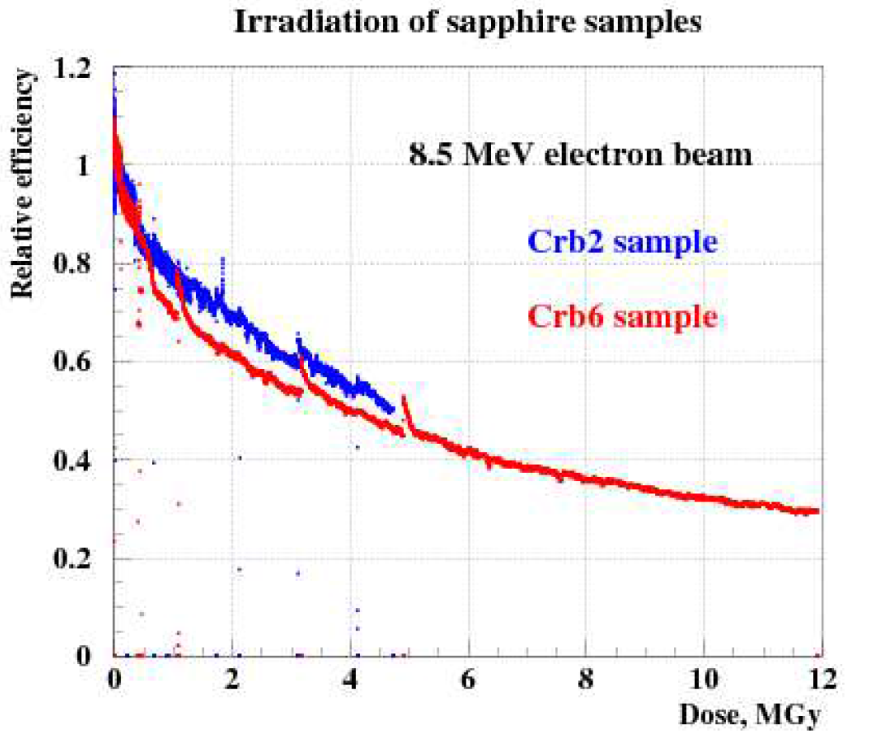
Photon detection system
γ profiler
Measurement of the angular spectrum of photons (two stations)
Single crystal sapphire strip sensors
Low CCE
Fast
Radiation hard
2 cm
Photon beam
2 cm
0.01 cm
200+200 strips
Pitch: 100 μm
JINST 10 (2015) 08, P08008

Slide 20
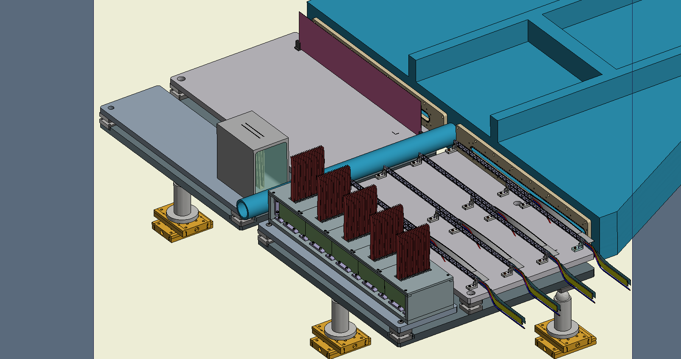
Positron detection
Tracker
ECAL

Slide 21
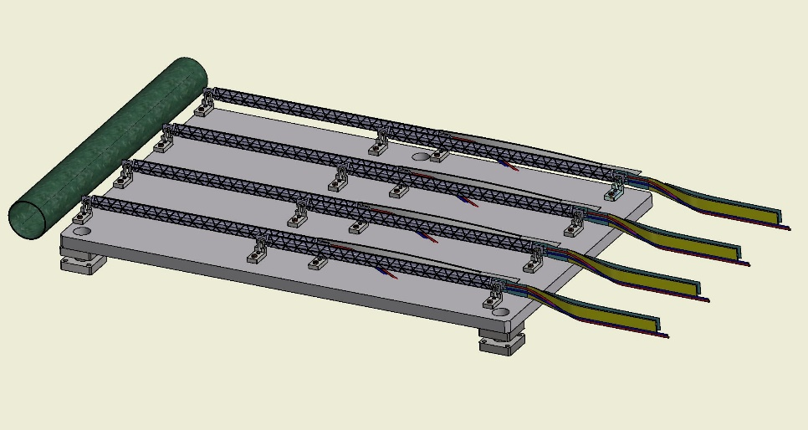
Tracker
Four layers of ALPIDE silicon pixel sensors
Pixel size 27x19 μm², resolution 5 μm
binary readout
X/X₀ = 0.357 %
Detection efficiency 99 %
Noise rate <10⁻⁵
Used in ALICE ITS
50 cm

Slide 22
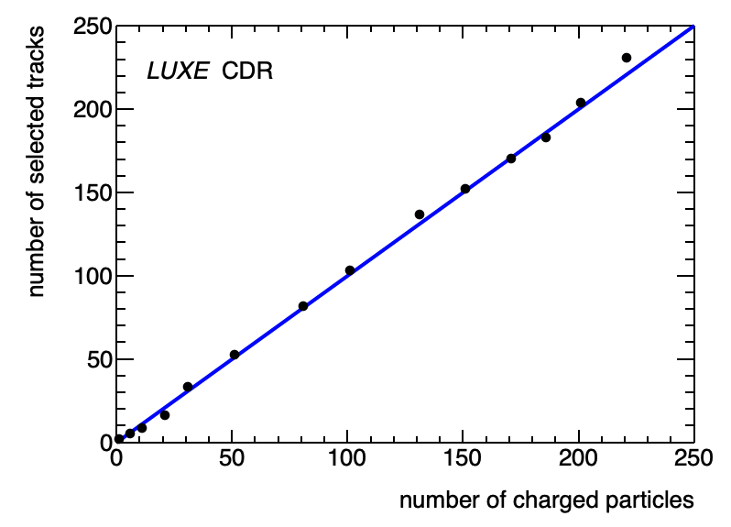
Tracker
Performance studies
Momentum
resolution
Track efficiency
Track counting
Energy spectrum

Slide 23
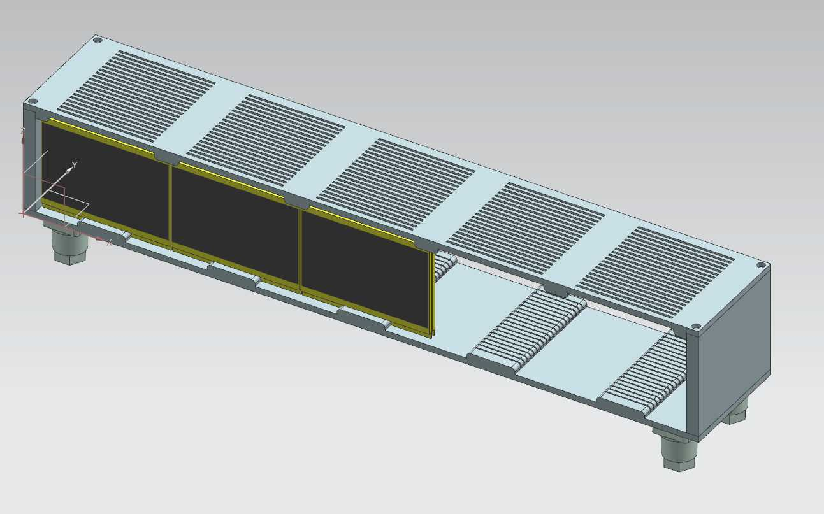
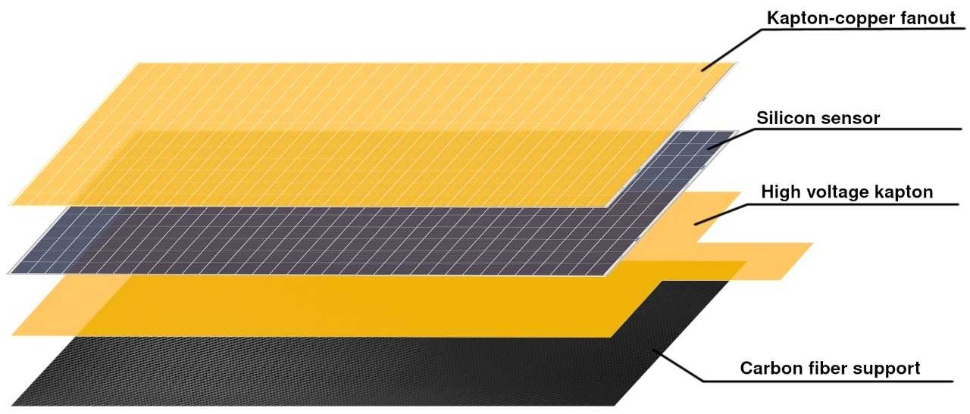
ECAL
Si W (GaAs W) sampling calorimeter
Challenge: small Moliere radius (showers on top of widely spread background)
  Pad size: 5x5 cm²
  W thickness: 1 X₀
  Per tower 20 sensors/plates
6cm
56cm
Sensor plane design
FCAL technology

Slide 24
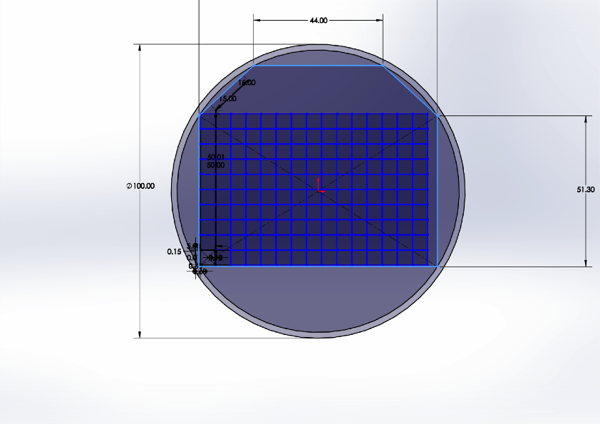
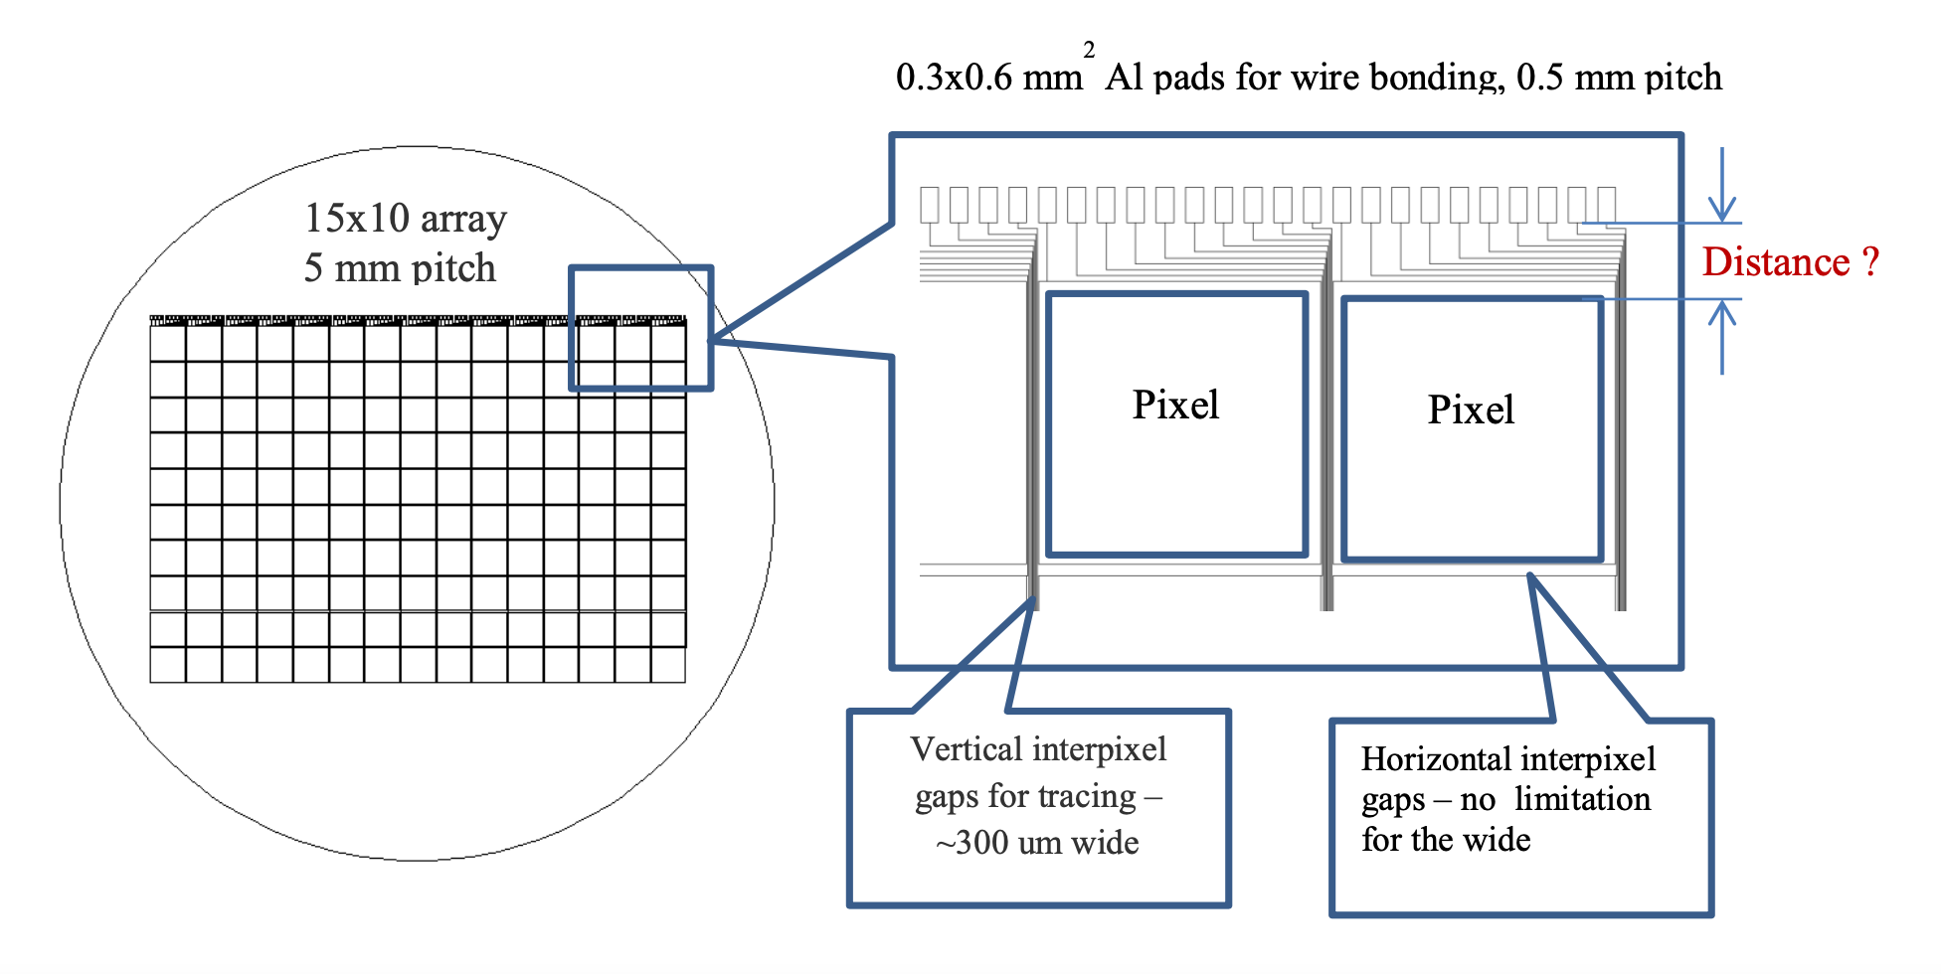
ECAL
Advanced sensor techology (collaboration with Tomsk State University)
Thickness of the sensor planes below 1mm
Less cross talk to other pads
Less lost contacts

Slide 25
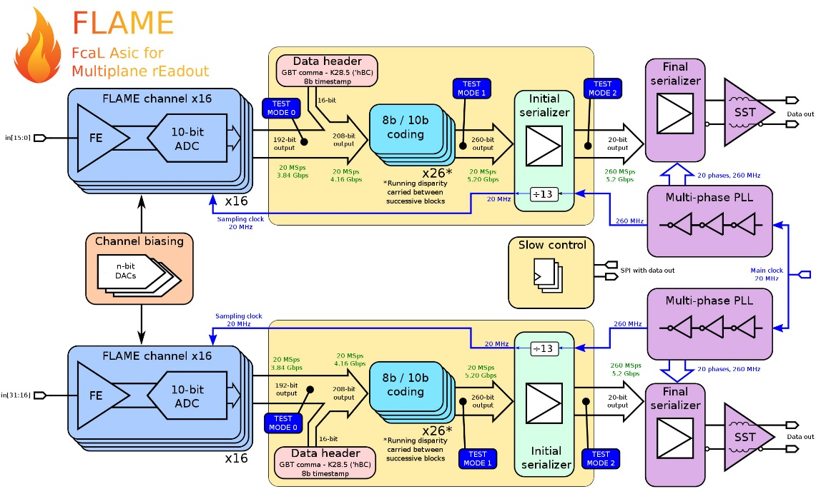
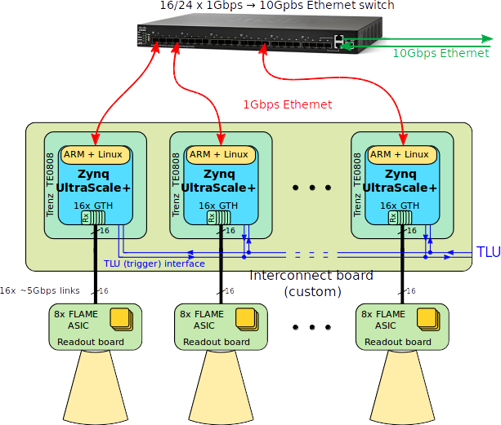
ECAL
FE electronics
130 nm TSMC technology, (charge sensitive peamplifier, 10 bit ADC)
developed within FCAL, parts also used in the CMS HGCAL upgrade
Data preprocessing with FPGA
Recent test-beam measurements, depostited energy in layer 3

Slide 26
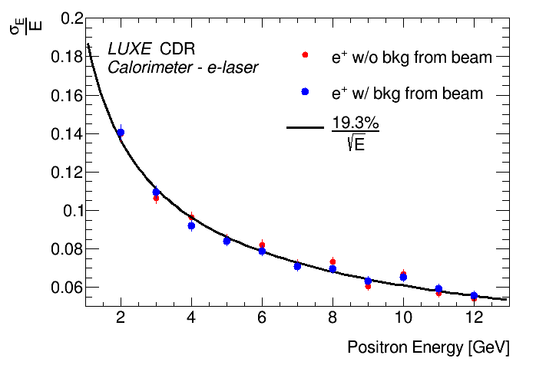
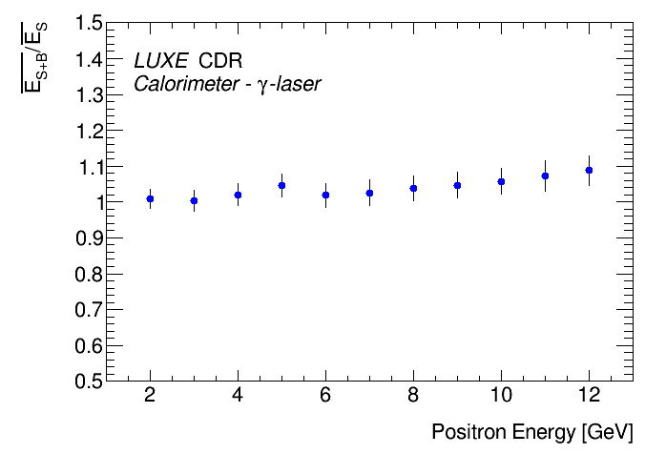
ECAL
Performance studies
Low energy background
beam

Slide 27
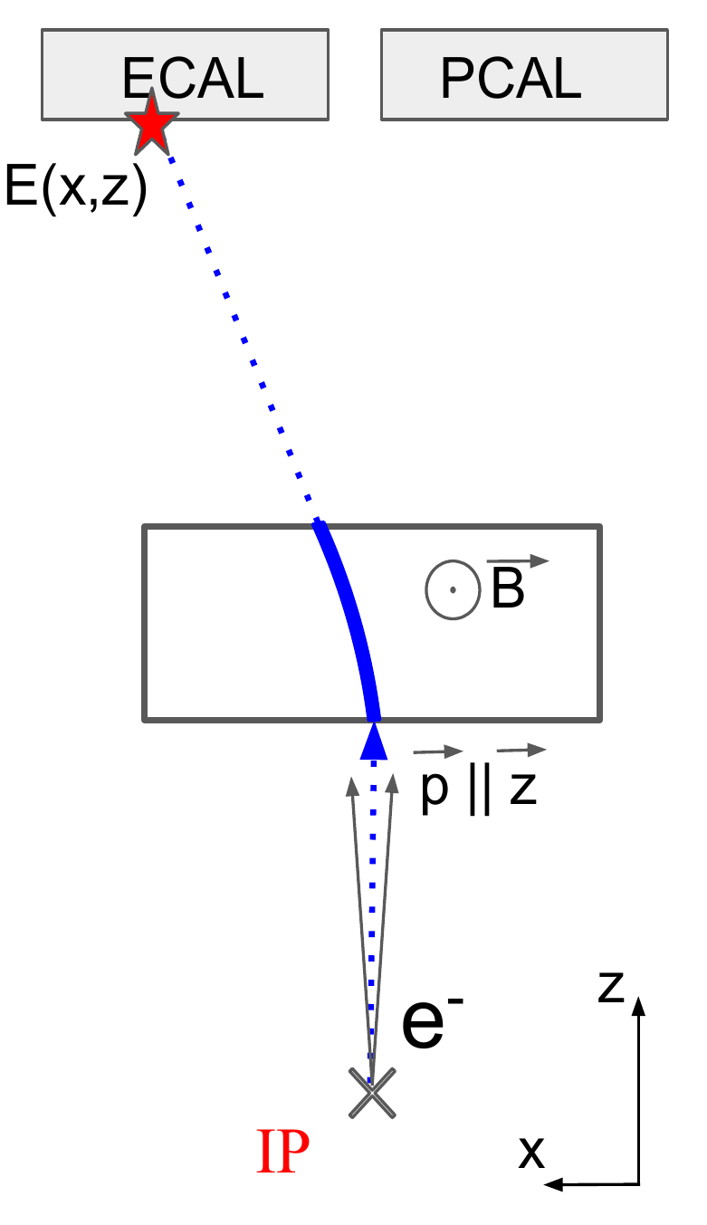
ECAL
Overlap of showers for a large number of particles
Use the expected deposition as a function of the impact point in x (deflection plane of the magnet)
Resolution of the measured number of positrons

Slide 28
Calice Prototype in LUXE
Version 1:
Supplement or cover part of the ECAL
Fiducial volume 18 x 18 cm²
CALICE
Version 2:
Measure electrons in BW studies
CALICE

Slide 29
Conclusion
Physics
LUXE will open a new avenue of research probing QED in electron-light and photon-light collisons
LUXE will cross the Schwinger limit in the quantum non-linear parameter, or the ‚boiling point of the vacuum‘
New phenomena may occur there

Slide 30
Conclusion
Apparatus and detectors
LUXE will be an electron-laser scattering experiment using the XFEL superconducting accelerator and a CPA laser (JETI40 ➔ 350 TW)
Several cutting-edge detector technologies developed for particle physics experiments will be applied
A key subdetector is a finely grained and highly compact ECAL

Slide 31
backup
backup

Slide 32
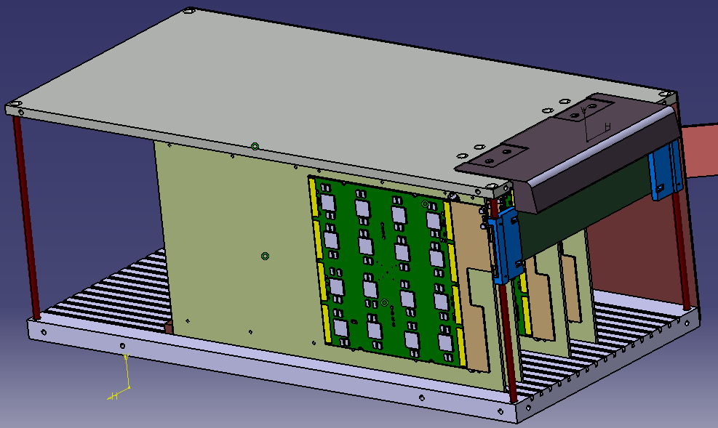
Phase 0 calorimeter
Fiducial volume 18 x 18 cm²
Pad size 5 x 5 mm²
20 detector planes correspond to 12 X₀
FE chip on sensor (less compact)
Readout using Calice standard

