Slide 1
Positron Source Introduction
Kaoru Yokoya, KEK
ILC-IDT Work Package Review Meeting

Slide 2
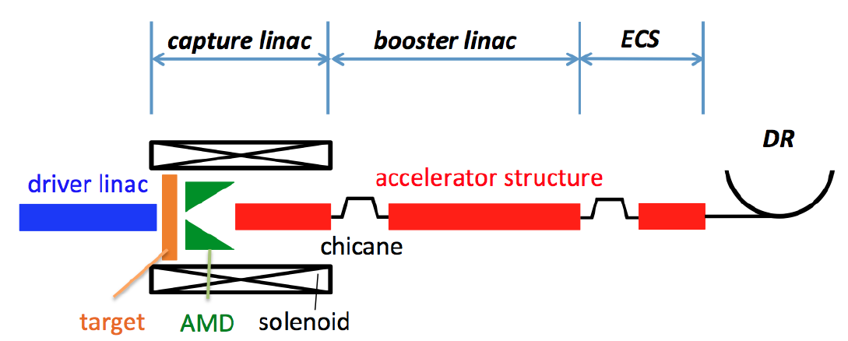
Two Positron Schemes
Undulator Scheme
Baseline (TDR vol.3-I Sec.4.3.2-10 and vol.3-II, Chap.5)
Electron beam (>100GeV) goes through helical undulator → photons (> several MeV) → target → positron
New scheme
Polarized positron
Electron-Driven Scheme
Backup (only a very brief description in TDR vol.3-I Sec.4.3.11.1)
A few GeV electron linac → target → positron
Long experience
Unpolarized positron
3GeV electron from a dedicated linac
125GeV electron

Slide 3
Positron Group Report
Positron Working Group Report, May 23, 2018,
http://edmsdirect.desy.de/item/D00000001165115
Already more than 2.5 years since then. There are some progresses since then.
But at present both of the two schemes still have remaining technical issues
Need demonstration of 100% technical feasibility as early as possible

Slide 4
Selection of the Scheme
The positron scheme for the project start must be decided
Deadline of the decision
Should have sufficient time for the remaining R&D
Design must be fixed as early as possible for the process “internal design review → external review → budget request”
As a compromise, we are planning the “selection” in the middle of the third year of the Pre-Lab (~ Sept. 2024)
Some work packages contain the issues that must come to results by this deadline

Slide 5
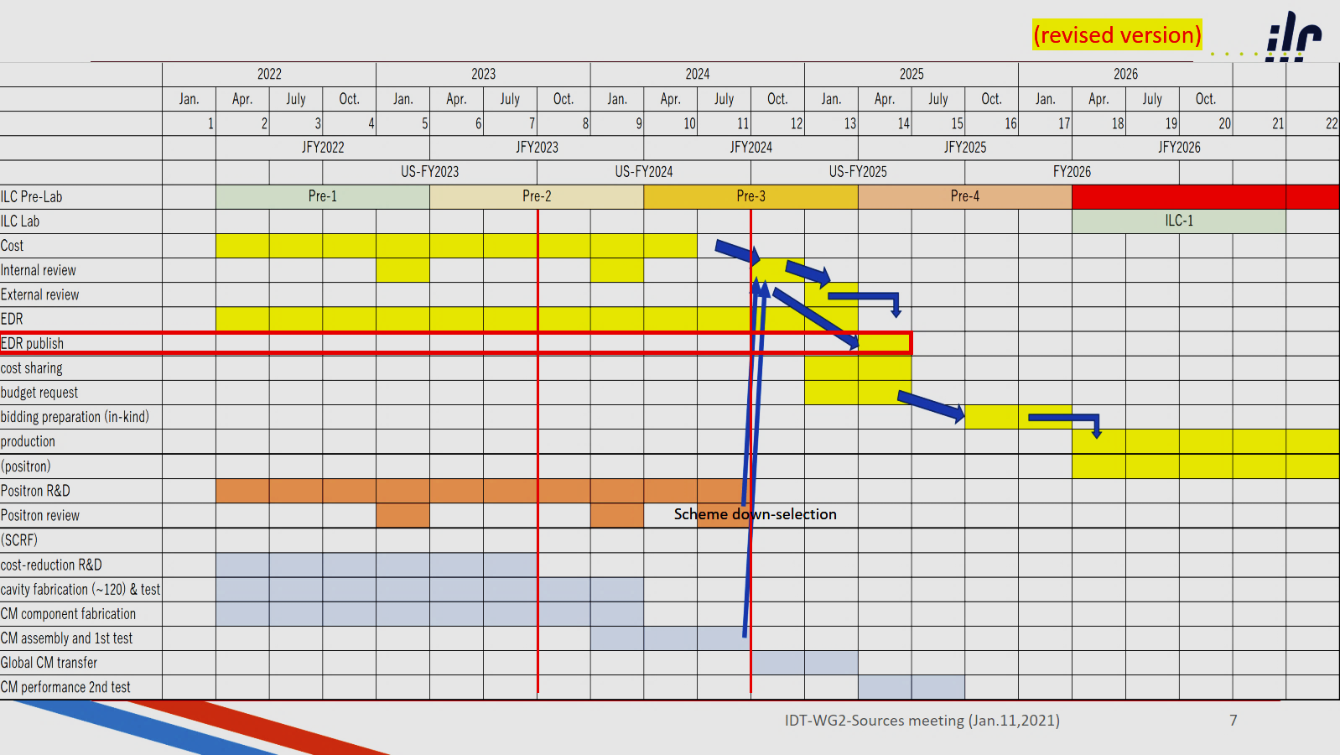
Pre-Lab Timeline

Slide 6
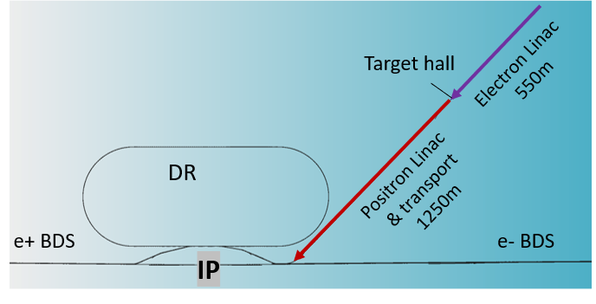
Tunnel Configuration
Two schemes require different tunnel configuration
Right now the CFS team is considering the tunnel layout below
If the e-driven scheme is selected, it is installed in separate tunnel (read line below)
Main tunnel will be the same as in TDR. The space for the undulator scheme will be reserved for future upgrade to polarized positron
Thus, the undulator system can be installed later without large CFS work
Keep in mind, however, minimum CFS design for the undulator system is needed from the beginning (e.g., the location of the target hall, width of the BDS tunnel, etc.)
If the undulator scheme is selected, the extra tunnel for the e-driven system will not be constructed

Slide 7
Work Packages
Electron Source
WP4 Electron Source
Positron source
Undulator Scheme
WP5 Undulator
WP6 Target
WP7 Focusing system
(Photon dump will be discussed in the DR/BDS/DUMP group)
e-Driven Scheme
WP8 Target
WP9 Flux Concentrator
WP10 Capture Cavity
Common Issue
WP11 Target Maintenance

