Slide 1
Area system 3.2 Electron Driven Positron Source
  An overview of E-Driven system is described.
  Goals of the technical preparation is described.

Slide 2
WP8: Target
Technical preparation plan is described for each items.
  Target stress calculation with FEM
  Vacuum seal
  Target module prototyping
Status and prospects

Slide 3
WP-9: Flux Concentrator
Technical preparation plan is described for each items.
  Flux concentrator conductor design.
  Transmission line design.
  Target module prototyping.
Status and prospects

Slide 4
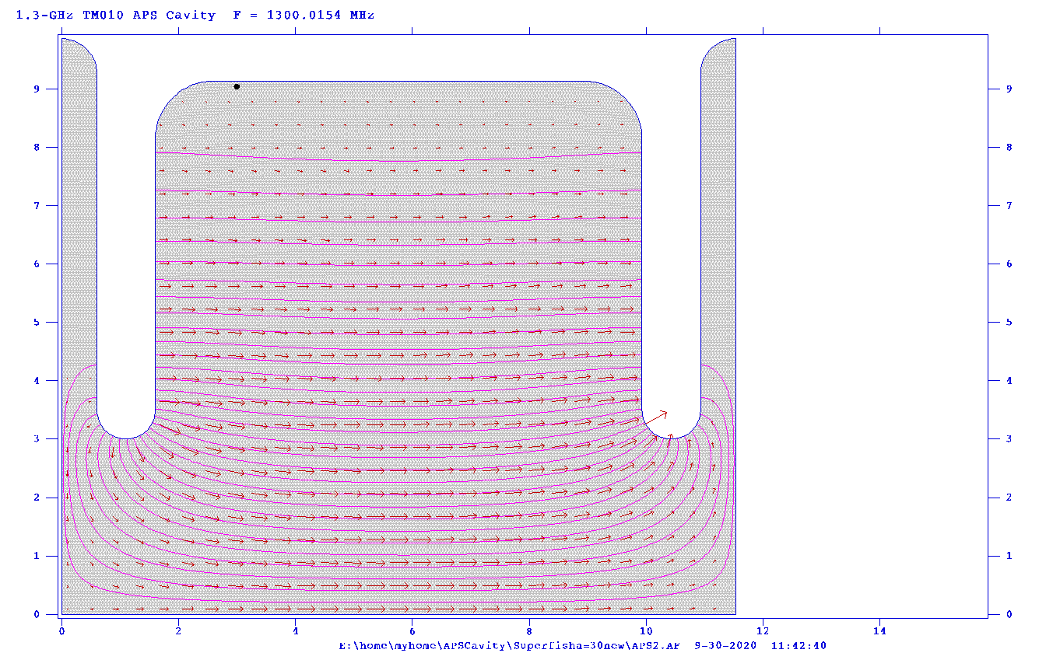
WP-10: Capture linac
Technical preparation plan is described for each items.
  RF design of APS cavity.
  Beam loading estimation and compensation method.
  Capture linac operation and commissioning.
  Power unit prototyping.
  Solenoid prototyping.
  Capture linac prototyping.
Status and prospects.

Slide 5
Summary
Schedule of WP is summarized as a chart with critical milestones.

Slide 6
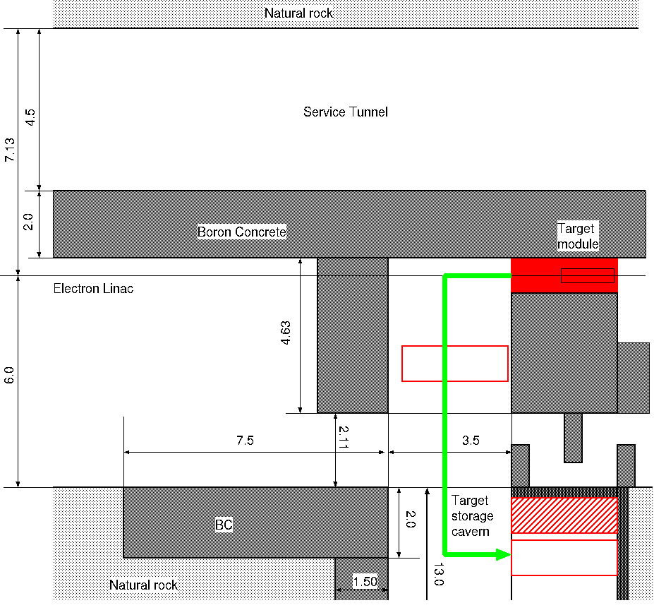
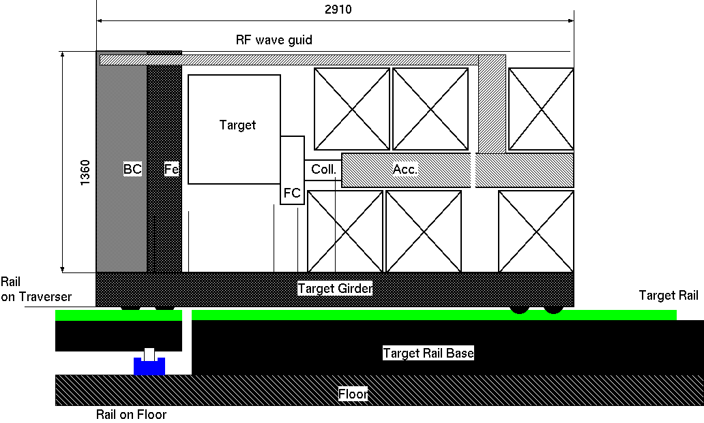
WP-11: Target Maintenance
Technical preparation plan is described for WP.
Status and prospects.

