Slide 1
LCWS 2021 Preparation
Benno List, DESY
IDT WG2 Meeting 16.2.2021

Slide 2
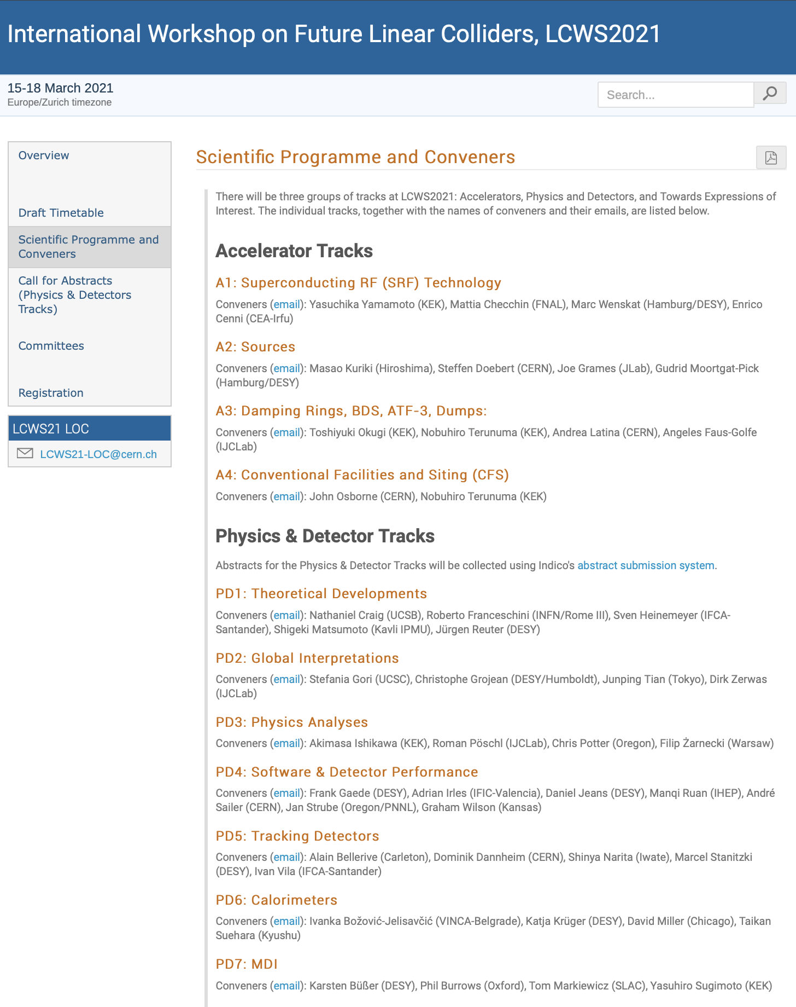
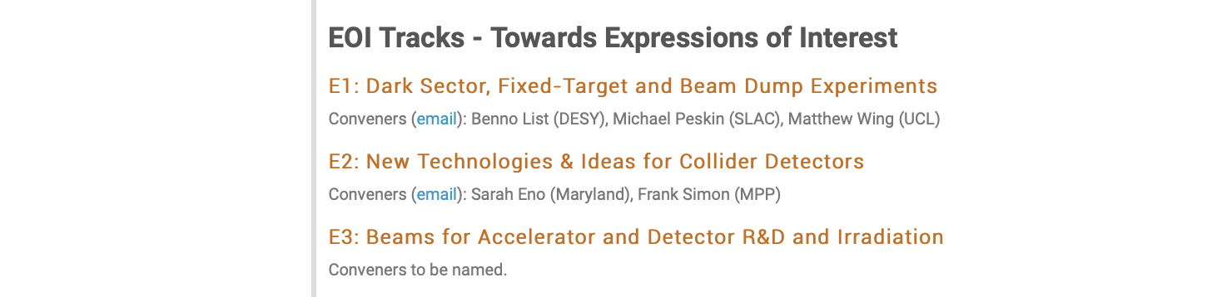
LCWS 2021
Date: March 15-18, 2021
Fully virtual, no attendance fee
Home Page: https://indico.cern.ch/event/995633/overview
Registration is open
4 Accelerator tracks, corresponding to WG2 subgroups
4 Plenaries at Int’l Meeting Time, 3h
Overall plenary Monday & Thursday
Accelerator Plenary Tuesday
Physics & Detectors Plenary Wednesday
Weekly meetings of LOC and PC
Meeting for accelerator parallel sessions Friday, 26.2., 14:00 UTC

Slide 3
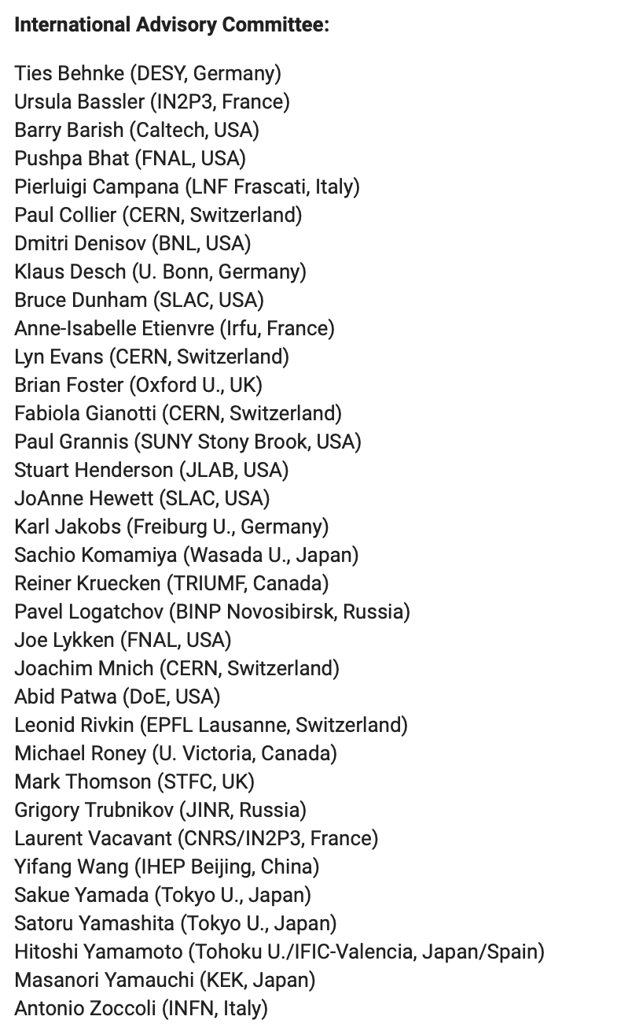
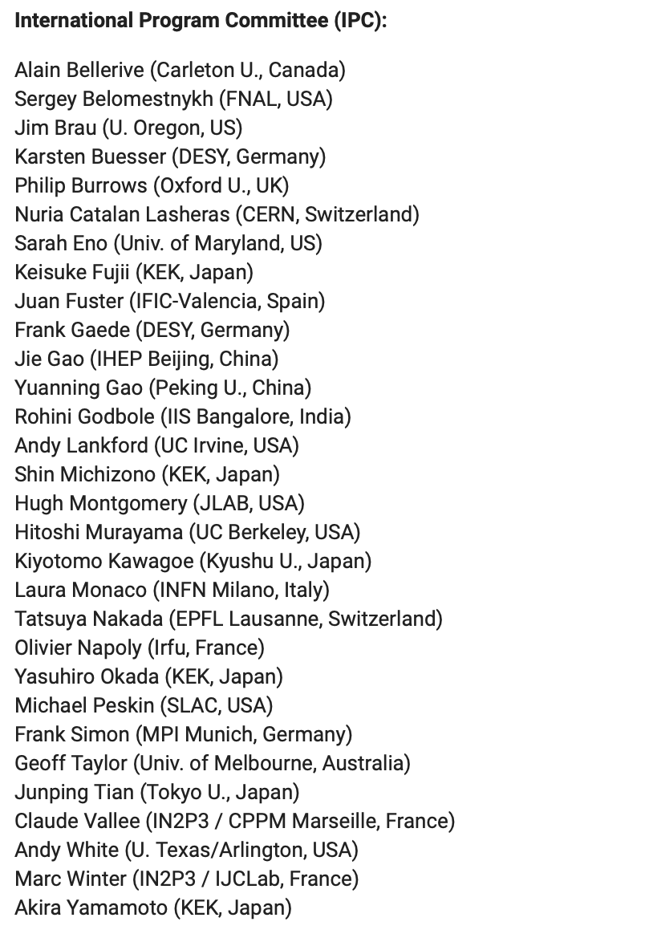
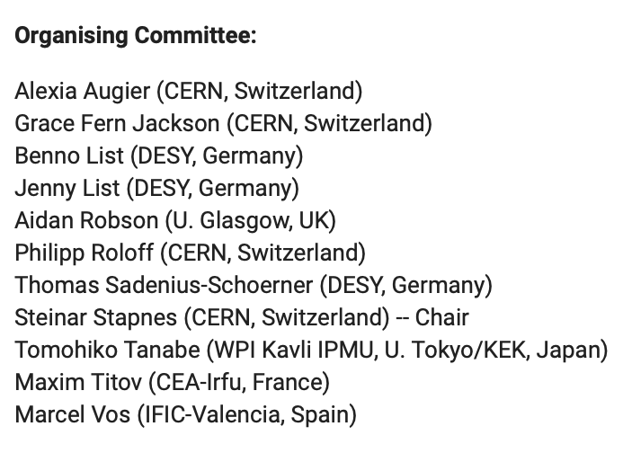
Committees

Slide 4
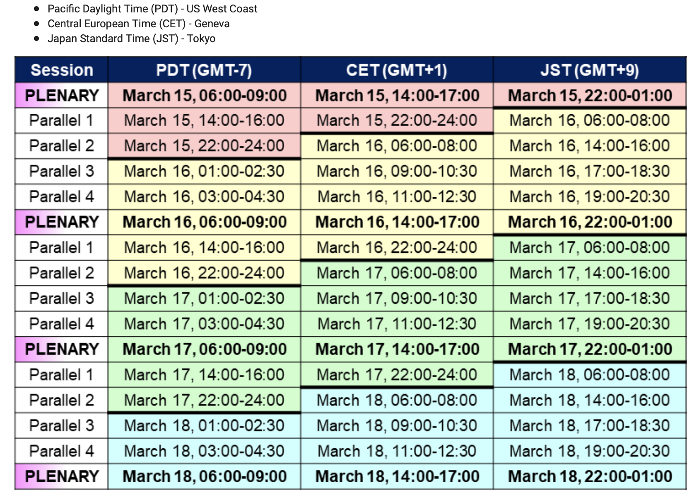
Session Overview

Slide 5
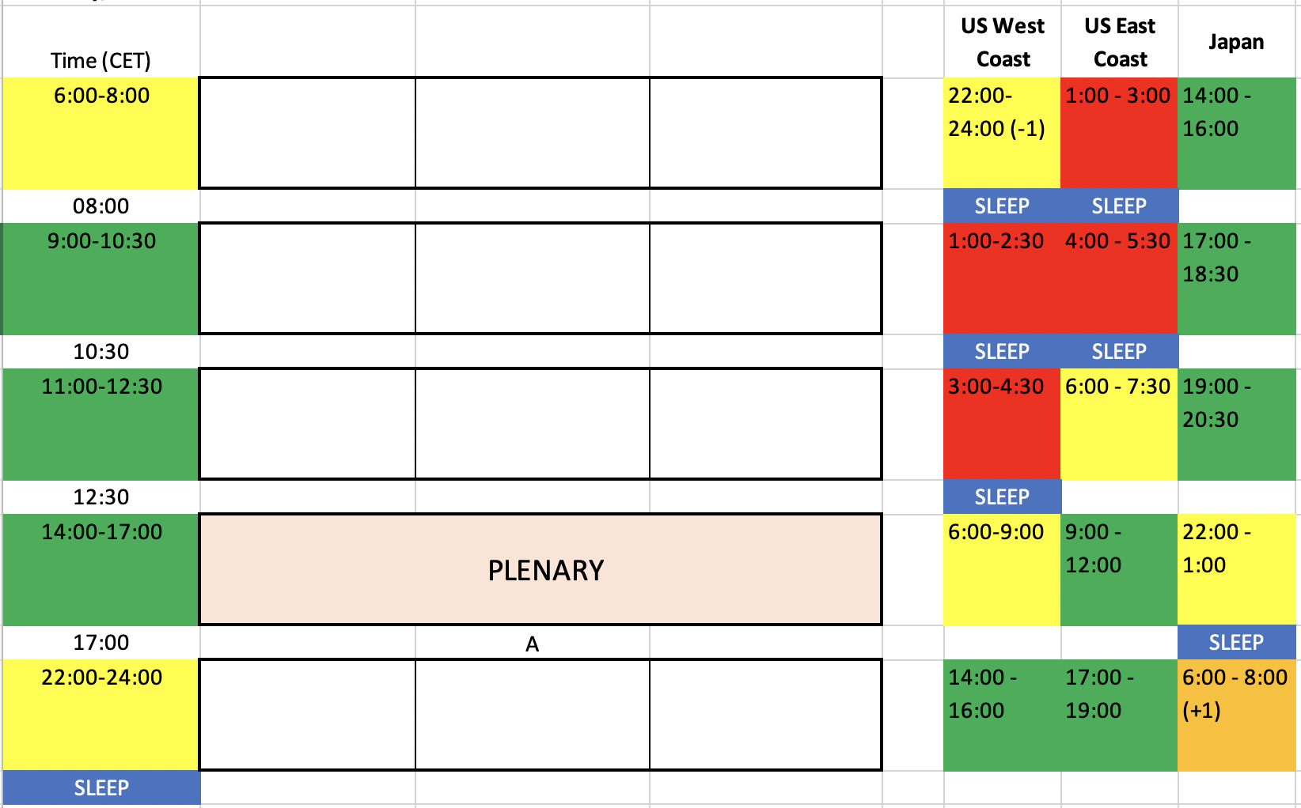
Generic Layout of a Day
Plenary: 4 days: 14:00-17:00 CET ~doable for all
Parallel Sessions: 3 days per slot:
Early Morning 6:00-8:00 (Tue-Thu)
OK for Europe (% UK) (if no late session before)
Great for Japan
Bad - Prohibitive for U.S. (West coast doable)
Morning 9:00-10:30 (Tue-Thu)
Great for Europe and Japan
Prohibitive for U.S.
Morning 11:00-12:30 (Tue-Thu)
Great for Europe and Japan
Bad - Prohibitive for U.S. (East coast doable)
Late evening 22:00-24:00 (Mon-Wed):
Great for U.S.
Difficult for Japan (5 hours sleep after plenary!)
Doable for Europe

Slide 6
Accelerator Sessions and Conveners
Superconducting RF (SRF):
Yasuchika “Kirk” Yamamoto, KEK - OK
Mattia Checchin, Fermilab - OK
Marc Wenskat, Uni Hamburg / DESY - OK
Enrico Cenni, CEA - OK
Sources:
Masao Kuriki, Hiroshima Univ - OK
Steffen Doebert, CERN - OK
Joe Grames, Jlab - OK
Gudrid Moortgat-Pick, Hamburg U. / DESY - OK
Damping Rings, BDS, ATF-3, Dumps:
Toshiyuki Okugi, KEK - OK
Nobuhiro Terunuma, KEK - OK
Andrea Latina, CERN - OK
Angeles Faus-Golfe, LAL - OK
CFS:
Nobuhiro Terunuma, KEK - OK
John Osborne, CERN - OK
Accelerator Plenary:
Steinar Stapnes, CERN
Phil Burrows, Oxford
Shin Michizono, KEK
Benno List, DESY

