Slide 1
10th meeting of SRF subgroup in IDT/WG2
Announcement on LCWS2021
International review
Preparation progress for crab cavity workshop
Author list/Participating laboratory in technical preparation document
Progress report about high-pressure gas safety act for ILC
Others (if any)
Attendees: A. Yamamoto, S. Michizono, H. Hayano, K. Umemori, N.C. Lasheras, S. Posen, S. Belomestnykh, R. Rimmer, R. Geng, E. Cenni, L. Monaco, A. Lankford,
P. McIntosh, S. Stapnes, L.G. Tabares, M. Ross, Kirk
https://agenda.linearcollider.org/category/256/
You can download 4th version of the draft
Kirk

Slide 2
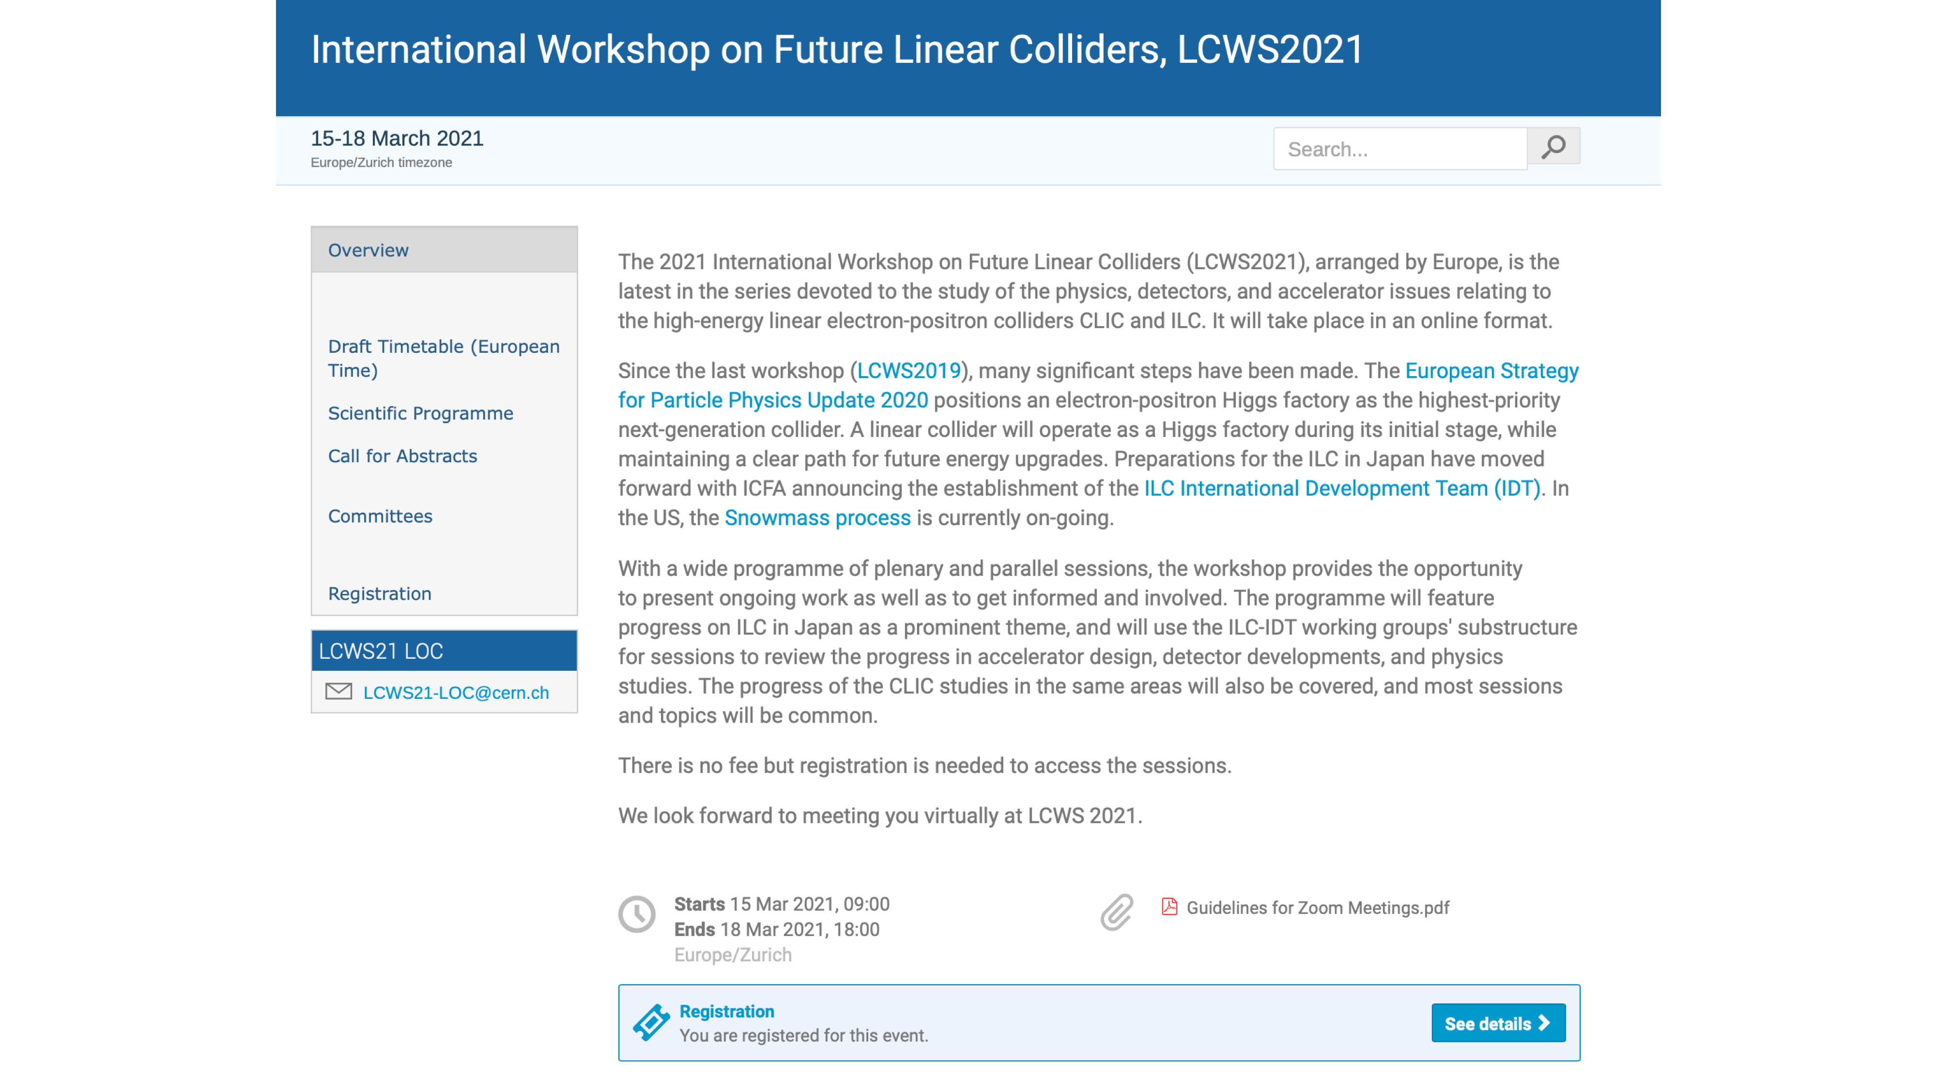
Superconducting RF (SRF):
Yasuchika “Kirk” Yamamoto, KEK
Mattia Checchin, Fermilab
Marc Wenskat, Uni Hamburg / DESY
Enrico Cenni, CEA

Slide 3
International (internal) review on SRF technology
Date/time: 26/Feb (?)
Organizer: IDT Executive Board
Chair person: Tor Raubenheimer (SLAC)
Reviewers: Nine reviewers from three regions (Asia, Americas, Europe)
Day0-4: Overview, Presentations, Discussions
Contents/Presenters: Overview (Kirk)
WP-1 (Sergey Belomestnykh)
WP-2 (Kirk)
WP-3 (Peter McIntosh)
Before the review, every presenter has to upload the slides
Each talk has 30 min incl. questions for SRF presentations
Important points:
Are there any items missing from the table of budget request?
Contents of WP-1, -2, and -3 are valid?
Only proposal will be presented, not recent status of R&Ds
Material concerns (background for each item should be presented):
Recipe of surface treatment
Nb material
Design of Tuner/Coupler/SCQ-Magnet
Submission of 1st draft deadline @22/Feb
Discussions on the slides in the SRF subgroup meeting 22:30~ 22/Feb (Mon) @JST (Not Tuesday!)

Slide 4
Preparation progress for crab cavity workshop
Date/time: 18/Feb (Thu)
22:00~25:00 @JST, 14:00~17:00 @EU, 13:00~16:00 @UK, 8:00~11:00 @US Eastern, 7:00~10:00 @US Central, 5:00~8:00 @US Pacific
Organizer: IDT WG2 SRF subgroup (chairperson is Kirk)
Web: https://agenda.linearcollider.org/event/9090/
Expected attendees: Members of SRF subgroup
G. Burt, A. Wheelhouse, S. Pattalwar from UK
R. Calaga from CERN
J. Delayen/Subashini De Silva from ODU/JLAB
S. Yakovlev from FNAL
※the person with the underlined name is the candidate presenter
Agenda: (1) Introduction (Kirk)
(2) Proposal from UK (Graeme Burt)
(3) Proposal from CERN (Rama Calaga)
(4) Proposal from JLAB/ODU (Jean Delayen, Subashini De Silva)
(5) Proposal from FNAL (Vyacheslav Yakovlev)
(6) Discussions on technical issues and preparation for the international review
Each talk has 30 min incl. questions
Discussion items:
Who presents at the international review? → Peter McIntosh
Who or which lab. organizes the activity of crab cavity after this workshop?
Each design is fitted to the installation area?
RF property is valid?
Timing issues and present achievement to be checked (everyone can gather these information)
https://zoom.us/j/92368371954?pwd=WlFJcHRLdm00Rm5OaEVvU2IwTDZNUT09
Meeting ID: 923 6837 1954
Passcode: 693078
Proposal from BNL will be put additionally

Slide 5
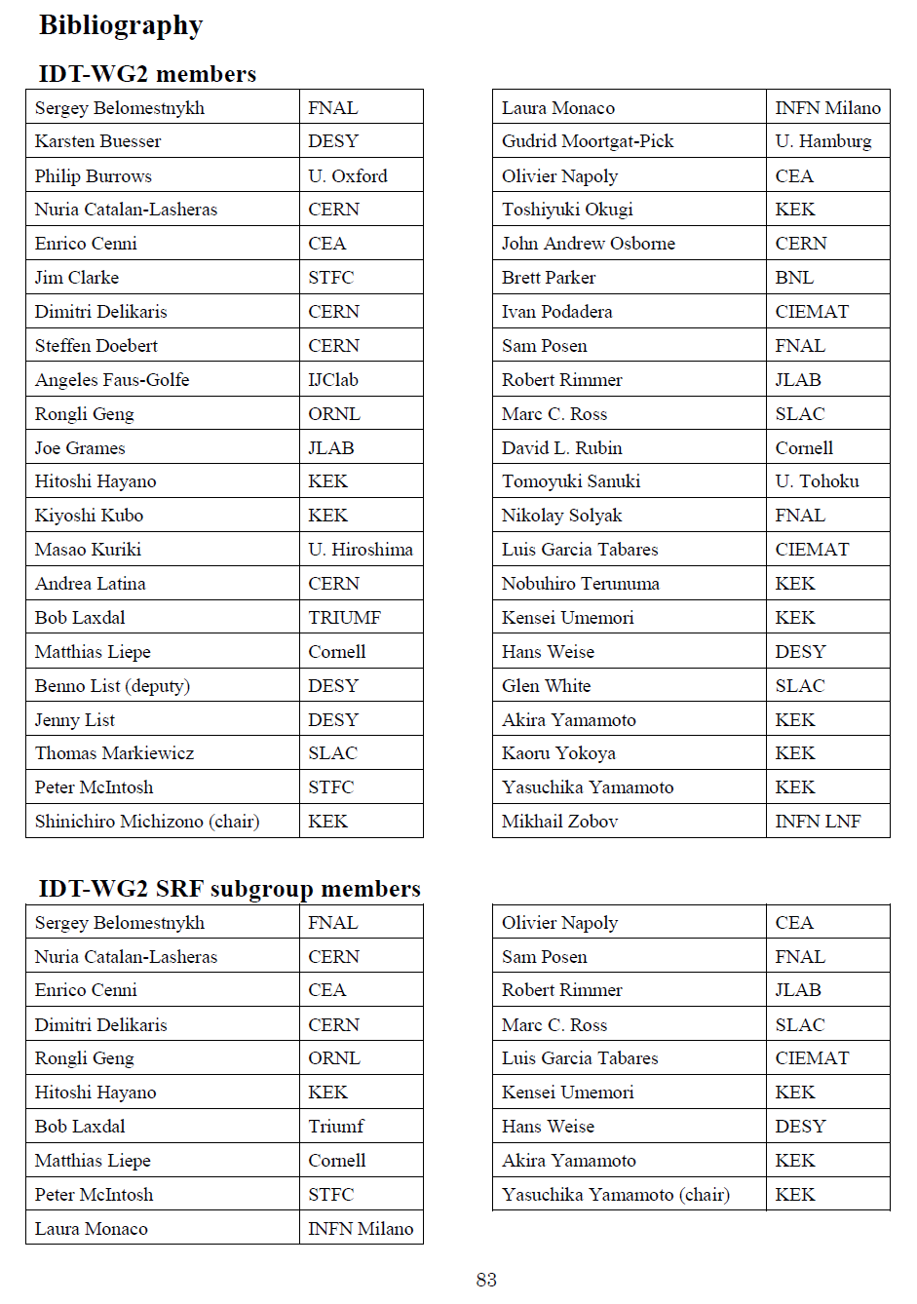
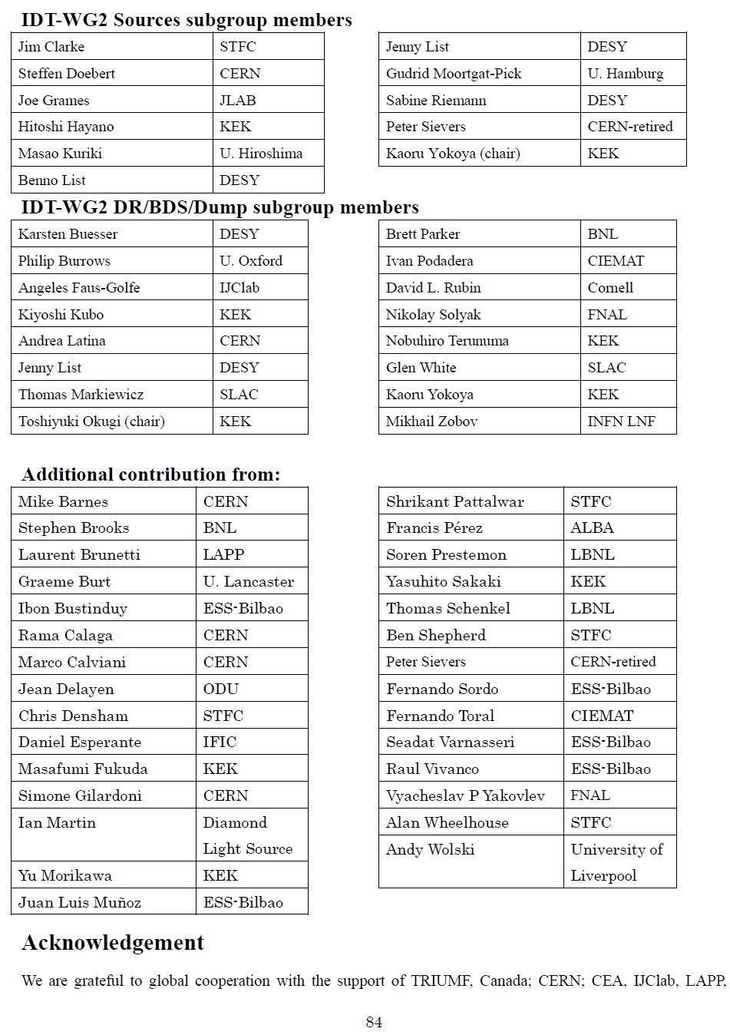
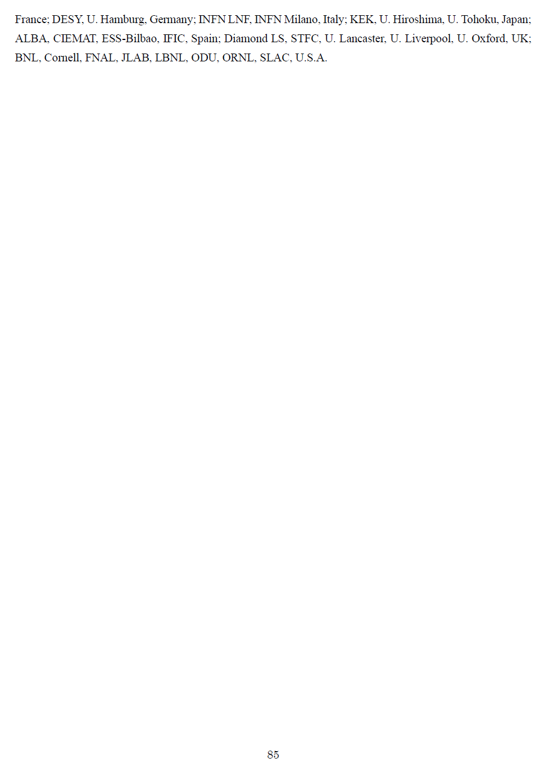
Progress of technical preparation document
Ver.4 was released
Included “Executive summary”, “Technical preparation document”, “Appendix”
“Appendix” is confidential, and the others are opened
Please check “Author list” and “Participating laboratories”
“Author list” includes not only WG2 members, but additional experts in each subgroup

Slide 6
Schedule of SRF (incl. crab) subgroup meeting in IDT/WG2
Meeting # | Date | Contents
 | 8/Jan | Submission of budget request to EB
8 | 12/Jan | International review, Explanation on cost estimation, Discussions on crab cavity workshop plan
 | 19~21/Jan | TTC meeting 2021 on virtual
9 | 26/Jan | Discussions on crab cavity workshop plan, technical preparation document, international review, HPG safety act in Japan
10 | 9/Feb | Announcement on LCWS2021, Presenters are fixed at international review, Author list in technical preparation document, HPGC
 | 16~17/Feb | Snowmass AF7 –Subgroup RF–
 | 18/Feb | Crab cavity workshop
11 | 22/Feb (Mon) | Discussions on the slides for the international review (Submission deadline of draft slide)
 | 26/Feb | International review on SRF
12 | 2/Mar | SRF program in LCWS2021
 | 15~18/Mar | 9th International Workshop on "Thin films applied to Superconducting RF: Pushing the limits of RF Superconductivity"
 | 15~18/Mar | LCWS 2021 on virtual hosted by CERN
13 | 23/Mar
 |  | Preparation for MOU between/among laboratories
 | Jun~Jul | Submission of budget request to MEXT, in case of Japan
 | 28/Jun~2/Jul | SRF 2021 on virtual
 | 26~29/Oct | International conference related to ILC on virtual hosted by Japan (True name is not fixed yet!)

Slide 7
Questions/Discussions/Comments (memorandum) @10th meeting
International review
The chair person is Dr. Tor Raubenheimer at SLAC
All presenters were fixed in this meeting, because we don’t have enough time to prepare for the review
Peter will present WP-3 including the proposals from the other institutes
Dates not fixed yet, but at the end of Feb. or early Mar. (under progress)
Each presentation has 30 min including questions
Crab cavity workshop
What is the criteria for technical items?
Kirk will explain again at the introduction of the workshop
SLAC/BNL/LBNL will join
Anyone will be assigned as a coordinator, or co-organizers after this workshop?
Focus on technical issues, not decisions
Final circular including the zoom link will be delivered soon
Technical preparation document
Version 4 was released just before this meeting
Authors and participating laboratories list were checked by the SRF subgroup members
High pressure gas safety act for ILC
Akira Yamamoto-san explained the recent progress about HPG safety act
Recent SRF applications were presented, IFMIF, RILAC, LCLS-II, HL-LHC crab cavity
Communication with QST, CERN, FNAL, JLAB, SLAC has been done
Translation by Kirk

