Slide 1
10th meeting of SRF subgroup in IDT/WG2
Announcement on LCWS2021
International review
Preparation progress for crab cavity workshop
Author list/Participating laboratory in technical preparation document
Progress report about high-pressure gas safety act for ILC
Others (if any)
Attendees: A. Yamamoto, S. Michizono, H. Hayano, K. Umemori, N.C. Lasheras, S. Posen, S. Belomestnykh, R. Rimmer, R. Geng, E. Cenni, L. Monaco, A. Lankford,
P. McIntosh, S. Stapnes, L.G. Tabares, M. Ross, Kirk
https://agenda.linearcollider.org/category/256/
You can download 4th version of the draft
Kirk

Slide 2
IDT-WG2 organization
IDT EB
Charges of Sub-groups
Discuss and coordinate the topics for
- technical preparation (remaining topics) at Pre-lab
- preparation for mass production at Pre-lab
- possible schedule at Pre-lab
- international sharing candidates of these activities
- final technical design and documentation (EDR)
Report to the IDT-WG2
IDT WG2
Shin Michizono (Chair)
Benno List (Deputy)
Tuesday
(bi-weekly)
Tuesday
(bi-weekly)
SRF
Wednesday
(bi-weekly)
DR/BDS/Dump
Yasuchika Yamamoto | KEK
Sergey Belomestnykh | FNAL
Nuria Catalan | CERN
Enrico Cenni | CEA
Dimitri Delikaris | CERN
Rongli Geng | ORNL
Hitoshi Hayano | KEK
Bob Laxdal | Triumf
Matthias Liepe | Cornell
Peter McIntosh | STFC
Laura Monaco | INFN Milano
Olivier Napoly | CEA
Sam Posen | FNAL
Robert Rimmer | JLAB
Marc C. Ross | SLAC
Luis Garcia Tabares | CIEMAT
Kensei Umemori | KEK
Hans Weise | DESY
Akira Yamamoto | KEK
Toshiyuki Okugi | KEK
Karsten Buesser | DESY
Philip Burrows | U. Oxford
Angeles Faus-Golfe | LAL
Kiyoshi Kubo | KEK
Andrea Latina | CERN
Jenny List | DESY
Thomas Markiewicz | SLAC
Brett Parker | BNL
Ivan Podadera | CIEMAT
David L. Rubin | Cornell
Nikolay Solyak | FNAL
Nobuhiro Terunuma | KEK
Glen White | SLAC
Kaoru Yokoya | KEK
Mikhail Zobov | INFN LNF
In order to avoid the regular conflict with SRF and DR/BDS/Dump subgroup,
I would like to propose to move DR/BDS/Dump from Tuesday to Wednesday.
Dump
Sources
Monday
(bi-weekly)
Civil engineering
Nobuhiro Terunuma | KEK
Toshiyuki Okugi | KEK
Kaoru Yokoya | KEK
Jim Clarke | STFC
Steffen Doebert | CERN
Joe Grames | JLAB
Hitoshi Hayano | KEK
Masao Kuriki | U. Hiroshima
Benno List | DESY
Gudrid Moortgat-Pick | U. Hamburg
Nobuhiro Terunuma | KEK
John Andrew Osborne | CERN
Tomoyuki Sanuki | U. Tohoku
Chris Densham(STFC)
Marco Calviani (CERN)
Yu Morikawa (KEK)
Fernadno Sordo (ESS Bilbao)
Peter Sievers (CERN)
Peter Sievers (CERN)
Sabine Riemann (DESY)
CRAB

Slide 3
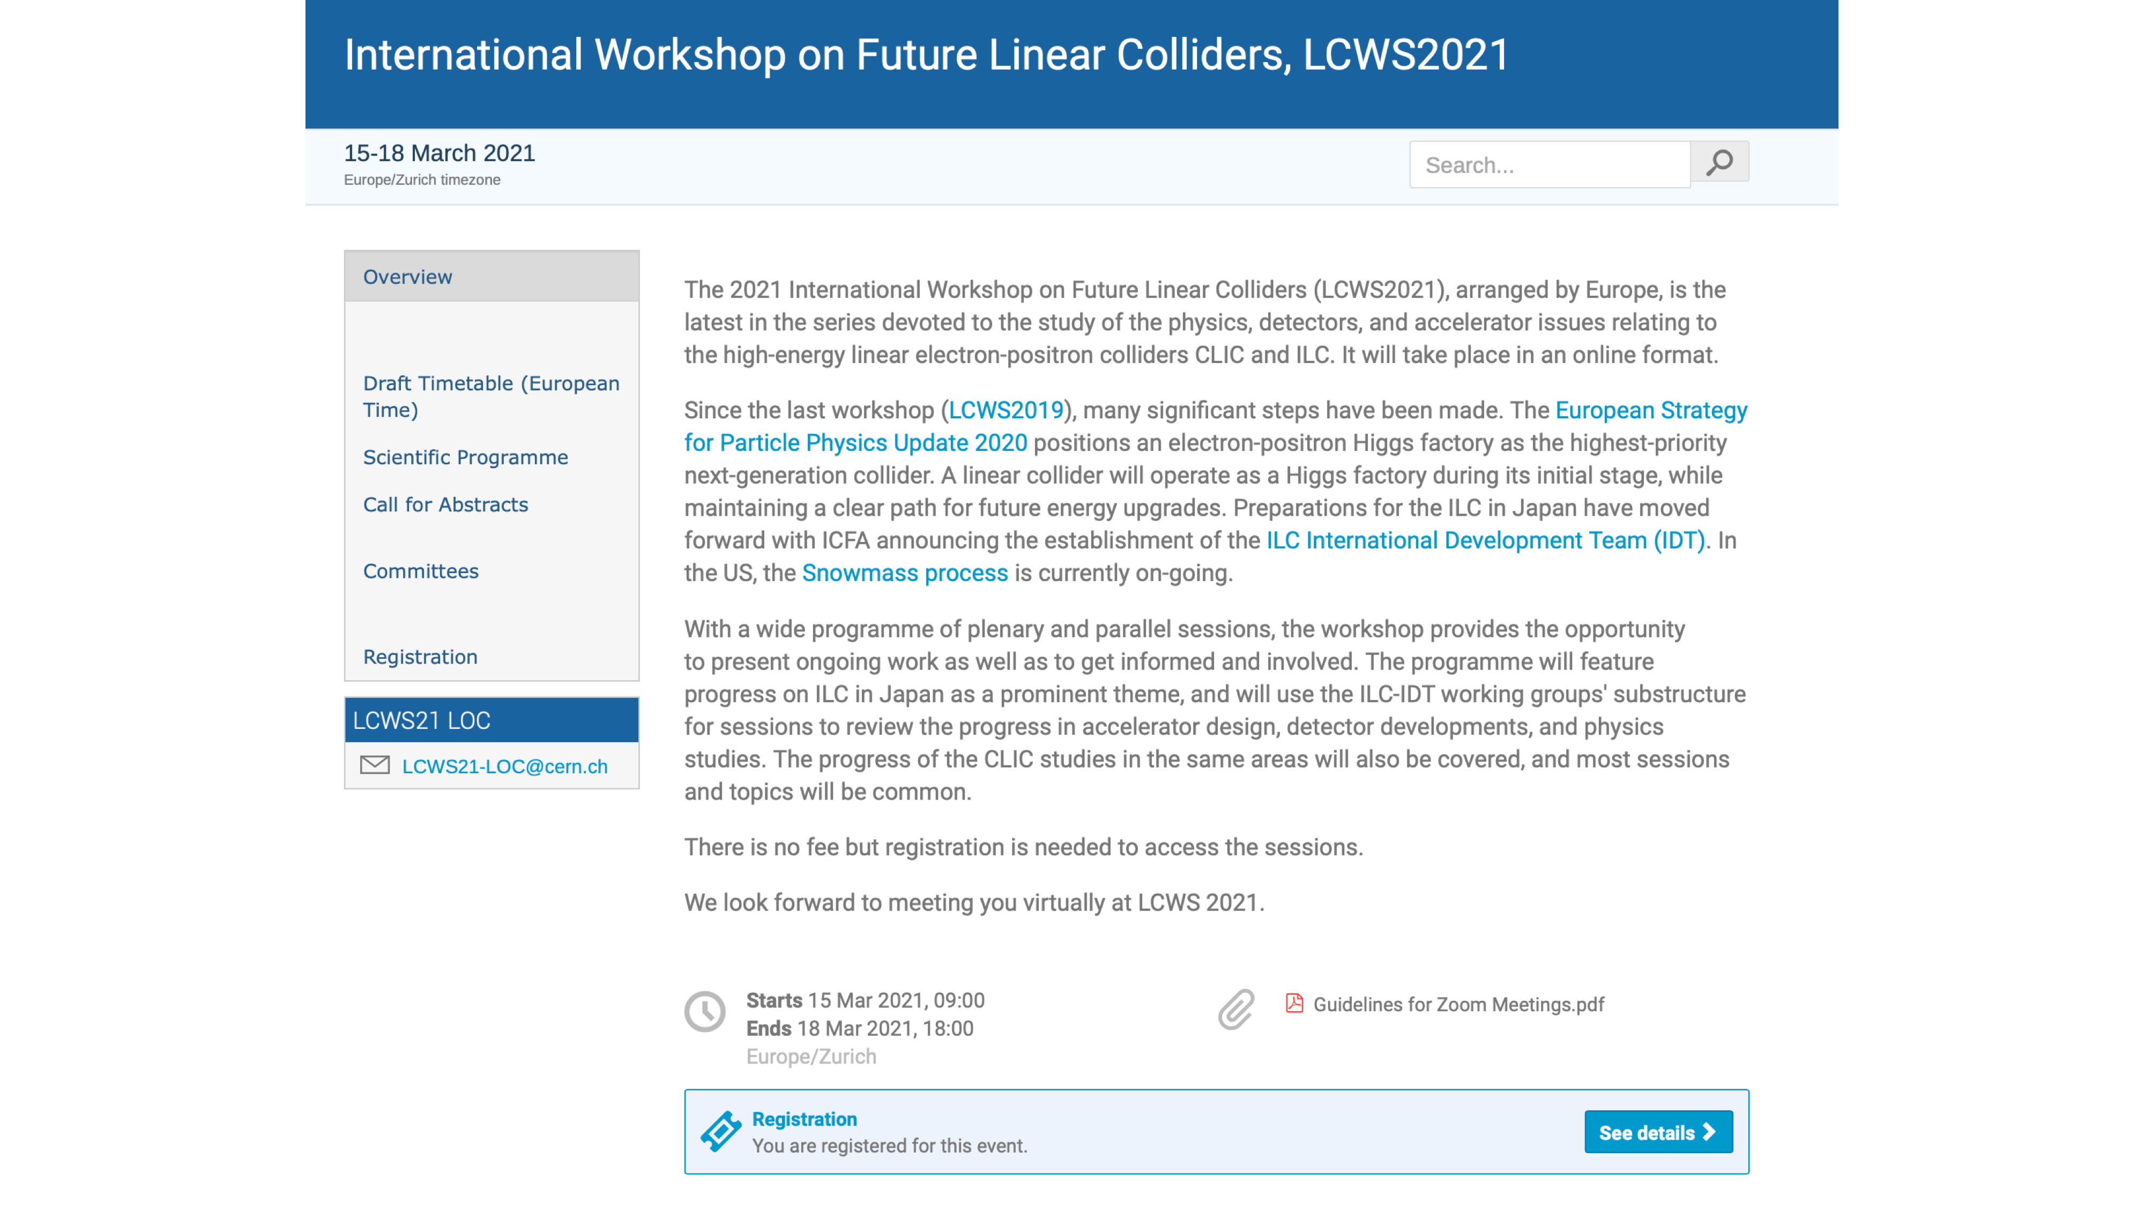
Superconducting RF (SRF):
Yasuchika “Kirk” Yamamoto, KEK
Mattia Checchin, Fermilab
Marc Wenskat, Uni Hamburg / DESY
Enrico Cenni, CEA

Slide 4
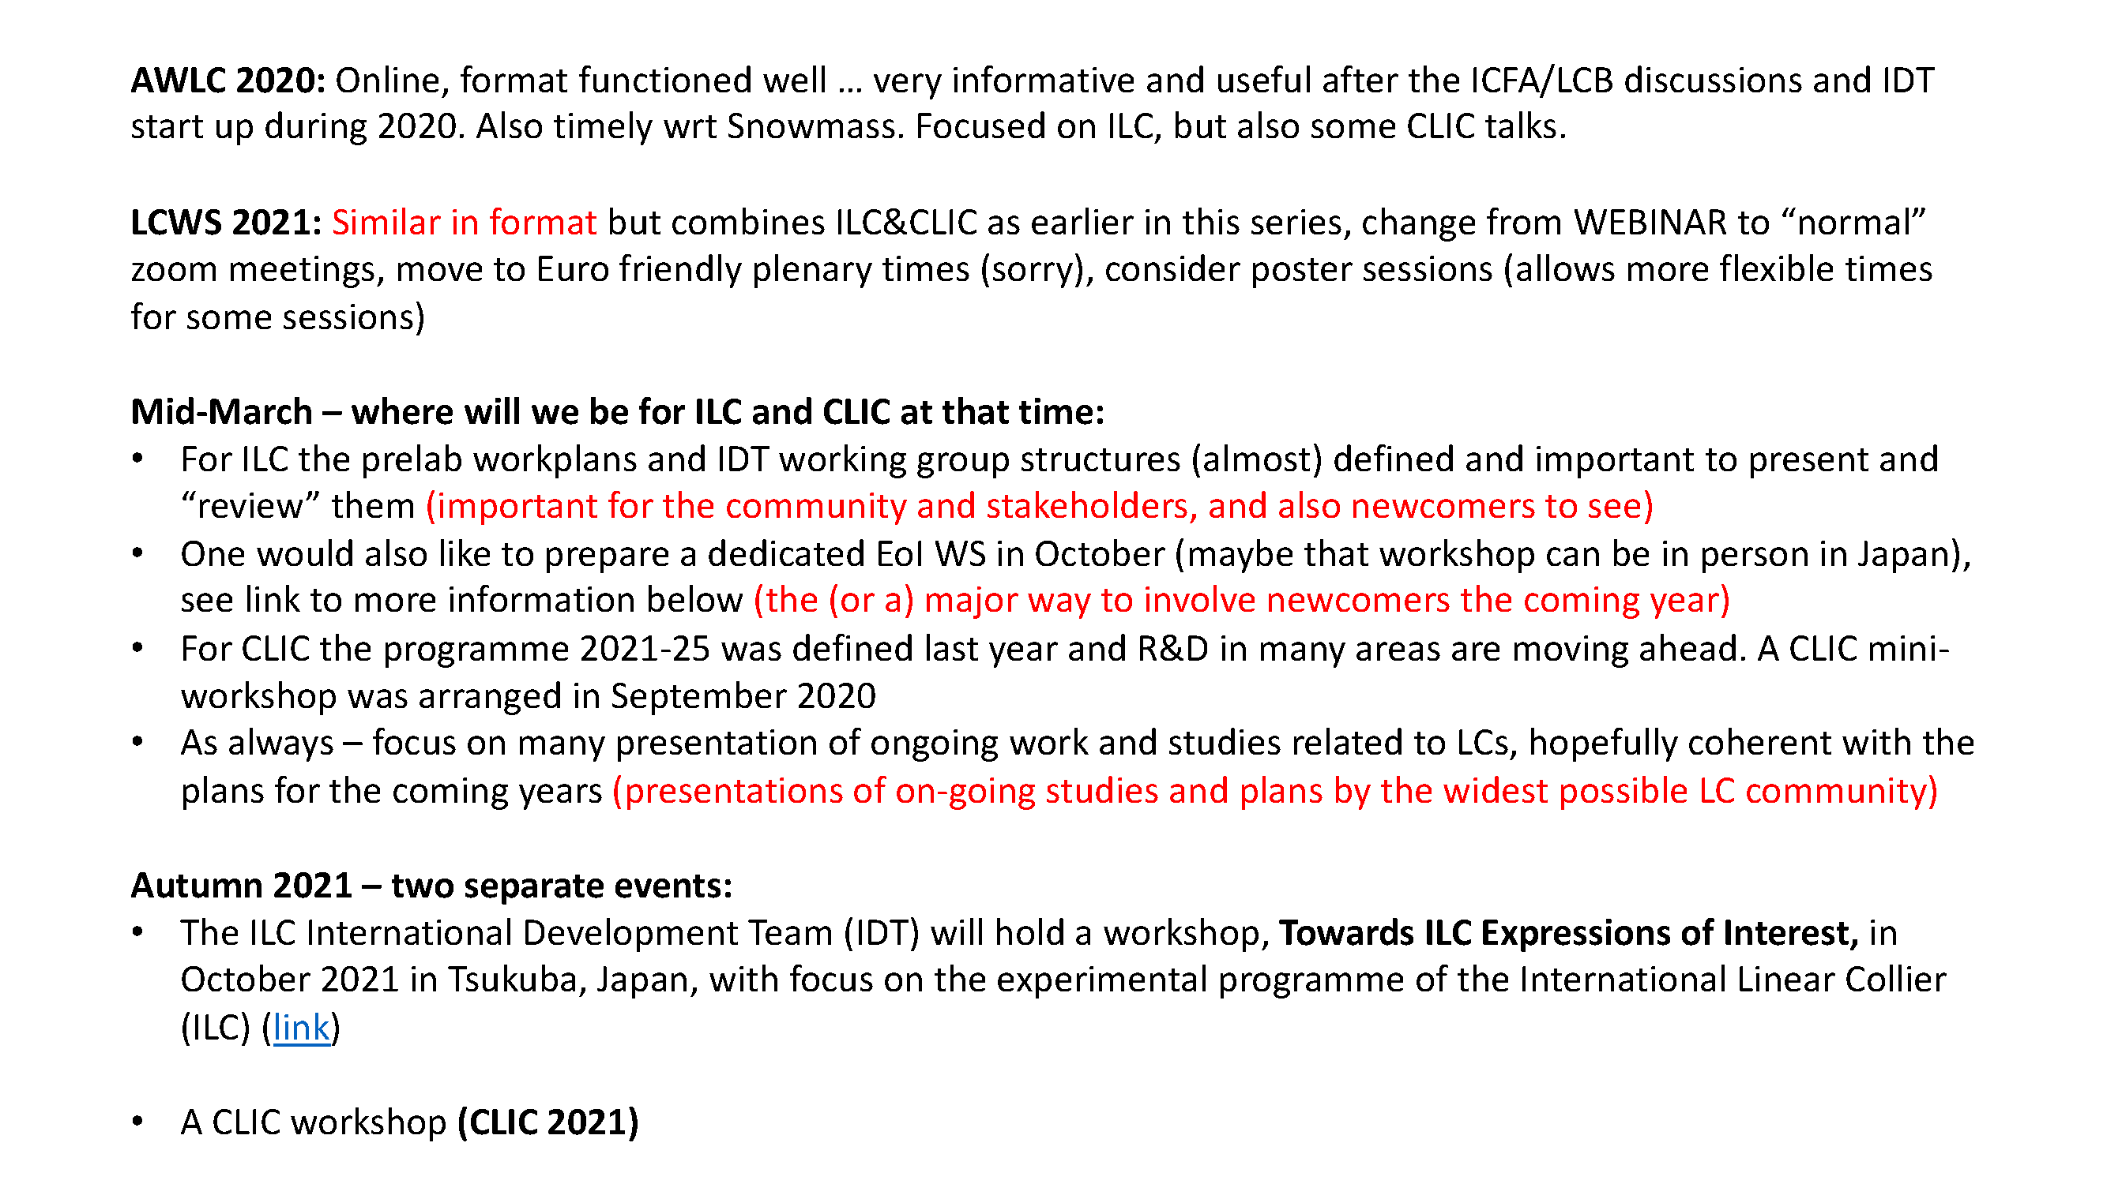

Slide 5
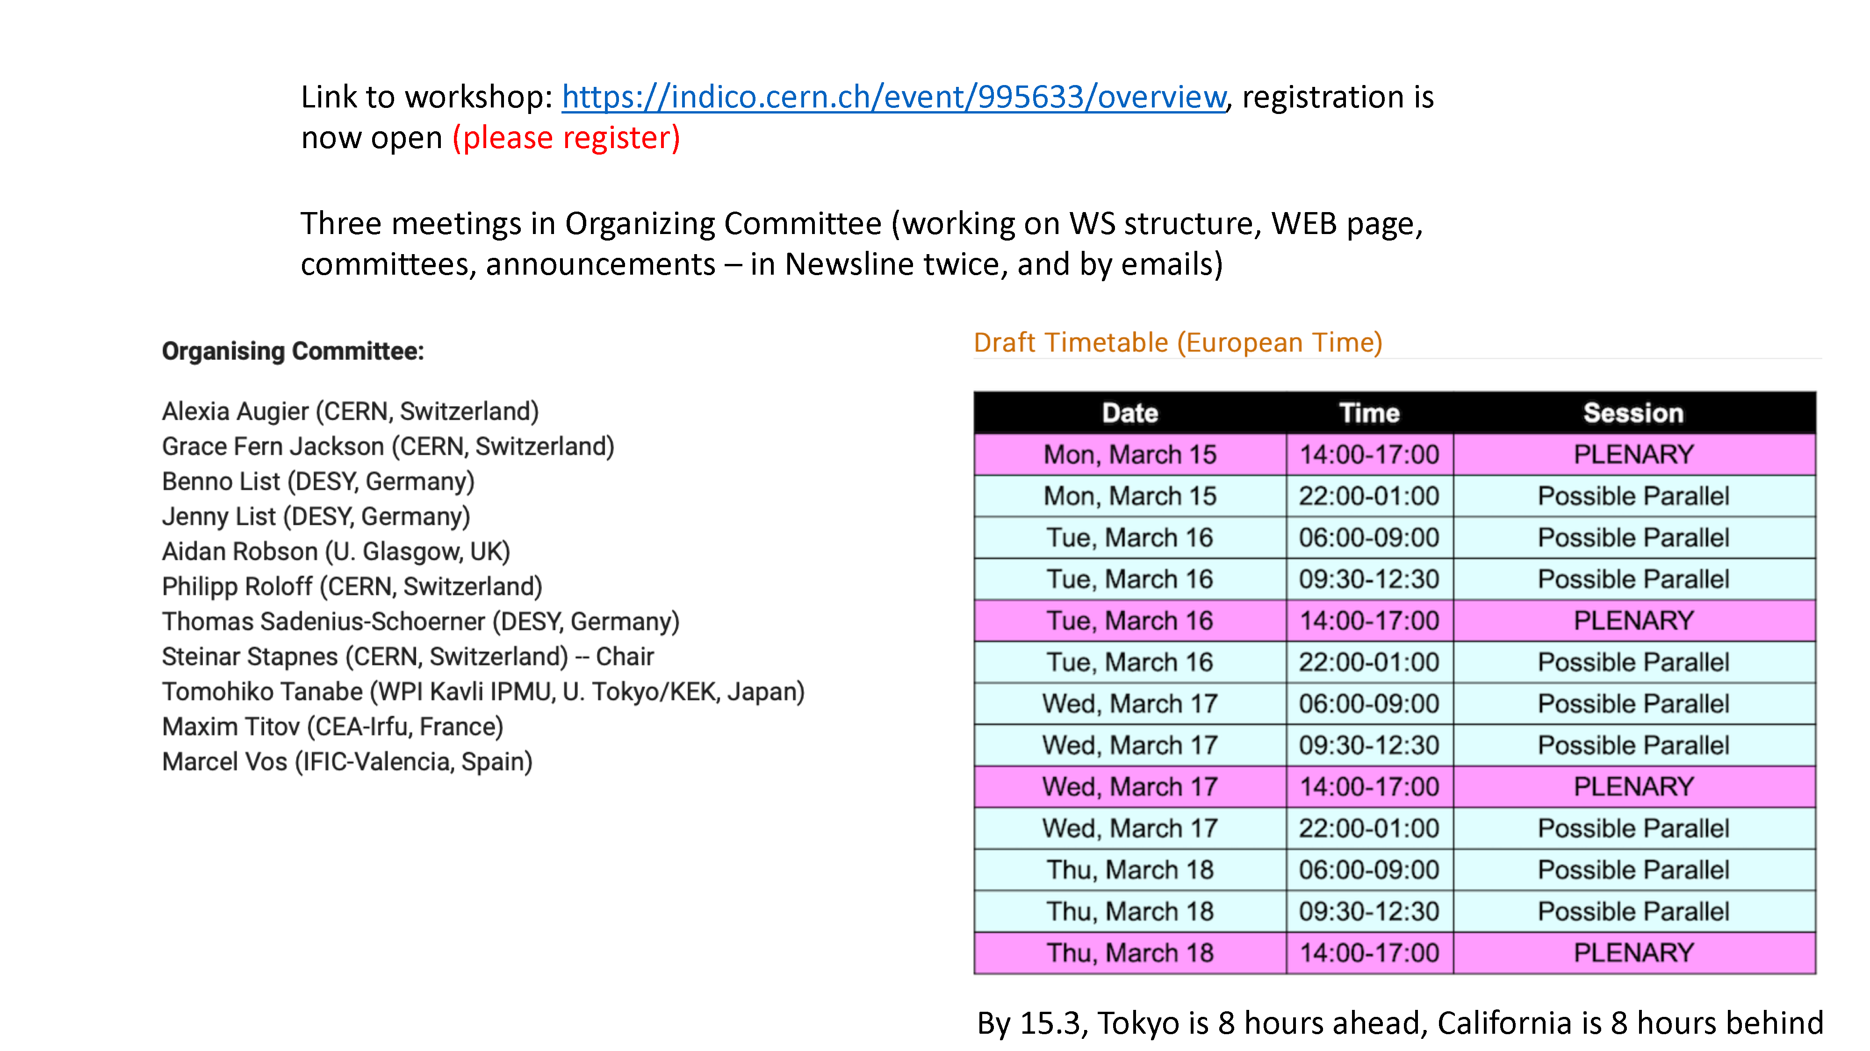

Slide 6
International (internal) review on SRF technology
Date/time: Feb. or Mar. (~3 hours)
Organizer: IDT Executive Board
Chair person: Tor Raubenheimer (SLAC)
Reviewers: Nine reviewers from three regions (Asia, Americas, Europe)
Day0-4: Overview, Presentations, Discussions
Contents/Presenters: Overview (Kirk)
WP-1 (Sergey Belomestnykh)
WP-2 (Kirk)
WP-3 (Peter McIntosh)
Before the review, every presenter has to upload the slides
Each talk has 30 min incl. questions for SRF presentations
Important points:
Are there any items missing from the table of budget request?
Contents of WP-1, -2, and -3 are valid?
Only proposal will be presented, not recent status of R&Ds
Material concerns (background for each item should be presented):
Recipe of surface treatment
Nb material
Design of Tuner/Coupler/SCQ-Magnet

Slide 7
Preparation progress for crab cavity workshop
Date/time: 18/Feb (Thu)
22:00~25:00 @JST, 14:00~17:00 @EU, 13:00~16:00 @UK, 8:00~11:00 @US Eastern, 7:00~10:00 @US Central, 5:00~8:00 @US Pacific
Organizer: IDT WG2 SRF subgroup (chairperson is Kirk)
Web: https://agenda.linearcollider.org/event/9090/
Expected attendees: Members of SRF subgroup
G. Burt, A. Wheelhouse, S. Pattalwar from UK
R. Calaga from CERN
J. Delayen/Subashini De Silva from ODU/JLAB
S. Yakovlev from FNAL
※the person with the underlined name is the candidate presenter
Agenda: (1) Introduction (Kirk)
(2) Proposal from UK (Graeme Burt)
(3) Proposal from CERN (Rama Calaga)
(4) Proposal from JLAB/ODU (Jean Delayen, Subashini De Silva)
(5) Proposal from FNAL (Vyacheslav Yakovlev)
(6) Discussions on technical issues and preparation for the international review
Each talk has 30 min incl. questions
Discussion items:
Who presents at the international review? → Peter McIntosh
Who or which lab. organizes the activity of crab cavity after this workshop?
Each design is fitted to the installation area?
RF property is valid?
Timing issues and present achievement to be checked (everyone can gather these information)
Proposal from BNL will be put additionally

Slide 8
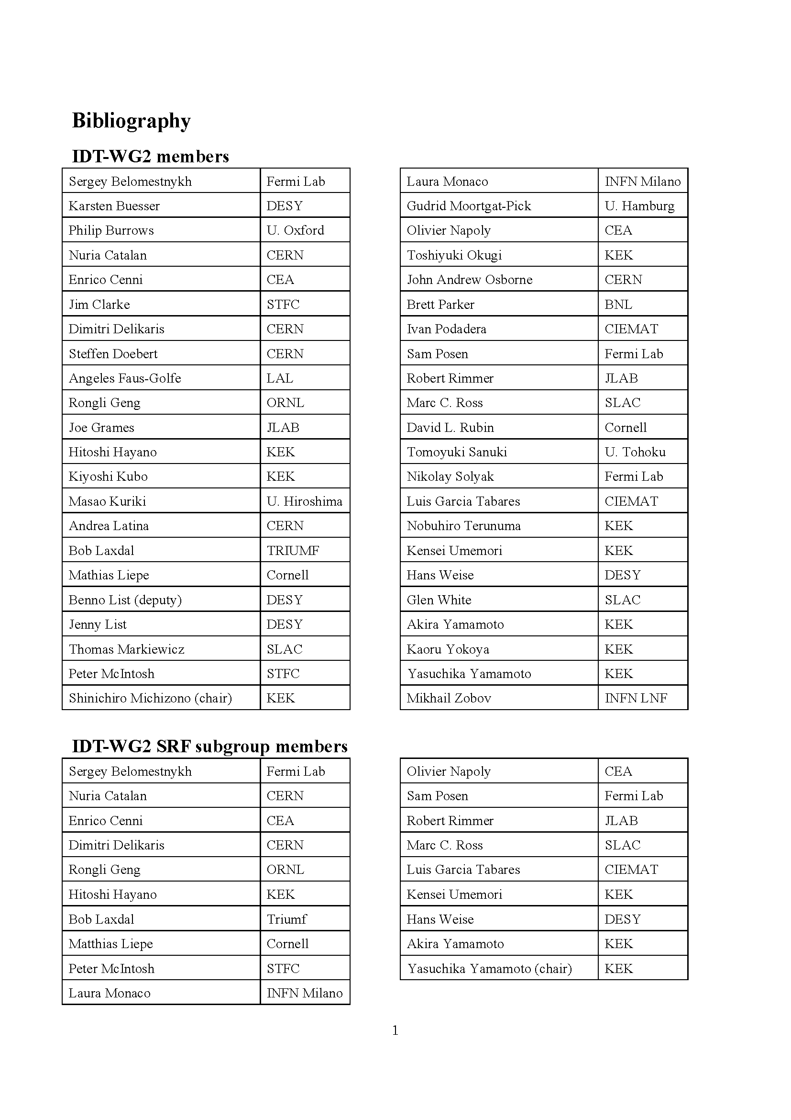
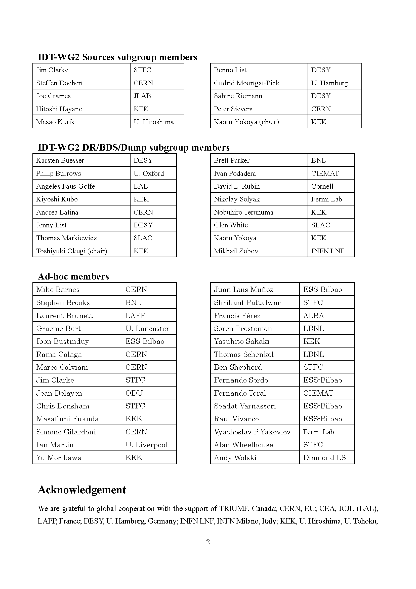
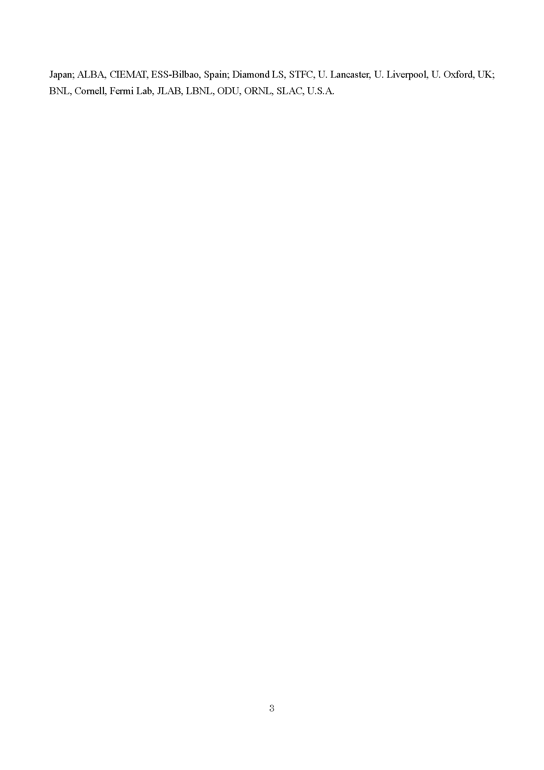
Progress of technical preparation document
Ver.4 was released
Included “Executive summary”, “Technical preparation document”, “Appendix”
“Appendix” is confidential, and the others are opened
Please check “Author list” and “Participating laboratories”
“Author list” includes not only WG2 members, but additional experts in each subgroup

Slide 9
Schedule of SRF (incl. crab) subgroup meeting in IDT/WG2
Meeting # | Date | Contents
 | 8/Jan | Submission of budget request to EB
8 | 12/Jan | International review, Explanation on cost estimation, Discussions on crab cavity workshop plan
 | 19~21/Jan | TTC meeting 2021 on virtual
9 | 26/Jan | Discussions on crab cavity workshop plan, technical preparation document, international review, HPG safety act in Japan
10 | 9/Feb | Announcement on LCWS2021, Presenters are fixed at international review, Author list in technical preparation document, HPGC
 | 18/Feb | Crab cavity workshop
11 | 23/Feb
 | Feb or Mar | International review on SRF, BDS, Sources, Discussions
12 | 9/Mar
 | 15~18/Mar | 9th International Workshop on "Thin films applied to Superconducting RF: Pushing the limits of RF Superconductivity"
 | 15~18/Mar | LCWS 2021 on virtual hosted by CERN
13 | 23/Mar
 |  | Preparation for MOU between/among laboratories
 | Jun~Jul | Submission of budget request to MEXT, in case of Japan
 | 28/Jun~2/Jul | SRF 2021 on virtual
 | 26~29/Oct | International conference related to ILC on virtual hosted by Japan (True name is not fixed yet!)

Slide 10
Questions/Discussions/Comments (memorandum) @10th meeting
International review
The chair person is Dr. Tor Raubenheimer at SLAC
All presenters were fixed in this meeting, because we don’t have enough time to prepare for the review
Peter will present WP-3 including the proposals from the other institutes
Dates not fixed yet, but at the end of Feb. or early Mar. (under progress)
Each presentation has 30 min including questions
Crab cavity workshop
What is the criteria for technical items?
Kirk will explain again at the introduction of the workshop
SLAC/BNL/LBNL will join
Anyone will be assigned as a coordinator, or co-organizers after this workshop?
Focus on technical issues, not decisions
Final circular including the zoom link will be delivered soon
Technical preparation document
Version 4 was released just before this meeting
Authors and participating laboratories list were checked by the SRF subgroup members
High pressure gas safety act for ILC
Akira Yamamoto-san explained the recent progress about HPG safety act
Recent SRF applications were presented, IFMIF, RILAC, LCLS-II, HL-LHC crab cavity
Communication with QST, CERN, FNAL, JLAB, SLAC has been done
Translation by Kirk

Slide 11
References
KEK homepage
https://www2.kek.jp/ilc/en/
Technical Design Report
https://ilchome.web.cern.ch/publications/ilc-technical-design-report
https://www2.kek.jp/ilc/en/docs/
The International Linear Collider Progress Report 2015
https://www2.kek.jp/ilc/en/docs/
The International Linear Collider – A Global Project
Submitted to European Particle Physics Strategy Update, 2020.
https://indico.cern.ch/event/765096/contributions/3295702/
ILC Action Plan
https://www.kek.jp/ja/newsroom/2016/01/06/1400/
https://www.kek.jp/ja/newsroom/2018/04/24/1200/
Recommendations on ILC Project Implementation
https://www.kek.jp/ja/newsroom/attic/20191001_%20ILC%20Project.pdf

Slide 12
Backup slides including old slides

Slide 13
Minor changes in task list for technical preparation
SRF
Main linac and SRF
※Based on TDR
Cavity Industrial-production Readiness
Cryomodule transport and Performance assurance
Crab Cavity
Bunch compressor and others (not only SRF)
Engineering design report
Cavity and cryomodule production
Cryomodule transport (“Global CM transfer”)
※Hub-lab. Infrastructure added in CM and crab

Slide 14
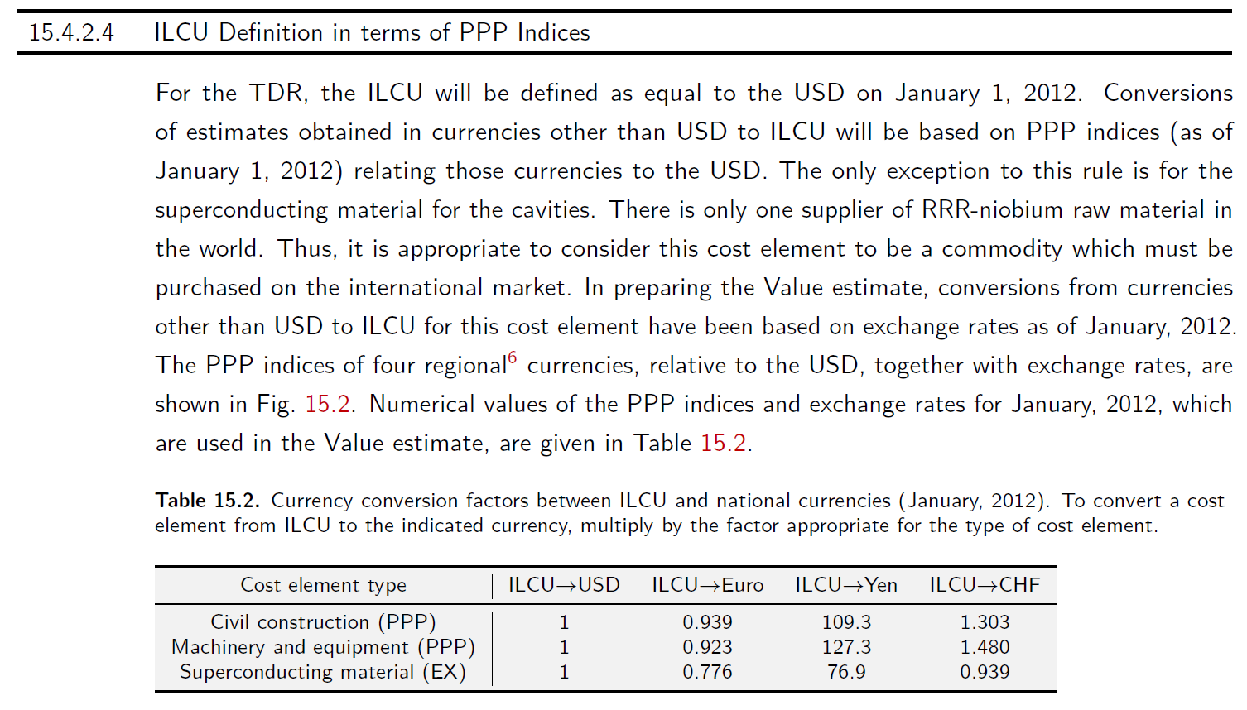
Reconfirmation of cost unit in ILC
ILCU (ILC unit) has been used as the cost unit for ILC since GDE era
Based on US dollars as of January 2012 (1 ILCU = $1)
TDR Vol.3 II

Slide 15
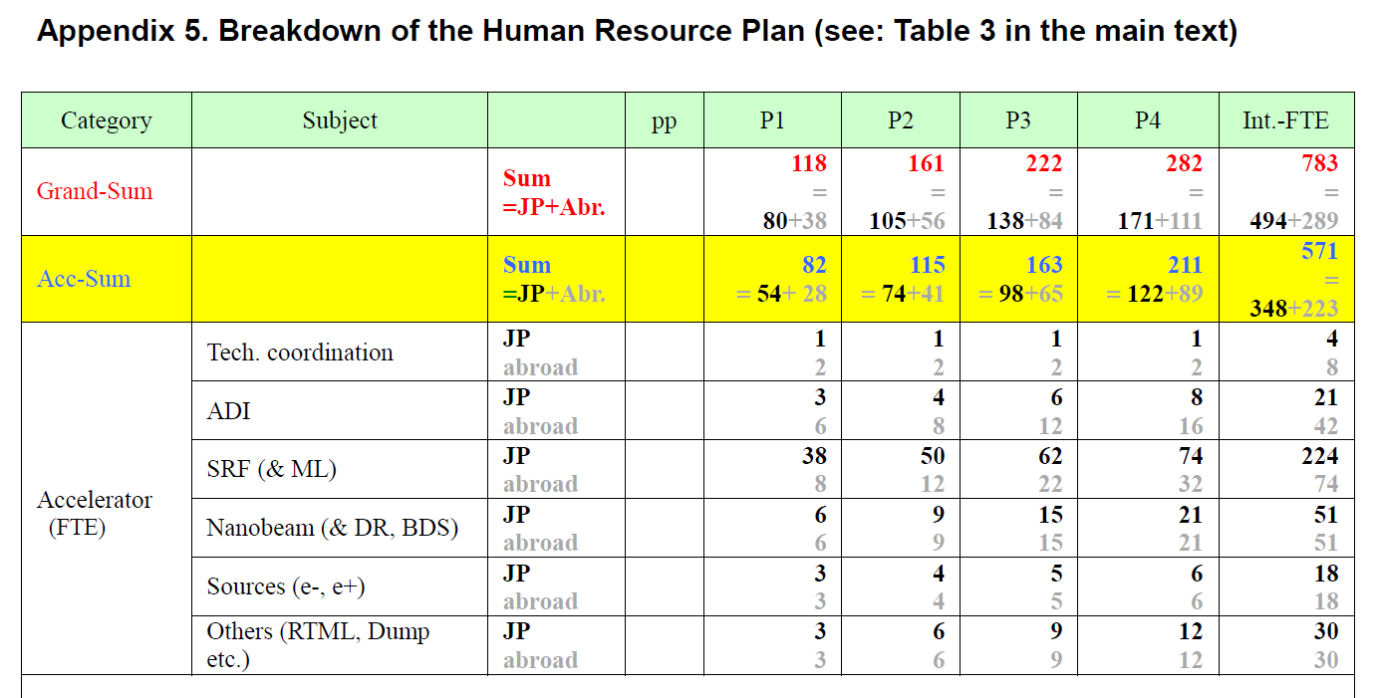
FTE-yr estimated in ILC Action Plan 2016
ML and SCRF has 224 (Japan) and 74 (abroad)
KEK ILC Action Plan 2016

Slide 16
IDT-WG2 organization
Bi-weekly Tuesday meeting: Sep.22, Oct. 6, 20,…
Charges of Sub-groups
Discuss and coordinate the topics for
- technical preparation (remaining topics) at Pre-lab
- preparation for mass production at Pre-lab
- possible schedule at Pre-lab
- international sharing candidates of these activities
Report to the IDT-WG2
IDT WG2
Shin Michizono (Chair)
Benno List (Deputy)
https://agenda.linearcollider.org/category/256/
SRF
Bi-weekly Tuesday
Oct.13,27,…
DR/BDS/Dump
Bi-weekly Tuesday
Oct.13,27,…
Yasuchika Yamamoto | KEK
Nuria Catalan | CERN
Enrico Cenni | CEA
Dimitri Delikaris | CERN
Rongli Geng | JLAB
Hitoshi Hayano | KEK
Bob Laxdal | Triumf
Matthias Liepe | Cornell
Peter McIntosh | STFC
Laura Monaco | INFN Milano
Olivier Napoly | CEA
Sam Posen | FNAL
Robert Rimmer | JLAB
Marc C. Ross | SLAC
Luis Garcia Tabares | CIEMAT
Hans Weise | DESY
Akira Yamamoto | KEK
Toshiyuki Okugi | KEK
Karsten Buesser | DESY
Philip Burrows | U. Oxford
Angeles Faus-Golfe | LAL
Jenny List | DESY
Thomas Markiewicz | SLAC
Brett Parker | BNL
David L. Rubin | Cornell
Nikolay Solyak | FANL
Nobuhiro Terunuma | KEK
Glen White | SLAC
Kaoru Yokoya | KEK
Mikhail Zobov | INFN LNF
All members belong to some sub-group(s).
Sources
Bi-weekly Monday
Oct.12,26,..
Kaoru Yokoya | KEK
Jim Clarke | STFC
Steffen Doebert | CERN
Joe Grames | JLAB
Hitoshi Hayano | KEK
Masao Kuriki | U. Hiroshima
Benno List | DESY
Gudrid Moortgat-Pick | U. Hamburg
Civil engineering
Nobuhiro Terunuma | KEK
John Andrew Osborne | CERN
Tomoyuki Sanuki | U. Tohoku
Ivan Podadera ivan.podadera@ciemat.es
Peter Sievers Peter.Sievers@cern.ch
Sabine Riemann<sabine.riemann@desy.de>
2pm UTC (6am US Pacific, 8am US Central, 2pm U.K., 3pm Geneva, 11pm Japan)

Slide 17
Main tasks in technical preparation period
based on “Recommendations on ILC Project Implementation”
Cavity and cryomodule production
100 cavities produced in preparation for mass production
~1% of full production
Japan: 50 cavities, other regions/countries: 50 cavities
By new cost-effective production method
Plug-compatibility re-confirmed/re-established
Surface preparation recipe baseline/guideline to be re-established
To be checked RF performance/success yield
High pressure gas regulation in Japan (cavity/cryomodule production)
Coupler/Tuner improved/produced/assembled/tested
Superconducting magnet (quad.+dipole combined) in CM to sustain under dark current irradiation from high-gradient SRF linac
Cryomodule (CM) production/test
Cryomodule transport (“Global Cryomodule transfer”)
Shipment/transport incl. inspection
RF performance rechecked after transport
Crab cavity is listed additionally as third issue

Slide 18
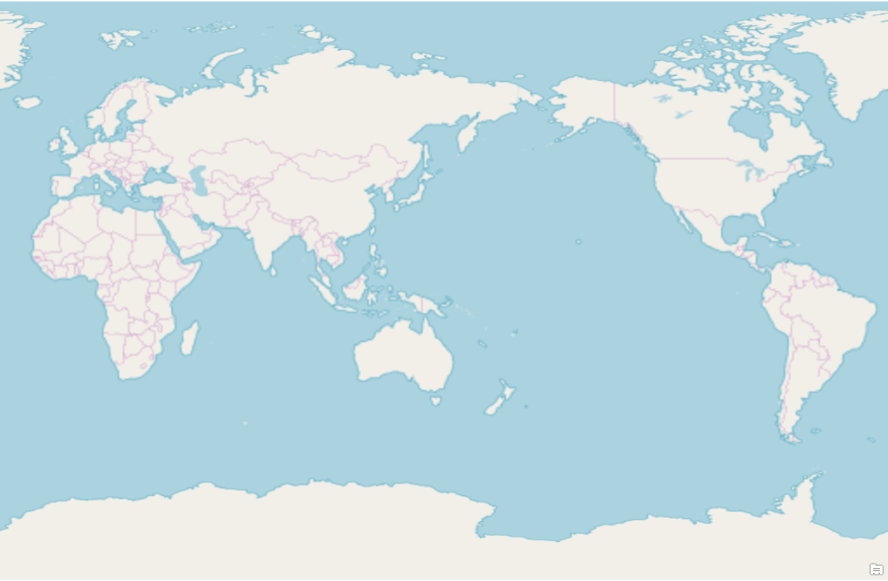
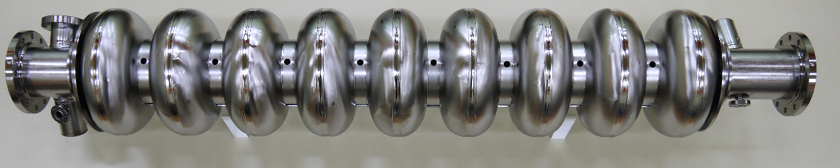
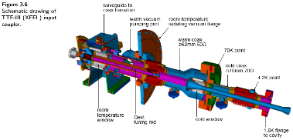
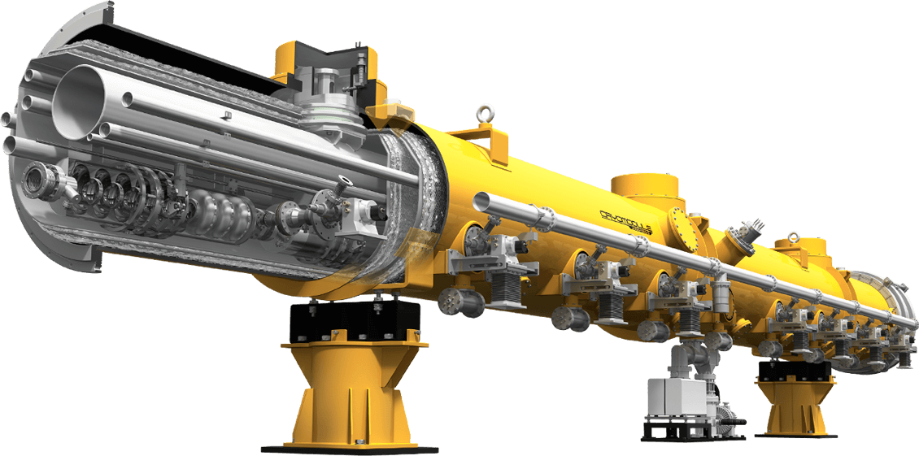
Update of # of cavity/cryomodule produced in technical preparation period
Before this production starts, tuner design should be fixed!!
Done by Japan-U.S. collaboration
Europe
Japan
Americas
x ?
30 + 30
50
From Matthias’s report
x ?
16 + 16?
>16
x ?
2 + 2
>2
We think the first CM should be satisfied with HPG
In the both plans of Japan and Americas, upgrade of infrastructure as function of hub-laboratory is also included!

Slide 19
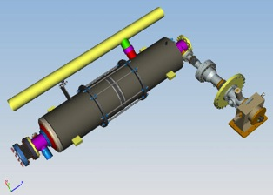
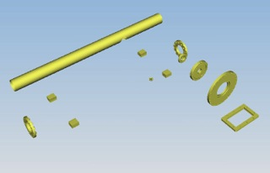
Plug-compatible Conditions in TDR
SRF-Report at ILC-PAC
12/05/14, 12/12/13
Interface and Process established, in TDR, 2013
Item | TDR Baseline
Cavity shape | TESLA
Length | Fixed, L = 1,247 mm (61 mm shorter than XFEL)
Beam pipe flange | Fixed
Suspension pitch | Fixed
Tuner | Blade
Coupler flange (cold end) | 40 mm
Coupler pitch | Fixed
He –in-line joint | Fixed

Slide 20
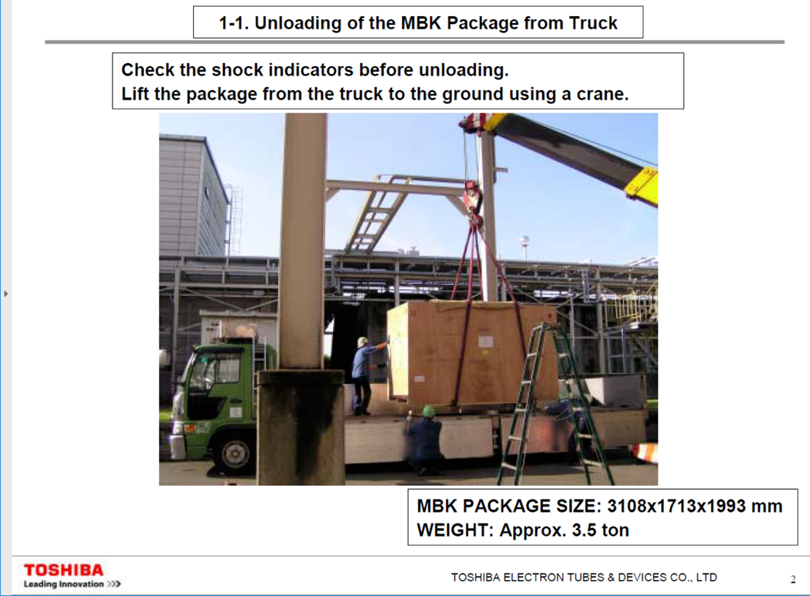
Global cryomodule transfer in technical preparation period
T.B.D.
Europe
Japan
Americas
conforming to high-pressure gas regulation
Multi-beam klystron transportation from Japan to EU
New CM production/test
@America/EU
Transportation
(Surface shipment)
CM inspection/test @Japan
Note: Returning the CMs to Europe/Americas for redundant confirmations, to be discussed.

Slide 21
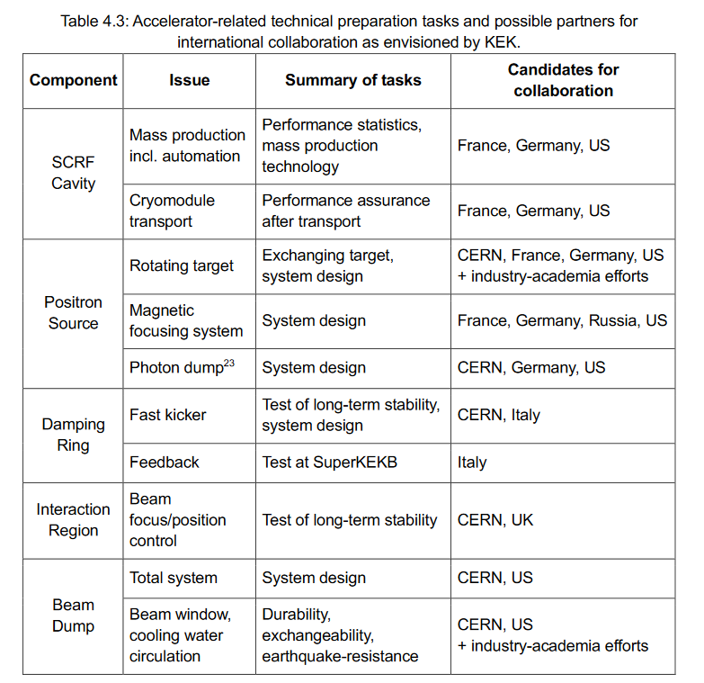
Preparation for task list/budget request
Michizono-san and Kirk are preparing for document and task list including budget request for the technical preparation period.
We will submit the preliminary version to EB early December.
Then, the SRF subgroup has to fix the task list until the end of this month.
Budget request will be added
Name of laboratories will be added
Component | Issue | Task | Candidates
CM SCQ(+D) | Sustainability against SRF dark current | Absorb heating and not causing quench | US and Spain
Tuner | Design not fixed | Reconfirmation Wider range piezo | Japan and US
Crab cavity is listed additionally as third issue
If you don’t have any other input, we can fix these two (plus one) tasks as the list of SRF

Slide 22
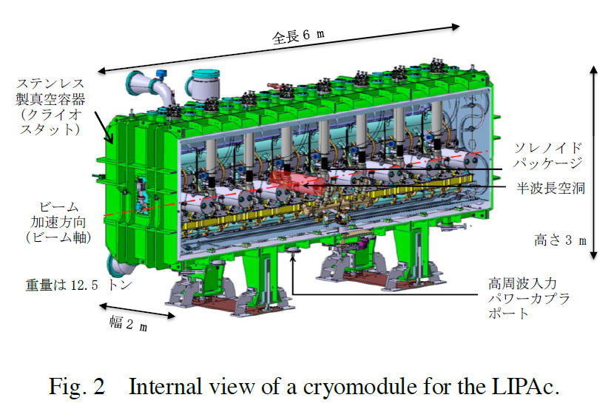
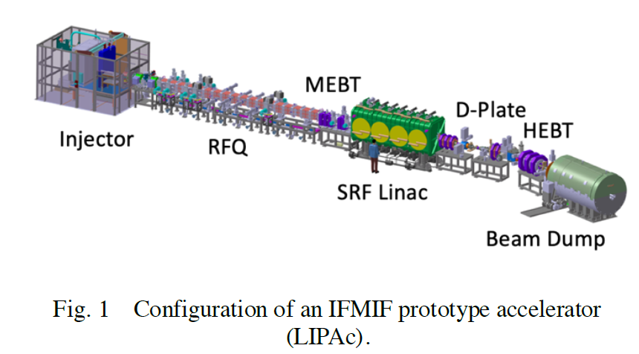
High pressure gas regulation and schedule of cavity/CM production
Regarding high pressure gas (HPG) regulation, KEK is currently trying to launch a task force.
Recently, cavities and cryomodule components produced in Europe have been delivered to Rokkasho for IFMIF project.
After the delivery, every part including cavity string is assembled at Rokkasho (under prgress).
I think we can learn a lot from this experience.
Mr. Kasugai replied that he may provide his presentation reviewing his effort for IFMIF, and possibly at LCWS2021.
We will have a first meeting about HPG between KEK and QST on 25/Nov.
As a proposal, since it is impossible to manufacture cavities compatible with HPG in the first year of the technical preparation period, we will manufacture 10 cavities that are not compatible only in the first year. If we decide to manufacture a cavity compatible with HPG from the next fiscal year and later, it will open the way for the ILC to be used as spare cavities, which will be an effective utilization measure.
For construction of CM, we think that the "global transfer" cryomodule program shall start from the beginning of the technical preparation period, in order to properly satisfy the HPG regulation process in Japan.
There are two different types of rules (general rule and cryoplant rule (cryo-plant in refrigeration mode with closed gas-flow circuit)) in HPG in Japan. We think cryoplant rule is preferable for ILC.
It is necessary to discuss/consider this matter more with many experts.
Linac and CM in IFMIF
(courtesy of Kasugai-san)

Slide 23
Brief view of High-Pressure Gas Regulation
Step 1 (discussion)
Before cavity/CM production, we need to discuss with KHK (authority of HPG in Japan)
KHK requests to submit necessary documentations (material certificate, EBW method, simulation results related to mainly mechanical crush, etc.)
KHK may request Charpy impact test for Nb material
KHK may request TIG welding test between cavity and helium tank
Step 2 (production)
Cavity/Cryomodule production satisfying high pressure gas regulation
KHK may stand by during production
Step 3 (inspection)
Must undergo completion inspection for cavity
These issues will be drastically changed in case of RS ordinance!

Slide 24
Required number of cavities, and performance improvement by recent surface treatment for ILC
Recently, some ideas for improving cavity performance (mainly Q₀ value) have been tested.
Even if these attempts of cost down R&D are successful, we will not reduce the number of cavities required for the ILC-250 presented after TDR.
The performance improvement achieved after TDR is considered as an additional margin (insurance).
And, it will be positioned as a technology for more efficient and appropriate upgrades in the future.
The performance of the cavities manufactured during the preparation period shall also satisfy the specifications of TDR.
Further, for the purpose of improving the cavity performance, the number of recent surface treatments has been increasing, but it is also a factor of cost increase.
In the first place, it is necessary to consider cost effective improvement while maintaining the spirit of cost reduction.
The selection of niobium material and surface treatment method can be finally selected in each country or each laboratory.
Similarly, it is necessary to agree that each country or each laboratory is responsible for the cost increase associated with it.
We plan to hold a session at LCWS2021 (around spring in 2021) to discuss cost reduction R&D, and which is the best method. Probably also in TTC meeting 2021.

Slide 25
Accelerator activities at ILC Pre-lab phase
Presented by S. Michizono in IDT-EB meeting
Technical preparations /performance & cost R&D [shared across regions]
SRF performance R&D, quality testing of a large number of cavities (~100), fabrication and shipping of cryomodules from North America and Europe (for validating shipping)
Positron source final design and verification
Nanobeams (ATF3 and related): Interaction region: beam focus, control; and Damping ring: fast kicker, feedback
Beam dump: system design, beam window, cooling water circulation
Other technical developments considered performance critical
Final technical design and documentation [central project office in Japan and possibly regional project offices ]
Engineering design and documentation, WBS
Cost confirmation/estimates, tender and purchase preparation, transport planning, mass-production planning and QA plans, schedule follow up and construction schedule preparation
Site planning including environmental studies, CE, safety and infrastructure (see below for details)
Review office
Resource follow up and planning (including human resources)
Preparation and planning of deliverables [distributed across regions, liaising with the central project office and/or its satellites]
Prototyping and qualification in local industries and laboratories, from SRF production Iines to individual WBS items
Local infrastructure development including preparation for the construction phase (including Hub.Lab)
Financial follow up, planning and strategies for these activities
Civil engineering, local infrastructure and site [host country assisted by selected partners]
Engineering design including cost confirmation/estimate
Environmental impact assessment and land access
Specification update of the underground areas including the experimental hall
Specification update for the surface building for technical scientific and administrative needs
Technical preparation
Engineering Design Report (EDR)
Planning and preparation of Hub lab.
Civil engineering

Slide 26
Assumed Pre-lab timeline
Presented by S. Michizono in IDT-EB meeting
For Engineering design
1st year: Work on TDR-based cost-estimate confirmation, started by an international team centered on the Pre-lab.
2nd year: Complete the cost-estimate confirmation, and an internal review in the latter half of the 2nd year.
The review also reports on the progress of technical issues during the preparation period.
3rd year: Conduct an external review and completed scrutiny of costs and risks.
Complete the draft of Engineering Design Report (EDR).
4th year: Publish EDR (in first half yr), report progress on technical issues,and prepare each large bid.
For technical preparation (example of SCRF and positron)
1st year: Extend SCRF cost reduction R&D, Start a pre-series SCRF cavities production preparing for industrialization
Continue positron survey
2nd year: Complete SCRF cost-reduction R&D, and extend the work to assemble the cavities with cryomodule (CM),
Select positron scheme
3rd year: Demonstrate “Global CM transfer, aiming at HPG legal-process, shipment, and SRF QA test after transport
Mature Lab. planning and preparation
Prototyping of critical items (such as positron target)
4th year: Evaluate CM performance based on CM shipment, and prepare for Hub Lab. functioning
Progress prototyping of critical items (such as positron target)

Slide 27
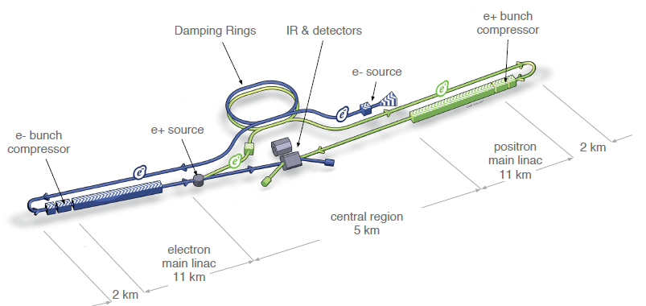
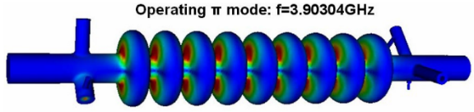
Kick-off meeting for crab cavity
Crab cavity system is essential for ILC
No progress after TDR
Prototype CM is necessary (Nomura Research Institute, Ltd. considered not-matured technology)
Kick-off meeting will be held 30 min earlier before next SRF subgroup meeting on 24/Nov
Expected attendees: SRF subgroup, BDS subgroup, UK members related to crab cavity R&D in TDR, Crab cavity members for HL-LHC (?)
Discussion items: Work list in technical preparation period, Cavity design, Responsible laboratories, etc.
For higher luminosity
ILC RDR parameter, by CAIN simulation
Cavity design presented in TDR
Not using crab cavities reduces luminosity by 80%!

Slide 28
Pre-Lab schedule (translated into table)
 | Technical preparation period (Fiscal year)
Items | 1 |  | 2 |  | 3 |  | 4
Cost down R&D
Cost estimation based on TDR
Review |  |  |  | Internal | External
Engineering design report |  |  |  |  |  | Draft | Publish
Prototyping of critical items
Preparation for mass-production technology
These schedules are under discussions!
Writing
We have to fit the SRF schedule to this overall schedule!

Slide 29
Brief view of cavity production by cost-effective method, and the best recipe
Step 1 (production)
Cavity production by cost-effective method incl. selection of Nb material
Reconfirmation of plug-compatibility (only flanges)
Not necessary for satisfying high pressure gas regulation of Japan
Not necessary for helium tank
Step 2 (decision of surface/heat treatment methods)
Cold temp. EP or standard EP?
N-dope, N-inf, Low temp. baking, Mid temp. baking, etc.?
Step 3 (RF performance check)
VT1, but if not successful, VT2 done (after VT3, to be discussed)
Step 4 (success yield)
Estimate success yield for 1st pass and 2nd pass (after 3rd pass, to be discussed)
Technical workshop is necessary
Technical workshop is necessary

Slide 30
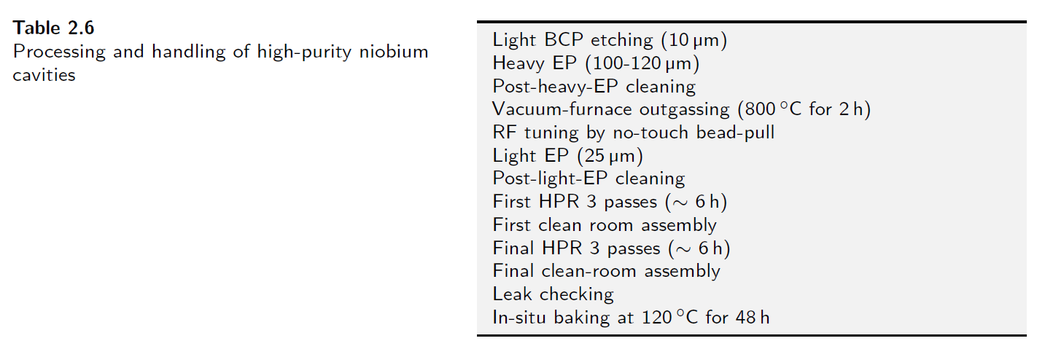
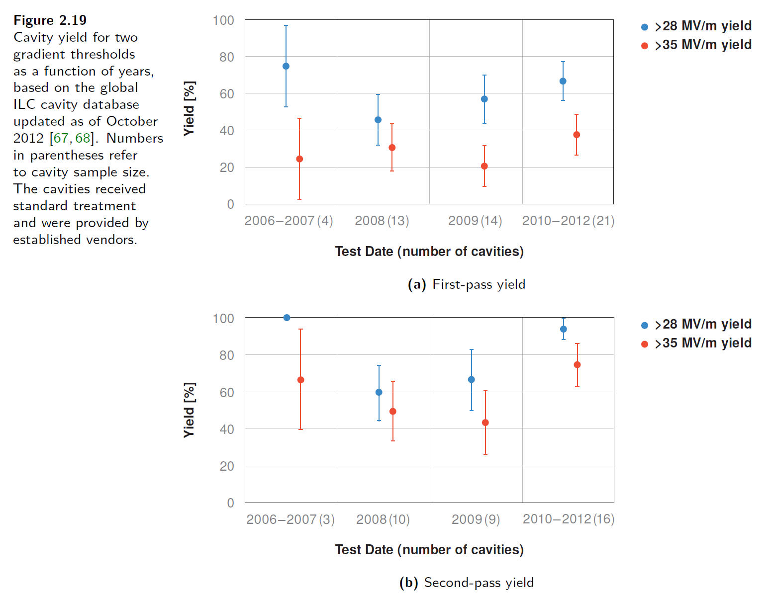
How many cavities are produced for mass production?
We can refer Volume 3 Part 1 in TDR.
At that time, 16 9-cell cavities (out of > 50 cavities, recognized as identical in fabrication and surface process) were used to evaluate cavity performance.
In the preparation phase, at least ~ 20 or much more cavities are necessary to evaluate recent surface treatment method including fabrication method much advanced since TDR.
Not only surface treatment method but also what type of Nb material/fabrication method is used has to be discussed.
Discussion item
Treatment method in TDR
History of cavity performance
When we evaluate success yield of cavity performance,
each region/lab. has to select one method of fabrication and surface process.
But, we don’t need world-unified method of fabrication and surface process.
Helium tank/tuner are not necessary for this evaluation
# of cavities | Japan (/Asia) | Americas | Europe
w/o helium tank/tuner | 20 | 20 | 20
w/ helium tank/tuner
At least 20 cavities are produced

Slide 31
Brief view of “Global CM transfer”
Step 1 (production)
Cavity/Cryomodule production satisfying high pressure gas regulation
Step 2 (performance check)
Checking RF performance and success yield in each region
Step 3 (transport)
Designing/developing cage and shock damper
Inspecting vacuum pressure and mechanical damage after transport
Step 4 (performance re-check)
Re-checking RF performance and success yield in Japan (maybe in others)

Slide 32
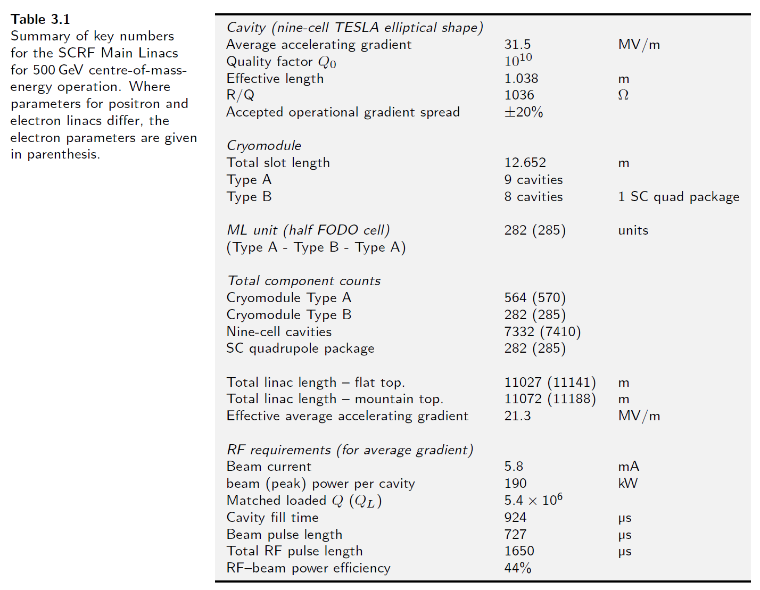
How many cryomodules are produced for mass production?
ILC needs two types of cryomodules; Type A and Type B.
Any laboratory has never produced same types of CM as ILC.
High pressure gas regulation of Japan should be also satisfied for ILC.
As first step, each region produces one prototype CM (not necessary for conforming high pressure gas regulation).
Type B is preferred, as it includes systems of SC-Q magnet/cold BPM.
Prototype CM is produced and tested in each region.
As second step, each region produces at least one CM conforming high pressure gas regulation of Japan.
That CM (Type B is preferred) is produced and tested in each region.
If possible, Type A can be also produced.
As final step, each region carries out global CM transfer to Japan.
CM produced in second step is available.
Discussion item
# of cavities/couplers/CMs | Japan (/Asia) | Americas | Europe
Cavity | 16 + spare | 16 + spare | 16 + spare
Power coupler | 16 + spare | 16 + spare | 16 + spare
Cryomodule | 2 | 2 | 2

Slide 33
Brief report of KEK-DOE meeting
The meeting done at 7:00~8:22 on 27/Oct (JST)
Organized by A. Lankford
35 people attended
Japan: S. Michizono, A. Yamamoto, K. Yokoya, N. Terunuma, Kirk
Members of SRF subgroup in Americas: R. Rimmer, M. Liepe, R. Laxdal, R. Geng, S. Posen
Michizono-san presented ILC overview, IDT, technical preparation, budget request from KEK, Recommendations on ILC Project Implementation, SCRF, positron source, damping ring, final focus system, beam dump, potential US accelerator contribution, and so on.
A lot of discussions/questions/comments

Slide 34
Brief report of SRF session in AWLC2020
20 impressive presentations incl. three large-scale operating/on-going projects
Presentation time was too short! Necessary to be considered in next LCWS
Each topic:
E-XFEL by Nick; Four degraded cavities during operation, Stable RF availability, Piezo has impact on beam dynamics
LCLS-II-HE by Mattia; 2/0 doping was chosen as standard recipe, Cold temperature (<13℃) EP used, Higher Q₀/E_{acc} than LCLS-II was already achieved in CM test
PIP-II by Genfa; Two CMs (HWR and SSR1) constructed/tested and testing, common design of 325/650 MHz CMs
Tuner by Yuriy; LCLS-II tuner is strong candidate for to ILC (no design changes required), piezo study is necessary
Power coupler by Denis; 776 couplers operated stably, 4 couplers had no conditioning and overheating, Much higher power operation is necessary for ILC
Robotics by Stephane; Robotics study is under progress using ESS cavities, Goes to assembly of flange/coupler in future

Slide 35
Mission of SRF subgroup in IDT/WG2
List work items in ILC preparation period
Plug-compatibility of design to be re-confirmed/re-established
Mass production
Global CM transfer
Any other?
List technical concerns (if any)
Although E-XFEL has been successfully constructed and operated (and LCLS-II also in progress), are there any concerns for ILC to be constructed in Japan?
High pressure gas (HPG) regulation to be globally handled
In Japan, IFMIF (@Rokkasho) requested CM construction to EU (satisfied with HPG regulation)
Contents specialized in Japan?
List human resources/budget/schedule for each work item and in each region/lab.
Necessary to discuss how to share each work item for each region/lab.

Slide 36
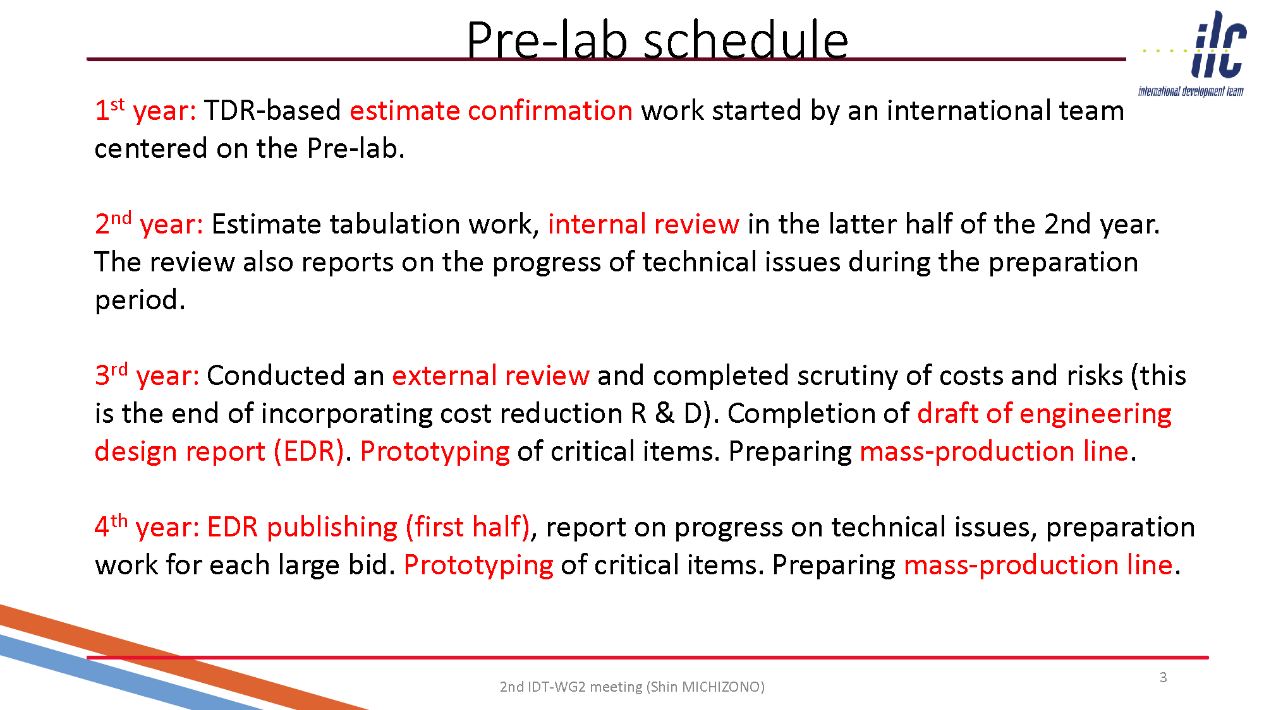

Slide 37
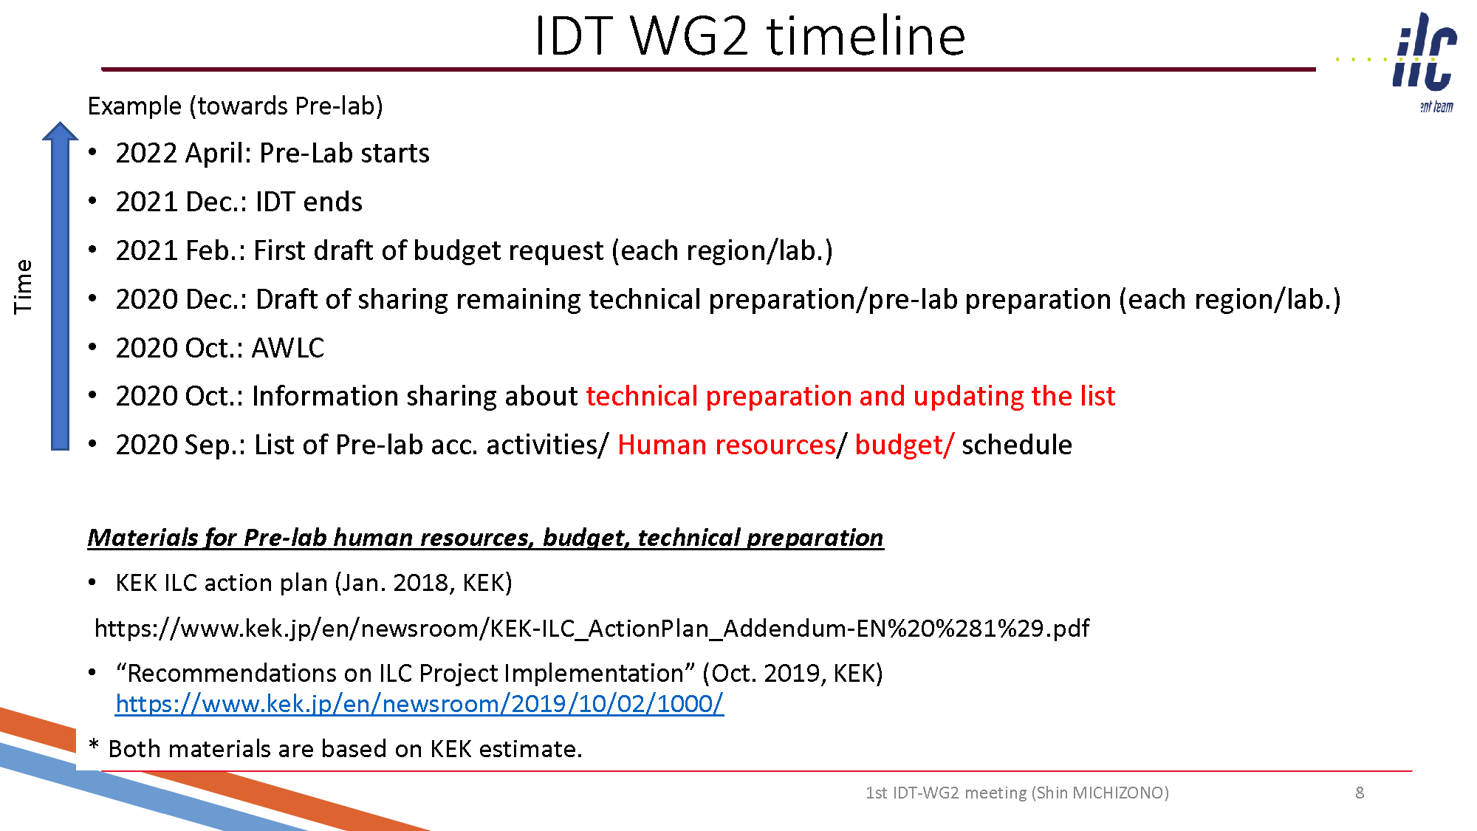
2021, Submission of budget request in each region/lab,
(2021, early Summer: Submission of budget request to MEXT, in case of Japan)

Slide 38
Progress of High-Pressure Gas Safety Act in Japan
Two categories in Japan (see next slide by Nakai-san)
General High-Pressure Gas Safety (General HPGS) Ordinance (Regulations)
Refrigeration Safety (RS) Ordinance
Current status of KEK as follows (due to historical reason since 1970’s)
SC Magnet systems have (mostly) moved to the RS Ordinance
SC Cavity (SRF) systems have (mostly) stayed at the General HPGS Ordinance
Recent advances in new SRF cavity/CM projects in Japan, as follows
RILAC SRF cavities @RIKEN with the RS Ordinance → in operation since 2020
IFMIF SRF cavities @QST with RS Ordinance → under construction
We are considering “Refrigeration Safety Ordinance” is suitable for ILC, instead of “General High Pressure Gas Safety Ordinance”!
(See more explanation following)

Slide 39
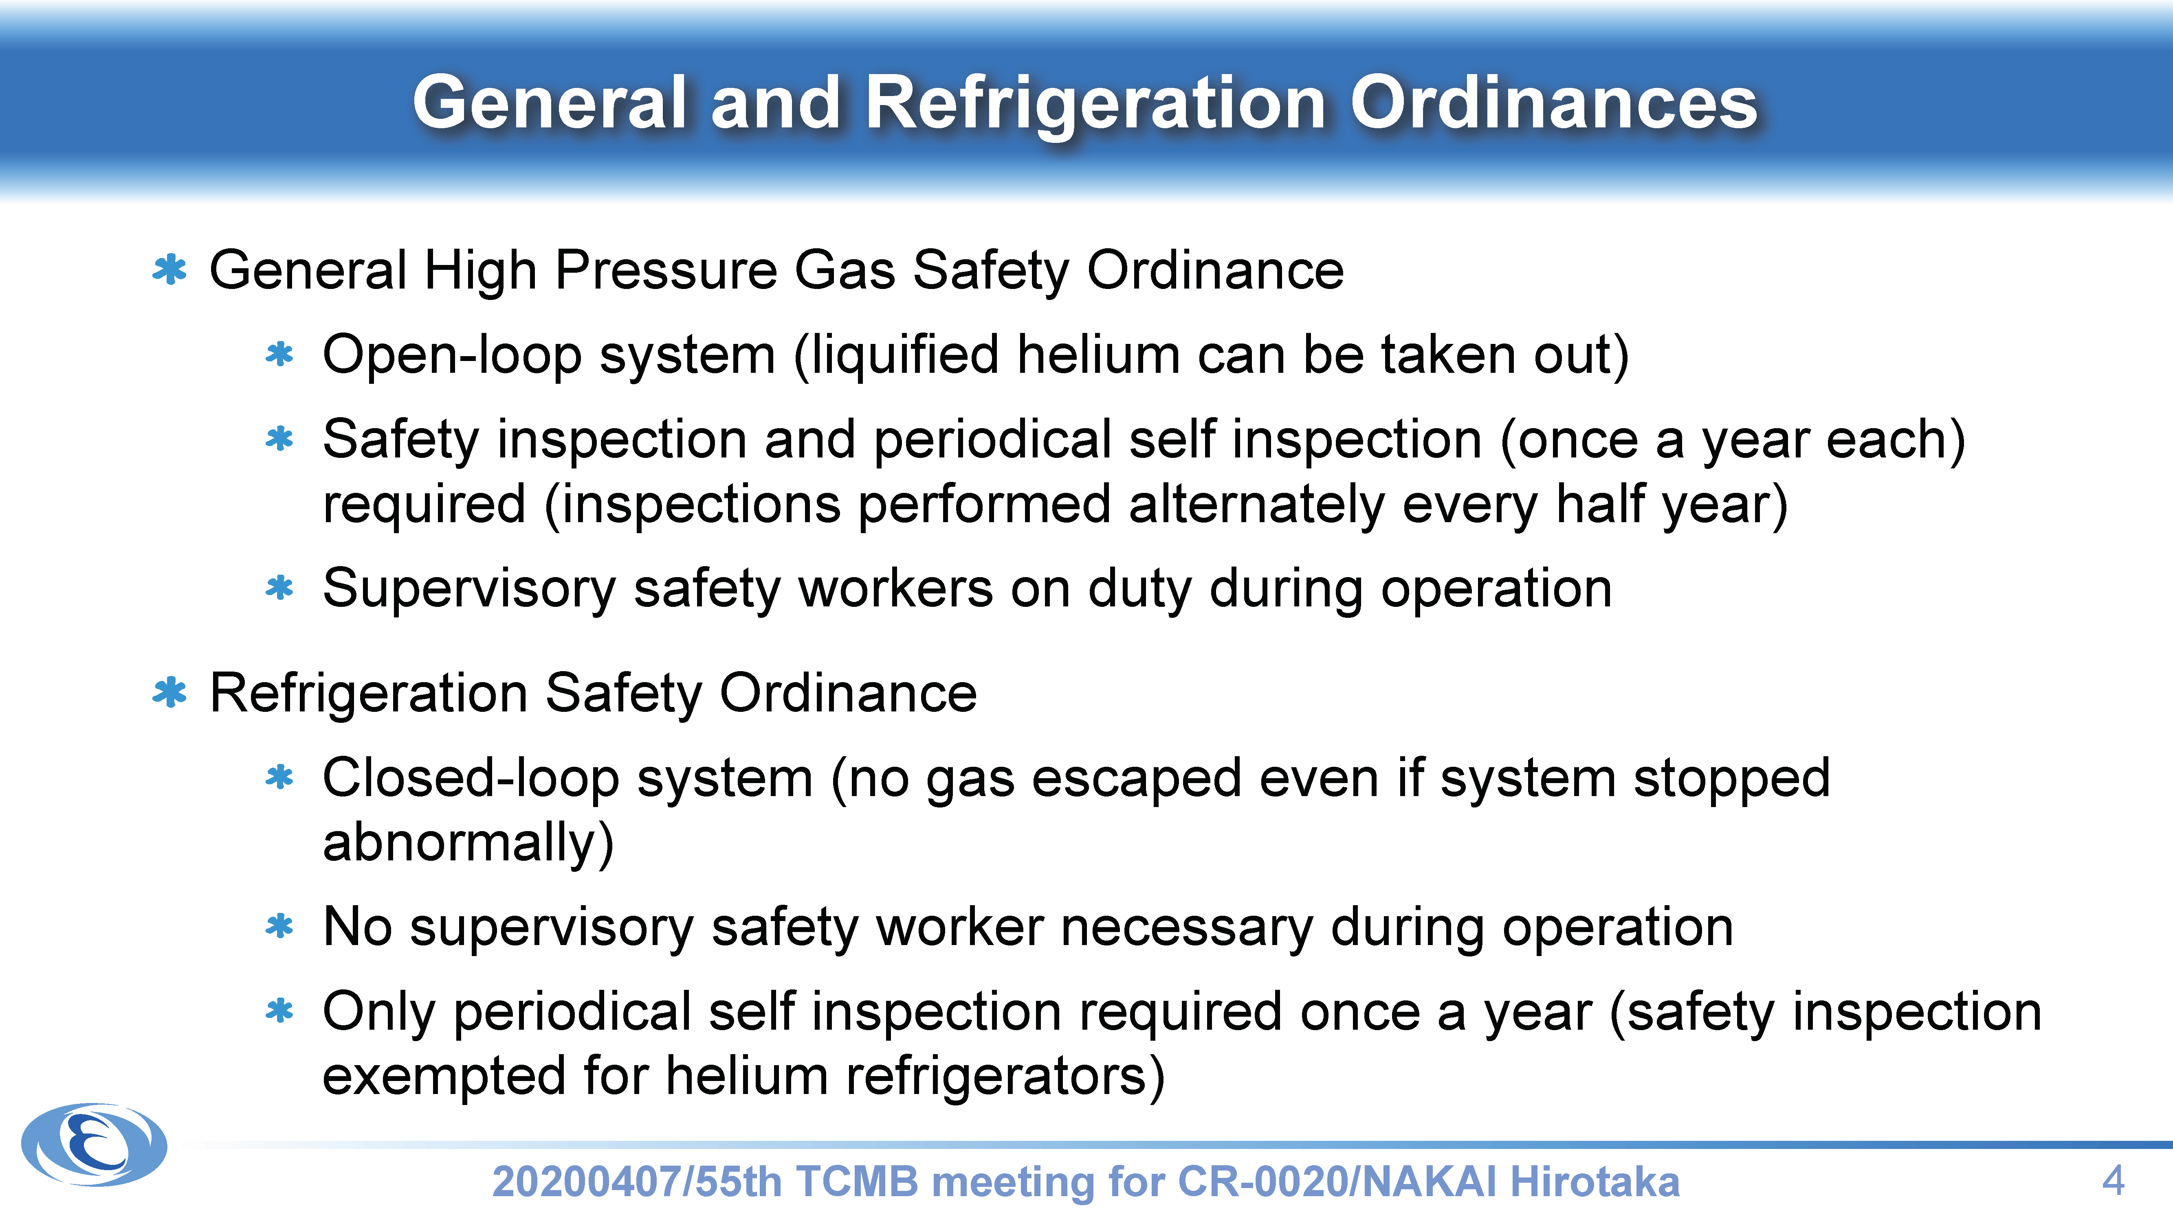

Slide 40
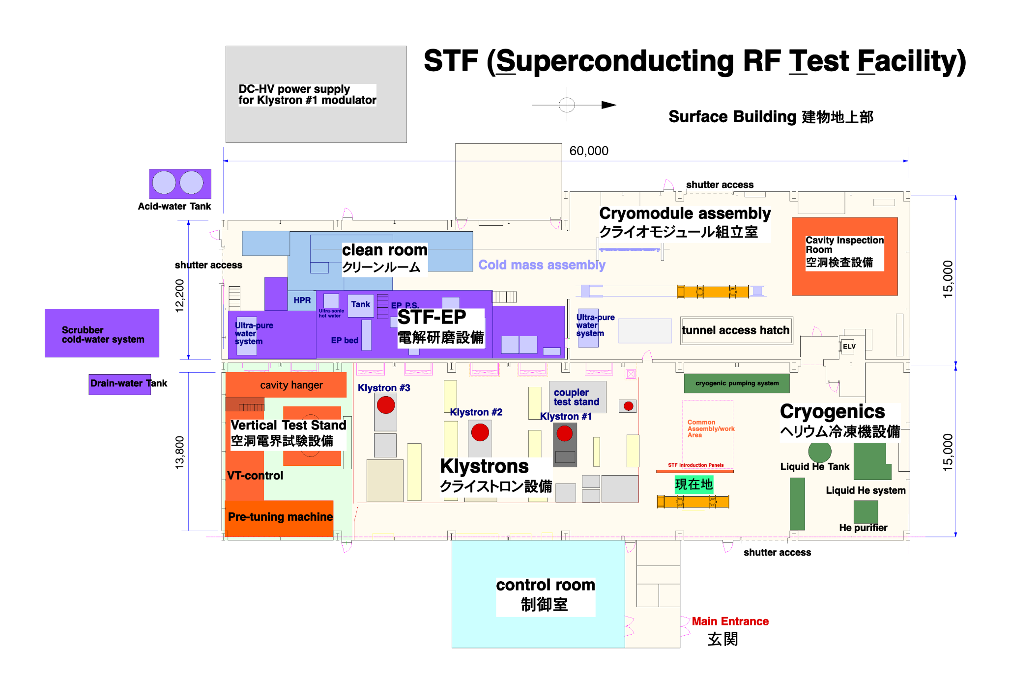
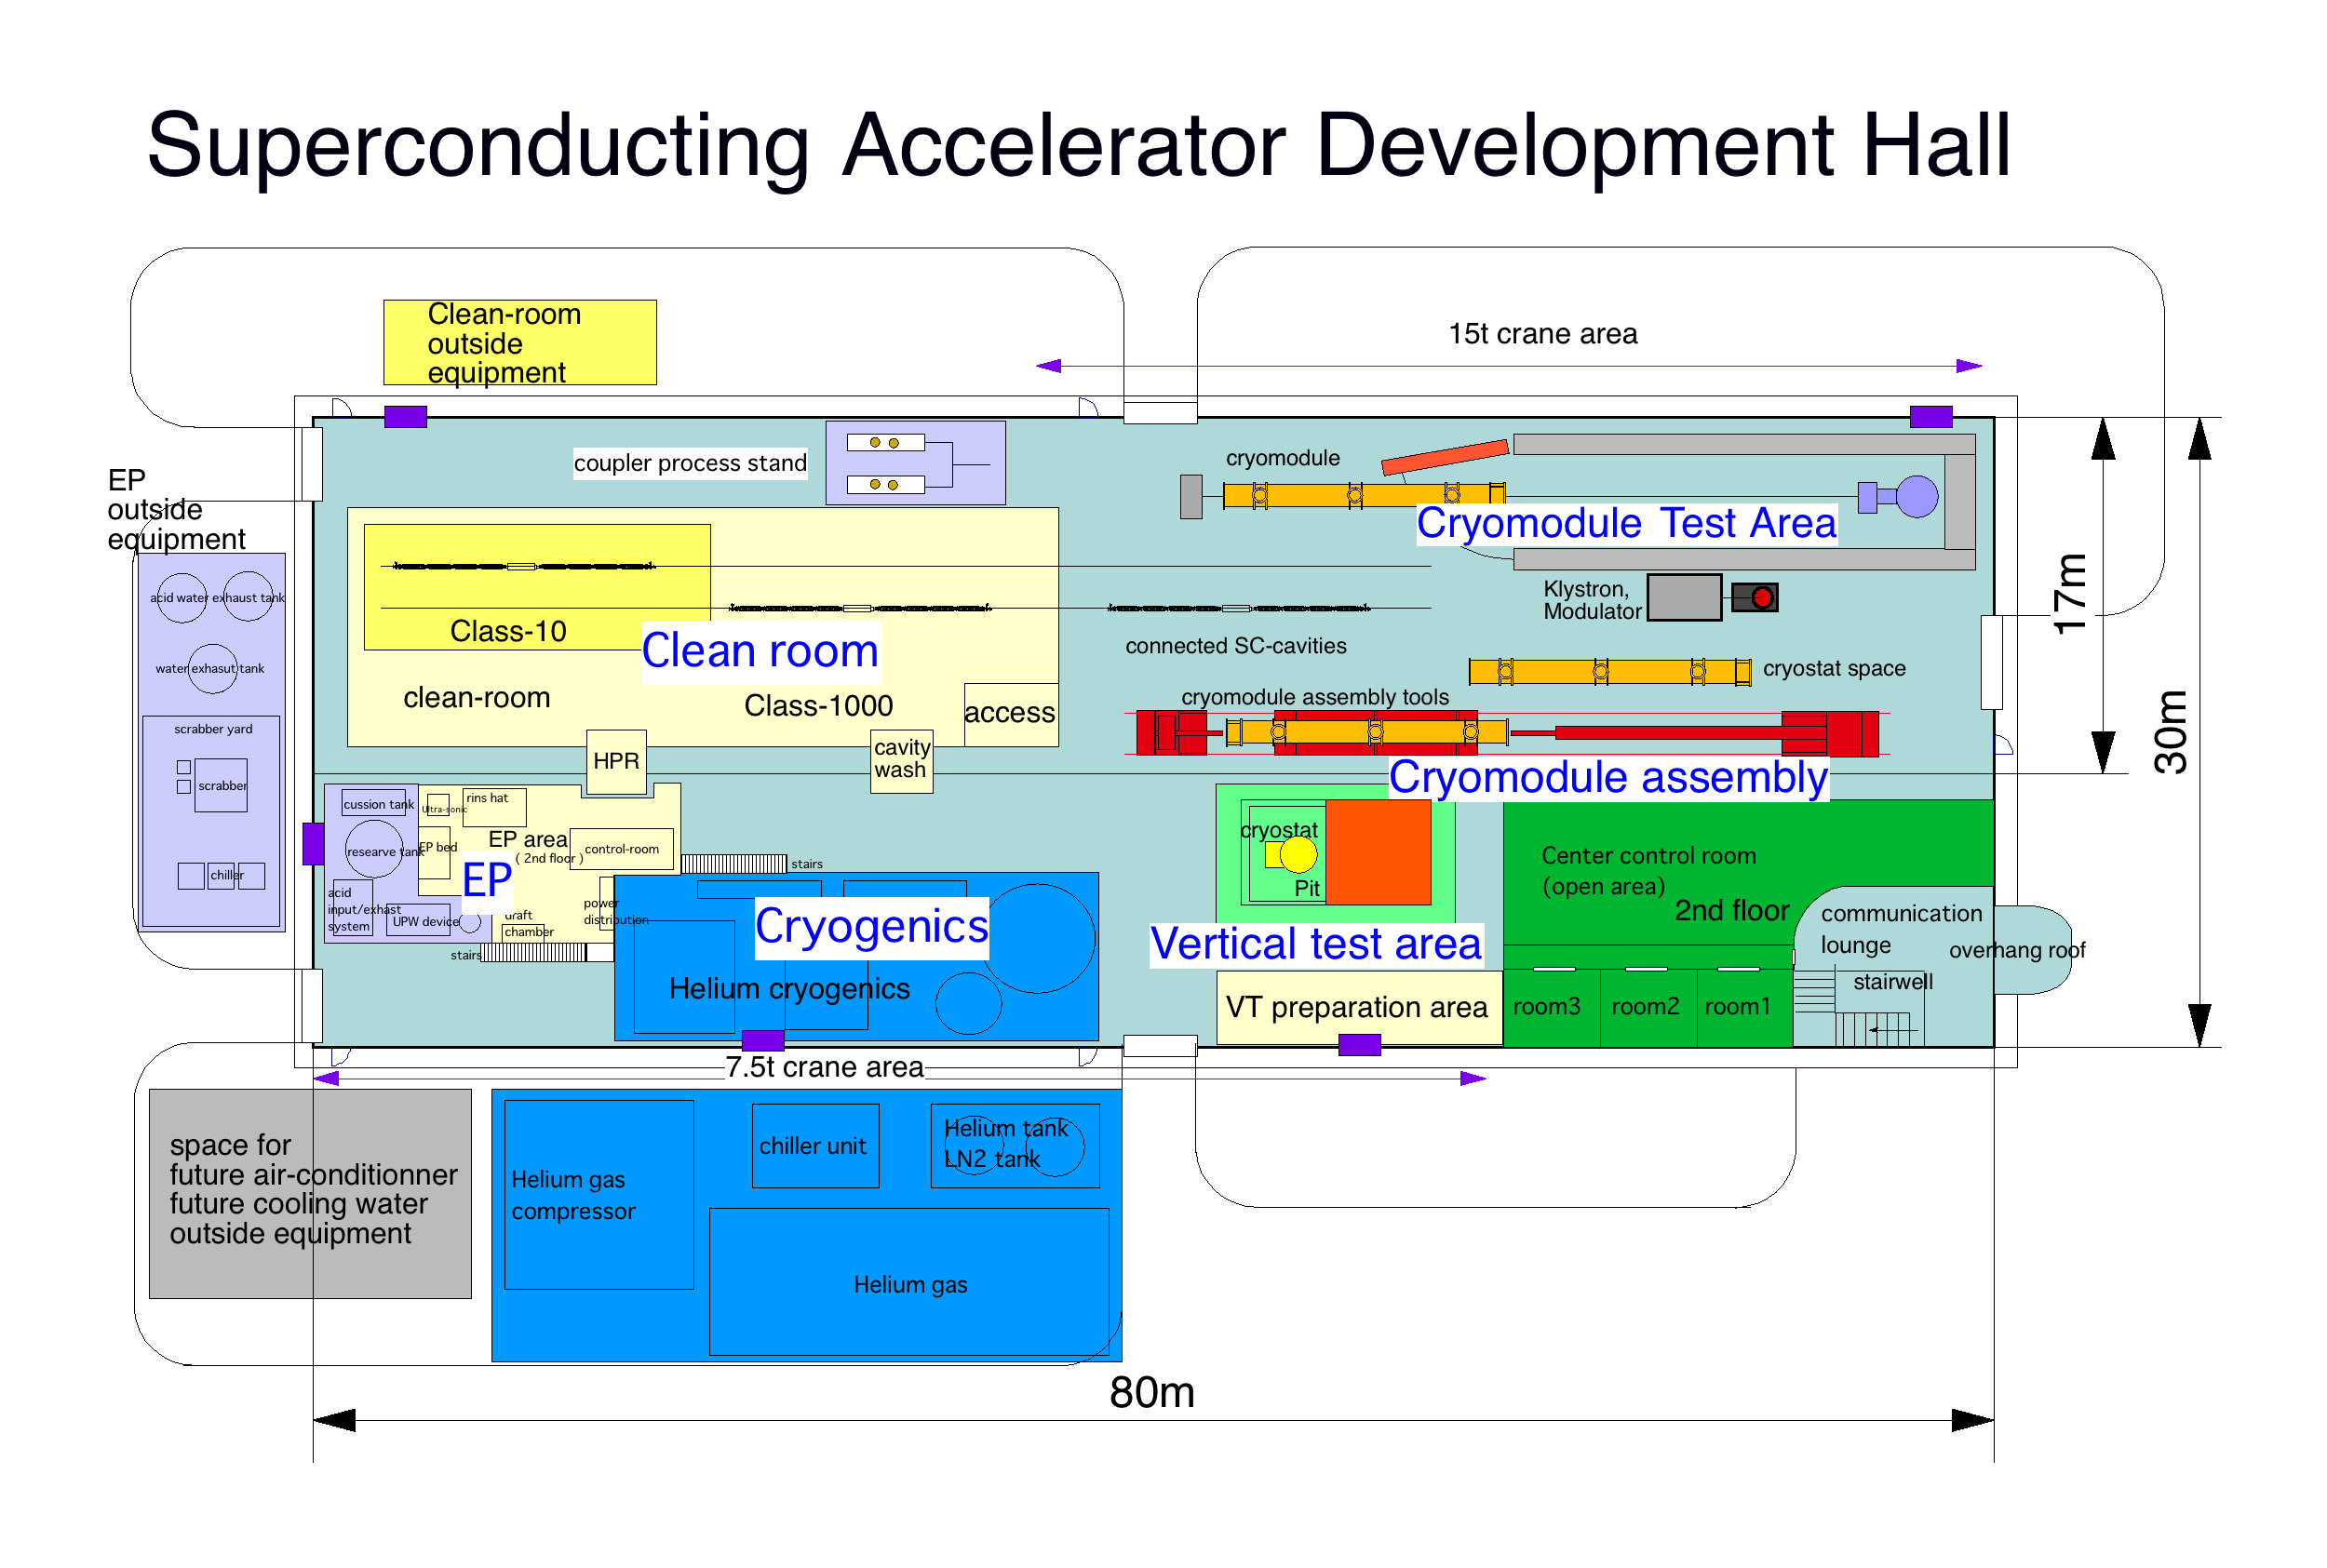
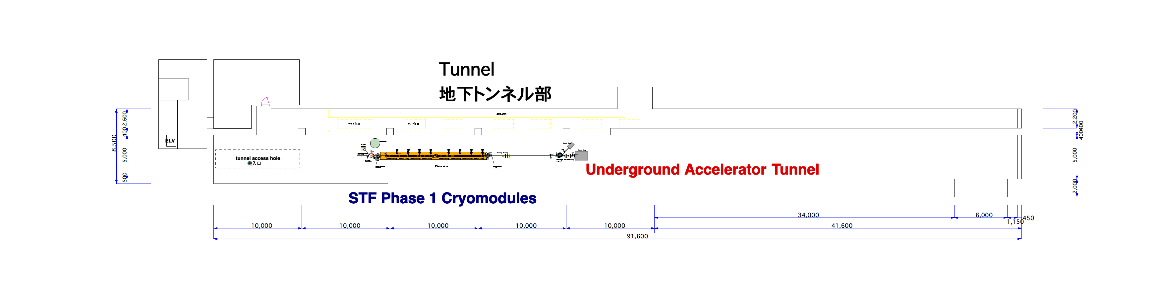
Schematic view of STF/COI in KEK (Current Status/Plan)
STF
(ground level)
COI
CM test cave
(for WP-2 “CM transport”)
General High Pressure Gas Safety Ordinance
General High Pressure Gas Safety Ordinance, currently, and a possibility to convert to Refrigeration Safety Ordinance to be investigated.
STF
(tunnel)

Slide 41
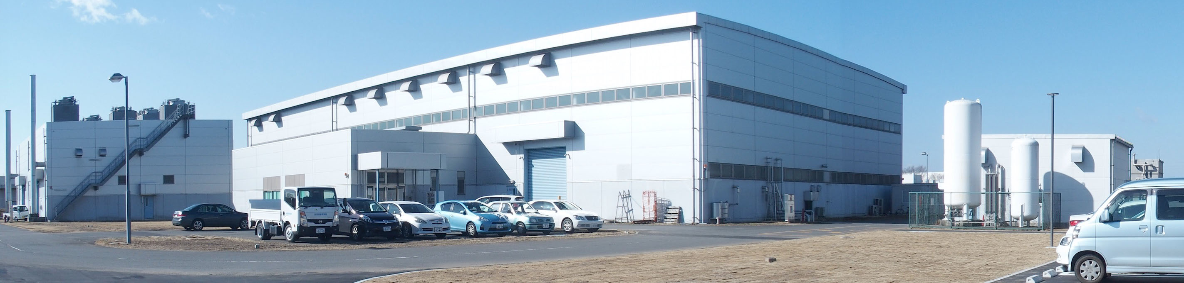
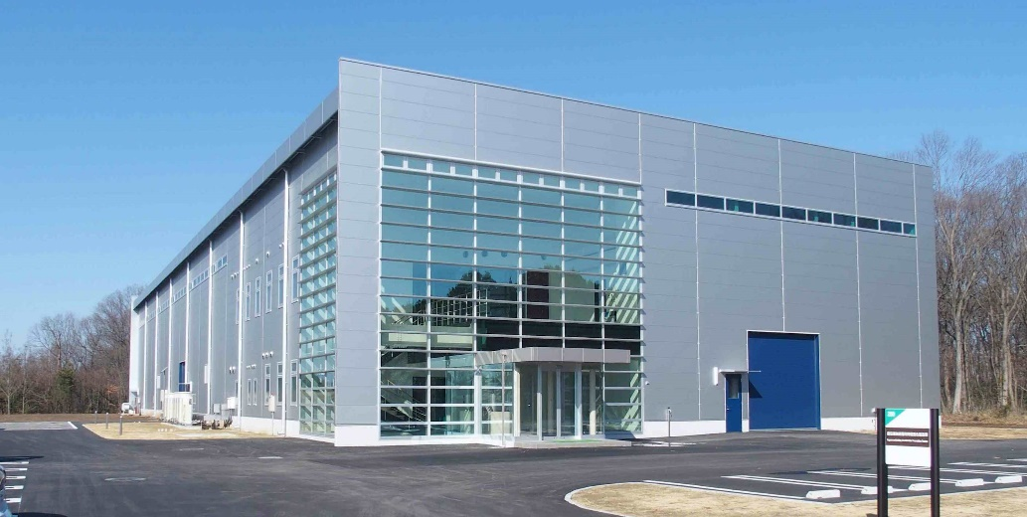
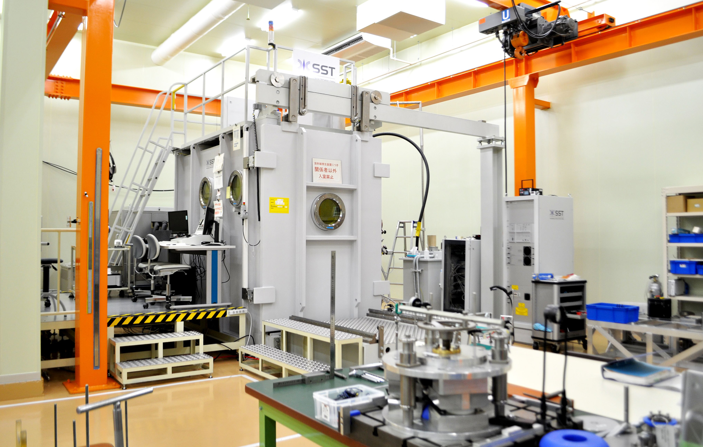
In case of Japan (KEK)…
Demonstration of beam acceleration satisfied with ILC spec.
STF
Infrastructure upgrade for hub-lab. is mandatory!
COI
CFF
Mass production of CM
Mass production of cavity

Slide 42
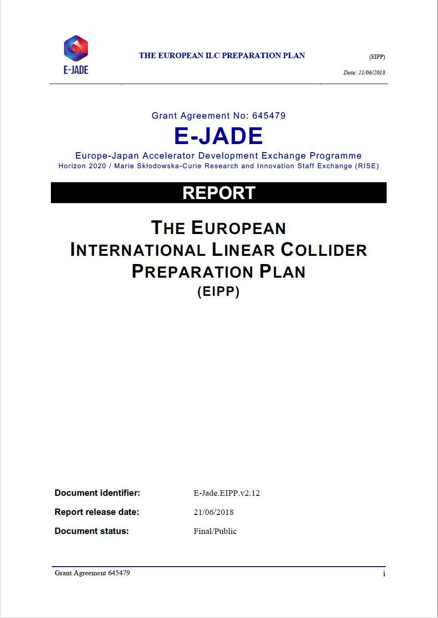
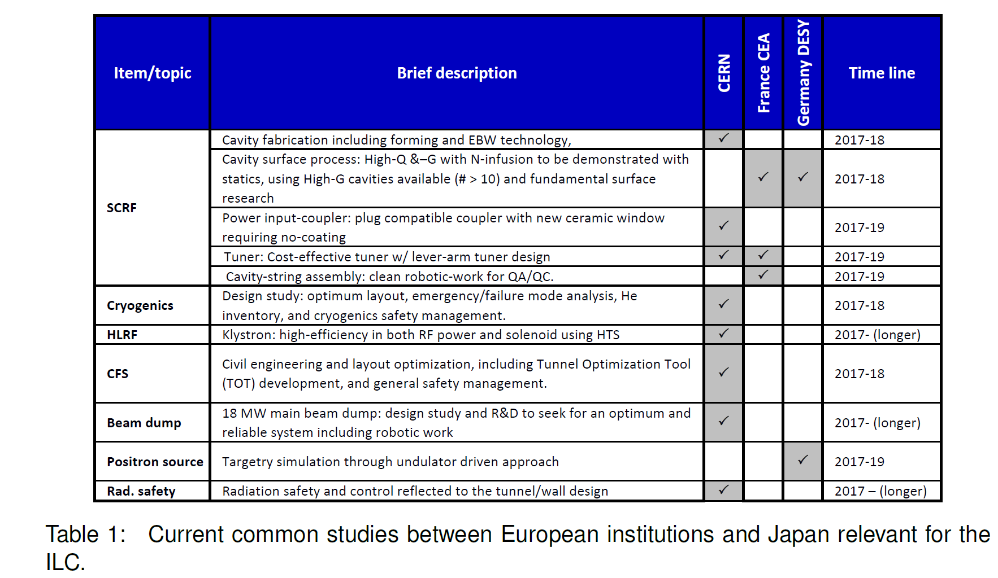
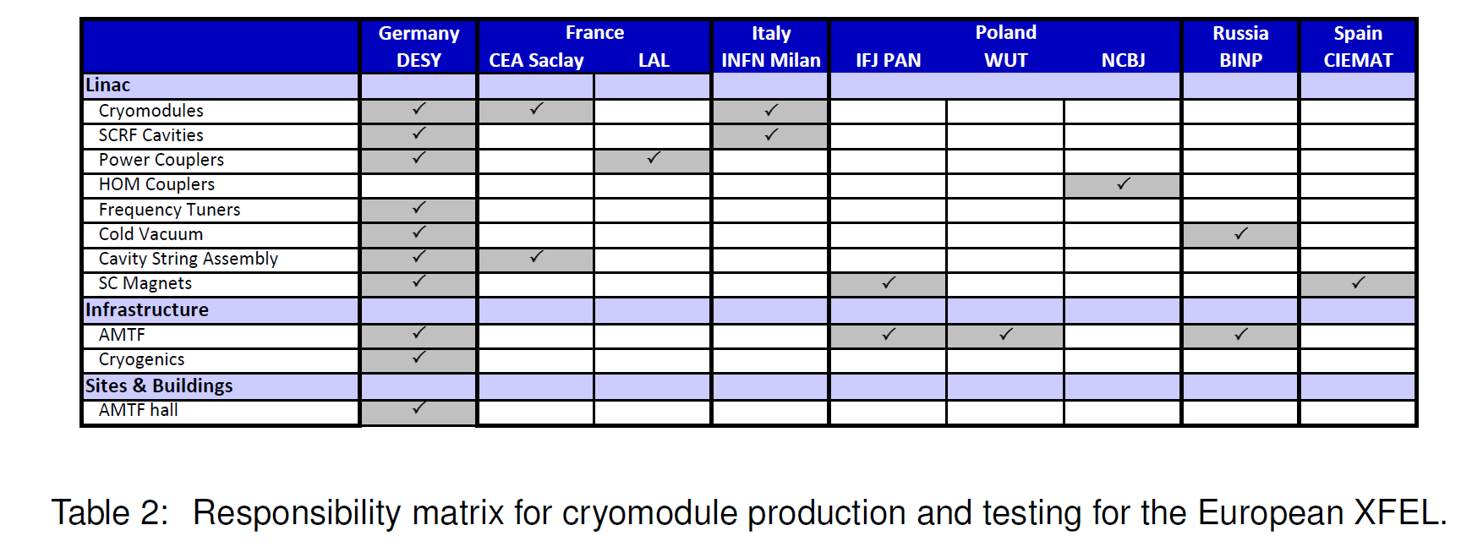
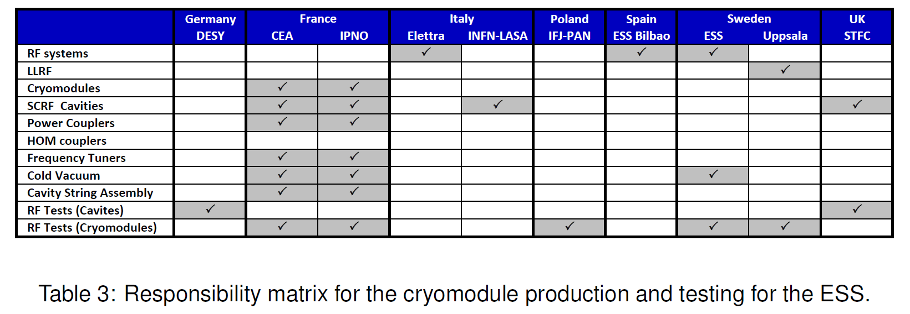
Contribution from each lab. (case of E-JADE)
Kirk will make template table after discussion with Michizono-san and Akira Yamamoto-sensei. Please wait a minute!
SRF sub-groups need to make similar table for each region (Asia, America).
Addition to these items, some new contents need to be added to the table.
CM transportation, automation, etc.
And, budget, human resources…
KEK starts development of automation technique

Slide 43
Work packages of SRF at ILC (it’s too early!)
Item | Brief description
1.3 GHz Cavities | Order/fabrication, preparation , surface treatment, VT
1.3 GHz cavities for positron beamline | T.B.D., Not necessary for many cavities, Order/fabrication, preparation , surface treatment, VT
Power couplers | Order/fabrication, preparation, assembly, high power test
HOM couplers | Order/fabrication, tuning
Frequency tuners incl. piezo | Order/fabrication,
Cavity string assembly | Overall works in clean room
Cryomodules | Order/fabrication, assembly incl. waveguide system (preparation by HLRF), cold test
Cold vacuum incl. HOM damper | Beamline connection of CM-to-CM, Pumping systems, Open/close gate valves
SC Q/D-magnet + BPM Systems | Order/fabrication, test
Alignment | Cavity-to-cavity, Cavity-to-CM, CM-to-CM
3.9 GHz Cavity System | For bunch compression in injector, Same type as E-XFEL/LCLS-II
650 MHz Cavity System | For damping ring, KEKB type?
Crab Cavity System | For head-on collision, Design not fixed, Discussion is necessary with BDS group
High Level RF System | Klystron, modulator, waveguide, dummy load, variable hybrid, phase shifter, circulator?
Low Level RF System | Construction of control systems incl. feed-forward/feed-back (closed-loop operation)
Cryogenics | For VT and module test, He/N₂ line connection in tunnel
Global CM transfer | CM transfer to Japan by ship
High pressure gas regulation | To satisfy Japanese law
Installation | CM installed into accelerator tunnel
Machine protection (?) | Performance degradation, dark current, radiation security, possible quench of SCQ-magnet, etc.

Slide 44
Questions/Discussions/Comments (memorandum) @9th meeting
Crab cavity workshop
The workshop date is fixed on 18/Feb
All speakers agreed to join and present their proposals
Technical preparation document
The document is separated into public part and confidential part
Cost/FTE-yr/Participating labs. are included in the confidential as appendix
Cost estimation is committed? Authorized by DG?
At international review, cost estimation will be reviewed. First of all, this has to be done by bottom-up scheme.
In Europe, the situation to get budget is too complicated. Negotiation should be done each by each country.
In this document, general cost/FTE-yr are shown regardless of individual circumstances, but local cost is different at each region.
International review
The date is not fixed
Presenter for WP-3 will be decided in the crab cavity workshop
High pressure gas safety act in Japan
Detailed presentation was given by Akira Yamamoto-san (Nakai-san’s slide is also useful to understand)
When cavity/CM to transport to Japan is manufactured abroad, we (KEK/Abroad Labs or Company) need to visit to KHK (High-pressure gas authority of Japan) and local government (Ibaraki-ken, Iwate-ken and etc.) to discuss something “before production”. After their agreement to produce cavity/CM or construct SRF accelerator, we can start the production. We have to submit a lot of documents, drawings, inspection sheets, and etc. We need to get High-pressure gas safety act diploma (KEK can support instead of abroad labs.).
Translation by Kirk

Slide 45
Questions/Discussions/Comments (memorandum) @8th meeting
International review
Global situation and proposal can be presented, not status of each region and R&D
Technology topics are included?
The background can be presented
Recipe for surface treatment, Nb material, design of tuner/coupler/SCQ-Mag
FNAL can present about WP-1
After the crab cavity workshop, this review will be held, and someone will present about WP-3 (to be discussed in the workshop)
Detailed explanation on cost estimation based on TDR
MILCU is used up to when?
Translation table should be added in the table
How much is MILCU expectedly increased in 2022-2025?
20-30%, or 10-15%?
Crab cavity workshop
Should be held before the international review
At 17/Feb, Snowmass will be held in US, 18/Feb is much better
Kirk is the chair person for this workshop, but after this, we have to discuss who leads the activity of crab cavity?
And, also who will present in the international review?
Other technical items should be discussed
LCWS2021
Not fixed yet, but there are four parallel sessions incl. CLIC
Until the end of Jan, it will be fixed
Translation by Kirk

Slide 46
Questions/Discussions/Comments (memorandum) @7th meeting
Transport of crab cavity CM
Cost estimation of crab cavity CM transport looks reasonable
TRIUMF has a plan to transport the CMs of crab cavity for HL-LHC, on the ground and by plane
Cage and shock damper will be designed and developed
Infrastructure of hub-lab
In Europe, request from each lab. will be summarized, very complicated
In US, FNAL/JLAB have some new ideas for CM production at the double rate
Coupler cost/# of SC-Q
Additional explanation for the changed items
Coupler cost includes mainly mechanical production, quite different from cavity production (incl. surface treatment, He-tank, magnetic shield, VT, etc.)
# of CM in US may be doubled
In this draft, necessary to consider well-balance among three regions or more
In the ideal case, 1/3 at Asia, 1/3 at Americas, 1/3 at Europe
Baseline (Maximum/minimum success?) can be presented in the draft
Success yield
90% means the success yield after 2nd pass in TDR
90% should be hold, even if the cost reduction will be successful
If we find revolutionary idea/method, how to proceed to be discussed
After 3rd pass, to be discussed, but those cavities can/should be used for ILC because of lower cost dissipation
Crab cavity
Special workshop is necessary early 2021, LCWS2021?
Mid. of February can be good candidate
UK, CERN, FNAL, JLAB and TRIUMF will join
FTE-yr of Japan is three times higher than abroad?
Original number was decided in the ILC action plan
In this draft, FTE-yr is based on the ILC action plan, but we changed a little from that
Translation by Kirk

Slide 47
Questions/Discussions/Comments (memorandum) @6th meeting
Budget request
Cost of cavity production includes everything from production to cavity string excluding infrastructure as hub-laboratory
Helium tank, magnetic shield, surface treatment, clean room work, high pressure gas regulation, VT (after 2nd pass)
Additional lecture/meeting is necessary for high pressure gas regulation of Japan (not this year, but needs to be hurried)
Unit cost is preferable?
Cavity and coupler cost looks valid
Coupler production includes preparation work, waveguide system to connect between two couplers for RF processing at test bench excluding klystron/modulator
Number of CM in abroad
In US, as we already presented in the previous subgroup meeting, totally four CMs will be produced (FNAL/J-LAB), the number is increased
The number of abroad production needs to be discussed well in Europe
Remaining cavities (not used for CM production) and bad performance cavities
If the performance is good and HPG is satisfied, those cavities can be in stock for ILC (may be not used in technical preparation period)
If the performance is bad and HPG is satisfied, those cavities can be repeatedly surface-treated and tested to achieve the good performance
If the performance is bad and HPG is not satisfied, those cavities can be used for the other purpose
If a cavity with poor performance appears, it is necessary to discuss in advance whether or not the cavity equips a helium tank in production
Additional infrastructure
If you need some additional items, you can put them into hub-lab. infrastructure in ML-SRF-2
ex) klystron/modulator, CM test cave, coupler test area, clean room, pre-tuning machine, EP facility, vacuum furnace for heat treatment, etc.
UK team needs the CM test area (cave?) as the additionally necessary infrastructure for crab cavity
Crab cavity
Japan may/can not control the management for this, because too many labs. have strong interest
Candidate labs: UK, FNAL, J-LAB, TRIUMF, CERN?
In the current budget request, only abroad has some number in budget/FTE-yr
CM transportation
Simulation and support from DESY are necessary
Cost of cage/shock damper looks reasonable
Cost of ground transportation to be checked
Cost of sea shipment may be increased, if a special container is necessary (because CM length for ILC is longer than E-XFEL)
KEK will have the meeting with a transportation company this month
Breakdown is necessary for each quantity and FTE-yr for abroad
FTE-yr
EDR needs some people, then we put 10 FTE-yr for each
Release
If you keep this sheet confidentially, we can release → already done
Translation by Kirk

Slide 48
Questions/Discussions/Comments (memorandum) @5th meeting
Plug-compatibility
One design should be selected. More than two types, we need two jigs, and will experience complicated situation.
We can decide only flanges of cavity and CM, it dose not mean two types are used
Relation between surface treatment and cost increase
We think selection of surface treatment is flexible, but we also need to think about the cost increase related to the selected method
The words of “mass production” may be misunderstood, it’s much better to use the other ones
SCQ is included in CM production?
Yes, Spain is added as the new contributor
Steiner will organize the meeting in Europe to discuss cavity/CM production and test, how shared, how proceeding
Crab cavity is unknown to discuss
Budget request
Local or global to be submitted?
How much precise is the draft?
In Japanese case, we need to submit by August of the previous fiscal year. We need to complete the draft by the end of this year, discuss it with EB, and go to each lab. for consultation.
In Americas and Europe, it will be a different process. At least, the process will be slower than in Japan.
In Europe, we need to hold a meeting because we have to discuss the proposal first
The SRF budget request does not include the cost of infrastructure as function of hub-lab, but FNAL and J-LAB plan to construct new experimental facilities. If it is built during the technical preparation period, the new experimental facility will be available only around the final fiscal year, and there will not be enough time to demonstrate its function as a facility.
There are various approaches in each lab and each region, and it is difficult to unify all of them. Of course, it may be behind the expected plan, so you don't have to think so seriously.
The SRF subgroup concluded that there are three main tasks (cavity/CM production, global CM transfer, crab cavity) during the technical preparation period
If there is more input from Europe and Americas, we think it can be added later
How about the SRF subgroup meeting on 22/Dec?
CERN and Spain are on Christmas holidays
Americas has no problem
Translation by Kirk

Slide 49
Questions/Discussions/Comments (memorandum) @4th meeting
Reports from U.S.
M. Liepe presented the schedule/task list
There are two stages of cavity production; yield study (1) and yield study (2), totally 60 new 9-cell cavities produced
To be discussed yield study (2)
Really necessary? By new vendor in US? By new recipe?
Global CM transfer done in 4th year of technical preparation period. It’s also to be discussed.
S. Posen presented the infrastructure of CM assembly in FNAL
Two lines of cavity string assembly available in clean room enlarged for PIP-II
In CM test area, one CM test available. For second, space of klystron to be checked
Test stand of power coupler to be discussed/checked
B. Rimmer presented the present infrastructure of CM assembly/test, and upgraded plan for ILC in J-LAB
Three assembly lines of CM and one cave for CM test at present for CEBAF, LCLS-II-HE, and SNS
Possibly additional clean room, and test cave to be constructed in the same building
Requests from Akira and Kirk
Tuner should be put to the list, and we need to discuss the final design between Japan and U.S. before the technical preparation period
Please consider the preparation area/test stand of power coupler in U.S. labs. (one klystron maybe available for both CM test and power coupler test)
Task list to be fixed in the next SRF subgroup meeting on 24/Nov
Any other than cavity/cryomodule production, and cryomodule transport recommended in ILC project implementation?
Cost down R&D
Think about the balance between cost increase and performance improvement
In LCLS-II-HE, EP x 3 and HT x 2 (In TDR, EP x 2 and HT x 1), but may be reduced the number in future
In TDR, the number of final EP was limited to up to twice to evaluate the success yield
In TDR, 10 % margin in RF power
For higher gradient operation than TDR (above 35 MV/m @CM operation), piezo should be improved for wider frequency range
We should not change number of cavity/CM/klystron from TDR
To be discussed in the next LCWS, and TTC meeting 2021, and to be reconfirmed
Crab cavity
Kick-off meeting held on 24/Nov 30 min earlier the SRF subgroup meeting, organized by Okugi-san (as the leader of BDS Gr.) and Kirk
Design of cavity, coupler, tuner, CM to be discussed, establishment of collaborators, possible schedule, what we can do before technical preparation period
Every member of SRF and BDS subgroup can join, and Kirk will send the invitation to G. Burt and R. Calaga
If you know any other candidate person, please tell me before the next meeting
High pressure gas regulation
Kirk explained very shortly (the time is over)
Necessary for longer time to discuss in the future meetings
Before cavity/CM production in Japan, we have to visit to KHK (authority) and discuss with them; need to pass each by each step (too complicated processes)
CEA has the experiences for HPG of Japan, and U.S. labs. have different situation (DG in each lab. can make a decision for HPG)
Translation by Kirk

Slide 50
Questions/Discussions/Comments (memorandum) @3rd meeting
Translation by Kirk
50 cavities satisfied with HPG? Or not? Cost should be effectively used. Cavities w/o helium tank is used for only estimation of success yield
10 cavities w/o tank in 1st year, 10 cavities w/ tank satisfying with HPG in 2nd year…
Necessary for learning impact on high pressure gas regulation of Japan
How much is one cavity estimated?
Flexibility in surface treatment is necessary, to be discussed
To be decided in technical workshop
International workshop is necessary to review material/fabrication/surface treatment methods
plug-compatibility reconfirmed
To be held after TTC meeting 2021 or next LCWS2021?
New vendors in US
Important to find cavity fabrication vendor, in not only US but the other countries
To be checked qualification, learning curve expected, capability of large number production, etc.
In GDE, cost estimation has been done by some vendors, but one vendor was dominant
Reexamine lesson/learned from what GDE have done
After E-XFEL construction, cavity fabrication cost is not changed, or a little changed
Cost of power coupler increased
Laboratory-vendor collaboration in cavity fabrication is also necessary
KEK has already done
Year and year plan is necessary in each region for technical preparation period
Americas laboratory proposals in next meeting
Kirk requests responsible persons in each lab.

Slide 51
Questions/Discussions/Comments (memorandum) @2nd meeting
CM production
Existing CM or New CM?
In Japan, before production, we have to discuss with KHK (authority of high pressure gas in Japan)
During production, inspection by KHK is necessary
CM transfer
Shipping/High pressure gas regulation can be separated
Also rechecking cavity performance after shipping
No cavity vendor in U.S., but same process as LCLS-II can be used
How many cavities are produced? 20 at minimum. It depends on budget.
Fabrication (incl. Nb material)/surface treatment to be discussed
In TDR, second pass was available. How many times in surface treatment is available? It also depends on cost, and to be discussed.
Reliability
Cost-effectiveness
Same method of fabrication and surface treatment as technical preparation period has to be used in construction of ILC
Global CM transfer among Japan/U.S./EU to be discussed (Japan → U.S./EU?)
For fair international collaboration
There are strict rules in high pressure gas regulation of Japan
It may take longer time to solve this
How many prototypes do we need?
No prototype CM in LCLS-II → The construction started immediately (some of existing cavities are used)
Three prototype CMs in E-XFEL (PXFEL series)
Translation by Kirk

Slide 52
Questions/Discussions/Comments (memorandum) @1st meeting
Surface treatment
Which surface treatment method (EP, HT) is selected in mass production?
Surface treatment method is flexible, rather, plug-compatible design of cavity package should be fixed
To investigate yield rate, same method should be used. One method in each region (Japan, US, EU)?
Always think about which method is used in mass production (performance, cost effective)
Choice as advanced technology should be left, even though new method does not work well at present
Power coupler
Power coupler needs a lot of improvements for ILC
D. Kostin will present those issues and some suggestions in AWLC2020
CM transportation
13 CMs will be transferred from EU to US by plane in PIP-II (2023-2024?)
CM of ILC needs very large cage for marine transportation. After arrival at Japan, the cage may be sent back.
Cost of aerial transportation is much higher than marine
Cost of marine transportation is included into budget of each region
Design of cage and supporting jigs is necessary
“CM transportation” is not appropriate, then ”Global CM transfer” is better?
Necessary to fix design of tuner/coupler until second year of technical preparation phase when technical review is done
Additional membership (Michizono-san discussed with Andy and Steiner)
Budget request of SRF including technical preparation
Budget request of subgroup → WG1 → each laboratory → Conclusion of MOU
Mass production and Global CM transfer should be summarized to one page for each until end of this year
Preparation for conclusion of MOU after Feb/2021
Introduction of activity of SRF subgroup will be presented in AWLC2020
Request to upload meeting slide on INDICO
Translation by Kirk

