Slide 1
UK ILC Crab Design
Prof Graeme Burt, Lancaster University / Cockcroft Institute
On behalf of the UK team at Lancaster and STFC

Slide 2
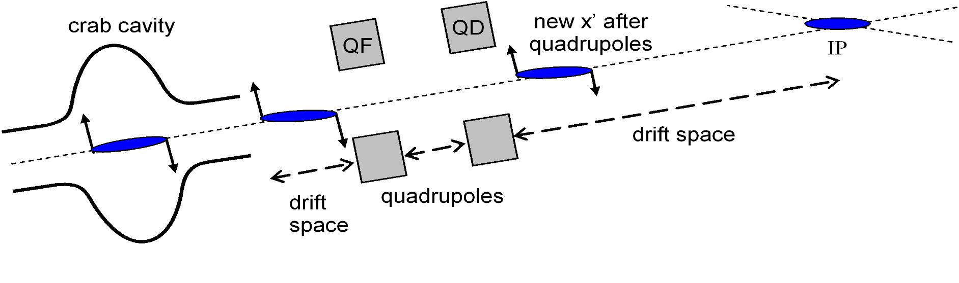
Crab Cavity Parameters
Crossing angle | 14 mrad
Cavity frequency, GHz | 3.9
Amplitude at 1TeV CM, MV | 2.6
Max amplitude with operational margin, MV | 4.1
RMS relative phase stability for 2% rms Luminosity drop | 0.094°
RMS amplitude stability for 2% rms Luminosity drop | 6.6%
Horizontal beam clearance, mm | 15
Vertical beam clearance, mm | 10
Allowable X beam jitter at crab cavity, μm | 500
Allowable Y beam jitter at crab cavity, μm | 35
Crab cavities positioned close to IP @ ~ 12 m.
Original design is for 1 TeV CoM, now 250 GeV CoM. Do we need to consider full energy?
Elliptical designs should be able to reach 7 MV/m so at 250 GeV we ONLY need a single 3 cell design.
Two 6-9 cells needed at 1 TeV

Slide 3




ILC Crab Cavity Collaboration Team (c. 2008)
Cockcroft Institute:
  Graeme Burt (Lancaster University)
  Richard Carter (Lancaster University)
  Amos Dexter (Lancaster University)
  Philippe Goudket (ASTeC)
  Roger Jones (Manchester University)
  Alex Kalinin (ASTeC)
  Lili Ma (ASTeC)
  Peter McIntosh (ASTeC)
  Imran Tahir (Lancaster University)
FNAL:
  Leo Bellantoni
  Mike Church
  Tim Koeth
  Timergali Khabiboulline
  Sergei Nagaitsev
  Nikolay Solyak
SLAC:
  Chris Adolphson
  Kwok Ko
  Zenghai Li
  Cho Ng
  Andrei Seryi
  Liling Xiao

Slide 4
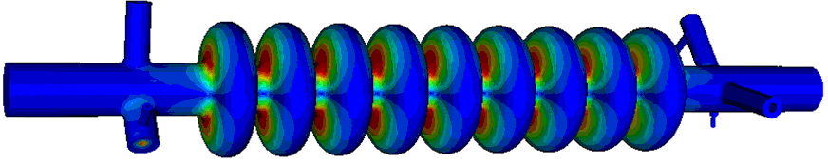
ILC-CC Design
Input Coupler
Based on the FNAL CKM Cavity
LOM Coupler
SOM Coupler
HOM Coupler
Beam-pipe radius = 18mm
Cavity iris radius = 15mm
Equator Radius = 47.37mm
Squashed to give >10 MHz dipole mode separation
In hindsight it may have been better to develop a racetrack solution with a larger polarisation separation. It would be prudent to revisit this.

Slide 5
Power requirements
Longitudinal electric field on axis is zero for the dipole mode
Beamloading loading is zero for on axis bunches
Bunches pass cavity centre when B transverse = 0 hence off axis E = maximum
Crab cavities are loaded by off axis bunches
Dipole deflection cavities are not loaded by off axis bunches
Power requirement for 9 cells (500 GeV CoM) ~ a few kW
Adding an allowance for loading from microphonics suggests an external Q of 3e6

Slide 6
Modal Calculations in MAFIA
Lower Order Modes, 2.8 GHz
Operating and Same Order modes at 3.9 GHz
High impedance monopole modes are not a problem
Narrowband dipole modes seen up to 18 GHz
1st Dipole passband
Trapped 5th dipole passband at 8 GHz
High dipole impedances seen at 10 GHz and 13 GHz

Slide 7
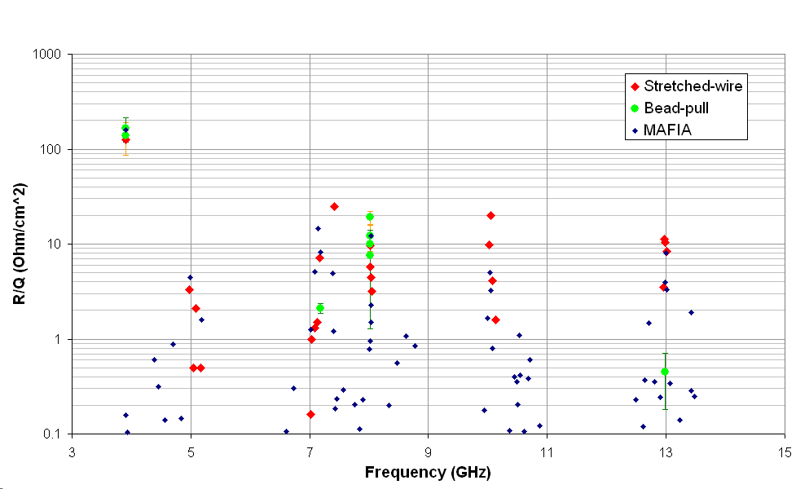
Mode Measurements

Slide 8
3.9 GHz elliptical: External Q factor s required for couplers
Beam-pipe cut-off
Same Order Mode, tough spec, requires active damping
Trapped modes might need attention
These specs are not tough but might need checking

Slide 9
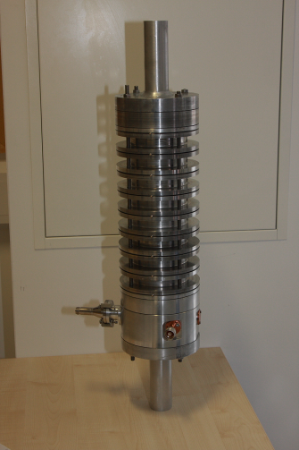
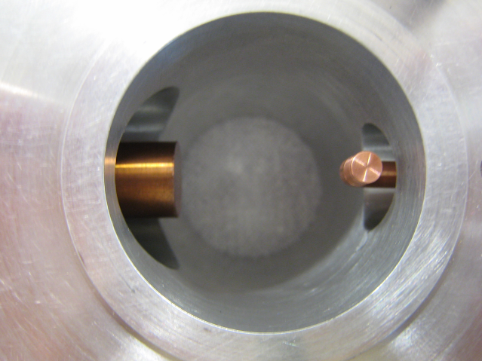
Lower Order Mode Coupler
Hook type LOM coupler designed by FNAL/Lancaster and improved by SLAC
No filter, uses polarisation to avoid coupling to the crabbing mode
The LOM coupler prototype was found to give good agreement with both MWS and Omega3P simulations.

Slide 10
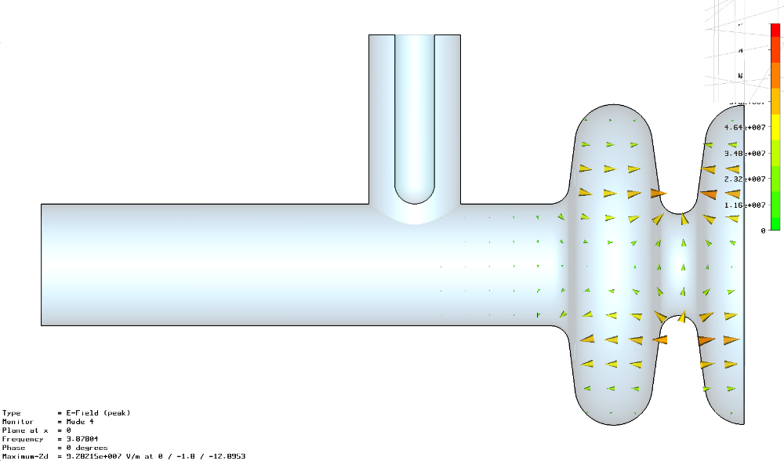
Cockcroft SOM Coupler design
The SOM coupler is currently a simple coaxial structure.
The problem is that as we decrease the SOM external Q we make the coupler susceptible to damping the operating mode.
Assuming 10 Watts mean power flow in the coupler, and we meet the SOM damping spec then we need to align the coupler to within 1.4 degrees.
May be better to use a racetrack cell shape to separate the vertical and horizontal mode in frequency and use a filter

Slide 11
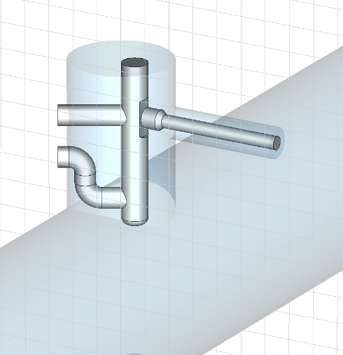
HOM Coupler
The original HOM coupler was based on the EU-XFEL 3rd harmonic HOM coupler that’s slightly modified.
SLAC redesigned the coupler but did not check all modes just the first two passbands.

Slide 12
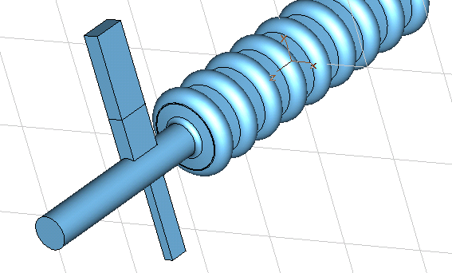
SLAC HOM Notch harmonic
The prototype measurements have shown that the SLAC HOM coupler has several stop-bands, such that some HOMs will not be damped. One such stop-band is at 8.0GHz, coinciding with a very dangerous HOM.
This turns out to be a resonance with the TE21 mode cut-off in the beampipe. This led to two solutions not fully followed up
Use of a WG HOM coupler
Using a different beampipe diameter on each side of the cavity and have two HOM coupler

Slide 13
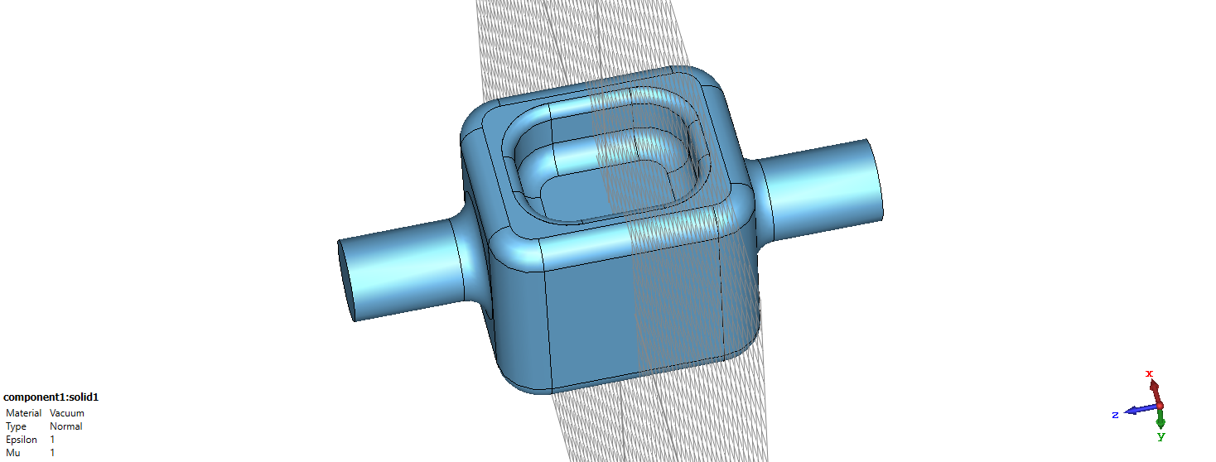
1.3 GHz RFD cavity for ILC
Same dimensions as the 3.9 GHz elliptical (100 mm height with 36 mm aperture)

Slide 14
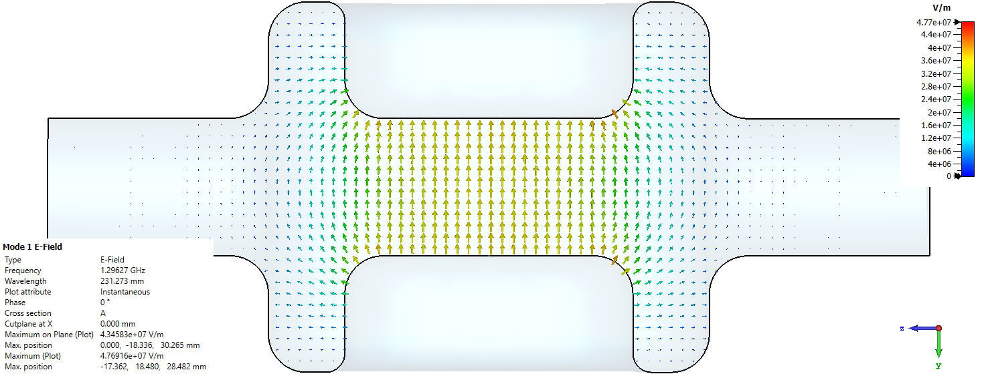
RF properties
Lower peak magnetic fields than the 3.9 GHz elliptical (10 MV/m may be possible so two single cells/IP might be possible at 250 GeV but eight/IP at 1 TeV)
Higher Epk but very low in both cases. R/Q significantly less, probably not a major issue
While gradient is 30% higher the required voltage is 300% larger compared to 3.9 GHz elliptical.

Slide 15
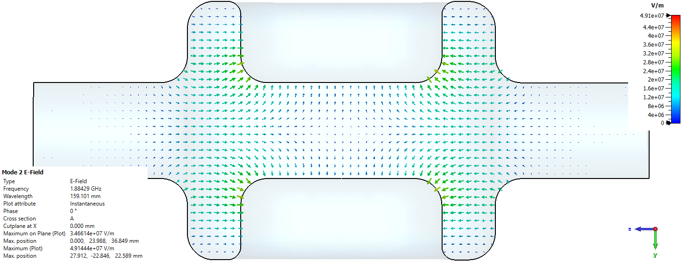
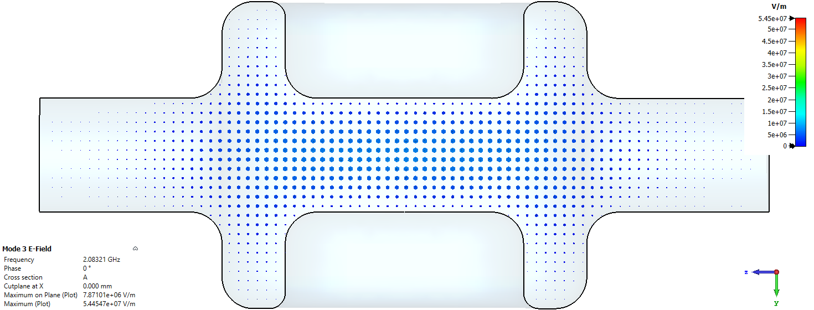
RFD resonances of note
1st monopole mode
No lower order mode, 1st monopole is at 1.88 GHz
Pretty fast attenuation in beamipe, will need on-cell coupling like LHC
Same order mode
Vertical dipole mode is at 2.08 GHz, well separated
No longer an issue

Slide 16
LLRF/Synchronisation Scheme (Final)
Crab to crab jitter is more important than crab to beam/clock so if using an external clock we need to half the jitter (or at least sqrt(2) for rms)
We proposed an RF interferometer to measure the phase at each cavity and synchronise
The longer the distance between cavities the harder that is, a longer distance would need optical links.
After consulting with Cockcroft synchronisation experts we now believe that an optical system can achieve the tolerances over 1 km and hence distance is no longer an issue
e⁻
e⁺
synchronous
reference
phase
s
ignals
phase
detector
detector
divide
to
board
A
board
B
divide
to
1.3 GHz
Load
~ 50 metre
1.3 GHz
c
avity
c
ontrol
low loss
c
avity
c
ontrol
(high power)
A/D
coax link
A/D
phase shifter
FPGA
pin diode switch
FPGA
DSP
Load
1.3 GHz
1.299.8 GHz
Load
DSP
vector
oscillator
reference
vector
mod.
D/A
oscillator
D/A
mod.
A/D
A/D
FPGA
D/A
phase
3.9 GHz
FPGA
shifter
oscillator
vector
interferometer line
mod.
D/A
length adjustment
circuits
pin diode
precision
linac timing
switch
reflector
circuits

Slide 17
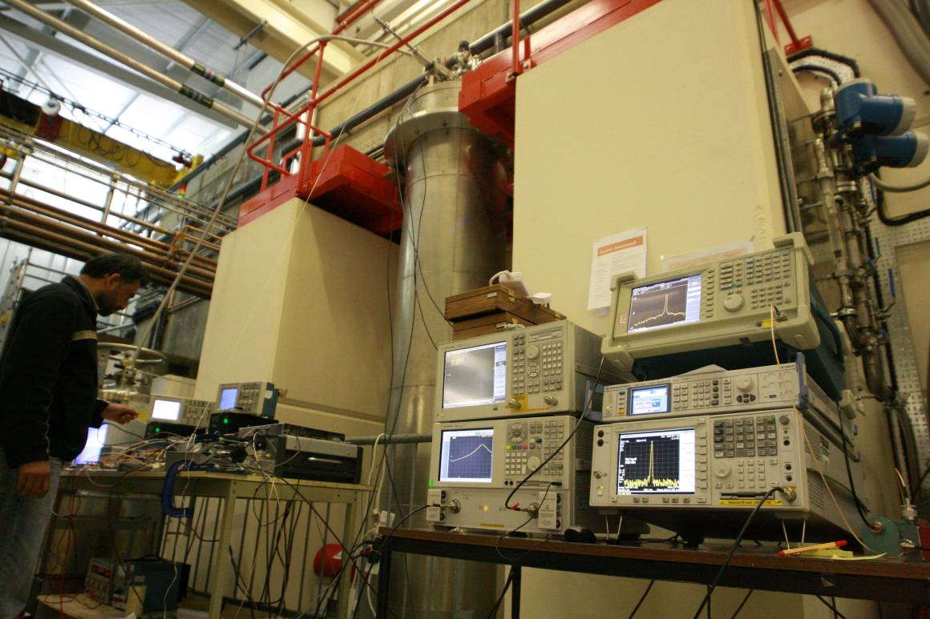
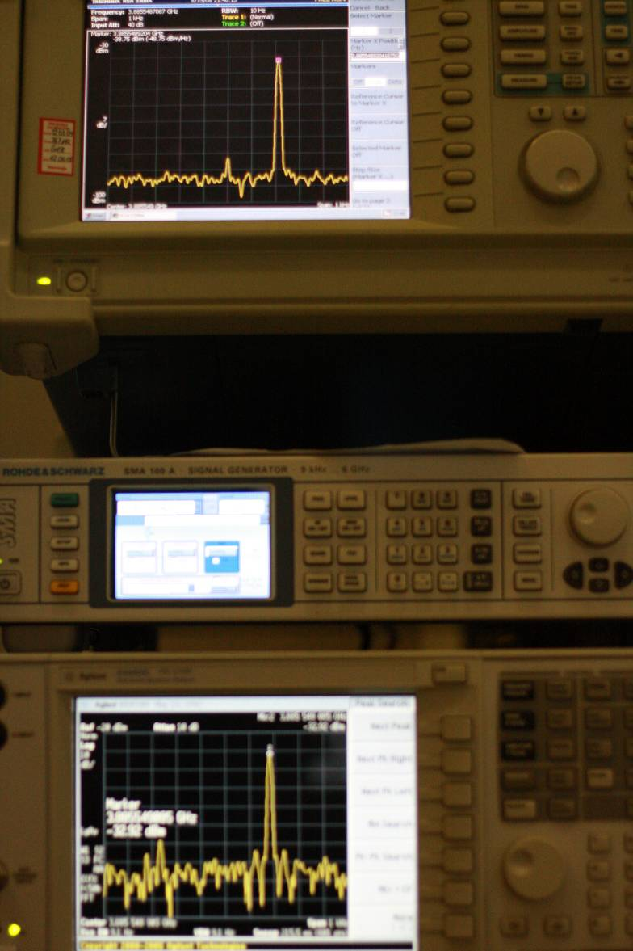
Vertical Cryostat Synchronisation tests
The synchronisation of two crab cavities was performed in a VTC in 2008
Prior to locking DBM = 2V pk to pk
With lock DBM = 50 mV pk to pk
Prior to locking r.m.s jitter = 4 deg
Achieved 100 milli-deg r.m.s.
Target = 120 milli-deg r.m.s.

Slide 18
Cavity Alignment (Anti-crabbing)
Crab Cavity Effect
Anti-Crab Effect
If the cavity has a roll misalignment it will cause a small crossing angle in the vertical plane.
Adding a single cell crab cavity in the vertical (rather than horizontal) plane can correct for vertical crabbing and offsets due to cavity misalignment, wakefields or other sources of error such as x-y coupling.
This will significantly reduce the luminosity

Slide 19
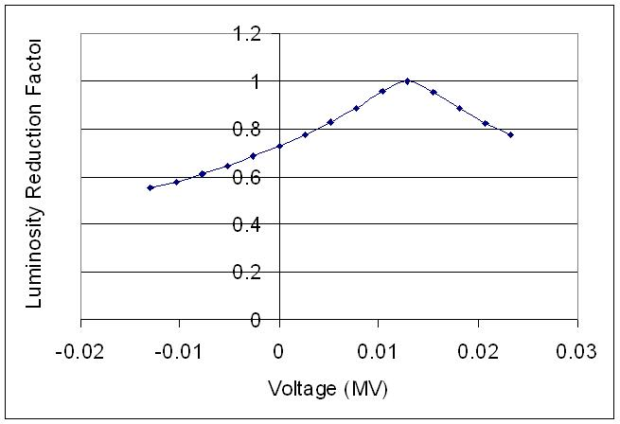
Anti-Crab Voltage
As we vary the anti-crab cavity voltage we can see the luminosity increasing back to the optimum value. 100% of the luminosity can be recovered in this way.
As we only require 10’s kV this can be performed with a normal conducting cavity
0.5 degree roll misalignement

Slide 20








HL-LHC Crab Collaboration
Cavities
Cryomodules

Slide 21
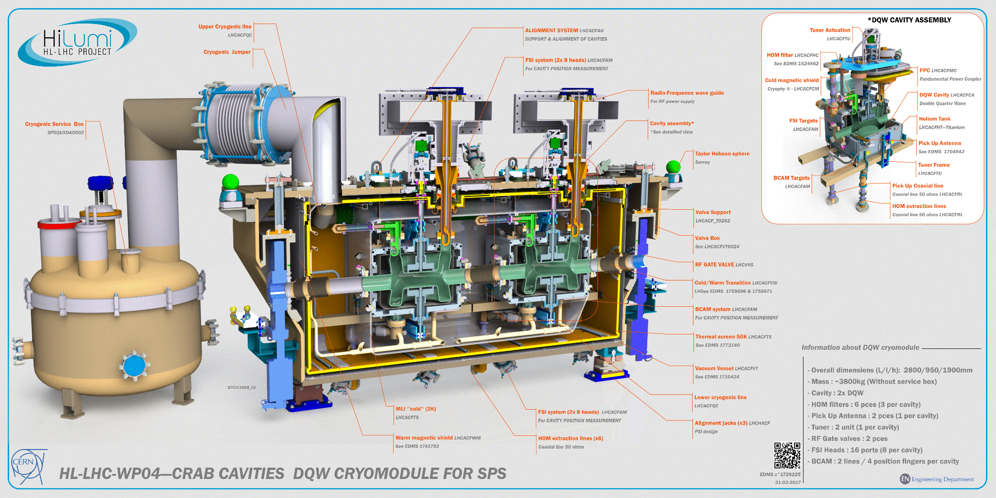

Slide 22
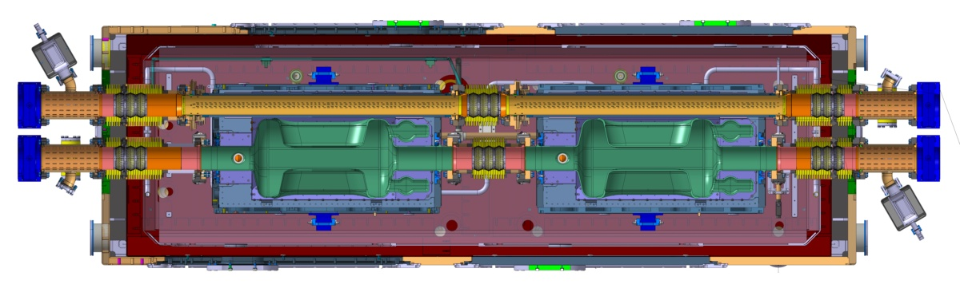
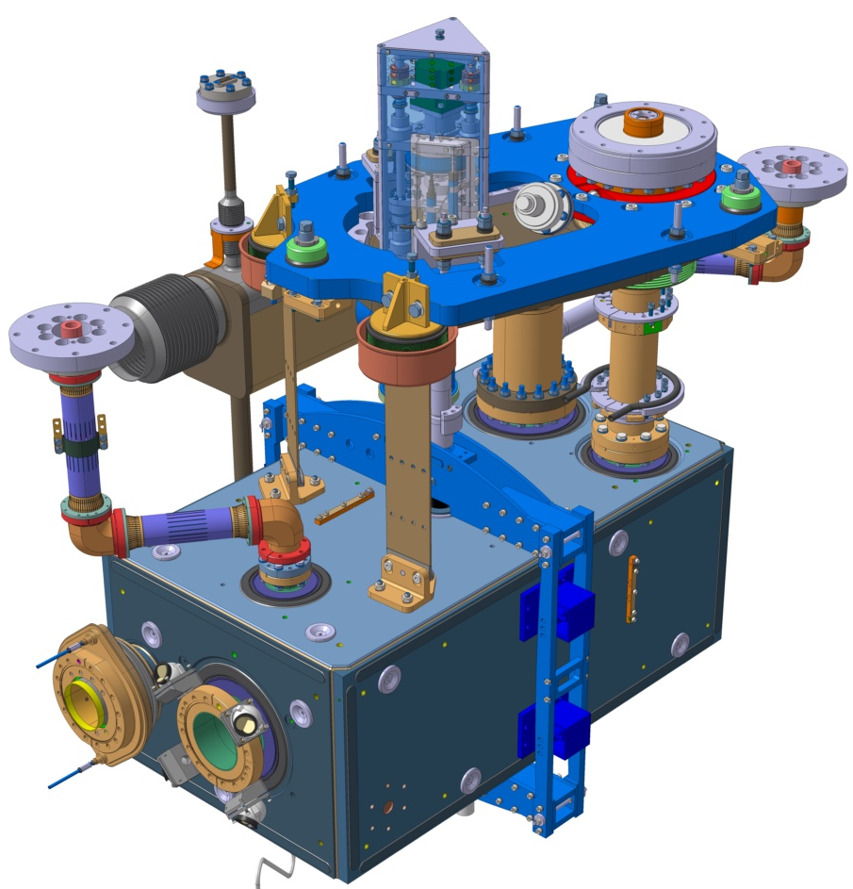
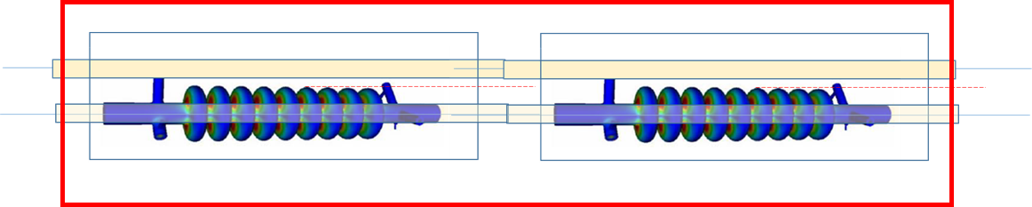
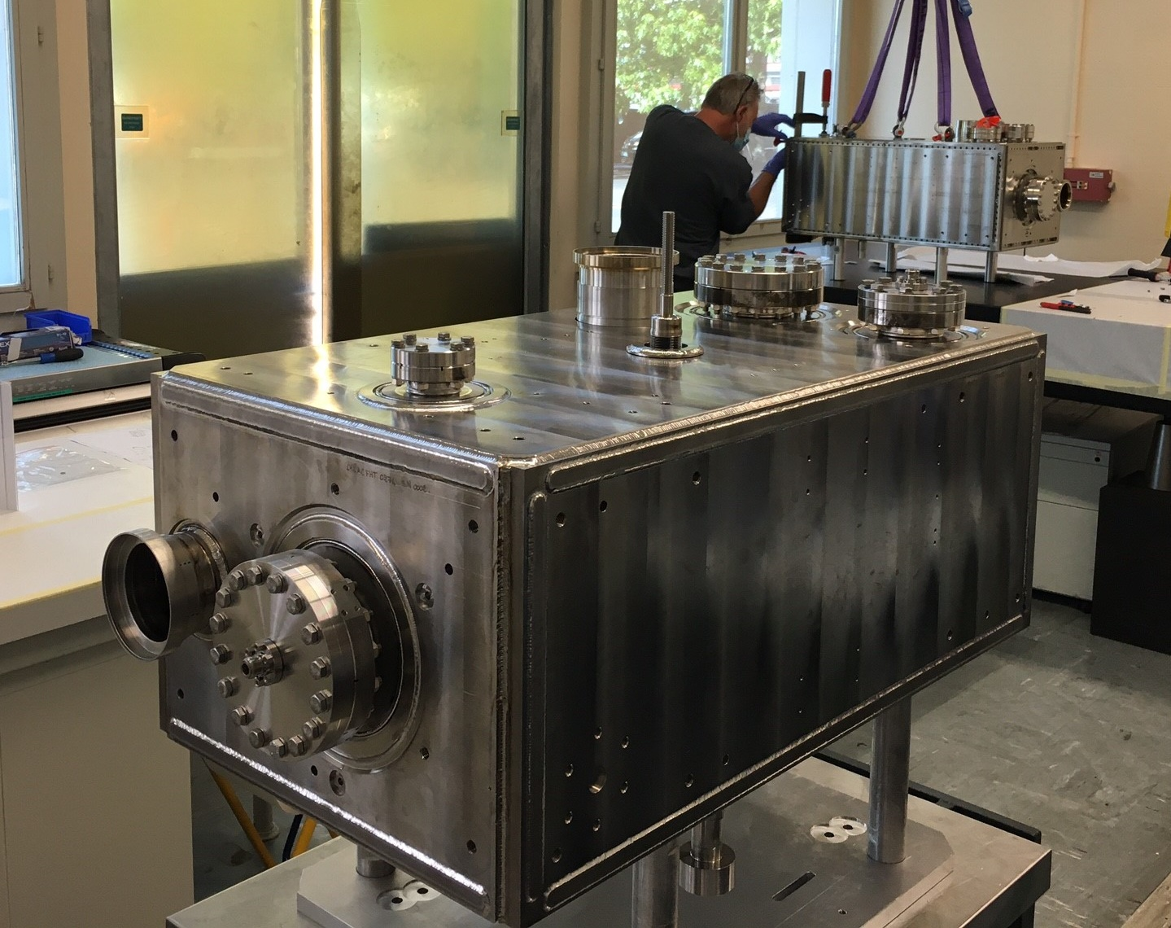
ILC Crab Cavity Cryomodule solutions
The solutions applied to HL-LHC may also suit the ILC-CC provided the dump beamline can be accommodated inside the Cryomodule.
LHC/SPS has proven solutions with beamlines going through the cryomodule either inside or outside the LHe vessel.
If this works for location at 14m then modifying it for the locations at 44m and 77m will not be too complicated.
197mm (Gap between the beam pipes)
Liquid Helium Reservoir
150 mm – max cavity radius

Slide 23
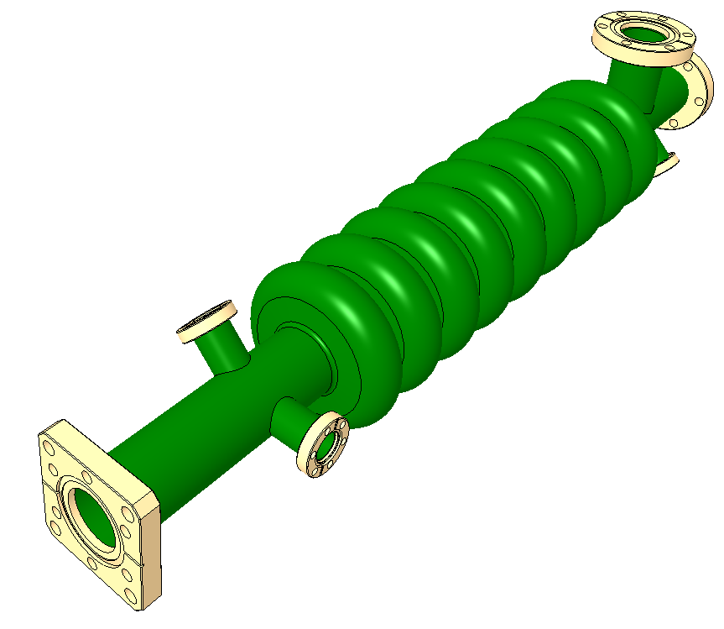
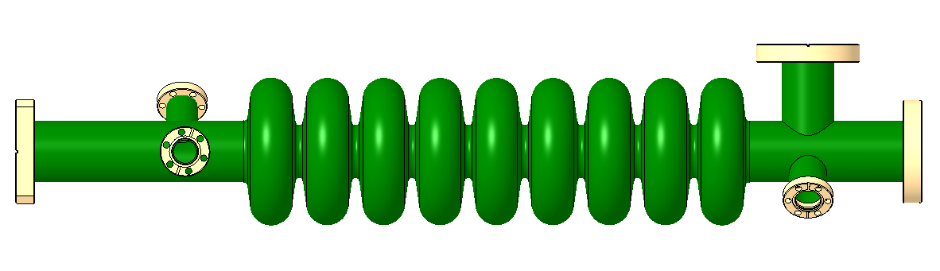
9 cell elliptical crab cavity – 3.9 GHz
Ø101
617

Slide 24
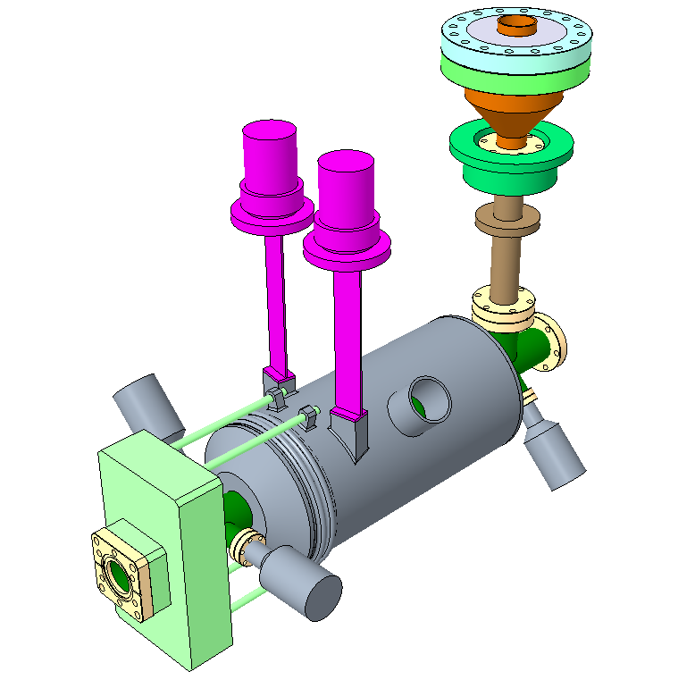
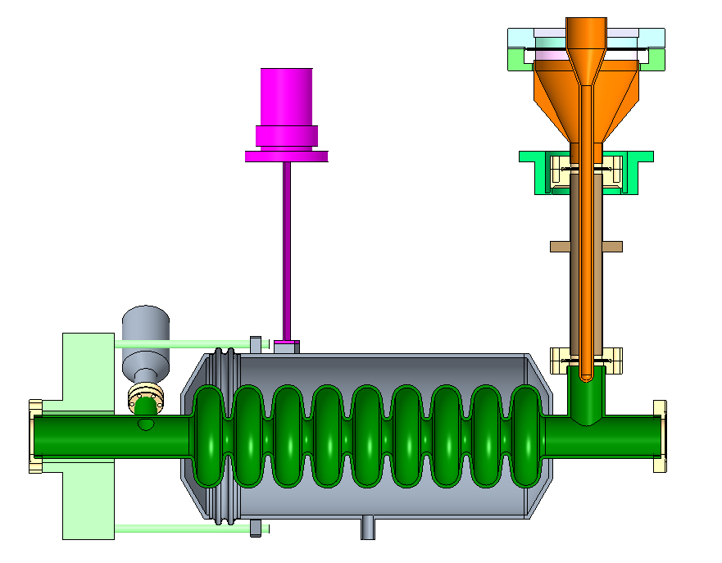
Dressed Cavity
Fixed Input Coupler
Support Blades
Thermal Intercept
Helium Tank - Ø160
Tuner Rep

Slide 25
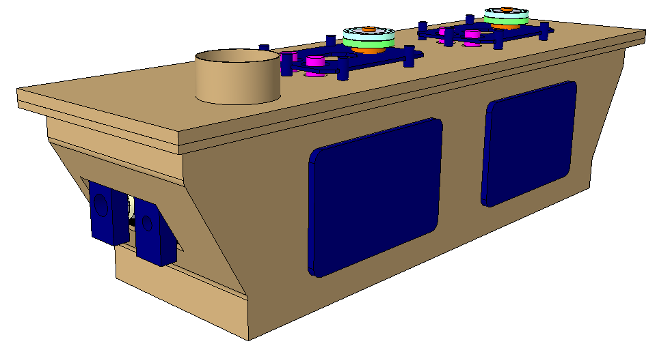
Cryomodule Concept Design
Kinematic Supports
Top Loaded
Jumper
Windows
External Gate Valves
OVC Max Dims (LxWxH)
2240 x 647 x 577

Slide 26
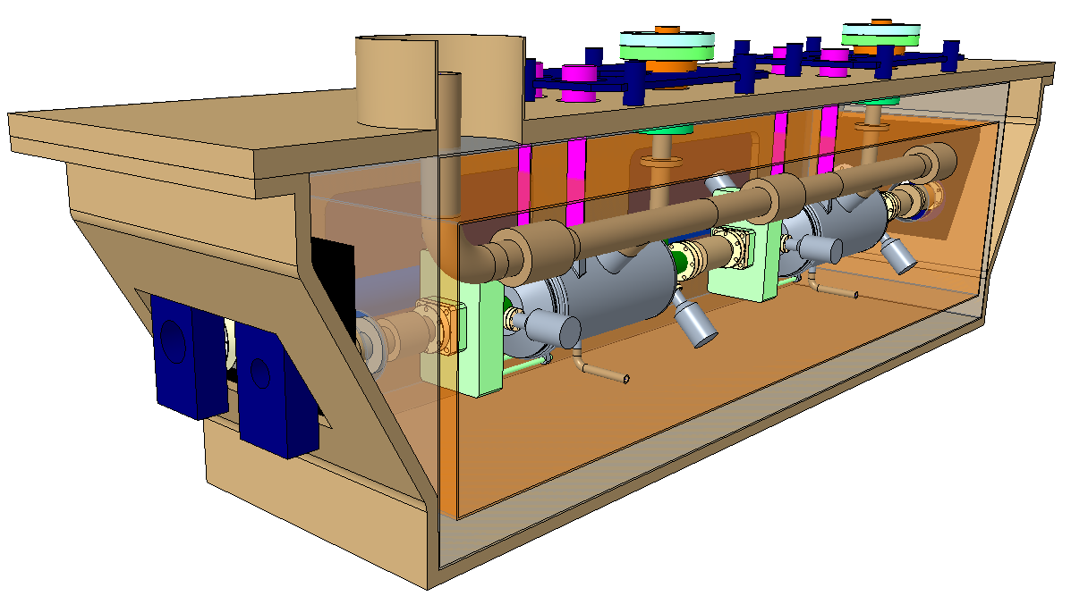
Cryomodule Concept Design

Slide 27
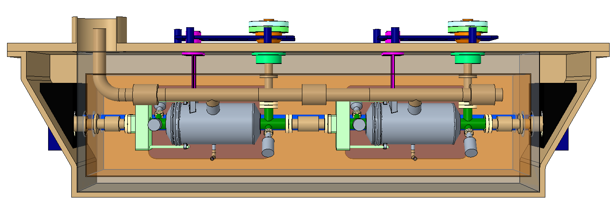
Cryomodule Concept Design
Warm Magnetic Shield
Bi-Phase Line
Thermal Screen
Valve Box
Helium Inlet
Cold-Warm Transitions

Slide 28
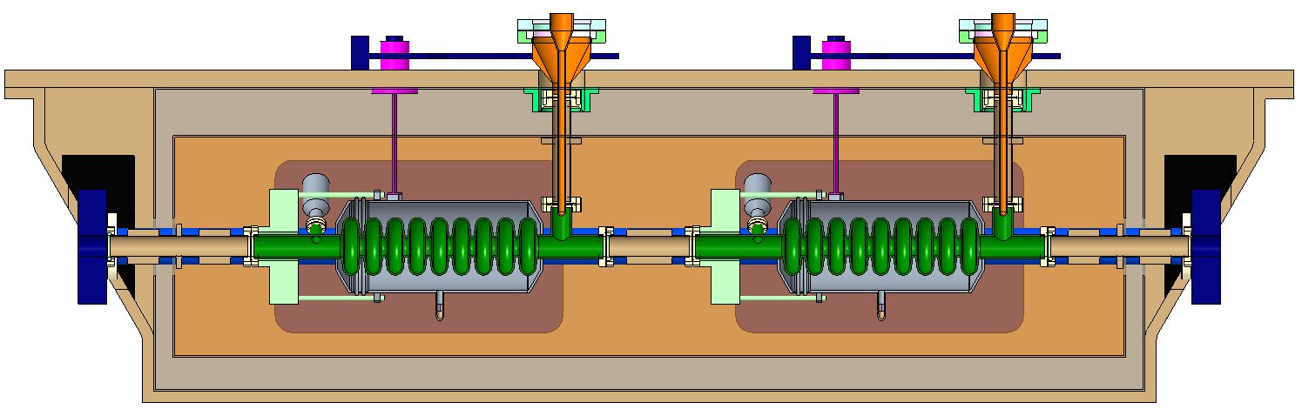
X Section

Slide 29
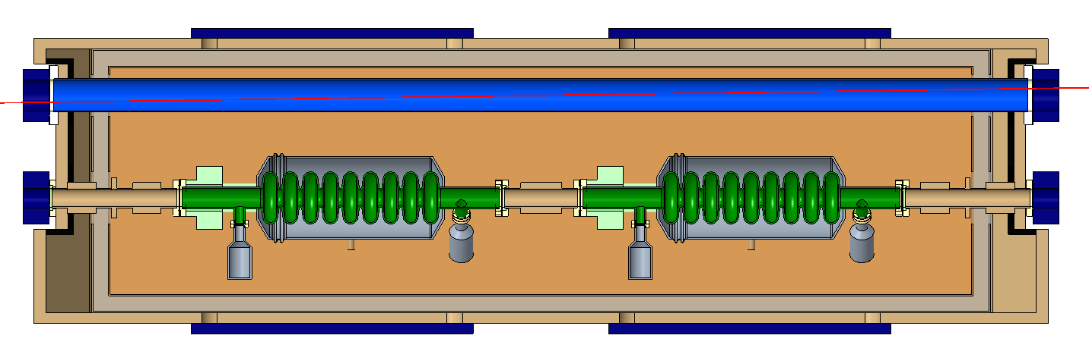
Y Section
Parallel beamlines
2nd beamline crosses at 0.014rad
197
1984

Slide 30
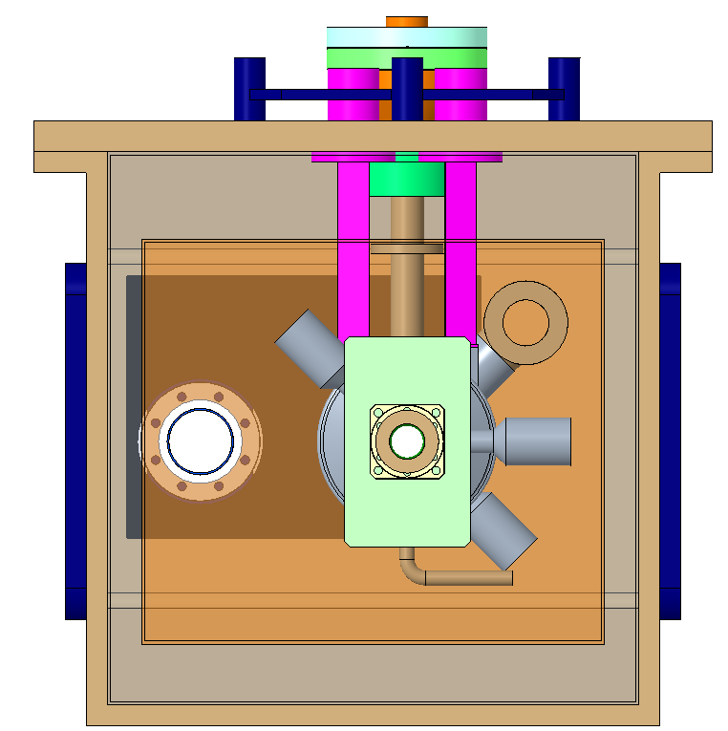
Z Section

Slide 31
UK ILC Pre-lab bid
We are currently preparing an invited bid to the UK funding council which includes the design update of the 3.9 GHz cavity/HOM couplers (can be modified if another design chosen), production of a full dressed ILC cavity and a major contribution to the cryomodule design effort.

Slide 32
Conclusions
250 MeV only needs a 3 cell cavity per IP but 1 TeV requires 2 x 6 or 9 cell cavities per IP if elliptical
Wakefields were a major issue at 1 TeV, need reassessed at 250 GeV
LOM/SOM/HOM couplers needs some redesign and we advise investigating a racetrack cell shape.
Using an RFD cavity may allow two single cells per IP at 1.3 GHz, but HOM couplers become far more complex. Also would need a multicell version for 1 TeV as eight single cells per IP is very large.
Hence 3.9 GHz elliptical is still optimal
Alignment may be an issue, may need an anti-crab cavity
Conceptual cryomodule design for 1 TeV exists

