Slide 1

ILC Crab Cavities, First Thoughts
R. Calaga, CERN
Feb 18, 2021
Compact Cavities
RF Noise
Caution: Extremely preliminary thoughts put together for qualitative discussion
All numbers to be re-checked !!

Slide 2
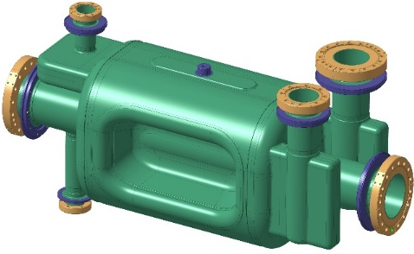
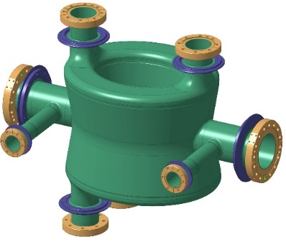
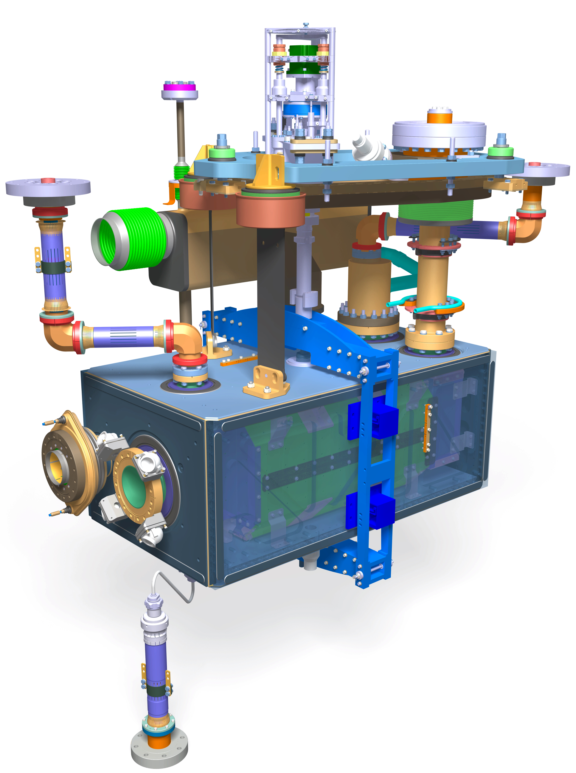
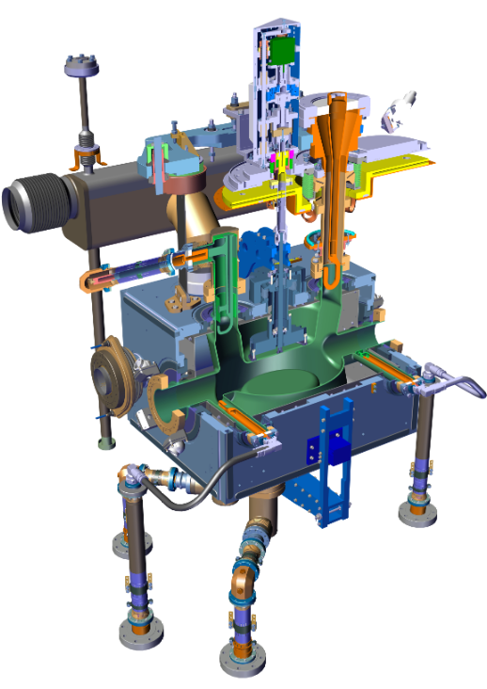
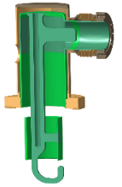
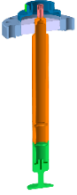
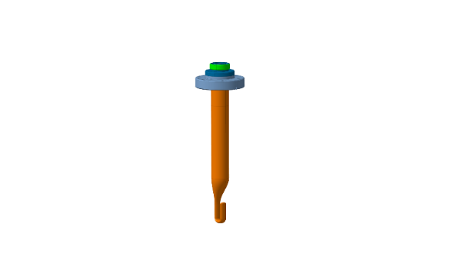
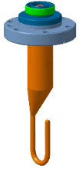
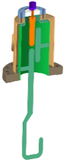
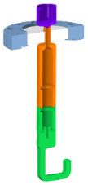
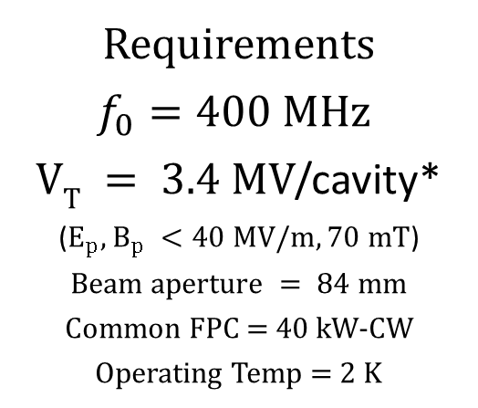
HL-LHC Crab Cavities
Double Quarter Wave
(up to to 6 MV)
RF Dipole
(up to 7 MV)
Requirements
$f_{0}=400 MHz$
$VT = 3.4 MV$/cavity*
($E_{p}, B_{p} <40 MV/m, 70 mT$)
$$Beam aperture = 84 mm$$
Common FPC = 40 kW-CW
Operating Temp = 2 K

Slide 3
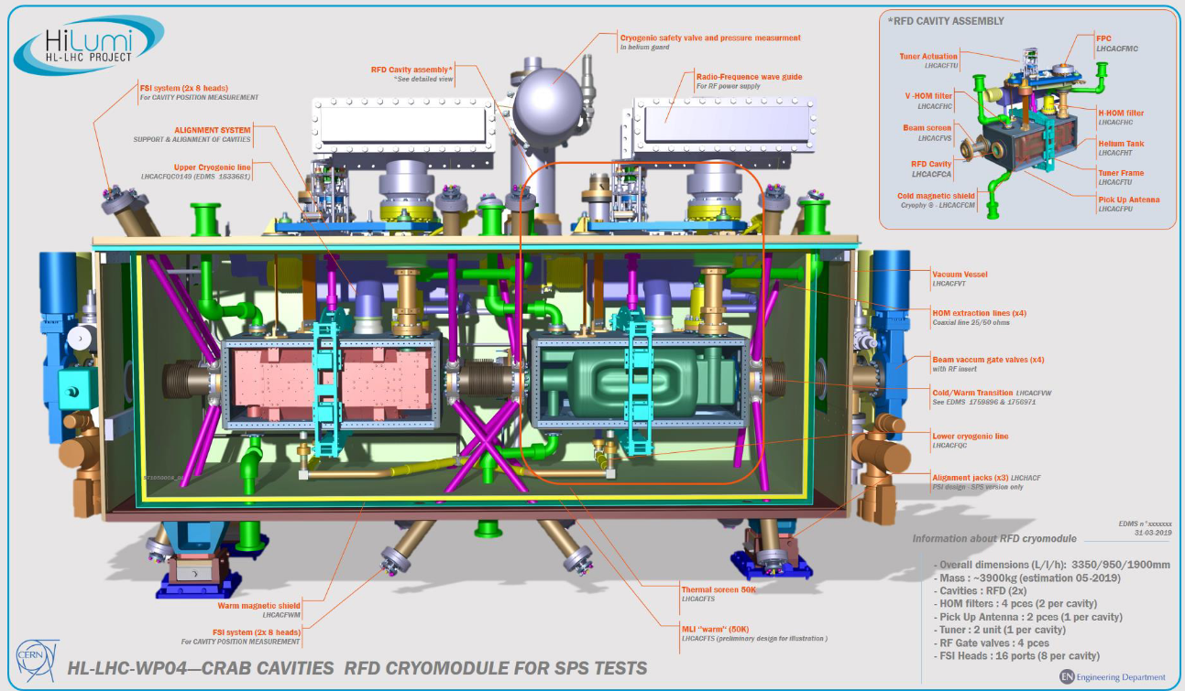
HL-LHC Crab Cavity Cryomodule (RFD)
Length ~ 3m
HOM lines (green), alignment (magenta)

Slide 4
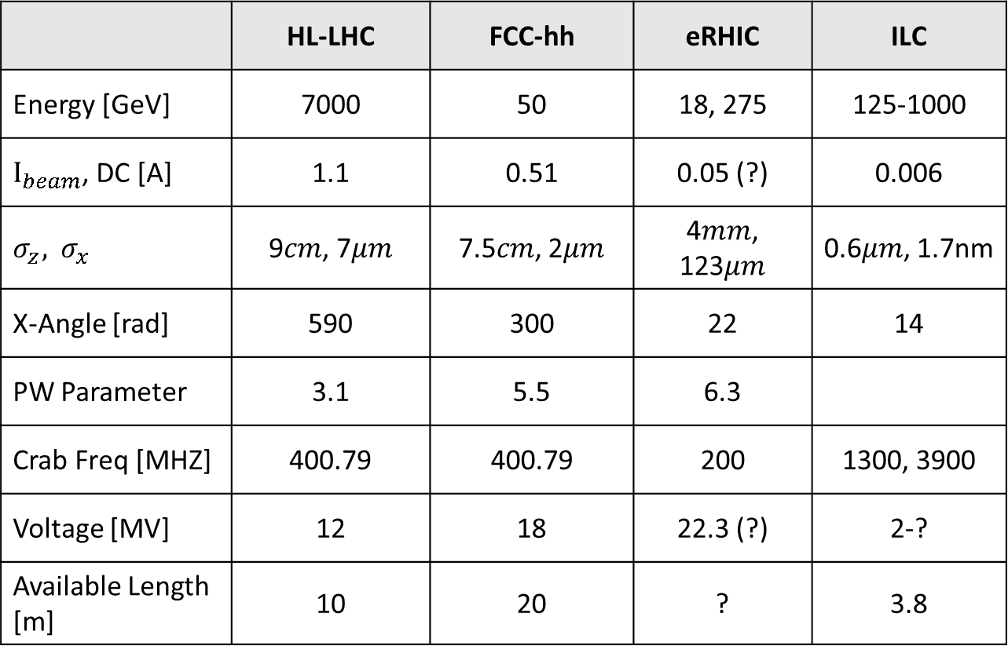
Parameter Comparison (RECHECK Numbers!)
 | HL-LHC | FCC-hh | eRHIC | ILC
Energy [GeV] | 7000 | 50 | 18, 275 | 125-1000
$I_{beam}$, DC [A] | 1.1 | 0.51 | 0.05 (?) | 0.006
$$σ_{z}, { σ}_{x}$$ | 9$cm$, 7$μm$ | 7.5$cm$, 2$μm$ | 4$mm$, 123$μm$ | 0.6$μm$, 1.7nm
X-Angle [rad] | 590 | 300 | 22 | 14
PW Parameter | 3.1 | 5.5 | 6.3
Crab Freq [MHZ] | 400.79 | 400.79 | 200 | 1300, 3900
Voltage [MV] | 12 | 18 | 22.3 (?) | 2-?
Available Length [m] | 10 | 20 | ? | 3.8

Slide 5
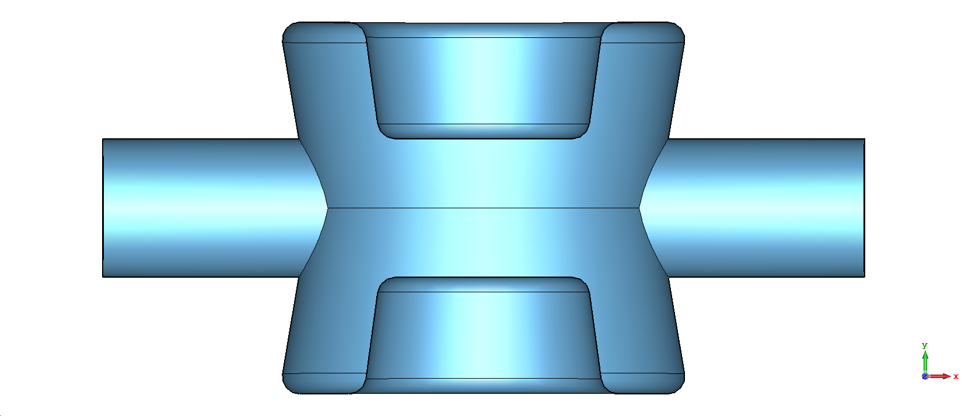
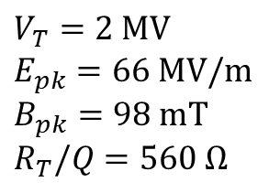
DQW Crab Example for ILC at 1.3 GHz
$$V_{T}=2 MV$$
$$E_{pk}=66 MV/m$$
$$B_{pk}=98 mT$$
$R_{T}/Q$ $=560 Ω$
67.4 mm
40 mm
40 mm
220 mm
CST file: https://cernbox.cern.ch/index.php/s/OEEIMPyR7fKN9kP

Slide 6
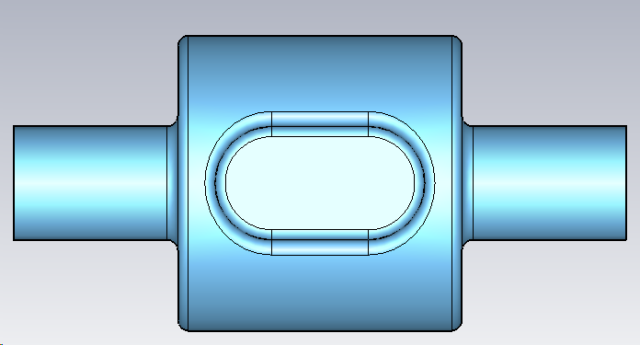
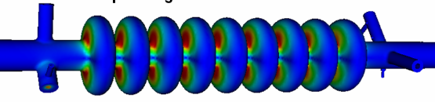
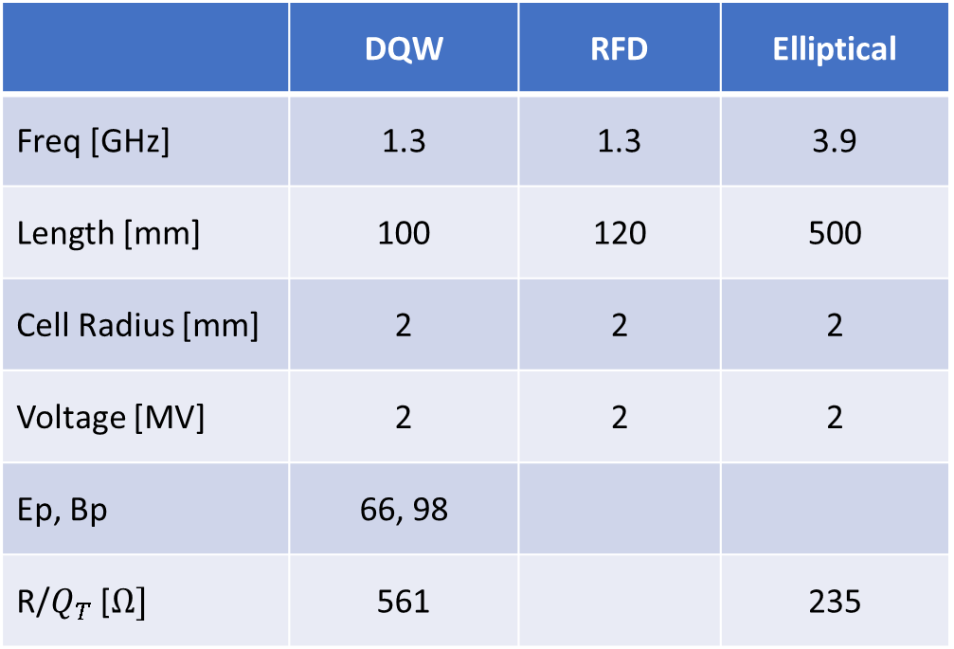
Preliminary Comparison (to be completed!)
Too many cells?
 | DQW | RFD | Elliptical
Freq [GHz] | 1.3 | 1.3 | 3.9
Length [mm] | 100 | 120 | 500
Cell Radius [mm] | 2 | 2 | 2
Voltage [MV] | 2 | 2 | 2
Ep, Bp | 66, 98
R/$Q_{T}$ [$Ω]$ | 561 |  | 235

Slide 7
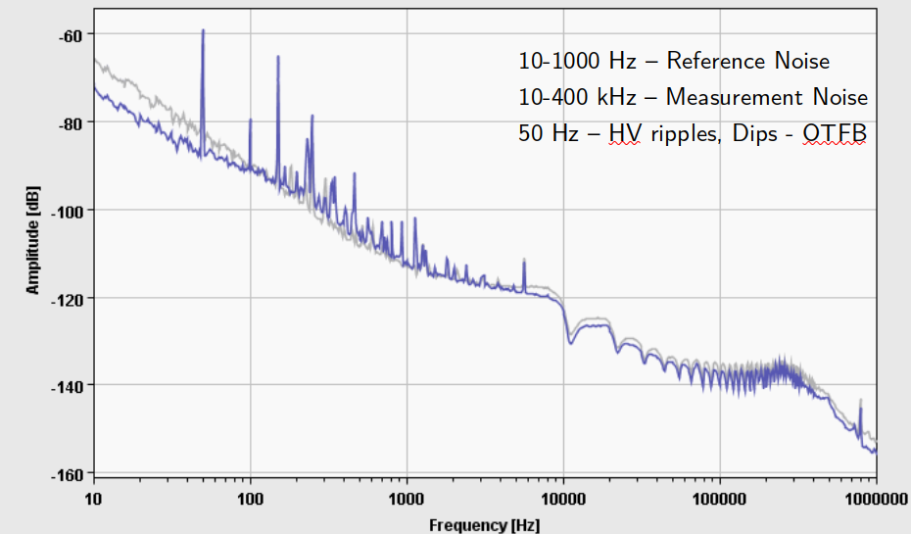
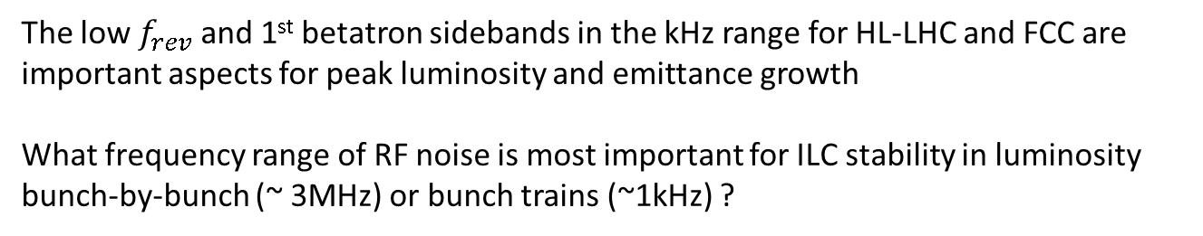
RF Noise
The low $f_{rev}$ and 1st betatron sidebands in the kHz range for HL-LHC and FCC are important aspects for peak luminosity and emittance growth
What frequency range of RF noise is most important for ILC stability in luminosity bunch-by-bunch (~ 3MHz) or bunch trains (~1kHz) ?
LHC Measurements
FCC: 3 kHz
LHC: 11 kHz

Slide 8
RF Noise Contd.
Fast control at the cavity level & “slower” control across the IP perhaps needed for the ILC
For SPS crab cavities & AWAKE experiments ~3 km phase compensated fiber optic links were used to transmit the 400 MHz reference signals.
Phase stability of ~10 ps is feasible (integrated 10 Hz – 1 MHz), below this some additional tricks can be applied to go as low as 1ps. Some 100 fs level stability is being estimated for the white-rabbit technology (integrated between 10 Hz – 40 MHz)
Cavity
Cavity
300 m optical link ?
IP Control
LLRF
LLRF

