Slide 1
Crab Cavity Effort at BNL
Binping Xiao
Feb 18 2021

Slide 2
LHC crab cavity design is a collaboration between BNL, JLab, CERN, UK and SLAC:
Jlab: Naeem Huque, Anne, McEwen, HyeKyoung Park, Tom Powers, Haipeng Wang
BNL: Ilan Ben-Zvi, Silvia Verdú-Andrés, Qiong Wu, Binping Xiao
CERN: Rama Calaga, Ofelia Capatina and more
UK: Graeme Burt, James Mitchell
SLAC: Zenghai Li, Alex Ratti
EIC crab cavity design is a collaboration currently between BNL, JLab, ODU and SLAC, with contributions from:
BNL: Zachary Conway, Douglas Holmes, Kevin Smith, Silvia Verdu Andres, Qiong Wu, Binping Xiao, Wencan Xu, Alex Zaltsman
JLab: G. Krafft, James Henry, Joseph Matalevich, Tim Michalski, HyeKyoung Park, Joseph Preble, Robert Rimmer, Mark Wiseman
ODU: Subashini De Silva, Jean Delayen
SLAC: Zenghai Li
And this list is expanding.

Slide 3
Requirements
20mrad crossing angle, close to BNL EIC at 25mrad.
3.9GHz for TE11 type cavity, or 1.3GHz for TEM type cavity.
36mm beampipe ID.
1.845MV at 1.3GHz, or 0.615MV at 3.9GHz, for 20mrad and 500GeV beam.
0.73ms 5.8mA 5Hz beam.* CW SRF for pulsed beam with possible low average HOM power.
Impedance requirements? (Longi, Trans, for 1.3GHz cavity)
  LHC double quarter wave (DQW) (100kΩ, 10MΩ/m) → EIC DQW (1kΩ, 1MΩ/m) → EIC wide open waveguide (WOW) (1kΩ, 30kΩ/m)
“Progress towards crab cavity solutions for the ILC” https://lss.fnal.gov/archive/2006/conf/fermilab-conf-06-541.pdf
*”The International Linear Collider” https://indico.cern.ch/event/797182/contributions/3420956/attachments/1840327/3017240/ILC-RedLHC.pdf
Notes:
11.5MV is set so that in case 1 cavity is not working properly, the rest 3 can provide 33.83MV.
Epk & Bpk the lower the better.

Slide 4
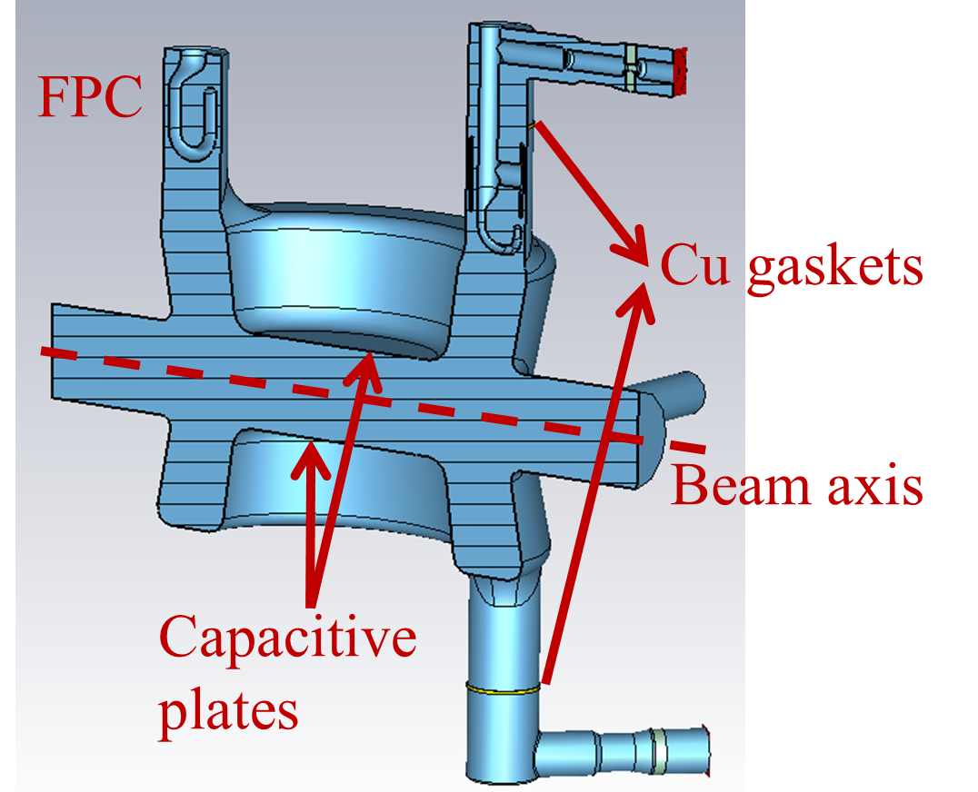
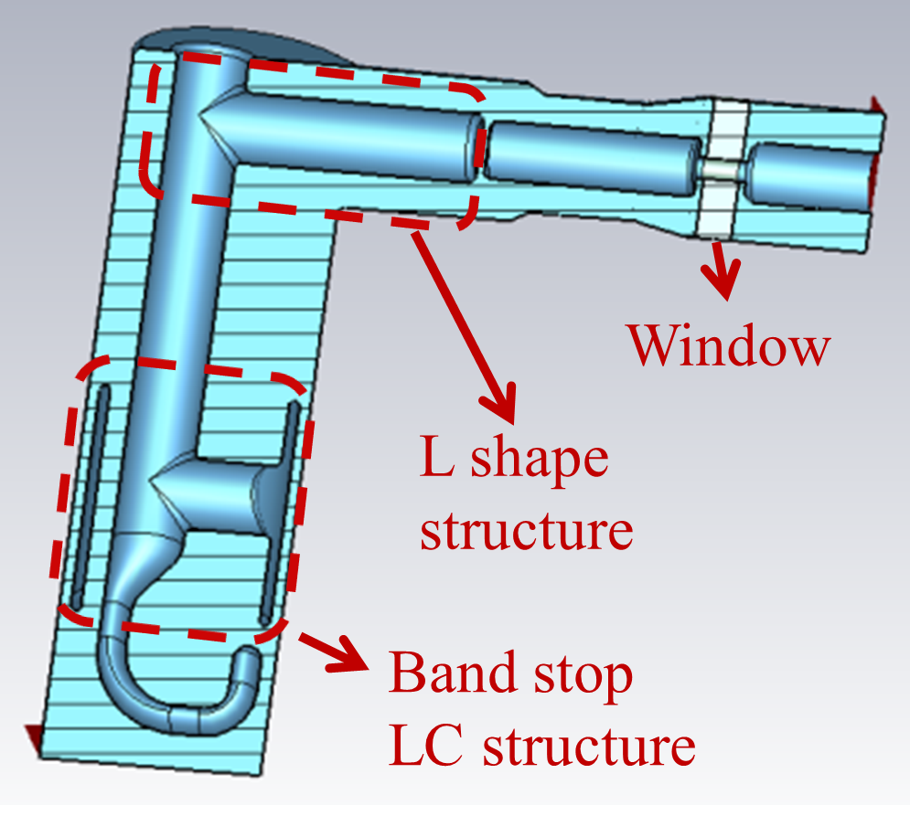
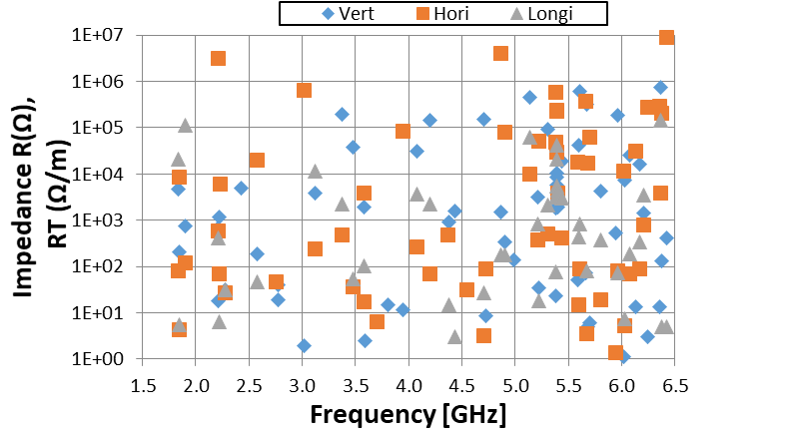
LHC DQW design
(Scaled to 1.3GHz)
A BNL/CERN/UK effort
Cavity with three coax HOM filter.
25.8mm ID beampipe.
Vt:1.15MV, Epk: 41.3MV/m, Bpk: 80.0mT.
Max imped, longitudinal: 1.2e5Ω, transverse: 8.8e6Ω/m.
Notes:
3.4MV, 72.8mT, 37.6MV/m, 87ohm G. R/Q_t 429.3ohm.

Slide 5
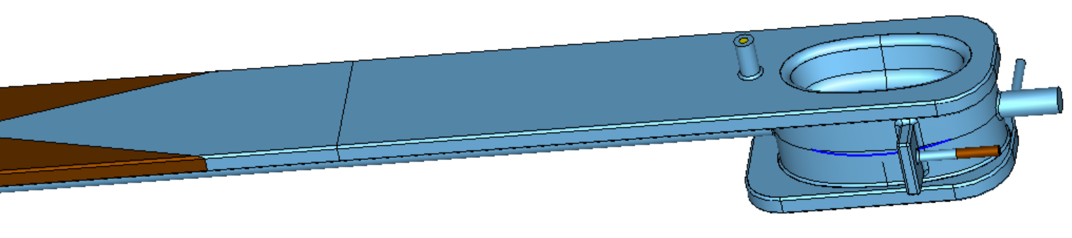
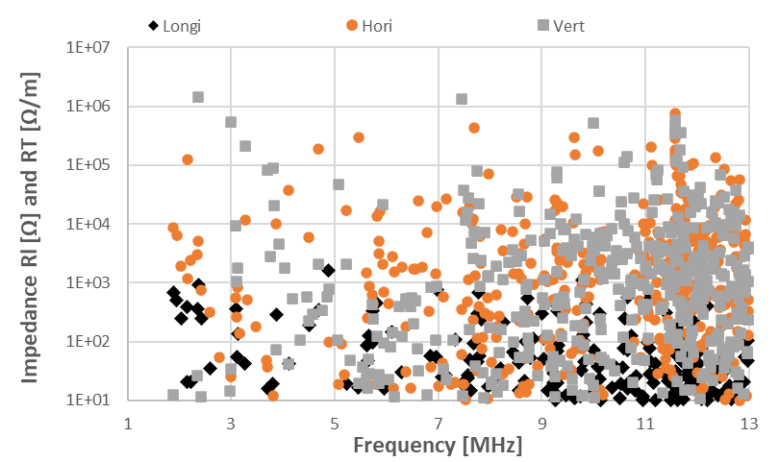
EIC DQW design
HHOM
(Scaled to 1.3GHz)
Cavity with one rect waveguide and one rect to coax coupler.
15.2mm ID beampipe (too small).
Vt:2.0MV, Epk: 51.6MV/m, Bpk: 80.0mT.
Max imped, longitudinal: 1.6e3Ω, transverse: 1.5e6Ω/m.
VHOM
Notes:
3.4MV, 72.8mT, 37.6MV/m, 87ohm G. R/Q_t 429.3ohm.

Slide 6
EIC WOW design
WOW type crab cavity, initially proposed by T. Khabiboulline et. al (FNAL), & A. Grudiev (CERN).
A SLAC/BNL effort.
RFD type cavity with wide open beampipe ports to damp HOMs by propagating to external SiC absorbers.
For 394MHz cavity with 320mm ID beampipe, TE11 cutoff is at 549 MHz and TM01 cutoff is at 717MHz.
Cavity shape is tailored to push lowest HOM frequency higher so that all HOM can be damped on SiC absorbers.

Slide 7
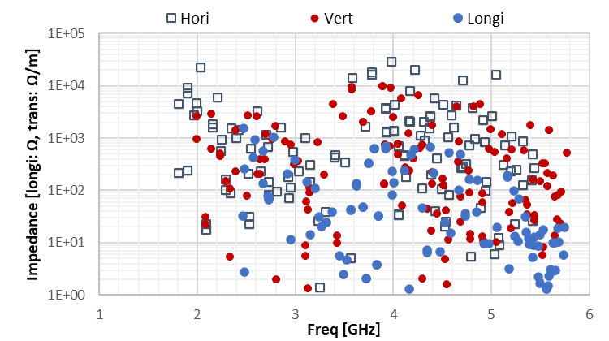
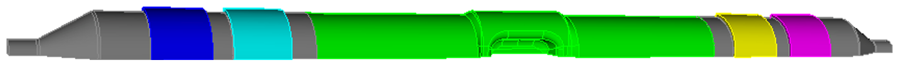
EIC WOW design
(Scaled to 1.3GHz)
Two SiC absorbers on each side.
30.3mm ID beampipe.
Vt: 1.27MV, Epk: 50.4MV/m, Bpk: 80.0mT.
Max imped, longitudinal: 1.5e3Ω, transverse: 2.9e4Ω/m.
1meter length.
One 2-cell cavity can provide >1.845MV deflecting voltage.

Slide 8
Summary
DQW with 3 coax HOM filters is designed for LHC.
To lower the longitudinal impedance, a DQW with one rect waveguide and one rect to coax waveguide for HOM damping is designed.
To lower both longitudinal and transverse impedances, a WOW type RFD with SiC absorbers on beampipe is designed. The geometry is simple.
For all 3 designs, providing 1.845MV by a single cell cavity is challenging and needs further optimization.
The WOW type crab cavity has the potential to be a multicell design, and one 2-cell cavity can provide the voltage needed for ILC at 1.3GHz.

Slide 9
Thank you!

