Slide 1
Work Breakdown Structure for the Prelab phase
Benno List, DESY
13th IDT WG2 Meeting
6.4.2021

Slide 3
WBS Structure for Prelab-Phase
WBS: “A deliverable-oriented hierarchical decomposition of the work to be executed by the project team” [PMBOK]
Different project phases are projects of their own, with their own WBS:
WBS for Technical Design Phase TDP
WBS for Prelab phase
WBS for construction phase
In each phase, prepare WBS for next phase
Define WBS for prelab phase now
Define construction project WBS in prelab phase
Guiding principles of a WBS:
Deliverable-oriented
Compatible with work organisation
What are the deliverables in the Prelab phase?
Final deliverables: construction-ready design, project plan, cost book
Intermediate deliverables: Component counts, power estimates, requirements, design criteria…
EDR is a human-readable summary of these design deliverables

Slide 4
Deliverables

Slide 5
Deliverables of the Prelab-Phase -> And who does it
Accelerator design*
Overall integrated design -> AD&I
Sources, DR, RTML, ML, BDS -> Acc. areas
Artefacts: Lattice, beam parameters, system description, imput for CFS design criteria (requirements), component counts, design for specific components, availability data,
Technical components design*
Magnets, vacuum, diagnostics, LLRF, controls, dumps, collimators, survey and alignment, installation… -> Technical system groups
Artefacts: Component designs, technical data, prototypes, subsystem design, component unit costs, production plans, requirements
SCRF design and prototypes*
Cryomodules, cavities, couplers, tuners, SC quad, BPM, HLRF (klystrons, modulators, PDS), cryogenics -> SCRF groups
Artefacts: Component designs, technical data, prototypes, subsystem design, component unit costs, subsystem costs, production plans, requirements
Conventional facilities and site design*
Civil engineering (caverns, tunnels, surface buildings) design
Technical infrastructure (el. Power, water, HVAC, network, transport, safety, …) designs
Site design (Campus, transport, water, power lines, housing…)
Artefacts: Requirements / design criteria, construction plans, costs, schedule, schematics, env. impact assessment,
Project plan*
Cost estimate, cost book, project implementation plan, project schedule, construction project WBS and organisation, logistics plan, legal framework… -> project office
Engineering plan
System architecture, Requirements, Risks, CAD model, Technical Documentation, QA plan…
Outreach & PR material
Web site, videos, lectures, exhibitions… -> Outreach team
* = “based on TDR, consolidated and updated”

Slide 6
Proposed 1st level elements of a Prelab WBS
THE ACCELERATOR (PRODUCT)
Accelerator Design and Integration
Design the accelerator, its accelerator subsystems and their subsystem specific components
Design accelerator components (except SCRF/HLRF), including instrumentation and controls (Technical systems)
SCRF (incl. HLRF) Technology
Design all SCRF and HLRF components and the cryogenic system, for the ML and other accelerator subsystems, produce prototypes, qualify vendors and hub labs, establish/qualify production sites and companies
Conventional Facilities and Siting
Design all conventional facilities and the site
CROSS-SECTIONAL ACTIVITIES
Project Management and Legal Affairs
Perform project management of the prelab phase (cost, schedule, …)
Prepare Project Management of the Construction phase
Systems Engineering and Quality Management
Support systems engineering processes of prelab phase (documentation, CAD, requirements, …)
Prepare Systems Engineering processes for construction phase (all of the above, risk management, quality management, …)
Safety and Environment
Manage all safety, health, radiation and environmental protection issues
Outreach and Public Relations

Slide 7
Accelerator Areas and Technical Systems
RDR: Structured along technical systems (magnets, vacuum, instrumentation…)
TDR: Structured along accelerator areas (sources, damping rings, main linac…)
Both are needed:
Accelerator design focusses on overall system design, beam dynamics etc
Technical systems provide component design and costs, and concept / design of specific system:
Magnets and power supplies: Powering concept, cable dimensions, distribution of power supply stations…
Instrumentation: Overall concept for beam steering etc
Controls and LLRF: Design of control system, LLRF system, data acquisition…
Decision: Separate WBS groups for
Accelerator design and integration
Technical systems?
AD&I has clearly defined deliverables: Integrated design of whole accelerator complex
Technical systems: Overall deliverable is sum of all subsystem deliverables?
WBS structure should reflect deliverables, and responsibility / autority
Proposal: Keep AD&I and technical systems under one roof, with one coordinator
SRF (+HLRF): Of central importance for the project: keep as separate WBS group

Slide 8
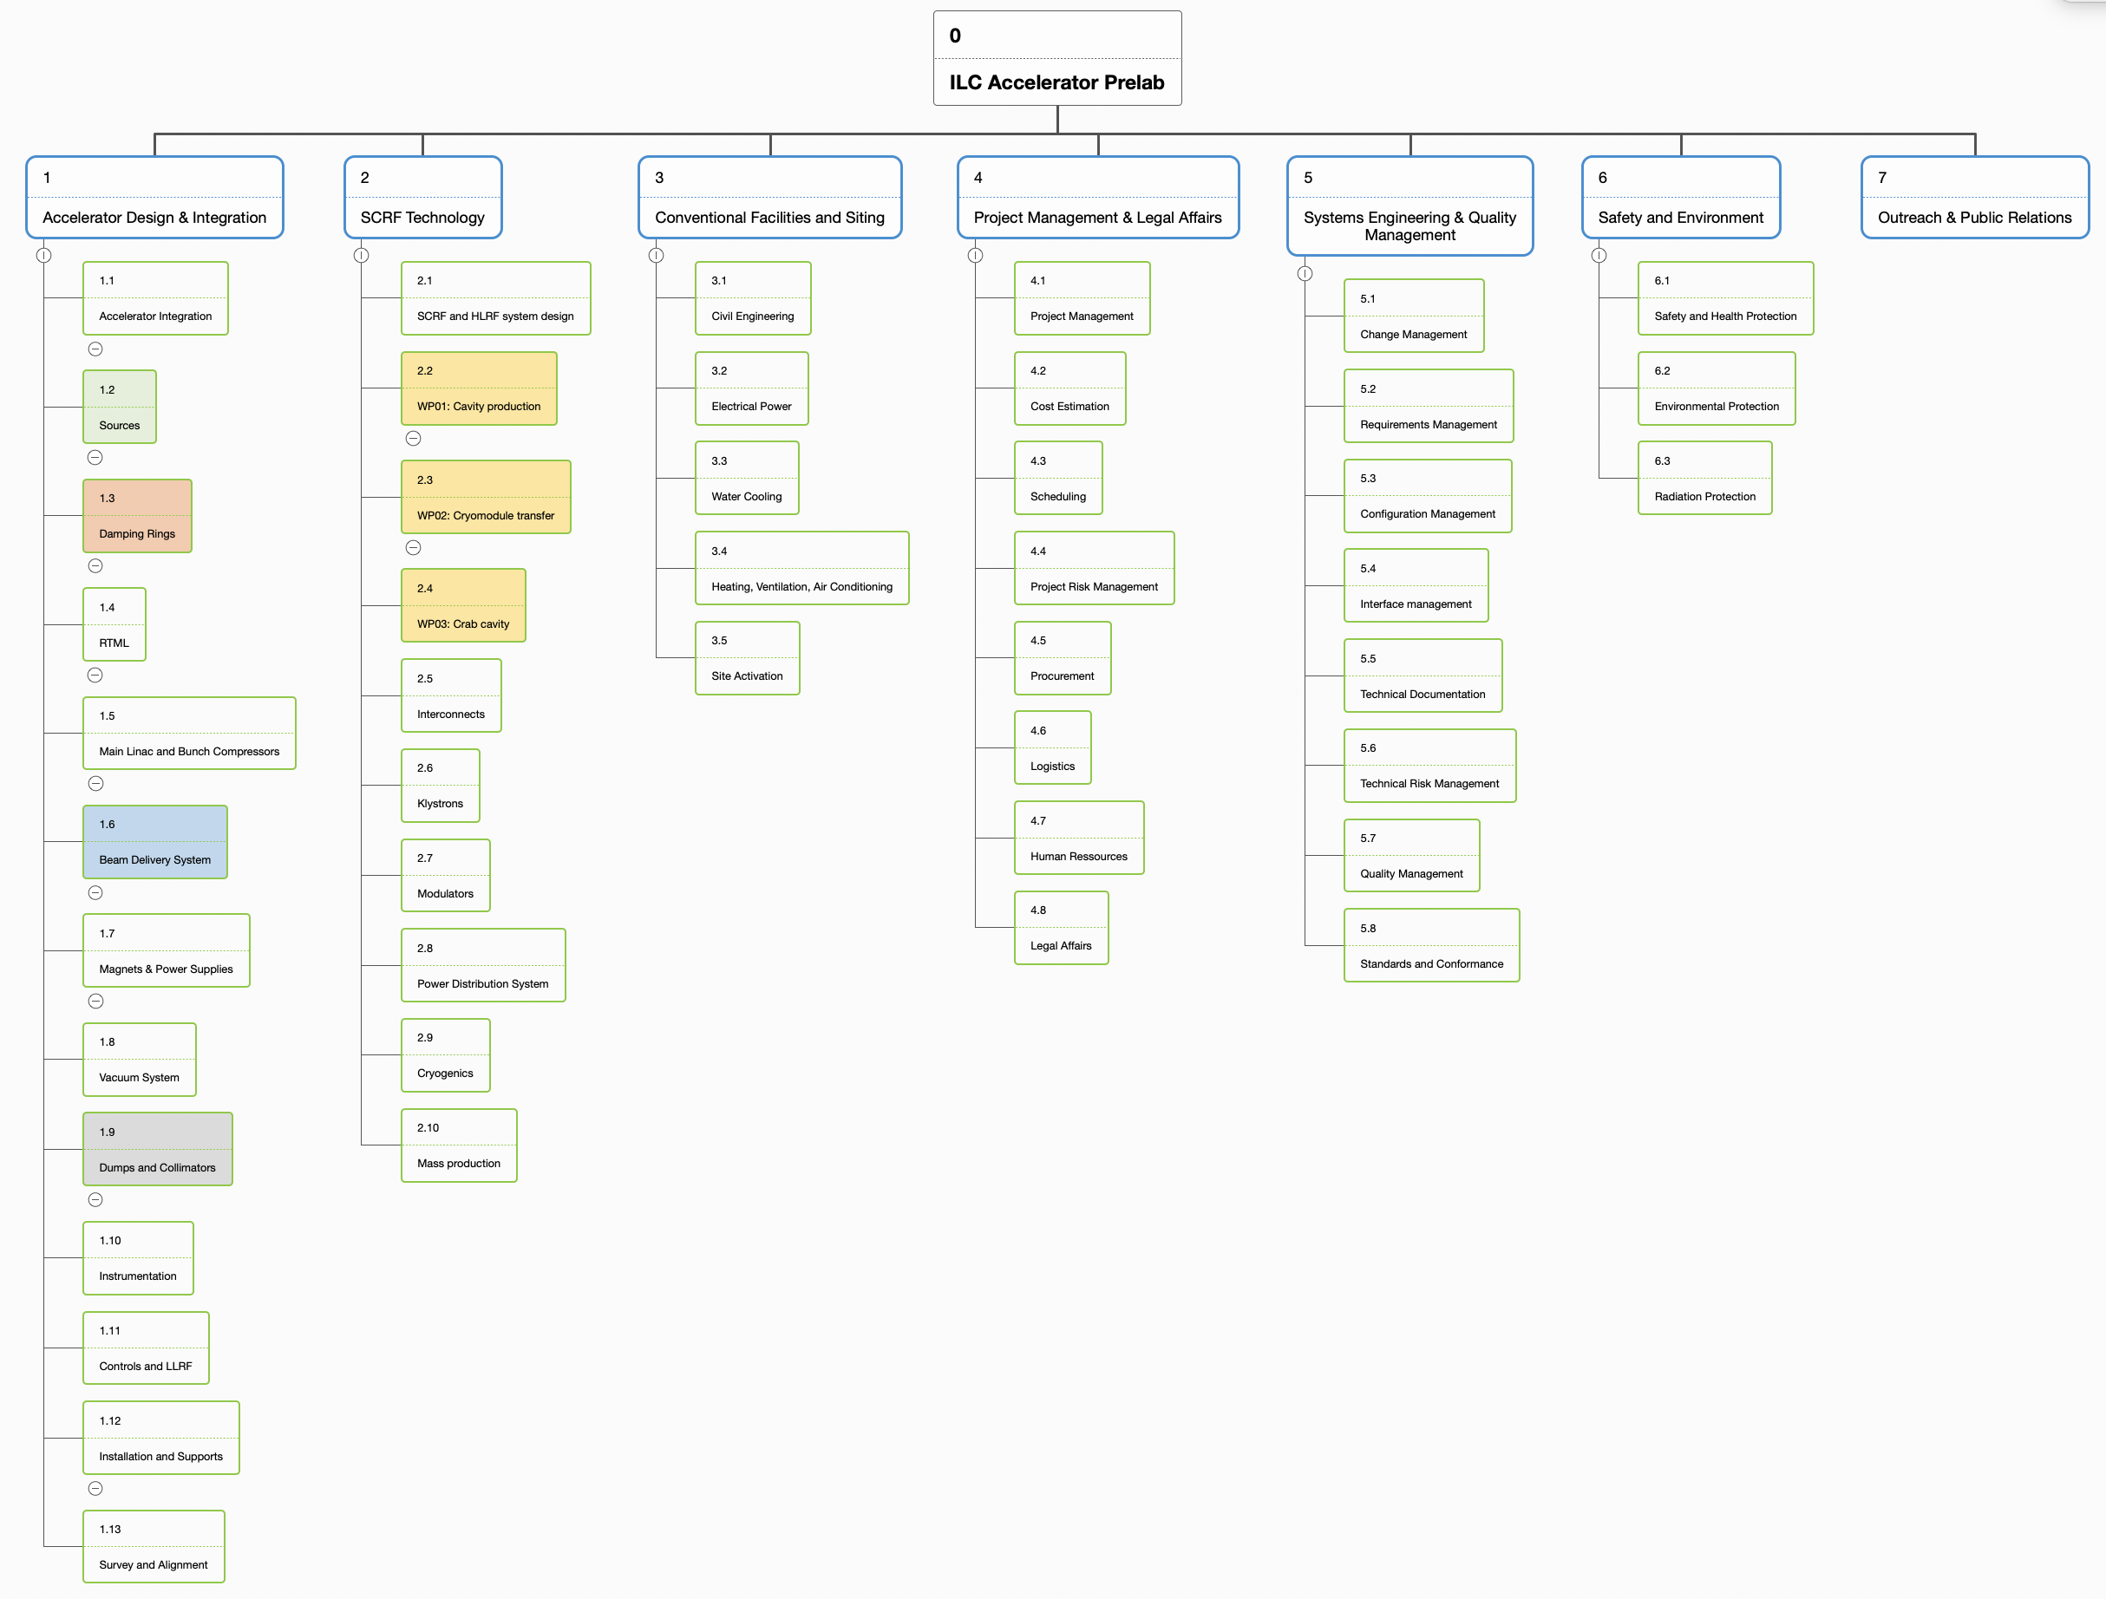
Technical preparation and engineering design
Technical preparation plan focusses largely on R&D and prototyping, with some system design work packages (DR) and some component designs (crab cavity, main dump, photon dump)
Augment the 18 TPP work packages already defined with additional emgineering design work packages in one structure

Slide 9
Accelerator areas
Cross-sectional activities
Technical systems

Slide 10
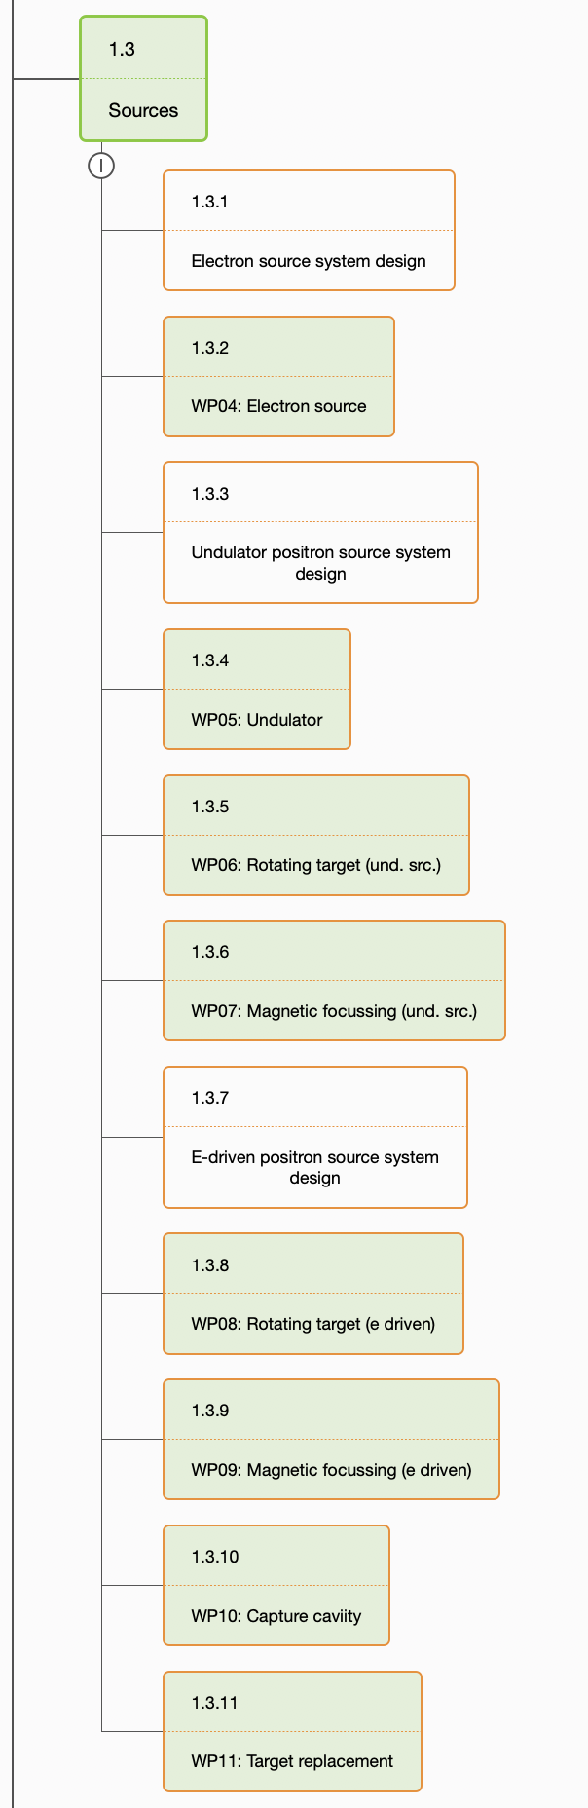
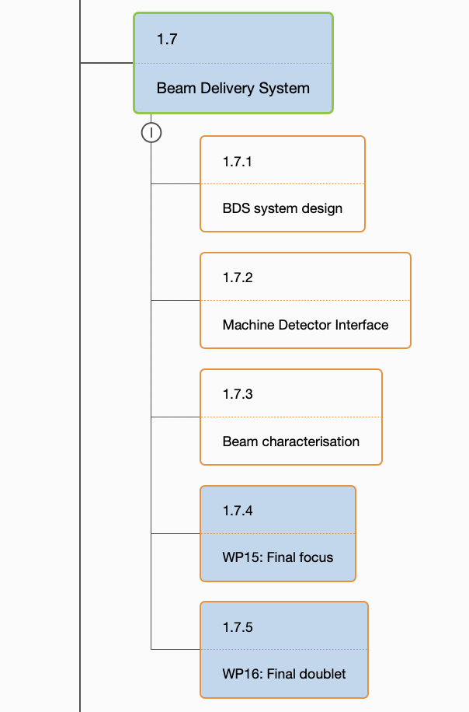
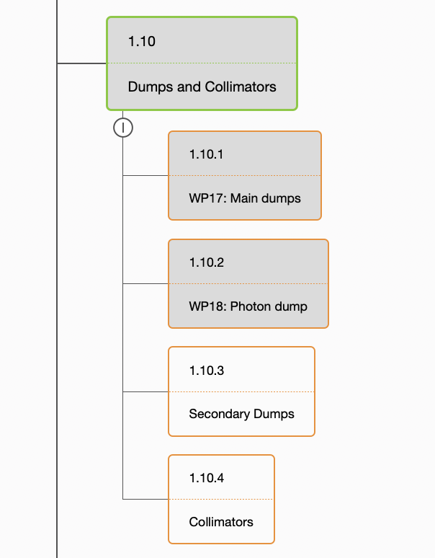
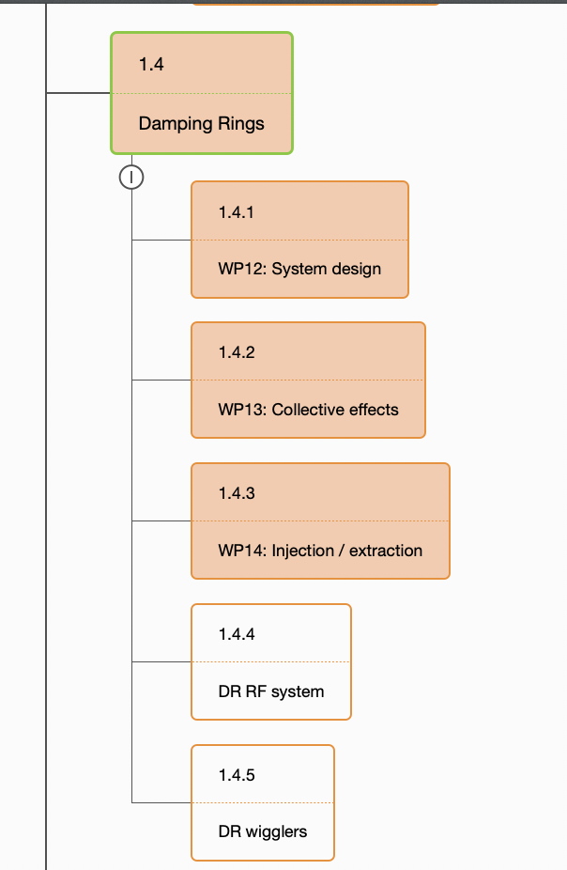
Existing TPP work packages
Area systems “Damping ring” and “Beam delivery system” from TP plan remain, some additional WPs are added
Area systems “electron source” and “positron source” share many aspects (booster design, transfer tunnels etc)
unite under one roof?
Add “system design” work packaqges that design all beamlines, lattice, make simulations etc
Area system “beam dump” continues as technical system “dumps and collimators”

Slide 11
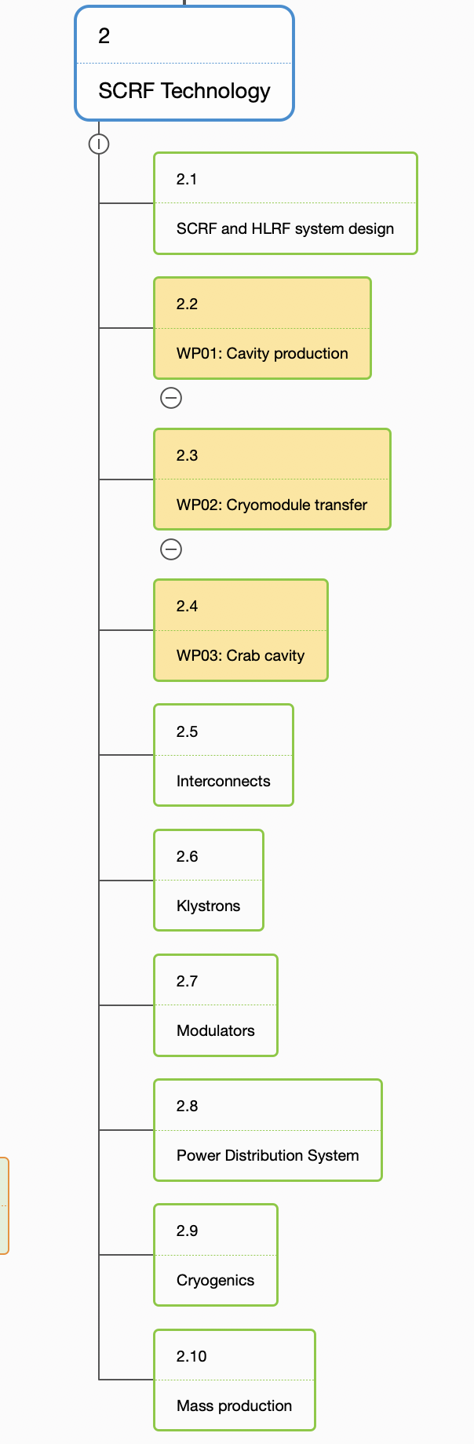
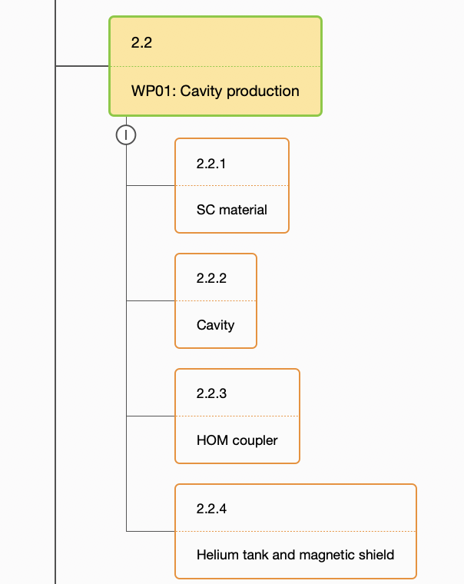
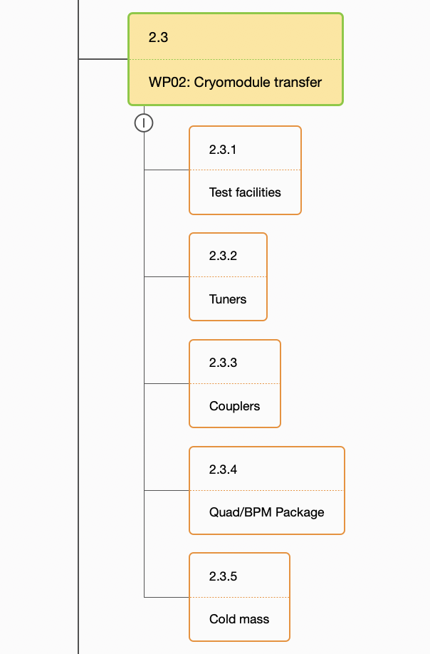
SCRF Technology
Central to project’s success
WP01 and WP02 are large (in terms of scope and ressources), could be decomposed in smaller packages for better definition
Add
Overall system design (complete RF units and cryo strings)
Design of interconnections
HLRF packages: Klystron, modulator, power distribution (waveguide) system
Cryogenics
Mass production as separate WP?
Includes modules for source 5GeV boosters!
Keep “Main Linac and Bunch Compressors” as separate WP in AD&I: design of BC, abort lines, beam dynamics of ML

Slide 12
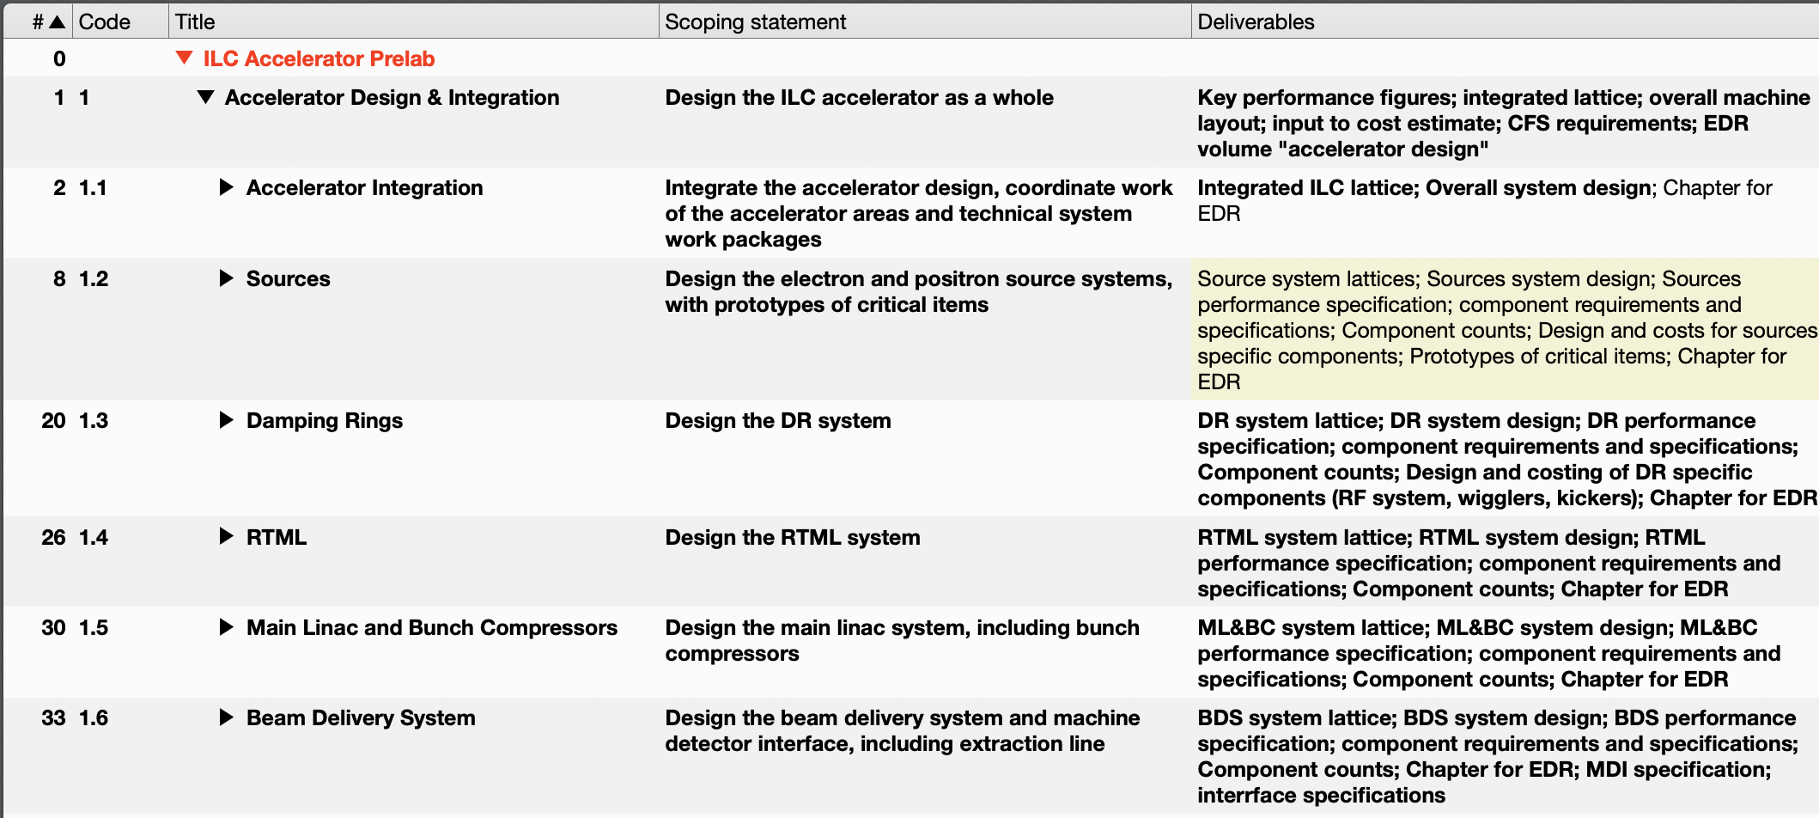
Scoping statements and deliverables
For each WBS item, describe the scope of work to be done, the deliverables and their state
For deliverables, provide a list
Technical area work packages – a rough proposal, to be discussed and refined by responsible subgroups, as far as they exist!

Slide 13
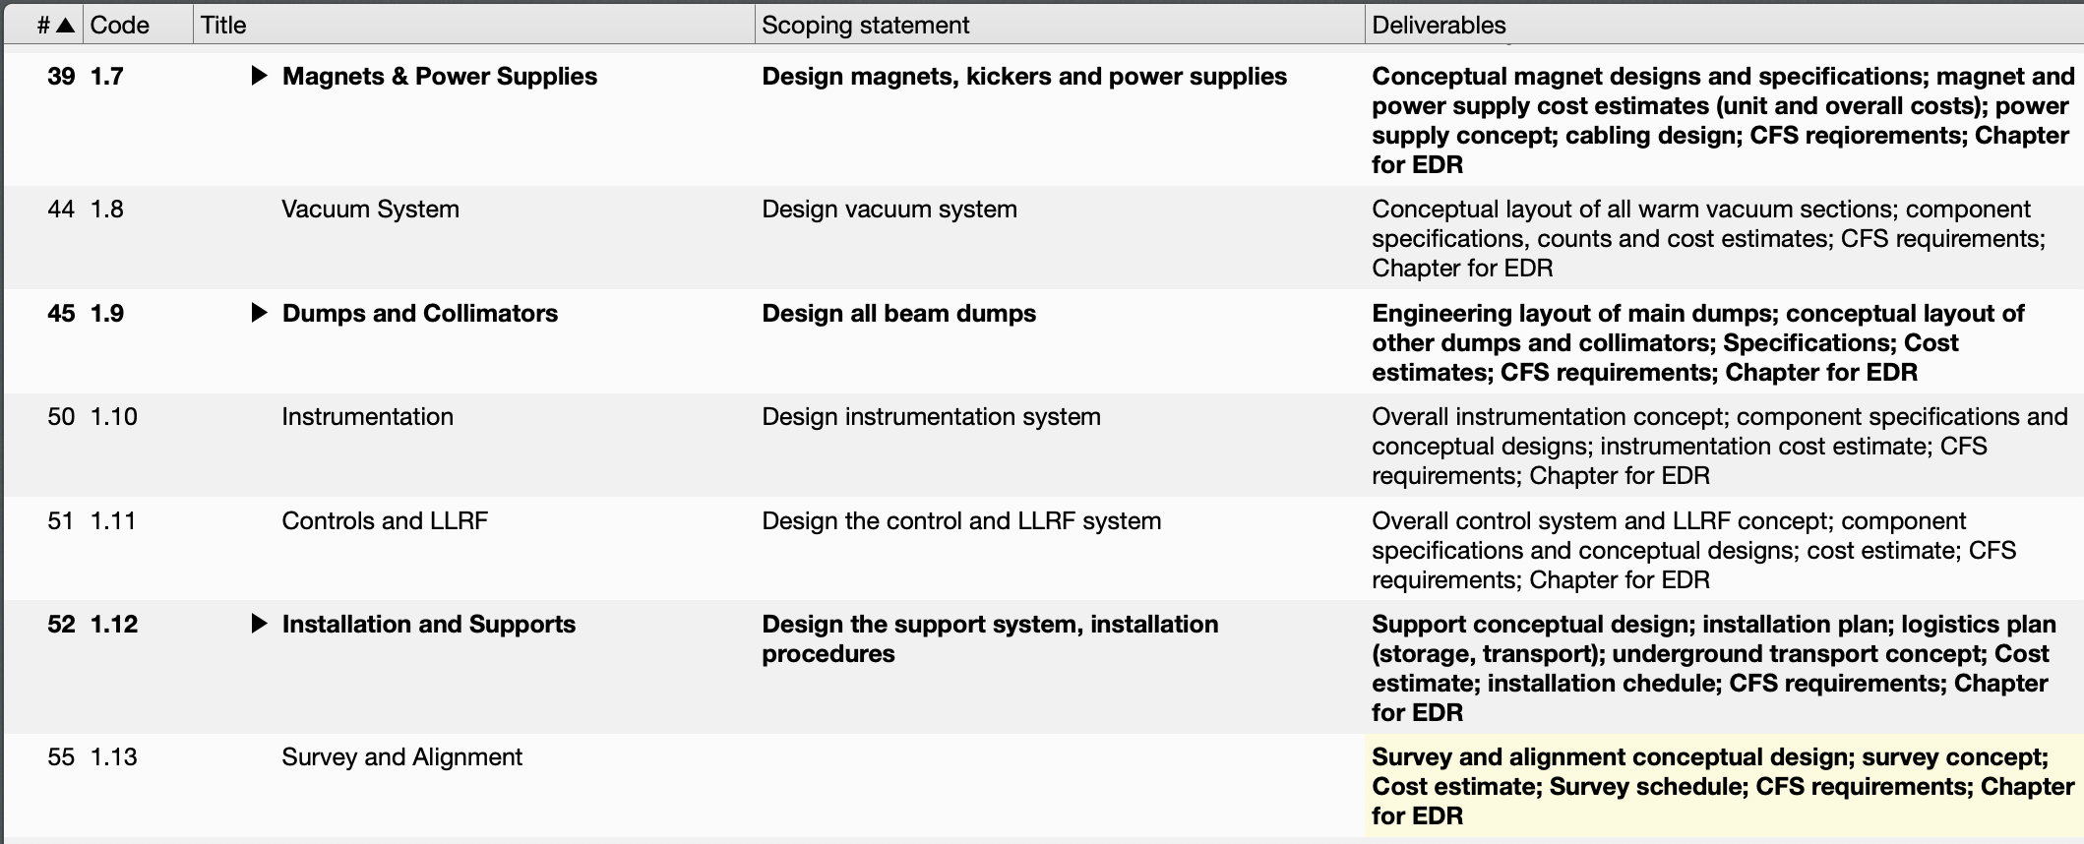
Technical system work statements

Slide 14
Relation between accelerator areas and technical systems
Accelerator area work packages lay out the accelerator, plan lattice etc
Component specifications go to technical system work packages
Technical systems design / specify components and supporting system (e.g. power supplies)
Specifications go back to accelerator area groups (e.g. space requirements)
Cost information goes to cost estimation WP (attributes capture “DR” as accelerator area)
Requirements for electricval power, cooling water, rack space go to CFS
Damping rings
Layout
CFS
Requirements: Int. Field, Aperture etc
Component count
Specifications: Size, current, power
Power, cooling, Cable space
Cost Estimation
Magnets and power supplies
Magnet and power supply costs

Slide 15
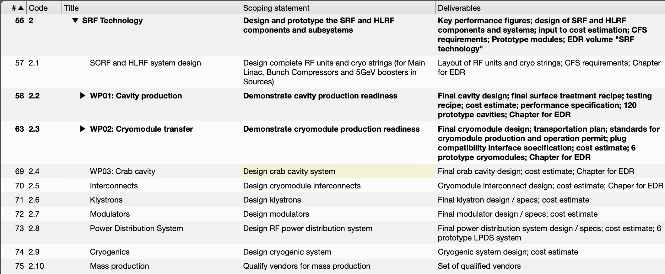
SRF Technolology work packages and work statements
This is only a very rough proposal, should be formulated by SRF subgroup!
Currently, WP01 and WP02 focus very much on R&D. Extend their mandate?

Slide 16
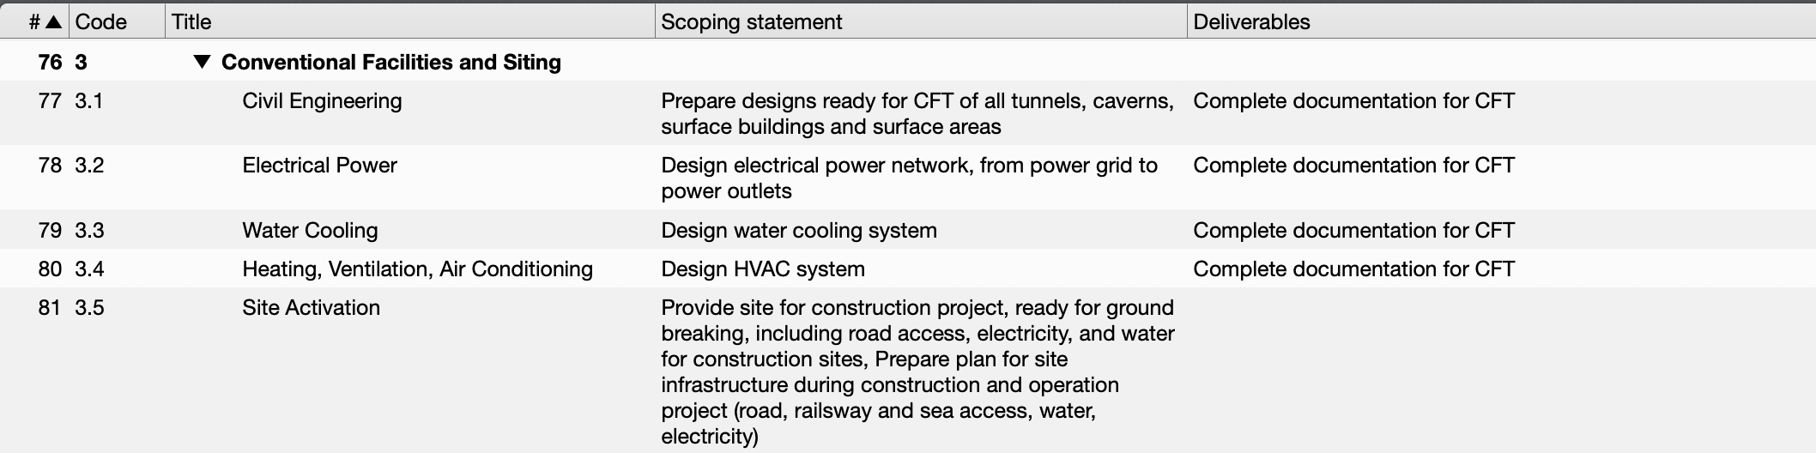
Conventional Facilities and Siting
Scoping needs to be defined
What is the deliverable at the end of the Prelab? Documents for Call-for-Tender? A prepared site ready for ground breaking, with all construction permits?
PLACEHOLDER

Slide 17
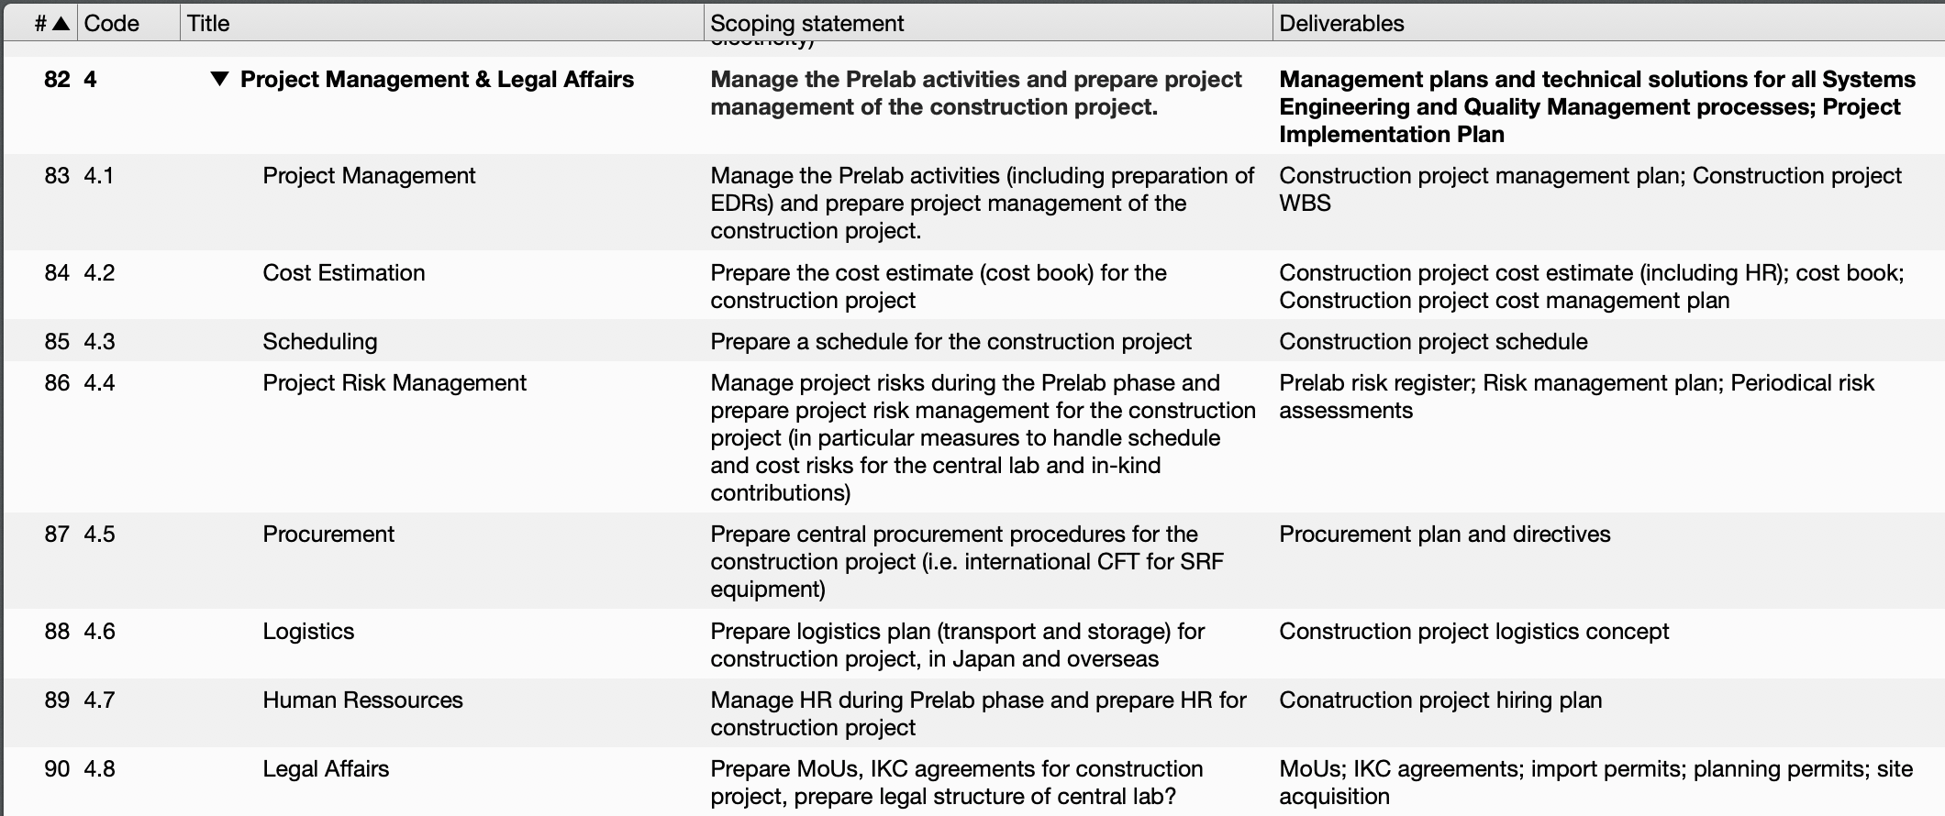
Project Management & Legal Affairs
Manage the project during Prelab phase
Plan the construction phase
Provide processes and implement technical solutions: Costing, scheduling, logistics…

Slide 18
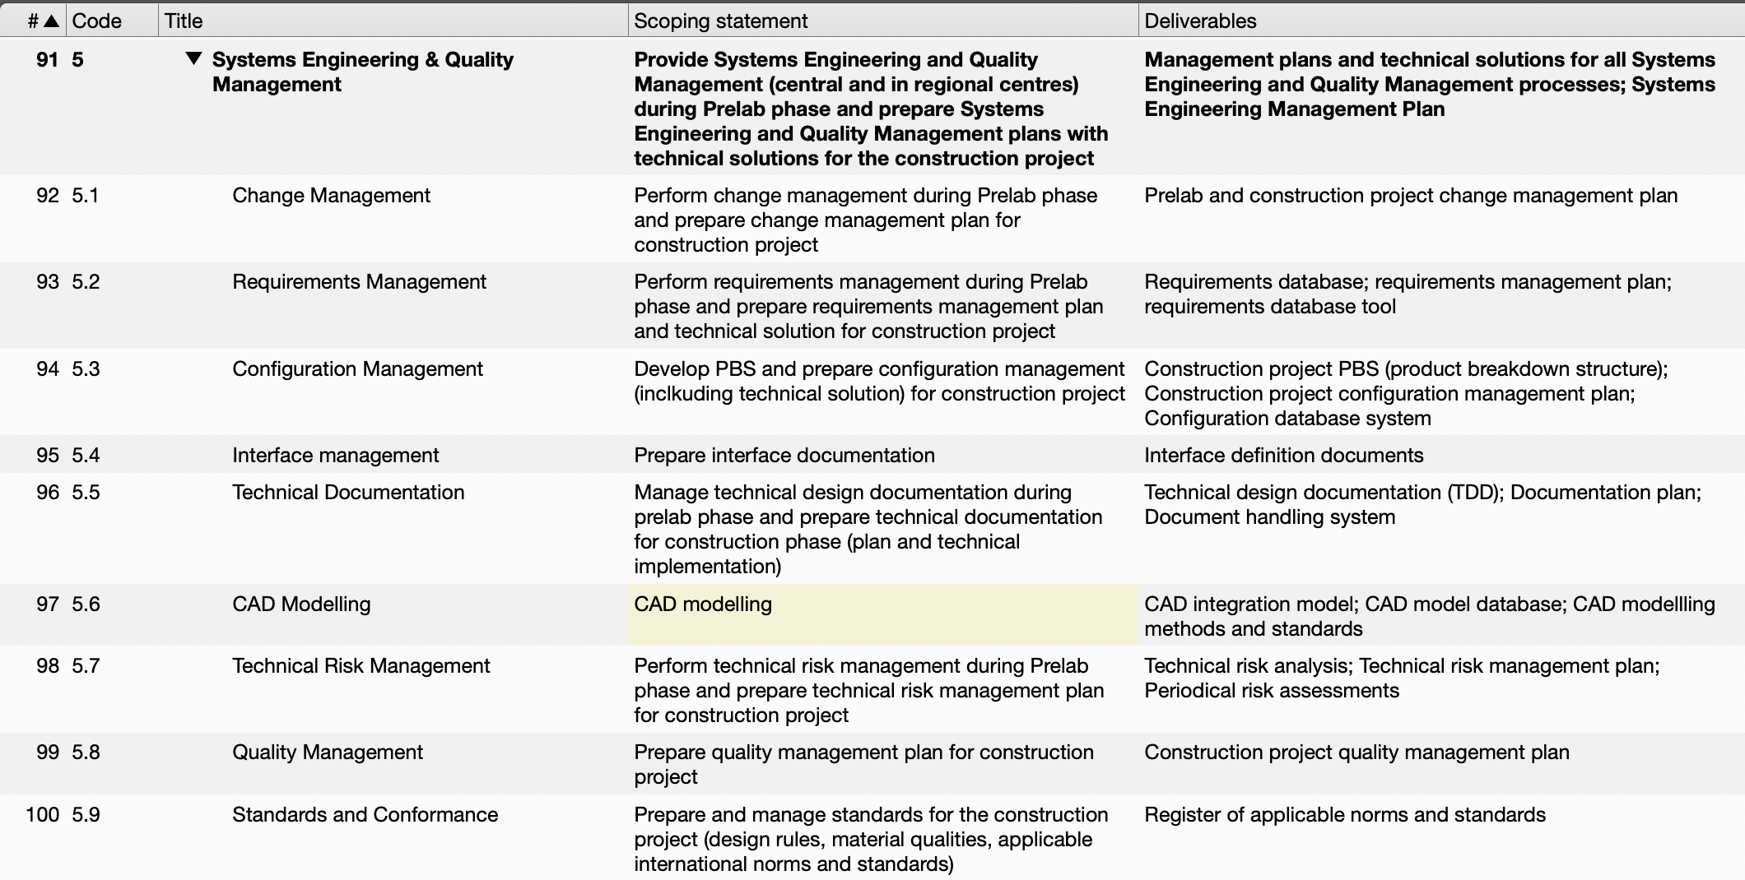
Systems Engineering and Quality Management
Perform Systems Engineering processes during Prelab phase (documentation, requirements, change management, CAD modelling, interface documentation…)
Plan the construction project (PBS, requirements,…)
Provide processes and technical solutions (Req. database, CAD systems, PLM system)

Slide 19
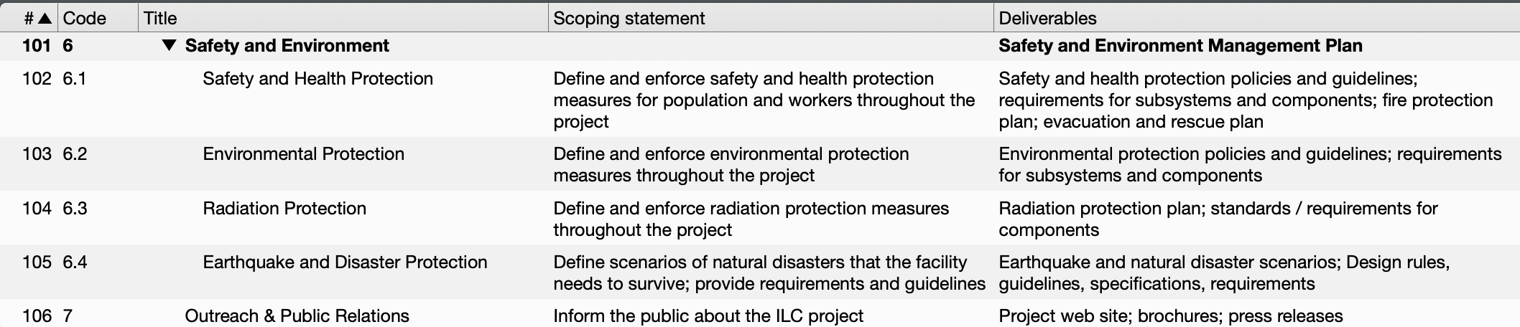
Safety and Environment, Outreach & PR
Safety, Environmental Protection, Radiation protection need supervision within the project, during Prelab and in construction project – are separate work packages
Provide guidance for all other work areas: Define policies, guidelines, applicable standards
Enforce these policies within the project

Slide 20
Ressource Estimates
Ressource estimates (work and money) must come from domain experts
Where applicable, existing subgroups should provide estimates
For others: Contact experts from the community
Prelab must provide services and support for Project Management, Systems Engineering, Quality Management etc
Manage / support the Prelab phase itself
Plan the construction
Provide the technical solutions
What can be provided in-kind? How much can (or should) be decentralized? Needs discussion!

Slide 21
Conclusions
Need a clear definition of the desired outcome of the Prelab phase, in particular for Civil Facilitiies & Siting
CFS planning drives the process. Each step of the CFS process needs input from accelerator design, and makes certain changes very expensive or impossible
The Prelab needs to organize the whole design process. R&D and engineering design should be part of a single design activity

Slide 22
Reserve

Slide 23
WBS and Documentation
Technical Design Documentation is organized along WBS
WBS: “A deliverable-oriented hierarchical decomposition of the work to be executed by the project team” [PMBOK]
Different project phases are projects of their own, with their own WBS:
WBS for Technical Design Phase TDP
WBS for Prelab phase
WBS for constructionm phase
In each phase, prepare WBS for next phase
Define WBS for prelab phase now
Define construction project WBS in prelab phase
http://www-fusion-magnetique.cea.fr/etn-qpn/ws-scheduling/EFDA%20Conference%20-%20Scheduling.pdf
Example: ITER WBS. Top Level ist programme phase

Slide 24
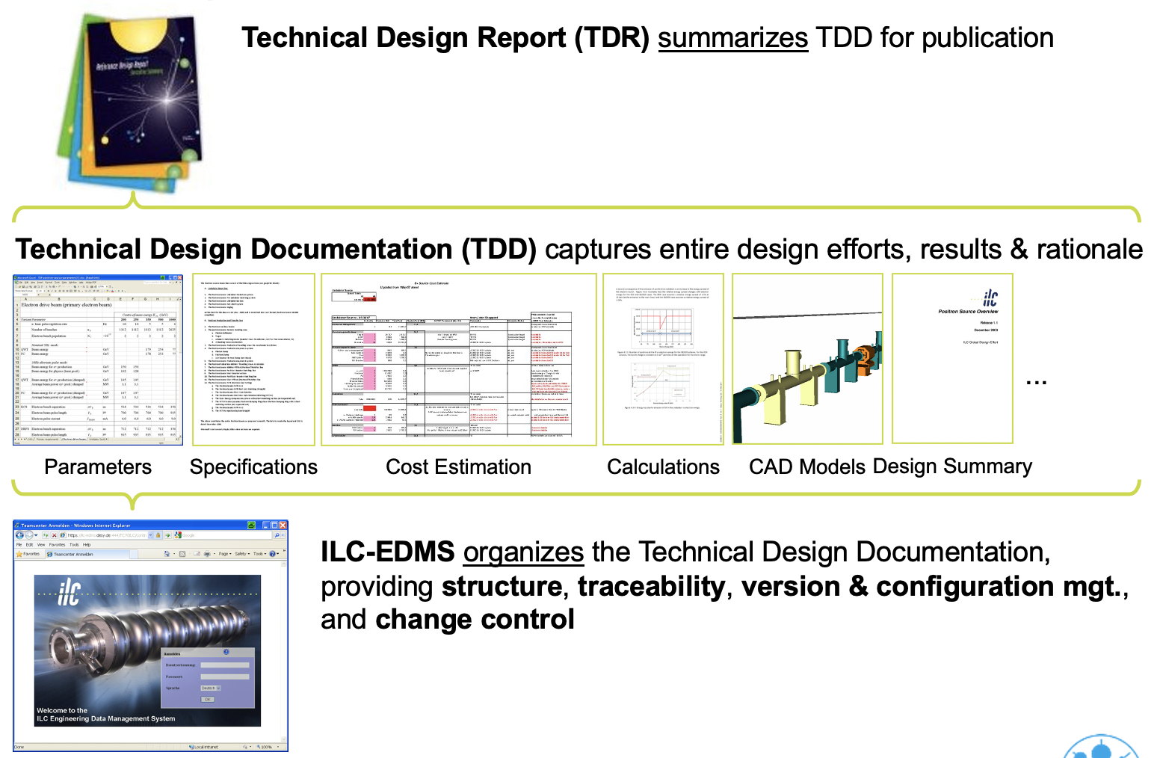
TDR and Technical Design Documentation

Slide 25
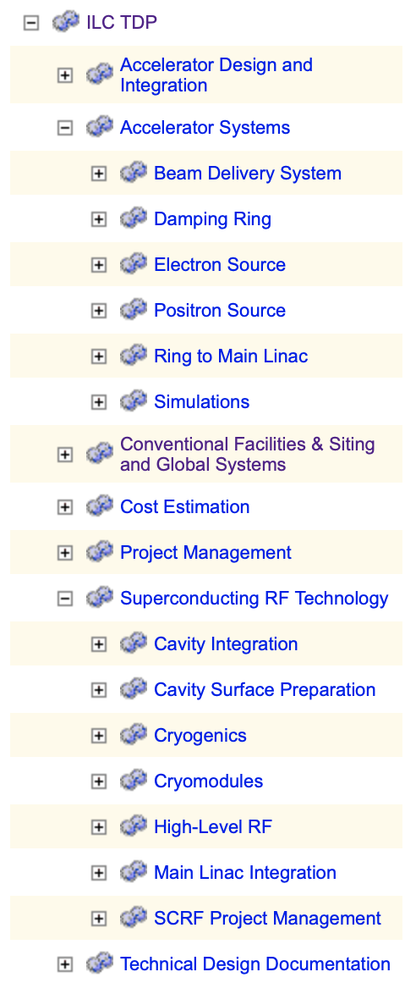
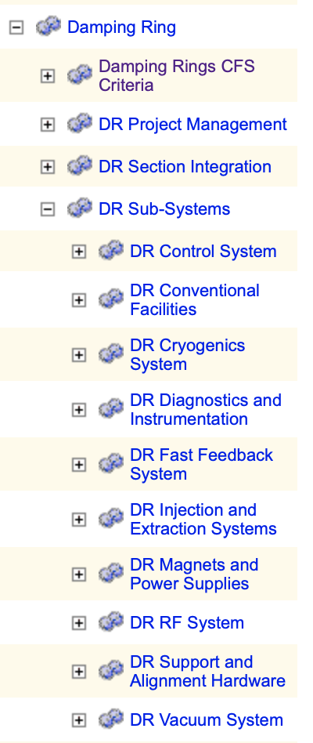
Structure of TDD from TDR (TDP-II) phase
WBS for Technical Design Phase II (TDP-II) was never fully formulated
Provisional WBS used to structure Design Documentation
Main Structure:
Accelerator systems
SCRF technology
CFS
Some cross cutting activities: AD&I, Costing, Project management, Documentation
Other Technical Areas (magnets, vacuum, …) from RDR only present as parts of accelerator systems
After Black December (12/2008), value engineering reduced to bare minimum, technical area groups outside SCRF non-existing -> No top-level element for Technical areas other than SCRF

Slide 26
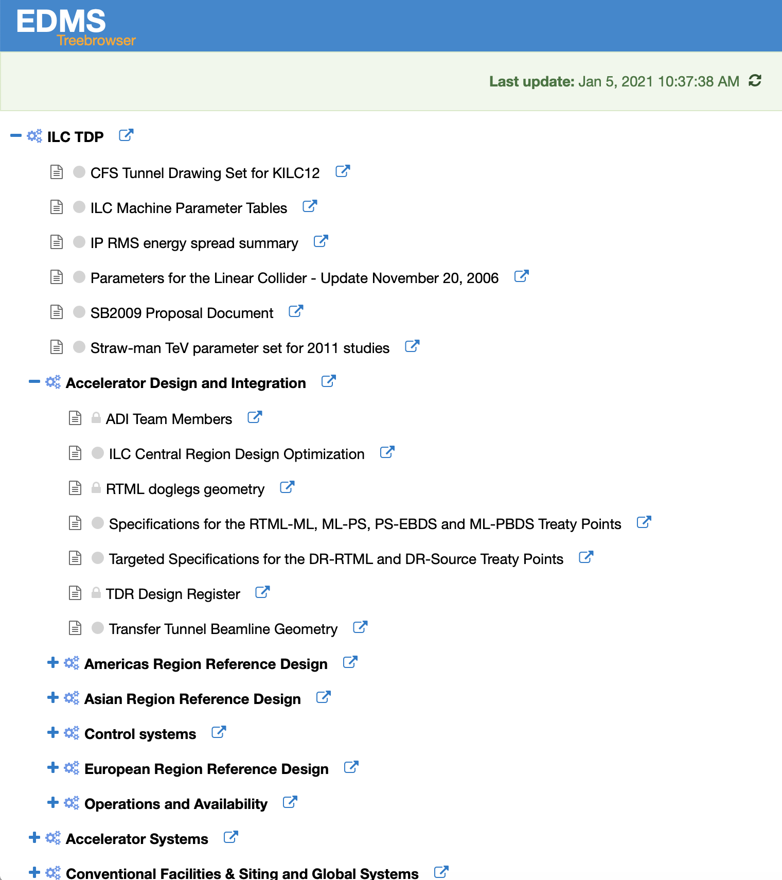
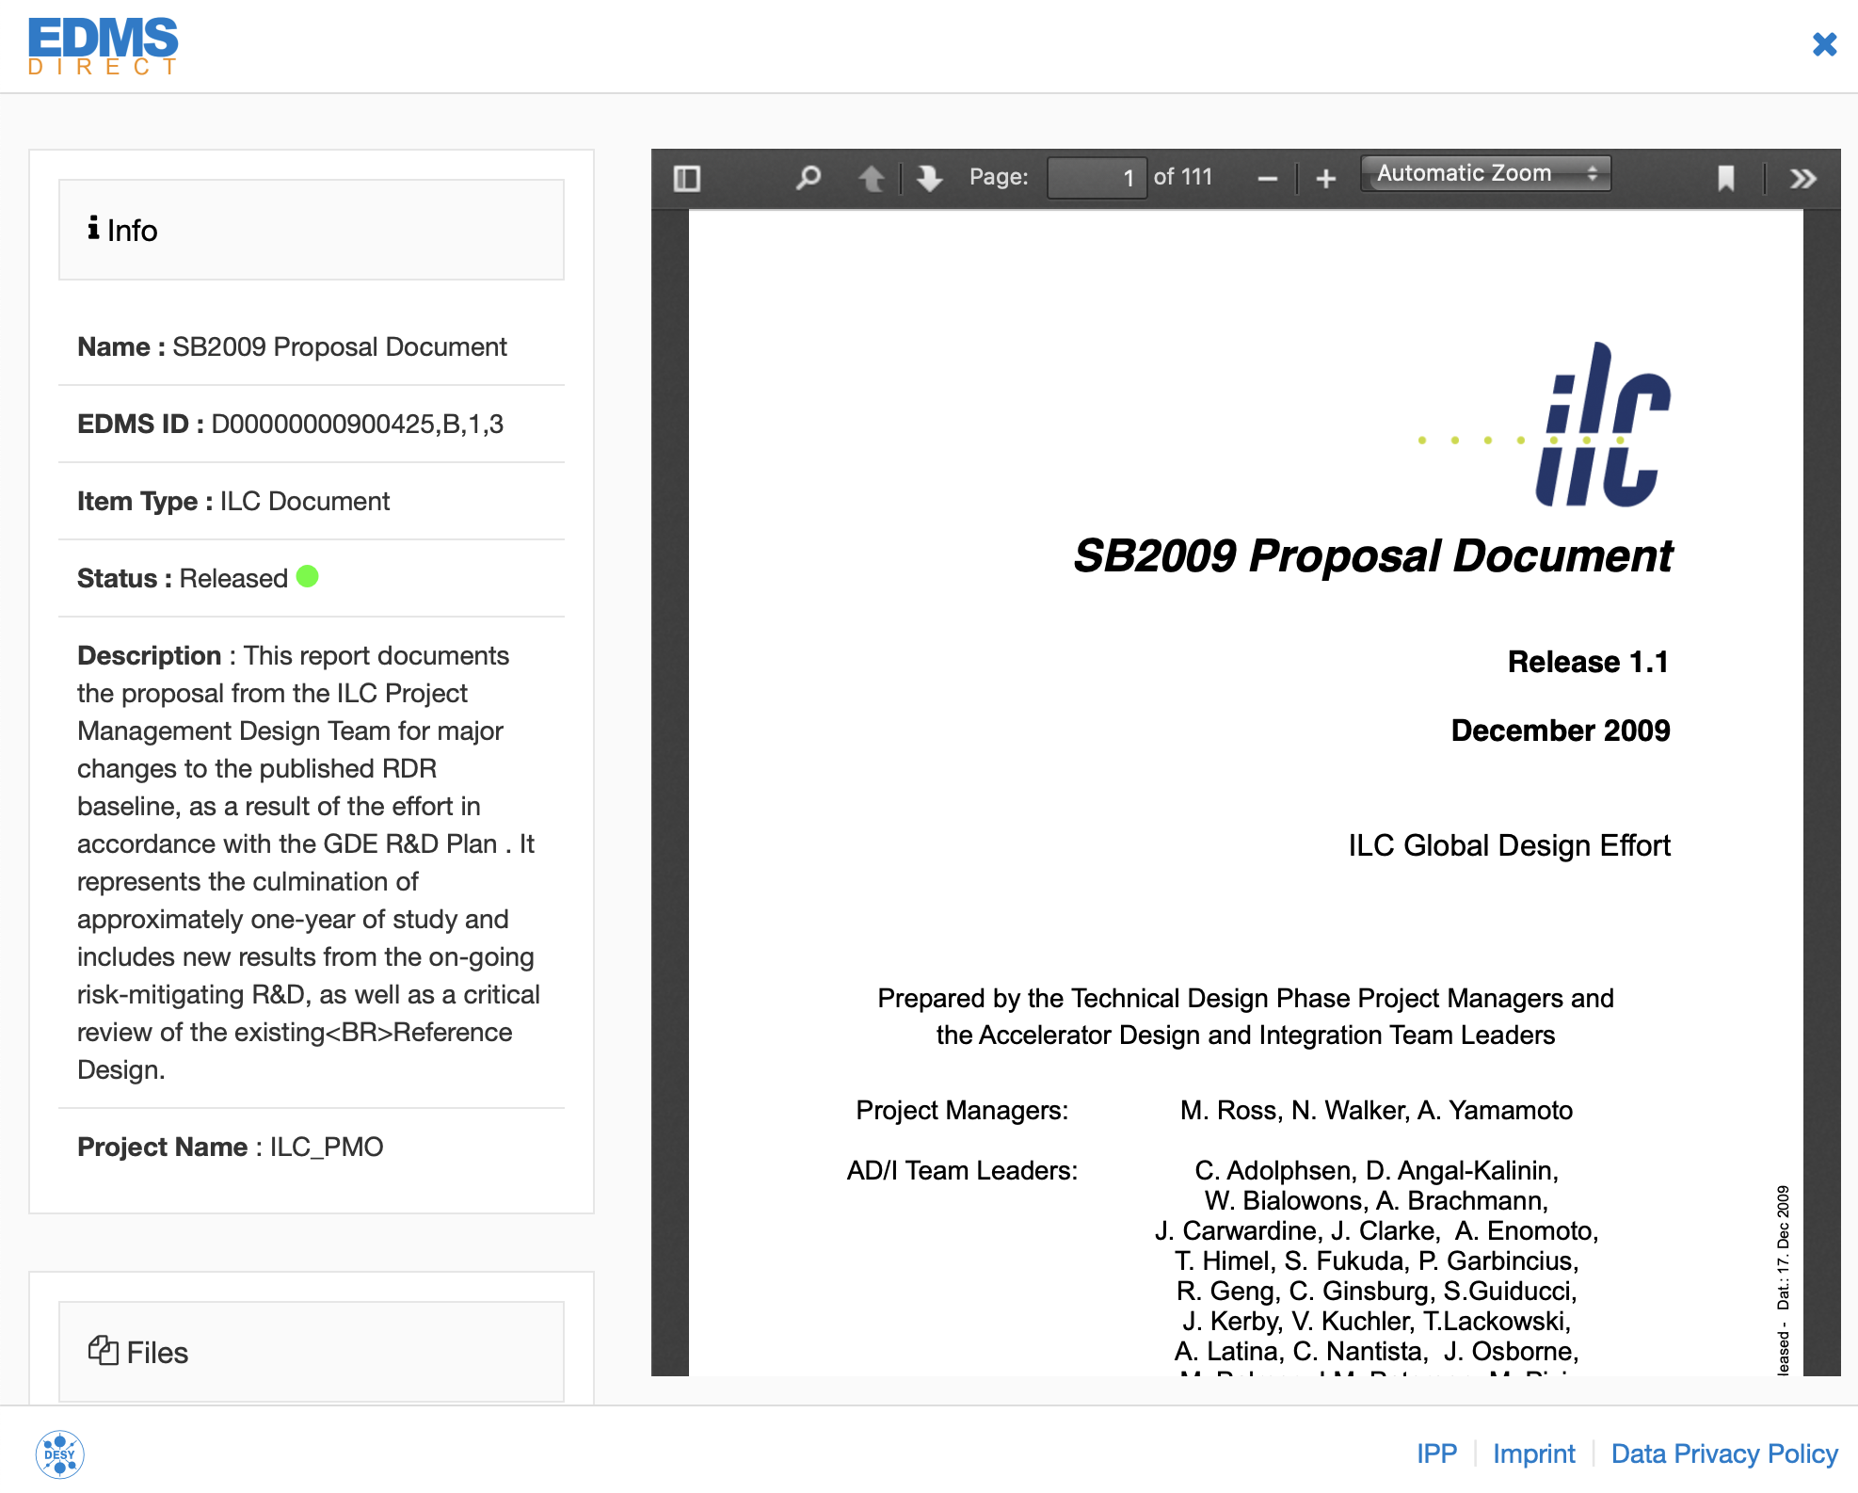
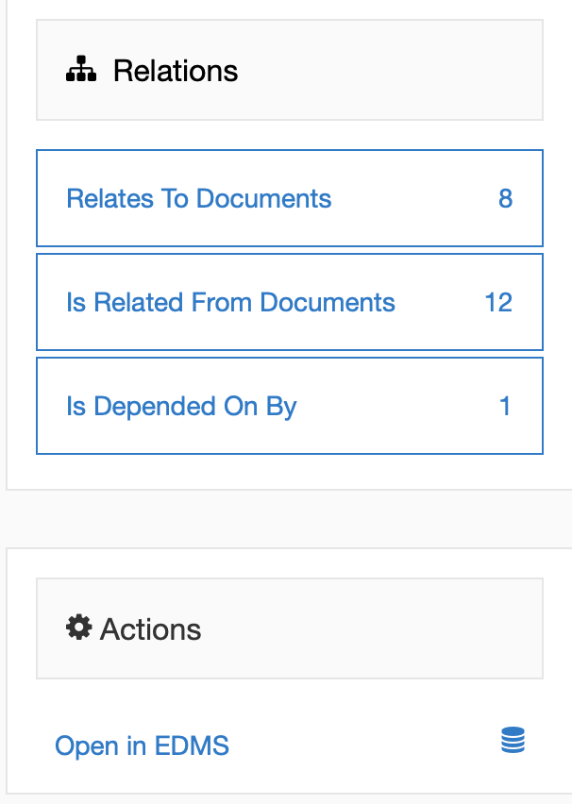
Access to TDD
New Web interface: https://edmsdirect.desy.de/treebrowser/ilc/
Provides easy navigation through the TDR WBS and the associated documentation
No log-in required
Integrated preview of document PDF
Documents are interrelated through links
Link to EDMS interface also provided
Some elements (costs!) are only available after log in with EDMS account, documents are visible only in full EDMS client

Slide 27
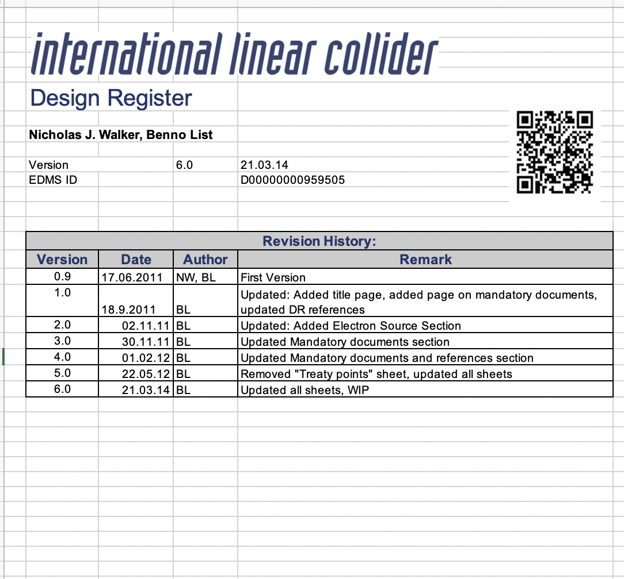
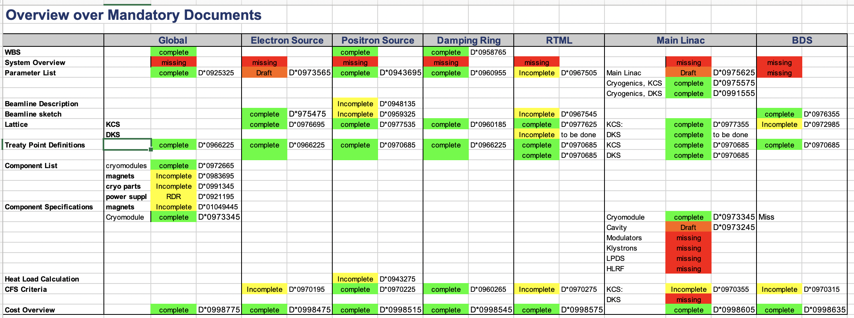
Design Register
Design Register gives overview over design status of accelerator systems and their documentation
Has a list of “mandatory documents” whose status is tracked
Includes cross references
Good practice: Prepare a list of artefacts / mandatory documents to be provided by the work packages
Drawings / CAD models
Schematics
Data sheets / specifications
Requirements
Calculations: Power, heat, costs, availability…
Procedure descriptions (installation, alignment, diagnostics, maintenance,…)

Slide 28
CFS documentation – Americas and Japan
CFS Design Criteria for all subsystems
Americas Region TDR for CFS
Japanese Studies
D00000000990585
D00000000979905
D00000000979935
D00000000960625
D00000001011835
D00000001011805

Slide 29
Possible 2nd Levels
Accelerator Design and Integration
Accelerator System Integration
Integrate accelerator subsystems, provide overall design and performance
Sources
Design electron and positron sources and specific components (undulator, target regions, gun and laser system)
Damping Rings
RTML
Main Linac and Bunch Compressors
Design Main Linacs and Bunch Compressors, based on SCRF design
BDS
SCRF and HLRF Technology
Cryomodules
Design all L-Band cryomodules for Main Linac, sources
Produce, transport to and test prototypes in Japan
Cavities
Cavity Material
Tuners
Couplers
Quad / BPM package
Klystrons
Modulators
Waveguide distribution
Cryogenics

Slide 30
Possible 2nd Levels, cont’d
Project Management and Legal Affairs
Project Management and WBS
Costs
Schedule
Project Risks
Procurement
Logistics
Human Ressources
Legal Affairs
Systems Engineering and Quality Management
Technical Documentation
Requirements Management
Technical Risks
Quality management
Configuration Management
Standards and Conformance
Change Management
Outreach and Public Relations
Safety and Environment
Safety and Health Protection
Environmental Protection
Radiation Protection

Slide 31
Possible 2nd Levels, cont’d
Accelerator Components
Magnets, Kickers and Power Supplies
Vacuum
Dumps and Collimators
Instrumentation
Controls and LLRF
Installation, Supports and Girders
Survey and Alignment
Conventional Facilities and Siting
Civil Engineering
Electrical Power
Water Cooling
Heating, Ventilation, Air Conditioning
Site Activation

Slide 32
WBS Structure and Costing
Cost estimate from TDR phase
WBS based – organized according to a WBS
Bottom-up – add number * unit costs of all components
Final result was reported in a matrix form: (accelerator systems) X (technical areas)
Cost estimate is based on WBS of construction project – need not be identical with WBS of prelab phase!
In strictly WBS based costing, a “Magnets” work package would contain all costs for fabrication of magnets, ”installation” would contain costs of installation -> a parallel “Damping Rings” work package would not include these costs!
Does not answer “How much do the Damping Rings cost?” or “Which components drive DR costs?”
TDR WBS tried to answer these questions by a convention for levels 1/2 of WBS
1: Accelerator systems
2: technical areas
Runs into many problems:
CFS: two systems in one tunnel
Same components in different systems: How to handle one-off costs, quantity rebates, spares
Strength of a WBS based costing is 100%-rule: Every level is exactly the sum of its parts
Reports on cost distribution are based on attributes, not on structure!
Distinguish atomic items from items that are summed up
Atomic items get attributes to allow all kinds of reports
Cost sharing over attributes must be possible (e.g. 75% BDS, 25% Sources)

