Slide 1
ILC EB
Since our last meeting:
  LCWS 2021, 51 parallel session, 292 talks, 900+ registered, LC school, Industry session, ANA
  New Physics and Technologies
Acc. Technical Preparation Document, review and revisions, rev. 5 available
Main documents available at: https://agenda.linearcollider.org/event/9179/
WBS for Prelab includes TPD WPs and more (as EDR, infrastructure and industry qualification)
(Benno)
Many new initiatives related to WG3 (Jenny)
Documents to MEXT in May, main one intermediate report by EB (next slide)

Slide 2
ILC EB
Prelab planning document from the IDT (interim report), around 40 pages.
It covers the organizational parts of the Prelab and summaries of the accelerator, site, physics and detector work foreseen during the Prelab phase.
Prelab Organization, Legal structure and start up process
Workplan (acc, site, det&phys)
Not yet public. Discussed in WG1 meeting today. Will be passed by ICFA.
Aimed to be support document for Funding Applications, first in Japan

Slide 4
European Planning
Discussion of timeline for European (and Americas) planning from the IDT point of view:
Identify "Interest and Capabilities" for contributions to WPs, including specific about these potential contributions, and also possible contributions to the Engineering Design by end June.
Ultimately this should fit into the WBS entries, but for the time being use Technical Preparation WPs supplemented by Engineering Design items in WBS.
Two levels:
WP interests and capabilities
Bottom up resource estimates

Slide 5
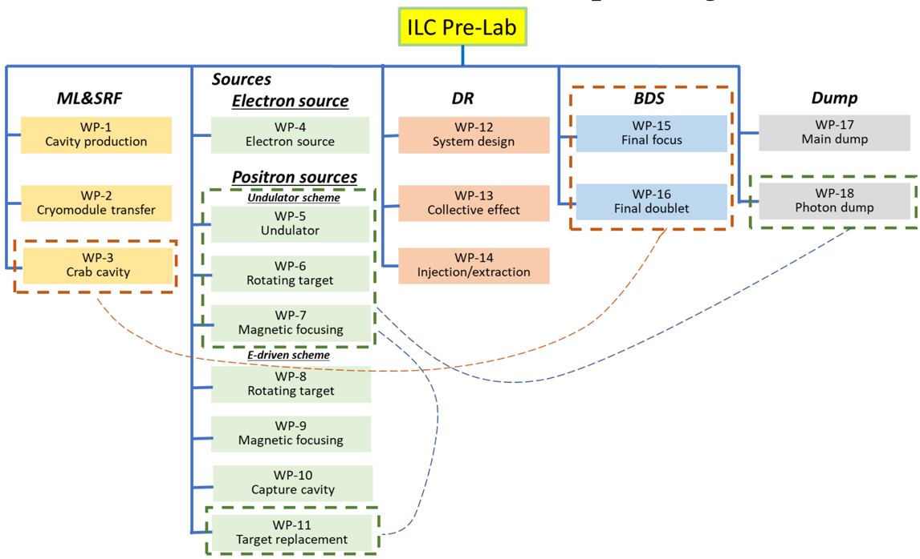
Pre-lab work-packages
Dumps
CERN, Spain
ML & SRF
CEA, CERN, CIEMAT, UK, INFN Milano, DESY
Not all European SRF labs represented (see later)
Additionally (in WBS but not in TPD):
Long term cryo collaboration with CERN.
HiEff RF another relevant activity
SRF “basic” R&D for fabrication improvements or long term performance improvements (i.e. for upgrades)
DR/BDS
DESY, UK, IJClab, CERN, Spain, INFN-LNF
ATF3 interests: UK, Germany, France, CERN, Spain
Other light-sources labs possible (DR)
WBS design entries to be checked
Sources
DESY, UK, CERN
IJCLab also, other groups also possible (FCC-ee, Dafne)

Slide 6
SRF and ML – WP 1 and 2
The ILC SRF regional prelab goals are considered very achievable for cavities and modules in terms of capabilities and facilities, also participation the crab cavity WPs, and main linac SC magnet developments are being planned
The role of each laboratory are to be defined in agreement with other commitments on the Pre-lab timescale (ESS, PIP-II, HiLumi, EU-XFEL operation and upgrades for example)
The final destination is Japan and not DESY so this also implies changes in work-sharing with respect to the EU-XFEL model, for DESY in particular
And to repeat, new laboratories and new capabilities will be integrated
Specific Pre-lab funding is needed and need to be requested at the right time to the relevant funding bodies
IN PROGRESS
Similar for crab-cavities, the detailed overall Pre-lab programme is being defined, the main European laboratories involved in the planning are in the UK and CERN
Notes:
LAL and IPNo

Slide 7
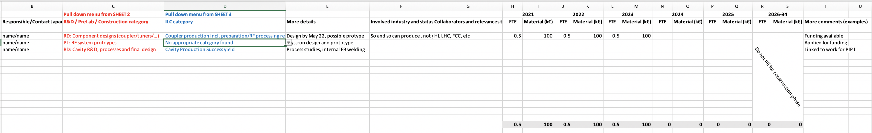
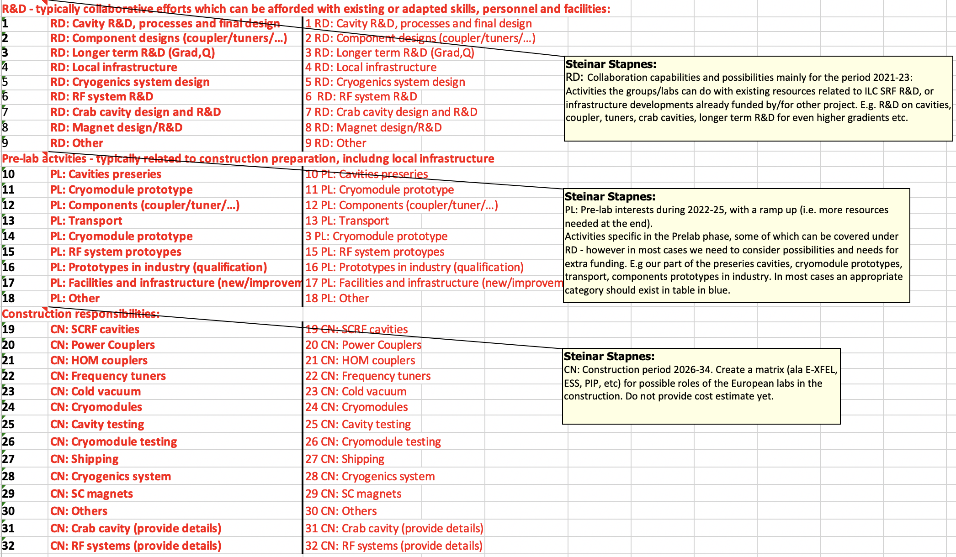
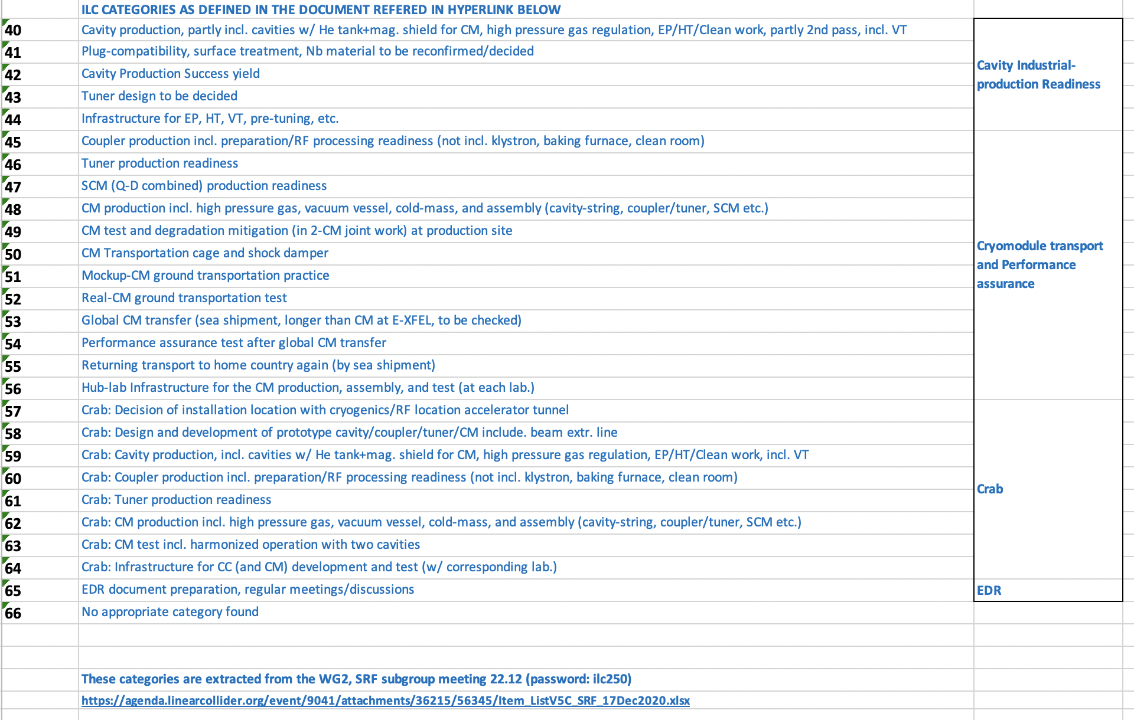
Pre-lab planning “from groups”
European SRF meetings
Pre-lab effort at two “intensity” levels:
R&D interests and capabilities, link to “local” strategic interests [Scientific and Technical Collaboration]
Existing/continuing common studies and/or generic R&D resources
Identification and preparation of ILC prelab deliverables, in almost all cases new resources required
In both cases identify existing or potential partners and industries, material and personnel estimates, timeline, infrastructure needs and availability
Based on Pre-lab Technical work-packages, but allows some flexibility

