Slide 1
14th Meeting of SRF Group in IDT/WG2
Introduction to WBS (Work Breakdown Structure)
Tuner review (by Yuriy)
Others (if any)
Attendees: A. Yamamoto, S. Michizono, H. Hayano, K. Umemori, S. Posen, S. Belomestnykh, R. Rimmer, R. Geng, M. Liepe, N. C. Lasheras, E. Cenni, L. Monaco,
A. Lankford, B. List, S. Stapnes, M. Ross, D. Delikaris, P. McIntosh, Y. Pischalnikov, C. Pagani, P. Burrows, Kirk
https://agenda.linearcollider.org/event/9179/
You can download 5th version of TPD
Kirk

Slide 2
Tentative summary of WBS related to SRF
We need to consider the other materials than TPD for WBS
WBS for PreLab Phase
TPD:
WP-1
WP-2
WP-3
Detailed system design for real construction
Cryogenics design for real construction
HLRF (klystron/modulator/power distribution) system design for real construction
Engineering Design Report (EDR)
Already done!
Additional item:
650 MHz SRF system for DR
Additional item: ?
We may not need any cost, but HR is necessary

Slide 3
Length difference between TESLA and ILC cavities
XFEL TESLA-Cavity
ILC-Cavity
36mm
H. Hayano

Slide 4
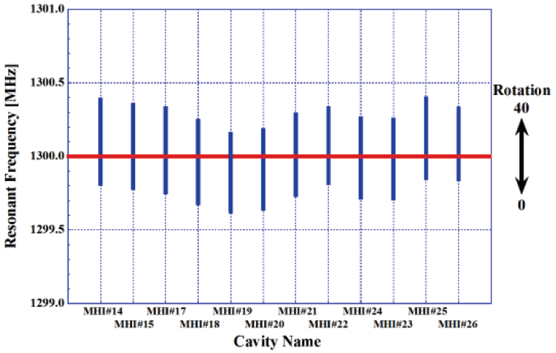
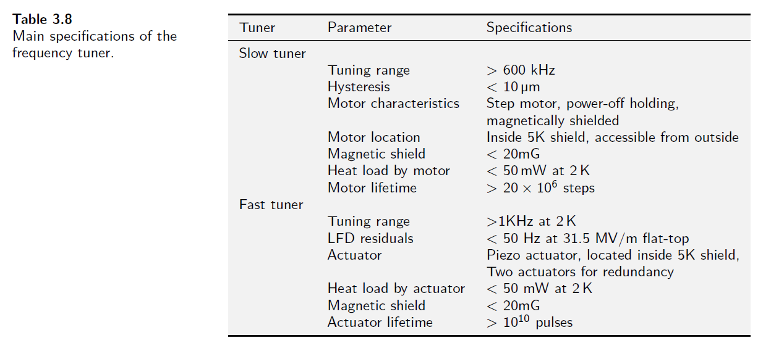
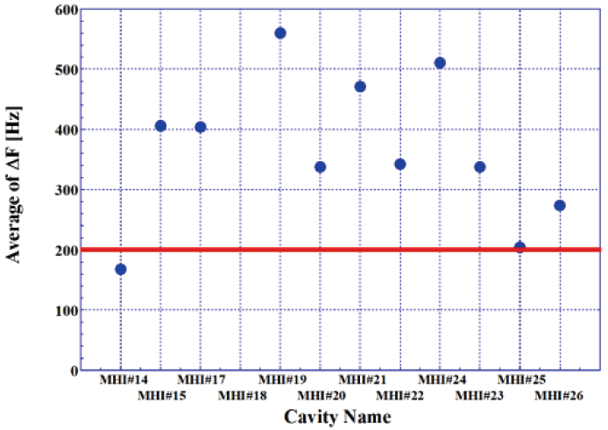
Table 3.8 in TDR Vol.3 Part II
Results in STF-2

Slide 5
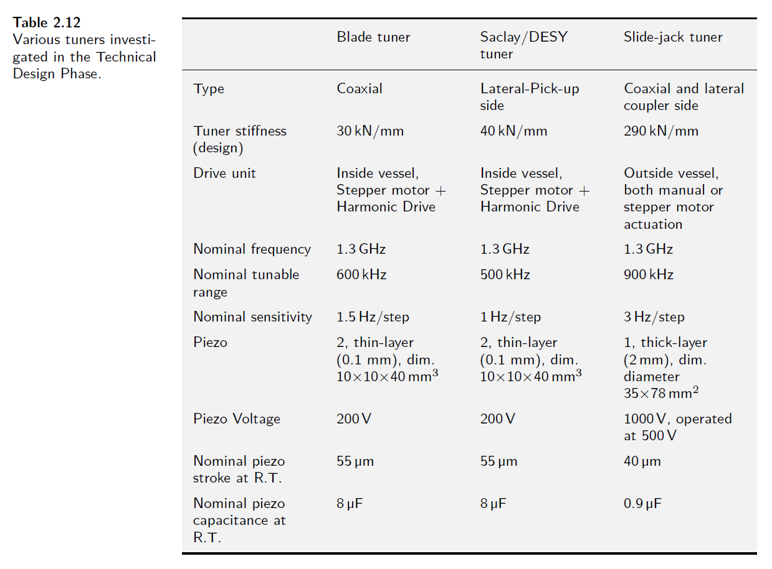
Table 2.12 in TDR Vol.3 Part I
Based on S1-Global

Slide 6
(modified) Table 2.12 in TDR Vol.3 Part I
Revised Table 2.12 "Various tuners investigated in the Technical Design Phase." |  |  |  | 12/Apr/2021 Revised by Yuriy + Kirk
 | (SLIM) Blade tuner [1] | Saclay/DESY tuner [2] | Slide-jack tuner [3] | Double-lever tuner [4]
Type | Coaxial | Lateral-Pick-up side | Coaxial and lateral coupler side | Lateral-Pick-up side
(fit to) Beampipes of TESLA Cavity | short-short, short-long | short-long | short-short, short-long | short-short, short-long
Cavity/Tuner system stiffness | 30 kN/mm | 30 kN/mm | 290 70 kN/mm | 40 kN/mm
Drive unit | Inside vessel | Inside vessel | Outside vessel | Inside vessel
 | Stepper motor | Stepper motor | Stepper motor | Stepper motor
 | Harmonic Drive | Harmonic Drive | both manual or stepper motor actuation | Planetary Gear Drive
Nominal frequency | 1.3 GHz | 1.3 GHz | 1.3 GHz | 1.3 GHz
Nominal tunable range | 600 kHz | 500 kHz | 900 kHz | 800 kHz
Nominal sensitivity | 1.5 Hz/step | 1 Hz/step | 3 Hz/step | 1.4 Hz/step
Coarse tuner hystersis | 100Hz | 100Hz |  | 45Hz
Piezo | 2, thin-layer | 2, thin-layer | 1, thick-layer | 2 , thin-layer
 | (0.1 mm), dim. | (0.1 mm), dim. | (2 mm), dim. | (0.1 mm), dim.
 | 10 x 10 x 40 mm³ | 10 x 10 x 36 mm³ | diameter 35 x 78 mm² | 10x 10 x 36 mm³
Piezo Voltage | 200 V | 120 V | 1000 V, operated at 500 V | 120 V
Nominal piezo stroke at R.T. | 55 μm | 40 μm | 40 μm | 40um
Nominal piezo capacitance at R.T. | 8 μF | 13 μF | 0.9 μF | 13 μF
Nominal tunable range (tested at 2K) | 2,000 Hz | 800 Hz | ~600 Hz @500 V | 3,000 Hz
Capability to repair (motor + piezo) | No | No | OK | OK
# of tuner operated in accelerators | 8 @FNAL/FAST | 800 @E-XFEL | 14 @STF-2, Quantum Beam | 320+180 @LCLS-II (HE)
# of tuner operated in S1-Global | 2 | 2 | 4
[1] https://lss.fnal.gov/archive/2011/conf/fermilab-conf-11-101-td.pdf
[2] LLRF Tests of XFEL Cryomodules at AMTF: First Experimental Results (cern.ch)
[3] Cryomodule Tests of Four Tesla-Like Cavities in the STF Phass-1.0 for ILC (cern.ch)
[4] https://accelconf.web.cern.ch/IPAC2015/papers/wepty035.pdf

Slide 7
Schedule of SRF (incl. crab cavity sub-) Group Meeting in IDT/WG2
Meeting # | Date | Contents
12 | 9/Mar | Discussions and preparation for the SRF session in LCWS2021
 | 12/Mar | International review “debriefing”
 | 15~18/Mar | 9th International Workshop on "Thin films applied to Superconducting RF: Pushing the limits of RF Superconductivity"
 | 15~18/Mar | LCWS 2021 on virtual hosted by CERN
 | 25/Mar | 1st Crab Cavity Meeting as the crab cavity subgroup in the SRF group
13 | 30/Mar | Update TPD (WP-1, 2, 3), Recent progress in KEK
14 | 13/Apr | WBS, Tuner review by Yuriy
15 | 27/Apr
16 | 11/May
17 | 25/May
18 | 8/Jun
19 | 22/Jun
 | 28/Jun~2/Jul | SRF 2021 on virtual
 | 26~29/Oct | International workshop for potential ILC experiments on virtual hosted by Japan (True name is not fixed yet!)
The deadline of WBS is around one month later!

Slide 8
Questions/Discussions/Comments (memorandum) @14th meeting
WBS
Scope and Deliverables for each item should be well-considered
SRF Group is responsible for 650 MHz SRF system in DR?
We can think of the both directions, Area System and Technical Items
Probably, complicated matrix for HR is necessary for the both directions
Some people join the ML and SRF, and also DR
J-LAB was responsible for 650 MHz SRF system in RDR and TDR
Tuner design is categorized in WP-1, and tuner production in WP-2
The deadline of WBS is around one month later
Americas and Europe will start to negotiate with their governments from the end of this month
WBS is the useful item for this
In WP-3, WBS will be discussed in the next meeting
In the next SRF Group meeting, we can discuss more
Tuner
Yuriy presented the tuner review as one good candidate for ILC
Bias voltage is necessary for piezo drive?
Change of LFD is one direction, then it is not necessary
When we change the design of tuner from TDR, we need to submit the change request by convention
Expert meeting should be organized to be discussed soon
This organization is Kirk’s homework
In pulsed mode, LFD compensation is not too difficult as there are only linear changes
It is important to suppress ringing of cavity as much as possible
Translation by Kirk

Slide 9
References
KEK homepage
https://www2.kek.jp/ilc/en/
Technical Design Report
https://ilchome.web.cern.ch/publications/ilc-technical-design-report
https://www2.kek.jp/ilc/en/docs/
The International Linear Collider Progress Report 2015
https://www2.kek.jp/ilc/en/docs/
The International Linear Collider – A Global Project
Submitted to European Particle Physics Strategy Update, 2020.
https://indico.cern.ch/event/765096/contributions/3295702/
ILC Action Plan
https://www.kek.jp/ja/newsroom/2016/01/06/1400/
https://www.kek.jp/ja/newsroom/2018/04/24/1200/
Recommendations on ILC Project Implementation
https://www.kek.jp/ja/newsroom/attic/20191001_%20ILC%20Project.pdf

