Slide 1
Discussion of WBS for DR/RTML/BDS area systems
2021/04/28
T. Okugi
IDT WG2 DR/BDS/DUMP group meeting

Slide 2
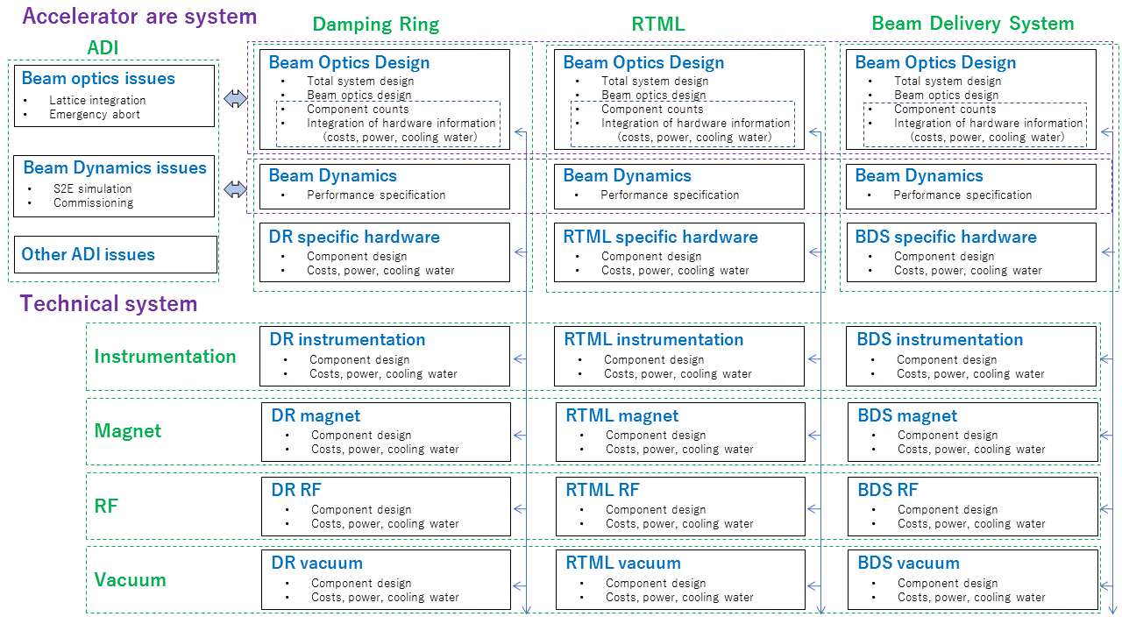
Simple WBS in Pre-Lab period (to write the ILC EDR)
. . .
+ work packages
+ work packages
+ work packages
. . .

Slide 3
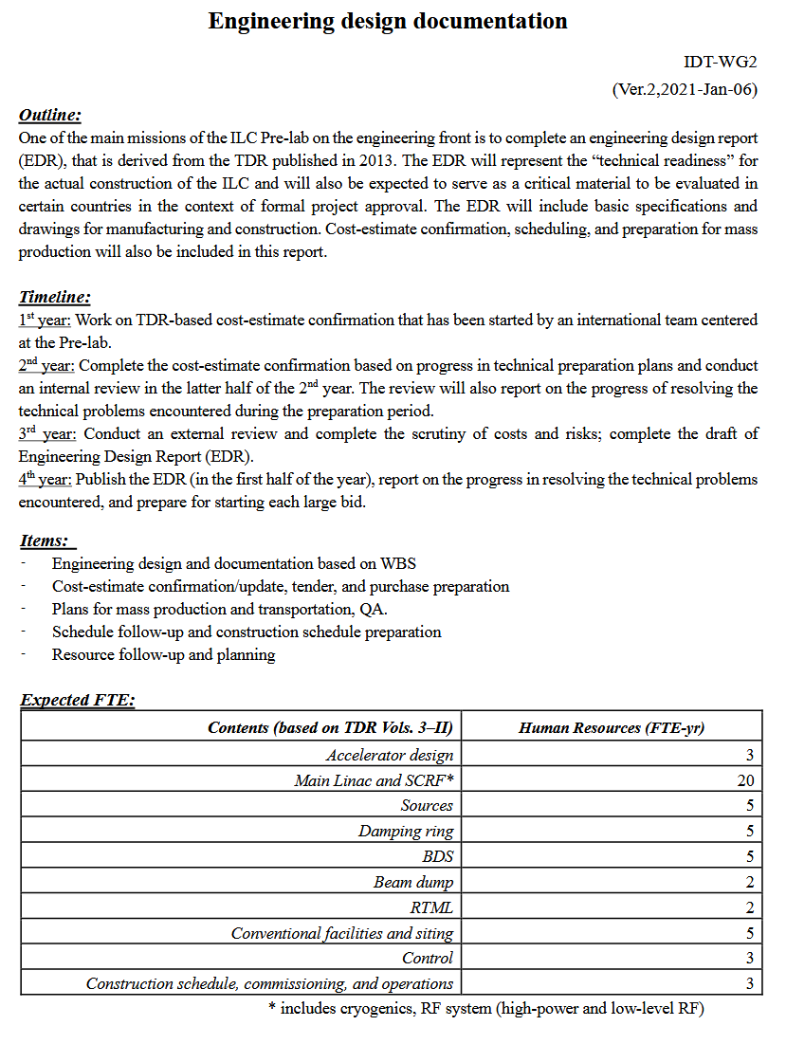
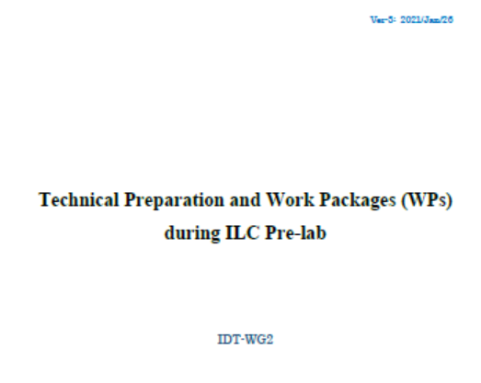
Technical preparation document
Engineering design document
The number of HR will be updated (by Shin at the last WG2 meeting.)
3

Slide 4
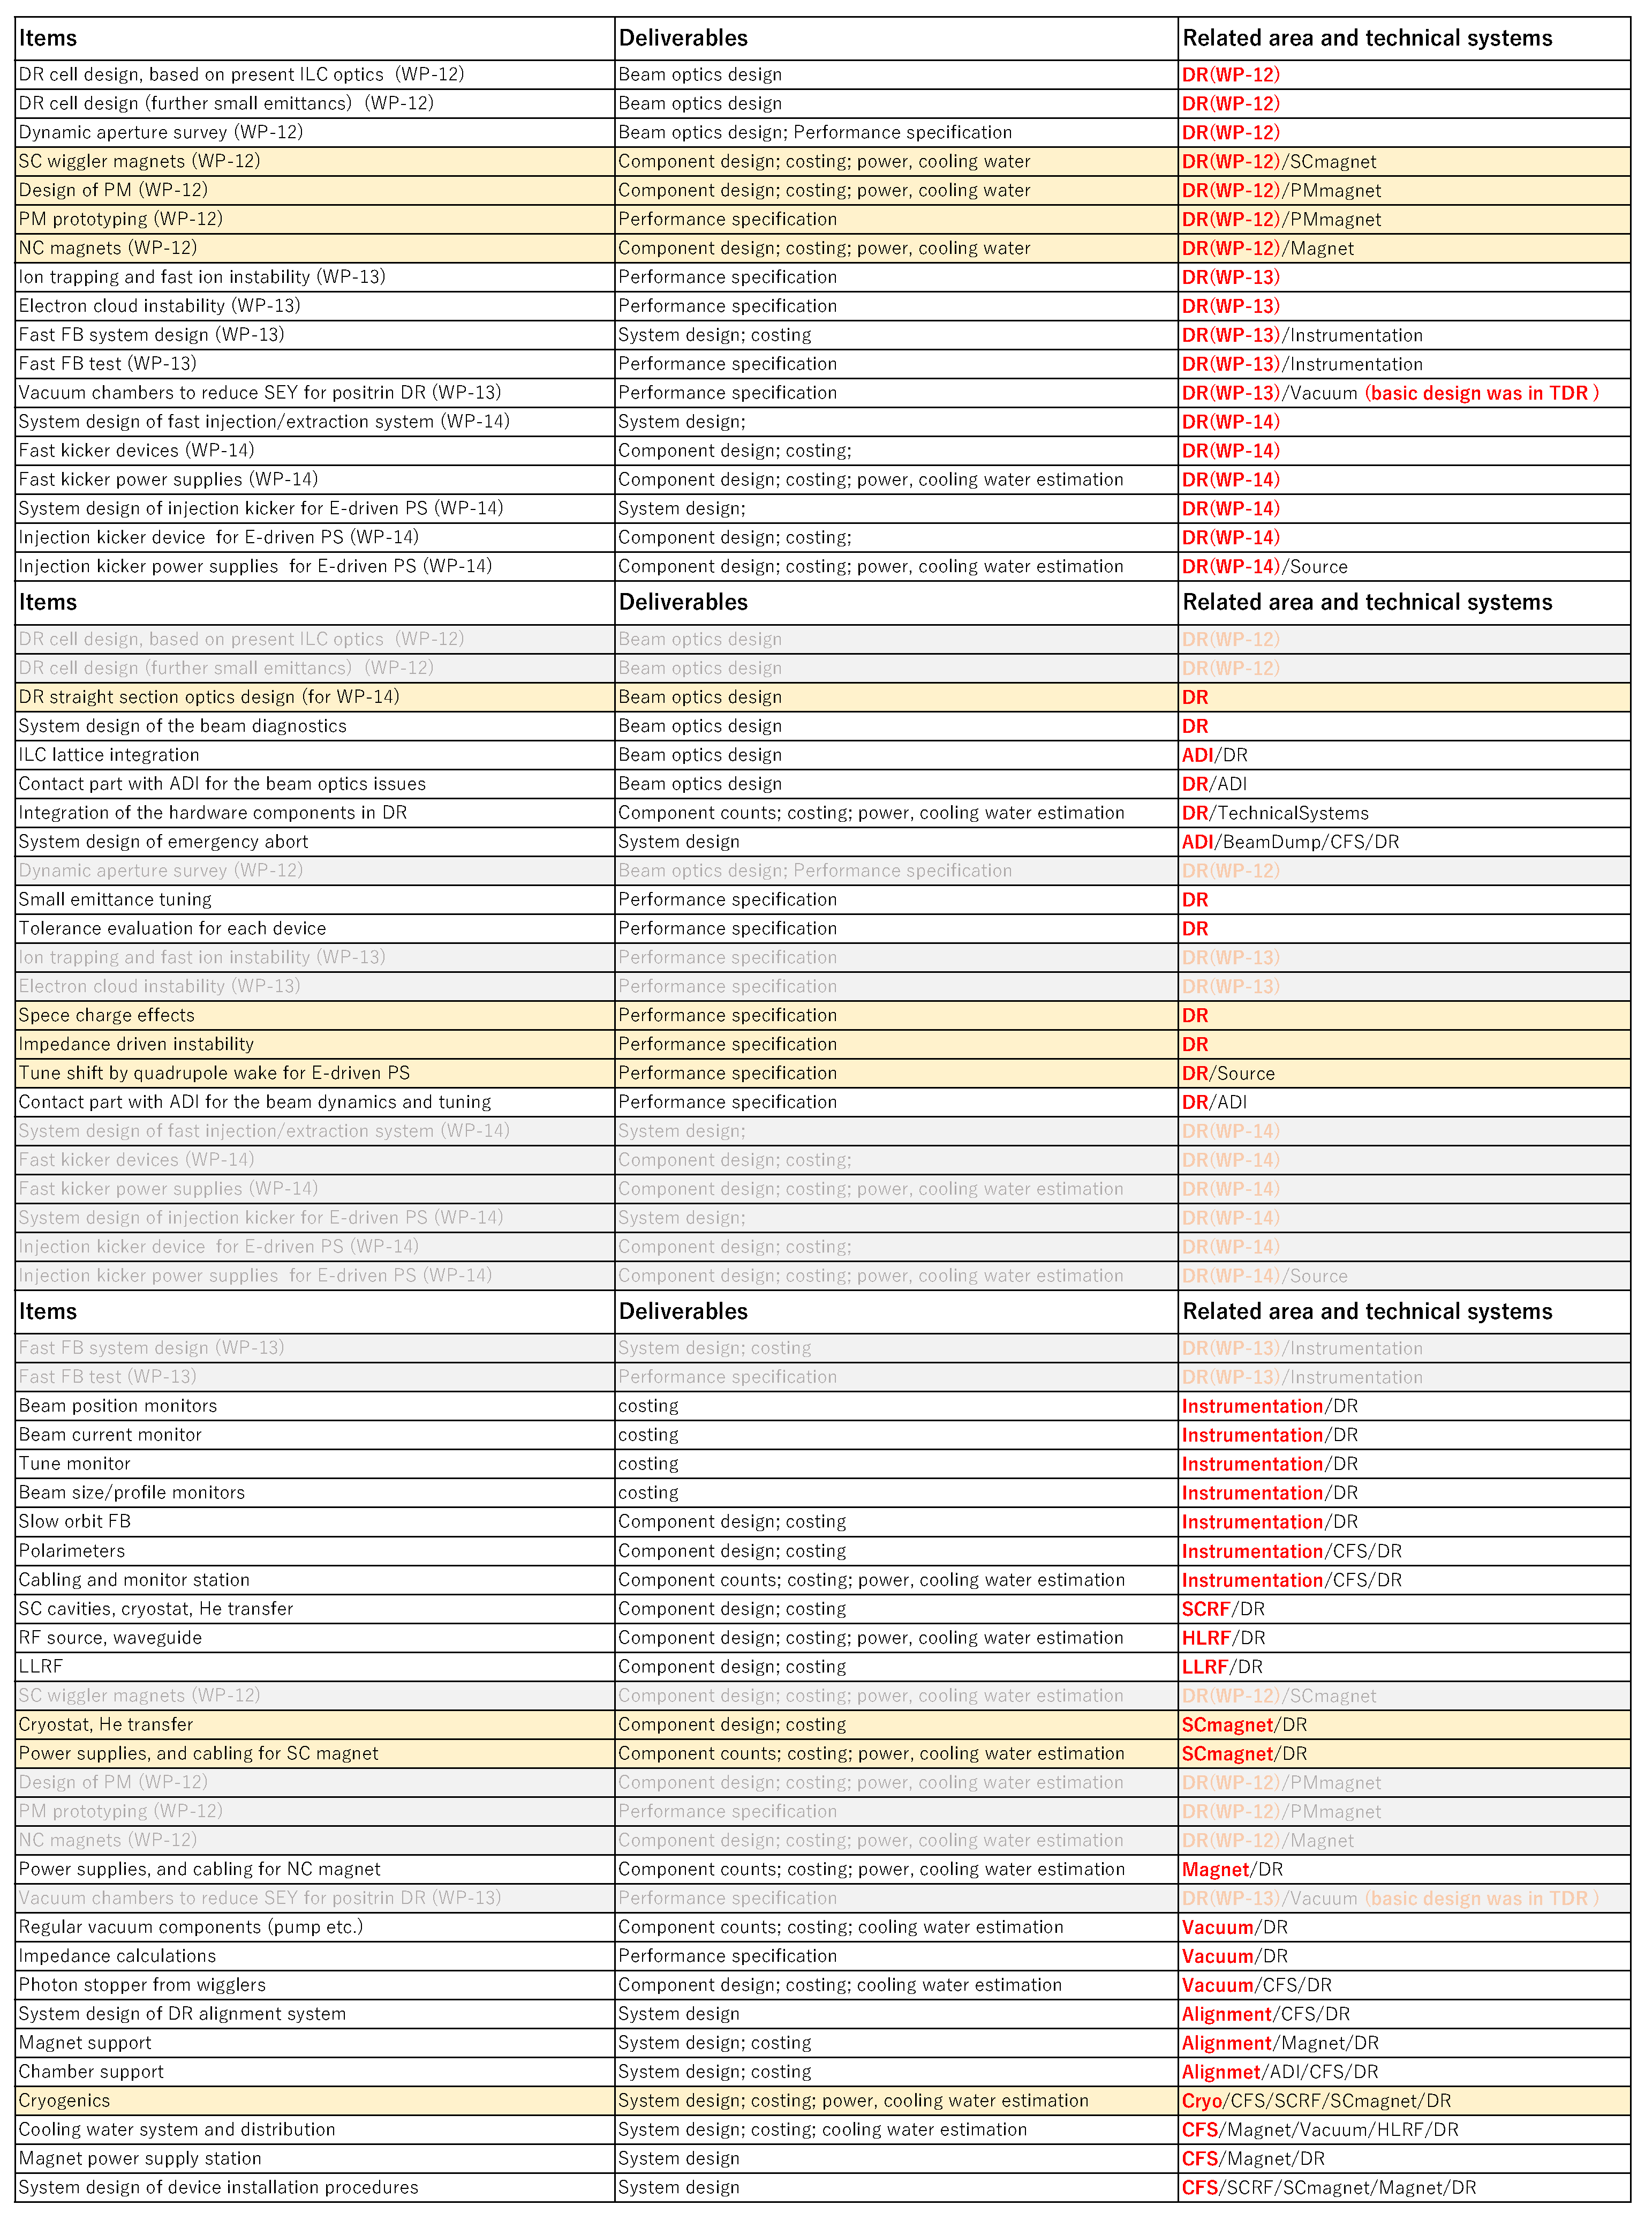
Damping Ring
Work packages
  WP-12
  WP-13
  WP-14
List up all items for EDR related to DR
Picked up the WP related items
from the to-do-list of both area and
technical systems and categorized.
Resource
of technical
preparation
Area system
Optics design and
system integration
Beam dynamics
and tuning
Fast kicker
DR area system
3WPs
Remaining items
  of original area systems
Technical system
Instrumentation
Magnet
RF
Vacuum
Resource
of EDR
Technical system
Remaining items
of original technical systems
To be integrated the item
of each technical category
for all area systems
. . . .

Slide 5
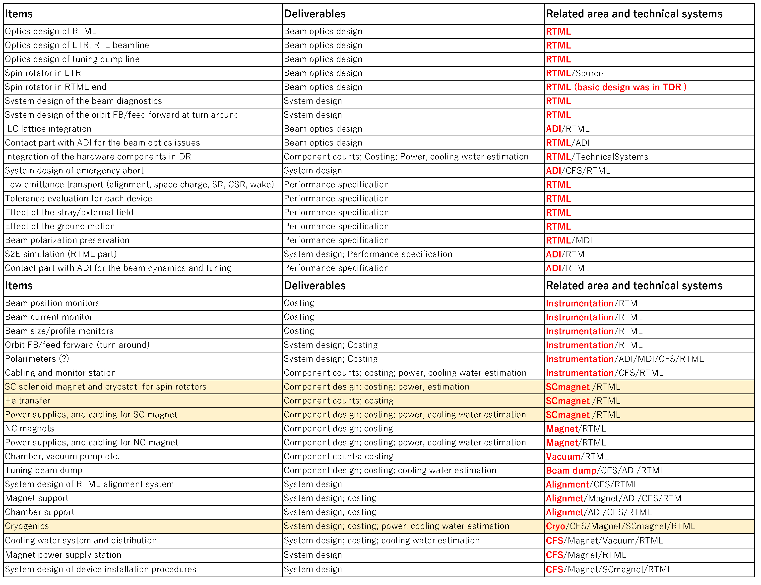
RTML
List up all items for EDR related to RTML
Area system
Optics design and
system integration
Beam dynamics
and tuning
RTML area system
Resource
of EDR
Technical system
Instrumentation
Magnet
RF
Vacuum
Technical system
To be integrated the item
of each technical category
for all area systems
. . . .

Slide 6
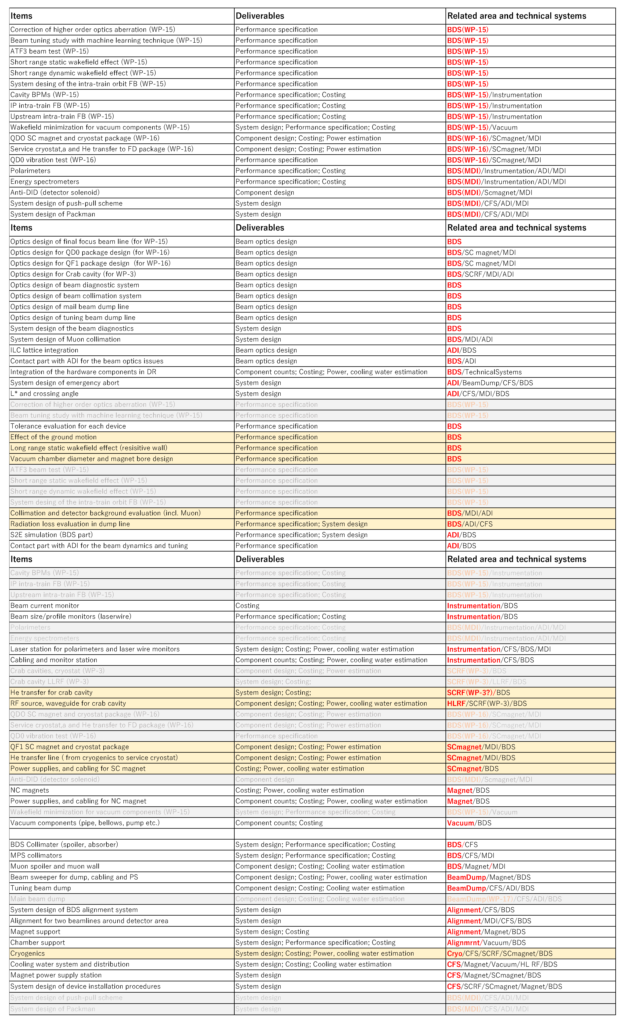
Beam Delivery System
Work packages
  WP-15
  WP-16
  MDI
List up all items for EDR related to BDS
Picked up the WP related items
from the to-do-list of both area and
technical systems and categorized.
Resource
of technical
preparation
Area system
Optics design and
system integration
Beam dynamics
and tuning
BDS area system
2WPs
MDI related items
Remaining items
  of original area systems
Resource
of EDR
Technical system
Instrumentation
Magnet
RF
Vacuum
Technical system
Remaining items
of original technical systems
To be integrated the item
of each technical category
for all area systems
. . . .

Slide 7
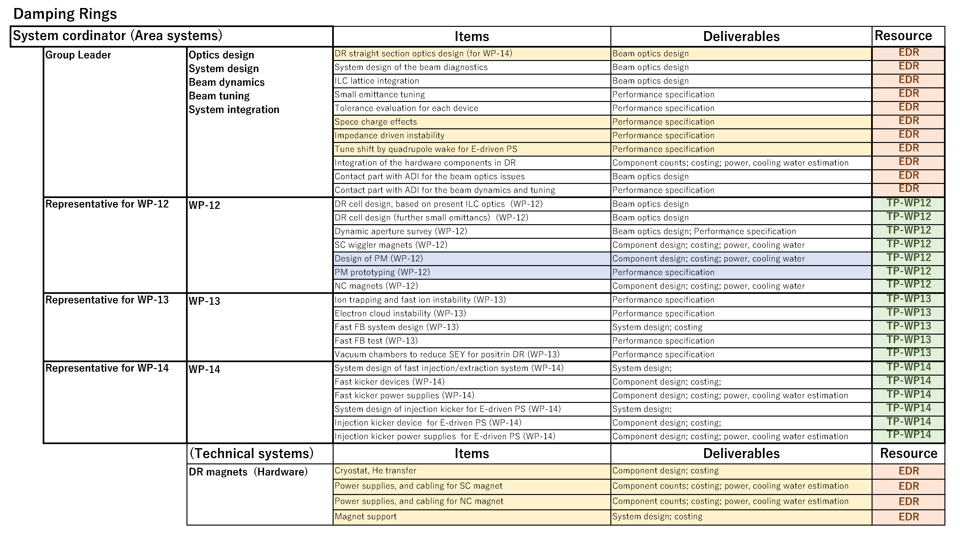
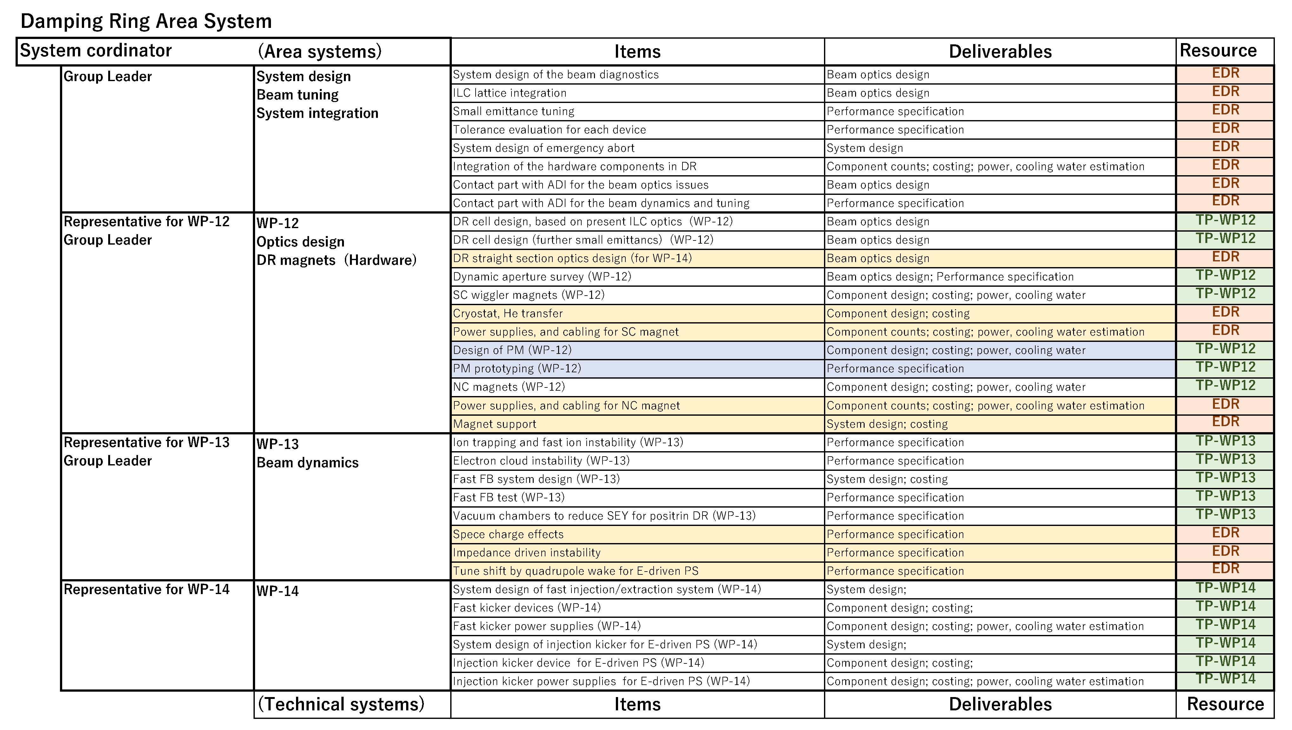
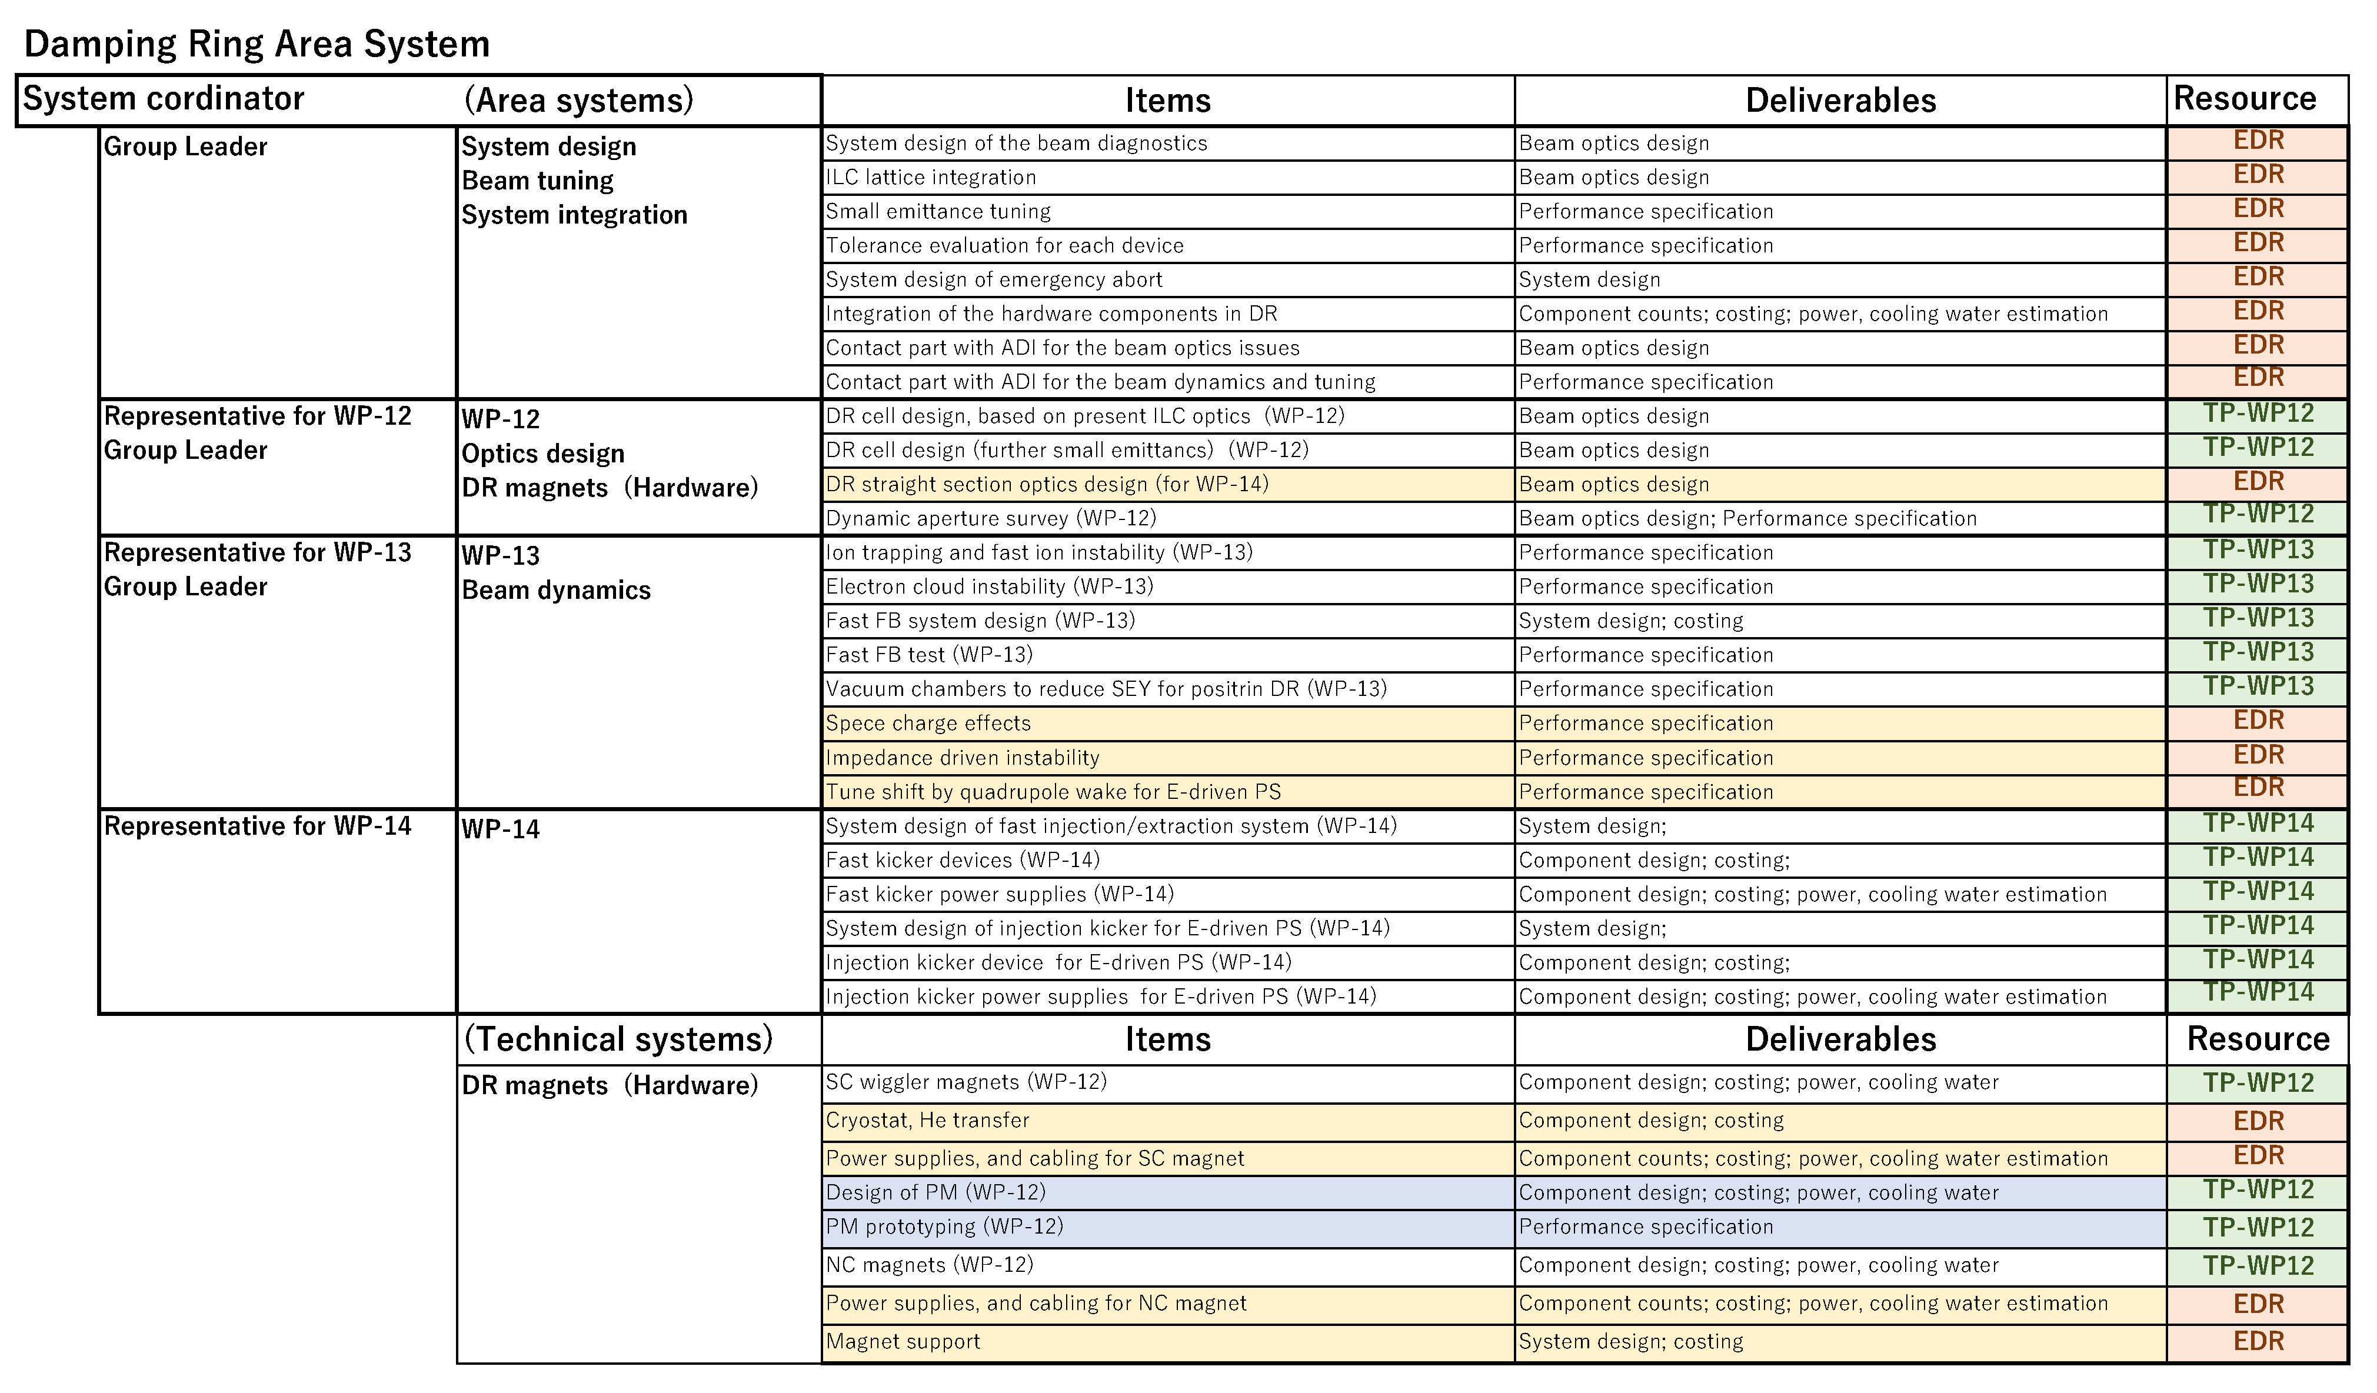
WBS of DR area system in the Pre-Lab period
(A) Workpackage oriented
Workpackage oriented
Easy to manage the resources in Pre-Lab period.
(B) Work item oriented (all WP items belong to area system)
Some items in are/technical systems are moved to the WP groups.
  ( Works for SC wiggler/cryostat/PS are in same group.)
Representative of WPs will cover some group leaders in area system.
Easy to manage the design work in Pre-Lab period.
(C) Work item oriented ( some WP items will do technical system)
All of magnet design will be done in the technical system, not area system.
The resource of WP-12 will be managed by area system,
  and divided to magnet group in the technical system.
Easy to manage the design work of the technical system.
(B) Work item oriented ( all WP items belong to area system )
(C) Work item oriented ( some WP items in technical system )
Part of WP12
resources

Slide 8
Opinion of Andy Lankford
Any of the three structures is manageable during the Pre-lab phase.
I think that one of the work item oriented structures (B) or (C) will work best. I believe that the decision between (B) and (C) needs to be consistent with how the division between area systems and technical systems for other area systems.
If the DR magnets are going to be designed by the magnet technical system to DR area system specification, then I would think that (C) is better than (B).
Also, if the SC wiggler magnet design, cryostat design, and wiggler power supply design are split among technical systems, then I believe that the coordination of these designs should
probably live in the DR area system (or possibly the magnet technical system).
Another consideration is how the RTL WBS is defined. I think that there should be a consistent philosophy to the structure for both DR and RTL (and probably BDS as well).

Slide 9
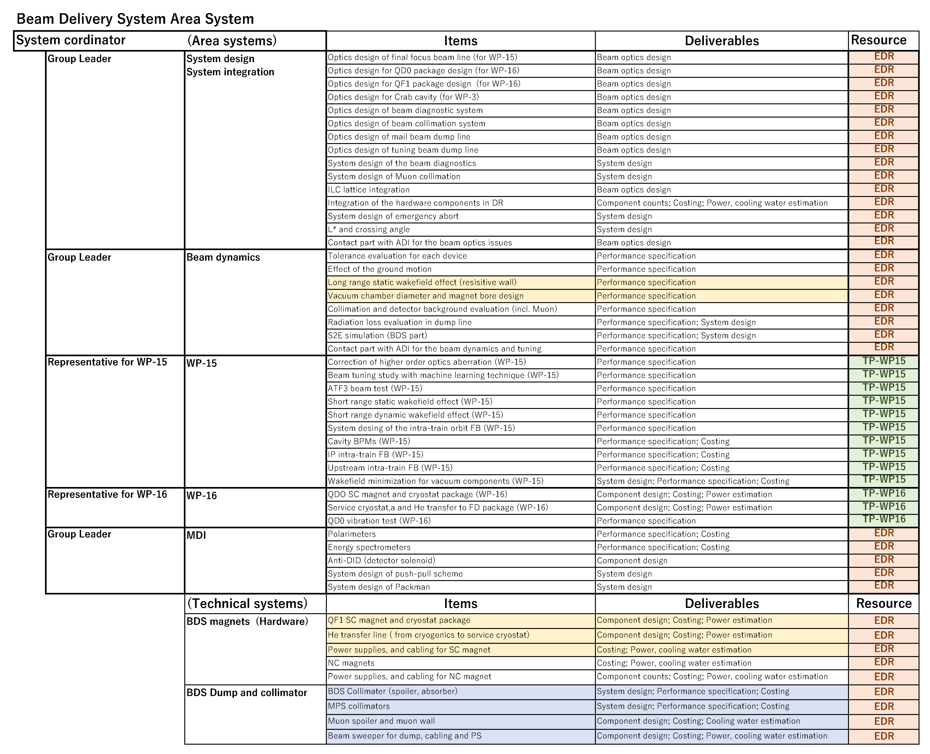
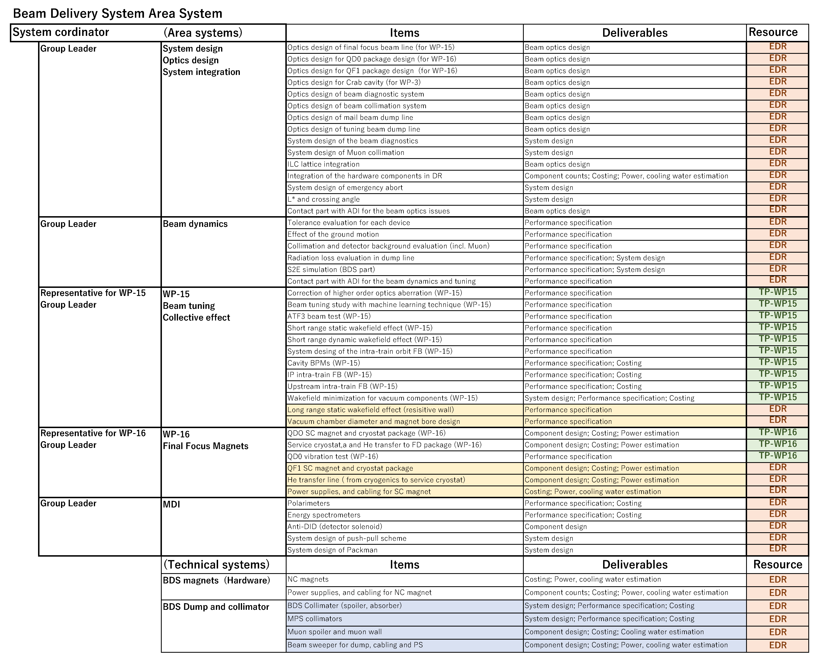
WBS of BDS area system in the Pre-Lab period
Workpackage oriented
Easy to manage the resources in Pre-Lab period.
(B) Work item oriented (all WP items belong to area system)
Representative of WPs will cover some group leaders in area system.
Easy to manage the design work in Pre-Lab period.
(A) Workpackage oriented
(B) Work item oriented
Should BDS collimator and Muon spoiler be managed by dump group ??

Slide 10
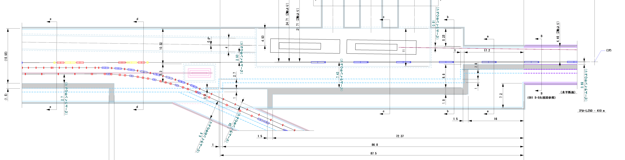
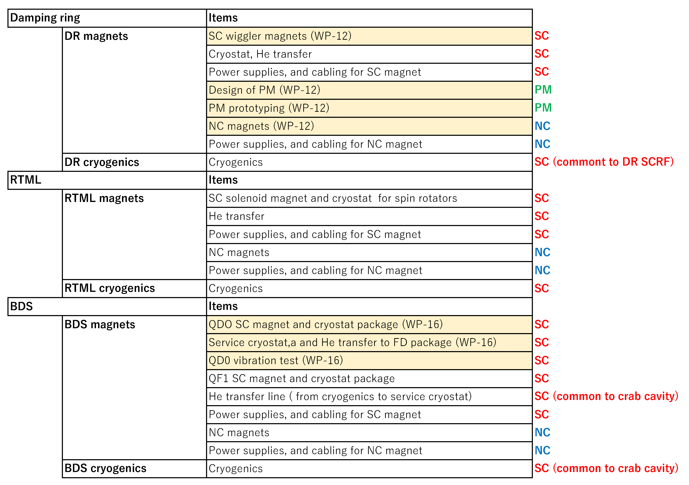
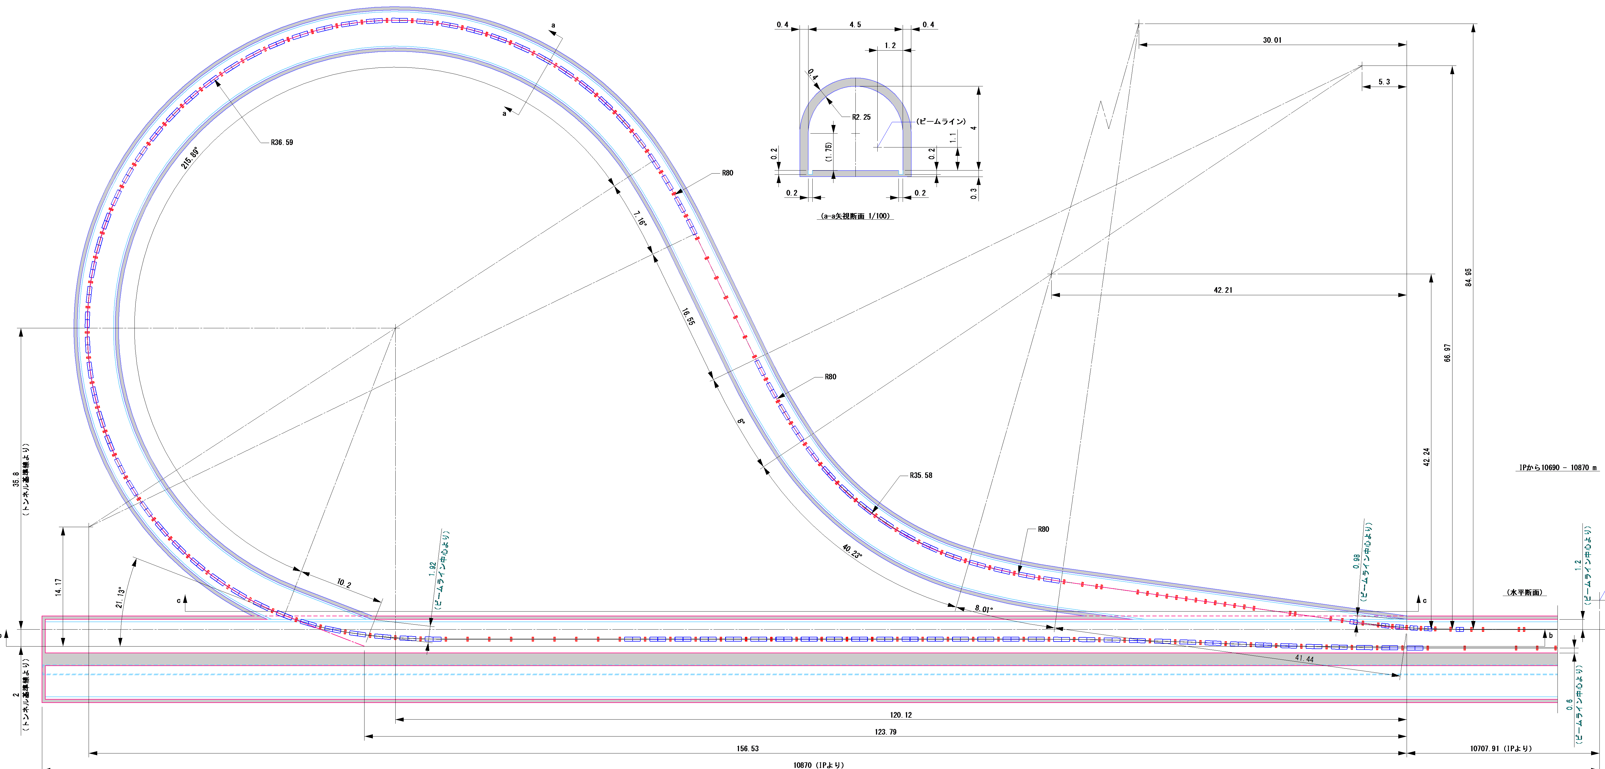
Magnet technical system for DR/RTML/BDS area system
Source and ML (BS and warm section) also have NC magnets.
Source also has SC undulators.
We’d better to consider how to make WBS by taking account of Source and ML area system, too.
Other NC and MC
magnets ??
Better to be managed
by DR area system ?
SC solenoids
for upstream spin rotator
To do list for magnet technical system
DR
SC solenoids
for DS spin rotator

Slide 11
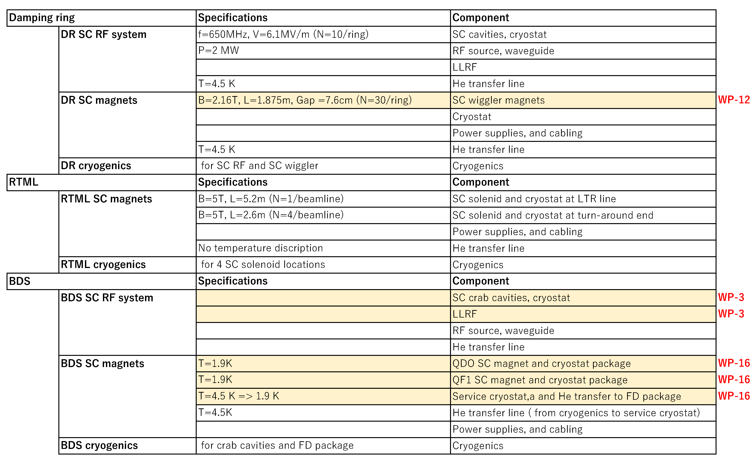
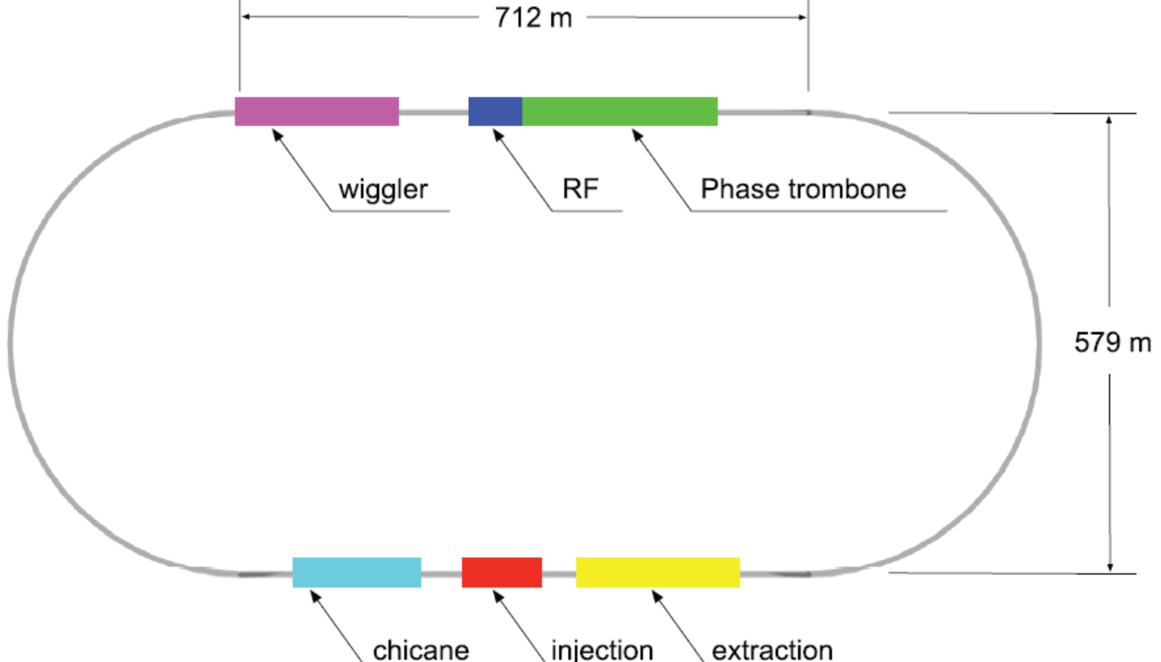
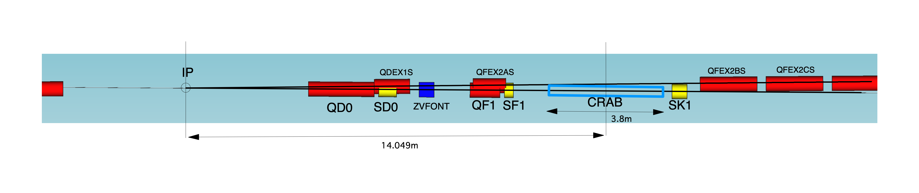
SC technologies for DR/RTML/BDS area system
SC magnet
SCRF
SC devices in DR
SC devices in BDS
SC magnet
SCRF
Cryogenics and He transfer lines should be common
for the SC magnets and SCRF.
It is very important how to coordinate the SC technology.
But, I think it is not matter for our group.
QD0 package
QF1 package
Crab cavity

Slide 12
Next group meeting
Date and time : May 12th (WED) 22:00 JST
We would like to discuss the WBS of the BDS area system.
Are there any other items that should be included in the to-do-list?
What items in the list would be more efficient to handle in the same group as WP?
I would be happy if the following people could present their views from their respective positions.
Angeles from WP-15
Brett from WP-16
Karsten or Tom from MDI

