Slide 1
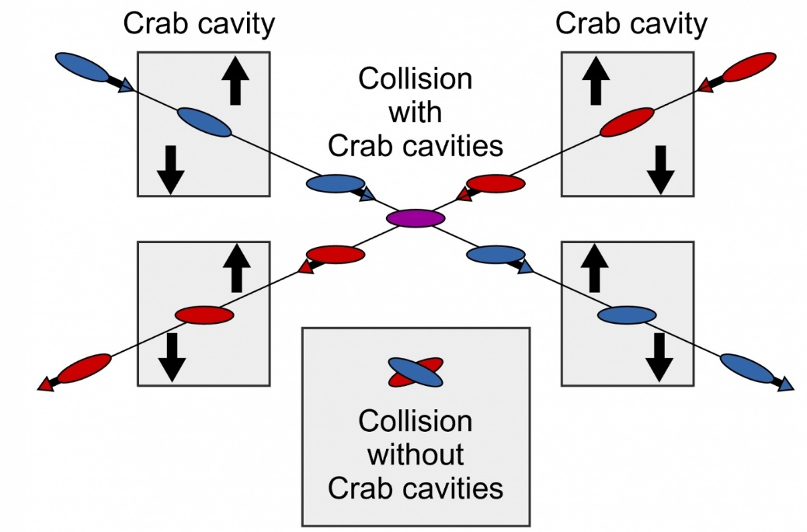

Machine SRF: Crab Cavities
Summary
Graeme Burt on behalf of Peter McIntosh,
UKRI-STFC Daresbury Laboratory
ILCX2021
29th October 2021

Slide 2
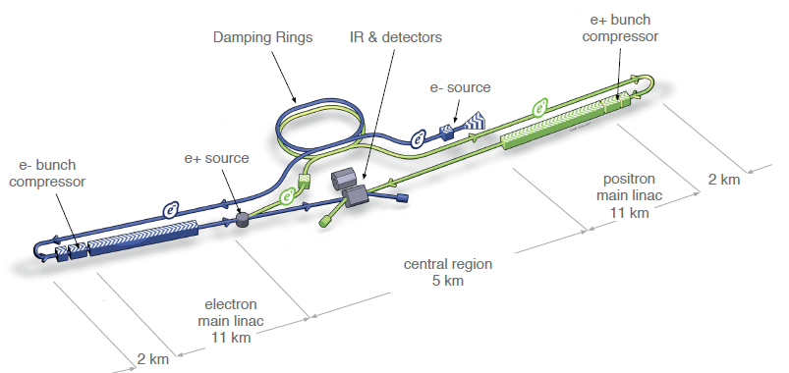
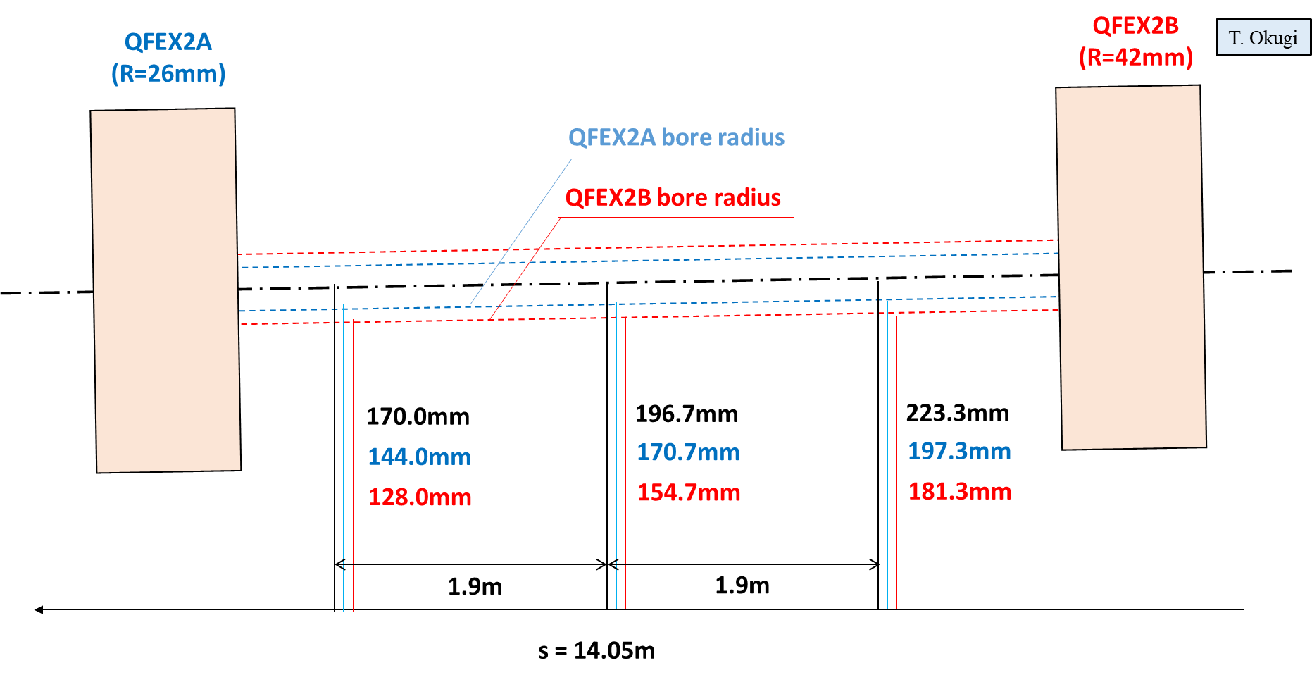
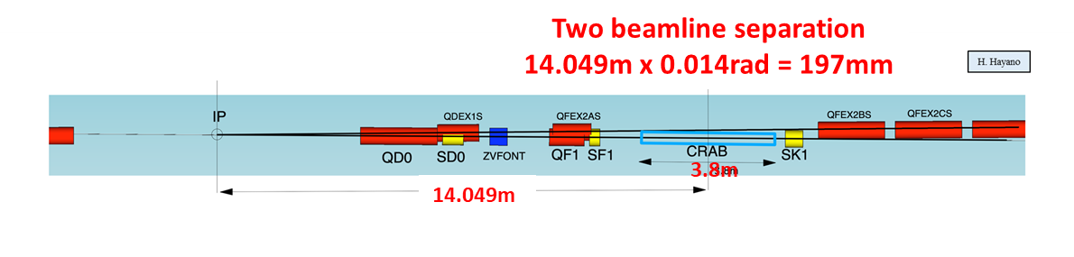
ILC Crab Cavity (CC) Requirements
ILC RDR parameter, by CAIN simulation
CC system is indispensable for ILC!
Luminosity reduced by >80% without CCs!
No development progress since TDR (2013).
Further development required as CC considered not-matured technology (Nomura Research Institute, Ltd):
  During the technical preparation period (Pre-Lab), prototype CM should be constructed and tested.
IP

Slide 3
ILC CC Specifications
Parameter | 250 GeV CoM (Post-TDR) |  | 10Hz Upgrade^{1,2} |  | 1 TeV CoM²
Beam Energy (GeV) e- | 125 |  |  |  | 500
Crossing Angle (mrad) | 14
Installation site (m from IP) | 14
RF Repetition Rate (Hz) | 5 |  | 10 |  | 4
Number of bunches | 1312 |  | 2625 |  | 2450
Bunch Train Length (ms) | 727 |  | 961 |  | 897
Bunch Spacing (ns) | 554 |  | 366
Beam current (mA) | 5.8 |  | 8.75 |  | 7.6
Beam size at CC location (X, Y,Z) (mm,um,um) | 0.97, 66, 300
Beta function at CC location (X, Y) (m,m) | 23200, 15400
Cryomodule installation length (m) | 3.8
Horizontal beam-pipe separation (m) | 0.197 (centre) ±0.0266 (each end of installation length)
Operating Temperature (K) | 2
Crab Cavity Specifications
Cavity Frequency (GHz) | 3.9 | 2.6 |  | 1.3 | 3.9 | 2.6 | 1.3
Total Kick Voltage (MV) | 0.615 | 0.923 |  | 1.845 | 2.5 | 3.7 | 7.4
Amplitude regulation/cavity (% rms) | 3.5 (for 2% luminosity drop)
Relative RF Phase Jitter (deg rms) | 0.069
Timing Jitter (fs rms) | 49 (for 2% luminosity drop)
Longitudinal impedance threshold (Ohm) | CC wake-potential input to BDS wakefield simulations
Trasverse impedance threshold (MOhm/m) (X,Y) | 48.8, 61.7
Cavity field rotation tolerance/cavity (mrad rms) | 5.2 (for 2% luminosity drop)
Beam tilt tolerance (H and V) (mrad rms and urad rms) | 0.35, 7.4 (for 2% luminosity drop)
Minimum CC beam-pipe aperture size (mm) | 20 (same as FD magnets)
Minimum Extraction beam-pipe aperture size (mm) | 20

Slide 4
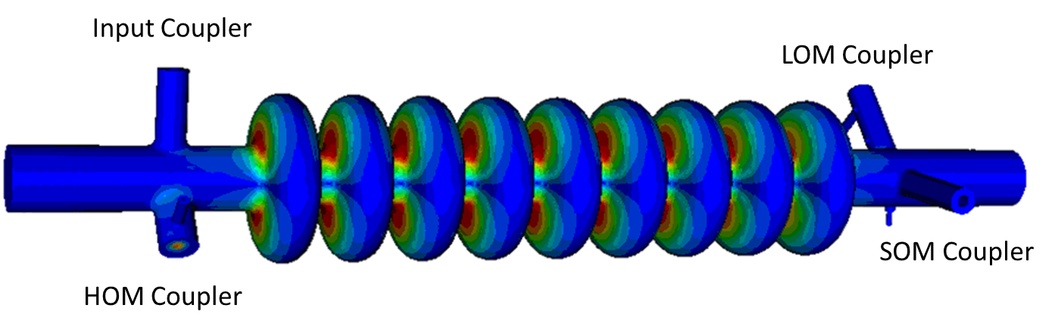
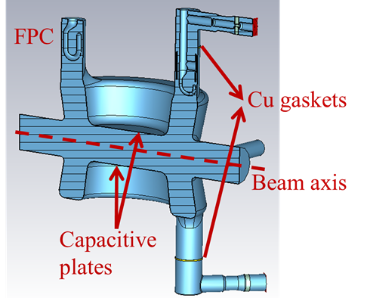
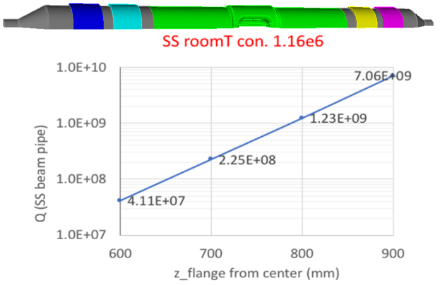
ILCX2021 SRF Machine: Crab Cavity session (27th Nov)
21:30 | Crab Cavity Introduction, Specifications and Development Update | Peter McIntosh (STFC)
21:45 | Elliptical/Racetrack | Graeme Burt (Lancaster University)
22:05 | RF Dipole (RFD) | Jean Delayen (ODU/Jlab)
22:25 | Double Quarter Wave (DQW) | Silvia Verdu Andres (CERN)
22:45 | Wide Open Waveguide (WOW) | Binping Xiao (BNL)
23:05 | Quasi-waveguide Multicell Resonator (QMiR) | Andrei Lunin (FNAL)
23:25 | Nest Steps and Plans | Peter McIntosh (STFC)
23:35 | Discussion (25 mins) | Specifications, Design options, Plans … etc

Slide 5
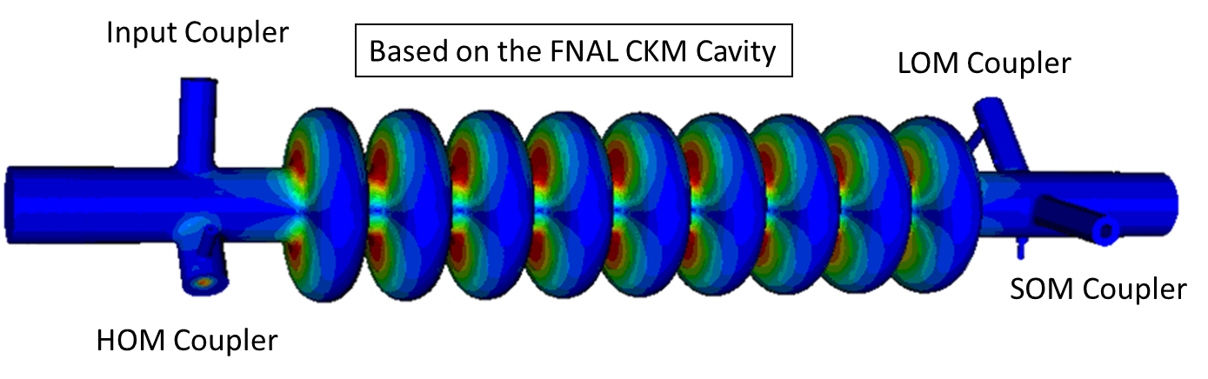



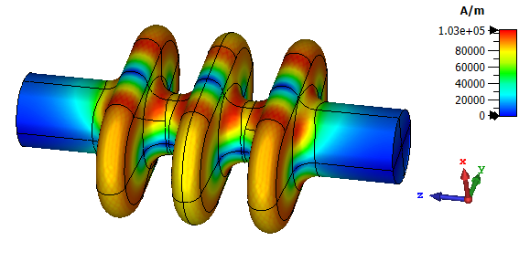
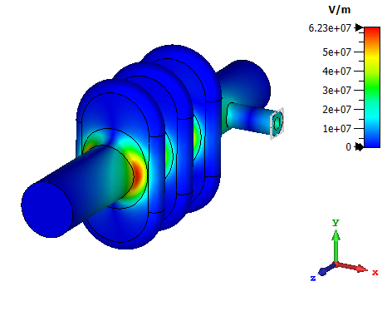
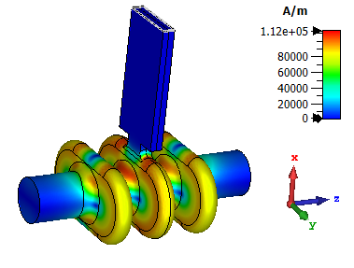
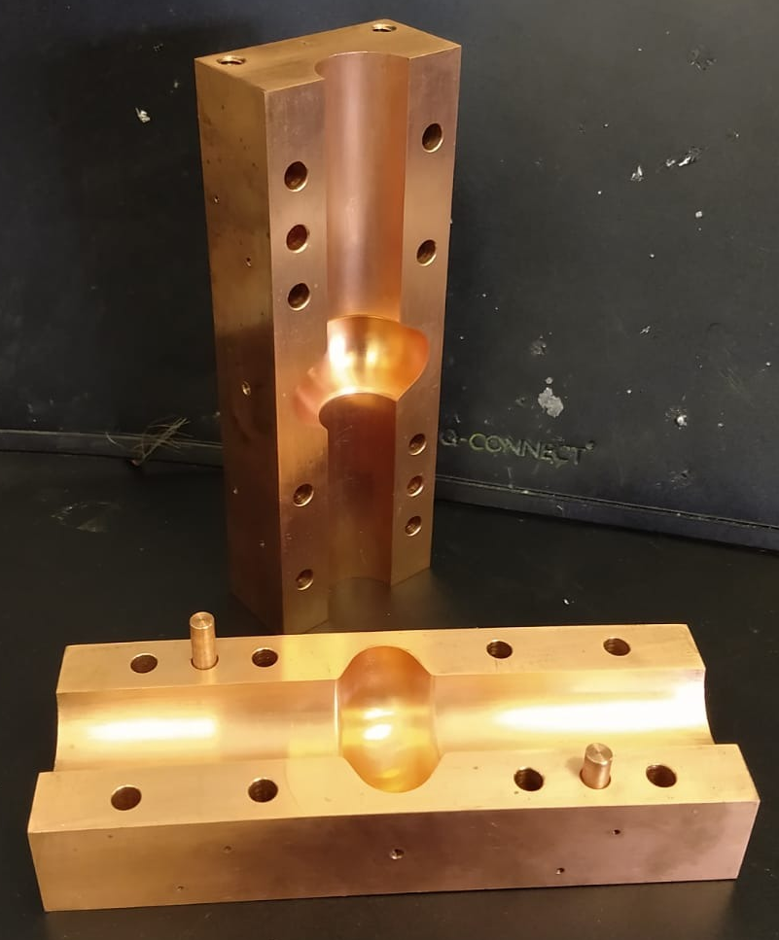
Elliptical/Racetrack – G Burt (Lancaster U, UK)
ILC RDR/TDR Crab Cavity Solution
Decided to re-optimise the ILC crab cavity to increase the gradient and further separate the SOM, now achieves 9 MV/m @ 80 mT.
At 3.9 GHz for 250 GeV, requires a 3-cell cavity @ 5 MV/m, or 2 cells at @8 MV/m.
Coax and waveguide solutions being investigated but original coax HOM damper designs already prototyped in copper (mature)
CERN and Lancaster separately developed split cavities (SWELL) for thin film coated cavities.
Summary
3.9 GHz elliptical still optimal - can achieve same gradient as a 1.3 GHz cavity, needs only 1/3 of the length.
Can use a single cavity per IP at 1 TeV so simpler than several single cells and mature technology.
Original design

Slide 6
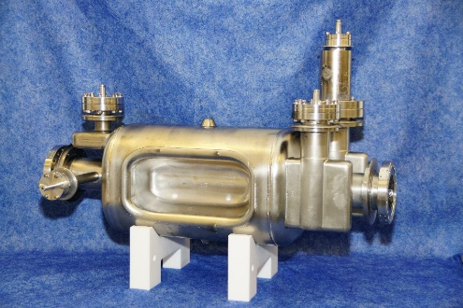
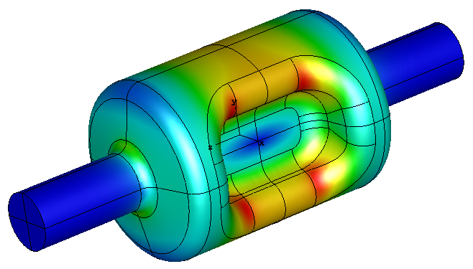
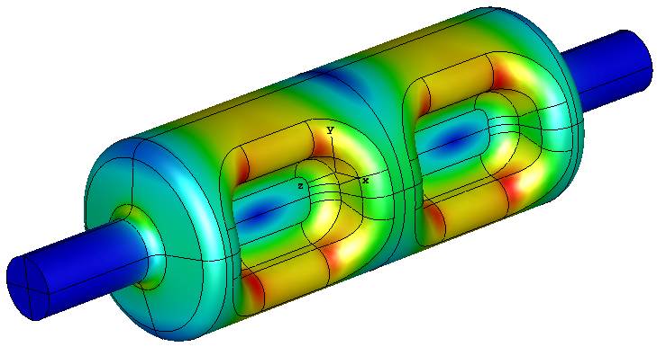
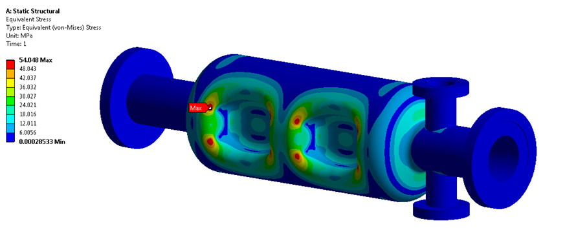
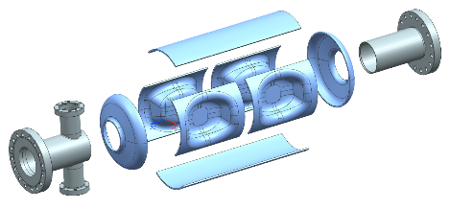
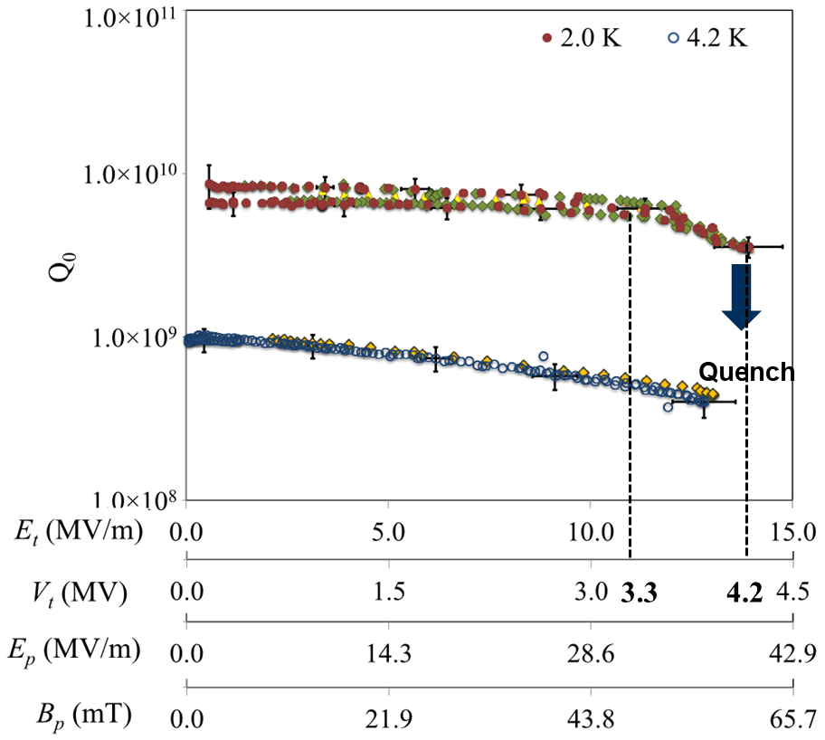
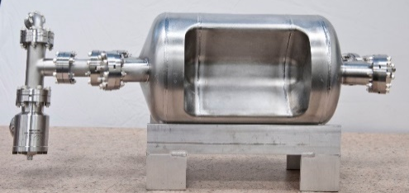
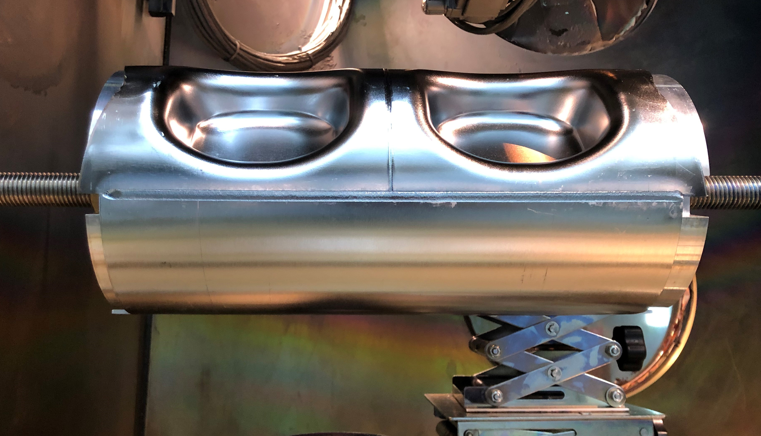
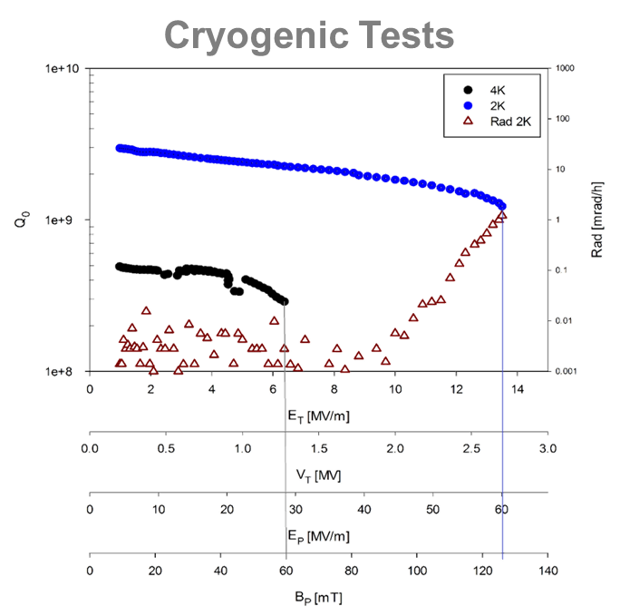
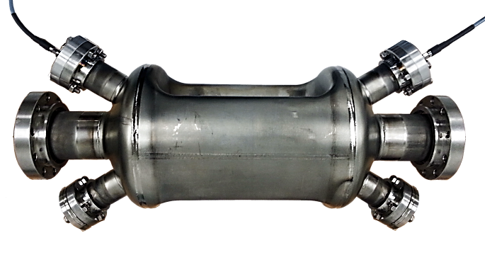
RF Dipole – J Delayen (ODU/Jlab, USA)
Crab Cavity Manufacture
JLEIC 952MHz RFD
ILC 1.3 GHz RFD
Property | 1-cell | 2-cell
Operating frequency [GHz] | 1.3 | 1.3
SOM [GHz] | – | 1.188
1st HOM [GHz] | 2.085 | 1.932
E_{p}/E_{t}* | 3.84 | 3.98
B_{p}/E_{t}* [mT/(MV/m)] | 8.04 | 7.94
B_{p}/E_{p} [mT/(MV/m)] | 2.10 | 1.99
G [Ω] | 133.0 | 137.2
R/Q [Ω] | 280.2 | 556.7
R_{t}R_{s} [Ω²] | 3.7×10⁴ | 7.6×10⁴
V_{t} [MV] | 1.0 | 2.0
E_{p} [MV/m] | 33.3 | 34.54
B_{p} [mT] | 69.7 | 68.82
Total V_{t} [MV] | 1.845 | 1.845
No. of cavities | 2 | 1
Pole separation, beam aperture (mm) | 30 | 30
Cavity Length [mm] | 172.32 | 297.4
Cavity Diameter [mm] | 107.4 | 109.4
Pole Length [mm] | 85 | 85
HL-LHC 400MHz RFD
JLab 499MHz RFD Deflector
Summary:
Design looks reasonable, with further possibilities to optimize.
Long-range wakefield analysis needs more work:
  Shorter bunch, short range.
Number of cells is still an open question.
JLAb/MEIC 750MHz RFD

Slide 7
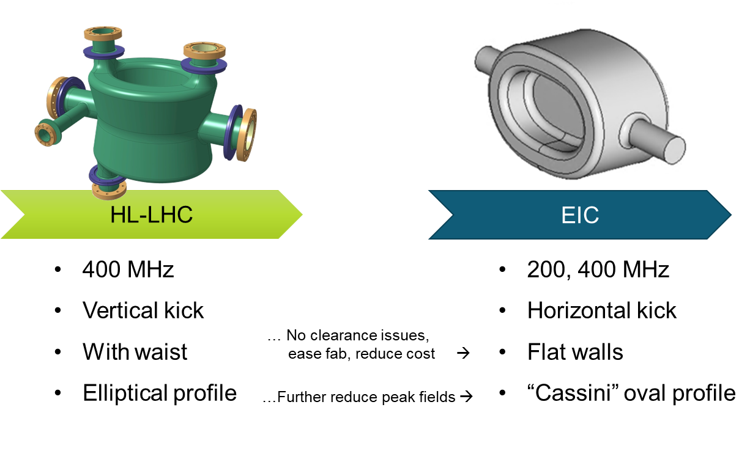
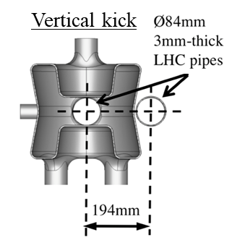
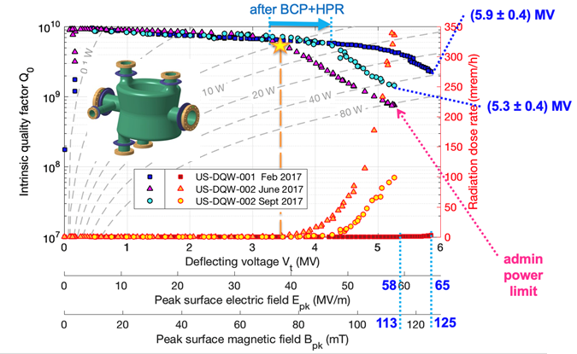
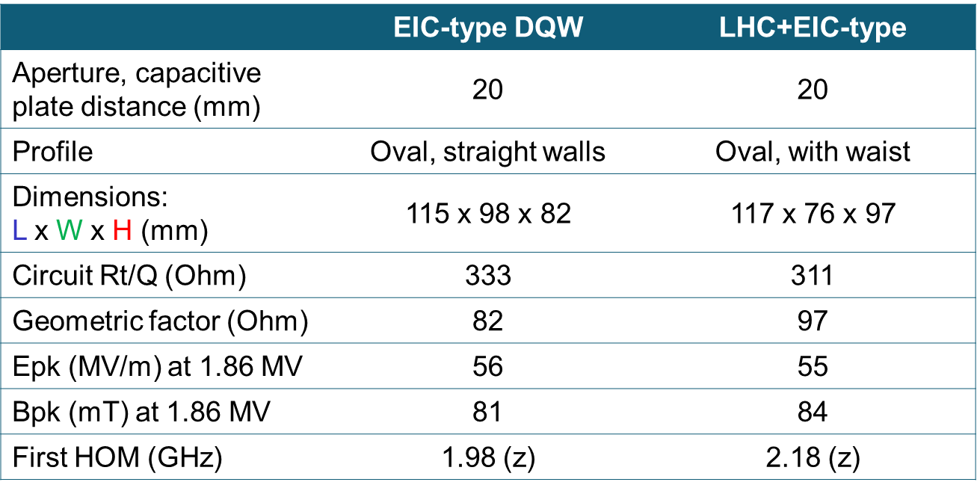
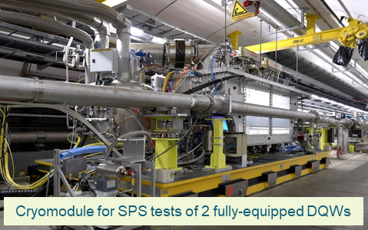
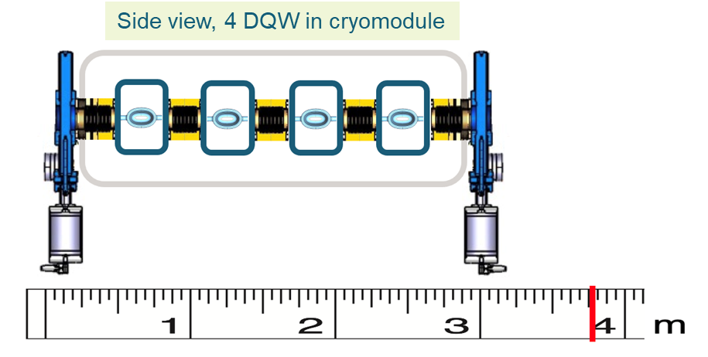
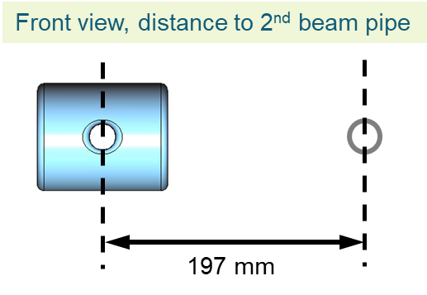
Double Quarter Wave – S Verdu Andres (CERN, Switzerland)
HL-LHC 400 MHz DQW
“Born” to satisfy tight spatial constraints imposed by the 2nd beam pipe of LHC, the DQW is remarkably compact.
DQW used for first crabbing of proton bunches at SPS; test campaign will continue over 2022.
For ILC at 1.3GHz
2 DQW designs being explored (HL-LHC and EIC variants):
Coupler integration may drive the choice between the two.
Input Coupler
loaded Q ~ 10⁶ needs input power <2 kW for cavity BW of 1.3 kHz.
HOM Couplers
coaxial or waveguide or combination can be used to damp the HOMs.
Due to high frequency of the 1st HOM, a waveguide/stub coupled to an antenna is efficient and simple solution. (Rectangular WG with a ~ 7.5 cm has f_{c,TE10} = 2 GHz.)
Summary
DQW cavity is compact solution for ILC crabbing system. One single-cell cavity provides 1.86 MV with safe max. peak fields.
Tuner/coupler integration can be borrowed from HL-LHC & EIC.
DQW compactness opens manufacture out of ingot.

Slide 8
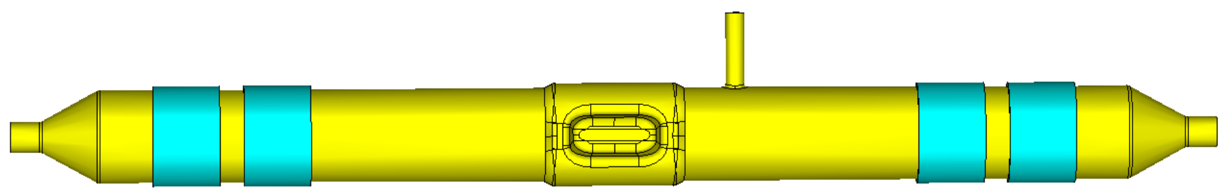
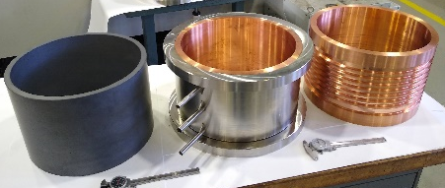
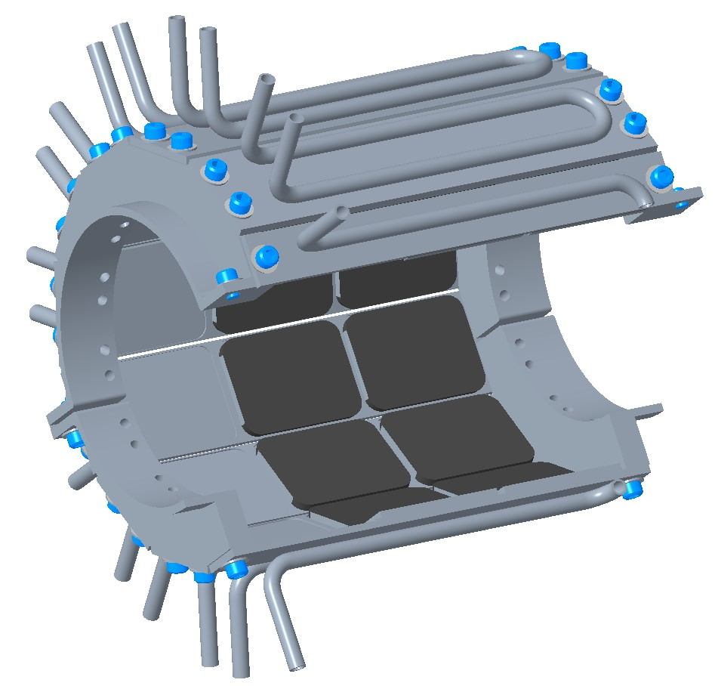
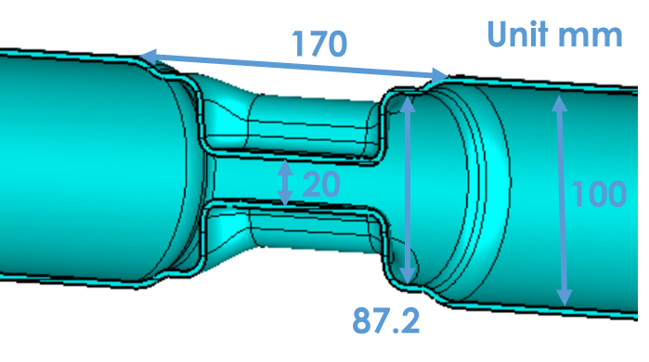
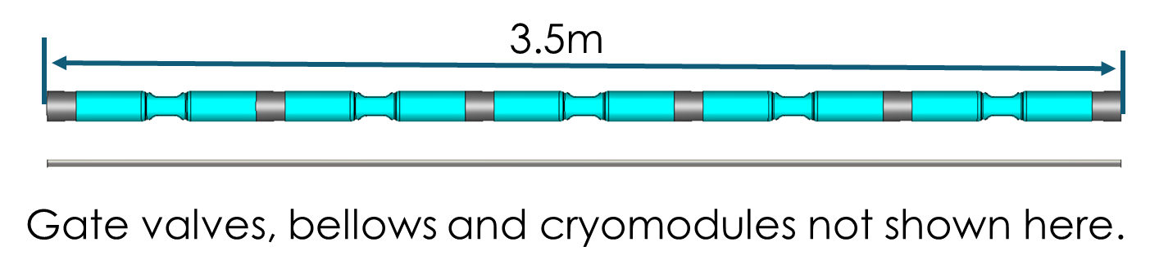
Wide Open Waveguide – B Xiao (BNL, USA)
EIC WOW type cavity
Needs 1.845 MV for 125 GeV case and 7.4 MV for 500 GeV case.
If we use 2 cavities for 125 GeV and 5 cavities for 500 GeV, and 1.48 MV per cavity, peak fields drop to 43.3 MV/m Epk and 74.1 mT Bpk.
Beam Line Absorber (BLA)
Optimization of BLA is still on-going.
Possible solutions include one BLA with tapered thicknesses, two BLAs with different thicknesses (uniform thickness in each), and BLA with ferrite tiles.
Cavity String (estimation)
Property | Value
Operating frequency [GHz] | 1.300
1st longitudinal HOM [GHz] | 2.318
1st transverse HOM [GHz] | 1.878
E_{p}/E_{t} with E_{t}=V_{t}/(λ/2) | 3.37
B_{p}/E_{t} [mT/(MV/m)] | 5.77
B_{p}/E_{p} [mT/(MV/m)] | 1.71
G [Ω] | 112.0
R/Q [Ω] | 732.2
R_{t}R_{s} [Ω²] | 80470
Scaled to ILC at 1.3 GHz
Shrink-fit SiC (W. Xu)
Tile SiC
(T. Schultheiss, SBIR)
Tile ferrite (TT2-111R)
for LEReC
Summary:
WOW is good cavity solution for ILC, with FPC/PU/BLA all outside the helium vessel.
Finished preliminary cavity design and optimization on cavity & BLA is on-going.
More effort on ancillaries (FPC/PU, RF window, amplifier, tuner etc) is needed. Very tigh space requirements.

Slide 9
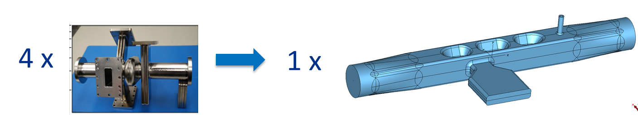
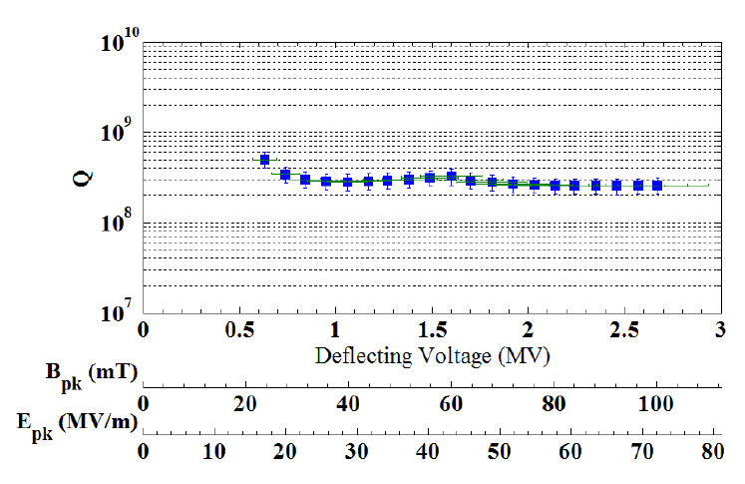
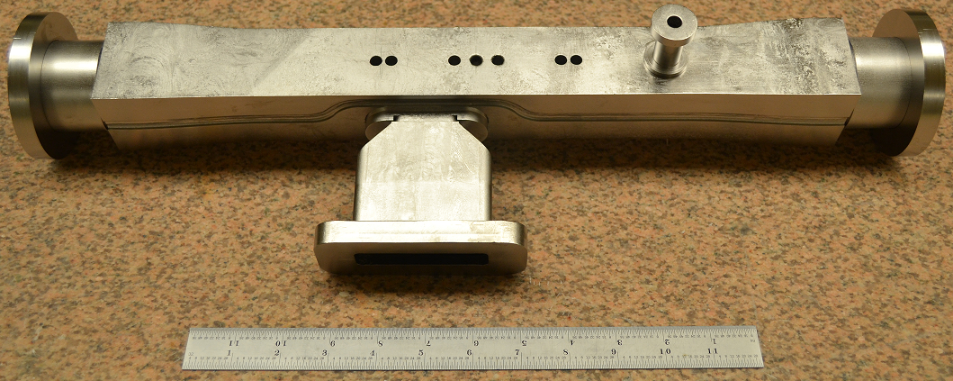
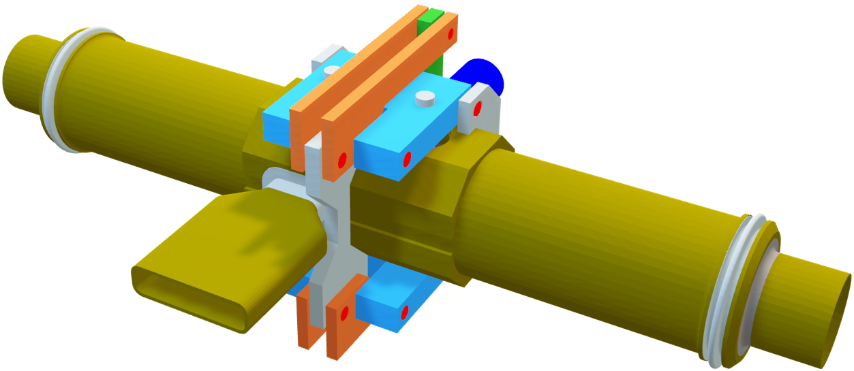
Quasi-waveguide Multicell Resonator – A Lunin (FNAL, USA)
QMiR cavity proposed as replacement of Mark-II deflecting cavity for APS/SPX project.
Prototype built and tested at ANL in 2013.
Measured max. deflecting voltage of 2.7 MV exceeds design goal of 2 MV @ 2K.
Relatively low Qo (3E8) due to extra RF losses at covering flanges.
QMiR has a record high (R/Q)t >1kΩ
QMiR Cavity for ILC (scaled to 2.6 GHz)
There are 2 Same Order Modes (SOM) with low (R/Q)*Q.
SOM/HOM external couplings Qext < 10⁴.
SOM/HOMs longitudinal and transverse impedances (@1mm):
  (R/Q)z <= 100 Ω, (R/Q)x <= 1 Ω and (R/Q)y <= 10 Ω
SOM/HOM spectrum is sparse and strongly damped.
Freq | 2815 MHz
V_{kick} | 2 MV
E_{max} | 55 MV/m
B_{max} | 76 mT
(R/Q)_{Y} | 1040 Ω
G | 130
W_{STOR} | 0.23 J
Summary:
QMIR is good option for the ILC Crab Cavity.
Very compact and simple - has acceptable loss/kick factors.
Peak field presented were low but aperture was a factor of 2 smaller than requirements. Likely to increase peak fields.
Required RF power (overhead 100%): Pgen < 1 kW but again with a much smaller aperture.
No MP in operation voltage domain.

Slide 10
WP3 Crab Cavity Developments
Options study (currently underway):
Elliptical/Racetrack RFD DQW WOW QMiR
Cavity down-selection #1 (Sept 22):
  EM design optimisation for cavity, couplers (input and HOM) and tuner.
  Select 2 primary options to take forward to prototype stage.
Cavity down-selection #2 (Sept 23):
  Choose most optimum single CC technology solution from prototype tests.
Propose to use both prototype CC’s in VTS for synchronisation studies.
Use final chosen design as basis for 2-cavity CM integration design and prototype
  Targeted basis for ILC Pre-Lab phase.

Slide 11
Session Discussion
Beam aperture specification clarified as >20mm relating to beam halo expectation as result of collimation. Synchrotron radiation may require a larger aperture which needs more studies
  Noting <20mm would make cavity cleaning more difficult in any case.
High field multipacting for lower frequency (1.3 GHz) dipole cavities requires careful optimisation, due to resonances close to fundamental mode. MP free demonstrated for 3.9 GHz elliptical and 2.8 GHz QMiR.
Smaller cavity geometries (either elliptical at 3.9 GHz or compact 1.3 GHz) could benefit from ingot machining manufacture, easier to control tuning sensitivity and cheaper.
Pulsed operation introduces Lorentz Force detuning challenges, preference therefore for CW mode of operation – no reason why not identified.
CC system solution must be conservatively specified, not push extreme operation, as its robustness and reliability must be critically preserved:
  Limit Epk to ~20 MV/m for example (however no design currently achieves this, would require 40% more cavities).
The 1st CC technology down-selection in Sept 22 must include all expected cryomodule components, cavity, couplers, tuner, dampers, bellows, tapers etc.

Slide 12
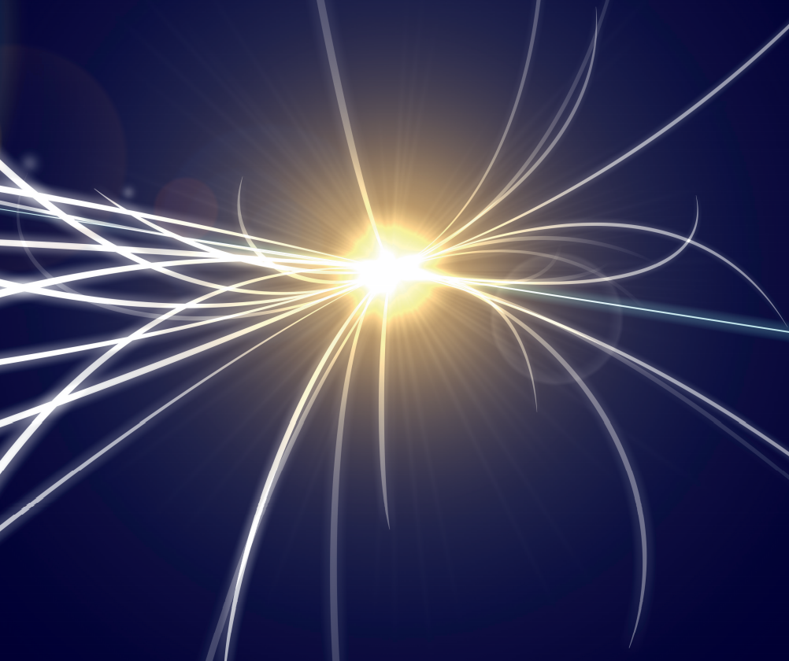

MANY THANKS
Questions?

