Slide 1
ILCX2021
Machine-Source session summary
Masao KURIKI (Hiroshima U.)

Slide 2
Machine Source Session
Discussion about ILC injector (electron and positron) development.
All 8 contributions for positron source development. No contributions for electron.
2 of 2 hours sessions.

Slide 3
Day 1 (Oct. 27)
Power Incident on the ILC helical undulator vacuum chamber : K. Alharbi
ILC Positron Target : Material Analysis : T. Lengler
A tapered pulsed solenoid as optical matching device for the undulator based ILC positron source: C. Tenholt
Update on the development of the active plasma lens as an Alternative Optical Matching Device : M. Formela

Slide 4
Day 2 (Oct. 28)
E-Driven positron source R&D by industry-government-academia collaboration : T. Takahashi (Hiroshima U.)
Target R&D of E-Driven positron source : T. Omori (KEK)
Beam-loading compensation on Capture linac of E-Driven positron source : S. Konno (Hiroshima U. )
System integration of E-Driven positron source: M. Kuriki (Hiroshima U. )

Slide 5
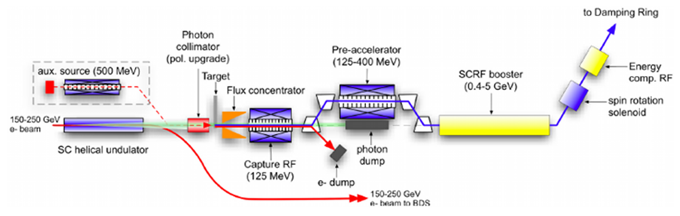
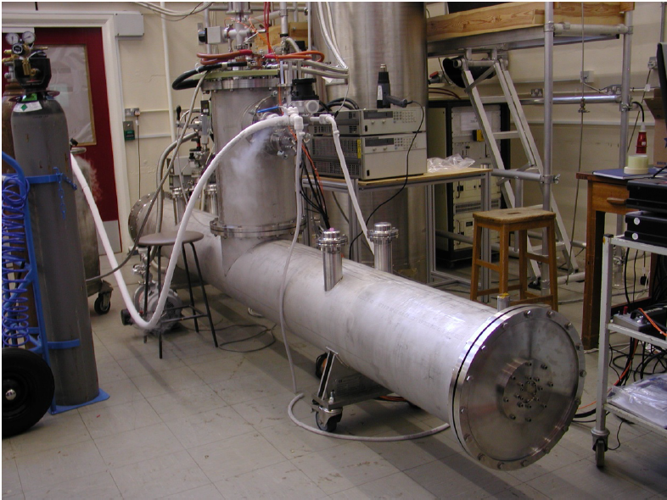
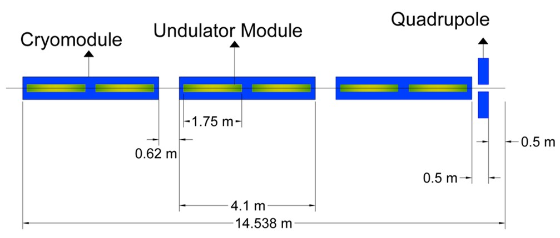
Power Incident on the ILC helical undulator vacuum chamber
Khaled Alharbi
Some photons are absorbed in Undulator leading thermal loss and quenching.
These photons should be collimated.
Helical Undulator Prototype
D.Scott et al.,
https://link.aps.org/pdf/10.1103/PhysRevLett.107.174803
2nd module
Unnnndulator!!!
× 22
1st module
5

Slide 6
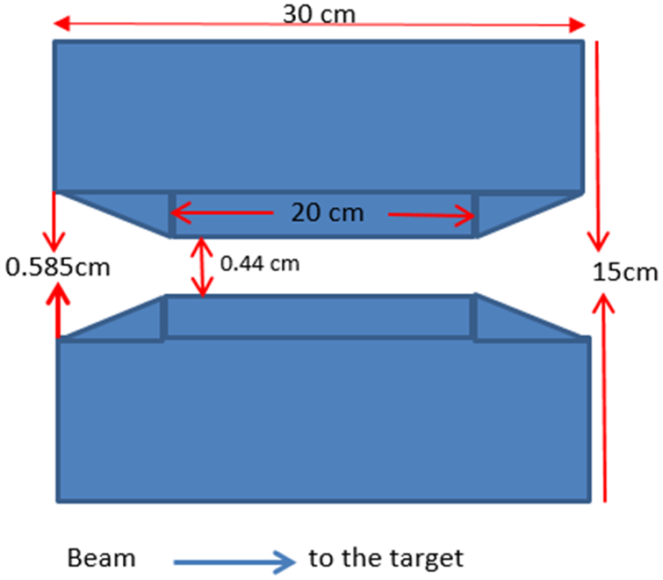
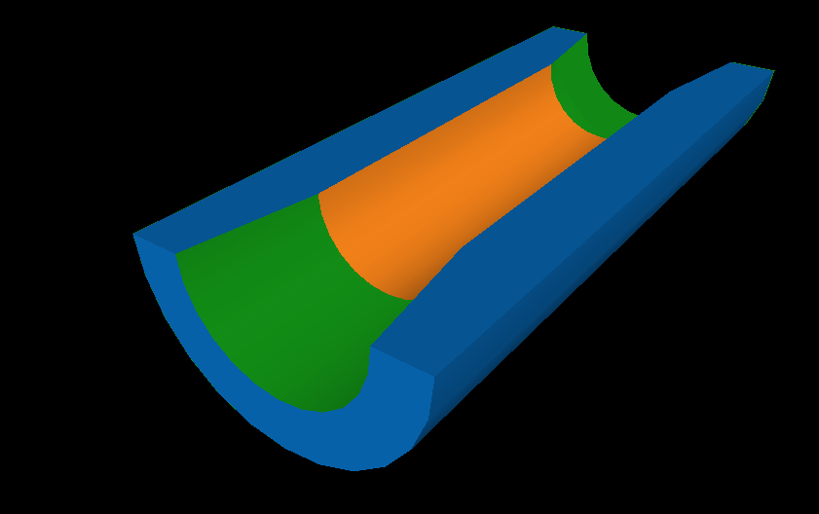
Photon Mask Design
Mask Design depends on:
The average incident photon energy (Ideal and Realistic)
The available area reserved for helical undulator (319.66m)
A possible mask design:
Cylinder with tapered opening
Masks must mainly stop photons of few MeV energy.
Material: High Z-materials, large density and small radiation length are needed:
Material | Atomic number | Radiation Length (cm) | Melting point (K)
Copper (Cu) | 29 | 1.44 | 1358
Tungsten (W) | 74 | 0.35 | 3695

Slide 7
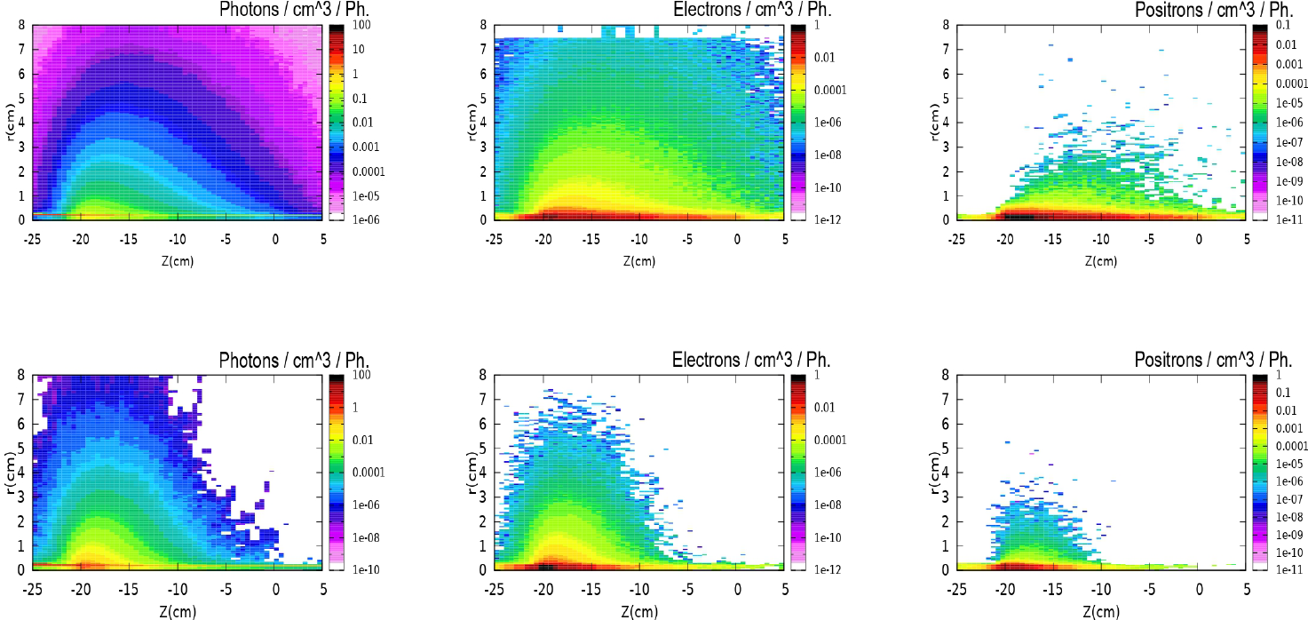
Secondary Particles Density along Cu and W masks (Realistic Undulator)
Photons
Electrons
Positrons
Cu Mask
W Mask

Slide 8
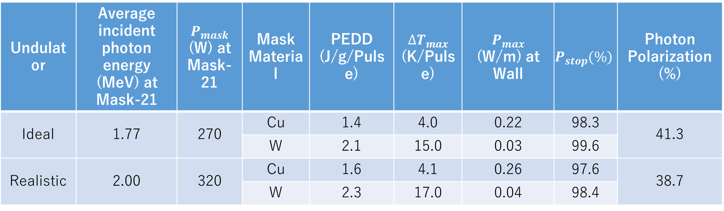
Results:
Undulator | Average incident photon energy (MeV) at Mask-21 | $$P_{mask}$$ (W) at Mask-21 | Mask Material | PEDD (J/g/Pulse) | ${∆T}_{max}$ (K/Pulse) | $P_{max}$ (W/m) at Wall | $$P_{stop}(\%)$$ | Photon Polarization (%)
Ideal | 1.77 | 270 | Cu | 1.4 | 4.0 | 0.22 | 98.3 | 41.3
 |  |  | W | 2.1 | 15.0 | 0.03 | 99.6
Realistic | 2.00 | 320 | Cu | 1.6 | 4.1 | 0.26 | 97.6 | 38.7
 |  |  | W | 2.3 | 17.0 | 0.04 | 98.4

Slide 9
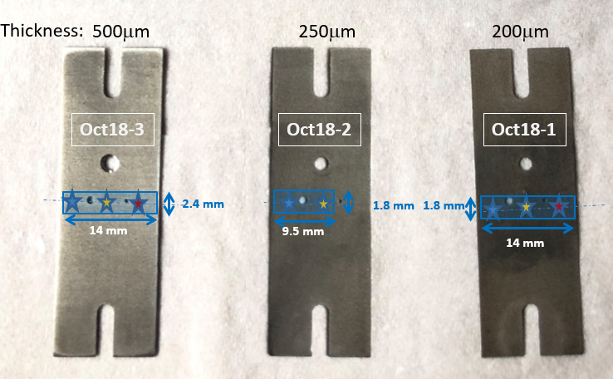
Table of irradiation
ILC Positron Target: Material Analyses
T. Lengler (U. of Hamburg)
 | Spot | Irradiation Duration [min] | Repetition rate [Hz] | Pulse length [ms] | ΔT per pulse [K] | Duty factor | T_{ave} at spot [C]
Oct18-1 | Top | 90 | 10 | 1.5 | 335 | 0.03 | 155
200μm | Middle | 40 | 20 | 1.5 | 350 | 0.015 | 98
 | Bottom | 40 | 100 | 1.0 | 240 | 0.10 | 365
Oct18-2 | Top
250μm | Middle | 45 | 120 | 1.0 | 230 | 0.12 | 425
 | Bottom | 40 | 140 | 0.5 | 170 | 0.07 | 300
Oct18-3 | Top | 40 | 100 | 0.5 | 170 | 0.05 | 280
500μm | Middle | 40 | 100 | 1.0 | 230 | 0.10 | 435
 | Bottom | 40 | 140 | 0.5 | 160 | 0.07 | 345
positions: top ⬄
middle ⬄
bottom ⬄
Continuous irradiation of the middle spot for Sample 1
→ Much heavier load than expected at the ILC
Electron beam diameter: 0.12 mm
3.5 MeV Electrons

Slide 10
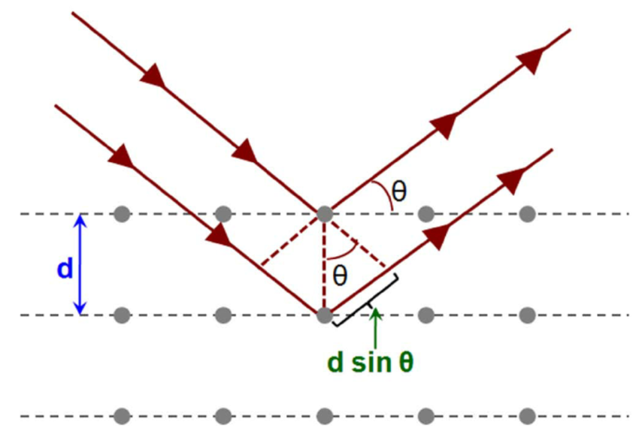
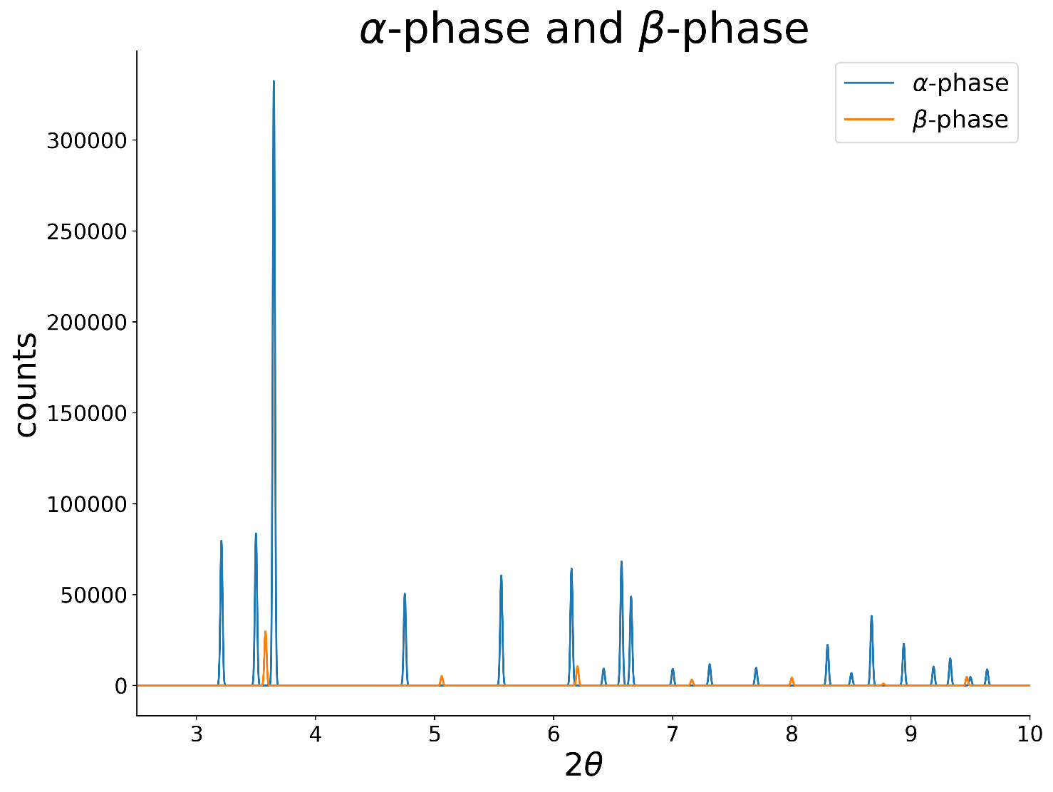
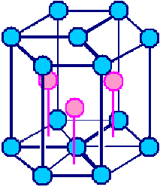
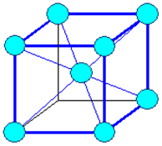
Diffraction analysis
wavelength: 0.14236 Å
α-phase: 95%
β-phase: 5%
Polycrystalline Ti-6Al-4V
α-phase
β-phase
hcp
bcc
www.tf.uni-kiel.de/matwis/amat/mw1_ge/kap_3/backbone/r3_3_1.html

Slide 11
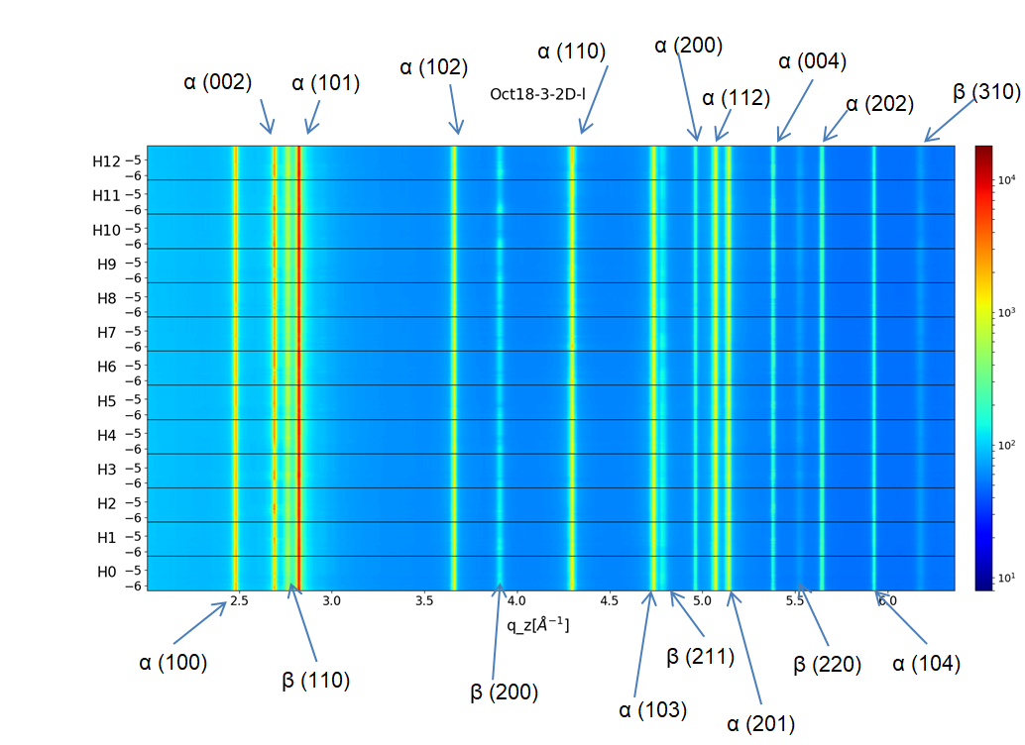
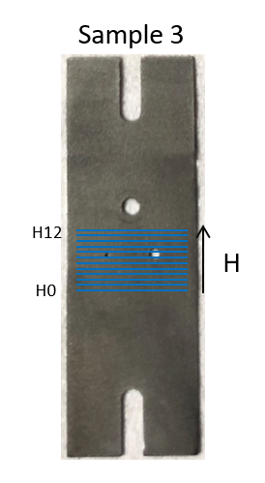

Analysis
α- and β-peaks stable
no indication of major radiation damage
no major changes caused by intended irradiation

Slide 12
A tapered pulsed solenoid as optical matching device for the undulator based ILC positron source:
C. Tenholt

Slide 15
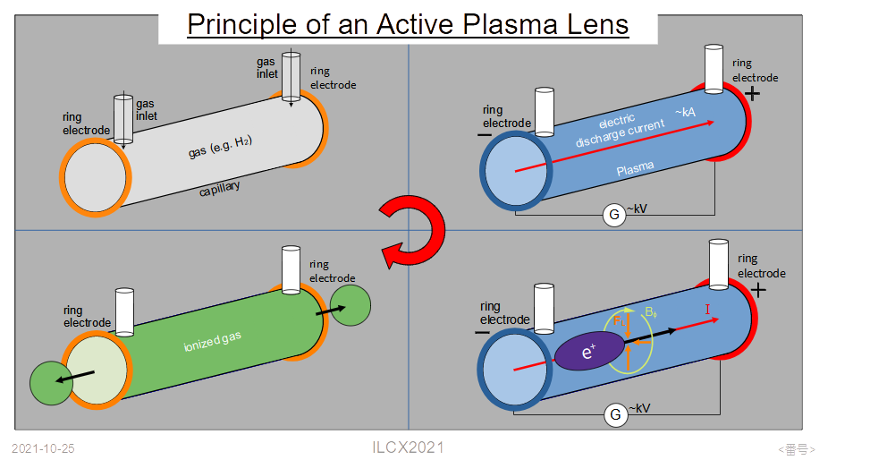
Update on the Development of the Active Plasma Lens as an Alternative Optical Matching Device
M. Formela

Slide 16
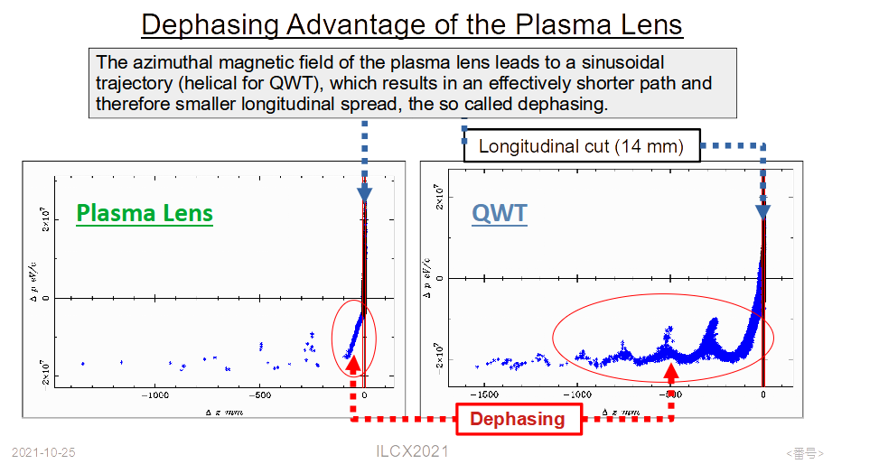

Slide 17
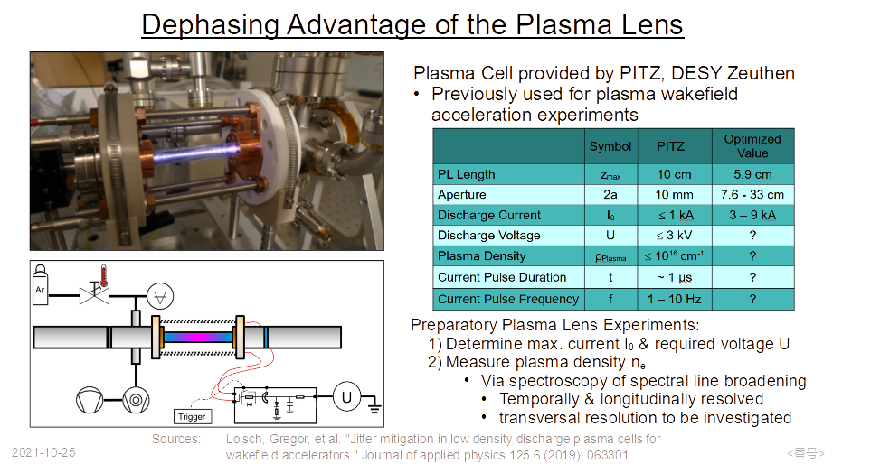

Slide 18
E-Driven Positron Source R&D by Industry-Government-Academia collaboration
T. Takahashi

Slide 21
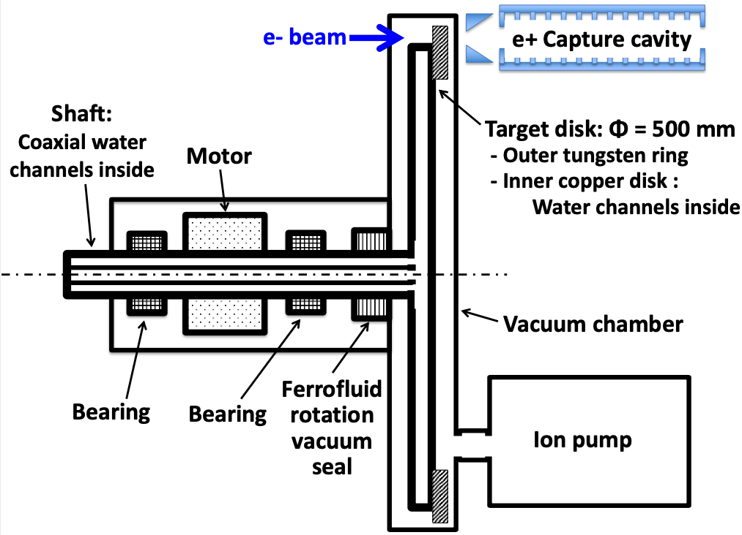
ILC E-Driven e+ Source
Rotation Target R&D
Works by Rigaku, Hiroshima U., and KEK
28-Octorber-2021
ILCX 2021, Tsukuba, Fully Remote
presented by T. Omori (KEK)

Slide 22
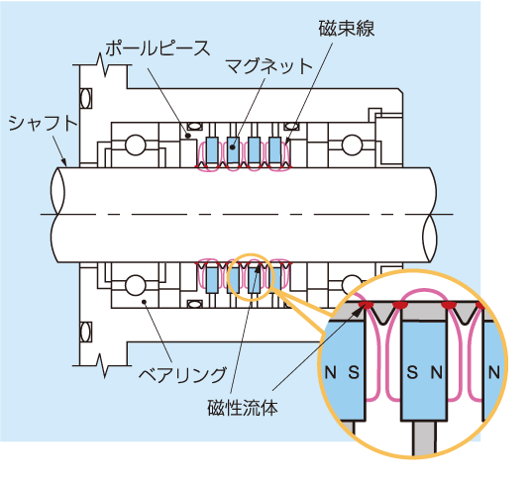
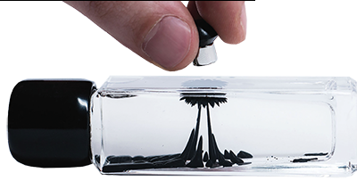
Ferrofluid Seal
Vacuum seal
+
Rotating shaft
Vacuum
Air
ferrofluid
= base oil + iron powders (~10 nm) + surfactant
(oxide iron powders) (界面活性剤)

Slide 23
Prototype #2: Two-stage Vacuum Seal
We started the experiment at the beginning of September 2020.
10⁻⁴
rotating at 225 rpm (design value)
Result: Spikes disappear.
Conclusion: Two-stage seal is effective
Spikes
It seemed vacuum still went better and better, but we are forced to stopped the experiment on 8-Jan-2021 to go next step.
Pressure of Main Chamber (Pa)
10⁻⁵
Spikes disappear
9-Sep-2020
6-Nov-2020
3-Dec-2020
8-Jan-2021
10⁻⁶
1.1x10⁻⁶ Pa
One stage
Two stage
No sub-pumping
（intermediate point: atmospheric pressure）
sub-pumping
Turbopump
~5x10⁻⁴ Pa
sub-pumping
Ion Pump
~ 3x10⁻⁶ Pa

Slide 24
We added the dummy target disk.
Fabrication at RIGAKU workshop
Jan. 2021
Assembling at KEK
Feb.-Mar. 2021

Slide 25
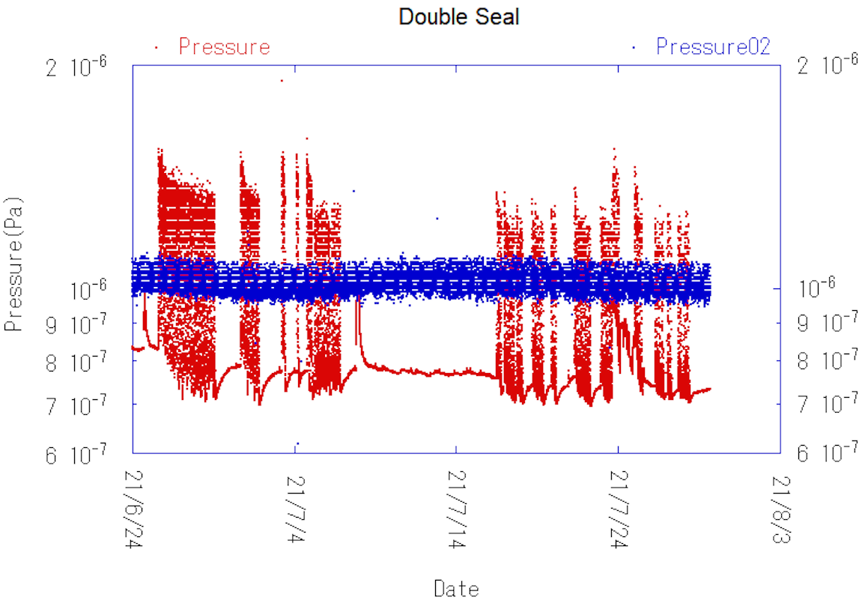
Prototype #2 with Dummy Disk
Vacuum Data, Enlarged Plot : From 24th July to 29th July, 2021
2x10⁻⁶ Pa
Rotation at 225 rpm (design value)
Pressure of Main Chamber
Spike
~ 1.2E-6 Pa
1x10⁻⁶ Pa
x 1.5
7.4x10⁻⁷ Pa
29th July
6x10⁻⁷ Pa
Pressure of Intermediate Point
We achieved 7x10⁻⁷ Pa with dummy disk
with small spikes

Slide 26
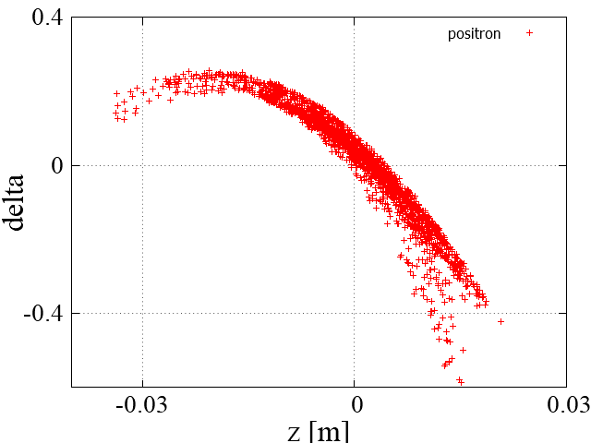
Beam-loading Compensation on Capture Linac of E-Driven Positron Source
S. Konno, M. Kuriki, Z. Liptak ,
T. Takahashi, H. Nagoshi (Hiroshima University)
K. Yokoya, J. Urakawa, M. Fukuda,
Y. Seimiya, T. Ohmori (KEK)
S. Kashiwagi (Tohoku University)
28-October-2021

Slide 27
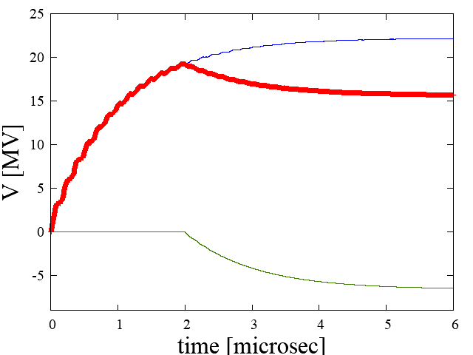



Beam loading compensation
  A deceleration field is generated by beam (beam loading).
  Therefore, cavity voltage varies giving energy fluctuation in a pulse.
  Because the positron is not on crest of RF curve, not only the real component, but also imaginary component is induced.
  Beam loading can’t be compensated by adjusting RF amplitude.
RF voltage
$$V_{c}$$
Cavity voltage
Beam voltage
$$V_{RF}$$
$$V_{beam}$$

Slide 28




















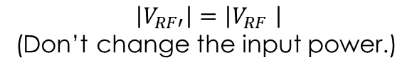





Off crest beam loading compensation
  In the case of off crest, the above method cannot compensate for complex components.
  By applying phase modulation, compensation is possible.
Phase plot
Phase plot
$$t<t_{b}$$
$$t>t_{b}$$
$$t<t_{b}$$
$$t=t_{b}$$
$$t=t_{b}$$
$$t>t_{b}$$
$V_{c }\left(t\right)$ is constant.
$V_{c }\left(t\right)$ is not constant.
$$V_{RF′}$$
$$\left|V_{RF′}\right|=\left|V_{RF} \right|$$
(Don’t change the input power.)
$$V_{RF}\left(t\right)$$
$$V_{RF′}\left(t\right)$$
$$V_{c }\left(t\right)$$
$$V_{c }\left(t\right)$$
$$V_{RF}$$
$$V_{c }\left(t\right)$$
$$V_{RF}$$
$$V_{beam}\left(t\right)$$
$$V_{beam}\left(t\right)$$
Change the RF phase
$$V_{beam}$$
$$V_{beam}$$
$V_{RF}$ : Steady-state RF voltage
$V_{beam}\left(t\right)$: Transient-state beam voltage
$V_{RF}\left(t\right)$ : Transient-state RF voltage
$V_{c }\left(t\right)$: Transient-state cavity voltage
$V_{RF′}$ : Steady-state RF voltage (phase modulation)
$V_{beam}$ : Steady-state beam voltage

Slide 29
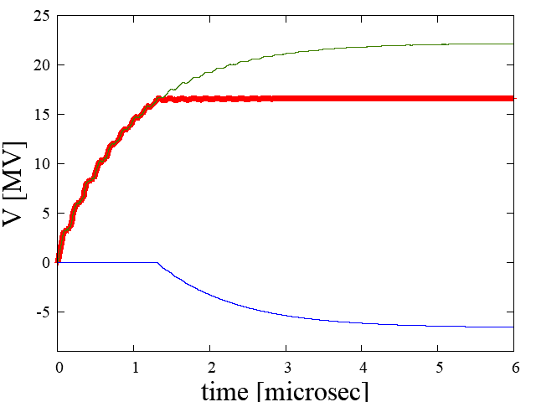
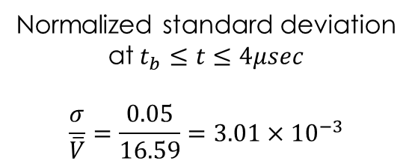
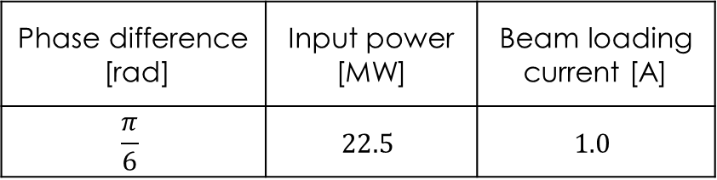


Beam loading compensation off crest
Phase difference [rad] | Input power [MW] | Beam loading current [A]
$$\frac{π}{6}$$ | $$22.5$$ | $$1.0$$
Normalized standard deviation
at $t_{b}≤t≤4μsec$
$$\frac{σ}{\overline{V}}=\frac{0.05}{16.59}=3.01×{10}^{−3}$$
$\overline{V}$:Average voltage
$$t_{b}=1.32μsec$$
Time dependence of cavity voltage

Slide 30
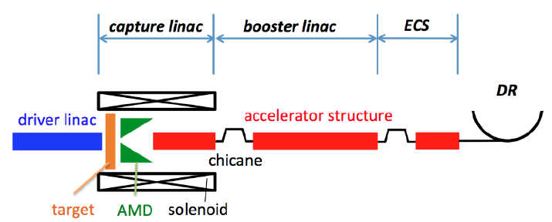
ILCX2021 Accelerator Source Session
System integration of
ILC E-Driven Positron Source
M. Kuriki, S. Konno, Z. Liptak,
T. Takahashi, T. Omori,
J. Urakawa, H. Hayano, K. Yokoya

Slide 31
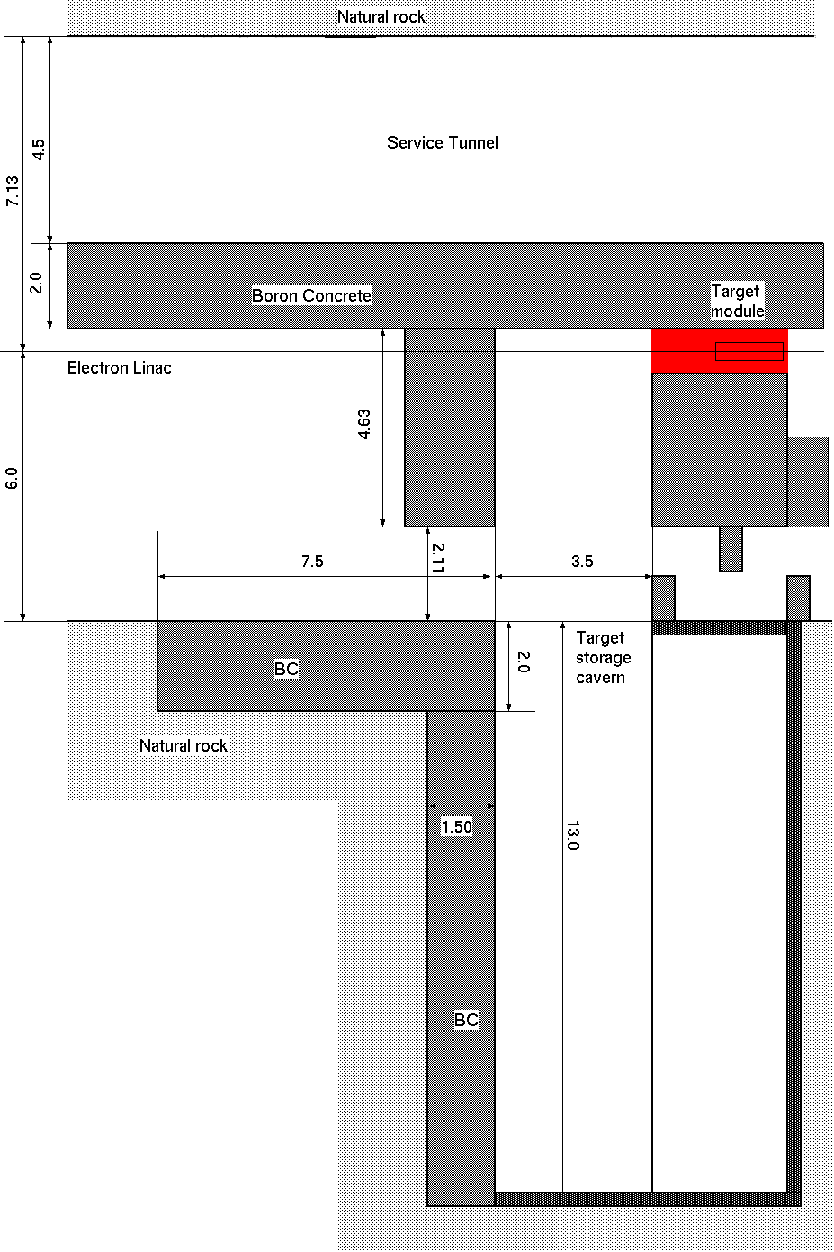
Target Section
For the radiation shield, the target is surrounded by 2m thick boronized concrete blocks.
Used targets are stored in a cavern.
The target module consists of target, FC, collimator, and the first RF cavity. The module is mounted on a wagon with shield.
It is designed with copulations A. Miyamoto and P. Sievers.
Unit (m)

Slide 32
Capture Linac unit
RF load
RF load
BPM
BPM
L-band 1.27m APS
L-band 1.27m APS
L-band 1.27m APS
L-band 1.27m APS
1500.00
1500.00
1500.00
1500.00
λ
173.1
115.4
173.1
230.8
3/4λ
λ/2
3/4λ
6692.4

Slide 33
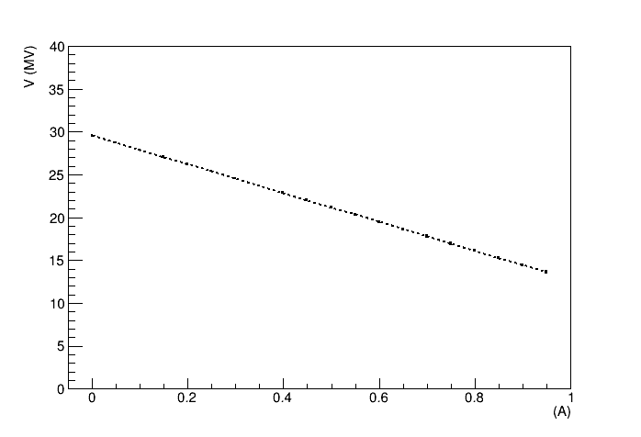
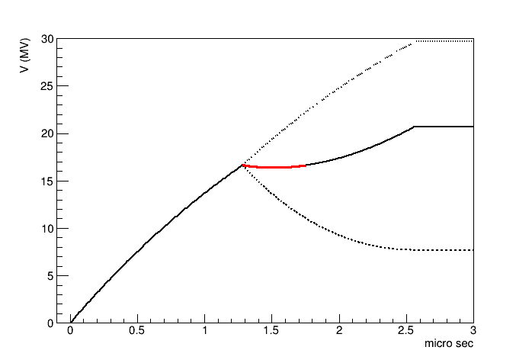

2m L-band TW Accelerator
Accelerator for Positron booster
Parameter | Value
Shunt impedance | 48.0 MΩ/m
Length | 2.00m
τ (attenuation) | 0.261
t_{f} | 1.28 μs
Shunt impedance and length are scaled with the same manner.
Accelerating voltage per tube is $16.5 ± 0.1 MV$ with 22.5 MW input.
RF voltage
Pulse
train
Cavity voltage
Beam loading voltage
Beam loading current

Slide 34
The whole system

Slide 37
Summary of Summary
8 contributions only for positron source.
4 for Undulator and 4 for E-driven.
Progresson target, capture device, photon colimator for Undulator.
Progress on target, thermal analysis, beam loading compensation, and the system integration for E-Driven.
Positron R&D is one of the main issue in pre-lab. We source group are vigorous! (at least until the pre-lab. end).

