Slide 1


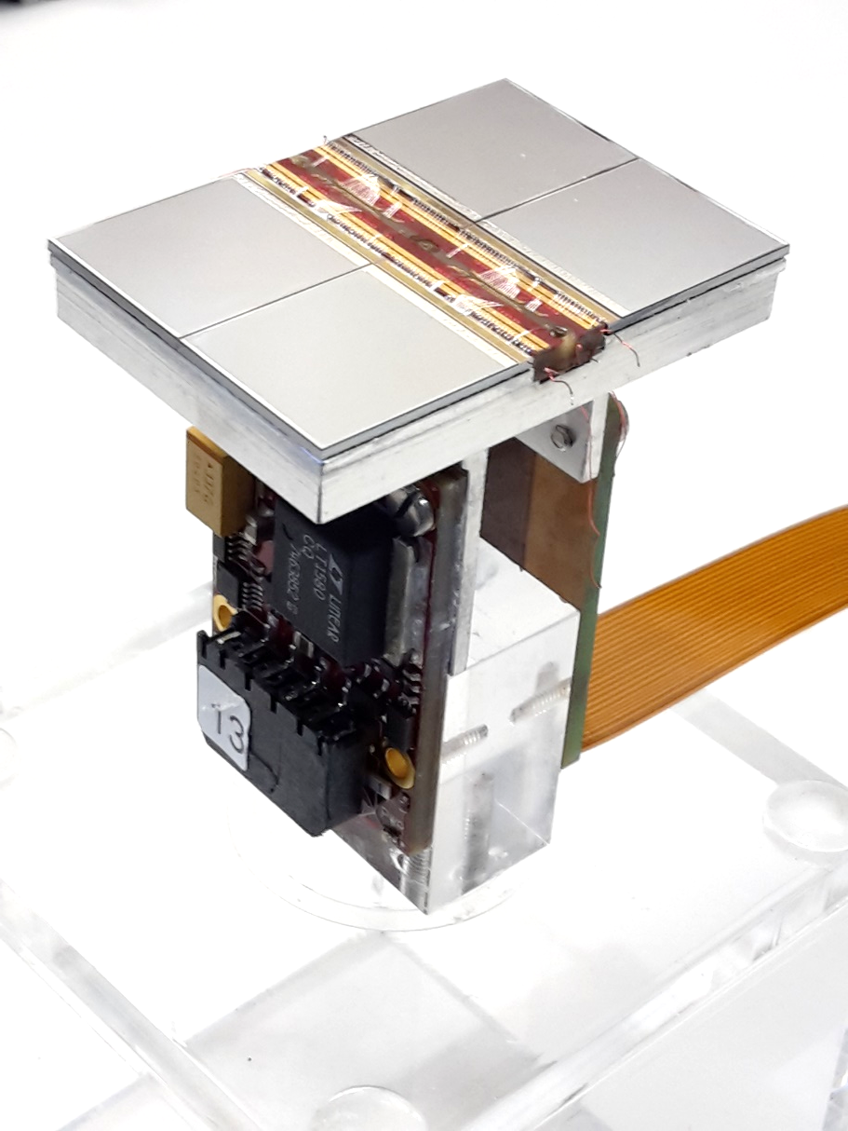


Towards a Pixel
Time Projection Chamber
Yevgen Bilevych, Klaus Desch, Harry van der Graaf, Fred Hartjes, Jochen Kaminski, Peter Kluit, Naomi van der Kolk,
Cornelis Ligtenberg,
Gerhard Raven, and
Jan Timmermans
ILCX2021

Slide 2
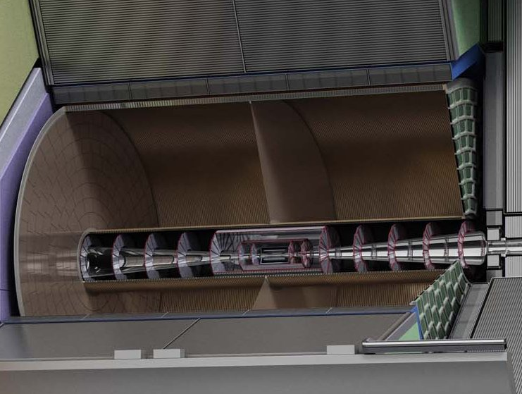
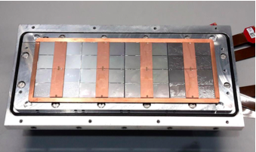
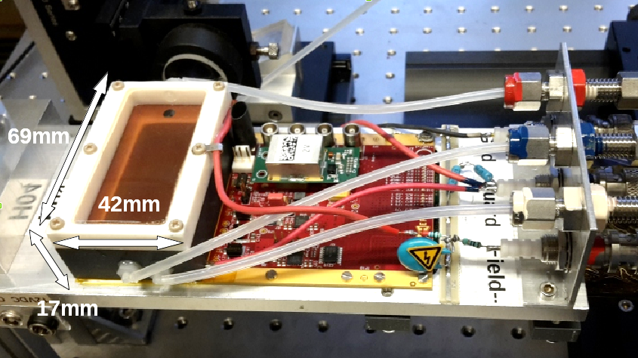
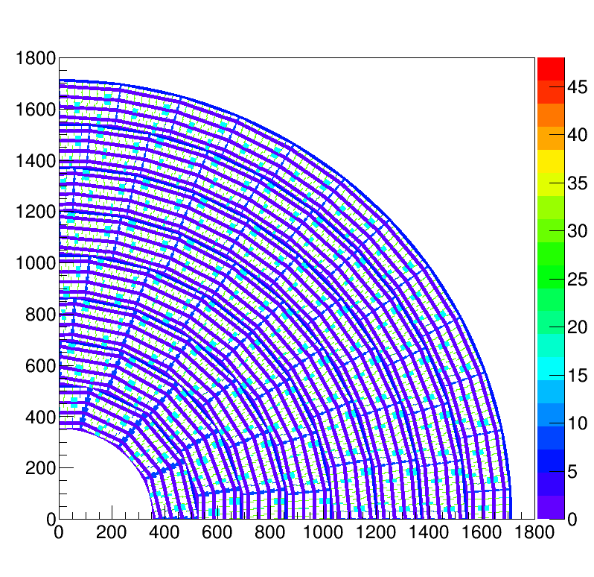
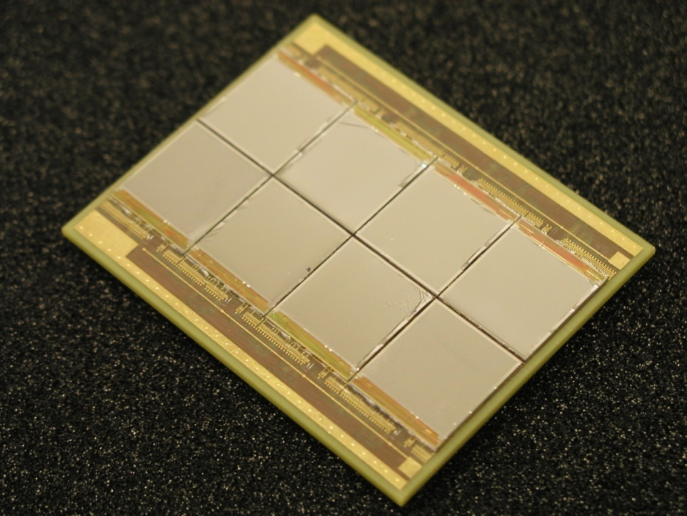
Pixel TPC
(Octopuce)
(TimePix1) TPX3 chip Quad Module TPC plane
(2007-14) 2017 2018 2019

Slide 3
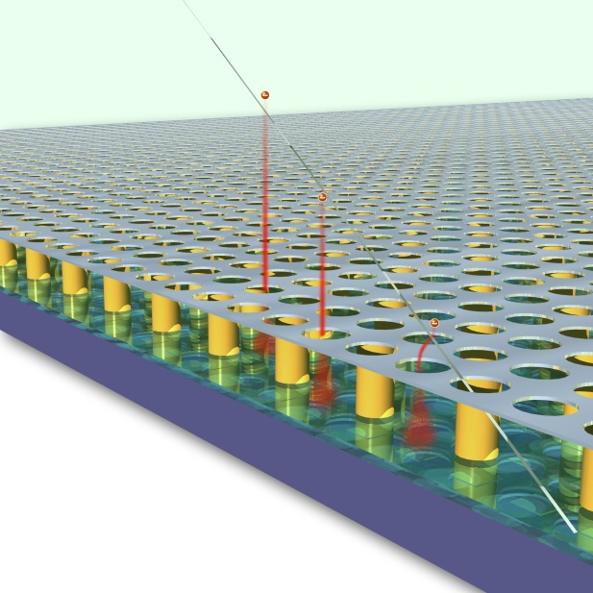
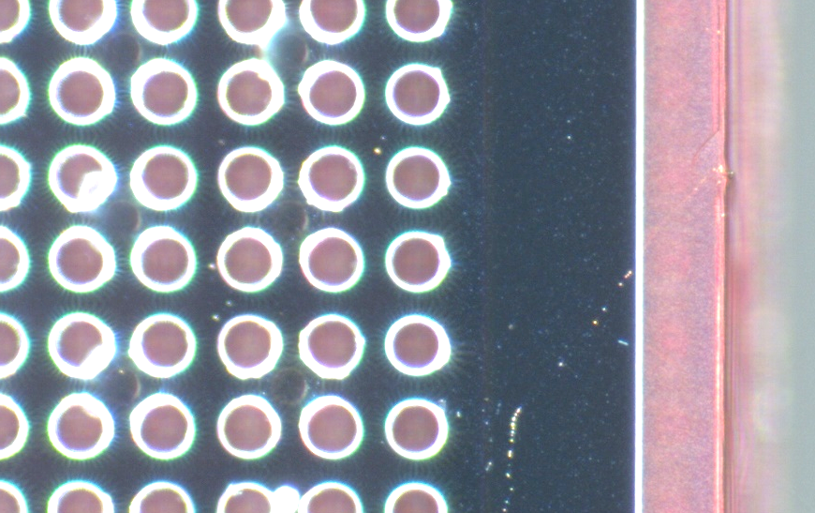
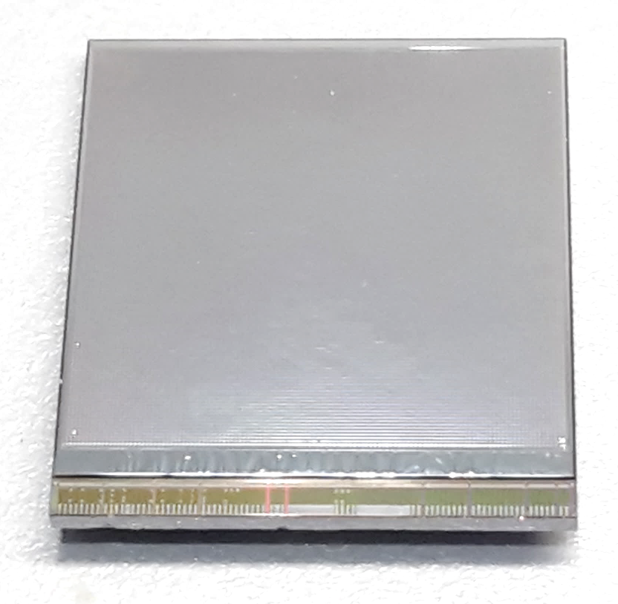
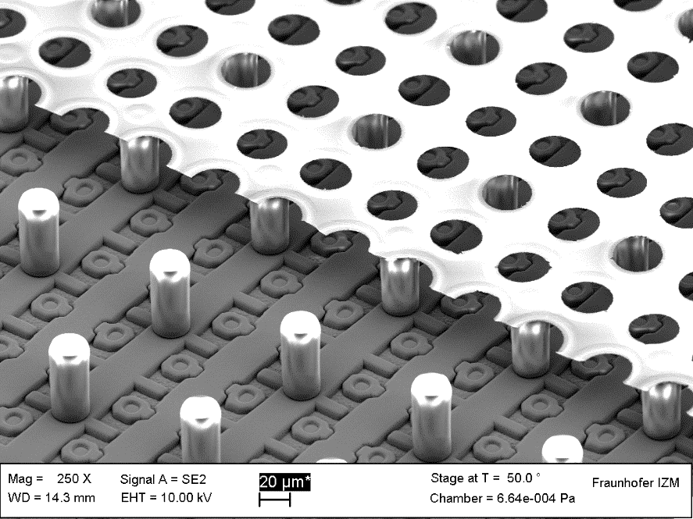
GridPix technology
Pixel chip with integrated Grid (Micromegas-like)
InGrid post-processed @ IZM
Grid set at negative voltage (300 – 600 V) to provide gas amplification
Very small pixel size (55 µm)
detecting individual electrons
dyke
55 µm
Aluminium grid (1 µm thick)
35 µm wide holes, 55 µm pitch
Supported by SU8 pillars 50 µm high
Grid surrounded by SU8 dyke (150 µm wide solid strip) for mechanical and HV stability
50 µm

Slide 4
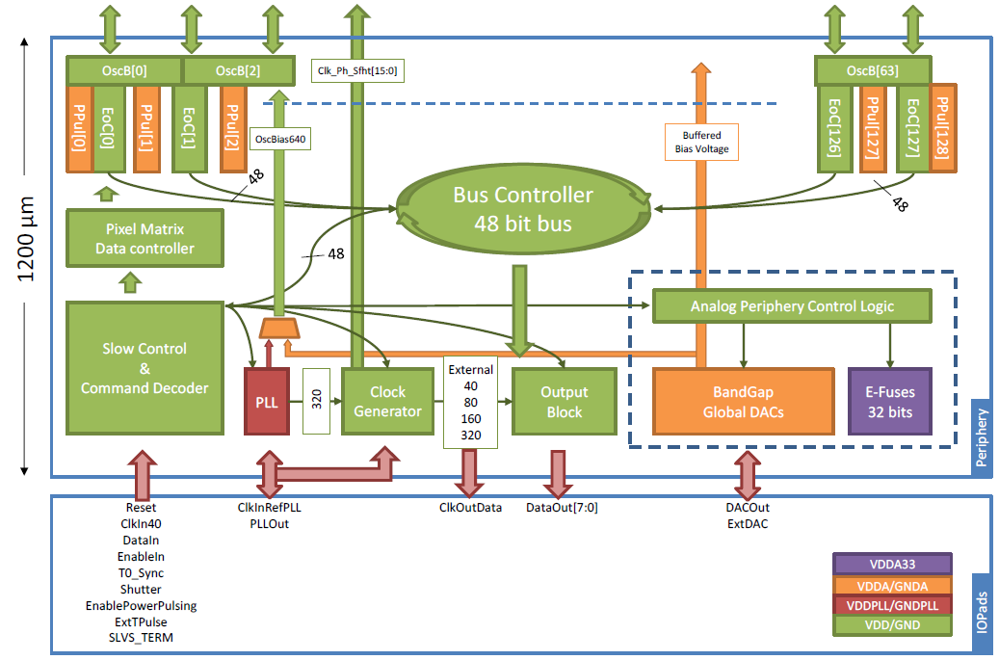
Pixel chip: TimePix3
256 x 256 pixels
55 x 55 µm pitch
14.1 x 14.1 mm sensitive area
TDC with 610 MHz clock (1.64 ns)
Used in the data driven mode
  Each hit consists of the pixel address and time stamp of arrival time (ToA)
  Time over threshold (ToT) is added to register the signal amplitude
  compensation for time walk
  Trigger (for t₀) added to the data stream as an additional time stamp
Power consumption
  ~1 A @ 2 V (2W) depending on hit rate
  good cooling is important
Sensitive area
14.1 mm
2+3 mm

Slide 5
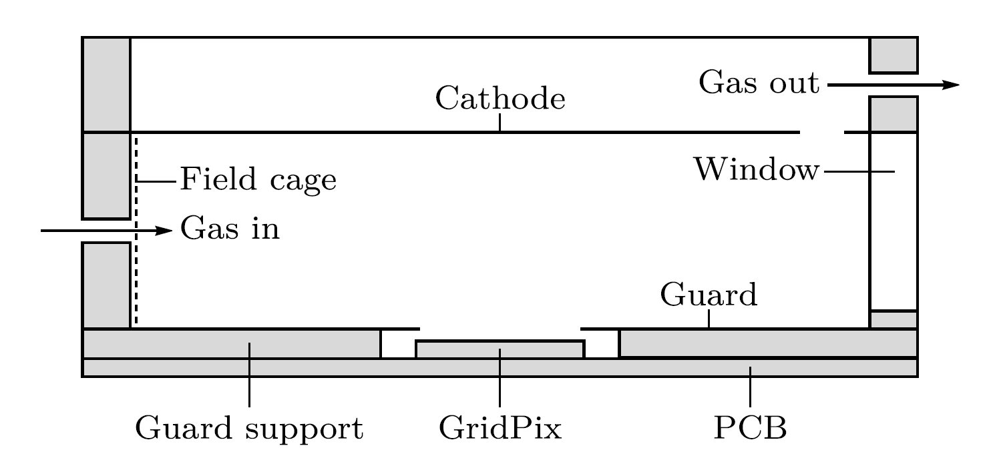
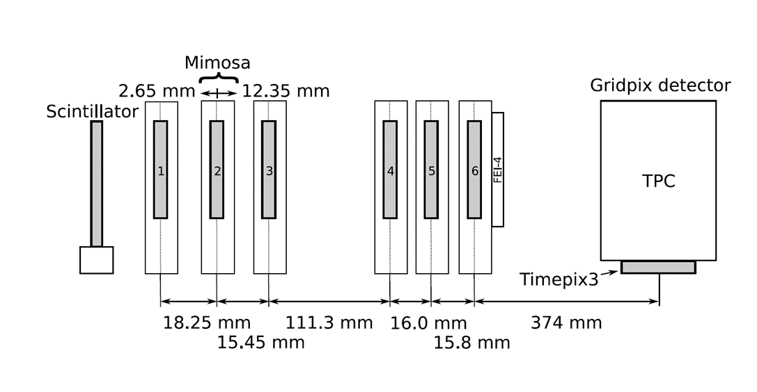

Single chip test in test beam Bonn (June 2017)
ELSA: 2.5 GeV electrons
Tracks referenced by Mimosa telescope
Gas: Ar/CF₄/iC₄H₁₀ 95/3/2 (T2K)
Electrons: ~100 e/cm
E_{d} = 280 V/cm, V_{grid} = -350 V
--------- Mimosa telescope ---------
Detector with guard and field shaper
@Bonn
Published paper on 2017 testbeam: https://doi.org/10.1016/j.nima.2018.08.012

Slide 6
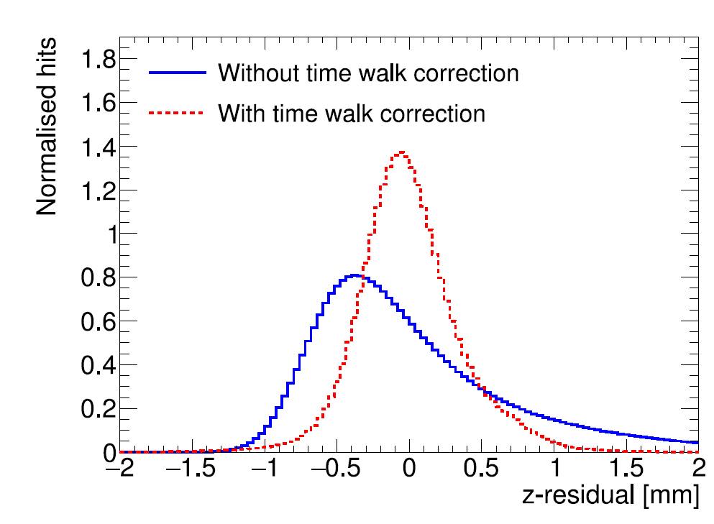
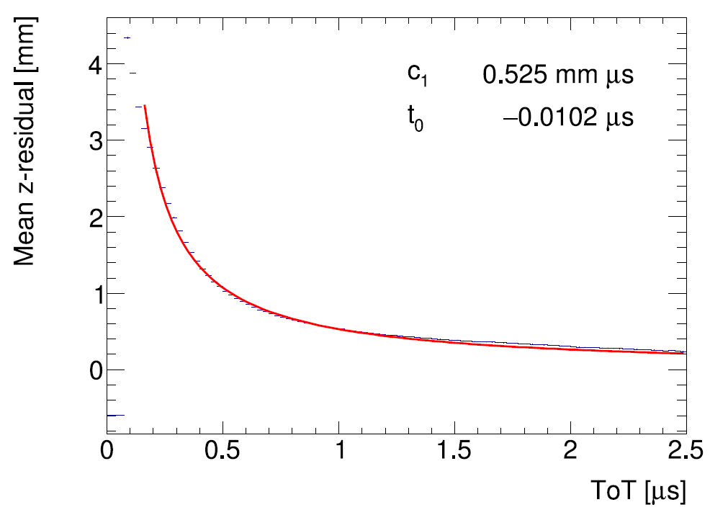
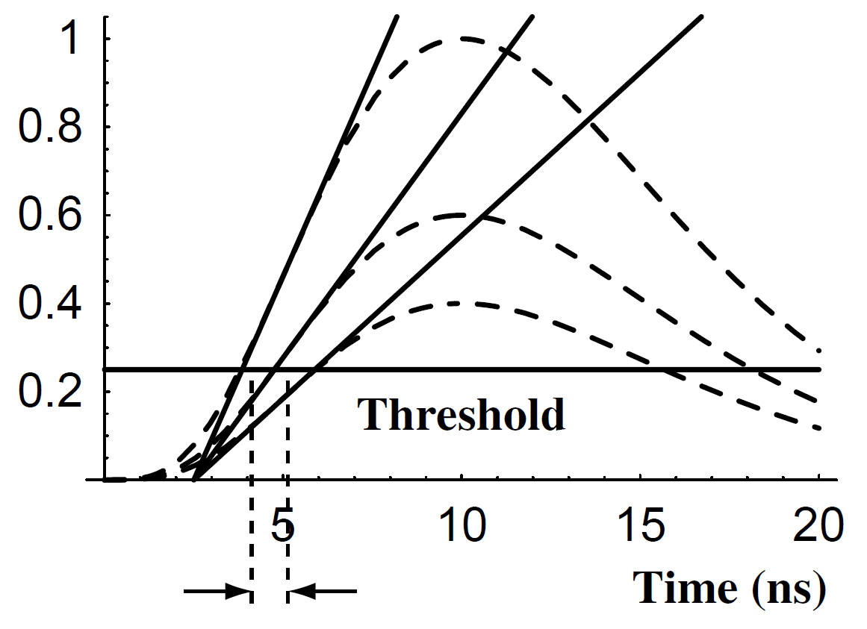
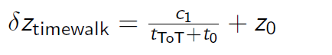
TimePix3 time walk correction
Time walk error: time of arrival depends on signal amplitude
Residual distribution improved
Higher order corrections did not yield further improvements
Correction using Time over Threshold (ToT) as a measure of signal strength
(Blum, Particle detection 2008)

Slide 7
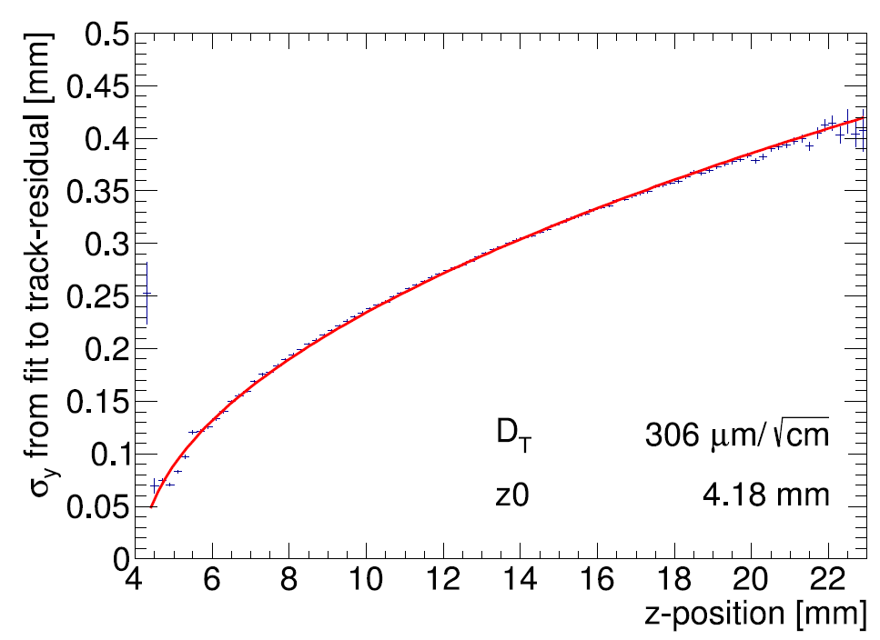
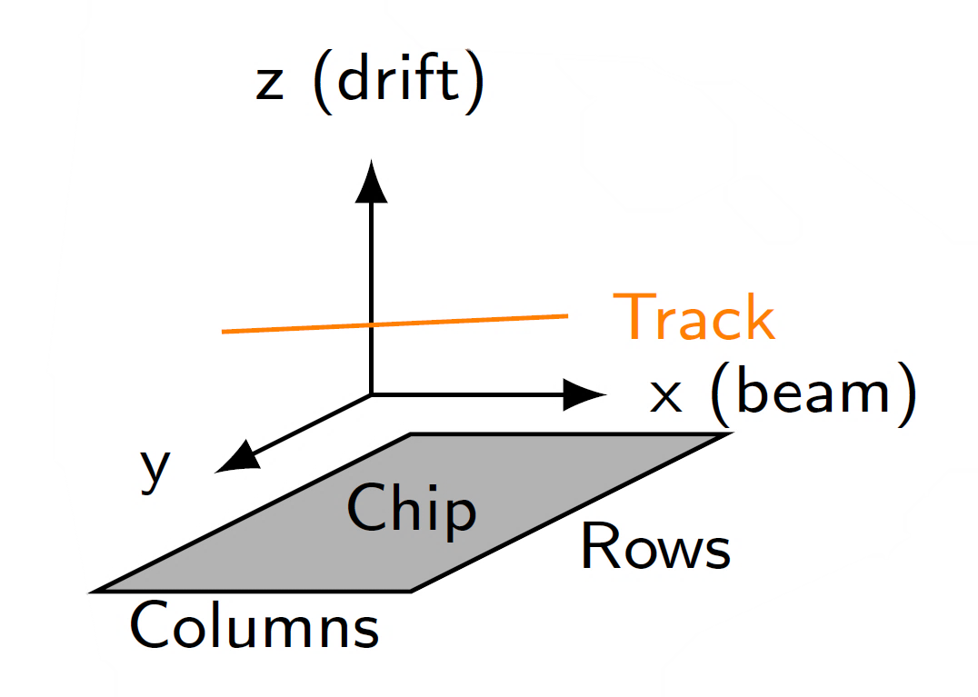
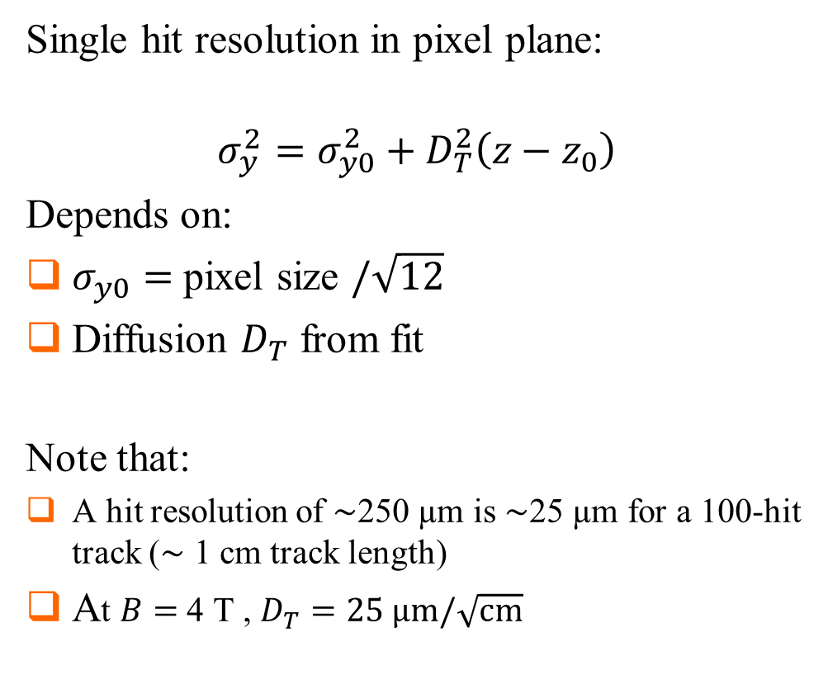
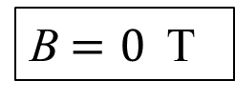
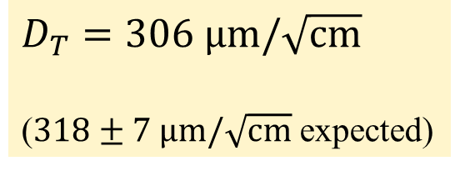
Single hit resolution in transverse direction
Single hit resolution in pixel plane:
$$σ_{y}^{2}=σ_{y0}^{2}+D_{T}^{2}\left(z−z_{0}\right)$$
Depends on:
$σ_{y0}=$ pixel size $/\sqrt{12}$
Diffusion $D_{T}$ from fit
Note that:
A hit resolution of $\sim$250 µm is $\sim$25 µm for a 100-hit track ($\sim$ 1 cm track length)
At $B=$ 4 T , $D_{T}=25 \text{μm}/\sqrt{\text{cm}}$
B$=0$ T
$D_{T}=306 \text{μm}/\sqrt{\text{cm}}$
($318±7 \text{μm}/\sqrt{\text{cm}}$ expected)

Slide 8
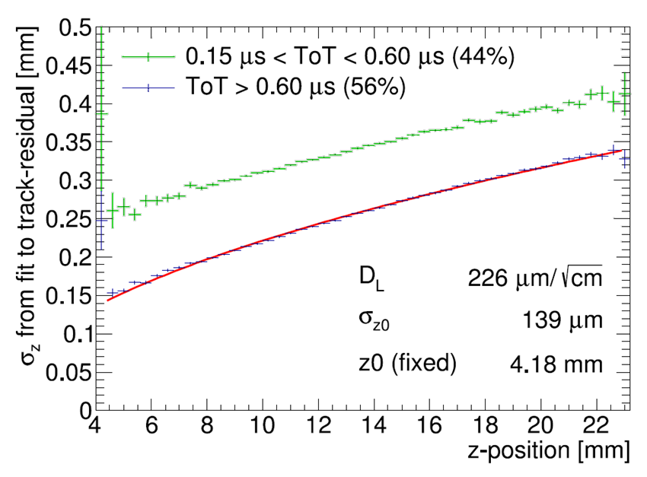
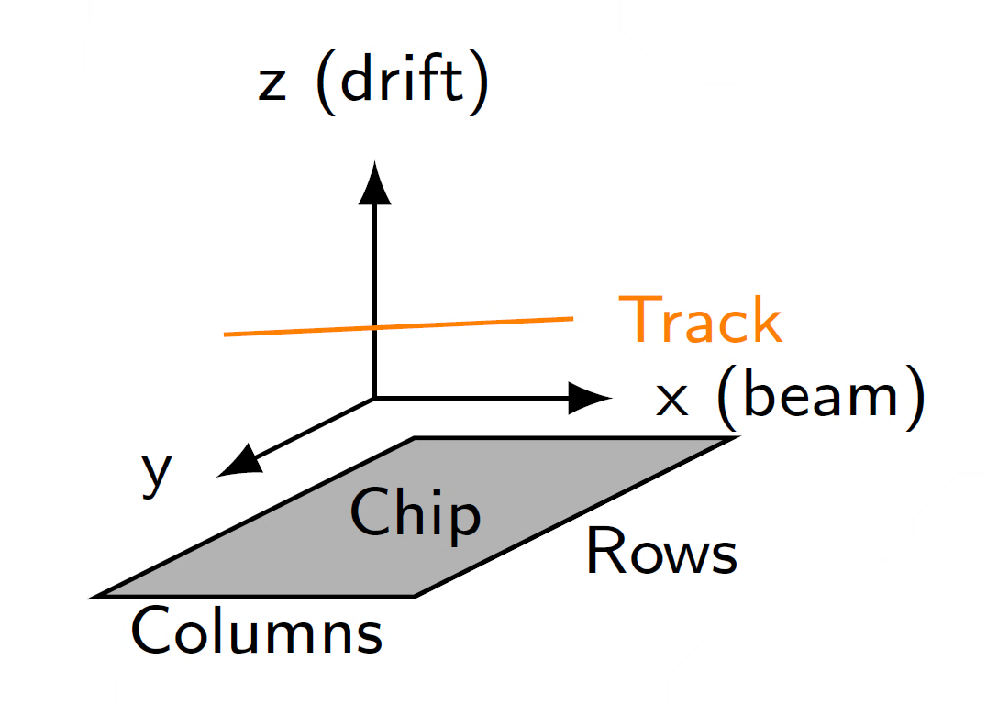
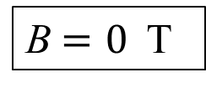
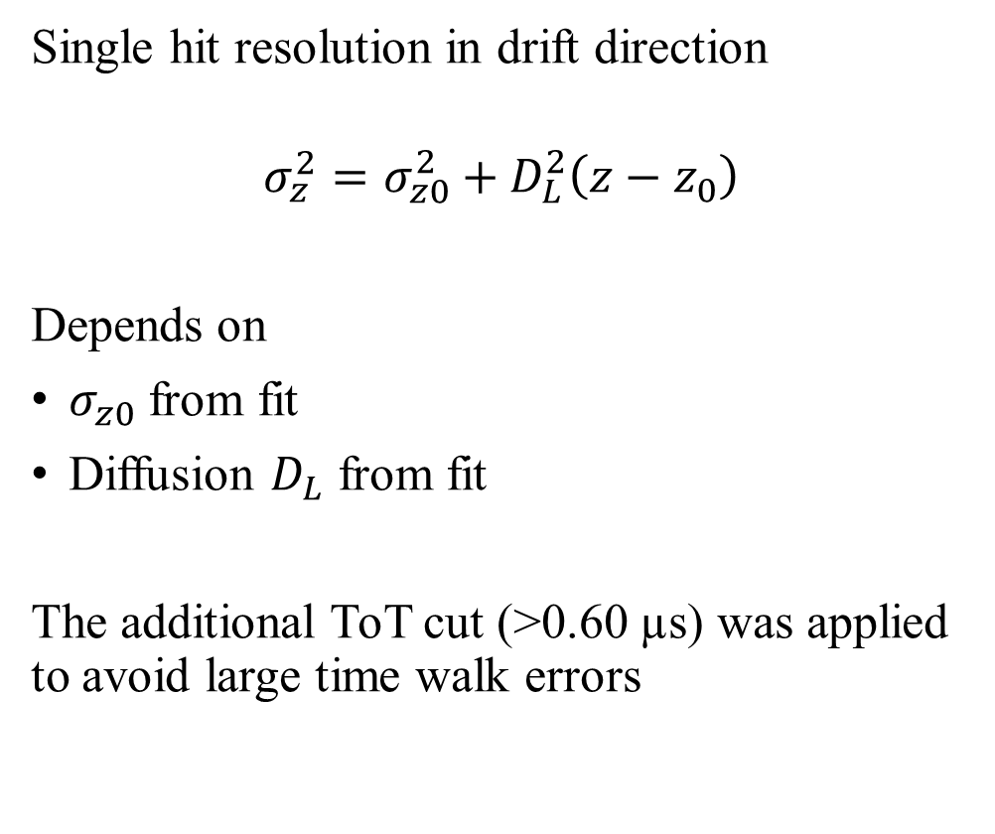
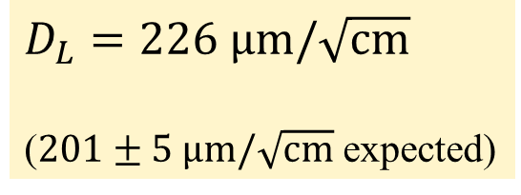
Single hit resolution in longitudinal direction
Single hit resolution in longitudinal direction
Single hit resolution in drift direction
$$σ_{z}^{2}=σ_{z0}^{2}+D_{L}^{2}\left(z−z_{0}\right)$$
Depends on
$σ_{z0}$ from fit
Diffusion $D_{L}$ from fit
The additional ToT cut (>0.60 µs) was applied to avoid large time walk errors
B$=0$ T
$D_{L}=226 \text{μm}/\sqrt{\text{cm}}$
($201±5 \text{μm}/\sqrt{\text{cm}}$ expected)

Slide 9
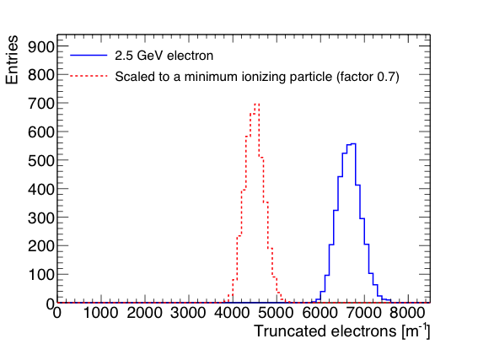
Pixel dE/dx performance
dE/dx resolution with truncated mean
  From the single chip tracks; 1 m long tracks are made;
  nr of electrons counted in slices of 20 pixel and reject 10% highest slices
  Distances along track are scaled by 1/0.7 to get an estimation for the dE/dx of a MIP
  Resolution is 4.1% for a 2.5 GeV electron and 4.9% for a MIP
Separation S = (N_{e} − N_{MIP})/σ_{e}
8σ MIP-e separation for a 1 meter track
A pixel readout can in principle within the resolution (diffusion) separate primary from secondary clusters. dE/dx can be measured by cluster counting and performance separation enhanced.

Slide 10
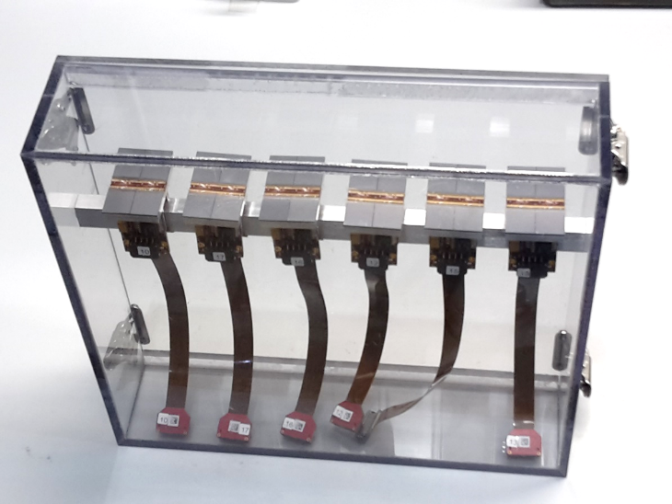
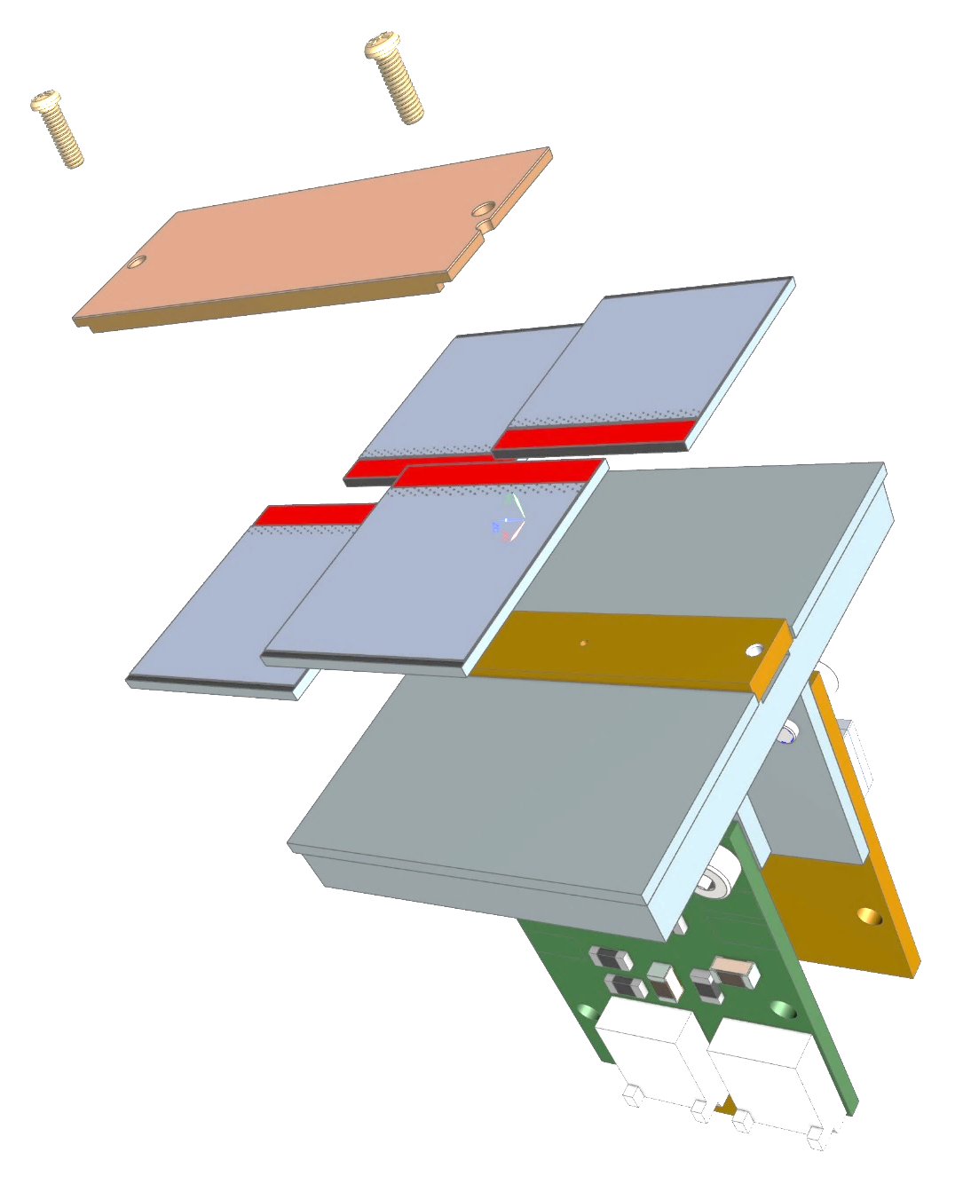
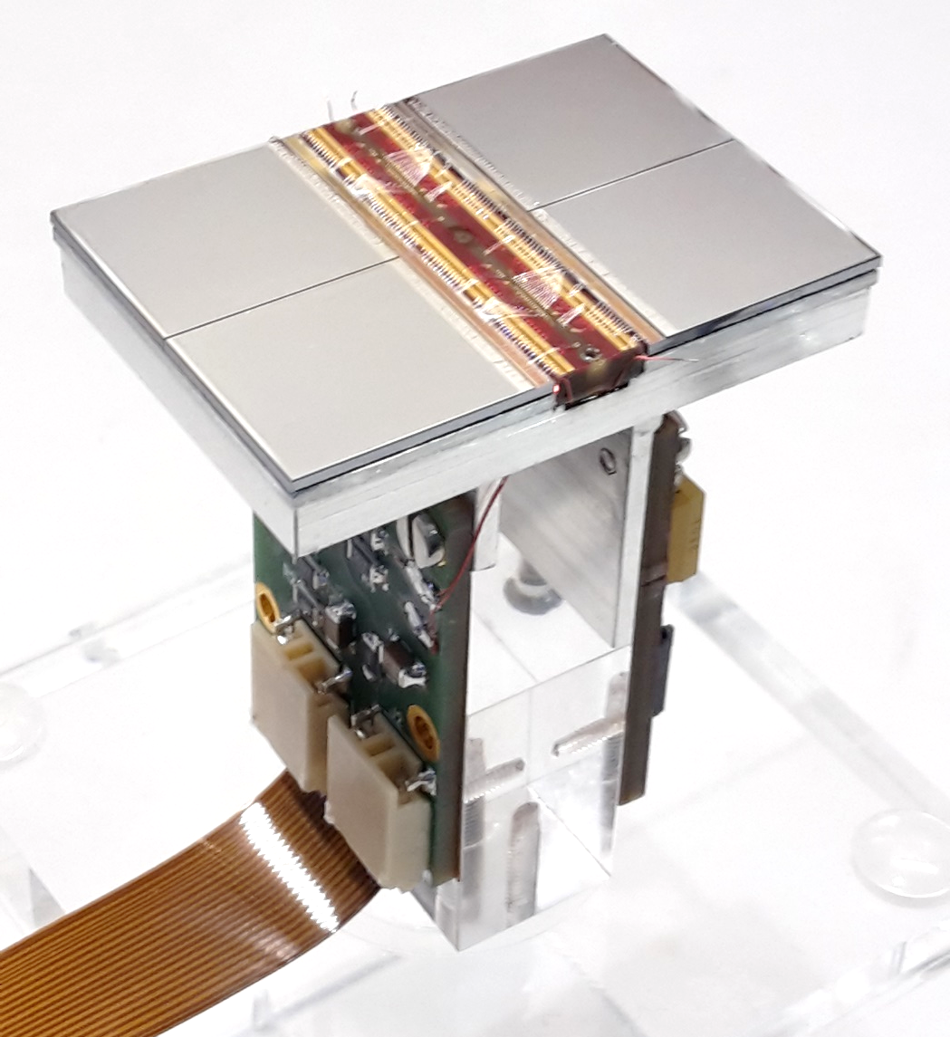
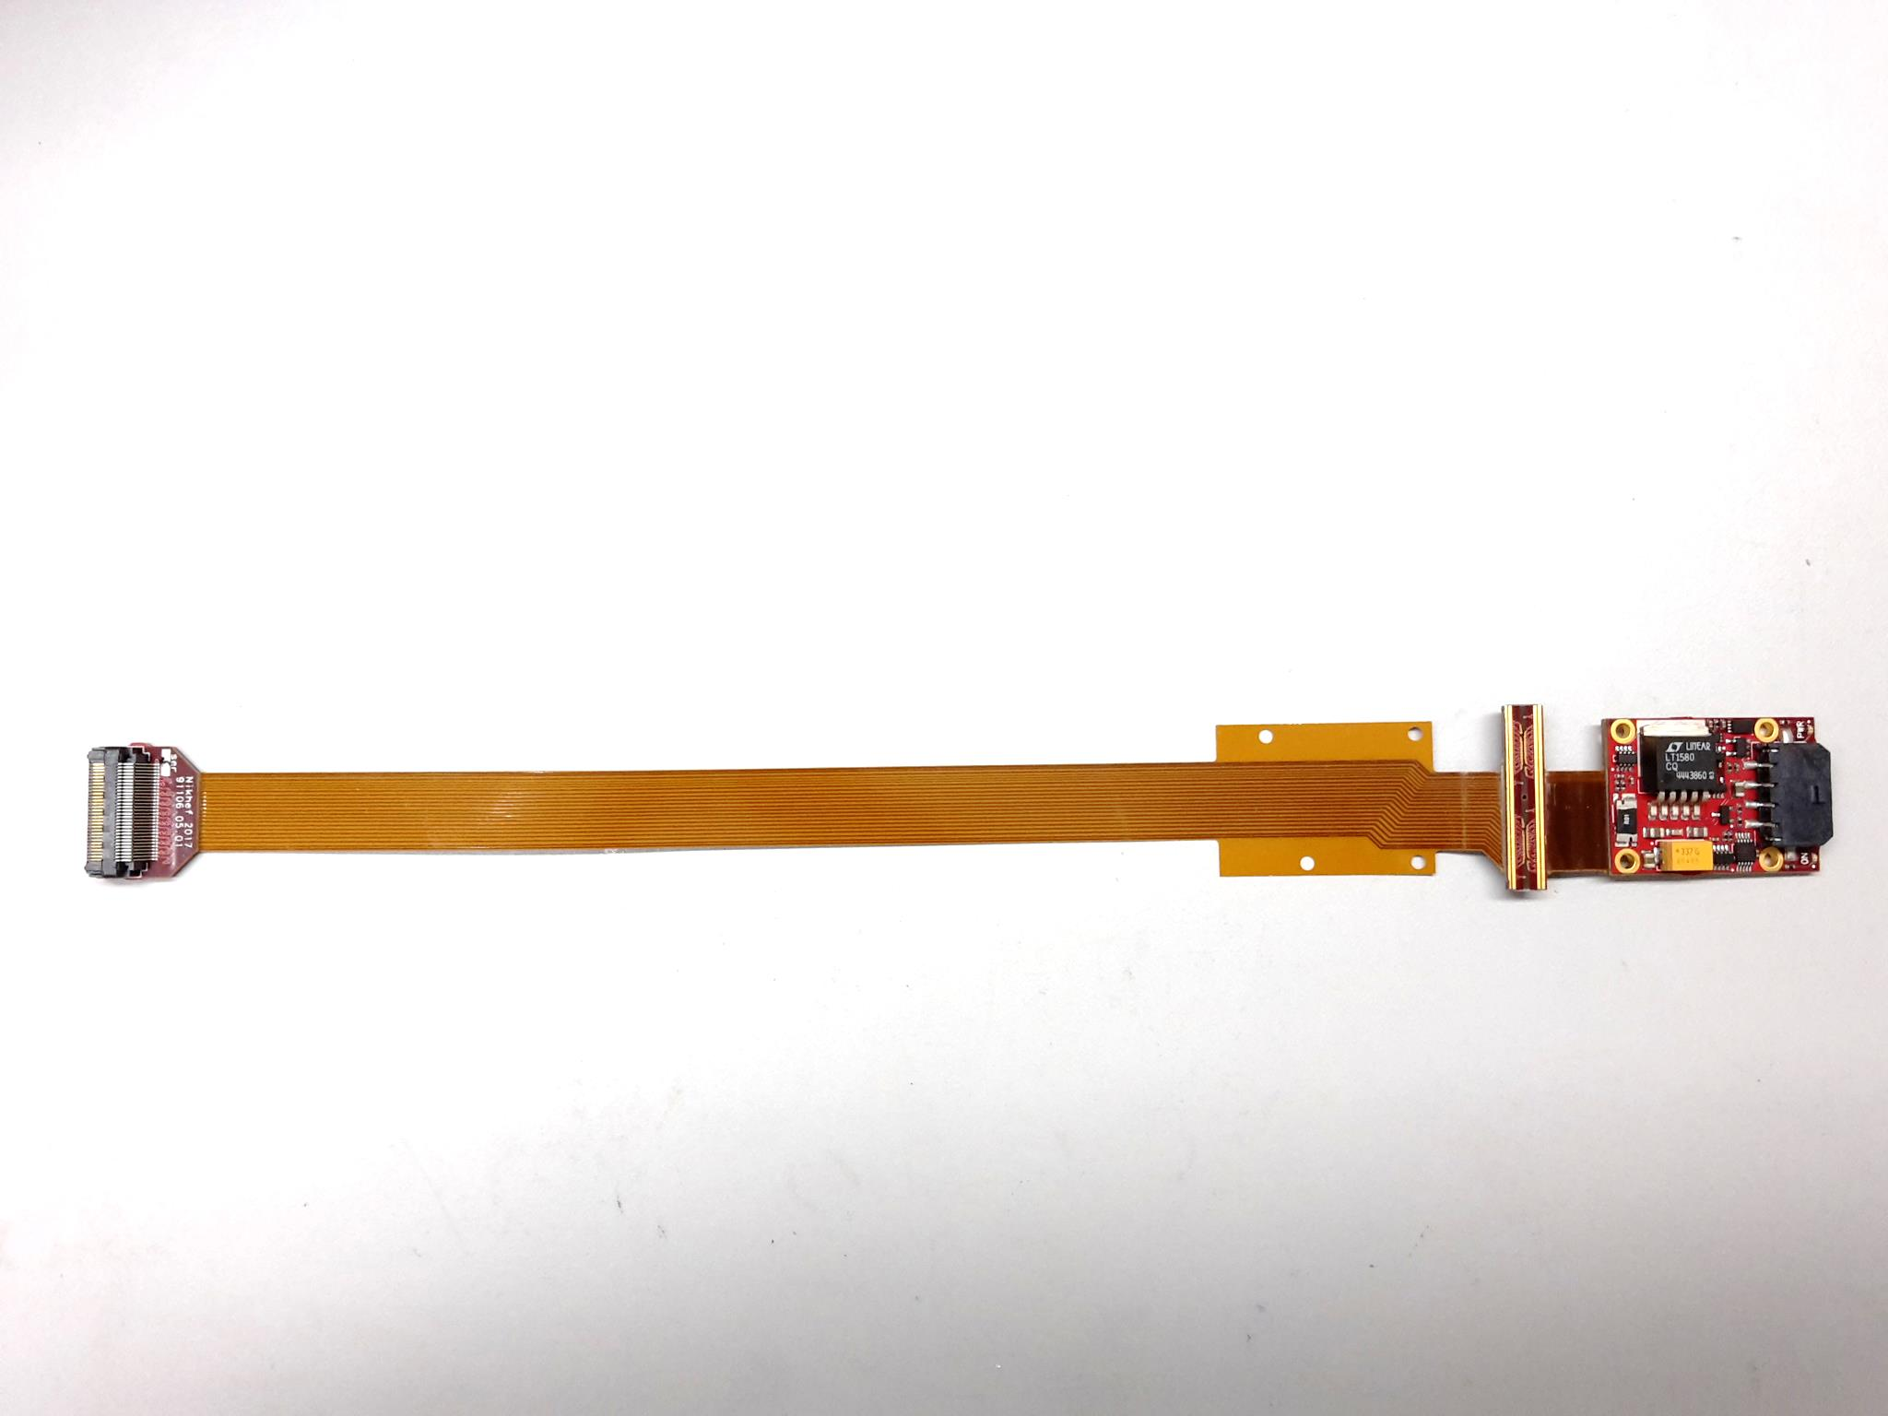
QUAD design and realization
Four-TimePix3 chips
All services (signal IO, LV power) are located under the detection surface
The area for connections was squeezed to the minimum
Very high precision 10 μm mounting of the chips and guard
QUAD has a sensitive area of 68.9%
DAQ by SPIDR
39.6 x 28.38 mm
series of QUADs
Guard
TPX3
TPX3
TPX3
TPX3
COld
CArrier

Slide 11
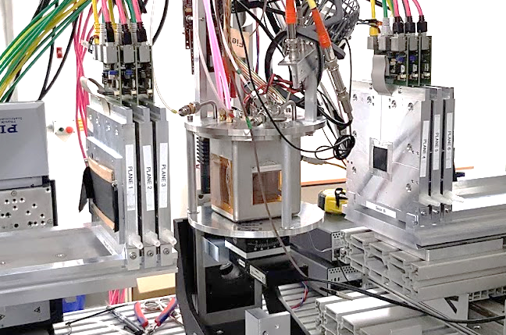
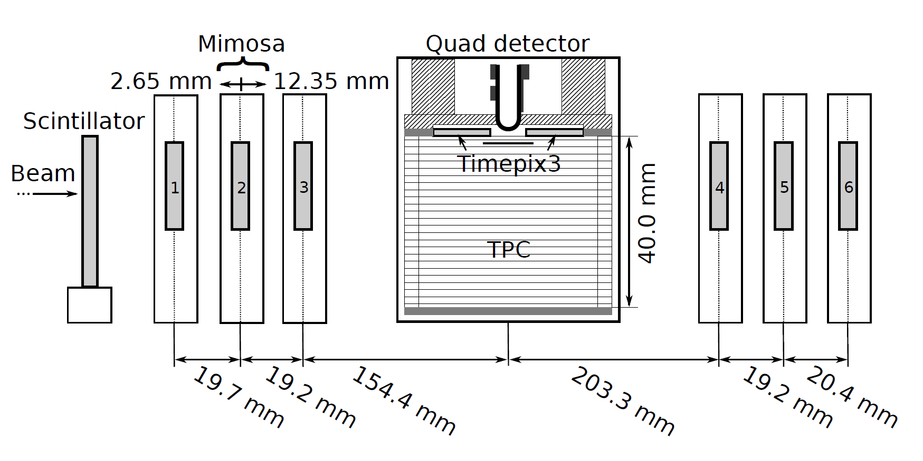
QUAD test beam in Bonn (October 2018)
ELSA: 2.5 GeV electrons
Tracks referenced by Mimosa telescope
QUAD sandwiched between Mimosa planes
  Largely improved track definition
  6 planes with 18.4 μm × 18.4 μm sized pixels
Gas: Ar/CF₄/iC₄H₁₀ 95/3/2 (T2K)
E_{d} = 400 V/cm, V_{grid} = -330 V
Typical beam height above the chip: ~1 cm
Published NIMA https://doi.org/10.1016/j.nima.2019.163331
@Bonn
Field cage

Slide 12
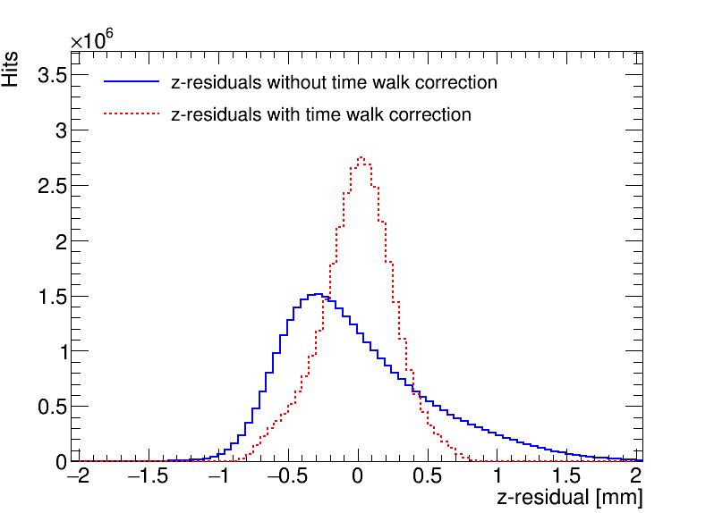
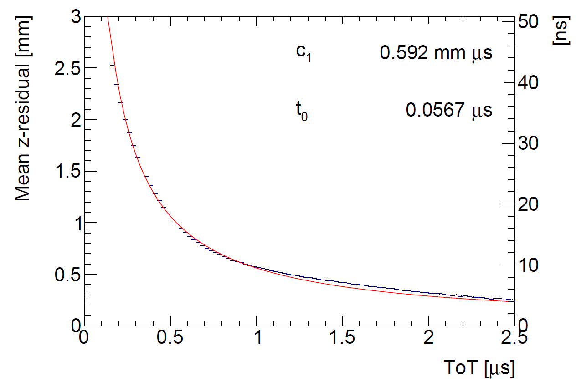
QUAD time walk results
Time walk correction works well
Applied for all analysis results

Slide 13
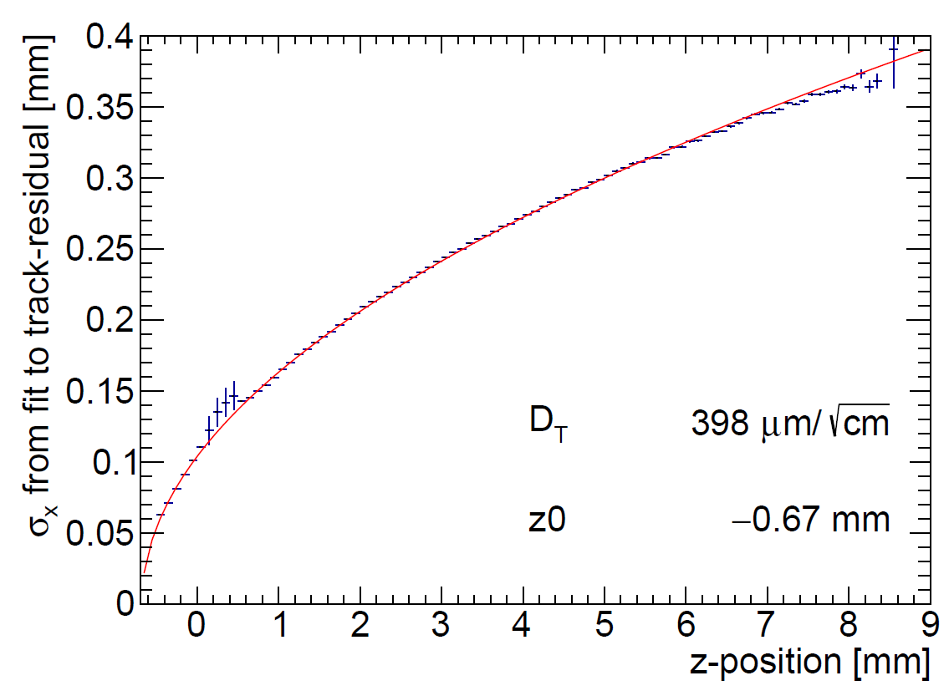
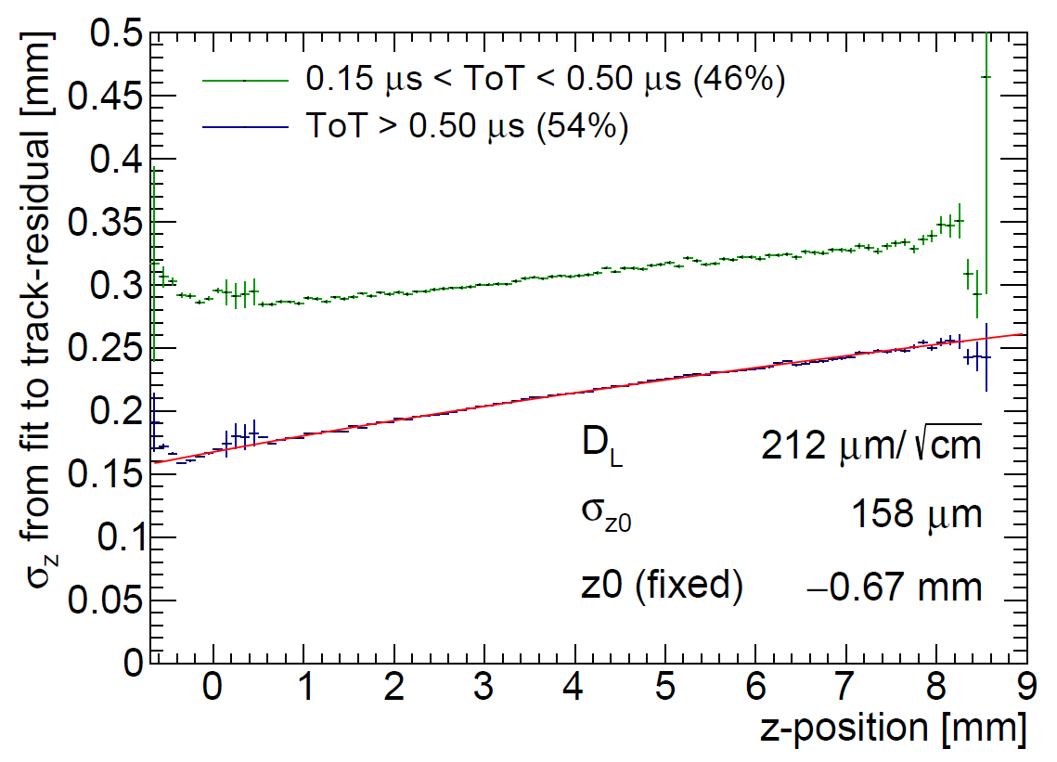
QUAD single hit resolution
Transverse
Longitudinal
D_{T} = 398 μm/√cm
D_{L} = 212 μm/√cm
The D_{T} value is rather high due to an error in the gas mixing (too low CF4)

Slide 14
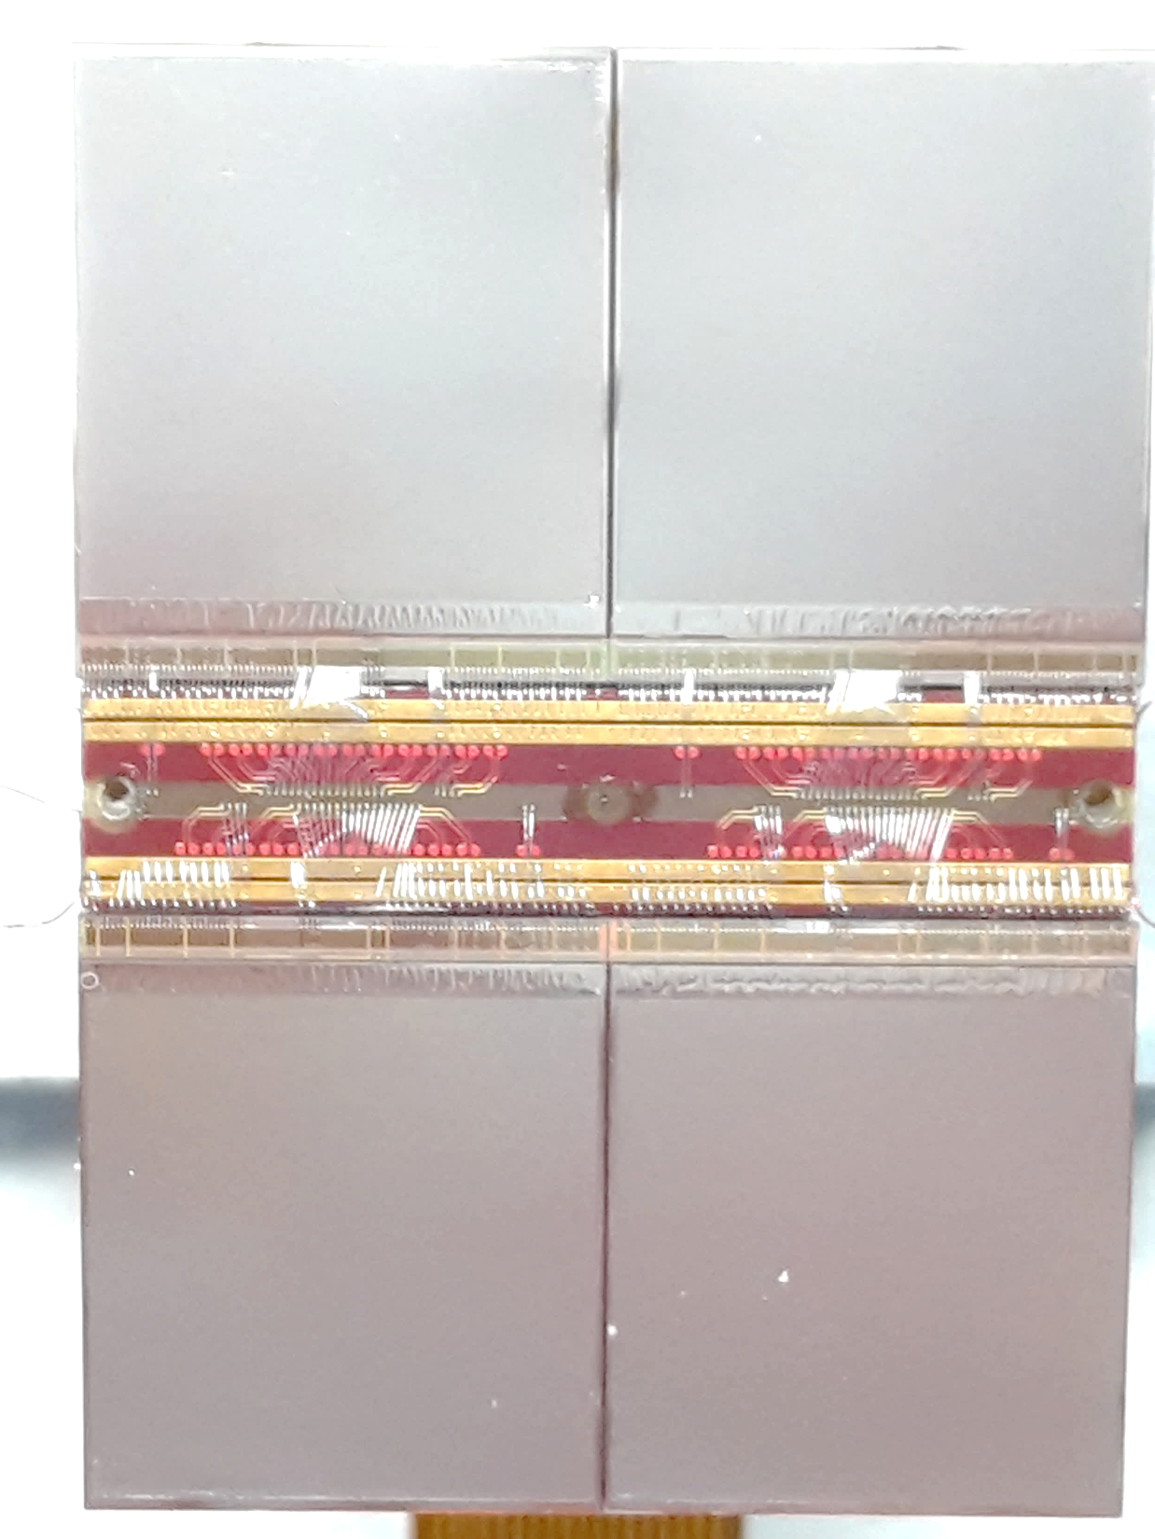
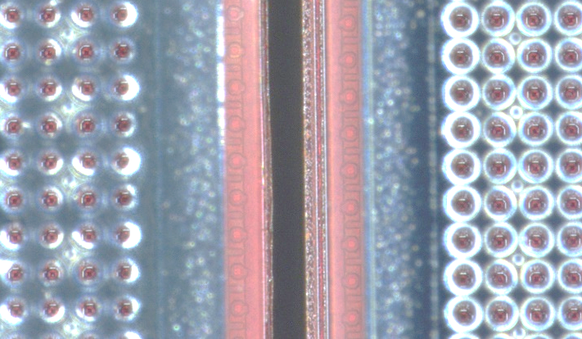
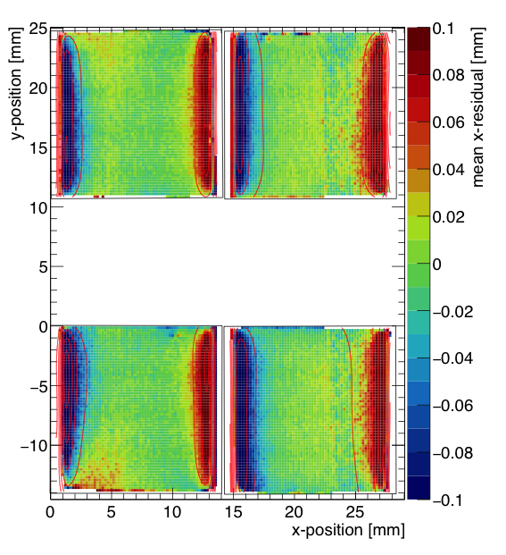
QUAD edge deformations (XY)
Small deformations due to
  Dead zone between chips
  Grounded region between chips
Are corrected by:
  fitted correction function
  adding proper guard wire electrode
Grounded region

Slide 15
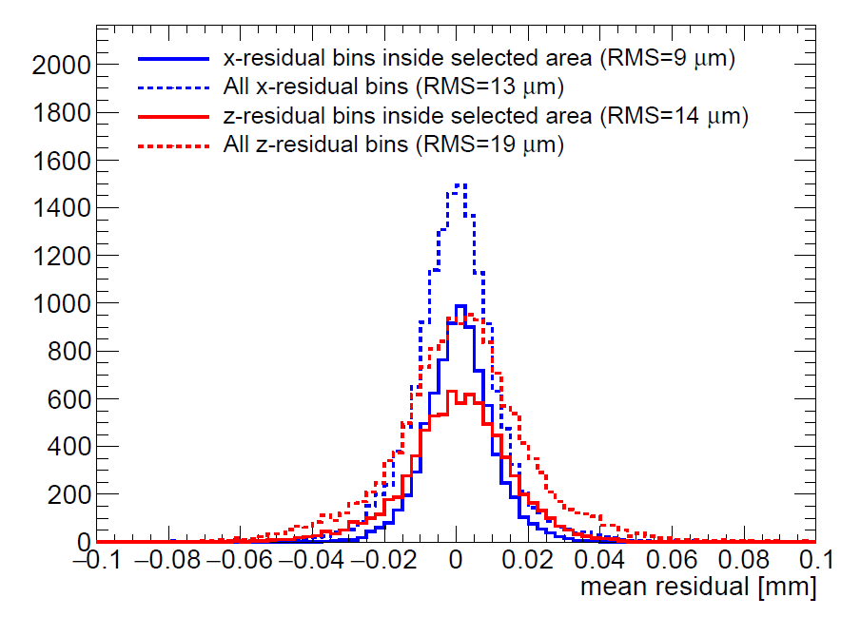
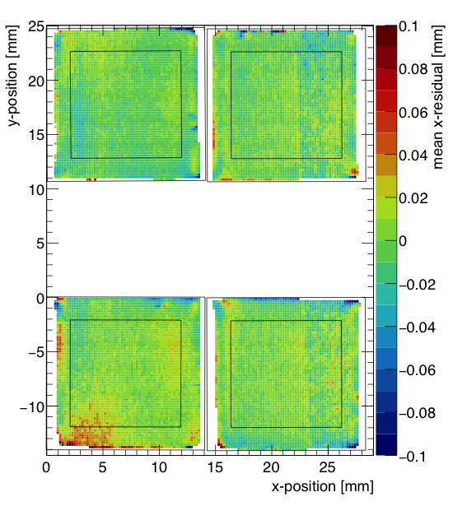
QUAD deformations in transverse plane (XY)
After applying fitted edge corrections
RMS of the mean residuals are 13 μm over the whole QUAD
XY

Slide 16
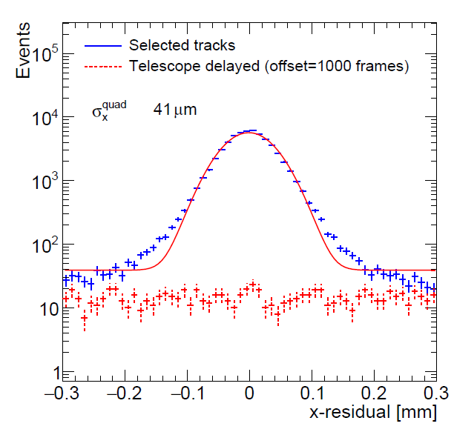
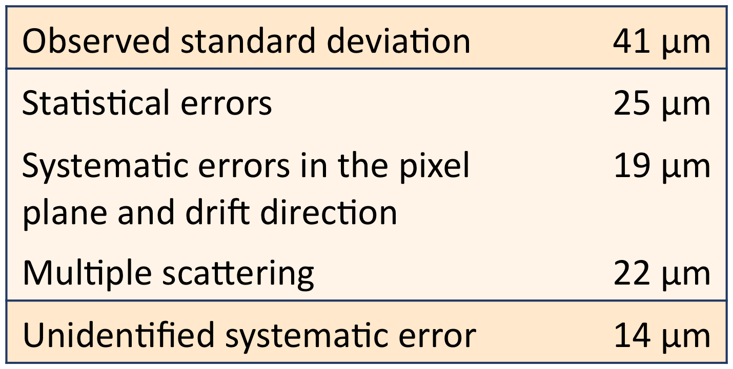
Combined resolution (XY) of a QUAD
Below a breakdown of the uncertainties and sources is given
The observed resolution can be understood if an additional contribution of 14 μm is added
XY

Slide 17
Next: QUAD as a building block
8-QUAD module with field cage
in red guard wires

Slide 18
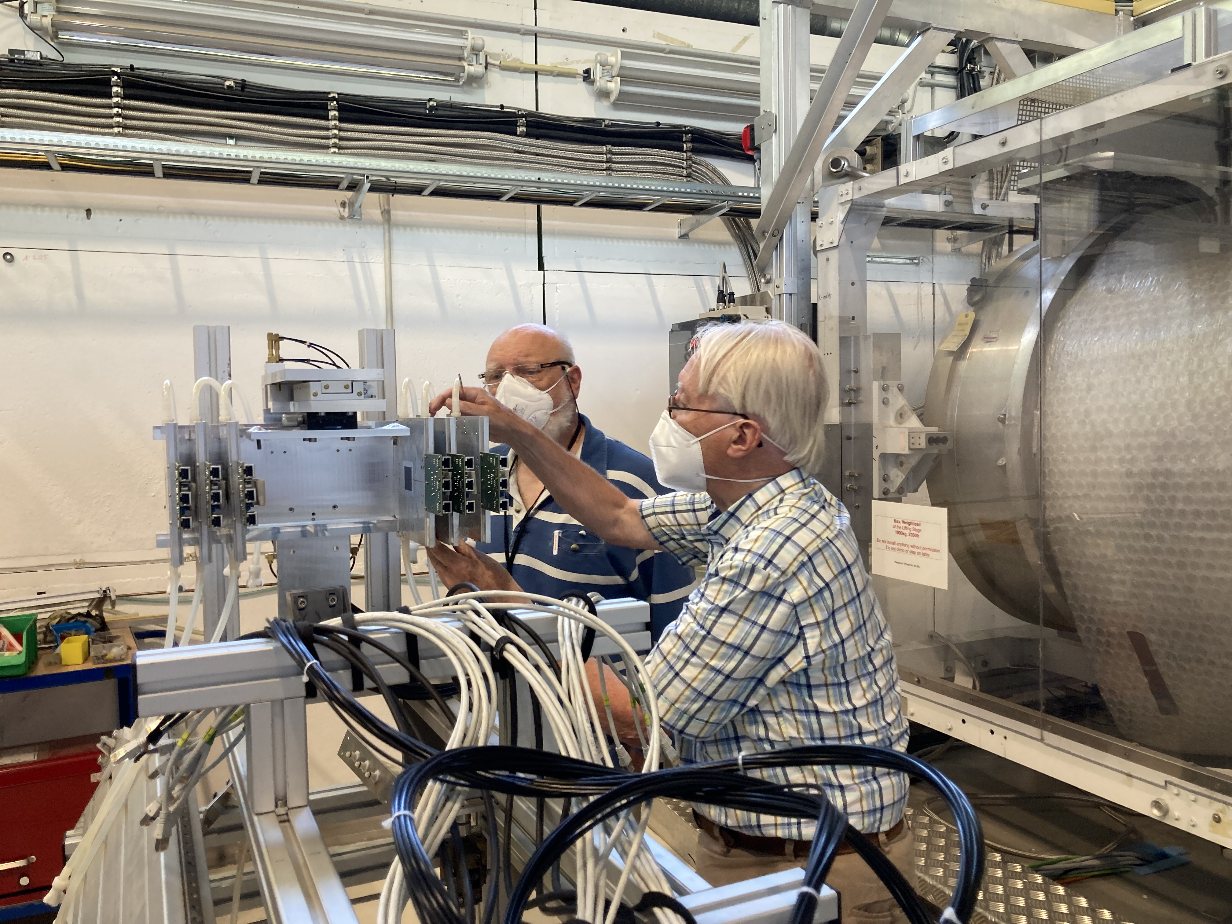
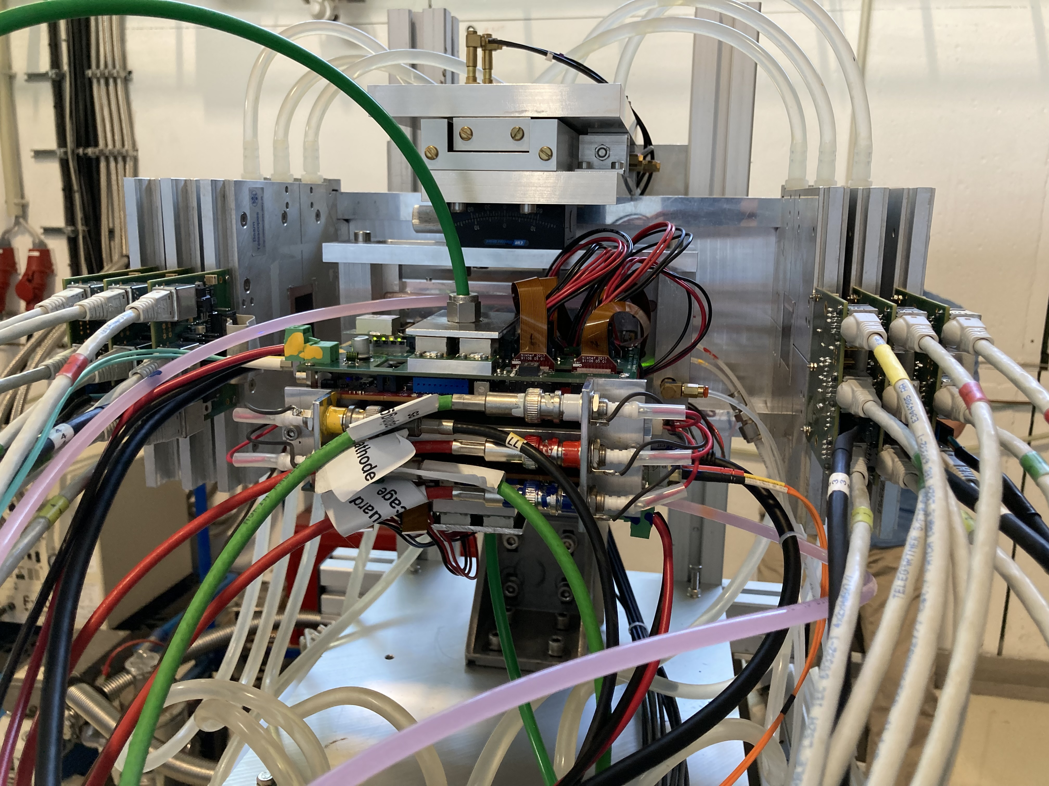
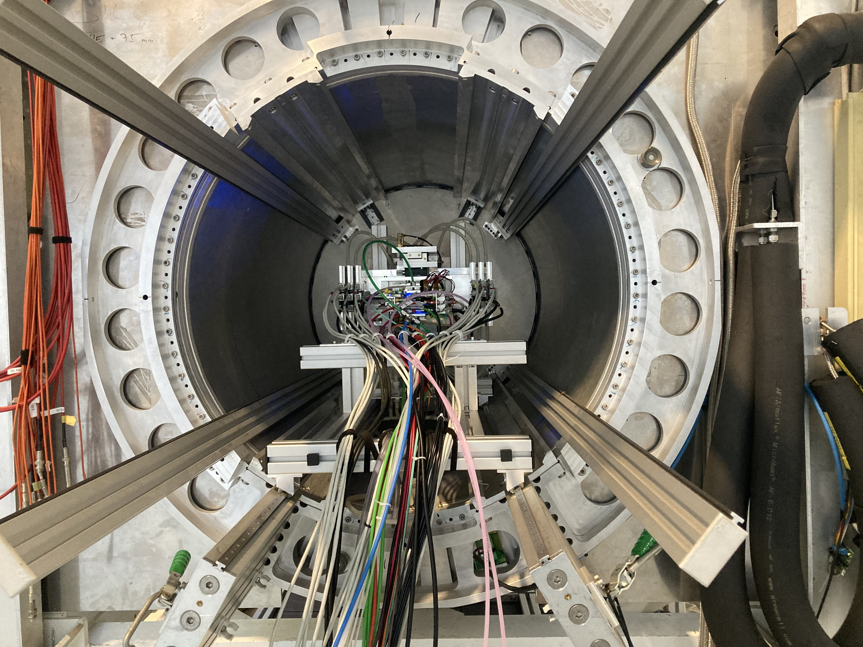
DESY testbeam June 2021
Mounting the 8 quad module between the silicon planes
sliding it into the 1 T PCMAG solenoid

Slide 19
DESY testbeam June 2021

Slide 20
DESY testbeam June 2021

Slide 21
DESY testbeam and double grid idea
High statistics data taken with different B fields
The Silicon telescope has been aligned and gives excellent track predictions
A beautiful data set and we look forward to study resolutions and deformations
Opportunity to exploit particle identification with dE/dx
The ion back flow IBF can be reduced significantly using a double grid to a value of IBF*Gain < 1 (see backup slides)

Slide 22
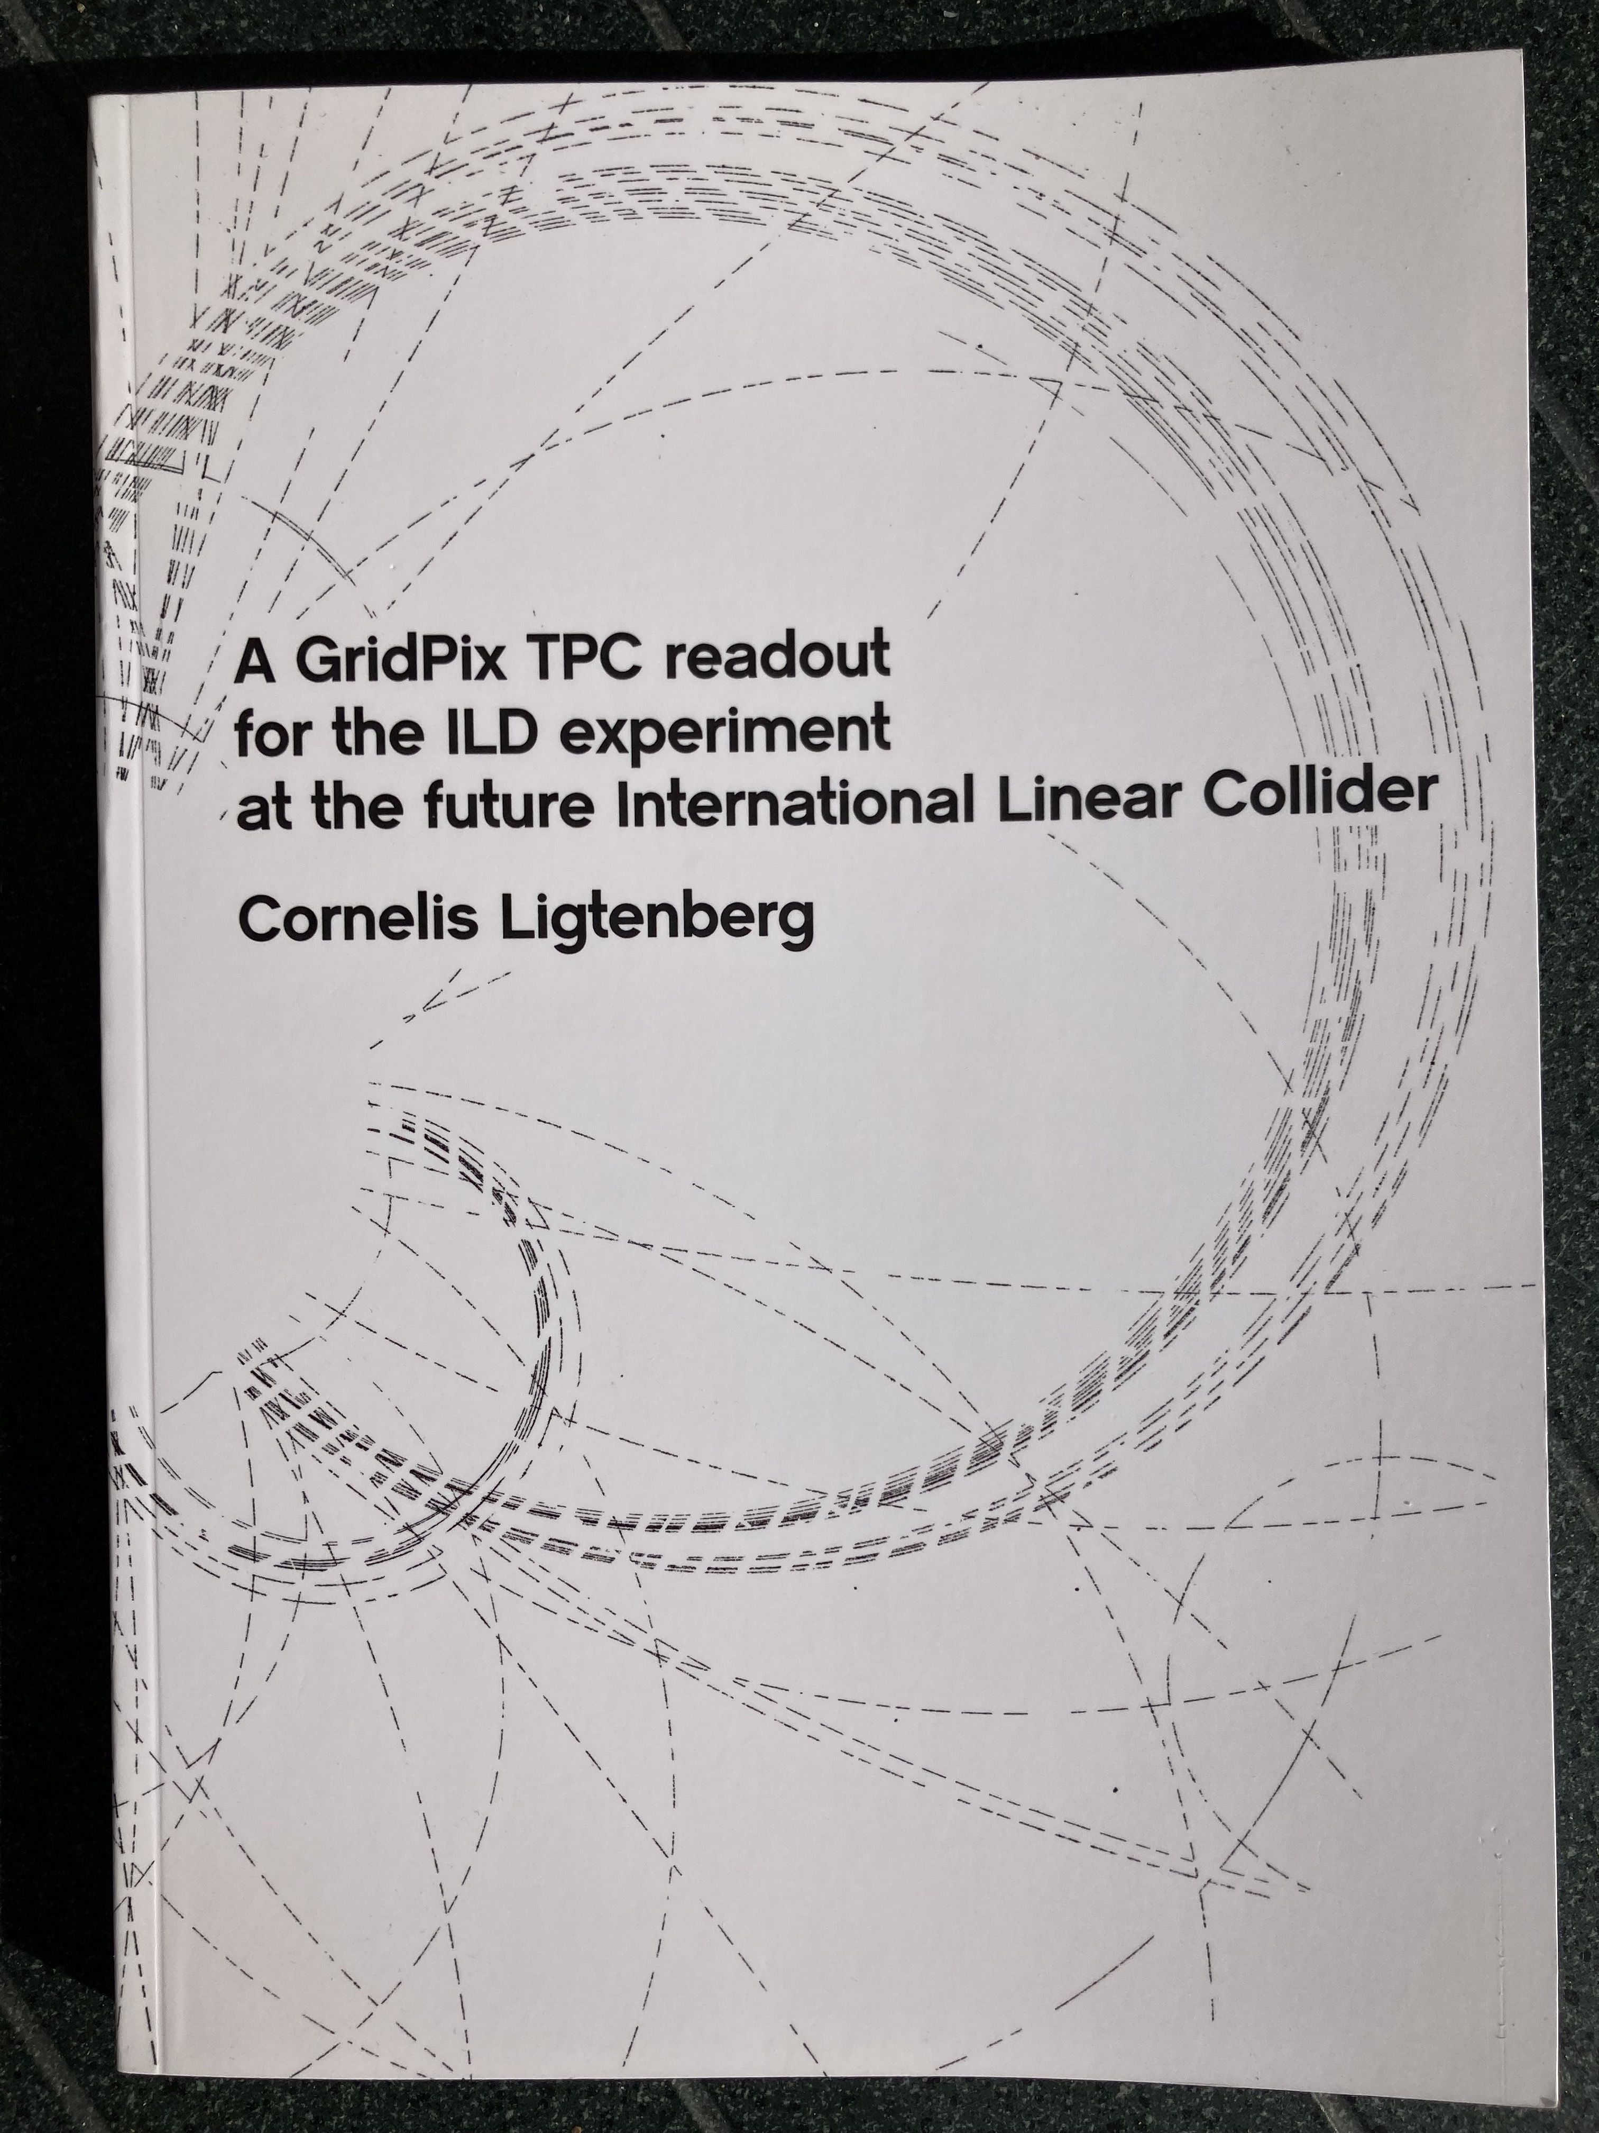
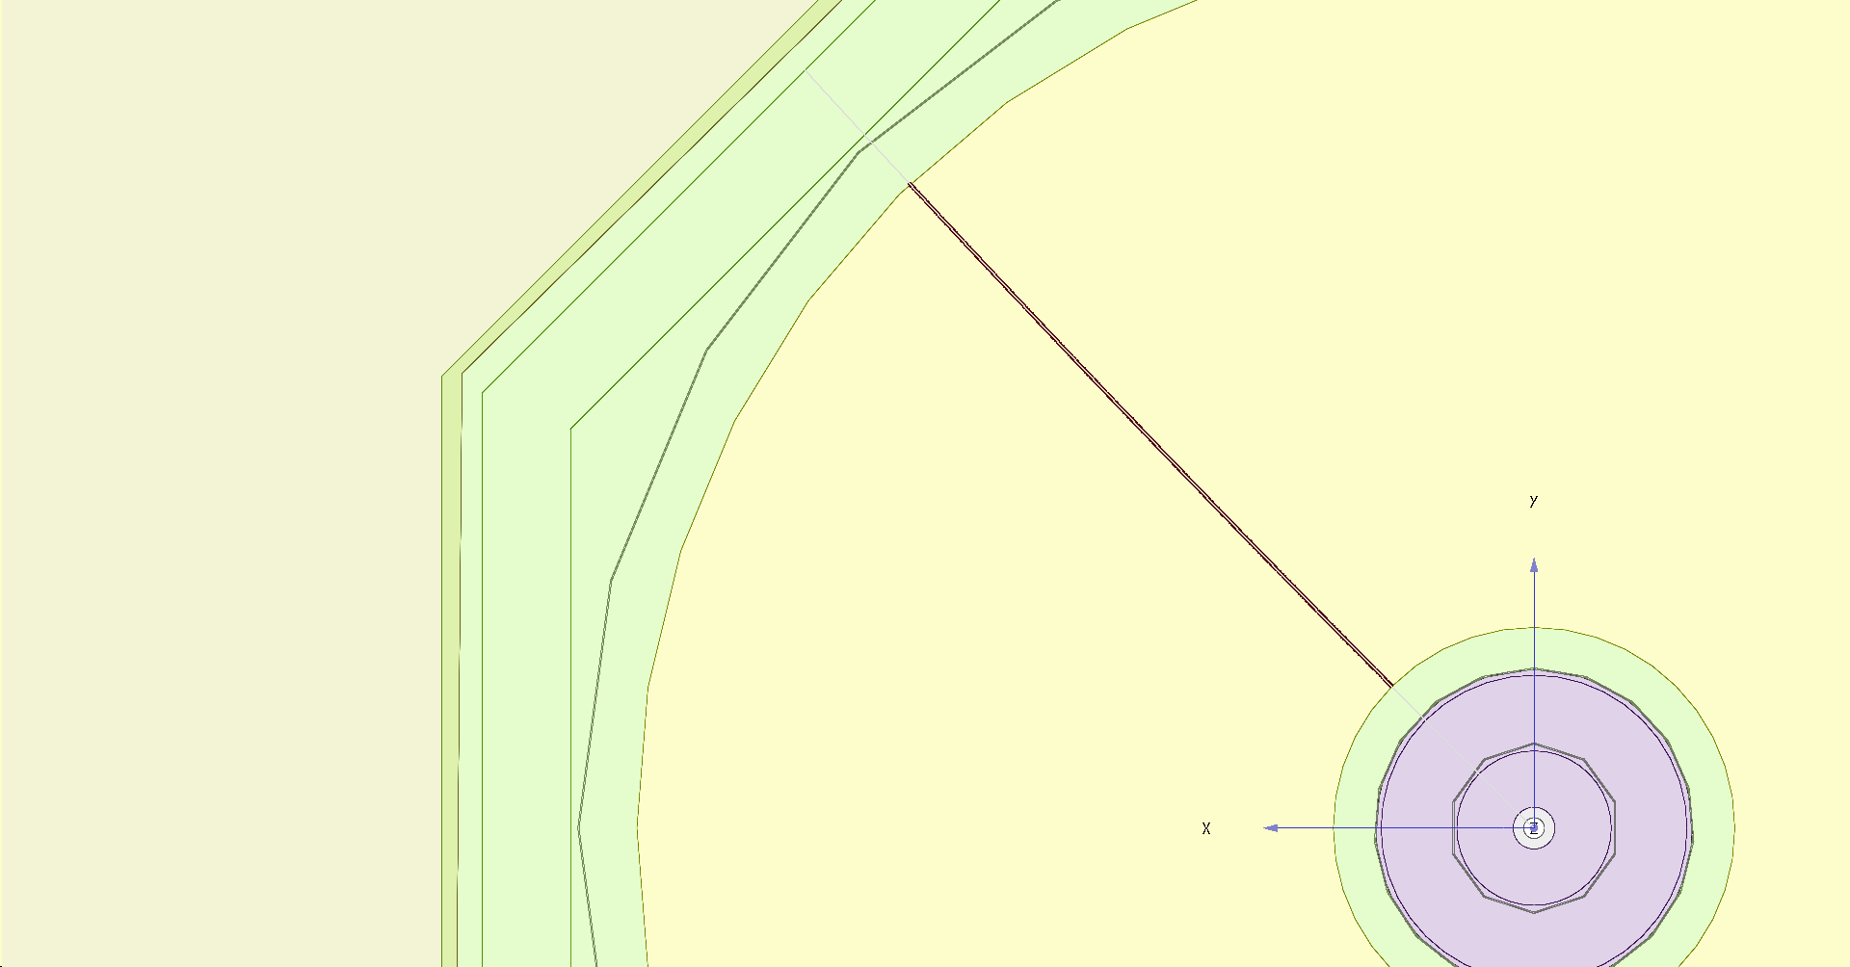




Simulation of ILD TPC with pixel readout
To study the performance of a large pixelized TPC, the pixel readout was implemented in the full ILD DD4HEP (Geant4) simulation
Changed the existing TPC pad readout to a pixel readout
Adapted Kalman filter track reconstruction to pixels
PhD Kees Ligtenberg
https://www.nikhef.nl/pub/services/biblio/theses_pdf/thesis_C_Ligtenberg.pdf
pixels
pads
50 GeV muon track with
pixel readout

Slide 23


Performance of a GridPix TPC at ILC
From full simulation the momentum resolution can be determined
Momentum resolution is about 15% better for the pixels with realistic coverage (with the quads arranged in modules 59%) and deltas.

Slide 24
Conclusions
A single chip GridPix detector was reliably operated in a test beam in 2017
  Single electron detection => the resolution is primarily limited by diffusion
  Systematic uncertainties are low: < 10 µm in the pixel xy plane
  dE/dx resolution for a 1 m track is 4.1%
  A Quad detector was designed and the results from the 2018 test beam presented
  Small edge deformations at the boundary between two chips are observed
    added guard wires to the module to obtain a homogeneous field
    After correcting the edges, deformations in the transverse plane shown to be < 15 µm
An 8-Quad module has been designed with guard wires
  Deformations in the transverse plane for one quad are shown to be < 15 µm
Test beam data taken at DESY are being analysed
A pixel TPC has become a realistic viable option for experiments
  High precision tracking in the transverse and longitudinal planes, dE/dx by electron and cluster counting, excellent two track resolution, digital readout that can deal with high rates

Slide 25



Single chip deformations
The RMS of the mean residuals is 7 μm in the pixel plane and 21 μm (0.3 ns) in the drift direction in the selected region
XY
Z
How can we make an even better detector?
  Improve the quality (homogenity) of the InGrid; redesign the dike and edges
  Go to a large areas keeping the field distortions (at edges) minimal -> QUAD

Slide 26

QUAD deformations in drift plane (Z)
After applying fitted edge corrections
RMS of the mean residuals are 19 μm over the whole QUAD
XY

Slide 27

8-quad module deformations
One of the quads inside the 8-quad modules has been measured using laser tracks
No edge corrections are applied
The result is encouraging; the guard wires that run over the quad edges define a homogeneous field
The RMS in the large rectangular area (near the edges) is only 14 μm
Current plan is to do a test beam at DESY and Bonn as soon as all 8-quads can be read out simultaneously
Preliminary

Slide 28
Design of a double Grid
Drift region
Second Grid
here
250 μm
Intermediate Field
GridPix
50 μm
High field

Slide 29
Ion backflow for a double grid
Here calculations for the IBF of the two grids in case one has a total Field Ratio FR of about 240 – normal GridPix operation.
For the simulations the FR of the top grid was put at 16. The lower Grid(Pix) was at FR 16 too. Total FR 256.
In order to reach IBF*Gain(2 10³) below one has to choose a slightly
smaller hole size of 25 or 20 microns.
Ion backflow | Hole 30 μm | Hole 25 μm | Hole 20 μm
Top grid | 2.2% | 1.2% | 0.7%
GridPix | 5.5% | 2.8% | 1.7%
Total | 12 10⁻⁴ | 3 10⁻⁴ | 1 10⁻⁴
transparancy | 100% | 99.4% | 91.7%

