Slide 1
ILC 1.3 GHz CM. 2021
Design status on 10/28/21,
by Y. Orlov, behalf FNAL and KEK teams

Slide 2
Outline
1.3 GHz cavity
SC magnet
Cavity string
Cold mass
Cryogenic piping compare
1.3 GHz CM
Transportation
Interconnection

Slide 3
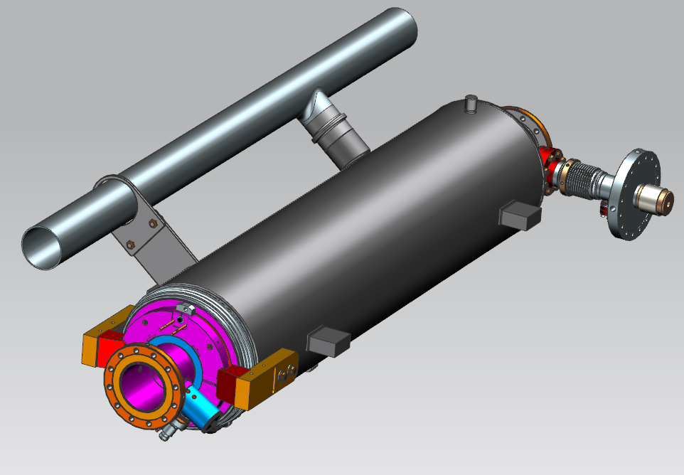
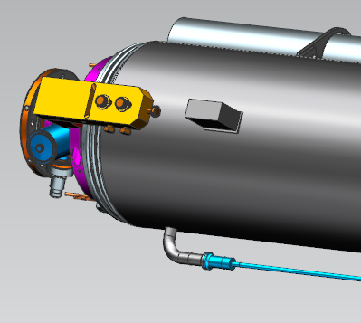
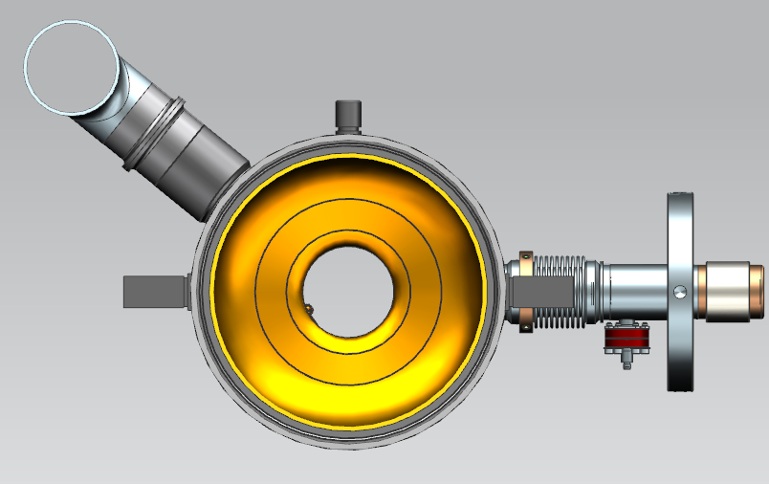
1.3 GHz ILC cavity (short-short)
SS
Ti-SS transition
9-cell cavity, TESLA style
1247.4mm, flange to flange
Support lugs - LCLS-II
He vessel material: Ti Gr2
2-phase pipe material: SS316L
Ti-SS transition joins used:
- warm up nozzle
- 2 phase pipe connection
Ti Gr2
342
24
Ti-SS transition
support lugs

Slide 4
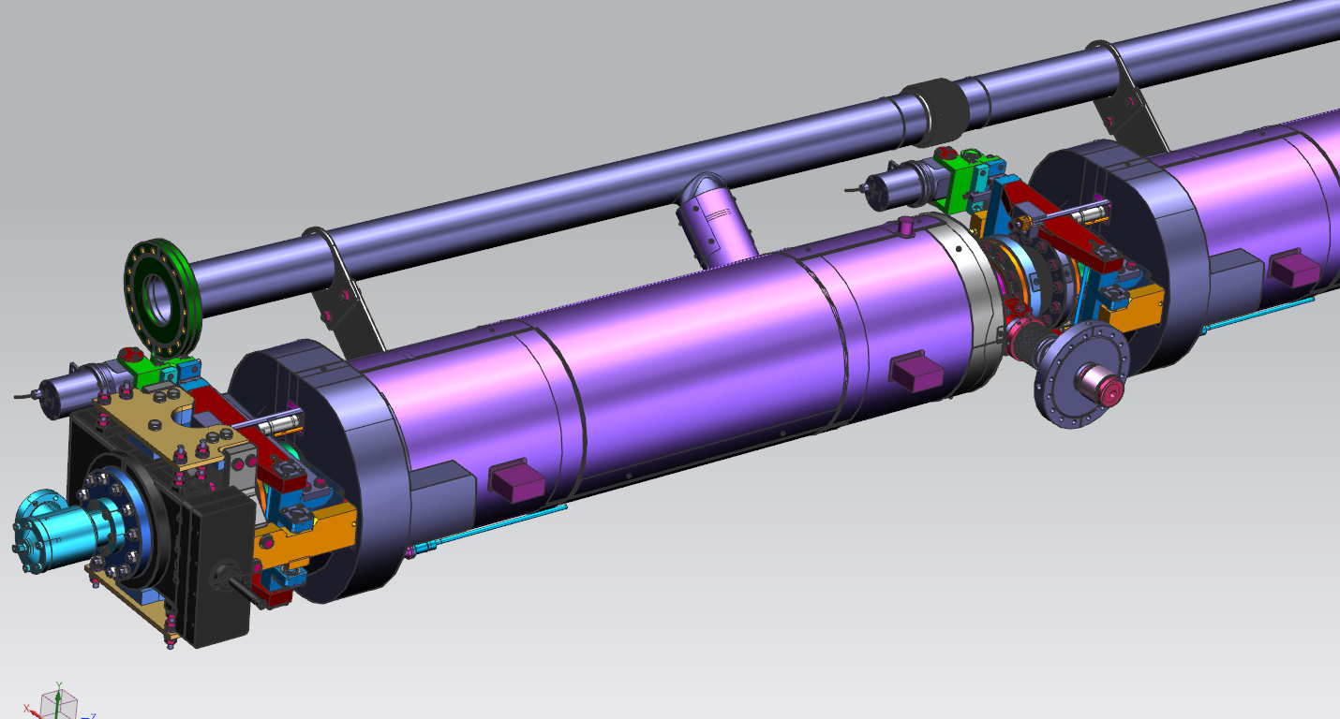
1.3 GHz cavity #1 (with tuner, magnetic shielding and GV)
LCLS-II style tuner will be used
  (cavity #1 – tuner with extended arms)
One-layer external magnetic shieled (LCLS-II style)

Slide 5
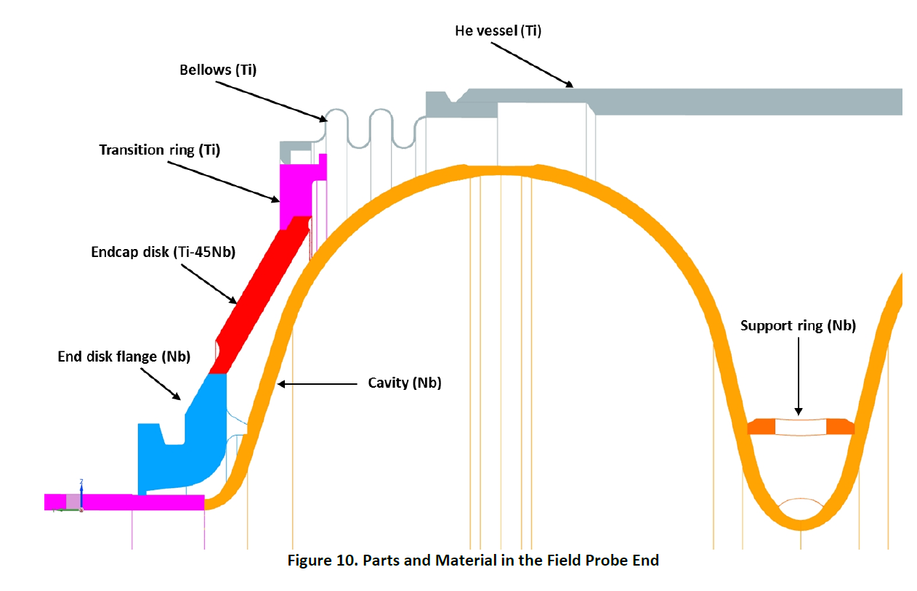
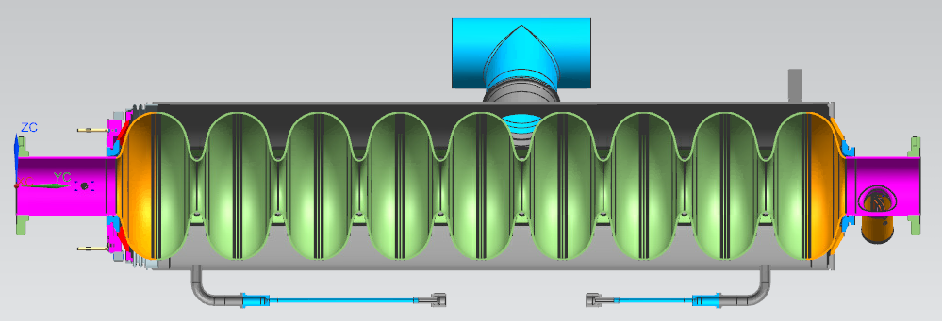
Bellows and Magnetic shield
Mag. Shield inside helium tank as suggested in TDR (KEK)
This cross-sectional view is confidential? KEK got from the FNAL document.
(From Kirk presentation)

Slide 6
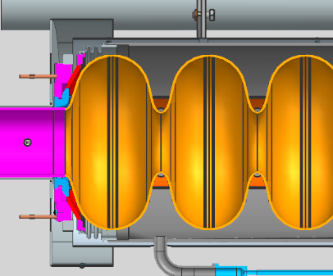
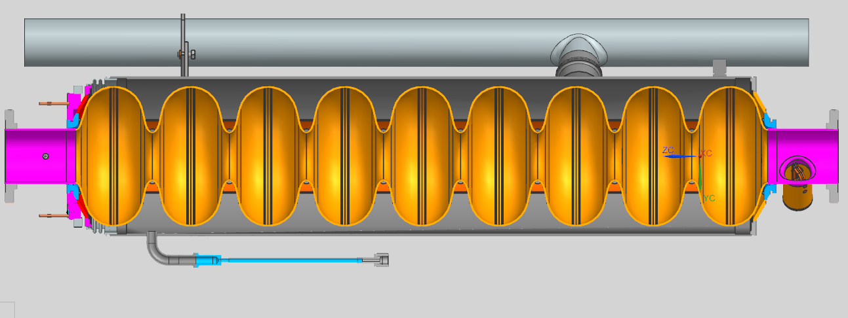
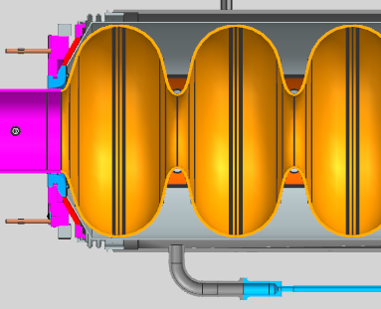
1.3GHz ILC Cavity with Mag shielding (for discussion)
External Mag. Shielding (LCLS II)
Internal Mag. Shielding (KEK)

Slide 7
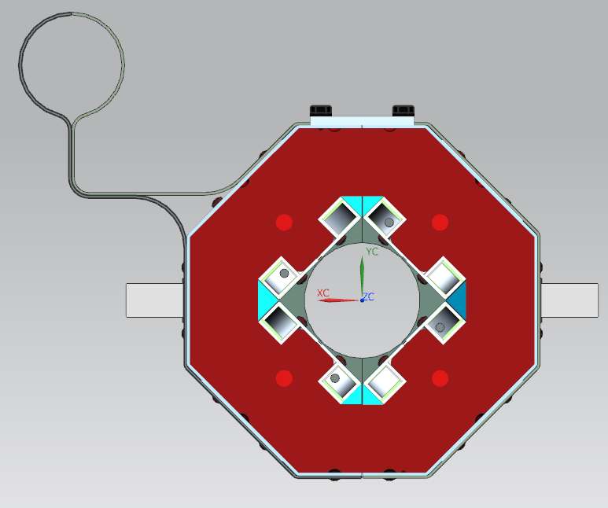
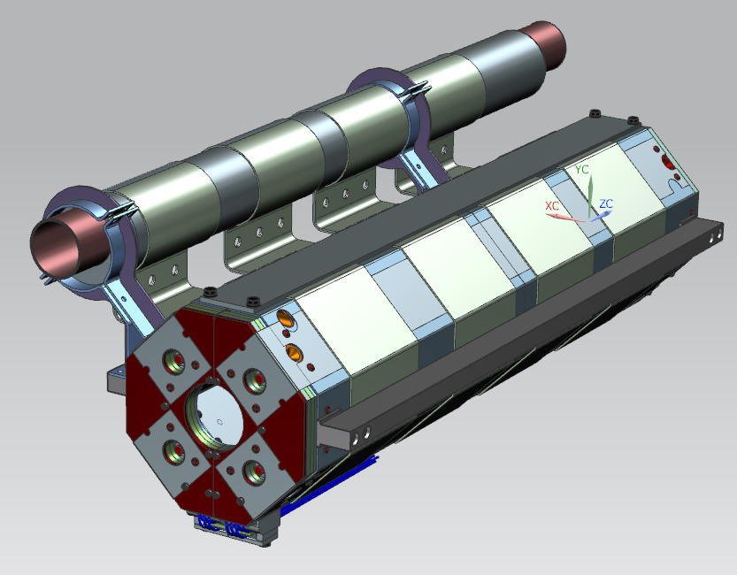
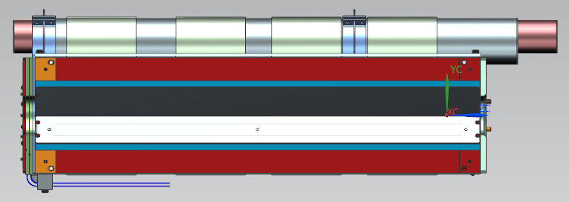
1.3 GHz ILC magnet
Al thermal straps
250
24
support rails
342
ILC conduction cooled splittable quad, ~1 m
Magnet 2-phase pipe have extra volume for He
Optional: Magnet 2phase pipe from Al (Al-SS transition?)
1000

Slide 8
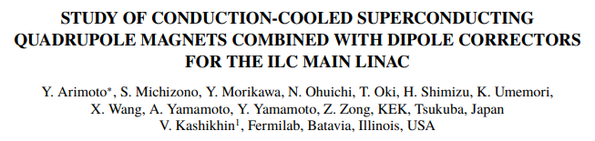
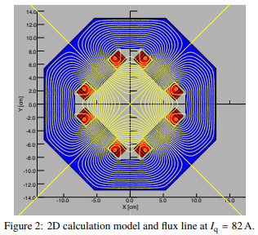
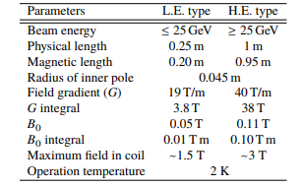
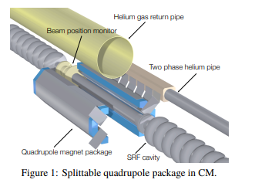
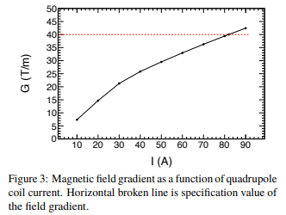
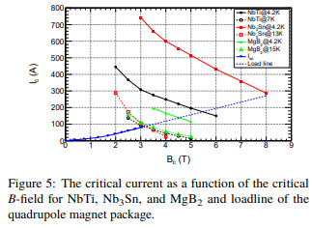
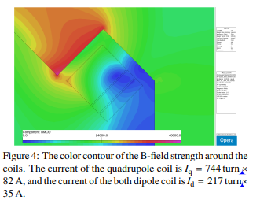
From IPAC2021 paper

Slide 9
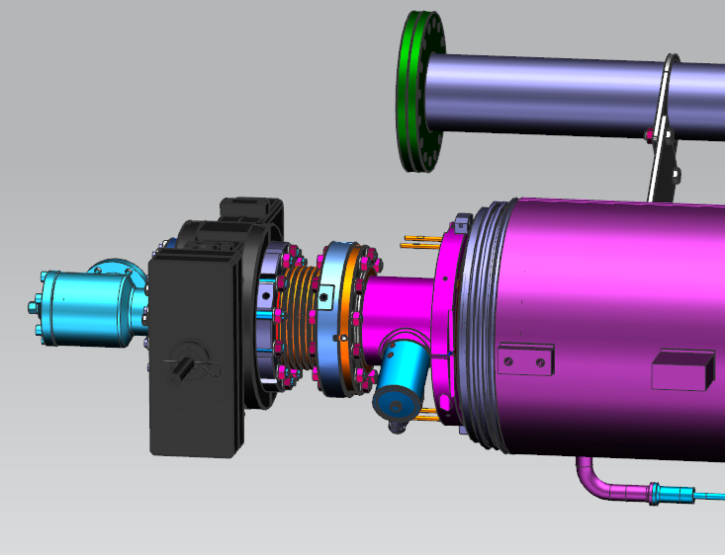
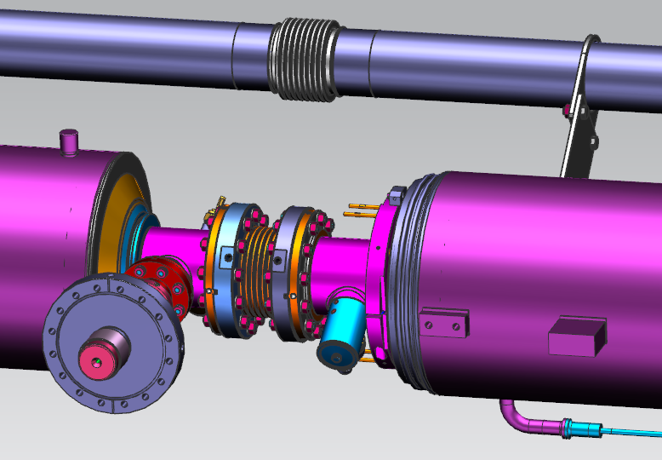
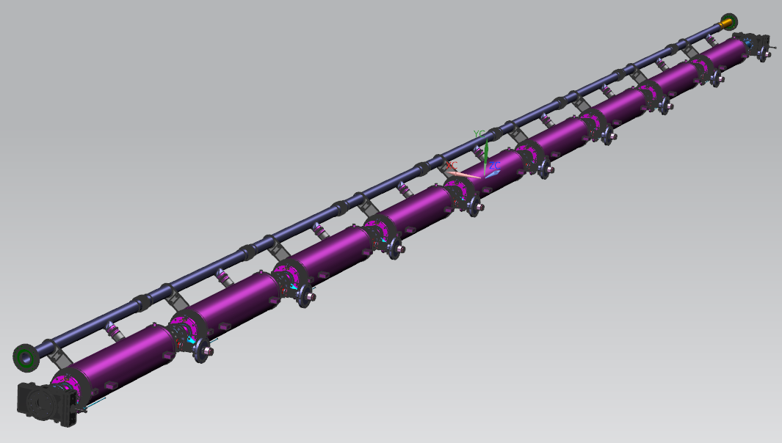
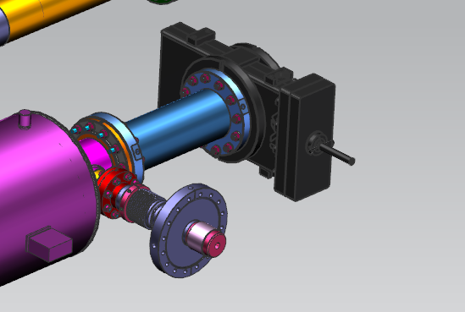
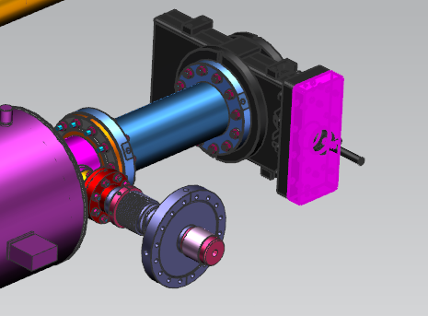
1.3 GHz cavity string-A
2 phase bellows
GV
BP bellows with
Al gaskets
DS GV with spool
GV

Slide 10
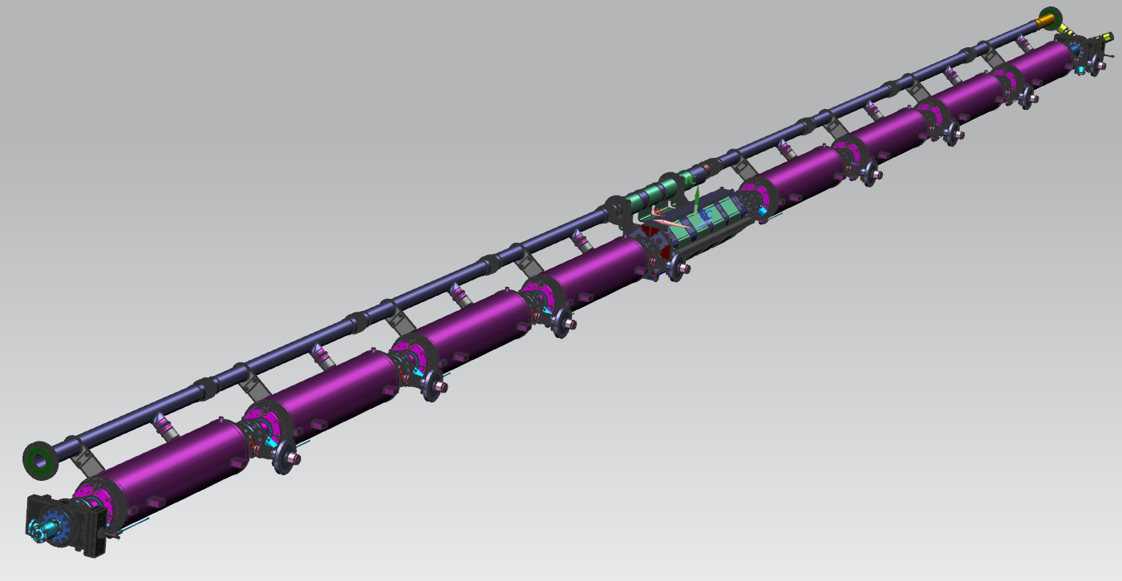
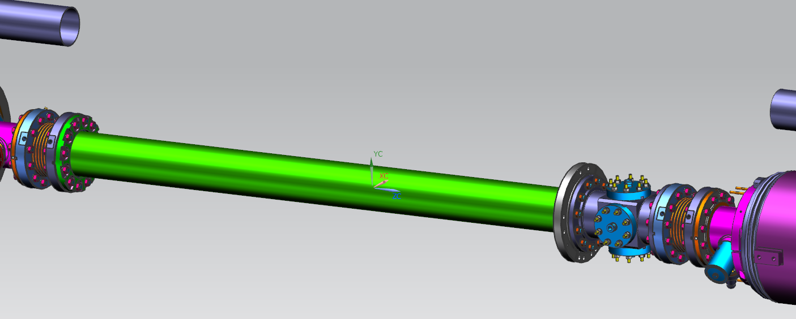
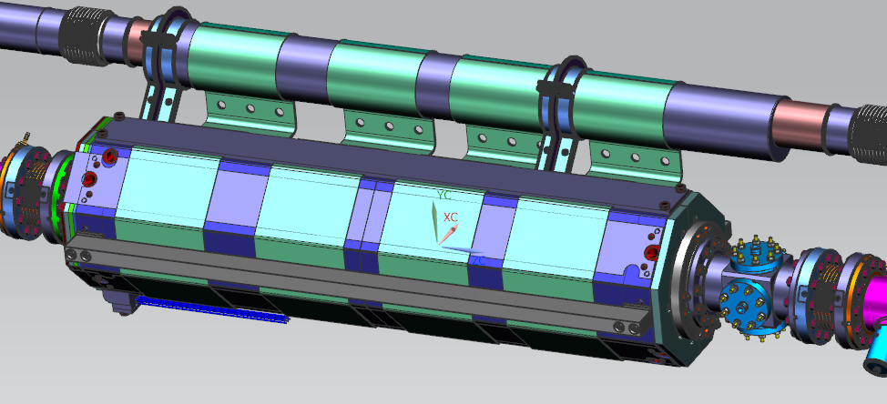
1.3 GHz cavity string-B
2 phase bellows
GV
BP bellows with
Al gaskets
magnet BP spool
GV
splittable SC magnet

Slide 11
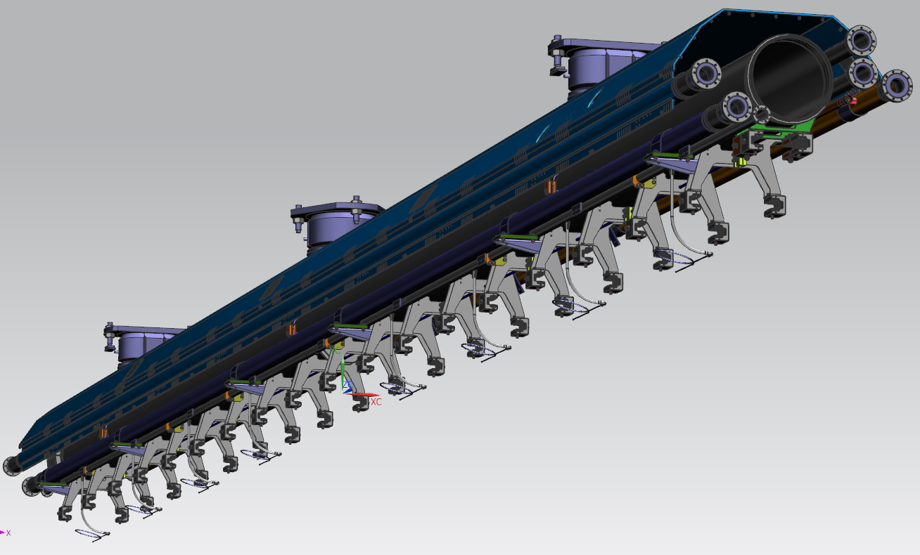
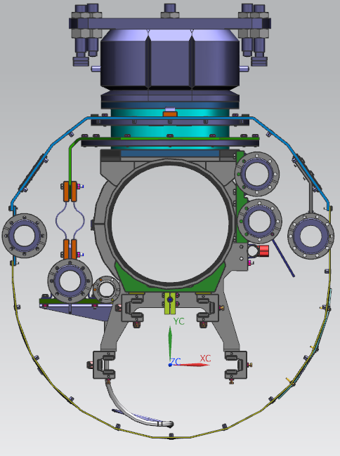
1.3 GHz cold mass upper
Invar rod
cavities/magnet
needle bearings
supports
Not shown
70 K lower thermal
shield

Slide 12
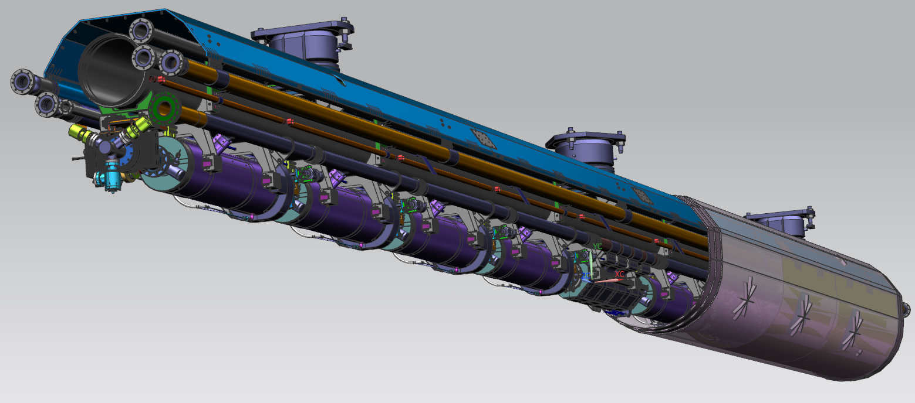
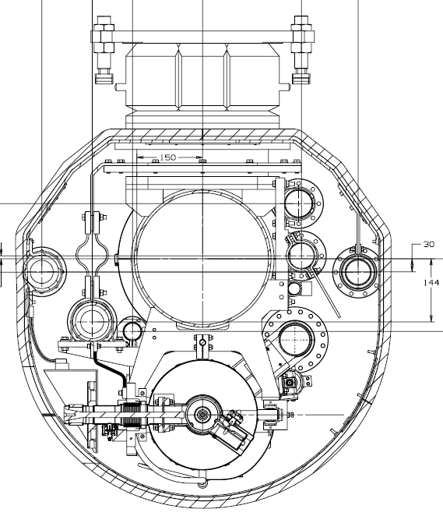
1.3 GHz cold mass – ILC
quad can be replaced with
a 1.3 GHz cavity
70 K thermal shield
70 K Insulation
All cryogenic piping and
Cavities He Vessels are wrapped
With 10 layers of MLI
5K&70K thermal intercepts

Slide 13
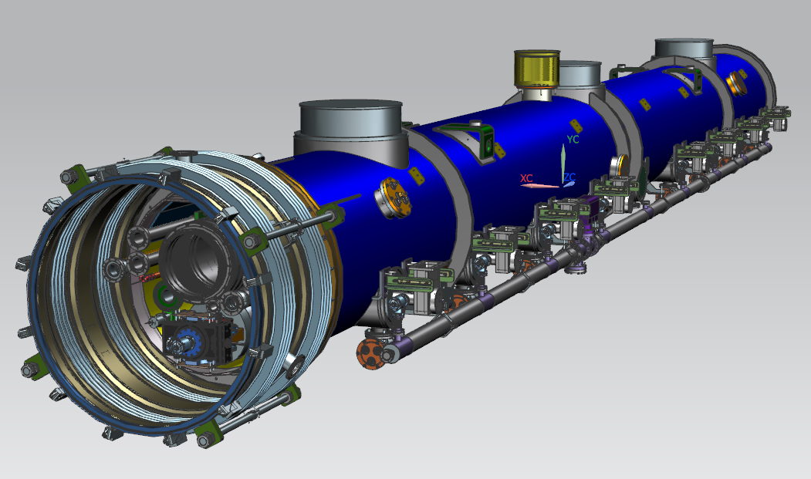
1.3 GHz ILC CM-B
1.3 GHz ILC-2021, is the next generation of:
1.3 GHz T4CM + 1.3 GHz XFEL + 1.3 GHz LCLS-II

Slide 14
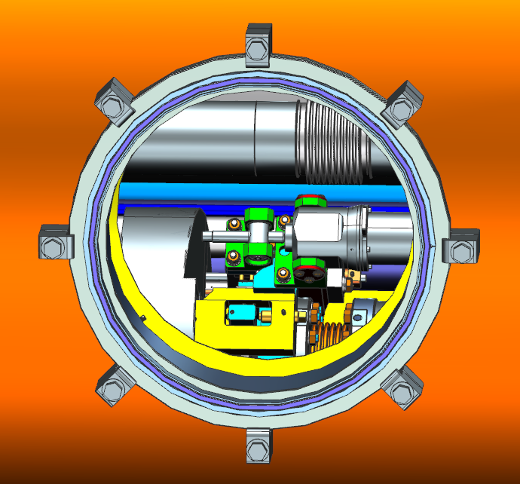
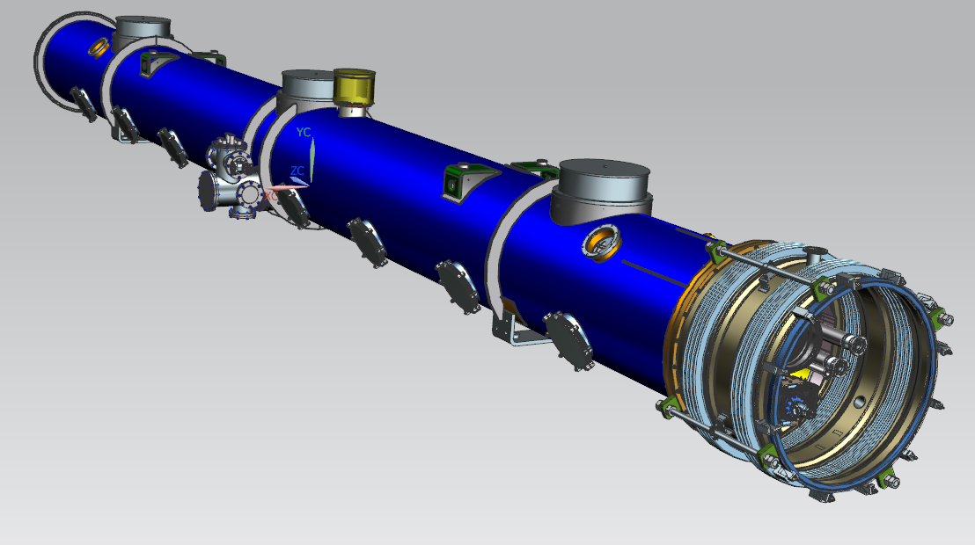
1.3 GHz ILC CM-B
magnet current leads box
(with HTC CL-KEK)
8 tuner motor
access ports (LCLS-II)
Vacuum vessel is identical for types “A” and “B”

Slide 15
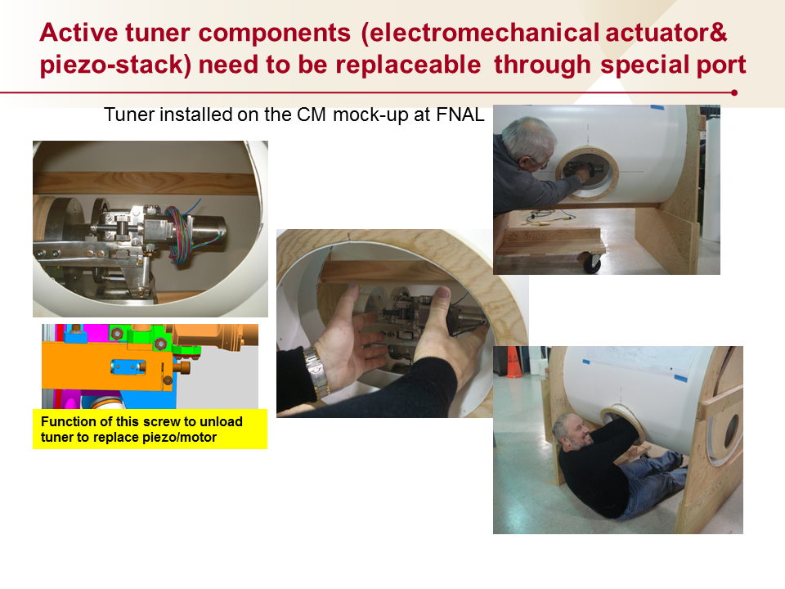
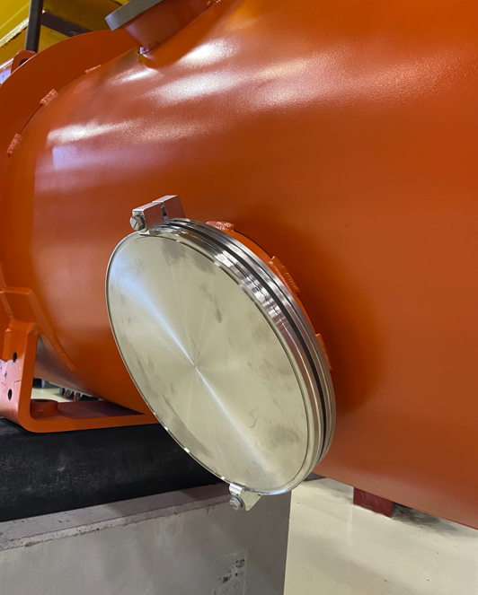
LCLS-II tuner access port

Slide 16
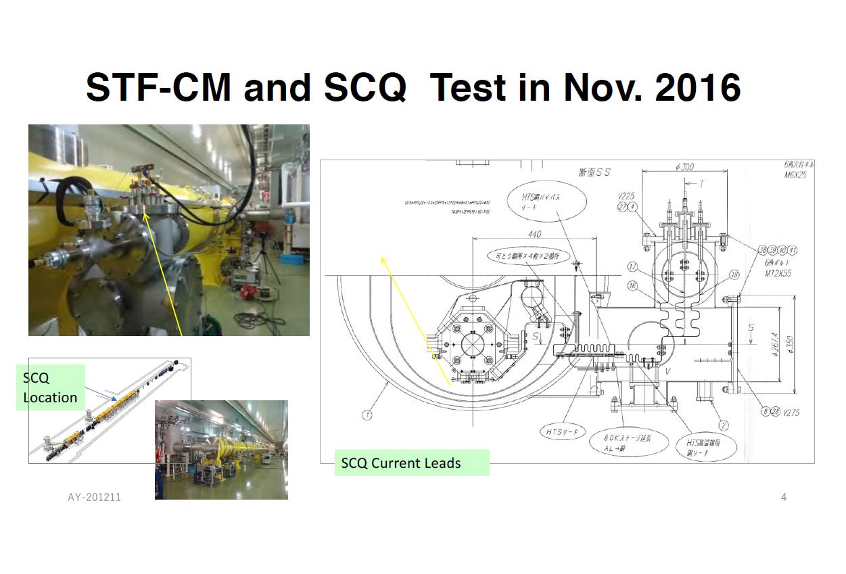
KEK SC magnet CL
Akira Yamamoto, Hirotaka Shimizu, and Nobuhiro Kimura
in Cooperation with Vladiir Kashikhin, and
with acknowledgement to Toshiba Corporation
Date: 2021-8-12

Slide 17
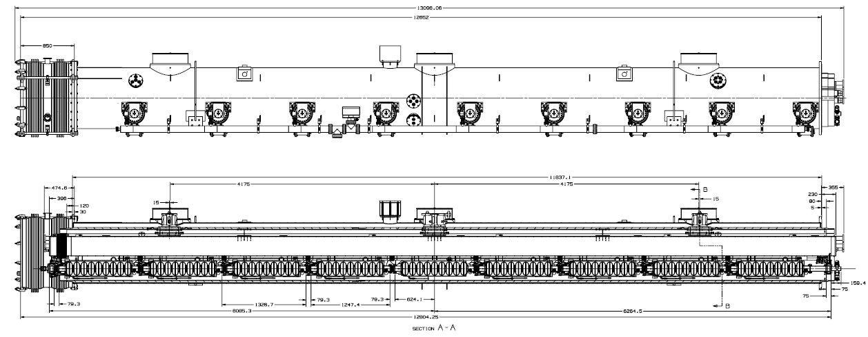
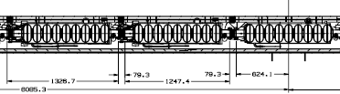
1.3 GHz ILC CM-A, layout

Slide 18
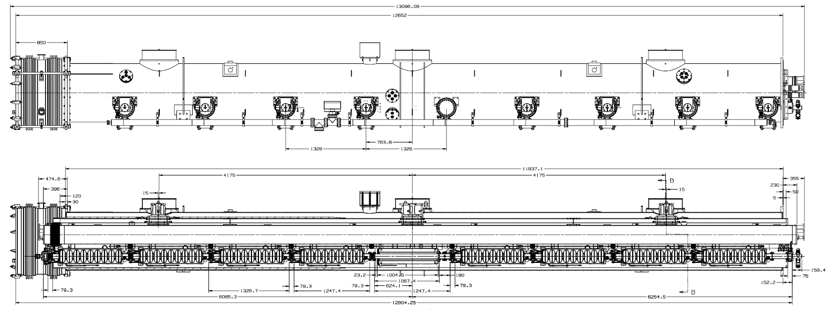
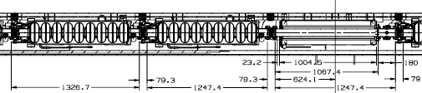
1.3 GHz ILC CM-B, layout
Magnet instrumentation area
Cold: MC-MC
Warm: MC-MC

Slide 19
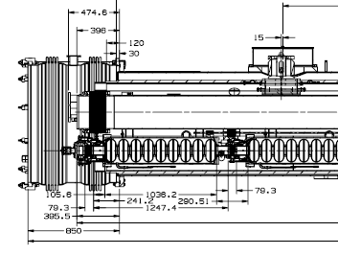
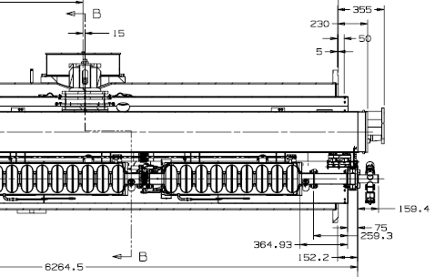
1.3GHz ILC CM-B, layout
12804
(CM slot)

Slide 20
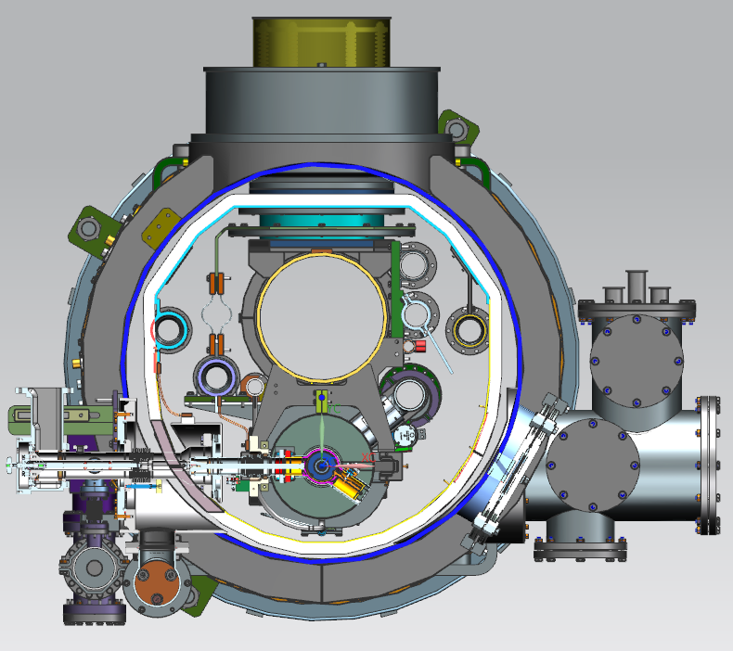
ILC CM line designation
Line B
Line H
Line F
Line D
Line A
Line C
Line E
Line GG

Slide 21
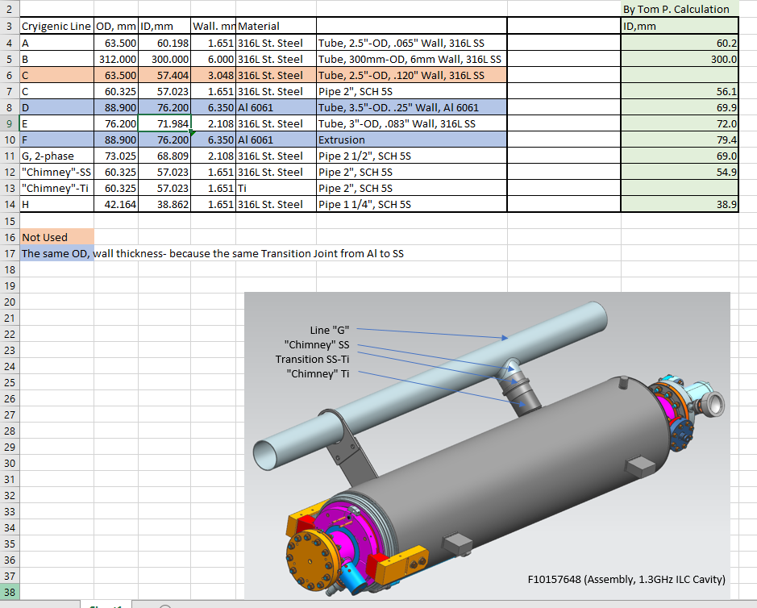
ILC CM cryogenic piping sizes

Slide 22
TESLA-style cryomodules compared - 1
(60.2)
(300)
(57.0)
(76.2)
(72.0)
(76.2)
(68.9)
(57.0)
Yuriy Orlov and Tom Peterson for the LCLS-II Team
LCLS-II CM Assembly Meeting
17July 2014
(38.9)
BLUE for ILC 2021CM

Slide 23
TESLA-style cryomodules compared - 2
1326.7
12804
NO,
but retain
intercepts
Yuriy Orlov and Tom Peterson for the LCLS-II Team
LCLS-II CM Assembly Meeting
17July 2014
BLUE for ILC 2021 CM

Slide 24
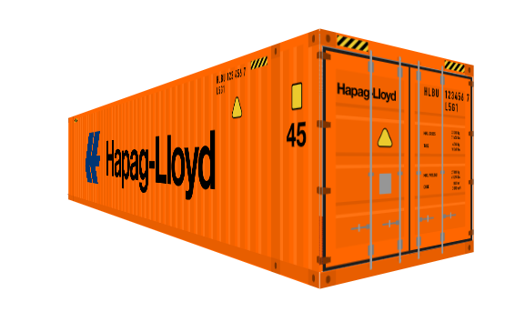
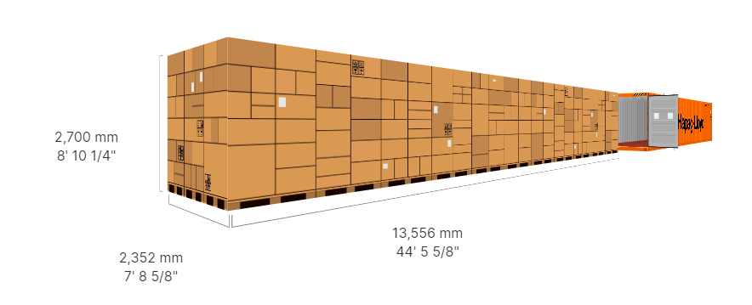
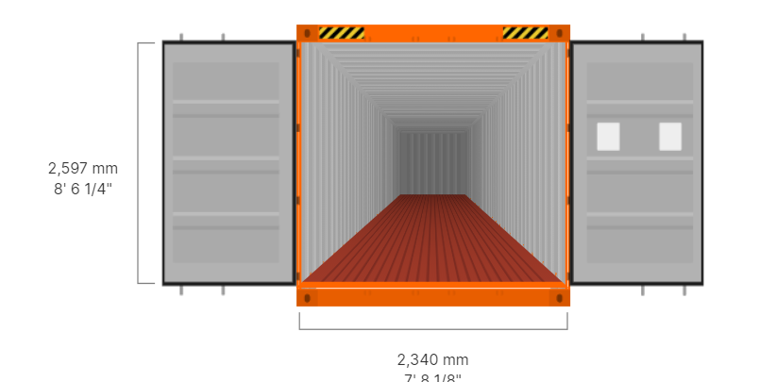
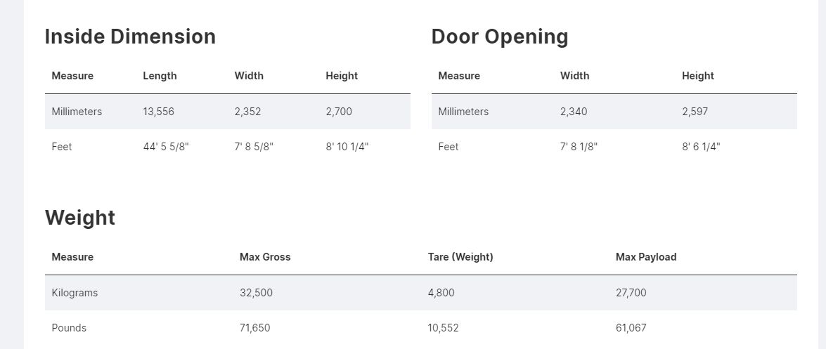
Typical 45’ container

Slide 25
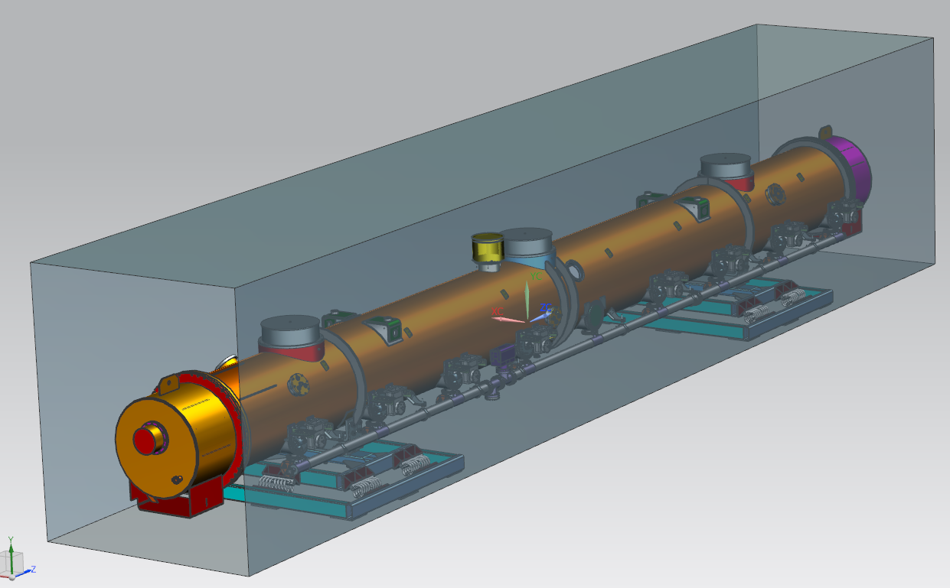
Transportation of 1.3 GHz CM
Inside volume of 45’ container
Transportation platforms
(proposal)

Slide 26

Transportation of 1.3 CM
DESY transportation
feed cap
DESY transportation
end cap
(~7cm)
(~8cm)

Slide 27

1.3 GHz CM’s interconnection
700 mm
11 mm
8 mm
HOM absorber

Slide 28

1.3 GHz CM’s interconnection
CM1
CM2
HOM
interconnection bellows

Slide 29
Backup slides

Slide 30


ILC TDR Layout
Damping Rings
Polarised electron source
Ring to Main Linac (RTML)
(including
bunch compressors)
e+ Main Linac
e- Main Linac
Parameters | Value
C.M. Energy | 500 GeV
Peak luminosity | 1.8 x10³⁴ cm⁻²s⁻¹
Beam Rep. rate | 5 Hz
Pulse duration | 0.73 ms
Average current | 5.8 mA (in pulse)
E gradient in SCRF acc. cavity | 31.5 MV/m +/-20% Q₀ = 1E10
E+ source

Slide 31

1.3 GHz ILC CM, Section 1

Slide 32

1.3 GHz ILC CM, Section 2

Slide 33



Tuners
XFEL
LCLS-II
T4CM

Slide 34



Magnet Packages with BPM
XFEL
LCLS-II
(BPM before Magnet)
T4CM

Slide 35


1.3GHz cavities (9 elliptical cells)
(Long-Short)
He Vessel Bellows
XFEL
(Long-Short)
LCLS-II
Ti-SS Transition
(Short-Short)
T4CM
Ti Mini CF

