Slide 1
ILC Elliptical/Racetrack Crab Design
Prof Graeme Burt, Lancaster University / Cockcroft Institute
On behalf of the UK team at Lancaster and STFC

Slide 2




ILC Crab Cavity Collaboration Team (c. 2008)
Cockcroft Institute:
  Graeme Burt (Lancaster University)
  Richard Carter (Lancaster University)
  Amos Dexter (Lancaster University)
  Philippe Goudket (ASTeC)
  Roger Jones (Manchester University)
  Alex Kalinin (ASTeC)
  Lili Ma (ASTeC)
  Peter McIntosh (ASTeC)
  Imran Tahir (Lancaster University)
FNAL:
  Leo Bellantoni
  Mike Church
  Tim Koeth
  Timergali Khabiboulline
  Sergei Nagaitsev
  Nikolay Solyak
SLAC:
  Chris Adolphson
  Kwok Ko
  Zenghai Li
  Cho Ng
  Andrei Seryi
  Liling Xiao

Slide 3
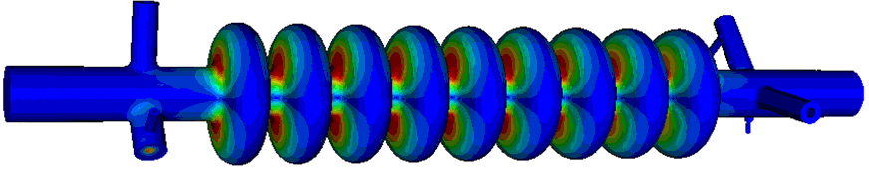
ILC-CC Design
Input Coupler
Based on the FNAL CKM Cavity
LOM Coupler
SOM Coupler
HOM Coupler
Beam-pipe radius = 18mm
Cavity iris radius = 15mm
Equator Radius = 47.37mm
Squashed to give >10 MHz dipole mode separation
In hindsight it may have been better to develop a racetrack solution with a larger polarisation separation. It would be prudent to revisit this.

Slide 4
Modal Calculations in MAFIA
Lower Order Modes, 2.8 GHz
Operating and Same Order modes at 3.9 GHz
High impedance monopole modes are not a problem
Narrowband dipole modes seen up to 18 GHz
1st Dipole passband
Trapped 5th dipole passband at 8 GHz
High dipole impedances seen at 10 GHz and 13 GHz

Slide 5
3.9 GHz elliptical: External Q factor s required for couplers
Beam-pipe cut-off
Same Order Mode, tough spec, requires active damping
Trapped modes might need attention
These specs are not tough but might need checking

Slide 6
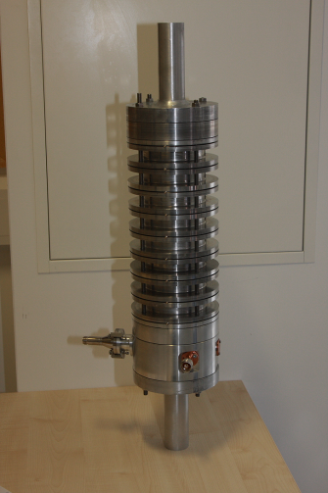
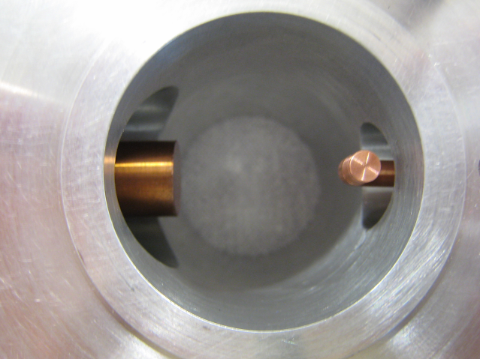
Lower Order Mode Coupler
Hook type LOM coupler designed by FNAL/Lancaster and improved by SLAC
No filter, uses polarisation to avoid coupling to the crabbing mode
The LOM coupler prototype was found to give good agreement with both MWS and Omega3P simulations.

Slide 7
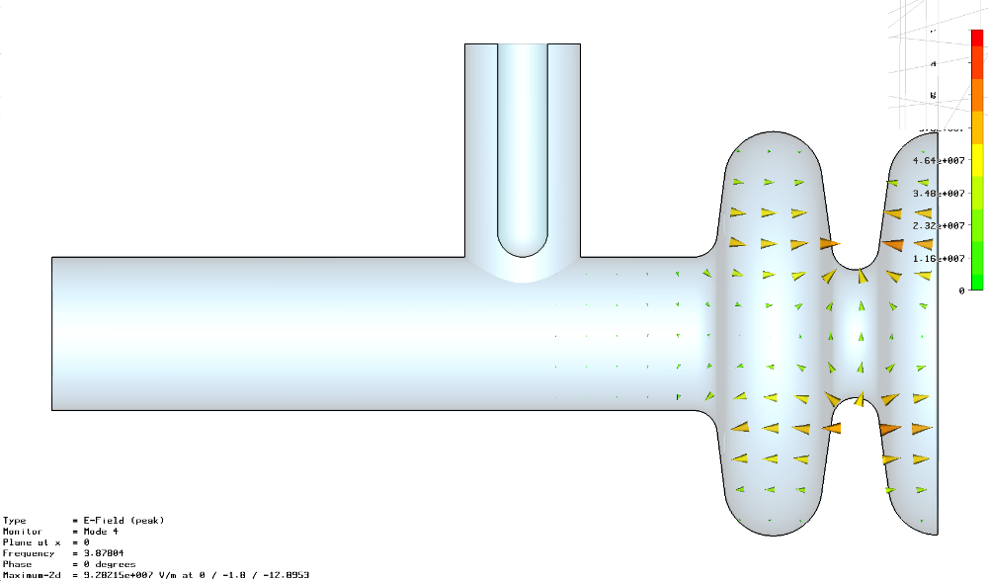
Cockcroft SOM Coupler design
The SOM coupler is currently a simple coaxial structure.
The problem is that as we decrease the SOM external Q we make the coupler susceptible to damping the operating mode.
Assuming 10 Watts mean power flow in the coupler, and we meet the SOM damping spec then we need to align the coupler to within 1.4 degrees.
May be better to use a racetrack cell shape to separate the vertical and horizontal mode in frequency and use a filter

Slide 8
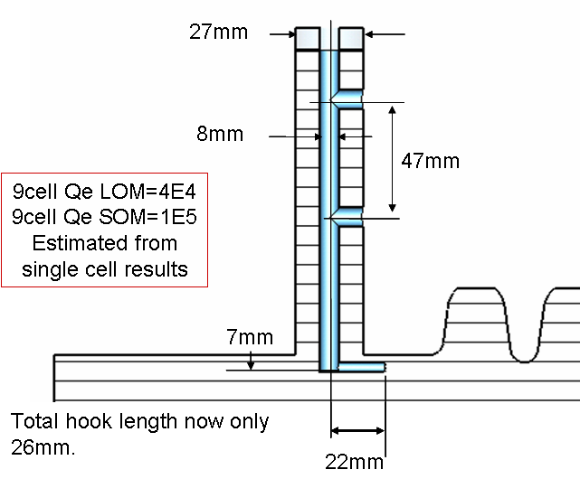
SOM/LOM Coupler Development
SLAC design for HOM and LOM couplers and Cockcroft Institute SOM and Power coupler designs used in prototypes.
New Cockcroft design for integrated SOM/LOM coupler is a significant improvement on SLAC designs.

Slide 9
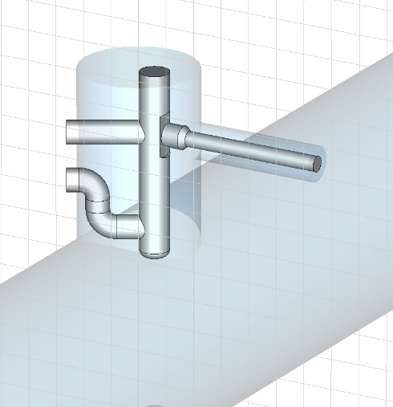
HOM Coupler
The original HOM coupler was based on the EU-XFEL 3rd harmonic HOM coupler that’s slightly modified.
SLAC redesigned the coupler but did not check all modes just the first two passbands.

Slide 10
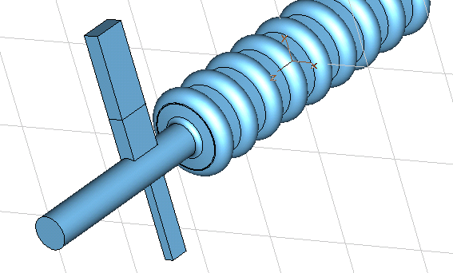
SLAC HOM Notch harmonic
The prototype measurements have shown that the SLAC HOM coupler has several stop-bands, such that some HOMs will not be damped. One such stop-band is at 8.0GHz, coinciding with a very dangerous HOM.
This turns out to be a resonance with the TE21 mode cut-off in the beampipe. This led to two solutions not fully followed up
Use of a WG HOM coupler
Using a different beampipe diameter on each side of the cavity and have two HOM coupler

Slide 11
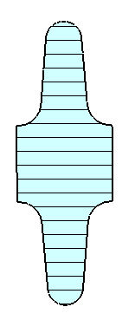
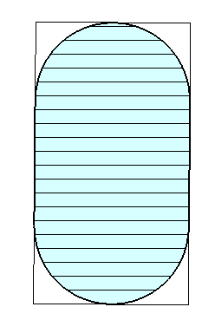
Re-optimizing the ILC crab
Minor radius
Decided to re-optimise the ILC crab cavity to increase the gradient and separate the SOM
Kept frequency at 3.9 GHz as its compact and required gradient decreases linearly with frequency
250 GeV ILC requires a 3-cell cavity @ 5 MV/m, or 2 cells at @8 MV/m
3 x 3 cells or a single 9 cell @7.5 MV/m at 1 TeV
Equator rounding radius
Iris rounding radius
Major radius

Slide 12
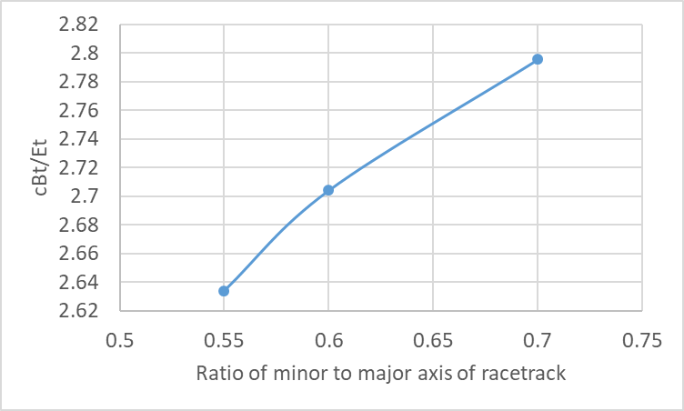
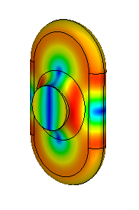
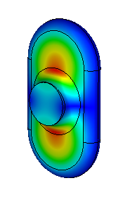
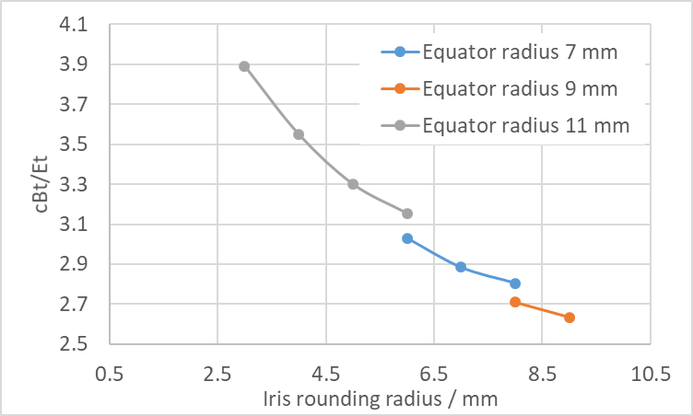
Improved geometry
The surface magnetic field decreases as the ratio of minor to major axis decreases (below 0.5 its starts to increase but with our aperture this is not an allowed geometry anyway)
The surface electric field is too low to worry about
It appears we want a small equator radius and a large equator radius (ie short cavity with a thick iris)
Yet to understand why as this would normally be bad
Should be able to achieve 9 MV/m
Magnetic
Electric

Slide 13
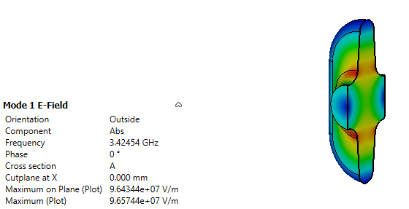
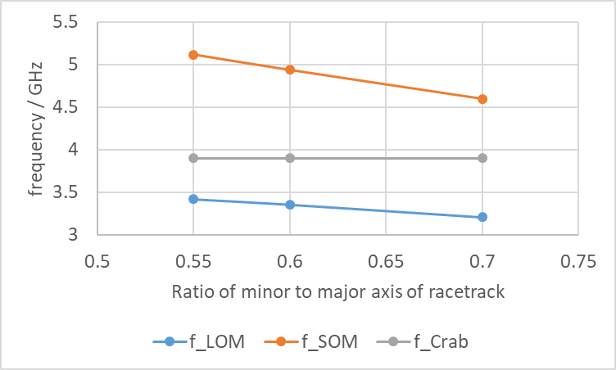
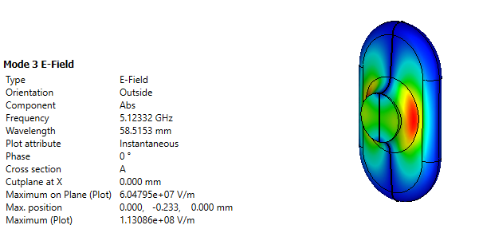
Varying the ellipticity to tune the LOM/SOM
One issue with making the cavity highly elliptical is the lower order mode moves closer to the crabbing mode
Now looking at more complex geometries to separate more
Ideally LOM and SOM spacing equal
Lower order mode (LOM)
Same order mode (SOM)

Slide 14
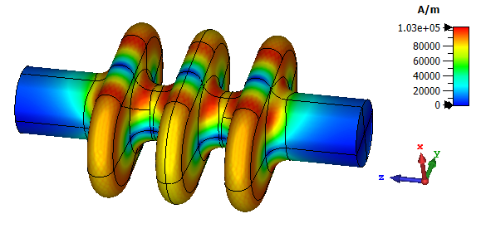
3 cell cavity
End cells initially had lower peak magnetic field
Larger beampipes (18 mm) were used on the end cells to aid damping
Iris was increased until the peak magnetic field was the same on all iris
  Rt/Q =109 Ohms
  Gradient@80 mT = 9.1 MV/m
  Epeak =37 MV/m
  f_LOM =3.4 GHz
  f_SOM =4.65-5.1 GHz
  Rt/Q_SOM = 40 Ohms

Slide 15
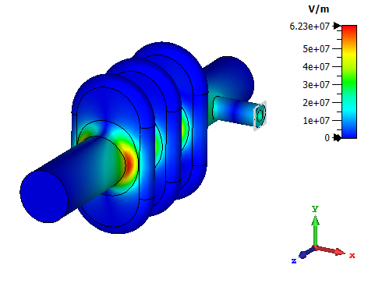
Coaxial damper
Specification is Rt/Q*Qe = 60 MOhm/m
Rt/Q_SOM=40 hence Qe= 1.5e6
Initial trials suggest this is simple to achieve
Q_crabbing mode=2e8 - 1e9
Q_SOM=1500 – 6000
Q_LOM=1e6 – 1e7

Slide 16
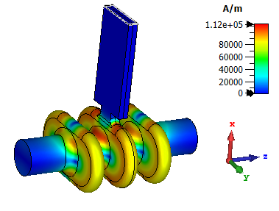
Waveguide damping
Q_crabbing mode=1e8
Q_SOM=9000
Q_LOM=1.8e5
Current design very overcoupled
Jlab developed an on-cell waveguide for SPX, provides better LOM damping

Slide 17
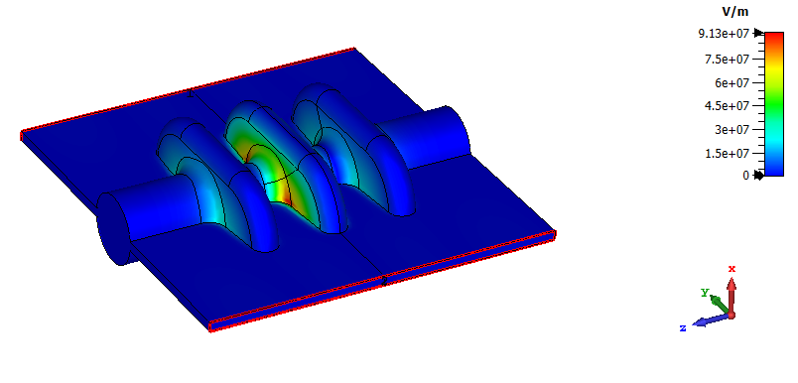
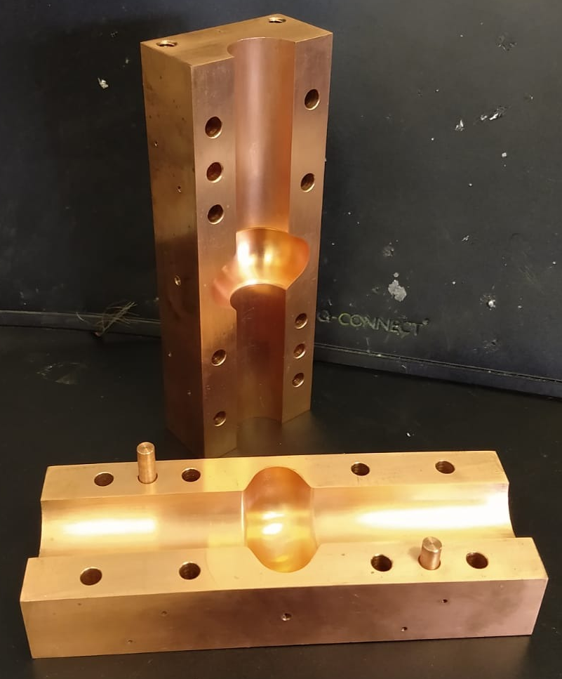
SWELL
CERN and Lancaster separately developed split cavities (SWELL) for thin film coated cavities
Small gap between two halves used for damping, for FCC there is a coax coupler in the gap which can reject operating mode
Can weld far from fields
Machined copper cavities have better tolerances so anticrabbing roll tolerance easier to achieve
Q_crabbing mode=6e6
Q_SOM=300
Q_LOM=2e7

Slide 18
Conclusions
We believe 3.9 GHz elliptical is still optimal as can achieve same gradient as a 1.3 GHz compact crab but needs a 3rd of the length and could use a single cavity per IP at 1 TeV so simpler than 9 single cells.
LOM/SOM/HOM couplers needs some redesign
Investigating a racetrack cell shape which allows a higher gradient.
Jlab have demonstrated that using symmetry to reject crabbing mode when damping the SOM/LOM is feasible
Coax, WG and SWELL damping being considered.

