Slide 1



Power Incident on the ILC helical undulator vacuum chamber
Khaled Alharbi
ILCX-2021
Oct 26th – 29th , 2021

Slide 2
Content
INTRODUCTION.
POWER DEPOSITED AT MASK.
PHOTON MASK DESIGN: considering Copper and Tungsten as materials
ENERGY DEPOSITION AND TEMPERATURE RISE :
  PEDD and Temperature at the mask.
POWER INCIDENT along UNDULATOR WALLS: considering primary photons and secondary particles.
CONCLUSION.

Slide 3
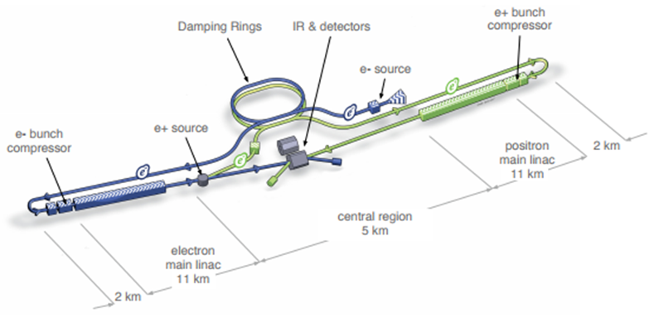
INTRODUCTION
International e+ e- Linear Collider (ILC)
Collision energy: initially 250GeV, upgrade 350GeV, 500GeV.
Two Sources: polarized electron source and undulator-based positron source.
Two Damping Rings : for electrons and positrons with energy 5 GeV.
Two main LINACs with Superconducting Cavities, total length up to 30km.
Interaction Point (IP) with 2 push-pull detectors.

Slide 4
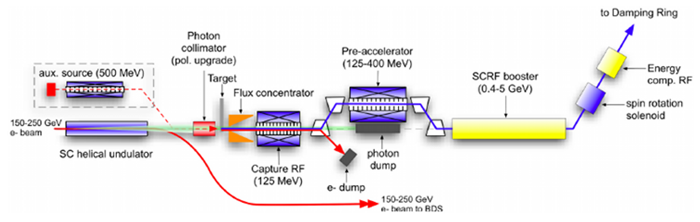
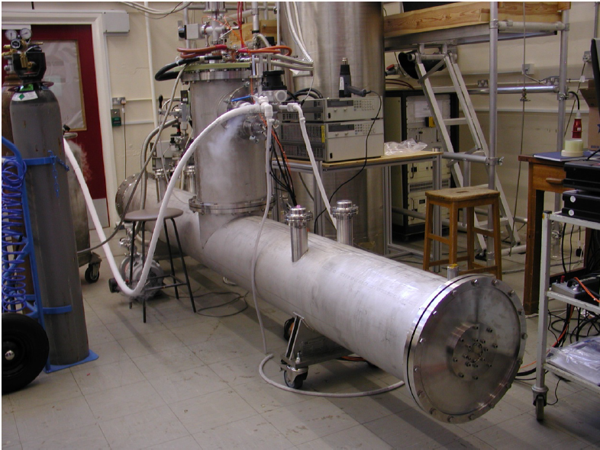
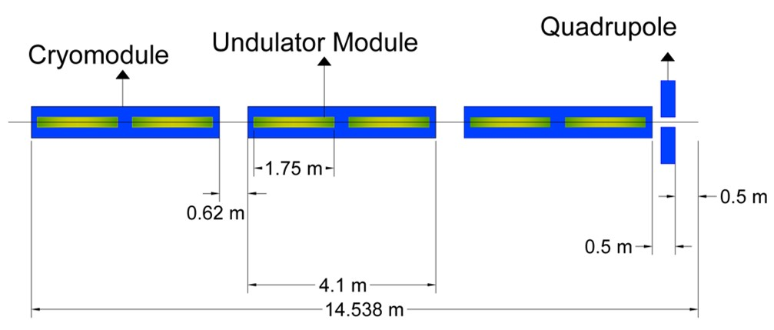
Helical Undulator based Positron Source for the ILC
e- beam passes a long superconducting Helical Undulator and produces a circularly polarized photon beam.
Photons hit spinning Ti6Al4V target (0.2X₀ – 0.4X₀) and produce e+e- pairs.
e+ are captured and accelerated up to 5GeV and sent to positron damping ring.
Two undulator modules with 1.75m each inserted in one cryomodule of 4m length
In total: 132 modules = 66 cryomodules
Quadrupoles are located after each three cryomodule, in total 23 quads
Maximum 231m active undulator length, 320 m total length
Undulator aperture 5.85mm
Helical Undulator Prototype
D.Scott et al.,
https://link.aps.org/pdf/10.1103/PhysRevLett.107.174803
2nd module
Unnnndulator!!!
× 22
1st module
4

Slide 5
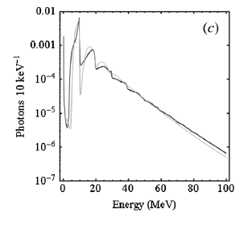
Ideal and Real undulator
Undulator prototype (details see: D.Scott et al., PRL 107(2011)1784803)
Photon Spectra measured for the 2 modules of the undulator prototype
B field in undulator prototype measured with Hall probe.
The realistic photon spectra of the ILC undulator calculated by introducing the realistic error size into the magnetic field strength.
HUSR can do that:
  HUSR: Helical Undulator Synchrotron Radiation
    Developed at Cockcroft Institute by David Newton.
    Simulates photon spectra produced by a Helical Undulator including undulator B field and period errors
      B field and period errors randomly introduced into the period and field.
    HUSR calculates also the photon polarization
    Simulations use ΔK and Δλ from the “better” undulator prototype module

Slide 6
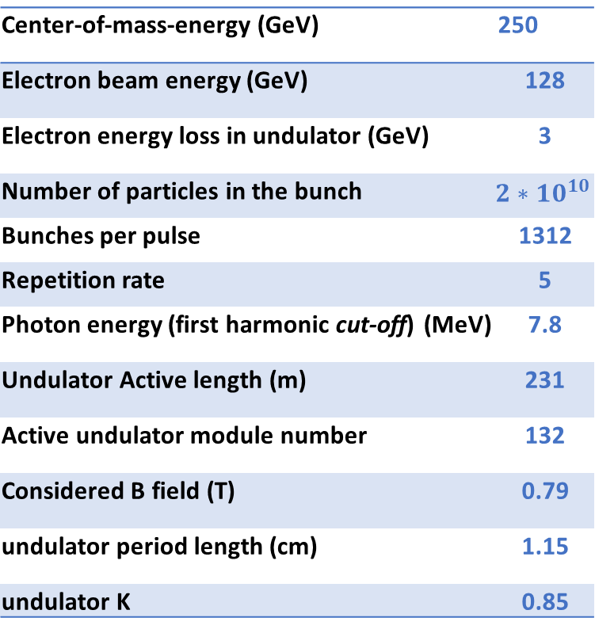
Parameters of the helical undulator
ILC superconducting helical Undulator
Power deposition on the wall from synchrotron radiation must be ≤1W/m
  see also Duncan Scott, 2008, https://ethos.bl.uk/OrderDetails.do?uin=uk.bl.ethos.490620
  To achieve vacuum requirements, e.g. see O. Malyshev EuroTeV https://avs.scitation.org/doi/10.1116/1.2746876.
Goal:
  To study the energy deposited at the photon masks for ideal and realistic undulator at ILC250GeV.
  A principle design of photon masks for the ILC Positron Helical Undulator.
  Power deposition along the wall of ideal and realistic undulator: deposited by primary photons and secondary particles.
Center-of-mass-energy (GeV) | 250
Electron beam energy (GeV) | 128
Electron energy loss in undulator (GeV) | 3
Number of particles in the bunch | $${2∗10}^{10}$$
Bunches per pulse | 1312
Repetition rate | 5
Photon energy (first harmonic cut-off) (MeV) | 7.8
Undulator Active length (m) | 231
Active undulator module number | 132
Considered B field (T) | 0.79
undulator period length (cm) | 1.15
undulator K | 0.85

Slide 7
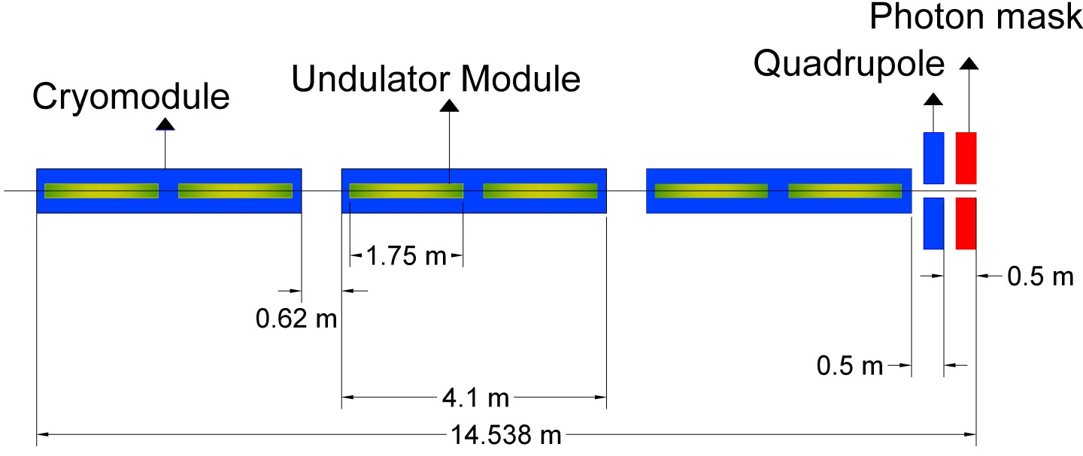
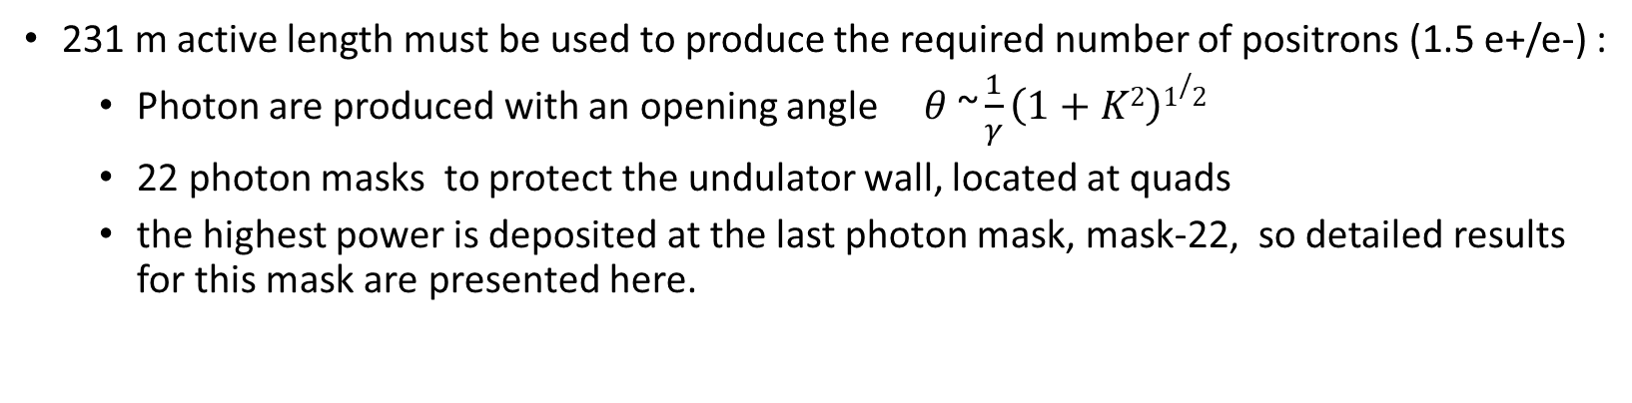
POWER DEPOSITED AT THE last MASK (Mask-22)
231 m active length must be used to produce the required number of positrons (1.5 e+/e-) :
  Photon are produced with an opening angle $θ\text{ \sim }\frac{1}{γ}\left(1+K2\right)1/2$
  22 photon masks to protect the undulator wall, located at quads
  the highest power is deposited at the last photon mask, mask-22, so detailed results for this mask are presented here.
 | Average Incident Photon Energy (MeV) | Power Deposited at Last Mask (W)
Ideal | 2.01 | 336
Realistic | 2.14 | 361

Slide 8
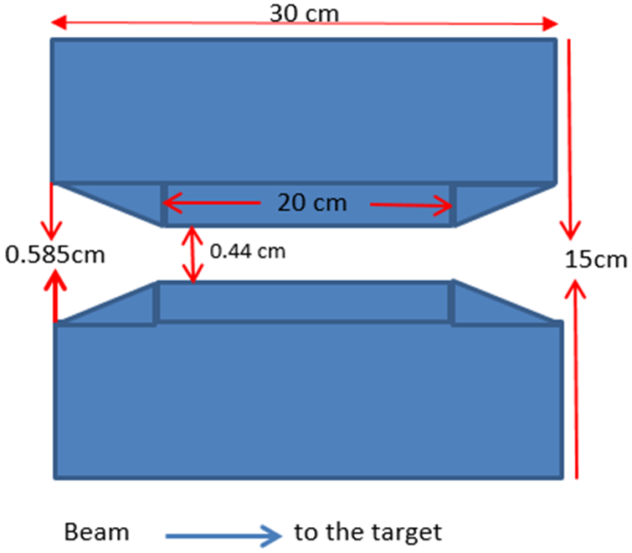
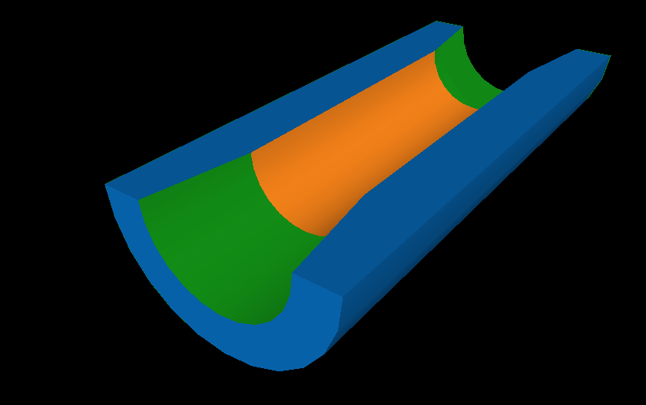
Photon Mask Design
Mask Design depends on:
The average incident photon energy (Ideal and Realistic)
The available area reserved for helical undulator (319.66m)
A possible mask design:
Cylinder with tapered opening
Masks must mainly stop photons of few MeV energy.
Material: High Z-materials, large density and small radiation length are needed:
Material | Atomic number | Radiation Length (cm) | Melting point (K)
Copper (Cu) | 29 | 1.44 | 1358
Tungsten (W) | 74 | 0.35 | 3695

Slide 9
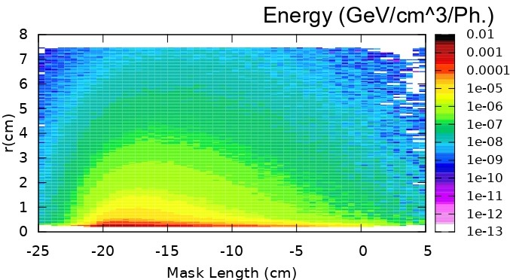
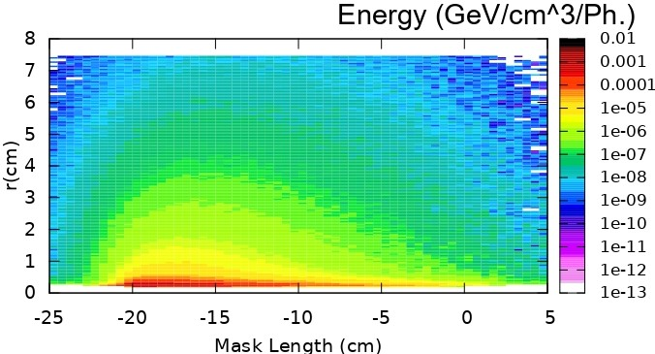
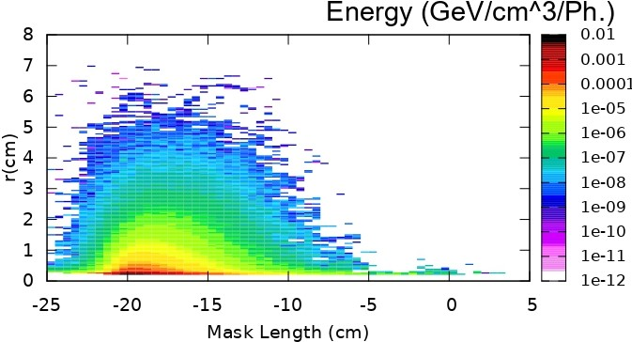
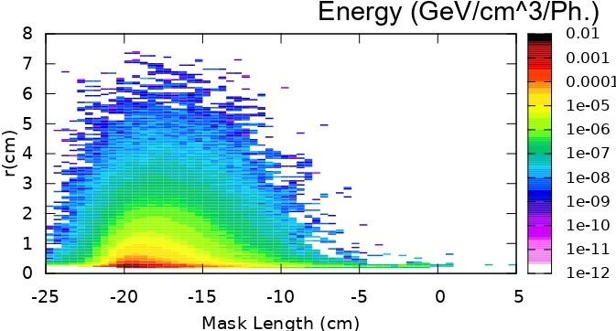
ENERGY DEPOSITION ALONG COPPER OR TUNGSTEN MASK-22
Ideal undulator spectrum
Realistic undulator spectrum
Copper
Tungsten

Slide 10
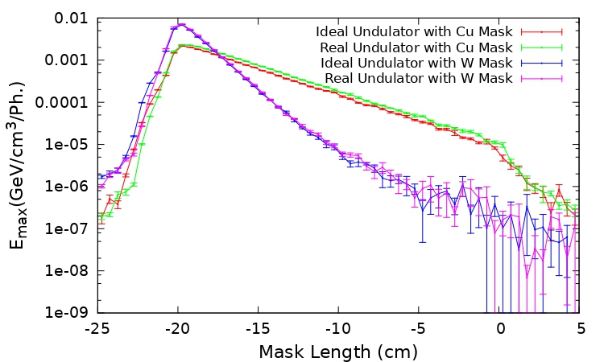
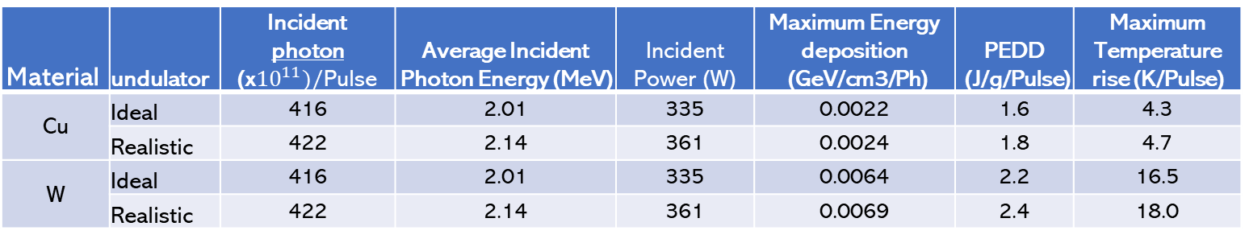
MAXIMUM ENERGY DEPOSITION ALONG THE MASK (ideal and realistic undulator)
Photon Masks must avoid Peak Energy Deposited Density (PEDD) values that could damage the material and cause failure of Photon Masks.
The limits for instantaneous temperature rise and PEDD in copper are 30 K and 12 J/g at room temperature, respectively. More details: https://inis.iaea.org/collection/NCLCollectionStore/_Public/38/027/38027945.pdf?r=1
Therefore, the photon mask are SAFE against damage.
Material | undulator | Incident photon (x${10}^{11})/$Pulse | Average Incident Photon Energy (MeV) | Incident Power (W) | Maximum Energy deposition (GeV/cm3/Ph) | PEDD (J/g/Pulse) | Maximum Temperature rise (K/Pulse)
Cu | Ideal | 416 | 2.01 | 335 | 0.0022 | 1.6 | 4.3
 | Realistic | 422 | 2.14 | 361 | 0.0024 | 1.8 | 4.7
W | Ideal | 416 | 2.01 | 335 | 0.0064 | 2.2 | 16.5
 | Realistic | 422 | 2.14 | 361 | 0.0069 | 2.4 | 18.0

Slide 11
Incident Power at Undulator walls
HUSR is used to calculate the power deposition into the undulator walls.
The power deposited along the undulator walls is simulated by increasing the distance between observation points along the undulator line and the exit of an undulator module per (meter).
Power deposition:
  Ideal mask: masks stop all the incident power.
  Cu and W mask: photon back-scattered and the secondary particles left the mask and deposited on wall are considered. Here simulated by FLUKA.

Slide 12
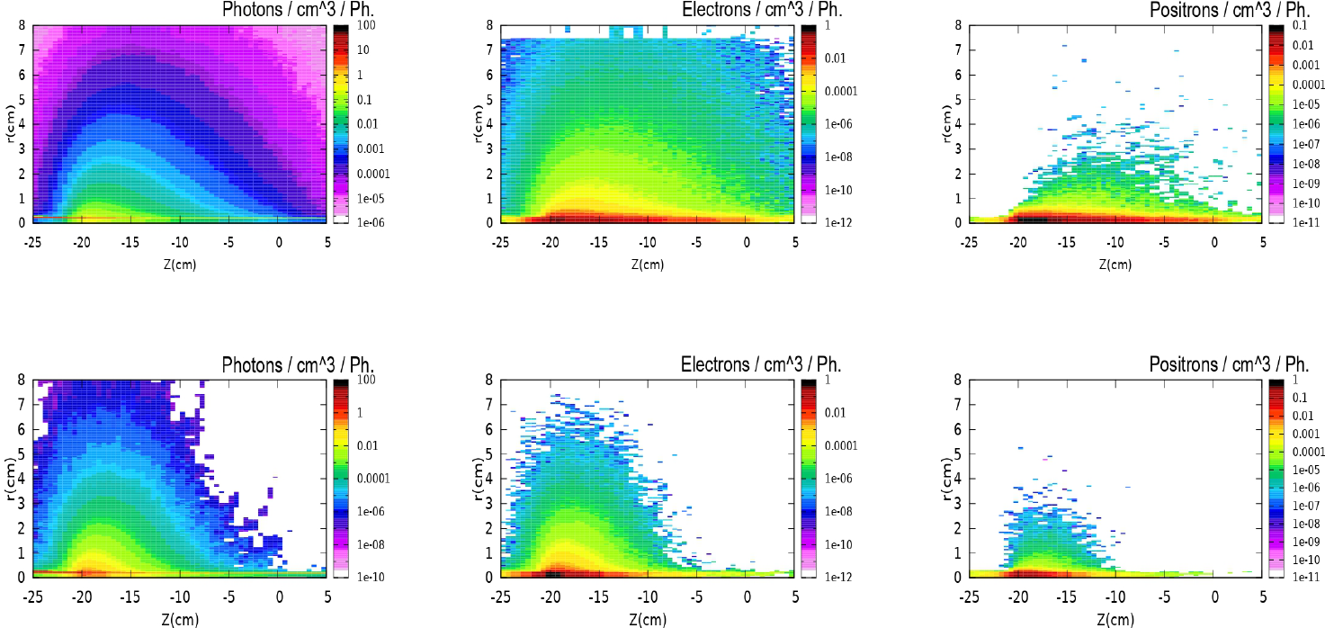
Secondary Particles Density along Cu and W masks (Realistic Undulator)
Photons
Electrons
Positrons
Cu Mask
W Mask

Slide 13
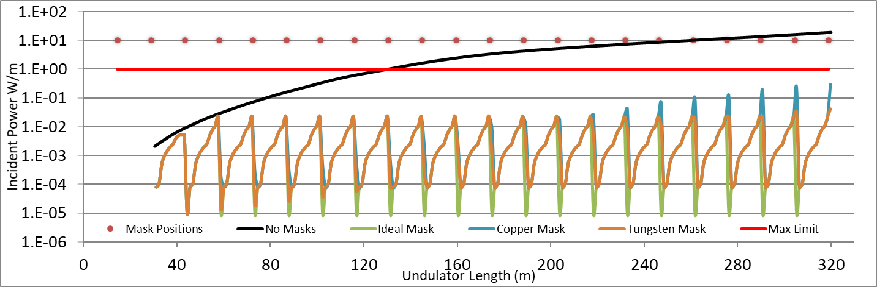
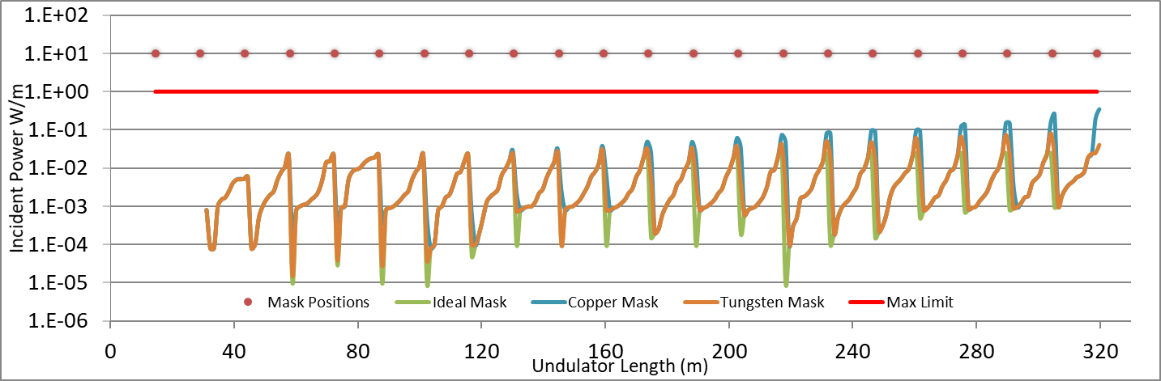
Incident Power at Undulator walls
Ideal Undulator
Realistic Undulator

Slide 14
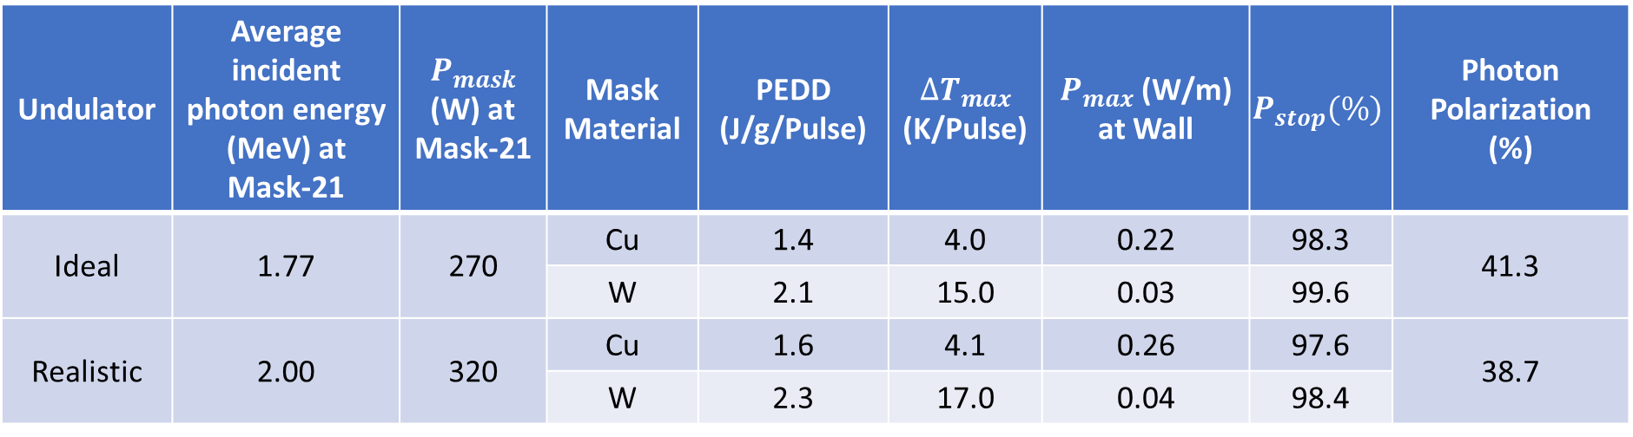
Results:
Undulator | Average incident photon energy (MeV) at Mask-21 | $$P_{mask}$$ (W) at Mask-21 | Mask Material | PEDD (J/g/Pulse) | ${∆T}_{max}$ (K/Pulse) | $P_{max}$ (W/m) at Wall | $$P_{stop}(\%)$$ | Photon Polarization (%)
Ideal | 1.77 | 270 | Cu | 1.4 | 4.0 | 0.22 | 98.3 | 41.3
 |  |  | W | 2.1 | 15.0 | 0.03 | 99.6
Realistic | 2.00 | 320 | Cu | 1.6 | 4.1 | 0.26 | 97.6 | 38.7
 |  |  | W | 2.3 | 17.0 | 0.04 | 98.4

Slide 15

Conclusion
Masks are needed to protect undulator wall from synchrotron radiation (limit 1 W/m).
Two possible photon mask materials with a high photon absorption efficiency have been modelled.
In the last mask (Mask-22) 361W (336W) are deposited in case of a realistic (ideal) undulator.
Studies ($E_{cm}$=250) show that energy deposition and temperature rise are safely below the load limit recommend for the mask materials:
  For example, the PEDDs at Mask-22 are 1.8 and 2.4 J/(g*pulse) for Cu and W masks , respectively, in case of realistic undulator.
  Also, maximum temperatures rise are 4.7 and 18 K/pulse for Cu and W masks, respectively, in case of realistic undulator.
More importantly, both mask materials can keep the power deposited into walls below the acceptable limit, in ideal and realistic undulator cases.
An appropriate solution might be to use a W mask since its length can be shorter, which could help implement the masks into the undulator line.

Slide 16

Thank you for your attention
Questions
&
Comments

