Slide 1



A New Readout Scheme for RPC and Other Gaseous Detectors
Imad Laktineh
on behalf of the FLC-Lyon group
IP2I, Lyon, France

Slide 2
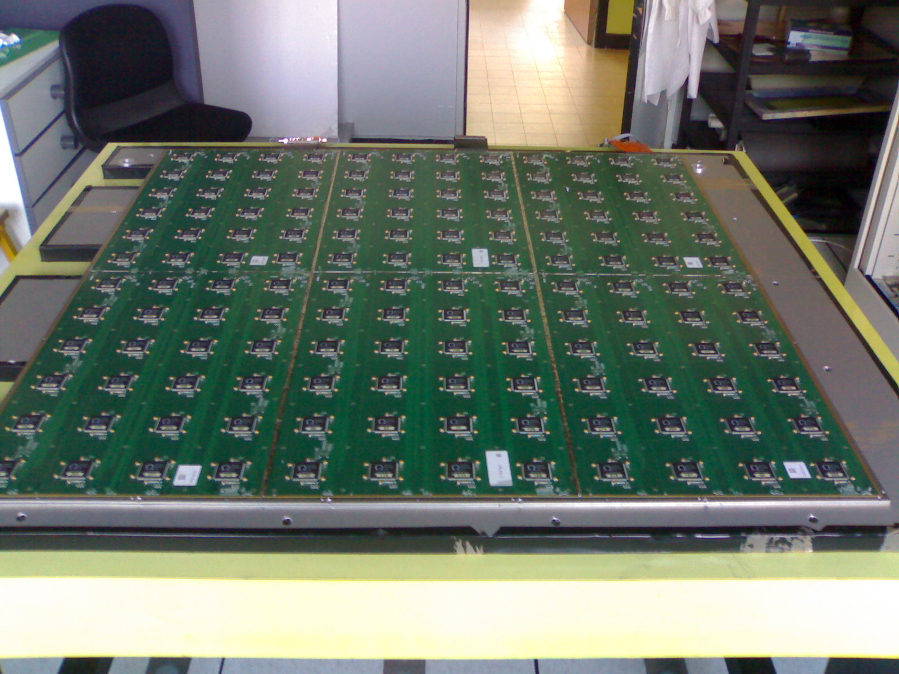
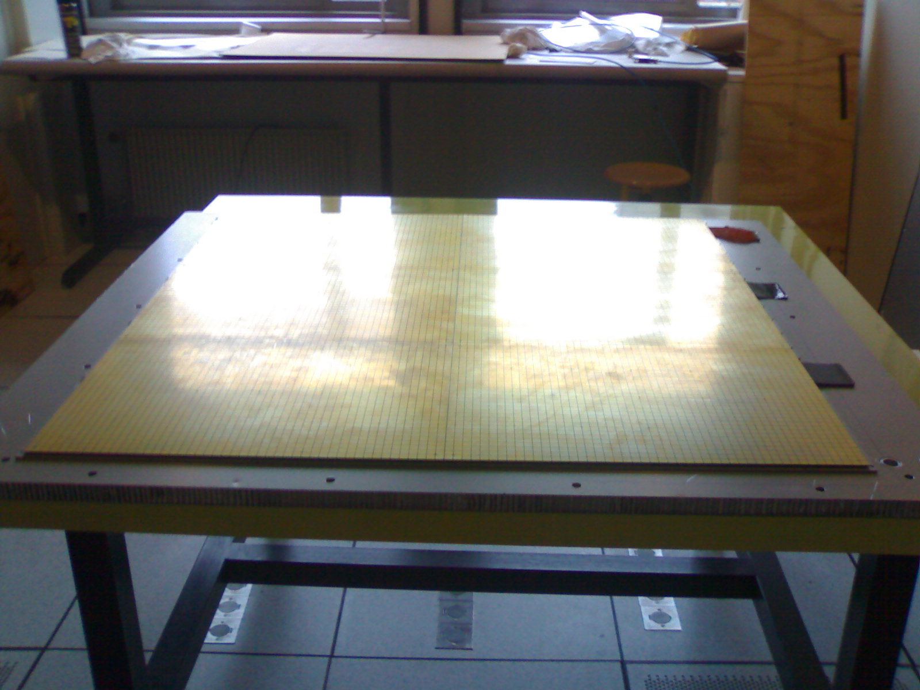
Resistive Plate Chambers (RPC):
Are fast timing detectors
Can be built with large surface, excellent homogeneity and very small dead zone
Are robust and cheap.
Several ways to read out RPC:
Using one-end readout pick-up strips (either one direction on the anode side as for current CMS RPC or two directions: one on the anode and one on the cathode as for ATLAS)
or two-end readout using excellent time measurement as the one proposed for CMS iRPC upgrade
project
Using pick-up PADs as for SDHCAL (CALICE)

Slide 3
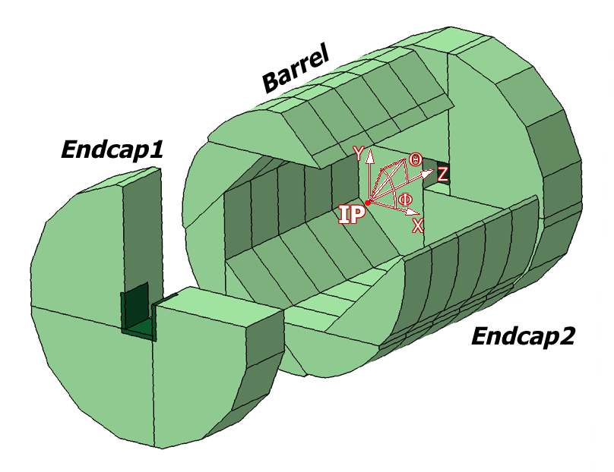
Why we need a new concept?
ILD SDHCAL concept
ILC, CECP calorimeters baselines are all high-granularity PFA-based.
SDHCAL is one of the HCAL baselines for both with tens of millions of channels
Only about 10³ will be fired for each collision. So the channels are idle almost all of the time but continue to consume power and to produce heat, necessitating in case of circular colliders active cooling → reduced PFA performance
This statement applies for all high granular calorimeters other options.

Slide 4
Why we need a new concept?
Reducing the number of pads/pixels is not an option since this leads to less granularity → inefficient PFA.
Can we do something to save power and money without impacting the physics
?

Slide 5
There is a solution
PCT/EP2018/053561
Use pickup pads/pixels to have excellent granularity
Connect the pads/pixels in a special way: woven strips
Two neighboring pixels are connected to two different strips of different directions
Each strip is connected to one electronic channel
Share the charge among a few ones
Cross the fired strip to determine the position
NXN → 3N : Reduction of electronic channels, power consumption and occupancy

Slide 6
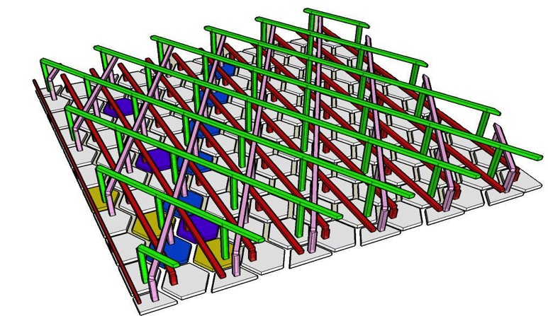
There is a solution
PCT/EP2018/053561
Use pickup pads/pixels to have excellent granularity
Connect the pads/pixels in a special way: woven strips
Two neighboring pixels are connected to two different strips of different directions
Each strip is connected to one electronic channel
Share the charge among a few ones
Crossing the fired strip to determine the position
1 intersection
=
1 “Hit”
NXN → 3N : Reduction of electronic channels, power consumption and occupancy

Slide 7
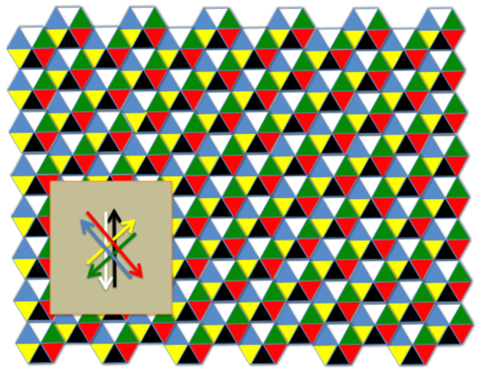
Important features:
The pad/pixel size should be slightly smaller than the charge extension to feed at least two pads/pixels. In gaseous detector this is always possible (RPC or resistive MPGD).
Having 3 or more directions allows one to eliminate ambiguities (ghost particles)
One can read the signal from both sides and get profit of the difference in time of signal arrival to confirm the position resolution and get the absolute time as well.

Slide 8
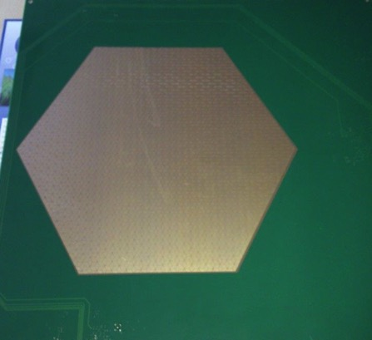
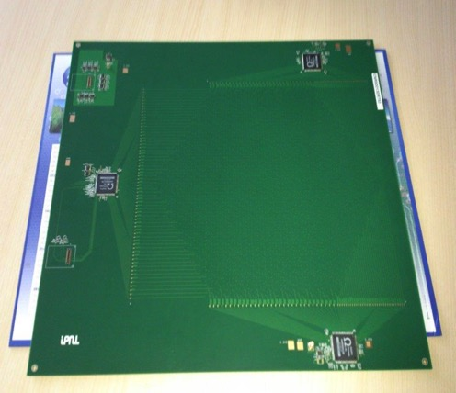
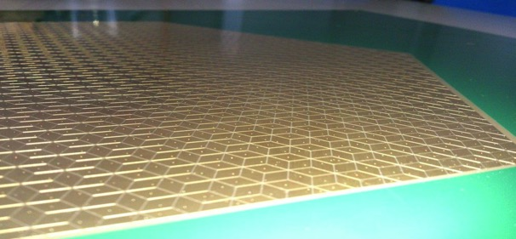
Realization
The new scheme was used to design a PCB with lozenges-based structure and
3 directions. The readout electronics was set on the same PCB. HARDROC2 ASICs (64-ch, 2-bit) conceived for SDHCAL are used.
30 cm
3 HR2 ASICs rather than 20 for the same surface
High granularity
Lozenge’s large diagonal : 8 mm

Slide 9
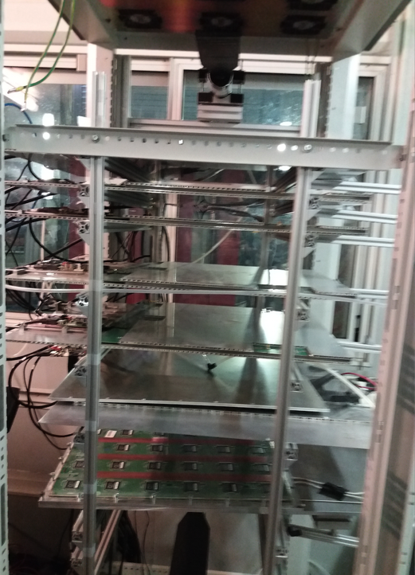
Setup with 5 detectors equipped with the new readout scheme

Slide 10
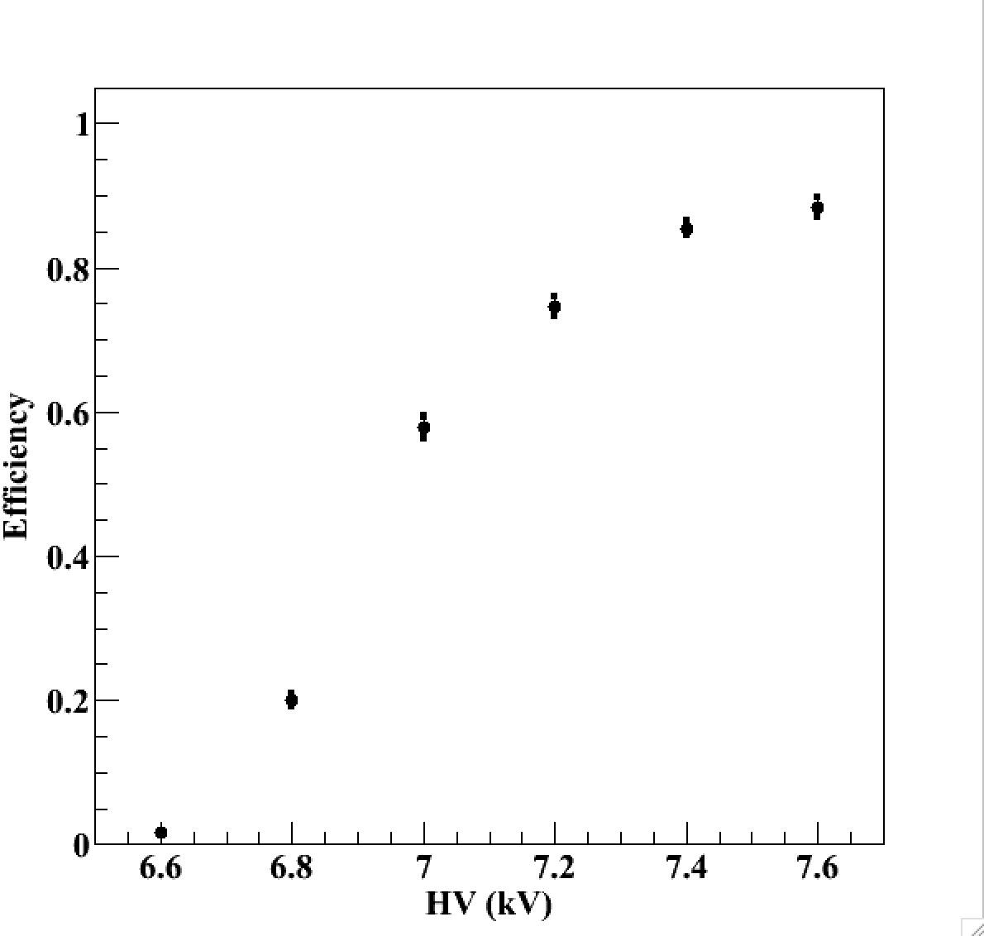
Efficiency vs HV
Threshold ≈ 80 fC
Triggerless mode
TFE(93%)
CO2 (5%)
SF6 (2%)

Slide 11
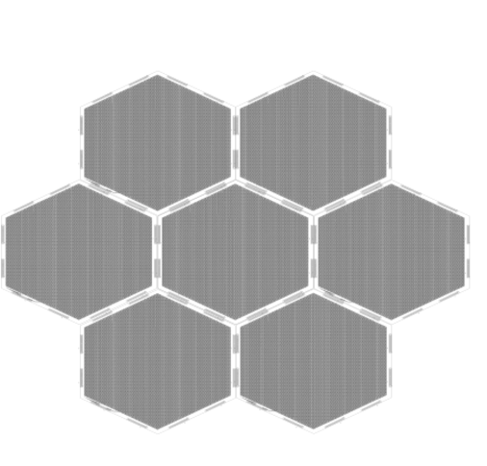
Large surface detectors
To instrument very large gaseous detectors the readout electronics could not be part of the PCB. It is therefore mandatory to separate strip panels from the readout electronics.
A simple scheme is proposed:
FEB
“Well matched impedance will help to keep the signal in good shape for long distances”

Slide 12
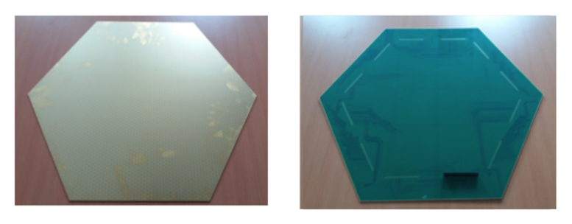
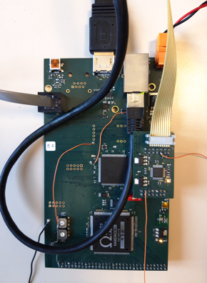
Large surface detectors
62 cm
A board hosting
One Hardroc2 ASIC
One Microcontroller
To be plugged directly on the back of the PCB, on the edge to read out 64 woven strips (1 HR2 ASIC).

Slide 13
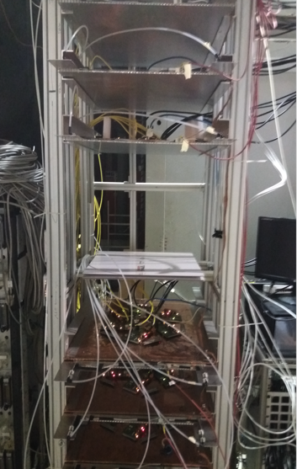
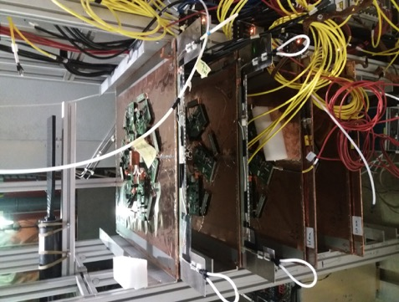
SETUP
The new readout scheme was tested first using a SC-PMT (trigger mode) and then in a triggerless mode.

Slide 14
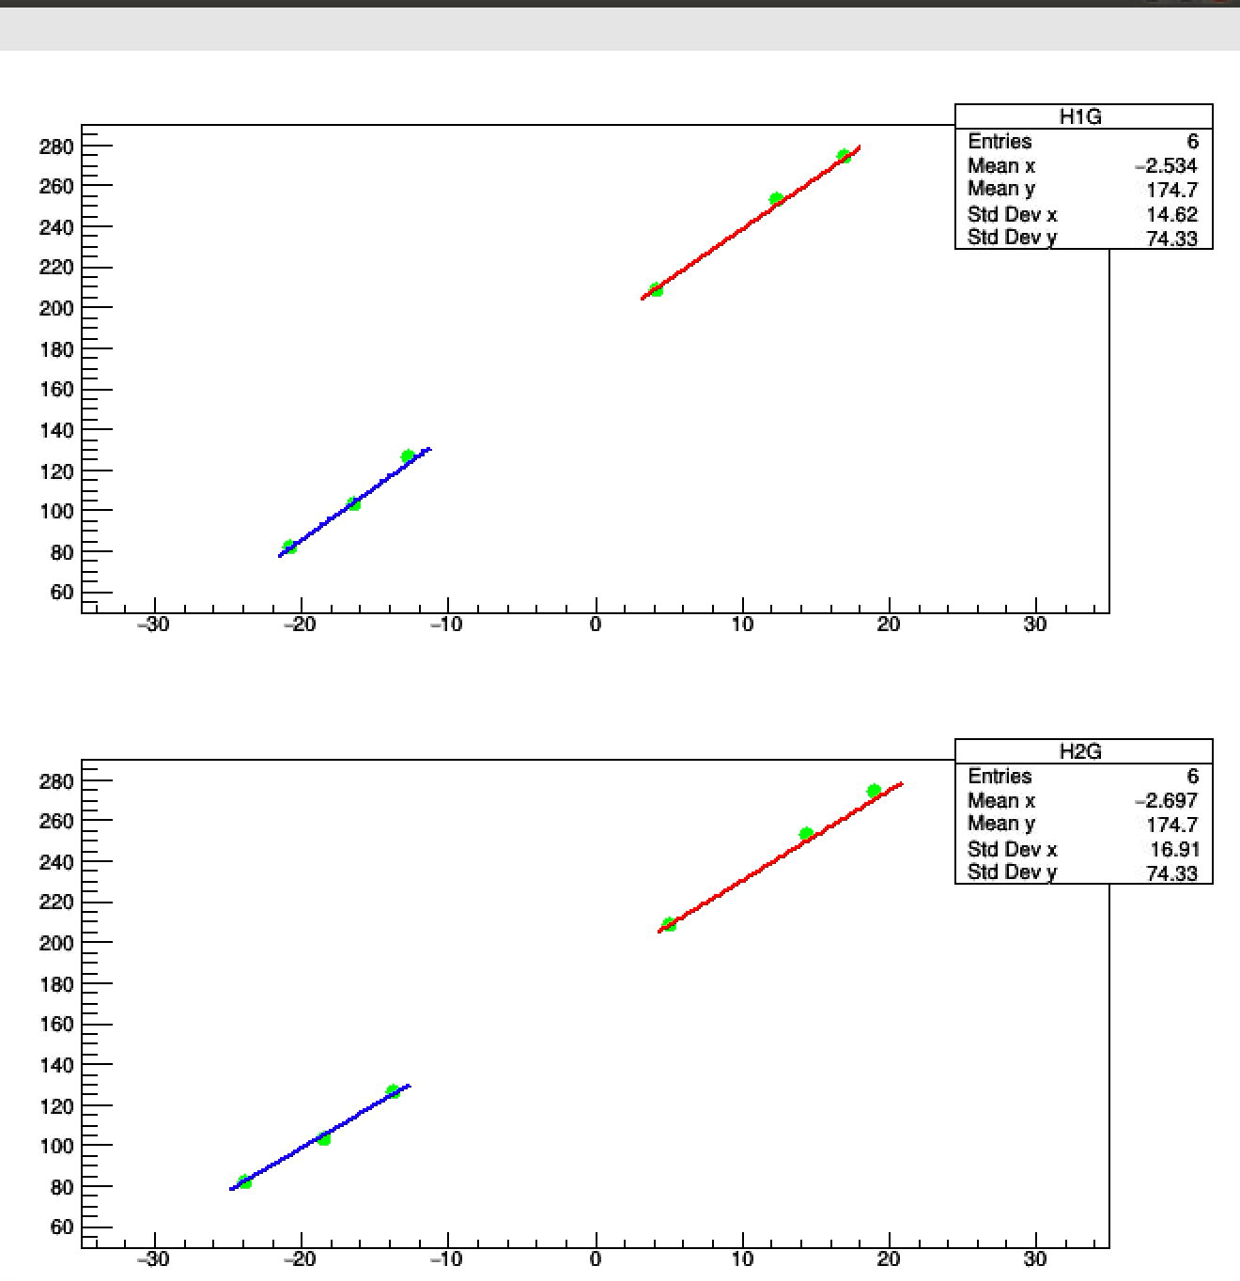
Movie

Slide 15
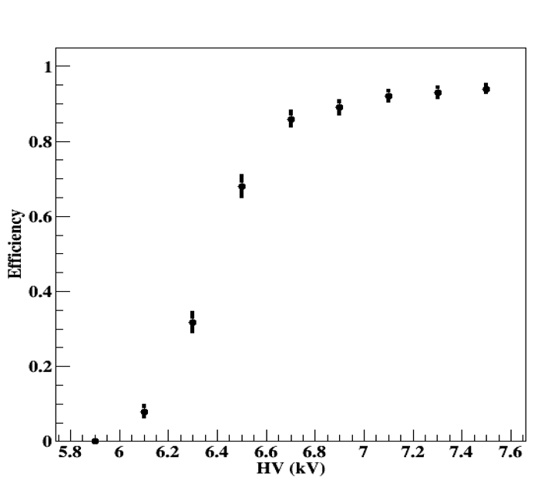
Efficiency
TFE(93%)
CO2 (5%)
SF6 (2%)

Slide 16
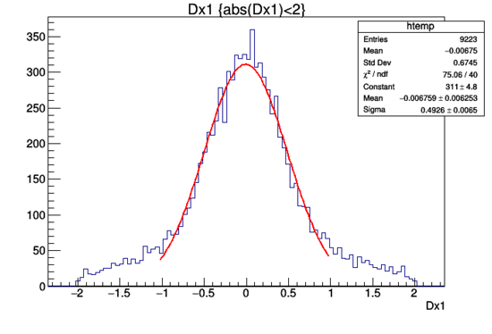
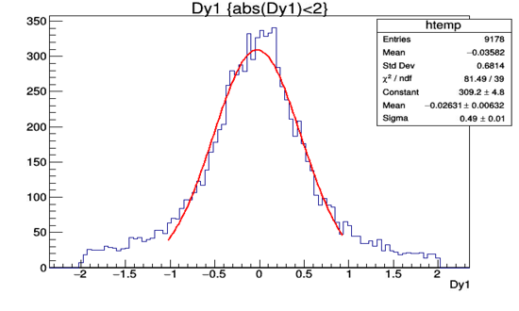
Spatial resolution
X-residuals (cm)
Y-residuals (cm)
Similar to the one obtained with 1cm X 1cm pickup pads of the SDHCAL RPC.

Slide 17
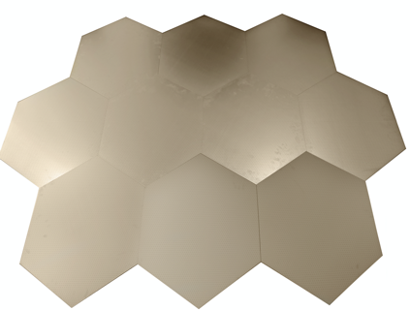

Next Step
We are building large detectors similar to those to be used in muon system in future experiments ( ILC, CEPC, FCC, Mathusla…) but also in the SDHCAL calorimetry concept and will instrument them with the new concept.
For this we need to associate several PCB with no dead zone in-between.
Large detection area can be instrumented by assembling easily many PCB.

Slide 18
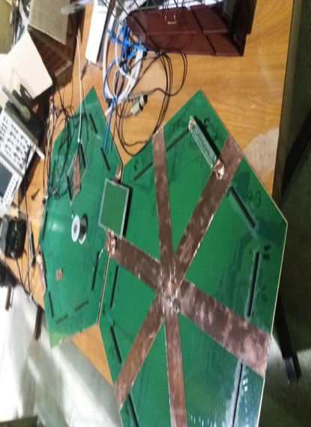
Next Step
Connection of two neighboring PCBs is made through the connectors on the backside of the PCB.
No signal loss was observed by injecting a signal on the furthest end of the first PCB and detecting it on the opposite side of the second one.

Slide 19
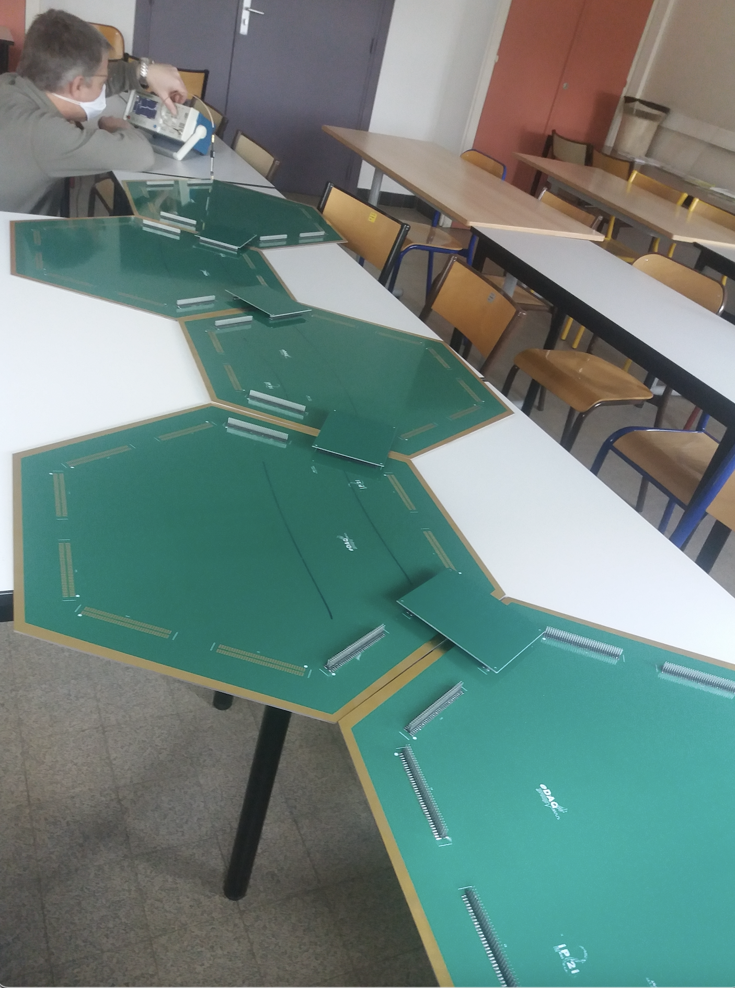
We added five of them

Slide 20
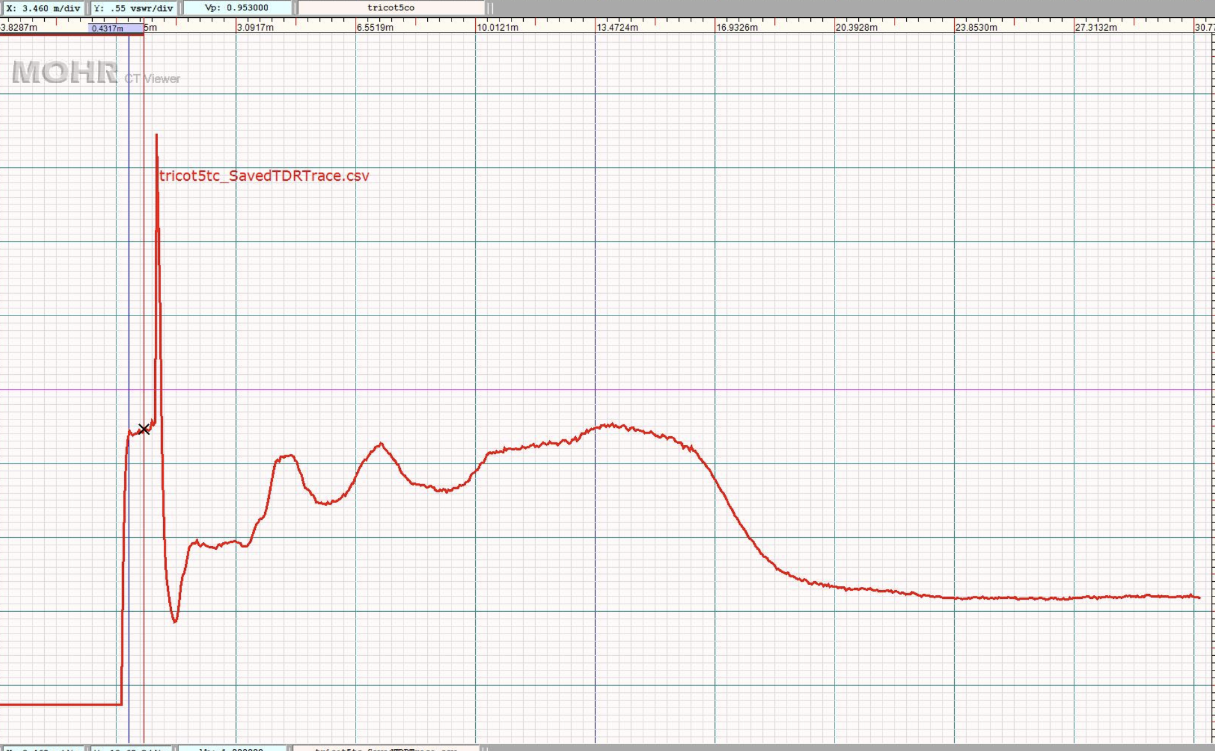
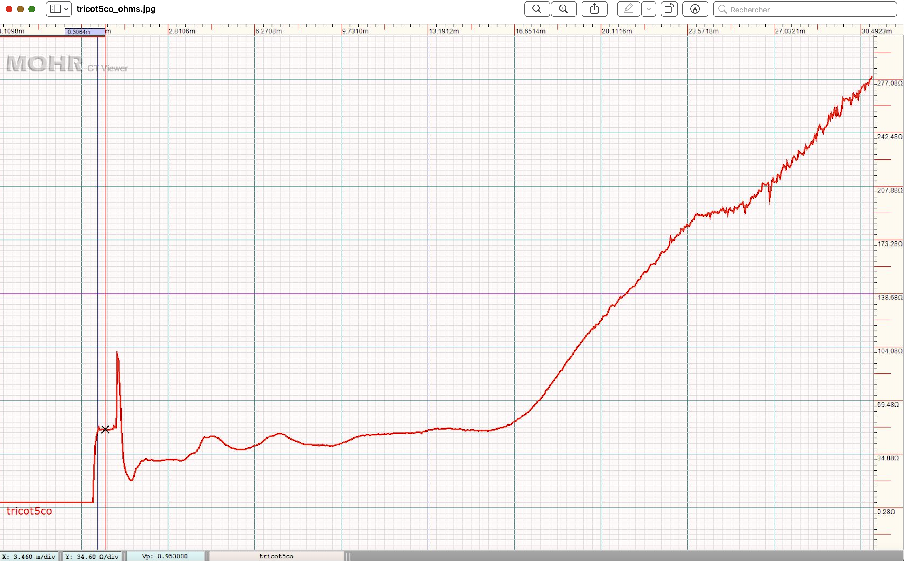
End point
Probe
50Ω
TDR measurement

Slide 21
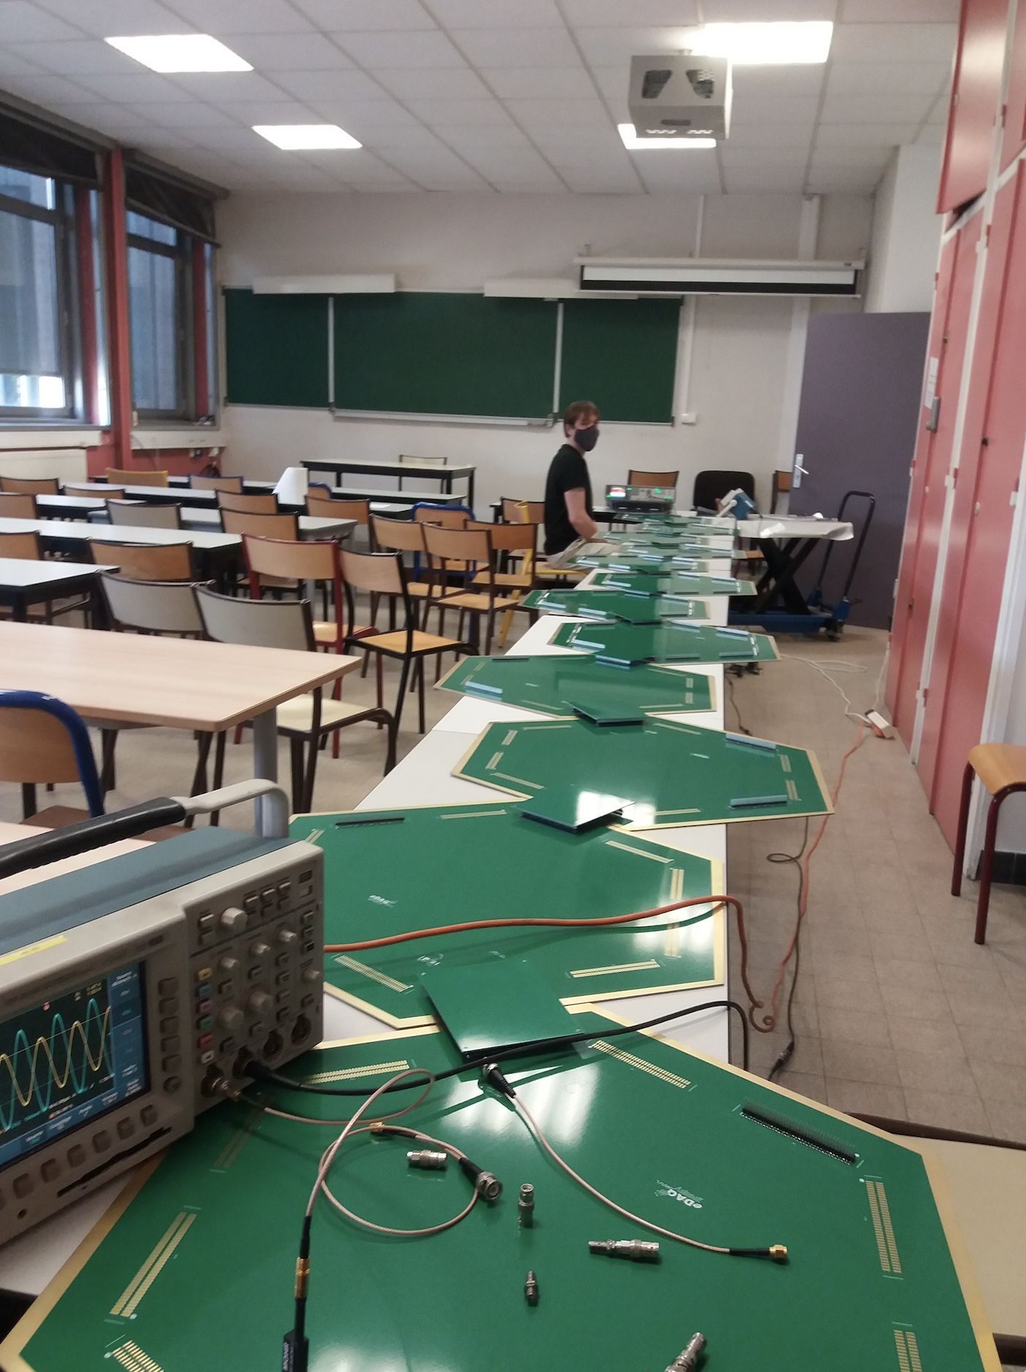
We added 10 of them

Slide 22
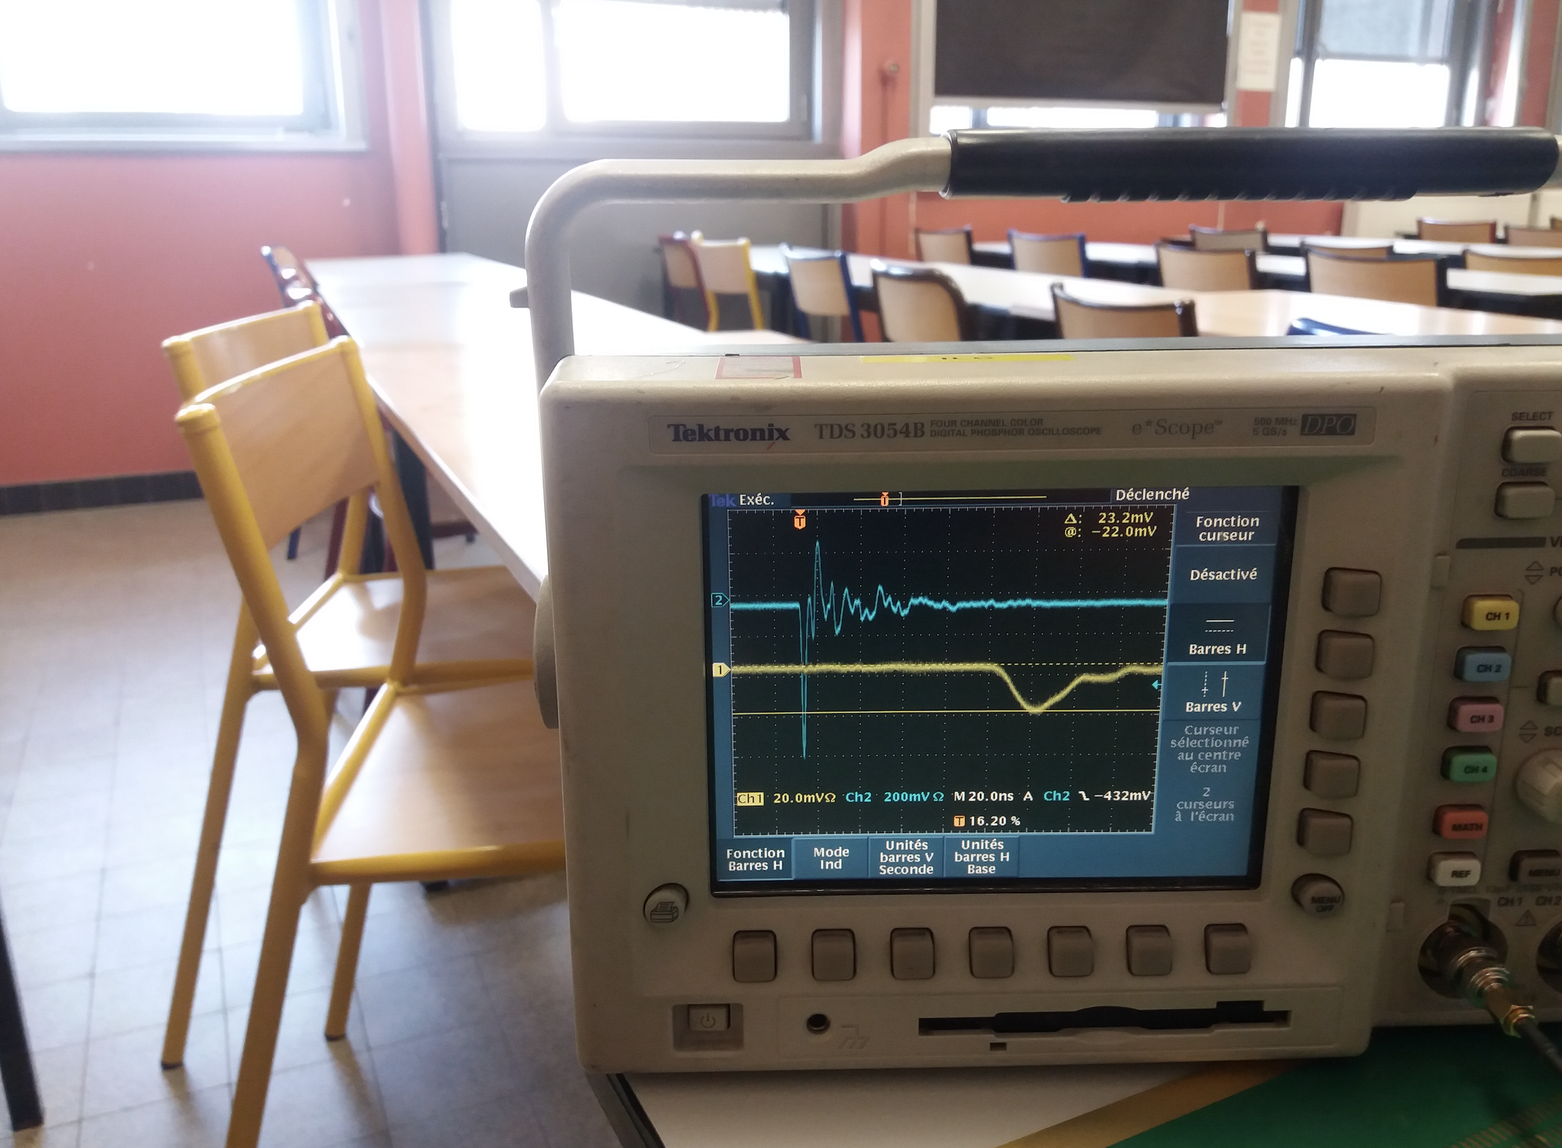
The shape of a RPC-like signal injected on one end and detected on the the opposite one ( > 7 m) is different but the charge loss is rather small).

Slide 23
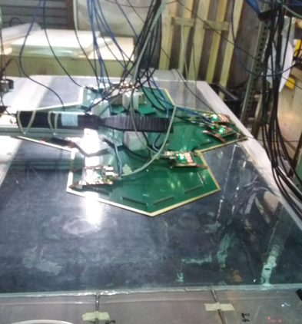
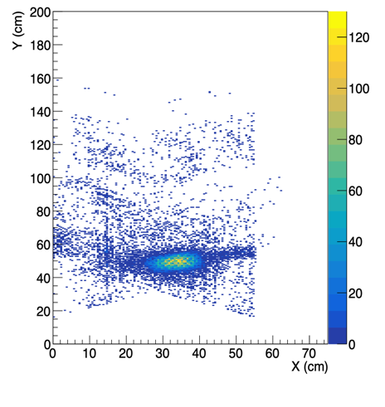
On large GRPC
The new scheme is being tested on a large GRPC (2m x 1 m) with several PCBs
Reconstruction efficiency (1 direction efficiency is not included) is around 90%.
Next step: study the possibility to use this scheme for tail catcher

Slide 24
Conclusion
A new scheme allowing a reduced cost and reduced power consumption without reducing the granularity is proposed to equip large RPC detectors
The scheme could be applied to resistive MPGD in principle. Two resistive MicroMegas are being designed and built in collaboration with CERN Technical Staff with this new scheme
Study to assess the possibility to use it in SDHCAL and SDHCAL tail catcher os to come soon
Half-hexagonal PCB were designed and will be produced soon to adapt the hexagonal shape for the readout of rectangular RPC

Slide 27
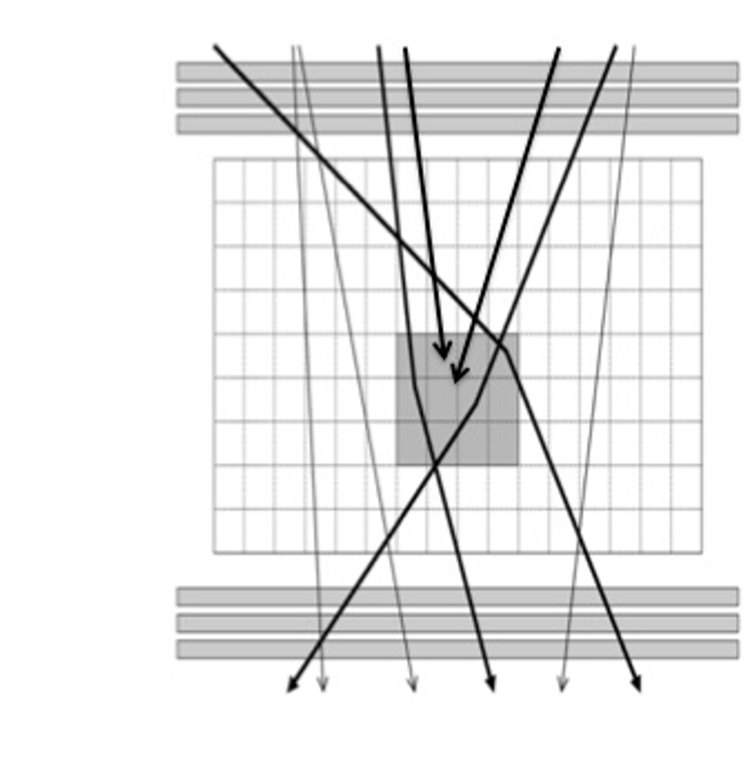
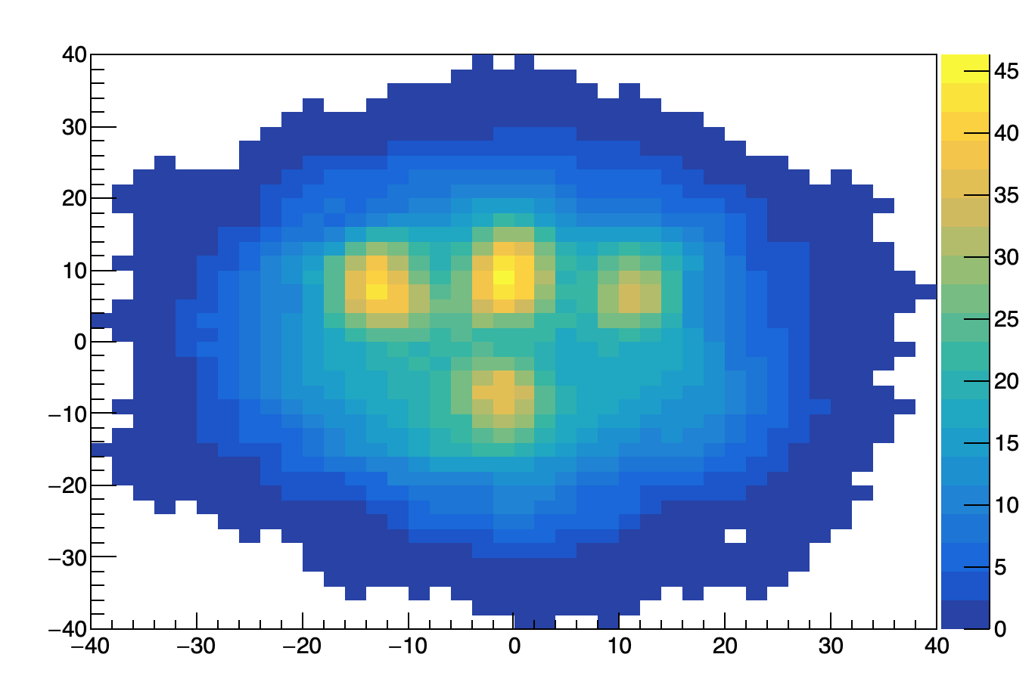
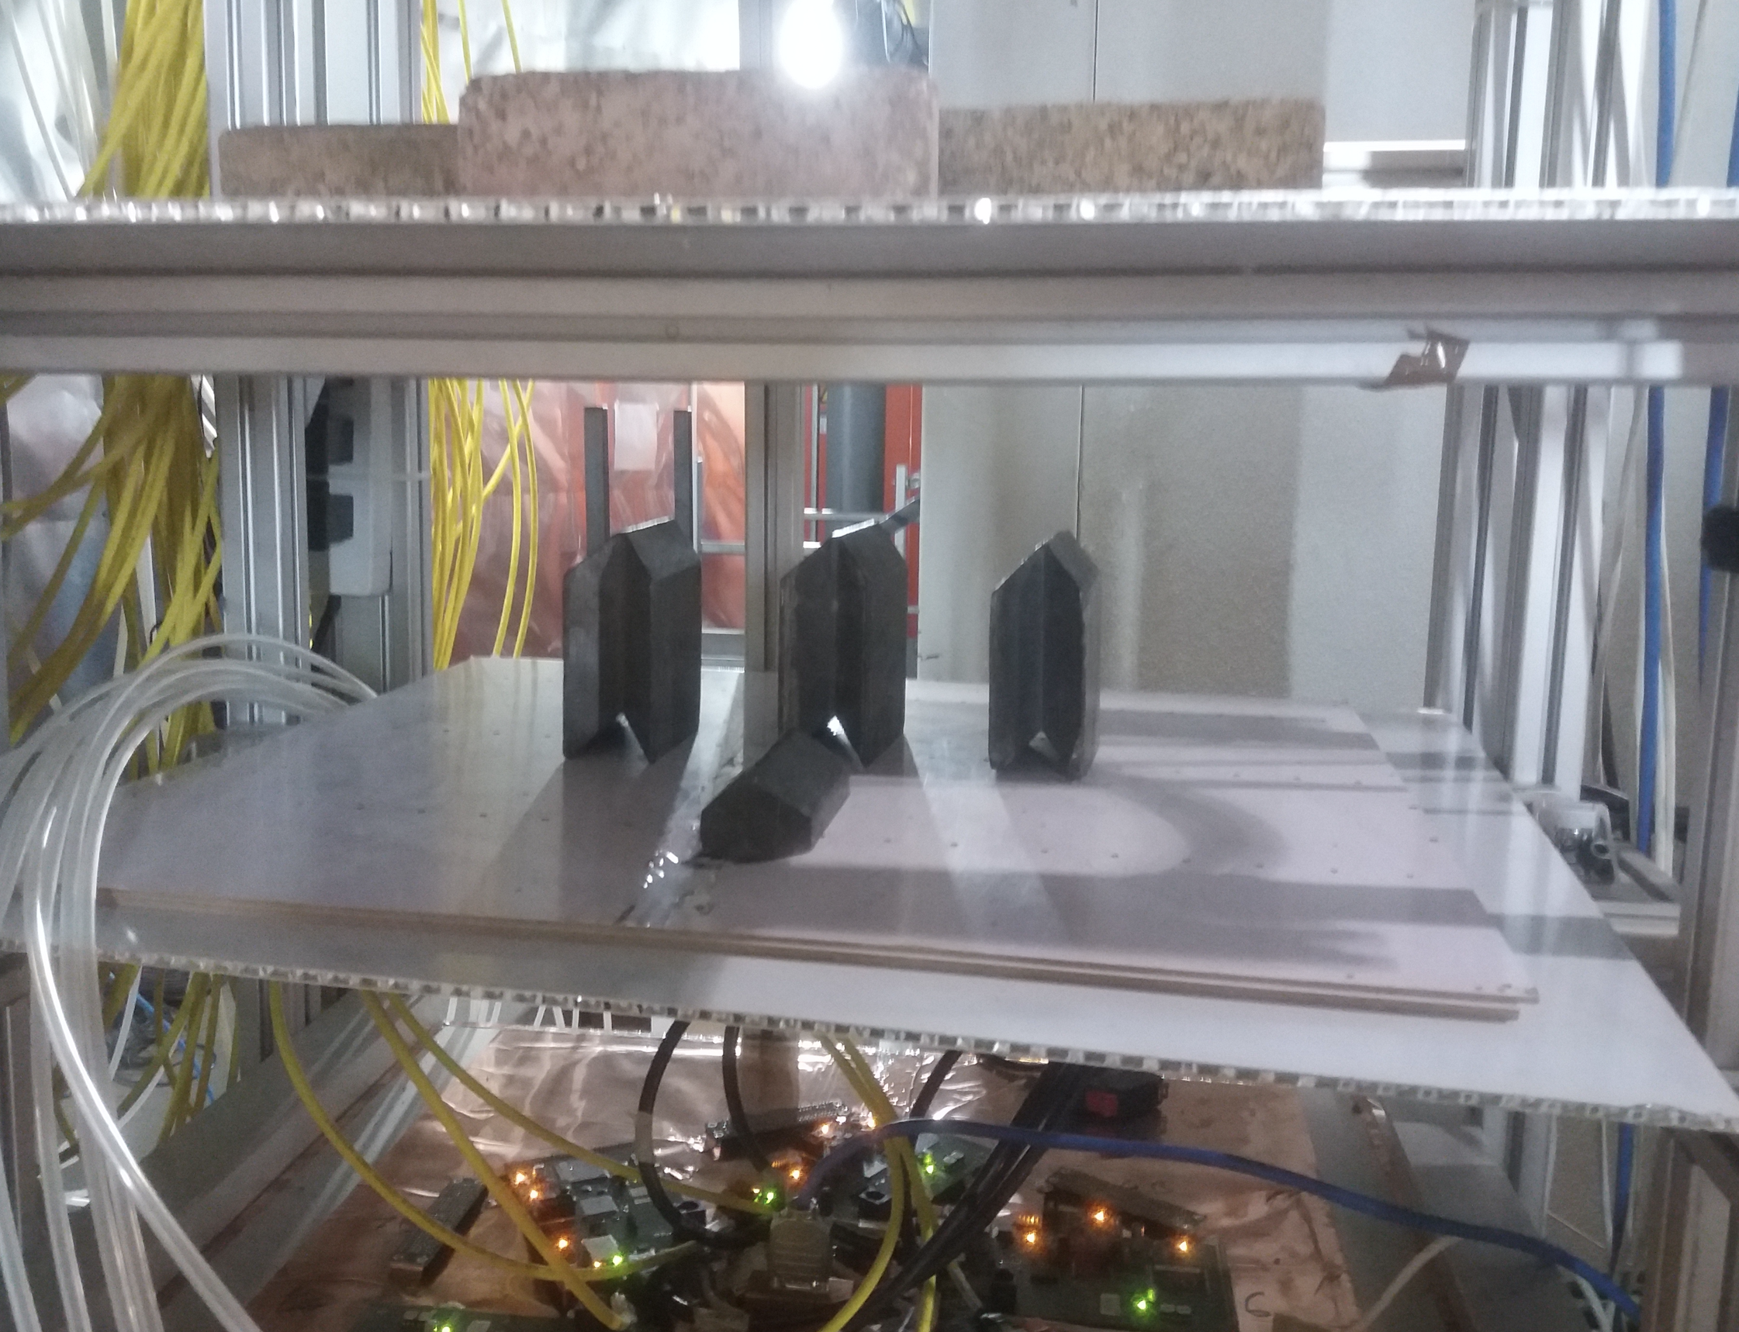
An attempt to use the new scheme in home security application is being attempted.
Hidden blocks of different dense materials were found using multiple scattering techniques.
This is only possible with a precise angular measurement of the two segments.
Y (cm)
X(cm)

Slide 28
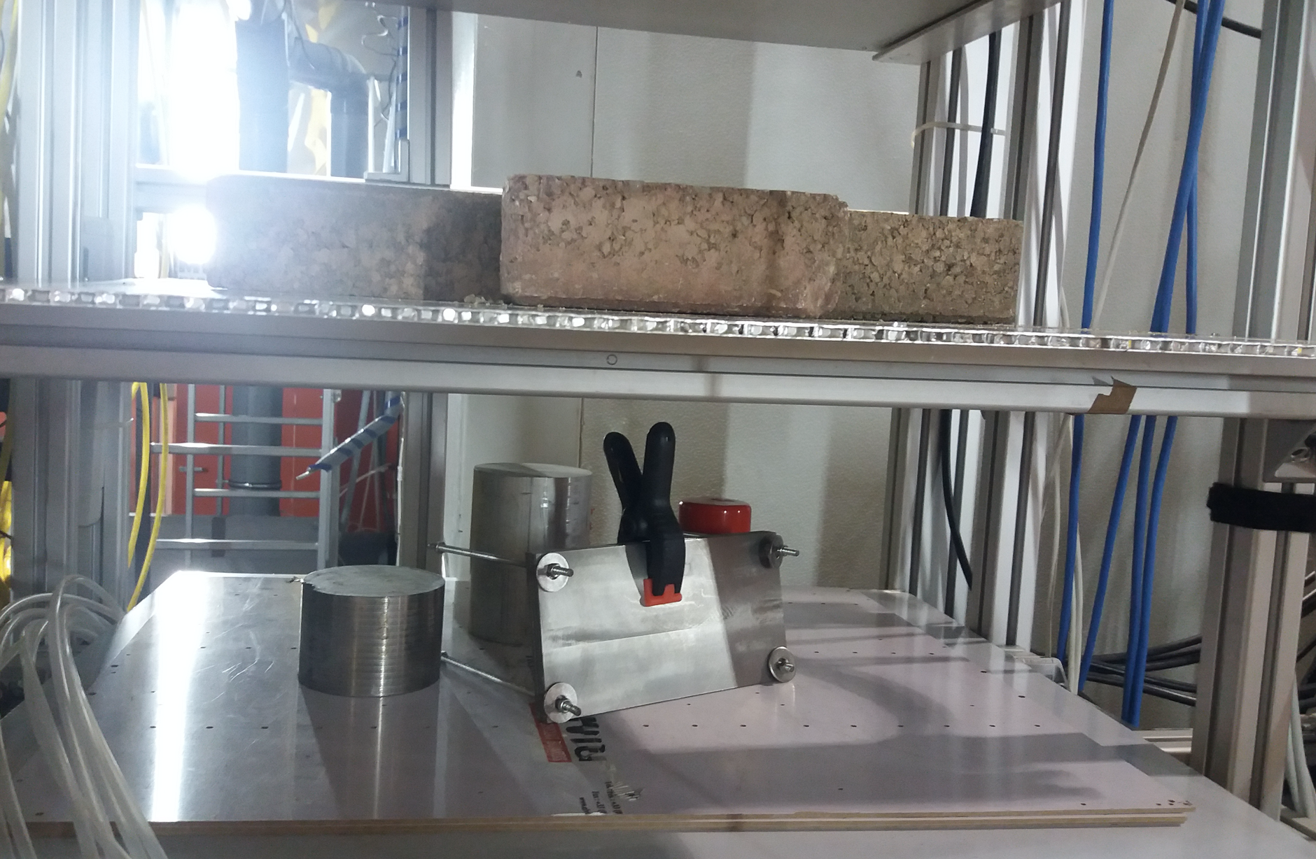

Slide 29
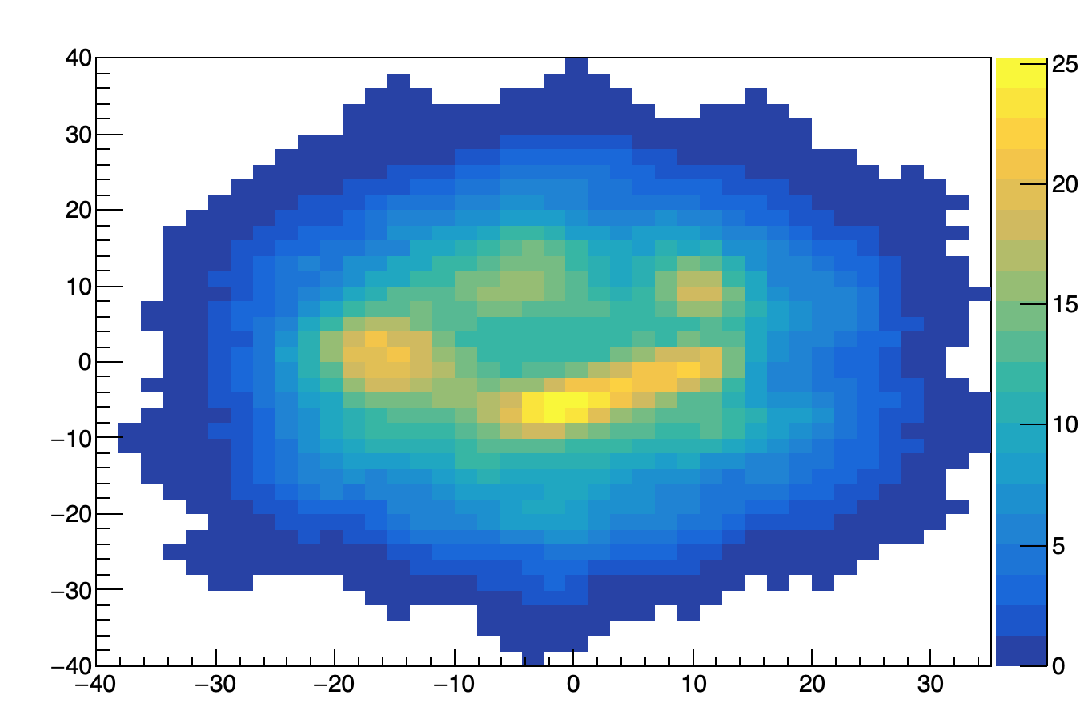
Y (cm)
X(cm)

Slide 30
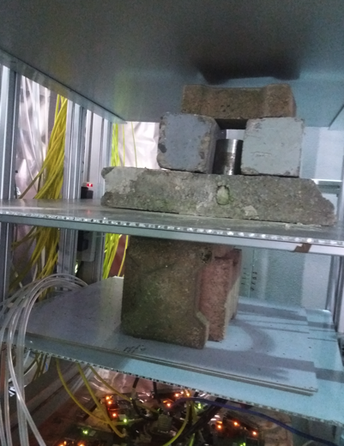
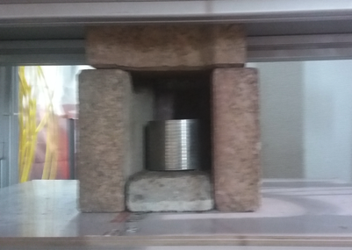
First floor
Seond floor

Slide 31
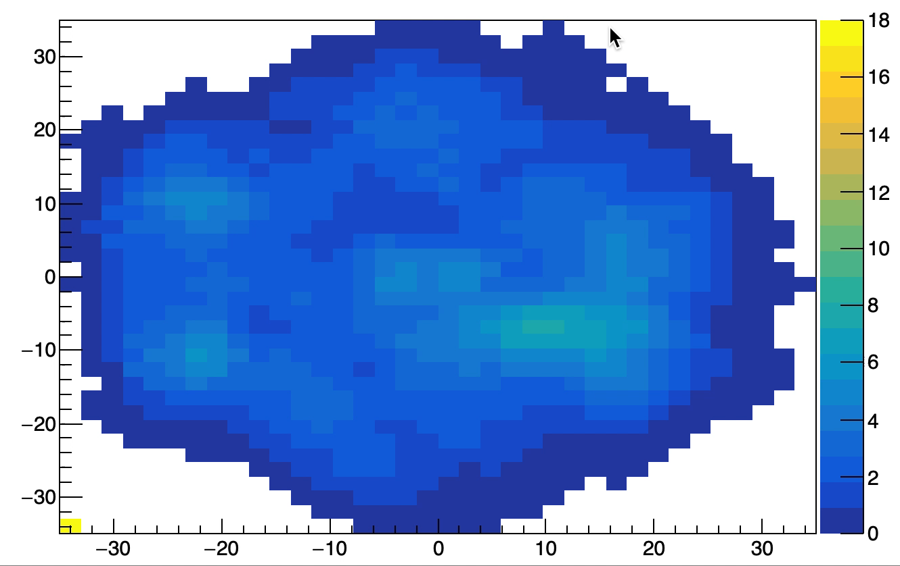
Movie-Zscan
Y (cm)
X(cm)

Slide 32
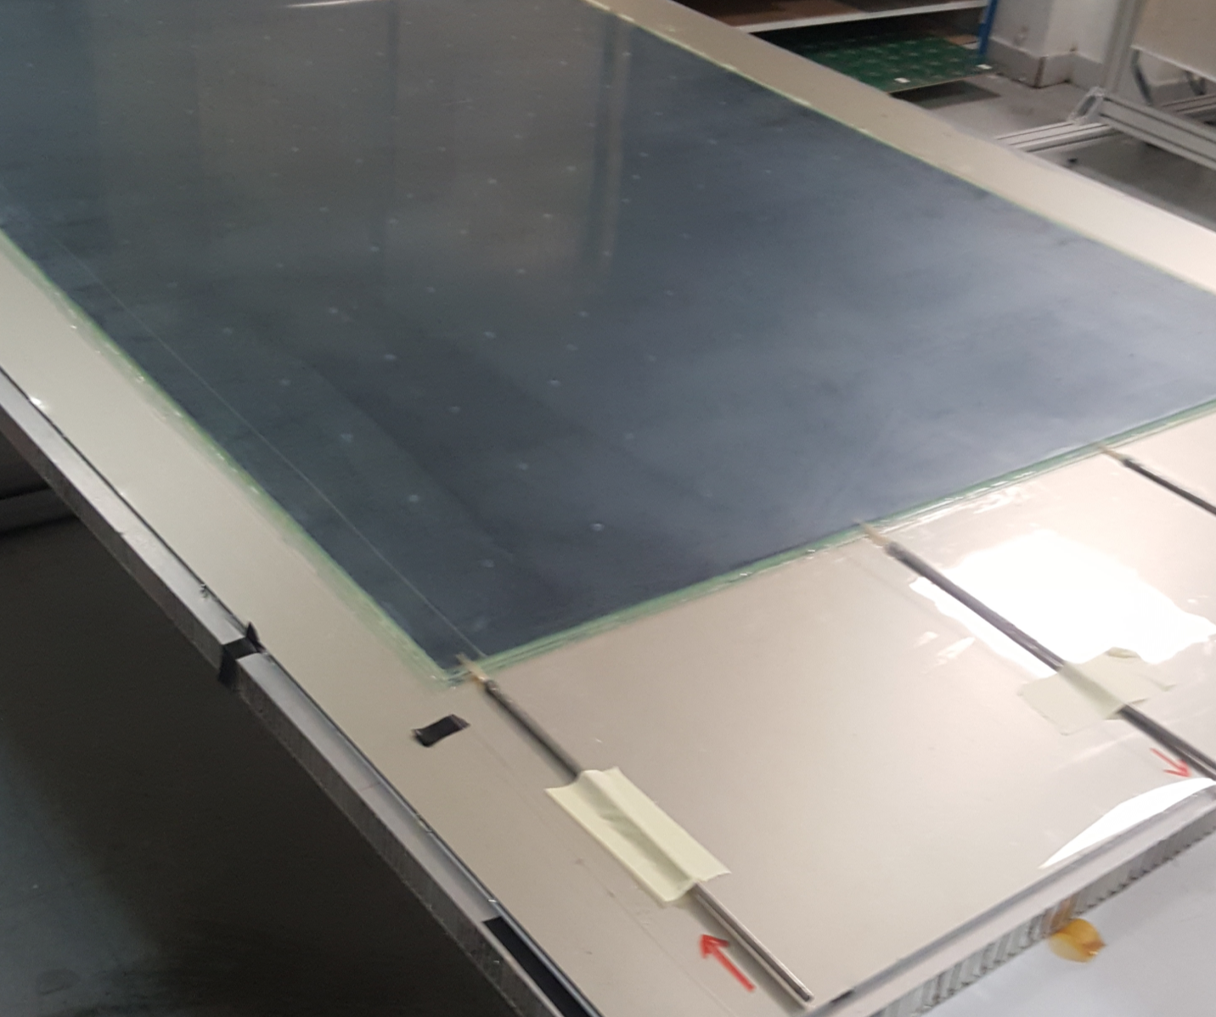
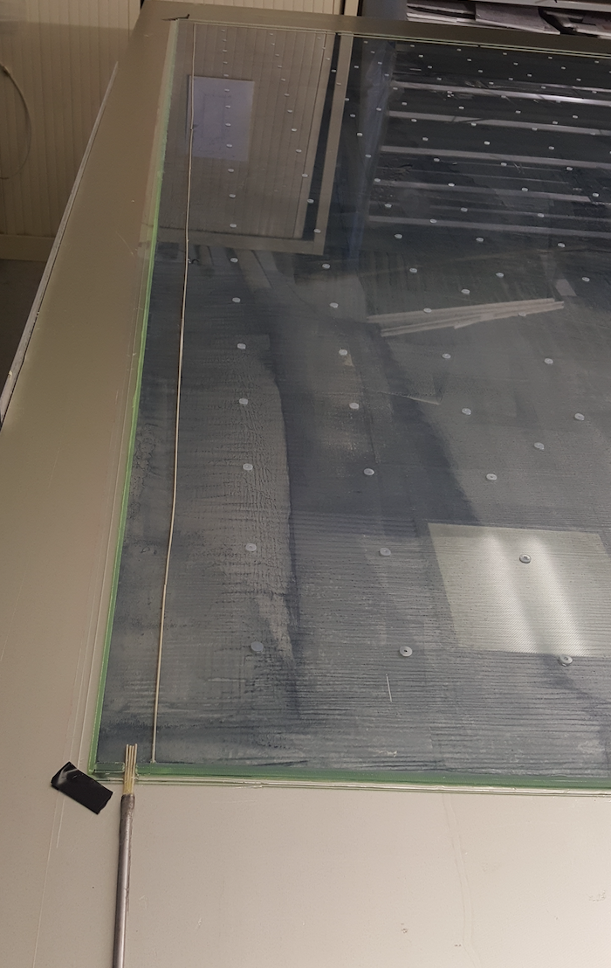
Large RPC

