Slide 1
Overview of the AAA activities
Tohru Takahashi
Hiroshima University/AAA
October 26, 2021

Slide 2
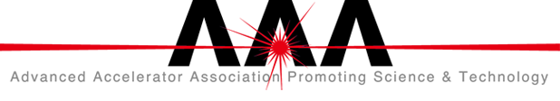
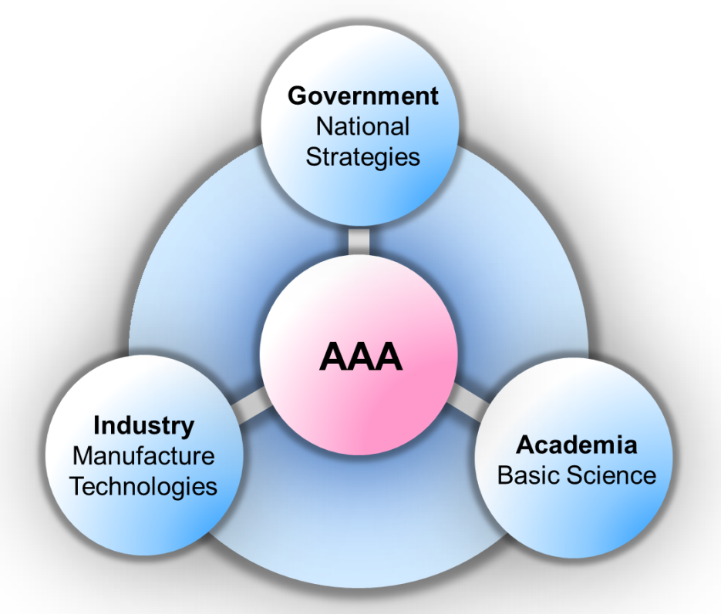
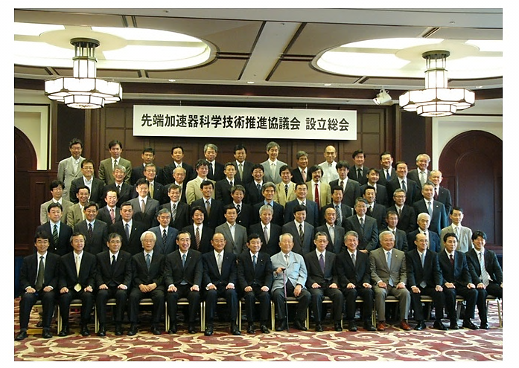
Advanced Accelerator Association
Promoting Science and Technology
To promote inter-sectoral collaboration
in accelerator technology
Organized 2008
Notes:
AAA is a General Incorporated Association organized in 2008
to promote inter-sectoral (government-industry-academia collaboration
in accelerator technology

Slide 3
The central model
of the collaboration
as of July 20, 2021
102 Companies
41 Research Institutions
Notes:
To promote inter-sectoral collaboration, we set the ILC as the central model of the collaboration
as of July 20, 2021, the membership is
102 companies
41 research institutions

Slide 4
Organization
Eternity Supreme Advisor
Late Kaoru Yosano
Honorary Chair
Late Masatoshi Koshiba
Supreme Advisor:
Takeo Kawamura
Special Advisors:
Hiroya Masuda
Hiroaki Takahashi
Senior Advisors:
Yoichi Tao
Junichi Nishiyama
Masao Ninomiya
Toshiyuki Sakamoto
Chair: Takashi Nishioka
Vice Chair: Atsuto Suzuki
Board of Directors
Representative Director
Takashi Nishioka (MHI)
Directors
Atsuto Suzuki (Iwate Pref. Univ.)
Masanori Yamauchi (KEK)
Yuzo Onishi (Kyoto Univ.)
Masahiro Inagaki (Kyocera)
Mamoru Hatazawa (Toshiba)
Hidetoshi Takehara (Hitachi)
Noriyuki Takazawa (MELCO)
Kunihisa Yamura (Iwate Chambers of Commerce)
Auditor
Sachio Komamiya (Waseda Univ.)
General Meeting
Corporate Organizations
and Institutional Organizations
Secretariat
Secretary General
Masanori Matsuoka
Technology Study Group
Chair: Hitoshi Hayano
Project Promotion Study Group
Chair: Satoru Yamashita
Outreach Group
Chair: Hiroyuki Yoshizumi
->Tohru Takahashi
Notes:
The organization of the AAA
The chair is Takashi Nishioka, the former president of Mitsubishi Heavy Industry
The vice chair is Atsuto Szuki, the president of Iwate Prefectural University and former director of KEK
The Secretay genral is Matanori Matsuoka of MHI
Under the management structure, we have 3 working groups
Technical Study Group, chaired by Hitoshi Hayano
Project Promotion Study group, chaired by Statoru Yamashita
Outreach group, Tohru Takahashi took over the role of the chair from Mr. Hiroyuki Yoshizumi of Kyosera Corporation late July.

Slide 5
Working groups
Technology study group
Promoting industry-academia collaboration
  sharing accelerator (ILC) technology
Stimulating application/innovation of accelerator technology
Project promotion study group
Comprehensive actions to realize ILC
  International relations
  Regional Revitalization and Community Development
  Safety and Disaster Prevention
Outreach group
Getting public understanding accelerator science by
  transmitting information of impact on society/industries

Slide 6
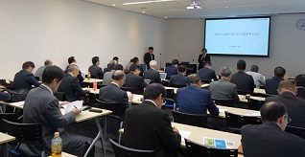
Technology Study Group
Used to have face-to-face technology seminars regularly..
Remote seminars jointly with Iwate ILC seminar
July 14 2020
ILC status, ILC design, ILC exp. Hall
September 23 2020
Tohoku ILC promotion center, Knowledge transfer in CERN and EU, Photon factory
November 26 2020
ILC desig, Accelerator technology in Medical application, IDT-WG and Industry
February 4 2021
SRF electron gun, SRF cavity and regulation, Acc. technology and industry
May 10 2021
ILC detector, Cryomodule and wave guides, Large e-beam 3D printer, company participation
July 14 2021
Pre-Lab WP, e-driven e+ source, photon dump in undulator e+ source, Introducing GES Co. Ltd.
October 7 2021
HL-LHC and magnet R&D, RIBF improvement, report from SRF2021
Notes:
The one of the main activities of Technology study group is to have seminars to introduce the state of art technology in accelerator science, to company menbers
Unfortunately, we have not have face-to-face meeting since January 2020 but have remote seminars regularly.

Slide 7
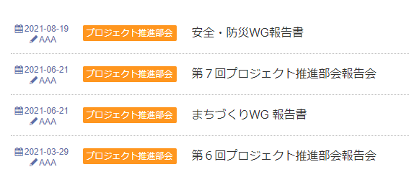
Project Promotion Study Group
Mar. 29, 2021 6th Working Group meeting
Jun. 21, 2021 7th Working Group meeting
Jun. 21, 2021 Regional Revitalization
and Community Development WG Report
Utilization of waste heat
New mobility society
Aug. 19, 2021 Safety and Disaster Prevention WG Report
Outcome of 10 years of activities
Single-tunnel design
Siting issues
Facility construction
Safety/Disaster Prevention
Notes:
Project promotion group has various kind of activities
These are an example of recent topics.
In addition to the regular meeting, tow working group report was published this year
Regional Revitalization and Community Development WG Report, which descries studies of utilization of waste hear and new mobility society
Safety and Disaster Prevention WG Report has published outcome of their more than 10 years of activity
Single-tunnel design, Siting issues, Facility construction, Safety/Disaster Prevention
let me introduce some topics from the report

Slide 8
Community Development around ILC
2021 2025 2035 2050・・・2085・・・
ILC construction ILC operation
Vision2035
Energy Sustainability
Innovations in Mobility
Advanced Information infrastructure
Knowledge Transfer
Healthcare and Education
Area Management
M.Matsuoka LCWS2021 (mod. by t.t)
Notes:
This work was done by revitalization and community development working group set a the vision 2035 and consider issues as
energy sustainability,
innovation in mobility,
advanced information infrastructure,
knowledge transfer,
healthcare and education, and
area management.

Slide 9
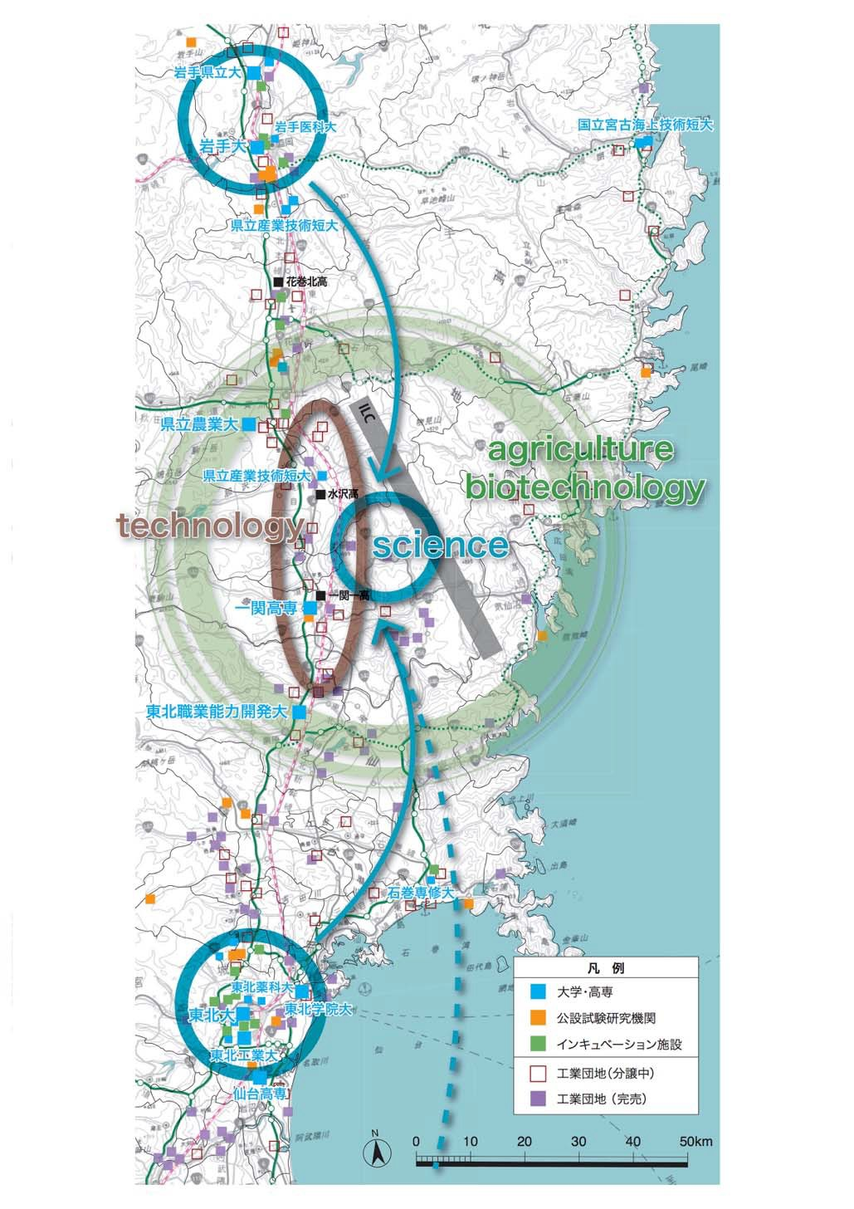

Town development
Vision2035
Morioka
Knowledge transfer
Tohoku ILC Eco-system
IP Campus
Mobility
Autonomous driving / eVTOL
Eco-town
utilizing ILC waste heat
Green ILC / Energy Sustainability
Agricultural, forestry, fisheries bases
utilizing waste heat and other
sustainable energy sources
Main Campus
eVTOL flight base
Logistics base
Distribution base
Community Area
Highway
Advanced Communication Infrastructure
Healthcare/Education
Internationalization and ICT
Sendai
Accommodation / Residence
Albergo Difuso
best use of local resources
Shinkansen
Airport
Reference Information: "Tohoku and Kitakami Area Grand Design with ILC"
M.Matsuoka LCWS2021 (mod. by t.t)
Notes:
(next generation town)
The ILC is expected to be built in the area of Iwate and Miyagi prefecture. The main campus will be located almost middle of two large cities, Morioka and Sendai. Both cities have the airport and advanced industrial accumulation base including science facilities, universities and private companies. Researchers and their families can choose the variety of accommodation using convenient transportation such as Shinkansen or highway driving. We believe that the area around the ILC will be attractive not only for researchers but for other people by means of area management and installing new technologies such as eVTOL. Old houses in Tohoku area will be also attractive for accommodation and residence.

Slide 10

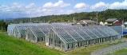







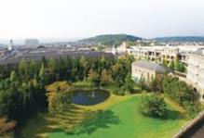
Sustainable community development coexisting with forests and nature
Vision2035
・ Community of appropriate size (200-300 units)
・ All wooden
・ Green garden community
Wooden Residence
●Growth management of community
(Returning development profits to the community)
Town Center
・ Commercial facility
・ Hotel
・ Business center
Greenbelt and Agricultural complex
●Incorporate cutting-edge technologies
(Society 5.0/ICT・AI)
Large scale heat storage
Local production and
local consumption of energy
Central green park
Sports Facilities
Square and Marche
Child facilities
Restaurants
Hotel
・Healthcare ・Mobility
・Robot service / guidance
・Solar heat plan
・Unused biomass heat use
・Unused waste heat recovery
Areas where ILC-related companies, medical care, education, robotics, AI technology, etc. are concentrated
Main road
■Next generation mobility area
Fully automatic operation (Level 4 or more)
eVTOL takeoff and landing
・ Seamless transportation and logistics
・ People flow / logistics interlocking service
Old city Area
(local community)
・Efforts to foster exchange between communities
・Improve regional brands in the old city
M.Matsuoka LCWS2021 (mod. by t.t)
Notes:
(Basic model of the ILC community )
Basic model of the ILC community is shown this slide. One of the important concept is sustainable community development that coexists with forests and nature. I
t has some design codes of all wooden, green garden, local production and local consumption of energy, etc. On the other hand, this town will be evolving with the next generation technology in the field of healthcare, mobility, robotics and so on.

Slide 11
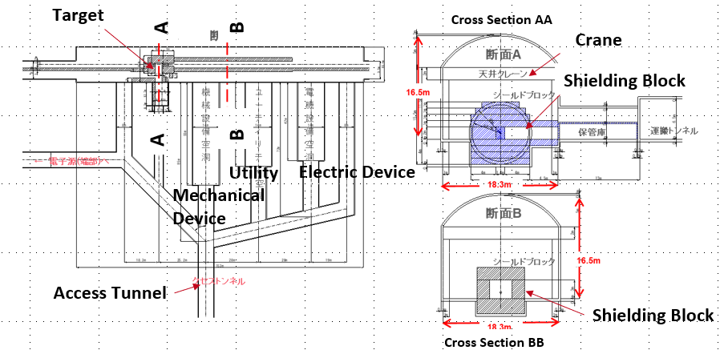
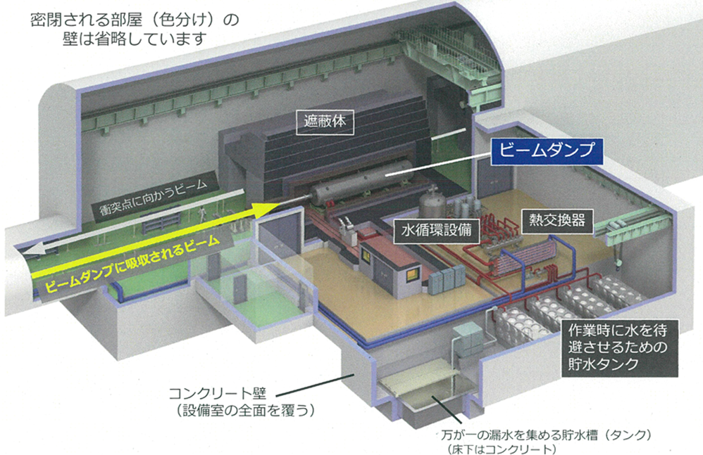
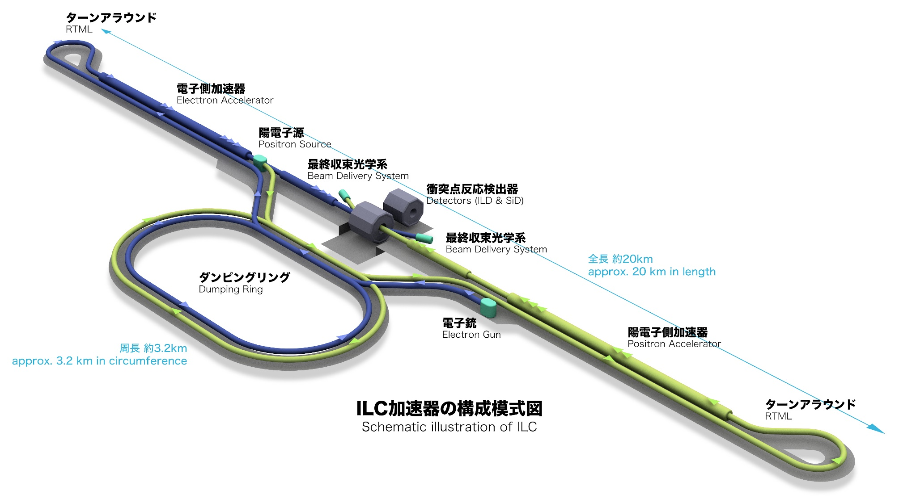
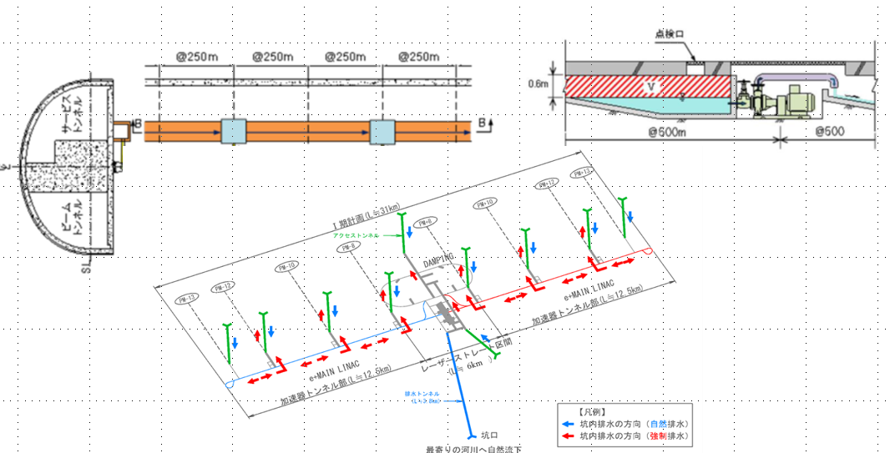
Safety and Disaster Prevention
Radiation protection
  Beam Dump
  Positron source
Drainage system
Positron Source
Beam Dump
Drainage system
(w/ or w/o power supply)
M.Matsuoka LCWS2021 (mod. by t.t)
Notes:
(High radiation)
The beam dump and the positron source are high radiation facilities and needed to study the appropriate structures for setting and handling safe radiation shieldings. Today I would like to focus on the positron source which was studied by safety and disaster prevention working group of AAA this year.

Slide 12

Outreach Working Group
No face-to-face symposium since Feb. 2020
Putting more effort on social media platform

Slide 13
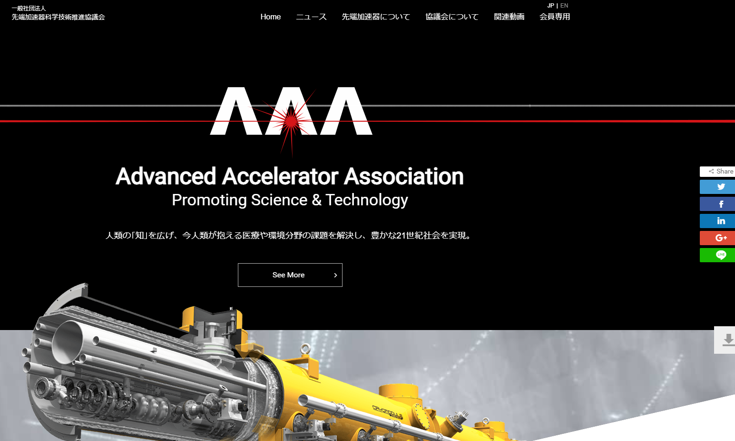

Slide 14
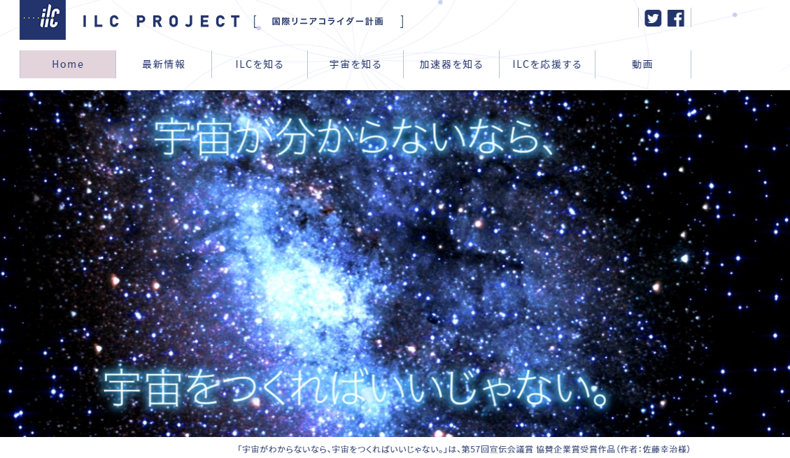

Slide 15
「宇宙がわからないなら、宇宙をつくればいいじゃない。」
Mr. Koji Sato: AAA prize in 57th public announcement meeting
If you don't understand the universe, just create one
(translation by tt)

Slide 16
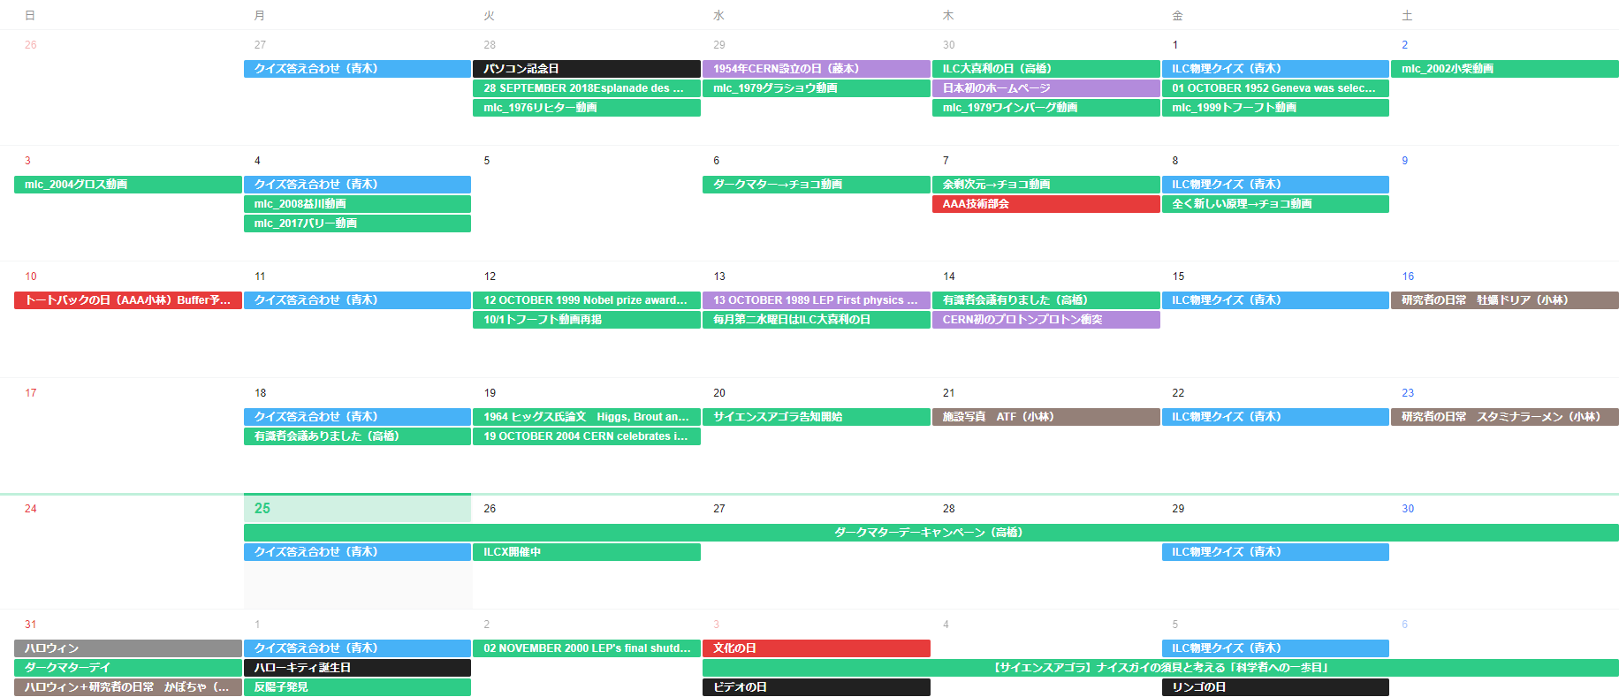
KEK-AAA meeting for social media(twitter) use
CERN birthday
First Web site in Japan
Nobel Prize in Physics
First Proton Collision at CERN
Higgs’s Paper on PRL
ILCX2021

Slide 17
Pre-Lab WPs (only a week to correct information….)
WP | Area | experiences w/ ILC | interestes | related activities
1. ML and SRF:
WP-1 | Cavity production
WP-2 | Cryomodule transfer
WP-3 | Crab cavity
2. Electron Source:
WP-4 | Electron source
3.Positron Source:
3.1 Undulator scheme:
WP-5 | Undulator
WP-6 | Rotating target
WP-7 | Magnetic focusing
3.2 e-Driven scheme:
WP-8 | Rotating target
WP-9 | Magnetic focusing
WP-10 | Capture cavity
WP-11 | Target replacement
4. DR
WP-12 | System design
WP-13 | Collective effect
WP-14 | Injection/extraction
5. BDS
WP-15 | Final focus
WP-16 | Final doublet
6. Dump
WP-17 | Main dump
WP-18 | Photon dump
Notes:
We sent questionnaire to AAA member about pre-lab work packages
Unfortunately, we did it a week ago and enough time to collect information
Greens are the area in which AAA members express their interest (already has activity, expressed interests, related technology or activities in a company,,,)
We could expect effective collaboration with companies in work packages

Slide 18
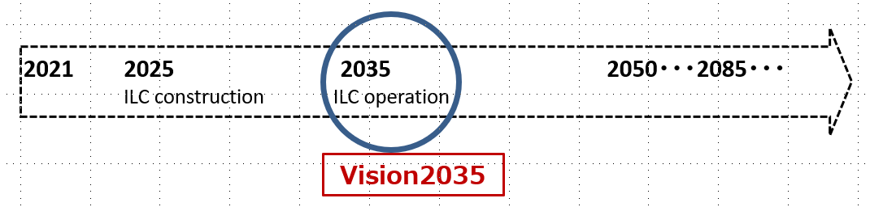
Technology transfer
Project Promotion
More than 10 years of activity
to promote inter-sectoral collaboration
in accelerator technology
Public outreach
Notes:
AAA is an organization to promote inter-sector collaboration in accelerator technology
We have been active in the areas of technology transfer, project promotion and publich outreach
to realize ILC in Japan

