Slide 1
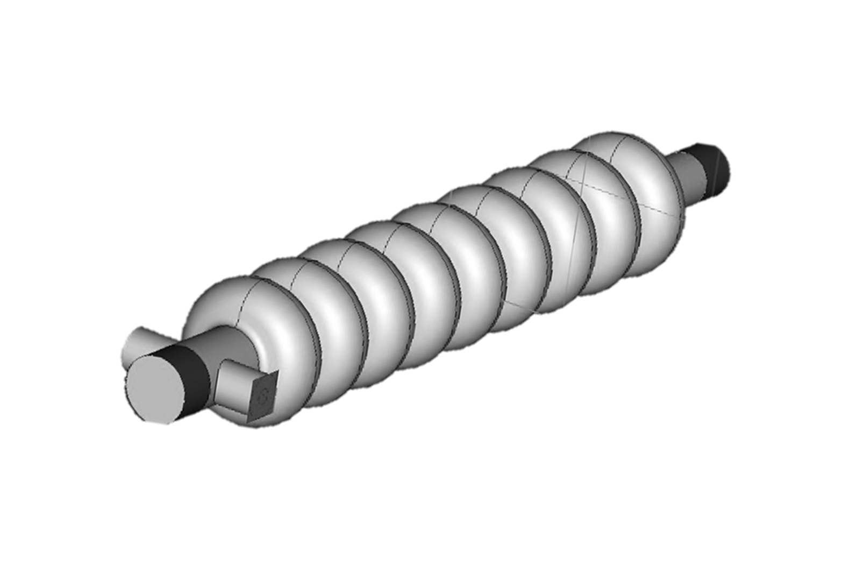

ACCELERATOR TECHNOLOGY : A SUSTAINABLE APPROACH
TO CLEAN INDIAN RIVERS
Raghava Varma
INDIAN INSTITUTE OF TECHNOLOGY BOMBAY
MUMBAI, INDIA

Slide 2
Contributors to the presentation
Dr. Abhishek Pathak
Ms. Manisha Meena
Mr. Pankaj Kumar
Ms. Anjali Kavar
Ms. Pragya Nama
IIT BOMBAY
SAMEER BOMBAY
Dr. Abhay Deshpande
Dr. Tanuja Dixit

Slide 3
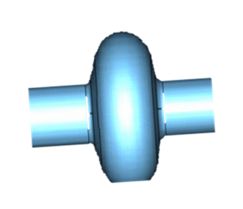
1. MOTIVATION
2. REQUIREMENTS
CONTENTS
3. EXPERIMENT
4. PRELIMINARY DESIGN

Slide 4
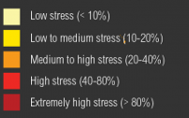
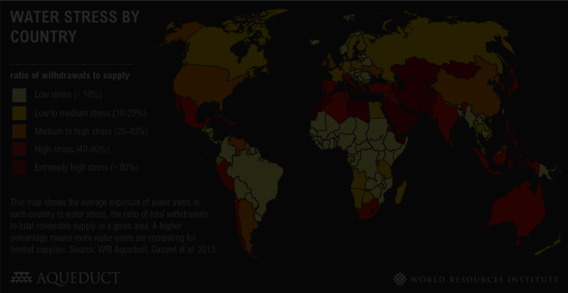
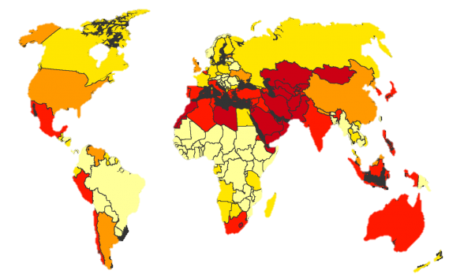
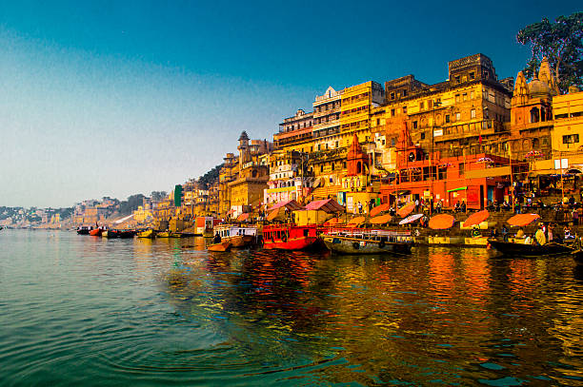
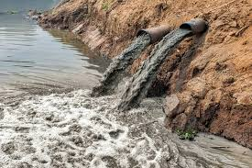
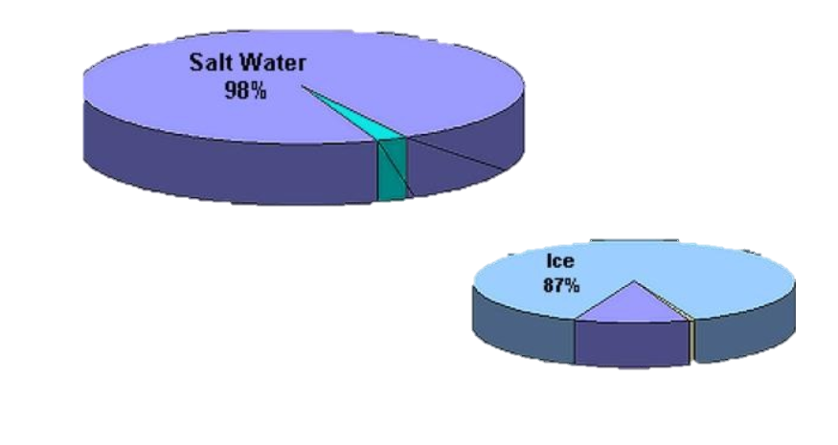
MOTIVATION
1. Domestic and industrial wastes
2. Harmful pesticides and fertilisers
3. Animal carcasses and unburned human corpses
4. Mass bathing and ritualistic practices
Parameters | Permissible limit | Allahabad (Mawaiyanala) | Varanasi (Bathing ghat I)
BOD (mg/l) | ≤ 10 mg/l | 22.67 | 18.7
DO (mg/l) | > 5mg/l | 0.52 | 3.46
COD (mg/l) | ≤ 50 | 82.08 | 73.29
Faecal coliform (Mpn/100ml) | ≤ 250 | 12500-32500 | 4100000
Conductivity (μs/cm) | 250 | 928.0 | 833.0
PH | 6.5-8.5 | 7.6 | 8.98
Color (Pt scale, Hz Units) | No visible color | 27.79 | -
Rivers & Lakes (1%)
Fresh water (2%)
Earth water distribution & Stress levels
Ground water (12%)
Gange’s water quality parameters

Slide 5



Eco friendly technology (no secondary waste generation, no use of catalysts and heating)
REQUIREMENTS
Removal of Total Organic Compounds (TOCs).
Removal of COD (Chemical Oxygen Demand), BOD (Biological Oxygen Demand).
Removal of colour, odour etc. and TN (Total Nitrogen), TP (Total Phosphorus) compounds.
Disinfection of disease causing micro-organisms (such as E-coli and pathogens).
Destruction of contaminant of emerging concerns (CECs).
Compact, reliable, energy efficient and ease to control
Removes colour by destruction of double bonds in azo compounds
Destruction of CECs
ELECTRON BEAM
TECHNOLOGY
About 100% disinfection of micro-organisms by destruction of their DNA’s and Detoxification of water
Removes organic impurities with radiation chemical reactions
Removes odor by opening rings of aromatic compounds
Removes heavy metals by redox conversion

Slide 6
CONTAMINENTS OF EMERGING CONCERNS
CEC Class | Example Compounds | CEC Class | Example Compounds
Antibiotics | Tetracycline, Erytromycin | Antimicrobials | Triclosan
Detergent metabolites | Nonylphenol | Disinfectants | Alcohols, Aldehydes, oxidizing agents
Disinfection By- Products (DBPs) | Chloroform (NDMA) | Estrogenic Compounds | Estrone, Estradiol, Nonylphenol, Bisphenol A
Explosives | TNT, RDX | Fragrances | Galaxolide
Pharmaceuticals | Fluoxetine (Prozac), Ibuprofen Carbamazepine, Diphenhydramine | Insect repellents | DEET (N,N-diethyl-meta- toluamide)
Personal Care Products | Para-hydroxybenzoate | Fire and Flame retardants | Polybrominated Diphenyl Ethers (PBDEs)
Solvents | Ethanol, kerosene | Plasticizers | Dioctyl Phthalate
Reproductive hormones | Dihydrotestosterone (DHT), Progesterone, Estrone, Estradiol | Pesticides and insecticides | Permethrin, Fenitrothion, Bacillus thuringiensis israelensis (B.t.i.)
Steroids | Cholesterol, Coprostanol, Estrone, Progesterone | Surfactants | Sodium Lauryl Sulfate

Slide 7
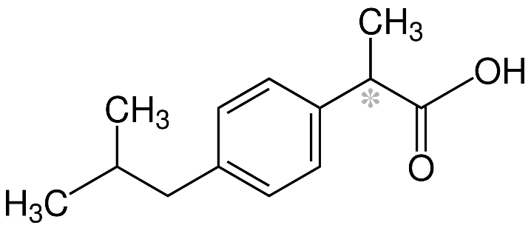
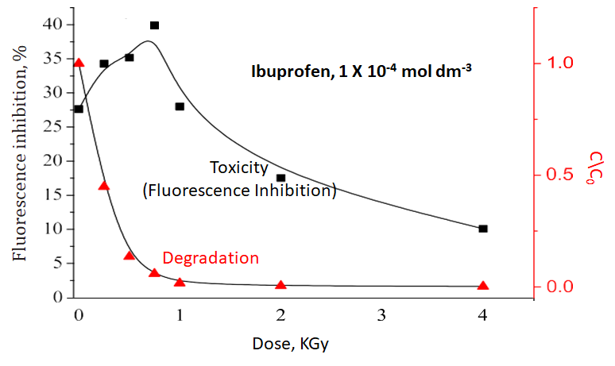
DEGRADATION OF CECs : IBUPROFEN
Degradation of Emerging Organic Contaminant by OH radicals: (Ibuprofen)
OH radical is strong oxidizing species.
Forms after irradiation of water by radiation.
OH radicals attack the ring.
Reduction in Ibuprofen concentration.
Toxicity first increases then decreases.
https://doi.org/10.1016/j.scitotenv.2013.01.007

Slide 8

Effectiveness of electron beam irradiation
Dyes
Examined content | Method of treatment | concentration | Matrix | Dose (kGy) | Removal (%)
Reactive Red 21 Cibacron Yellow 6 G Reactive Blue XBR | EB EB EB + H₂O₂ | 50 mg/L 100 mg/l 800 mg/l | Aerated Std. solutions Aerated Std. solutions Aerated Std. solutions | 7 kGy 3 kGy 25 kGy | 100% 97 % 80 %
Methylene chloride Trichloroethylene (TCE) | EB EB + Ozone | 102 μM 100 μg/L | Treated groundwater Tap water | 5.0 kGy 0.2 kGy | 91.6% 90 %
Benzotriazole Perfluorooctanoic acid Nonylphenol ethoxylate | EB EB EB | 0.45 mg/L 515 mg/L 2.5 μg/L | Std. solutions with persulfate Phosphate buffer, high alkalinity Wastewater | 15 kGy 6.0 kGy 4.2 kGy | 64 % 96 % 90 %
Cd, Cr(VI), and Pb(II) Co(II), Cu(II), Sr(II) Organolead compounds and Pb(II) EB | EB EB EB | 2 mg/L Cd, 5 mg/L Pb & Cr 0.85-Co, 0.79-Cu, 0.57-Sr mM 0.2 mM each Pb(II) | Std. solutions with formate Wastewater + humic acid & UV/TiO2 treatment Std. solutions for Pb(II) with formate | Cd-2.7, Pb-1,Cr- 2.8 kGy 50 kGy for all Pb(II) & Met₃Pb: 4 kGy, Et₃Pb: 2 kGy | 90 % 100 % 75 % 90 %
Atrazine Carbendazim Fenvalerate | EB EB EB | 6 mg/L 42 μM (1:20 diluted waste) 5 mg/L | Std. solutions Std. solution, dilute wastewater Std. solutions | 1.0 kGy 26 kGy 8 kGy | 95 % 100 % 78 %
Carbamazepine Chlortetracycline Primidone Sulfamethoxazole | EB EB EB EB | 50 g/L 30 mg/L 25-100 mg/L 30 mg/L | Std. solutions, surface water Std. solutions Std. solutions Std. solutions | 1 kGy , 2kGy 0.6 kGy 0.5-2.2 kGy 1.1 kGy | 90% 90 % 90 % 90 %
Total coliforms Fecal coliforms Total bacteria count Bromate | EB EB EB EB | 1.3*10E07/100 ml 7.3*10E06/ 100 ml 3.1*10E06/100 ml 99.8 mg/l | Raw domestic wastewater Raw domestic wastewater Raw domestic wastewater Phosphate buffer | 2 kGy 3 kGy 3 kGy 2.0 kGy | red. By 3 orders Red. By 4 orders 100 %
Halogenated hydrocarbon
Industrial Pollutants
Metal Ions
Pesticides
Pharmaceu- ticals
Coliform
Trojanowicz, Marek, et al. "Gamma-ray, X-ray and Electron Beam Based Processes." Advanced Oxidation Processes for Waste Water Treatment. Academic Press, 2018. 257-331.

Slide 9
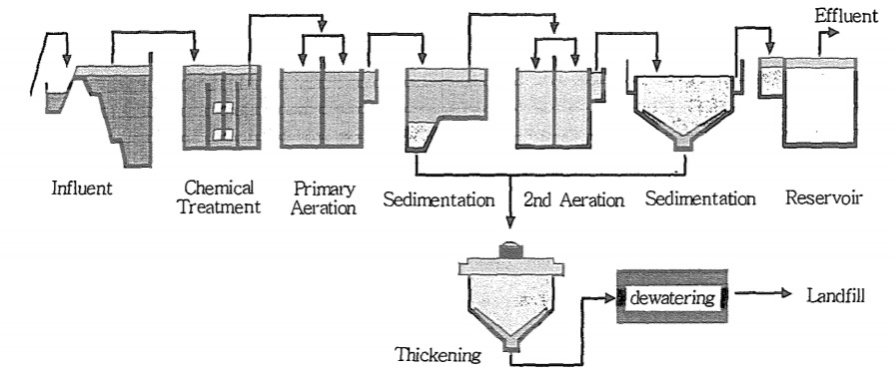
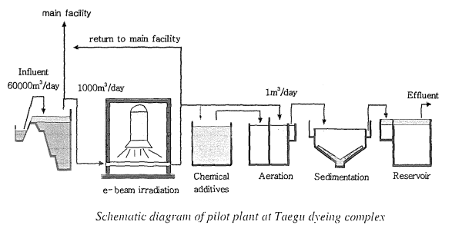
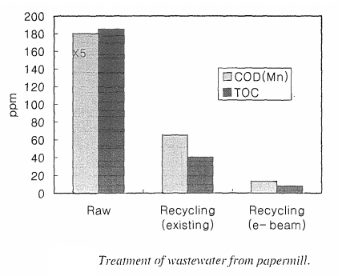
Without disturbing the original operation and just by adding EBT, one can ensure the NGT norms for industrial effluents
EBT+conventional techniques (An Example)
Pilot plant for waste water from dyeing process at TAEGU DYEING INDUSTRIAL COMPLEX
Factories are used for dip dyeing, printing and yarn dyeing
Large amount of highly coloured industrial waste water is generated
A pilot plant to treat 1000 m³/day waste water is installed.
Biological treatment facility
RESULTS
Electron Accelerator
Energy: 1 MeV
Power: 40 kW
Dose: 1-2 kGy
17 hrs of biological treatment = 8 hrs biological after EB treatment
Most significant improvements result in decolorizing and destructive oxidation of organic impurities in waste water.
Reduction of chemical reagent consumption upto 50%
Reduction in treatment time
Increase in flow rate by 30-40%
Biological + EB treatment

Slide 10
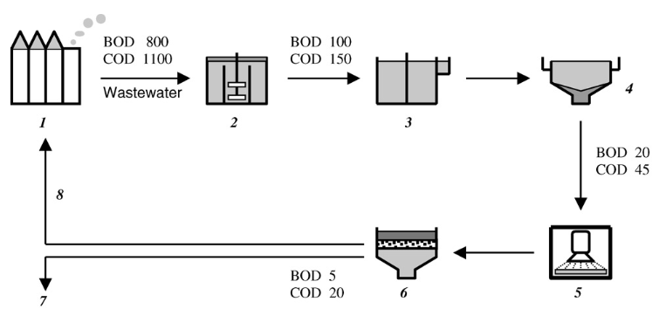
EBT+conventional techniques (Another Example)
Commercial Plant Design for Wastewater from Papermill
Major products of company are papers for newsprint (made of recycled paper)
Papermill company consumes 18,000 m³ water per day
Previous purification plant use 2 stages of chemical and biological treatment
Dose: 1 kGy
Flow rate: 15,000 m³ per day
3 EB accelerators with total power 300 kW
RESULTS
Raw wastewater from papermill
Coagulation
Biological treatment
Sedimentation
Irradiation (+coagulation)
Filtration by sand filter
Effluent
Recirculated waste water (70-80%)
Best results obtained by EB treatment after biological treatment combined with coagulation and filtration
70-80% of water can be reused in paper producing process after EB treatment as compared to 20-30% recycle before EB treatment
Additional removal of impurities is upto 80% in TOC (Total Organic Compounds) values

Slide 11
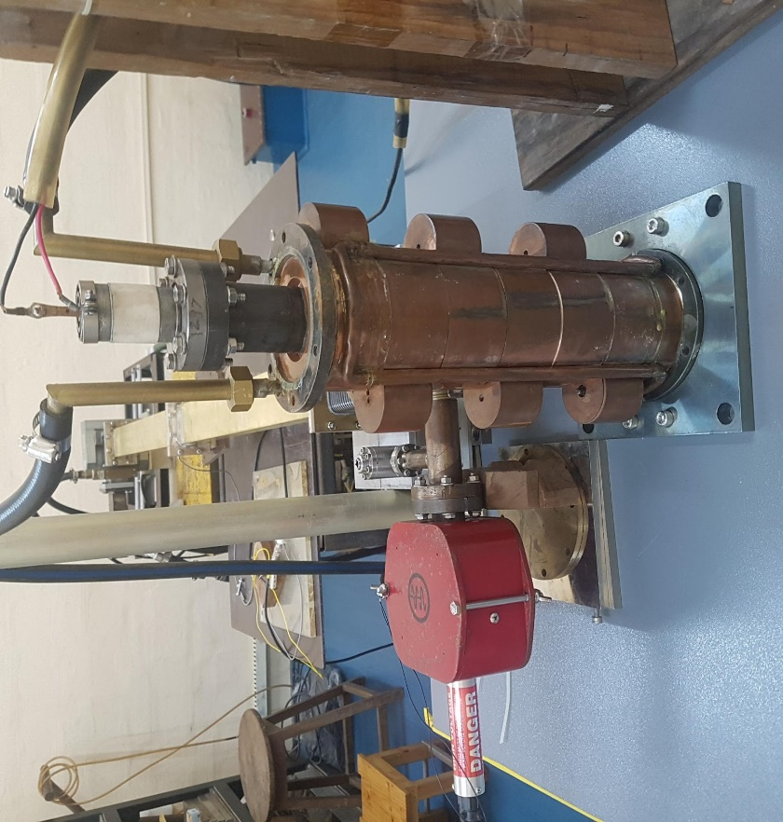
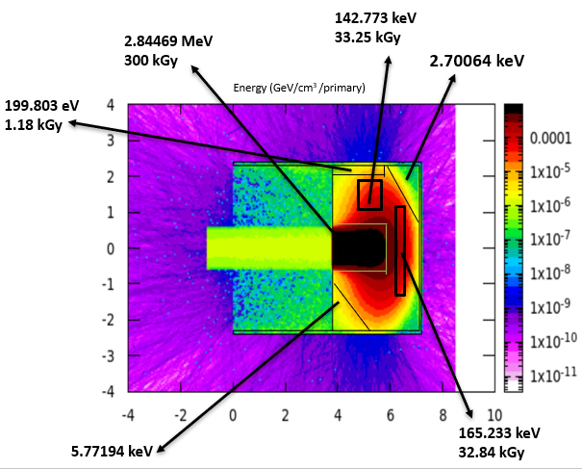
EXPERIMENTAL SETUP
We have irradiated water samples from pharmaceutical industry with EB accelerator (Beam power 90W) at SAMEER (Beam radius 0.6 cm)
Energy : 6 MeV
Beam current: 15.9 μA
Electron energy deposition is not uniform due to small beam scan area (pencil beam) as the accelerator used to test is of medical application
Our proposed system will have power of 40kW and larger beam scan area.
Better Results

Slide 12
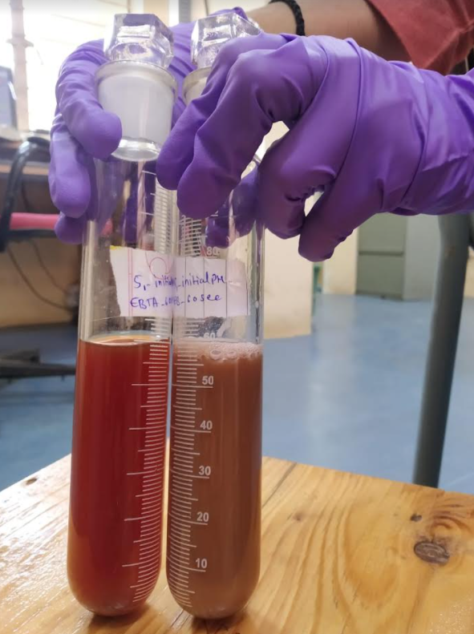
EXPERIMENTAL results
Sample | Process_irradiation time | COD(Cr) (mg/L) | % reduction in COD
S1 | EBC_15s | 14640 | 26.20%
 | EBC_60s | 13120 | 33.87%
 | CEB_15s | 12320 | 37.90%
 | CEB_60s | 11120 | 43.95%
S2 | EB_15s | 512 | 27.27%
 | EB_60s | 672 | 4.5%
 | EB_120s | 608 | 13.63%
 | EB_8min | 320 | 54.54%
 | EBC_15s | 320 | 54.54%
 | EBC_60s | 358.4 | 49.09%
 | EBC_120s | 233.6 | 66.81%
S3 | EB_15s | 1728 | 18.18%
 | EB_60s(cont.) | 1856 | 12.12%
 | EB_60s(break) | 1504 | 28.78%
 | EB_120s | 1632 | 22.72%
 | EB_8min | 960 | 54.54%
S1: feed to striper (Initial COD -> 19,840)
S2: feed to RO (Initial COD -> 704)
S3: MEE-3 feed water (Initial COD -> 2336)
EB : Electron beam irradiation
EBC : Coagulation after electron beam irradiation
CEB : coagulation before irradiation

Slide 13
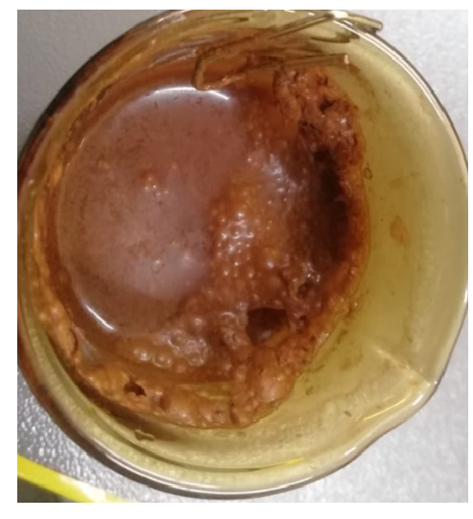
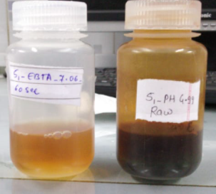
EXPERIMENTAL results
Sample | Process_irradiation time | COD(Cr) (mg/L) | % reduction in COD
 | EBA_15s | 584 | 17.04%
 | EBA_60s | 480 | 31.18%
 | EBO_15s | 504 | 28.40%
 | EBO_60s | 520 | 26.13%
 | EBTA_15s | 512 | 27.27%
 | EBTA_60s | 480 | 17.04%
 | CEB_15s | 1664 | 28.76%
 | CEB_60s(cont.) | 1792 | 23.38%
 | CEB_60s(break) | 1376 | 41.09%
 | CEB_120s | 1440 | 31.81%
 | EBC_15s | 1472 | 30.30%
 | EBC_60s(cont.) | 1696 | 19.69%
 | EBC_60s(break) | 1408 | 33.33%
EBA : Electron beam irradiation with air flow
EBO :Electron beam irradiation with ozone flow
EBTA : Electron beam irradiation with air flow and TiO₂
S2
Visual RESULTS
S3
BEFORE IRRADIATION
AFTER IRRADIATION
Conversion of soluble impurities to insoluble
Color Reduction

Slide 14
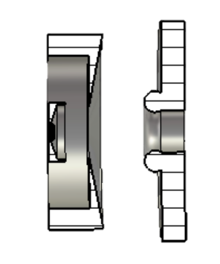
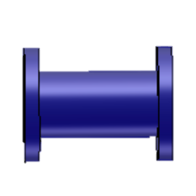
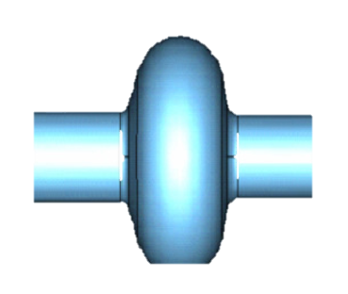
Preliminary design

Slide 15
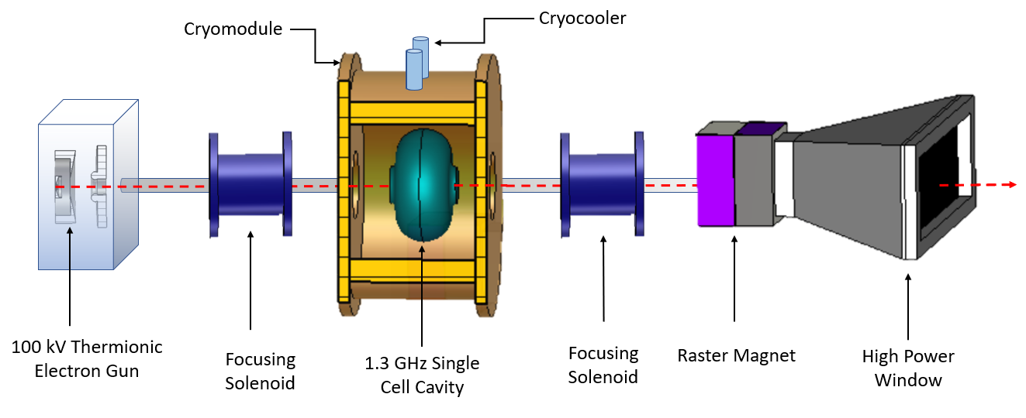
ACCELERATOR ROADMAP
A 40 kW, 40 mA, 1 MeV High Intensity Compact Superconducting Electron Accelerator (HICSEA)

Slide 16

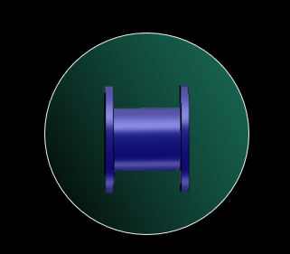
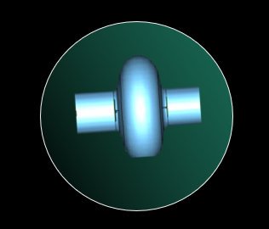
ACCELERATOR ROADMAP
1. GEOMETRY OPTIMIZATION
1. SOLENOID DESIGN
1. RF DESIGN
2. CURRENT OPTIMIZATION
2. FRINGE FIELD OPTIMIZATION
2. FREQUENCY TUNING
3. CATHODE MATERIAL STUDY
3. SOLENOID CORE OPTIMIZATION
3. RF EFFICIENCY OPTIMIZATION
4. BEAM DYNAMICS
4. PLACEMENT OPTIMIZATION
4. MULTIPACTING
5. EMITTANCE OPTIMIZATION
5. CODE DEVELOPMENT
5. HIGHER ORDER MODE STUDY
6. LORENTZ FORCE DETUNING

Slide 17
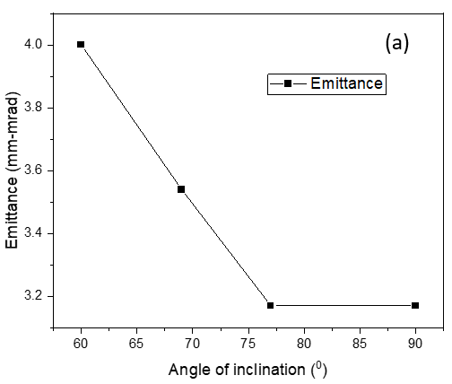
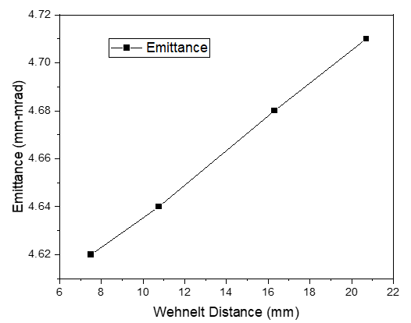
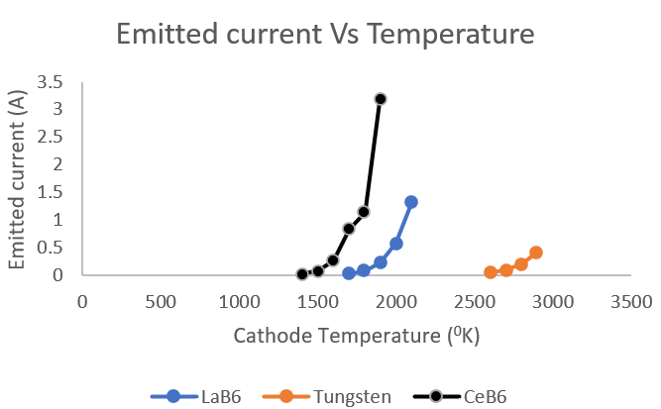
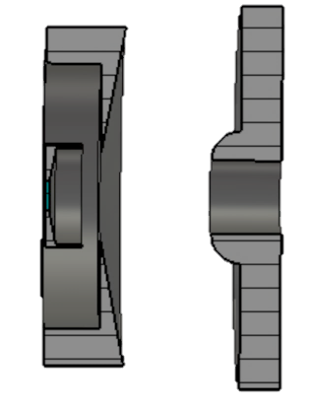
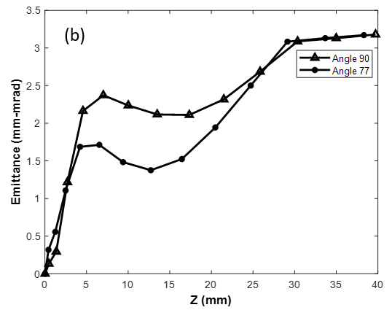
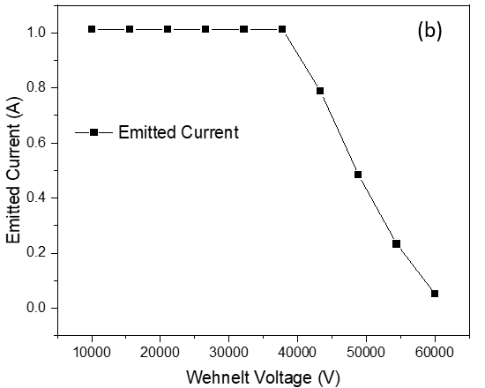
GEOMETRY OPTIMIZATION
(e)
(c)
Gun Parameters | Values
Cathode material | CeB₆
Cathode radius | 2 mm
Pierce angle (a) | 77⁰
Cathode-Wehnelt distance (b) | 7.5 mm
Wehnelt radius | 18 mm
Cathode-Anode Distance | 22.5 mm
Cathode Potential | -60 kV
Anode Potential | 0 kV
Current | 1.012 A
Temperature | 1912 K
Wehnelt Potential | -35 kV
Emittance | 3.46 mm-mrad
(d)
1 A current region
(C)
Fig: (a) Effect of angle of inclination of focusing electrode on emittance, (b) emittance growth over the distance from cathode, (c) Effect of Wehnelt edge distance on emittance, (d) Effect of biasing on beam current, (e) Maximum achievable current as a function of temperature for different cathode materials.
Final Gun parameters

Slide 18
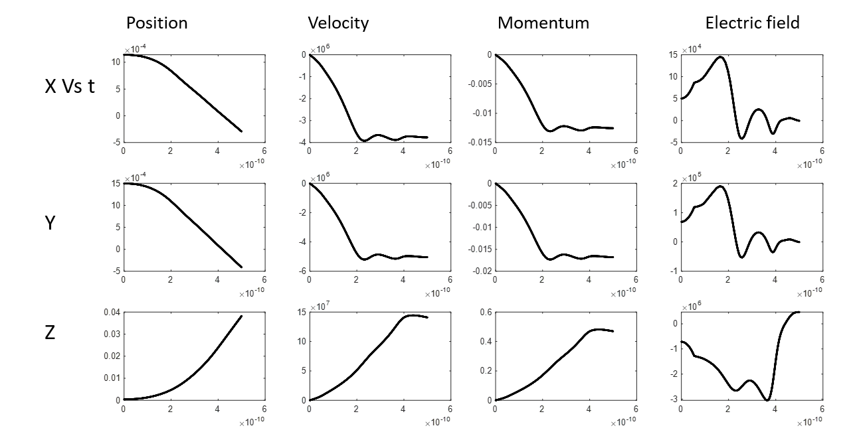
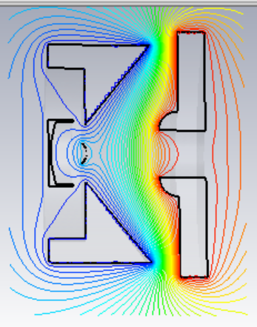
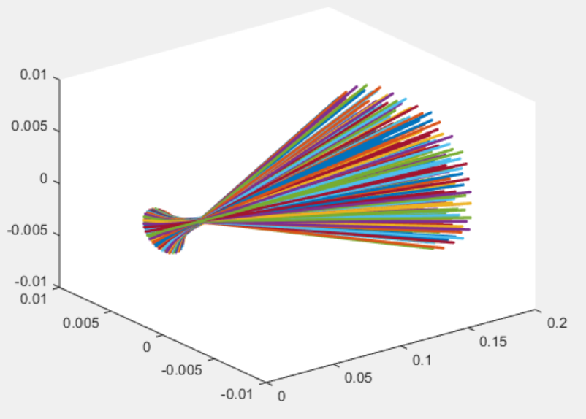
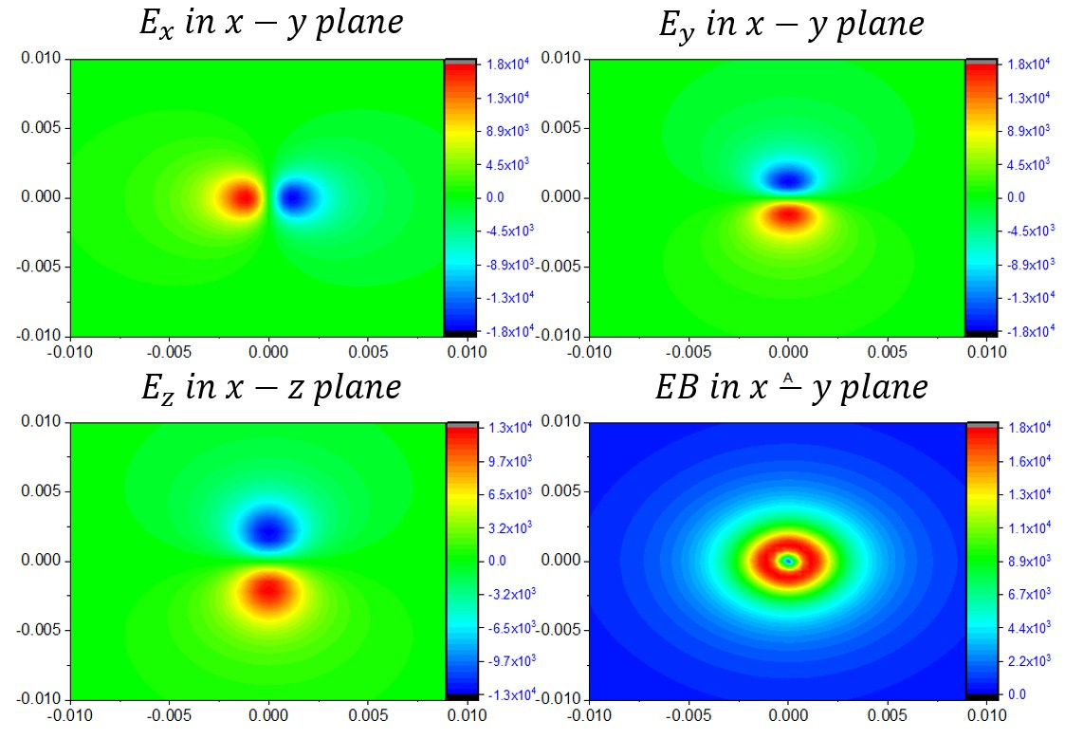

BEAM DYNAMICS
CHARGE
DEPOSITION
POTENTIAL FROM DESIGNED GEOMETRY
Single particle trajectory
MOMENTUM EVOLUTION
CALCULATION
$$Δt$$
POTENTIAL CALCULATION
FORCE CALCULATION
POTENTIAL FROM PARTICLE DISTRIBUTION
Multi-particle trajectory

Slide 19
GEOMETRY OPTIMIZATION
2(a)
1(a)
2(a)
Parameters | Values
Inner thickness of iron core | 5 mm
Outer thickness of iron core | 10 mm
Distance between gun and iron core of solenoid | 1 mm
Iron core thickness | 9 mm
Length of solenoid | 5 cm
Inner radius of solenoid | 35 mm
Outer radius of solenoid | 100 mm
Solenoid Current | 2 A
Number of Turns | 2000
1(a)
2(b)
1(b)
1(b)
2(b)
Final solenoid parameters
Variation of beam emittance (a) and beam size (b) along beam axis with the solenoid length.
Variation of beam emittance (a) and beam size (b) along beam axis with separation between gun and solenoid.

Slide 20
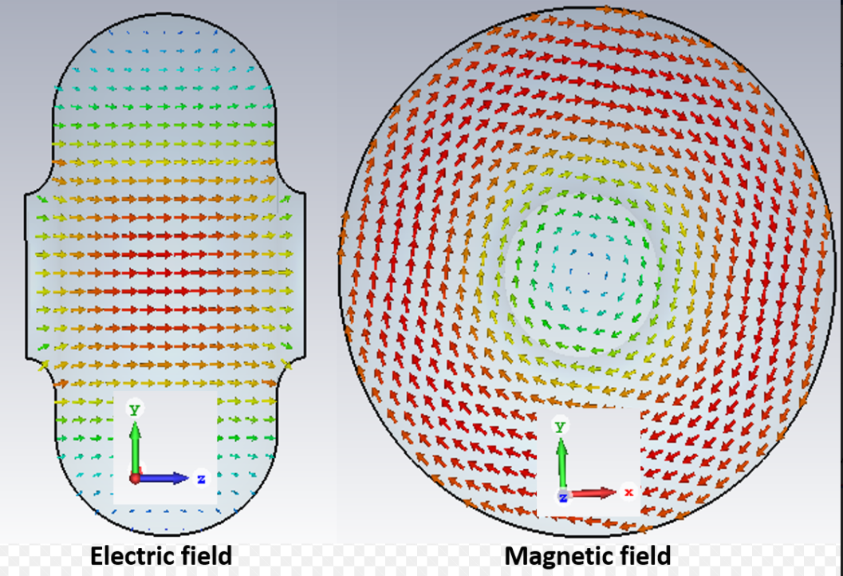
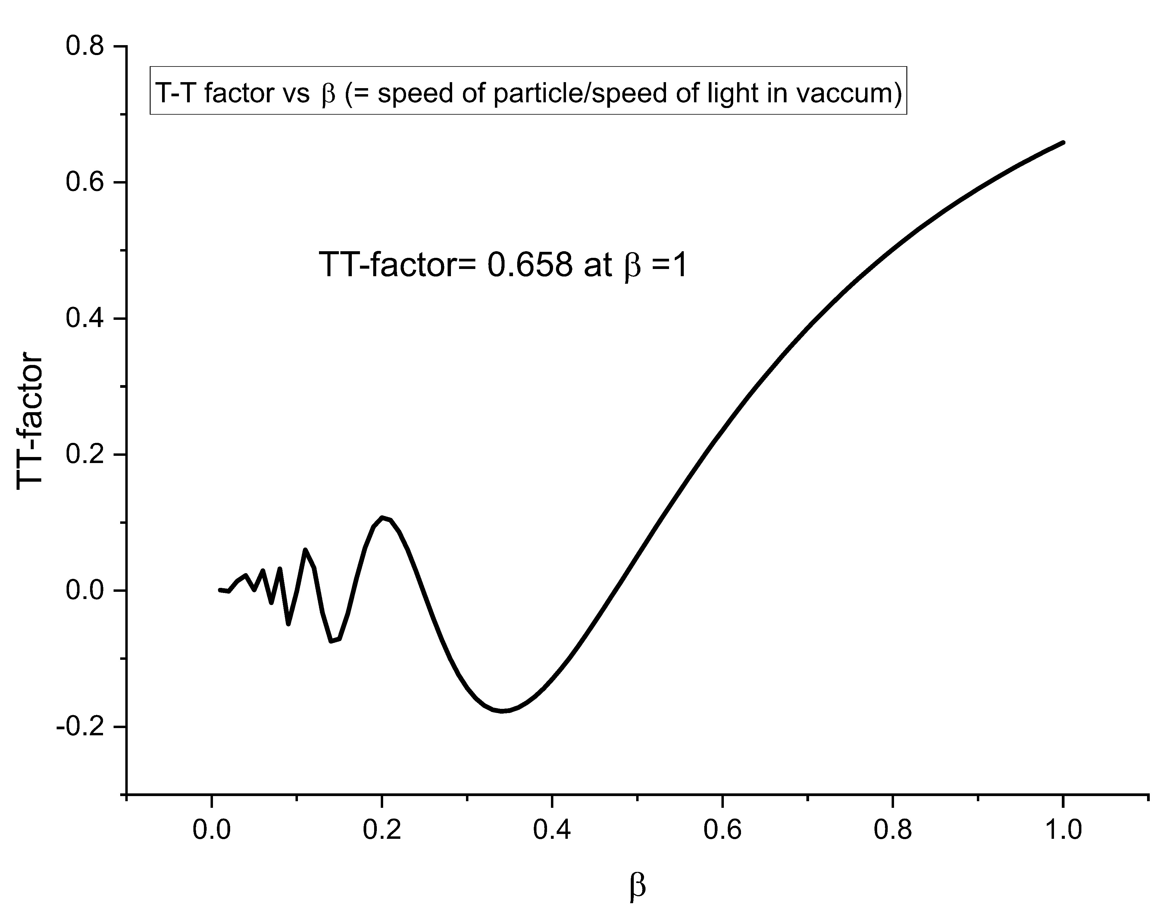
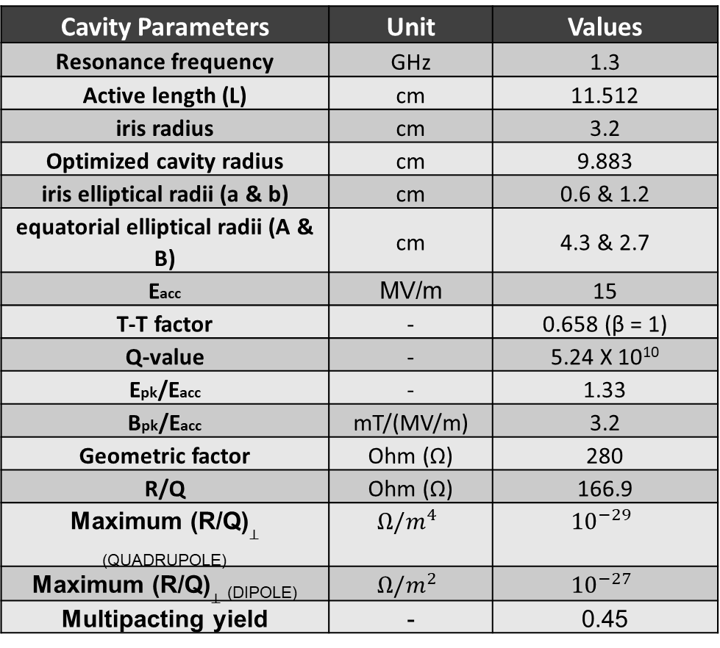
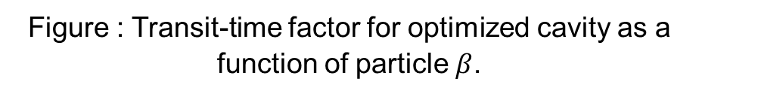
RF DESIGN & OPTIMIZATION
Cavity Parameters | Unit | Values
Resonance frequency | GHz | 1.3
Active length (L) | cm | 11.512
iris radius | cm | 3.2
Optimized cavity radius | cm | 9.883
iris elliptical radii (a & b) | cm | 0.6 & 1.2
equatorial elliptical radii (A & B) | cm | 4.3 & 2.7
Eacc | MV/m | 15
T-T factor | - | 0.658 (β = 1)
Q-value | - | 5.24 X 10¹⁰
Epk/Eacc | - | 1.33
Bpk/Eacc | mT/(MV/m) | 3.2
Geometric factor | Ohm (Ω) | 280
R/Q | Ohm (Ω) | 166.9
Maximum (R/Q)$⊥$ _{(QUADRUPOLE)} | $$Ω/m^{4}$$ | $${10}^{−29}$$
Maximum (R/Q)$⊥$ _{(DIPOLE)} | $$Ω/m^{2}$$ | $${10}^{−27}$$
Multipacting yield | - | 0.45
Figure : Electric and Magnetic field distribution in the optimized cavity
Figure : Transit-time factor for optimized cavity as a function of particle $β$.
Table : RF parameters for optimized cavity

Slide 21
What has been accomplished?
This work is a part of the proposal submitted by the Government of India to the Government of Japan, under the Science And Technology Research Partnership (SATREPS) scheme of the Government of Japan.
Under this scheme Prof. Shinichiro Michizono and collaborators from Japan will submit a similar proposal to the Japan Science & Technology.
If evaluated favourably it will be funded by JST & JICA.
National Mission for Clean Ganga (NMCG) a GOI body has rated the project very highly and have agreed to put the pilot plant at Varanasi, the cradle of Hindu civilization and one of the oldest cities in the world.
First attempt to design the accelerator has been accomplished.

Slide 22
OUR Collaborators
From Japan
Name | Affiliation | effort | Research subject in charge
Prof. Shinichiro Michizono | KEK, Tsukuba (Principal Investigator) | 10 | Management of the entire study
Prof. Kensei Umemori | KEK, Tsukuba | 10 | Superconducting system evaluation
Prof. Emeritus, Hitoshi Hayano | KEK, Tsukuba | 25 | Superconducting thin film
Prof. Hiroshi Sakai | KEK, Tsukuba | 10 | Superconducting thin film
Prof. Hirotaka Nakai | KEK, Tsukuba | 10 | Cryomodule
Associate Prof. Takayuki Saeki | KEK, Tsukuba | 10 | Superconducting thin film
Assistant Prof. Taro Konomi | KEK, Tsukuba | 10 | Cavity evaluation
Prof. Masakazu Washio | Waseda | 10 | Electron beam irradiation
Assistant Prof. Yuya Koshiba | Waseda | 20 | Electron beam irradiation
Mr. Kouki Yamashita | Waseda, Master M2 | 20 | Electron beam irradiation
Prof. Masao Kuriki | Hiroshima | 10 | Electron beam irradiation
Associate Prof. Jinfeng Yang | Osaka, Ibaraki | 10 | Electron beam irradiation
Prof. Hiroyuki Hama | Tohoku, Sendai | 5 | DC Gun and irradiation
Associate Prof. Sadao Miura | Tohoku, Sendai | 5 | DC Gun and irradiation
Associate Prof. Shigeru Kashiwagi | Tohoku, Sendai | 5 | DC Gun and irradiation
Prof. Toshinari Tanaka | Nihon, Chiba | 15 | DC electron source development
Assistant Prof. Yoske Sumitomo | Nihon, Chiba | 5 | DC electron source development
Assistant Prof. Takeshi Sakai | Nihon, Chiba | 5 | DC electron source development
From India
Heart Felt gratitude to Prof. Junji Urakawa for all the help in bringing the proposal to its final form.

Slide 23

My Obeisance to my Sensei Prof. Atsuto Suzuki for all his help guidance and above all courage in formulation of this Project.

Slide 24


