Slide 1
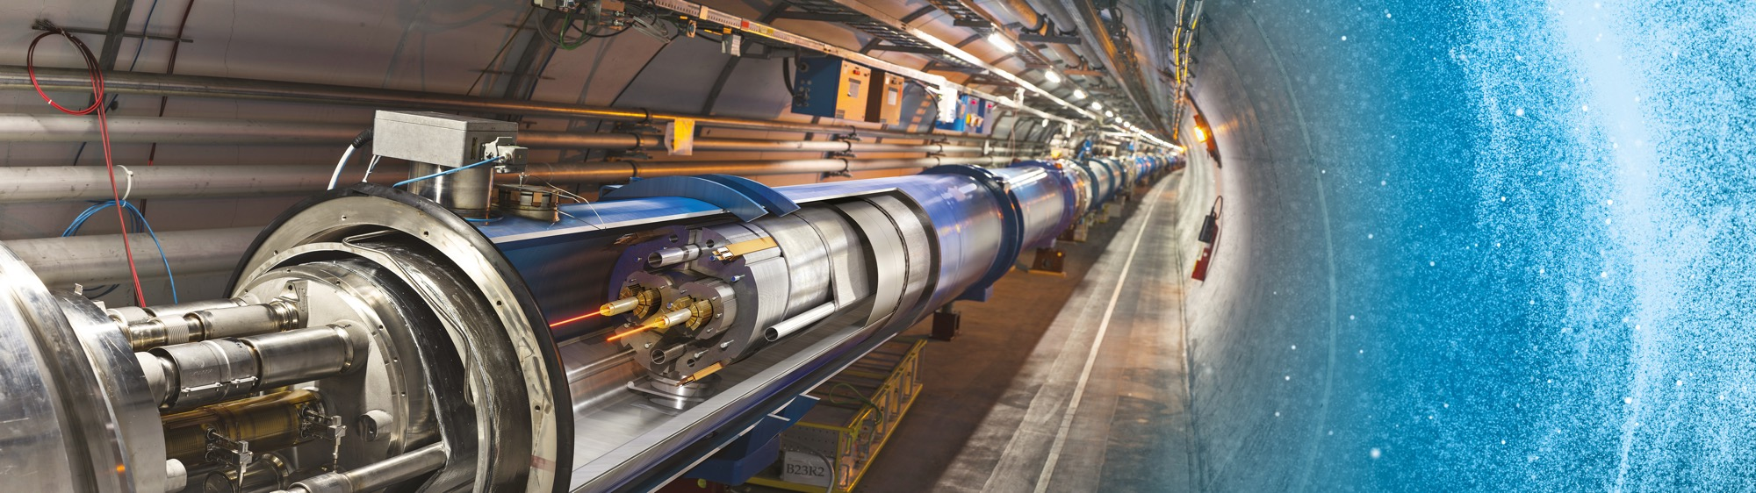
Introduction to procurement at CERN
CERN における（国際）調達に関する紹介
26/10/2021
C.Lara, on behalf of the Procurement Service

Slide 2
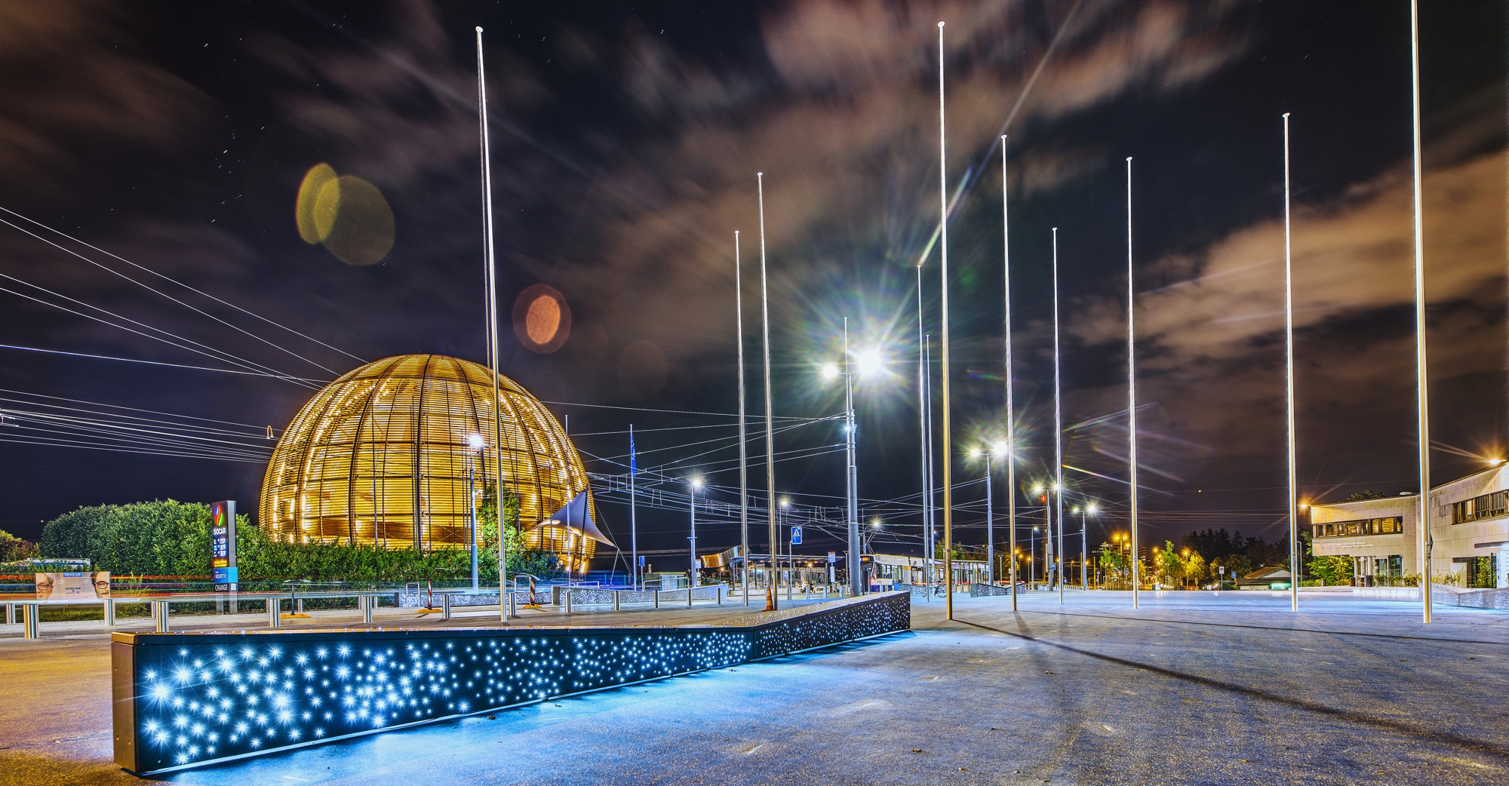
AGENDA
Introduction
Statistics
Procurement @ CERN - the rules
Impact of
Doing business with CERN
Success stories

Slide 3
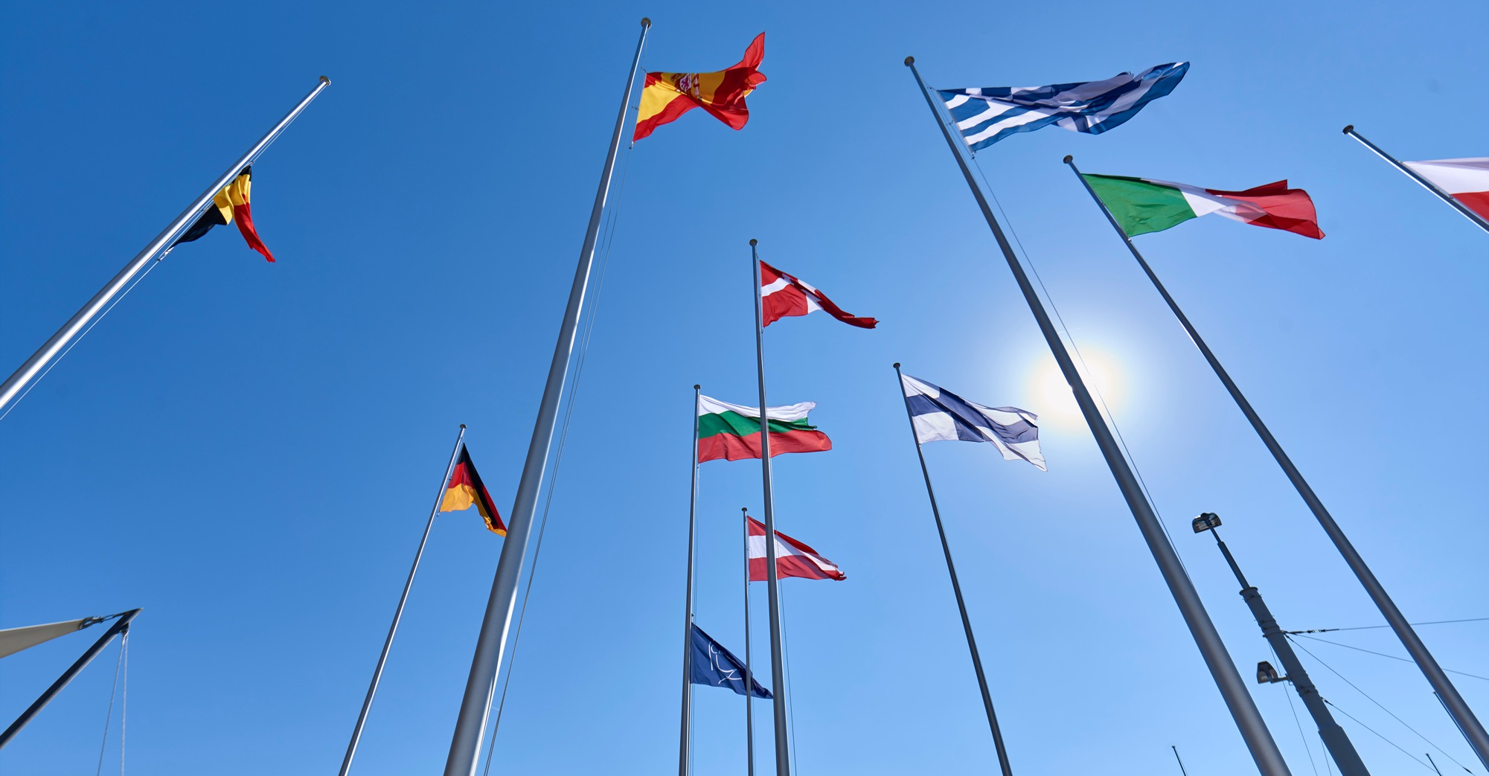
INTRODUCTION

Slide 4

CERN - the world’s biggest laboratory for particle physics.
International Organization
established on 1 July 1953 (CERNは1953.7に設立）
“Science for Peace”.
Immunity of jurisdiction
and execution.
CERN は国家統括から免除。 法的紛争は国際調停によって解決。
Notes:
This slide addresses two questions:
“Where are we?”
Use the map to indicate the location of CERN, headquartered in Geneva, straddling the Franco-Swiss border
“What is CERN?”
CERN is one of the world’s leading laboratories for particle physics
CERN’s vision (long-term goal) is to understand the fundamental particles and laws of the Universe (This is the Vision statement that features in CERN’s communication strategy)
Thus, CERN is first and foremost a research laboratory

Slide 5
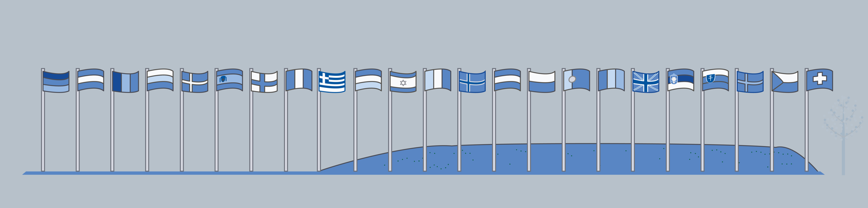
CERN is entitled to establish its own internal rules necessary for its proper functioning, including:
CERN は内部ルールによって、物品やサービスを調達。
Procurement Rules
Safety Rules
Staff Regulation of its own personnel

Slide 6

In 1954 CERN had 12 Member States
Today CERN has 23 Member States
23 Member States
3 Associate Member States in the pre-stage to membership
7 Associate Member States
6 Observers, incl.Japan
Geographical & cultural diversity
110 nationalities,
from 77 countries
Yearly Budget（年間予算）: ~1.1 BCHF（11億スイスフラン）
Every member contributes in proportion to its GDP
10/20/2021
Notes:
The speaker can highlight CERN’s second mission as stated when it was established: to foster peaceful collaborations between nations that had recently been at war.
This slide will have information on the country of the visiting delegation:
Location on the world map
Date of accession (if Member State or Associate Member State)
For information:
Member States – Austria, Belgium, Bulgaria, Czech Republic, Denmark, Finland, France, Germany, Greece, Hungary, Israel, Italy, Netherlands, Norway, Poland, Portugal, Romania, Serbia, Slovak Republic, Spain, Sweden, Switzerland, United Kingdom
Associate Member States in the pre-stage to membership – Cyprus, Serbia, Slovenia
Associate Member States – India, Lithuania, Pakistan, Turkey, Ukraine, Estonia
Observers – USA, Russia, Japan, (EU, JINR, UNESCO)

Slide 7
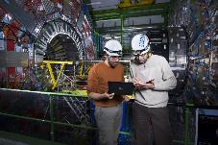
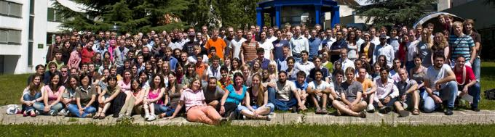
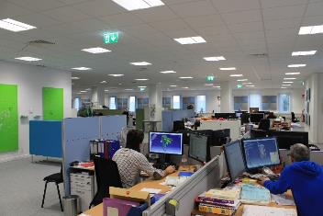
Who works here? 誰がここで働いている？
CERN employs representatives of a wide range of professions - physicists, engineers, technicians, craftsmen, administrators, secretaries, ...
Staff members (2015) ：正職員 ~2500
~ 3% research physicists 物理研究者
~ 41% engineers and scientists 技術者、科学者（加速器科学）
~ 35% technicians 技能者
~ 16% clerks and administrative 点検・検査、管理運営
~ 5% hand workers 手作業
+ Fellows and apprentices: ~630 フェロー、見習い
+ Users: ~ 12000 ユーザー
… + about 2000 people from external contractors 業務委託
10/20/2021
Notes:
The speaker can highlight CERN’s second mission as stated when it was established: to foster peaceful collaborations between nations that had recently been at war.
This slide will have information on the country of the visiting delegation:
Location on the world map
Date of accession (if Member State or Associate Member State)
For information:
Member States – Austria, Belgium, Bulgaria, Czech Republic, Denmark, Finland, France, Germany, Greece, Hungary, Israel, Italy, Netherlands, Norway, Poland, Portugal, Romania, Serbia, Slovak Republic, Spain, Sweden, Switzerland, United Kingdom
Associate Member States in the pre-stage to membership – Cyprus, Serbia, Slovenia
Associate Member States – India, Lithuania, Pakistan, Turkey, Ukraine, Estonia
Observers – USA, Russia, Japan, (EU, JINR, UNESCO)

Slide 8

Four pillars underpin CERN’s mission
RESEARCH
EDUCATION
& TRAINING
COLLABORATION
INNOVATION

Slide 9

STATISTICS

Slide 10
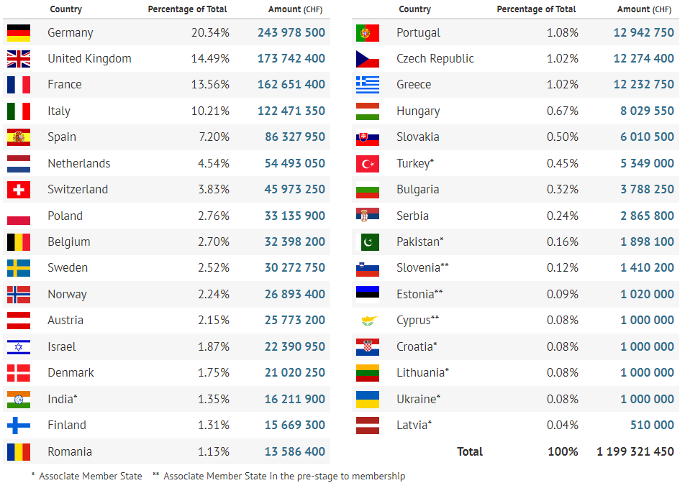
Yearly Budget (contributions 2021)

Slide 11
Procurement Expenditure (MCHF)

Slide 12
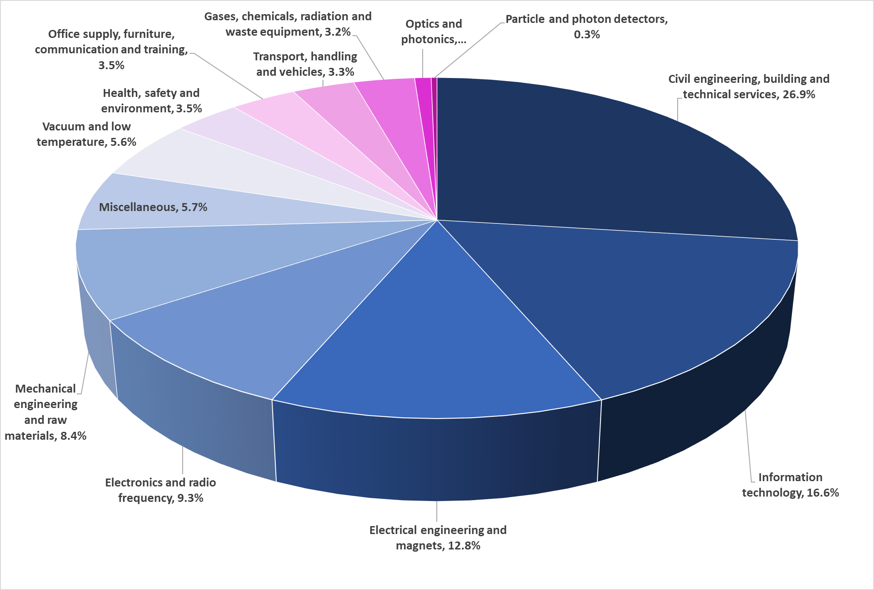
Supplies (235MCHF spent in 2020 – CERN budget only)
(日常的な用品・サービス)

Slide 13
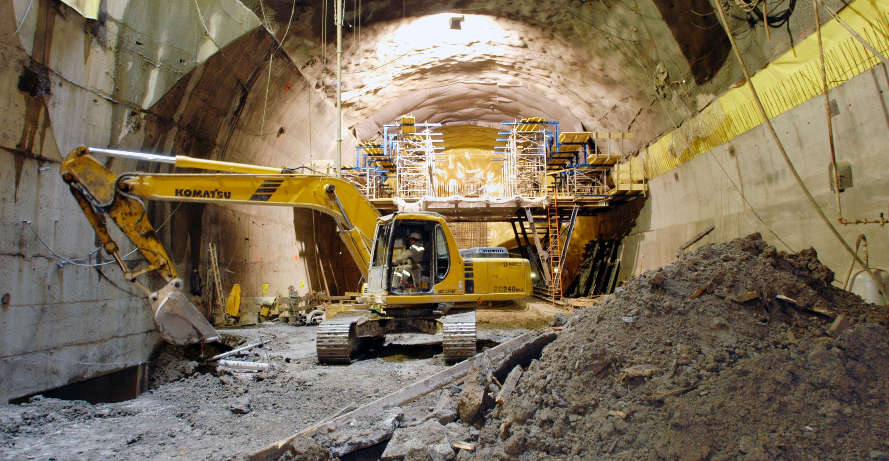
What do we buy?
Civil engineering:
  Construction
  Renovation of buildings
  Metallic structures
  Earthworks
  Roads
Cooling and ventilation
equipment

Slide 14
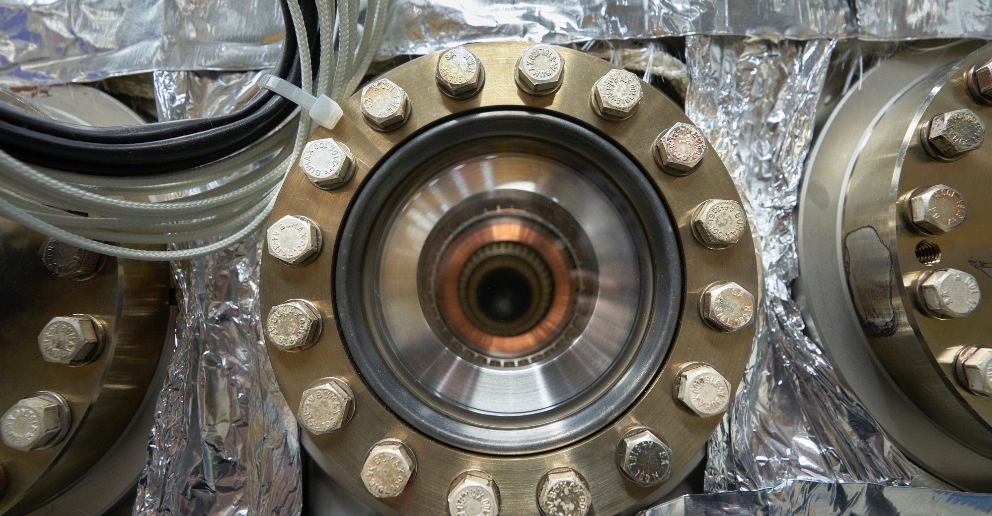
What do we buy?
Electical engineering and magnets
  Transformers
  Switchboards and switchgear
  Cables
  Automation
  Power supplies
  Magnets

Slide 15
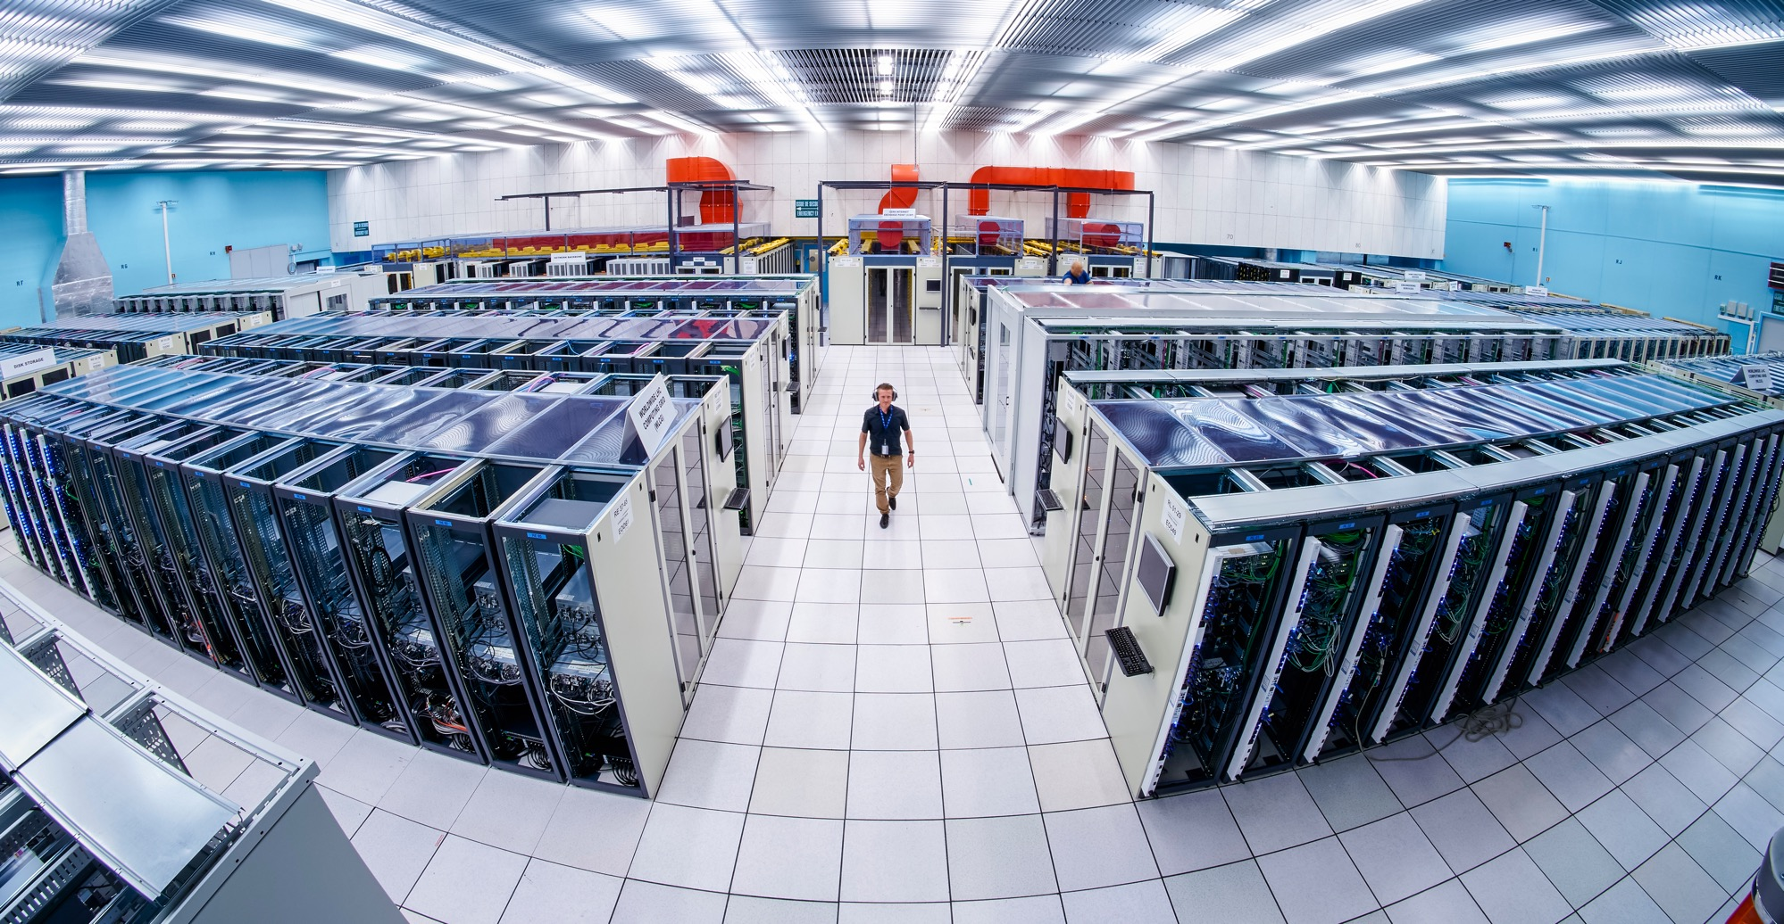
What do we buy:
Information Technology
  Computing systems
  Servers
  Software
  Network equipment
  Personal computer equipment

Slide 16
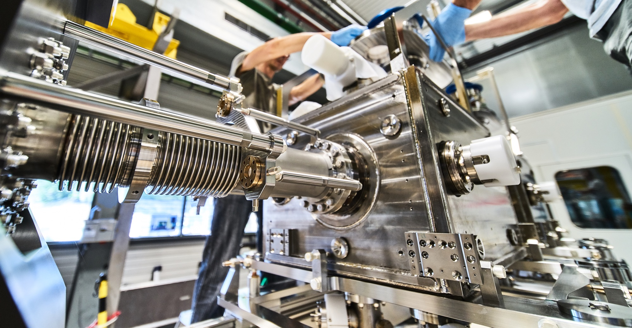
What do we buy?
Mechanical engineering and raw materials:
  Machining
  Sheet metal work and arc welding
  Special fabrication techniques
  Raw materials, finished and semi-finished products (plates, pipes, etc.)
  Offsite engineering and testing

Slide 17
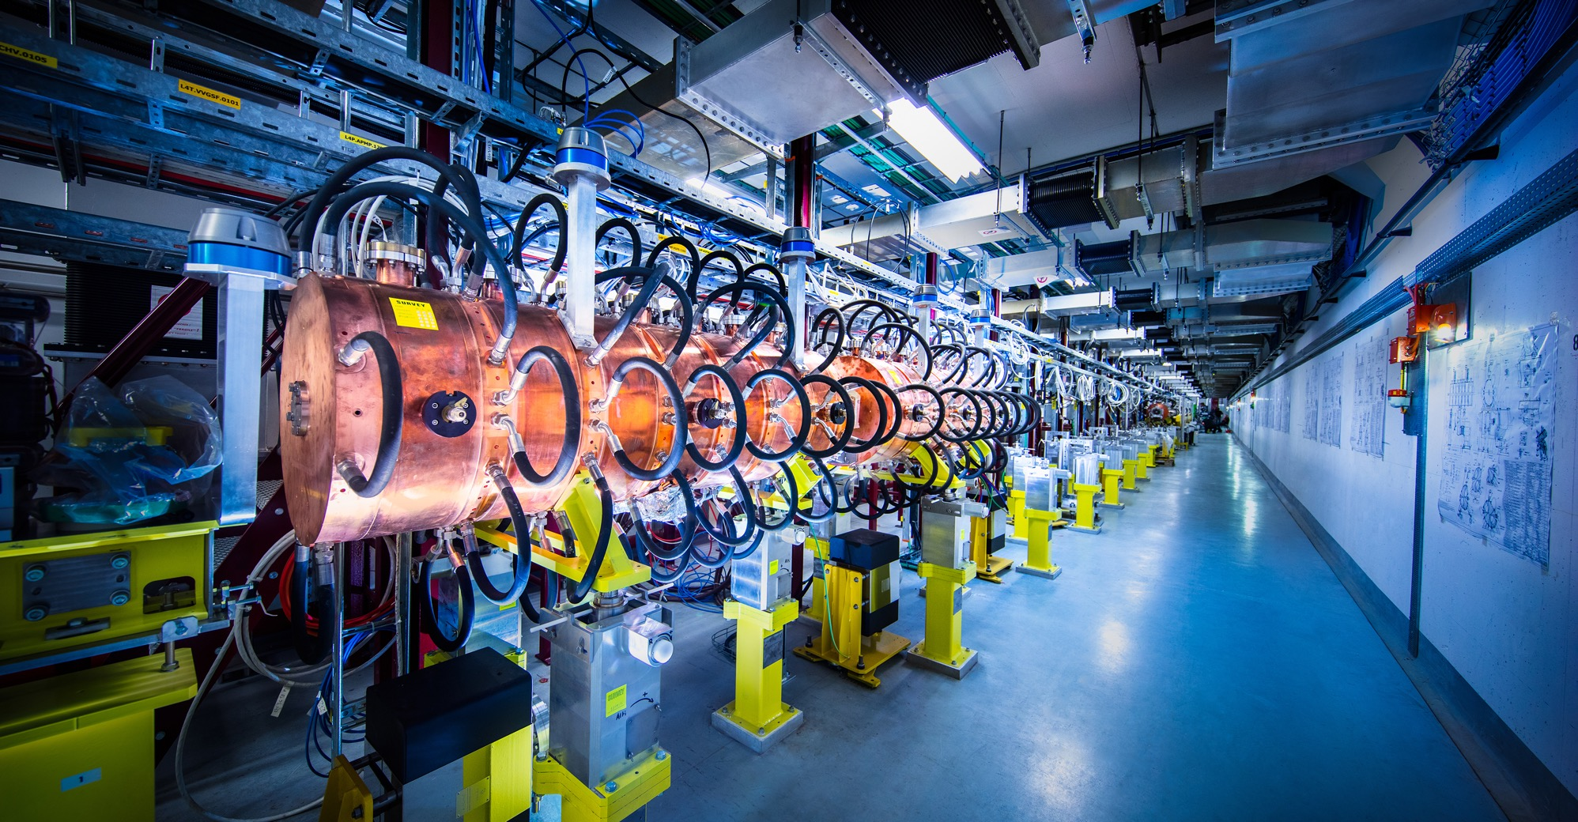
What do we buy?
Electronics and radiofrequency:
  Electronic components (active, passive)
  PCBs and assembled boards
  LV and HV power supplies
  Radiofrequency plants
  Amplifiers

Slide 18
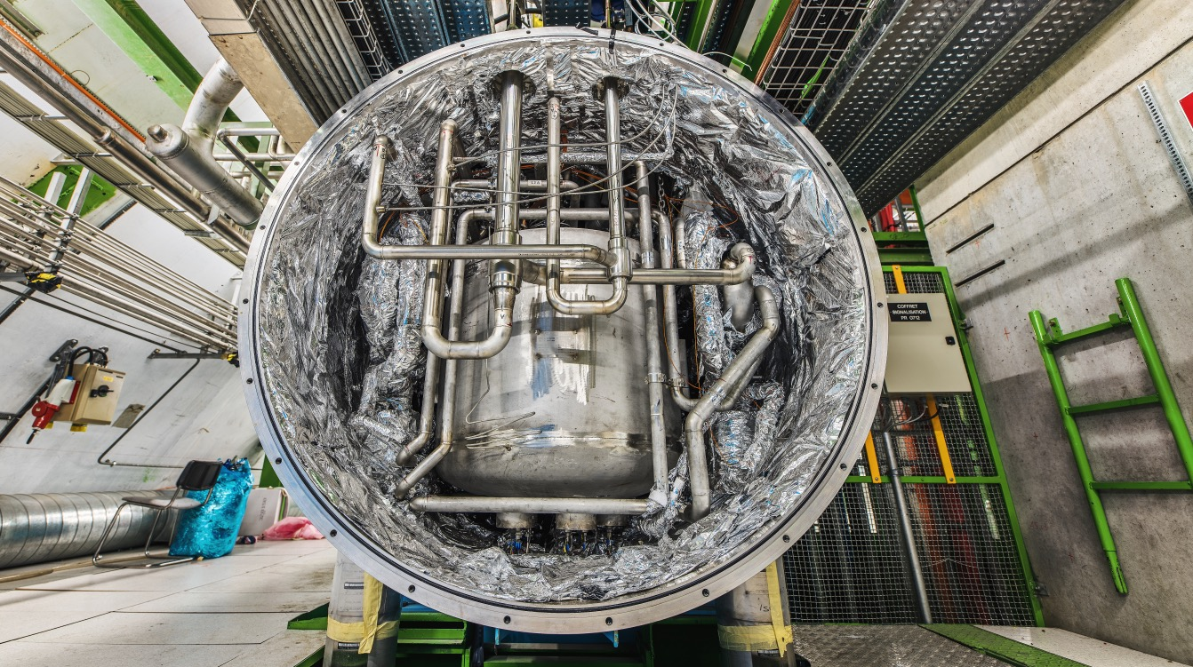
What do we buy?
As well as:
  Cryogenic and vacuum equipment
  Optics and photonics
  Particle and photon detectors
  Health and safety equipment,
  Transport and handling equipment
  Office supply, furniture

Slide 19
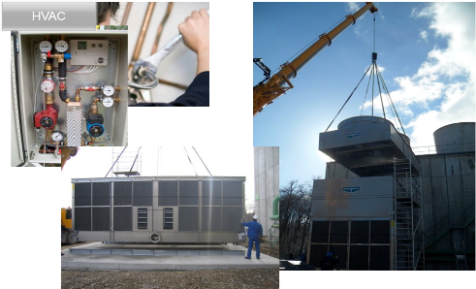
What do we buy? Industrial services at CERN
CERN における工業的サービス（数値）
~150 MCHF in 2020
~70 contracts
~80% of the contract price corresponds to labour costs
~1’500 persons on a daily basis at CERN
Type of services ordered by CERN:
  Facility management
  Transport and handling
  Welding
  Electromechanical work
  Cabling
  Mechanical workshop
  HVAC
  …

Slide 20
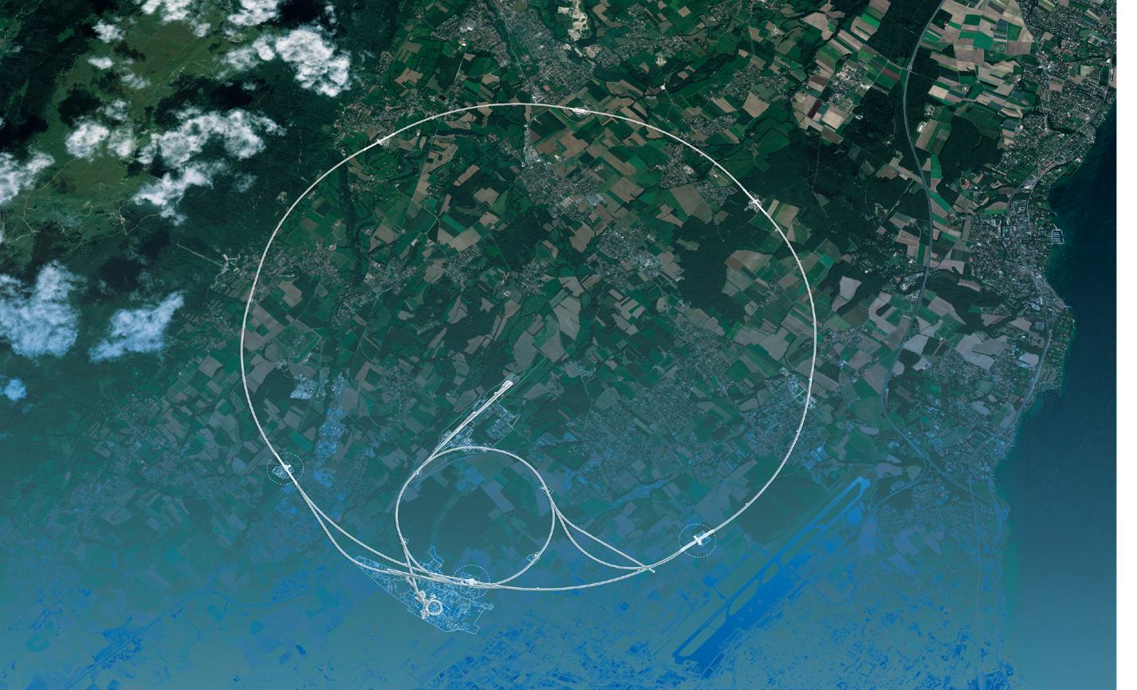
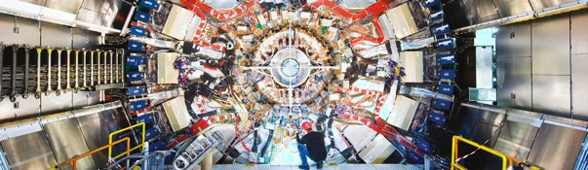
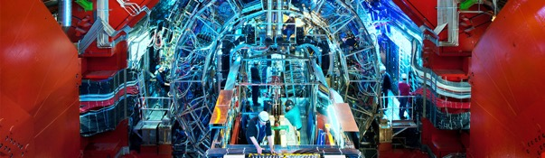
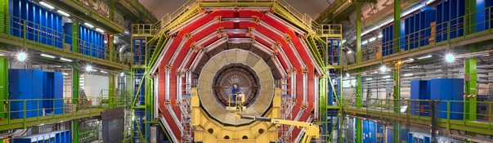
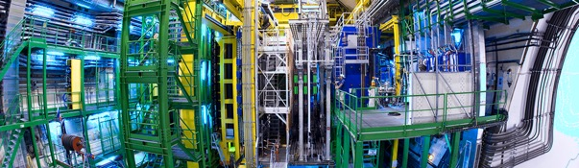
We also buy for the LHC experiments
CMS
ALICE
ATLAS
LHCb

Slide 21

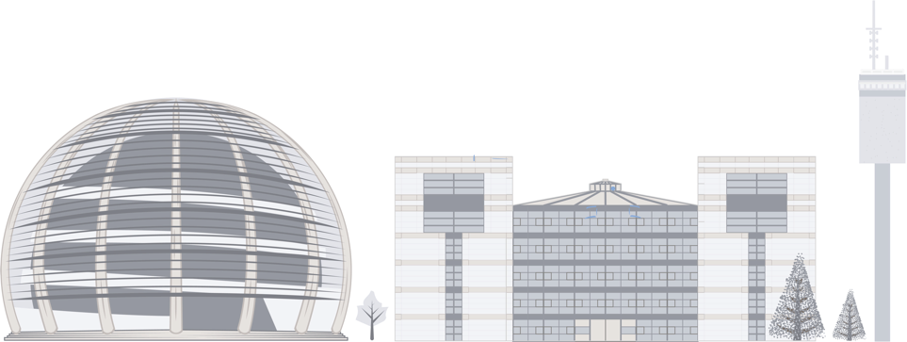
PROCUREMENT @CERN
the rules

Slide 22
The Procurement Service
CERN 調達ルールの目的
Mission
The Procurement Service (PS) procures all supplies and services for CERN
Meeting the specified and contractual technical, delivery
and performance requirements
契約は、すべての技術、財政、納入の要求を保証する。
At the lowest possible overall cost
すべてのコストを、できる限りCERN のために低く保つ。
While achieving balanced industrial return for CERN Member States
メンバー国のために、バランスのとれた産業・工業的リターンを達成する、
連合、分割、限定的入札を含む適切な手順（制限なし）の設定による。
Respecting CERN
Procurement Rules

Slide 23
Principles of the Procurement Rules (1/4)
1
Transparency and Impartiality
2
Tenders open to Member States only
3
Objectivity and equal treatment: tendering packages are objective and impartial

Slide 24
Principles of the Procurement Rules (2/4)
Selective tendering procedures: CERN’s tendering procedures are not open to any interested firms
Confidentiality: Opening and evaluation of bids as well as negotiations are not public

Slide 25
Principles of the Procurement Rules (3/4)
Award for supplies (and services, exceptionally) based on:
Lowest compliant bid
Technical
Financial
2
Delivery

Slide 26
Principles of the Procurement Rules (4/4)
Award for industrial services based on:
Best Value For Money
2
No alignment rule

Slide 27
Alignment rule
連合ルール
Applicable for:
1
Contracts awarded on the lowest
compliant basis (mainly supply contracts)
2
With a total amount exceeding
100’000 CHF.
Under certain conditions as defined in CERN Procurement Rules, a bidder offering goods originating* in poorly balanced Member States is allowed to align his price to that of the
lowest bidder and thereby be awarded the contract.
RULE
* At least 60% for supply contracts or; at least 40% for service contracts awarded on the lowest compliant basis.

Slide 28

Industrial return coefficient
Industrial return
coefficient
Over a 4-year period:
Very poorly balanced : < 0.40
Poorly balanced (PB) : 0.40 ≥ x < 1
Well balanced (WB): ≥ 1
For Supply contracts and for a
12-month period starting on
1st March, defined as:
“The ratio between a Member State's percentage share of the value of all Supply contracts and that Member State's percentage contribution to the CERN Budget over the same period”.
Status definition
% expenditure in the MS
/!\ Applicable coefficient is based on the average of the last 4 years 適応する係数は、過去４年平均を基本
Return Coef.=
% contribution to CERN budget for this MS

Slide 29
Country of origin
Calculation of industrial return is based on origin of supply or services:
供給またはサービスの源（原産）を基本として算出
SUPPLIES
“Country(ies) where the supplies (including their components and sub-assemblies) are manufactured or undergo the last major transformation by the contractor or its sub-contractor”
物品の生産、主たる構成（原産国）
If at least 60% of the total amount of the bid comes from a poorly balanced MS, then the whole bid will be treated as that from a bidder in a poorly balanced MS.
“Country(ies) in which the bidder is established.”
サービスの源（国）、契約者がその施設（企業所在地）を持っている源（国）
If at least 40% of the total amount of the bid comes from a poorly balanced MS, then the whole bid will be treated as that from a bidder in a poorly balanced MS.
SERVICES

Slide 30
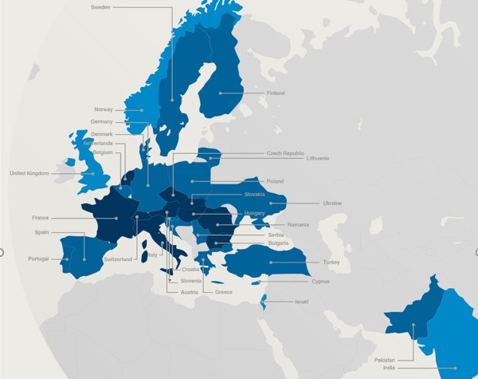

Poorly balanced Member States (Supplies)
(1st March 2021 – 28 February 2022, based on the previous 4 calendar years):
Well Balanced | Poorly Balanced | Very Poorly Balanced
Austria Bulgaria Czech Republic France Hungary Italy Netherlands Romania Slovakia Switzerland | Belgium Croatia* Cyprus* Denmark Finland Germany Greece Lithuania* Pakistan* Poland Portugal Serbia* Slovenia* Spain Sweden Turkey* Ukraine* | Estonia* India* Israel Latvia* Norway United Kingdom
*Associate Member States

Slide 31
Limited tendering
« Limited tendering is foreseen by the CERN Procurement Rules to improve the industrial return of very poorly balanced Member States. »
Conditions
Firms established in very poorly balanced Member States only (industrial return <0.4);
ILO can ask to add firms, provided they are established in very poorly Member States.
Used in case where there is sufficient competition;

Slide 32

Impact of
Doing business with CERN

Slide 33
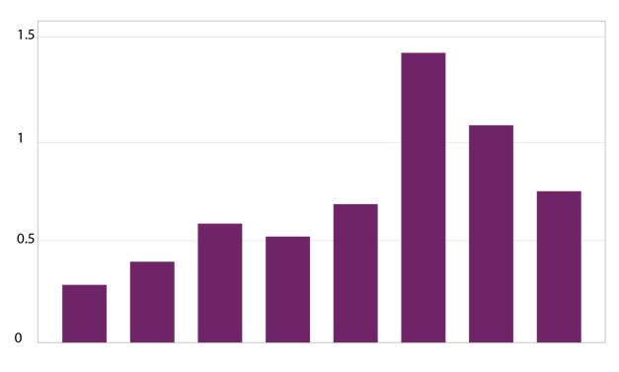
The economical impact of CERN Procurement on supplier’s performance (Castelnovo et al, 2018)
Empirical studies (by the analysis of financial data from 1995 to 2008 from 365 CERN suppliers for the LHC) show that after working with CERN on high-tech contracts, CERN suppliers
out-perform their peers by:
Investing more in R&D and filing more patents
Higher productivity, revenue and profitability
Order/contract received from CERN
Increase in R&D
Innovation
Productivity growth
increase revenues & profitability
Patents per firm
More than
2 years before
2-1 years before
Date of order
1,2 years later
3,4 years later
5,6 years later
7,8 years later
More than
8 years later
Notes:
Average number of patents filed before and after the beginning of the procurement relationship with CERN
The X-axis shows the «relative years», that are the difference between a given year and the year the first order is received. Therefore, CERN(0) is, for each company, the year of beginning of the procurement relationship.

Slide 34
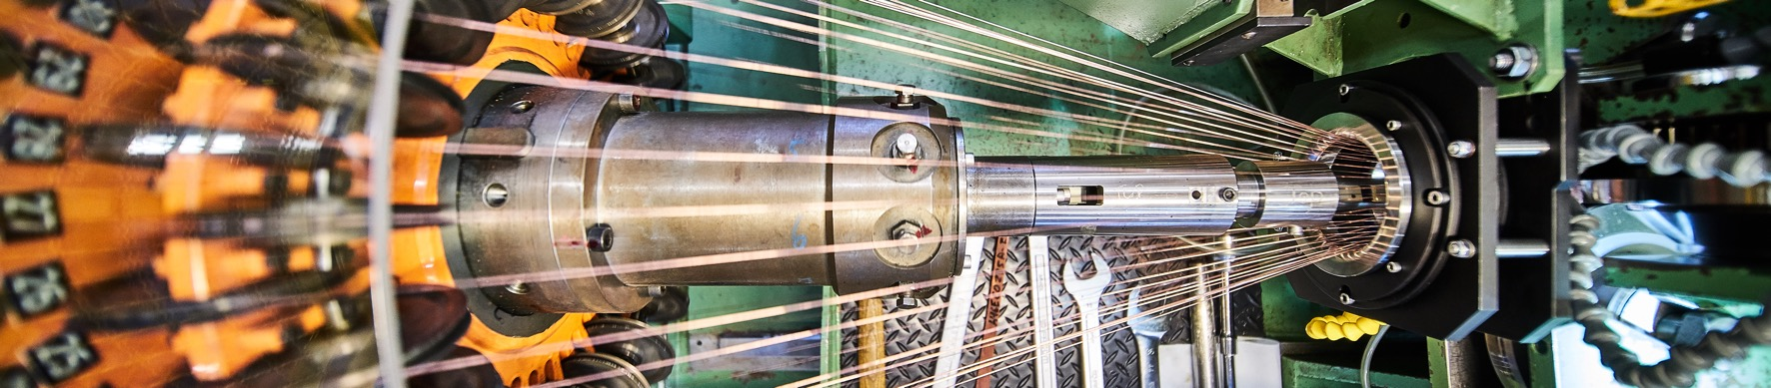
Doing business with CERN: the facts
Supplier survey (669 suppliers in 33 countries, 2017):
48%
improved products and services
42%
developed new products
55%
improved technical knowledge
in their field
18%
found or opened a new market to address
62%
used CERN as a marketing reference
Notes:
The key message here is that CERN is an open institution: open to its neighbours, and open to citizens from across the globe. We welcome them to CERN and go out to meet them
This slides summarises the outreach activities carried out by CERN.
It also includes a mention of CERN’s fundraising activities, for projects that are not part of CERN’s core activity. These fall into three categories: education & outreach, culture and creativity, innovation and knowledge exchange

Slide 35
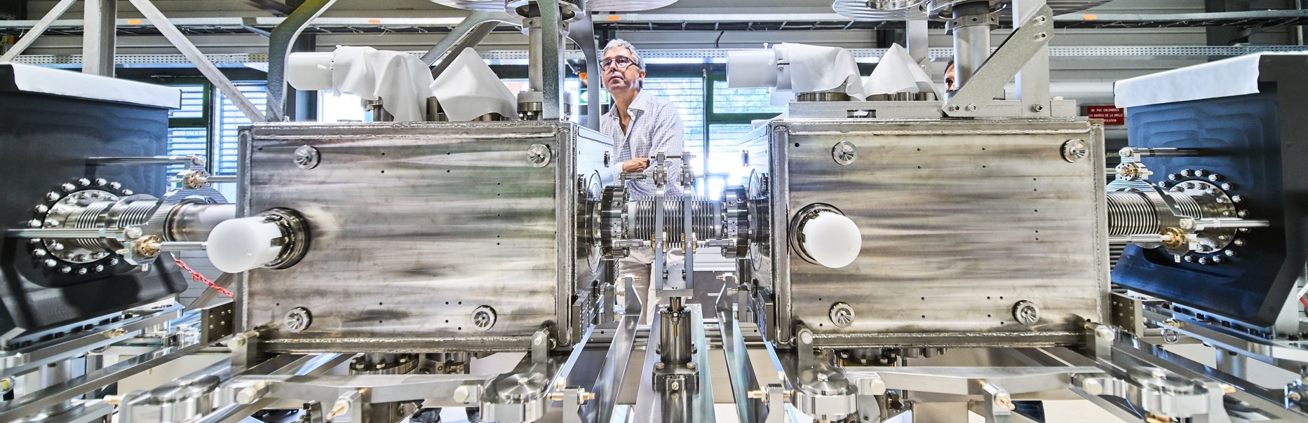
Doing business with CERN: the facts
Using CERN as a marketing reference improve
the reputation as suppliers

Slide 36
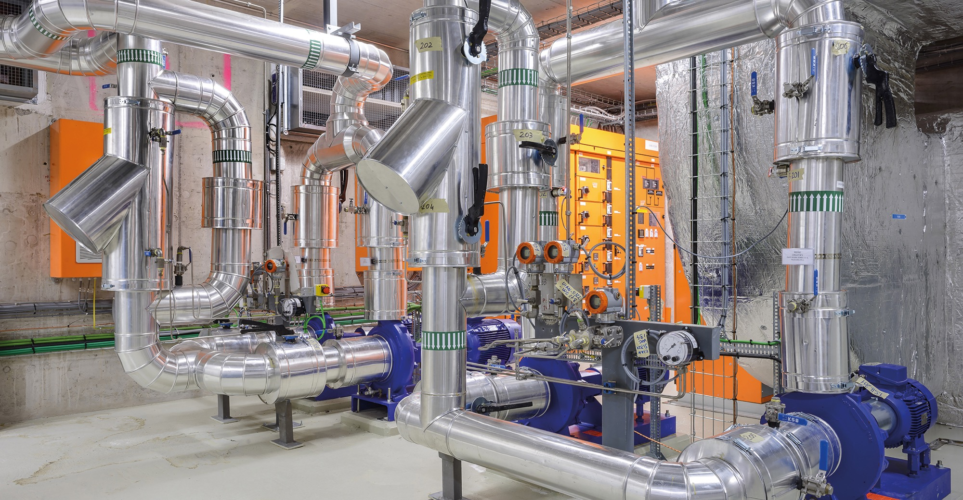
Social
Cost-Benefit Analysis (CBA) calculated by the University of Milan
“Each CHF invested in
HL-LHC project pays back approximately 1.8 CHF on societal benefits, including scientific, economic and cultural value (development of innovative technologies, industrial spillovers, skills acquired by students, etc.).”

Slide 37

Success stories

Slide 38
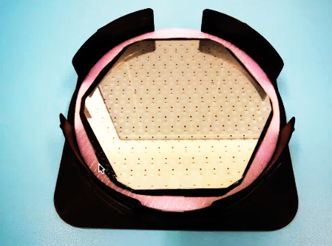
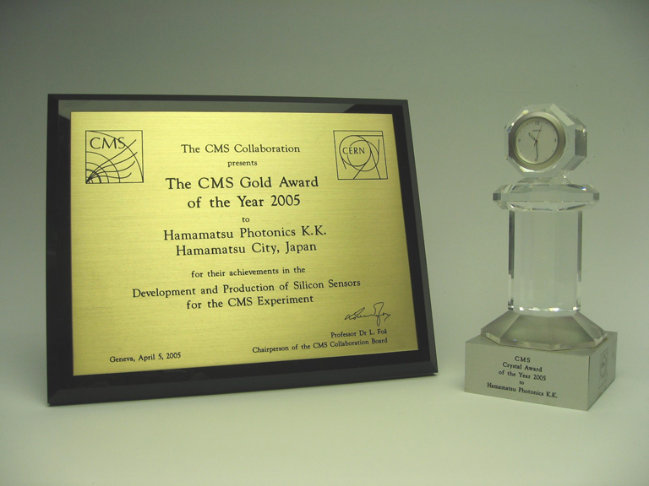
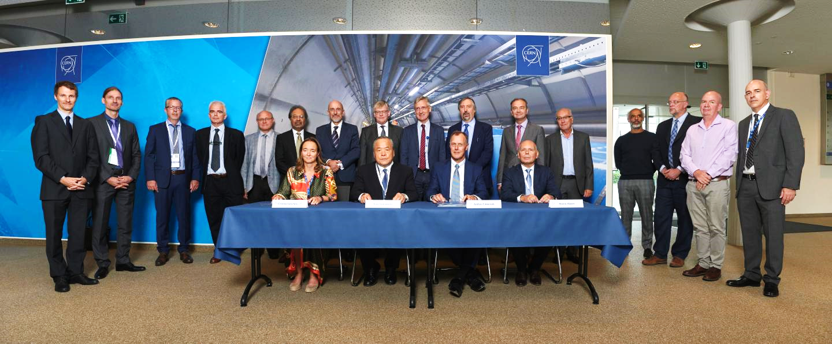
Hamamatsu Photonics (HPK)
Supply: Silicon sensors, silicon photomultipliers, sensor hybridization services, etc.
A collaboration that started more than 15 years ago with LHC construction
HPK is now involved in ATLAS and CMS Phase II upgrades
In 2005 and 2008, CMS & ATLAS experiments granted HPK with a CERN Industry Award.

Slide 39

Kuraray Co. Ltd
Supply: Plastic Scintillating Fibers (a radiation detecting material supporting cutting-edge physics research)
In 2018, LHCb granted Kuraray with an Industry Award in recognition of the Company’s contribution to its research activities.

Slide 40
Thank you !
どうもありがとうございました !

