Slide 1
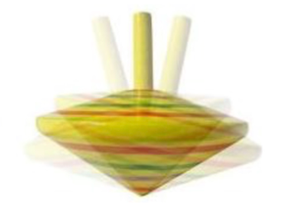

The ILC (?), SUSY,
& the Tiny (g-2) Muon Wobble
Nausheen R. Shah
Baum, Carena, NRS, Wagner, arXiv: 2104.03302
ILC IDT WG3 – Mini Symposium on Muon (g-2)
Thursday May 27, 2021

Slide 2
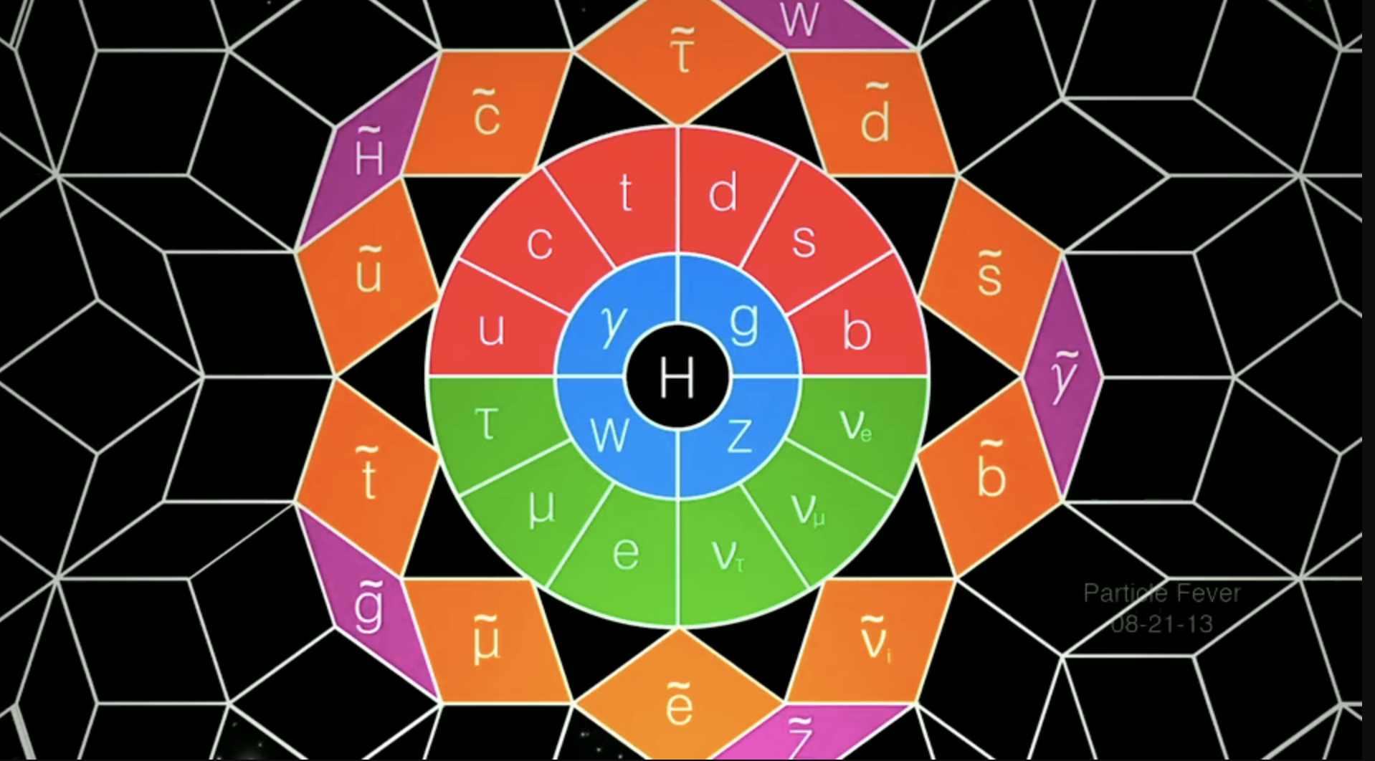
The answer to everything: Notorious Supersymmetry
“Particle Fever” – The movie

Slide 3
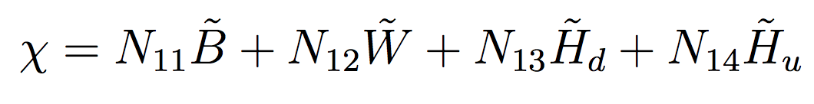
Let's start at the VERY beginning.
A VERY good place to start!
MSSM Charginos & Neutralinos
SM Gauge Bosons and Higgs (2HDM in SUSY) Superpartners
Bunch of weakly coupled neutral Majorana fermions, lightest stable due to R-parity: WIMP!
B: SU(2) singlet
Bino M₁ g₁
{W⁰, W¹, W²}: SU(2) triplet
Winos M₂ g₂
1 neutral, 2 charged
{H_{u} H_{d}}: SU(2) doublets
Higgsinos μ Yukawas etc
2 neutral, 2 charged
MSSM: 4 neutral “Neutralinos”, mixtures of interaction states (Also 2 charged “Charginos”
mixtures of wino and Higgsinos).

Slide 4
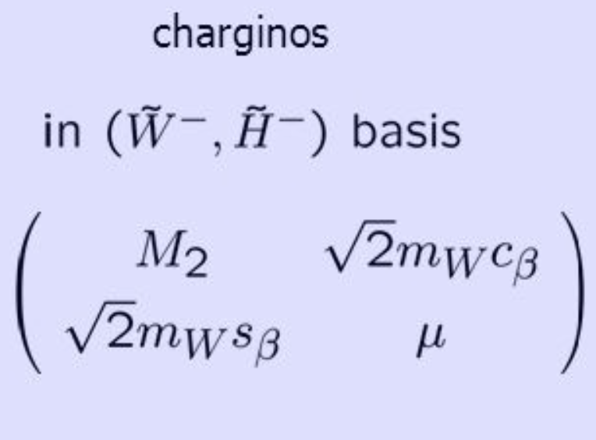
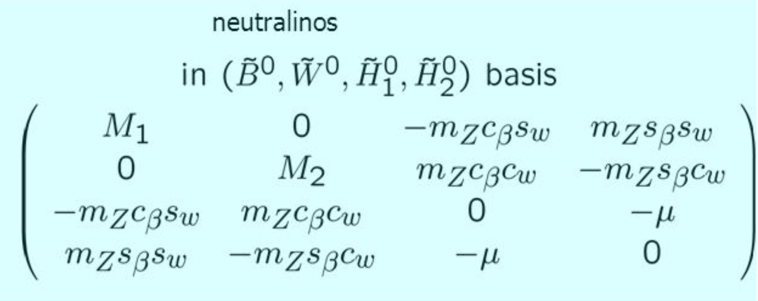
MSSM Charginos & Neutralinos:
Mass Matrices
At Tree-level:
Charginos: M₂, μ, tan β
Neutralinos: + M₁
A good starting point for SUSY parameter/mass spectrum
determination

Slide 5
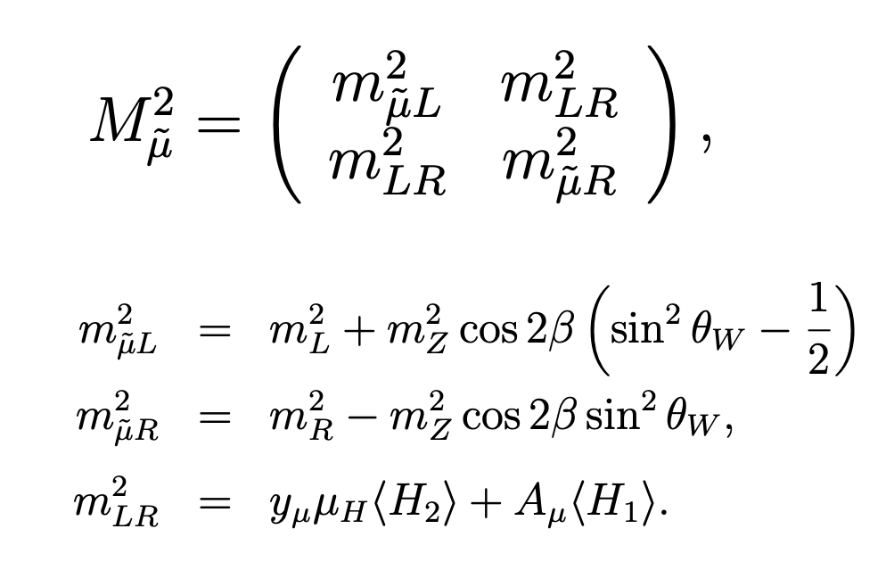
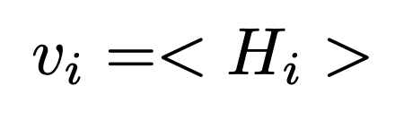
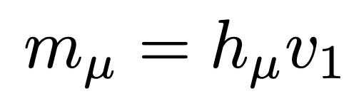
Slepton Sector
Masses are determined by mixing between the left and right-handed sleptons.
Mixing most relevant for the case of tau sleptons (staus).

Slide 6
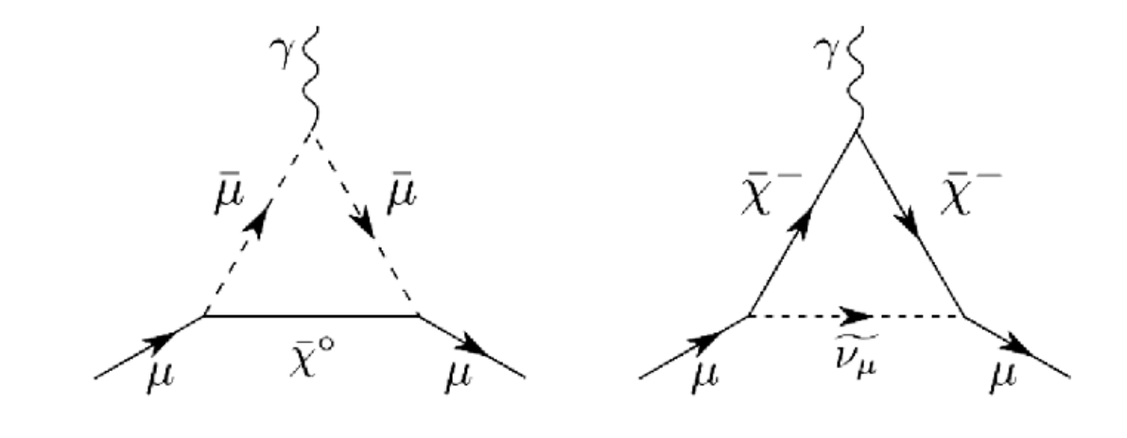
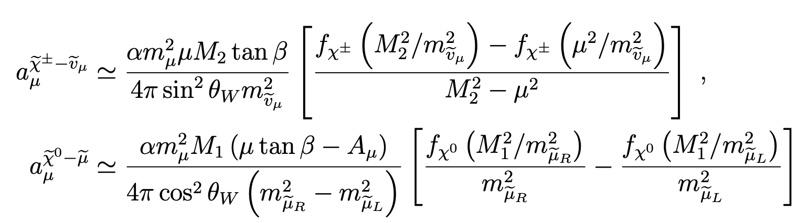
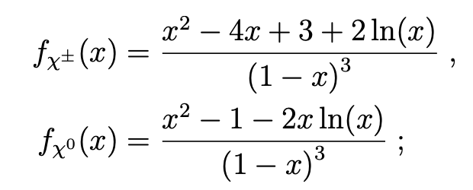
( g_{μ} – 2 )?
Dominant Contributions:
Barbieri, Maiani,’82; Ellis et al,’82; Grifols and Mendez,’82;
Moroi,’95; Carena, Giudice, Wagner, ’95; Martin and Wells, ’00 …

Slide 7
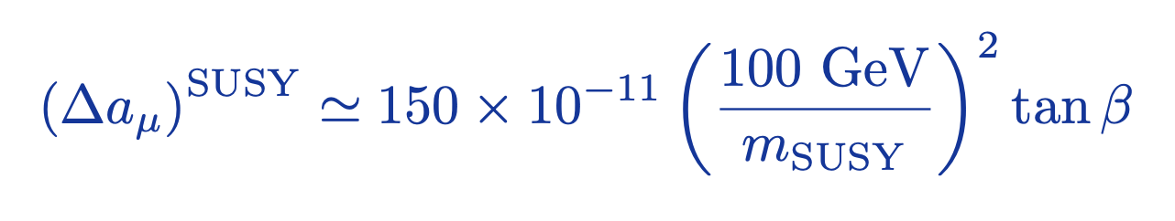
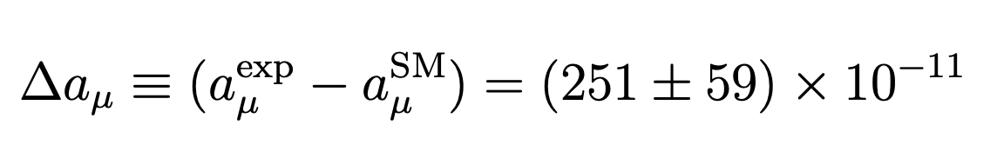
Rough Approximation
If ALL weakly interacting SUSY particle masses same, AND the gaugino masses had the same sign:
Anomaly could be explained:
For tanβ = 10, m_{SUSY} ~ 250 GeV
For tanβ = 60, m_{SUSY} ~ 700 GeV
(consistent with the unification of the top and bottom Yukawas).

Slide 8
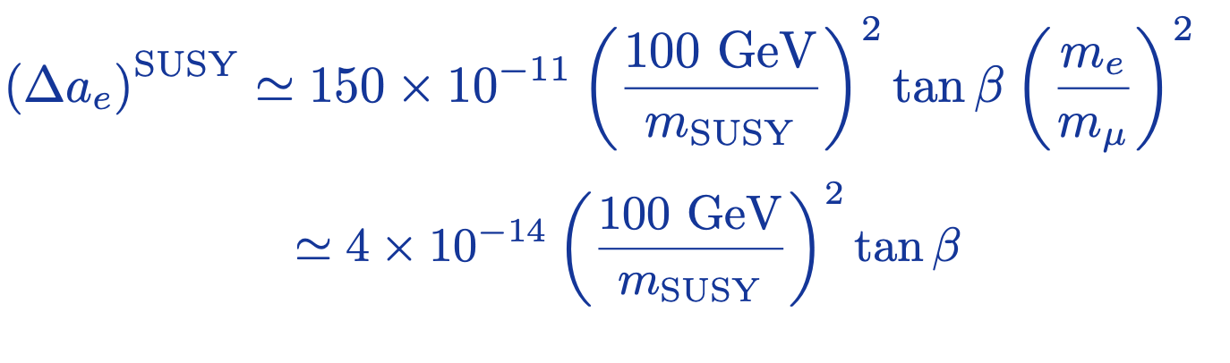
What about electron ( g – 2 )??
The same contributions apply to the electron case (with appropriate substitutions).
In particular, both contributions are suppressed by the square of the electron mass rather than the muon mass!
To explain the muon anomaly, (100 GeV/m_{SUSY})² tanβ ~ 1.5
Δa_{e} contribution order of magnitude smaller than current uncertainties!

Slide 9

But isn’t SUSY already ruled out below the TeV scale ??

Slide 10
LHC: All about the Strong Stuff
Guinos:
  If decay directly to 3rd generation squarks, gluinos must be heavier than about 1.5 to 2.2 TeV
  Cascade decays into intermediate chargino/neutralino states and compressed spectrum present the weakest limits, and the bound falls short of 2 TeV for non-compressed spectrum. Bound of 2.2 TeV in the most extreme case.
  Hard to evade the TeV bound.
Stops:
  Higgs mass implies stops masses heavier than ~ 1 TeV
  Combining all searches, in the simplest decay scenarios, it is hard to avoid the constraints 600 GeV - 1.2 TeV for stops.
  We are just starting to explore the mass region suggested by the Higgs mass!

Slide 11
All that Weak stuff?
Situation here is far less well defined than in the strongly interacting sector.
Sleptons, in particular staus, are only weakly constraint beyond the LEP limits.
Winos as NLSP’s are the strongest constrained particles.
In general, a SUSY scenario with large cascade decays with light electroweakinos is the most natural one and the least constrained so far.

Slide 12
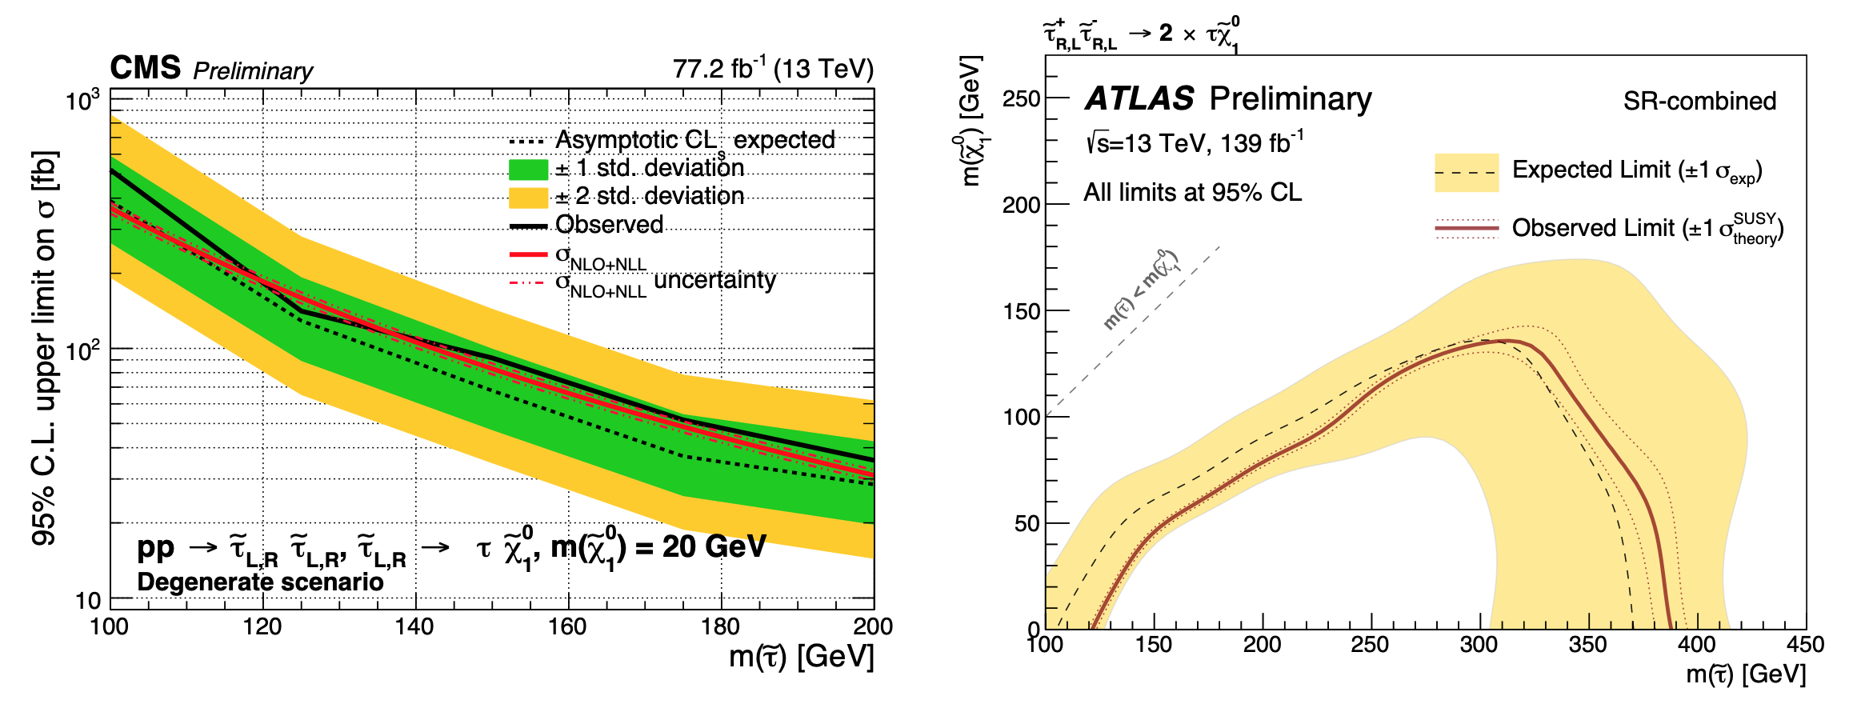
Stau searches: Bounds depend on mixing!
Weak limit at this point, we are now exploring limits beyond LEP.
Observe that this assumes degenerate stau masses.

Slide 13
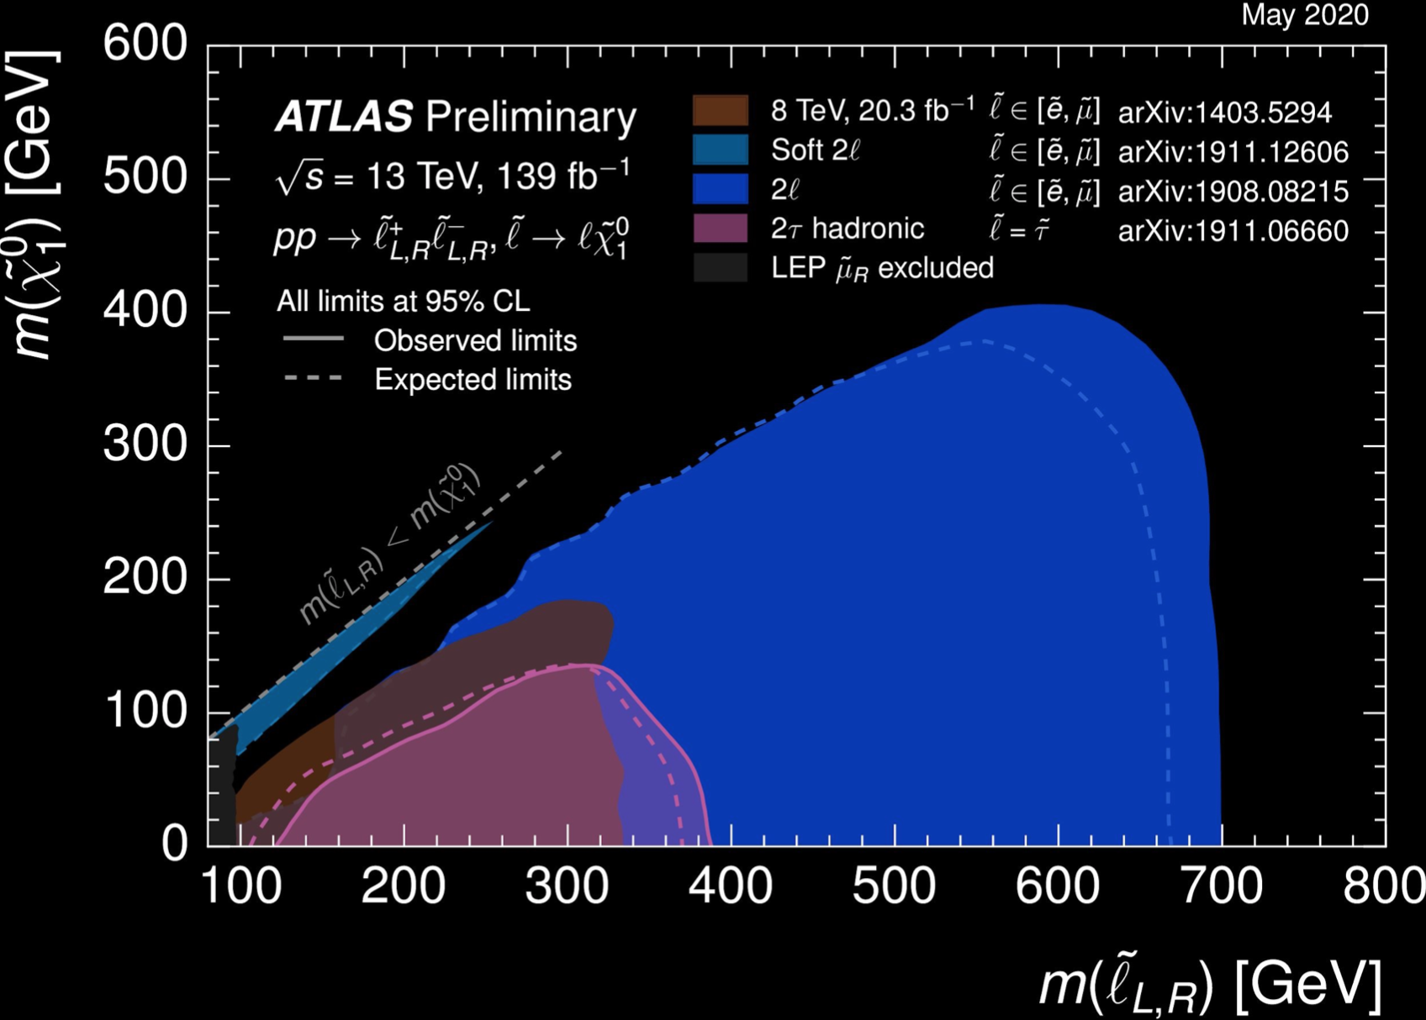
Slepton Searches
Assuming all leptons are degenerate, bound can be as large as 700 GeV.
Bounds are significantly relaxed if mass difference between sleptons and neutralinos is smaller than ~100 GeV.

Slide 14
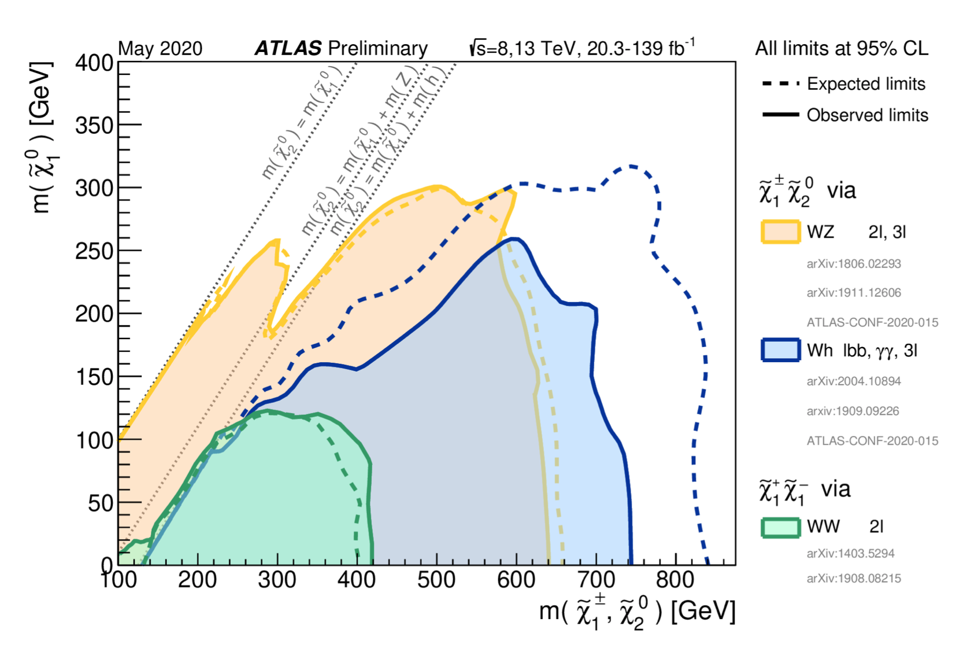
Current Electroweakino Mass Bounds
Wino NLSP, BR = 1

Slide 15
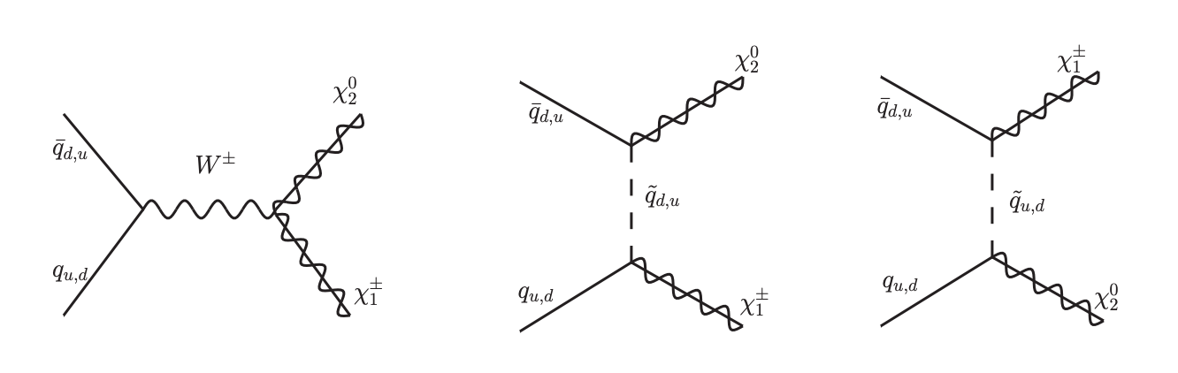
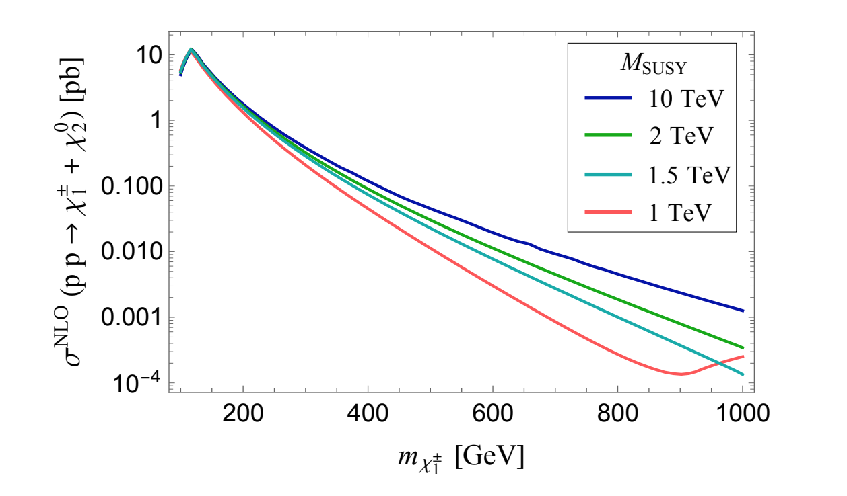
But also… The Squarks!
In evaluating these bounds the squarks have been decoupled.
But cross section depends on the squark masses due to t and u channel contribution to them
Liu, McGinnis, Wagner, Wang, arXiv:2008.11847
The resulting cross sections may differ by factors of a few!

Slide 16
How about neutralino WIMPS for
Dark Matter?
So … ( g_{μ} – 2 ) wants
light neutralinos, charginos, and sleptons,
& so far LHC seems OK with it…

Slide 17
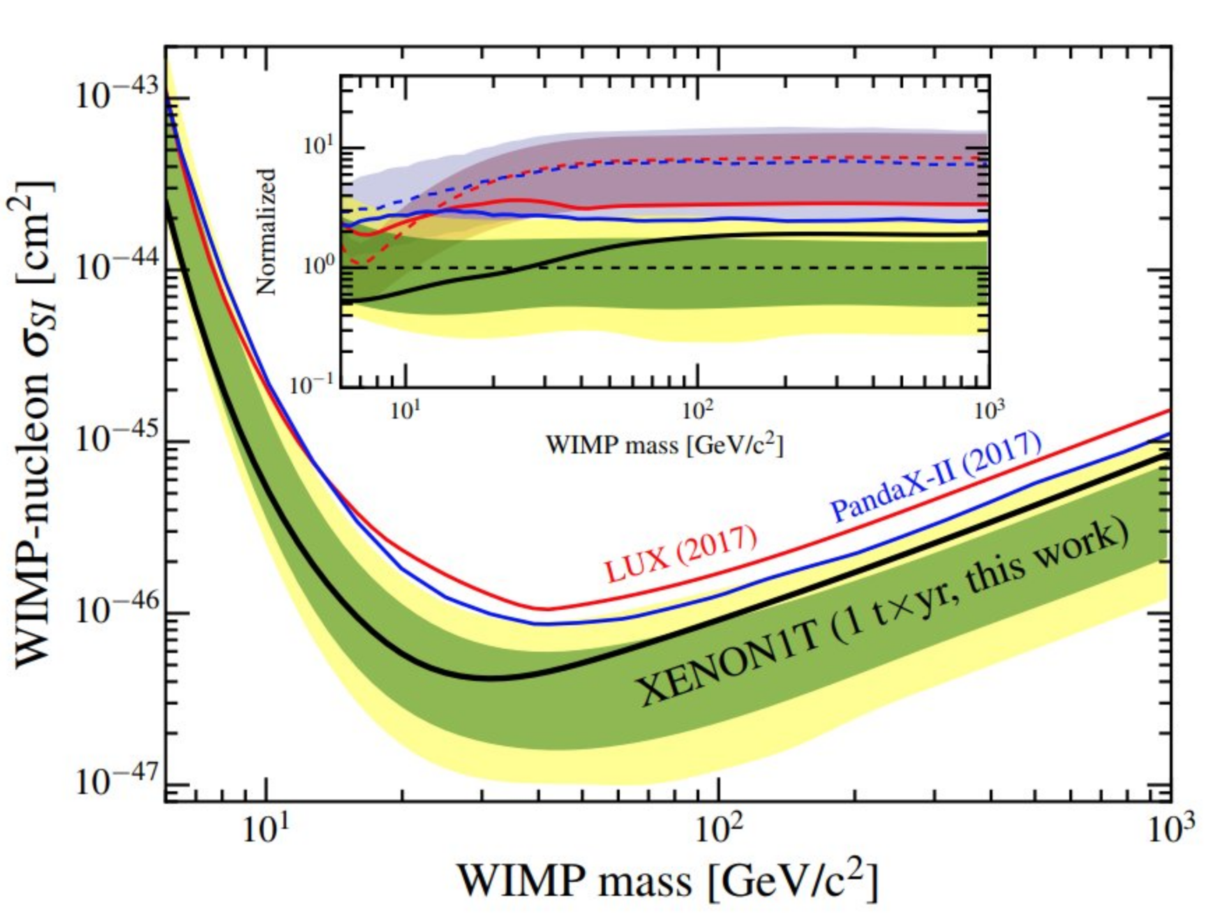
SI DD + Ωh² ??
χ
χ
SI DD
φ_{i}
Ωh²
χ
SM
φ_{i}
SM
SM
χ
SM
XENON1T arXiv:1805.12562
m_{χ} ~ few 100 GeV
Break the Connection!
Co-annihilation/resonance
Multiple mediators for destructive interference
ALL consistent with ( g_{μ} – 2 )!!

Slide 18
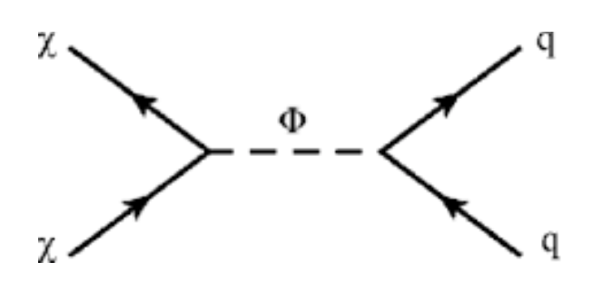
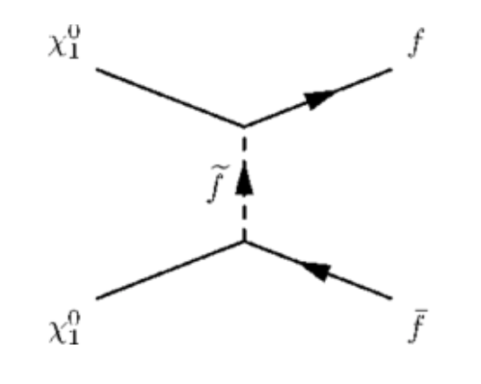
Relic Density: Annihilations
Light Binos with mass close to M₁ excellent candidates for Dark Matter.
s-channel Resonance:
When the neutralino mass is close to a half of the mediating particle mass (eg: Higgs particle). Highly constrained for the light Higgs.
Direct search bounds on Heavy Higgs seriously limit resonant annihilation of light neutralinos consistent with ( g_{μ} – 2 ).
t-channel annihilation with light staus.
Happens also in a natural way at large tanβ.
NRS, Pierce, Freese’13

Slide 19
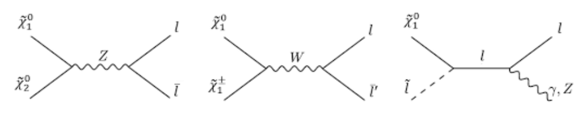
Relic Density: Co - Annihilations
Happen when the DM can annihilate against other rapidly annihilating particles.
Mass difference of DM with the other rapidly annihilating particles must be ~O(few 10s GeV).
Naturally leads to COMPRESSED SPECTRUM for searches in the missing energy channel.
Some relevant channels in the case of sleptons or Winos
(too light Higginos/small μ leads to large SD cross sections).

Slide 20
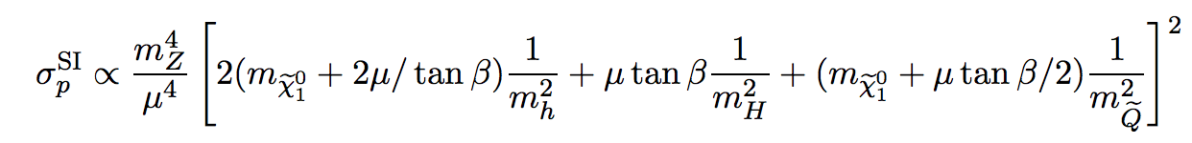
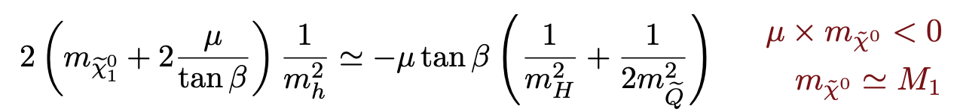
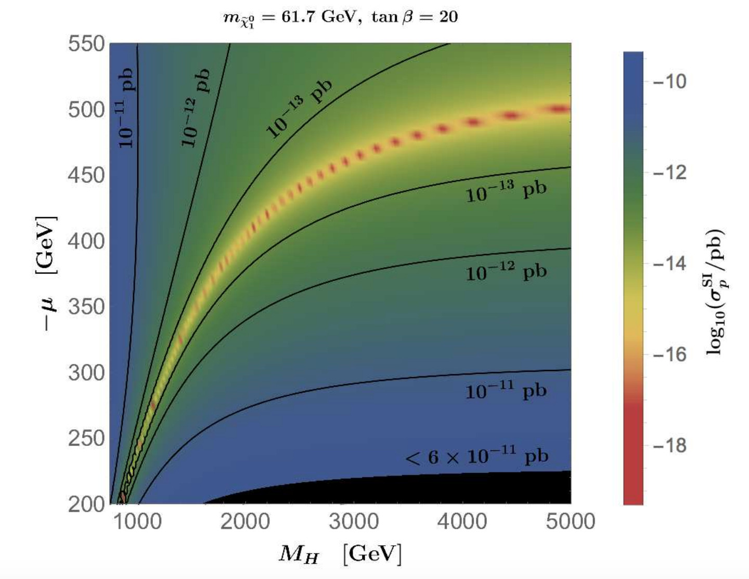
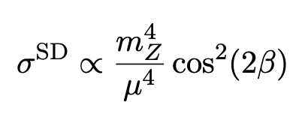
Direct Detection
Cheung, Hall, Ruderman ‘12,
Huang, Wagner ‘14,
Cheung, Papucci, NRS, Stanford, Zurek ‘14,
Han, Liu, Makhapadhyay, Wang ‘18.
Small SI DD can easily be obtained via blind spots.
Negative values of μ x M1 :
Much weaker spin-independent direct detection bounds
SD DD:
No cancellations!
Lower limit on μ
Carena, Osborne, NRS, Wagner, ‘18

Slide 21
( g_{μ} – 2 ) &
Dark Matter Direct Detection

Slide 22
So, What Do We Have?
Baum, Carena, NRS, Wagner, arXiv:2104.03302
Small SI DD: negative values of μ x M₁.
SI DD also suppressed for large values of μ.
(g_{μ} -2) has two contributions:
Bino: proportional to μ x M₁
Chargino: proportional to μ x M₂
Bino contribution is negative in proximity of blind spot
but becomes subdominant at smaller values of μ.
Chargino contribution dominant if all masses of the same order
and suppressed at large μ .
(g_{μ} - 2) needs to be positive => (g_{μ} - 2) + SI DD:
Large values of μ, or
Smaller values of μ and opposite sign for the gaugino masses.

Slide 23
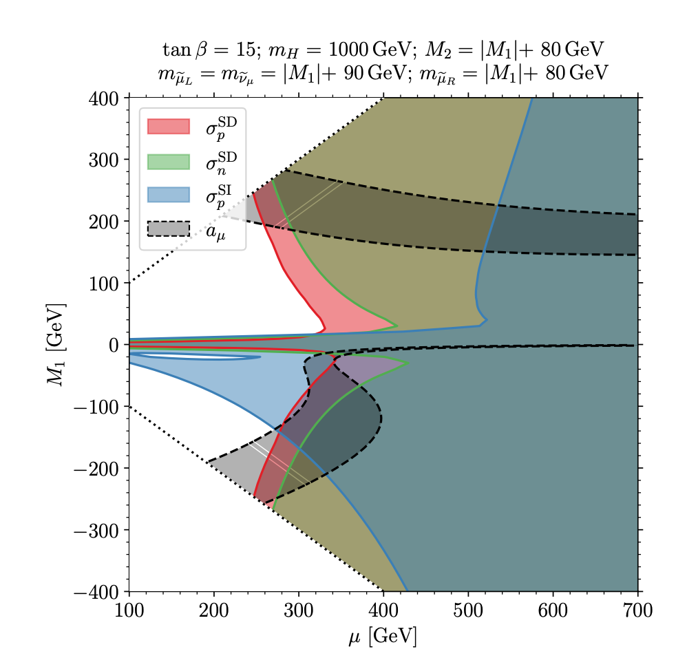
A Qualitative Picture
Baum, Carena, NRS, Wagner, arXiv:2104.03302
Shaded regions are allowed.
Large hierarchy of values of μ between + and - values of the Bino mass parameter is observed.
Compatibility of Direct Detection and (g_{μ} -2) Constraints for a representative example of a compressed spectrum. Stau co-annihilation is assumed

Slide 24
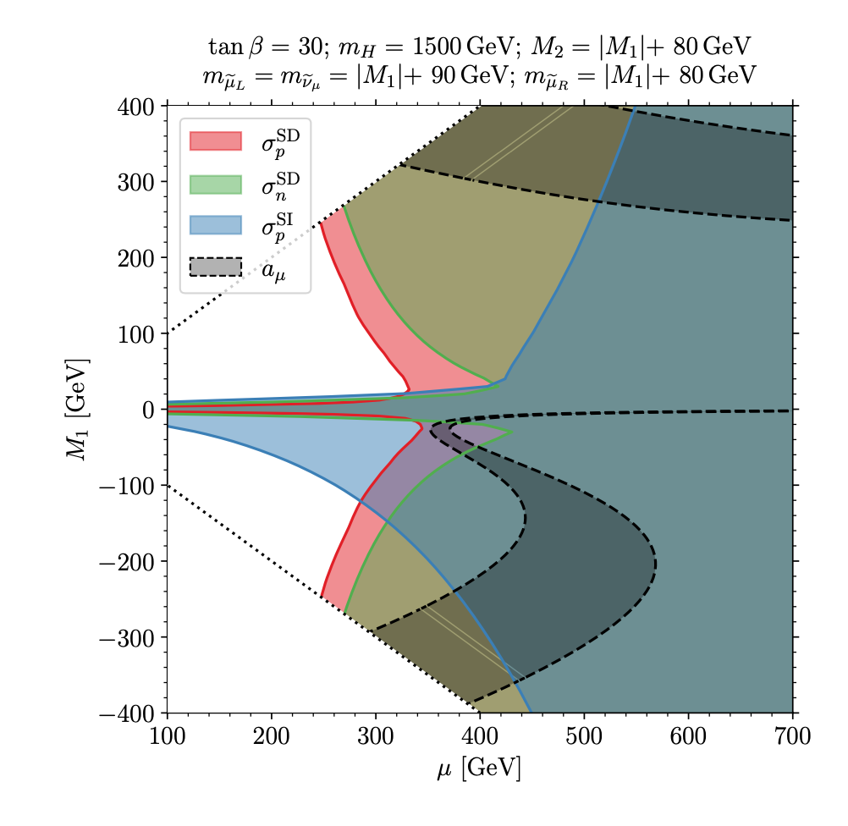
A Qualitative Picture
Baum, Carena, NRS, Wagner, arXiv:2104.03302
Small values of μ < 500 GeV may only be obtained for negative values of the Bino mass parameter.
Compatibility of Direct Detection and g_{μ} -2 Constraints for a representative example of a compressed spectrum. Stau co-annihilation is assumed

Slide 25
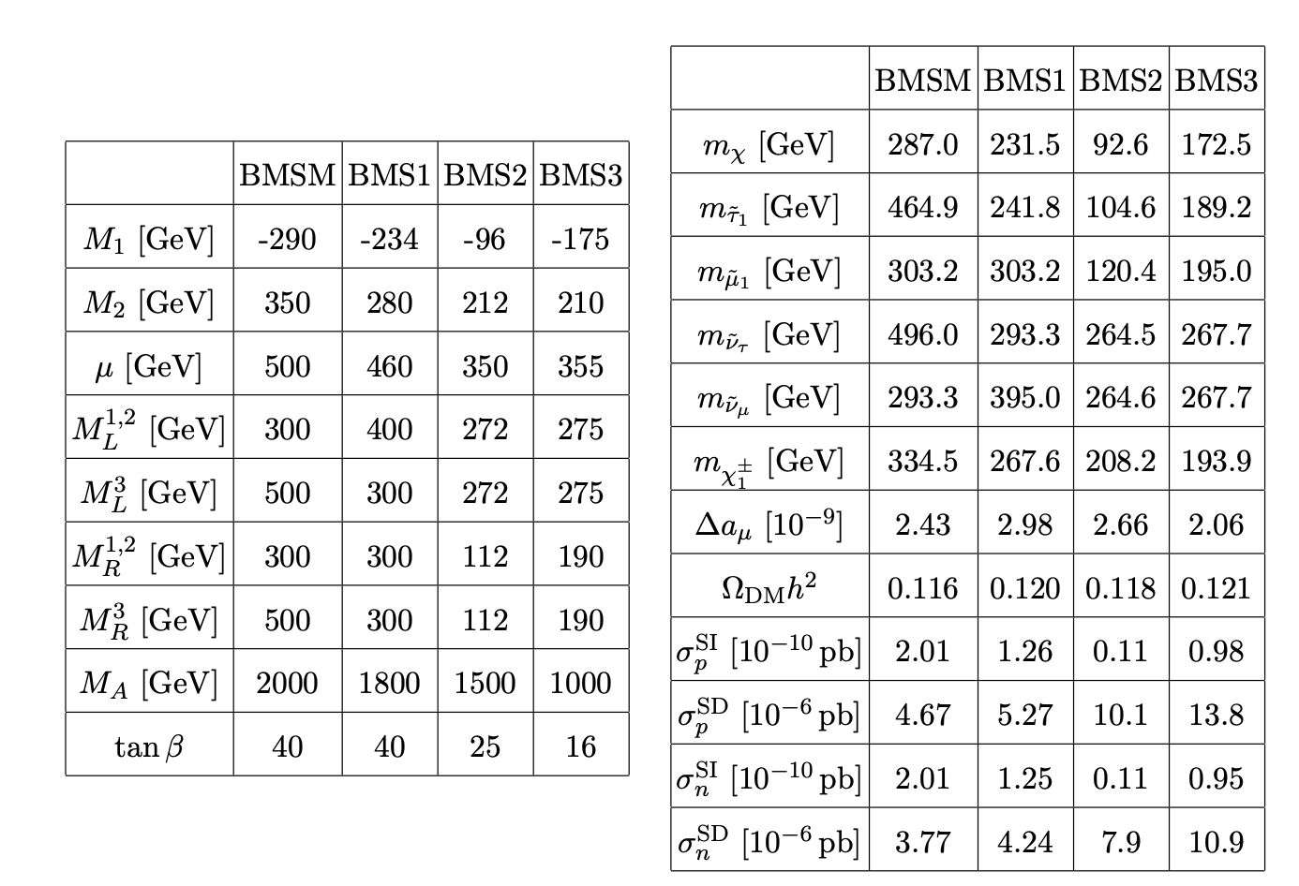
Benchmarks for Negative ( μ x M₁ )
BMSM :
Co-annihilation with a muon sneutrino,
BMS1 :
Co- annihilation with a light stau,
BMS2 :
Annihilating via stau mediated t-channel
BMS3 :
Co-annihilation with staus and charginos.

Slide 26
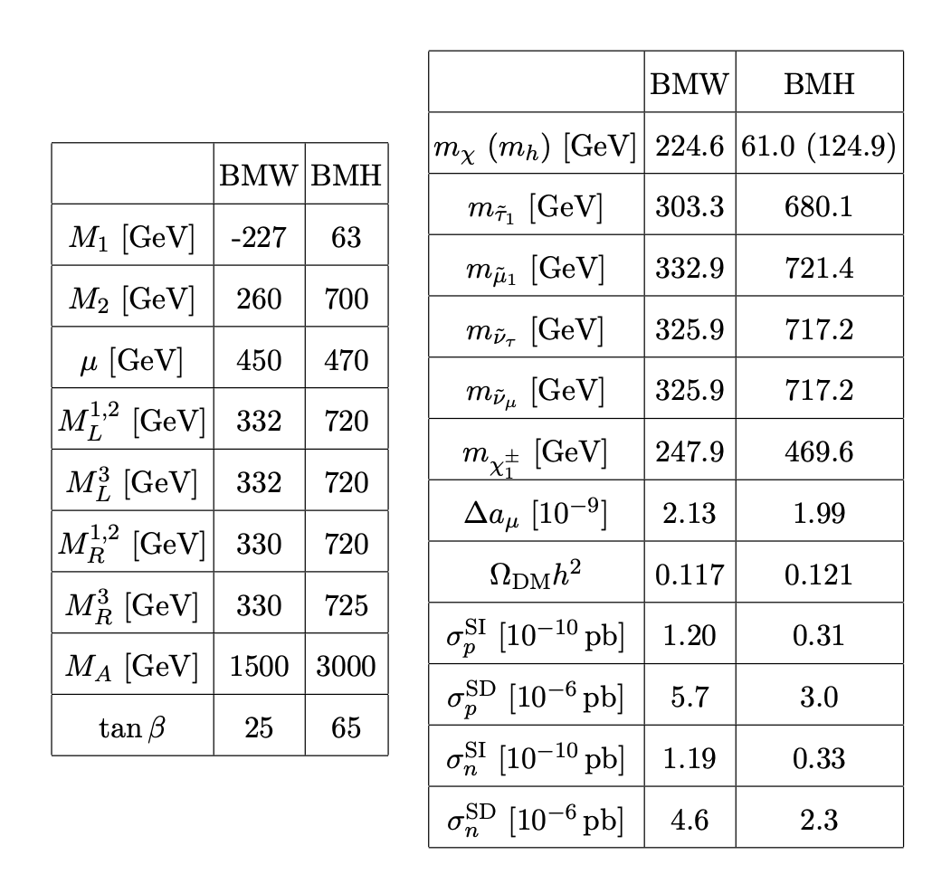
Benchmarks for Negative ( μ x M₁ ) & Resonance
BMW :
Co-annihilation with a Wino.
BMH :
s-channel resonant annihilation via the SM-like Higgs boson.

Slide 27
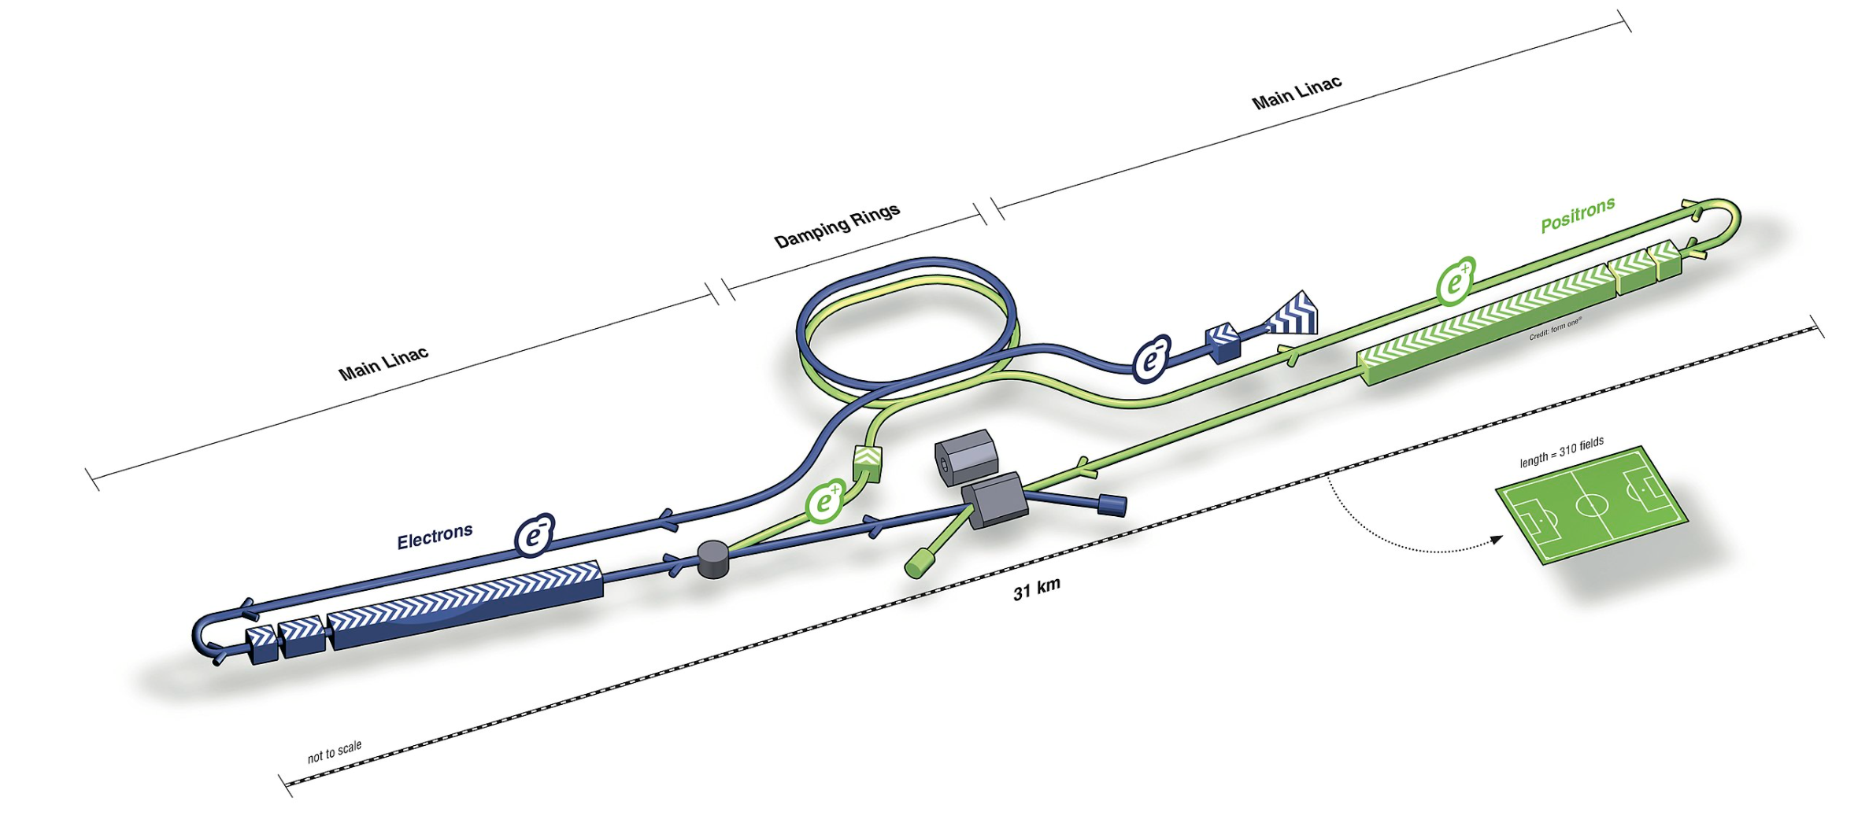
ILC?
High-Lumi LHC: Most gain in such spectra
-- statistics rather than energy limited.
But bounds on Higgsinos will remain weak.
ILC:
e+e- machine: can DIRECTLY probe weak physics!
IF kinematically accessible
Compressed Spectra NOT a bottle neck!
(See S. Heinemeyer talk )

Slide 28

Thank You!
SM WORKS TOO WELL!
Fermilab (g_{μ} - 2) confirms previous Brookhaven result!
Other Flavor Anomalies may also be present… Need confirmation
May be hint of New Physics
What are the right questions?
Natural SUSY:
Light Higgsinos, Neutralinos, Charginos & Sleptons
With relative signs, can accommodate (g_{μ} - 2) & Dark Matter!
Data + Theory:
Where to look next!
ILC:
Could probe relevant mass spectra – IF enough energy!
“May we live
in interesting times.”

Slide 29
BACk up slides

Slide 30
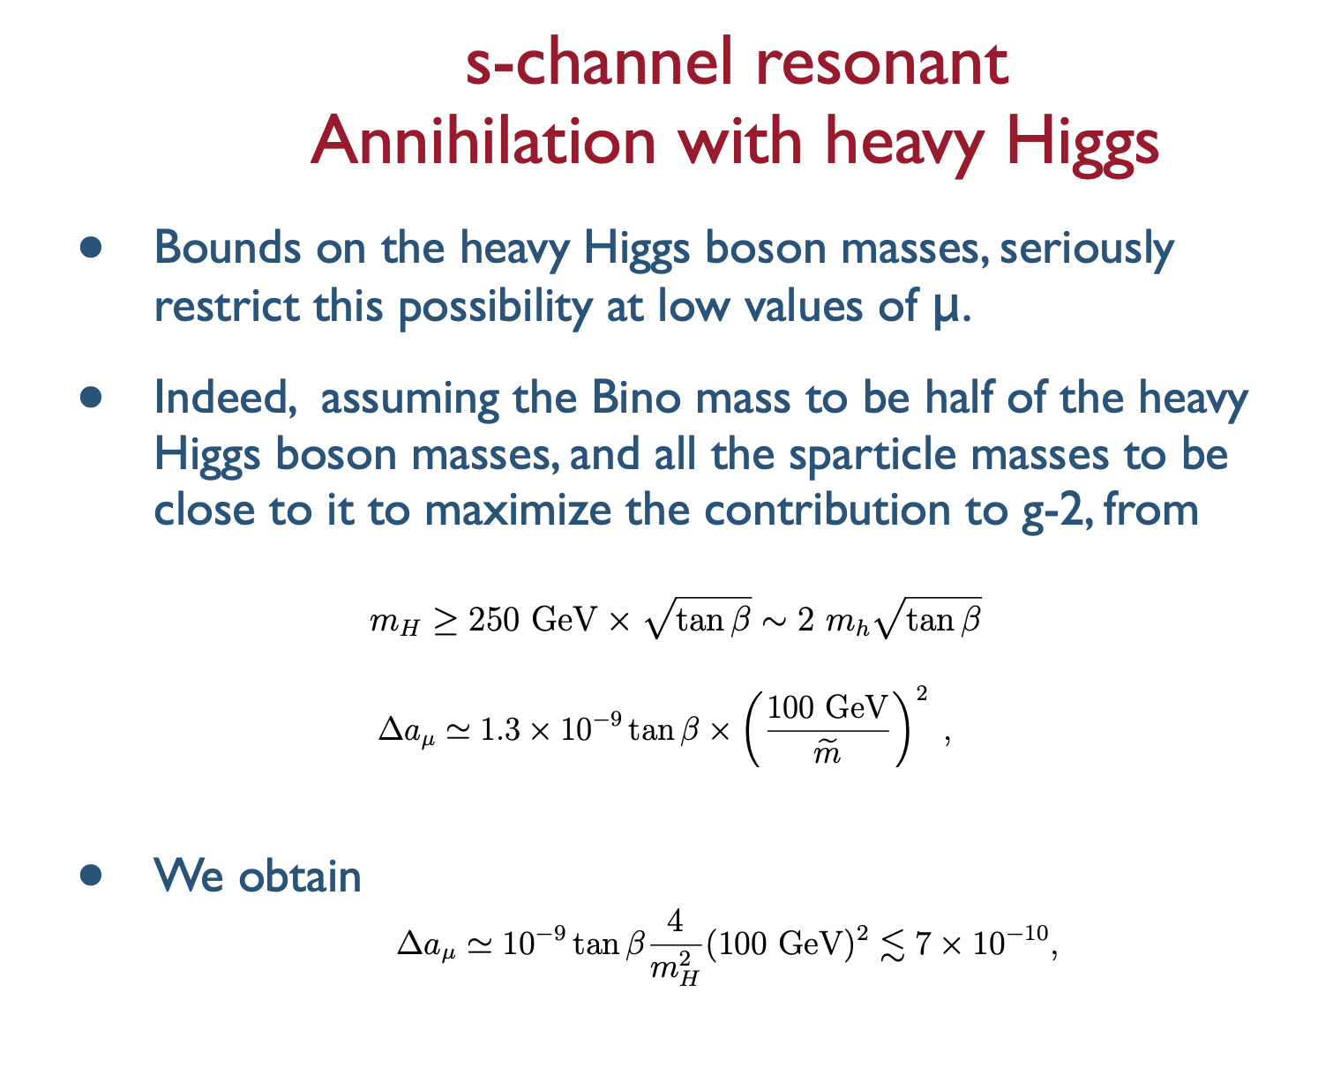

Slide 31
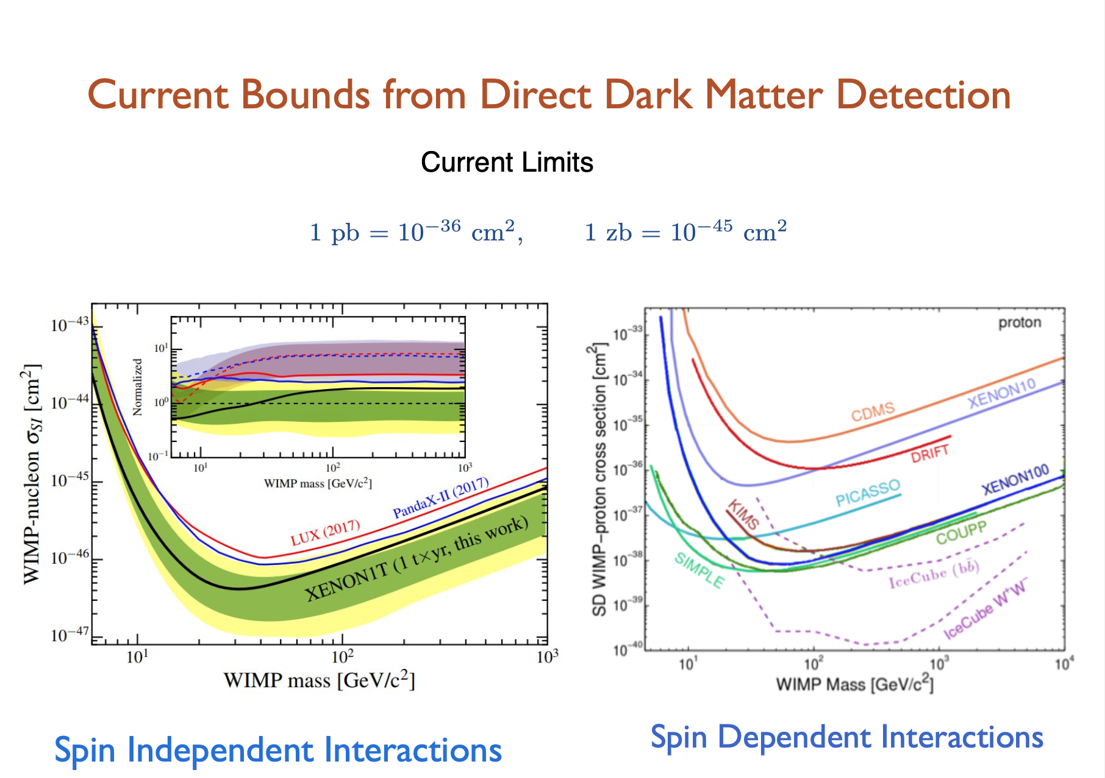

Slide 32
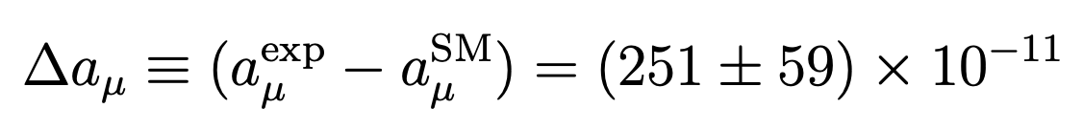
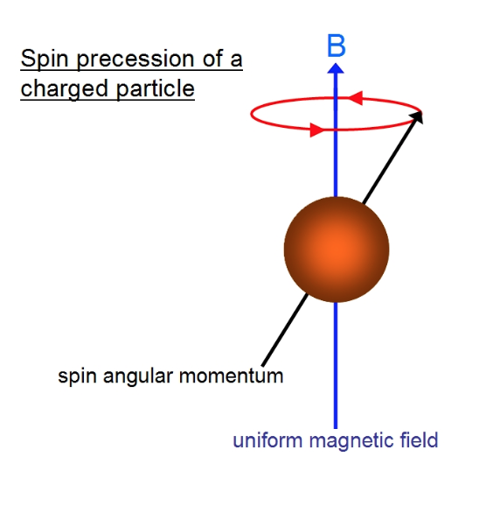
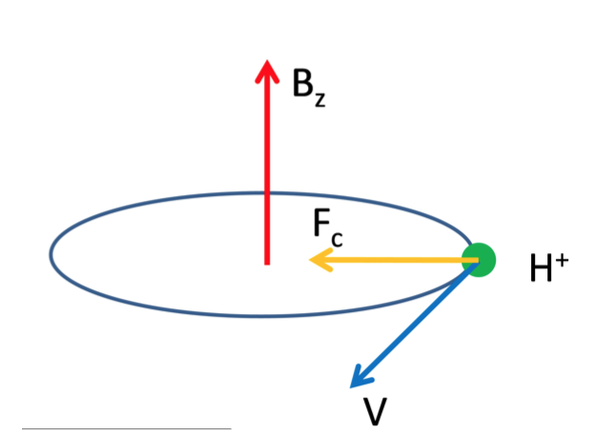
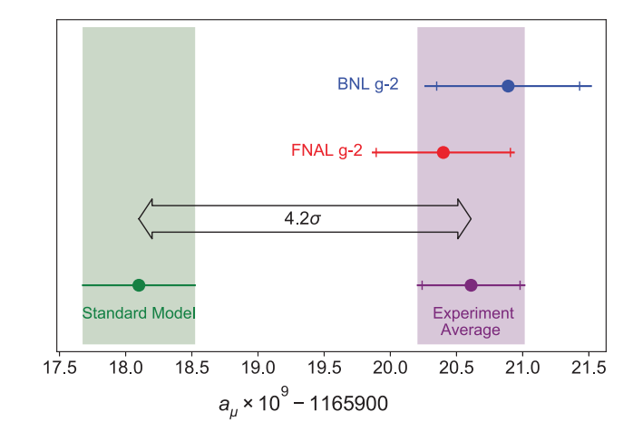
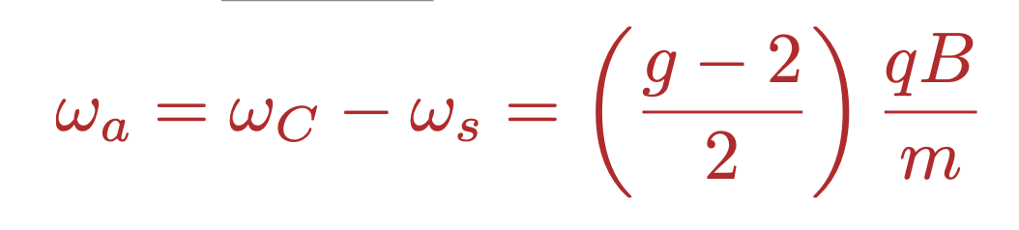
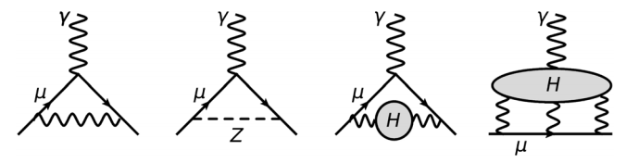
Flavor Anomalies!!
Anomalous magnetic moment of the muon
Fermilab Muon g-2
  (g_{μ}−2)/2 = 0.00116592061(41)
  FNAL Muon g-2, PRL Apr 2021.
ω_{C}
ω_{s}
MUONS??

Slide 33
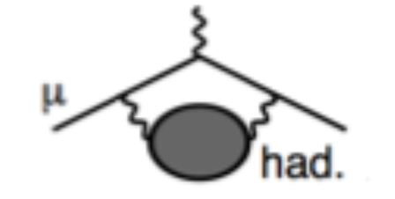
Hadronic Vacuum Polarization Contribution --BMW Lattice calculation:
Is there in fact tension with the SM??
The Lattice results should be taking seriously. However, we should clearly wait for other lattice groups to corroborate the BMW result.
HVP effects would impact the variation of the fine structure constant, affecting precision measurements at M_{Z}. Any correction from the current values should be limited to energies below 0.9 GeV, as is also confirmed by the BMW study.
Crivellin et al, 2003.04886; Kezhavarzi, Marciano, Pasera, Sirlin, arXiv: 2006.12666
Tension with low energy data could be resolved by large systematic errors in the cross section evaluations or by new physics contributing to them. Both possibilities look unlikely, but certainly not impossible.
May also be resolved by some unaccounted systematic error in the lattice evaluations. BMW provides a detailed account of their error estimates and will be double checked by other lattice groups (expected in the next year or so).

Slide 34
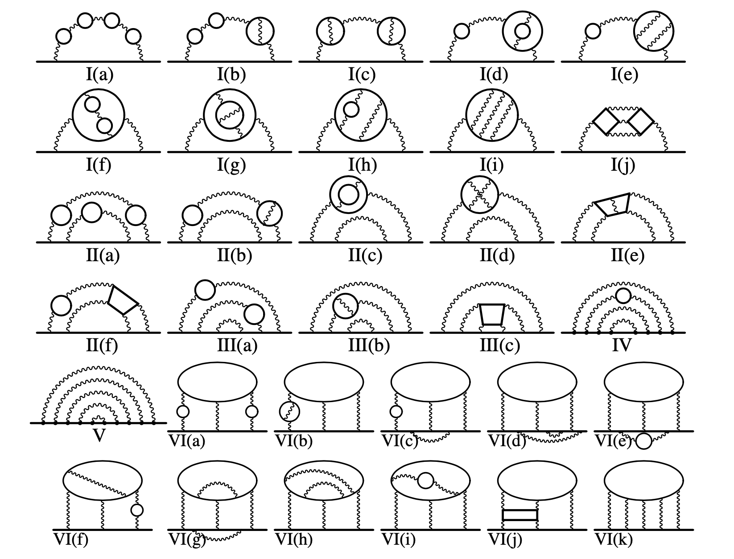
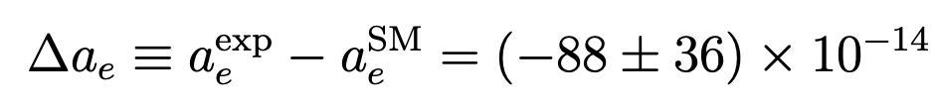
Electrons??
5-Loop QED Contributions!
The QED corrections to (g-2) of the electron are known up to 5-loops.
The agreement between theory and experiments is one of the greatest triumphs of science and of the SM!
Parker et al, 1812.04130

