Slide 1
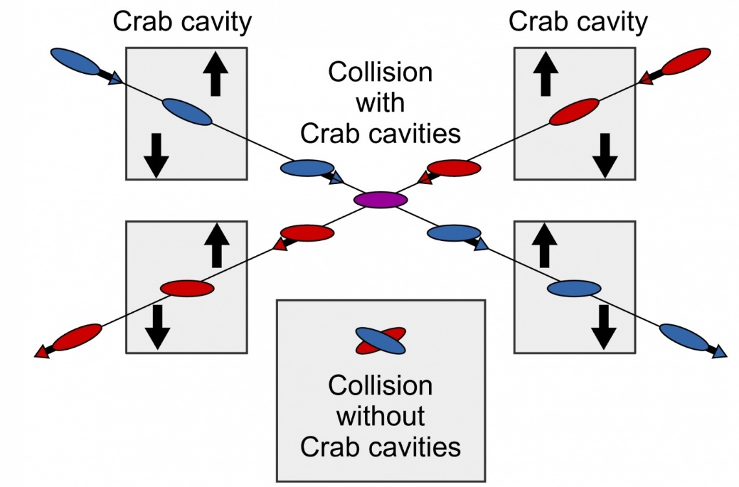

WP3: 3rd Crab Cavity Meeting
Peter McIntosh,
UKRI-STFC Daresbury Laboratory
25th May 2021

Slide 2
Agenda for Today
Pre-Lab Scope of Work
Crab Cavity Specifications Review
Pre-Lab Planning for cavity down-selection process
Summary and next steps

Slide 3
1. Pre-Lab Scope of Work
Reminder:
Key changes from original Pre-Lab scope of work include:
  Early stage development agreed for cavity EM design optimisation.
  Two cavity technology down-selection processes incorporated:
    First: Select 2 most optimum integrated cavity designs (cavity, couplers, tuner) to move into prototyping stage a validation.
    Second: Perform final cavity technology selection to be used as basis for integrated cryomodule design.
  Perform 2-cavity synchronisation test using the 2 prototype cavities demonstrated at a suitable lab partner location.
  Crab cavity Pre-Lab scope will result in a final engineering design of a 2-cavity cryomodule solution, ready for prototyping beyond the Pre-Lab phase.

Slide 4
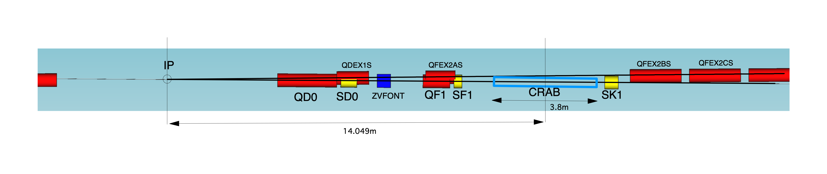
Crab cavity requirement
Crab cavity location ( present ILC optics deck )
two beamline distance
14.05m x 0.014rad = 197mm
The tolerances were calculated only by geometrical effect, not included the beam-beam effect
 | Parameters
Longitudinal distance from IP | 14.05 m
Horizontal distance from dump line | 0.197 m
Minimum aperture | 20 mm diameter ( same as FD magnets )
Beam sizes at crab cavity ( x / y / z ) | 0.97 mm / 66 um / 300 um
R12 (crab cavity to IP) | 17.4 m
R34 (crab cavity to IP) | 2.5 m
Tolerance of horizontal beam tilt angle | 0.35 mrad rms. (2% luminosity drop)
Tolerance of vertical beam tilt angle | 7.4 urad rms. (2% luminosity drop)
Tolerance of cavity amplitude | 3.5 % rms. / cavity (2% luminosity drop)
Tolerance of rotation of cavity field | 5.2 mrad rms. / cavity (2% luminosity drop)
relative timing jitter requirement | 49 fs rms. ( 2 % luminosity drop )
Okugi-san issued 25/5

Slide 5
Discussion
Beam-cavity jitter – Not so tight
The dominant timing issues is relative jitter between crab cavities.
The following effect affects for beam cavity timing issues, but I think it are not so significant.
  Nonlinear field of crab cavity
  Traveling focusing (offset at FD sextupoles)
Requirement of cavity impedance – Not so tight
The crab cavities will be put to the beam transport line, not storage ring.
Single bunch wake is dominant for the crab cavities such as ILC ML (bunch separation was 554 ns).
Longitudinal wake field is negligible for single element ( I = 5.8 mA ).
The dynamic transverse wakefield effects is small impact for the single element such as single cavity BPM.
The static transverse wakefield effect can be correctable such as single cavity BPM.
In order to simulate the effect, we need time distribution of the wakefield, not impedance number.
Tolerances for the cavity position alignment
When the field is pure dipole field, crab cavity position does not affect to IP beam.
It strongly depends on the field distribution of the crab cavity.
We need the field distribution of the crab cavity, when we will evaluate the tolerance.
Okugi-san issued 25/5

Slide 6
2 and 3. ILC CC Specifications and Pre-Lab Plan
Draft specification parameters can be found here:
  https://agenda.linearcollider.org/event/9224/

Slide 7
4. Next Steps
Progress action areas to complete CC system specifications.
Embed planned activities into the revised ILC WBS structure and use as basis for next stage WP3 reviews.
My suggestion is for monthly updates for next 3 months (upto July).
Afterwards to then set more optimised technical sessions to review design progress for each CC solution.
Target converged design optimisation for Decision-1 during Pre-Lab phase.

