Slide 1
14th Meeting of DR/BDS/DUMP group
Date : 2021/04/20 (Wed)
Attendees : Karsten Buesser, Philip Burrows, Stephen Brooks, Angeles Faus-Golfe, Jenny List, Kiyoshi Kubo,
    Thomas Markiewicz, Shin Michizono, Toshiyuki Okugi, Brett Parker, Ivan Podadera, David L. Rubin,
    Ben Shephard, Fermado Sordo, Nobuhiro Terunuma, Andrzej Wolski, Mikhail Zobov
Topics : WBS for DR/RTML/BDS area systems (continued)
15th Meeting of DR/BDS/DUMP group
Date : 2021/05/12 (Wed)
Attendees : Karsten Buesser, Philip Burrows, Angeles Faus-Golfe, Andy Lankford, Andrea Latina, Kiyoshi Kubo,
    Shin Michizono, Toshiyuki Okugi, Ivan Podadera, David L. Rubin, Robert Ryne, Nikolay Solyak,
    Fermado Sordo, Nobuhiro Terunuma, Glen White, Jean-Luc Vay, Kaoru Yokoya, Mikhail Zobov
Topics : WBS for BDS area systems

Slide 2
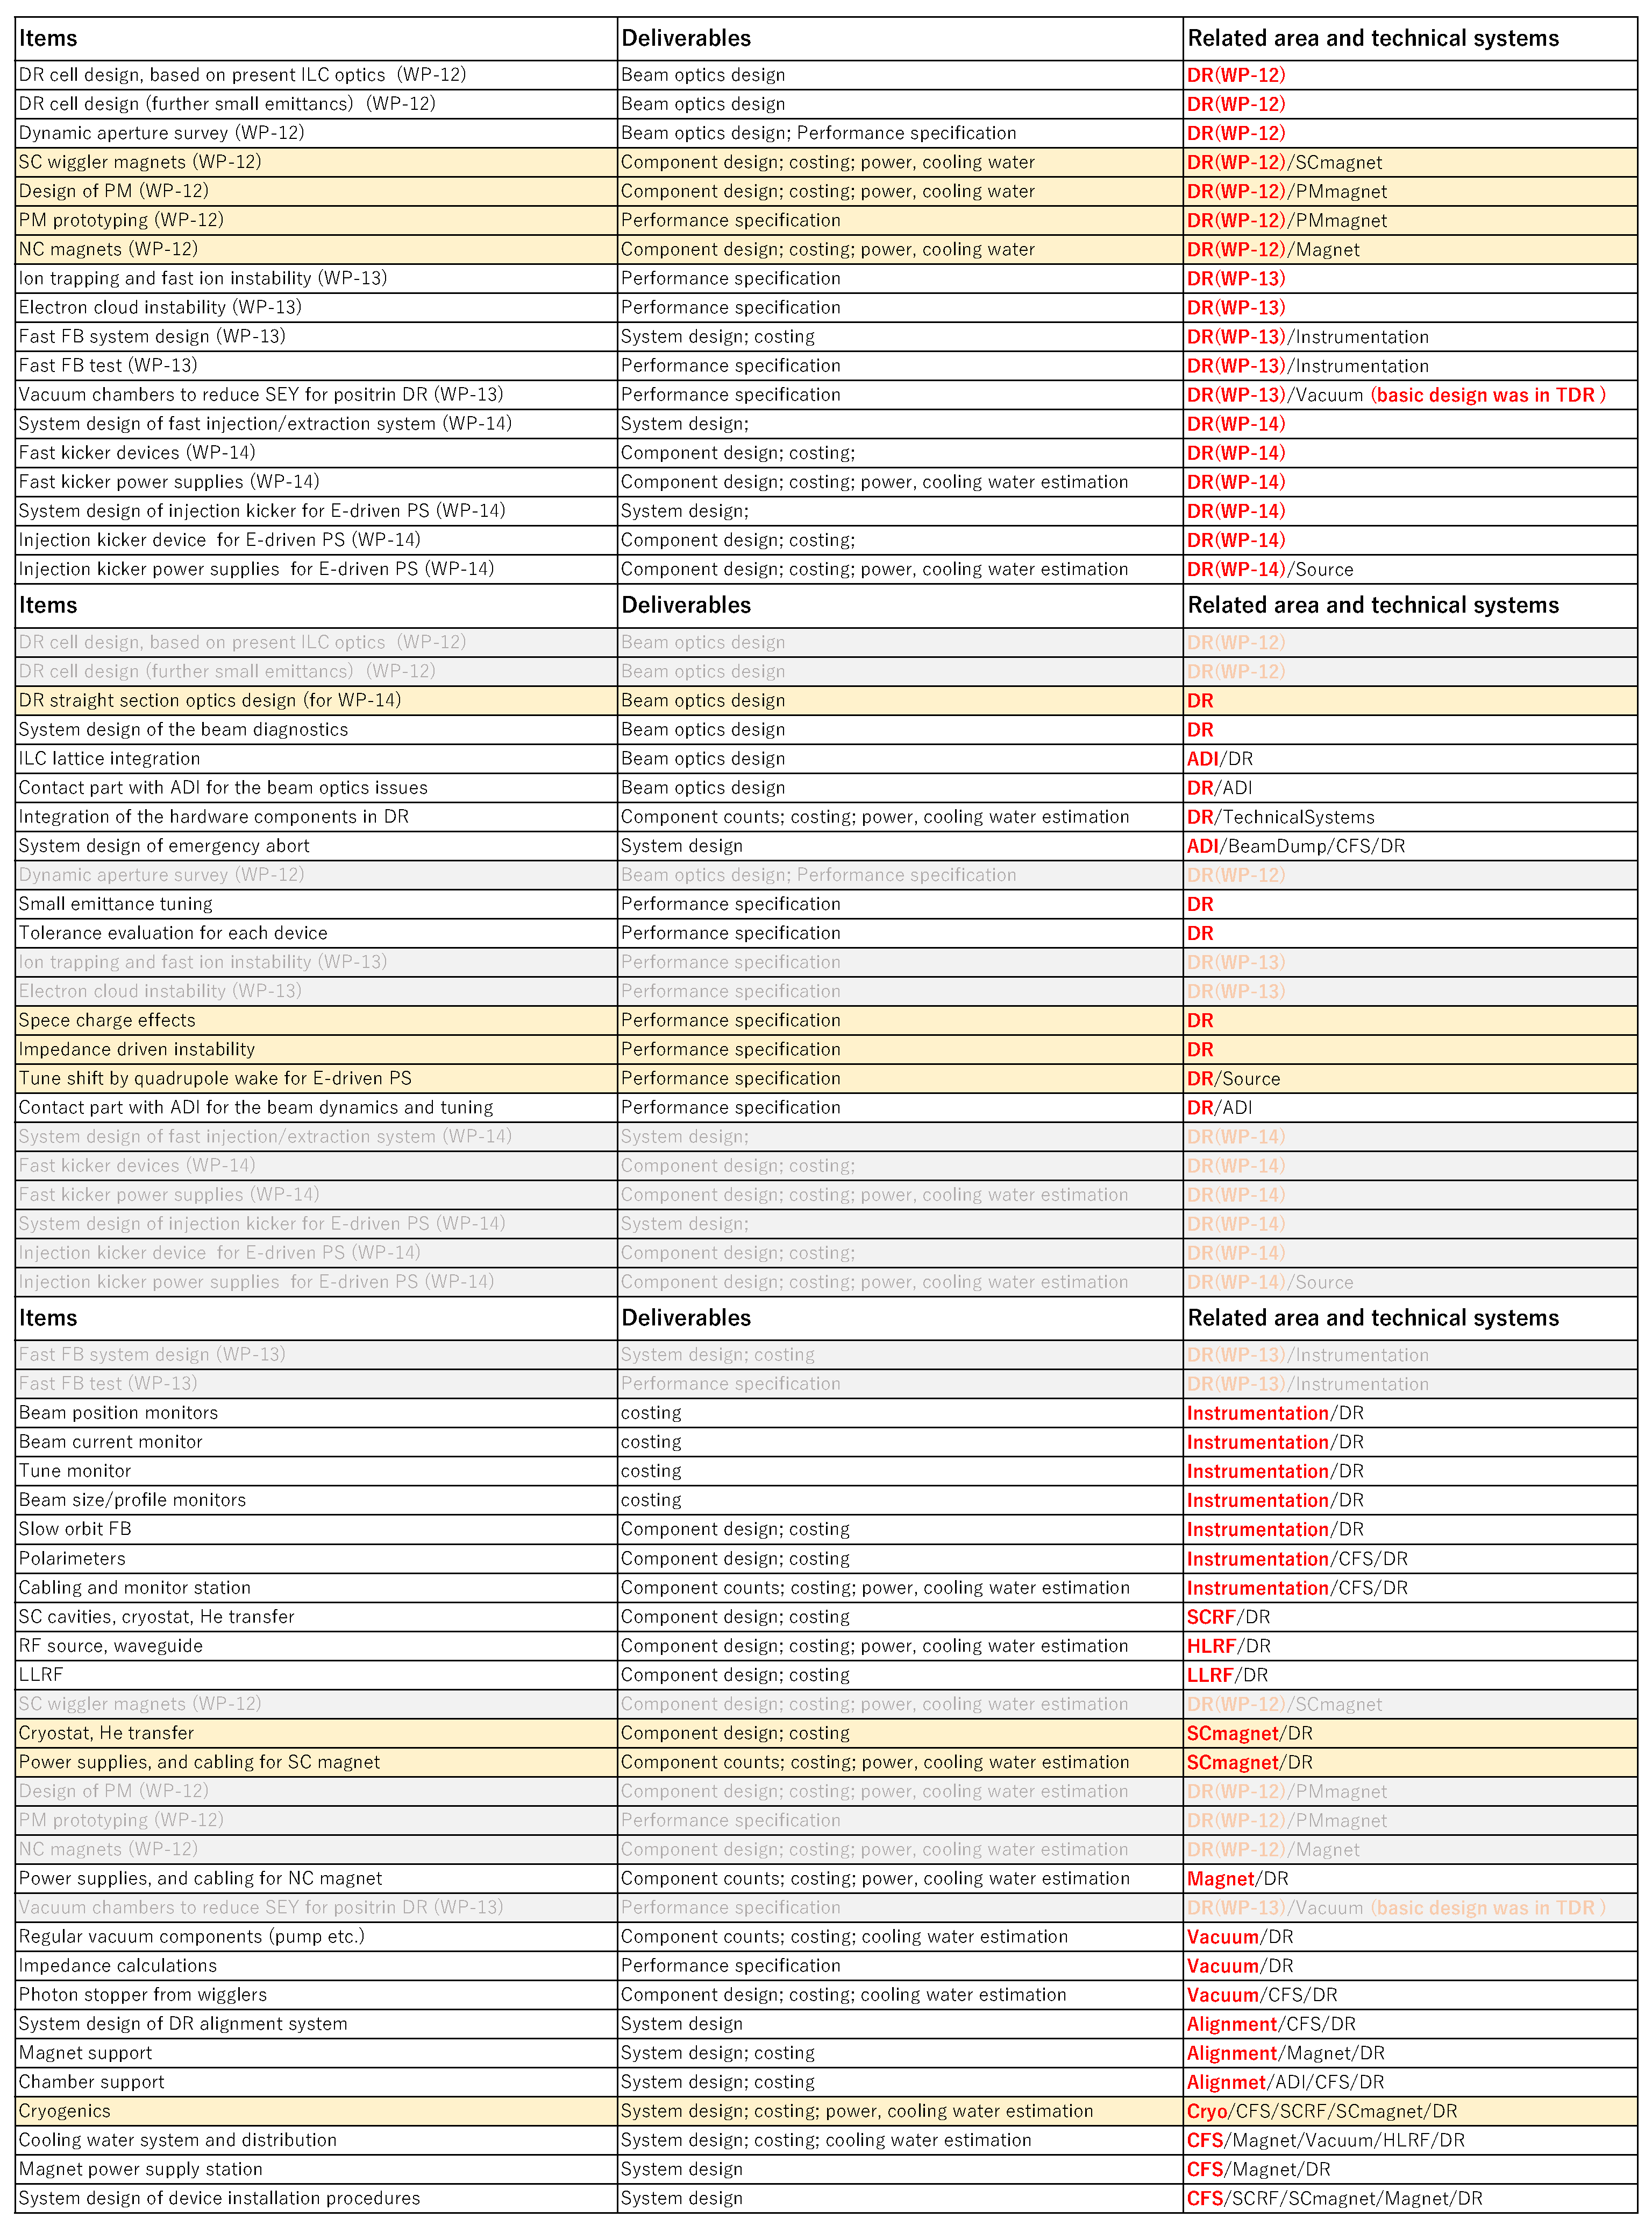
Damping Ring
Work packages
  WP-12
  WP-13
  WP-14
List up all items for EDR related to DR
Picked up the WP related items
from the to-do-list of both area and
technical systems and categorized.
Resource
of technical
preparation
Area system
Optics design and
system integration
Beam dynamics
and tuning
Fast kicker
DR area system
3WPs
Remaining items
  of original area systems
Technical system
Instrumentation
Magnet
RF
Vacuum
Resource
of EDR
Technical system
Remaining items
of original technical systems
To be integrated the item
of each technical category
for all area systems
. . . .

Slide 3
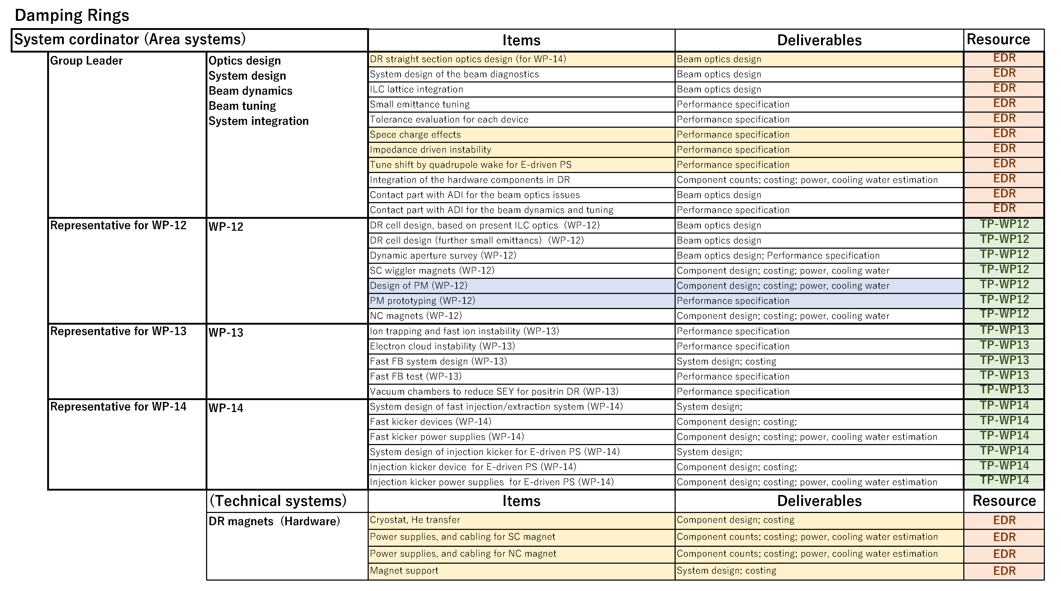
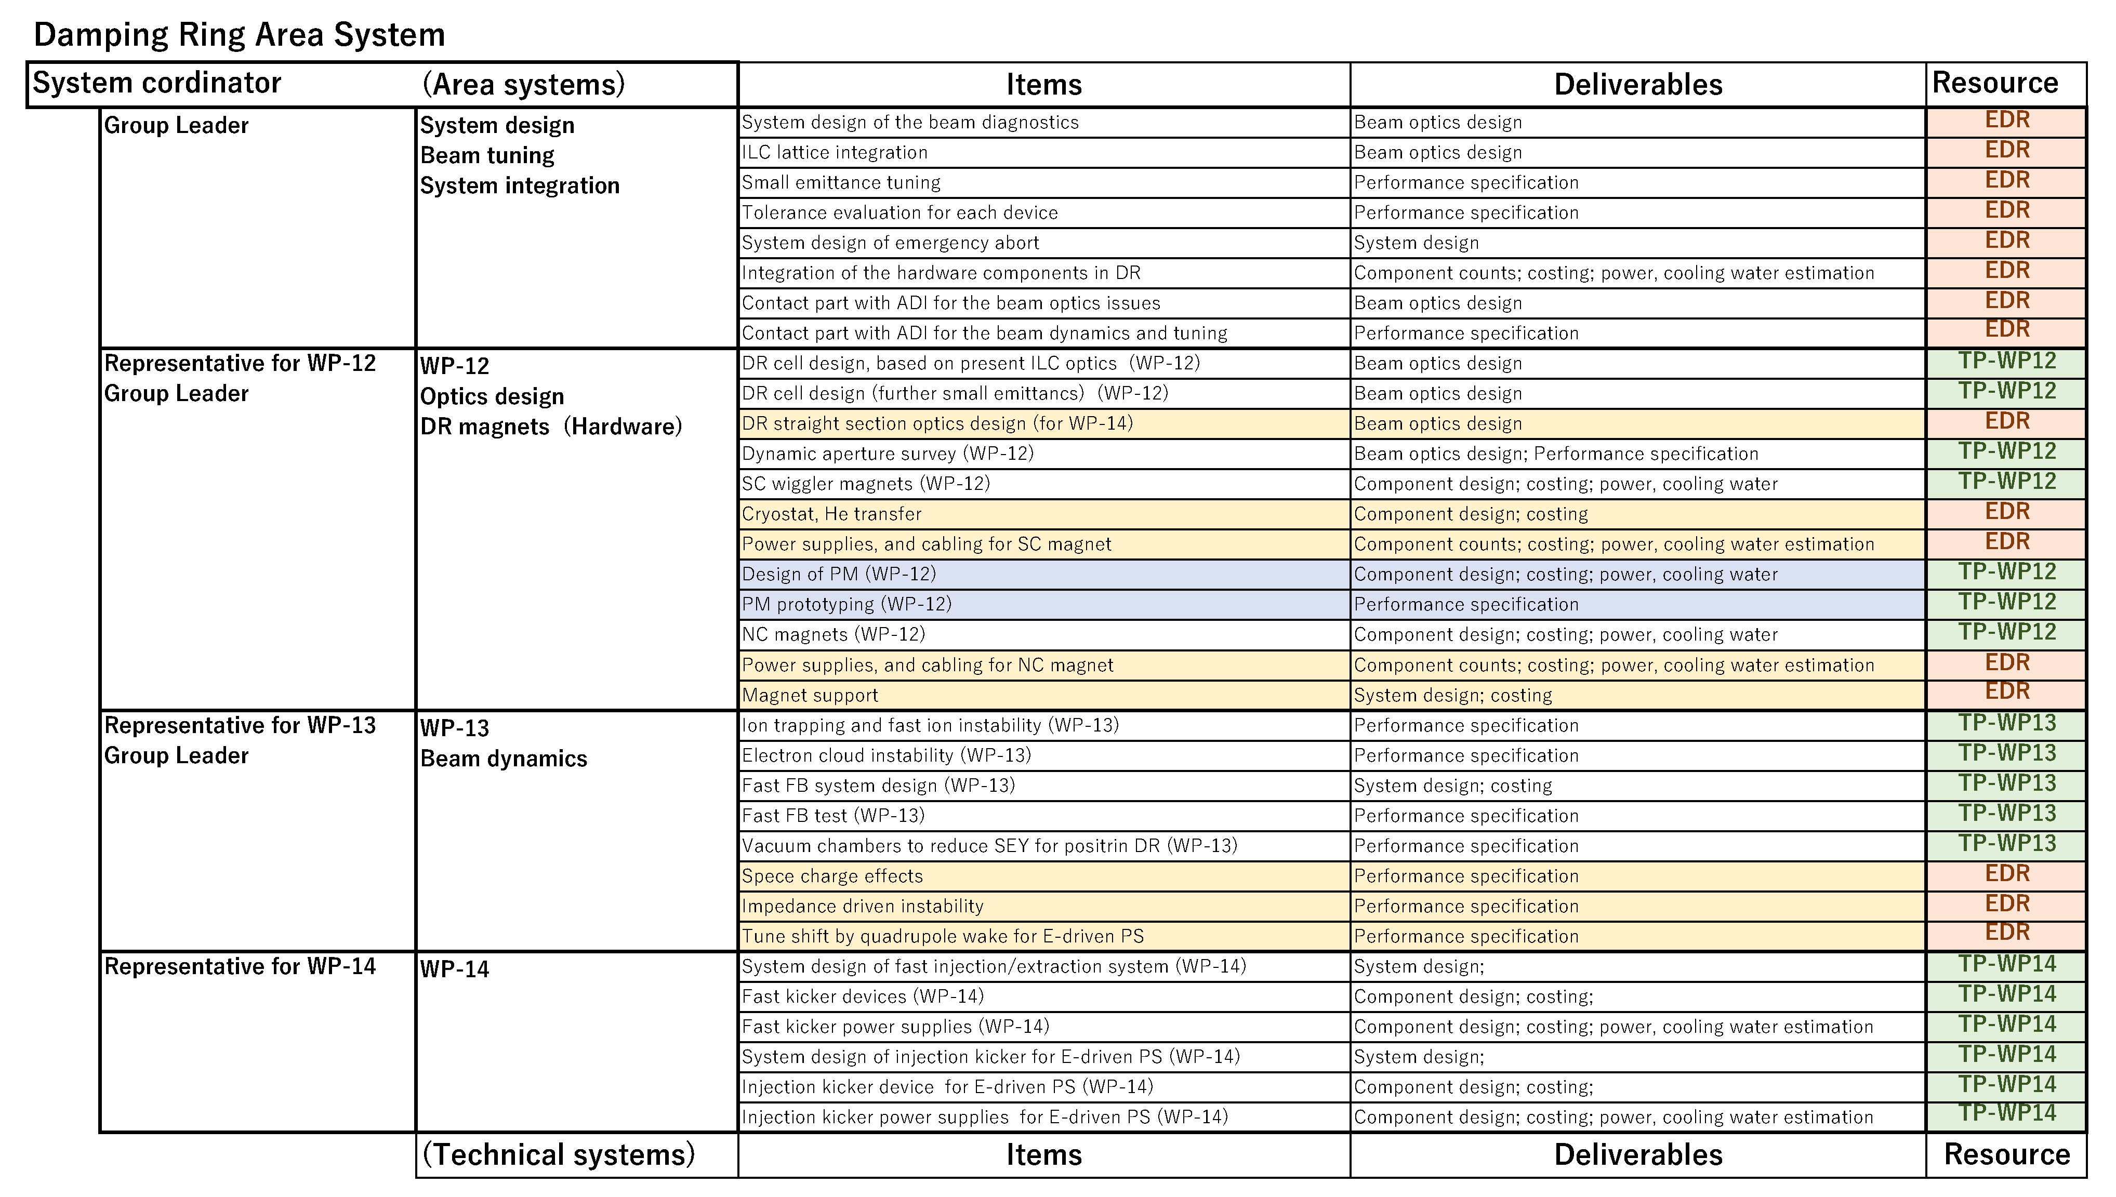
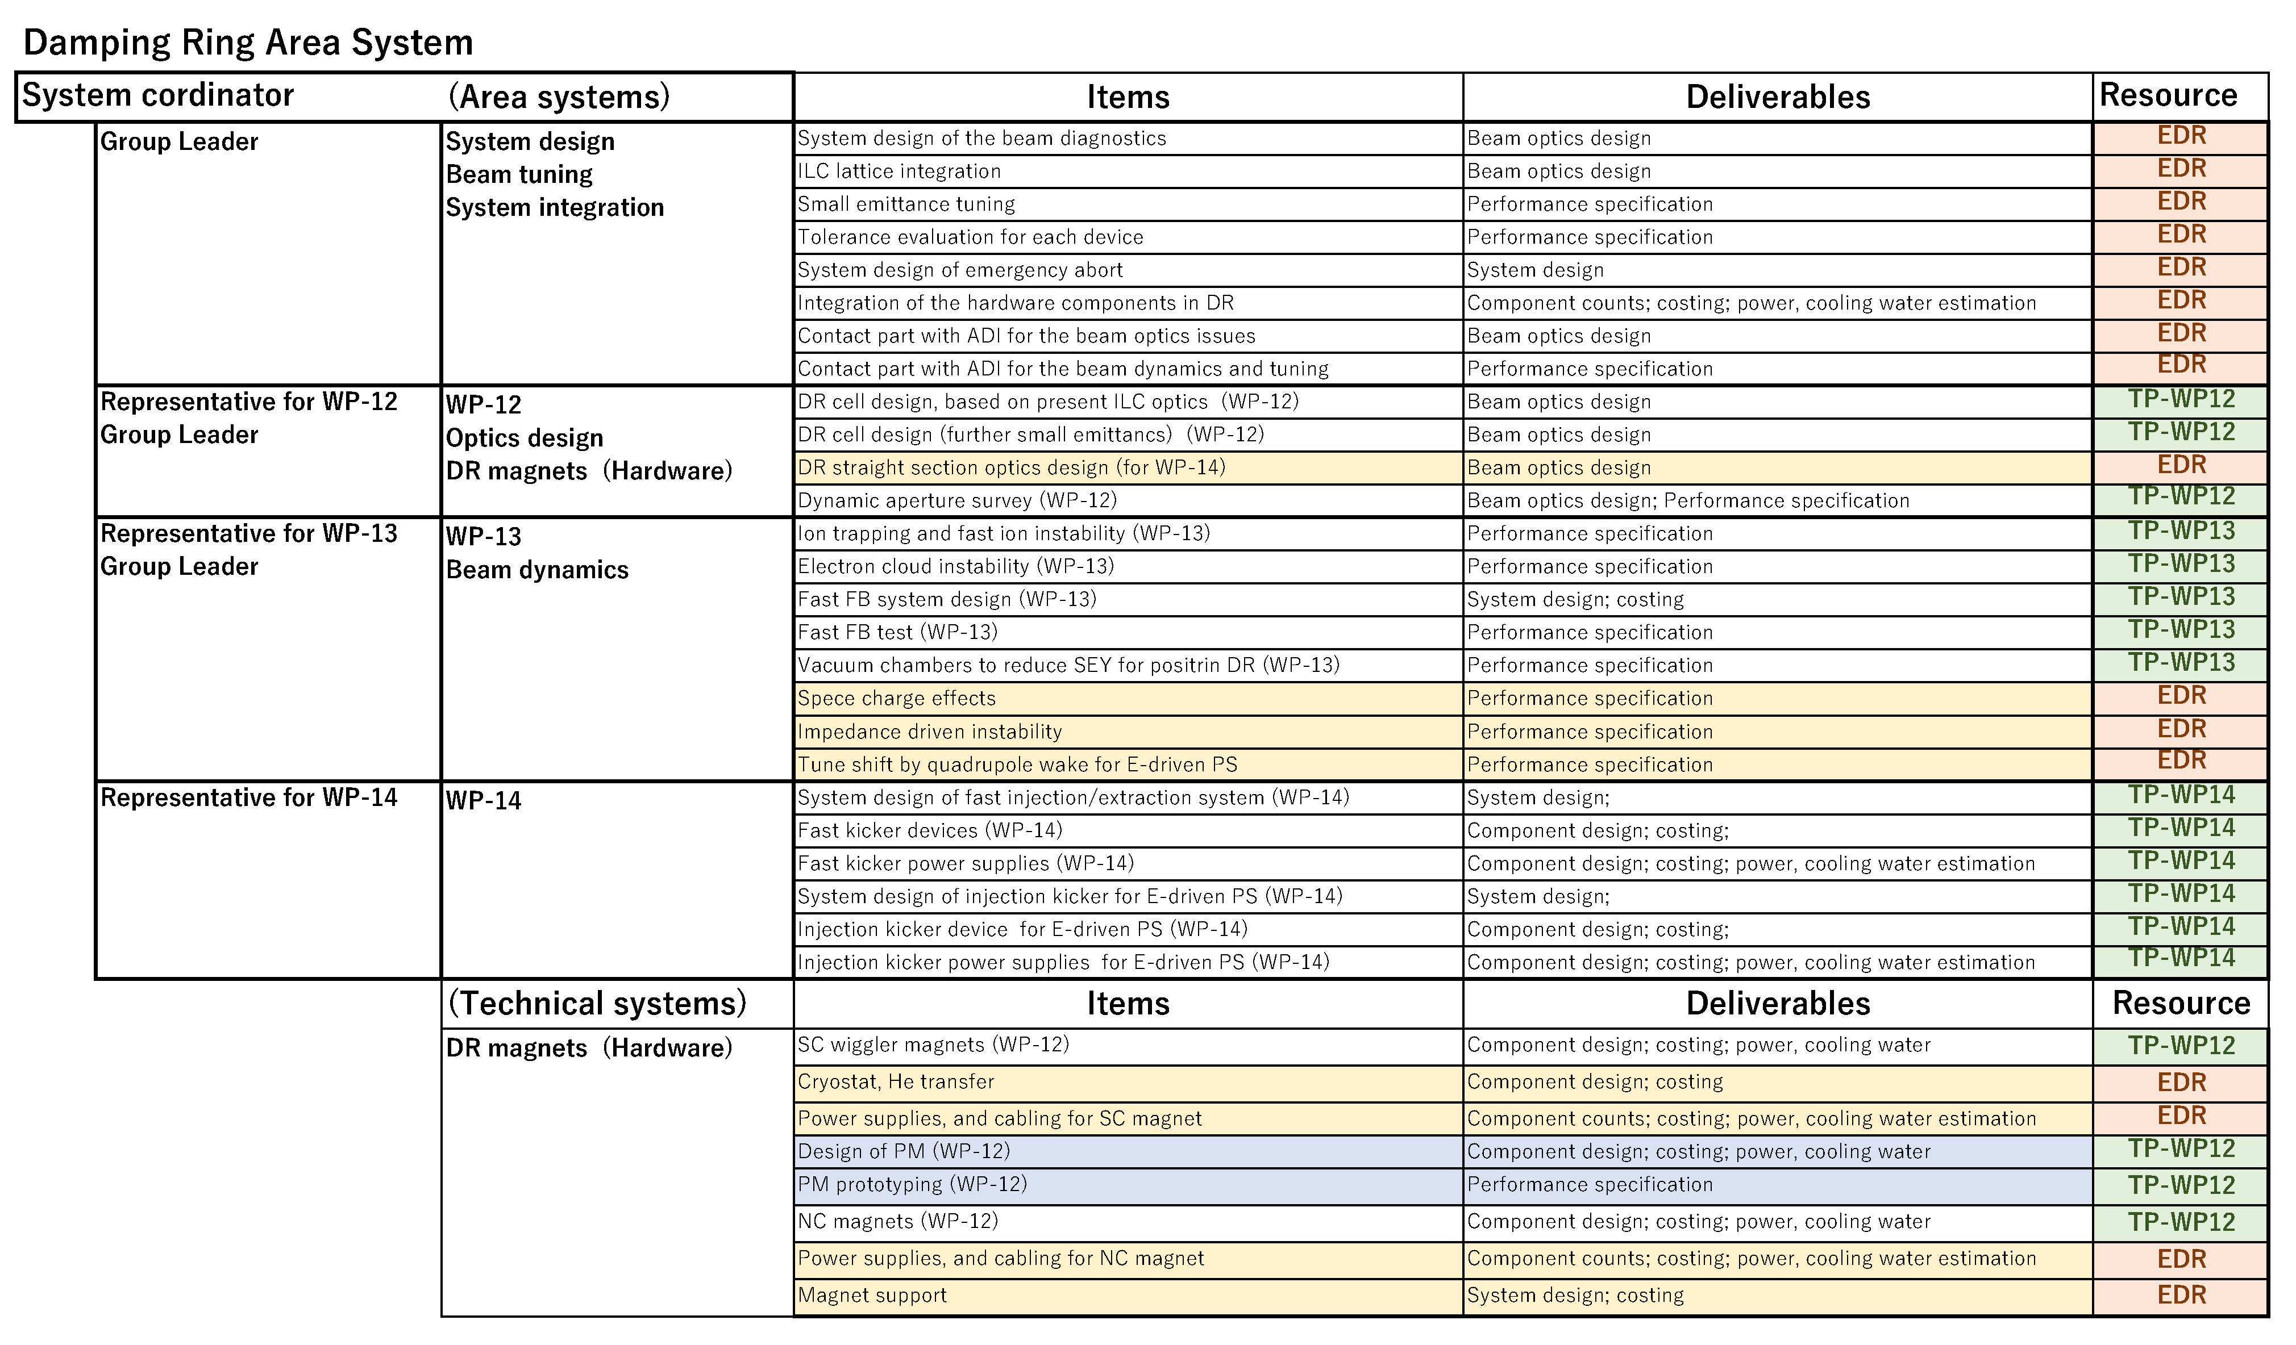
WBS of DR area system in the Pre-Lab period
(A) Workpackage oriented
Workpackage oriented
Easy to manage the resources in Pre-Lab period.
(B) Work item oriented (all WP items belong to area system)
Some items in are/technical systems are moved to the WP groups.
  ( Works for SC wiggler/cryostat/PS are in same group.)
Representative of WPs will cover some group leaders in area system.
Easy to manage the design work in Pre-Lab period.
(C) Work item oriented ( some WP items will do technical system)
All of magnet design will be done in the technical system, not area system.
The resource of WP-12 will be managed by area system,
  and divided to magnet group in the technical system.
Easy to manage the design work of the technical system.
(B) Work item oriented ( all WP items belong to area system )
(C) Work item oriented ( some WP items in technical system )
Part of WP12
resources

Slide 4
Opinion of Andy Lankford
Any of the three structures is manageable during the Pre-lab phase.
I think that one of the work item oriented structures (B) or (C) will work best. I believe that the decision between (B) and (C) needs to be consistent with how the division between area systems and technical systems for other area systems.
If the DR magnets are going to be designed by the magnet technical system to DR area system specification, then I would think that (C) is better than (B).
Also, if the SC wiggler magnet design, cryostat design, and wiggler power supply design are split among technical systems, then I believe that the coordination of these designs should
probably live in the DR area system (or possibly the magnet technical system).
Another consideration is how the RTL WBS is defined. I think that there should be a consistent philosophy to the structure for both DR and RTL (and probably BDS as well).

Slide 5
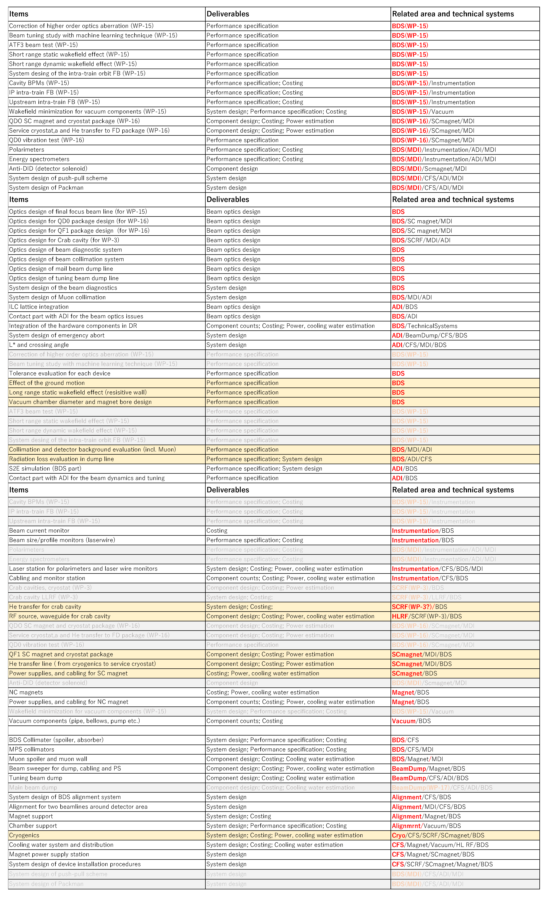
Beam Delivery System
Work packages
  WP-15
  WP-16
  MDI
List up all items for EDR related to BDS
Picked up the WP related items
from the to-do-list of both area and
technical systems and categorized.
Resource
of technical
preparation
Area system
Optics design and
system integration
Beam dynamics
and tuning
BDS area system
2WPs
MDI related items
Remaining items
  of original area systems
Resource
of EDR
Technical system
Instrumentation
Magnet
RF
Vacuum
Technical system
Remaining items
of original technical systems
To be integrated the item
of each technical category
for all area systems
. . . .

Slide 6
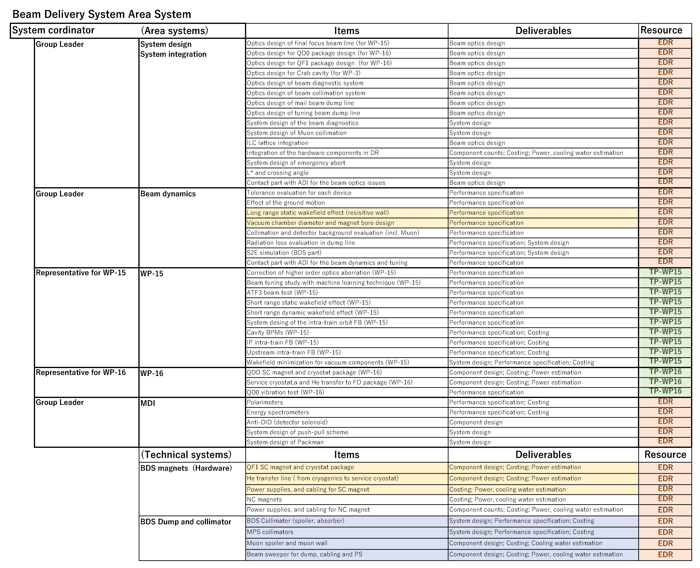
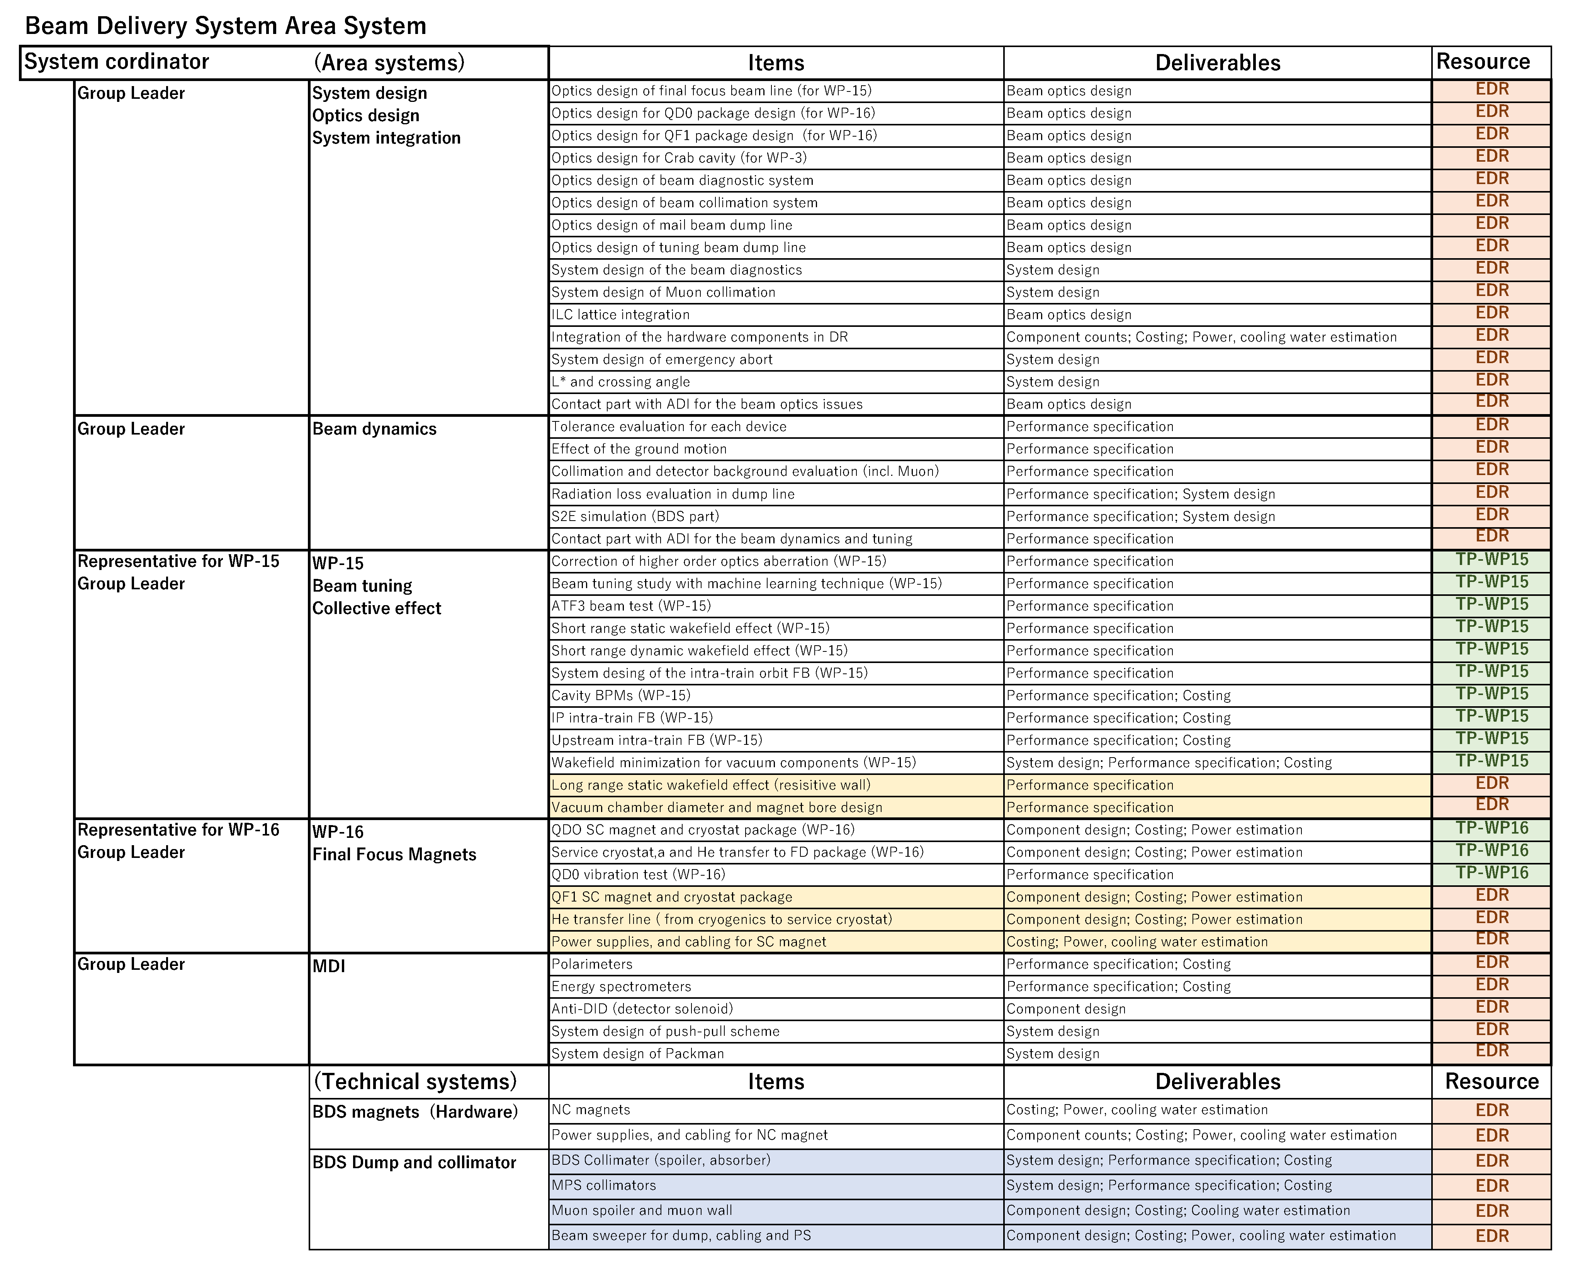
WBS of BDS area system in the Pre-Lab period
Workpackage oriented
Easy to manage the resources in Pre-Lab period.
(B) Work item oriented (all WP items belong to area system)
Representative of WPs will cover some group leaders in area system.
Easy to manage the design work in Pre-Lab period.
(A) Workpackage oriented
(B) Work item oriented
Should BDS collimator and Muon spoiler be managed by dump group ??

Slide 7
Discussion of WBS for BDS area systems
Angeles presented that both structures (WP oriented, Work item oriented ) are manageable during the Pre-lab phase.
  But, there should be a consistent philosophy of WBS to the structure for BDS as well.
Kersten presented the topics in Pre-Lab phase as a point of MDI.
  Topics with direct impact on physics
  Topics with impact on detector design
  CFS topics with impact on detector design, assembly, maintenance
  Topics with indirect impact on MDI
BDS spoiler should belong to the same group to WP-15.
  BDS absorber should be designed in DUMP system (Angeles, Nobuhiro).
S2E for polarization should also be considered (Jenney).
Luminosity monitor (incoherent pair monitor) should be added to BDS instrumentation (Karsten).
  Luminosity monitor is a task to be considered as a part of detector design.
  Polarimeter and energy spectrometer are treated in MDI group in BDS area system.
Detector solenoid and Anti-DID are tasks to be considered as a part of detector design (Karsten).

Slide 8
Technical system

Slide 9
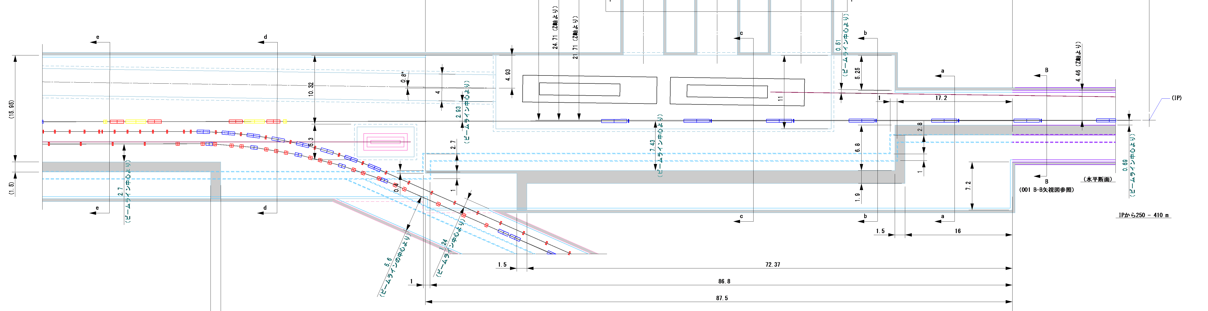
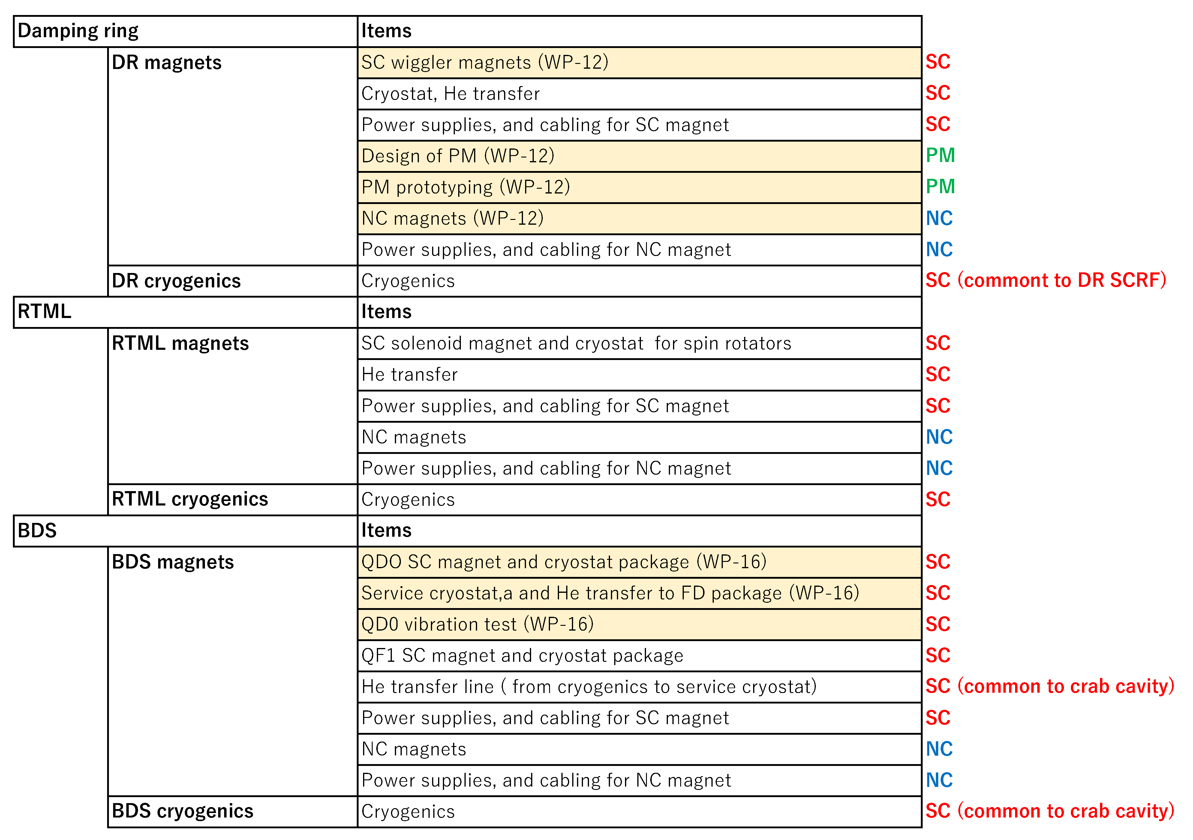
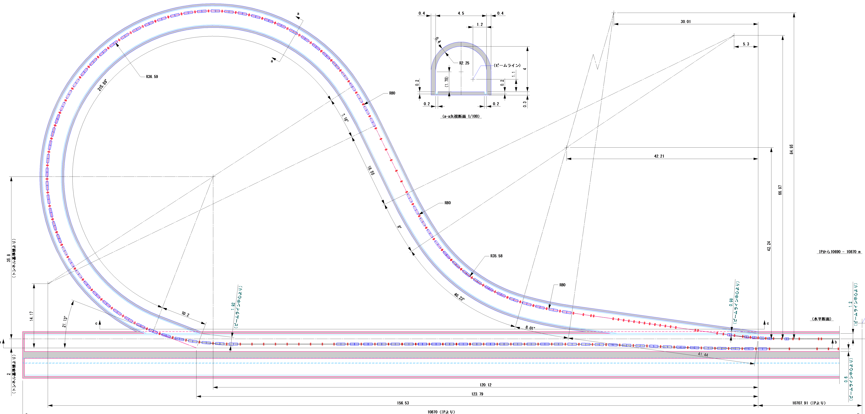
Magnet technical system for DR/RTML/BDS area system
Source and ML (bunch compressor and warm section) also have NC magnets.
Source also has SC undulators.
We’d better to consider how to make WBS by taking account of Source and ML area system, too.
Other NC and MC
magnets ??
Better to be managed
by DR area system ?
SC solenoids
for upstream spin rotator
To do list for magnet technical system
DR
SC solenoids
for DS spin rotator

Slide 10
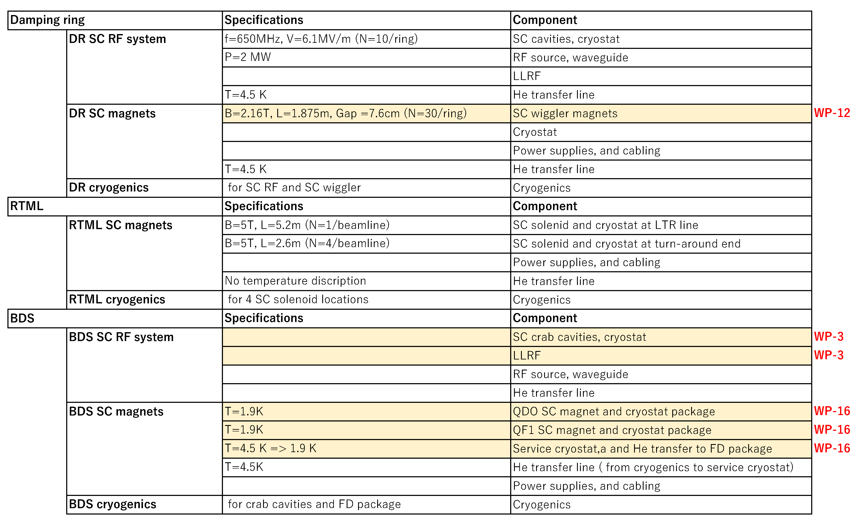
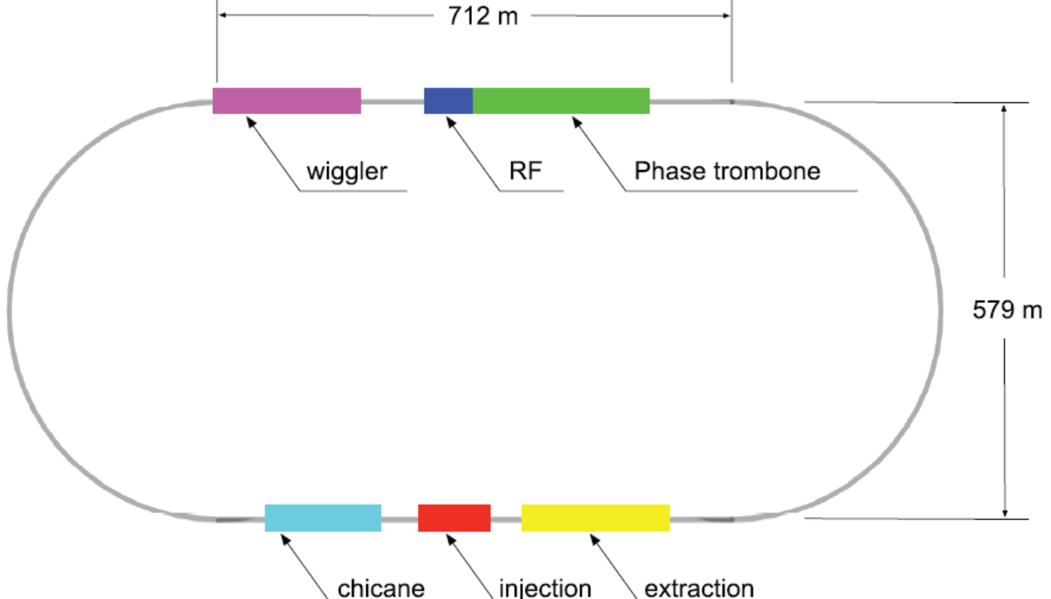
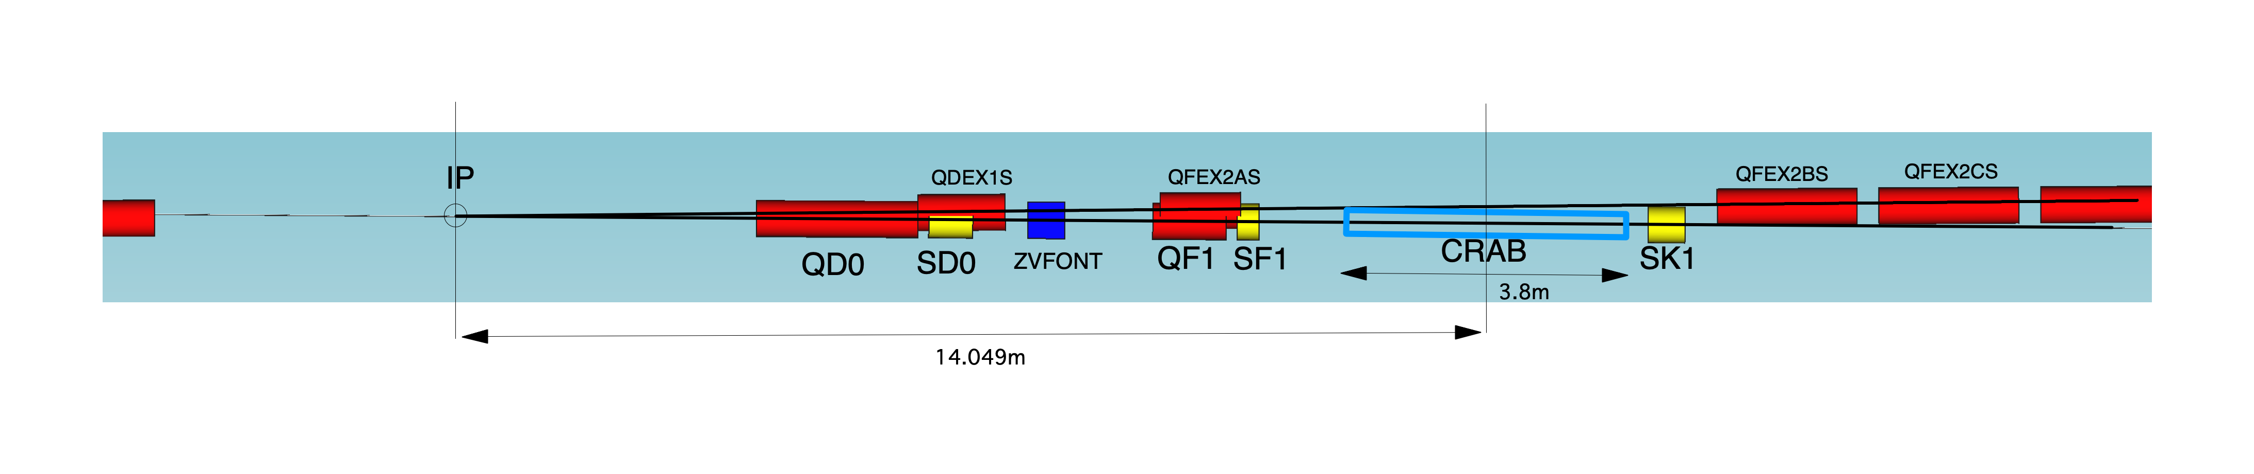
SC technologies for DR/RTML/BDS area system
SC magnet
SCRF
SC devices in DR
SC devices in BDS
SC magnet
SCRF
Cryogenics and He transfer lines should be common
for the SC magnets and SCRF.
It is very important how to coordinate the SC technology.
But, I think it is not matter for our group.
QD0 package
QF1 package
Crab cavity

Slide 11
Next group meeting
Date and time : June 9th (WED) 22:00 JST
Continuous discussion of WBS in Pre-Lab period.
  WBS of the BDS area system from WP-16 (Brett)
  WBS of the DR area system.
Are there any other items that should be included in the to-do-list?
What items in the list would be more efficient to handle in the same group as WP?
HR in the Pre-Lab period.

