Slide 1

Some Thoughts on WBS for ILC Damping Ring Collective Effect Studies
Mikhail Zobov

Slide 2
Goals and Requirements
The collective effect studies are necessary to provide beams stable in all three directions and to preserve beam quality in terms of emittance, energy spread, bunch length and shape etc. In addition, damage of vacuum components due to high circulating current should be avoided.
Much work has been done during the TDR phase. However, now the collective effects should be evaluated for the damping rings with the updated beam optics that aims at the horizontal emittance reduction and at improving luminosity of ILC250. The studies should take into account new technologies and novel design solutions developed after TDR preparation and experience gained during the recent years.

Slide 3
WP13 (Technical Preparation Document)
Most critical issues, MEXT’s ILC Advisory Panel suggestions
System Coordinator | (Area Systems) | Items | Deliverables | Resource
Representative of WP-13 | WP-13 | Ion trapping and fast ion instability | Performance specification | TP-WP13
 |  | Electron cloud instability | Performance specification | TP-WP13
 |  | Fast feedback system design | System design; costing | TP-WP13
 |  | Fast feedback system test | Performance specification | TP-WP13
 |  | Vacuum chamber to reduce SEY in the positron DR | Performance specification | TP-WP13

Slide 4
EDR Oriented Work (Important but less critical)
Impedance related effects and instabilities
Space charge effects
Intrabeam scattering
Transient beam loading
other

Slide 5
Other issues (?)
Longitudinal bunch-by-bunch feedback
Fast orbit feedback
Other

Slide 6
Impedance related effects and instabilities
Single bunch instabilities and effects
Bunch lengthening and microwave instability in the longitudinal plane
The turbulent mode coupling instability (TMCI) in the transverse plane
Multibunch instabilities and effects
Resistive wall instability
Instabilities due to beam interaction with higher order modes (HOM) trapped
in the vacuum chamber componens, both transverse and longitudinal
Shift of betatron frequencies due to quadrupolar resistive wall wake fields
Transient beam loading effects of non-uniform beam pattern/gaps
Overheating of the vacuum chamber components/hardware
Possible deliverables: DR impedance model, design specification of the low impedance vacuum chamber components, performance specification

Slide 7
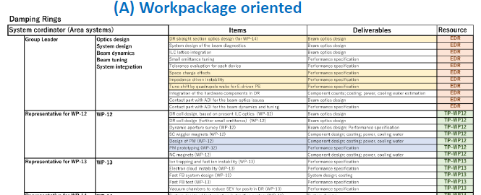
WBS: work item oriented versus work package oriented
I am strongly in favor of the Work Oriented WBS. The Work Package oriented WBS seems to be a bit artificial since the people studying the collective effects (often the same) are separated in two different groups

Slide 8
Proposed Work Oriented WBS
System coordinator | Area systems | Item | Deliverables | Resource
Representative of WP13, Group Leader | WP13 Beam Dynamics | Ion trapping and fast ion instability | Performance specification | TP-WP13
 |  | Electron cloud instability | Performance specification | TP-WP13
 |  | Fast feedback system design | System design; coasting | TP-WP13
 |  | Fast feedback system test | Performance specification | TP-WP13
 |  | Vaccum chamber to reduce SEY in positron DR | Design specificaion | TP-WP13
 |  | Impedance related effects and instabilities | DR impedance model; design of low impedance components; performance specification | EDR
 |  | Space charge effects | Performance specification | EDR
 |  | Intrabeam scattering | Performance specification | EDR
 |  | Transient beam loading | Perfomance specification | EDR

Slide 9
Collaboration and intercommunication with WPs and Technical Area systems
WP-12
Vacuum
WP-13
Beam Dynamics
RF
WP-14
Instrumentation

