Slide 1
16th Meeting of DR/BDS/DUMP group
Date : 2021/06/09 (Wed)
Attendees : Philip Burrows, Andy Lankford, Thomas Markiewicz, Miguel Magan, Shin Michizono, Kiyoshi Kubo,
Toshiyuki Okugi, , Ivan Podadera , Soren Prestemon, Robert Ryne, Nikolay Solyak, Ben Shephard,
Nobuhiro Terunuma, Jean-Luc Vay, Glen White, Kaoru Yokoya , Mikhail Zobov
Topics : WBS for DR/RTML/BDS area systems (continued).
- DR WBS as point of WP-13 (corrective effect) by M. Zobov
- Scope and deliverables of WBS by T. Okugi

Slide 2
“Some Thoughts on WBS for ILC Damping Ring Collective Effect Studies” by M. Zobov at IDT WG2 DR/BDS/DUMP group Mtg.
EDR Oriented Work (Important but less critical)
Impedance related effects and instabilities
Single bunch instabilities and effects
Bunch lengthening and microwave instability in the longitudinal plane
The turbulent mode coupling instability (TMCI) in the transverse plane
Multibunch instabilities and effects
Resistive wall instability
Instabilities due to beam interaction with higher order modes (HOM) trapped
in the vacuum chamber componens, both transverse and longitudinal
Shift of betatron frequencies due to quadrupolar resistive wall wake fields
Transient beam loading effects of non-uniform beam pattern/gaps
Overheating of the vacuum chamber components/hardware
Impedance related effects and instabilities
Space charge effects
Intrabeam scattering
Transient beam loading
other
Other issues (?)
Longitudinal bunch-by-bunch feedback
Fast orbit feedback
Other
Possible deliverables: DR impedance model,
design specification of the low impedance vacuum chamber components,
performance specification

Slide 3
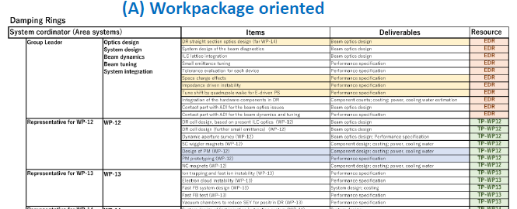
WBS: work item oriented versus work package oriented
“Some Thoughts on WBS for ILC Damping Ring Collective Effect Studies” by M. Zobov at IDT WG2 DR/BDS/DUMP group Mtg.
I am strongly in favor of the Work Oriented WBS. The Work Package oriented WBS seems to be a bit artificial since the people studying the collective effects (often the same) are separated in two different groups

Slide 4
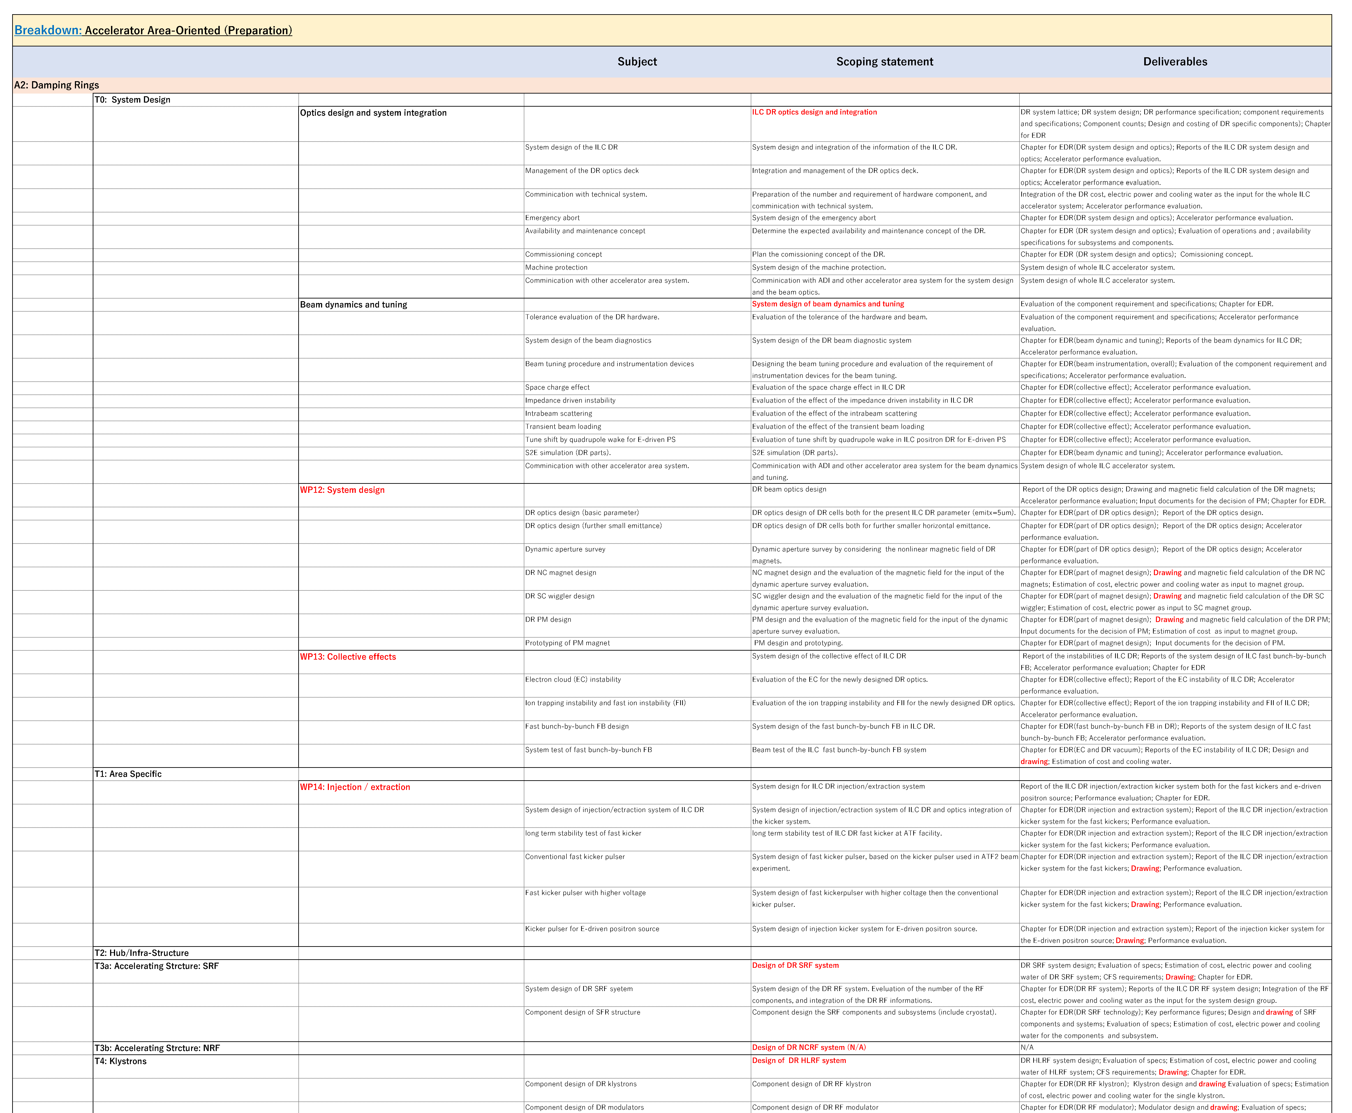
Scope and deliverables of WBS by T. Okugi
Rank are set to be different
for area system and technical
system to fit the WBS template
(WP oriented)
Optics &
system integration
Area system
Beam dynamic &
beam tuning
WP-12
Technical
systems
WP-13
WP-14
SCRF
NCRF
Klystron (HLRF)

Slide 5
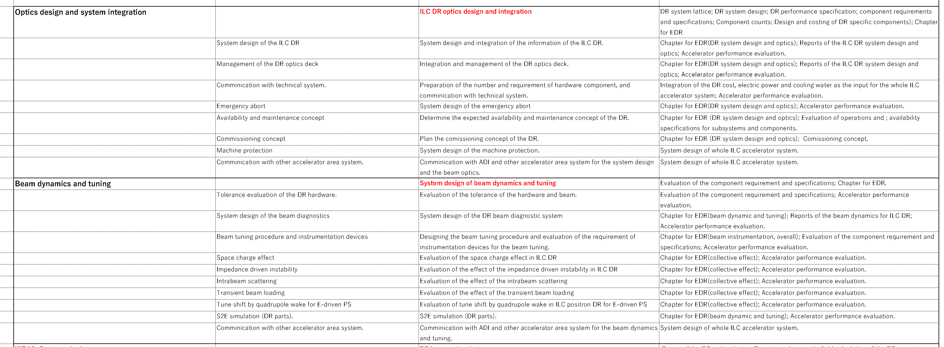
Tentative WBS; scope and deliverables – DR area system
Scope ;
Optics design and management (DR part);
System design and integration of DR area system;
Machine protection, Availability, Commissioning;
Communication with the technical system;
Communication with ADI;
Beam dynamics and tuning;
Deliverables ;
EDR; Report of the items;
Optics deck and management (DR part);
System design of whole ILC accelerator system (DR part);
Component counts and system integration (cost, electric power, cooling water);
Accelerator performance evaluation;
Evaluation of component performance and requirement;

Slide 6
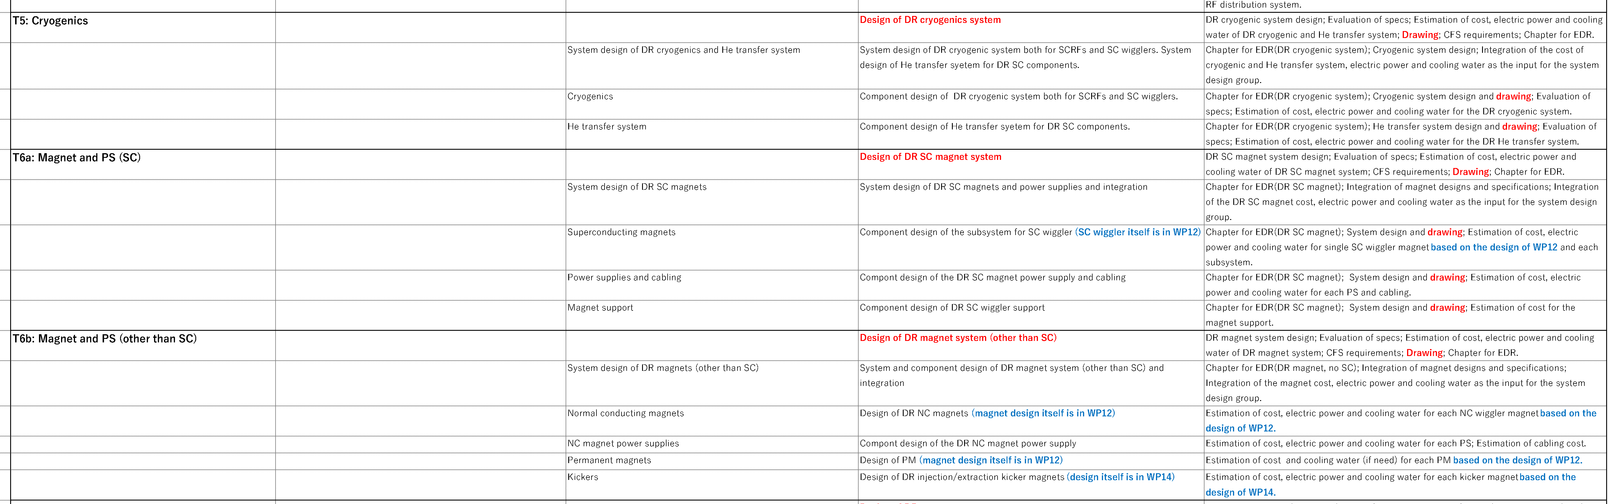
Tentative WBS; scope and deliverables – Technical system (DR part)
Cryogenics
SC magnets
Magnets (other than SC)
Scope ; System design and component design of each technical system (DR part);
Since some part are listed in WP,
the comments are put.
Deliverables ;
EDR; System design of technical system;
Component design, specification and drawing;
Evaluation of (cost, electric power, cooling water) for each component;
Integration of (cost, electric power, cooling water) for entire technical system of DR part (input for DR area system);
Accelerator performance evaluation;
Evaluation of CFS requirement;
“Drawing”s are added for most of items
by the discussion of the group meeting.
Present version of WBS for DR/RTML/BDS are put in Indico of today’s meeting.

Slide 7
Next group meeting
Date and time : June 23rd (WED) 22:00 JST
Continuous discussion of WBS in Pre-Lab period.
  WBS of the BDS area system from WP-16 (Brett)
HR in the Pre-Lab period.
  I will explain how to evaluate the HR for BDS/RTML/BDS area system,
  presented at WG2 Mtg. on 6/1.

