Slide 1
Sources Subgroup Summary
K. Yokoya, for IDT-WG2 Jun.7
Jun.7 16th Regular meeting
  Masao Kuriki, Hitoshi Hayano, Gudi Moortgat-Pick, Joe Grames, Kaoru Yokoya, Steffen Doebert, Shin Michizono, Jenny List, Andy Lankford, Sabine Riemann, Peter Sievers, Tsunehiko Omori (Some are missing, perhaps)
  Indico https://agenda.linearcollider.org/event/9253/
Example of WBS: WBS for EIC
  Grames, 210603_ILC_WG2_Grames.pptx
Update of WBS for electron source (Yokoya)
Update of WBS for electron-driven source (Kuriki)
  WBS-Sources-v0.3mk.xlsx
Discussion on the structure of WBS
  Electron source
  Undulator source
    Undulator section
      System design
      Technical systems
    5GeV booster
  Electron-driven source
    3GeV driver
    5GeV booster
Ｌatest ＷBS uploaded to indico
  WBS-Sources-v9.xlsx

Slide 2
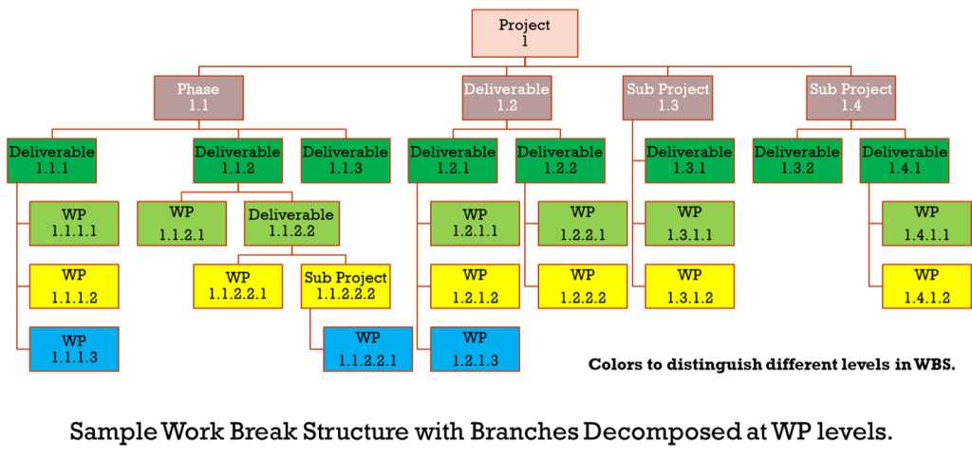
Work Breakdown Structure
Breaks down 100% of the work into a structure
Provides a graphical representation or outline of the project scope
Larger tasks are broken into manageable parts, that can be supervised & estimated

Slide 3
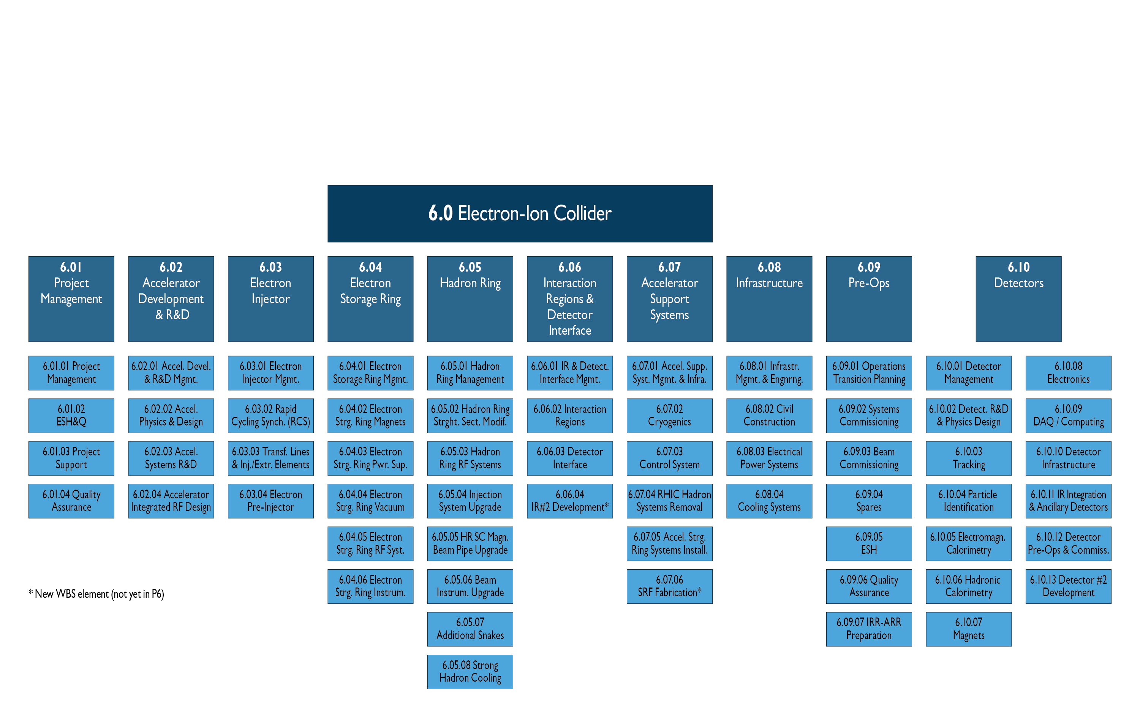
Example: EIC Work Breakdown Structure
Breaks down 100% of the work into a structure
Provides a graphical representation or outline of the project scope
Larger tasks are broken into manageable parts, that can be supervised & estimated

