Slide 1
16th Meeting of SRF Group in IDT/WG2
4-year-profile of cost for TPP (based on ILC action plan)
Progress of WBS (scope and deliverable updated)
Progress of CM design
Progress of HPGS
Progress of tuner (other slide by Yuriy)
Others (if any)
Attendees: A. Yamamoto, S. Michizono, K. Umemori, H. Hayano, S. Posen, B. List, S. Stapnes, M. Ross, M. Liepe, B. Laxdal, A. Lankford, D. Delikaris, E. Cenni,
P. Burrows, Kirk
https://agenda.linearcollider.org/category/256/
You can download every slide from this link
Kirk

Slide 2
4-year-profile of cost for TPP
Recently, 4-year-profilce of cost based on ILC action plan was revised for TPP
 | Year/Date | 8/Jun/2021
 | Items | Japan |  |  |  |  |  | Abroad |  |  |  |  |  | Sum | Japan | Abroad
 |  |  | P1 | P2 | P3 | P4 | Sum |  | P1 | P2 | P3 | P4 | Sum
 |  | (Oku-Y) |  |  |  |  |  | (Oku-Y) |  |  |  |  |  | (Oku-Y) | (FTE-yr) | (FTE-yr)
1 | [WP-1] Cavity Industrial-Production Readiness
 | -Cavity industrial-production readiness to be demonstrated (JP:40, AB: 80)
2 | [WP-2] Cryomodule (CM) Assembly, Global Transfer and Performance Assurance
 | -Ancillaries production (Coupler/Tuner/SCM) (JP:2, AB:4)
 | -CM production (JP:2, AB:4)
 | -CM performance assurance, CM string assembly (2 CMs)
 | -CM Global transfer, Performance assurance after transport
3 | [WP-3] Crab Cavity System
4 | [Infrstructure-A] ]KEK-STF Beam Operation Demonstration (1.5 CM + 0.5 CM)
 | -Tunnel expansion, cryogenics and klystron gallery upgraded
 | -Upgrading STF accelerator (+0.5 CM)
5 | [Infrastructure-B] KEK-STF/COI Hub-lab. Functionality (production, assembly, test)
 | -Cavity fabrication facility (Wire-saw, EBW-renewal, etc)
 | -VT system with four cavities
 | -CM assembly/production incl. cavity string assembly
 | -CM test area (2 CMs available)
 | -Cryogenics system upgraded (separated from STF)
 | -HLRF/LLRF system installed
 | -Horizontal Test Area with single cavity (STF: coupler/tuner)
 | -COI building expansion for CM string
6 | [Infrastructure] Upgrading Abroad hub-lab. Functionality (production, assembly, test)
7 | Electric power, Maintenance work for testing, assmebly work
8 | EDR and Construction/Project Preparation (Documentations)
Sum

Slide 3
Update of scope/deliverable in WBS (Overall/WP-1)
# | Code | Title |  |  | Scoping statement | Deliverables
56 | 2 | SRF Technology |  |  | Design and prototype the SRF and HLRF components and subsystems | Key performance figures; design of SRF and HLRF components and systems; input to cost estimation; CFS requirements; Prototype modules; EDR volume "SRF technology"
57 | 2.1 |  | ML and SRF system design (overall management) |  | Design complete RF units and cryo strings (for Main Linac, Bunch Compressors and 5GeV boosters in Sources) | Layout of RF units and cryo strings; CFS requirements; Chapter for EDR
58 | 2.2 |  | WP01: Cavity production (Incl. ML DR, & others) |  | Demonstrate cavity production readiness | Final cavity design; final surface treatment recipe; testing recipe; cost estimate; performance specification; 120 prototype cavities; Chapter for EDR
59 | 2.2.1 |  |  | SC material | Define SC material standard | Final material definition; standard specification for 120 prototype cavities
 |  |  |  | baseline/cost-down material to be decided (before TPP?) | Decide the baseline before TPP
60 | 2.2.2 |  |  | Cavity production/surface-process | Design cavity; Baseline surface process to be decided. Demonstrate the SRF cavity industrial production readiness with satisfying the plug-compatibility for the cavity-string assembly in the CM. | Drawings of cavity package, Manual for baseline surface process/ Completion of 120 cavity production (40 per region), for the success yield evaluation and for 2 CM assembly (16 per region).
 |  |  |  | baseline/cost-down surface-process to be decided (before TPP?) | Should be decided before TPP Demonstrate the SRF cavity industrial production readiness | Completion of 120 cavity production (40 per region), for the success yield evaluation and for 2 CM assembly (16 per region).
 |  |  |  | high pressure gas safety regulation | Discussion with authority/Sample test/Mechanical simulation/Documentation Establish the guideline to adapt to HPGS regulation in Japan, and globally optimize the cavity fabrication process to be adaptable to the safety regulation in Japan. | Final document to be submitted to authority Receive the safety inspection result (certificate) to be approved by the HPGS authority in Japan.
61 | 2.2.3 |  |  | HOM coupler (measurement and tuning?) | Design and production of HOM coupler / end groups | Tuning range of HOM coupler; Material for use
62 | 2.2.4 |  |  | Helium tank and magnetic shield | Design and production of helium tank and magnetic shield | Final material definition; material for 120 prototype cavities; Drawing of helium tank and magnetic shield
 |  |  |  | tuner design | Design and production of tuner | Drawing of tuner
 |  |  |  | Vertical Test + Success Yield Verification | (Surface treatment and) Vertical test to confirm the SRF cavity performance for the success yield evalution. | Success yield result and to satisfy the success yield fraction of 90 % to reach the ILC SRF cavity performance of E = 35 MV/m (+/-20%) at Q ≥ 0.8E10 with sufficient statistics by using about a half of 40 cavities per region.
 |  |  |  | Infra-structure and Test Facilities: JP | Establish and demonstrate the Hub-Lab function for supervising the SRF cavity production and performance verification. | Realization of the necessary facilities, utilities, and the Hub-Lab functioning.

Slide 4
Update of scope/deliverable in WBS (WP-2)
# | Code | Title |  |  | Scoping statement | Deliverables
63 | 2.3 |  | WP02: Cryomodule asembly, transfer, and performance assurance |  | Demonstrate cryomodule production/asembly readiness, and realize global CM transfer across oceans, and confirm the CM performance assurance. | Final cryomodule design; transportation plan; standards for cryomodule production and operation permit; plug compatibility interface soecification; cost estimate; 6 prototype cryomodules; Chapter for EDR. - 6 CMs completion (2 per each region) with the plug-compatibility to be connected to each other and with satisfying the HPGS regulation in Japan. - 2 CMs (one from Europe and one from Americas) transported to Japan, ant the perforamance assured to satisfy the ILC performance specification of E = 31.5 MV/m (average) and Q ≥ 1 E10 (average).
64 | 2.3.1 |  |  | CM Horizontal Test + Degradation Mitigation (before and after transport) | Provide test facilities Demonstrate the CM performance to satisfy the ILC SRF specification, and to reproduce the perforamce after the connection work for two CMs (including the connection to the test bench). | Test capabilities for cavities and cryomodules in all three regions; Success yield plot in CM test - 2 CMs (one from Europe and one from Americas) transported to Japan, ant the perforamance assured to satisfy the ILC performance specification of E = 31.5 MV/m (average) and Q ≥ 1 E10 (average). - Confirmation of the CM performance maintained after the CM string (actually two CMs in Pre-Lab phase) connection work.
 |  |  |  | CM Transport (categorized into 4 items as follows)
 |  |  |  | Transport design | Design cage/shock damper Establish the safe CM tranport technology and process, with ship-tranport acress the oceans. | Final design of cage/shock damper; cost estimate Production of the tranport cage.
 |  |  |  | Mock-up CM transport twice | Trailer size should be checked Confirm the tranport scheme including physical size and tranportation by using the transport cage adaptable for both ground tranportation and sea shipment. | Demonstration of the safe tranport at first on the ground
 |  |  |  | Global transport | Container size should be checked Demonstrate the safe CM tranport across the oceans. | Final container size; cost estimate Successful global transer of the CM across the oceans.
 |  |  |  | Returning transport | if necessary, Confirm capability of the CM transport, even after the CM test in Japan, for reconfirmation of the performance reproducibility after transport repeated. | Confirmation of the CM performance after transport back to Europe and Americas, just in case.
65 | 2.3.2 |  |  | Tuners | Establish the design and fabricate tuners in cooperation with WP1. | Final tuner design and drawings; cost estimate; Complete 60 prototype tuner production to be assembled into the 6 CMs (2 CMs per region).
66 | 2.3.3 |  |  | Couplers | Establish the design and fabricate couplers in cooperation with WP1. | Final coupler design and drawings; cost estimate; Complete 60 prototype coupler production to be assembled into the 6 CMs (2 CMs per region).
67 | 2.3.4 |  |  | Quad/BPM Package | Establish the design and fabricate cryomodule quad/BPM/corrector packages | Final quad/BPM package design and drawings; cost estimate; Complete 6 prototype packages to be assembled into the 6 CMs (2 Cms per region).
68 | 2.3.5 |  |  | Cold mass and V. Vessel (CM design/fabrication/assembly + Inter-connect) | Establish the design and fabricate cryomodule cold mass | Drawing of CM; cost estimate; Complete 6 Type-B CM cold-mass.
 |  |  |  | high pressure gas safety regulation | Discussion with authority/Sample test/Mechanical simulation/Documentation Establish the guideline to adapt to HPGS regulation in Japan, and globally optimize the CM fabrication process to be adaptable to the safety regulation in Japan. | Final document to be submitted to authority and local government Receive the safety inspection result (certificate) to be approved by the HPGS authority in Japan.
 |  |  |  | Hub-Lab, CM H. Test Facilities, coupler process (Infra: JP) | Establish and demonstrate the Hub-Lab function for supervising the SRF CM production and performance verification. | Realization of the necessary facilities, utilities, and the Hub-Lab functioning.

Slide 5
Update of scope/deliverable in WBS (WP-3)
# | Code | Title |  |  | Scoping statement | Deliverables
69 | 2.4 |  | WP03: Crab cavity |  | Design crab cavity system | Final crab cavity design; cost estimate; Chapter for EDR
 |  |  |  | CC design including coupler, tuner etc. | Establish the baseline design with downselection to two crab cavity pacakges, Design crab cavity, coupler, tuner | Design prototype crab cavity with two designs Complete the design document and drawings for the protytpe fabrication.
 |  |  |  | CC model and prototype production | Fabricate the prototype crab cavities and evaluate the perforamnce. | Complete 2 x 2 prototype (one is for model work) crab cavities and their performance tests with confirmation of the CC performance required for the ILC.
 |  |  |  | Vertical test including hamonized operation | Downselect one crab cavtiy design based on the evaluation of the two prototypes. | Test result from VT with two crab cavities Complete the downselect process and the documentation for the process.
 |  |  |  | CC-CM design | Establish the CC-CM design | Final design CC-CM Complete the engineering design work and the final design documentation
 |  |  |  | WP3: CC Infra-structure (TBC))

Slide 6
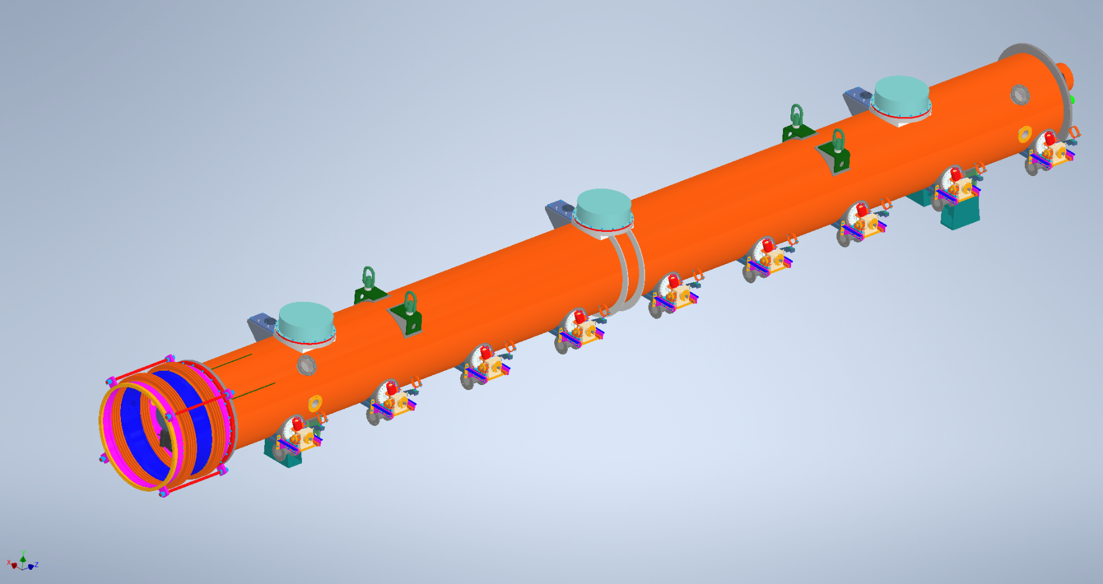
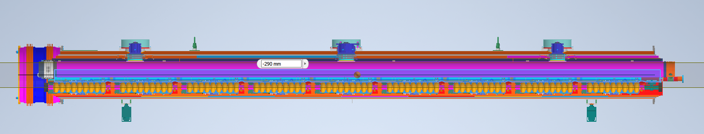
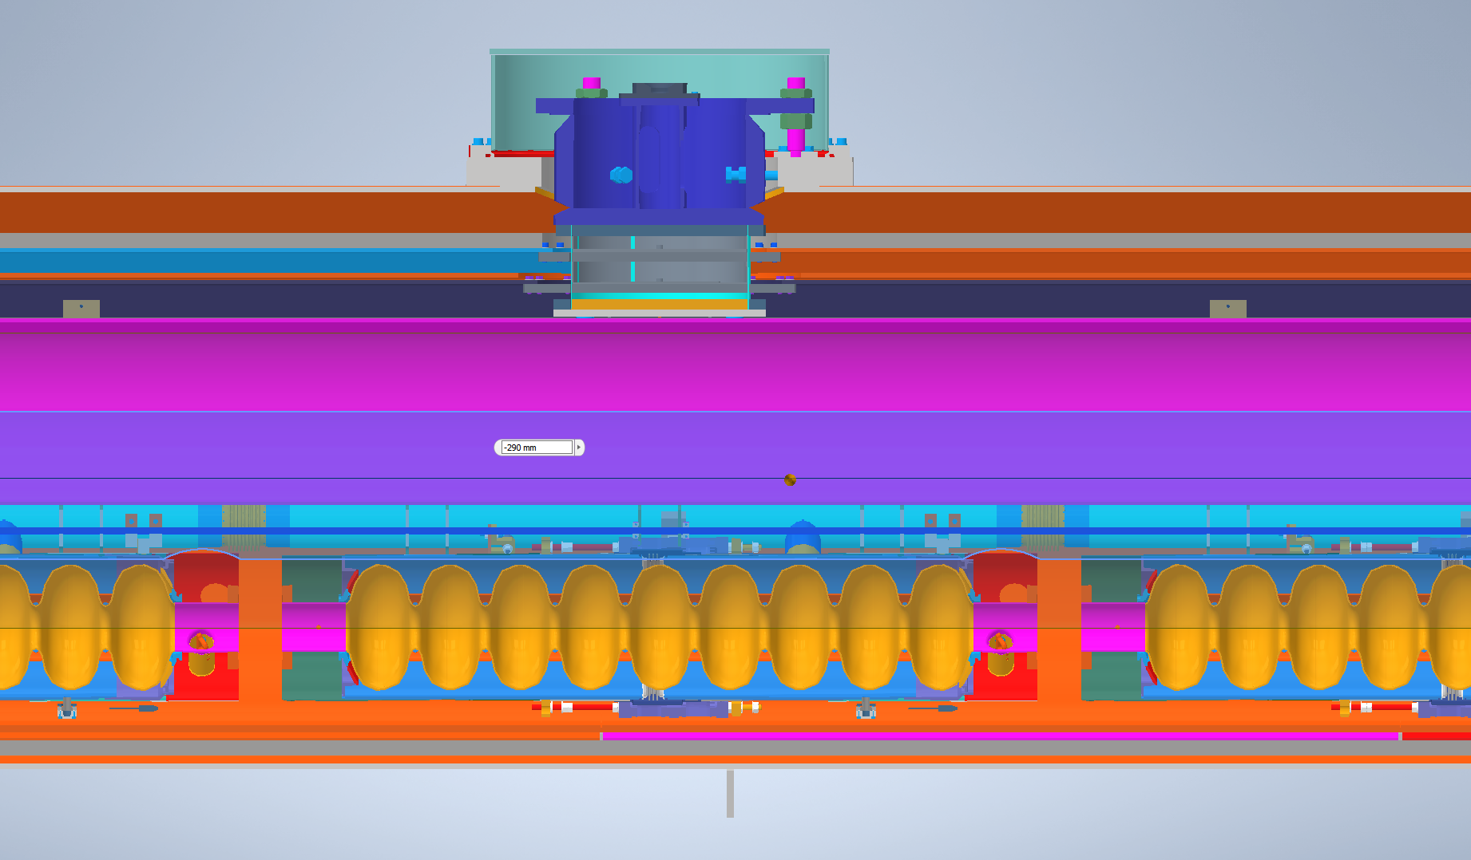
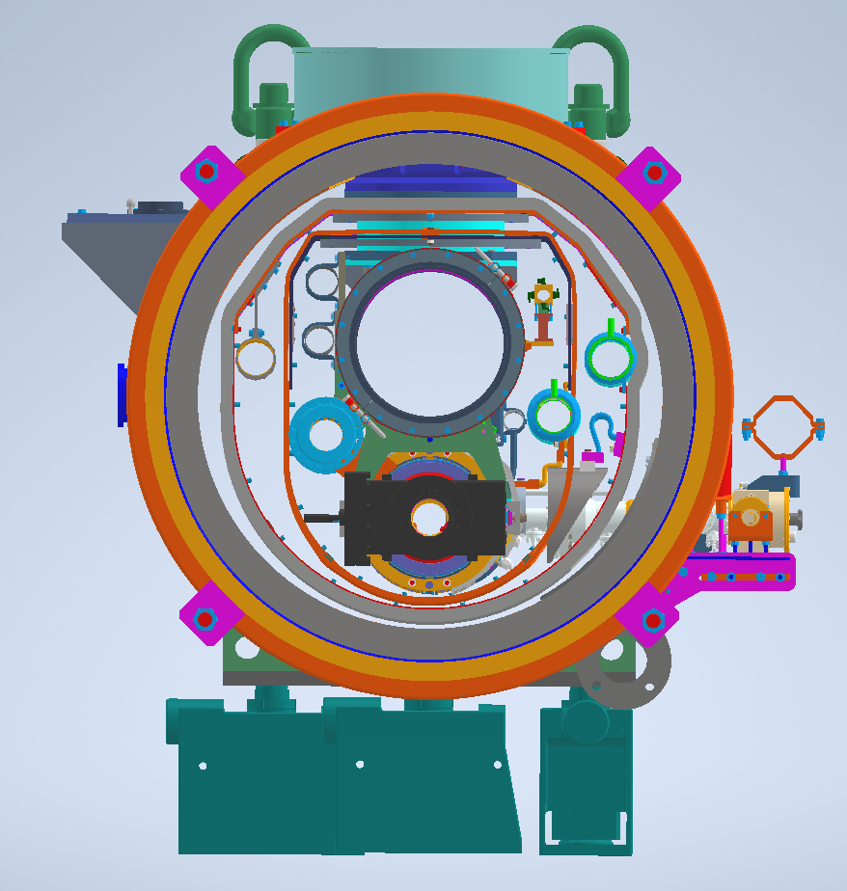
CM Drawing Data (received from Ohuchi-san)
Type-A CM (9 cavities)
No bellows!

Slide 7
TESLA-style cryomodules compared - 1
Slide by T. Peterson (Received from Akira Yamamoto-san)
Peterson - LCLS-II Cryomodule Design - 7 Oct 2014

Slide 8
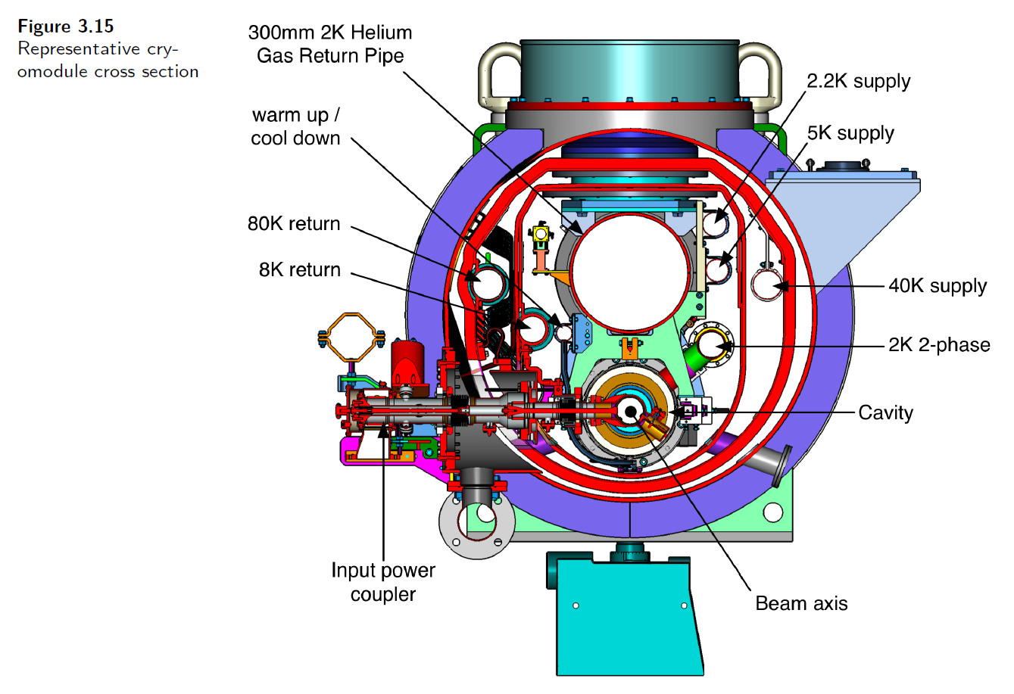
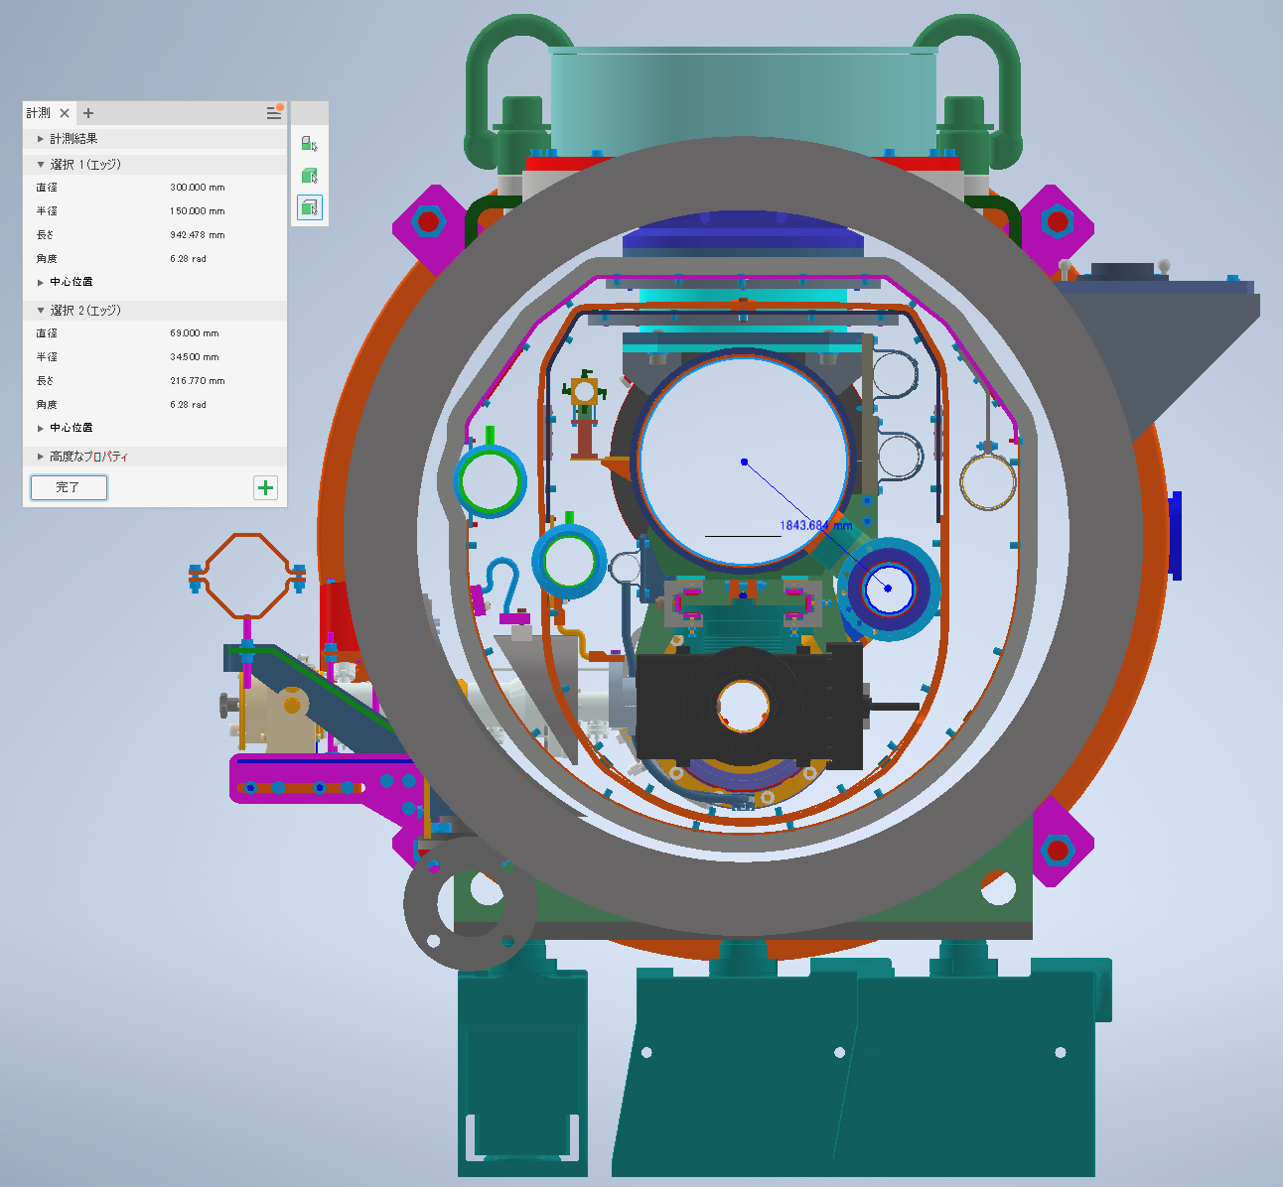
Comparison of CM drawing between TDR and KEK
Diameter of each pipe
Gas Return Pipe | 300.0 mm
2K 2-phase pipe | 69.0 mm
The diameter of every pipe is consistent!
※Only dia. of GRP is shown in TDR

Slide 9
TESLA-style cryomodules compared - 2
Peterson - LCLS-II Cryomodule Design - 7 Oct 2014
Slide by T. Peterson (Received from Akira Yamamoto-san)

Slide 10
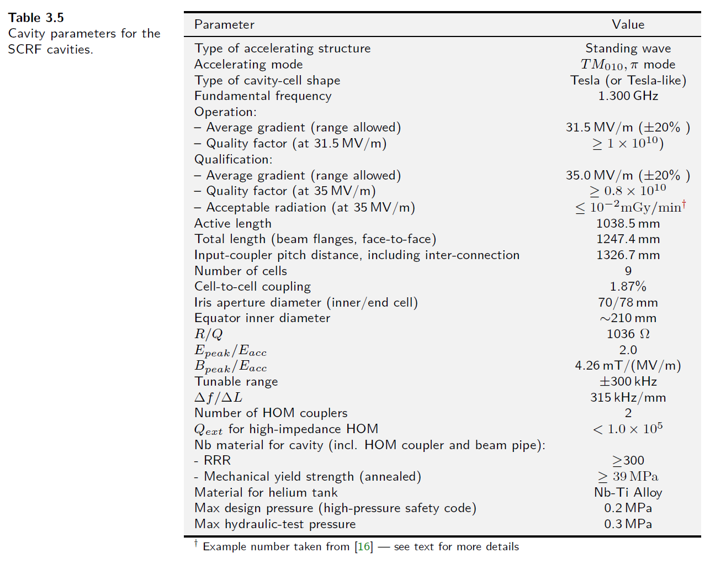
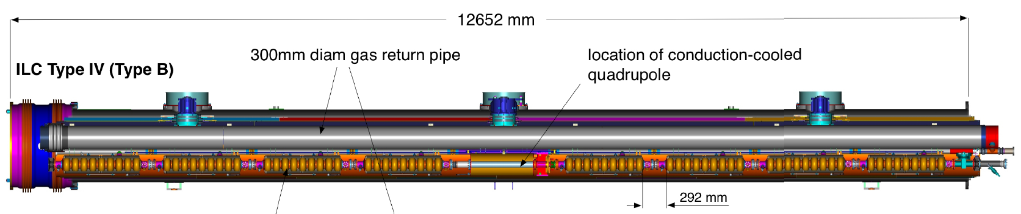
Distance between input couplers
Type-B CM (8 cavities + SCM/BPM)
1326.7 mm
Coupler-to-coupler
1326.7mm – 1247.4mm = 79.3mm (from Table 3.5)
But, from right figure, it’s 82 mm!
Which is correct?
The total length of CM should be checked!

Slide 11
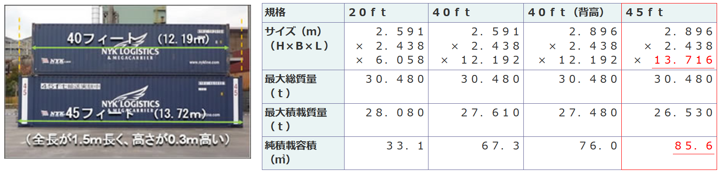
How long CM is available for container?
When starting CM design, we have to take care of the total length to install into container
1.5 m longer, 0.3 m higher
Ministry of Land, Infrastructure, Transport and Tourism of Japan

Slide 12
Starting point of CM drawing for ILC
There were some meetings between KEK and FNAL/SLAC to discuss CM drawing including tuner system
Drawing developed in the GDE era is old
We’d like to start with the CM drawing for LCLS-II
Still tentative conclusion for JP/US
Discussion with colleagues in EU is necessary
This plan is under progress between Japan and US
Probably, the CAD software will be common in future
NX is used in FNAL/DESY (from Omet-san)
INVENTOR/AUTOCAD (AUTODESK) are used in KEK
Creo (PTC) is used by Ohuchi-san

Slide 13
Progress of HPGS
Visit to local government in Ibaraki-ken prefecture (KEK Tsukuba campus) to discuss HPGS
Three times: 3/Mar, 23/Apr, 21/May
Discussion time per meeting: 2~3 hours
Looks like the discussion is going toward good direction
To be checked the max. allowable pressure value (see next page)
Legal handling changes depending on whether it is 160 mm (dia.) or more or less
How about GRP of 300 mm?
Not discussed yet when testing CM abroad
Before testing CM performance, inspection by authorized person of HPGS should be done
Need to be inspected separately even if the vendors are different?

Slide 14
Schedule of SRF (incl. crab cavity sub-) Group Meeting in IDT/WG2
Meeting # | Date | Contents
12 | 9/Mar | Discussions and preparation for the SRF session in LCWS2021
 | 12/Mar | International review “debriefing”
 | 15~18/Mar | 9th International Workshop on "Thin films applied to Superconducting RF: Pushing the limits of RF Superconductivity"
 | 15~18/Mar | LCWS 2021 on virtual hosted by CERN
 | 25/Mar | 1st Crab Cavity Meeting as the crab cavity subgroup in the SRF group
13 | 30/Mar | Update TPD (WP-1, 2, 3), Recent progress in KEK
14 | 13/Apr | WBS, Tuner review by Yuriy
15 | 27/Apr | Progress of WBS, tuner
 | 27/Apr | 2nd Crab Cavity Meeting as the crab cavity subgroup in the SRF group
 | 25/May | 3rd Crab Cavity Meeting as joint meeting with the BDS group, mainly discussed the specification of crab cavity
16 | 8/Jun | 4-yr-profile of cost, WBS updated, CM drawing including HPGS, Proposal to decide tuner system
17 | 22/Jun
 | 28/Jun~2/Jul | SRF2021 on virtual hosted by MSU
18 | 6/Jul
19 | 20/Jul
20 | 3/Aug
 | 26~29/Oct | ILC Workshop on Potential ILC Experiments (ILCX2021) hosted by KEK at Tsukuba/Japan (the detail is not fixed)

Slide 15
Questions/Discussions/Comments (memorandum) @16th meeting
Translation by Kirk
WBS
Looks WBS of EIC (Joe presented in the sources meeting on this Monday) is quite different from ILC
Currently, “Area Systems” is positioned at the top category, and “Technical Systems” is the next
Looking for a better solution to summarize
If you have new inputs, please tell us
CM drawing
Better to start from the drawing based on LCLS-II than that developed in GDE
Sending the drawing of LCLS-II is currently in progress, but will be a little late
This includes SC-magnet, coupler, cavity, tuner, HOM damper, etc
HPGS
Before testing CM abroad as the first performance test, you need to get the approval from the authorized person of HPGS from Japan (probably)
Production of CM → Inspection for HPGS → Cold test at each lab. → CM transfer → Inspection for HPGS at KEK → Cold test at KEK
IFMIF project in QST/Japan is different from ILC
Their CM is never constructed in CEA, all components including resonators are delivered to Japan, then constructed there
QST dose not need to get the approval of HPGS at CEA
Tuner
Take care of this issue
Some experts can give advice/comment
EDR/EDP
Not discussed yet in the SRF group meeting

Slide 16
References (updated!)
Proposal for ILC Pre-lab
https://www.interactions.org/press-release/ilc-international-development-team-publishes-proposal-ilc
Technical Preparation and Work Packages
http://doi.org/10.5281/zenodo.4742018
KEK homepage
https://www2.kek.jp/ilc/en/
Technical Design Report
https://ilchome.web.cern.ch/publications/ilc-technical-design-report
https://www2.kek.jp/ilc/en/docs/
The International Linear Collider Progress Report 2015
https://www2.kek.jp/ilc/en/docs/
The International Linear Collider – A Global Project
Submitted to European Particle Physics Strategy Update, 2020.
https://indico.cern.ch/event/765096/contributions/3295702/
ILC Action Plan
https://www.kek.jp/ja/newsroom/2016/01/06/1400/
https://www.kek.jp/ja/newsroom/2018/04/24/1200/
Recommendations on ILC Project Implementation
https://www.kek.jp/ja/newsroom/attic/20191001_%20ILC%20Project.pdf

