Slide 1


Overview on simulation implementation for the testbeam 2020
Alina – Tania Neagu
Mihai Potlog

Slide 2
Outline
Testbeam setup:
  setup description, Lumical configuration,
  code check: geometry construction and overlaping
Data collection, .root file structure
Results
Notes:
check the geometry for the studied cases impling geometry construction, checking overlaps and sensitive detector assignation;
evaluation of data retrievement in Sensitive Detector class with proper identification of geometries and correct retrieving of data;
overview the construct of ROOT analysis manager which handles the corresponding data output format

Slide 3

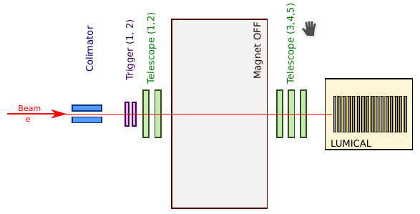
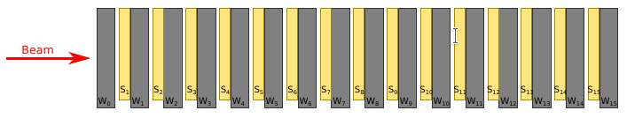
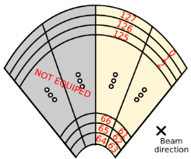
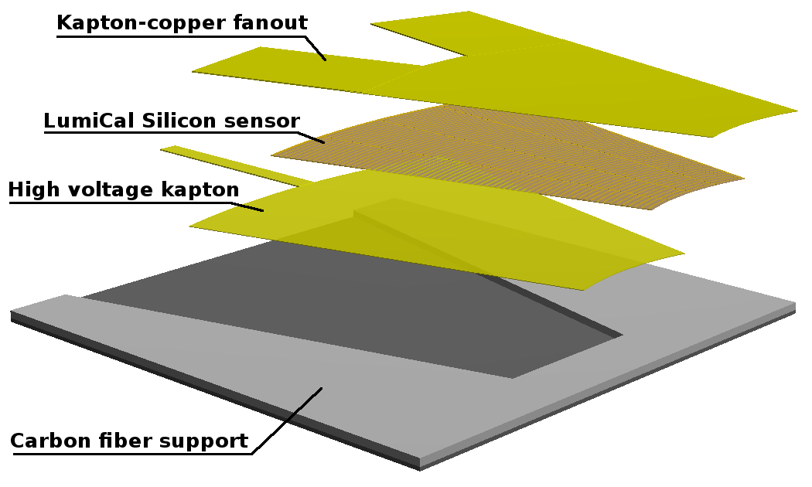
Testbeam setup
Regular configuration:
Beam spot after the colimator ~5mm x 5mm
Two scintilator triggers operating in coincidence mode
5 telescope planes – 2 before and 3 after the magnet
Magnet switched OFF
LumiCal placed on movable table
LumiCal configuration:
15 sensor layers (S1 - S15) glued to tungsten absorbers (W1 – W15) ->config. A
Additional tungsten layer in front of the stack (W0) -> config. AA
Sensor components:
kapton fan-out
LumiCal sensor
high-voltage kapton
carbon fiber support
Sensor position:
only sectors R1 and R2 are equiped

Slide 4
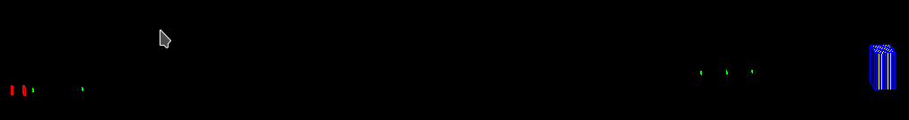
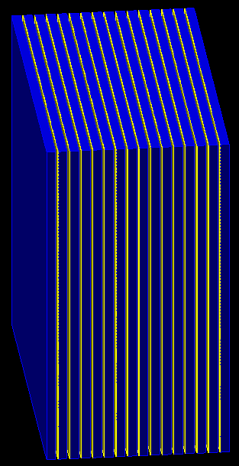
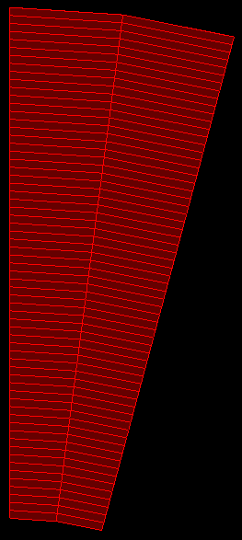
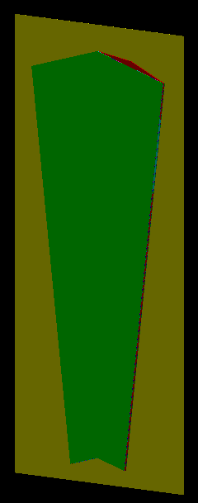
Testbeam setup: visualisation
Geometry construction for testbeam configurations
Lumical detector configuration A (15 sensors)
Lumical sensor components
sectors R1 and R2
64 pads each

Slide 5
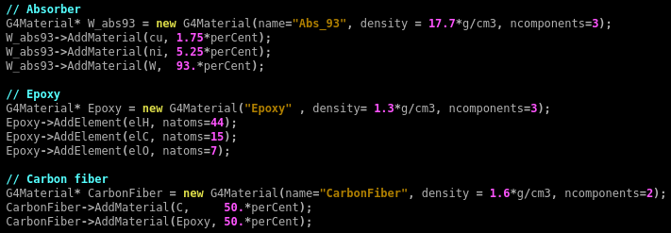
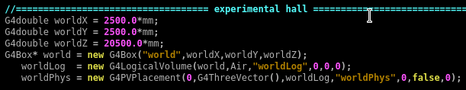
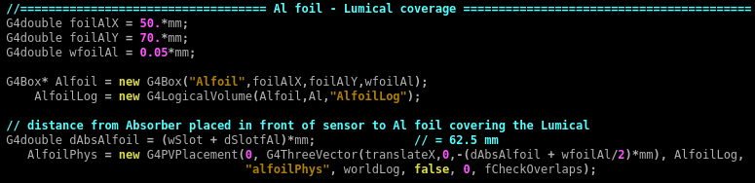
Geometry construction
Geometry construction for testbeam configurations
Derive own concrete class from G4VUserDetectorConstruction abstract base class
Implement the method Construct()
1. construct all necessary materials
C
U
R
R
E
N
T
S
I
T
U
A
T
I
O
N
2. define shapes, logical volumes and position of the experimental hall
3. define shapes, logical volumes and position of the coverage of LumiCal – Al foil

Slide 6
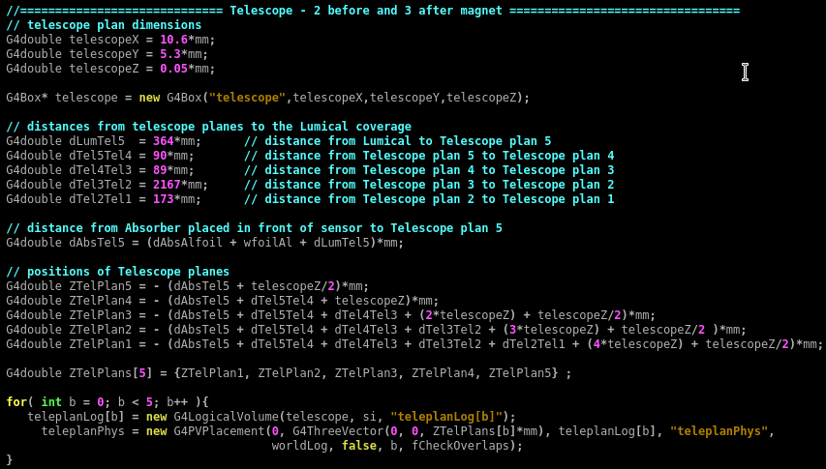
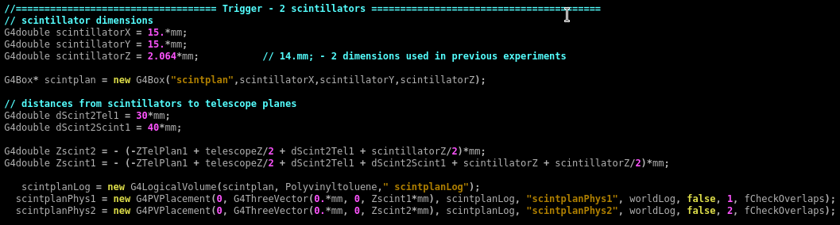
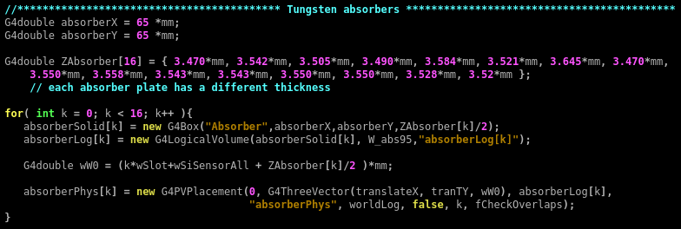
Geometry construction
4. define shapes, logical volumes
and position of the telescope
C
U
R
R
E
N
T
S
I
T
U
A
T
I
O
N
5. define shapes, logical volumes and placed the scintillators
6. define shapes, logical volumes and placed the tungsten absorbers

Slide 7
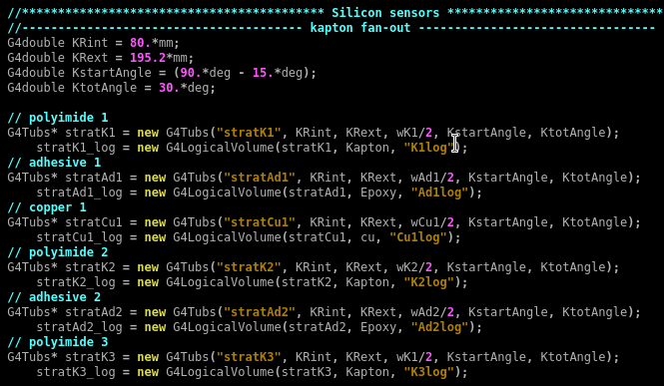
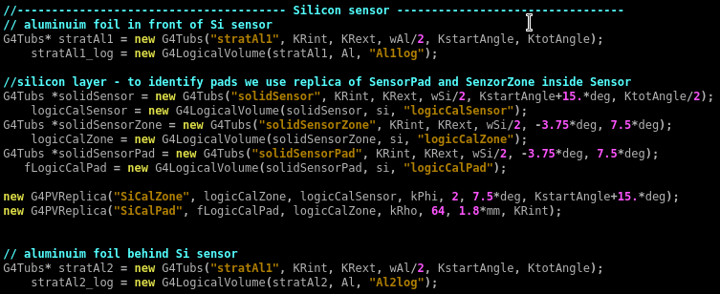
Geometry construction
7. define shapes and logical volumes of silicon sensors with all their components starting with kapton fan-out
C
U
R
R
E
N
T
S
I
T
U
A
T
I
O
N
8. define shapes, logical volumes
and placed the silicon sensor
silicon sensors are constructed using G4PVReplica method to identify easily the pads

Slide 8
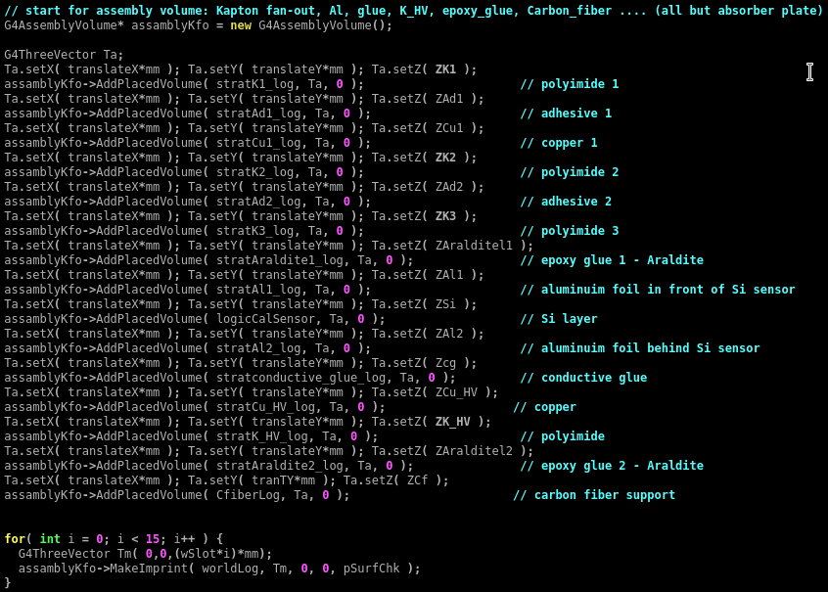

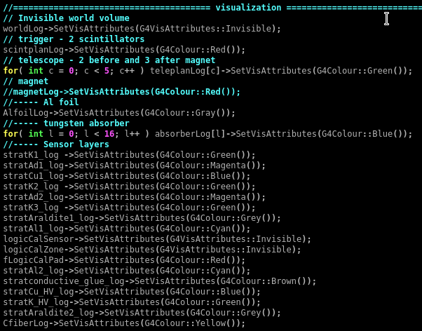
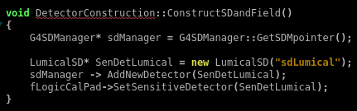
Geometry construction
9. define assembly of an entire silicon sensor
10. define a region for sensors
in order to apply various
conditions on it
placement of all 15 silicon sensors using MakeImprint
11. visualization of all
constructed shapes
Instantiate sensitive detectors and set them to corresponding volumes

Slide 9
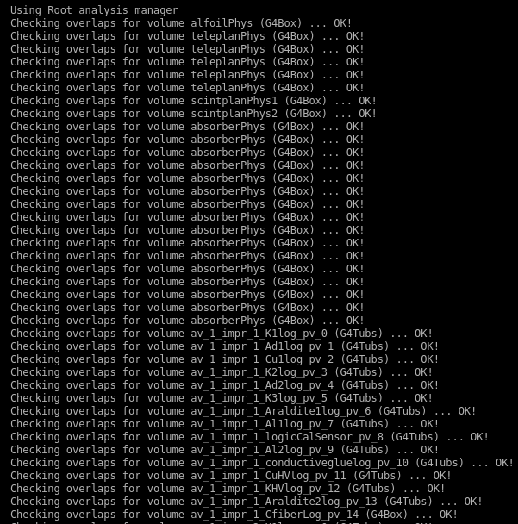

Overlap checking
Each one of the geometry element constructed had the option for the checking of the volume overlaps activated
tungsten absorbers
silicon sensors assembly components
Outcome of the overlap checking

Slide 10
Geometry construction and overlap checking
Geometry construction:
rather simplist with some minor point of high interest;
geometry constructed having placed the first sensors in the (0,0,0) coordinates; all other geometries are placed with respect to this one;
tungsten absorbers:
a G4Box shape;
each absorber has a different width;
construction of solid made inside a loop with the width for absorbers taken from an array;
telescope:
a G4Box shape;
positioned using Z axis coordinates taken from an array;
scintillators:
a G4Box shape;
each placed individually using regular G4PVPlacement class;
sensors:
each layer constructed individually from kapton fan-out to carbon fiber support;
silicon sensor build using G4PVReplica which replicates the pads horizontally and the sectors vertically;
everything wrapped in an assembly;
the assembly is positioned several times using a loop and a geometry overlap checking.

Slide 11
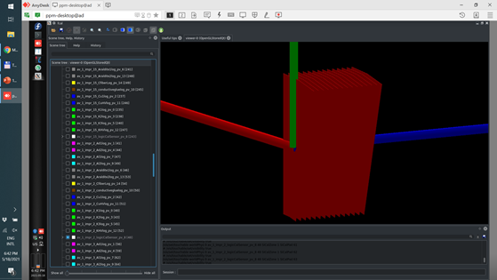
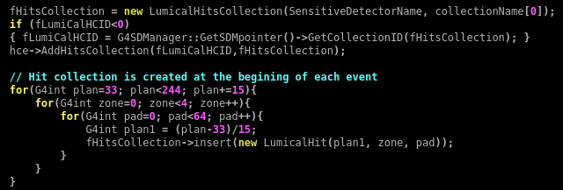
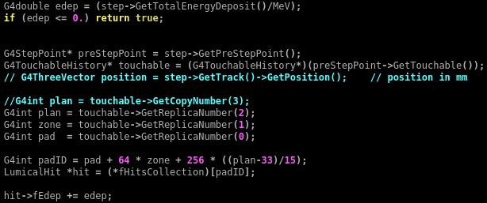
Data collection
Data are collected using Sensitive Detectors which has the goal of creating hits objects through the following virtual methods:
Initialize()
ProcessHits()
EndOfEvent()
Intialize() - create a hit collection at start of an event
at each step in a sensitive detector, the ProcessHit() method is invoked which create, fill and stores the Hit objects

Slide 12

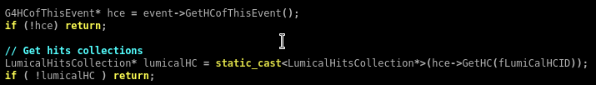
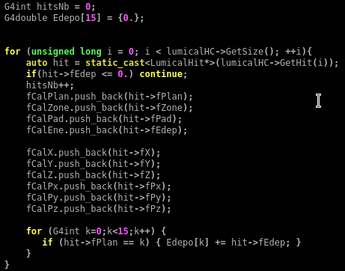
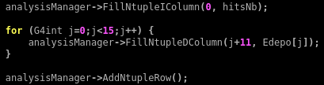
Processing hit information
Data are retrieved using EventAction:EndOfEventAction() class
get the index number of the hit collection - which is unique and don’t change during a run
retrieve the pointer to the hits collection with the GetHC() method using the collection index
loop through the entries of hits collection to access individual hits
store the output in analysis objects

Slide 13
Output datafile
Data are collected using Sensitive Detectors which has the goal of creating hits objects through the following virtual metods:
Initialize()
ProcessHits()
EndOfEvent()
// Default settings
analysisManager->SetVerboseLevel(1);
analysisManager->SetFileName("fcal");
// Creating ntuples
if ( fEventAction ) {
analysisManager->CreateNtuple("LumicalTree", "Calorimeter data");
analysisManager->CreateNtupleIColumn("nHits"); // Id = 0
analysisManager->CreateNtupleIColumn("Plan", fEventAction->fCalPlan); // Id = 1
analysisManager->CreateNtupleIColumn("Sector", fEventAction->fCalZone); // Id = 2
analysisManager->CreateNtupleIColumn("Pad", fEventAction->fCalPad); // Id = 3
analysisManager->CreateNtupleDColumn("Energy", fEventAction->fCalEne); // Id = 4
analysisManager->CreateNtupleDColumn("pos_x", fEventAction->fCalX); // Id = 5
analysisManager->CreateNtupleDColumn("pos_y", fEventAction->fCalY); // Id = 6
analysisManager->CreateNtupleDColumn("pos_z", fEventAction->fCalZ); // Id = 7
analysisManager->CreateNtupleDColumn("px", fEventAction->fCalPx); // Id = 8
analysisManager->CreateNtupleDColumn("py", fEventAction->fCalPy); // Id = 9
analysisManager->CreateNtupleDColumn("pz", fEventAction->fCalPz); // Id = 10 2
stringstream nameformat;
G4String edname;
for(G4int k = 1; k < 16; k++){
G4String columname = "Edep";
nameformat << k;
columname += nameformat.str();
nameformat.str("");
edname = columname;
analysisManager->CreateNtupleDColumn(edname);
}
analysisManager->FinishNtuple();
RunAction class
Create analysis manager, Creatie ntuples
Energy deposited in each plane

Slide 14
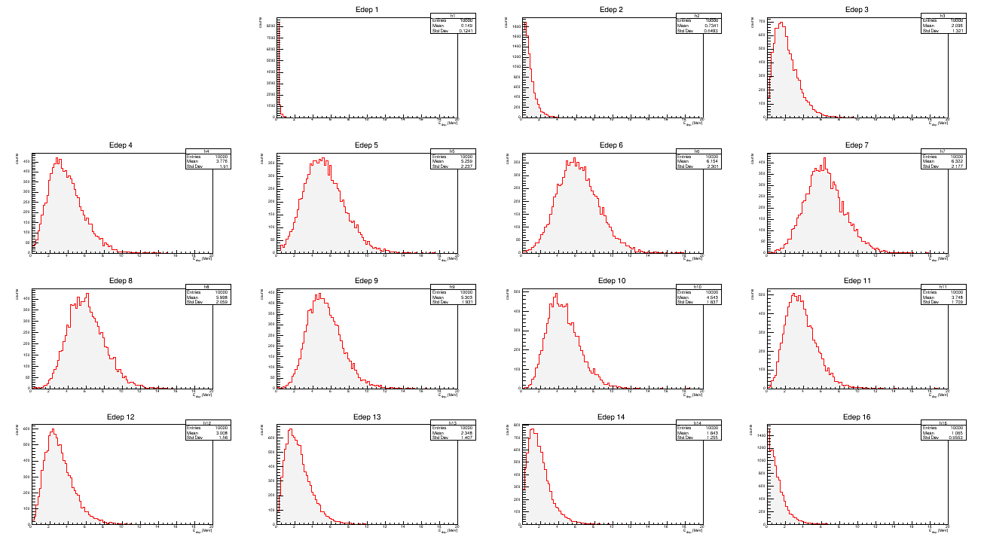
energy deposited spectrum from different X0 - config. AA
Results

Slide 15
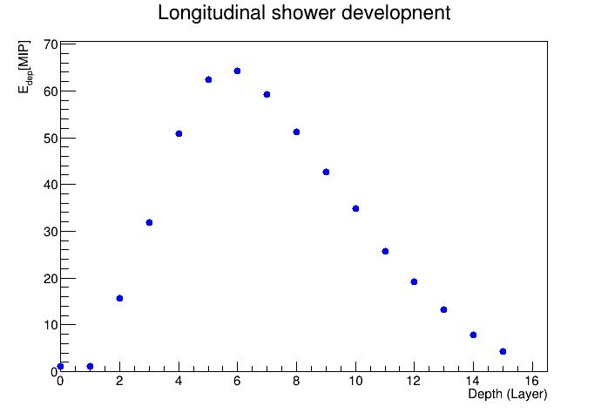
Results

Slide 16
THANK YOU!

Slide 17
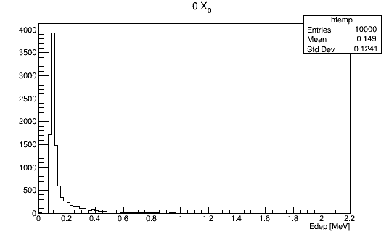
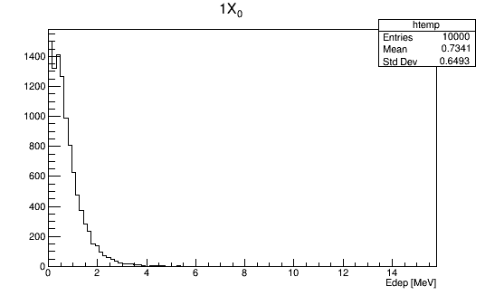
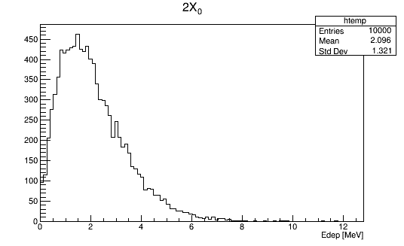
Results

Slide 18
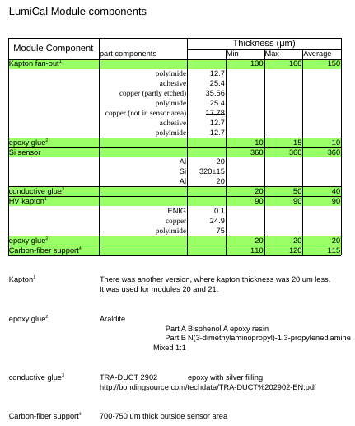
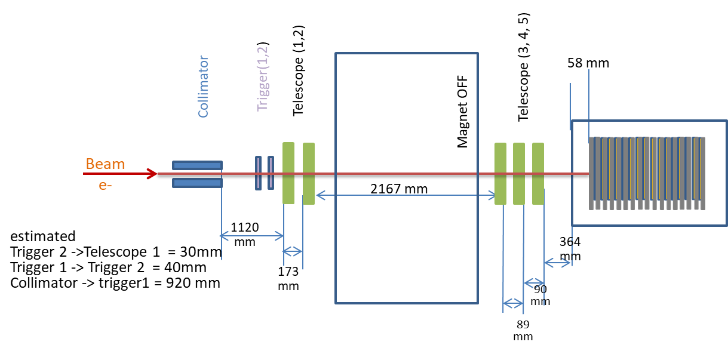
Testbeam setup
layer | sensor | plate | Thickness [mm]
1 | - | Plansse 2 | 3.520
2 | 52 | Plansse 3 | 3.470
3 | 51 | MGS3 | 3.542
4 | 29 | Plansse 1 | 3.505
5 | 59 | Plansse 5 | 3.490
6 | 10 | MGS1 | 3.584
7 | 57 | MGS2 | 3.521
8 | Free | MGS5 | 3.645
9 | 53 | MGS6 | 3.470
10 | 60 | A2 | 3.55
11 | 64 | A8 | 3.588
12 | 42S | B24 | 3.543
13 | Old T2 | B23 | 3.543
14 | Old C3 | B12 | 3.55
15 | 61 | B17 | 3.55
16 | Old C4 | A5 | 3.538
17 | 58 | Plansse 4 | 3.474
Brand | Density | Chemical composition
 |  | W | Ni | Cu
Plansee | 18 | 95% | 3.5% (estimated) | 1.5% (estimated)
MGS | 17.7 | 93% | 5.25% | 1.75%
JINR | 18 | 95% | 3.5% (estimated) | 1.5% (estimated)

Slide 19
Part II

Slide 20
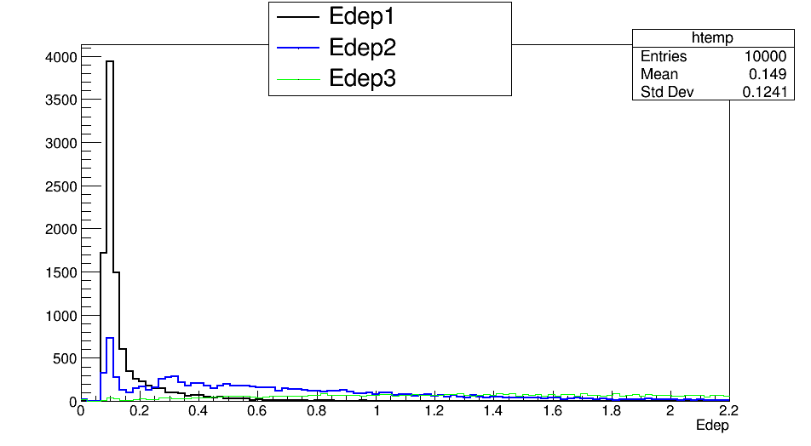
Suggestion 1: to apply the same bin for Edep 1 and Edep 2

Slide 21
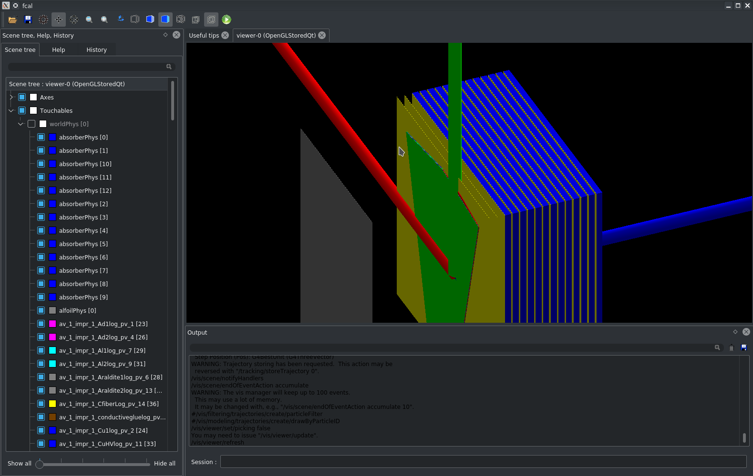
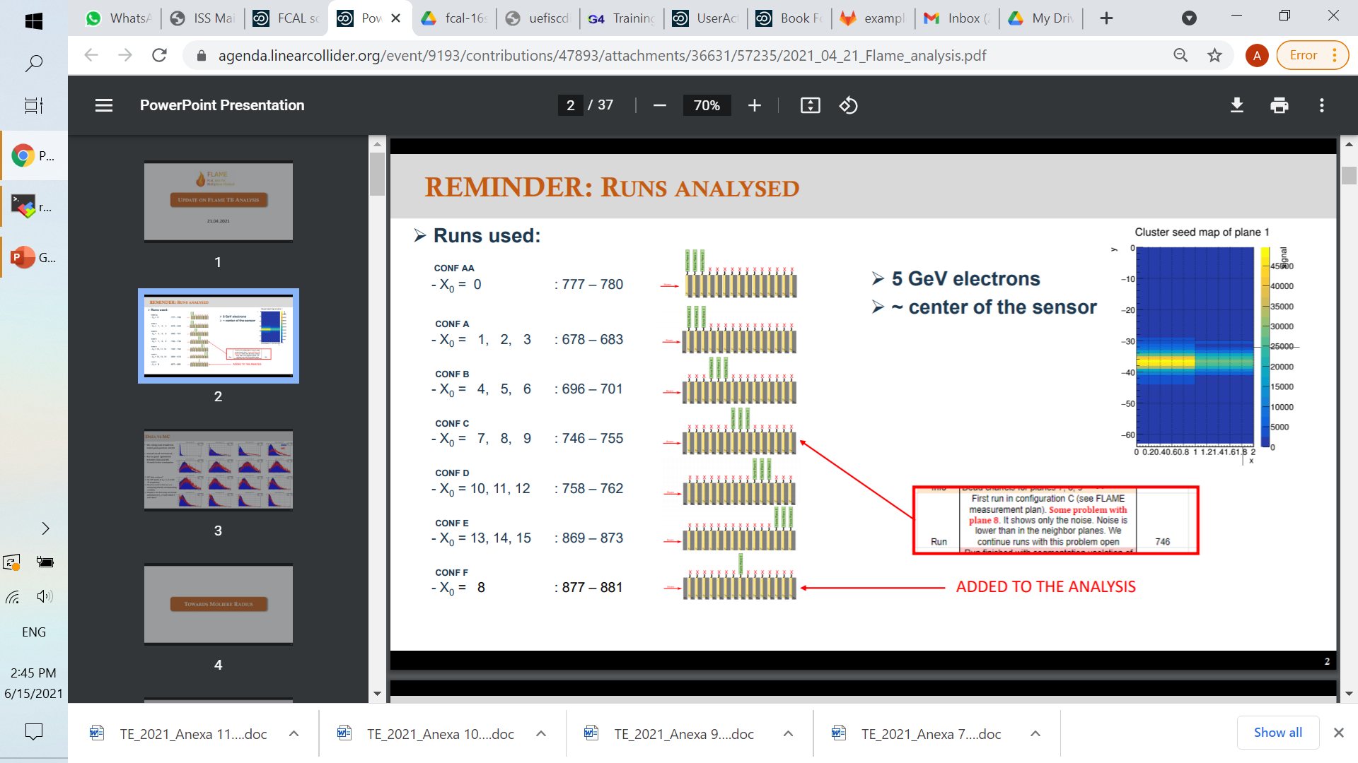
Suggestion 2: to simulate a configuration without the first 2 W absorber in order to studied the behavior of sensors 2 and 3
1
2
3
4
Conf aaaa
...
Conf AA

Slide 22
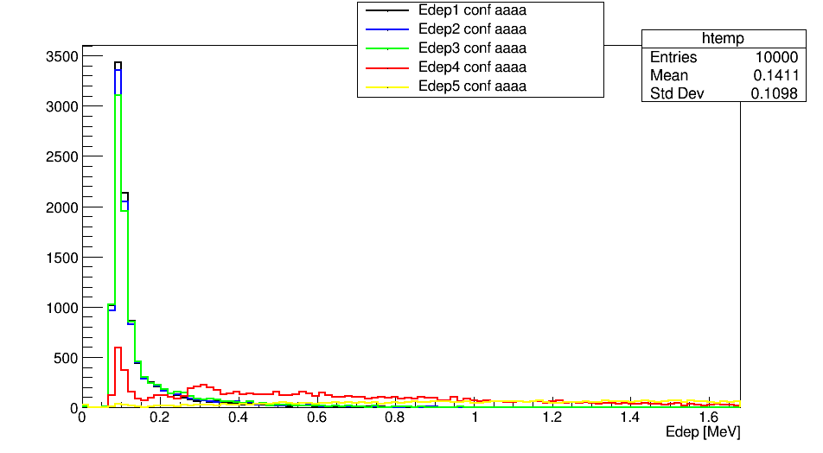
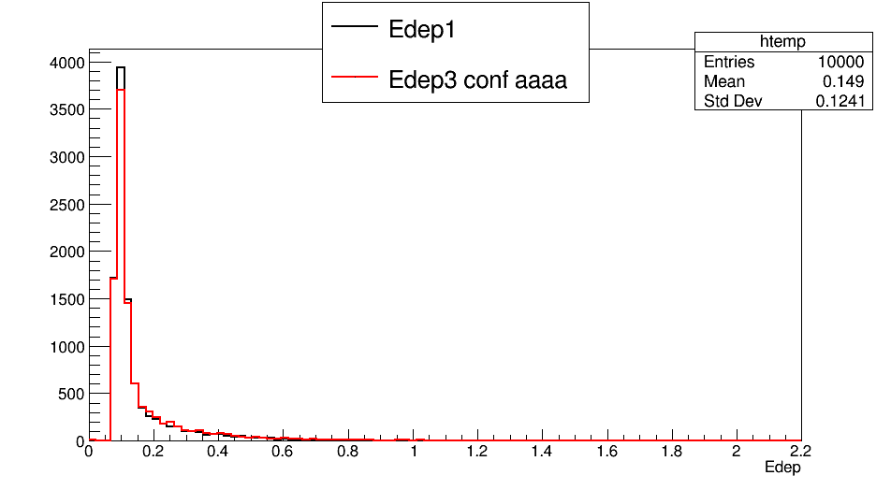
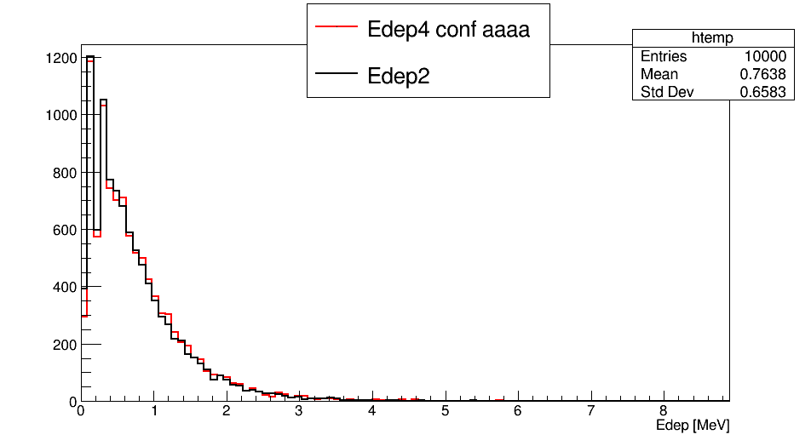
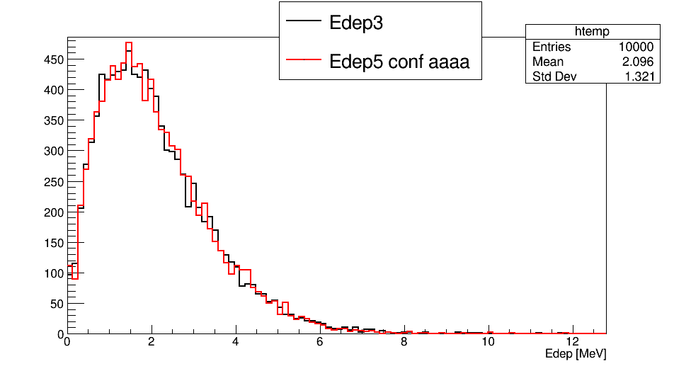
Energy deposited in sensors
un-normalised

Slide 23
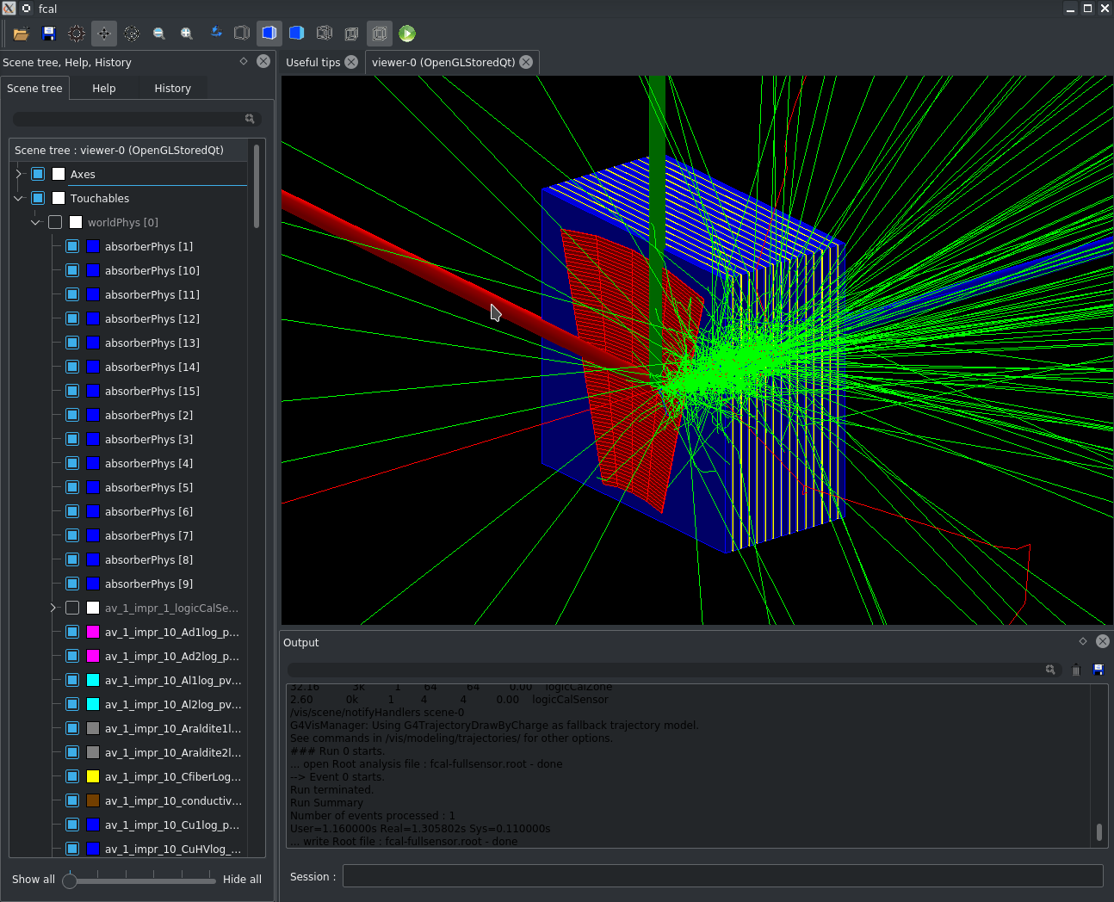
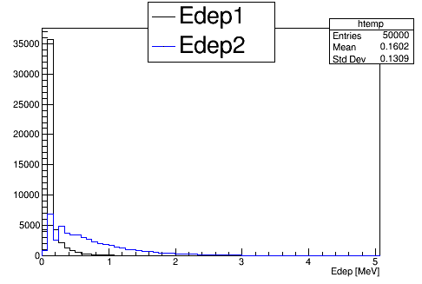
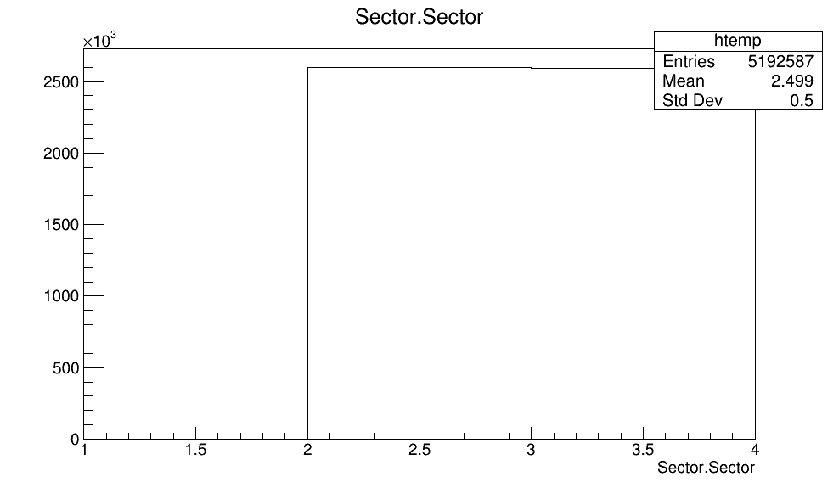
Suggestion 3: to move beam in pad 27 (like in experimental data) to implement all 4 sectors to increase statistics at 50000 events

Slide 24
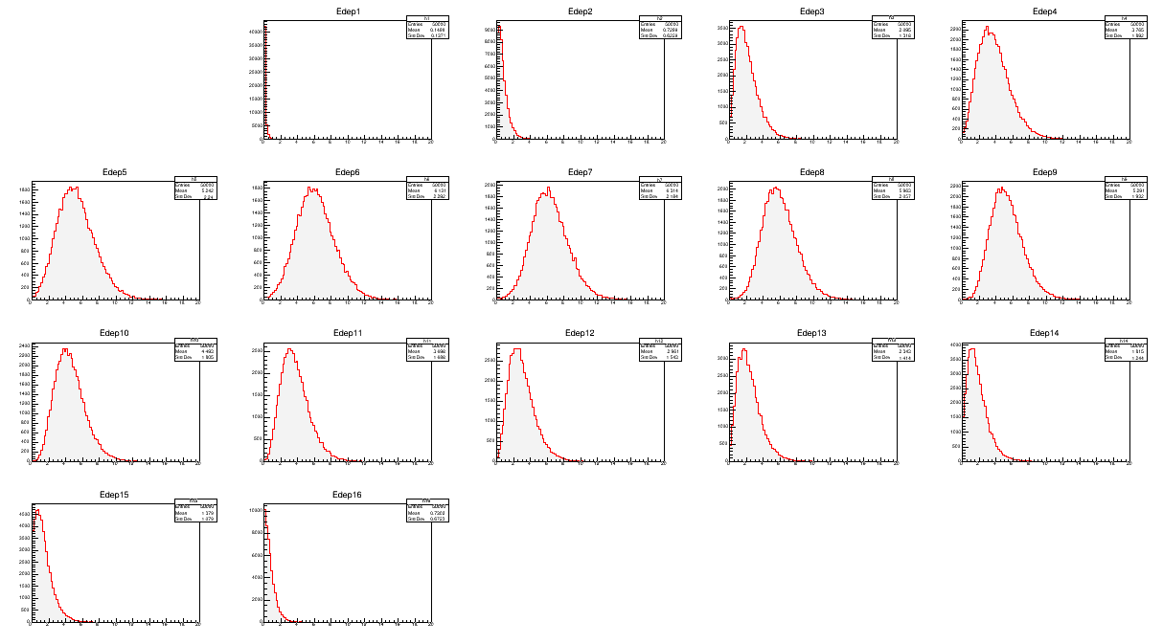
energy deposited spectrum from different X0 - config. AA

Slide 25
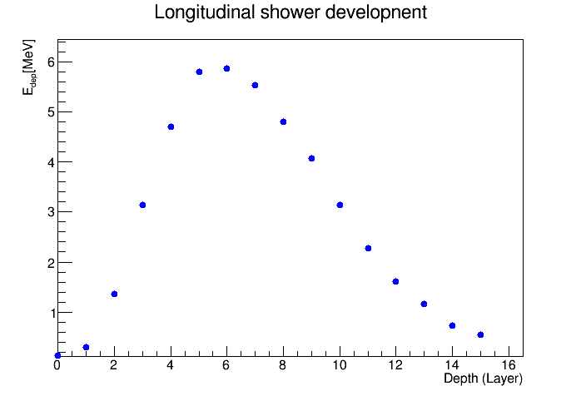

Slide 26
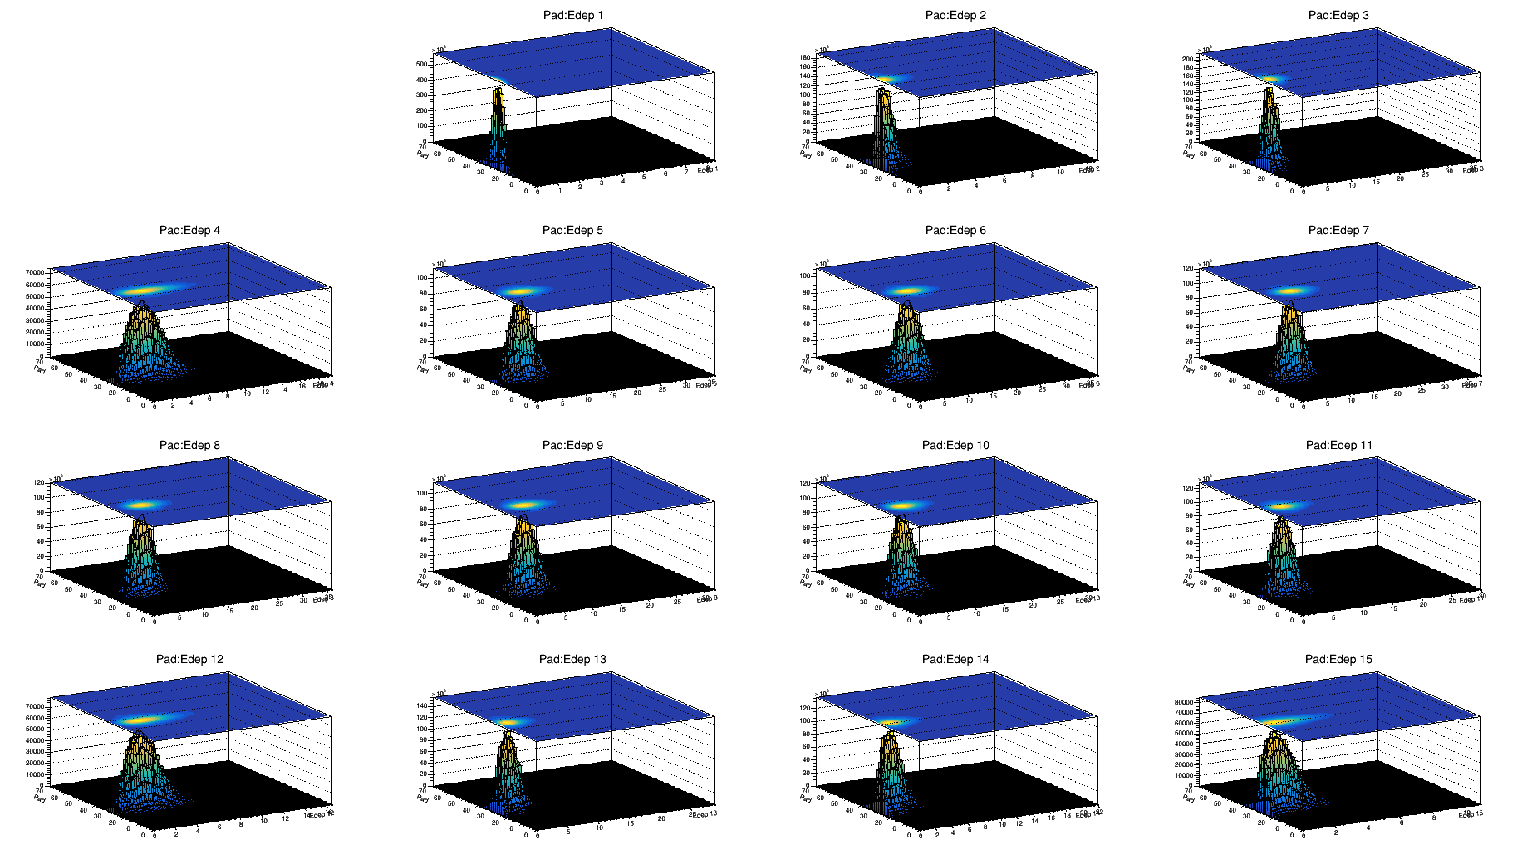
Suggestion 4: to plot energy deposited in each pad for each plane

Slide 27
Conclusions
Still needed further investigation on energy deposition
Ghost hits at boundary mistaken as real hits;

Slide 28
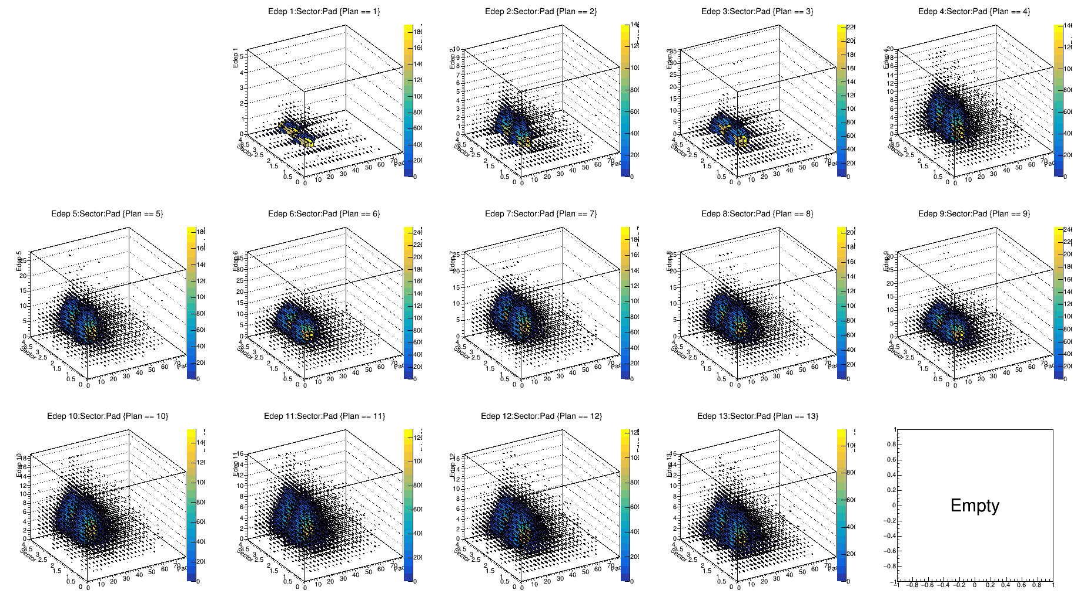
3D representation of energy deposited in each plan for each sector/pad *
* For a configuration where energy deposited was collected in all 4 sectors

