Slide 1
Plan of WG2 Groups
Kaoru Yokoya
Sources Group Meeting 17 June 21, 2021

Slide 2
New WG2 organization
From Slides by Shin Michizono in WG2 on Jun.15
Initial emphasis is planning the Pre-lab program which allows for the smooth transition from IDT phase to Pre-lab phase
Builds upon existing WG2 structure
Aims of the technical preparation WP sub-groups
Starting from the “Technical preparation document (TPD)”
More detailed description of work and schedule for each WP
Aims of the Engineering Design and Documentation (ED&D) Planning Taskforce
Define what EDR (+ documentation) contains
Review what additional work beyond technical design documentation (incl. TDR) is needed for engineering design and documentation (ED&D)
Include integration and cross-cutting activities in planning
Develop more detailed description of ED&D work and schedule
Including integrating results of technical preparations WPs into ED&D
Start with existing WG2 members and encourage wider participation.
Expect existing WG2 members to be a member of at least one group or subgroup
Expect some people will participate in both tech. prep. WP subgroups and ED&D subgroups
Hope & expect that participants will continue working into Pre-lab
Discussions will be reported at each parent group meeting

Slide 3
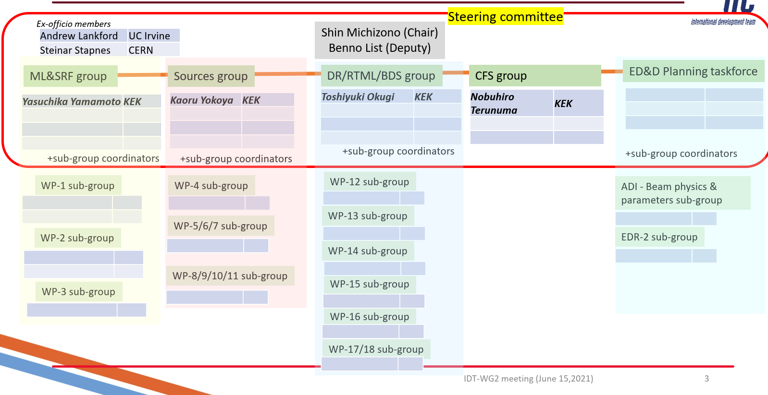

Slide 4
WP sub-groups
Starting from the “Technical preparation document (TPD)”
More detailed description of work and schedule for each WP
Necessary for budget request for O(M$)
Possible subgroups in Sources
WP4: Electron source
WP5+6+7: Undulator source
WP8+9+10: e-Driven sources
WP11: separate subgroup? Maybe, absorbed in the above two
Can the subgroup be formed?
Resources?
How often should the parent group (i.e., Sources) meet?
Timeline
End of this year??
Other groups
Mostly, one WP corresponds to one subgroup
They will have a step to nominate subgroup leader

