Slide 1
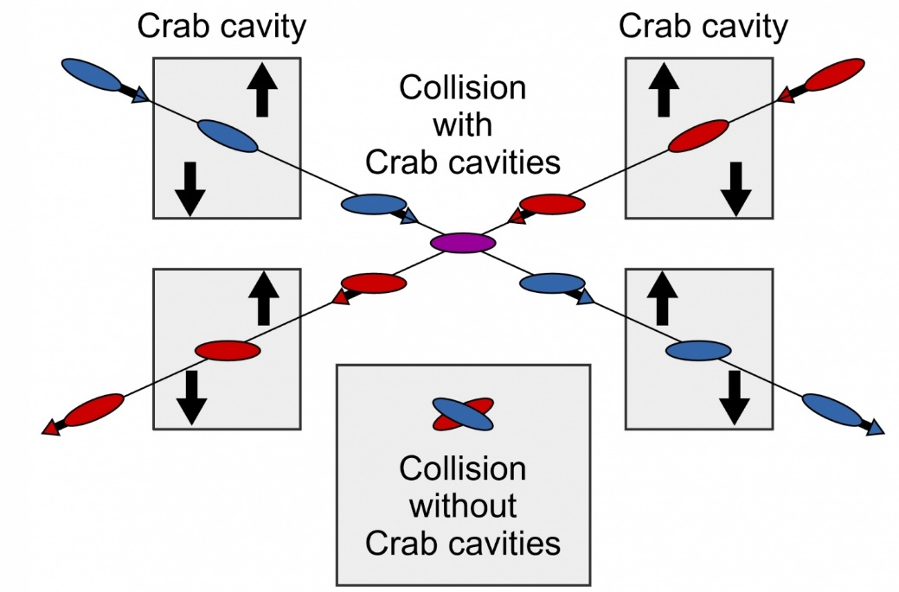

WP3: 4th Crab Cavity Meeting
Peter McIntosh,
UKRI-STFC Daresbury Laboratory
13th July 2021

Slide 2
Agenda for Today
Review Specifications Developments
Agree Development Plans
Fix Project Review Meetings

Slide 3
1. Review Specification Developments (1/3)
Updated CC Specifications (v8):
https://agenda.linearcollider.org/event/9290/
Update includes:
X, Y beta-function at CC location
Alignment and HOM tolerance discussion meeting held on 25/6, which reviewed:
Process used for TDR determination of tolerances – G Burt (ULAN)
Impedance determination process used for the QMiR cavity – A Lunin (FNAL)
ILC BDS assessment for impedance and alignment tolerances – T Okugi (KEK)
Agree next steps:
https://indico.stfc.ac.uk/event/356/
Access Key: ILCWP3Spec

Slide 4
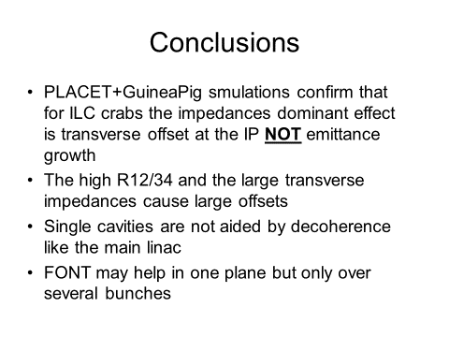
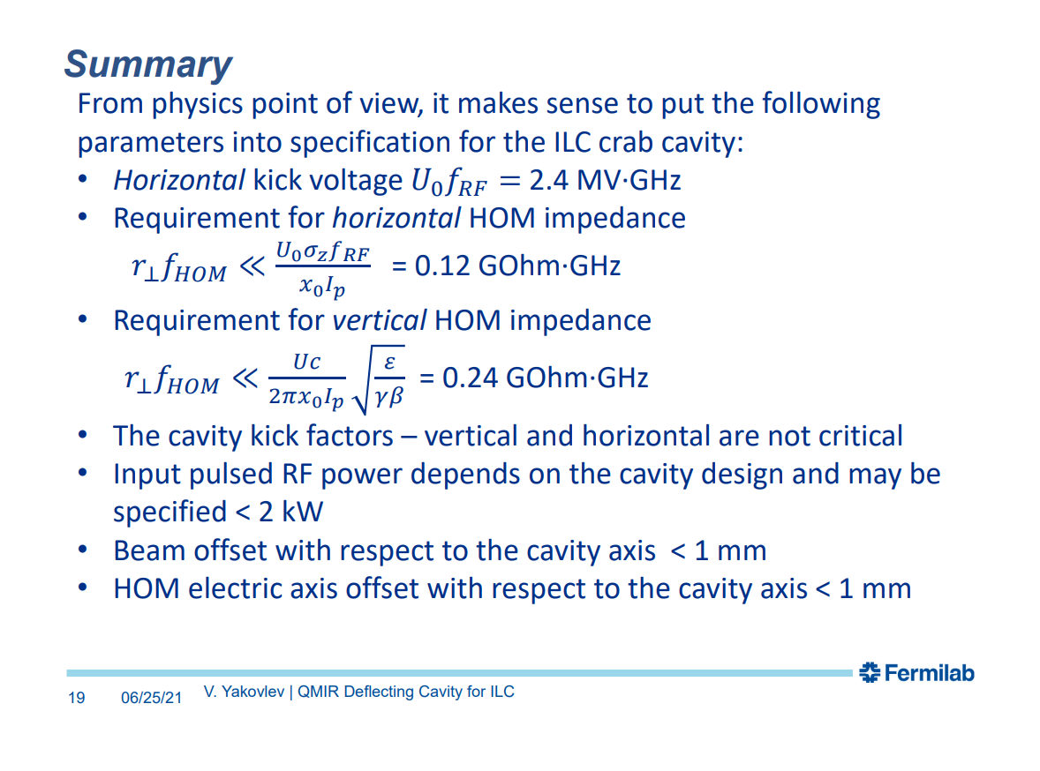
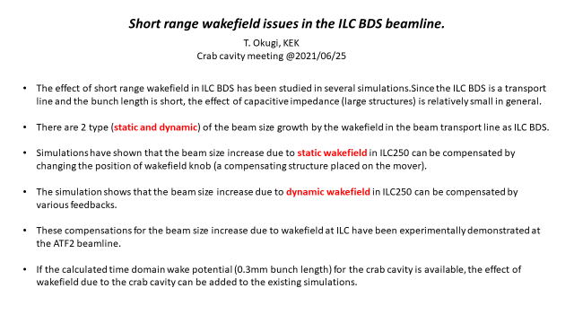
1. Spec. Developments – Summaries (2/3)
G Burt
A Lunin
T Okugi

Slide 5
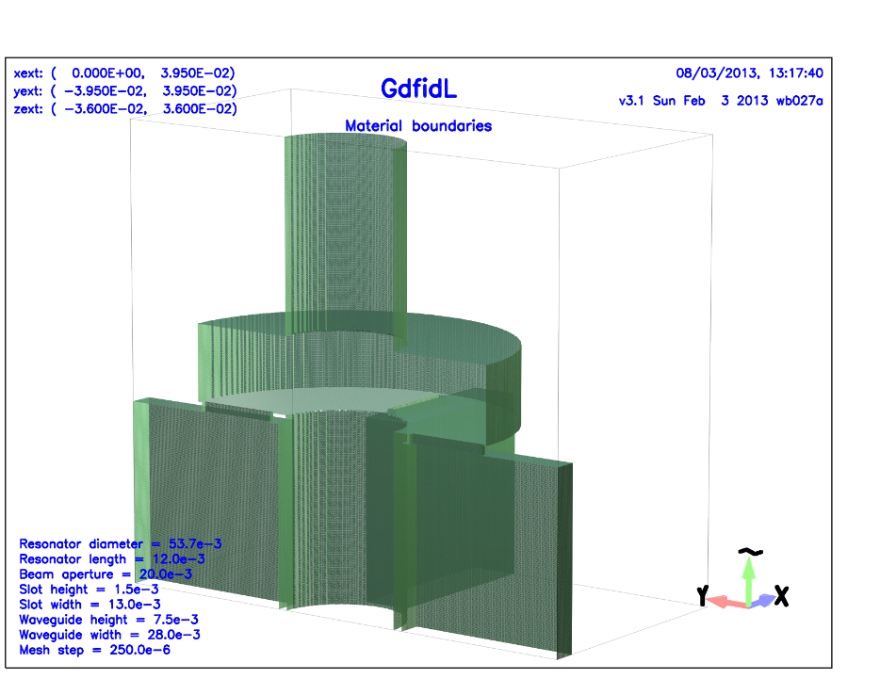
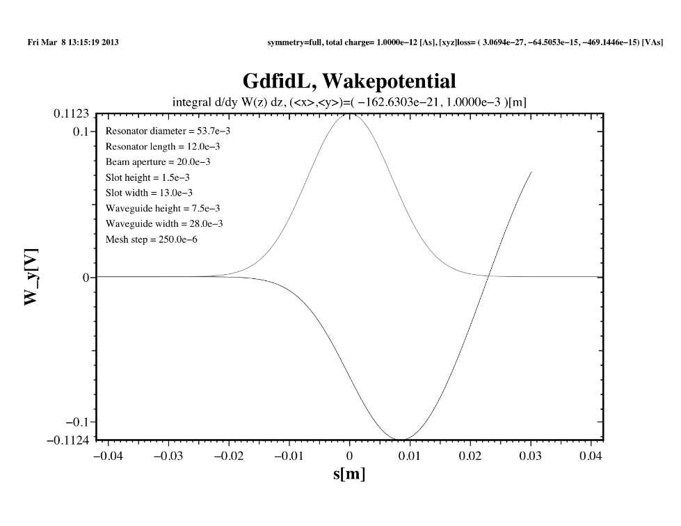
1. Cavity Wake Potential (3/3)
Agreed to try and provide some example cavity wakepotential input into the ILC BDS simulations:
3.9 GHz TDR elliptical - ULAN
2.6 GHz QMiR - FNAL
1.3 GHz RFD - ODU
1.3 GHz QWR/WOW – BNL
Any others?
Okugi-san comments:
This is an example of the GdfidL output:
GdfidL will provide the output in csv format.
We don't care about the format.
As long as we know how the kick field changes over time, we can integrate it.
Trying to source GdfidL users who can help ... any suggestions?

Slide 6
2. Agree Development Plans

Slide 7
3. Fix Project Review Meetings
Priority to complete CC system specifications.
Pre-Lab now not expected to start in 2022 as originally planned.
Propose to initiate cavity design process amongst WP3 collaborators.
Set more optimised workshop reviews to assess design progress for each CC solution – Sept, Dec 2021 and March, June 2022, with intermediate catch-up meetings.
Target converged design optimisation for Decision-1 during 2022 (Nb: previously Pre-Lab Phase).
Propose:
1st Workshop Review of CC Design Status – Tues 7th Dec 2021
2nd Workshop Review of CC Design Status – Tues 21st Jun 2022
Decision 1: EM Design Optimisation and Down-Select – Tues 27th Sept 2022

