Slide 1
Response to Advisory Panel
Aug.30. 2021 Souces Group
Still on the way of preparation
Eventually, “Slide preparation taskforce” will write the final version

Slide 2
ILC advisory panel
First advisory panel was held on July 29.
https://www.mext.go.jp/kaigisiryo/2021/mext_00253.html
Charges of the panel:
Prospects for international research cooperation and cost sharing
Academic significance and understanding of the public and scientific community
Clarification of technical feasibility
Reasonableness of cost estimates
Prospects for training and securing human resources
Other issues related to ILC
Schedule:
The panel is planned to be concluded by the end of 2021, or at latest by the end of March 2022.
2nd panel (120 min.)
-Overview of the ILC project and the history to date [5+5].
-IDT proposal [15+20].
-Technical feasibility and validity of cost estimate (accelerator) [20+25].
-Discussions among expert committee members [30].
Speakers are not decided yet. (negotiation with MEXT)
From S.Michizono,
WG2 Aug.24.2021
See the note on Aug.3 in the WG2 mailing list

Slide 3
Slide preparation taskforce
From S.Michizono,
WG2 Aug.24.2021
In order to prepare the slides at the ILC advisory panel, “slide preparation taskforce” was organized. (Chair: Prof. Kawagoe (Kyushu U.))
Not only the accelerator, but also other presentations will be advised by this taskforce.
From accelerator, Michizono, Terunuma, Kuriki, Sanuki are the members.
Concerning the accelerator related presentations, these drafts are under preparation
  Basic information about ILC progress (up to now)
  Since most of the advisory panel members are non-expert (of the accelerators), we have to include basic information about the ILC technology.
  (b) Response to the previous ILC advisory panel and SCJ
    Response to the issues pointed out
    Activities from 2018 to 2021
  (c) WPs during pre-lab (corresponding to the issues raised by ILC advisory panel and SCJ)
  (d) In addition, I asked some of the IDT-WG2 members to prepare the ILC related activities (~2018, 2018~2021, and future potential for the WPs). (USA, England, France, Spain, CERN etc.)
Total presentation time for them will be less than 30 min. (Even though we will submit various materials, the presentation slides themselves are ~30.)
Please understand that this task force handles the editing of the slides.
Based on the information at each group on July.
Based on “Pre-lab proposal”

Slide 4
Advisory Panel: future meetings
Dates not decided yet. October?
2nd meeting (not final yet)
  Overview of ILC (Mori) 15+15
  Physics (Murayama) 15+15
  Technology (Michizono) 20+25
  IDT proposal (Nakada) 15+20
  Discussion of the panel 30
3rd Meeting (not final yet)
  Technology establishment, cost estimation (civil, environment, safety) (Terunuma) 5+10
  Academic meaning (Asai) 10+20
  International cooperation, cost sharing (Yamauchi) 10+20
  Human resource (Okada) 5+10
  Discussion of the panel 30

Slide 5
Achievement of ILC technology and future plan
Basic
Draft
Since the publication of the Technical Design Report (TDR) in 2013, the key technical developments have progressed and >90% of the technologies required for construction have been established.
Will come back to this slide later
From S.Michizono, WG2 Aug.24.2021
60%
70%
80%
90%
100%
Technology achievement |  | tasks
SRF cavity | (construction and operation of the EuXFEL, the role of the accelerator prototype) | International shared mass production demonstration (Confirmation of performance achievement)
Cryomodule (CM) | 技術設計 → 技術開発 → モデルワーク → プロトタイプ （システム・プロトタイプ；EuXFEL 完成・運転実績) | (International transfer demonstration)
e- source |  | confirmation
e+ source Undulator scheme |  | Target, magnetic focusing
e+ source e-driven scheme |  | Target, capture cavity
DR |  | Kicker
Final focus |  | Stable operation
Dump |  | Remote handling
2021
～2018
Technology development ->Model work-> Prototype (CFF) (STF)
2018～2021
High performance and cost reduction of cavities
～2018
Tech. Design->Tech. Development->Model->Tech. Demonstration
～2018
Tech. Design->Tech. Development->Model
2018～2021
Tech. Demonstration
～2018
Tech. Design->Tech. Development ->Model
2018～2021
Tech. Demonstration
～2018
Tech. Design->Tech. Development->Model-> Tech. demonstration achieved at KEK ATF
～2018
Tech. Design->Tech. Development->Model-> Tech. demonstration achieved at KEK ATF
～2018
Tech. Design->Tech. Development->Model
2018～2021
Facility design
：～2018
：2018～2021
：2022～
Model work: small-scale models, partial/component models.
Prototype: demonstration at the full scale.
Demonstrator: Technology transfer (to industry) for manufacturing of actual equipment.

Slide 6
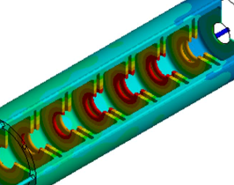
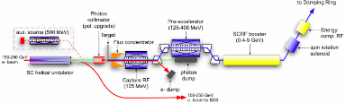
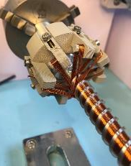
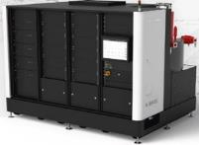
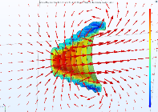
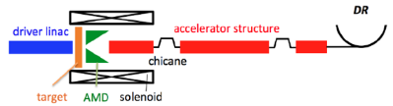
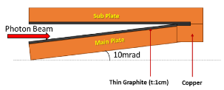
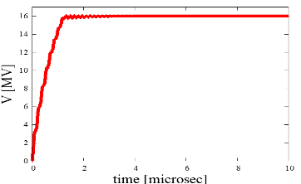
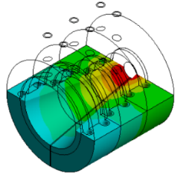

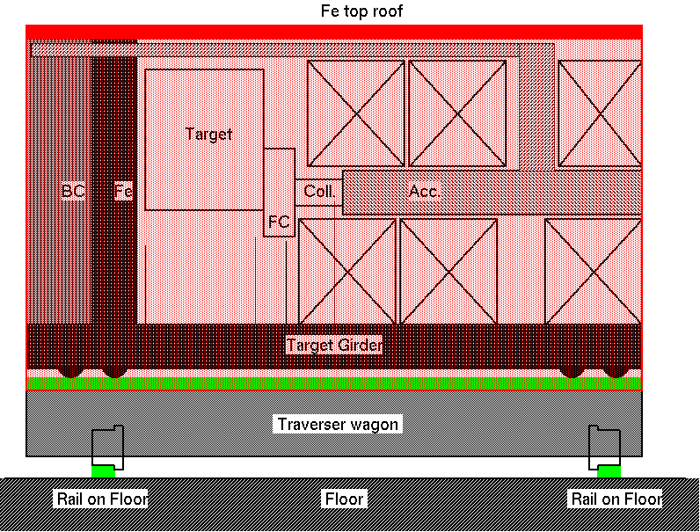
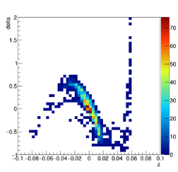
Progress in positron source
(b)Response
Draft
～2018 tech. design
2018～2021 tech. verification
2022～Detailed design.
Target Prototyping
Vacuum characteristics Testing
APS cavity
High-speed rotating positron target, Technology Design
Target thermal simulation
Ti target beam test
RF stability test
e+ source total design
Practical Operation of Superconducting Helical Undulator (APS)
Undulator prototype
Pulse solenoid design
Photon dump design
Target maintenance
Loading compensation
Mag. focusing
Paricle simulation
Thermal analysis
Plan A:Undulator scheme
Plan B:e-driven scheme (same tunnel)
Plan C:e-driven scheme (extra tunnel)
6

Slide 7
Positron Source
Advisory Panel and SCJ Reports
There are still many issues to be resolved regarding beam dumping, positron source, electron source, beam control, damping ring injection/extraction system, etc. (Advisory panel p5)
In the main preparatory phase, it is planned that the prototype of the rotating target will be made and the magnetic focusing system immediately after the positron source will be developed. The technology selection is to be made by the second year of the main preparatory phase. The strategy should be clarified, taking into account the R&D cost. (SCJ)
Clarification of the policy for the two proposals on positron sources, which includes many development elements, taking into account development costs. (Advisory panel , Jul.29, 2021)
Development till 2018
2 possible schemes, undulator and e-driven
  Undulator scheme provides with polarized positron but is a new method
  e-Driven scheme is technically sure
Development of 2 schemes in parallel, taking into account the potential of physics of polarized positrons
Report on the ILC Positron Source was compiled by the Positron Working Group. (May 2018)
Development Since 2018
For the electron-driven system, the technical design was completed in 2019 in collaboration with the university and KEK. Long-term vacuum and radiation resistance tests of a life-size prototype of the target, and detailed design of the magnetic focusing and capture cavities were conducted. The beam loading compensation was studied in detail and the method was established.
For the undulator method, progress has been made in target and pulse solenoid design.
There is a proposal for international cooperation including performance improvement at the Pre-Lab. Technology selection is planned for the third year of the Pre-Lab to determine the results.

Slide 8
Comparison of 2 Schemes of Positron Source
Advisory Panel and SCJ Reports
Clarification of the policy for the two proposals on positron sources, which includes many development elements, taking into account development costs. (Advisory panel , Jul.29, 2021)
R&D cost:
  Undulator: 1.5 OkuYen, 10 FTEy
  e-Driven: 4.4 OkuYen, 5 FTEy
The method will be finalized in the third year of the Pre-Lab in order to assess the results of the development studies already conducted for the Pre-Lab
Undulator method: Detailed design of target, magnetic focusing, and overall design reflecting facility design
E-Driven method: magnetic focusing, fabrication of prototypes of capture cavities and high-power tests, pulsed power supplies for them, fabrication of prototypes of RF sources, combined test of magnetic focusing and target prototypes.
System development, including maintenance of targets, is a common issue to be addressed.

Slide 9
Undulator Positron Source
Advisory Panel and SCJ Reports
The helical undulator scheme is adopted as the positron source. It contains some technologies under development such as the cooling of the target irradiated by the gamma rays from the undulator and the replacement method of the activated target. (Adv.P. p32)
Helical undulator scheme has no experience technically and contains many elements which require R&D. (SCJ)
Development till 2018
Prototype undulator to achieve the necessary magnetic field were built in the past and showed good results
By reexamining the target thickness and other factors, it was found that the heat load was reduced to less than half.
Development Since 2018
A long undulator is used in the European XFEL, and the necessary techniques for undulator positron source such as alignmen error and orbit correction have been accumulated. The optimization of the undulator parameters is proposed.
The durability test of the titanium alloy of the target was carried out, and good results were obtained.
Design of the pulsed solenoid is ongoing as the magnetic focusing device
The target exchange system being developed for the e-driven source can be used for the undulator scheme
What’s to be done in the Pre-Lab
Detailed design of the helical undulator source will be promoted, and R&D to improve its performance and reliability will be promoted through international cooperation.

Slide 10
Electron-Driven Positron Source
Advisory Panel and SCJ Reports
The conventional target method of positron source is not an easy target to achieve to obtain the prescribed beam intensity stably. (SCJ, p.7)
Development till 2018
KEK, Hiroshima University, Waseda University, and the BINP in Russia have led the research and development of the e-driven positron source.
Conceptual design completed, working on technical design and considering testing on targets
Development Since 2018
For the rotating target using magnetic fluid, it has been confirmed that there is no problem with the vacuum seal degradation due to radiation exposure.
For the magnetic focusing circuit, we have completed the electromagnetic design of the flux concentrator based on the BINP experience, and are currently working on the thermal design
For the capture cavity in the beam focusing section, a highly stable APS cavity was designed and a compensation method of beam loading was established.
Pre-lab
High power testing using prototypes of key components (rotating target, magnetic focusing, APS cavity) to improve reliability through long-term operation
Detailed design of the replacement system for the irradiated target.

Slide 11
Maturity of Technology ?
What is the percentage of maturity?
Benno mentioned TRL (Technology Readiness Level)
  Nine levels
  DoEfile.pdf uploaded today ‘s indico site (see page 9)
  Similar level definition for Horizon2020
  h2020-wp1415-annex-g-trl_en.pdf also uploaded
The following slides are still on the way. Eventually, the slide taskforce will create the final version

Slide 12
DOE - TRL

Slide 14
Horizon 2020 Work Programme 2014-2015

Slide 15
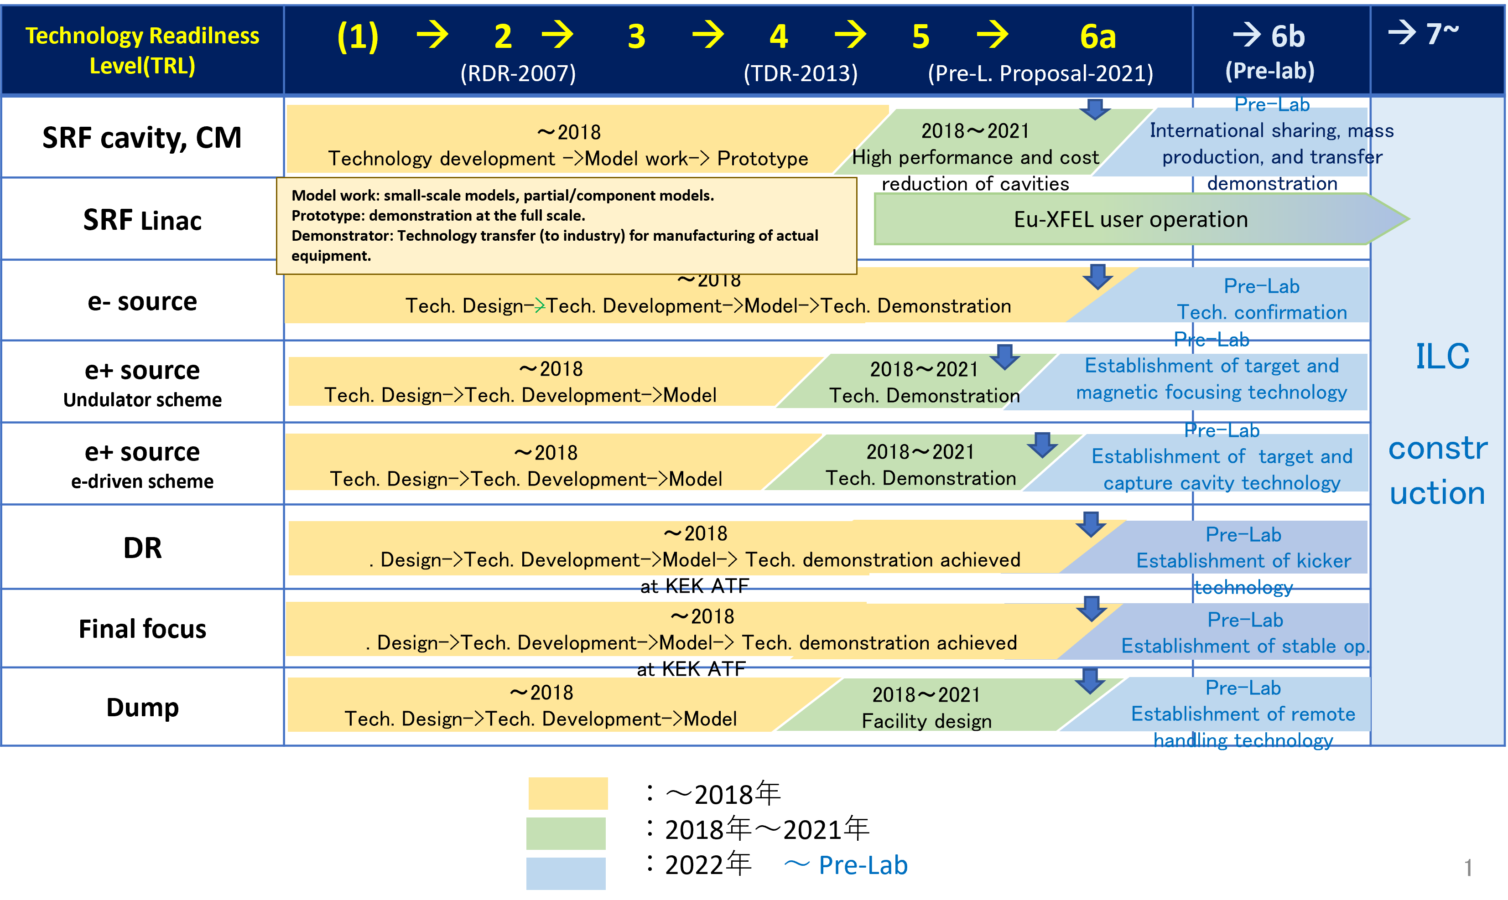
Achievement of ILC technology and future plan
Since the publication of the Technical Design Report (TDR) in 2013, key technological developments have been made and the Technology Readiness Level (TRL) for construction has reached 5 to 6a.

Slide 16
Technology Readiness Level
Rel. Level | TR L | DOE (US) | Horison2020 (EU) | ILC ( proposed） | ILC ( 提案）
 |  |  |  |  | SRF | Others
Basic technology research | 1 | - Basic principle observed and reported | Basic principle observed and reported | GDE (Global Design Effort for TDR) | 技術選択：Technology selection 概念設計： Reference design → 技術・コストレビュー： Technology & Cost Estimate Review → RDR (Reference Design Report) | 技術選択 Technology selection 概念設計 Reference design
 | 2 | - Technology concept and/or application formulated | Technology concept formulated |  | 概念設計 Reference Design RDR | 概念設計
Research to prove feasibility |  |  |  |  | RDR (Reference Design Report)
 | 3 | - Analytical and exp. critical function and/or charact. proof of concept | Experimental proof of concept |  | 技術設計： Technical design 要素技術開発： Component development 要素・モデルワーク: Comp. model-work 技術・コストレビュー： Technology and Cost-Estimate Review TDR (Technical Design Report) | 要素技術開発 Tech. Development (component)
Technology development | 4 | - Component and/or system validation in Lab. environment. | Technology validation in Lab. |  | 要素・モデルワーク: Comp. model-work → 技術・コストレビュー： T-C Review | 要素モデルワーク
 | 5 | - Lab-scale, similar system validation in relevant env., (industry ,,) | Technology validated in relevant environment (industrially relevant,,,) | LCCーIDT | 要素技術実証 Component technology validation Comp. Prototype | 要素・プロトタイプ Comp. Prototype
Technology demonstration | 6 | - Engineering pilot-scale, similar (prototypical) system validation in rel. env.(industry ,,,) | Technology demonstrated in relevant environment (industrially relevant ,,,) |  | 加速器での実証 → Eu-XFEL | 加速器での実証 → KEK-ATF & Others
 |  |  |  | Pre-Lab | 国際分担・量産技術、 国際移送・性能実証 Prod. Readiness, Trans. | 課題技術実証 Tech. Readiness
System commissioning | 7 | - Full-scale, similar (prototypical) system demonstrated in a relevant environment | System prototype demonstration in operational environment | Construction | 工業化プレシリーズ Industrial Pre-series 量産 Mass production 組み込み Installation コミッショニング Commissioning | システムプロト実証、 System Prototoype 建設 Construction 組み込み Installation コミッショニング Commissioning
 | 8 | - Actual system completed and qualified through test & demonstration | System completed and qualified |  | SRF LINAC 建設
System operation | 9 | - Actual system operated over the full range of expected condition | Actual system proven in operational environment (competitive manufacturing ,,,) | Operation | 加速器運転・物理実験 Acc. Operation and Physics
CD0
CD1
CD2
CD3
CD4

Slide 17
Backup Materials
Work Packages

Slide 18
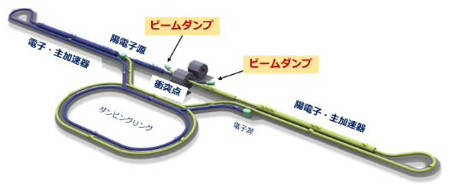
IDT (2019B)
The International Working Group presented a technical preparation plan for the issues pointed out by the Advisory Panel SCJ. The report outlines the necessary technical issues that should be addressed through international cooperation, as well as potential partners for international cooperation.
超伝導空洞
ILC国際ワーキンググループ報告書の提言より
https://www.kek.jp/ja/newsroom/2019/10/02/1000/
これを基に、IDT-WG2で検討を進めた。
陽電子源
ダンピングリング
衝突点
ビームダンプ

Slide 19
Technical Issues
IDT-WG2 discussed about the technical issues pointed out by Advisory Panel and SCJ, and summarized them as Work Packages in TPD (Technical Preparation Document)
ILC Pre-Lab
SRF
～41 OkuYen,
285 ftey
Electron
～2.5OkuYen, 6fte-y
Damping Ring
～2.5OkuYen, 30fte-y
BDS
～2OkuYen, 16fte-y
Beam Dump
～3OkuYen, 12fte-y
WP-4
Electron gun
WP-12
System design
WP-15
Final focus
WP-17
Main dumo
WP-1
Cavity
Positron ～6OkuYen, 15fte-y
Undulator type
実際の空洞・モジュール製造
WP-13
Collective effect
WP-16
Final focus magnet
WP-18
Photon dump
WP-2
Module
WP-5
Undulator
WP-14
Injection/extraction
WP-3
Crab Cavity
WP-6
Rotating target
Sorry, I did not translate this page.
Just showing the PreLab Organization and cost&FTE
WP-7
Magnetic focusing
e-Driven type
WP-8
Rotating Target
For detail see
http://doi.org/10.5281/ zenodo.4742018
WP-9
Magnetic fucusing
WP-10
Capture cavity
WP-11
Target Maintenance
技術課題提案書は、Tor Raubenheimer氏（SLAC国立加速器研究所、加速器部門・加速器研究系研究主幹）を委員長とするレビュー委員会で審議された。
世界全体で約60億円*、360fte-y程度を分担する。（ここには、WP実施に必要となる基盤設備の整備費用は含まれていない。）（ * ILCU（2013年の米ドル）を100円と換算した金額）
物納貢献として国際的に分担される。

Slide 20
Electron Source
The electron source has already achieved the target specifications. What remains to be done is to incorporate new technologies after TDR.
Main components: drive laser, high voltage gun, photo cathode
WP-4 Electron Gun incorporates technological progress since TDR
Drive laser system: revisit the laser progress and build a prototype o demonstrate the required beam pattern.
Design and prototype a photocathode electron gun with a higher voltage based on the technology incorporated in recent photocathode electron guns built for other accelerators.
A strained superlattice GaAs/GaAsP photocathode, based on recent technology, will provide even higher quantum efficiency and electron polarization.
Polarized Electron Source
circularly pol. laser
GaAs
Photo-cathode
electrons

Slide 21
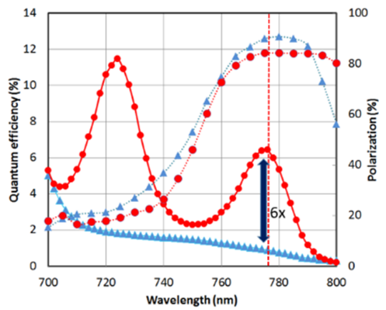
WP-4：偏極電子源
電子源はすでに目標仕様を達成している。残されているのは、TDR以降の新技術の取り込みである。
偏極電子源の基本設計には、駆動レーザー、DC200kVの高電圧光陰極電子銃、80%以上の偏極を実現するGaAs/GaAsP光電面、電子入射器の設計要件が含まれている。
（最終確認事項）
プロトタイプの駆動レーザーを完成させ、それを使って高電圧銃からの歪んだ超格子GaAs/GaAsP光電面の高バンチチャージ、高ピーク電流条件を確認する。
TDR以降、レーザー、高圧ガン、光電面の技術的な改良が行われており、信頼性、性能、コストを改善する設計とする。
Parameter |  | TDR
Number Electrons per microbunch | N_{e} | 3 x 10¹⁰
Number of microbunches | n_{b} | 1312
Width of microbunch | t_{b} | 1 ns
Time between microbunches | Δt_{b} | 556 ns
Microbunch rep rate | f_{b} | 1.8 MHz
Width of macropulse | T_{B} | 729 μs
Macropulse repetition rate | F_{B} | 5 (10) Hz
Charge per micropulse | C_{b} | 4.8 nC
Charge per macropulse | C_{B} | 6300 nC
Average current from gun (C_{B} x F_{B}) | I_{ave} | 31.5 (63) uA
Average current macropulse (C_{B} / T_{B}) | I_{B} | 19.8 mA
Duty Factor in macropulse (1 ns / 556 ns) | DF | 0.18 %
Peak current of micropulse (I_{B} / DF) | I_{peak} | 11 A

Slide 22
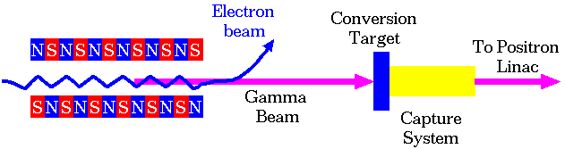
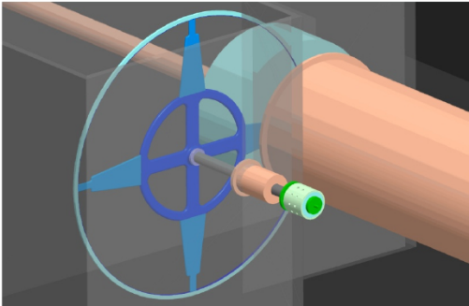
Undulator-type Positron Source
The technical design of the undulator positron source has been completed at TDR. What remains is the detailed technical design of the components and the creation of prototypes.
To generate a circularly polarized photon, a helical magnetic field is created (undulator).
230m undulator needed for sufficient number of photons
Polarized photons hit the target and create polarized positrons
The target is rotated and cooled handle the heat load of photons
Produced positrons are effectively captured by the magnetic focusing system
WP-5 Undulator：Past prototype realized sufficiently strong magnetic field. Conduct simulation studies and design optimization of masks, magnetic field errors and alignment effects to limit heat intrusion into superconducting magnets.
WP-6 Rotating target: detailed technical design of the radiative cooling target. Trial manufacture and testing of magnetic bearings for rotating targets
WP-7 Magnetic focusing: In order to achieve the target positron yield, an improved design using a pulsed solenoid and alternative designs such as QWT (quarter wave transformer) are under consideration. The design is being finalized, and a prototype is being fabricated and tested.

Slide 23
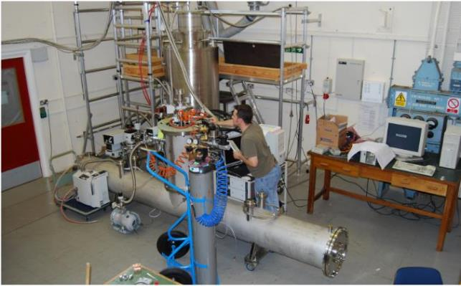
WP-5 Undulator
Field length of each undulator is 1.75m, 2 undulators in one cryostat
A pair of undulators realized sufficient field strength in GDE time
Issues for WP-5: Alignment, masking, operation at 125GeV
Undulator design: make use of the experience of long undulators at XFEL etc
(Final confirmation)
Simulation of the influence of misalignment and field errors
Mask: protect undulator against heating by the photons
Detailed simulation by masking
Possible further optimization of undulator parameters for low electron energies

Slide 24
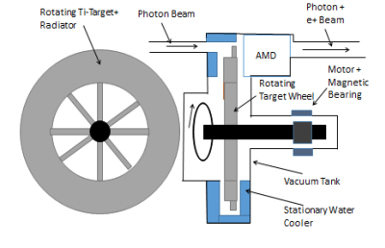
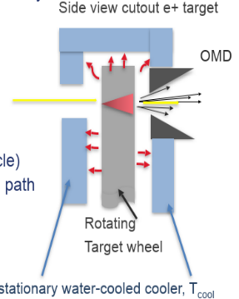

WP-6: Rotating Target for Undulator Source
The technical design of the undulator positron source has been completed at TDR. What remains is the detailed technical design of the components and the creation of prototypes.
Titanium alloy parget (Ti-6Al-4V), 7mm thick
Heating by the photon beam ~2kW
Target diameter 1m, rotating at 2,000rpm, cooled by radiation cooling
Detailed engineering design and production studies yet to be done
Already some examples using radiation cooling in various accelerators
  CNGS (CERN) graphite targets immersed in stationary He gas were cooled primarily by radiation, supplemented by natural convection. Radiation-cooled targets have also been studied and used in experiments at FRIB-US, J-PARC, PSI, and RAL-UK.
（課題事項）
WP-6: From final stage of design to production of a prototype

Slide 25
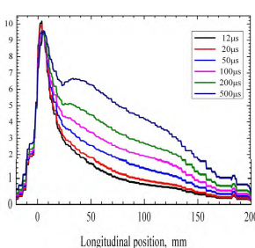
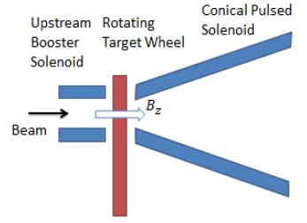
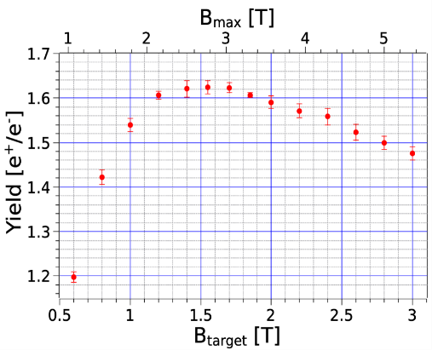
WP-7：磁場収束
The technical design of the undulator positron source has been completed at TDR. What remains is the detailed technical design of the components and the creation of prototypes.
TDRでは、Optical matching device(OMD)として3.2Tのピーク磁場を持つ収束装置を採用しており、約1msの磁場フラットトップを期待したが、長パルスでは，表皮効果のために磁場の時間変化が避けられないことが判明。
パルスソレノイドを用いた改良型の設計を検討中。
QWT（Quarter Wave Transformer）、プラズマレンズ、新しい集光装置などを用いた設計も検討されている。
（課題事項）
WP-7では、設計を最終決定し、プロトタイプを製作して、プロトタイプ・ターゲット・システムで試験を行う。

Slide 26
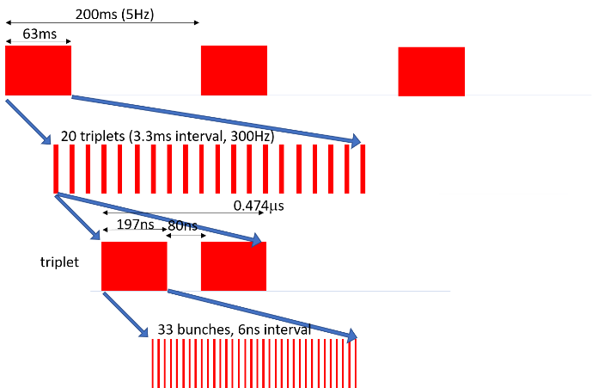
電子駆動陽電子源
電子駆動型陽電子源は2019年に技術設計が終了した。残されているのは、プロトタイプによる試験である。
電子駆動型陽電子源では、駆動用線形加速器で電子ビームを発生させ、回転ターゲットで（偏極していない）陽電子を発生させる。
陽電子は磁気的に収束され、キャプチャーリニアック、電子を除去するシケイン、ブースターリニアック、陽電子ダンピングリングへと進む。
WP-8 回転ターゲット：ターゲット応力・疲労評価、真空シール寿命確認、モジュール試作
WP-9 磁気収束システム：磁気収束導体の電気・熱・機械的特性シミュレーション、電源・伝送ライン設計、システム試作・試験
WP-10 （キャプチャーリニアックの）捕獲空洞：部品設計と試作、ビーム負荷補償と調整方法の検討
Parameter | Value | Unit
Drive beam energy | 3.0 | GeV
Bunch charge | 4.0 | nC
N of bunches in a pulse | 66 | bunches
Bunch spacing in a pulse | 6.15 | ns
Average current in a pulse | 0.78 | A
Pulse repetition | 300(100) | Hz

Slide 27
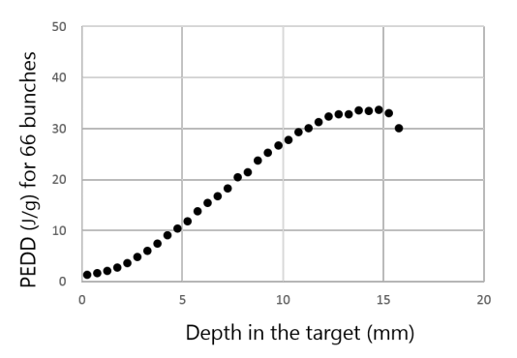
WP-8 電子駆動用回転ターゲット
電子駆動型陽電子源は2019年に技術設計が終了した。残されているのは、プロトタイプによる試験である。
電子駆動型では、陽電子生成ターゲット材料はW-Re合金で、冷却用水路を持つ銅製ディスクに取付。
直径0.5m、厚さ16mmのターゲットを、225rpmで回転。
磁性流体により真空は保持される。
回転軸とユニット本体の隙間に充填してシールを形成し、永久磁石で固定。
モーター、ベアリング、吸水口の回転ジョイントなどは空気に曝されている。
（最終確認事項）
ターゲットの応力や疲労をより正確に計算し、設計を改善する。
プロトタイプを用いて信頼性の高い長期運転を確認する。

Slide 28
WP-9：電子駆動用磁場収束
電子駆動型陽電子源は2019年に技術設計が終了した。残されているのは、プロトタイプによる試験である。
電子駆動型における磁気収束のために，フラックスコンセントレーター（銅製の2導体のを使った磁場収束装置 ）を利用
一次導体は螺旋状のコイルで、軸に沿って磁界を発生
もう1つの部品は2次導体で、一次側の磁界によって誘起された二次導体の渦電流が流れ、円錐状の空間に磁界を発生させる。
軸に沿って5Tの磁界が誘起される。ビームホールの直径は16mmである。
（課題事項）
磁気収束装置の工学設計を完成させる。（導体の熱・電気設計、伝送路設計、電源設計）
（最終確認事項）
システムの試作を行い、確実に動作することを確認する。
Parameter | Value | Unit
Peak field | 5.0 | Tesla
FC size | 120 x 180 | mm²
Conical cavity length | 100 | mm
Front aperture diameter | 16 | mm
Rear aperture diameter | 64 | mm
Number of windings | 16 | turns
Ohmic loss | 14 | kW

Slide 29
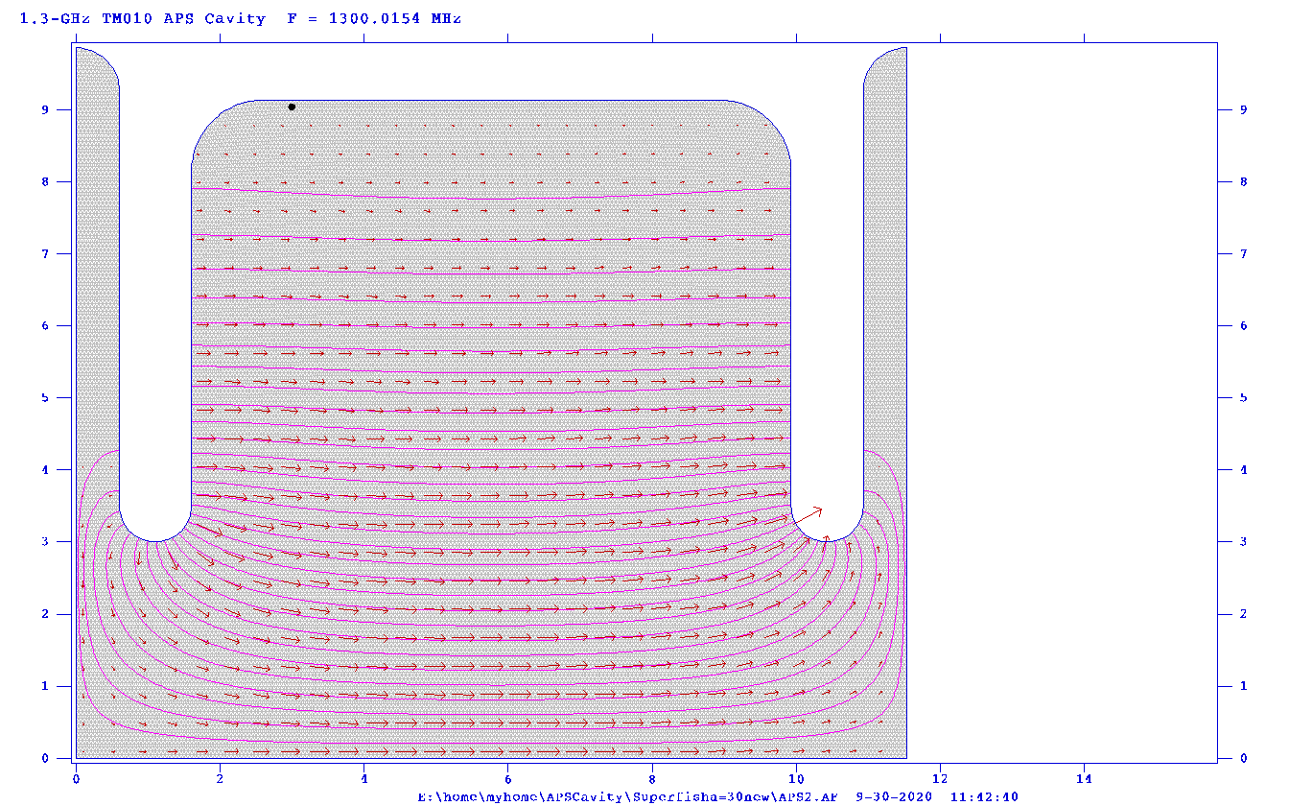
WP-10：捕獲空洞
電子駆動型陽電子源は2019年に技術設計が終了した。残されているのは、プロトタイプによる試験である。
キャプチャーリニアックは、0.5Tのソレノイドで囲まれたAPS空洞（捕獲空洞）で構成される。
開口部が広く、πモード定在波空洞よりもRF安定性に優れている。
クライストロンは、50MWの電源を2μsのパルス幅で供給する。
（最終確認事項）
この条件より性能の高いSバンドのクライストロンは存在するが、設計を発展させたLバンドクライストロンの製作する。
キャプチャーリニアック用APS空洞のRF設計と試作、電源ユニットの試作、ソレノイドの試作、空洞と電源の試運転を行う。
キャプチャーリニアックの動作モードは、減速キャプチャー方式という特殊なものであるため、ビーム負荷の補正や調整方法を検討する必要がある。

Slide 30
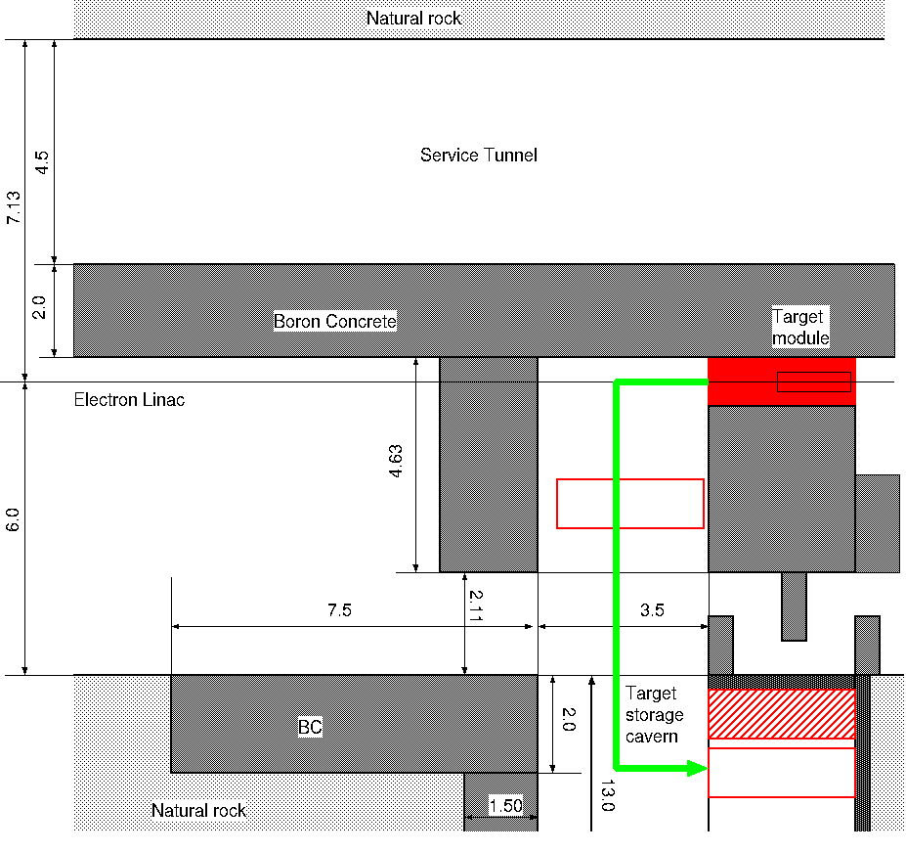
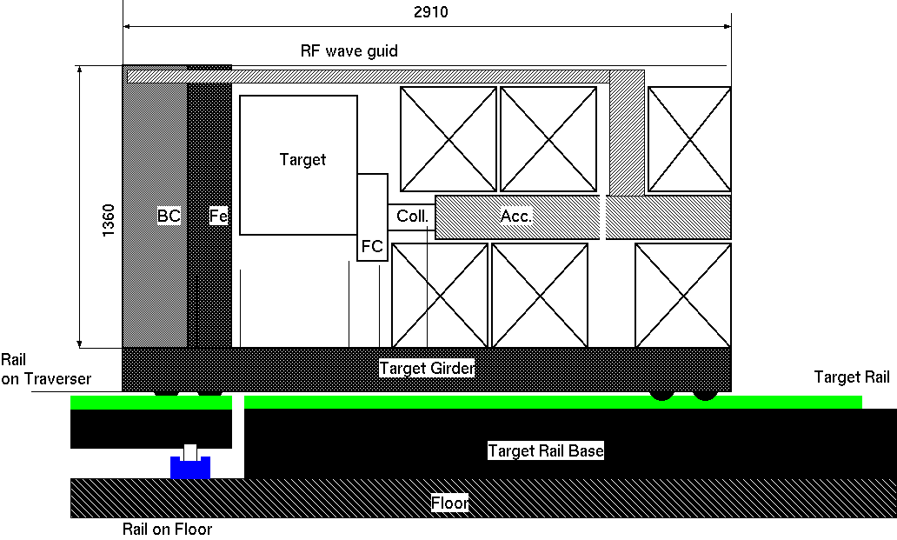
WP-11 Target Maintenance System
ターゲットの保守はアンジュレータ型・電子駆動型陽電子源の共通項目で概念設計は終了している。残されているのは、詳細技術設計の完成である。
陽電子源ターゲットからの放射線は、厚さ2mのホウ素化コンクリートのシールドによって閉じ込められる。
100時間の冷却後も、ターゲット表面には10Sv/hの線量。
ターゲットは放射線損傷のため、2年ごとに交換しなければならず、交換の際には、作業者の放射線被ばくを十分にコントロールする必要がある。
ターゲットモジュールは、ターゲット、収束器、第一加速空洞などで構成。
RF、電力、水、制御などの接合部の多くは、モジュールのフロントパネル上に組み立てられており、これらの接合部を安全に切り離す。
（最終確認事項）
ターゲット交換システムの技術設計を完成させ、モックアップを製作する。

Slide 31
ILCX
ILC Workshop on Potential Experiments (ILCX2021) (26-29 October 2021): Sessions · ILC Agenda (Indico) (linearcollider.org)

Slide 32
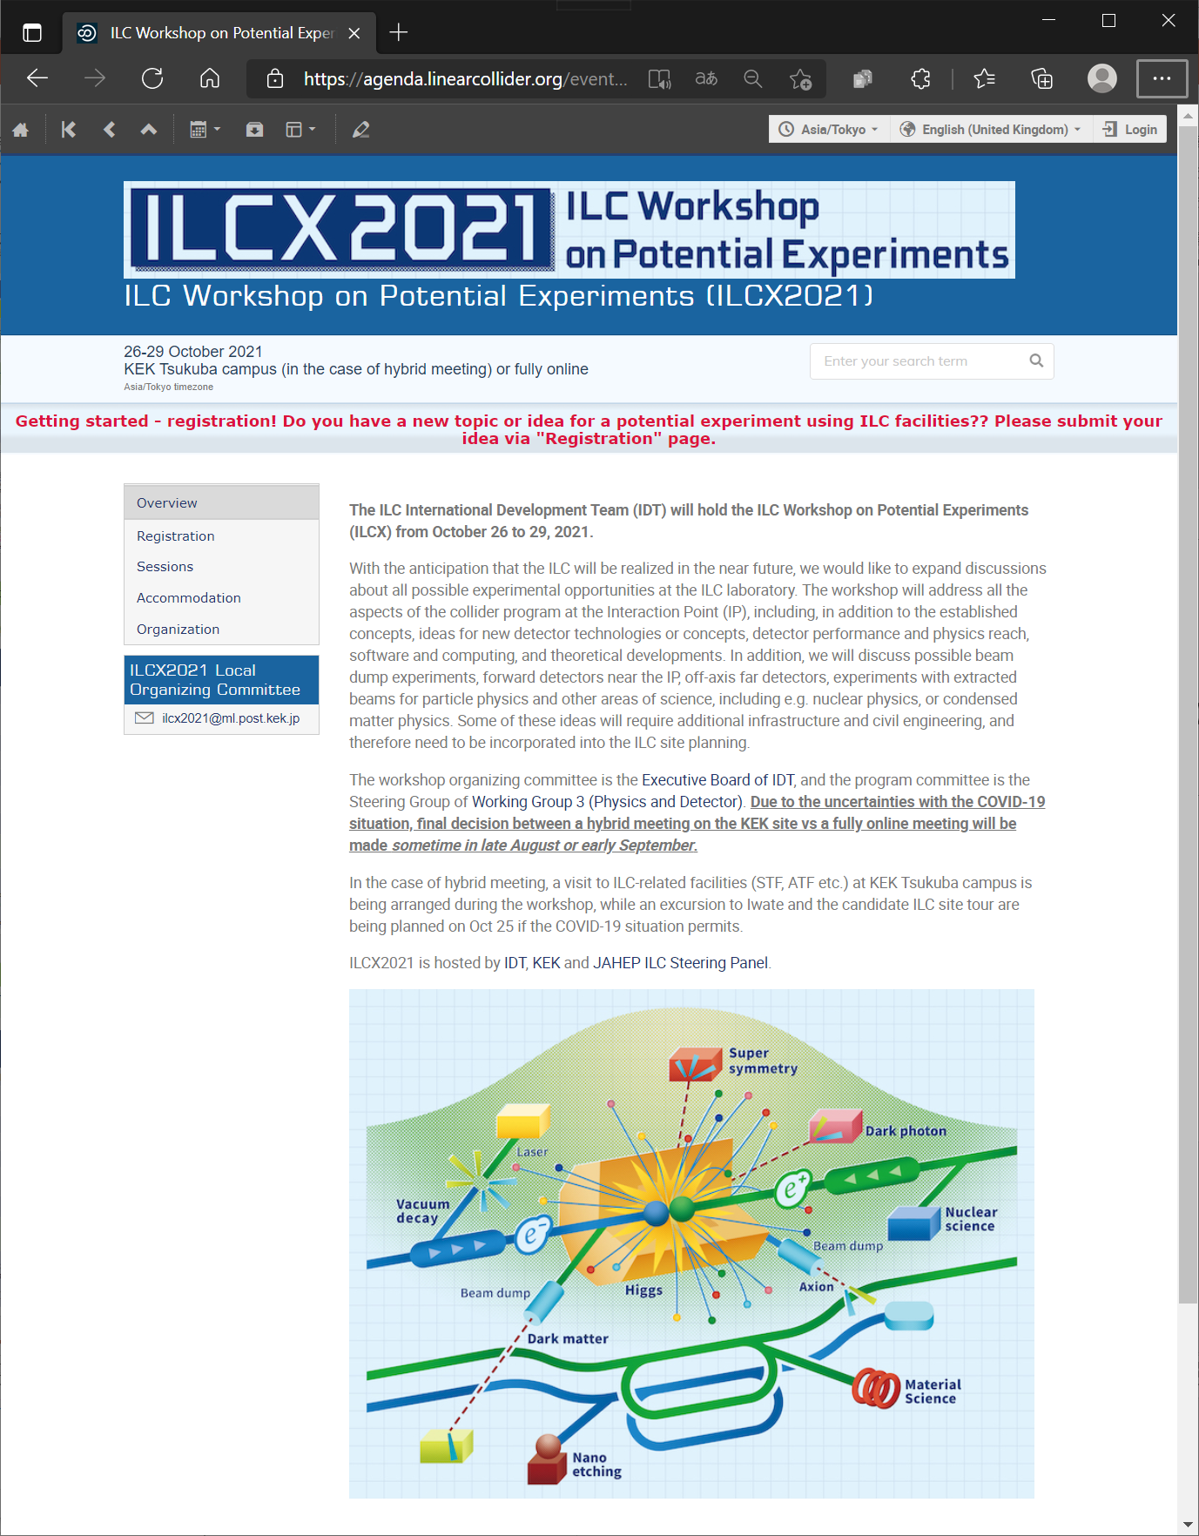
Hybrid or full-remote
https://agenda.linearcollider.org/event/9211/
  Please register!
26-29 October 2021
Parallel sessions are available
  Topical workshop? (such as CM design,crab cavity, etc.)
  Some dedicated discussion?
  Please start discussion at each group!

Slide 33
