Slide 1
Planning the ILC Pre-Lab Work: IDT-WG3 WP16 Status (FF/MDI)
Brett Parker
IDT-WG3 MDI-Physics Subgroup Meeting
September 17, 2021 via Zoom

Slide 2
IDT-WG3 WP16 Comprises Two Efforts
Complete QD0 Prototype Vibration Testing (this is work left unfinished in the TDR era).
Improve the ILC Final Focus Magnet Design (e.g. update and modernize by taking into account new ideas and magnet technology).

Slide 3
IDT-WG3 WP16 Task #1
Complete the QD0 Prototype Vibration Testing.

Slide 4
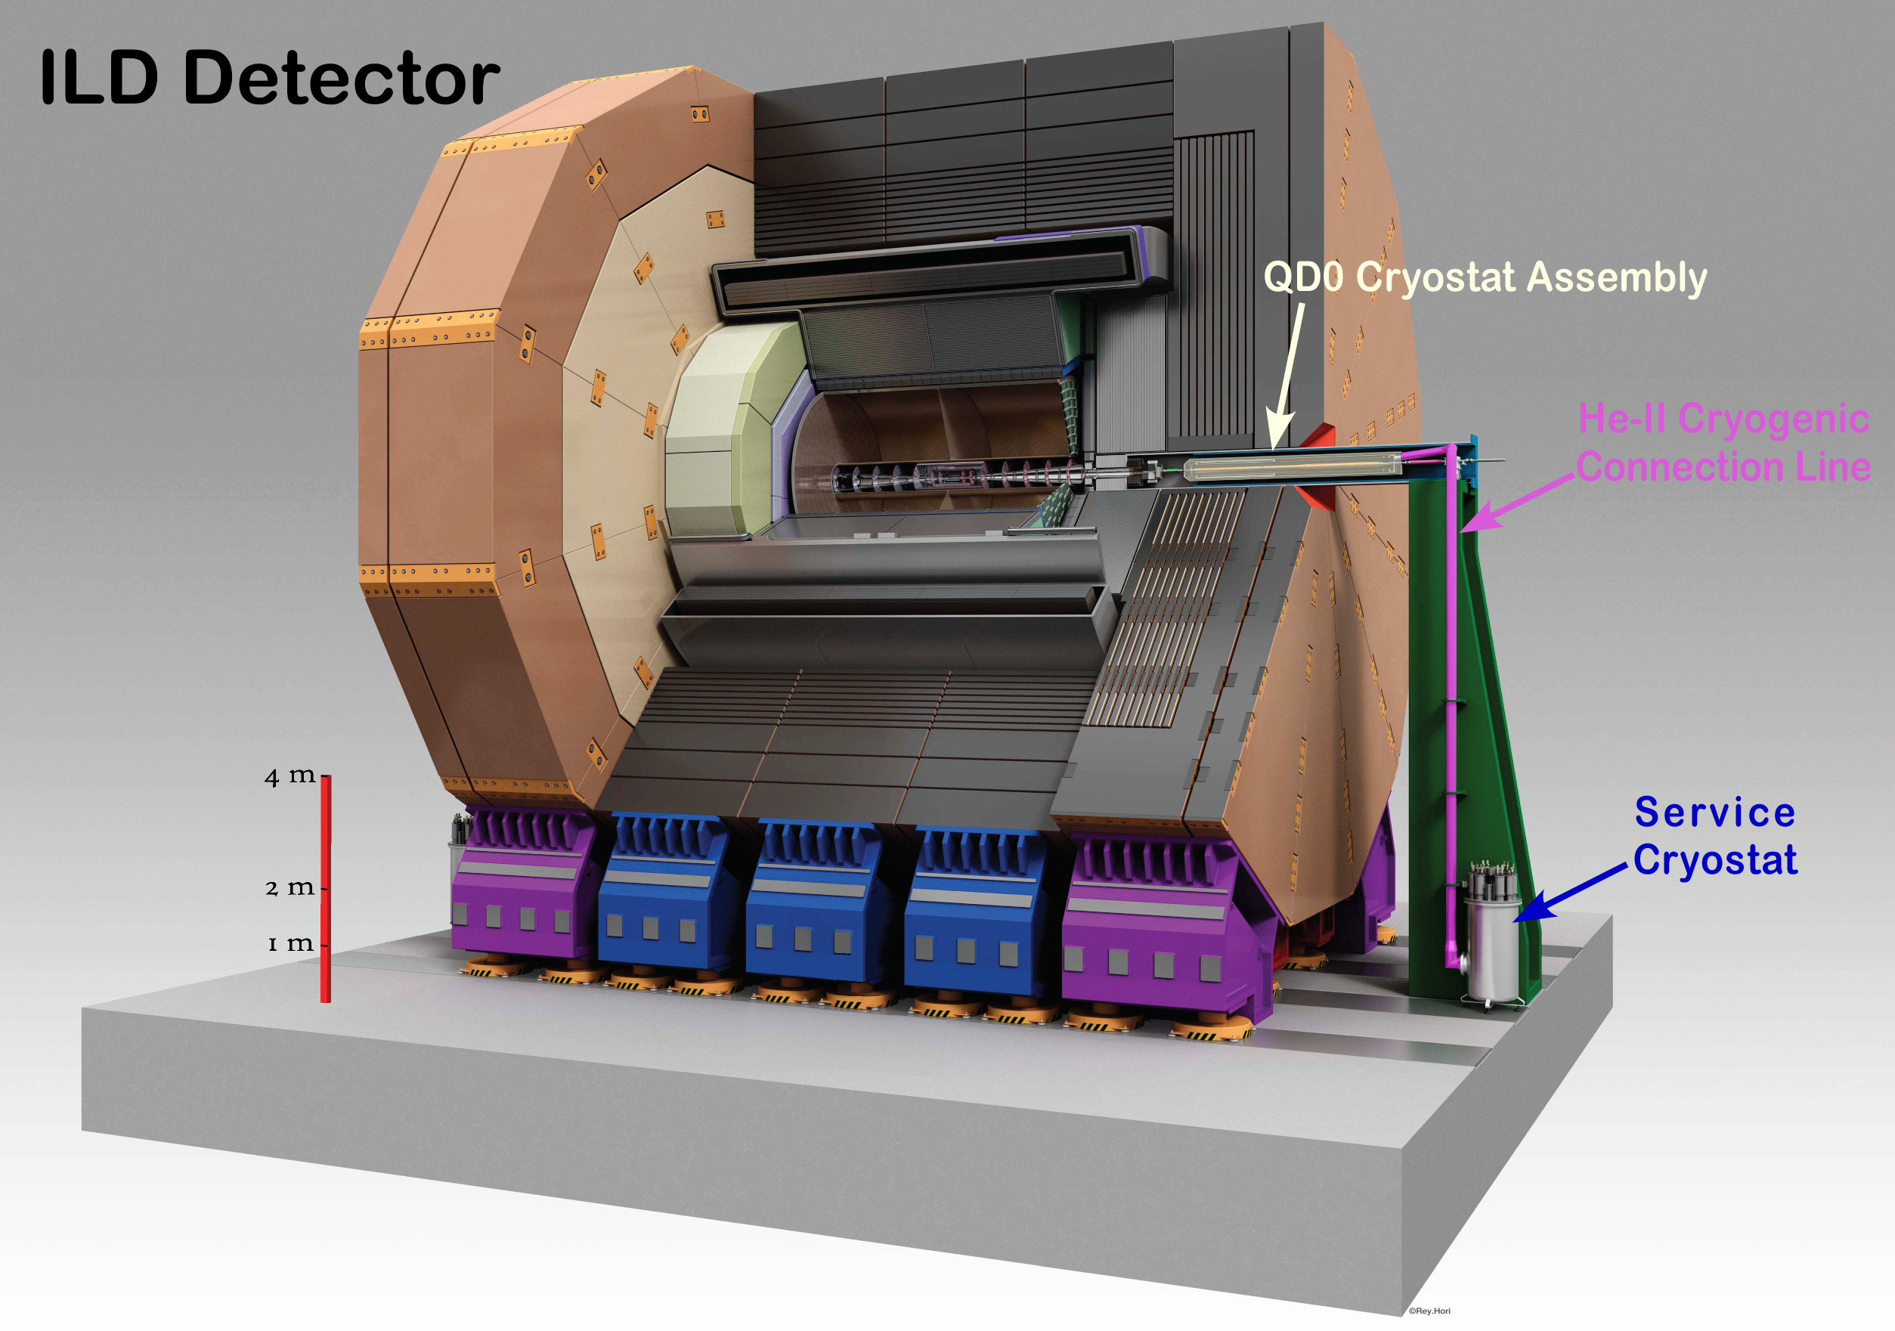
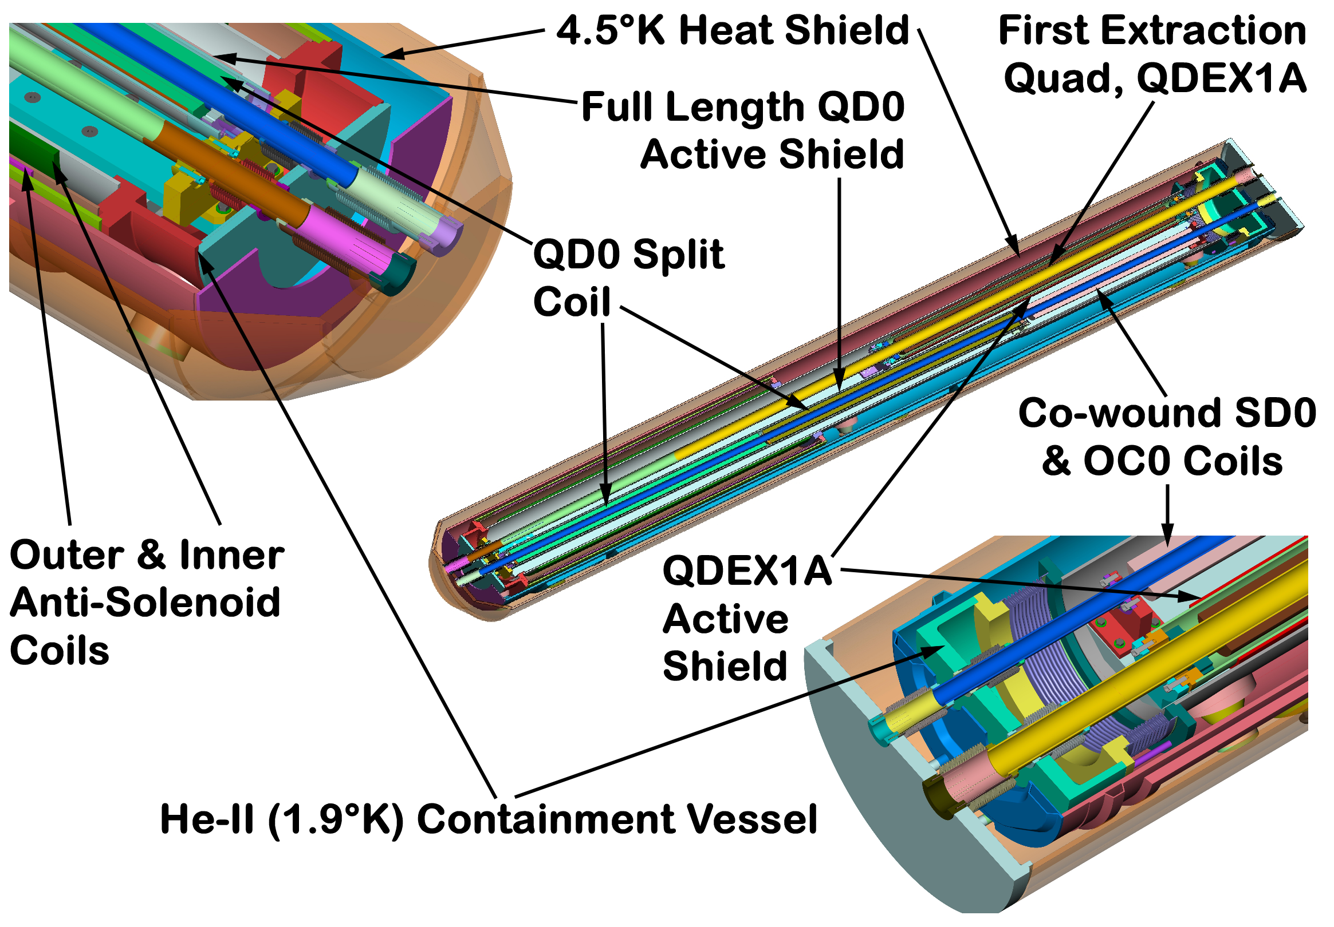
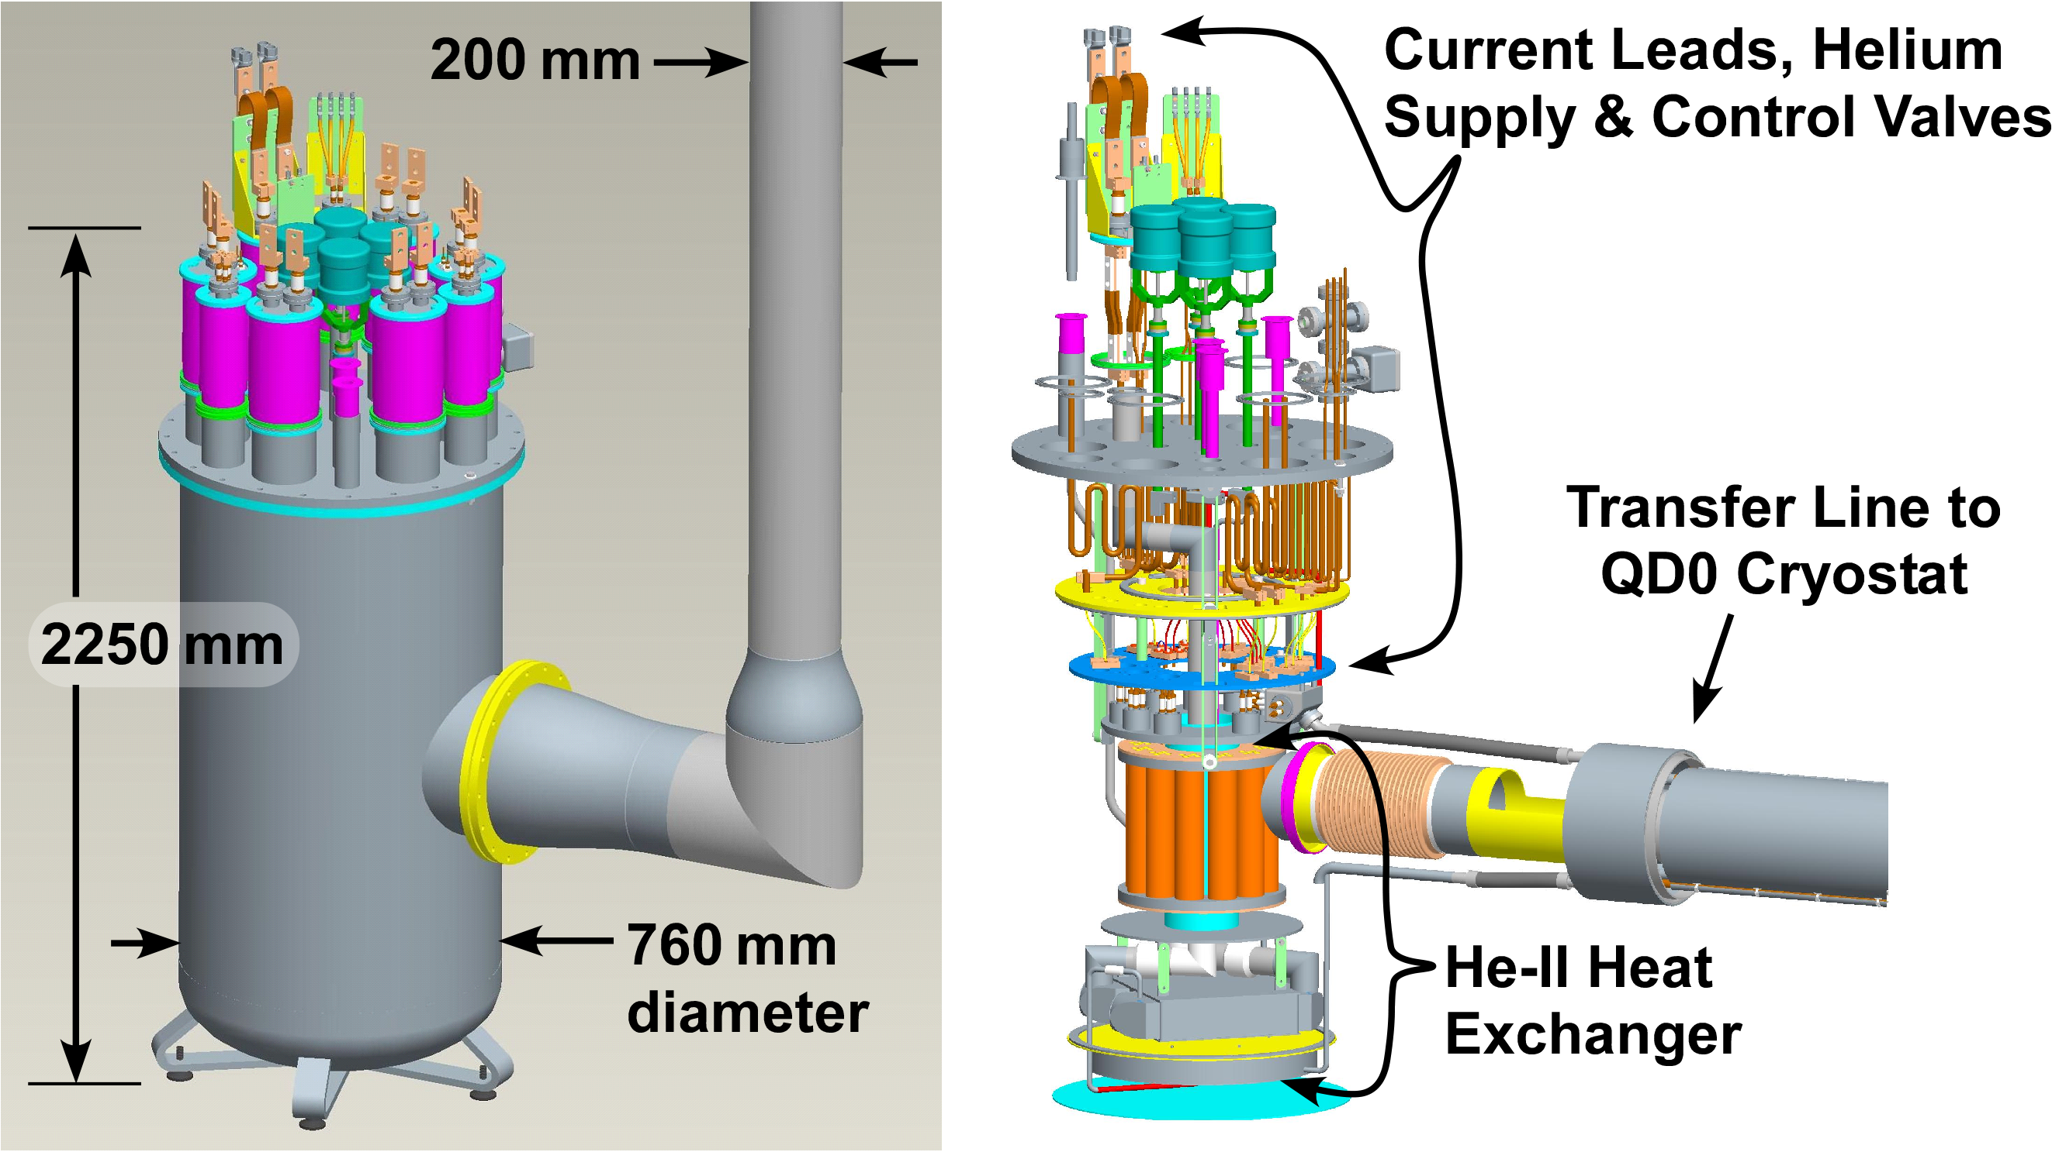
ILC Final Focus Magnets: TDR R&D Review
Concept uses 1.9 K pressurized superfluid helium cooling in order not to need “flowing cryogens” (avoids a sourse of vibration).
ILC Requirement is 50 nm QD0 vibrational stability!

Slide 5
Complete QD0 Prototype Vibration Testing
  The TDR Baseline uses an actively shielded QD0 produced via BNL Direct Wind technology.
  We must finally clarify lingering questions re. the Final Focus vibration stability (QD0 Cryostat with its Service Cryostat were nearly finished… but never tested).
  So, we now look to restart the QD0 vibration measurement R&D for the EDR (this work is closely related to ongoing US/Japan R&D to measure the SuperKEKB IR QCS motion in situ).

Slide 6
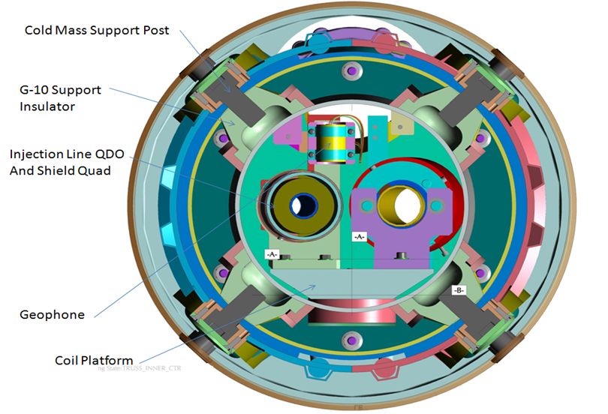
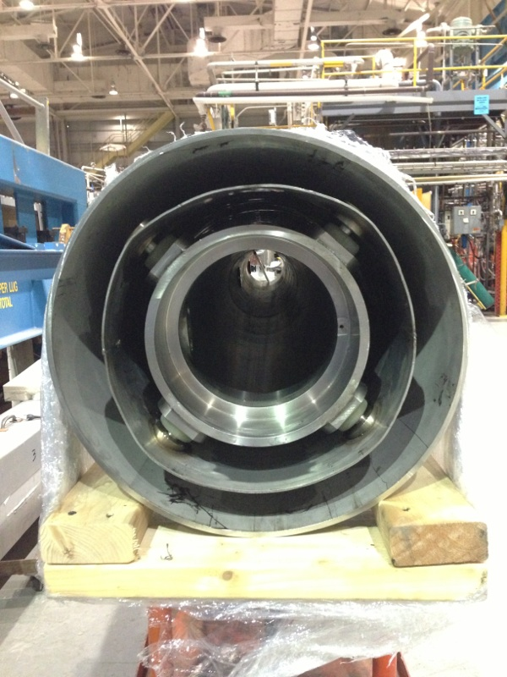
ILC QD0 R&D Magnet Cryostat Review
2014 Status
ILC QD0
The ILC QD0 R&D magnet prototype cryostat is 90% complete and almost ready for insertion of the magnet coils on the “sled assembly.”
Finishing the Magnet Cryostat was given higher priority than making the transfer line parts.
ILC QD0 R&D Magnet Cryostat Assembly

Slide 7
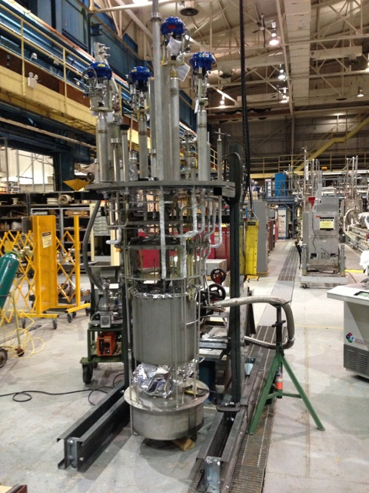
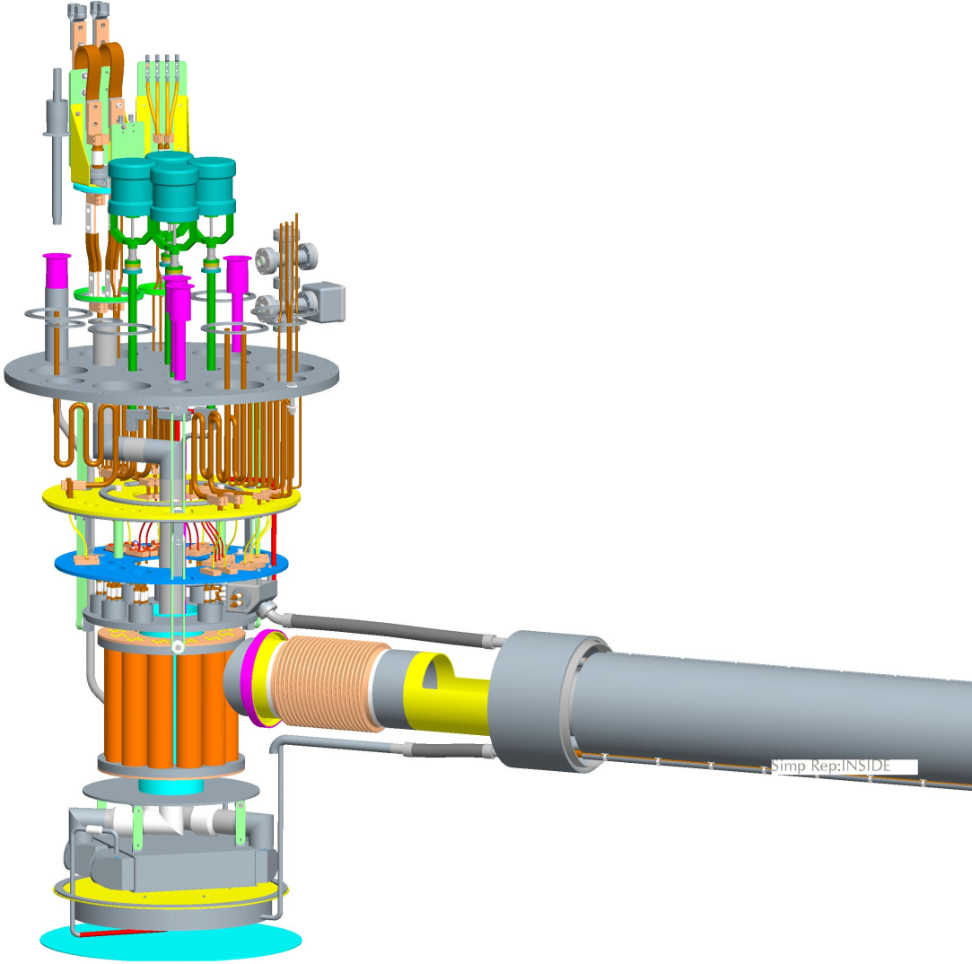
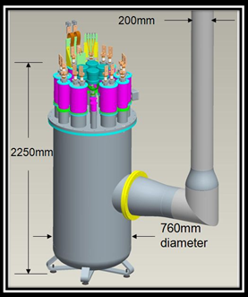
ILC QD0 R&D Service Cryostat Review
Final assembly of the R&D Service Cryostat
was proceeding.
Plan was to test it using a dummy heat load attached to where the transfer line exists.
We wanted to mount
a geophone alongside
the dummy load to characterize
sources of vibration.
Transfer line parts drawings do
exist but all work has remained
stopped due to lack of funding.
2014 Status
ILC Service Cryostat undergoing final leak testing before assembly with outer vessel.
ATRO

Slide 8
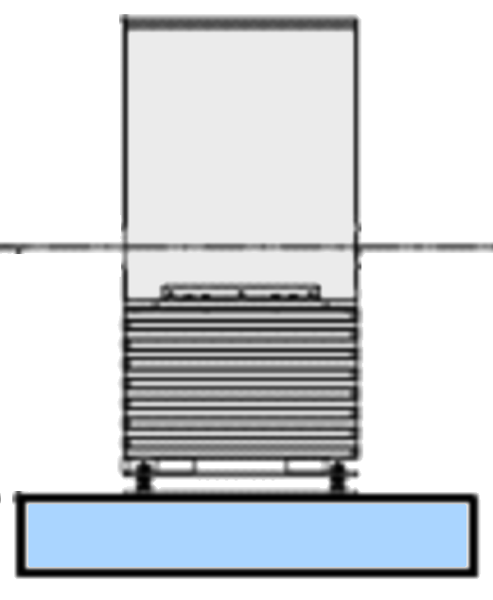
Task #1: Complete QD0 Prototype Vibration Testing.
RHIC IR magnets have observable vibration when two-phase liquid helium flows (also observed on test stand via geophones and laser system). For the ILC QD0 we deliberately use 1.9 K superfluid He-II cooling to avoid having cryogens “flow” (cooling via long transfer line is effectively conduction cooling). For the ILC QD0 it is important to test this hypothesis as early as possible.
Laser ports with view to cold mass
BNL has already manufactured most of the parts needed for the QD0 R&D prototype vibration test (need transfer line & cryostat support).
Concept: Measure magnetic center movement via multiturn pickup coil and cross check against internal/external geophones and laser doppler vibrometer looking at cold mass inside the main cryostat.
We take advantage of US/Japan program SuperKEKB developments.
Previous work shows that it is much easier to stabilize a pickup coil, as we look to do, with support from both ends, (Note: SuperKEKB in situ measurements will use single-sided support geometry).
Cold and Warm Geophones
X/Y Pickup Coil
QD0 Cryostat
Double Sided Active / Passive Isolation Support
QD0 R&D Prototype Vibration Test Setup

Slide 9
IDT-WG3 WP16 Task #2
Look for opportunities to improve the ILC-250 FF design by taking into account new FF concepts and advances in superconducting magnet technology since the ILC/GDE TDR (now over 7 years ago).

Slide 10
Task #2: Improve the ILC Final Focus Magnet Design.
Task #2 is maybe better characterized as “Review the ILC Final Focus Magnet Design.”
The task is motivated by our desire to take advantage of new magnet technology and IR design concepts that were developed after the ILC TDR design was published.
Maximizing ILC 250 GeV performance is also an important consideration (e.g. not just rescaling down from 500 GeV).
It is possible that we conclude that the TDR baseline is still the best choice; however, we can use the pre-Lab time to flesh out the baseline design while evaluating alternatives.

Slide 11
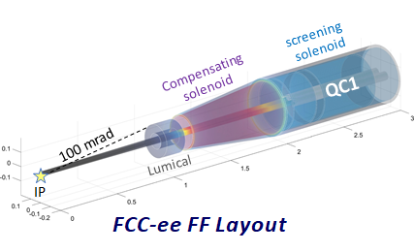
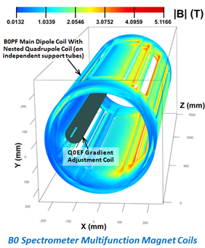
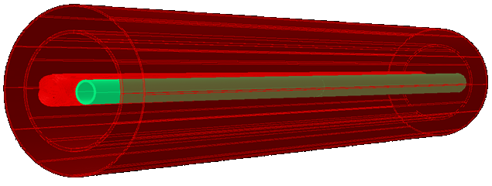
Task #2: Improve the ILC Final Focus Magnet Design.
The ILC TDR IR baseline was optimized for 500 GeV CM energy; however, if we initially run several years at 250 GeV, we can look to reoptimize the IR magnet coil parameters (cost of new IR magnets for a 500 GeV IR upgrade is expected to be small compared to the cost of missing luminosity during initial ILC running).
In the past 7 years BNL Direct Wind technology and IR design experience has advanced tremendously (examples: Double Helical coil winding for EIC and FCC-ee IRs and the Sweet Spot coil concept for EIC).
We should also formulate detector specific anti-solenoid configurations and confirm that these designs satisfy ILC FF optics and MDI requirements.
We see some possibility to reduce the transverse size of the QD0 cryostat in the detectors (MDI desirable).
We should coordinate with the experiments re. their plans to implement (or not) any anti-DID coils for background reduction (again needs MDI coordination).
QC1 Local Field Tailoring
EIC Sweet Spot Coil Example
Compact Force-Neutral Anti-Solenoid

Slide 12
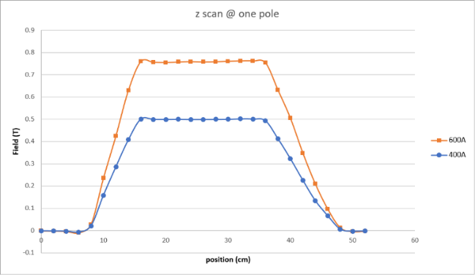
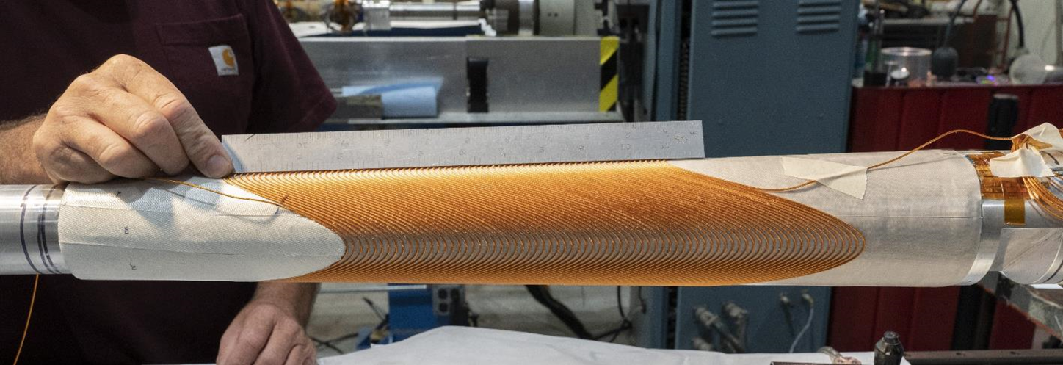
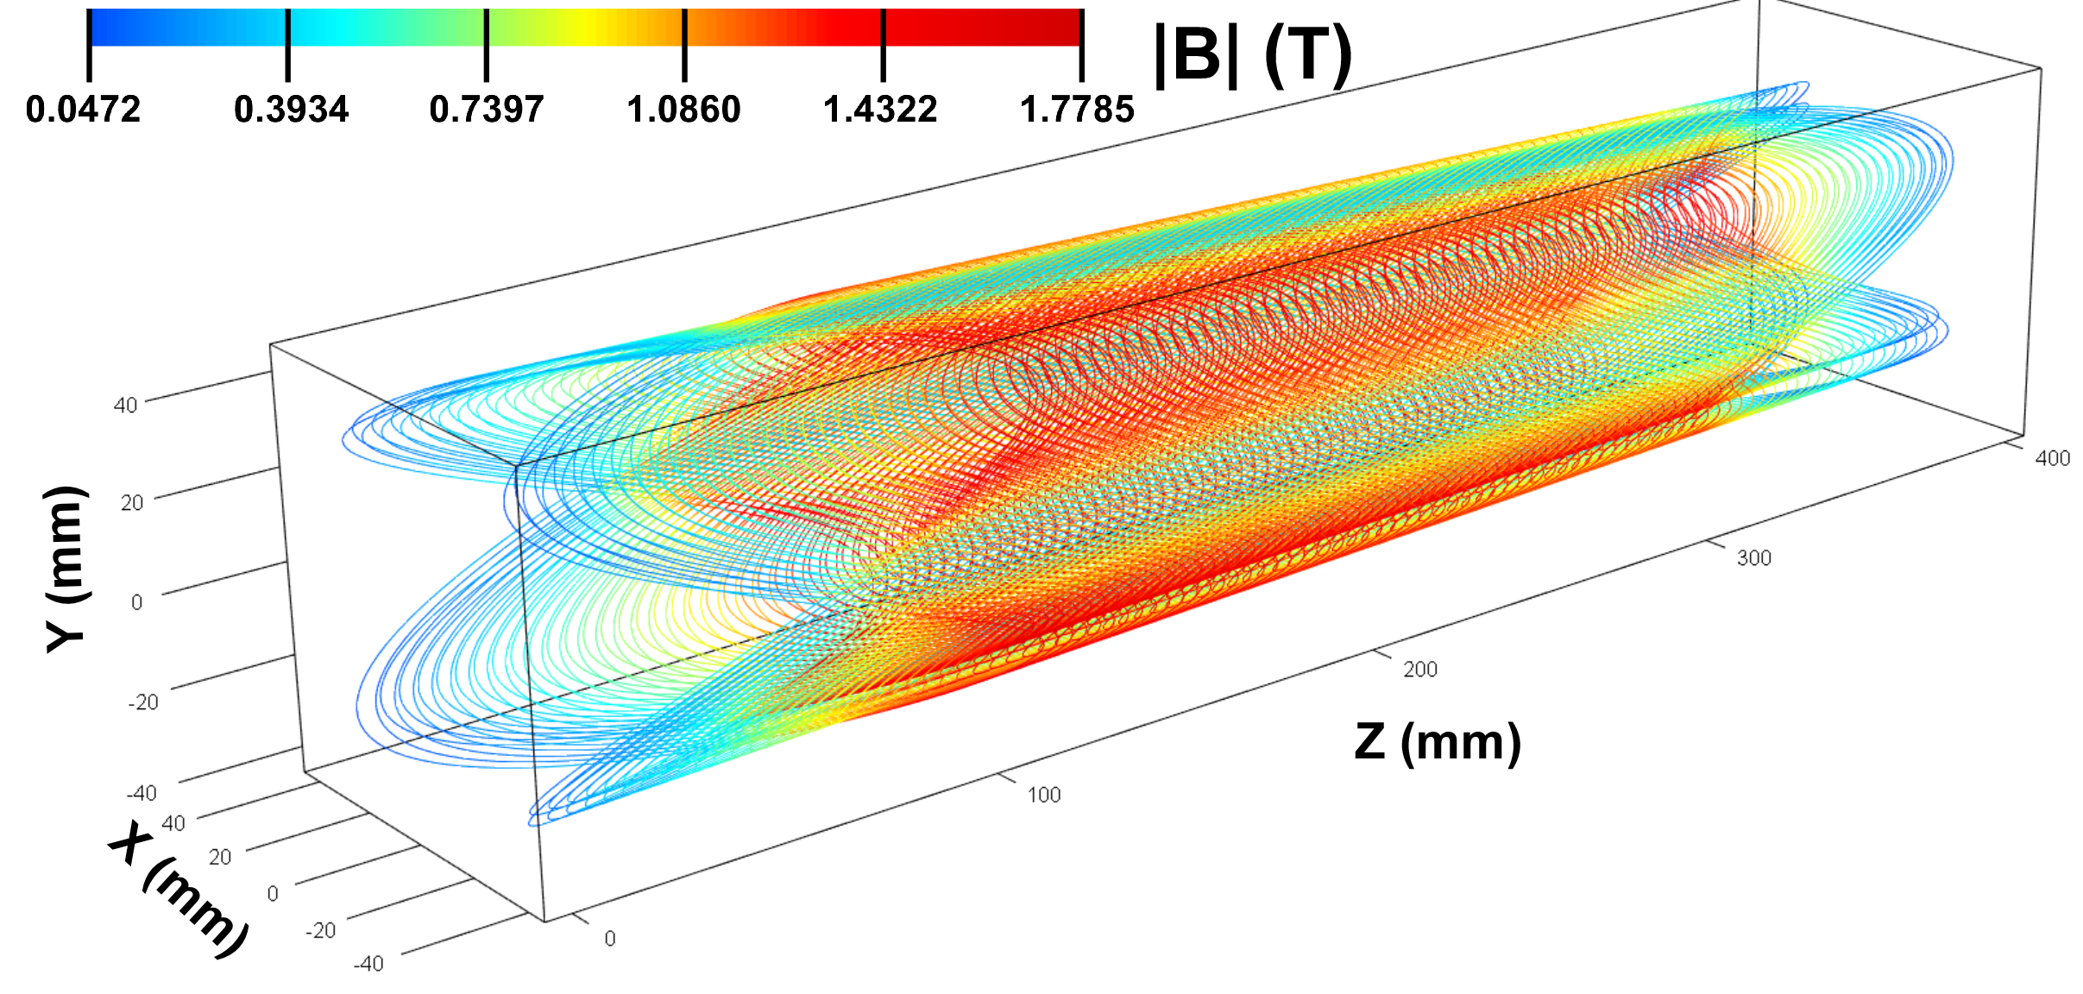
Tapered Constant Gradient Quadrupole R&D for EIC FF.
Tapered coils are used for some of the EIC low-β quads.
To fit inside limited space, we use Double Helical coils produced via the BNL Direct Wind process (see below).
R&D Test Coil: 4 layers, aperture varies from 60 to 80 mm over its 0.4 m length, gradient is 43 T/m (30-40 mm inner radius).
Although aperture varies, the gradient is maintained constant.
Field Measurements
Tapered Quadrupole – no training, reached 960 A short sample
Calculated Coil Field
H. Witte et.al. http://dx.doi.org/10.1109/TASC.2019.2902982.
Double Helical coils are also useful for the FCC-ee IR.

Slide 13
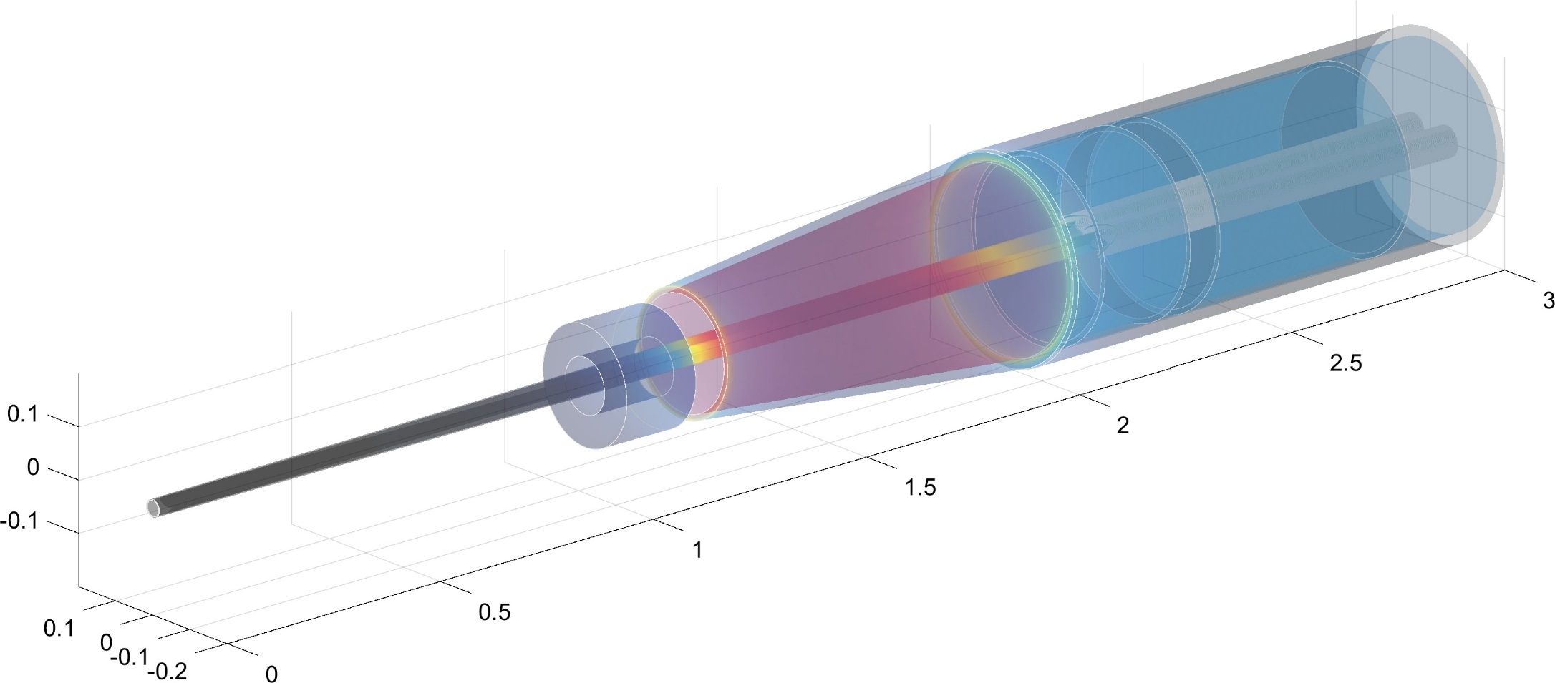
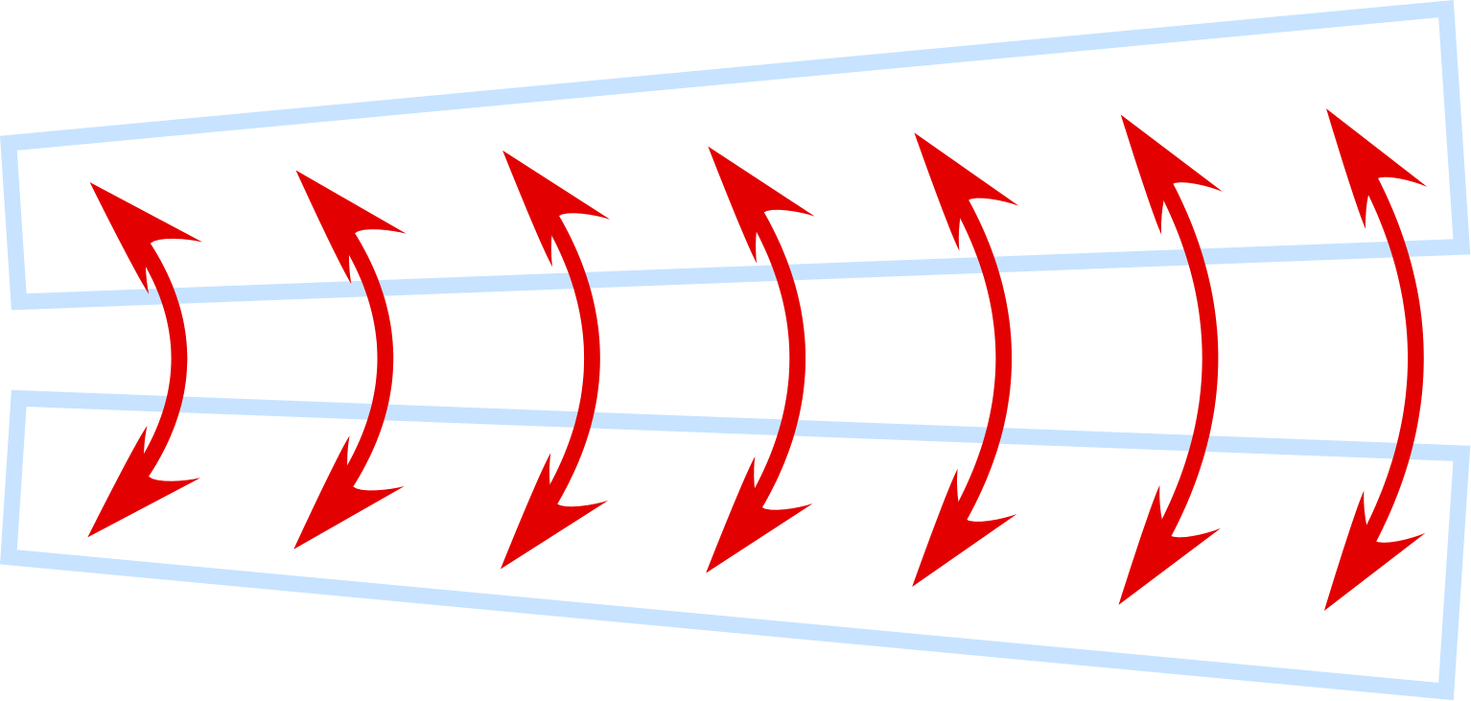
CERN FCC-ee FF Magnets: Double Helical Baseline.
Challenge: Deal with magnetic crosstalk between the QC1 IR quadrupoles*.
FCC-ee IR
screening
solenoid
2D-top view with expanded x-coordinate
Compensating solenoid
QC1
100 mrad
QC1
Compensating solenoid
Lumical
IP
Uses Double Helical (CCT) magnet technology.
Be
shielding
Central detector
Lumical
Answer: Use flexible Double Helical coil design to locally adjust QC1 field much like we are doing for the BNL EIC IR.
HOM absorbers
L*=2.2m
L* = 2.2 m distance from IP to first quadrupole, 2 T detector
*See M. Koratzinos “News on the Q1 magnet prototype,” FCC Week 2021 (link to pdf slides).
We could use BNL Direct Wind technology to make double helical coils that by design eliminate magnetic cross talk.
ILC downstream FF must accept a highly disrupted outgoing beam!

Slide 14
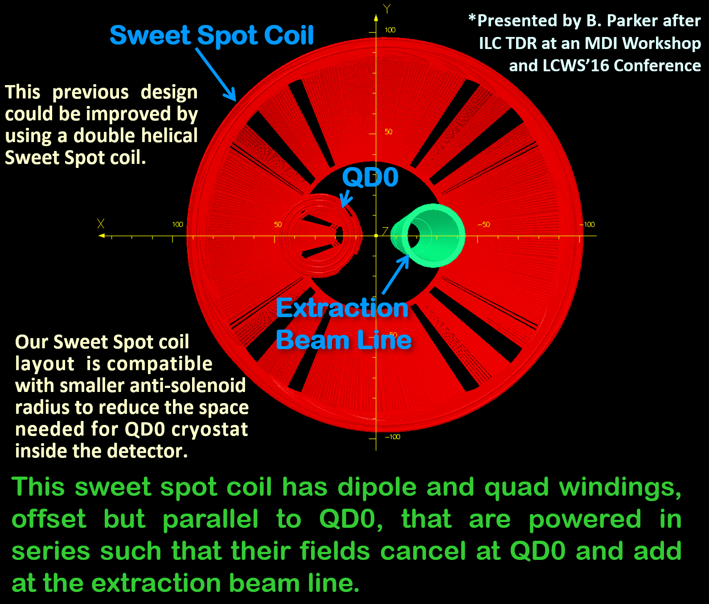
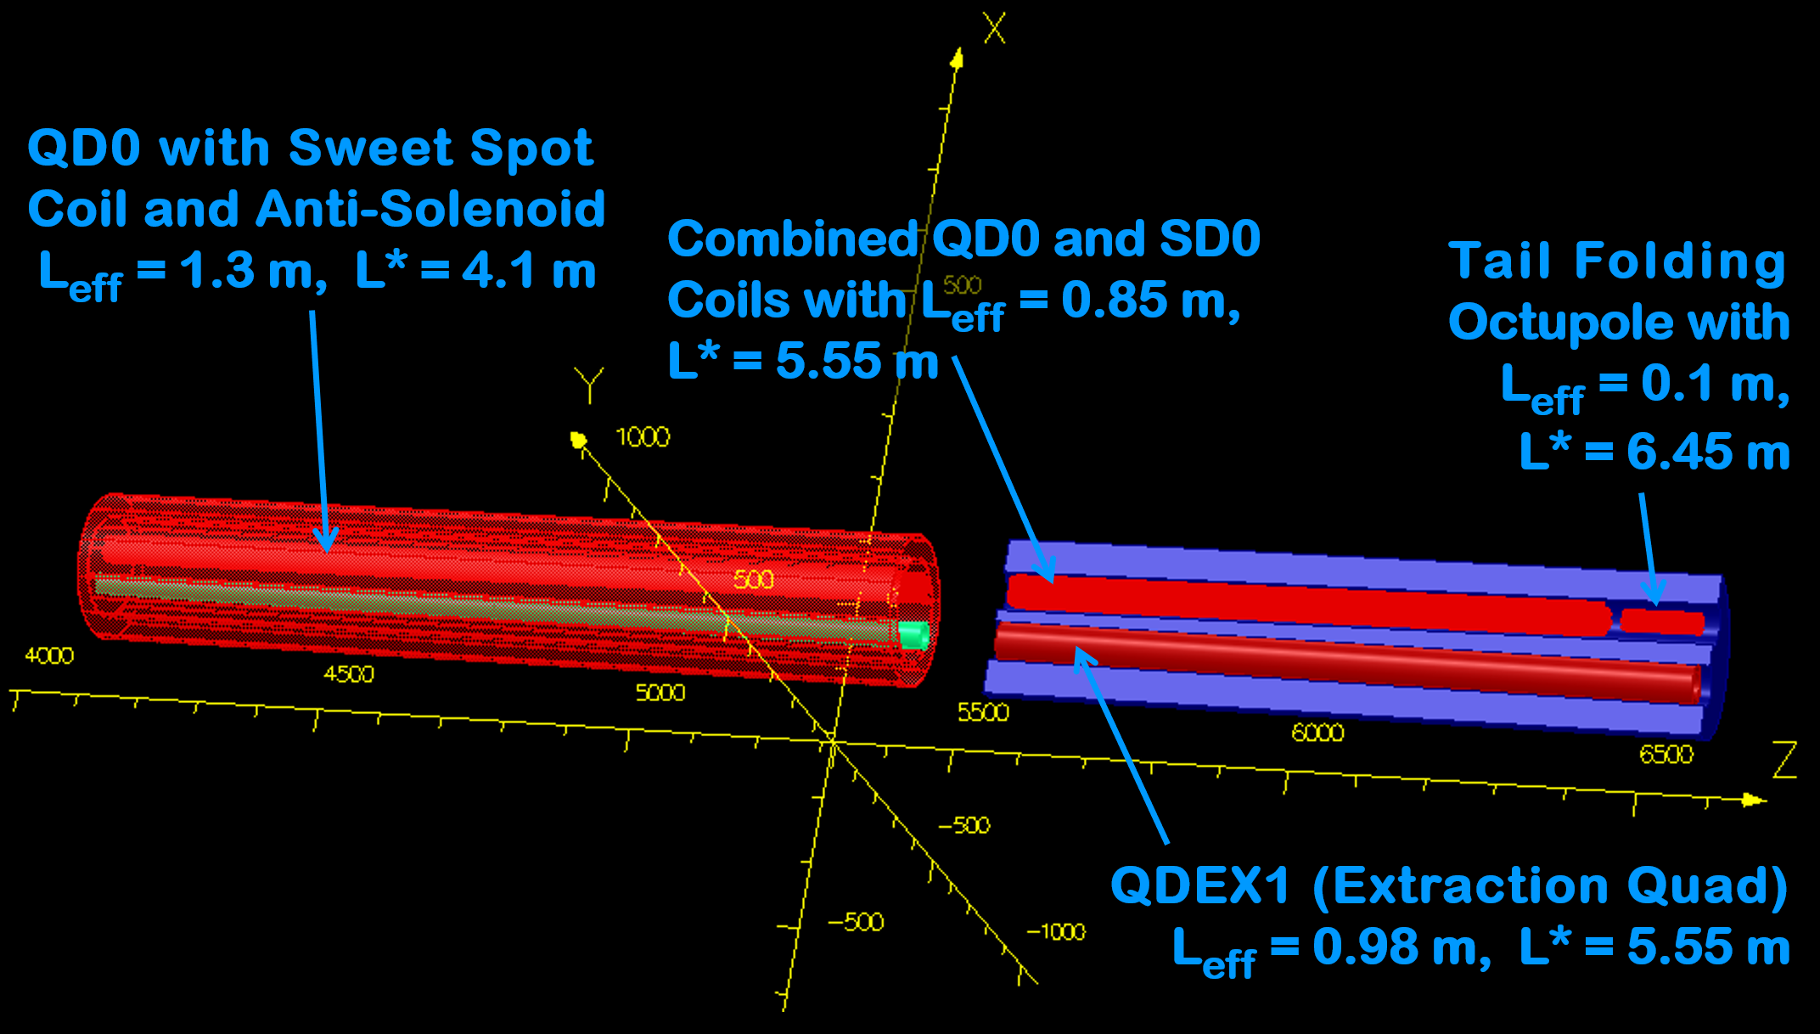
Consider Using a “Sweet Spot” coil design for QD0.
Quadrupole and Dipole Coils (powered in series)
Overlay a dipole coil with field, B_{o}, and a second quadrupole coil that has gradient , G_{o}.
Define the distance, X_{o} = B_{o}/G_{o}
Then B(-X_{o})= 0 and B(X_{o})= 2B_{o}
Thus, if QD0 is centered at the B=0 field point of the combined dipole and quadrupole coils, we can create an arbitrary field at some point outside QD0 without shifting QD0’s field center.
QD0
-X_{o}
X_{o}
By=2B_{o}
By=0
A Sweet Spot coil is planed for the EIC IR B0 Forward Spectrometer magnet (for details see backup slide).

Slide 15
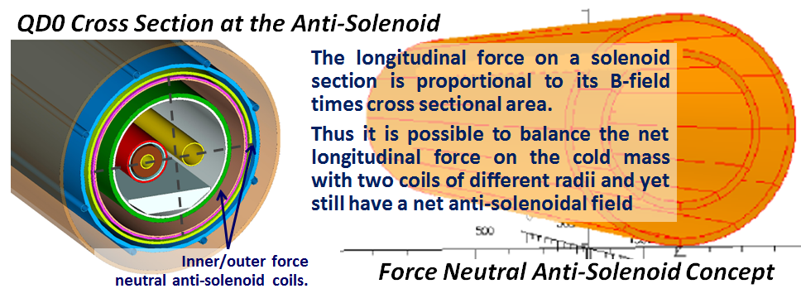
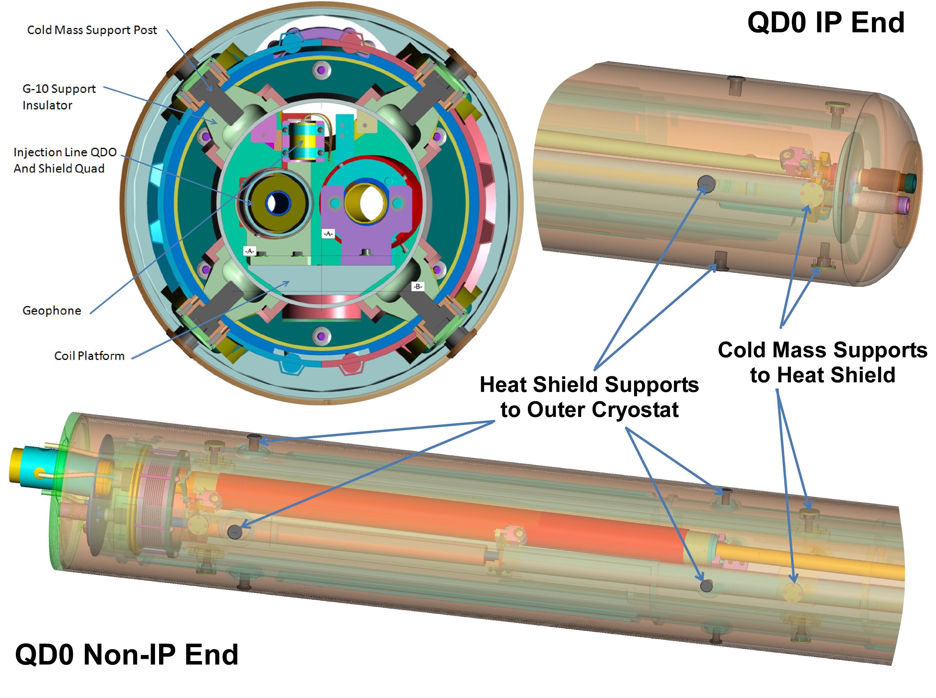
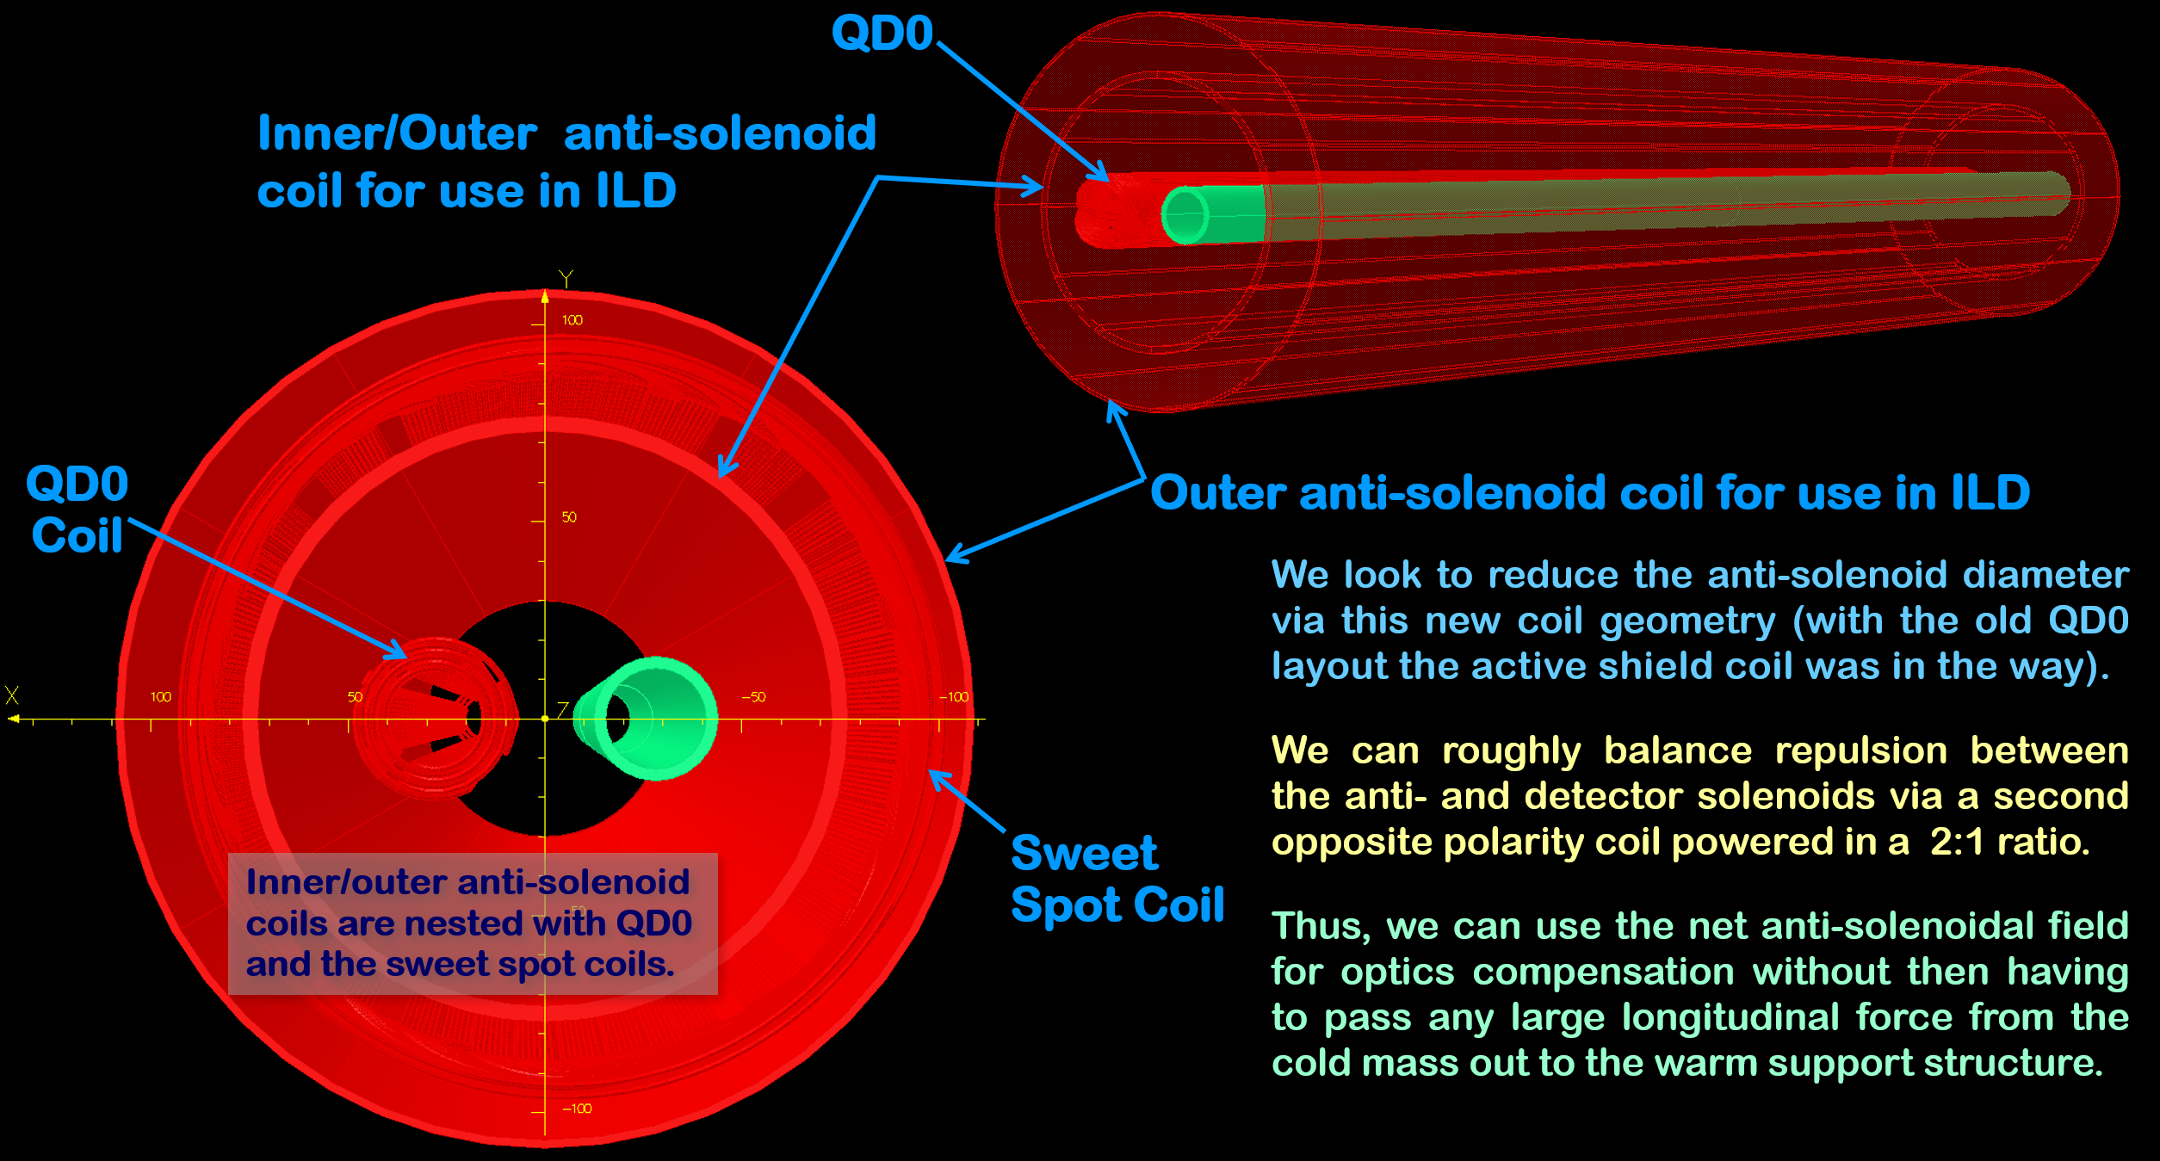
TDR QD0 Cryostat Also Contains an Anti-Solenoid.
In order not to have to deal with 40 tons of axial force in the warm-to-cold transition, we instead use a “force neutral” anti-solenoid coil scheme; there is no net force on cold mass (otherwise adds to heat load).
Sweet Spot Design
Sweet Spot design naturally fits with anti-solenoid and may allow reducing QD0 cryostat diameter.

Slide 16
Some Special Considerations Regarding Task #2.
Because the ILD and SiD solenoid designs differ greatly, their respective QD0 anti-solenoid coil layouts need customization.
We (re)investigate IR performance tradeoffs for moving QD0 to larger L* (e.g. go from inside detector hall to the tunnel).
While we should not make choices that will “prohibit a future energy upgrade,” we may still configure QD0 for optimum performance at 250 GeV (replacing QD0 in an upgrade is a small cost compared to having years of reduced luminosity).
And in the end, even if we do not make major changes to the ILC TDR baseline, we certainly need to rebuild the MDI and engineering design teams in the pre-Lab phase to be ready for the final ILC in Japan EDR design effort.

Slide 17
Backup Material
Some backup slides showing the TDR active shielded QD0 coil, an overview of the SuperKEKB vibration measurement program and the application of the Sweet Spot concept to the EIC B0 spectrometer magnet.

Slide 18
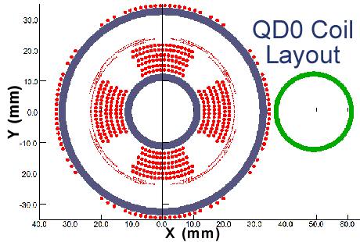
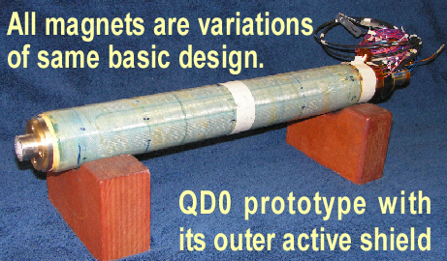
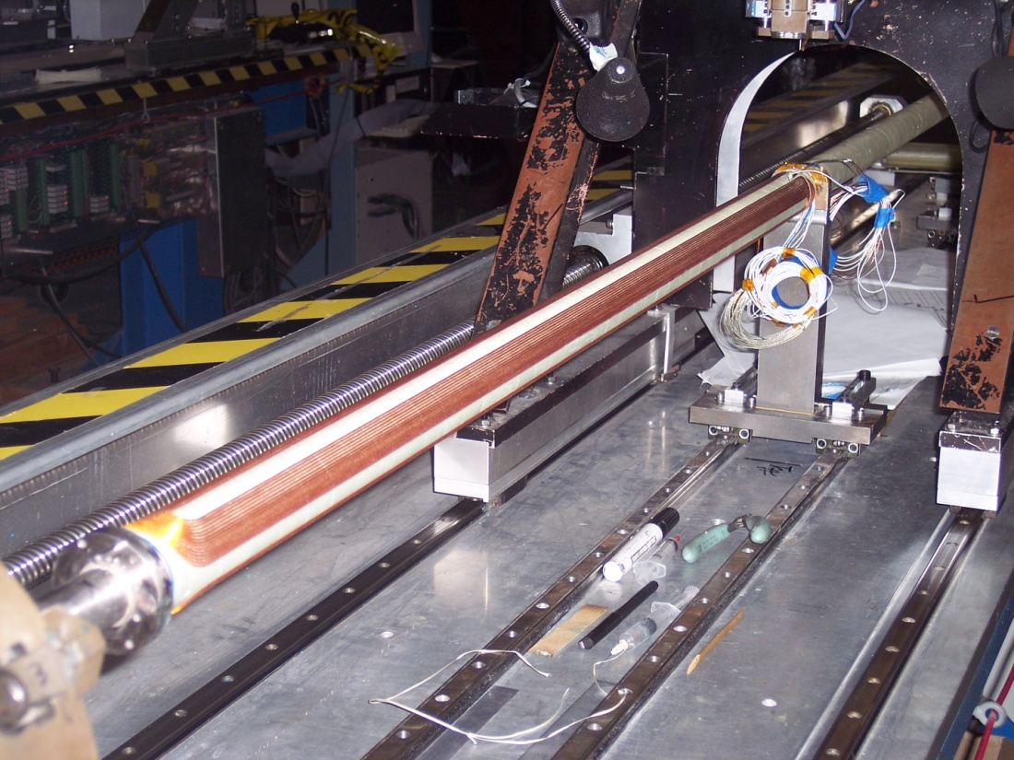
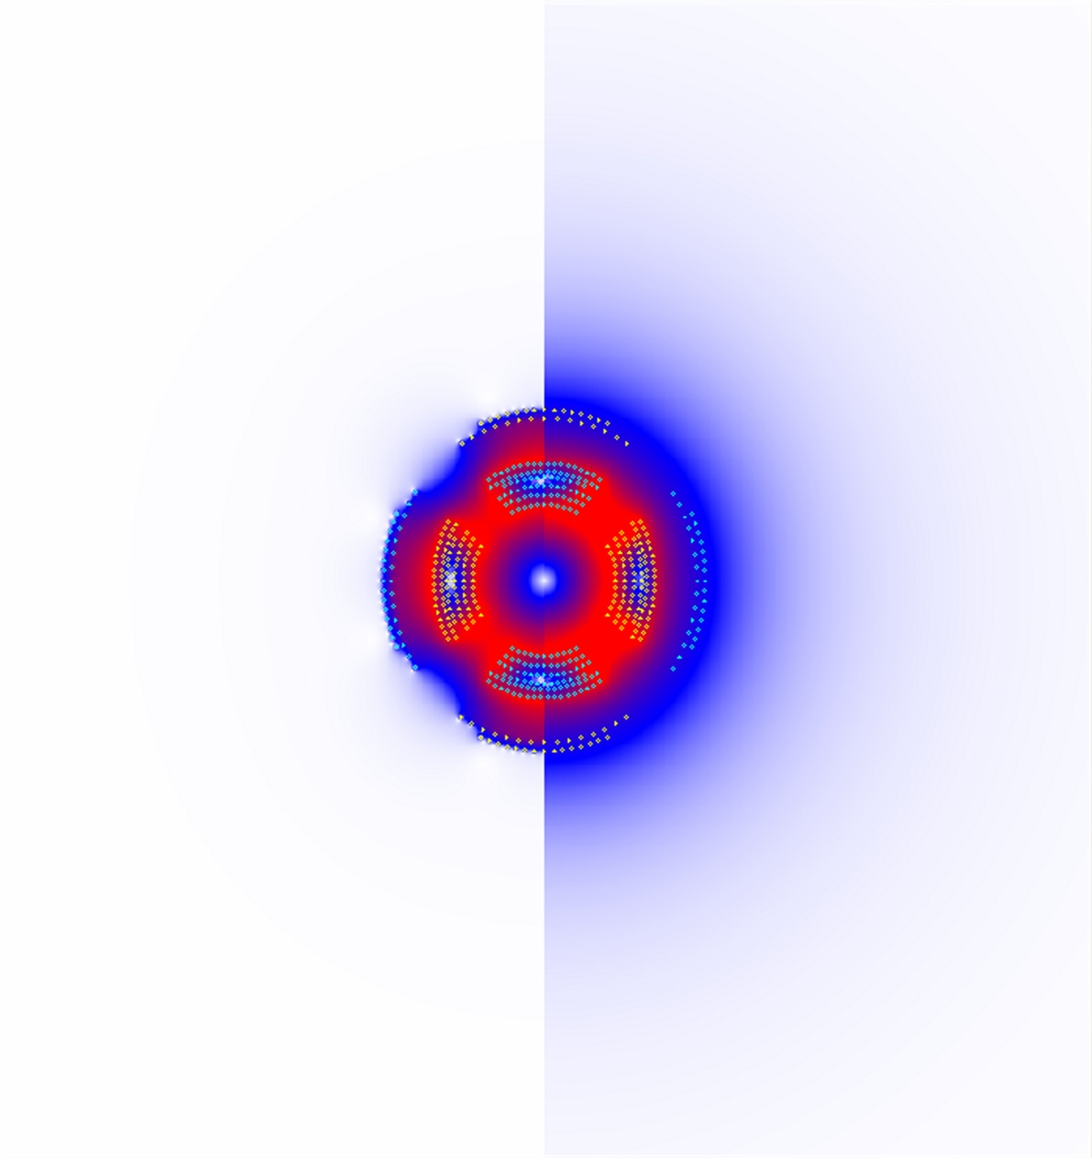
ILC Final Focus Magnets: TDR Baseline Design Review.
QD0 Split Coil Winding
Incoming Beam
Outgoing Disrupted Beam
Main coils & correctors are wound on common support tube.
For the ILC IR we only need to pass the outgoing highly disrupted beams cleanly on to the beam absorbers.
Main requirement is to shield outgoing beam from any strong external fields… which is done with an active shielding coil.
Main 2.2 m QD0 coil is split in half for low energy optics flexibility and to ease manufacturing challenges.
Note there is only a partial anti-solenoid overlapping QD0 (just enough to avoid luminosity loss due too overlapping fields†).
Off
On
QD0 Prototype Test Coil with Active Shielding
†Y. Nosochkov and A. Seryi, “Compensation of Detector Solenoid Effects on the Beam Size in a Linear Collider,”
Physical Review Special Topics - Accelerators and Beams, DOI: 8. 10.2172/829740.
QD0 with Active Shield Off/On

Slide 19
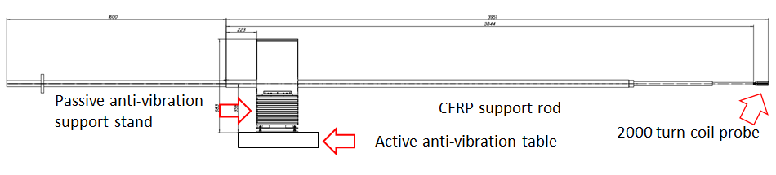
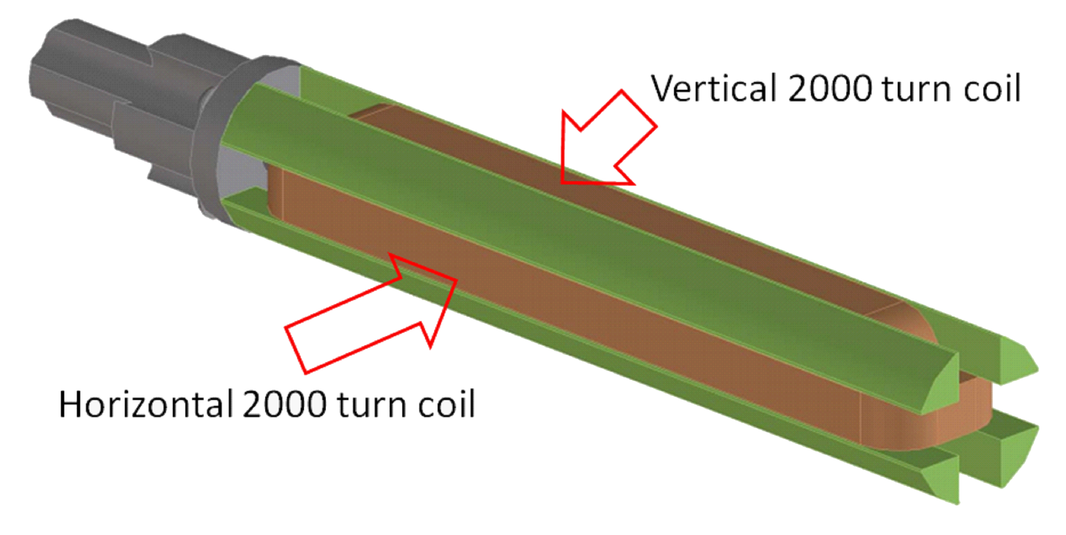
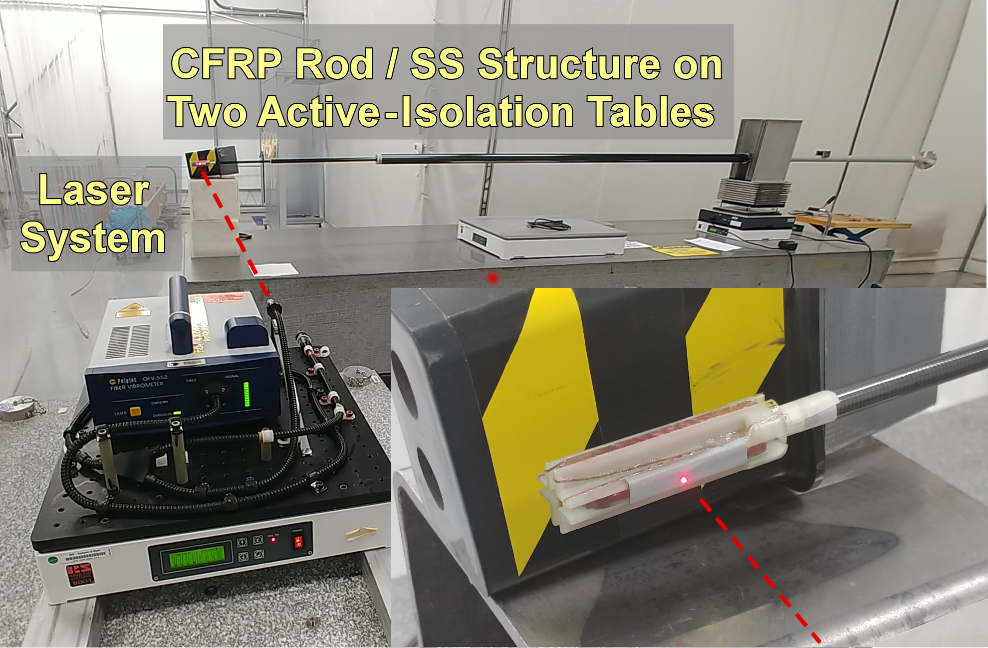
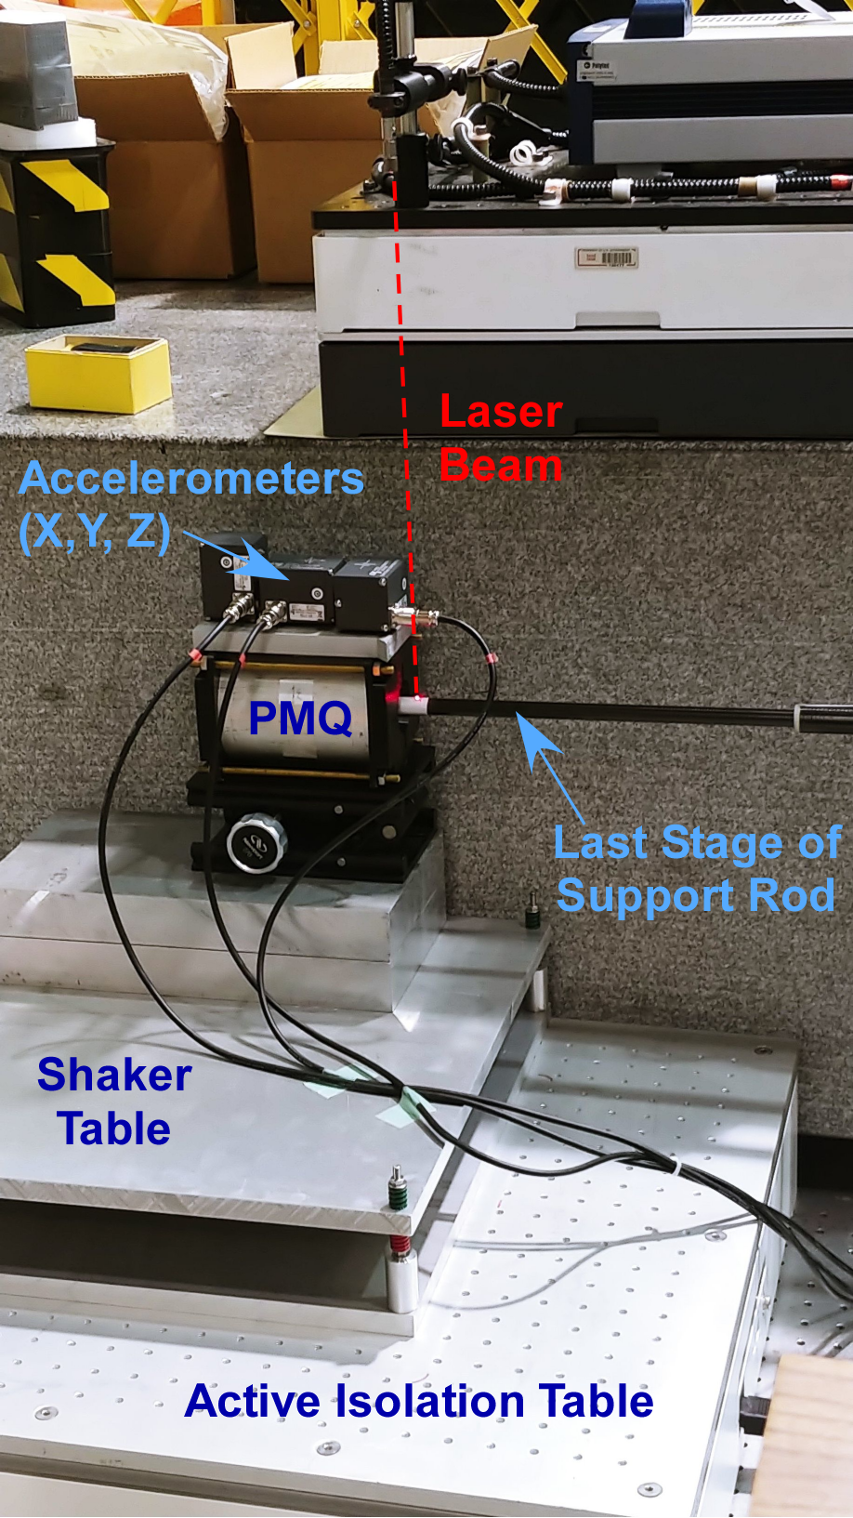
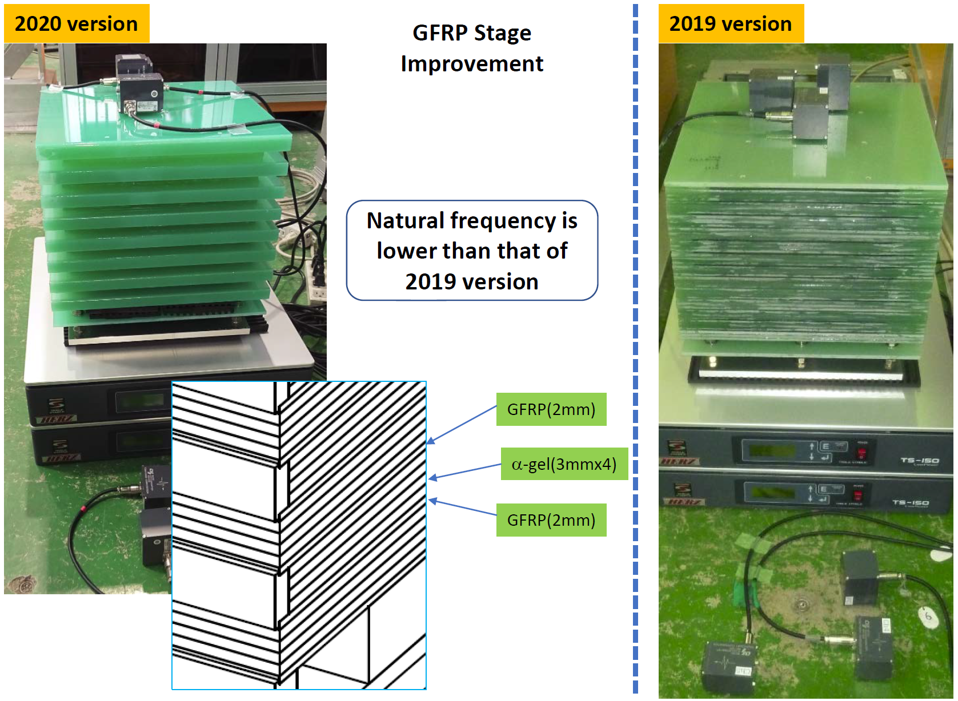
SuperKEKB IR Magnet Vibration Measurement R&D.
Multiturn Probe Coil
SuperKEKB Probe Coil Support System
SuperKEKB IR stability budget is 5 nm integrated motion @10 Hz (ILC QD0 is 50 nm to stay within bunch feedback capture range).
R&D is in progress to measure with 1 nm sensitivity (US/Japan).
Magnetic center change seen as voltage on multiturn probe coil.
But we must stabilize probe coil to measure the real motion.
Use laser for non-contact probe stability measurement and put the probe coil in a PMQ (IR quad stand in) to see voltage signal.
But for IR magnets in Belle-II we only have access from one side and single-sided support is more difficult than double sided support (multiple generations of support improvement).
In 2021 we demonstrated probe support rod stability of 1 nm.

Slide 20
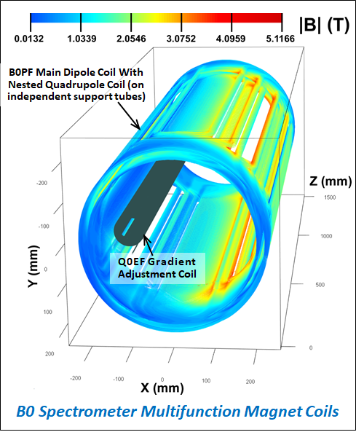
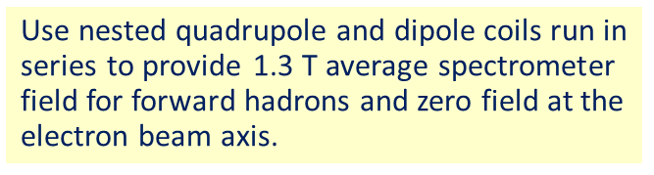
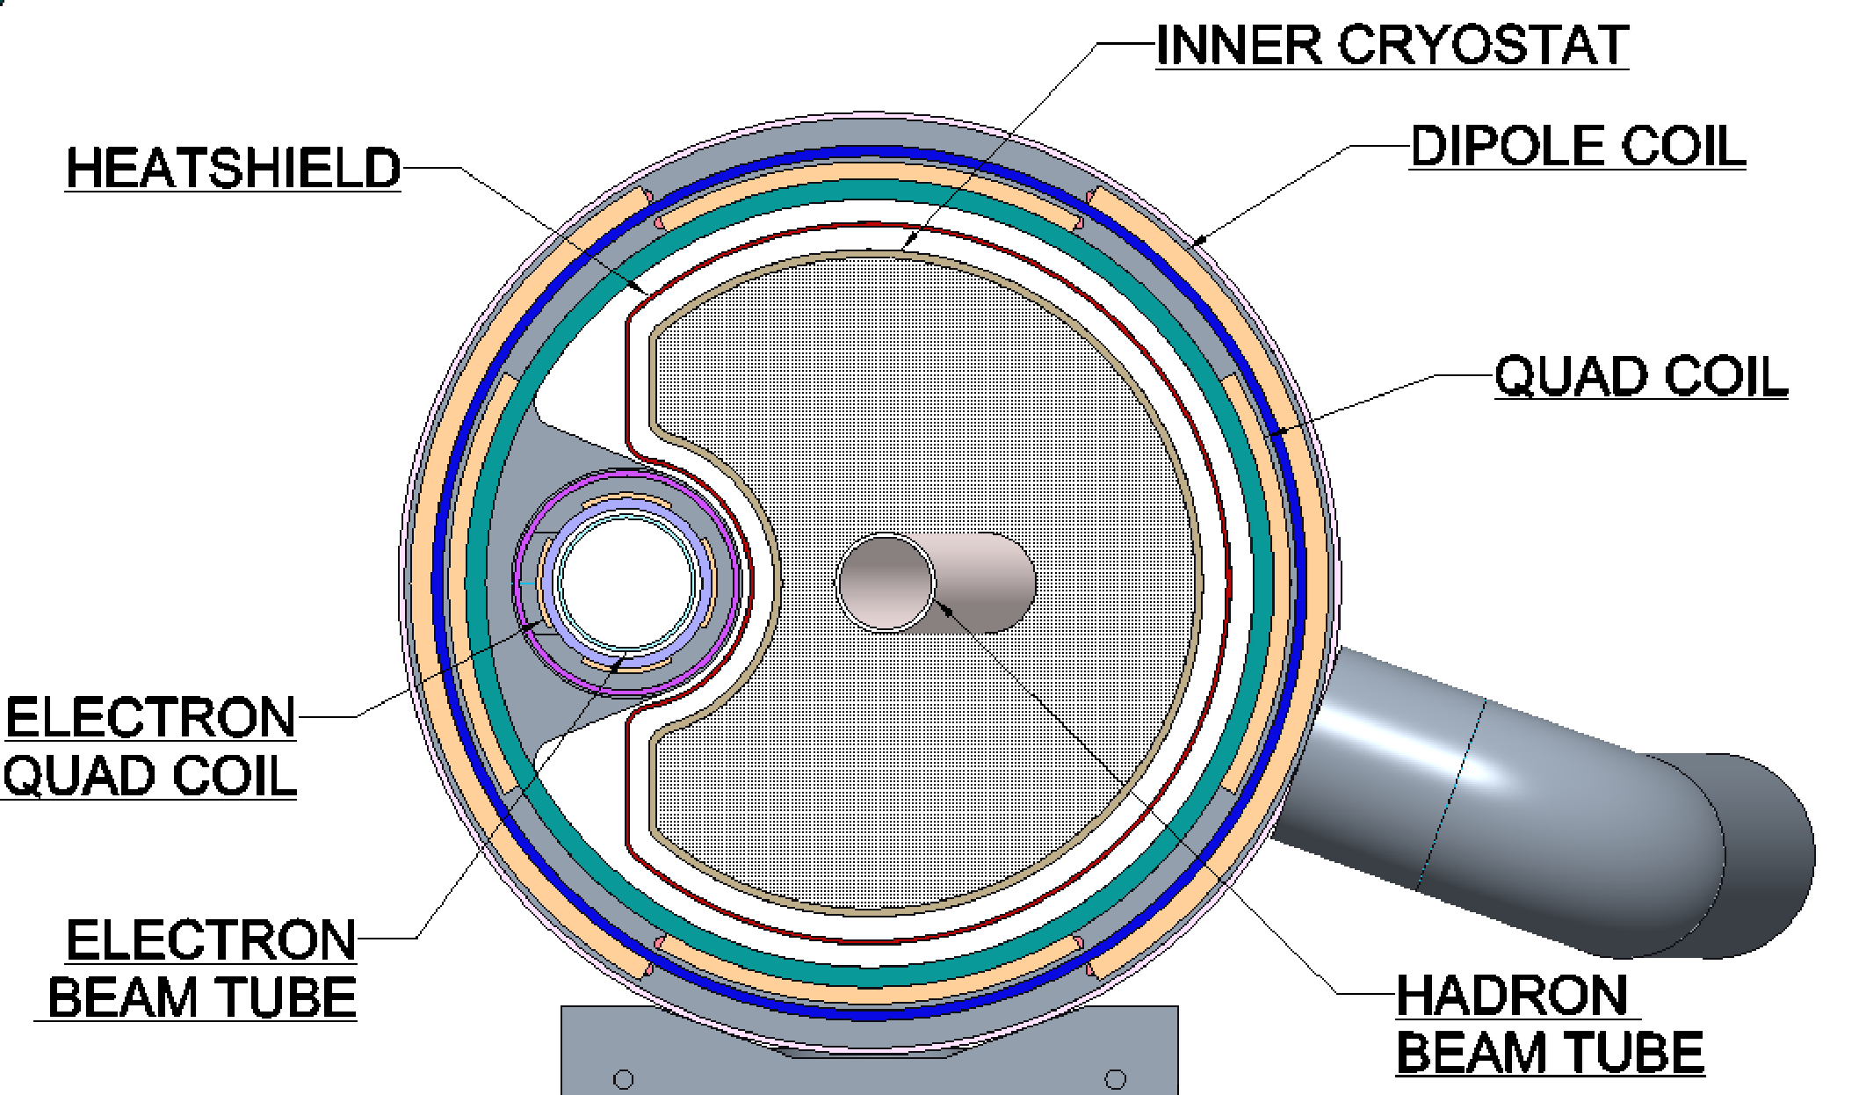
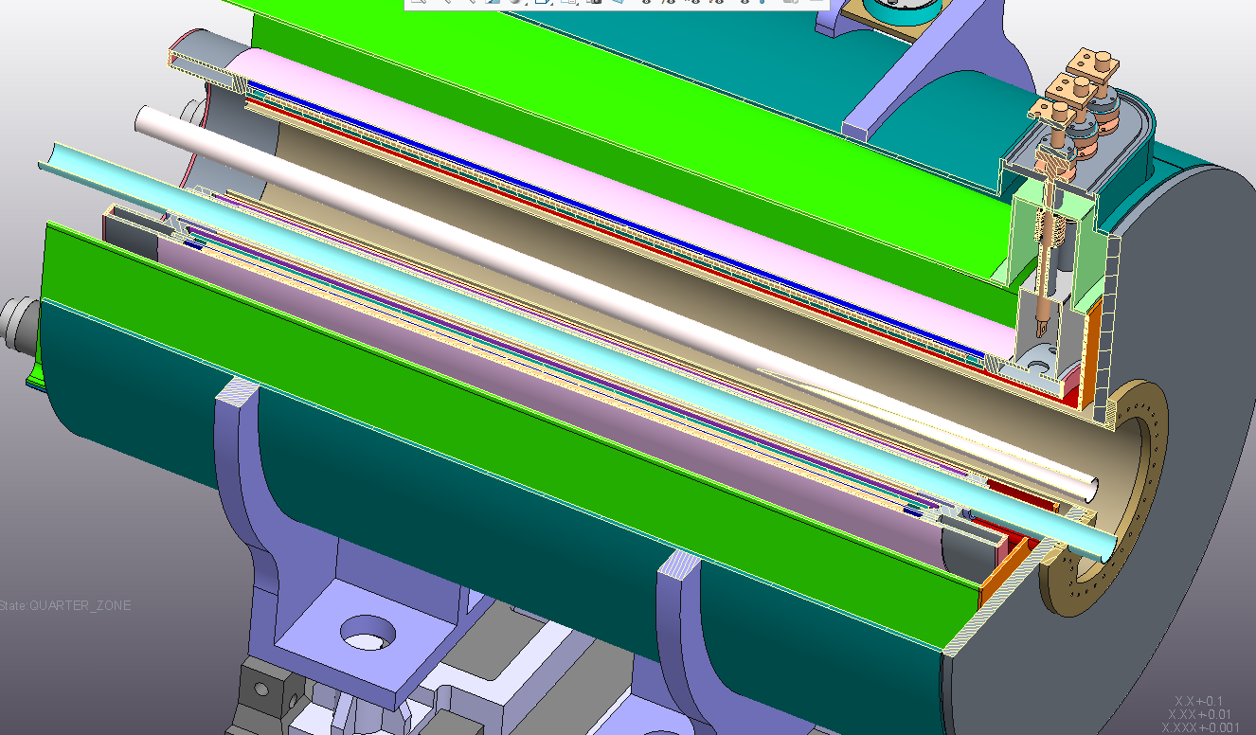
Sweet Spot Example: EIC B0 Spectrometer Magnet.
Warm space available for physics detectors†
Challenge is to have warm space for physics detectors with magnetic field very close to the first electron IR quad.
Answer is to put the electron quad at a zero-field axis in the hadron combined function magnet.
Hadron coils give some focusing gradient but zero dipole field at the electron beam axis.
However, the hadron and electron beam energies must be separately adjustable to explore different kinematic regions…
Thus, we provide an electron quadrupole field adjustment coil.
Note: All coils are aligned parallel to the electron beam, so the hadron beam crosses B0 with the full 25 mrad crossing angle.
Hadron Beam
Electron Beam
†Q0EF physically covers some of the forward physics acceptance between the electron and hadron beams.

