Slide 1
Introduction of the BDS magnets for ILC
2021/09/17
Toshiyuki OKUGI, KEK
IDT WG3 MDI meeting

Slide 2
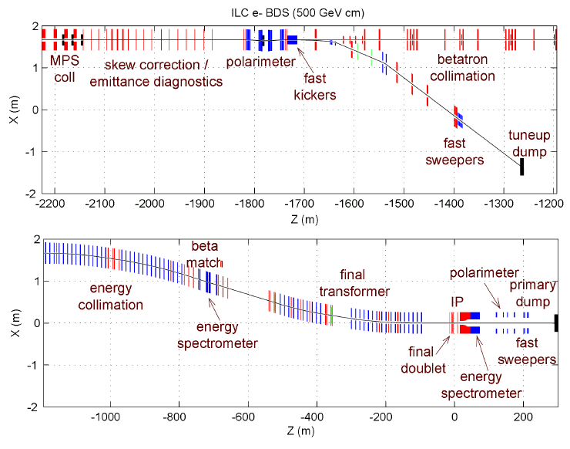
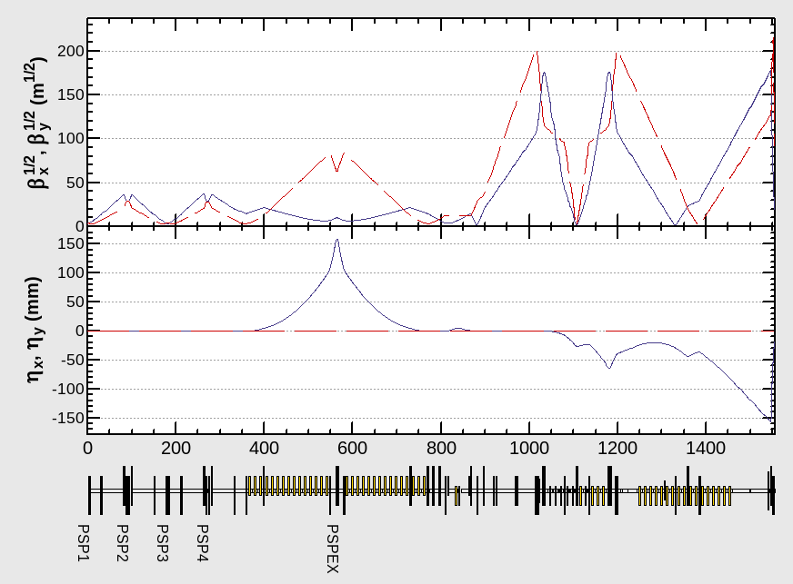
Overview of BDS (Beam Delivery System)
BDS consists of
- beam diagnostic section.
- collimator system.
- final focus beam line.
- beam extraction line.
BDS is the beamline after main linac.

Slide 3
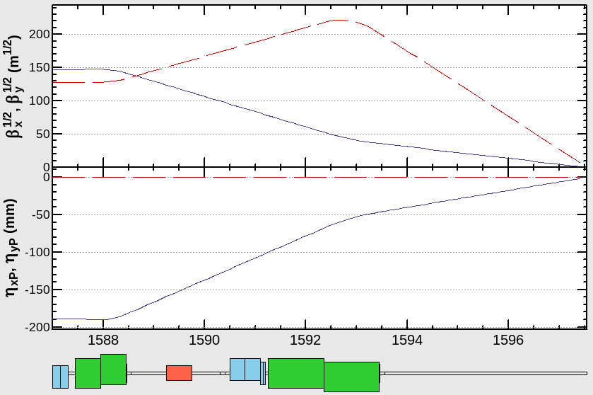
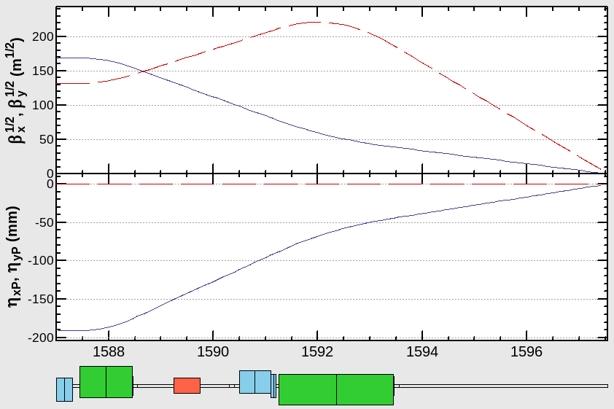
Application to low energy (E_{CM}=250GeV)
ECM=250GeV
The field strength for ECM=250GeV is a half to ECM=500GeV.
When we only use a half of FD magnets,
the beta functions at FD magnets are decreased.
Therefore, the collimation depth can be increased.
Half length of FD was used.
QF1B
QF1A
QD0B
QD0A
ECM=250GeV
0.5
1.1m
IP
ECM=500GeV
0.5
0.5
1.1m
1.1m
ECM=500GeV
Beta
The geometry optimizes the more difficult low-energy optics
and allows the higher-energy optics to deviate slightly from the optimum value.
Full length of FD was used.

Slide 4
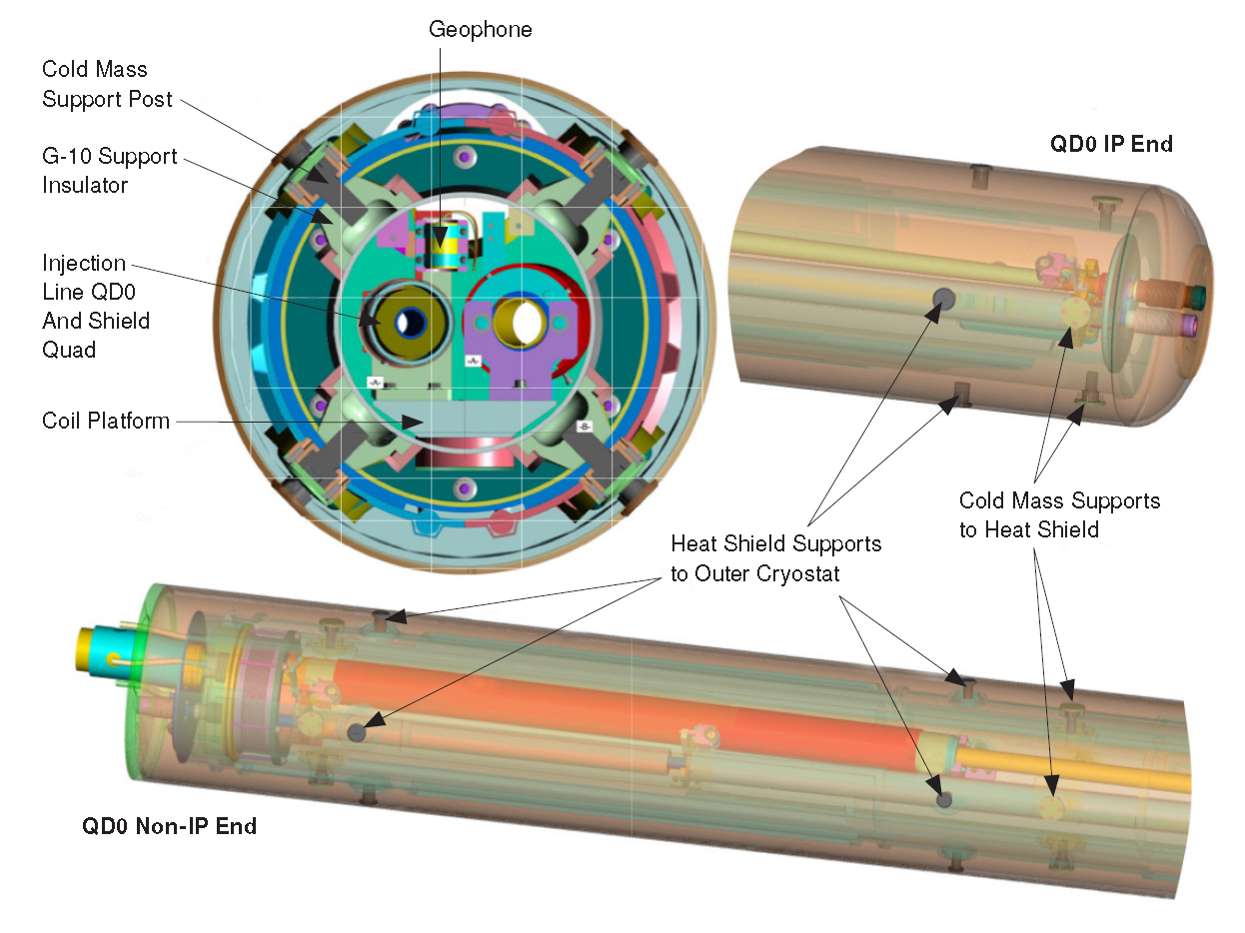
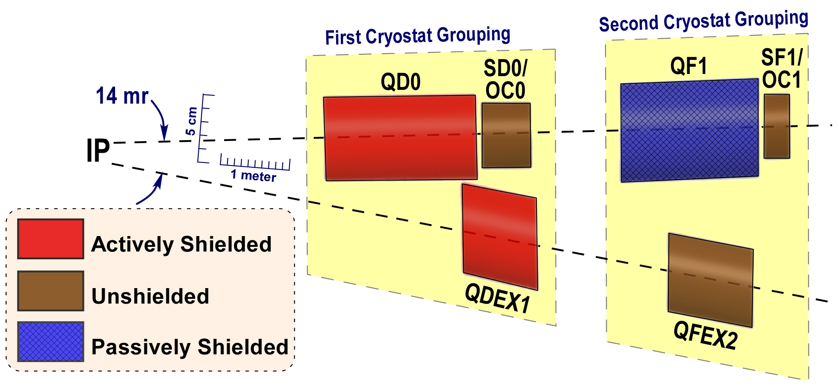
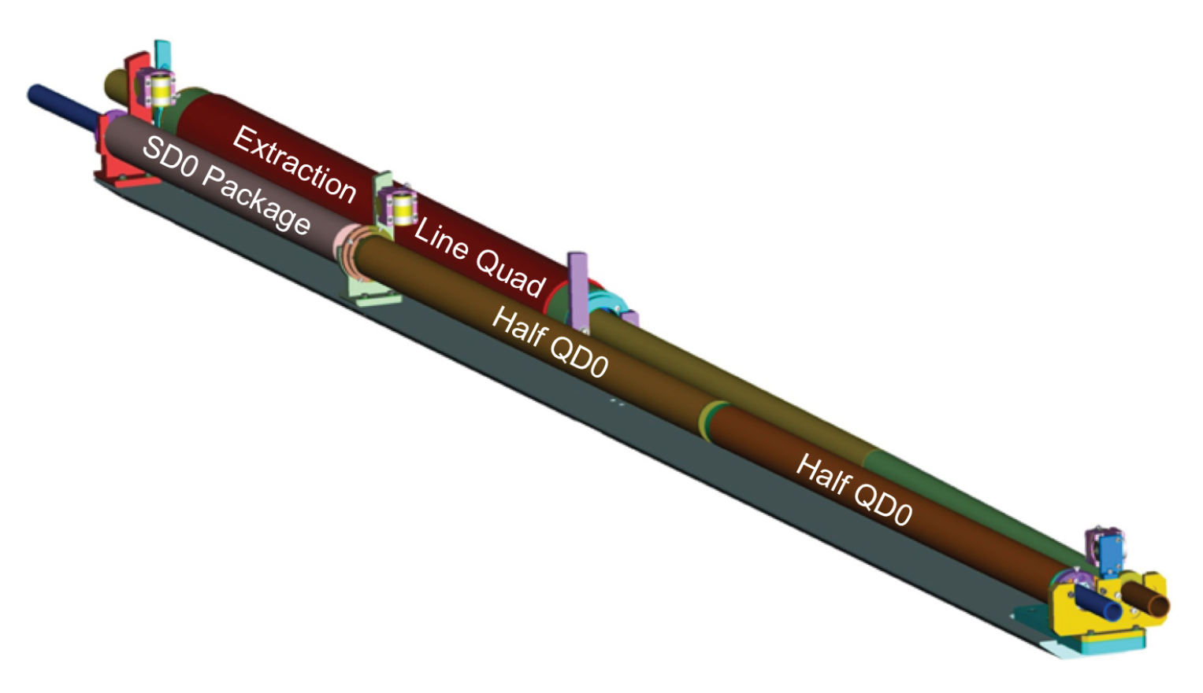
Cryomodule of Final Doublet and Extraction Quads
We will use the 2 set of cryomodules for ILC IP region.
Supported
with Detector
Supported to
Accelerator Tunnel
We can split the QD0 magnet
to be half length of magnets
(to be explained for low energy operation)

Slide 5
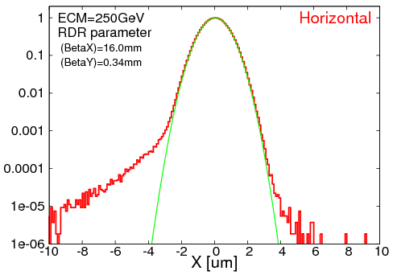
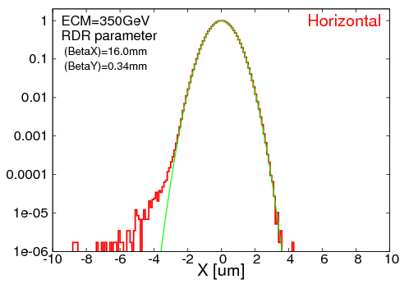
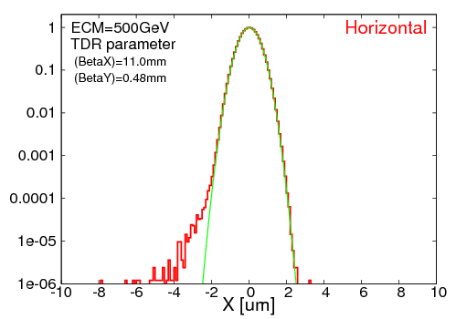
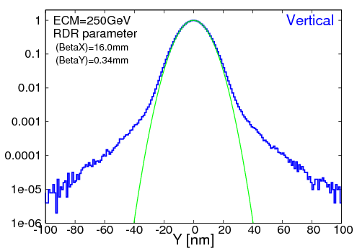
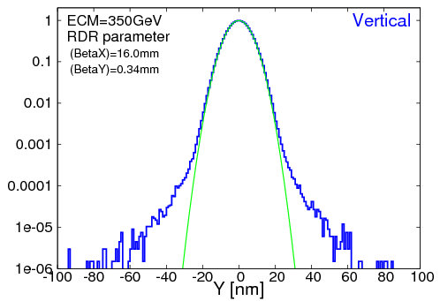
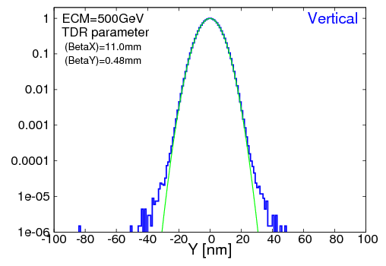
IP beam profile
ECM=250GeV
ECM=350GeV
ECM=500GeV
Horizontal
Profile
ECM=250GeV
ECM=350GeV
ECM=500GeV
Vertical
Profile
Simulation Results for ECM<500GeV optics ( no SR )
ECM | Horizontal |  | Vertical |  | Relative Luminosity
 | design beam size | simulation (core) | design beam size | simulation (core)
250GeV | 0.729um | 0.755um | 7.66nm | 7.81nm | 94.7%
350GeV | 0.683um | 0.690um | 5.89nm | 5.97nm | 97.8%
500GeV | 0.474um | 0.482um | 5.86nm | 5.89nm | 97.8%

Slide 6
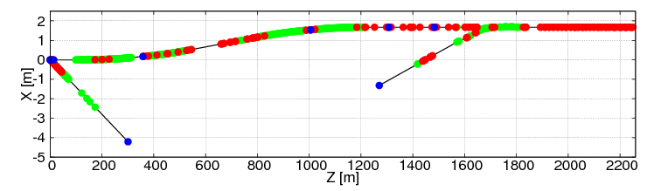
Application to high energy (E_{CM}=1TeV)
The beam optics is designed to be expandable to ECM=1TeV in the same tunnel.
Beam optics up to 500 GeV can be used with electromagnets to support beam optics up to 1 TeV.
When ECM=1TeV, the Final Doublet strength must be twice as strong as when ECM=250-500GeV. What technology will be used for this purpose has not been decided at present.
Section B
from Energy Collimator
Section A
to betatron collimator
The number of components both for ECM=500GeV and ECM=1TeV
( not include the dumpline )
 | Energy [GeV] | # of BEND | # of QUAD | # of SEXT | # of Steer | # of PS | # of Mover | # of BPM
Section A | 500 | 16 | 64 | 0 | 19 | 73 | 70 | 78
 | 1000 | 43 | 108 | 0 | 19 | 115 | 108 | 116
Section B | 500 | 63 | 33 | 7 | 55 | 46 | 40 | 101
 | 1000 | 176 | 41 | 7 | 55 | 56 | 48 | 112

Slide 7
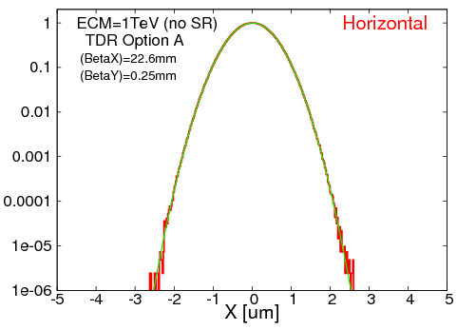
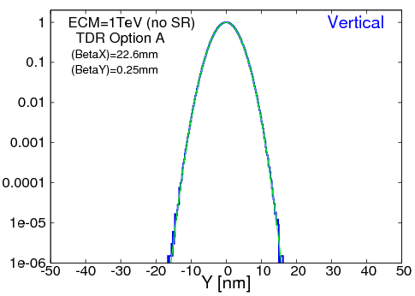
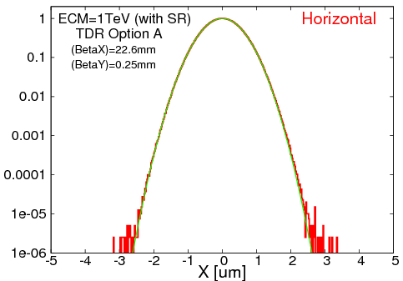
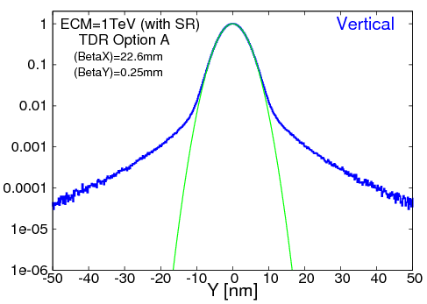
Simulation Results for ECM=1TeV optics
<< no SR >>
<< with SR >>
Aberrations due to synchrotron radiation
 | Horizontal |  |  | Vertical |  |  | Relative Luminosity
 | design | rms | core | design | rms | core
no SR | 0.481um | 0.481um | 0.481um | 2.99nm | 2.99nm | 2.99nm | 99.8%
with SR |  | 0.499um | 0.498um |  | 3.71nm | 3.15nm | 91.7%
Luminosity of more than 90% can be achieved for ECM=1TeV, even with the effect of synchrotron radiation on the beamline.

Slide 8
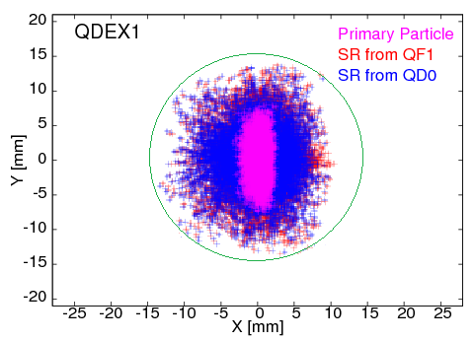
Consideration of collimation depth
Detector apertures
Arrangement of the Collimators
Beta Function at SP2/SP4 = (X; 1000m / Y; 1000m)
Phase Advance (SP2/SP4) = (X; 0.5 pi / Y; 1.5 pi )
Phase Advance (SP4/ IP ) = (X; 5.5 pi / Y; 4.5 pi )
EtaX at SPEX = 0.158m
IP
Source for background
Halo particles
SR form halo particles
QF1
QD0
QDEX1
20 φ
20 φ
28 φ
30 φ
Energy
collimation
IP phase
collimation
FD phase
collimation
When the L* of QD0 is increased, the L* of QDEX1 in the extraction line must also be increased.
Since the collimation depth is limited mainly by the fact that SR from the Final Doublet hits QDEX1, the collimation depth becomes more severe when L* is increased.
SP2/SP4 X ; 0.86mm
SP2/SP4 Y ; 0.98mm
SPEX X ; 1.60mm
( Dp/p = 1% )
30φ

Slide 9
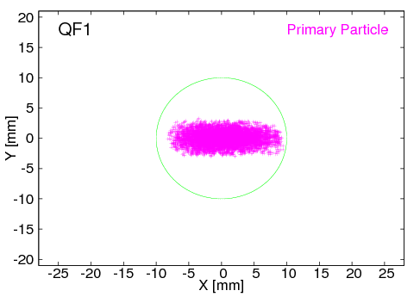
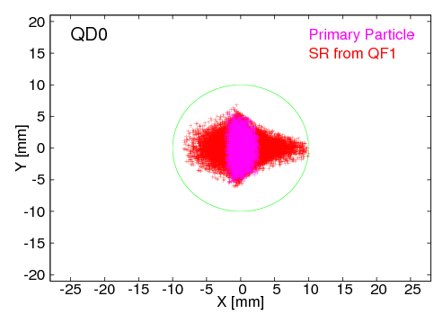
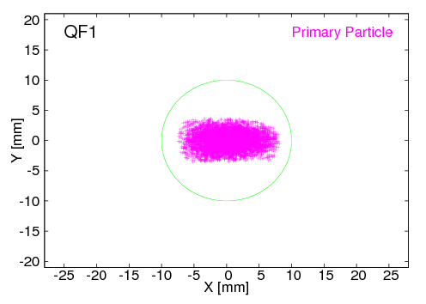
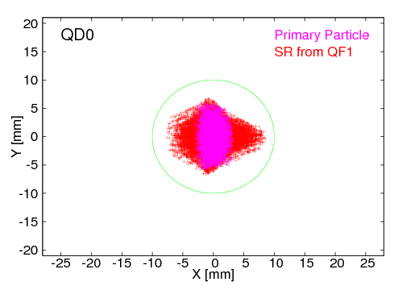
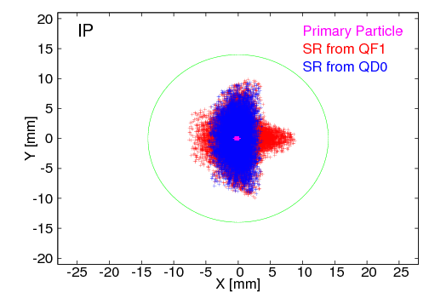
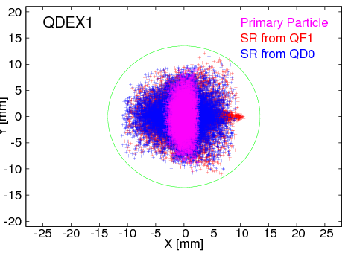
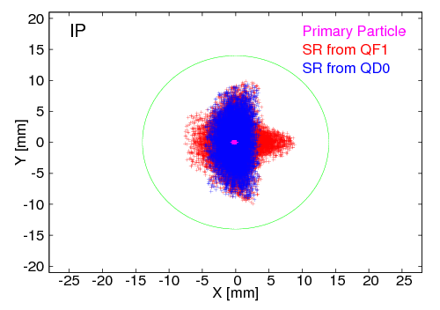
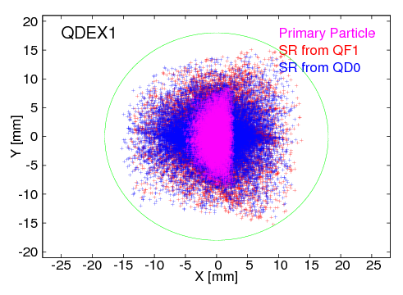
Synchrotron radiation around IP area
Shorter QD0 L*
Longer QD0 L*
Horizontal limit
Horizontal limit
The situation of QDEX1 limit
will be changed by the parameters
- the location of QDEX1.
- the aperture of QDEX1.
- the vertical aperture of collimator.
QF1
QD0
IP
QDEX1

Slide 10
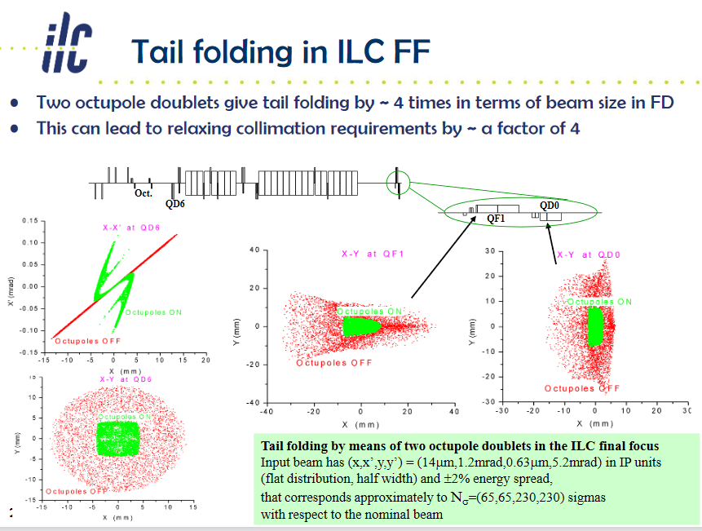
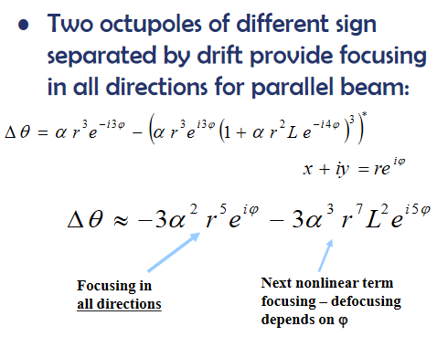
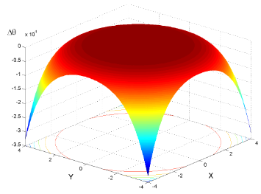
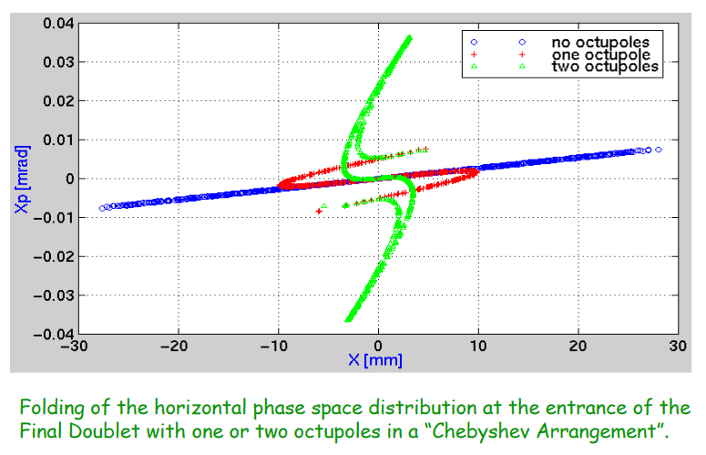

Slide 11
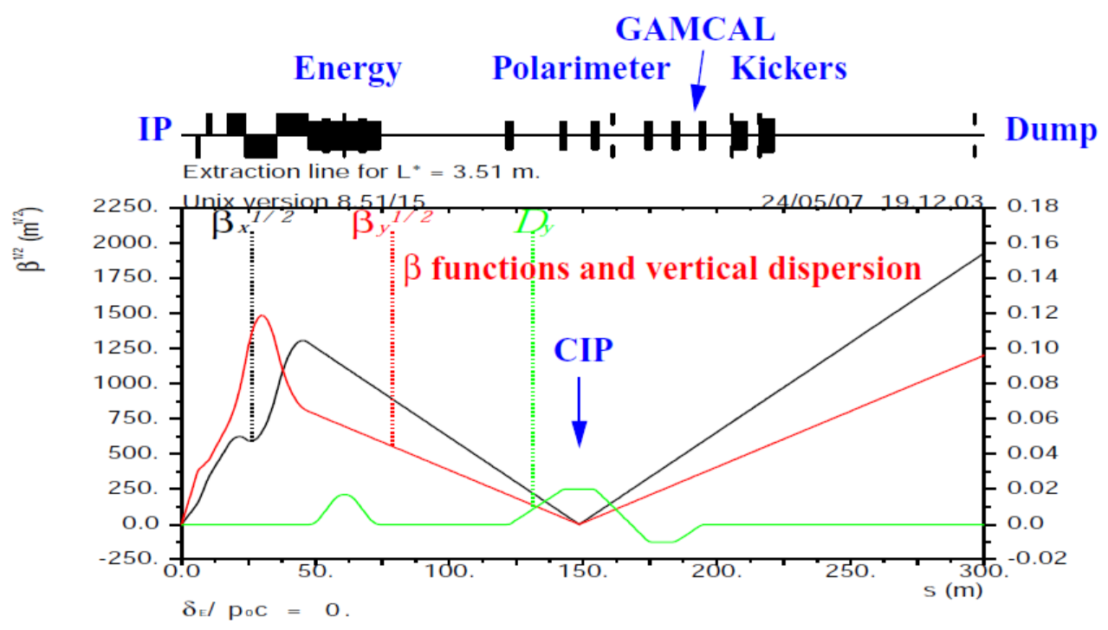
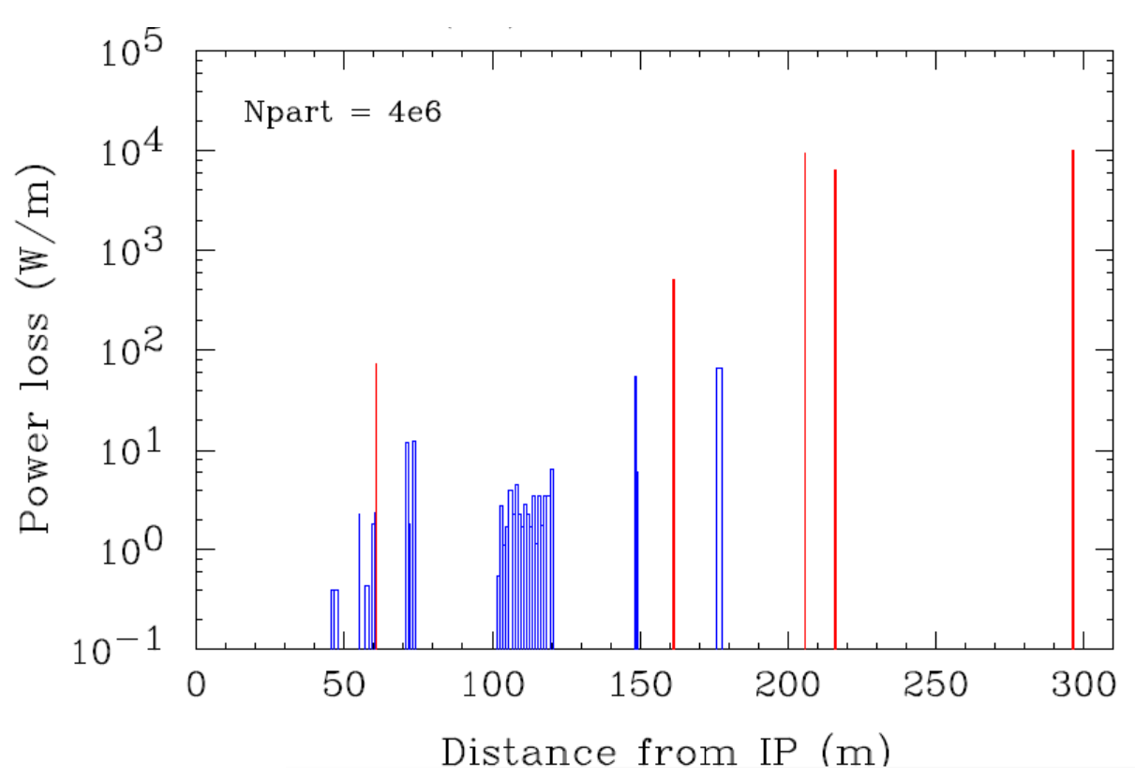
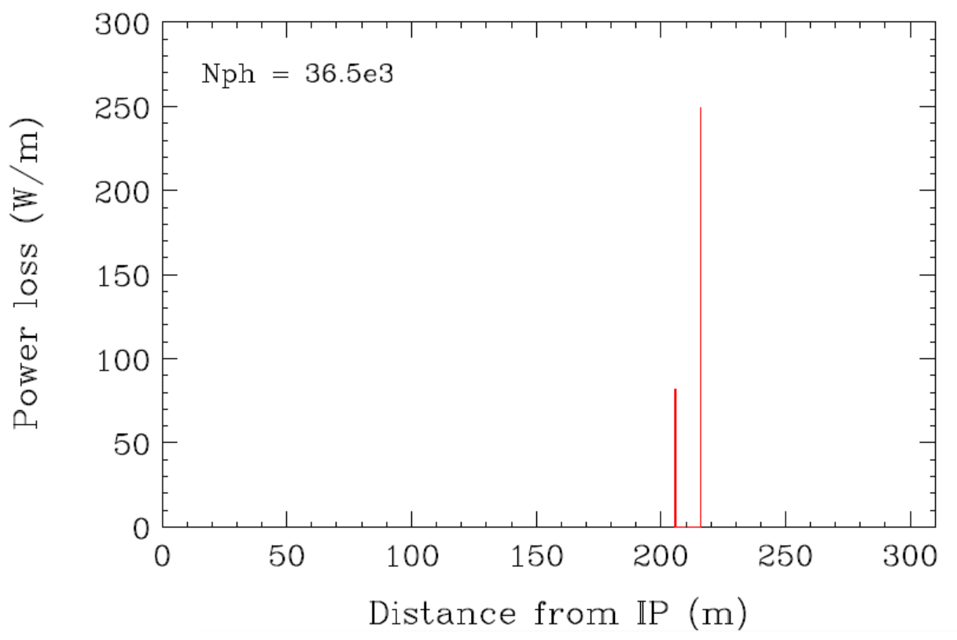
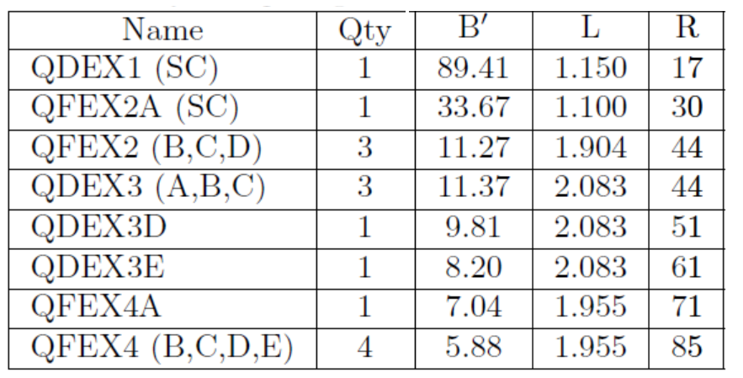
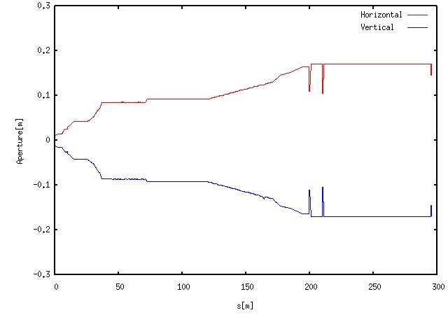
ILC beam extraction line
Power loss at extraction line (beam-beam effect)
E. Marin and Y. Nosochkov et al., LCWS 2013
Disrupted charged particles
Beamstrahlung photons
The ILC extraction line uses large-diameter quadrupole magnets (maximum bore diameter 170 mm) to transport the beam with large beam spread by the beam-beam effect to the dump with minimal loss.
When the L* of QD0 is lengthened, the L* of the extraction quadrupole magnet QDEX1 is also lengthened, and the diameter of the quadrupole magnet in the entire extraction line should be increased more.
Therefore, the design of the entire extraction line needs to be redesigned.
Quadrupole magnets in extraction line
Y. Nosochkov et al., LCWS/ILC 2007
First two quadrupoles : SC magnets in FD package
Other quadrupoles : Large aperture NC magnets
Apertures for Dumpline

Slide 12
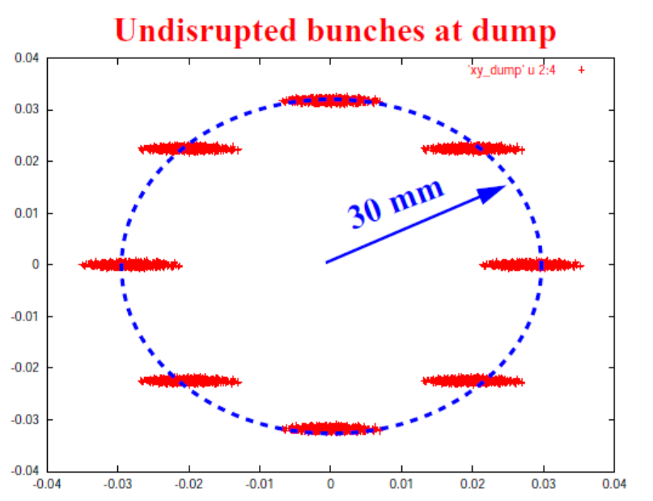
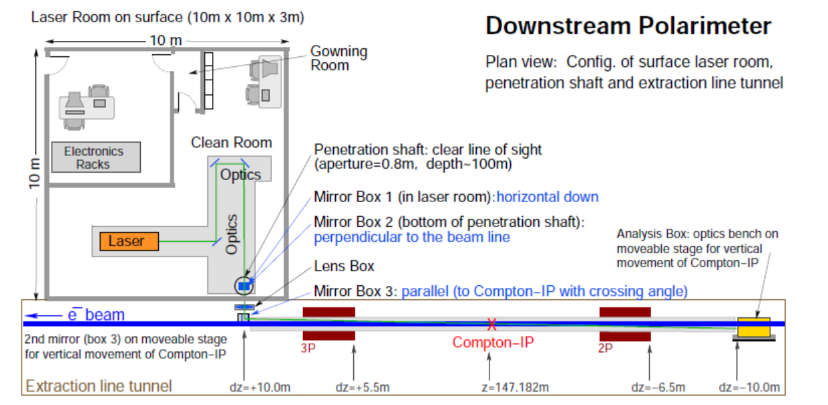
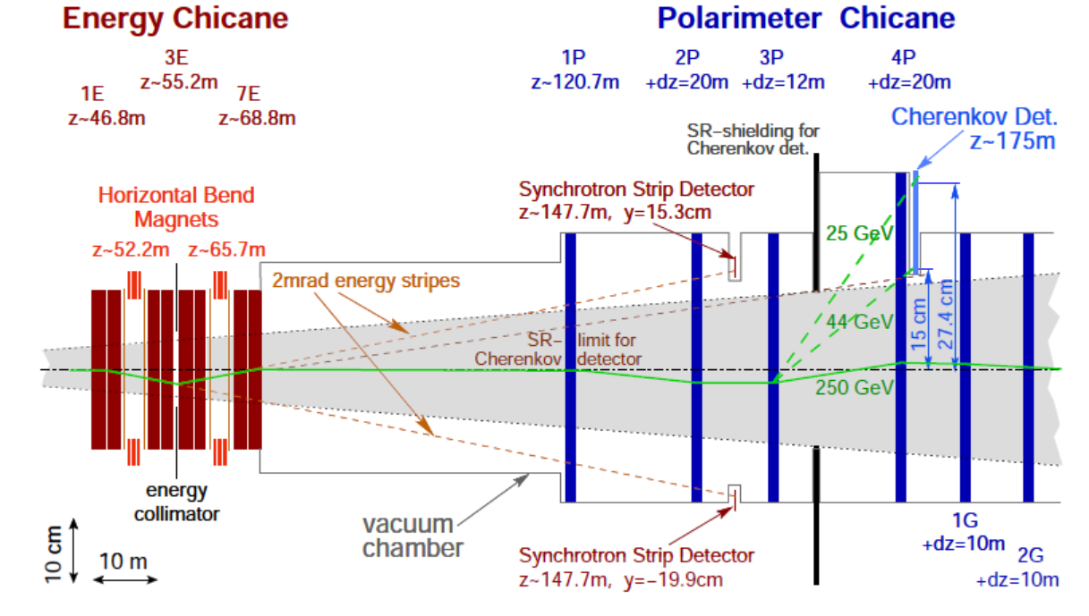
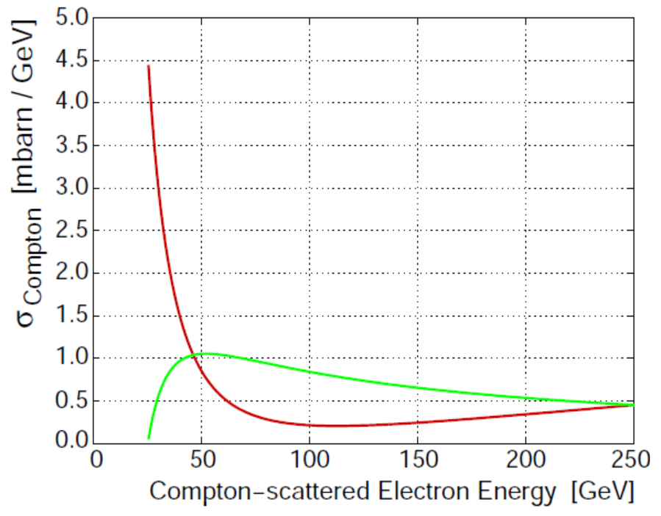
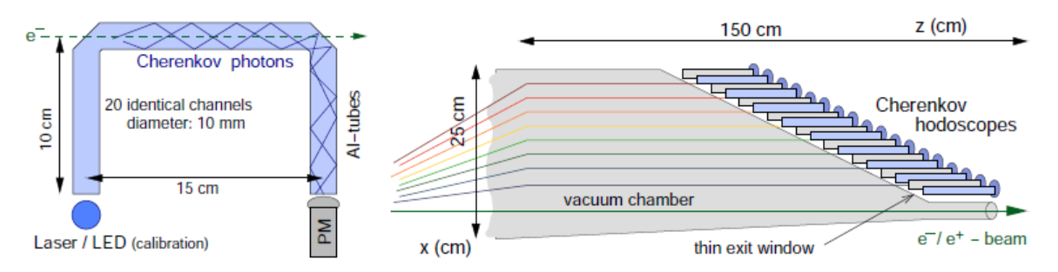
Beam diagnostics for ILC beam extraction line
ILC extraction line beam diagnostics
Cross section of Compton scattering
with different beam polarization

Slide 13
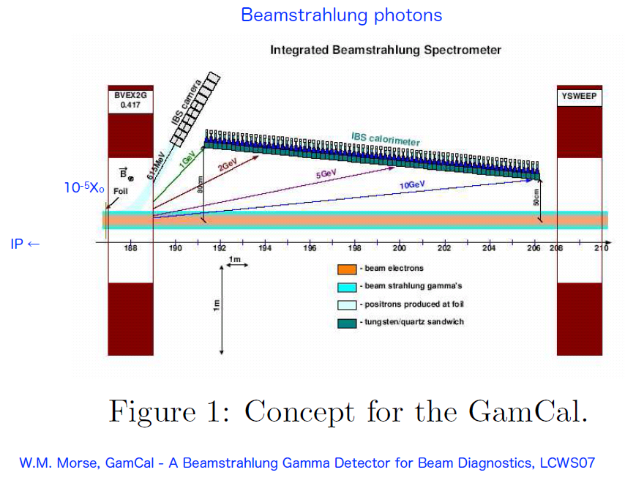
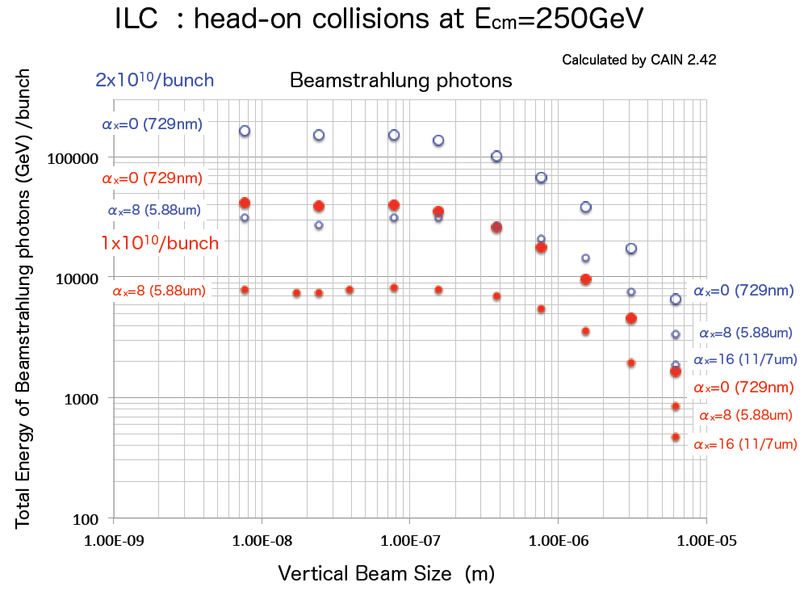
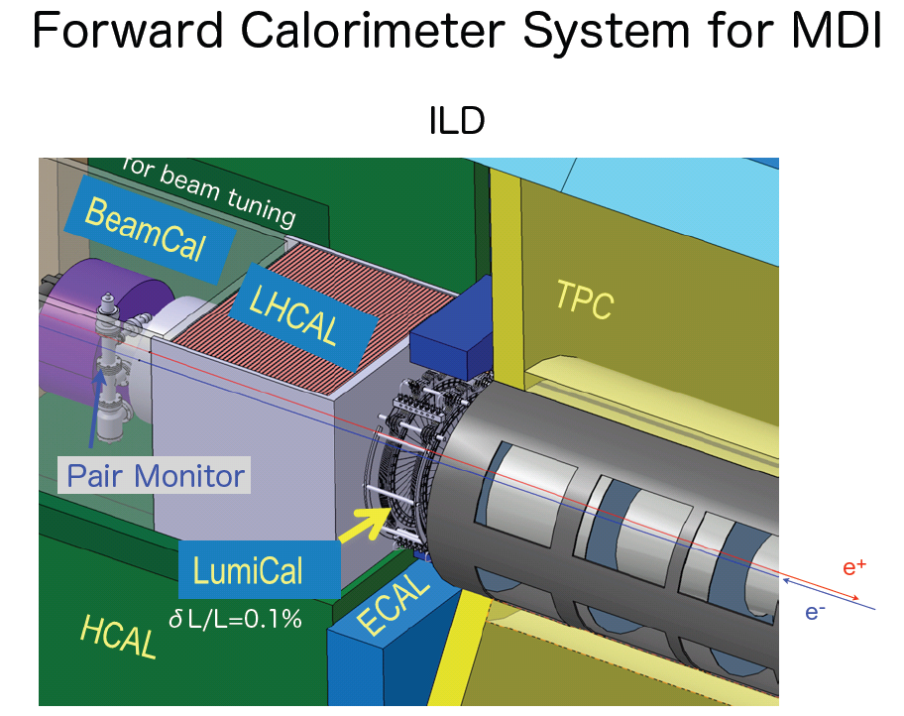
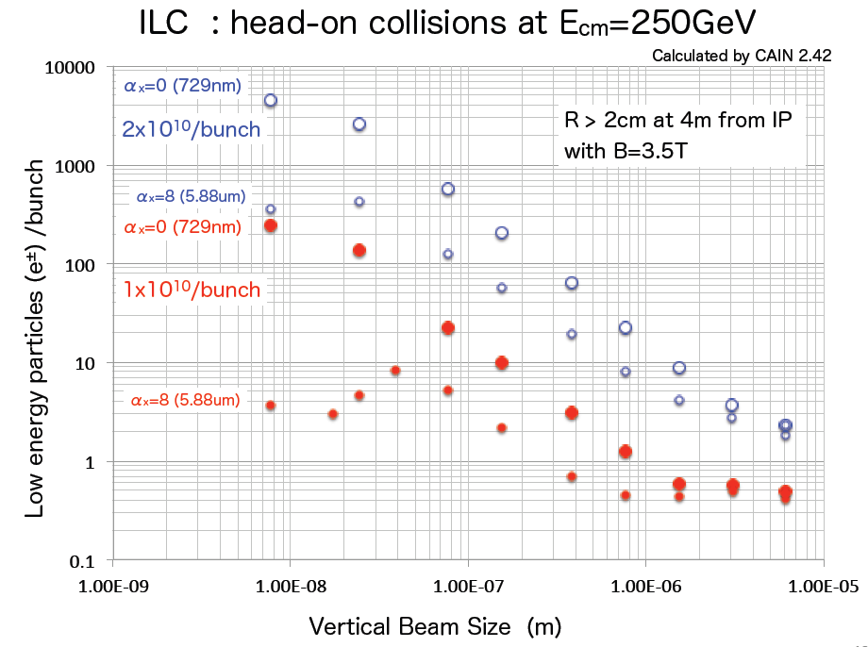
IP beam size tuning
The beam size will be optimized by monitoring the Luminosity monitor in actual ILC beam operation.
Sigma > 1um
For large beam size
( larger than 1 um)
For small beam size
( smaller than 1 um)
Sigma < 1um
presented by T.Tauchi (KEK) at AWLC2014

Slide 14
Backup

Slide 15
Is it better to take the bending angle of the dipole magnet infinitely large?
The higher-order aberration derived energy spread becomes stronger.
The larger the emittance dilution due to synchrotron radiation become larger for the high energy beam.
There is an optimum value of bending angle for each beam energy.
I have considered the ILC final focus optics with long L* in the past.
Large L* optics for ILC
Toshiyuki OKUGI, KEK
2014/ 5/ 15
AWLC2014, Fermilab

Slide 16
Long L* and Chromaticity
Chromaticity correction
The difference in particle trajectory is created by the difference in energy.
The strength of the sextupole magnet depends on the position of the particle passing through it.
The angle at which a particle injects a quadrupole magnet depends on its energy.
In order to squeeze the beam to the same size at the focus, it is necessary to squeeze the beam at the same divergence angle.
The beam size at the final focus magnet becomes larger.
The chromatic aberration at the focal point becomes larger.
This is especially effective in “the low energy region”, because the beam size passing through the magnet is large.
Small difference in position
due to energy in sextupole
Large difference in position
due to energy in sextupole
When the L* is long, the chromatic aberration becomes larger, and a strong chromatic aberration compensation is needed.
Requires strong sextupoles
Spatial aberration becomes large
Enough to use weak sextupoles
Spatial aberrations are small.

Slide 17
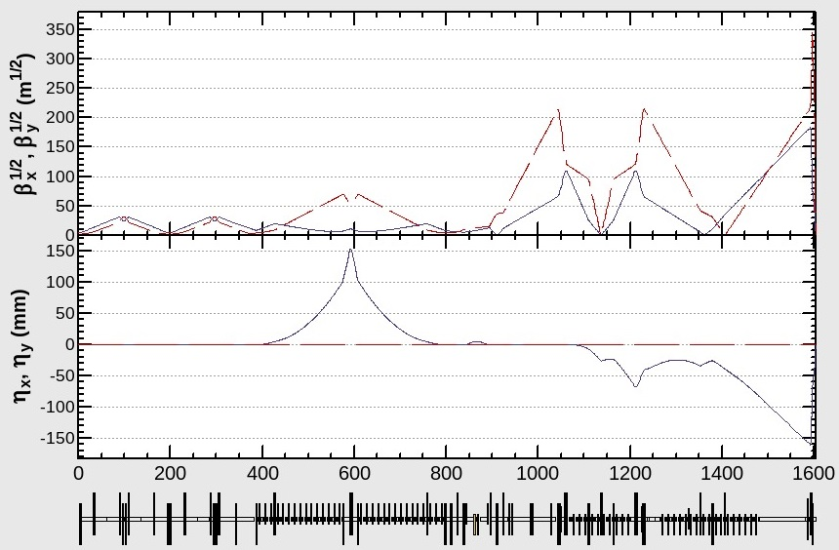
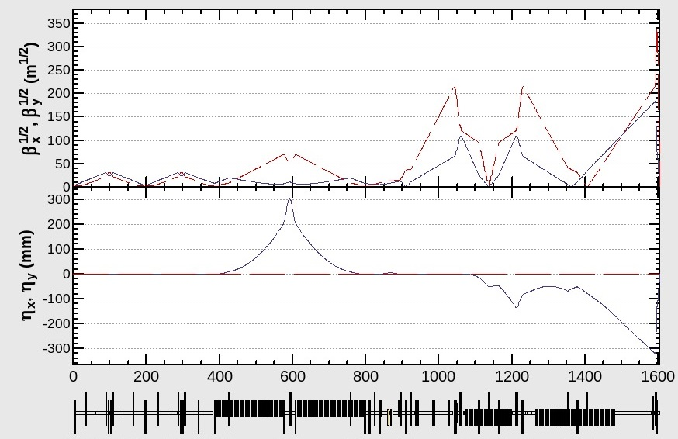
L*=7.0m optics based on ILC RDR optics (ECM=500GeV)
Since the (2nd order and higher) geometrical aberration for large L* optics was large
the large L* optics is more difficult than the small L* optics, even if we set same chromaticity.
1st step optimization
2nd step optimization
In order to reduce the beam size at SF6, SF5 and SD4,
the beta function at the section was reduced
(ATF2-like optimization).
The strength of dipole magnet was increased to twice to increase the dispersion and reduce the strength of sextupoles.

Slide 18
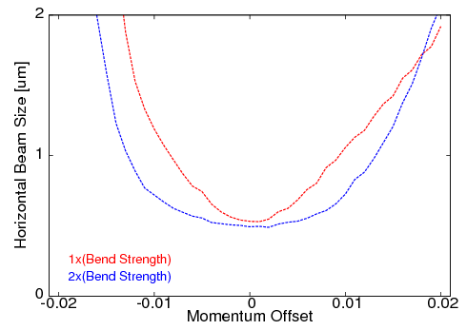
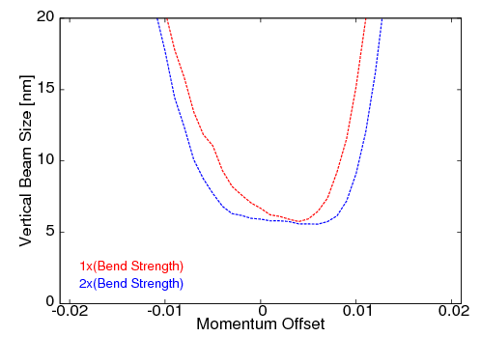
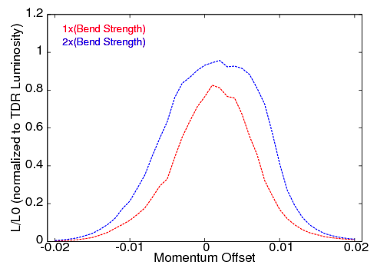

Performances for the optics with strong bending magnet
Optics was matched to ILC TDR parameters.
Bandwidth of sigmaX for E=250GeV
Bandwidth of sigmaY for E=250GeV
Effect of SR
Even at ECM=500 GeV,
some effects of synchrotron radiation are appeared.
IP Beam Size at E=250GeV | sigmaX* | sigmaY*
w/o Synchrotron Radiation | 0.50um | 5.81nm
with Synchrotron Radiation | 0.50um | 5.95nm
σp/p = 0.12%
σp/p = 0.12%
Luminosity Bandwidth for E=250GeV
Energy Dependence of Luminosity
At AWLC2014, this proposal was rejected.
The reasons are
Energy extendability
Collimation depth
Aperture of the dumpline .
σp/p = 0.12%
σp/p = 0.12%
The luminosity was increased to almost 97%, and the bandwidth increased.
But, the luminosity reduction for low energy was still large.

Slide 19

The current ILC FF optics are designed to support energies of ECM=250GeV-1TeV with the same geometry.
However, the FF optics is not optimized for each energy, because the bending angle of the dipole magnet does not have an optimum angle for each energy.
In order to optimize for each energy, we need to choose optimal bending angle of dipole for each beam energy.
A layout to optimize for two energies, ECM=250GeV and 1TeV, was proposed in 2017.

Slide 20





Strong dipole for low energy
IP beam profile at ECM=250GeV
Original beam optics
Synchrotron radiation for BDS at ECM=500GeV
Beam optics with strong bending magnet
Momentum Spread Growth by Synchrotron Radiation
 | Collimator | FF beamline | Total
B = 1.0 x B0 | 0.0058% | 0.0017% | 0.0061%
B = 1.5 x B0 | 0.0059% | 0.0020% | 0.0062%
B = 2.0 x B0 | 0.0060% | 0.0024% | 0.0064%
Horizontal Emittance Growth by Synchrotron Radiation
 | Collimator | FF beamline | Total
B = 1.0 x B0 | 0.45% | 0.07% | 0.52%
B = 1.5 x B0 | 0.67% | 0.49% | 1.16%
B = 2.0 x B0 | 1.49% | 2.06% | 3.55%
Horizontal beamline offset
is shifted by 1m at 2xB0.
Even at ECM=500 GeV, the effect of SR is not so small (1 TeV is impossible).

Slide 21





New beamline layout to allow ECM=250GeV to 1TeV
ECM=500GeV
Upstream beamline
Entire beamline
Add horizontal bend at BDS entrance.
When we upgrade the energy to ECM=1TeV, we will align the IP position and angle of the two beamlines by adjusting the angle of this horizontal bend and the energy collimator.
This beam optics improves the performance of ECM=250 GeV, and has the expendability up to ECM=1 TeV.
This was proposed in 2017, but was rejected because of the slightly longer beamline (cost).
Upstream beamline
ECM=1TeV
Entire beamline
Small kick angle
for energy collimator
Beam kick
at horizontal bend

Slide 22




Optimization of bending angle for ECM=1TeV
X
Geometrical Aberration
SR Aberration
Optimum
Original
No Errors
$${σ_{p}}/p=0.100\%$$
$${ β}_{x}^{∗} =0.0226 \text{m}$$
$${ β}_{y}^{∗} =0.00025 \text{m}$$
Y
Optimum bending angle is 70% of original.
( balanced geometrical aberration and SR aberration )
No Errors

