Slide 1
ILC 1.3GHz CM. 2021
Design status on 08/24/21,
by Y. Orlov, S. Belomestnykh

Slide 2
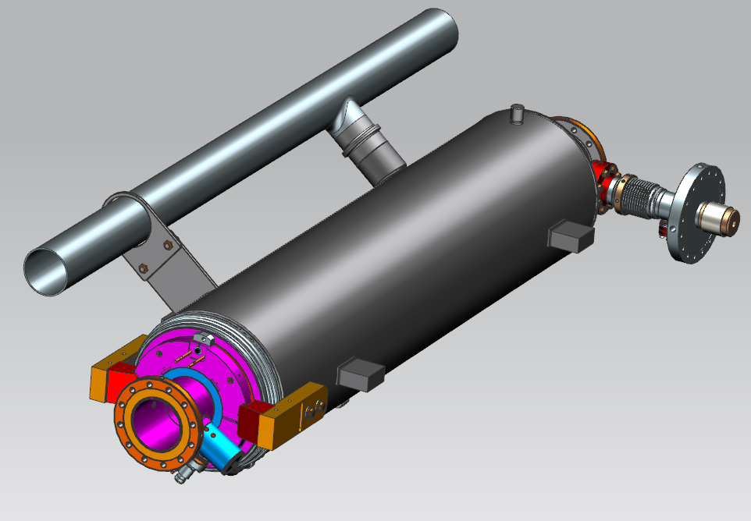
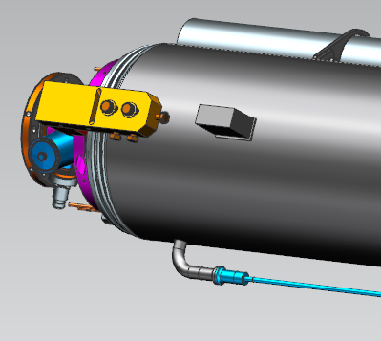
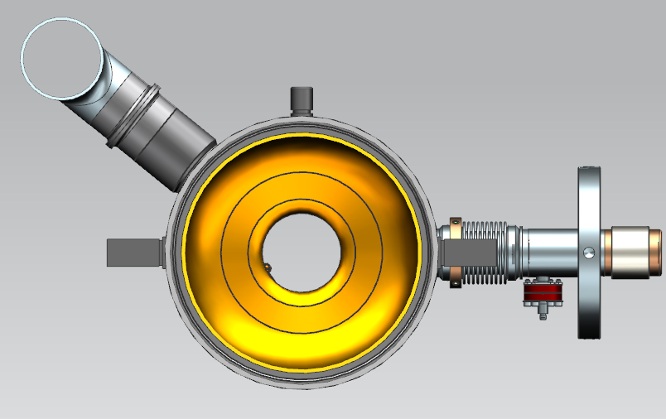
1.3 GHz ILC Cavity (Short-Short)
SS
Ti-SS
Support Lugs - LCLS-II
He Vessel material: Ti Gr2
2-phase pipe material: SS316L
Ti-SS transition joins used:
- warm up nozzle
- 2 phase pipe connection
Ti Gr2
342
24
Ti-SS
Support Lugs

Slide 3
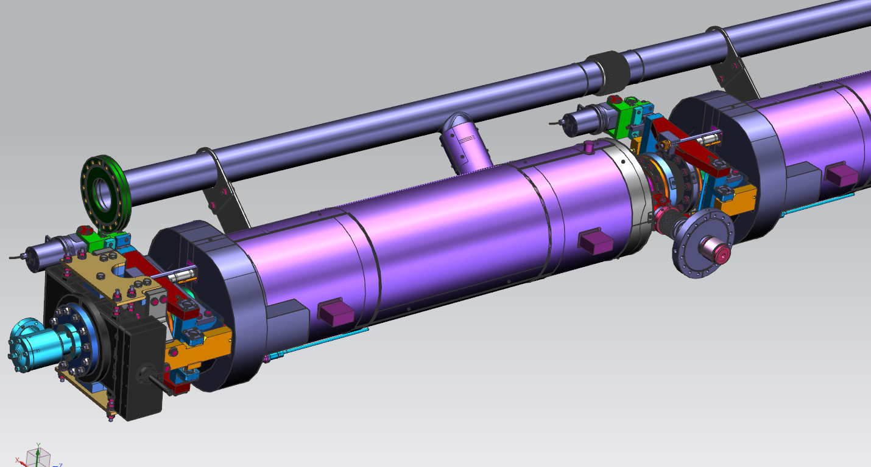
1.3 GHz Cavity #1 (with Tuner, Mag. Shielding and GV
LCLS-II tuner will be used
  (cavity #1 – LCLS-II tuner with extended arms)
One-layer external magnetic shieled

Slide 4
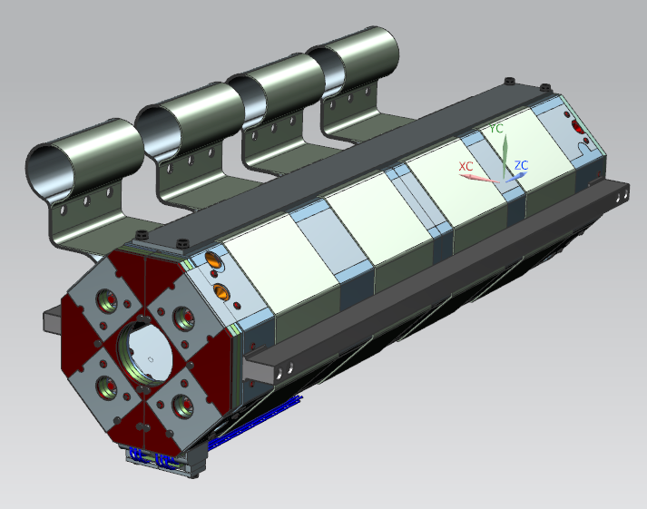
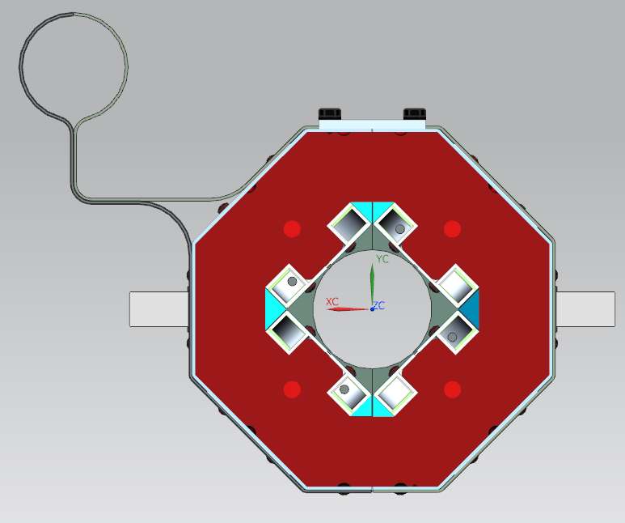
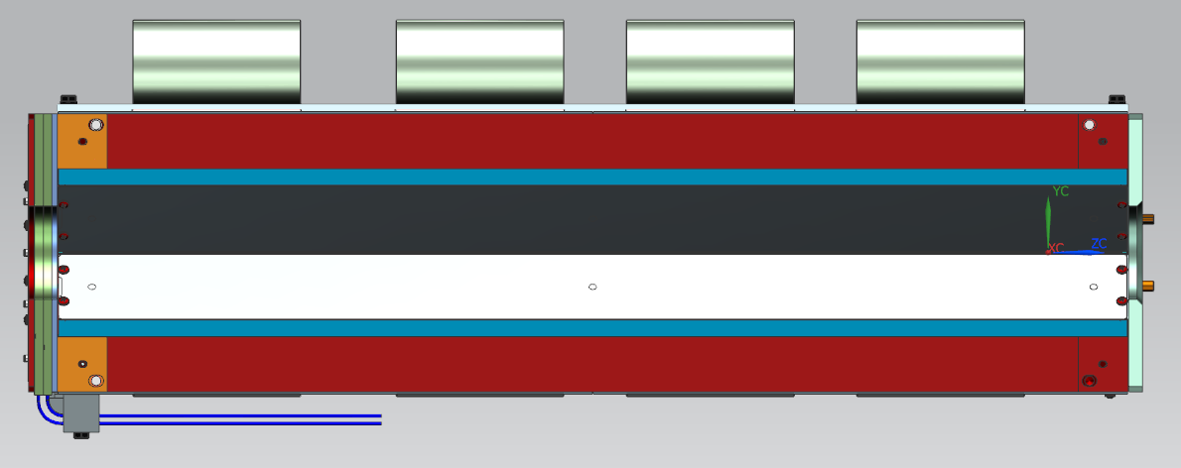
1.3 GHz ILC Magnet
Al Thermal straps
250
24
342
ILC Conduction Cooled Splittable QUAD ~1m
1000

Slide 5
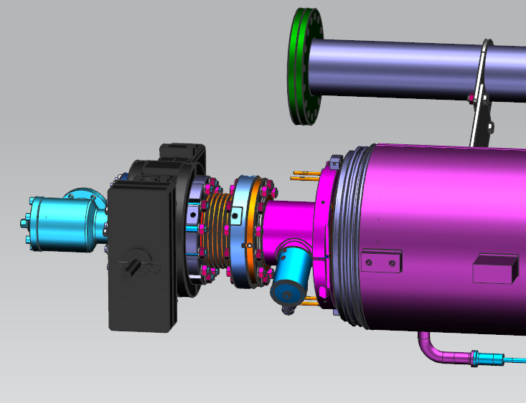
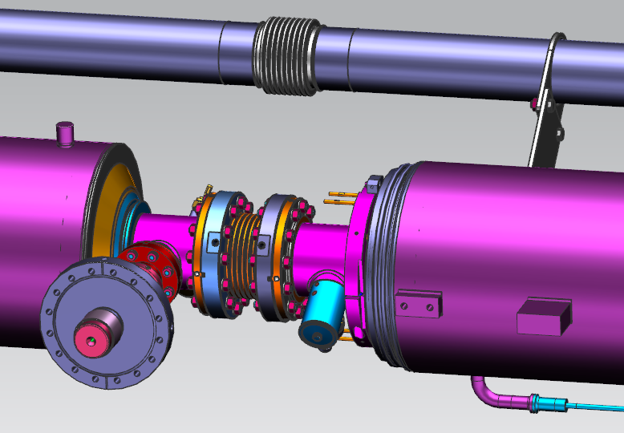
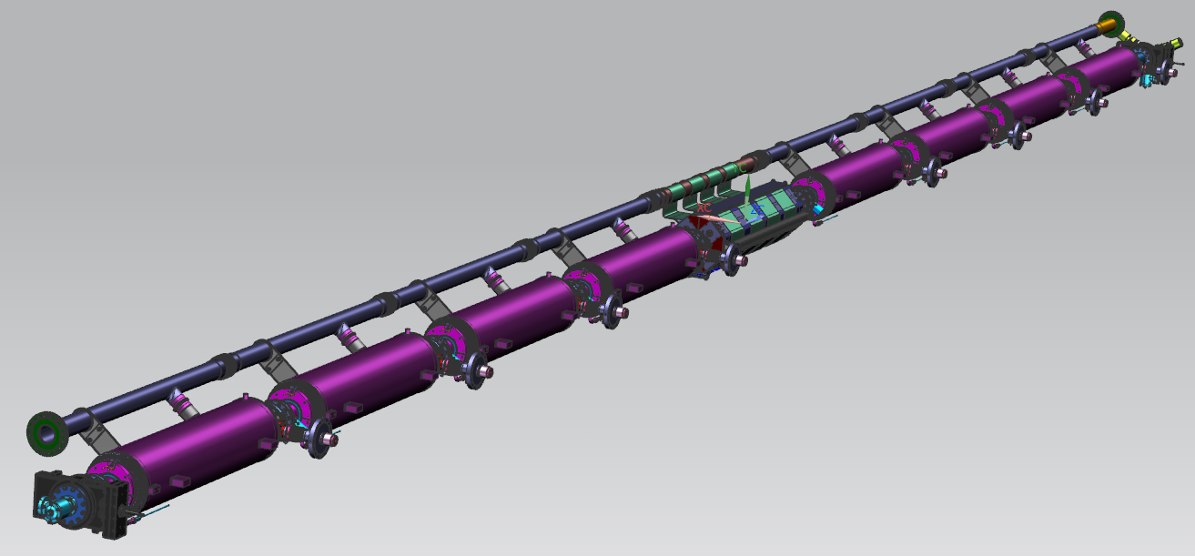
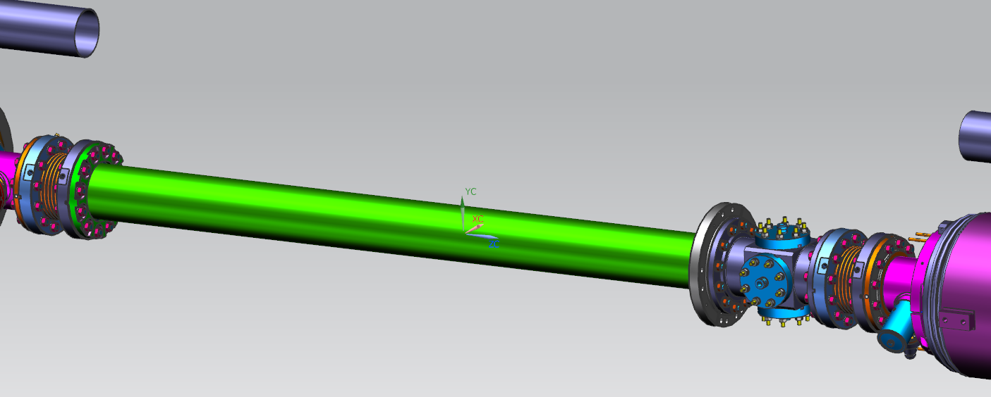
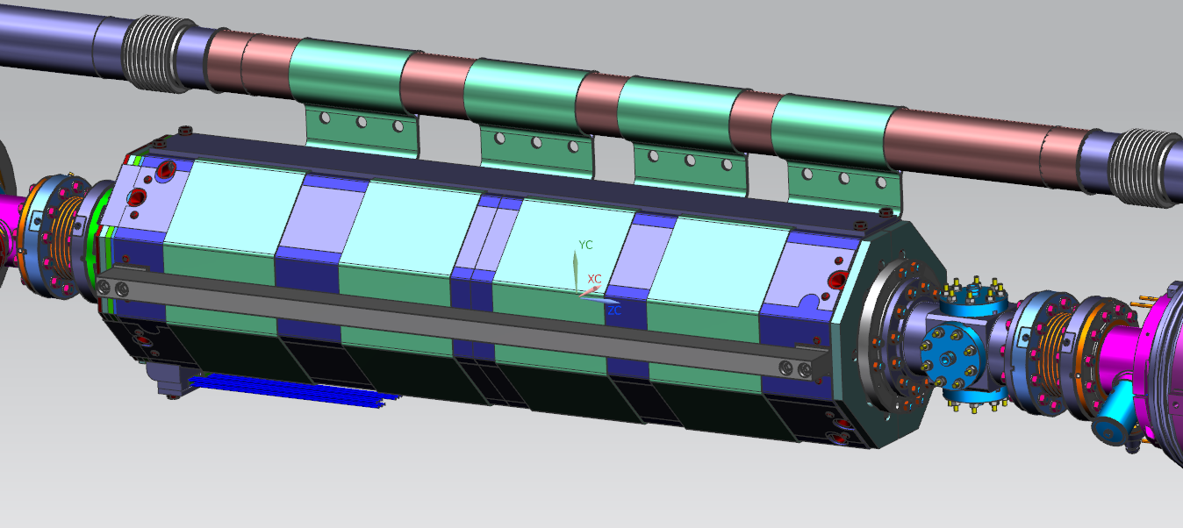
1.3 GHz Cavity String
2 phase Bellows
GV
BP Bellows with
Al Gaskets
Magnet BP spool
GV
Splittable SC Magnet

Slide 6
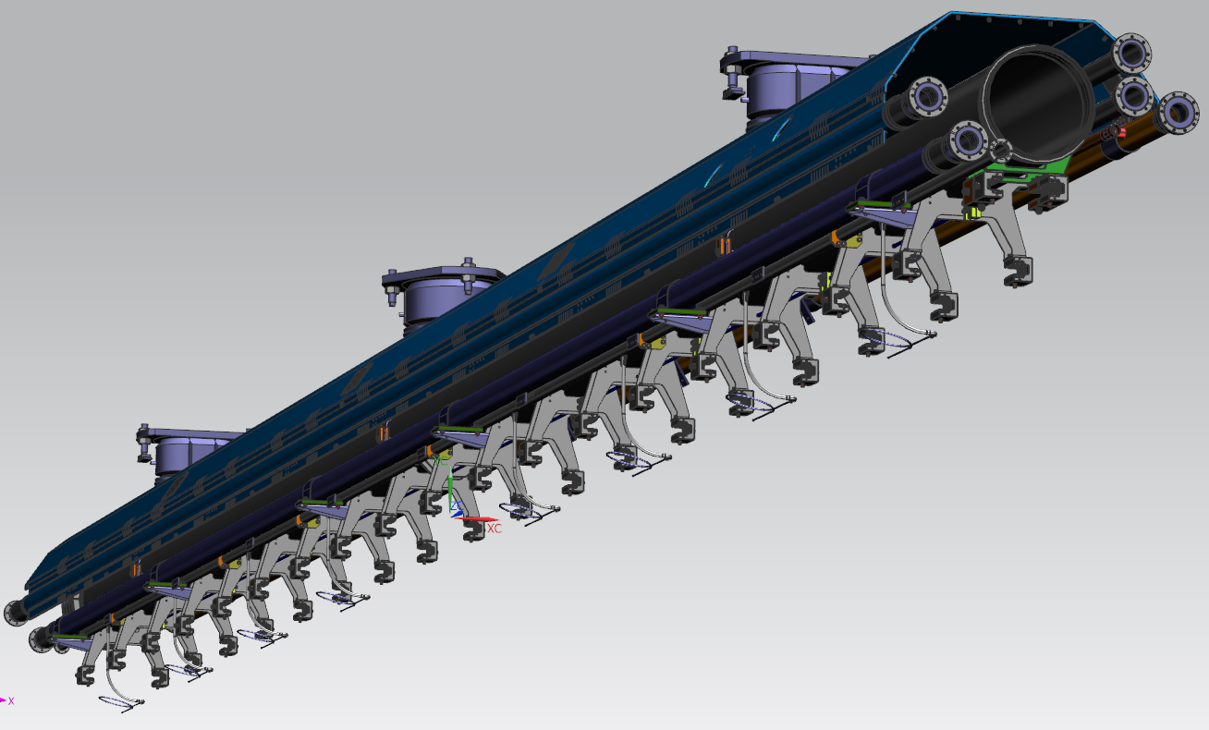
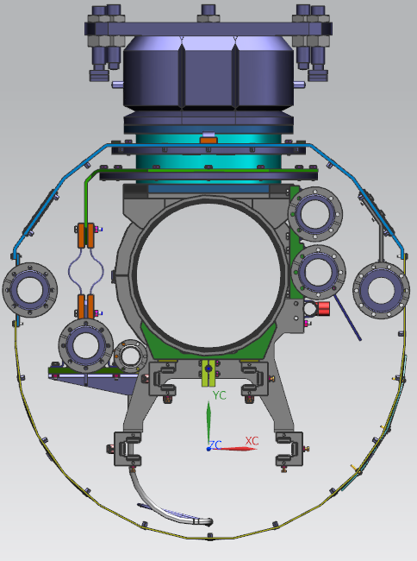
1.3 GHz Cold Mass Upper
Invar Rod
Cavities/Magnet
Needle bearings
supports
Not shown
70K Lover Thermal
Shield

Slide 7
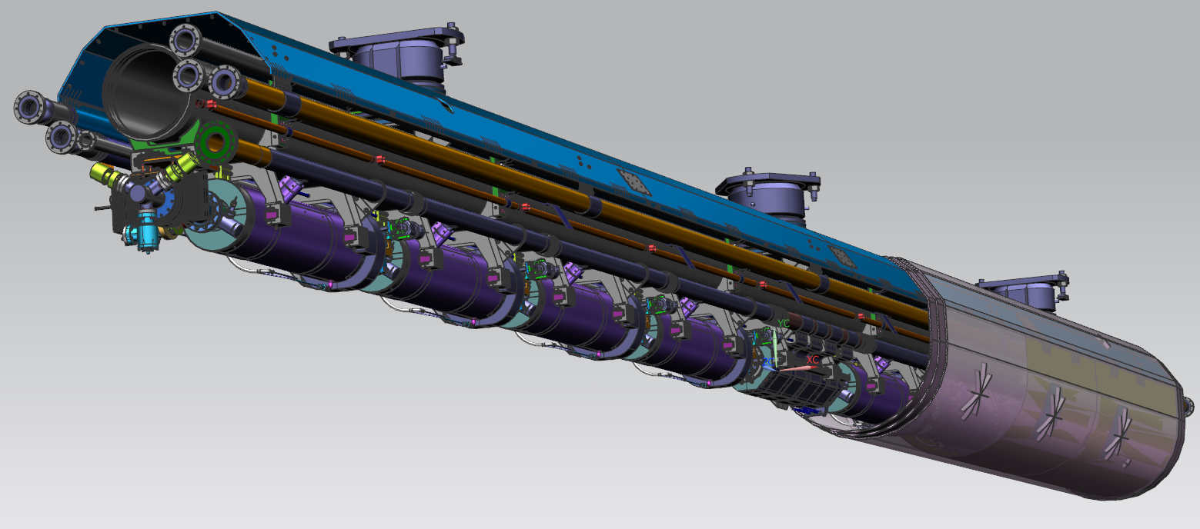
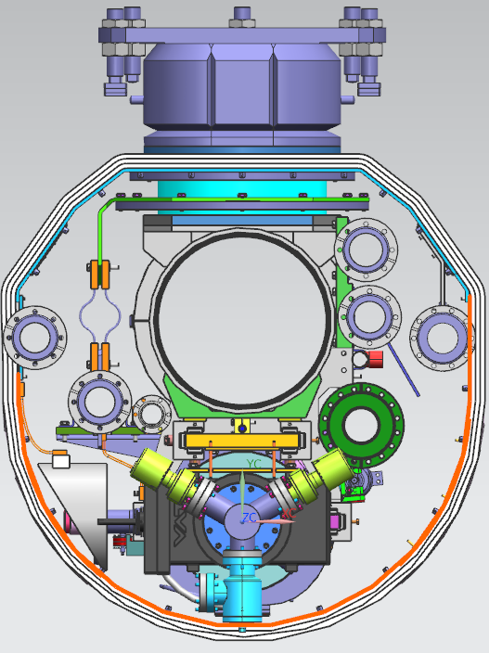
1.3 GHz Cold Mass - ILC
Quad can be replaced with
1.3GHz Cavity
70K Insulation

Slide 8
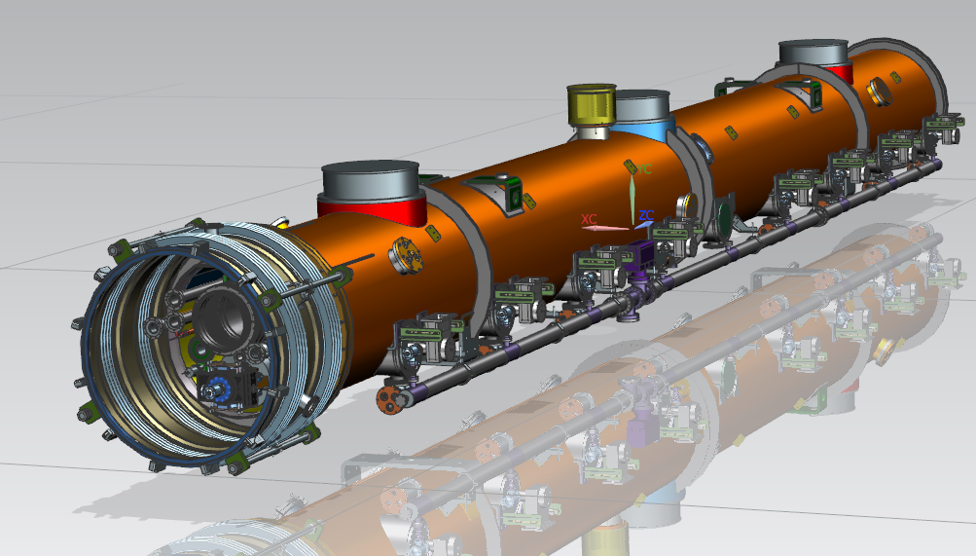
1.3 GHz ILC CM (PC view)

Slide 9
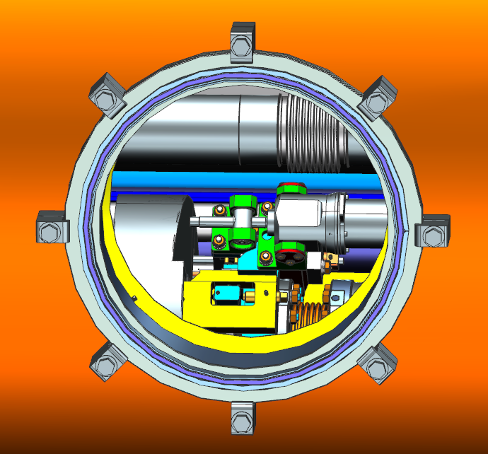
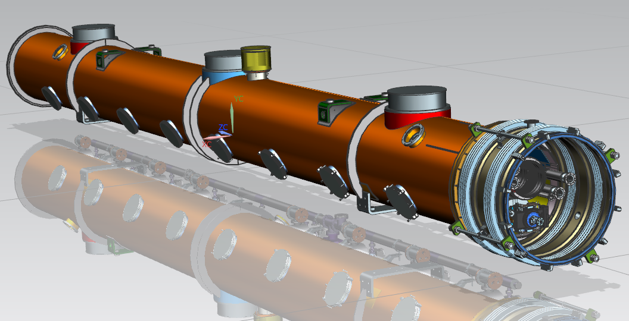
1.3 GHz ILC CM (TP view)
8 Tuner Motor
Access ports

Slide 10
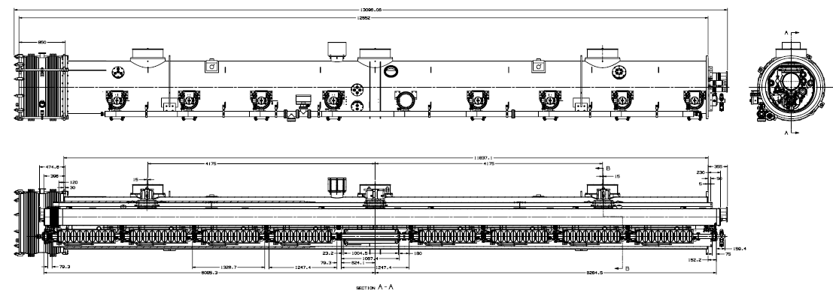
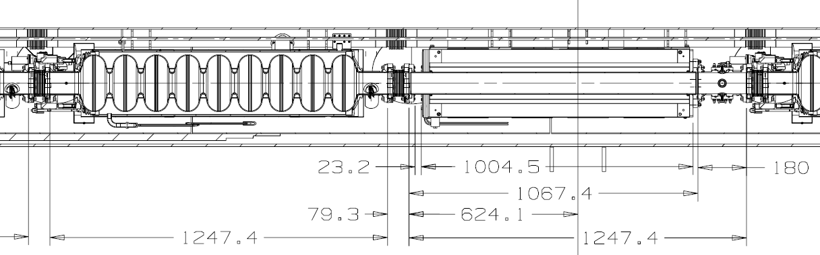
1.3 GHz ILC CM, Layout
Magnet instrumentation
area

Slide 11
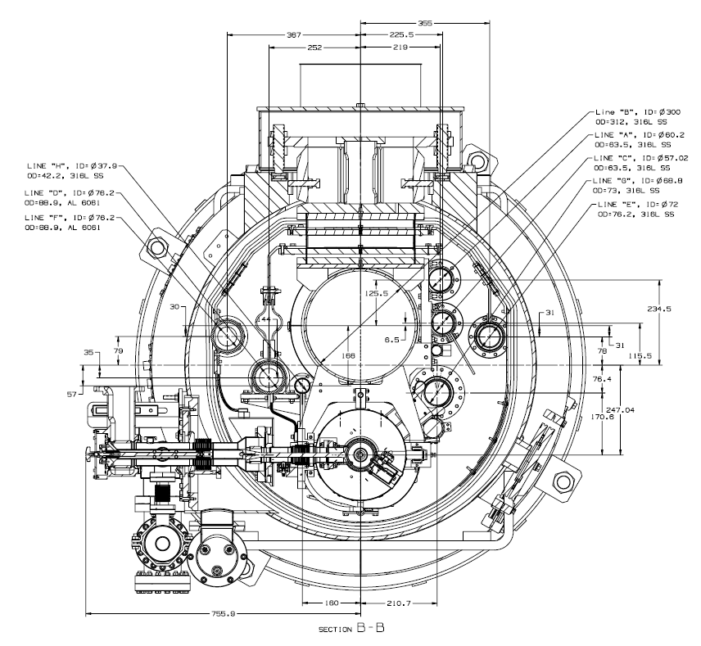
1.3 GHz ILC CM, Section

Slide 12
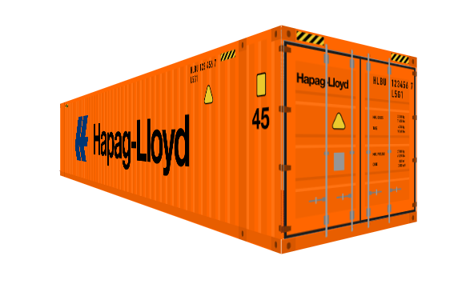
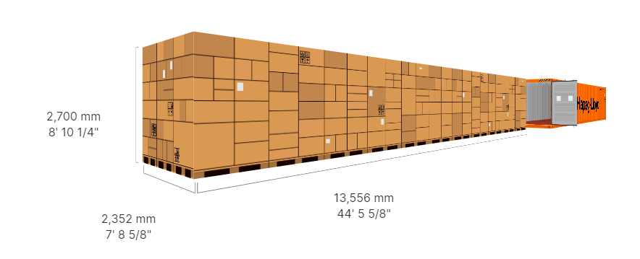
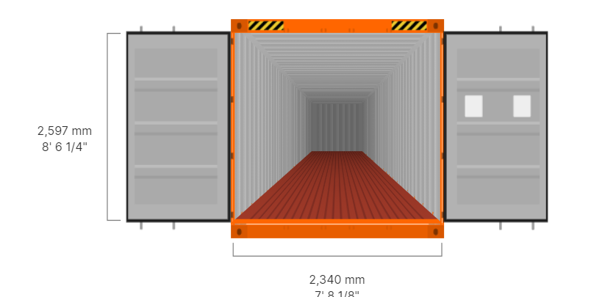
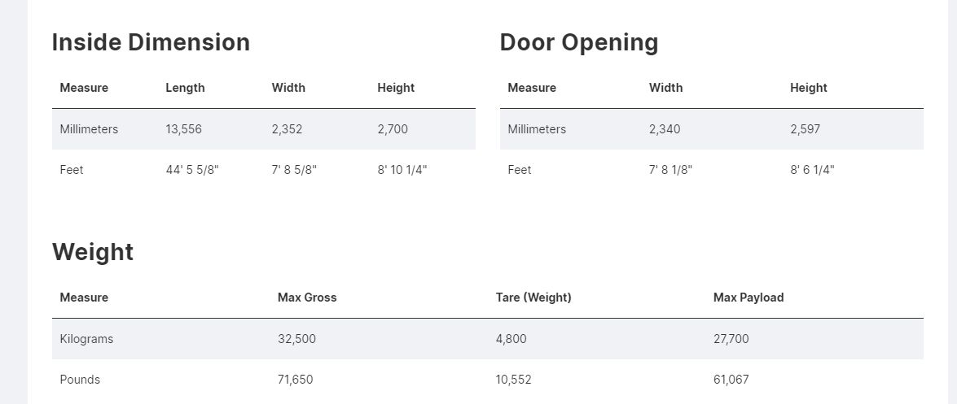
Typical 45’ container

Slide 13
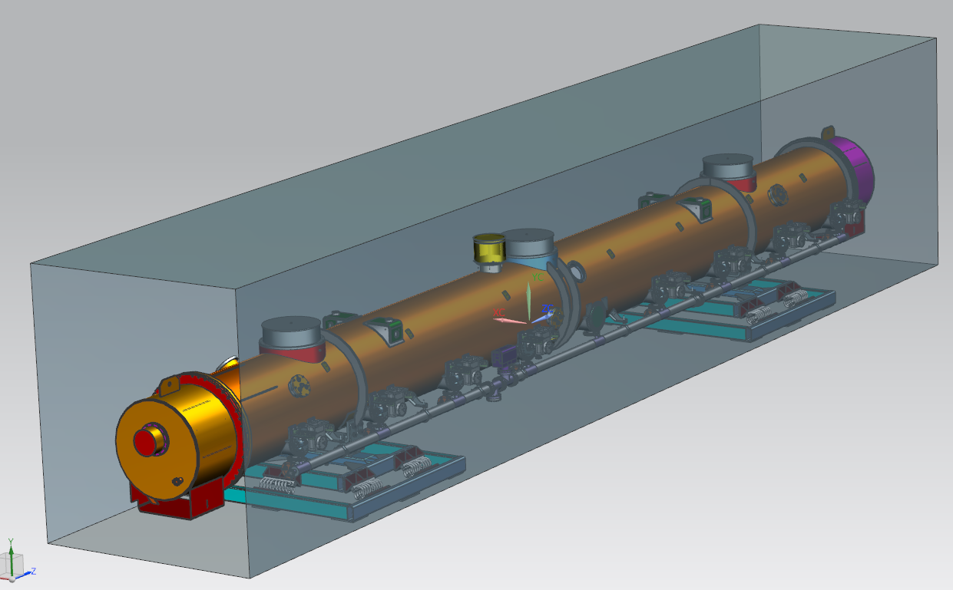
Transportation of 1.3 GHz CM
Inside volume of 45’ container
Transportation's platforms

Slide 14
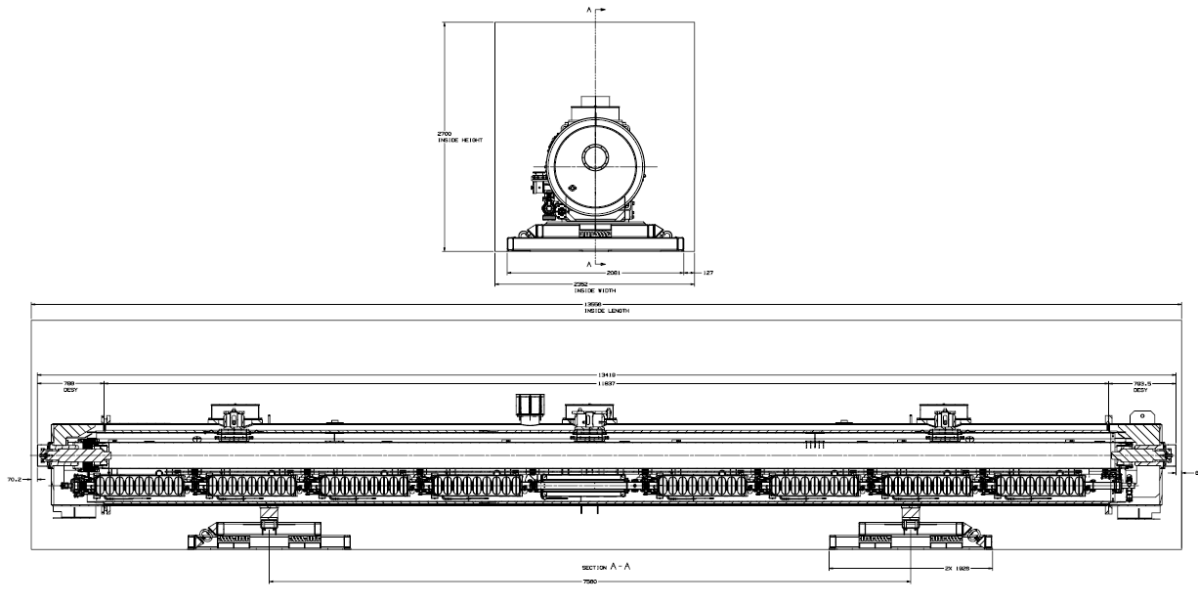
Transportation of 1.3 GHz CM Layouts
DESY Transportation
Feed Cap
DESY Transportation
End Cap

Slide 15
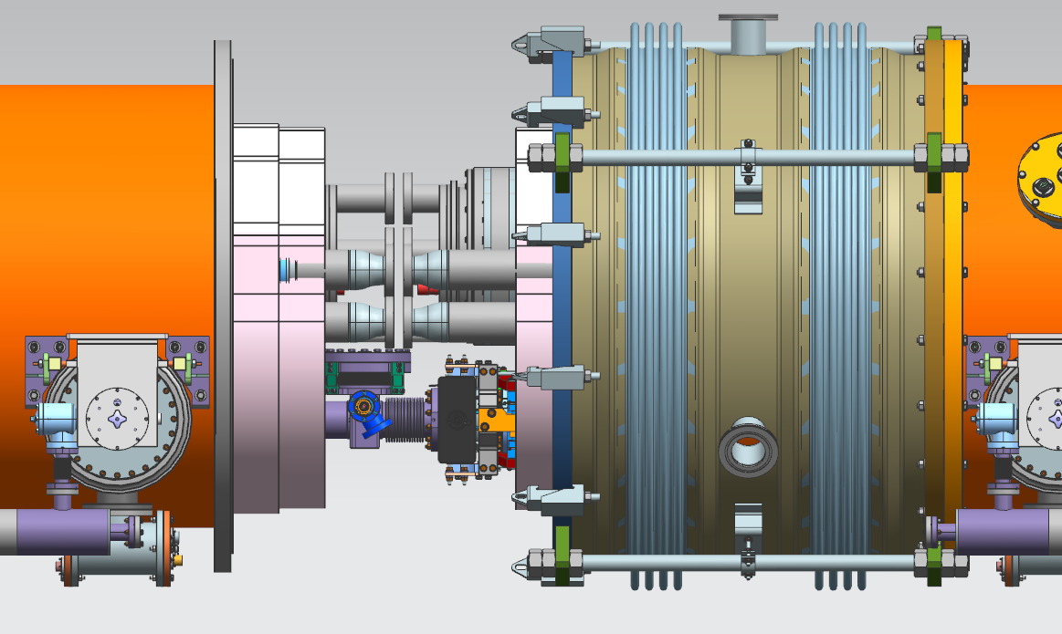
ILC 1.3 GHz CM’s Interconnection
700mm
11mm
8mm
HOM Absorber

Slide 16
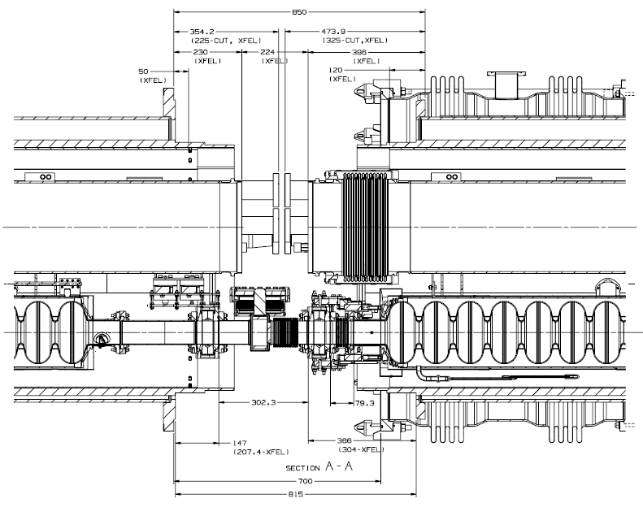
1.3 GHz CM’s Interconnection Layout
CM1
CM2
HOM
Interconnection Bellows

